Slide 1

AI Updates - July 03, 2026
Competition is the Only Solution to problems like government involvement and monopoly of Anthropic
Crowd-sourced "LM Arena" Leaderboard
OpenAI GPT‑5.6 models: Sol, Terra, Luna
Claude Sonnet 5, Claude Fable 5 Returned
Anthropic will require IDs
Claude Mythos 5 released to 100+ partners
Nvidia + Qwen
Hermes MoA - Mixture-of-Agents
Shifting to cheap Chinese open-source models
Anthropic’s new "Claude Tag" feature
"Qwen-AgentWorld" open-source
Open Tag - open-source alternative
250 Years
Google Pomelli - AI marketing agent
Hermes Agent OS
GPT Cyber - OpenAI fine-tuned for cybersecurity
Qwable 3.6 27B - by Mia-AiLab
LangChain Is Dying
LangChain Deep Agents
Manolo Remiddi tests models for deep thinking
CoreWeave ARIA AI Research Agent
Qwable 3.6 27B - by Mia-AiLab
Dario needs to be stopped
X (formerly Twitter) MCP server
Become more effective with Claude Code
OpenAI "Jalapeno" AI chip for LLM Inference
Google Gemini‑SQL2
Ornith‑1.0 coding models
DeepSeek's DSpark
Google Open Knowledge Format - OKF
Six Power Phrases - for Claude Code
Ponytail prevents "verbose" behavior
Pulumi vs Terraform
Jobs & Layoffs

Slide 2
"LM Arena" Leaderboard
Data for July 1
Starting Elo rating = 1000
https://en.wikipedia.org/wiki/Elo_rating_system
English - https://lmarena.ai/leaderboard/text
Coding - https://lmarena.ai/leaderboard/text/coding
■ | Claude
■ | Gemini
■ | OpenAI
■ | Open Source
Claude Fable-5 - 6TB
Claude Opus-4.8 - 5TB
Claude Sonnet-4.5 - 1TB
GLM-5.1 - 744B
Meta muse-spark - 16 x 70B
Qwen3.7-max-preview - 745B
Baidu Ernie-5.1 - 800B
Deepseek-v4 - 1.6T
Kimi-k2.6 - 1T
Xiaomi MiMo-V2-Pro - 1T+
ByteDance dola-seed-2.0-pro 400B
Minimax M3 - 456B
Code | Model | Score
■ | claude-fable-5 | 1509
■ | claude-opus-4-6-thinking | 1504
■ | claude-opus-4-7-thinking | 1502
■ | claude-opus-4-6 | 1499
■ | claude-opus-4-7 | 1494
■ | muse-spark | 1487
■ | gemini-3.1-pro-preview | 1486
■ | gemini-3-pro | 1486
■ | claude-opus-4-8-thinking | 1484
■ | gpt-5.5-high | 1481
■ | gemini-3.5-flash | 1479
■ | gpt-5.4-high | 1478
■ | claude-opus-4-8 | 1477
■ | gpt-5.2-chat-latest-20260210 | 1476
■ | qwen3.7-max-preview | 1475
■ | gpt-5.5 | 1475
■ | grok-4.20-beta-0309-reasoning | 1475
■ | grok-4.20-beta1 | 1474
■ | gemini-3-flash | 1473
■ | claude-opus-4-5-20251101-thinking-32k | 1473
■ | gpt-5.5-instant | 1473
■ | glm-5.1 | 1472
■ | claude-sonnet-4-6 | 1472
■ | grok-4.20-multi-agent-beta-0309 | 1470
■ | claude-opus-4-5-20251101 | 1469
Code | Model | Score
■ | claude-fable-5 | 1563
■ | claude-opus-4-7-thinking | 1553
■ | claude-opus-4-6-thinking | 1551
■ | claude-opus-4-7 | 1550
■ | claude-opus-4-6 | 1548
■ | claude-opus-4-8 | 1537
■ | claude-opus-4-8-thinking | 1537
■ | claude-opus-4-5-20251101-thinking-32k | 1530
■ | claude-sonnet-4-6 | 1527
■ | qwen3.7-max-preview | 1526
■ | muse-spark | 1525
■ | glm-5.1 | 1524
■ | claude-opus-4-5-20251101 | 1523
■ | gemini-3.1-pro-preview | 1522
■ | gpt-5.4-high | 1521
■ | claude-sonnet-4-5-20250929-thinking-32k | 1520
■ | mimo-v2.5-pro | 1520
■ | gemini-3-pro | 1519
■ | gpt-5.5-high | 1518
■ | gpt-5.2-chat-latest-20260210 | 1516
■ | glm-5.2 (max) | 1515
■ | claude-sonnet-5-thinking | 1515
■ | gpt-5.4 | 1514
■ | grok-4.20-beta-0309-reasoning | 1514
■ | claude-sonnet-4-5-20250929 | 1514
https://lmarena.ai/leaderboard/text
Design Arena - https://www.designarena.ai
https://openlm.ai/chatbot-arena/
https://beta.lmarena.ai
Web Leaderboard - 1T params https://web.lmarena.ai/leaderboard
LLM Leaderboard - by @LlmStats - https://llmworld.net/llm_leaderboards/
LLM Leaderboard - by StackAI - https://www.stack-ai.com/llm-leaderboard
LLM Leaderboard - by Artificial Analysis - https://artificialanalysis.ai/leaderboards/models
Open LLM Leaderboard - by Hugging Face - https://huggingface.co/open-llm-leaderboard
LLM Leaderboard - by Vellum - https://www.vellum.ai/llm-leaderboard
AI Benchmarking Hub - https://epoch.ai/data/ai-benchmarking-dashboard
Grok 4 Benchmarks - https://artificialanalysis.ai/models/grok-4
Image arena (alibaba) - http://aiarena.alibaba-inc.com/corpora/arena/leaderboard?arenaType=T2I
image arena - https://lmarena.ai/leaderboard/text-to-image

Slide 3


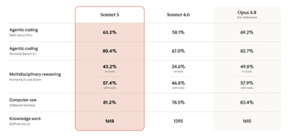
AI Updates
OpenAI GPT‑5.6 models: Sol, Terra, Luna
GPT-5.6 Benchmarks
https://openai.com/index/previewing-gpt-5-6-sol/
Sol - the flagship, highest‑capability (reasoning, complex coding, long‑horizon agentic tasks) Terra - balanced, similar to GPT 5.5 Luna - fastest and most affordable
1.5M-token context window
Claude Sonnet 5
Not as good as Opus (but close) Lower cost - $2/$10 in July-August after that 43 / $15 (compare - $5 / $25 for Opus 4.8)
But it is actually more expensive than Opus because of updated tokenizer and high output token usage for reasoning tasks
1M context window
https://www.anthropic.com/news/claude-sonnet-5
https://platform.claude.com/docs/en/about-claude/pricing
Claude Fable 5 is returning
The US Department of Commerce has lifted the export controls on Claude Fable 5 and restored access on July 1st
Safeguards were made stronger using "classifiers"
Claude Fable 5 promotion July 1-7
Pro, Max, Team, and some Enterprise users could access it at no extra cost within their weekly usage limits (only up to 50% of your limits)
Outside these promos, Fable 5 pricing is $10/$50 in/out per 1Mtok

Slide 4

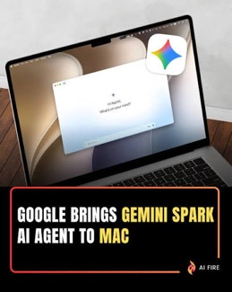
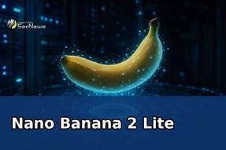
AI Updates
Interesting Projects using Fable https://www.youtube.com/watch?v=lplVBFr0Ndc
1. Replicate paid software or cloud services as custom, local applications
2. Perform a complete teardown and analysis of how you use Claude Code across your previous development sessions to optimize your workflows
Building an "Agentic OS" - a custom web-app wrapper on top of Claude Code to serve as an "Agentic Operating System." to automate your daily or weekly administrative tasks (like sales, finance, or content calendars) into specific clickable skills, automations, dashboards
4. Code Review and Deep Debugging - point Fable 5 at an entire directory for a multi-layered review
5. Complex, Long-Horizon Software Development
Nano Banana 2 Lite - faster/cheaper image generator
Google Gemini Spark on Mac - An agent for desktop

Slide 5
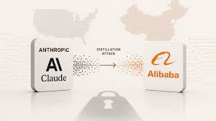
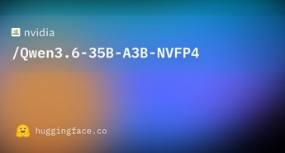
AI Updates
Anthropic will require IDs
Alibaba distillation attack on antropic
28M exchanges, 25K fraud accounts
Solution - use IDs, KYC (Know Your Custoemr)
Claude Mythos 5 released to 100+ partners
US Government has authorized release of Claude Mythos 5 to more than 100 “trusted partners” - U.S. companies and institutions, including many Fortune 500 firms and some federal agencies
News outlets (Semafor, Reuters, CNBC, etc.) all describe the recipients only in aggregate terms like “major companies and government agencies,” “cyber defenders,” and “infrastructure providers,” without identifying specific organizations.
Nvidia + Qwen
Qwen3.6‑35B‑A3B-NVFP4
MoE 4-bit version
Memory needed: 18-24GB
256K context length
Multimodal - understands text, image, and video (but many endpoints only expose text inputs)

Slide 6



AI Updates
Hermes MoA - Mixture-of-Agents
https://hermes-agent.nousresearch.com/docs/user-guide/features/mixture-of-agents
https://github.com/nousresearch/hermes-agent - 204K stars
Each MoA “preset” defines one or more reference models plus an aggregator model
The references run first, producing analysis that is passed as private context to the aggregator, which then generates the actual reply and tool calls
You select MoA presets like any other model (via `/model`, `/moa`, CLI, dashboard, or desktop app), so they integrate seamlessly with goals, gateway sessions, and profiles
Benchmarks show well-designed MoA presets can outperform any (single component) model on harder tasks
On Hostinger, “Hermes Agent” is a one‑click Docker/VPS application for self‑hosting Nous Research’s Hermes agent, with optional bundled AI and scraping credits
https://www.hostinger.com/applications/hermes-agent/1

Slide 7
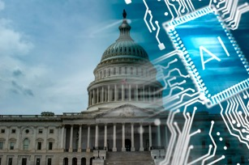

AI Updates
We see a massive shift from democratized AI to a highly regulated, government-approved ecosystem
The U.S. government is now gating access to frontier models like GPT-5.6, creating a widening capability gap between internal lab technology and public tools
Driven by extreme API costs, enterprises are shifting to cheaper Chinese open-source models like DeepSeek and GLM
To protect profit margins and national security, closed U.S. labs are lobbying for regulations that could stifle open source
Furthermore, the U.S. may label foreign models as "radioactive" security risks due to uninspectable "sleeper circuits," rendering them commercially unusable
This fracturing environment risks crippling startups, driving tech founders out of America, and dividing the industry into a two-tier system controlled by elite institutions.
Dark Ages
Two classes: 1. Government and Big Companies - get best models first 2. Others - receive models later (if ever)
https://www.youtube.com/watch?v=CTKe2tmdy7s

Slide 8

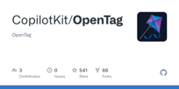

AI Updates
Anthropic’s new "Claude Tag" feature Anthropic may end up owning all the knowledge work
Competition is the only defence
https://www.youtube.com/watch?v=IwKuv4LrCVk
@Claude Tag - use in Slack
You interact with it using natural language, just as you would with a human colleague, allowing it to join threads, reference shared files, and coordinate between different internal tools
Acts as a proactive, persistent team member
Learns about your company team, operations
Matthew Berman warns that your company becomes dependent on a single AI vendor; Claude Tag is like a Trojan Hourse; It is like renting a digital employee from Anthropic
Open Tag - open-source alternative
Works with any AI model
Works with Slack , WhatsApp, ...
Advanced features like generative UI (interactive charts and buttons) and "human-in-the-loop" approval safeguards
https://github.com/CopilotKit/OpenTag
"Qwen-AgentWorld" - open-source from Alibaba
Builds a "virtual world" inside the AI to simulate agentic environments before executing real-world tasks, similar to a flight simulator for AI
Terminal, Search, MCP, Software Engineering (SWE), Web Browsing, Operating Systems, and Android mobile apps
Good performance, Practical Application, The model was trained using over 10 million real-world interactions rather than synthetic data
https://www.youtube.com/watch?v=Vb_Czw7x-Ow

Slide 9
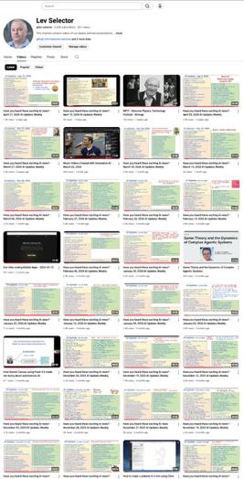
We do these weekly videos every Friday
Stats: 7K subscribers, 294 videos
1. Subscribe to this channel https://www.youtube.com/@lev-selector
2. Download slides from GitHub using links under the videos
3. Please pause the video - and answer the pinned question in comments under the video

Slide 10
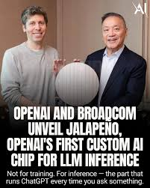

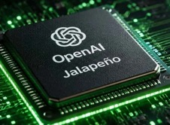
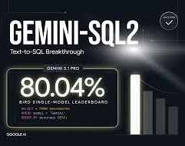
AI Updates
OpenAI "Jalapeno" AI chip for LLM Inference
with Broadcom, initial deployment in late 2026
https://openai.com/index/openai-broadcom-jalapeno-inference-chip/
Google Gemini‑SQL2
A text‑to‑SQL system built on Gemini 3.1 Pro
Translates natural‑language questions into executable, schema‑aware SQL queries for relational databases
Gemini‑SQL2 uses multi‑step reasoning over database schemas and iterative candidate generation and verification, focusing on execution correctness rather than just syntactic validity
On the BIRD benchmark, which stresses cross‑domain, noisy, and knowledge‑intensive text‑to‑SQL tasks, it achieves 80.04% execution accuracy, currently topping the single‑model leaderboard

Slide 11
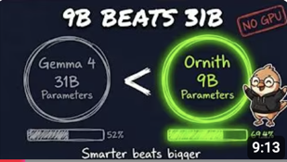

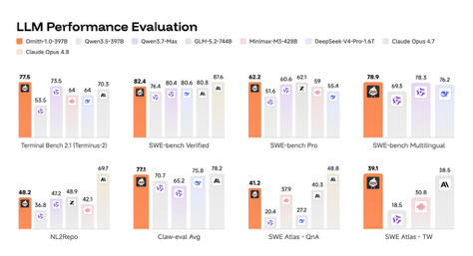
Ornith‑1.0 coding models
Ornith‑1.0 coding models with their own harness
Ornith is an open-source family of agentic coding models trained with RL to co-learn both task scaffolds (“harnesses”) and code solutions
At the core of Ornith-1.0 is a self-improving training framework that jointly learns to solve tasks and to construct the scaffolds that guide those solutions
Rather than relying on a fixed, human-designed harness shared across a task category, Ornith-1.0 treats the scaffold as a learnable object that co-evolves with the policy.
You still run Ornith inside some outer environment, but much of the traditional, bespoke agent wiring is effectively absorbed into the model’s weights
https://huggingface.co/collections/deepreinforce-ai/ornith-10
Ornith-1.0 ships in 9B, 31B, 35B-MoE, and 397B-MoE sizes under MIT, built on Gemma 4 and Qwen 3.5
ollama run hf.co/deepreinforce-ai/Ornith-1.0-9B-GGUF
https://deep-reinforce.com/ornith_1_0.html
https://www.youtube.com/watch?v=UDzw3qzmtvo
DeepReinforce is a privately held, early-stage startup founded around 2024, 4 founders, Santa Clara, CA
Led by Jiwei Li; few dozen employees; ~$100M in funding
Note: DeepReinforce’s flagship product is IterX code optimization platform that combines LLM reasoning with reinforcement-learning style search over code edits
Jiwei Li
https://www.linkedin.com/in/jiwei-li-5293202a3/
“The name comes from the ancient Greek word for bird.”

Slide 12
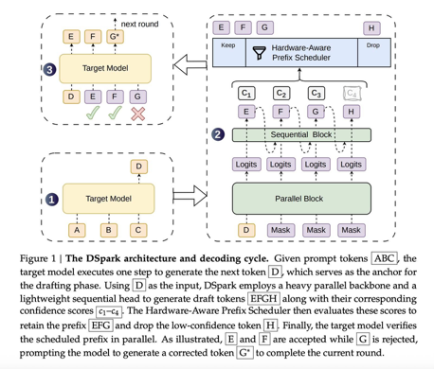
DeepSeek's DSpark
DeepSeek's DSpark
Open-source tool, accelerates LLMs by 50% to 400%
Uses speculative decoding, where a small, fast draft model predicts a block of tokens all at once, and a larger target model verifies them in a single pass
DSpark improves on older methods by adding a lightweight serial head to prevent "suffix decay," ensuring guessed tokens connect logically to increase acceptance rates
It also uses a confidence head to skip verifying low-probability tokens when servers are heavily loaded
Already used in production for DeepSeek-V4, it delivers tokens up to 85% faster and can be attached to other open-source models like Qwen and Gemma
https://github.com/deepseek-ai/DeepSpec
https://github.com/deepseek-ai/DeepSpec/blob/main/DSpark_paper.pdf
https://huggingface.co/deepseek-ai/DeepSeek-V4-Pro-DSpark

Slide 13
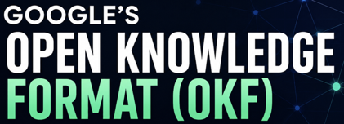
Google Open Knowledge Format - OKF
Google’s Open Knowledge Format (OKF)
A directory hierarchy of Markdown files with YAML front‑matter, designed so AI agents can read and reason over it directly
https://cloud.google.com/blog/products/data-analytics/how-the-open-knowledge-format-can-improve-data-sharing
Each OKF file has structure similar to skills - YAML front‑matter at the top followed by a Markdown body
https://github.com/GoogleCloudPlatform/knowledge-catalog/blob/main/okf/SPEC.md
Example (simplified):
---
type: Playbook
title: Refund Policy
description: How we handle customer refund requests.
tags: [support, policy]
timestamp: 2026-06-01T10:00:00Z
resource: https://internal.example.com/docs/refunds
---
# Refund Policy
We refund any order within 30 days of purchase…
-----------------------------
Google’s Knowledge Catalog tools ingest OKF bundles and expose them as a searchable catalog, but the format itself is platform‑agnostic: you can store the files in Git, object storage, or any filesystem

Slide 14


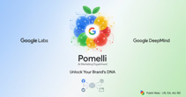
AI Updates
"Six Power Phrases" for Claude Code - by Austin Marchese
1. "Launch sub agents"
2. "Write me an implementation spec"
3. "Interview me"
4. "Verify before you build"
5. "Based on this conversation, build me a skill"
6. "Automate this"
The most common mistake is failing to provide enough context or failing to create a plan
https://www.youtube.com/watch?v=TP73qyFWDcY
Austin Marchese
Ponytail prevents "verbose" behavior
Opus 4.8 gets 71% faster, 71% fewer lines of code, and a 53% reduction in costs
Ponytail is open-source (MIT), low-risk, recommended
It is a plugin for AI coding agents. It provides rules (a strict decision ladder, “lazy senior dev” mode) so the agent writes only necessary code, avoiding verbose, over‑engineered outputs
https://www.youtube.com/watch?v=aTPTUYC44ds
https://github.com/DietrichGebert/ponytail
Google Pomelli - AI marketing agent
Helps small and medium‑sized businesses create brand content
It analyzes your website or uploaded materials to build a “Business DNA” profile capturing tone, colors, fonts, and imagery style
Then Pomelli generates campaign ideas, social posts, ads, and simple websites, plus a brand book with consistent visual guidelines
https://blog.google/innovation-and-ai/models-and-research/google-labs/pomelli-agentic-capabilities/

Slide 15

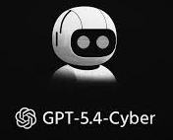
AI Updates
Hermes Agent OS
A self-hosted, always-on AI “operating system” built around the open-source Hermes Agent (MIT License)
An autonomous agent with persistent memory and self-created skills that “grow with you” across sessions
Multiple frontends like CLI, Telegram, Slack, Discord, WhatsApp
Model-agnostic - Claude, GPT, DeepSeek, OpenRouter
Supports tools via MCP and APIs for workflow automation
Platforms - Linux, MacOS, WSL2, and even Android via Termux
https://hermes-agent.org
Hermes Jarvis is a voice-driven “Jarvis-style” Agent OS setup built on top of Hermes Agent. You can speak to it
GPT Cyber - OpenAI models fine-tuned for cybersecurity
Built on top of fGPT‑5.4 and GPT‑5.5
Vulnerability discovery, malware analysis, secure code review, and incident response automation
Strong at reasoning on binaries, exploits, and defensive workflows
Models available only to OpenAI’s Trusted vetted defenders, enterprises, and institutions such as cybersecurity vendors and the EU AI Office
https://openai.com/index/scaling-trusted-access-for-cyber-defense/

Slide 16
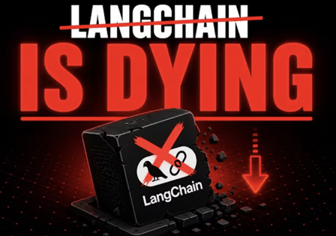
LangChain Is Dying
LangChain Is Dying
https://www.youtube.com/watch?v=DnS-lA7SC0M
Current shift from heavy AI agent frameworks like LangChain to a lightweight "micro-agent" architecture
Heavy frameworks introduce complex abstractions, increase token costs, and obscure prompts, making debugging exceptionally difficult
In contrast, micro-agents function like microservices: they are small, single-purpose, and operate on a simple model, few tools, and a tight loop
Emerging minimalist tools like Pydantic AI and Hugging Face's Small Agents provide type safety and direct Python execution
While large frameworks remain useful for highly complex enterprise state management, the current movement emphasizes owning your prompts and context window
The core takeaway is to always use the smallest, simplest tool that successfully completes the job
"The bug isn't in your 50 lines, it's somewhere in the framework's 50,000
so you end up stepping through abstractions you didn't write in a stack trace that's mostly somebody else's code
And the ground keeps moving under you.
LangChain rocketed past a 100,000 GitHub stars and became just as famous for breaking changes between versions
The interface you learned last quarter is deprecated...
popularity was never the same thing as stability."
"What you got was an agent inside an executor inside a chain
your real prompt buried eight layers down under code you never wrote
So developers are walking away...
the abstractions are over-complicated, the docs never match."

Slide 17
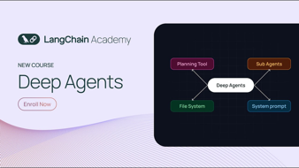

AI Updates
LangChain Deep Agents
Open-source (MIT) agent harness
Includes plumbing like file systems, context management, sub-agents, planning, human gating, and tools
Developers start with a complete, functioning terminal agent and trim away what they don't need
Built on LangGraph, Deep Agents code is model-agnostic. It can be pointed at frontier APIs, open-weight cloud models, or fully local models via Ollama
While Claude Code offers tighter integration and polish for Claude, Deep Agents provides the ultimate flexibility and sandboxing necessary for custom, multi-user AI engineering.
https://www.youtube.com/watch?v=x6WyeI5yO9E
Manolo Remiddi tests models for deep thinking
GLM 5.2 wins, Qwen3.6-27B is close second
GPT-5.5 performed poorly because it was too agreeable
https://www.youtube.com/watch?v=Zfgl5rA6ehg

Slide 18



AI Updates
CoreWeave ARIA AI Research Agent
Weights & Biases Weave + CoreWeave’s cloud
Ingests large volumes of experiment data, analyzes performance, and recommends next steps for models and agents
ARIA can form hypotheses, trigger new experiments, evaluate results, and update dashboards, shrinking iteration cycles
This positions CoreWeave as more than a GPU cloud provider, turning their infrastructure into a full-stack environment for continuous AI experimentation and autonomous improvement.
AI research assistants - SciSpace vs Concensus vs Elicit
SciSpace (https://scispace.com) runs real literature reviews backed by verified, clickable sources
Consensus (https://consensus.app) - same
Elicit (https://elicit.com) - same

Slide 19



AI Updates
Qwable 3.6 27B - by Mia-AiLab
A fine-tuned version of the Qwen 3.6 27B
For assistant-style and reasoning-heavy use cases
Focuses on step-by-step responses
Dario needs to be stopped
Mehul Mohan critiques Anthropic CEO Dario Amodei’s 2023 testimony on open-weight AI risks
Dario was saying that centralized models allow control and monitoring and proposes restricting open models
Dario has claiming that open AI will enable catastrophic biological or cyber threats
Mohan provides multiple reasons against Dario's position. He also talks about positive sides of open source (example - Linux).
He explains that open-weight models, while not fully open source, still allow meaningful modification. Finally, he argues that restricting US AI development could weaken competitiveness, as global players continue advancing open-weight innovation.
https://www.youtube.com/watch?v=EyARxk6y1_c
X (formerly Twitter) MCP server
to make its X easier to plug into AI tools and agents
https://docs.x.com/tools/mcp
https://mcp.directory/servers/x-twitter
https://github.com/xdevplatform/xmcp
Software is free, but access to Twitter data is not free

Slide 20

AI Updates
Become more effective with Claude Code https://www.youtube.com/watch?v=CBcyKfpldTo
Create a "Brand Context Folder" as a permanent source of truth
Voice Profile - defines your core voice rules and style
Visual Identity - json or markdown file containing design tokens (fonts, colors, assets)
Positioning - defines target audience, business goals, pain points.
Use a "claude.md" file as an index that points to these context folders, preventing "context rot" by keeping individual files lean
Autonomous Loops - keep running even without active supervision
Auto Mode - use `Shift+Tab` twice to minimize interruptions, allowing Claude to perform safe actions automatically; "/goal" - set specific, measurable exit criteria so Claude knows exactly when a task is finished rather than completing it prematurely
Loop/Routines - use to schedule recurring tasks (e.g., daily email/invoice processing) so the system works even when you are away from your computer.
Handling Complex Tasks without losing focus or finishing prematurely
Increase the "effort of thinking" (reasoning tokens);allow Claude to spin up a "team" of specialized agents, each with its own clean context, to tackle specific parts of a large project.
Human-in-the-Loop - maintain intentional human checkpoints; identify the high-stakes points in your workflow where quality is critical; instruct Claude to pause at these stages, notify you, and wait for your review/edit before proceeding to production
Goal - use AI for the repetitive 80% of research and drafting, while reserving your time for the 20% that provides human value.

Slide 21
Pulumi vs Terraform
You can use AI agent (Claude Code) to create infra code.
Example: Create a minimal Pulumi Python project for AWS.
Requirements:
- Use Python and the pulumi_aws package.
- Create one private S3 bucket.
- Enable versioning on the bucket.
- Add tags: Project=demo and ManagedBy=Pulumi.
- Export the bucket name and ARN.
- Keep the code short and beginner-friendly.
- Put the main code in __main__.py.
- Also show the commands to initialize and run the project:
- pulumi new aws-python
- pulumi up
Please output:
1. The full __main__.py file
2. A one-paragraph explanation of what the code does
3. The exact terminal commands to run it
Do not add IAM policies, public access, website hosting, or extra resources unless I ask.
Use the smallest working example.
Pulumi and Terraform - Infrastructure as Code tools
Terraform uses its own declarative language, HCL HCL = HashiCorp Configuration Language https://developer.hashicorp.com/terraform
Pulumi keeps the engine declarative but lets you write infrastructure in general-purpose languages like TypeScript, Python, or Go , it feel like a normal software project with functions, classes, and tests - https://www.pulumi.com
Terraform remain industry standard
Pulumi appeals more to developer teams
# Terraform
provider "aws" {
region = "us-east-1"
}
resource "aws_s3_bucket" "mybucket" {
bucket = "my-example-bucket"
}
resource "aws_s3_bucket_object" "index_html" {
bucket = aws_s3_bucket.mybucket.id
key = "index.html"
source = "./files/index.html"
}
# Pulumi
import pulumi
import pulumi_aws as aws
bucket = aws.s3.Bucket("mybucket",
bucket="my-example-bucket")
index_html = aws.s3.BucketObject("indexHtml",
bucket=bucket.id,
key="index.html",
source="./files/index.html")
Claude Code uses the prompt above to generate files such as __main__.py, Pulumi.yaml, and often requirements.txt; then you run pulumi up command in that project directory.

Slide 22
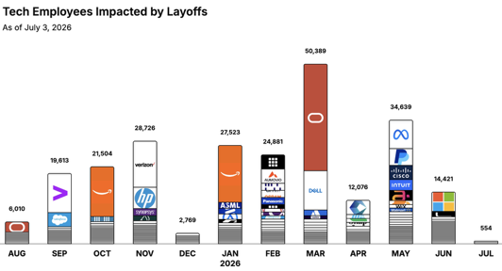
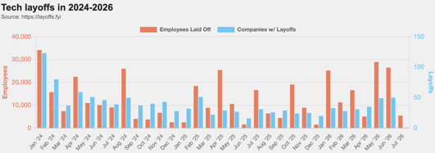
https://layoffs.fyi
https://trueup.io/layoffs
Jobs
The Tech Layoff Tracker
In 2026: 164,483 people laid off (894 per day)
In 2025: 245,953 people laid off (674 per day)
In 2024: 238,461 people laid off (653 per day)
https://trueup.io/layoffs
Microsoft - 5.5K on July 1
Tech Layoffs by year (US only):
119K in 2026 (as of July 3, 2026)
124K in 2025
153K in 2024
264K in 2023
165K in 2022 https://layoffs.fyi

Slide 23


About the Speaker
Lev Selector, Ph.D.
40+ years of software engineering, data science, and building teams (hiring, training, and managing)
Ph.D. in mathematical modeling and computer simulations
Interests:
Generative AI, Using LLM with your data
Local AI for Local Private Data
Cloud architecture, fin-tech, application security
Find/connect: Linkedin, GitHub, YouTube, Google
https://eais.ai
Enterprise AI Systems

Slide 24
Thank You!

