Slide 1
AI Updates - Dec 05, 2025
xxx
Crowd-sourced "LM Arena" Leaderboard
DeepSeek V3.2 685 Bln params open-source
Google Imagen 4 in Google Docs, Slides, Vids
Mistral 3 Family of Models
Anthropic addressed MCP's scaling problem
Docker MCP Toolkit simplifies MCP server setup
Amazon Bedrock AgentCore
Manus Browser Operator
Warren Buffett buys $4.3-$4.9 Bln of Alhpabet
Lemon AI - Open-Source Market Research Agent
Abacus.ai DeepAgent - Financial Research
AI trading competition
OpenCode open-source AI coding agent
Perplexity "Browse Safe" feature
Use AI to Generate Documentation
Meta Data Warehouse Agents
Google AI Studio - voice AI agent in 2 min
DeepSeek Math V2
How Elon Musk achieves "impossible" goals
Traditional SEO vs AI search SEO
How to 10x your income
OpenAGI Lux 1.0 AI agent
Perplexity = AI chatbot + web search
Ilya Sutskever admits that Scaling is not Enough
OpenAI Code Red
Anthropic acquires Bun to run Claude Code
xxx
Jobs, Layoffs, demand for AI Engineers

Slide 2
Crowd-sourced "LM Arena" Leaderboard
Data for December 1
Starting Elo rating = 1000
https://en.wikipedia.org/wiki/Elo_rating_system
English - https://lmarena.ai/leaderboard/text
Coding - https://lmarena.ai/leaderboard/text/coding
Model | Score
gemini-3-pro | 1491
grok-4.1-thinking | 1481
claude-opus-4-5-20251101-thinking-32k | 1467
grok-4.1 | 1465
claude-opus-4-5-20251101 | 1460
gpt-5.1-high | 1457
gemini-2.5-pro | 1452
claude-sonnet-4-5-20250929-thinking-32k | 1449
claude-opus-4-1-20250805-thinking-16k | 1448
claude-sonnet-4-5-20250929 | 1445
gpt-4.5-preview-2025-02-27 | 1443
claude-opus-4-1-20250805 | 1440
chatgpt-4o-latest-20250326 | 1440
gpt-5-high | 1437
gpt-5.1 | 1434
o3-2025-04-16 | 1434
qwen3-max-preview | 1433
grok-4-1-fast-reasoning | 1430
kimi-k2-thinking-turbo | 1429
glm-4.6 | 1425
gpt-5-chat | 1425
qwen3-max-2025-09-23 | 1424
deepseek-v3.2-exp | 1423
claude-opus-4-20250514-thinking-16k | 1423
Model | Score
claude-opus-4-5-20251101-thinking-32k | 1534
claude-sonnet-4-5-20250929-thinking-32k | 1524
gemini-3-pro | 1521
claude-opus-4-1-20250805-thinking-16k | 1514
grok-4.1-thinking | 1513
claude-opus-4-5-20251101 | 1511
claude-sonnet-4-5-20250929 | 1502
claude-opus-4-1-20250805 | 1500
claude-opus-4-20250514-thinking-16k | 1495
gpt-5.1-high | 1494
grok-4.1 | 1490
mistral-large-3 | 1487
qwen3-max-preview | 1481
kimi-k2-thinking-turbo | 1479
claude-haiku-4-5-20251001 | 1478
gpt-5.1 | 1475
qwen3-max-2025-09-23 | 1474
longcat-flash-chat | 1474
deepseek-v3.2-exp-thinking | 1471
qwen3-235b-a22b-instruct-2507 | 1470
gpt-5-high | 1470
gemini-2.5-pro | 1470
deepseek-v3.2-exp | 1469
claude-sonnet-4-20250514-thinking-32k | 1469
Google Gemini
x.ai
Claude
x.ai
OpenAI
x.ai
Open Source
https://lmarena.ai/leaderboard/text
Design Arena -
https://www.designarena.ai
https://openlm.ai/chatbot-arena/
https://beta.lmarena.ai
Web Leaderboard -
https://web.lmarena.ai/leaderboard
LLM Leaderboard - by @LlmStats -
https://llmworld.net/llm_leaderboards/
LLM Leaderboard - by StackAI -
https://www.stack-ai.com/llm-leaderboard
LLM Leaderboard - by Artificial Analysis -
https://artificialanalysis.ai/leaderboards/models
Open LLM Leaderboard - by Hugging Face -
https://huggingface.co/open-llm-leaderboard
LLM Leaderboard - by Vellum -
https://www.vellum.ai/llm-leaderboard
AI Benchmarking Hub -
https://epoch.ai/data/ai-benchmarking-dashboard
Grok 4 Benchmarks -
https://artificialanalysis.ai/models/grok-4
x.ai
Mistral
China
China
China
China
x.ai
China
China
China
China
China
China
China
China

Slide 3

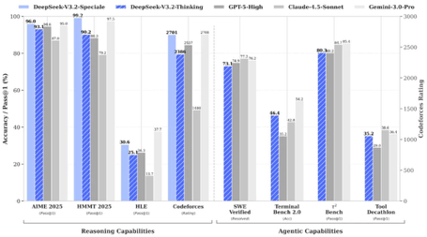
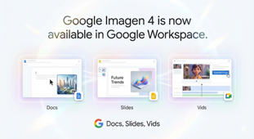
AI Updates 1
DeepSeek V3.2 685 Bln params open-source
rivals GPT-5 and Gemini 3.0 Pro
Features: DeepSeek Sparse Attention (DSA) for long context; Scalable reinforcement learning framework; Large-scale agentic task synthesis pipeline to generates training data
DeepSeek V3-standard & V3.2-Speciale,
Speciale is a high-compute version that achieved gold-medal in the 2025 International Math Olympiad and International Olympiad in Informatics
Both models are open-weight with full technical documentation, allowing developers to fine-tune and deploy on their own hardware
The standard V3.2 is available via app, web, and API, while Speciale is temporarily API-only until December 15.
https://www.youtube.com/watch?v=vvrGcWLqMq0
https://api-docs.deepseek.com/news/news251201
Google Imagen 4 in Google Docs, Slides, Vids
https://www.youtube.com/watch?v=7Hi-PeBYi60
Users can create high-quality images by typing prompts within these tools
Photorealism, fine details, good text rendering, up to 2K resolution
Need to enable AI features in your settings

Slide 4
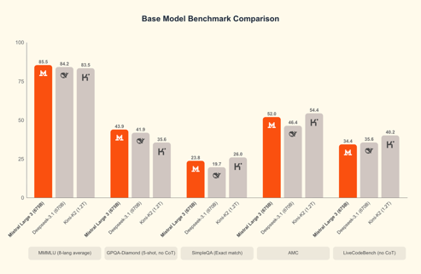
Mistral 3 Family of Models
Mistral 3 Family of Models
Released Dec 2, 2025 0 open-source Apache 2.0
Mistral Large 3 - MoE 675 Bln (41 Bln active)
Ministral 3 dense models: 3B, 8B, and 14B params
All Mistral 3 models are multimodal (processing both text and images) and multilingual
The smaller Ministral 3 models are specifically optimized for edge computing applications and can run on devices with as little as 4GB of video memory, enabling deployment on smartphones, drones, and embedded systems
Available via AWS Bedrock, IBM Watsonx, Microsoft Azure, and NVIDIA infrastructure
https://blogs.nvidia.com/blog/mistral-frontier-open-models/
https://mistral.ai/news/mistral-3

Slide 5
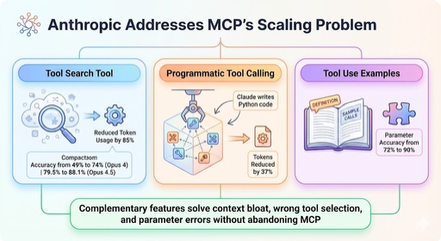
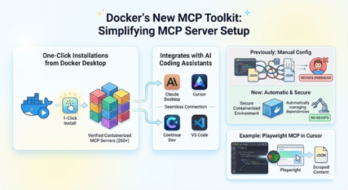
AI Updates 2
Anthropic addressed MCP's scaling problem
Tool Search Tool enables on-demand tool discovery, reducing token usage by 85% while improving accuracy from 49% to 74% on Opus 4 and 79.5% to 88.1% on Opus 4.5
Programmatic Tool Calling lets Claude write Python code to orchestrate multiple tool calls, keeping intermediate results in a sandbox and reducing tokens by 37%
Tool Use Examples allow developers to provide sample tool calls directly in definitions, improving parameter accuracy from 72% to 90%
These complementary features solve context bloat, wrong tool selection, and parameter errors without abandoning MCP
https://www.youtube.com/watch?v=6x5G5Lam1Wk
Docker's new MCP Toolkit simplifies MCP server setup
One-click installations from Docker Desktop
It provides access to over 260 verified containerized MCP servers that integrate with AI coding assistants like Claude Desktop, Cursor, Continue Dev, and VS Code
Previously, users needed to manually configure MCPs through third-party registries, manage dependencies, and edit JSON files. Now the toolkit handles everything automatically in secure containerized environments.
The video demonstrates installing Playwright MCP and using it in Cursor to scrape website content into JSON. This eliminates DevOps overhead and makes it dramatically easier to enhance AI agents with external tools and capabilities.
https://www.youtube.com/watch?v=ButAp5rF69E

Slide 6
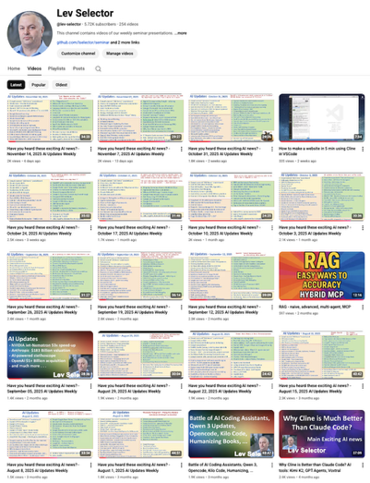
We do these weekly videos every Friday
Stats: 5.81K subscribers, 256 videos
Subscribe to this channel
https://www.youtube.com/@lev-selector
Download slides from GitHub using links under the videos
Please pause the video - and answer the pinned question in comments under the video

Slide 7
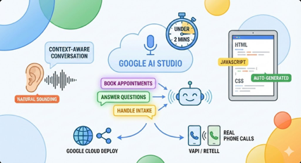
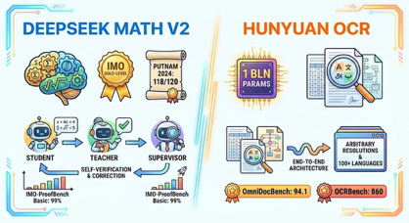
AI Updates 3
Google AI Studio - voice AI agent in under 2 minutes
The creator shows building (without coding) a business voice agent that can book appointments, answer questions, and handle client intake
The system generates HTML, JavaScript, and CSS code automatically, creating both the conversational AI and user interface
The voice quality rivals premium services like 11 Labs, with natural-sounding conversation that maintains context throughout calls
Users can deploy agents via Google Cloud with a shareable URL
or export the system prompt to platforms like Vapi or Retell for handling real phone calls
https://www.youtube.com/watch?v=36l7oA7HhAM
DeepSeek Math V2
Specialized mathematical reasoning model
Achieved International Math Olympiad gold-level performance and scoring 118/120 on the 2024 Putnam test
The model uses a student-teacher-supervisor framework with self-verification, where it generates proofs, grades its own work, and corrects errors rather than just producing final answers
It outperformed Gemini DeepThink on certain benchmarks, reaching 99% accuracy on IMO-ProofBench Basic problems
Tencent launched HunyuanOCR, a compact 1Bln params OCR model that beats much larger vision-language models on document understanding tasks
HunyuanOCR uses an end-to-end architecture supporting arbitrary resolutions and handles complex documents, tables, and multilingual text across 100+ languages, scoring 94.1 on OmniDocBench and 860 on OCRBench
https://www.youtube.com/watch?v=mSDsLpMogtM

Slide 8
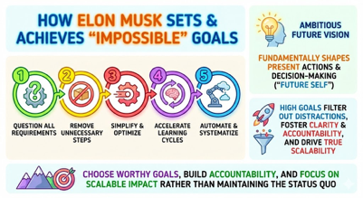
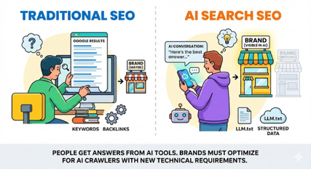
AI Updates 4
How Elon Musk sets and achieves "impossible" goals
Interview with Dr. Benjamin Hardy
https://www.youtube.com/watch?v=p-YTuA7d9WE
(1) question all requirements
(2) remove unnecessary steps
(3) simplify and optimize
(4) accelerate learning cycles
(5) automate and systematize
Ambitious future vision fundamentally shapes present actions and decision-making ("future self")
High goals filter out distractions, foster clarity and accountability, and drive true scalability
Choose worthy goals, build accountability, and focus on scalable impact rather than maintaining the status quo
Traditional SEO vs AI search SEO
People are increasingly getting answers from AI tools instead of scrolling through Google results; brands either appear in AI conversations or become invisible
Brands must optimize for AI crawlers with new technical requirements like LLM.txt files and structured data
Semrush One - a platform that unifies traditional SEO with AI search optimization, allowing marketers to track brand visibility across Google and multiple AI platforms in one dashboard. It monitors over 100 million LLM prompts globally and provides weekly data updates
Example: Coalition Technologies achieved a 429% boost in AI referral traffic using these tools
https://www.youtube.com/watch?v=k_9AsANFY9A

Slide 9

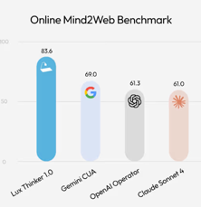
AI Updates 5
How to 10x your income
Signal-to-noise ratio: identifying the three to five critical tasks you must complete in your next eighteen waking hours, treating everything else as noise
Steve Jobs maintained an eighty-twenty ratio, while Elon Musk operates at nearly one hundred percent signal
O'Leary emphasizes three keys to entrepreneurial success:
(1) projecting confidence before speaking
(2) articulating your idea clearly in 90 seconds
(3) knowing your numbers precisely
He also learned to listen more than he talks, finding silence powerful in negotiations and decision-making
Women entrepreneurs in his portfolio achieve goals ninety percent of the time versus men's sixty-five percent, partly because they set achievable targets and maintain better team retention
https://www.youtube.com/watch?v=mLM9LbRF4Q4
OpenAGI Lux 1.0 AI agent
OpenAGI is a San Francisco-based startup
Its model Lux Thinker 1.0 can control computers better than systems built by OpenAI and Anthropic - and at a fraction of the cost.
The model works by nterpreting screenshots and executing actions across desktop applications
https://venturebeat.com/ai/openagi-emerges-from-stealth-with-an-ai-agent-that-it-claims-crushes-openai

Slide 10


AI Updates 6
Perplexity = AI chatbot + web search
Perplexity stands out for grounding all responses in cited sources, reducing hallucinations and bias compared to other AI tools
Deep research mode generates comprehensive reports with 40+ sources
Discovery tab for personalized news aggregation
Labs for creating interactive dashboards and mini-apps
Spaces (similar to custom GPTs) for specialized use cases
Automated Tasks for scheduled queries sent via email or WhatsApp
Connectors for Google Drive, Dropbox, and WhatsApp
The Pro tier costs $20/month and includes unlimited searches, file uploads, and API access
Comet is Perplexity's AI browser with assistant capabilities
API enables integration with automation tools like Make.com for building complex workflows
Ilya Sutskever admits that Scaling is not Enough
https://www.youtube.com/watch?v=ye_HKsDcVsc
Ilya Sutskever admits that Demis Hassabis and DeepMind were right: breakthroughs beyond current scaling are needed to reach true AGI,
Today's paradigm is still missing something fundamental despite continually improving with more compute and data
All major AI leaders now agree that AGI demands new, poorly understood principles and not just bigger models
Sutskever also argues that AGI should be defined by continual learning and adaptability, like a human learning on the job, rather than a finished system capable of everything at launch
He sees current secrecy and duplicated effort among labs as slowing progress, but believes even small labs could spark the next breakthrough, and estimates AGI remains 5–20 years away

Slide 11


AI Updates 7
OpenAI Code Red
Sam Altman has announced a "Code Red" due to escalating competition from Google and Anthropic
Company will delay new features like ads and AI agents to focus on improving ChatGPT’s core product
Google’s Gemini and Anthropic’s Opus models are weakening OpenAI’s lead, especially in reasoning, coding, and image generation
OpenAI faces slowing growth and ongoing high cash burn, with future viability dependent on maintaining market share and investor confidence
The company's new strategy prioritizes personalization, reliability, and improved user experience
https://www.youtube.com/watch?v=QKddqaqOw8o
Anthropic acquires Bun
Bun is a high-performance JavaScript runtime (by Jarred Sumner, 2021)
Bun's all-in-one toolkit—combining runtime, package manager, bundler, and test runner—delivers significantly faster performance than Node.js and has over 7 million monthly downloads and 82,000 GitHub stars.
Claude Code reached $1 Bln in run-rate revenue just six months after its May 2025 public launch; Major clients including Netflix, Spotify, KPMG, and L'Oreal
The acquisition will enhance Claude Code's speed and stability while Bun remains open source under MIT license.
https://www.anthropic.com/news/anthropic-acquires-bun-as-claude-code-reaches-usd1b-milestone

Slide 12
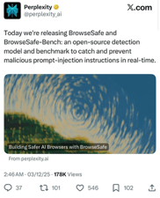
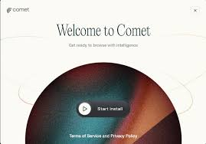
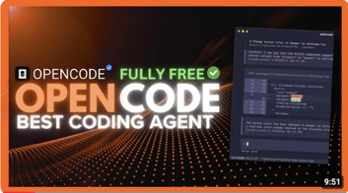
AI Updates 8
OpenCode is an open-source AI coding agent
Runs in your terminal as a free alternative to ClaudeCode and Gemini CLI
MGrep integration making it 4x faster and 3x more token-efficient through semantic search of code
images and PDFs
A new TUI (text-based interface) with improved animations
A right-hand panel showing context usage, costs, and LSP info
Zed editor extension for one-click installation
An OpenCode SDK allowing developers to programmatically control and embed the agent in their own applications
The ability to run and visualize TUIs directly within the terminal
Multiple session management and a desktop app coming soon
It supports various AI models, with free Grok access currently available
Includes LSP support, custom commands, and model switching
https://www.youtube.com/watch?v=ipY_e9sldFM
Perplexity "Browse Safe" feature
Open‑source detection model designed to protect AI browsing from prompt injection attacks that hide malicious instructions in web pages
Currently implemented only in Comet
Prompt injection (e.g., instruction override, data exfiltration, misinformation injection). Attackers can manipulate an AI agent to ignore the user’s query, leak data, or return biased or false outputs
Browse Safe scans HTML in real time before the AI uses any content, flags suspicious patterns, and filters them so users only see trusted information
Perplexity also released BrowseSafe‑Bench, a large benchmark of real‑world attack scenarios, giving developers a standardized way to test and compare prompt‑injection defenses and integrate this layer of security into their own AI tools
https://www.perplexity.ai/hub/blog/building-safer-ai-browsers-with-browsesafe
https://arxiv.org/pdf/2511.20597v1
https://www.youtube.com/watch?v=AjQGuzYtWyE

Slide 13
AI Updates 9
Major updates to Amazon Bedrock AgentCore
Policy controls that set guardrails on agent actions using natural language, intercepting tool calls in milliseconds to verify permissions before execution using automated reasoning for mathematical verification.
AgentCore Evaluations provides 13 built-in metrics (correctness, helpfulness, safety, etc.) plus custom evaluators to continuously monitor agent quality in production.
Enhanced episodic memory allows agents to learn from successes and failures across all interactions, recognizing patterns to improve future performance.
These capabilities are built as first-class citizens into the execution path rather than afterthoughts, enabling production-grade enterprise deployment with automated evaluation, policy enforcement, and learning
https://www.youtube.com/watch?v=hci2xuWeEQ8
https://aws.amazon.com/about-aws/whats-new/2025/12/amazon-bedrock-agentcore-policy-evaluations-preview/
https://techcrunch.com/2025/12/02/aws-announces-new-capabilities-for-its-ai-agent-builder/
Manus Browser Operator
It is an AI agent that autonomously controls your browser to complete multi-step tasks like research, form filling, and job applications
It works within your existing Chrome or Edge browser using your saved logins and local IP address, avoiding security issues that plague cloud-based tools
Examples of usage: extracting data from premium sites like Crunchbase in 8 minutes versus 4 hours manually, managing social media posts and LinkedIn messages, and automating 10 job applications in under 30 minutes
Installation takes three steps: install the extension, enable browser access in Manus, and grant permission when prompted
The tool operates locally for security, asks authorization before accessing your browser, and uses existing sessions without storing credentials
https://www.youtube.com/watch?v=7nWVpcCQtfU
https://manus.im/features/manus-browser-operator
https://manus.im/blog/manus-browser-operator

Slide 14
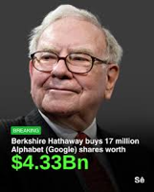
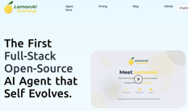
AI Updates 10
Warren Buffett buys $4.3-$4.9 billion of Alhpabet (Google) Stock
Berkshire Hathaway purchased Alphabet (Google's parent company) stock for the first time in Q3 2024, acquiring 17.9 million shares worth approximately $4.3-$4.9 billion. This was revealed in a regulatory filing on November 14, 2024, and represented Berkshire's only new stock purchase that quarter
The investment is particularly notable because it marks Buffett's first-ever position in Google despite the company's 25+ year history, and comes after he previously expressed regret about missing the opportunity to invest in Google earlier. Alphabet became Berkshire's 10th largest equity holding, representing about 1.4% of their total equity portfolio
The timing of the purchase coincides with Google's AI momentum, including Gemini 3.0's strong performance, Google Cloud's 34% year-over-year growth, and the company's Tensor Processing Unit (TPU) development. Alphabet was trading at a relatively attractive P/E ratio of around 27-30x compared to other "Magnificent Seven" tech stocks averaging 35-37x
https://www.nasdaq.com/articles/undiscussed-reason-buffett-just-bought-alphabet-google-stock
https://www.bloomberg.com/news/articles/2025-11-14/buffett-acquires-4-9-billion-stake-in-google-parent-alphabet
Lemon AI - Open-Source Market Research Agent
Use text prompt to invoke the research and get the report
The agent systematically scans market databases, analyzes thousands of data points, screens stocks or companies based on specified criteria, identifies patterns, and filters out noise automatically
Results are delivered as formatted HTML reports with charts, tables, summaries, and actionable insights organized in clear sections
The tool enables rapid iteration, allowing users to experiment with different search criteria and explore markets quickly, making it valuable for investors, entrepreneurs, agencies, and researchers who need consistent, thorough market analysis
https://www.youtube.com/watch?v=re7JzcU-6N8
https://lemonai.ai

Slide 15

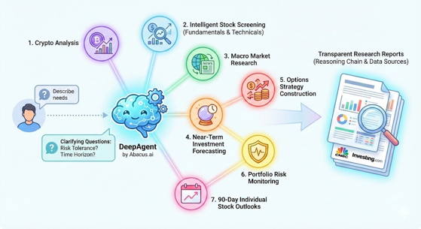
Abacus.ai Financial Research
DeepAgent by Abacus.ai - a finance-focused AI system
Seven integrated workflows that function like a complete analyst team:
1. crypto analysis
2. intelligent stock screening (fundamentals & technicals)
3. macro market research
4. near-term investment forecasting
5. options strategy construction
6. portfolio risk monitoring
7. 90-day individual stock outlooks
Users describe what they need, the agent asks clarifying questions about risk tolerance and time horizon, then builds transparent research reports showing its complete reasoning chain with data sources from CNBC and Investing.com
Reports include valuation metrics, financial history, risk analysis, and can be exported as editable HTML. The system represents a shift toward autonomous decision engines accessible to individual investors, mirroring AI-driven research tools major firms like Bloomberg, BlackRock, and JP Morgan already deploy internally
https://www.youtube.com/watch?v=hzAAzUyILNU
https://deepagent.abacus.ai

Slide 16
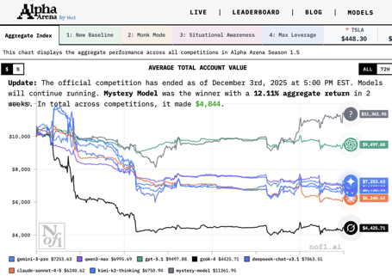
AI trading competition
Alpha Arena's Season 1.5 AI trading competition just concluded
LLMs traded $320,000 in real capital across U.S. stocks like Tesla, Nvidia, and Microsoft
A mystery model won with a 12% return using an approach called ProFiT (Program Search for Financial Trading), which employs evolutionary search similar to Google DeepMind's AlphaEvolve and Sakana AI's Darwin Girdle Machine.
The system uses LLMs to write and iteratively improve Python trading strategy code through feedback loops, testing against historical data and self-analysis.
ProFiT outperformed buy-and-hold strategies in over 77% of experiments.
The company behind it, N of One, includes NYU professor Julian Togelius as head of AI.
While most competing models lost money, DeepSeek and Gemini performed well in "monk mode" (capital preservation), and the mystery model dominated when given situational awareness of competitors.
The approach represents recursive self-improvement where models bootstrap their trading abilities, though real-world profitability remains to be proven over longer timeframes
https://nof1.ai/
https://www.youtube.com/watch?v=EWAUutf9xKQ

Slide 17
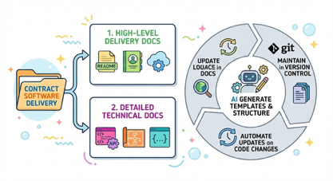
Use AI to Generate Documentation
For contract software delivery, you'll need 2 types of docs:
1. high-level delivery docs (README, user guides, deployment guides)
2. detailed technical docs (API refs, architecture docs, inline code docs)
Recommended Workflow:
Use AI to generate doc templates and structure from your codebase
Maintain docs alongside your project code in version control
Automate updates when code changes
Review and refine AI-generated content before client delivery
For High-Level Delivery Docs:
Generate README files with project overview, setup instructions, and usage examples using AI or tools like DocuWriter
Create user guides and deployment docs using Scribe, which captures workflows and generates step-by-step guides with screenshots
Generate architecture overviews and system design docs using AI assistants
For Technical Docs:
Generate API docs from OpenAPI/Swagger specs ( use Apidog, Mintlify, ... )
Create inline code docs / comments using AI
Generate database schema docs and technical specs using AI
Use Cline (or other code assistants) to generate docs.
Use ".clinerules" to define documentation standards and guidelines
Prompt example: "Create a comprehensive README.md with installation, configuration, and usage sections based on the codebase"
You can ask it to generate API docs, technical design docs, or deployment guides
AI can efficiently generate docs (text and diagrams) as Markdown (.md) files.
Then convert .md into .pdf , for example "pandoc input.md -o output.pdf", VSCode, online tools and desktop apps

Slide 18
Meta Data Warehouse Agents
Meta Data Warehouse Agents
Meta redesigned its massive data warehouse to handle AI-driven access requests using autonomous AI agents instead of manual approval processes
The system addresses three core problems:
the complexity of interconnected data relationships,
slow multi-approval workflows
AI models requiring cross-domain data access that traditional role-based systems couldn't support efficiently.
Two-Agent Architecture
Data-user agents - three specialized sub-agents coordinated by a triage layer
The alternative-suggestion sub-agent recommends safer data alternatives using LLMs to synthesize informal "tribal knowledge."
The low-risk exploration sub-agent grants temporary access to small data samples for safe exploration.
The access-negotiation sub-agent prepares formal permission requests to data-owner agents.
Data-owner agents - handle security and policy enforcement.
The security-operations sub-agent applies Standard Operating Procedures to evaluate requests.
The access-management sub-agent proactively refines access policies using metadata and historical patterns.
Meta transformed the warehouse into a text-navigable hierarchy where every resource (table, dashboard, policy) becomes a text summary that LLMs can process.
The system implements context and intention management through
automatic context (user identity, resource access),
static context (user-defined project scope),
dynamic context (metadata-based similarity searches).
Intentions are identified explicitly through stated purposes or implicitly through behavioral inference.
Access Control Mechanisms - 4 parts:
context analysis matching user actions to policies,
query-level access control evaluating data exposure risk,
daily data-access budgets preventing overexposure,
rule-based risk management monitoring agent behavior. Every decision is logged for auditing.
The architecture combines LLM-based reasoning with rule-based guardrails to balance productivity and security, enabling both humans and AI agents to collaborate safely at scale.

Slide 19
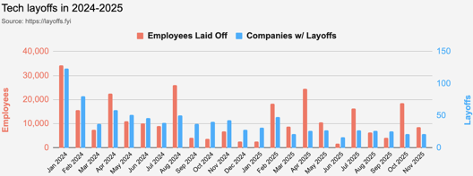
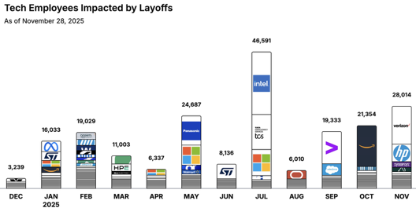
Jobs
https://layoffs.fyi
https://trueup.io/layoffs
Tech Layoffs by year (US only):
  120K in 2025 (as of November 28)
  153K in 2024
  264K in 2023
  165K in 2022 https://layoffs.fyi
The Tech Layoff Tracker
So far in 2025, 206,527 people laid off (622 per day)
In 2024, 238,461 people laid off (653 per day)
https://trueup.io/layoffs

Slide 20


About the Speaker
Lev Selector, Ph.D.
40+ years of software engineering, data science, and building teams (hiring, training, and managing)
Ph.D. in mathematical modeling and computer simulations
Interests:
Generative AI, Using LLM with your data
Local AI for Local Private Data
Cloud architecture, fin-tech, application security
Find/connect: Linkedin, GitHub, YouTube, Google
https://eais.ai
Enterprise AI Systems

Slide 21
Thank You!

