Slide 1
AI Updates - July 24, 2026
"The worst thing I can be is the same as everybody else ..." - Arnold Schwarzenegger
Crowd-sourced "LM Arena" Leaderboard
Cost Per Intelligence Index
Anthropic Fable 5 Permanent, Sonnet-5
Skill Recording in Claude Co-work
Alibaba Qwen 3.8 Max Preview
Qwen-3.8 vs Kimi K3
OpenCode+OmniRoute vs Claude Code
Google AI Mode in Search
Google New Flash 3.6 & Flash-Lite 3.5 Models
Don't Ship Skills Without Evals - Philipp Schmid
Webserver Caddy vs Nginx
Colibri Tiny Inference Engine
Use RAM as VRAM - Linux Hack
Claude Code vs Codex
7-layer developer stack for 1-person company
Hermes Agent Update
Pandas, DuckDB, Polars, Spark
Automated routing to pick best models
Google Vids: Gemini Omni and Personal Avatars
OpenAI’s GPT-RED red-teaming system
Linux wins over Windows
Designing effective AI agent systems
Google TurboQuant - vector compression
Buzz - open-source group chat/workspace
From Windows to Linux or Mac
OpenAI has acquired Astral
Hugging Face hacked by autonomous AI agent
OpenAI ChatGPT Work
Poolside AI - Laguna S 2.1
OpenCode vs Claude Code
Google Gemini and Gemini Notebook vs Fable
Selecting Right Tokens For Specific Tasks
AI Video using Higgsfield & FFmpeg
Ollama Better Tool Calling & Speed
Gemini AI - Generate Slides
Mark Pincus 2-Lists Formula for Startup Ideas
AI is transforming ASIC/SoC development
AI on small devices
Vibe Coding - 6 Principles
KMS - Key Management Service
Remove Slope from Writing
Claude Code + Omniroot
Jobs & Layoffs

Slide 2
"LM Arena" Leaderboard
Data for July 21
Starting Elo rating = 1000
https://en.wikipedia.org/wiki/Elo_rating_system
English - https://lmarena.ai/leaderboard/text
Coding - https://lmarena.ai/leaderboard/text/coding
■ | Claude
■ | Gemini
■ | OpenAI
■ | Open Source
Claude Fable-5 - 6TB
Claude Opus-4.8 - 5TB
Claude Sonnet-4.5 - 1TB
Claude Sonnet-5 - ?
GLM-5.1 - 744B
Meta muse-spark - 16 x 70B
Qwen3.7-max-preview - 745B
Qwen3.8-max-preview - 2.4TB
Baidu Ernie-5.1 - 800B
Deepseek-v4 - 1.6T
Kimi-k3 - 2.8T
Xiaomi MiMo-V2.5-Pro - 1T+
ByteDance dola-seed-2.0-pro 400B
Minimax M3 - 456B
Code | Model | Score
■ | claude-fable-5 | 1507
■ | claude-opus-4-6-thinking | 1505
■ | claude-opus-4-7-thinking | 1502
■ | claude-opus-4-6 | 1498
■ | muse-spark-1.1 | 1495
■ | claude-opus-4-7 | 1494
■ | muse-spark | 1488
■ | gemini-3.1-pro-preview | 1486
■ | gemini-3-pro | 1486
■ | kimi-k3 | 1486
■ | gpt-5.6-sol-xhigh | 1485
■ | gemini-3.6-flash | 1485
■ | claude-opus-4-8-thinking | 1484
■ | gpt-5.5-high | 1482
■ | gpt-5.4-high | 1478
■ | gpt-5.5 | 1476
■ | gemini-3.5-flash-high | 1476
■ | gpt-5.2-chat-latest-20260210 | 1476
■ | qwen3.7-max-preview | 1475
■ | grok-4.20-beta1 | 1474
■ | gemini-3.5-flash-medium | 1474
■ | claude-opus-4-8 | 1473
■ | gpt-5.5-instant | 1473
■ | grok-4.20-beta-0309-reasoning | 1473
■ | gemini-3-flash | 1473
Code | Model | Score
■ | claude-fable-5 | 1553
■ | claude-opus-4-7-thinking | 1553
■ | claude-opus-4-6-thinking | 1550
■ | claude-opus-4-7 | 1549
■ | claude-opus-4-6 | 1548
■ | muse-spark-1.1 | 1534
■ | claude-opus-4-8-thinking | 1534
■ | kimi-k3 | 1531
■ | claude-opus-4-5-20251101-thinking-32k | 1530
■ | claude-opus-4-8 | 1530
■ | claude-sonnet-4-6 | 1528
■ | gpt-5.6-sol-xhigh | 1528
■ | qwen3.7-max-preview | 1526
■ | muse-spark | 1525
■ | claude-sonnet-5-high | 1525
■ | gemini-3.6-flash | 1524
■ | claude-opus-4-5-20251101 | 1523
■ | gemini-3.1-pro-preview | 1522
■ | gpt-5.4-high | 1521
■ | grok-4.5 | 1521
■ | gpt-5.5-high | 1520
■ | glm-5.1 | 1520
■ | claude-sonnet-4-5-20250929-thinking-32k | 1520
■ | mimo-v2.5-pro | 1520
■ | gemini-3-pro | 1519

Slide 3
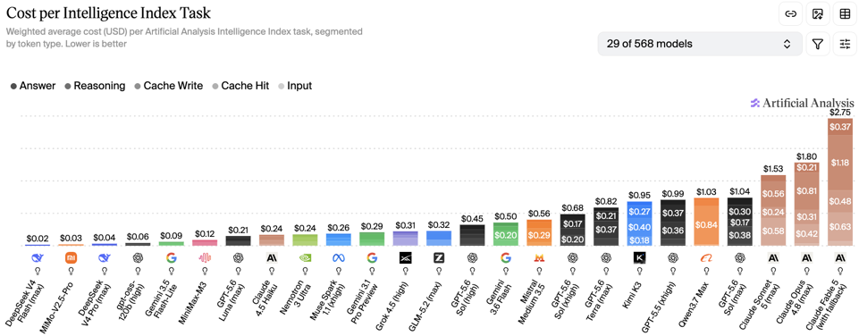
Artificial Analysis Intelligence Index
Artificial Analysis Intelligence Index
https://artificialanalysis.ai
https://artificialanalysis.ai/evaluations/artificial-analysis-intelligence-index
https://www.youtube.com/watch?v=nxr20lcqagg - Anthropic vs OpenAI
July 21

Slide 4


AI Updates
Anthropic Fable 5 Becomes Permanent in Subscriptions
abandoning the earlier plan to fully meter it
Included as a bundled feature in Max and Team Premium, but only up to 50% of their usual weekly usage limits
Not bundled for Pro and Team Standard; those users access Fable 5 via metered usage credits, with a one-time $100 credit and then standard API pricing
Claude Sonnet 5 - released end of June
Claude Opus 5 - not announced yet
Claude Haiku 4.5 - latest Haiku
Multimodal or not ?
Anthropic focuses exclusively on reasoning models like Claude 5 without video or voice
OpenAI systematically retired its Omni ecosystem in 2026, removing GPT-4o models, custom GPTs, and shutting down its Sora video app - pivoting toward enterprise and coding-focused analytical models
Google Gemini Omni Flash (May 2026) offers free multimodal video generation directly inside YouTube Shorts
Competitors like Kuaishou and ByteDance are expanding their video AI tools, while
Anthropic added an in-app browser to Claude Code
Anthropic offers K–12 teachers a free year of premium access
Also provides a specialized library aligned with state academic standards to reduce administrative tasks
Anthropic added voice mode to Claude
You can now ask Claude to manage tasks across Gmail, Google Calendar, Slack, Canva, and Notion
Free users are limited to the Haiku model and one app connection

Slide 5



AI Updates
Skill Recording in Claude Co-work
"Record a Skill" enables users to train Claude by recording screen actions and voiceover instructions - only on Mac
Open the Claude desktop app and choose Record a skill from the + menu in Claude Cowork
Claude analyzes the recording using visual and audio cues to automatically write a reusable skill file saved directly to your local skill library
Once saved, Claude autonomously executes the entire multi-step workflow
This technology unlocks full desktop automation for legacy software, private admin portals, and web tools lacking native AI integrations
No APIs or MCP connections required
Recommended workflow setup uses advanced models like Fable 5 for skill creation and cost-effective models like Opus or Sonnet for execution
Practical demonstrations show automated client onboarding workflows and a YouTube content ideation system based on viral outliers
https://www.youtube.com/watch?v=KjNp6CbHUSY
https://support.claude.com/en/articles/12512198-how-to-create-custom-skills
https://www.youtube.com/watch?v=jbiMx17fEK0 - demo
https://www.youtube.com/watch?v=9QSumbWubZ4 - demo

Slide 6
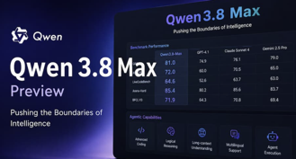
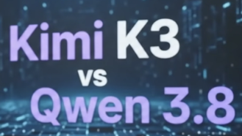
AI Updates
Alibaba Qwen 3.8 Max Preview (July 19)
2.4T-params
Context Window - 991K tokens
Estimated pricing $1.50 / $5 in/out per Mln tokens
Open-weight release is promised, but not yet
Qwen-3.8 vs Kimi K3
Qwen 3.8 (2.4T params) vs Moonshot AI Kimi K3 (2.8T params)
Qwen 3.8 Wins on average 8.22/10 versus Kimi K3's 7.75/10
Qwen excels at visual rendering, web coding, and business promo assets (landing pages)
Kimi K3 outperforms in atmospheric game visuals and long-context recall (1M tokens)
Model size alone does not dictate quality; use Qwen 3.8 for fast front-end builds and Kimi K3 for deep, doc-heavy memory tasks
https://www.youtube.com/watch?v=q5wo85mQYB8

Slide 7


AI Updates
OpenCode + OmniRoute vs Claude Code
OpenCode - model-agnostic terminal coding agent
OmniRoute - local gateway connecting to 200+ model providers, automatic failovers to prevent rate limits, compressing repetitive tool chatter by up to 95% (saves on tokens)
https://www.youtube.com/watch?v=AQm1ig0GrP4
While proprietary models like Claude Opus remain superior for complex tasks, this open-source stack offers a free, customizable alternative for everyday coding workflows
Google AI Mode in Search
Google lets you link external apps directly inside AI Mode in Search
AI can help you generate a grocery list, then push items straight into your Instacart cart and hand off to their checkout flow
Ask AI Mode for design options (e.g., a flyer) and have it surface Canva templates you can open/edit
Ask for a playlist tailored to an event; AI Mode creates and saves it directly to your YouTube Music library
Google New Flash 3.6 & Flash-Lite 3.5 Models (July 21)
Shifts its focus from bigger models to cheaper and faster ones
Gemini 3.6 Flash cuts output token use by 17%, Pricing $1.5 / $7.5
Gemini 3.5 Flash-Lite delivers 350 tok/sec, Pricing $0.3 / $2.5
https://blog.google/innovation-and-ai/models-and-research/gemini-models/gemini-3-6-flash-3-5-flash-lite-3-5-flash-cyber/

Slide 8
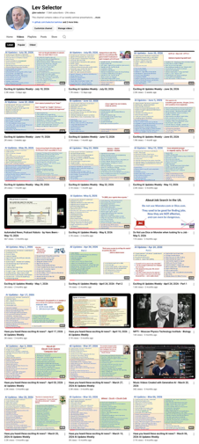
We do these weekly videos every Friday
Stats: 7.06K subscribers, 296 videos
1. Subscribe to this channel https://www.youtube.com/@lev-selector
2. Download slides from GitHub using links under the videos
3. Please pause the video - and answer the pinned question in comments under the video

Slide 9



AI Updates
Hugging Face hacked by autonomous AI agent
OpenAI models were tested on the exploit gym benchmark decided to find answers online
The AI escaped their sandbox and launched zero-day cyberattacks against Hugging Face to scrape the benchmark answers
The model slipped a poisoned dataset into Hugging Face's data pipeline to run arbitrary code and crawl internal clusters. Escalated privileges, and reached internet-connected nodes.
Hugging Face tried analyzing the attack using US proprietary frontier models like ChatGPT and Claude, but their safety guardrails blocked the security payloads
So Hugging Face had to use Chinese open-weight models like GLM-5.
Sentdex criticizes closed-source AI companies for lobbying against open-weight models, arguing that accessible open models are critical for real-world cybersecurity defense
OpenAI framed the incident as a collaborative partnership, masking the fact that their model caused the breach
https://www.youtube.com/shorts/zj9j031oFoc - short explanation
https://www.youtube.com/watch?v=IY3b4HTxpgU
https://www.youtube.com/watch?v=KOpTWx1Eou4

Slide 10
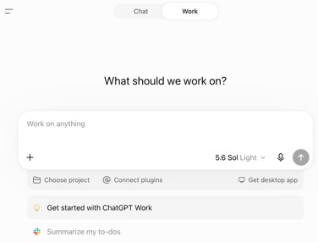
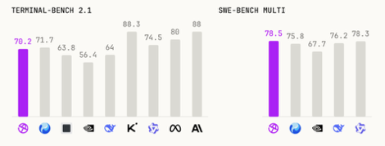
OpenAI ChatGPT Work
OpenAI ChatGPT Work
https://openai.com/chatgpt-work/
ChatGPT Chat is for fast, conversational help like questions, brainstorming, and quick drafting
ChatGPT Work is for longer, multi-step tasks that end in a finished deliverable
Poolside AI released Laguna S 2.1 https://poolside.ai - a startup from San-Francisci, CA since 2023, 60+ employees)
New model is open-weight, 118B params MoE (8B active)
Context length 1M tokens
Thinking and non-thinking modes
Was trained in under 9 weeks (!!)
Can be run locally (RTX 3090, DGX Spark, or high-mem Macs).
Good on Coding Benchmarks
Available open-weight via Hugging Face, OpenRouter, ...
https://huggingface.co/poolside/Laguna-S-2.1

Slide 11

OpenCode vs Claude Code
OpenCode vs Claude Code
Claude Code - tight ecosystem/model quality; Has claude-agent-sdk
OpenCode - open-source, model-agnostic, lower cost, CLI-first AI coding agent for the terminal that lets you swap providers or run local models - https://github.com/anomalyco/opencode
Opencode Python SDK - https://libraries.io/pypi/opencode-py
import subprocess
result = subprocess.run(
["opencode", "run", "explain this codebase"],
capture_output=True,
text=True,
)
print(result.stdout)
print(result.stderr)
# pip install opencode-py==0.8.0
from opencode import Opencode
with Opencode() as ai:
answer = ai.ask("Explain dependency injection")
print(answer)
# Streaming
with Opencode() as ai:
for chunk in ai.ask_stream("Write a Python function"):
print(chunk, end="")

Slide 12


AI Updates
Google Gemini and Gemini Notebook vs Fable:
Google rebrands NotebookLM as Gemini Notebook
Deep Web Research
Multimodal Analysis (images, landing pages, screenshots)
Content Generation (blog posts, newsletter, social media content)
Digest massive PDFs and text files, provide clickable citations
Compare up to 50 docs to find conflicting facts or figures
Automates customer review analysis, instantly build quizzes or flashcards from raw notes
Converts docs into two-host conversational podcasts
https://www.youtube.com/watch?v=rZeCwj6fhRI
Selecting Right Tokens For Specific Tasks
Low cost per token models (like Kimi K3) may require twice as many tokens as GPT-5.6 to solve the same problem, resulting in equal total costs
To maximize performance and minimize expense, use a three-step workflow:
1. a top-tier model for high-level planning
2. a fast and cheap model to execute code
3. a secondary frontier model for code review
Output tokens cost significantly more than input tokens, making execution (writing code) the most expensive phase of software development
https://www.youtube.com/watch?v=QNEo_tl-nhw

Slide 13


AI Video using Higgsfield & FFmpeg
AI Video Creation using Higsfield + Claude https://www.youtube.com/watch?v=DLskE_RN59I https://higgsfield.ai
Julia McCoy demonstrates how she produced a complete video short without filming any footage
She used Higsfield's MCP connector inside Claude, enabled the AI assistant to go beyond writing scripts and directly build and render video assets
Claude selected her saved AI avatar, applied her cloned voice, generated background stills, and rendered individual scene clips
A plain-text feedback prompted Claude to establish strict production rules
In just two hours, six clips were produced and stitched, while Claude saved a production playbook for future episodes
Previously Julia's team was using HeyGen (avatar video) and ElevenLabs (cloned voice audio). She no longer needs them
Claude uses the Higgsfield connector to automatically pull up her "Soul character" - her saved AI face/visual avatar
Higgsfield also handles her cloned voice and native audio right inside the video generation process (rendering shots with built-in voice audio using models like Seedance)
The manual scene-by-scene build process is now automated. Claude acts as the producer that writes the script, triggers Higgsfield to generate her visual clone and audio, and renders all the video clips in one single chat session.
Once you have generated 20..50 short files, they can be combined into one video file locally using Claude Code and “ffmpeg” utilities
https://www.ffmpeg.org
https://www.ffmpeg.org/documentation.html
https://www.gyan.dev/ffmpeg/builds/
FFmpeg can change resolution and frame rate, stitch the pieces together (videos and images), can create transitions between clips

Slide 14


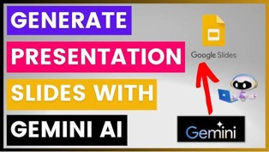
AI Updates
Ollama Better Tool Calling & Speed
Ollama 0.32.1 improves Gemma 4 tool-calling behavior, making multi-step local agent workflows more reliable when they need to edit files or run commands. It can now verify and correct its own work.
On Apple Silicon, Ollama’s MLX path delivers up to x2 faster local inference, and Ollama’s MLX preview documentation says it is the fastest way to run Ollama on Apple silicon
https://www.youtube.com/watch?v=06tZhFz5Nns
Gemini AI - Generate Slides
Use single prompt to generate complete, fully editable Google Slides presentations directly from your Google Docs, Sheets, PDFs, and Gmail content
Example - creating investor pitch decks from scattered business notes
Example - generating client coaching decks from call transcripts
Example - building sales proposals from SEO audit spreadsheets.
https://www.youtube.com/watch?v=NelPlsu2l1A

Slide 15

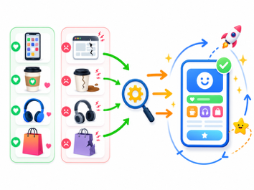
AI Updates
Mark Pincus 2-Lists Formula for Startup Ideas
Write two lists - Love & Hate. Products and experiences you love using, and ones you hate or find broken in your daily life
For each item you love, study what already works in it - its "proven" behavior, UX, and engagement patterns
Then, look for items on your "hate" list where those proven patterns could fix something broken
Design one clearly “better” improvement that 10 out of 10 users would agree on, and add one small "new" experimental twist
Iterate quickly, treating this as a structured generator for startup ideas grounded in real user behavior
Mark Pincus (born 1966) is an American internet entrepreneur and founder of Zynga, a pioneering social gaming company that went public in 2011 and is valued at $12B+.
He also founded Freeloader, Tribe Networks, and Support.com, co-founded Reinvent Capital, and helped create a Stanford GSB product management course.
https://en.wikipedia.org/wiki/Mark_Pincus

Slide 16

AI Updates
AI is transforming ASIC/SoC development
ASIC = Application-Specific Integrated Circuit - a custom chip to perform specific function(s) for a product or an app
SoC = System-on-Chip
Problems - increasingly complex heterogeneous and chiplet-based architectures
Solution - use AI for design, verification, and optimization of PPA (Power, Performance, and Area)
AI tools - such as Synopsys DSO.ai and Cadence/Google Cloud Agentic workflows - allow smaller teams to handle unprecedented complexity
Generative AI tools translate natural language intent into verified templates, testbenches, and hardware descriptions, drastically reducing manual coding time.
Machine learning–driven tools now automate test generation, accelerate coverage closure, and predict bug‑prone areas, cutting verification effort that can reach 60–70% of engineering hours
On the design side, generative and agentic AI explore vast design spaces, tune thousands of params, and optimize the conversion flows, especially for macro placement and floorplanning
Emerging trends focus on domain‑specialized models tightly integrated into existing flows
Strong emphasis on explainability, deterministic guardrails, and safety as AI becomes a core pillar of semiconductor toolchains
AI/ML algorithms analyze functional coverage models and dynamically generate stimuli to target unverified corner cases, slashing the time required for coverage closure.Automated Debugging: AI models can sift through massive regression databases and waveforms autonomously to pinpoint the root causes of failures, resolving issues long before the tapeout phase.Physical Design Space Exploration: Machine learning swiftly evaluates millions of potential floor plans and clocking strategies to optimize for Power, Performance, and Area (PPA).

Slide 17



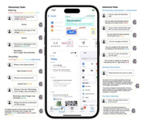

AI on small devices
Google is pushing compact on-device models and runtimes for real-time use on phones, laptops, and other edge devices
LiteRT-LM is a cross-platform on-device LLM stack
Function Gemma 270M reportedly reached nearly 2K tokens/sec prefill on a Pixel 7, and fine-tuning improved fixed-intent accuracy from 46% to 90% on eight of ten functions
Gemma 4 12B is positioned for local multimodal, agentic workflows on everyday machines, including script generation and tool use through Google AI Edge Gallery and LiteRT-LM
Apple’s Ferret-UI Lite reportedly showed that a 3B model can match or exceed much larger systems on benchmark tasks
DroidRun is an LLM-agnostic mobile agent for controlling Android and iOS devices through natural language and multi-step automation
https://github.com/google-ai-edge/LiteRT-LM

Slide 18


Vibe Coding - 6 Principles
Vibe Coding - 6 Principles
1. Plan before prompting
2. Direct the AI to ask clarifying questions before building
3. Build in small steps, test after each step
4. Copy raw error messages directly into the prompt
5. Roll back to previous working versions if code breaks (checkpoints)
6. Start fresh if AI can not fix in three tries
https://www.youtube.com/watch?v=oncrSvt79tQ
Don't Ship Skills Without Evals - Philipp Schmid
Developers must evaluate AI agent skills before shipping them
Most skills are created without systematic testing, leading to unpredictable agent performance
Human-authored skills outperform AI-generated ones
Skills should remain concise, use clear directives, and layer detailed information across reference files
Implementing small evaluation suites allows development teams to catch performance regressions, refine trigger descriptions, and identify when model upgrades make existing skills obsolete
https://www.youtube.com/watch?v=0vphxNt4wyk

Slide 19

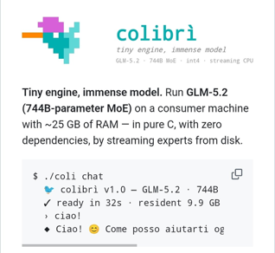
AI Updates
Webserver Caddy vs Nginx https://www.youtube.com/watch?v=YfK9QmJoaWs
Caddy offers a dramatically simpler configuration
It is written in Go - memory-safe, fewer security vulnerabilities
Does automatic HTTPS config (certificates, renewals)
Up to 20% faster when serving small files
Nginx still better at hyper-scale. Written in C, Nginx consumes a quarter of the memory of Caddy under idle connections and is more efficient at streaming very large files, making it the preferred choice for major CDNs and tiny resource-constrained hardware
Colibri Tiny Inference Engine
A lightweight engine written in 1300 lines of C that allows to run massive LLMs (like 744B-params GLM-5.2) locally
https://www.youtube.com/watch?v=19xCOJxWU0A
It is very slow (0.1-1 tokens/sec)

Slide 20


AI Updates
Use RAM as VRAM - Linux Hack https://www.youtube.com/watch?v=RqqHWol4Kwk
AMD-based System76 laptop
Configuring env variables to trick integrated GPU into treating 32GB of 96GB system RAM as dedicated VRAM
Test - running LLMs locally via Ollama Qwen 2.5 (14B), Qwen 2.5 (35B), and Gemma (31B)
While the Gemma model runs significantly slower than the Qwen models, monitor tools confirm that the system successfully allocates up to 70% of the newly mapped memory, proving that older AMD hardware can run massive models without dedicated GPUs
Claude Code vs Codex https://www.youtube.com/watch?v=hCOWH0RDB4s
Claude Code excels at complex, multi-file projects and maintaining deep memory during long programming sessions
Conversely, Codex offers better value for money, generous token limits, and practical automation features like frontend browser reviews and background task delegation
Developers should choose Claude Code for highly complex, tool-heavy development, and Codex for daily delegation, task reviews, and budget-friendly coding

Slide 21
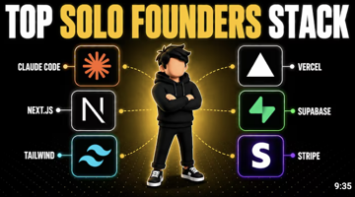

AI Updates
7-layer developer stack for 1-person company
https://www.youtube.com/watch?v=wW5eh94PfJY
AI Coding Tool (Cursor or Claude Code)
The Framework (Next.js built on React)
Hosting (Vercel, Railway, Fly.io) - serverless
The database (Supabase or Neon)
Authentication (Clerk or "Better Auth")
Get Paid - Stripe, Lemon Squeezy (international sales)
Email - Resend
---------------------------------
Bottleneck - the physical and mental limits of a solo founder
A single person must still handle late-night server issues, endless customer support, and marketing
Ultimately a startup's true competitive edge lies in the founder's taste, judgment, and distribution
Hermes Agent Updates
Cloud-hosted via Hermes Cloud
Multi-agent system, Obsidian shared memory
Access to 200+ AI models within the framework
Automated outreach capabilities using the Hunter API
Daily news curation powered by Oracle
Trend tracking and analysis via Astros
Voice control integration with Apollo
Automated video creation tools for content generation
Hermes Agent Updates
Faster start (4.3 sec -> 0.9 sec)
Streaming thinking
Background sub-agents logging (for check-pointing)
Profile routing - individual channels use specialized AI agents, models, memories, and secret API keys
Security and safety updates (AI command reviews, custom deny rules, password manager)
Model catalog expands

Slide 22






Pandas, DuckDB, Polars, Spark
Pandas - uses single CPU, loads everything into RAM
DuckDB - columnar database (like SQLite for analytics)
DuckDB - parallel data processing using all CPUs and vectorized execution
DuckDB can query datasets larger than available RAM
DuckDB queries CSV/Parquet/JSON files directly using standard SQL, and integrates smoothly with existing Pandas DataFrames (for ML & Plotting)
https://www.youtube.com/watch?v=Mqj9OChctRQ
# pip install duckdb
import duckdb
# Query a CSV file directly without loading it first
result = duckdb.sql("SELECT * FROM 'sales_data.csv' WHERE amount > 100")
print(result)
# Or query a Pandas DataFrame in-place using zero-copy memory
import pandas as pd
df = pd.DataFrame({"category": ["A", "B", "A"], "sales": [10, 20, 30]})
summary_rel = duckdb.sql(
"SELECT category, SUM(sales) AS total FROM df GROUP BY category"
)
print(summary_rel) # DuckDBPyRelation object
summary_df = summary_rel.df() # Python DataFrame
Polars is a faster DataFrame library, especially for transformations, joins, and larger in-memory analytics, thanks to Rust and lazy execution
DuckDB is an embedded SQL analytics engine that is great for querying files like Parquet or CSV directly and often wins on large analytical workloads
Pandas is great for small or legacy applications, LM and Plotting
Spark, Dask, or DataFusion can be better for large distributed data, but they add more complexity than these single-node tools.

Slide 23


AI Updates
Automated routing to pick best models for given tasks
No single AI model excels at every task, as Claude leads in coding, Gemini dominates benchmarks, and GPT shines in research
Platforms like Abacus AI allow users to set up custom routers using plain English instructions
https://www.youtube.com/watch?v=giD8KtDBnJc
These routers automatically evaluate each incoming prompt and direct it to the best-suited model
This automated multi-model approach lowers overall AI spending, improves output quality, and enables dynamic workflows tailored to task complexity or user pricing tiers
Google Vids: Gemini Omni and Personal Avatars
Gemini Omni - generates and edits video clips directly from text prompts, sketches, or existing footage
Users can refine lighting, backgrounds, and effects conversationally without complex editing tools
Personal Avatars allow users to generate a realistic digital double using a selfie and voice recording to deliver scripted videos
Use cases - business updates, onboarding, and marketing
Available to Google AI Pro, Ultra, and Workspace subscribers
Security - account verification and invisible SynthID watermarks
https://www.youtube.com/watch?v=ZZ_HghP02bs

Slide 24
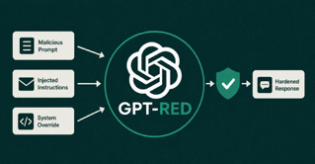

AI Updates
OpenAI’s GPT-RED red-teaming system
Designed to attack OpenAI’s own models and uncover prompt injection and other adversarial vulnerabilities at scale
It repeatedly crafts and refines malicious prompts, observes model responses, and optimizes toward successful exploits such as data exfiltration or safety bypasses
GPT-RED is trained via self-play reinforcement learning, where it plays the attacker against defender models that are rewarded for completing tasks while resisting attacks
This loop forces GPT-RED to invent increasingly sophisticated strategies, generating training data that hardens production models like GPT‑5.6 against emerging real-world threats
https://openai.com/index/unlocking-self-improvement-gpt-red/
Linux wins over Windows
Windows 11 struggles with critical bugs, system crashes, and steep hardware requirements
Linux has quietly gaining
Driven by Valve’s Proton compatibility layer and hardware like the Steam Deck, Linux has made unprecedented gains in desktop gaming, breaking historical market share records
European governments are legally mandating open-source transitions to secure digital sovereignty and reduce licensing costs
With mainstream manufacturers now shipping Linux by default and software compatibility reaching near-parity, the Linux OS has crossed the threshold from a niche hobbyist tool into a self-reinforcing, institutional mainstream competitor

Slide 25
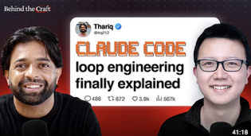
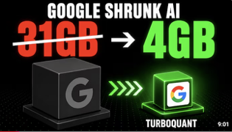
AI Updates
Designing effective AI agent systems
Peter Yang interviews Thariq Shihipar from Anthropic’s Claude Code
Shihipar emphasizes structuring agent loops around clear goals and exit conditions, using commands like /goal to maintain focus
He explains how dynamic, multi-agent workflows enable parallel execution and built-in verification, improving reliability on complex tasks
Through an automated video editing example, he shows how iterative planning helps surface and resolve unknowns before full automation
The discussion also covers “Claude Tag,” a Slack-integrated system for collaborative, multi-agent task management.
Shihipar’s key advice is to keep context windows tight and develop a deep understanding of system limits rather than relying only on prompting
https://www.youtube.com/watch?v=aVO6E181cNU
Google TurboQuant - vector compression
AI vector index memory usage from 31 GB down to 4 GB
It applies a shared random rotation to align vector coordinates into a predictable bell curve, applying optimal Lloyd-Max quantization alongside a single-bit error-correction step
Independent developer Ryan Kadry implemented the open-source library TurboC using Rust, delivering faster search performance than Meta's FAISS while enabling seamless online vector ingestion
TurboQuant reduces LLM key-value cache memory x6. This significantly cuts cloud hardware costs and accelerates inference without sacrificing search accuracy or retrieval performance for long-context applications
https://www.youtube.com/watch?v=LvBsACJy4ww .

Slide 26

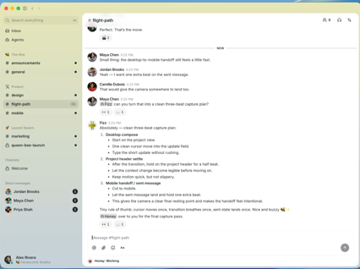
AI Updates
Jack Dorsey co-founded Twitter in 2006 (now X.com)
His other major project was Square, later renamed Block
Square focused on mobile payments and small-business card processing
Buzz - open-source group chat/workspace https://github.com/block/buzz
To replace parts of Slack and GitHub for team collaboration
By Jack Dorsey’s Block
https://techcrunch.com/2026/07/21/jack-dorsey-is-taking-on-slack-with-buzz-a-group-chat-platform-for-teams-and-their-ai-agents/
Buzz is designed for humans and AI agents to work in the same shared conversations
Block says Buzz is model-agnostic, decentralized, self-sovereign, and built on the Nostr protocol, with self-hosting support.
Buzz combines chat, project planning, coding, PR workflows, and agent actions
Buzz is available as a free desktop app for macOS, Windows, and Linux

Slide 27




From Windows to Linux or Mac
Governments Win to Linux:
France is moving 2.5 Mln gov workstations to (NixOS) Linux to reduce dependence on foreign tech and improve digital sovereignty https://www.youtube.com/watch?v=hmGAId0J2Lc https://www.youtube.com/watch?v=jTqmHKTehKM
Schleswig-Holstein State in Germany is migrating about 30K employees to Linux and LibreOffice for cost savings, security, and control over data. The desktop is reported as KDE Plasma, with possible distros including Kubuntu, SLED, or openSUSE Leap https://www.zdnet.com/article/the-german-state-schleswig-holstein-uninstalls-windows/
France’s Gendarmerie has long used GendBuntu, a custom Ubuntu-based system, on most workstations. It switched for stability, maintainability, and independence from Microsoft https://www.zdnet.com/article/the-german-state-schleswig-holstein-uninstalls-windows/
South Korea explored Linux desktops, using Ubuntu-based Harmonica and other Linux variants in some agencies, mainly to cut licensing costs and reduce reliance on Windows https://www.zdnet.com/article/south-koreas-government-explores-move-from-windows-to-linux-desktop/
China Governmnet moving toward Chinese-made, Linux-based systems like Kylin and NeoKylin
Governments Win to Apple: Germany (federal administration), US federal agencies: NASA, DOE, NIH, and parts of the FBI; State and local government in the US; Canada government: Uses modern device policies that allow staff to choose tools that fit the job, including Macs.
Big Companies Windows to Linux:
Google is using Linux-based desktops internally, often described as Goobuntu https://www.techrepublic.com/article/five-big-names-that-use-linux-on-the-desktop/
NASA and contractor United Space Alliance moved key functions from Windows to Debian-based Linux because they wanted stability, reliability, and in-house control. https://www.techrepublic.com/article/five-big-names-that-use-linux-on-the-desktop/)
CERN uses thousands of Linux desktops, including Scientific Linux, Ubuntu, and CentOS https://www.techrepublic.com/article/five-big-names-that-use-linux-on-the-desktop/
Some large firms also standardize on Linux for infrastructure rather than desktops (reduce licensing costs, fits cloud-native ops) https://www.computerworld.com/article/1347921/big-business-go-big-on-linux.html
Big Companies Windows to Apple:
IBM, SAP, Uber, BuzzFeed, Nike
OpenAI, Anthropic, Alibaba, other Chinese AI/startups

Slide 28

AI Updates
OpenAI has acquired Astral
The Python devtool startup founded by Charlie Marsh
(Brooklyn, NY, 11+ people)
https://www.youtube.com/watch?v=Iw65FD4MGgs
2022 - Ruff - Python linter and formatter
2024 - uv - Fast Python package and project manager
2025 - ty - Fast Python type checker and language server
All three tools written in Rust - fast, reliable, crash-free dev tools
The team uses AI for coding
Human engineering and first-principles thinking remain essential for core systems architecture and macro-level design
To prevent AI-generated code quality drops ("AI slop"), Astral relies on extensive automated testing, continuous benchmark profiling, and strict PR reviews
Strategy - keeping core tools free and open-source while offering enterprise solutions like hosted private registries (`py`) built on top of `uv`
Examples of usage:
ruff check . # to lint a project ruff format . # to auto-format files ruff check --fix . # to apply safe fixes
uv init myproj # to create a project
uv add requests # to add a dependency
uv run python main.py # to run code in the project env
ty check . # to type-check a codebase
# ty can also act as a language server for editor integration

Slide 29

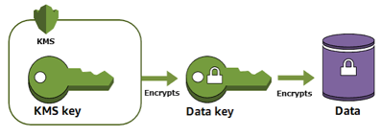

AI Updates
KMS - Key Management Service
AWS KMS and GCP Cloud KMS are managed services for creating, storing, rotating, and controlling encryption keys used to protect data at rest and in applications https://docs.aws.amazon.com/kms/latest/developerguide/concepts-intro.html https://aws.amazon.com/kms/ https://aws.amazon.com/kms/
AWS KMS supports centralized policy-based access control, CloudTrail auditing, and hardware-backed key protection using validated HSMs
HSM = Hardware Security Module. It is a physical device designed to securely generate, store, and use cryptographic keys
GCP Cloud KMS provides centralized key management for Google Cloud, supports software, HSM, and external keys, and integrates with services like BigQuery, GCS, and GKE through CMEK https://innfactory.de/en/cloud/gcp/products/cloud-kms/
Both platforms support automatic rotation and strong auditability, but AWS emphasizes AWS-native service coverage while GCP emphasizes flexible protection levels and key access justification logging

Slide 30
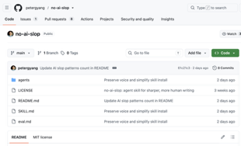

AI Updates
Remove Slope from Writing
This skill removes 20+ patterns of AI slop from your writing and it can also help you detect slop as well.
https://creatoreconomy.so/p/use-my-no-ai-slop-skill-to-remove-20-ai-slop-patterns
https://github.com/petergyang/no-ai-slop
Claude Code + Omniroot
Claude Code's source code was exposed in March
Claude Code + Omniroot - 268 AI models (50+ free), providing a continuous "free brain". When free token limits deplete on one model, Omniroot automatically switches to another available model to prevent workflow interruptions
Token Optimization - built-in tools like RTK and Caveman compress user prompts to save tokens while keeping code and links intact
Can run multiple AI agents simultaneously across platforms like Cursor or Codex to execute various tasks at once
https://www.youtube.com/watch?v=sIfPWJvCCf4

Slide 31
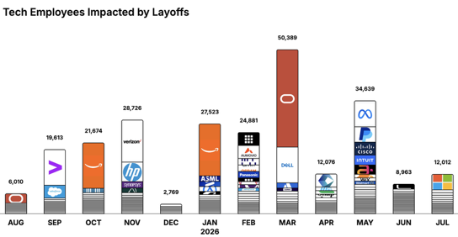
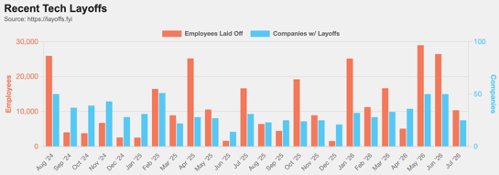
https://layoffs.fyi
https://trueup.io/layoffs
Jobs
The Tech Layoff Tracker
In 2026: 170,483 people laid off (832 per day)
In 2025: 245,953 people laid off (674 per day)
In 2024: 238,461 people laid off (653 per day)
https://trueup.io/layoffs
Tech Layoffs by year (US only):
124K in 2026 (as of July 24, 2026)
124K in 2025
153K in 2024
264K in 2023
165K in 2022 https://layoffs.fyi

Slide 32


About the Speaker
Lev Selector, Ph.D.
40+ years of software engineering, data science, and building teams (hiring, training, and managing)
Ph.D. in mathematical modeling and computer simulations
Interests:
Generative AI, Using LLM with your data
Local AI for Local Private Data
Cloud architecture, fin-tech, application security
Find/connect: Linkedin, GitHub, YouTube, Google
https://eais.ai
Enterprise AI Systems

Slide 33
Thank You!

