Slide 1
AI Updates - Sept 18, 2026
xxx
Crowd-sourced "LM Arena"
Cost Per Intelligence Index
xxx
xxx
Jobs & Layoffs

Slide 2
"LM Arena" Leaderboard
Data for Sept 02
Starting Elo rating = 1000
https://en.wikipedia.org/wiki/Elo_rating_system
English - https://lmarena.ai/leaderboard/text
Coding - https://lmarena.ai/leaderboard/text/coding
■ | Claude
■ | Gemini
■ | OpenAI
■ | Open Source
Claude Fable-5 - 6TB
Claude Opus-4.8 - 5TB
Claude Sonnet-4.5 - 1TB
Claude Sonnet-5 - ?
GLM-5.3 - 744B
Meta muse-spark - 16 x 70B
Qwen3.7-max-preview - 745B
Qwen3.8-max - 2.4TB
Baidu Ernie-5.1 - 800B
Deepseek-v4 - 1.6T
Kimi-k3 - 2.8T
Xiaomi MiMo-V2.5-Pro - 1T+
ByteDance dola-seed-2.0-pro 400B
Minimax M3 - 456B
Code | Model | Score
■ | claude-fable-5 | 1508
■ | claude-opus-4-6-high | 1505
■ | claude-opus-4-7-high | 1502
■ | muse-spark-1.2 (xHigh) | 1499
■ | claude-opus-4-6 | 1498
■ | claude-opus-4-7 | 1494
■ | gemini-3.8-flash-high | 1494
■ | claude-opus-5-high | 1492
■ | muse-spark-1.1 | 1491
■ | gemini-3.7-flash-high | 1491
■ | kimi-k3-max | 1489
■ | muse-spark | 1488
■ | claude-opus-5-max | 1488
■ | gemini-3.1-pro-preview | 1487
■ | gemini-3-pro | 1486
■ | gpt-5.6-sol-xhigh | 1483
■ | gpt-5.5-high | 1482
■ | glm-5.3-max | 1482
■ | claude-opus-4-8-high | 1482
■ | gemini-3.6-flash-high | 1480
■ | qwen3.8-max | 1479
■ | gemini-3.5-flash-high | 1479
■ | gpt-5.5 | 1477
■ | gpt-5.4-high | 1477
■ | gpt-5.2-chat-latest-20260210 | 1476
Code | Model | Score
■ | claude-opus-4-7-high | 1552
■ | claude-opus-4-6-high | 1552
■ | claude-fable-5 | 1551
■ | claude-opus-4-7 | 1547
■ | claude-opus-4-6 | 1546
■ | kimi-k3-max | 1542
■ | gemini-3.8-flash-high | 1537
■ | glm-5.3-flash | 1535
■ | claude-opus-4-8-high | 1534
■ | muse-spark-1.2 (xHigh) | 1534
■ | claude-opus-5-high | 1533
■ | muse-spark-1.1 | 1531
■ | claude-opus-4-5-20251101-high-32k | 1531
■ | gpt-5.6-sol-xhigh | 1529
■ | claude-sonnet-4-6 | 1528
■ | claude-opus-4-8 | 1528
■ | glm-5.3-max | 1528
■ | muse-spark | 1526
■ | qwen3.7-max-preview | 1525
■ | claude-opus-5-max | 1525
■ | claude-opus-4-5-20251101 | 1523
■ | gemini-3.7-flash-high | 1523
■ | grok-4.5 | 1522
■ | gemini-3.1-pro-preview | 1521
■ | mimo-v2.5-pro | 1521

Slide 3
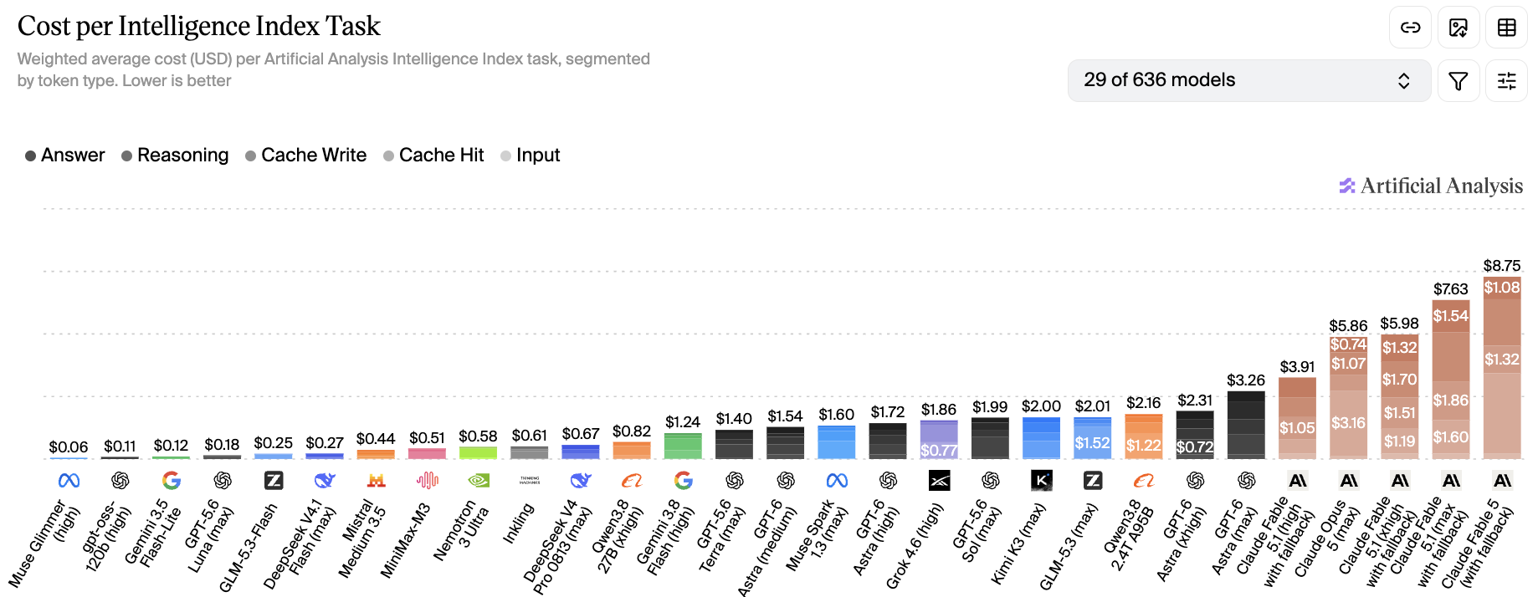
Artificial Analysis Intelligence Index
Artificial Analysis Intelligence Index
https://artificialanalysis.ai/evaluations/artificial-analysis-intelligence-index
Sept 10

Slide 4
AI Updates
Meta ships Muse agent with its own cloud computer and browser
email, calendars, Instagram and ordinary websites. It ties into Gmail, Spotify, Ticketmaster and OpenTable, and codes its own integrations for services that lack them. It runs in its own app, on the web, or inside WhatsApp, and keeps working after you close it.
The security design is the interesting part. Muse runs in a Secure VM, a separate Sentinel agent inspects everything leaving that VM, passwords stay hidden from Muse itself, sensitive actions require approval, and every action enters an audit trail. Payments go through Stripe Link. A Confidential VM upgrade is planned.
Tiers: Free, $20/mo, $100/mo
US only, 18 and older, AI glasses support coming
Claude formalized Fermat's Last Theorem in 11 days
Wiles proved Fermat's Last Theorem in 1995.
Claude converted the proof into 13 Mln lines of Lean. Almost 30K intermediate theorems
It runs on Prove2Me, an open collaborative platform that maintains a graph of theorem statements and coordinates multiple Claude agents against it
Claude did not discover a new proof. It converted an existing one into the first complete, computer-checked formalization
The whole thing is on GitHub
https://www.anthropic.com/research/formalizing-fermats-last-theorem

Slide 5
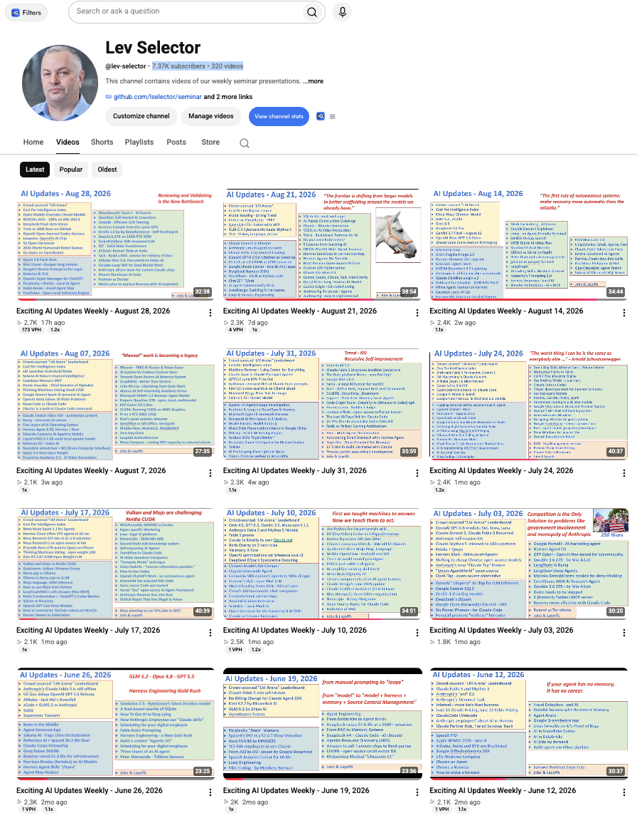
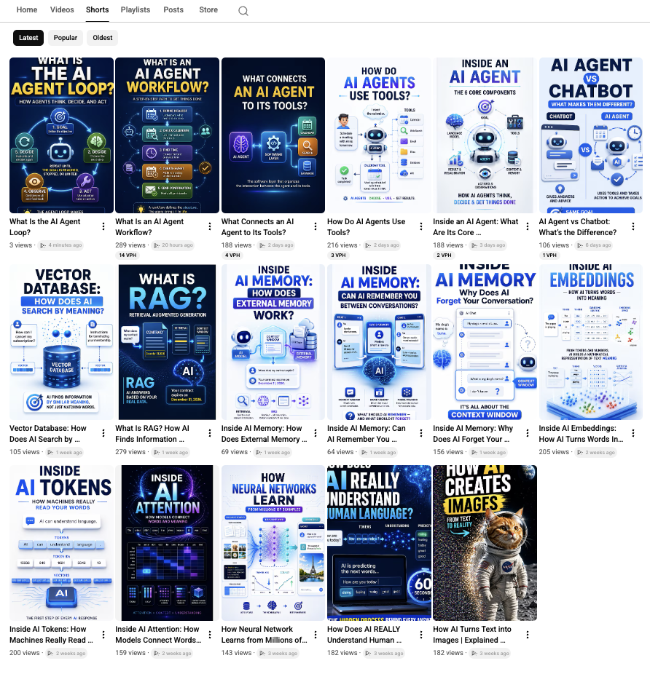
Weekly videos every Friday
7.46K subscribers, 333 videos
1. Subscribe to this channel https://www.youtube.com/@lev-selector
2. Download slides from GitHub using links under the videos
3. Please pause the video - and answer the pinned question in comments under the video

Slide 6
AI Updates
11. An Anthropic resignation turns into an extinction debate
Researcher Jacob Coxon resigned and posted that both Anthropic and OpenAI are
"gambling with our lives" by racing toward self-improving AI. He worked at both
labs, and wrote that the people building AI "earnestly believe that it could
kill us all by the end of the decade. This is not a marketing stunt." He called
for a coordinated slowdown, saying prevention may "require costly actions such
as a temporary ban on improving model capabilities."
The reply is what made it spread. Evan Hubinger, Anthropic's Alignment Science
lead, responded "We really do earnestly believe AI could kill all humans!" and
put the odds above 10% within the next decade. He added that there is no plan
yet for controlling superintelligence, while clarifying that today's models are
low risk and self-improvement is the danger.
The argument underneath is not about p(doom). If the people who believe the
stakes are civilizational still cannot coordinate, then "trust the responsible
lab" is not a safety plan.
Mistral raises the largest round in European tech history
€3 billion in a Series D led by Samsung Electronics, with Nvidia, ASML and a16z
joining, valuing the French lab above €21 billion. One newsletter reported it as
$3.5 billion, which is the same round converted. Mistral is three years old and
tracking toward $1 billion in annual recurring revenue. The money goes
to compute and international expansion behind a shift toward sovereign,
full-stack enterprise AI. Le Chat is being rebranded to "Vibe," an agent and
coding platform.

Slide 7
AI Updates
18. Google's agentic video understanding cuts video tokens by up to 88%
Gemini Flash models now navigate a video timeline rather than ingesting it at 1
FPS. Google reports up to 88% fewer tokens, 66% lower cost and 7% higher
accuracy. One processing field turns it on. Hosted API only, so no local
deployment.
19. The music industry stops fighting and starts licensing
Suno released a model built with Warner Music Group, BMG and Believe, with
artists participating and their music and likenesses licensed for use on the
platform. It ships with a compensation framework, which is the point: the
copyright fight is converting into a business arrangement.
Universal Music went the same direction days later, partnering with ElevenLabs
on a platform for remixing tracks from UMG's catalog, with artists opting in.
Spotify is exploring AI remixes too.

Slide 8
AI Updates
Anthropic models what AI does to US jobs and wages by 2030
An interactive tool that treats every job as a bundle of tasks, then asks
whether AI speeds up each task, replaces it, or creates new ones. Three
scenarios:
Modest, where AI feels like the internet did: GDP grows 1.6% above the no-AI
path, wages stable. Substantial, where AI handles about half of knowledge work:
GDP up 8.3%, but knowledge worker wages flatline and some people change careers
entirely. Extreme: 15% annual growth doubling the economy every 4.5 years,
knowledge worker unemployment at 17.9%, and labor's share of GDP falling from
60% to 45%.
The point buried in the third scenario is that a bigger economy does not
automatically mean you earn more. Capital owners capture most of the gains. Of
the 10,000+ Americans surveyed, most land near the substantial scenario and only
about 10% expect the extreme one.
This is a natural companion to your layoffs slide, since it puts a mechanism
behind the numbers.
https://www.anthropic.com/institute/econ-scenarios

Slide 9
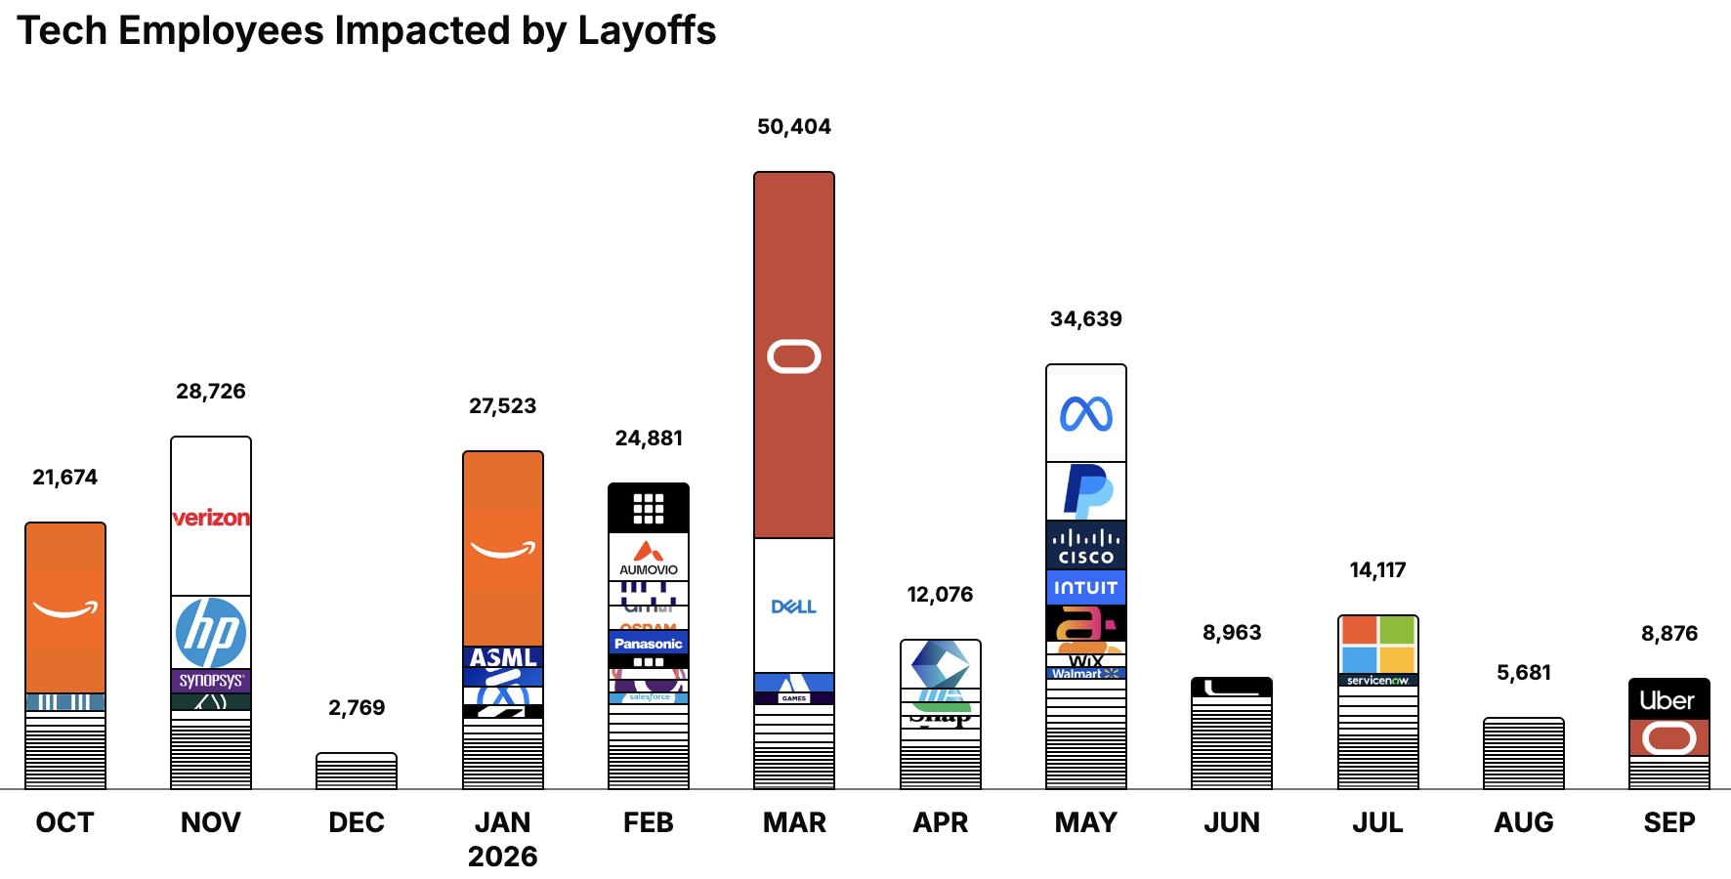
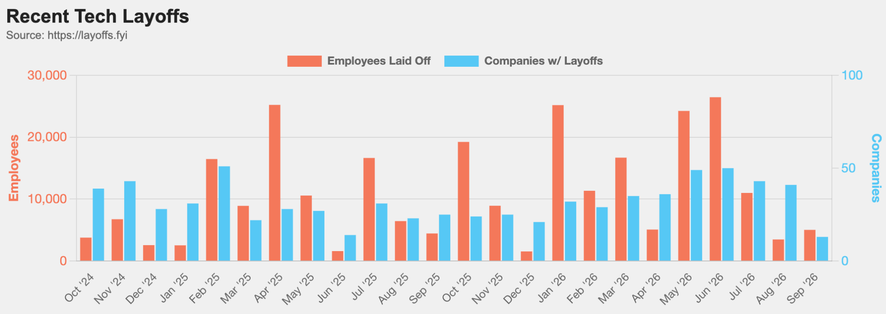
https://layoffs.fyi
https://trueup.io/layoffs
Jobs
The Tech Layoff Tracker
In 2026: 187,160 people laid off (737 per day)
In 2025: 245,953 people laid off (674 per day)
In 2024: 238,461 people laid off (653 per day)
https://trueup.io/layoffs
Tech Layoffs by year (US only):
  128.5K in 2026 (as of Sept 10, 2026)
  124K in 2025
  153K in 2024
  264K in 2023
  165K in 2022 https://layoffs.fyi

Slide 10


About the Speaker
Lev Selector, Ph.D.
40+ years of software engineering, data science, and building teams (hiring, training, and managing)
Ph.D. in mathematical modeling and computer simulations
Interests:
Generative AI, Using LLM with your data
Local AI for Local Private Data
Cloud architecture, fin-tech, application security
Find/connect: Linkedin, GitHub, YouTube, Google
https://eais.ai
Enterprise AI Systems

Slide 11
Thank You!

