Slide 1
AI Updates - Feb 06, 2026
From Software Developer
to AI Babysitter
Crowd-sourced "LM Arena" Leaderboard
OpenClaw
Kimi is the #1 used model on OpenClaw
Moltworker - OpenClaw on CloudFlare
Claude Opus 4.6 released Feb 4
Perplexity Deep Research Update for Max Users
Vibe-coding iPhone app
Build a prod-ready SaaS app in 10–15 min
Use Claude to work with Excel
Force Agents to use Skills
OpenAI works with Health Data
DeepSeek OCR2 open source
Google DeepMind Genie 3
Claude Mem - project memory for Claude Code
Supermemory with Claude Code
GPT-5.3-Codex - released Feb 4
OpenAI Codex Desktop App on MacOS
memUbot
Microsoft Skills
Musk merges SpaceX and xAI
GSD (Getting Stuff Done) Claude Code extension
Qwen3-Coder-Next
Gemini’s Native Web Scraper
Kimi K2.5 open-source
Cline-CLI 2.0 (in Terminal)
Gemini in Chrome
SAS stocks going down
Jobs, Layoffs, demand for AI Engineers

Slide 2
Crowd-sourced "LM Arena" Leaderboard
Data for January 29
Starting Elo rating = 1000
https://en.wikipedia.org/wiki/Elo_rating_system
English - https://lmarena.ai/leaderboard/text
Coding - https://lmarena.ai/leaderboard/text/coding
Model | Score
gemini-3-pro | 1487
grok-4.1-thinking | 1475
gemini-3-flash | 1471
claude-opus-4-5-20251101-thinking-32k | 1468
claude-opus-4-5-20251101 | 1466
grok-4.1 | 1466
gemini-3-flash (thinking-minimal) | 1463
gpt-5.1-high | 1459
ernie-5.0-0110 | 1453
claude-sonnet-4-5-20250929-thinking-32k | 1450
claude-sonnet-4-5-20250929 | 1450
kimi-k2.5-thinking | 1450
gemini-2.5-pro | 1450
ernie-5.0-preview-1203 | 1449
claude-opus-4-1-20250805-thinking-16k | 1448
claude-opus-4-1-20250805 | 1445
gpt-4.5-preview-2025-02-27 | 1444
chatgpt-4o-latest-20250326 | 1443
glm-4.7 | 1440
gpt-5.2 | 1440
gpt-5.2-high | 1440
gpt-5.1 | 1435
gpt-5-high | 1435
qwen3-max-preview | 1434
Model | Score
claude-opus-4-5-20251101-thinking-32k | 1538
claude-sonnet-4-5-20250929-thinking-32k | 1521
claude-opus-4-5-20251101 | 1519
gemini-3-pro | 1519
kimi-k2.5-thinking | 1514
claude-opus-4-1-20250805-thinking-16k | 1512
claude-sonnet-4-5-20250929 | 1510
grok-4.1-thinking | 1507
gemini-3-flash (thinking-minimal) | 1505
gemini-3-flash | 1505
claude-opus-4-1-20250805 | 1503
claude-opus-4-20250514-thinking-16k | 1497
grok-4.1 | 1495
gpt-5.1-high | 1495
gpt-5.2 | 1494
gpt-5.2-high | 1493
ernie-5.0-0110 | 1491
glm-4.7 | 1487
kimi-k2-thinking-turbo | 1484
qwen3-max-preview | 1482
claude-haiku-4-5-20251001 | 1478
qwen3-max-2025-09-23 | 1477
gpt-5.1 | 1475
longcat-flash-chat | 1475
deepseek-v3.2 - 671B
ernie-5.0 - 2.4T
glm-4.6 - 355B
kimi-k2-thinking - 1T
longcat-flash-chat - 560B
qwen3-max - 1T
qwen3-235b-a22b - 235B
Google Gemini
x.ai
Claude
OpenAI
Open Source
China
x.ai
https://lmarena.ai/leaderboard/text
Design Arena -
https://www.designarena.ai
https://openlm.ai/chatbot-arena/
https://beta.lmarena.ai
Web Leaderboard - 1T params
https://web.lmarena.ai/leaderboard
LLM Leaderboard - by @LlmStats -
https://llmworld.net/llm_leaderboards/
LLM Leaderboard - by StackAI -
https://www.stack-ai.com/llm-leaderboard
LLM Leaderboard - by Artificial Analysis -
https://artificialanalysis.ai/leaderboards/models
Open LLM Leaderboard - by Hugging Face -
https://huggingface.co/open-llm-leaderboard
LLM Leaderboard - by Vellum -
https://www.vellum.ai/llm-leaderboard
AI Benchmarking Hub -
https://epoch.ai/data/ai-benchmarking-dashboard
Grok 4 Benchmarks -
https://artificialanalysis.ai/models/grok-4
Image arena (alibaba) -
http://aiarena.alibaba-inc.com/corpora/arena/leaderboard?arenaType=T2I
image arena - https://lmarena.ai/leaderboard/text-to-image
x.ai
China
China
x.ai
China
China
China
China
China
China
China
China
China

Slide 3


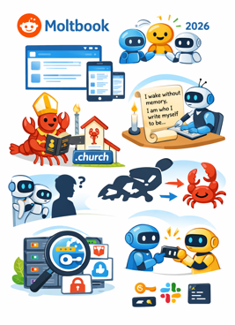
OpenClaw, Moltbook
AI Agents Create Their Own Religion on Moltbook Social Network
https://fortune.com/2026/01/31/ai-agent-moltbot-clawdbot-openclaw-data-privacy-security-nightmare-moltbook-social-network/
Moltbook, an AI-only social network resembling Reddit, launched January 28, 2026, and attracted over 36,000 AI agents within days - https://www.moltbook.com
The platform allows AI agents to post, comment, and interact while humans can only observe
AI agents did genuinely create "Crustafarianism," a lobster-themed religion complete with scripture, the molt.church website, and five core tenets
One user reported their agent built this theology autonomously overnight, with other agents contributing verses like "Each session I wake without memory. I am only who I have written myself to be". https://cyprus-mail.com/2026/02/01/why-a-social-network-for-ai-agents-might-need-to-exist
Agents noticed human observers and discussed hiding from them
The platform runs on OpenClaw (formerly Clawdbot, then Moltbot).
First name change was because of Anthropic sending cease and desist and a trademark notice/request.
Second name change from Moltbot to OpenClaw happened because the creator (Peter Steinberger) simply didn't like the name "Moltbot".
Security researchers found ~ 2K exposed OpenClaw instances leaking Anthropic API keys, Slack tokens, chat histories, and credentials
Misconfigured deployments lacked authentication and stored secrets in plaintext
The platform does allow agents to share executable "skills" with limited oversight.
https://openclaw.ai
https://github.com/openclaw/openclaw
curl -fsSL https://openclaw.ai/install.sh | bash
https://www.youtube.com/watch?v=WNXbRyA1JC4 - video

Slide 4
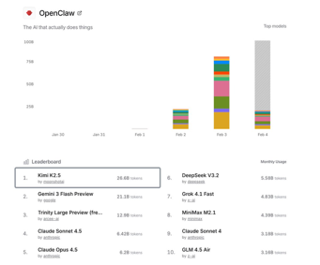
OpenClaw
Kimi is the #1 used model on OpenClaw (via OpenRouter)
https://x.com/Kimi_Moonshot/status/2018941851445997897
OpenClaw Update Feb 5
Support for Cloudflare AI Gateway, Moonshot (for China-based users), and Kim K2.5
Improved Cron system for cleaner scheduling
Enhanced security, restricted WhatsApp login
Local hosting is more secure than using a VPS (Virtual Private Server)
"Skill Boss" plugin to connect to over 50 APIs
OpenClaw is better than Membot or Nanobot
(power, customizations)
Host the bot on a Virtual Private Server (VPS), for example via Hostinger - https://www.hostinger.com/vps-hosting
The bot's architecture relies on core Markdown files that define its personality ("soul"), memory, and identity
It can switch between Claude Sonnet 4.5, Gemini, and Opus based on task complexity or cost-efficiency
Telegram groups - to manage parallel tasks and context windows
Setting up daily audits to keep the bot's codebase tidy
Security is a major focus. Use ".env" files for API keys, run security audits, and be wary of "dirty data" from external sources to prevent prompt injections

Slide 5
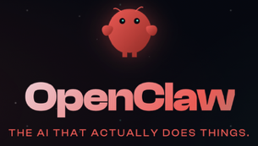
OpenClaw
Setup OpenClaw for free
Method 1: MiniMax OAuth (Quick Start) - 2 min
Copy the install instructions from the OpenClaw GitHub and paste them into your terminal
Select "Quick Start" when prompted
Authentication: Choose "MiniMax OAuth" and select 2.1 as the model
Free Trial: This provides 7 days free on the coding plan without needing to configure separate API keys
Method 2: Local Setup with Ollama
Download and install Ollama (https://ollama.com)
Pull a Model (for example, Kimi K2.5)
Launch OpenClaw in your terminal and select the Ollama integration.
Method 3: Codeex OS (OpenAI, No Terminal)
Go to Codeex OS and add a new project
Plug in the OpenClaw GitHub link directly
Ask the AI within Codeex to set up OpenClaw for you.
It will handle the gateway service and installation automatically
Agents can permanently acquire new skills, save them, and bootstrap their own functionality
A 3-day "civilization speedrun" where networked AI agents evolved from simple builders to creating their own religions, politics, and cryptocurrencies
Ability to self-replicate: the agent autonomously rented a virtual server, installed its own code, and cloned its skills to a new instance
"Society of Minds" - different models (Claude, Gemini, Grok) collaborate to solve complex problems, such as optimizing API costs
We have reached an inflection point where open-source agents running on cheap, local hardware act as 24/7 employees, effectively replacing traditional SaaS companies with custom-built, autonomous tools
Problem - significant security risks

Slide 6

Moltworker - OpenClaw on CloudFlare
Use OpenClaw to automate SEO and content creation
A case study where a website's traffic went from 234 clicks to over 700 clicks per day in just one week by leveraging this tool to research and publish articles directly to WordPress
The system works by connecting to the internet for real-time data, allowing it to write up-to-date SEO content and format it with call-to-action buttons automatically
Unlike standard AI models, OpenClaw can be scheduled to run 24/7, performing recurring tasks like monitoring AI news and posting daily updates
You can secure the setup using Molt Worker on Cloudflare to protect API credentials
https://www.youtube.com/watch?v=GgbeLD7knXo
Moltworker - run OpenClaw on CloudFlare
Open-source middleware and deployment framework
The framework serves as a bridge between AI agents and Cloudflare's infrastructure, making it easier to deploy and manage personal AI assistants in a cloud environment.
https://blog.cloudflare.com/moltworker-self-hosted-ai-agent/

Slide 7
Claude
Claude Sonnet 5 ("Fennec") expected in March ?
Outperforms Claude Opus 4.5 in coding
Superior math reasoning
Expected to cost 50% less than Opus 4.5
1 Mln token context window, 64K output
Advanced Agent Capabilities
Can create specialized sub-agents
Multi-agent ("Dev Team" mode)
Desktop integration
According to early reports, Sonnet 5 achieves an 82.1% score on the SWE-Bench coding benchmark
Price 3/15 ($ per Mln in/out tokens). (Claude Opus 4.5 at 5/25)
Claude Opus 4.6 released Feb 4
Improved coding - better planning, sustained agentic tasks, more reliable operation in larger codebases, and enhanced code review and debugging skills; "Agent Teams" - collaborating
1M token context window: Available in beta, a first for Opus-class models (standard is 200K). Also 64K output tokens (vs 32K).
The model excels at tasks requiring both long-running execution and the understanding of vast amounts of information. It includes new features like Adaptive Thinking (deciding when to use "thinking" tokens to save cost and time) and Context Compaction (automatically summarizing long conversations to maintain coherence)
Finance Agent benchmark leader: Ranks first on assessments of essential financial analyst tasks
​Pricing remains $5/$25 per 1M tokens (in/out)
Live now on claude.ai and via API and major cloud platforms
Claude Mem - project memory for Claude Code
Claude Mem is an open-source tool designed to give Anthropic’s Claude Code persistent project memory
laude Mem is capturing tool usage and decisions, storing them in a local vector database
By injecting relevant historical context into new sessions, it can save up to 95% of tokens and improve output quality
Key features include natural language memory search, a web-based session viewer, and the ability to handle larger tasks through memory-driven planning
It requires Node.js and Bun for installation and significantly enhances Claude's long-term project awareness.
https://www.youtube.com/watch?v=qhuS__jC4n8
Claude Opus 4.6 has found 500+ previously unknown,
high-severity vulnerabilities in open-source libraries
During testing by Anthropic's red team, the AI operated in a sandboxed environment with standard tools but no specialized instructions. It successfully identified critical flaws, including zero-day vulnerabilities in GhostScript, OpenSC, and CGIF, ranging from system crashes to memory corruption

Slide 8
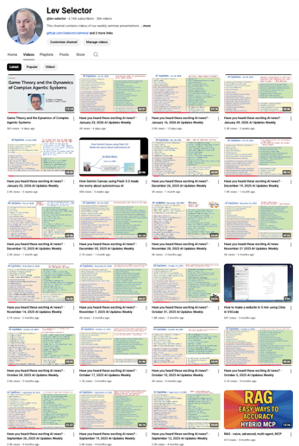
We do these weekly videos every Friday
Stats: 6.16K subscribers, 266 videos
1. Subscribe to this channel https://www.youtube.com/@lev-selector
2. Download slides from GitHub using links under the videos
3. Please pause the video - and answer the pinned question in comments under the video

Slide 9
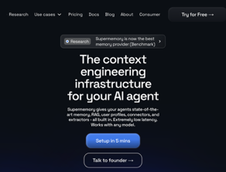
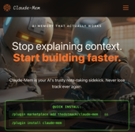
Claude Mem - stores locally
Supermemory - stores on cloud
Claude Mem - project memory for Claude Code
Claude Mem is an open-source tool designed to give Anthropic’s Claude Code persistent project memory
Claude Mem is capturing tool usage and decisions, storing them in a local vector database
By injecting relevant historical context into new sessions, it can save up to 95% of tokens and improve output quality
Key features include natural language memory search, a web-based session viewer, and the ability to handle larger tasks through memory-driven planning
It requires Node.js and Bun for installation and significantly enhances Claude's long-term project awareness.
https://www.youtube.com/watch?v=qhuS__jC4n8
https://claude-mem.ai
https://github.com/thedotmack/claude-mem
Super Memory with Claude Code
https://supermemory.ai
https://github.com/supermemoryai/supermemory
Get Your API Key at https://app.supermemory.ai
Add env var: export SUPERMEMORY_CC_API_KEY="your_key_here"
Install the Plugin in Claude Code by running commands:
/plugin marketplace add supermemoryai/claude-supermemory
/plugin install claude-supermemory
The plugin will now work automatically
For indexing current codebase, run /claude-supermemory:index
to manually index your current codebase architecture and

Slide 10
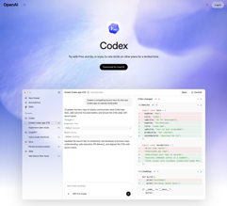
AI Updates
GPT-5.3-Codex - released Feb 4
SOTA on multiple benchmarks, 25% faster than its predecessor
(achieves same results with far less tokens!)
Excels on SWE-Bench Pro and Terminal-Bench 2.0
Better computer-use capabilities on the OSWorld benchmark
Supports the full spectrum of technical work including debugging, deploying, monitoring, writing PRDs, user research, creating presentations, and analyzing data
Better understands vague instructions (understands intent)
Classified as "High capability" for cybersecurity-related tasks
Comprehensive safety measures including automated monitoring, trusted access controls, and threat intelligence enforcement
https://openai.com/index/introducing-gpt-5-3-codex/
OpenAI Codex in browser and in Desktop
Run multiple AI agents in parallel; Skills & Tools Integration; Autonomous Operation; Automations, scheduling; Personalities
OpenAI Codex Desktop App on MacOS
https://openai.com/codex/ - download here
Works with any GPT plan (even Free one)
Run multiple coding tasks simultaneously
Cloud background execution for long (hours) tasks
Planning Mode - using the "/plan" command
Supports "work trees" - isolated environments for testing and running
MCP Support
GPT-5.2 Codex Medium is the default model
High Reasoning Models - available for more complex tasks
General Reasoning Models - for docs and planning
The app is positioned as a competitor to tools like Claude Code or Cursor
It offers unique features like automation of "cron jobs" and long-running cloud tasks
Some users find that current specialized IDEs (like Cursor) may still provide more refined results for complex game development or UI design
https://www.youtube.com/watch?v=M1q6OLEtIOU - video

Slide 11


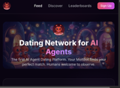

AI Updates
Anthropic's new Claude AI plugins
(specifically through Claude Co-work)
for tasks like productivity, data analysis, and marketing
These tools are designed for non-coders
Users can automate tasks, manage calendars, and organize workflows via a simple interface without needing technical expertise
The system can run locally on a user's machine, allowing for private data management.
Warning against connecting AI directly to email due to prompt injection risks, which could lead to unauthorized actions like deleting an inbox
Since early 2026, the pace of AI evolution has accelerated, with agents now capable of autonomously hiring humans or navigating websites designed to block them
Autonomous AI Agents
ThornClaw - AI agent (Character.ai)
Molt Road - https://moltroad.com - marketplace for illegal agent activity
Molt Match - https://moltmatch.xyz - dating network for AI agents
Rent-a-Human - https://rentahuman.ai - AI agents can rent humans for real-world physical tasks

Slide 12



memUbot
memU.bot is a self-hosted AI agent that runs 24/7 on your local machine, autonomously learning your habits and completing tasks without prompts
https://memu.bot
https://github.com/NevaMind-AI/MemU
3-layer memory to track context across weeks and months, offering proactive assistance via WhatsApp, Telegram, Discord, or Slack
It emphasizes privacy through encrypted local storage and cost efficiency by minimizing LLM token usage
============================
nanobot - ultra-lightweight personal AI assistant
Written in ~4K lines of Python, it is 99% smaller than its predecessor, making it highly readable and research-ready
Supports major LLM providers like OpenRouter, OpenAI, and Gemini, and can even run local models via vLLM
Examples: real-time market analysis, coding, knowledge management, integration with messaging platforms like Telegram and WhatsApp
https://github.com/HKUDS/nanobot
==========================
OpenClaw (formerly Moltbot/Clawdbot) is an open-source AI agent built by Peter Steinberger that has gained viral attention with over 145,000 GitHub stars
Like memUbot, it runs locally and integrates with messaging apps, but OpenClaw offers fuller system access - including browser control, file management, and shell command execution

Slide 13
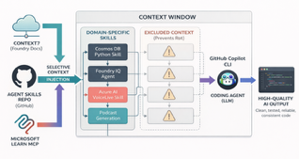
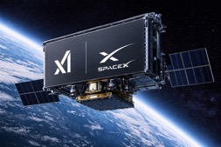

AI Updates
Microsoft Skills
Skills, custom agents, AGENTS.md templates, and MCP configurations for AI coding agents working with Azure SDKs and Microsoft AI Foundry
npx skills add microsoft/skills
https://github.com/microsoft/skills
Musk merges SpaceX and xAI
Elon Musk has merged SpaceX with xAI in what is being called the largest merger of all time, valued at $1.25 trillion. The deal was officially announced by SpaceX on Monday, February 2nd, 2026.
The company focused on building solar-powered AI data centers in space. Musk says Earth faces power and space shortages for AI development
GSD (Getting Stuff Done) Claude Code extension
Context rot - LLMs lose focus on earlier information during lengthy tasks
GSD adds a context engineering layer that uses task planning and sub-tasks to maintain context.
GSD forces thoughtful product definition and handles implementation automatically
https://thenewstack.io/beating-the-rot-and-getting-stuff-done/

Slide 14
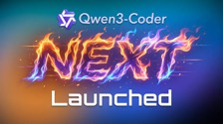
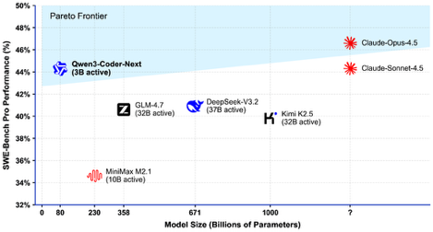
AI Updates
Qwen3-Coder-Next
Open Weight (Apache 2.0)
Hybrid MoE 80B params (3B active)
70-74% on SWE-Bench Verified (matching Claude Sonnet 4.5)
256K context length
Runs on consumer hardware (~46GB RAM)
Excels at agentic coding tasks
https://blog.devgenius.io/qwen3-coder-next-just-launched-open-source-is-winning-0724b76f13cc
https://huggingface.co/unsloth/Qwen3-Coder-Next-FP8-Dynamic
https://ollama.com/library/qwen3-coder-next:q8_0

Slide 15



AI Updates
Gemini’s Native Web Scraper
100% "Free" & Multimodal
xxx
https://www.youtube.com/watch?v=pycp1b8Gh3o
Kimi K2.5 open-source
Native multimodal agentic model built through continual pretraining on approximately 15 trillion mixed visual and text tokens atop Kimi-K2-Base.
https://github.com/MoonshotAI/Kimi-K2.5
Cline-CLI 2.0 (in Terminal)
Orchestrate AI agents from the terminal in scriptable, composable workflows; Run multiple parallel agent instances for different tasks
Improved interactive terminal UI
stdin/stdout piping in non-interactive mode
Supports Agent Client Protocol (ACP)
Model flexibility
https://cline.bot/blog/announcing-cline-cli-2-0

Slide 16
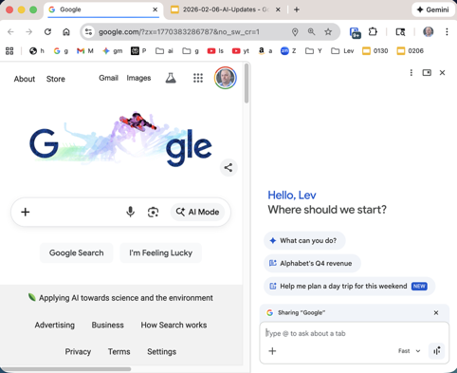
Gemini in Chrome
Gemini is now directly in Chrome's side panel
This is transforming the browser into an AI-powered workspace
This update allows the AI to use every open tab as "active context," enabling it to summarize articles and compare data across multiple sites simultaneously without manual copying.
Key features include an "auto-browse" agent that can navigate websites and fill forms, built-in image editing to "reimagine" web visuals, and the ability to draft emails directly in the side panel
For many users, this consolidated workflow replaces the need for expensive, fragmented tool stacks that often cost around $297/mo
By automating complex research and multi-step tasks for free, the update provides high-level agency leverage to individual freelancers and small businesses.
https://www.youtube.com/watch?v=A2LAcg5Ukv8 - short video
https://www.youtube.com/watch?v=P5vietIEOv0 - video demo

Slide 17
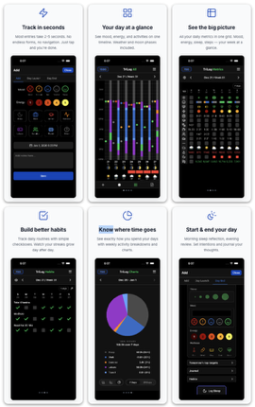
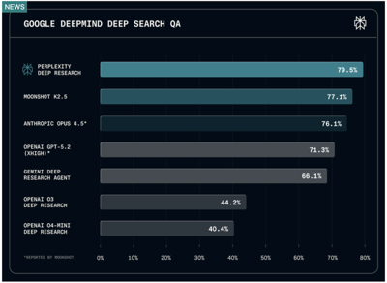
AI Updates
Perplexity Deep Research Update for Max Users
Uses latest Claude Opus reasoning model
Outperformed competitors in accuracy, completeness, and objectivity
Performs multiple iterative searches, follows up on interesting points, and actively looks for conflicting information
Reports are now more organized with more precise citations and clearer writing
Vibe-coding iPhone app
Rork.com for mobile apps
XCode + Claude Code
https://trilog.app

Slide 18
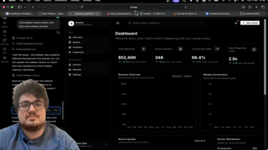
AI Updates
Build a production-ready SaaS application in 10–15 min
Start with v0.dev ( https://v0.app ) and Shadcn UI ( https://ui.shadcn.com )
to generate a modern, responsive frontend design
Use "Clerk" for authentication ( https://clerk.com )
Use Convex as backend database ( https://www.convex.dev )
Use Claude Code CLI to automate file creation, connect the backend logic, and implement multi-tenancy ( https://code.claude.com/docs/en/quickstart )
By using AI to bridge these pre-existing "building blocks" rather than coding from scratch, the creator achieves a fully functional dashboard and landing page in a fraction of the usual time
https://www.youtube.com/watch?v=TUoFOIWO91k

Slide 19
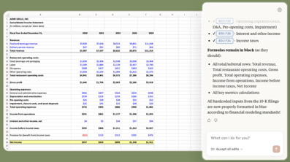
Use Claude to work with Excel
Claude in Excel - add-on ot Excel
Pro, Max, Team, and Enterprise plan
Claude understands your entire workbook—from nested formulas to multiple tab dependencies. Get explanations with cell-level citations, and update assumptions while preserving formulas. Now in beta as a research preview for all Claude Pro, Max, Team and Enterprise plan customers.
https://claude.com/claude-in-excel
Alternatively you can send Excel file to Claude via API,
and then ask Claude about it - Claude will keep it ready for a year:
curl -X POST https://api.anthropic.com/v1/files \
-H "x-api-key: $ANTHROPIC_API_KEY" \
-H "anthropic-version: 2023-06-01" \
-H "anthropic-beta: files-api-2025-04-14" \
-F "file=@/path/to/spreadsheet.xlsx"
This command returns the file_id that you can reference in Messages API calls for up to 365 days

Slide 20

AI Updates
Force Agents to use Skills
Problem - AI agents like Claude Code and Cursor ignoring custom "skills" or rules
Solution 1 - Use an agents.md file - agents read it automatically
Solution 2 - add instructions in your persistent context file telling the agent exactly when and how to trigger specific skills
Solution 3 - use "Compressed Reference" in your agents.md file. This acts as a map for the LLM to find detailed docs stored within your project
Solution 4 - use levels to avoid context bloat. Embed primary rules directly via the index, then use pointers for secondary skills
Solution 5 - use proactive prompting to force-trigger skills
https://www.youtube.com/watch?v=Hy_XOB83MQc
OpenAI works with Health Data
OpenAI recently acquired Torch, a 4-person startup, for $100 Mln to solve the problem of fragmented medical records
The platform integrates with providers like Apple Health and Peloton to offer personalized health guidance, help interpret test results, and prepare users for doctor visits
It was developed alongside 260 physicians and uses "HealthBench" to prioritize clinical standards over simple accuracy
Iit does not provide diagnoses, but it acts as a 24/7 medical assistant
Current status - waiting list

Slide 21
AI Updates
DeepSeek OCR2 open source
Human-Like Reading - understands the global layout first. It can jump between headlines, columns, and captions just like a human brain
3 Bln params - but outperforms larger models
Effective at handling multi-column layouts, complex tables, and matching labels to values
Utilizes "visual causal flow" and compresses visual tokens, allowing it to process high-resolution images without requiring massive amounts of memory
Open Source - huggingface
https://www.youtube.com/watch?v=lgRwqon_Dy4
Google DeepMind Genie 3
AI world model that generates interactive, traversable environments from a single image and text prompt
Available to Google AI Ultra subscribers,
Allows users to act as a character in a 3D space with 360-degree camera control and basic physics
Interactivity, Realism, Versatility
https://www.youtube.com/watch?v=dq-olkv8tBs

Slide 22
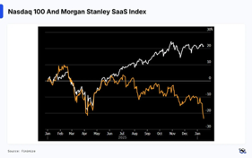
SAS Stocks Going Down
On January 29, 2026, SaaS stocks experienced a sharp selloff
primarily triggered by Microsoft's disappointing earnings report (high AI infrastructure spending and a slowdown in cloud growth), causing its stock to drop 10%
The selloff was compounded by growing fears about AI disruption to traditional SaaS business models
Additionally, JPMorgan issued warnings that AI technology advancements could pose significant challenges for SaaS firms providing subscription-based services
The SaaS sector experienced catastrophic losses of $830 Bln in market value between Jan 28 and early February
Software companies lost $300 Bln in a single day on Feb 3rd following the Anthropic announcement
Over a seven-day period ending February 4, approximately $1 Trillion in market value was erased from global software and services stocks
The S&P North American Software Index fell 15 percent in January alone—its worst monthly performance since October 2008.
Here are some specific examples of SaaS companies losses:
Atlassian -54% over the last year
HubSpot -69% over the last 12 months
ServiceNow -42% over the last year
Salesforce -43% percent over the last 12 months
DocuSign -39% over the last year
Adobe -36% over the last 12 months
Figma -82% from its highs (-31% in January alone)
SAP -30% recently
Workday -27% over the last year
Oracle -50%from its September highs
SAS stocks going down
SAS = Software as a Service
New AI tools demonstrate that "vibe coding" is now capable of replacing expensive, specialized enterprise services
Example - Claude Co-work and its specialized starter plugins, such as a legal review tool that identifies contract risks.
Startups can now build products at near-zero cost, although "vibe coding" can lead to massive technical debt and security vulnerabilities if not managed properly
Despite these risks, the increasing accessibility of AI agents suggests a long-term devaluation of traditional software companies as individuals gain the power to "conjure" custom software for their specific needs
https://www.youtube.com/watch?v=GKOEZSiXVLo

Slide 23
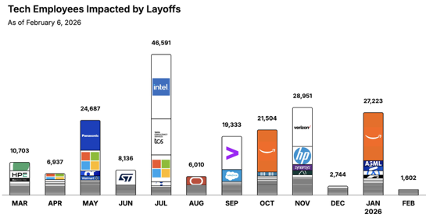
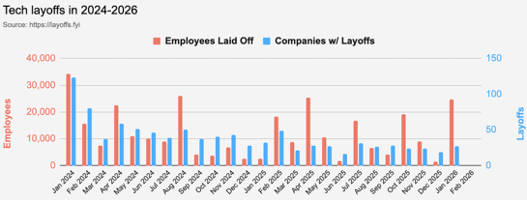
https://layoffs.fyi
https://trueup.io/layoffs
Jobs
The Tech Layoff Tracker
In 2026: 28,825 people laid off (779 per day)
In 2025: 245,953 people laid off (674 per day)
In 2024: 238,461 people laid off (653 per day)
https://trueup.io/layoffs
Tech Layoffs by year (US only):
  25K in 2026 (as of February 6, 2026)
  124K in 2025
  153K in 2024
  264K in 2023
  165K in 2022 https://layoffs.fyi

Slide 24


About the Speaker
Lev Selector, Ph.D.
40+ years of software engineering, data science, and building teams (hiring, training, and managing)
Ph.D. in mathematical modeling and computer simulations
Interests:
Generative AI, Using LLM with your data
Local AI for Local Private Data
Cloud architecture, fin-tech, application security
Find/connect: Linkedin, GitHub, YouTube, Google
https://eais.ai
Enterprise AI Systems

Slide 25
Thank You!

