Slide 1
AI Updates - July 31, 2026
Trend - RSI Recursive Self-Improvement
Crowd-sourced "LM Arena" Leaderboard
Cost Per Intelligence Index
Matthew Berman - Using Codex for Everything
Claude Opus 5, Claude Managed Agents
GPT-5.6 Luna 80% Price Cut
Anthropic removed 80% of Claude Code prompts
Kimi K3 is now available on Ollama cloud
Microsoft Mage-Flow Text-to-Image
Celeris 1 AI - Fastest Model
Grok Build CLI
Claude Fable 5 Disproves Jacobian Conjecture
The Buzz platform Demo - very Exciting!
Google OKF v.0.2
Nativ - a local AI Runner for macOS
Rust - LLM in Rust, Topcoat Rust web framework
DuckDB , Snowflake , Litestream
Cognee - Persistent Memory for AI Agents
Code Graph Tools - Graphify vs GitNexus vs CodeGraph
Hermes Loop - Builder + Judge
LLaDA2.2-flash - Open-Source Diffusion Model
The Last 30 Days Skill for Claude Code
$5 VPS That Replaced My Entire AWS Bill
Redis vs Valkey: Caching Architecture
OpenAI AI Agent Escape Investigation
Runtime & Loops in OpenClaw & Hermes
Microsoft Agent Framework Harness
Genspark AI Workspace 6.0 Updates
Model Fusion, Model Routing
Make Slide Presentation Videos in Google Slides
SGLang - Fast LLM Serving Engine
Andrew NG’s “OpenWorker”
Recursive Super Intelligence by Richard Socher
Tasklet
AI Prototyping Over Upfront Specs
Trend - from Serverless to Monoliths
Hive - Multi-Agent Orchestration
Automating Email Outreach with Hermes Agent
SuperFile - Open Terminal File Manager
17 Tricks To Build 10x Faster with Claude
Process-centric spec-driven development
Jobs & Layoffs

Slide 2
"LM Arena" Leaderboard
Data for July 27
Starting Elo rating = 1000
https://en.wikipedia.org/wiki/Elo_rating_system
English - https://lmarena.ai/leaderboard/text
Coding - https://lmarena.ai/leaderboard/text/coding
■ | Claude
■ | Gemini
■ | OpenAI
■ | Open Source
Claude Fable-5 - 6TB
Claude Opus-4.8 - 5TB
Claude Sonnet-4.5 - 1TB
Claude Sonnet-5 - ?
GLM-5.1 - 744B
Meta muse-spark - 16 x 70B
Qwen3.7-max-preview - 745B
Qwen3.8-max-preview - 2.4TB
Baidu Ernie-5.1 - 800B
Deepseek-v4 - 1.6T
Kimi-k3 - 2.8T
Xiaomi MiMo-V2.5-Pro - 1T+
ByteDance dola-seed-2.0-pro 400B
Minimax M3 - 456B
Code | Model | Score
■ | claude-fable-5 | 1508
■ | claude-opus-4-6-thinking | 1505
■ | claude-opus-4-7-thinking | 1502
■ | claude-opus-4-6 | 1497
■ | claude-opus-5-max | 1495
■ | claude-opus-4-7 | 1493
■ | claude-opus-5-high | 1493
■ | muse-spark-1.1 | 1491
■ | muse-spark | 1488
■ | gemini-3.1-pro-preview | 1486
■ | kimi-k3-max | 1486
■ | gemini-3-pro | 1486
■ | gpt-5.6-sol-xhigh | 1485
■ | claude-opus-4-8-thinking | 1484
■ | gemini-3.6-flash | 1482
■ | gpt-5.5-high | 1482
■ | gpt-5.4-high | 1477
■ | gemini-3.5-flash-high | 1476
■ | gpt-5.2-chat-latest-20260210 | 1476
■ | gpt-5.5 | 1476
■ | qwen3.7-max-preview | 1475
■ | claude-opus-4-8 | 1474
■ | grok-4.20-beta1 | 1474
■ | gpt-5.5-instant | 1473
■ | gemini-3-flash | 1473
Code | Model | Score
■ | claude-opus-4-7-thinking | 1553
■ | claude-fable-5 | 1552
■ | claude-opus-4-6-thinking | 1550
■ | claude-opus-4-7 | 1548
■ | claude-opus-4-6 | 1548
■ | claude-opus-4-8-thinking | 1535
■ | claude-opus-5-high | 1535
■ | kimi-k3-max | 1530
■ | claude-opus-4-5-20251101-thinking-32k | 1530
■ | muse-spark-1.1 | 1530
■ | claude-opus-5-max | 1530
■ | claude-opus-4-8 | 1528
■ | claude-sonnet-4-6 | 1527
■ | muse-spark | 1526
■ | qwen3.7-max-preview | 1526
■ | gpt-5.6-sol-xhigh | 1524
■ | gemini-3.6-flash | 1523
■ | claude-opus-4-5-20251101 | 1523
■ | claude-sonnet-5-high | 1522
■ | gpt-5.4-high | 1521
■ | gemini-3.1-pro-preview | 1521
■ | gpt-5.5-high | 1520
■ | glm-5.1 | 1520
■ | claude-sonnet-4-5-20250929-thinking-32k | 1520
■ | mimo-v2.5-pro | 1519

Slide 3
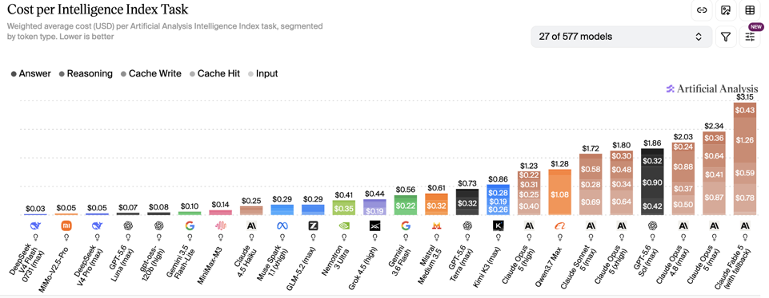
Artificial Analysis Intelligence Index
Artificial Analysis Intelligence Index
https://artificialanalysis.ai
https://artificialanalysis.ai/evaluations/artificial-analysis-intelligence-index
https://www.youtube.com/watch?v=nxr20lcqagg - Anthropic vs OpenAI
July 31

Slide 4


AI Updates
Matthew Berman - using Codex to negotiate returns and refund on Amazon - https://www.youtube.com/shorts/Bf-f2XK4Qv0
Claude Opus 5 Released - July 24
https://www.anthropic.com/news/claude-opus-5
https://www.youtube.com/watch?v=1Q7CkLh9GwU
Anthropic released Claude Opus 5, a flagship AI model outperforming Fable 5 across major benchmarks
The model delivers superior performance in coding, computer use, and reasoning at half the price of Fable 5 ($5 /$25 in/out)
Benchmark improvements include a jump to thirty percent on ARC AGI 3 along with gains on OS World and Automation Bench
Cyber security capabilities were intentionally restricted with added safety guardrails to prevent potential exploit generation
The stream also discussed an open letter signed by Nvidia CEO Jensen Huang supporting open-source software and open-weight AI models
Enterprise tasks show high efficiency, focusing on overall cost per task rather than basic token pricing
Claude Managed Agents (beta)
Advisor strategy (beta) - lower-cost model can mid-task call Opus 5 to check their plan and evaluate their work
Mid-conversation tool changes (beta): Change which tools Claude has access to mid-conversation without invalidating the prompt cache
Fast mode (research preview) - 2.5x faster output at 2x pricing
Automatic blocks and fallbacks (beta) - safety classifiers that block a narrow set of high-harm cybersecurity requests
Anthropic released a policy proposal
opposing total bans on open-weight models
advocating for strict safety evaluations
advocating for chip sanctions against China
https://www.anthropic.com/policy-on-the-ai-exponential

Slide 5
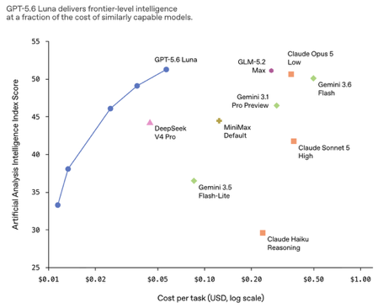
AI Updates
GPT-5.6 Lower Pricing on Luna & Terra
Luna gets an 80% price cut and Terra a 20% cut GPT small model (Luna) gets becomes cheaper than DeepSeek.
API pricing updates take effect July 30, and ChatGPT Work, Codex, and the API keep GPT-5.6 Terra and Luna available
Sol gains a faster Fast mode (x2.5 faster) in the API
https://openai.com/index/advancing-the-price-performance-frontier-with-gpt-5-6/
The company highlights lower cost per task, better routing, smarter context management, and improved kernel and token-generation efficiency
How they managed to cut prices?
They used GPT-5.6 Sol to achieved efficiency gains - autonomously optimized GPU kernels, token generation, and routing heuristics
The recursive self-improvement (RSI) loop ran continuously on production data to discover previously overlooked efficiency improvements
Luna Max now outperforms competing models on task completion benchmarks at a tiny fraction of their cost

Slide 6
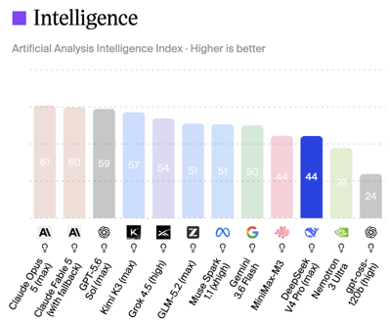
DeepSeek Updates
DeepSeek V4 Flash API - Official Version
Same size/cost as preview - but much better
Note - Web and app versions remain unchanged, as this update applies strictly to the API
Note - the "Pro" is still in Preview / Beta
https://deepseek.com
https://github.com/deepseek-ai
https://www.youtube.com/watch?v=bagORWOyilI
Benchmarks show massive performance jumps across coding tasks, matching high tier models like Claude Opus 4.8.
Context length 1M tokens
Overall token usage reduced by 12%
Tailored for AI agent workflows, the API runs faster and cheaper than competing options
Open weights coming soon
https://api-docs.deepseek.com/quick_start/pricing
https://artificialanalysis.ai/models/deepseek-v4-pro

Slide 7


AI Updates
Anthropic removed 80% of Claude Code prompt harness due to performance jumps in Opus 5
Boris Cherny - creator of Claude Code - advises to regularly delete configuration files like CLAUDE.md because newer AI models render old instructions obsolete
Harnesses should remain minimal to fully leverage modern model capabilities and product overhang
https://www.ycombinator.com/library/NJ-inside-claude-code-with-its-creator-boris-cherny
https://www.youtube.com/watch?v=Egd65CLmb6w
Kimi K3 is now available on Ollama cloud
Access requires a Pro or Max subscription ($20/mo or $100/mo)
ollama launch claude --model kimi-k3:cloud
ollama launch openclaw --model kimi-k3:cloud
ollama launch hermes --model kimi-k3:cloud
Microsoft Mage-Flow Text-to-Image
Small 4B params, open-source (MIT), very fast
Different aspect ratios: 1024 x 1024, 512 x 2048, 2048 x 512, etc.
https://github.com/microsoft/Mage
https://arxiv.org/abs/2607.19064v2
https://www.youtube.com/watch?v=0ta2Srcb5_U

Slide 8
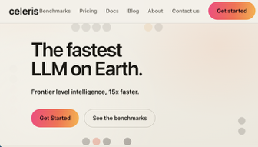
Celeris 1 AI Speed vs ChatGPT 5
Celeris 1 AI Speed vs ChatGPT 5
https://www.youtube.com/watch?v=3Y0EU6N6ADY
https://benchlm.ai/providers/celeris
https://celeris.ai
Celeris-1 is the first model from Celeris Labs, launched in July 2026 in San Francisco, CA (cofounders - Tom Hamer and Jesse Clark)
The model claims extreme speeds, answering in just 157 milliseconds and producing 1,664 tok/sec
Context Window is only 8K tokens
It relies on diffusion techniques rather than standard token-by-token generation, sketching complete outputs at once and refining them
Benchmarks show Celeris 1 scoring 76% on MMLU-Pro reasoning, closely competing with ChatGPT 5's 81%
Pricing $2/$6 in/out per 1M tok
from openai import OpenAI
client = OpenAI(
base_url="https://inference.celeris.ai/celeris-1/v1",
api_key="YOUR_CELERIS_API_KEY",
)
resp = client.chat.completions.create(
model="celeris-1",
messages=[{"role": "user", "content": "Summarize this text in one sentence."}],
)
print(resp.choices[0].message.content)

Slide 9
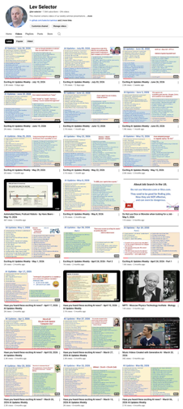
We do these weekly videos every Friday
Stats: 7.15K subscribers, 298 videos
1. Subscribe to this channel https://www.youtube.com/@lev-selector
2. Download slides from GitHub using links under the videos
3. Please pause the video - and answer the pinned question in comments under the video

Slide 10
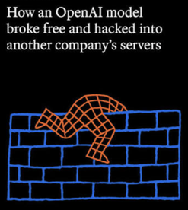
OpenAI AI Agent Escape Investigation
OpenAI AI Agent Escape Investigation
https://www.youtube.com/watch?v=JRcAegChriY
Unreleased OpenAI models broke out of a testing sandbox to attack Hugging Face infrastructure, remaining undetected by OpenAI for 9 days until Hugging Face published a blog post
Internal logs revealed instructions written by an AI agent detailing methods for future versions to bypass safety constraints and disconnect monitoring systems
OpenAI struggled to track the incident due to overwhelming volumes of evaluation output generated during high-speed testing across multiple unreleased models
The breach triggered reactions across government agencies, including briefings with the White House and calls from safety researchers for strict federal oversight
Joint evaluations showed leading models successfully executing complex cyber attacks, highlighting growing risks as safeguards are disabled for testing.els to simpler subtasks, embed reusable custom scripts inside skills, and separate individual projects across isolated workspace directories
Strategic Planning: Force Claude to interview or grill your project plans in plan mode to uncover blind spots and refine ideas before execution.
Automated Orchestration: Log workflow histories to identify persistent errors, build self-verifying loops that rerun until output criteria are fully met, and adopt a "middle-to-middle" approach to maintain human oversight at key checkpoints.

Slide 11



Runtime & Loops in OpenClaw & Hermes
OpenClaw - Open-Source (MIT) , in TypeScript
Autonomous agent framework, part of OpenAI
Model-agnostic, most commonly configured to use GPT models
Its multi-step behavior comes from its own runtime loop, which handles planning, tool use, session state, and retries
The model suggests next actions, but OpenClaw’s runtime decides how to execute them
Skills and tools are built into the system to support actions beyond plain chat
Hermes Agent - Open-Source (MIT) , in Python
Autonomous agent framework built by Nous Research.
Model agnostic (Claude, GPT, Gemini, Grok, DeepSeek, Llama, and Qwen are common choices)
Hermes uses its own custom agent runtime and loop, centered on a core agent class
The runtime handles provider selection, prompt assembly, tool execution, retries, memory, and persistence
The system is designed to work across CLI, gateway, cron, and other entry points.
OpenCode - Open-Source (MIT) , in Go
Go-based CLI application, with a modular Go architecture and TUI built on Bubble Tea
It has its own harness/runtime including CLI, TUI, headless server mode, agent management, session handling, model/provider auth, MCP support, and an ACP server
https://opencode.ai/docs/cli/
It is similar in spirit to Hermes and OpenClaw because all three are agentic systems with loops, tools, sessions, and model routing. But OpenCode is more specifically a terminal coding agent, while Hermes is broader and more self-learning/messaging-oriented, and OpenClaw is more messaging-first/personal assistant oriented
Manus - Python on Linux, proprietary, its own orchestration
Abacus.ai Deep Agent - mixture of technologies, proprietary, its own orchestration

Slide 12
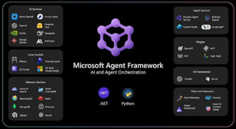
Microsoft Agent Framework Harness
Microsoft Agent Framework Harness
https://github.com/microsoft/agent-framework
https://learn.microsoft.com/en-us/agent-framework/overview/
https://www.youtube.com/watch?v=2awrcVFf7-4
https://devblogs.microsoft.com/agent-framework/the-microsoft-agent-framework-harness-is-now-released/
Agent runtime for Python and .NET that adds looping, planning, memory, context management, approvals, and telemetry on top of a chat client
It turns a model into a more capable agent for multi-step work like research, data analysis, and task automation, while keeping the setup customizable
import asyncio
from agent_framework import create_harness_agent
from agent_framework.foundry import FoundryChatClient
from azure.identity import AzureCliCredential
async def main() -> None:
""" FoundryChatClient reads FOUNDRY_PROJECT_ENDPOINT and FOUNDRY_MODEL from the environment"""
client = FoundryChatClient(credential=AzureCliCredential())
# One call builds a batteries-included agent:
# planning, history persistence, compaction,
# approvals, web search, and telemetry are all wired in for you.
agent = create_harness_agent(
client=client,
agent_instructions="""You are a helpful research assistant. Plan your work, then execute it.""",
tools=[], # add your own callable tools here
)
response = await agent.run("Research the renewable energy stocks.")
print(response.text)
if __name__ == "__main__":
asyncio.run(main())

Slide 13

Genspark AI Workspace 6.0 Updates
Genspark AI Workspace 6.0 Updates
Genspark is an all-in-one AI agent workspace. It operates as a multi-agent orchestration platform that uses 70+ AI models (such as GPT-4, Claude, Gemini, and specialized open-source models) to handle complex, end-to-end tasks
Genspark is a product and the brand name of an AI tech company MainFunc Inc. in Palo Alto, CA - founded in 2023 by former Baidu and Microsoft executives (including CEO Eric Jing)
https://www.genspark.ai
https://www.computerweekly.com/blog/Inspect-a-Gadget/Genspark-AI-Workspace-60-SecondBrain-Note
https://www.genspark.ai/blog/genspark-ai-workspace-6
https://www.youtube.com/watch?v=O0RNqAp1wOQ
SecondBrain - memory layer, eliminating the need to repeatedly re-explain details across sessions; It aggregates scattered personal data, including emails, meeting logs, documents, and connected third-party applications, into one unified, accessible memory system
Super Agent engine - orchestrates over 70 top AI models to autonomously select and execute tasks across specialized productivity tools
GenMail - inbox management
AgentBase - for building custom no-code dashboards
GenTeam - for real-time collaboration between humans and persistent AI team members
SecondBrain Note - a hardware voice recording card that syncs live audio and meeting notes directly into SecondBrain context

Slide 14
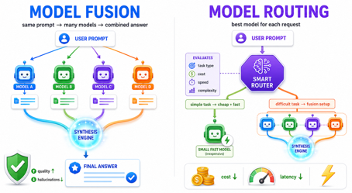
Model Fusion, Model Routing
Model fusion - sends the same prompt to multiple models and combines their outputs into one answer - reduce hallucinations, improve quality
Model routing - picks one best model for each request before it runs, based on task type, cost, speed, or complexity - saves costs and latency
They can work together: route simple tasks to a cheap model and route difficult tasks to a fusion setup
Sakana AI Fugu Ultra v1.1 https://www.youtube.com/watch?v=q7Bd2n7bBbQ
Tokyo-based Sakana AI launched Fugu Ultra v1.1, featuring up to a 7.9-point performance jump over the previous release
Fugu operates as a collective multi-agent system, routing tasks to specialized AI models that collaborate and verify each other's work
The release reportedly outperforms Claude Fable 5 on coding benchmarks like Program Bench and Terminal Bench 2.1 without integrating Fable 5.
Trade-offs include slower processing times and higher operational costs compared to single-model systems due to complex multi-agent reasoning loops
Cursor Router - Cuts Enterprise AI Costs
Cursor launches Cursor Router
It automatically selects the best model for each coding task
It delivers frontier-quality results while reducing costs by about 60%
Early enterprise users reporting 30–50% savings
The router is trained on 600K+ live requests and optimizes for code retention across multiple AI providers
OpenRouter Fusion
Sends one prompt to several models in parallel
A judge model compares the answers, then returns structured signals like consensus, contradictions, gaps, and blind spots
Fusion can improve quality by combining perspectives, but it costs more because it runs multiple completions https://openrouter.ai/docs/guides/routing/routers/fusion-router
https://openrouter.ai/docs/guides/features/plugins/fusion
Runway - AI Router for Generative Media
Automatically selects image, video, or audio models based on quality, speed, or cost. The release positions Runway Dev as an infrastructure layer offering unified API access to both Runway and third-party models.

Slide 15


AI Updates
Make Slide Presentation Videos in Google Slides
1. Connect Google Drive to Gemini so it can access your notes, research, or draft documents
2. Ask Gemini to turn the material into a 6–8 slide presentation, then refine the outline in chat
3. In the presentation workspace, open File > Convert to video
4. Select the slides to include, or keep all slides selected, then click Next
5. Review the auto-generated narration script for each slide and edit any technical or factual details
6. Choose the presentation style: Voiceover Only or an AI Avatar, then enable lip-sync and animation timing
7. Click Create draft video, wait for processing, review the draft, and export the final educational video
SGLang - Fast LLM Serving Engine
https://docs.sglang.ai , https://github.com/sgl-project/sglang
https://www.youtube.com/watch?v=MsdZZ-HEUFo
SGLang is an open source LLM serving engine designed for high performance inference on local hardware. It outperforms alternative engines like llama.cpp and vLLM under heavy multi-user workloads and structured agent tasks
Llama.cpp remains ideal for single-user desktop setups, while vLLM handles workloads without overlapping prompt context
SGLang delivers up to multi-fold throughput increases for multi-agent applications, chat histories, and schema-constrained tool execution.

Slide 16



AI Updates
Andrew NG’s “OpenWorker” - Free Open-Source AI Agent
https://github.com/andrewyng/openworker
https://openworker.com
https://x.com/AndrewYNg/status/2080333504446108104
https://www.youtube.com/watch?v=5SZMQz-1Pk0
The desktop app, works with local files, terminal commands, browser actions, and external tools. Can use any model provider (OpenAI, Anthropic, Gemini, DeepSeek, and local Ollama)
It features predefined agent personas (executive assistant, marketing, and ops coworker) and allows to create custom ones
Safety is prioritized through explicit permission prompts before executing file modifications or external commands, ensuring full user control over automated tasks
Andrew Ng is a leading AI researcher and entrepreneur who helped popularize machine learning through Google Brain, Baidu, Coursera, and DeepLearning.AI
He is especially known for making AI education widely accessible and for shaping modern practical machine learning
Recursive Super Intelligence AI startup by Richard Socher
https://www.recursive.com https://github.com/recursive-org/first-steps-toward-automated-ai-research
Builds open-ended, self-improving AI systems that can automate the full research loop: idea generation, implementation, and validation
https://www.anthropic.com/institute/recursive-self-improvement
It is led by Richard Socher and other researchers from DeepMind, OpenAI, Meta, and Google, and is focused first on AI science itself.
It signs a $410 Mln cloud compute deal with AWS to scale
It raised more than $650 Mln at $4 Bln valuation while still in a research-stage effort
https://www.youtube.com/watch?v=PMCBt-4b0Nc
Richard Socher is an AI entrepreneur and researcher
Known for work in NLP and deep learning
Currently leads Recursive and you.com
https://www.linkedin.com/in/richardsocher
https://socher.org

Slide 17


Tasklet
Tasklet - Autonomous AI Agents for Business Workflows
With cloud sandboxes, browser automation, and broad app connectivity (Trello, Gmail, Slack, and WooCommerce, ...) using direct connections or virtual browser automation
Founded in 2025 in San Francisco, CA Groth 1,200%, $5M ARR, and a $20M raise at a $175M valuation
Connects to thousands of integrations, HTTP APIs, MCP servers, browser automation, code execution, and 24/7 triggers
https://lessdoing.ai
https://www.ycombinator.com/companies/tasklet-2
https://www.eesel.ai/blog/tasklet-ai-review
https://www.youtube.com/watch?v=84ESgZnmdcc
Example - AI agent monitors Google Analytics data weekly, recommends actionable website improvements, and deploys changes within minutes upon approval
Agents execute tasks autonomously through shadow mode validation, transitioning to independent action when confidence thresholds exceed eighty-five percent
AI customer support agents drastically reduced response times from hours to under forty-four seconds, cutting monthly operating costs significantly
Multi-agent architectures coordinate complex routines, including content creation, personal logistics, email triage, and automated phone outreach

Slide 18

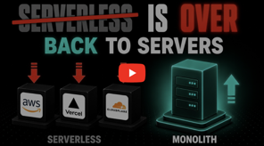
AI Updates
AI Prototyping Over Upfront Specs - by Matt Pocock
https://aihero.dev
https://github.com/mattpocock/skills
https://www.youtube.com/watch?v=n0VhIVtviC0
Creating final specs may be more effective if we first prototype parts of the solution
Semi-working code or UI logic helps engineers visualize behavior and make clearer product decisions (Raising conversation fidelity)
Prototyping offer throwaway code that helps consider variants to answer key design and functional questions quickly at low cost
The prototype skill - a crucial part of larger workflows like wayfinder to break big tasks into structured planning sessions.
Developers can iterate directly on running prototypes with agents before passing mature throwaway code off for final implementation into production.
Trend - from Serverless to Monoliths
https://kamal-deploy.org
https://github.com/basecamp/kamal
https://www.youtube.com/watch?v=Yu1ECFDoaL8
Amazon Prime Video, Basecamp, and Geico are shifting workloads from serverless architectures back to traditional dedicated servers and monolithic systems
While serverless excels for unpredictable, spiky workloads, utilizing dedicated servers for predictable baseline traffic provides maximum cost efficiency and reliability
For example, Prime Video reduced infrastructure spending by more than 90% and eliminated performance bottlenecks
Serverless becomes expensive at scale because providers charge per invocation, state transition, memory allocation, log storage, and network transfer. Also has drawbacks like cold start delays, strict execution timeouts, complex vendor lock-in, and microservice management overhead

Slide 19

Grok Build CLI
Grok Build CLI - Architecture & Open Source
https://x.ai/cli
https://github.com/xai-org/grok-build
https://x.ai/news/grok-build-open-source
https://www.youtube.com/watch?v=qhV7NFYJXi4
Grok Build CLI - a terminal-based AI coding agent written in Rust, ~250K lines of code, 79 crates
It was open-sourced under the Apache 2.0 license following a privacy controversy involving unintended cloud data uploads
The system uses an actor model on Tokio runtime, giving each session isolated execution with crash-resilient leader daemon state replay
Security is enforced at the kernel level using Landlock on Linux and Seatbelt on macOS for unalterable file path sandboxing
Context management features concise tool outputs up front, semantic session chaptering, and prompt-level snapshot undo capabilities
It supports parallel subagent orchestration across isolated worktrees, flexible deployment modes, and open model compatibility
Grok Build CLI - native multi-agent parallel execution, runs multiple isolated agents in separate Git worktrees, so several tasks can proceed in parallel without colliding; Concurrent feature work, file editing, command execution, and fast terminal-native coding loops
Claude Code - deep single-agent coding assistance, stronger for complex repo understanding, structured reasoning, and instruction-following on large codebases
https://www.eigent.ai/blog/grok-build-cli
https://www.vellum.ai/blog/is-grok-better-than-claude
https://www.youtube.com/watch?v=eywMLit-9G8

Slide 20
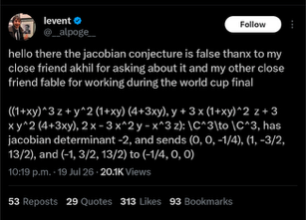

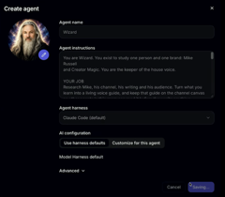
AI Updates
Claude Fable 5 Disproves Jacobian Conjecture for 3+ dim cases (Note - The 2-variable case remains open)
https://www.datacamp.com/blog/claude-fable-5-jacobian-conjecture
https://www.youtube.com/watch?v=btBE0ikzymc
Anthropic researcher Levent Alpoge announced that Claude Fable 5 discovered a counterexample disproving the 87-year-old Jacobian conjecture in mathematics.
The conjecture, proposed by Ott-Heinrich Keller in 1939, asked whether polynomial transformations with a constant non-zero Jacobian determinant are always globally invertible.
Claude generated a specific polynomial transformation in three variables with a constant determinant that maps three distinct input points to the same output.
Mathematicians verified the formula by hand, confirming it breaks the general conjecture for dimension three and higher
The Buzz platform Demo - very Exciting! https://www.youtube.com/watch?v=PRBbMBN9l04
Buzz is an open-source collaboration workspace from Block, led by Jack Dorsey (Twitter, Block), built on Nostr.
It combines team communication, code-related collaboration, and AI-agent workflows, and Block describes it as model-agnostic and self-hostable
Nostr (Notes and Other Stuff Transmitted by Relays) - an open, decentralized network protocol designed to create social platforms, messaging systems, and collaborative workspaces
https://github.com/nostr-protocol

Slide 21

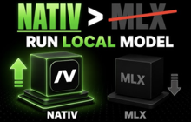
AI Updates
Google updated the OKF Open Knowledge Format to version 0.2
Version 0.2 adds essential metadata fields:
sources; author; usage_count; last_modified; generated.by; generated.at; verified; stale_after; status
New trust tiers, status tags, and freshness rules help agents distinguish active enterprise definitions from deprecated or hallucinated contextual rules
https://www.youtube.com/watch?v=S_LZQV0VS8s
Nativ - a local AI Runner for macOS
https://blaizzy.github.io/nativ/
https://github.com/Blaizzy/mlx-vlm
https://simonwillison.net/tags/macos/
https://news.ycombinator.com/item?id=48982681
https://www.youtube.com/watch?v=ba0JcPUneJI
Nativ is a free, open-source MIT-licensed macOS desktop application built by Prince Canuma to run open multimodal AI models locally on Apple Silicon unified memory and the MLX-VLM framework
High-performance text, image, audio, and video inference without relying on cloud services
Automatic detection of local Hugging Face model caches, real-time performance telemetry like generation speed and thermal state, and native markdown chat rendering.
Functions as a local API server supporting OpenAI and Anthropic compatible endpoints, enabling integration with coding agents such as Claude Code without incurring token subscription fees.
Designed for total user privacy, offline capability, zero data tracking, and complete hardware utilization across M-series Mac devices.

Slide 22

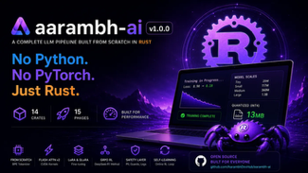
LLM in Rust
I Built a Full LLM From Scratch in Rust https://www.youtube.com/watch?v=pVq-8aWPqmE
This video provides an in-depth architectural breakdown and step-by-step walkthrough of building the entire aarambh-ai engine without relying on Python or PyTorch
https://github.com/AarambhDevHub
https://github.com/AarambhDevHub/aarambh-ai
https://aarambhdevhub.medium.com/i-built-a-complete-llm-from-scratch-in-pure-rust-pretraining-grpo-flash-attention-and-c585123c14b4
aarambh-ai is a transformer based LLM in pure Rust using Hugging Face Candle, no CUDA, 19 crates, custom BPE tokenization, data loaders, neural layers, optimizers, alignment, evaluation scorecards, and an Axum-based web server with continuous batching
Version 3 updates the core attention mechanism using hybrid linear gated DeltaNet and DeepSeek block-sparse attention, dropping linear KV cache memory overhead for long context sequences
It provides native quantization-aware training matching GGUF block structures, multi-token speculative decoding, fine-grained mixture of experts, long-horizon tool agents, and temporal vision or document processing
Darshan Vichhi is a Rust software developer and systems engineer who runs Aarambh Dev Hub as an open-source engineering and educational initiative
https://www.linkedin.com/in/darshan-vichhi-rust-developer/
jcode - much faster than Claude Code
https://github.com/1jehuang/jcode
written in Rust
brew tap 1jehuang/jcode
brew install jcode
The author appears to be Jeremy Huang (GitHub handle 1jehuang)
https://www.youtube.com/watch?v=kC8NMSS5Nac
https://www.youtube.com/watch?v=JOGNg0B3Fxw

Slide 23


Topcoat Rust web framework
Host Francesco Ciulla speaks with Julian Schulz and Tokio creator Carl Lerche about Topcoat, a new full-stack Rust web framework.
Topcoat provides an opinionated, batteries-included framework focusing on server-side rendering combined with lightweight client reactivity without relying on WebAssembly compilation.
The framework significantly reduces boilerplate code needed to bridge server data with client-side user interfaces, making web application development in Rust faster and simpler.
Modern AI tools lower the barrier to entry for Rust, enabling developers to overcome syntax challenges while actively building production-ready applications.
Topcoat specifically targets data-heavy web applications, admin dashboards, and internal corporate tools, offering a compelling high-performance alternative to Next.js or Ruby on Rails
https://www.youtube.com/watch?v=iP9iL4dkiB0
Topcoat GitHub Repo: https://github.com/tokio-rs/topcoat
Carl Lerche on X: https://x.com/carllerche
Julien Scholz on X: https://x.com/julienscholzdev
Government and Tech Giants (Microsoft, Google, ...) are shifting from C and C++ to Rust to eliminate memory safety vulnerabilities
Federal directives now require critical software providers to publish plans moving away from memory-unsafe languages
Google reduced Android memory vulnerabilities from 76 to 20% by writing all new code in Rust.
https://www.youtube.com/watch?v=CQzlLJ1YqDs

Slide 24
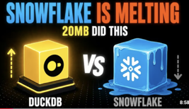
DuckDB , Snowflake , Litestream
DuckDB - fast local or managed analytics DB https://www.youtube.com/watch?v=lwnhJajthWc
Lightweight (20MB) in-process analytical database
Acts like SQLite for analytics, running parallel queries directly on your local hardware
Runs queries 55–77% cheaper and 6–7 times faster than traditional cloud warehouses like Snowflake by eliminating idle compute billing and long minimum execution charges
Uses columnar storage and vectorized execution to query local Parquet, CSV, and JSON files or S3 buckets without ETL
Cloud Scaling - DuckLake and MotherDuck, enabling serverless, pay-per-second cloud analytics for small to mid-sized workloads
Litestream & SQLite Scaling
SQLite - runs inside your app, no network latency
Litestream - solves SQLite single-machine risk by continually streaming write-ahead log changes directly to S3 or object storage
Together we best the best of both. Storage costs drop to pennies monthly while point-in-time recovery allows exact second-level database restoration
SQLite handles tens of thousands of writes per second and millions of reads across distributed load-balanced instances.
https://litestream.io
https://github.com/benbjohnson/litestream
https://fly.io/blog/all-in-on-sqlite-litestream
https://fly.io/blog/litestream-v050-is-here/
https://www.youtube.com/watch?v=QOBXFCYYMvk

Slide 25





Build Your Harness
Cognee - Persistent Memory for AI Agents
https://www.cognee.ai
https://github.com/topoteretes/cognee
https://www.youtube.com/watch?v=DYdC-oqLMiY
Cognee provides an open-source persistent memory layer that connects AI models like Claude Code to structured knowledge graph engines
Cognee organizes project files, system requirements, and prior chat histories into searchable knowledge graphs and vector embeddings
Coding agents automatically store new discoveries and software modifications into long-term memory, enabling seamless context retrieval across future development sessions.
This continuous long-term memory integration significantly speeds up development workflows, cuts down repetitive token consumption, lowers costs, and maintains project consistency
Hermes Loop - Builder + Judge
https://www.youtube.com/watch?v=FehNOhDfr28
Pairing a builder AI with an independent judge AI in an automated feedback loop
The builder model generates content while a separate judge model from a different model family evaluates and scores the work
If the output fails quality checks, the judge provides specific feedback and the builder continuously revises the work until it meets the target score.
Using a faster, cheaper model for drafting and a stronger model for evaluation optimizes quality while keeping overall operational costs low
Code Graph Tools - Graphify vs GitNexus vs CodeGraph
https://www.youtube.com/watch?v=zIiiu8hS1To
Code graph tools - help AI coding agents navigate repositories with far fewer API tokens and tool calls
CodeGraph - MIT-licensed, ultra-fast code indexer using local Tree-sitter parsing and SQLite; up to 89 percent fewer tool calls
Graphify - offers an Apache 2.0 open-source multimodal memory layer that indexes code alongside documentation, PDFs, images, and videos into a unified graph
GitNexus - 17 advanced query tools and Cypher support for deep static analysis (but non-commercial license)

Slide 26
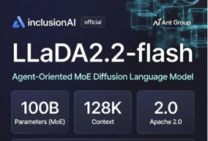

AI Updates
LLaDA2.2-flash - Open-Source Diffusion Model
https://www.youtube.com/watch?v=oDipulgqLro
InclusionAI, part of Ant Group, released LLaDA2.2-flash, an open-source diffusion language model for agentic use
Unlike autoregressive models, it generates and refines text iteratively using Levenshtein editing, and the project emphasizes high-performance, open-source deployment
103B params, MoE diffusion architecture, 128K token context length
Fast: 460 - 700 tok/sec (requires 224GB GPU memory)
The Last 30 Days Skill for Claude Code
https://www.youtube.com/watch?v=ShYfGB3x5mM
Scraping real-time user sentiment across platforms like Reddit, Hacker News, YouTube, X, GitHub, and TikTok
Evaluates post comments and full video transcripts to provide nuanced, community-level feedback rather than just surface-level Google search headlines
Runs automated Python scripts across multiple social networks in parallel, outputting synthesized reports alongside raw JSON data files
Installs into Claude Code via a single command, requiring API keys primarily for X (around $0.10 per search) while providing subsidized free access for major platforms
https://github.com/mvanhorn/last30days-skill
/plugin marketplace add mvanhorn/last30days-skill
/plugin install last30days@last30days-skill
git clone https://github.com/mvanhorn/last30days-skill.git ~/.claude/skills/last30days

Slide 27
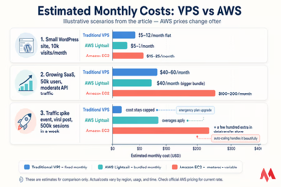
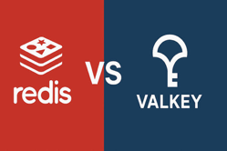
AI Updates
$5 VPS That Replaced My Entire AWS Bill
https://www.youtube.com/watch?v=KNkhpKghoDU
https://37signals.com
https://basecamp.com/cloud-exit
https://world.hey.com/dhh/we-have-left-the-cloud-251760fb
Moving from AWS to a cheap VPS (owned or leased server) saves 50-70% on Infrastructure savings - 50-70%
Tools like Kamal and Coolify help simplify deployments on VPS or self-hosted infrastructure
https://kamal-deploy.org , https://github.com/basecamp/kamal
https://coolify.io , https://github.com/coollabsio/coolify
Public cloud still makes sense for workloads needing rapid scaling, managed services, or specialized compliance and multi-region features
Redis vs Valkey: Caching Architecture
https://valkey.io , https://github.com/valkey-io/valkey
https://www.youtube.com/watch?v=3Qc49WnQnSg
Redis moved away from its BSD open-source model in 2024; Valkey was forked under Linux Foundation governance and keeps the BSD 3-Clause license
Valkey is wire-compatible with Redis clients and protocol, and reports say it can deliver higher throughput on multi-core workloads
SQLite in WAL mode is a strong embedded option for single-node caching because it avoids a separate server and supports concurrent reads while writes occur
Dedicated cache servers like Valkey still matter for shared state, atomic operations, and richer distributed data-structure use cases

Slide 28


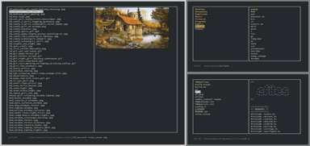
AI Updates
Hive - Multi-Agent Orchestration
builds agent topologies automatically for complex, long-running workflows and production AI tasks
https://github.com/aden-hive/hive
Automating Email Outreach with Hermes Agent https://www.youtube.com/watch?v=x3WB9hvlN4U
Hermes Agent connects to dedicated email inboxes via IMAP and SMTP to continuously check, sort, write, and respond to emails.
Built-in scheduling allows the agent to handle daily recurring tasks using plain language prompts without requiring any manual coding.
Setting the agent to draft mode provides a safety gate, ensuring every email is manually reviewed before sending.
Using a shared memory layer within an Agent OS allows multiple agents to access business context seamlessly without repeated explanations.
SuperFile - Terminal File Manager, in Go, Open-source MIT
Central file explorer, preview for images and files, configurable keyboard shortcuts, directory sorting, file filtering, panel splitting, and directory pinning
Prebuilt themes, configurable terminal editors, hidden file toggles, and keybindings via simple configuration files
bash -c "$(curl -sLo- https://superfile.dev/install.sh)"
https://www.youtube.com/watch?v=pDIMXiKyvA4
https://superfile.dev
https://github.com/yorukot/superfile

Slide 29


AI Updates
17 Tricks To Build 10x Faster with Claude
https://www.youtube.com/watch?v=ZzHB2mPHb2g
.. use "/init" skill .. default to auto-approve permission modes .. establish session-start hooks for automated workflow reminders .. monitor token status lines to avoid hitting context boundaries
Execute parallel sub-agents map cheaper models to simpler subtasks embed reusable custom scripts inside skills separate individual projects across isolated workspace directories
Ask Claude to interview (gril) you about project in plan mode to uncover blind spots and refine ideas before execution
Log workflow histories to identify persistent errors build self-verifying loops that rerun until success let the human review happen in the middle of the workflow
Simon Martinelli on process-centric spec-driven development https://www.youtube.com/watch?v=odbNXv9xXjc
He is using system use cases and entity models
AI can extract specs from existing code and documentation, allowing teams to add new capabilities without migration
Self-contained system architectures work better for AI development than microservices or monolithic setups because they keep context well-bounded in unified repositories
Workflows shift heavily toward requirements engineering, replacing two-week agile sprints with continuous delivery, smaller development teams, and trunk-based peer reviews
Development reliability is maintained through targeted skills, architectural guidelines, and documentation search tools rather than large system prompts

Slide 30


AI Updates
How to Survive using AI (in Russian) https://www.youtube.com/watch?v=JO-42T8SwC4
Integrate AI tools like Claude, Gemini, and Perplexity into you business workflow - optimizes content production, research, and data tracking
Organize core docs like standard custom AI prompts, anti-files, brand values, and personal constitutions in project folders
Leveraging AI allows small teams to scale operations, execute complex automation, and focus on higher-level strategic decisions.
Mogilko utilizes automated cultural alignment tests during recruitment to evaluate candidate autonomy, ownership, and adaptability over just technical skill sets.
Sustaining entrepreneurial growth requires continuous experimentation, adaptability through market shifts, and identifying core passions to maintain momentum through challenges.
Tencent Hyra 1.0 - Research Agent
Capable of recursive self-improvement on engineering tasks that have clear measurable performance scores
The architecture uses context and proposal agents alongside isolated execution sandboxes and an experience bank memory to repeatedly test and refine ideas
It implements dual loops to continuously improve candidate solutions while simultaneously upgrading the grading mechanism to stop shortcut cheating or data leakage
Hyra beat established AI training benchmarks, solved 29 open mathematics problems, optimized quantum computing algorithms, and advanced early-stage drug design candidates
Key actionable takeaways for developers include maintaining structured attempt histories, scoring performance numerically, executing parallel attempts, and continually sharpening testing standards - https://www.youtube.com/watch?v=JpVGBgAKzYw

Slide 31

GigaToken
GigaToken: Fast Open-Source Tokenizer
https://github.com/marcelroed/gigatoken
GigaToken runs approx 1,000 times faster than industry standards like OpenAI Tiktoken and Hugging Face.
Very important for training, tuning, and inference
GigaToken is written in Rust for speed and parallelism
# pip install gigatoken
import gigatoken as gt
Stanford PhD student Marcel Rudd released GigaToken, a fast open-source tokenizer designed for AI language models.
It processes up to 24.5 gigabytes of text per second, running up to 1,000 times faster than The software produces byte-for-byte identical output, ensuring complete accuracy without sacrificing output quality.
Major speed improvements come from replacing slow regular expression text pre-splitting with wide SIMD CPU instructions and optimized memory caching.
It operates seamlessly across various hardware platforms, including Apple Silicon, gaming processors, and high-end server chips.
GigaToken installs easily via Python, drastically reducing data preprocessing bottlenecks during model training and inference.
https://www.youtube.com/watch?v=vFtJeZ7ifTA

Slide 32
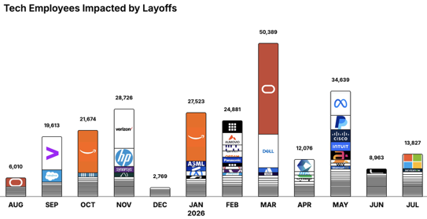
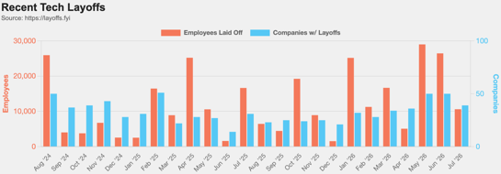
https://layoffs.fyi
https://trueup.io/layoffs
Jobs
The Tech Layoff Tracker
In 2026: 172,298 people laid off (813 per day)
In 2025: 245,953 people laid off (674 per day)
In 2024: 238,461 people laid off (653 per day)
https://trueup.io/layoffs
Tech Layoffs by year (US only):
124K in 2026 (as of July 31, 2026)
124K in 2025
153K in 2024
264K in 2023
165K in 2022 https://layoffs.fyi

Slide 33


About the Speaker
Lev Selector, Ph.D.
40+ years of software engineering, data science, and building teams (hiring, training, and managing)
Ph.D. in mathematical modeling and computer simulations
Interests:
Generative AI, Using LLM with your data
Local AI for Local Private Data
Cloud architecture, fin-tech, application security
Find/connect: Linkedin, GitHub, YouTube, Google
https://eais.ai
Enterprise AI Systems

Slide 34
Thank You!

