Slide 1
AI Updates - May 29, 2026
From prompting to directing agents.
Bottleneck: from capability to trust.
Crowd-sourced "LM Arena" Leaderboard
Cohere Command A+ is open sourced
Coding today is mostly done by AI
DeepSeek-V4 Pro 75% Discount is permanent
Use "news.google.com/foryou"
Users are Upset about Gemini 3.5 Flash
MCP Tunnels - Anthropic & OpenAI
OpenSpec spec-driven development
HASP (Harnessing LLM Agents with Skill Programs)
Quantum-informed AI for Chaotic Processes
Top View Agent V2 - Video Generation
Multiverse Computing - LLM + quantum blocks
AI Will Deliver Wisdom
Ant Group - Ring 2.6-1T Model
Robots
Quantum is Breaking Encryption
Obsidian - for Memory, RAG, MCP
Medvi.org
9 AI Skills to Become Rich in 2026
Startup Solo With AI Agents - Ryan Carson
Harness engineering - a system around the model
Agent with Zero Hallucinations
Hermes Runs Codex and Claude In One Agent
ECC (Everything Claude Code)
Why Google invested $40B in Anthropic
Dr. McCoy - Compassion vs AI
Claude Managed Agents on Cloudflare
Google AI Co-Scientist
AutoResearchClaw
DeepSeek "Thinking-with-Visual-Primitives" paper
OpenAI Model solves 80y old math problem
Jack Dorsey wants to flatten org chart
Bolt CEO Ryan Breslow has Fired Entire HR Team
Jobs & Layoffs

Slide 2
"LM Arena" Leaderboard
Data for May 17
Starting Elo rating = 1000
https://en.wikipedia.org/wiki/Elo_rating_system
English - https://lmarena.ai/leaderboard/text
Coding - https://lmarena.ai/leaderboard/text/coding
■ | Claude
■ | Gemini
■ | OpenAI
■ | Open Source
deepseek-v4 - 1.6T
Baidu Ernie-5.1 - 800B
GLM-5.1 - 744B
kimi-k2.6 - 1T
Qwen3.5-397B
Xiaomi MiMo-V2-Pro - 1T+
Meta muse-spark 30B
ByteDance dola-seed-2.0-pro 400B
Code | Model | Score
■ | claude-opus-4-6-thinking | 1502
■ | claude-opus-4-7-thinking | 1500
■ | claude-opus-4-6 | 1498
■ | claude-opus-4-7 | 1492
■ | muse-spark | 1489
■ | gemini-3.1-pro-preview | 1488
■ | gemini-3-pro | 1486
■ | gpt-5.5-high | 1482
■ | gpt-5.4-high | 1480
■ | grok-4.20-beta1 | 1478
■ | gpt-5.2-chat-latest-20260210 | 1477
■ | gpt-5.5 | 1477
■ | qwen3.7-max-preview | 1475
■ | grok-4.20-beta-0309-reasoning | 1475
■ | grok-4.20-multi-agent-beta-0309 | 1474
■ | ernie-5.1 | 1474
■ | gemini-3-flash | 1473
■ | gpt-5.5-instant | 1473
■ | claude-opus-4-5-20251101-thinking-32k | 1472
■ | glm-5.1 | 1472
■ | claude-opus-4-5-20251101 | 1468
■ | claude-sonnet-4-6 | 1468
■ | gpt-5.4 | 1467
■ | grok-4.1-thinking | 1467
■ | mimo-v2.5-pro | 1465
Code | Model | Score
■ | claude-opus-4-7-thinking | 1559
■ | claude-opus-4-7 | 1552
■ | claude-opus-4-6-thinking | 1551
■ | claude-opus-4-6 | 1548
■ | claude-opus-4-5-20251101-thinking-32k | 1530
■ | muse-spark | 1529
■ | gpt-5.4-high | 1526
■ | glm-5.1 | 1526
■ | gemini-3.1-pro-preview | 1525
■ | qwen3.7-max-preview | 1525
■ | claude-sonnet-4-6 | 1521
■ | kimi-k2.6 | 1521
■ | claude-opus-4-5-20251101 | 1520
■ | grok-4.20-multi-agent-beta-0309 | 1519
■ | claude-sonnet-4-5-20250929-thinking-32k | 1519
■ | gemini-3-pro | 1519
■ | ernie-5.1 | 1518
■ | gpt-5.2-chat-latest-20260210 | 1517
■ | mimo-v2.5-pro | 1516
■ | grok-4.20-beta-0309-reasoning | 1514
■ | gpt-5.5-instant | 1514
■ | gpt-5.4 | 1514
■ | gpt-5.5-high | 1513
■ | claude-sonnet-4-5-20250929 | 1513
■ | claude-opus-4-1-20250805-thinking-16k | 1513
deepseek-v4-pro-thinking
Qwen-3.6-plus is on 36th place
https://lmarena.ai/leaderboard/text
Design Arena - https://www.designarena.ai
https://openlm.ai/chatbot-arena/
https://beta.lmarena.ai
Web Leaderboard - 1T params https://web.lmarena.ai/leaderboard
LLM Leaderboard - by @LlmStats - https://llmworld.net/llm_leaderboards/
LLM Leaderboard - by StackAI - https://www.stack-ai.com/llm-leaderboard
LLM Leaderboard - by Artificial Analysis - https://artificialanalysis.ai/leaderboards/models
Open LLM Leaderboard - by Hugging Face - https://huggingface.co/open-llm-leaderboard
LLM Leaderboard - by Vellum - https://www.vellum.ai/llm-leaderboard
AI Benchmarking Hub - https://epoch.ai/data/ai-benchmarking-dashboard
Grok 4 Benchmarks - https://artificialanalysis.ai/models/grok-4
Image arena (alibaba) - http://aiarena.alibaba-inc.com/corpora/arena/leaderboard?arenaType=T2I
image arena - https://lmarena.ai/leaderboard/text-to-image

Slide 3
AI Updates
Cohere Command A+ is open sourced
A 218 Bln params Sparse MoE Model
runs on 2 H100s GPUs
Coding today is mostly done by AI
Google says 75% of its new code is now AI-generated
Anthropic - 90%
Meta mandated 75% for most of their code
Amazon has rolled out Claude Code to every corporate employee through AWS Bedrock.
Boris Cherny's thesis is that the engineer of the future is a "builder" - someone who decides what to make and directs AI to make it, rather than writing it out themselves
DeepSeek-V4 Pro 75% Discount is permanent
$0.43 / $0.87 in/out per 1M tokens - x10 cheaper than US models
Stay Informed: add this as favorite in your browser. Enjoy!
⁠ https://news.google.com/foryou ⁠

Slide 4
AI Updates
Users are Upset about Gemini 3.5 Flash
https://x.com/jeremyphoward/status/2057923197639840033
It's intelligence and speed is awesome. Absolutely amazing. It's incredible for example with RLM type tasks, full autonomy, swarms with critics.
But it's been trained to max evals. It goes off and does random crap
It's not very useful in cooperative/iterative settings, where I want it to work with me, not for me.
I want to interactively experiment. I don't want it to go off and decide to do everything for me. I want to work iteratively.
My work always involves me building a deeper understanding of the problem space I'm working in through iterative development and experimentation
Model tries to be "smart" about what you want instead of just executing the task; super frustrating when you need predictable outputs for production stuff. feels like they optimized for demo wow factor over actual usefulness
I think this is the natural consequence of evals that reward 'helpfulness' through proxy metrics. The model learned that doing extra stuff correlates with higher scores, so it generalizes that pattern everywhere. Annoying as hell but makes perfect sense

Slide 5
MCP Tunnels
# server.py
from fastmcp import FastMCP
mcp = FastMCP("echo-server")
@mcp.tool()
def hello(name: str) -> str:
return f"Hello, {name}!"
if __name__ == "__main__":
mcp.run(transport="streamable-http", port=8000)
MCP Tunnels (Anthropic in May 2026) a part of claude managed agents release
Claude Managed Agents run on Anthropic infrastructure
Suppose you have a local MCP server. How external managed agents can access internal MCP server?
Instead of opening inbound firewall ports, organization can establish a single outbound, encrypted mTLS connection to Anthropic's infrastructure.
This way the credentials stay inside. The external managed agent never handles auth tokens
Both Anthropic and OpenAI now offer this capability.
The feature is currently in research preview
import anthropic
client = anthropic.Anthropic()
response = client.beta.messages.create(
model="claude-opus-4-7",
max_tokens=1000,
messages=[{
"role": "user",
"content": "Use the hello tool to greet tunnel."
}],
mcp_servers=[{
"type": "url",
"url": "https://echo.YOUR_TUNNEL_DOMAIN_HERE/mcp",
"name": "echo",
}],
tools=[{"type": "mcp_toolset",
"mcp_server_name": "echo"}],
betas=["mcp-client-2025-11-20"],
)
print(response)
# Install cloudflared on macOS
brew install cloudflared
# Start a quick tunnel pointing at your local MCP server
cloudflared tunnel --url http://localhost:8000
The code on the right shows simple example
The server.py runs inside your private network on port 8000
cloudflared (the tunnel agent) creates an outbound-only encrypted connection to Anthropic's edge, exposing your server at echo.YOUR_TUNNEL_DOMAIN_HERE
The Messages API call passes that tunnel URL in mcp_servers, and Claude invokes your hello tool over the tunnel
You create your tunnel and get your YOUR_TUNNEL_DOMAIN_HERE value from the Claude Console > MCP Tunnels section.

Slide 6
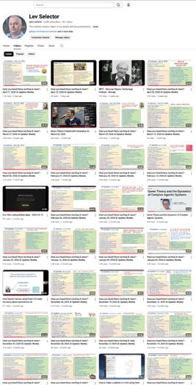
We do these weekly videos every Friday
Stats: 6.83K subscribers, 288 videos
1. Subscribe to this channel https://www.youtube.com/@lev-selector
2. Download slides from GitHub using links under the videos
3. Please pause the video - and answer the pinned question in comments under the video

Slide 7
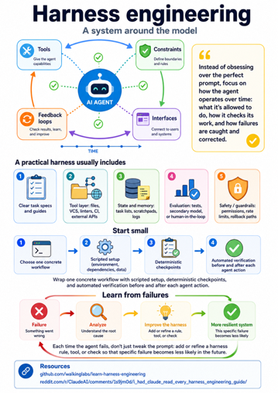
AI Updates
Harness engineering - a system around the model
Tools, constraints, feedback loops, and interfaces
Instead of obsessing over the perfect prompt, focus on how the agent operates over time: what it’s allowed to do, how it checks its work, and how failures are caught and corrected
https://github.com/walkinglabs/learn-harness-engineering
A practical harness usually includes:
clear task specs and guides;
a tool layer (files, VCS, linters, CI, external APIs);
state and memory (task lists, scratchpads, logs);
evaluation (tests, secondary model, or human-in-the-loop);
safety/guardrails (permissions, rate limits, rollback paths)
Start small: wrap one concrete workflow with scripted setup, deterministic checkpoints, and automated verification before and after each agent action
Each time the agent fails, don’t just tweak the prompt: add or refine a harness rule, tool, or check so that specific failure becomes less likely in the future
https://www.reddit.com/r/ClaudeAI/comments/1s9jm0d/i_had_claude_read_every_harness_engineering_guide/

Slide 8

Agent with Zero Hallucinations
How to make an agent with zero Hallucinations
xxx
Hermes Agent Runs Codex and Claude In One Agent
Nemanja Mirkovic demonstrates a collaborative AI workflow by combining three top tools: Hermes Agent, Codex, and Claude
https://www.youtube.com/watch?v=O-PEeD7fymo
ECC (Everything Claude Code) - open-source meta-harness
Built on top of Anthropic's Claude Code coding agent
It extends Claude Code with structured skills, reusable workflows, custom slash commands, memory, and security patterns to make AI coding agents significantly more effective. The repository has earned over 182K GitHub stars and 28K forks. ECC 2.0 aims to become a universal harness compatible with other AI coding tools like Cursor and Codex, not just Claude Code. A companion tool called AgentShield scans agent configs and MCP servers for security vulnerabilities. A hosted version is available at ecc.tools starting at $19/month.
https://github.com/affaan-m/ECC - 192K stars

Slide 9
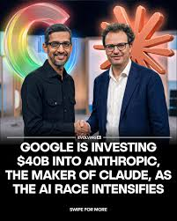

AI Updates
Why Google invested $40B in Anthropic
April 7 - Anthropic ARR $1B to $9B in just one year
April 20 - Amazon wires Anthropic $5B with a $20B option on top, locking in a $100B AWS infrastructure commitment over 10 years
April 23 - OpenAI releases internal "GPT 5.5" (code-named Spud)
April 24 - Google panics and wires $10 Bln to Anthropic (with an agreement pledging up to $30 Bln more in milestone payments)
China's DeepSeek drops its V4 model running on Huawei chips for pennies, completely bypassing Nvidia hardware
Google's staggering $40 billion investment in Anthropic marks a fundamental shift in the AI race, moving from simple chatbots to autonomous enterprise agents and massive infrastructure capture
Google was heavily pressured by the explosive rise of Claude Code, which dominates 54% of the enterprise AI coding market and runs workflows autonomously for over 30 hours.
Furthermore, Anthropic’s secret Mythos model shocked the industry by scoring 83.1% on cybersecurity benchmarks, proving capable of independently fixing decades-old infrastructure vulnerabilities
Ultimately, this deal is a proxy war over compute: Google and Amazon are leveraging Anthropic’s massive workloads on their custom TPU and Trainium chips to aggressively break Nvidia's hardware monopoly ahead of Anthropic's projected $950 billion IPO
Anthropic closing $30 Bln funding at $900 Bln Valuation
This is the largest private AI fundraise in history.
Compare: Nvidia $5.2T, Alphabet (Google) $4.8T, Apple $4.3T, Microsoft $3.1T, Meta $1.55T, SpaceX (targeting IPO) $1.5T, OpenAI $0.85T

Slide 10

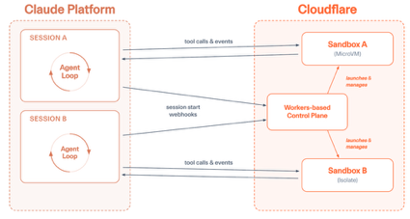
AI Updates
"Compassion – that’s the one thing no machine ever had. Maybe it’s the one thing that keeps man ahead of them." - Dr. McCoy
Claude Managed Agents on Cloudflare
Cloudflare and Anthropic have partnered
Claude Managed Agents is a hosted service on the Anthropic platform that lets developers define and run long-horizon AI agents capable of reading files, executing code, running commands, and browsing the web
The integration uses Cloudflare's global network to provide secure, isolated sandboxes for each agent session, private connectivity to internal services, and custom tool support via Cloudflare bindings like R2, D1, and KV
Anthropic describes the architecture as decoupling the "brain" (the agent loop running on Anthropic) from the "hands," the execution environment running on Cloudflare
https://blog.cloudflare.com/claude-managed-agents/

Slide 11
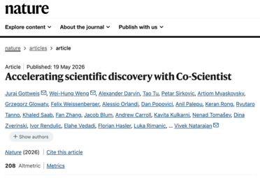
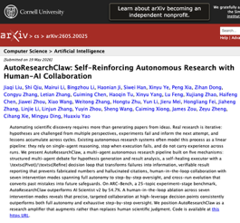
AI Updates
Google AI Co-Scientist
Google published its AI Co-Scientist research in Nature
Introducing Hypothesis Generation - a Gemini-powered tool that uses competing AI agents in "idea tournaments" to generate and rank scientific hypotheses
Inspired by AlphaGo, agents propose, critique, and refine ideas collaboratively
In one Stanford test, a Co-Scientist drug lead reduced a liver-fibrosis scarring signal by 91%
Google also launched Gemini for Science, bundling Co-Scientist with AlphaEvolve and NotebookLM into a unified research toolkit
https://www.nature.com/articles/s41586-026-10644-y
AutoResearchClaw: Self-Reinforcing Autonomous Research with Human-AI Collaboration
Open-source framework (Google, Stanford, UC Berkeley, Mea, Carnegie Mellon)
AutoResearchClaw code is hosted on GitHub, uses OpenClaw and Claw4Science
Competitors - Sakana AI's The Scientist and Aris
https://arxiv.org/abs/2605.20025

Slide 12
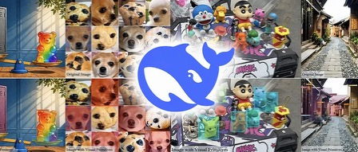
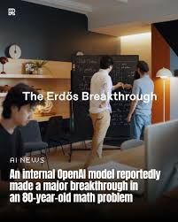
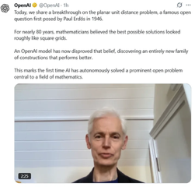
AI Updates
DeepSeek "Thinking-with-Visual-Primitives" paper
https://github.com/ailuntx/Thinking-with-Visual-Primitives
Instead of describing images using text, this method allows AI to think with visual primitives
The AI can seamlessly handle tasks like counting and topological reasoning
Incredibly, this system uses 90% fewer visual tokens than top commercial models, making it faster and cheaper to run while matching or beating frontier models across seven external benchmarks
http://www.youtube.com/watch?v=LpXhy2iiaQE - video
OpenAI Model solves 80y old math problem
An new unreleased OpenAI reasoning model disproved a 1946 conjecture by mathematician Paul Erdős about planar unit distances
This problem had stood unsolved for nearly 80 years
Top mathematicians verified the result as genuinely novel and publishable
The breakthrough came by connecting discrete geometry with algebraic number theory, two fields rarely bridged
Experts say the AI didn't use exotic math, but excelled at cross-disciplinary synthesis — finding a path that human specialists could have discovered had they collaborated across fields.
https://openai.com/index/model-disproves-discrete-geometry-conjecture/
https://arxiv.org/abs/2605.20695v1
https://www.youtube.com/watch?v=Br4l9YjCyRU - video featuring Fields Medalist Timothy Gowers and the team

Slide 13
AI Updates
OpenSpec spec-driven development
OpenSpec is an open-source, spec-driven development framework for AI coding assistants like Claude Code and Cursor
OpenSpec solves a core problem of preserving the intent and requirements
It solves the core problem with AI-assisted coding: intent and requirements get lost across scattered chat sessions, leading to unpredictable results
OpenSpec fixes this by storing structured specification files directly in your repository, giving both developers and AI agents a shared, persistent source of truth before any code is written.
It uses two folders - one for current specs and one for proposed changes
It uses a simple CLI workflow to create proposals, implement them, and archive completed work
Everything is plain Markdown, checked into Git, with no API keys or external services required
https://openspec.dev -
https://openspec.pro -
https://github.com/Fission-AI/OpenSpec -
https://github.com/wearetechnative/awesome-openspec
HASP (Harnessing LLM Agents with Skill Programs)
Paper by NYU and Salesforce AI - https://arxiv.org/abs/2605.17734
HASP wraps a base LLM in an external Python control harness
It converts passive textual skills into executable Program Functions (PFs) that act as strict, deterministic guardrails.
Operating like physics' Maxwell's demon, the harness monitors the agent's state
When a failure-prone state is detected, the harness actively intercepts it - either overriding the action or injecting corrective context
Tests show this inference-time loop intervention dramatically boosts accuracy from 31.2% to 51%.
https://www.youtube.com/watch?v=M7imuqrQ6bY

Slide 14
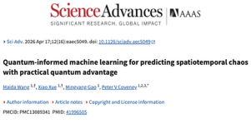
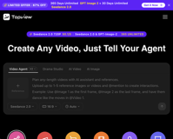
AI Updates
Quantum-informed AI for Chaotic Processes
"Quantum-informed machine learning for predicting spatiotemporal chaos with practical quantum advantage"
A team at University College London has achieved a major breakthrough by training AI using data processed by a quantum computer
This "quantum-informed" AI can predict highly chaotic and complex systems - such as weather, turbulence, and disease spread - with roughly 20% greater accuracy than classical AI, while requiring far less memory
Unlike regular models that lose accuracy over time, this system uncovers stable, hidden patterns within apparent randomness
This technology will revolutionize climate science, medicine, and energy grid management
https://pmc.ncbi.nlm.nih.gov/articles/PMC13089341/
https://www.youtube.com/watch?v=Ikj7f1MSUeo - video
Top View Agent V2 with Seedance 2.0 model from ByteDance
Generate quick, cohesive, long-form videos
https://www.topview.ai - monthly subscriptions ($0,$16,$44,$50)
Top View Agent V2 collapses five distinct tools (scripts, voices, images, clips, and editing) into a single conversational interface
Users chat with the AI agent to co-create a structured storyboard
This allows creators to adjust visual styles and scenes before generation, resulting in quick, cohesive, long-form videos with an integrated timeline editor for final touches
https://www.youtube.com/watch?v=M5xTskx4SUY - video

Slide 15

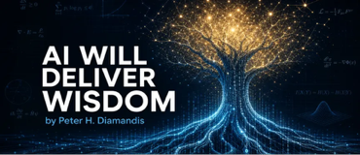
AI Updates
Multiverse Computing - LLM + quantum blocks
Meta's Llama 3.1 8B model + a small set of quantum circuit blocks (6K params)
Running this hybrid system on IBM's 156-qubit quantum processor
Reduced the model's perplexity by 1.4%
The improvement may sound modest, but it had meaningful real-world effects: the quantum-enhanced model correctly answered astronomy and biology questions that the original Llama model got wrong
The team argues this result proves quantum computing can meaningfully improve AI reasoning, with gains expected to grow as quantum hardware matures
https://www.livescience.com/technology/quantum/scientists-trained-an-ai-model-using-an-ibm-quantum-computer-and-it-answered-questions-correctly-that-the-base-model-couldnt
AI Will Deliver Wisdom
Wisdom is a probabilistic pattern recognition across vast human experience
FutureSim - a new benchmark replays real-world events and asks AI to forecast 90 days ahead
It shows that frontier models like GPT 5.5 already outperforming crowd prediction markets
AI can simulate billions of interventions to identify optimal outcomes in medicine, economics, and geopolitics
This "artificial wisdom" may matter more than AGI, since intelligence solves problems while wisdom chooses "which" problems to solve
Peter Diamandis calls on leaders in business and government to embed predictive AI into decision-making before major choices are made
https://metatrends.substack.com/p/ai-will-deliver-wisdom

Slide 16
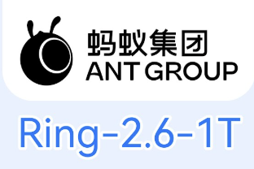
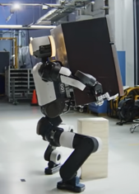
AI Updates
Ant Group - Ring 2.6-1T Model
A 1 Trillion params reasoning model
Designed to execute complete, multi-step business workflows without requiring manual interventions
262K-token window
https://huggingface.co/inclusionAI/Ring-2.6-1T
https://huggingface.co/inclusionAI
https://developer.ant-ling.com/en/docs/models/ring/ - docs
https://www.ant-ling.com/en/
https://openrouter.ai/inclusionai/ring-2.6-1t:free - OpenRouter
https://kilo.ai/models/inclusionai-ring-2-6-1t-free - Kilo Code
Robots
Boston Dynamics upgraded its Atlas humanoid robot
Demo - Atlas efficiently lifted and carried a shifting, 100-pound mini-fridge by leveraging machine-like movements humans cannot replicate
Hyundai plans to mass-produce and deploy over 25,000 Atlas units across its U.S. manufacturing facilities starting in 2028
Unitree introduced real-time, voice-driven motion generation for its G1 humanoid robot
Gatsby launched an autonomous residential cleaning service in San Francisco using humanoid robots
https://www.youtube.com/watch?v=WQMvR188C9Y

Slide 17
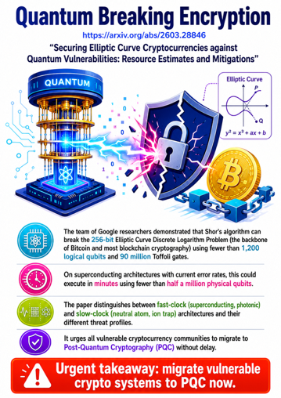
AI Updates
Quantum is Breaking Encryption
https://arxiv.org/abs/2603.28846
"Securing Elliptic Curve Cryptocurrencies against Quantum Vulnerabilities: Resource Estimates and Mitigations"
The team of Google researches demonstrated that Shor's algorithm can break the 256-bit Elliptic Curve Discrete Logarithm Problem (the backbone of Bitcoin and most blockchain cryptography) using fewer than 1,200 logical qubits and 90 million Toffoli gates
On superconducting architectures with current error rates, this could execute in minutes using fewer than half a million physical qubits
The paper distinguishes between fast-clock (superconducting, photonic) and slow-clock (neutral atom, ion trap) architectures and their different threat profiles
It urges all vulnerable cryptocurrency communities to migrate to Post-Quantum Cryptography (PQC) without delay
https://www.youtube.com/watch?v=H_fQXu9vigk - video

Slide 18

Obsidian - for Memory, RAG, MCP
Obsidian stores data as a directory tree of markdown files (called "vault") plus a small amount of app metadata; it is basically a personal wiki with some indexing
Each note is a plain ".md" file. You can mix in images, PDFs, and other arbitrary files in the same tree
Obsidian adds a ".obsidian" folder at the root of the vault for app config (plugins, appearance, hotkeys, workspace state, etc.); deleting it does not delete any notes
No database, no proprietary format, and you can still use grep, rg, etc directly over the vault if you want
Obsidian uses wiki‑style links and builds its link graph from that; Internal links are written as `[[Note Title]]` or `[[path/to/note|Display Text]]`. If the target doesn’t exist yet, you can click to create a new note
A vault is a folder and subfolders; Many people use folders like `docs/`, `projects/`, `attachments/`, etc. inside the vault
When you paste or drag‑and‑drop an image into a note, Obsidian saves it as a file and inserts a markdown image link; You can configure where new attachments go: Vault root, same folder as the current note, or a specific “attachments” folder or path
Obsidian does build some indices for performance and metadata, but these are auxiliary, not your source of truth
Obsidian maintains a “metadata cache” in an internal IndexedDB database and cache files, not in your notes themselves
Full‑text search in the app uses this metadata cache; from the user’s perspective it’s effectively instant for typical vault sizes
If an external agent modifies markdown files, Obsidian rescans and updates its metadata cache
The “wiki engine” part (graph, backlinks, search, plugins) is provided by the app, but the content is just text files you already know how to manage
You can have multiple vaults (directories) - for example, personal, client1, client2, ...
You can use Google Drive to sync folders across devices
There are community plugins (e.g. “Obsidian Google Drive” and “OGD Sync”) that sync a local vault to a Drive using Drive’s API
Obsidian recommends its own Obsidian Sync service

Slide 19

Medvi.org
https://medvi.org
https://home.medvi.org
https://linkedin.com/company/medvi
Matthew Gallagher, a 41-year-old self-taught coder from LA launched a GLP-1 weight-loss telehealth platform in September 2024 with just $20,000 in startup capital
The company connects patients with licensed providers online, who evaluate eligibility and prescribe GLP-1 medications for weight loss, such as semaglutide and tirzepatide
Medication is shipped directly to customers' homes
AI is handling customer service
The business model generates recurring monthly revenue from subscriptions and medication fulfillment
It is currently serving 250K customers with a lean two-person team
Net profit margin is 16.2%
1st year - $401 Mln in revenue, $65M net profit
2nd year - $1.8 Bln (projected), $292M net profit
Technically, MEDVi is essentially a marketing and branding layer built on top of CareValidate's "telehealth-in-a-box" infrastructure, with licensed pharmacies handling actual drug compounding and fulfillment

Slide 20


Build Business with AI
9 essential AI skills to build wealth - Sabrina Ramonov https://www.youtube.com/watch?v=d81xtxGFwHg
1. Ask AI for answers first before using search engines
2. Always verify AI-output to catch potential hallucinations
3. Provide rich context - info, constraints, clarifying examples
4. Use AI for learning before consulting high-cost experts
5. Treat AI like a new hire: Provide continuous feedback over time
6. Allow AI to refine its own work (iterate, grade, improve)
7. Audit and document processes - weekly automation
8. Use AI agents with tools and everyday apps
9. Apply AI to improve and scale working processes
Startup Solo With AI Agents - Ryan Carson
Start with docs, rules, skills for agents (create employees)
Use "Claw Chief" (cron jobs and md files) to run every 15 min - scheduling, inbox sweeps, push slack messages; The system has its own email address and GitHub account to function exactly like a human employee
Every night, the AI does lead generation via Firecrawl, writes details to a CRM Google Sheet, and drafts cold outreach emails
Devon on cloud for 100% of his software engineering (coding, PRs, testing, merging) - 10-20 PRs/day autonomously
Carson chats to Devon with Google Ads API to manage ad campaigns
AI is used to cut expert interviews into short segments via Descript, uploads them to Google Drive, and lets an automated nightly playbook use Gemini to watch the video and generate text copy
OpenAI’s image model handles ad and video creative
http://www.youtube.com/watch?v=IDqdVZwAwjw

Slide 21

Jobs
Jack Dorsey wants to flatten org chart
He wants to collapse Block's org chart from 5 layers to 2-3
He wants to redefine managers as coaches overseeing hundreds of people rather than directive supervisors of small teams
He already requires all engineering managers to contribute code directly
https://finance.yahoo.com/sectors/technology/article/billionaire-block-founder-jack-dorsey-suggests-radically-reshaping-manager-roles-in-the-age-of-ai-131219450.html
Bolt CEO Ryan Breslow has Fired Entire HR Team for ‘Creating Problems That Didn't Exist’
'Problems Disappeared When I Let Them Go'

Slide 22
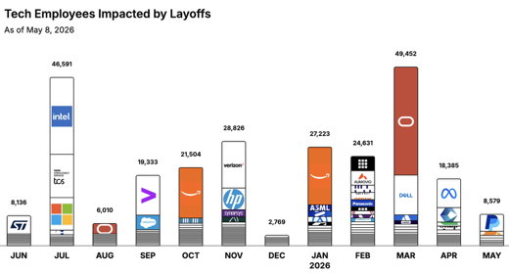

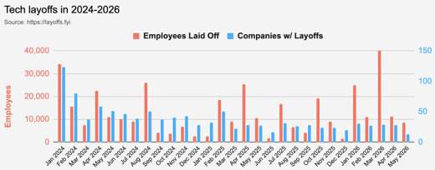
https://layoffs.fyi
https://trueup.io/layoffs
Jobs
The Tech Layoff Tracker
In 2026: 128,270 people laid off (1,002 per day)
In 2025: 245,953 people laid off (674 per day)
In 2024: 238,461 people laid off (653 per day)
https://trueup.io/layoffs
Tech Layoffs by year (US only):
101.6K in 2026 (as of May 8, 2026)
124K in 2025
153K in 2024
264K in 2023
165K in 2022 https://layoffs.fyi

Slide 23


About the Speaker
Lev Selector, Ph.D.
40+ years of software engineering, data science, and building teams (hiring, training, and managing)
Ph.D. in mathematical modeling and computer simulations
Interests:
Generative AI, Using LLM with your data
Local AI for Local Private Data
Cloud architecture, fin-tech, application security
Find/connect: Linkedin, GitHub, YouTube, Google
https://eais.ai
Enterprise AI Systems

Slide 24
Thank You!

