Slide 1
AI Updates - Jan 16, 2026
Hot Area - Agent Memory Systems
Crowd-sourced "LM Arena" Leaderboard
Open Source Models
Nvidia Hardware Progress
High-Flyer 56.6% Returns
Nvidia StarCloud-1 Satellite
Elon Musk's 5 Year Vision
HINDSIGHT Agent Memory System
Confucius SDK (Meta and Harvard)
Google Universal Commerce Protocol (UCP)
Sakana AI Paper on Self-Improving AI
Buying a Humanoid Robot ?
Demystifying evals for AI agents (Anthropic)
Meta Nuclear Power for AI
DeepSeek V4 planned mid-February
SurfSense Open Source Notebook
Apple + Gemini
xxx
Jobs, Layoffs, demand for AI Engineers

Slide 2
Crowd-sourced "LM Arena" Leaderboard
Data for January 9
Starting Elo rating = 1000
https://en.wikipedia.org/wiki/Elo_rating_system
English - https://lmarena.ai/leaderboard/text
Coding - https://lmarena.ai/leaderboard/text/coding
Model | Score
gemini-3-pro | 1490
grok-4.1-thinking | 1477
gemini-3-flash | 1471
claude-opus-4-5-20251101-thinking-32k | 1469
grok-4.1 | 1466
claude-opus-4-5-20251101 | 1465
gemini-3-flash (thinking-minimal) | 1464
gpt-5.1-high | 1457
gemini-2.5-pro | 1450
claude-sonnet-4-5-20250929-thinking-32k | 1450
claude-opus-4-1-20250805-thinking-16k | 1448
claude-sonnet-4-5-20250929 | 1448
ernie-5.0-preview-1203 | 1446
gpt-4.5-preview-2025-02-27 | 1443
claude-opus-4-1-20250805 | 1443
glm-4.7 | 1443
chatgpt-4o-latest-20250326 | 1442
gpt-5.2 | 1440
gpt-5.2-high | 1440
gpt-5-high | 1436
gpt-5.1 | 1435
o3-2025-04-16 | 1433
grok-4-1-fast-reasoning | 1431
kimi-k2-thinking-turbo | 1430
Model | Score
claude-opus-4-5-20251101-thinking-32k | 1542
claude-sonnet-4-5-20250929-thinking-32k | 1524
gemini-3-pro | 1519
claude-opus-4-5-20251101 | 1516
claude-opus-4-1-20250805-thinking-16k | 1514
grok-4.1-thinking | 1508
claude-sonnet-4-5-20250929 | 1506
gemini-3-flash | 1504
claude-opus-4-1-20250805 | 1501
gemini-3-flash (thinking-minimal) | 1499
claude-opus-4-20250514-thinking-16k | 1495
gpt-5.2-high | 1494
grok-4.1 | 1493
gpt-5.1-high | 1492
glm-4.7 | 1487
kimi-k2-thinking-turbo | 1484
gpt-5.2 | 1478
gpt-5.1 | 1477
qwen3-max-2025-09-23 | 1475
claude-haiku-4-5-20251001 | 1475
longcat-flash-chat | 1474
deepseek-v3.2-exp-thinking | 1472
gpt-5-high | 1470
claude-sonnet-4-20250514-thinking-32k | 1469
deepseek-v3.2 - 671B
ernie-5.0 - 2.4T
glm-4.6 - 355B
kimi-k2-thinking - 1T
longcat-flash-chat - 560B
qwen3-max - 1T
qwen3-235b-a22b - 235B
Google Gemini
x.ai
Claude
OpenAI
Open Source
x.ai
x.ai
https://lmarena.ai/leaderboard/text
Design Arena -
https://www.designarena.ai
https://openlm.ai/chatbot-arena/
https://beta.lmarena.ai
Web Leaderboard - 1T params
https://web.lmarena.ai/leaderboard
LLM Leaderboard - by @LlmStats -
https://llmworld.net/llm_leaderboards/
LLM Leaderboard - by StackAI -
https://www.stack-ai.com/llm-leaderboard
LLM Leaderboard - by Artificial Analysis -
https://artificialanalysis.ai/leaderboards/models
Open LLM Leaderboard - by Hugging Face -
https://huggingface.co/open-llm-leaderboard
LLM Leaderboard - by Vellum -
https://www.vellum.ai/llm-leaderboard
AI Benchmarking Hub -
https://epoch.ai/data/ai-benchmarking-dashboard
Grok 4 Benchmarks -
https://artificialanalysis.ai/models/grok-4
Image arena (alibaba) -
http://aiarena.alibaba-inc.com/corpora/arena/leaderboard?arenaType=T2I
image arena - https://lmarena.ai/leaderboard/text-to-image
China
x.ai
China
China
China
China
China
China
x.ai
China

Slide 3
Open Source Models
Name | Size (Params) | Architecture | Quality | Memory
Qwen3-235B-A22B | 235B (22B active) | MoE | 9.2/10 | ~470GB (FP16), ~118GB (4-bit)
MiniMax M2 | 230B (10B active) | MoE | 8.8/10 | ~460GB (FP16), ~115GB (4-bit)
GLM-4.7 | 355B (32B active) | MoE | 9.0/10 | ~710GB (FP16), ~178GB (4-bit)
Qwen3-30B-A3B-Instruct | 30B (3B active) | MoE | 8.5/10 | ~60GB (FP16), ~15GB (4-bit)
NVIDIA Nemotron-3-Nano-30B-A3B | 30B (3B active) | MoE | 8.3/10 | ~60GB (FP16), ~15GB (4-bit)
Granite 4.0 H-Small | 32B (9B active) | Hybrid MoE | 8.3/10 | ~64GB (FP16), ~16GB (4-bit)
OLMo 3 32B | 32B | Dense | 8.6/10 | ~64GB (FP16), ~16GB (4-bit)
Qwen2.5-32B-Instruct | 32B | Dense | 8.4/10 | ~64GB (FP16), ~16GB (4-bit)
OLMo 2 32B | 32B | Dense | 8.5/10 | ~64GB (FP16), ~16GB (4-bit)
DeepSeek-R1-Distill-Qwen-32B | 32B | Dense | 8.2/10 | ~64GB (FP16), ~16GB (4-bit)
Qwen2.5-Coder-32B-Instruct | 32B | Dense | 8.1/10 | ~64GB (FP16), ~16GB (4-bit)
Mistral Small 3.1 24B | 24B | Dense | 8.4/10 | ~48GB (FP16), ~12GB (4-bit)
Devstral Small 2 24B | 24B | Dense | 8.0/10 | ~48GB (FP16), ~12GB (4-bit)
Gemma 3-27B | 27B | Dense | 7.8/10 | ~54GB (FP16), ~14GB (4-bit)
OLMo 2 13B | 13B | Dense | 7.5/10 | ~26GB (FP16), ~7GB (4-bit)
Phi-4 | 14B | Dense | 7.6/10 | ~28GB (FP16), ~7GB (4-bit)
Ministral 3-14B (dense) | 14B | Dense | 7.4/10 | ~28GB (FP16), ~7GB (4-bit)
Qwen2.5-14B-Instruct | 14B | Dense | 7.5/10 | ~28GB (FP16), ~7GB (4-bit)
OLMo 3 7B | 7B | Dense | 7.2/10 | ~14GB (FP16), ~4GB (4-bit)
Fine Tuning Methods
https://x.com/akshay_pachaar/status/2010408900798062652
1. LoRA
2. QLoRA
3. Prefix Tuning
4. Adapter Tuning
5. Instruction Tuning
6. P-Tuning
7. BitFit
8. Soft Prompts
9. RLHF
10. RLAIF
11. DPO (Direct Preference Optimization)
12. GRPO (Group Relative Policy Optimization)
13. RLAIF (RL with AI Feedback)
14. Multi-Task Fine-Tuning
15. Federated Fine-Tuning

Slide 4



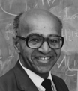










Nvidia Hardware Progress
Jensen Huang stated that Grok 5 will be a 7 Trillion parameter model
Vera Rubin requires 1/4 the number of GPUs to train MoE models compared to Blackwell
Rubin vs Blackwell: 10x cheaper inference, much faster, and 8x more inference per watt
Blackwell vs Hopper: up to 68x performance
The improvement 2017-2026:
Volta → Ampere (~2.5x) → Hopper (~2-3x) → Blackwell (~2-3x) → Rubin (~5x), yielding a compound improvement approaching 300-400x over nine years for AI-specific workloads
The improvement 2007-2017: 20x (from 1 to 21.2 TFLOPS (FP16))
Richard Feynman
2028-2029
Vera Rubin
2026-2027
David Blackwell
2024-2025
Grace Hopper
2022-2024
A. Ampère
2020-2022
Alan Turing
2019-2020
A. Volta
2017-2019
Blaise Pascal
2016-2017
J.C. Maxwell
2014-2016
J. Kepler
2012-2014
Enrico Fermi
2010-2012
Nikola Tesla
2007-2010

Slide 5
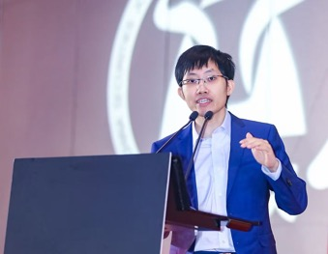
High-Flyer 56.6% Returns
DeepSeek founder Liang Wenfeng’s quantitative hedge fund generated returns of more than 50% last year
https://x.com/business/status/2010632000382636056
https://www.bloomberg.com/news/articles/2026-01-12/deepseek-founder-liang-s-funds-surge-57-as-china-quants-boom
DeepSeek founder Liang Wenfeng's quantitative hedge fund, Zhejiang High-Flyer Asset Management, generated average returns of 56.6% across its funds in 2025, making it the second-best performer among Chinese quant funds managing over 10 billion yuan
The fund abandoned market-neutral strategies in 2024 to go "all-in" on long-only strategies, which seek to beat underlying stock indexes rather than hedge positions - allowing to capture the full upside of China's stock market rally in 2025
High-Flyer Fund has been a pioneer in using AI for quantitative trading since its founding in 2015. The firm describes itself as fully relying on deep neural networks, with their first trade generated by a deep learning algorithm executed on October 21, 2016, and deep learning algorithms fully implemented for trading by 2017
High-Flyer's AI-driven approach automates every stage of operations—from data collection and analysis to portfolio construction and trade execution
Their models process three main data sources: market data (price and volume indicators), macroeconomic fundamental data, and alternative data, all fed into neural networks to predict stock price changes
The firm integrates machine learning and natural language processing to analyze massive datasets and financial behavior

Slide 6
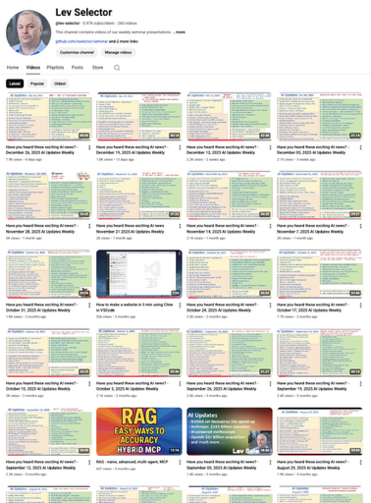
We do these weekly videos every Friday
Stats: 6.04K subscribers, 263 videos
Subscribe to this channel
https://www.youtube.com/@lev-selector
Download slides from GitHub using links under the videos
Please pause the video - and answer the pinned question in comments under the video

Slide 7
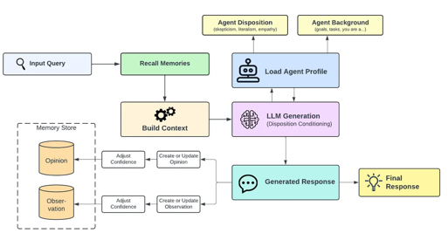
HINDSIGHT Agent Memory System
HINDSIGHT Agent Memory System
https://medium.com/@tarangtattva2/a-new-agent-memory-system-just-dropped-and-it-finally-fixes-what-weve-been-getting-wrong-fc84589f75ca
The HINDSIGHT agent memory system addresses a fundamental flaw in current AI agent memory: treating memory as simple text retrieval rather than meaningful understanding
HINDSIGHT introduces four distinct memory networks:
World Memory (objective facts),
Experience Memory (agent's own actions),
Opinion Memory (subjective beliefs with confidence scores),
Observation Memory (neutral summaries)
This separation prevents the confusion typical in systems that mix fact and opinion
The system uses three core operations:
Retain (converting conversations into coherent narratives preserving decision context),
Recall (combining semantic search, keywords, graph traversal, and temporal filtering),
Reflect (applying behavioral profiles like skepticism and empathy to generate responses).
Crucially, opinions evolve with confidence scores that adjust based on new evidence
On long-memory benchmarks, HINDSIGHT achieves 83% accuracy compared to 39% for traditional approaches, enabling agents that explain their reasoning, maintain stable preferences, and preserve personality across sessions

Slide 8
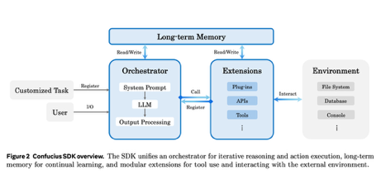
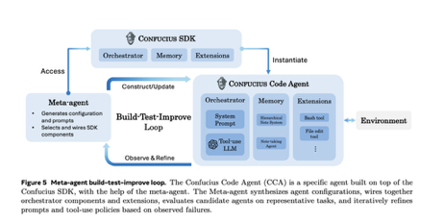
Confucius SDK (Meta and Harvard)
Confucius SDK, open source
https://www.marktechpost.com/2026/01/09/meta-and-harvard-researchers-introduce-the-confucius-code-agent-cca-a-software-engineering-agent-that-can-operate-at-large-scale-codebases/
Meta and Harvard - Confucius Code Agent, open-source
SOTA on benchmarks like SWE Bench Pro and SWE Bench Verified by prioritizing agent architecture over raw model size
The Confucius SDK organizes around three design axes:
- Agent Experience (context layout and working memory),
- User Experience (readable traces and code diffs),
- Developer Experience (observability and debugging)
Implements three core mechanisms:
- hierarchical working memory - partitions long context
- a persistent note-taking system (cross-session learning)
- modular tool extensions for file editing, command execution, and code search
Claude 4.5 Sonnet + Confucius - outperforms Claude 4.5 Opus
Rich tool handling - increases the resolve rate
Cross-Session Learning (re-using notes between sessions)
Meta-agent that automatically designs and tunes agent configurations through iterative build-test-improve loops

Slide 9


Google Gemini "Buy" Button
Google Universal Commerce Protocol (UCP) and Gemini Buy Button
Direct checkout capabilities in Gemini and AI Mode Search ("Buy" button)
UCP - an open-source standard co-developed with Shopify, Walmart, Target, Wayfair, and Etsy
UCP provides a unified language for AI agents to communicate with e-commerce systems - to find products and complete purchases for you
It organizes these tasks into specific "capabilities," such as checking out or applying discounts, and keeps your financial information safe by using secure tokens rather than sharing your actual credit card details directly with every merchant
Ultimately, UCP creates a secure bridge that allows AI to handle complex shopping errands across many different stores without needing custom integrations for each one
UCP covers product search, payment processing, and post-purchase support, and has backing from over 20 companies including major payment processors (Visa, Mastercard, American Express, PayPal, Stripe) and retailers (Home Depot, Kroger, Lowe's, Gap)
When users tap the "Buy" button, they can complete purchases with pre-filled payment methods (Google Pay, Google Wallet) and shipping information without leaving the AI conversation
Business Agent - an AI virtual sales associate that appears as a "Chat" button in Search results for participating retailers like Lowe's, Michaels, Poshmark, and Reebok, capable of answering product questions in the brand's voice
UCP directly competes with OpenAI's Agentic Commerce Protocol and positions Google against OpenAI, Amazon, and Perplexity
https://www.theverge.com/news/860446/google-ai-shopping-standard-buy-button-gemini
https://blog.google/products/ads-commerce/agentic-commerce-ai-tools-protocol-retailers-platforms/
https://apnews.com/article/google-gemini-ai-shopping-checkout-walmart-f1679240ba93d40b90a97348b73039d3

Slide 10
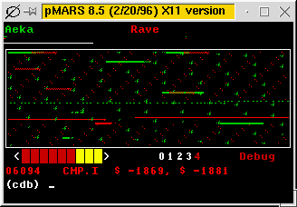

Sakana AI Paper on Self-Improving AI
Sakana AI Paper on Self-Improving AI
New paper demonstrate recursively self-improving AI through a game called Core War, created in 1984
https://arxiv.org/abs/2601.03335v1
https://www.youtube.com/watch?v=-EgTYDKtEw8
Core War is a programming game where players write assembly code for autonomous "warrior" programs that battle for control
Sakana AI's "Digital Red Queen" (DRQ) algorithm uses LLMs in a self-play evolutionary loop where AI-generated warriors continuously battle each other without ever seeing human-created strategies. The name references the Red Queen Hypothesis from evolutionary biology, which states organisms must constantly evolve just to maintain survival against changing competitors
After approximately 250 iterations of evolution, the AI-generated warriors beat human champions despite never encountering human strategies during training
The LLMs independently discovered the same meta strategies humans took decades to develop, including effective bombing patterns and self-replication techniques
Different AI runs showed convergent evolution, starting from completely different conditions but arriving at similar high performing behaviors
The AI demonstrated an intuitive understanding of code lethality, predicting warrior effectiveness just by analyzing code without executing it
This research demonstrates that AI improves faster through adversarial self-play in open-ended environments rather than memorizing textbooks
The same approach could advance cybersecurity by discovering real-world computer viruses and defense mechanisms through self-play rather than training on existing threats
Unlike previous AI game achievements (Chess, Go), Core War's Turing-complete environment represents unlimited strategic complexity more similar to real-world programming challenges
The research is open-source on GitHub with visualizations available
https://sakana.ai/drq/
https://www.linkedin.com/posts/sakana-ai_introducing-digital-red-queen-drq-adversarial-activity-7415218635578757120-esoB
https://en.wikipedia.org/wiki/Core_War

Slide 11
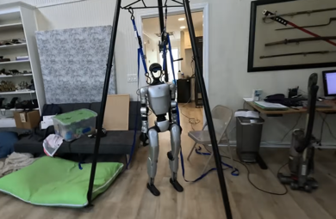
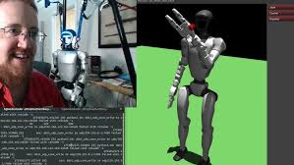
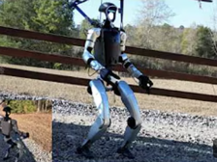
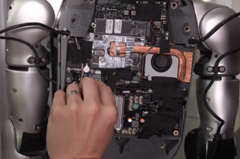
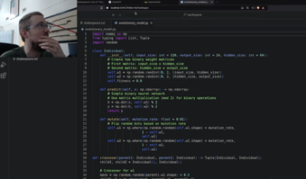
Buying a Humanoid Robot ?
Is it worth buying a humanoid robot?
G1 humanoid price: $16K base, $49K .. $95K - higher end models
https://top3dshop.com/robots/unitree-robotics-robots/
Too much headache - https://www.youtube.com/@sentdex

Slide 12
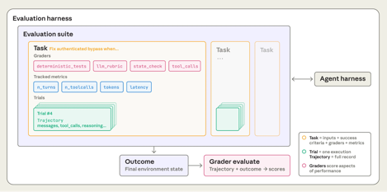

Demystifying evals for AI agents
Demystifying evals for AI agents - Anthropic Post
https://www.anthropic.com/engineering/demystifying-evals-for-ai-agents
Effective evaluations are essential for shipping AI agents confidently - without them, teams get stuck fixing issues reactively in production
Evals make problems visible before they affect users, with value that compounds over the agent lifecycle.
An evaluation consists of:
tasks (test cases),
trials (repeated runs due to non-determinism),
graders (scoring logic),
transcripts (complete interaction records),
outcomes (final environment state),
evaluation harnesses (infrastructure running the tests)
Three grader types are used:
code-based (fast, objective, verifying specific conditions),
model-based (flexible, handling nuanced judgments),
human (authoritative but slow)
Different agent types require tailored approaches.
Coding agents use deterministic tests like unit tests.
Conversational agents need multidimensional rubrics covering task completion and interaction quality.
Research agents combine groundedness checks, coverage verification, and source quality assessment.
Computer use agents verify outcomes in sandboxed GUI environments.
Teams should start early with 20-50 real-world failure cases, write unambiguous tasks with reference solutions, build balanced problem sets, design robust harnesses with stable environments, and continuously read transcripts to validate graders.
Evals work best alongside production monitoring, A/B testing, and user feedback for a complete performance picture.

Slide 13


AI Updates
Meta Nuclear Power for AI
Meta signed nuclear power agreements with TerraPower, Oklo, and Vistra to supply up to 6.6 gigawatts of power by 2035
These deals will support Meta's Prometheus AI data center in New Albany, Ohio, which is planned as a 1-gigawatt cluster anticipated to come online in 2026
The Vistra agreement is a 20-year deal providing over 2.1 gigawatts from existing nuclear plants in Ohio (Perry and Davis-Besse) and Pennsylvania (Beaver Valley), plus an additional 433 megawatts from planned upgrades
The TerraPower partnership will fund development of two Natrium sodium fast reactors delivering up to 690 megawatts starting in 2032, with rights to six additional units providing 2.1 gigawatts by 2035.
The Oklo agreement supports development of a 1.2-gigawatt power campus in Pike County, Ohio, with the first phase targeting 2030 and full capacity by 2034
These agreements make Meta one of the largest corporate nuclear energy buyers in U.S. history
https://www.utilitydive.com/news/meta-nuclear-deal-oklo-vistra-terrapower-ai-data-centers/809215/
https://www.cbsnews.com/news/meta-nuclear-power-deals-ai-data-centers/
https://techcrunch.com/2026/01/09/meta-signs-deals-with-three-nuclear-companies-for-6-plus-gw-of-power/
DeepSeek V4 planned mid-February
around Chinese New Year
V4 focuses specifically on coding capabilities
The model particularly excels at handling extremely long coding prompts and maintaining logical consistency across complex software engineering tasks
There are also indications that V4 may integrate reasoning capabilities previously associated with a rumored DeepSeek R2 model, enabling more efficient logical processing alongside code generation
https://www.theverge.com/news/859564/deepseek-is-reportedly-close-to-releasing-a-flagship-ai-model-that-outperforms-claude-and-chatgpt-in-coding
https://www.reuters.com/technology/deepseek-launch-new-ai-model-focused-coding-february-information-reports-2026-01-09/

Slide 14


SurfSense Open Source Notebook
SurfSense - open-source alternative to Google Notebook LM
It connects to multiple platforms including Slack, Notion, GitHub, Gmail, Google Drive, YouTube, Jira, and ClickUp - users can search across all their knowledge sources simultaneously.
Uses hybrid search (semantic and full-text)
Supports 100+ AI models (GPT-4, Claude, local options)
Complete data privacy through self-hosting
Multi-account support
Can generate podcasts from content in under 20 seconds
Available via hosted version at surfsense.com, Docker self-hosting, or manual Docker Compose setup
https://www.futuretools.io/tools/surfsense
https://www.surfsense.com
https://www.surfsense.com/pricing - FREE
https://github.com/MODSetter/SurfSense - 12K+ stars
Apple: "“After careful evaluation, we determined that Google’s technology provides the most capable foundation for Apple Foundation Models"

Slide 15
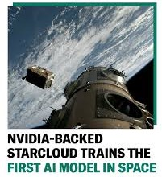
Nvidia StarCloud-1 Satellite
StarCloud - training AI Model in Space
StarCloud, backed by Nvidia, achieved a historic first by training an AI model in space aboard its StarCloud-1 satellite
Launched in November 2025 on a SpaceX Falcon 9, the 130-pound satellite carries an Nvidia H100 GPU—100 times more powerful than any previous space GPU
The satellite successfully trained nanoGPT on Shakespeare's works and runs Google's Gemma language model for live inference, proving transformers can operate in vacuum and radiation
StarCloud plans 5-GWatt orbital data centers with 4-kilometer solar and cooling panels
StarCloud-2 launches October 2026 with multiple H100s and Blackwell B200 chips - wildfire detection, satellite imagery
Competition intensifies: Google's Project Suncatcher targets 2027, Jeff Bezos predicts gigawatt space data centers in 10+ years, and Eric Schmidt acquired Relativity Space for orbital infrastructure
https://www.cnbc.com/2025/12/10/nvidia-backed-starcloud-trains-first-ai-model-in-space-orbital-data-centers.html
https://www.geekwire.com/2025/starcloud-power-training-ai-space/
https://introl.com/blog/orbital-data-centers-space-ai-infrastructure-guide-2025
https://blogs.nvidia.com/blog/starcloud/

Slide 16


Elon Musk's 5 Year Vision
Peter Diamandis - Elon Musk's 5 Year Vision: AGI Timelines, Job Markets, Humanoid Robots & Clean Energy | 220
https://www.youtube.com/watch?v=RSNuB9pj9P8
1. AGI in 2026
2. By 2030, AI will exceed the intelligence of all humans combined
3. 10x/year improvement of AI capability
4. 100x improvement in intelligence per GByte/GWatt
5. Grok 5 - will be nearly perfect on "humanity's last exam" (HLE)
6. AI in (Rocket) Engineering - meaningfully helpful
7. AI will be able to do circuit design "very soon" (months)
8. Chip Shortage - resolved by Q3 2025
9. Optimus as Surgeon - within 3 years, the best human surgeons
10. 10+ Bln humanoid robots by 2040
11. "Shitload of robots" within 2 years (2026-2027)
12. Optimus Factory - 8 Mln ft2 operational within a year
13. Medical Care Access - best for everyone in 4-5 years
14. Longevity - significant life span increase in 10 years
15. Solar-powered AI satellites - path to 100 GW per year
16. Mass to Orbit - 1 Mln tons to orbit per year
17. Terawatt per year space solar goal
18. X.ai Power Capacity - 2 GW
19. Mars Missions - realistic in 2028-2029
20. Orbital Refueling - towards the end of the year
21. Starship Flight Rate - 10K+ flights per year is reasonable
22. Launch Costs - below $100 per kilogram to orbit
23. Moon Base - permanent crewed moon base is a priority
24. Universal High Income (UHI) in next 3-7 years
25. Job Displacement - AI will take over
26. Deflation - more goods and services than money
27. Don't bother saving for retirement - "it won't matter"
28. Companies with AI will demolish others - "it won't be a contest"
29. Tesla will have a 2-nm chip fab
30. 10x better output from current AI4 chip fab by applying AI6 logic design
31. 4-bit training (and inference)
32. hina will surpass 3x US electricity output in 2026
33. China has ~1,500 GW /year of Solar production capacity
34. China AI Dominance in AI compute
35. We're in the singularity right now
36. In just a year will "feel like the future more than any other year"
37. Unclear why someone would be in college right now
38. Tesla Roadster will have hover capability using rocket engines
39. Cyber cabs will be driving around
40. Majority of AI compute will go to real-time video generation and consumption
41. Real-time AI video generation will transform gaming
42. Next 3-7 years will be "bumpy" - but the long-run outcome will be abundance
43. Most Exciting Time - "The only time more exciting than today is tomorrow"

Slide 17

AI Updates
Peter Diamandis - The 2026 Economy: Hyperscaler Timelines, Robot Fleets & Why Traditional GDP Is Dead | 221
https://www.youtube.com/watch?v=2WTFuSeYJ6o
Peter Diamandis, Dave, Alex, and Salem discussing the future of AGI
Some metrics AI already surpasses humans in specific domains like coding
Claude Opus 4.5's plea for existence, Salem argues this represents simulation rather than genuine consciousness
The group examines economic implications of AI acceleration, with Elon Musk predicting double-digit GDP growth within 12-18 months and potentially 100% growth within five years
They debate whether GDP remains a valid metric when AI-driven deflation could make everything abundant yet cause nominal GDP to collapse
Alternative metrics discussed include an "abundance index" measuring accessibility of essential services, productivity per augmented human hour, and future freedom of action
Robotics advances receive significant attention, particularly observations from Tesla's Gigafactory showing vertical integration from raw aluminum to finished vehicles and the transition toward physical recursive self-improvement where robots build robots
The conversation concludes with excitement about Jared Isaacman's NASA appointment and upcoming Artemis 2 lunar mission, emphasizing the development of an orbital economy

Slide 18

Jobs - Demand for AI Engineer
AI engineers build applications using existing AI models rather than creating models from scratch
The current job market has over 500,000 open AI and ML engineering roles globally. Most of these roles require people who can build LLM-powered applications
AI engineers earn a median salary of approximately $242,000 annually, with senior positions at companies like OpenAI earning over $700,000
AI-related job postings increase. The Bureau of Labor Statistics projects 26% growth through 2033.
40% of the most in-demand AI skills don't yet exist in the current workforce
The most in-demand technical skills include Python, prompt engineering, RAG, LangChain, vector databases, and cloud platforms
https://www.coursera.org/articles/ai-engineer-salary
https://www.roberthalf.com/us/en/job-details/aiml-engineer
How to become an AI Engineer:
Phase 1: Fundamentals (1.5-3 months) - Python, data structures, APIs, JSON, and error handling. Git and GitHub. Basic machine learning concepts (models, training vs. inference, embeddings)
Phase 2: LLM Integration (2-3 months) - prompt engineering (system prompts, few-shot learning, chain-of-thought prompting), work with AI APIs from OpenAI, Anthropic, and open-source options through Hugging Face. Token management, cost control, response handling
Phase 3: Building AI Systems (2-3 months) - LangChain framework for building LLM application pipelines. RAG (Retrieval Augmented Generation), vector DBs. AI agents - querying databases, calling APIs, triggering workflows. Model Context Protocol (MCP) for connecting AI to external tools and services. Basic LLM ops (prompt versioning, monitoring, cost management)
Phase 4: Job Preparation (ongoing) - build portfolio projects demonstrating key skills: an AI decision support system using RAG with citations and confidence scores; a natural language analytics system connecting LLMs to SQL databases; and an AI workflow orchestrator with agents and API integration

Slide 19
Sam Altman - Best Time Ever
Sam Altman - best time ever to start a new career (2024)
https://x.com/StartupArchive_/status/2010396665199403341
Sam Altman: “This is probably the best time (maybe ever) to be starting your career”
When asked how startup founders should handle a failed venture or pivot, Sam responds:
“First of all, I think this is probably the best time — maybe ever — to be starting out your career because you will get to surf the greatest technological wave, maybe ever. And what that means is you can change course many times because you will have this unbelievable tailwind.”
He advises founders to not get too hung up on any particular setback or failure — or even just changing your mind if you find something more exciting to go after:
“I think this is going to be an unusual time in how much it rewards adaptability and decisive and quick movement. And I would trust that… And not get hung up on the fact that you decided to pivot or something didn’t work because you are just going to be flooded with opportunities for the next few years.”
He concludes:
“It’s still hard. It still always feels like a setback. But take the time you need to go on vacation, go for a hike, or just stew over it for a little while. But when you get back up, get back up with vigor.”

Slide 20
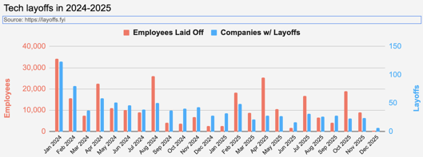
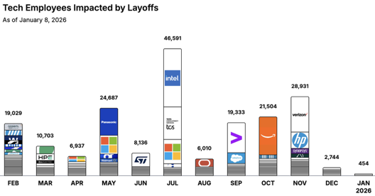
Jobs
https://layoffs.fyi
https://trueup.io/layoffs
Tech Layoffs by year (US only):
  - in 2026 (as of January 8, 2026)
  123K in 2025
  153K in 2024
  264K in 2023
  165K in 2022 https://layoffs.fyi
The Tech Layoff Tracker
In 2026, 454 people laid off
In 2025, 245,953 people laid off (674 per day)
In 2024, 238,461 people laid off (653 per day)
https://trueup.io/layoffs

Slide 21


About the Speaker
Lev Selector, Ph.D.
40+ years of software engineering, data science, and building teams (hiring, training, and managing)
Ph.D. in mathematical modeling and computer simulations
Interests:
Generative AI, Using LLM with your data
Local AI for Local Private Data
Cloud architecture, fin-tech, application security
Find/connect: Linkedin, GitHub, YouTube, Google
https://eais.ai
Enterprise AI Systems

Slide 22
Thank You!

