Slide 1
AI Updates - Dec 19, 2025
"Life rewards action, not intelligence"
- James Clear
"Do one thing and another and another"
- George Leonard
Crowd-sourced "LM Arena" Leaderboard
Gemini 3 Flash
Nvidia Nemotron 3
Abacus AI vs Manus AI
Google Gemma 4
OpenAI GPT Image 1.5 model in ChatGPT
Gemini Super Gems - Free workflow tool
Claude Chrome browser extension
Practical Claude Code Hints
AI advantage is compounding
Prompting Claude Code / Claude Opus 4.5
Claude Code's new plugins update
Anthropic’s Claude Code background sub-agents
Julia McCoy - "How I Clone Myself ..."
Amazon’s Graviton 5
Apple CLaRa Framework
Moonshots
ChatGPT 5.2 vs Claude Opus 4.5 vs Gemini 3
Nvidia can export H200 AI chips to China
Scaling Laws For Multi-agent Systems
NotebooksLM-Ultra
Continue Dev “Mission Control” dashboard
Nous Research Nomos-1 math open-source
Get AI compliance ready for 2026
Web Research Multi-Agent Architectures
Demis Hassabis about AI in 2026
Get Rich with AI in 2026
Integral AI = True AGI ?
Misc. AI Updates
Jobs, Layoffs, demand for AI Engineers

Slide 2
Crowd-sourced "LM Arena" Leaderboard
Data for December 16
Starting Elo rating = 1000
https://en.wikipedia.org/wiki/Elo_rating_system
English - https://lmarena.ai/leaderboard/text
Coding - https://lmarena.ai/leaderboard/text/coding
Model | Score
gemini-3-pro | 1491
grok-4.1-thinking | 1477
gemini-3-flash | 1477
claude-opus-4-5-20251101-thinking-32k | 1468
claude-opus-4-5-20251101 | 1465
grok-4.1 | 1464
gemini-3-flash (thinking-minimal) | 1461
gpt-5.1-high | 1458
gemini-2.5-pro | 1450
claude-sonnet-4-5-20250929-thinking-32k | 1449
claude-opus-4-1-20250805-thinking-16k | 1447
claude-sonnet-4-5-20250929 | 1446
gpt-4.5-preview-2025-02-27 | 1443
claude-opus-4-1-20250805 | 1441
gpt-5.2-high | 1440
chatgpt-4o-latest-20250326 | 1439
gpt-5.2 | 1439
gpt-5.1 | 1437
gpt-5-high | 1436
o3-2025-04-16 | 1433
qwen3-max-preview | 1433
grok-4-1-fast-reasoning | 1433
ernie-5.0-preview-1103 | 1431
kimi-k2-thinking-turbo | 1426
Model | Score
claude-opus-4-5-20251101-thinking-32k | 1541
claude-sonnet-4-5-20250929-thinking-32k | 1526
gemini-3-pro | 1521
claude-opus-4-5-20251101 | 1515
claude-opus-4-1-20250805-thinking-16k | 1514
grok-4.1-thinking | 1508
claude-sonnet-4-5-20250929 | 1506
gemini-3-flash | 1501
claude-opus-4-1-20250805 | 1500
gemini-3-flash (thinking-minimal) | 1496
claude-opus-4-20250514-thinking-16k | 1495
gpt-5.2-high | 1495
grok-4.1 | 1493
gpt-5.1-high | 1489
qwen3-max-preview | 1481
kimi-k2-thinking-turbo | 1479
gpt-5.1 | 1477
gpt-5.2 | 1477
claude-haiku-4-5-20251001 | 1476
qwen3-max-2025-09-23 | 1475
longcat-flash-chat | 1474
mistral-large-3 | 1474
deepseek-v3.2-exp-thinking | 1471
qwen3-235b-a22b-instruct-2507 | 1470
Google Gemini
x.ai
Claude
OpenAI
Open Source
x.ai
x.ai
https://lmarena.ai/leaderboard/text
Design Arena -
https://www.designarena.ai
https://openlm.ai/chatbot-arena/
https://beta.lmarena.ai
Web Leaderboard - 1T params
https://web.lmarena.ai/leaderboard
LLM Leaderboard - by @LlmStats -
https://llmworld.net/llm_leaderboards/
LLM Leaderboard - by StackAI -
https://www.stack-ai.com/llm-leaderboard
LLM Leaderboard - by Artificial Analysis -
https://artificialanalysis.ai/leaderboards/models
Open LLM Leaderboard - by Hugging Face -
https://huggingface.co/open-llm-leaderboard
LLM Leaderboard - by Vellum -
https://www.vellum.ai/llm-leaderboard
AI Benchmarking Hub -
https://epoch.ai/data/ai-benchmarking-dashboard
Grok 4 Benchmarks -
https://artificialanalysis.ai/models/grok-4
x.ai
China
China
China
China
China
x.ai
Mistral
China
China
China
China

Slide 3

AI Updates
Gemini 3 Flash
Performance, speed, and cost efficiency
It beats Gemini 3 Pro at coding !
Price: 1/4 of Gemini3 Pro, 1/3 of GPT 5.2, 1/6 of Claude Sonnet 4.5
(0.5 $ per Mln)
Very good on benchmarks
Gemini 3 Flash generates code faster using fewer tokens, producing results in 15-24 seccompared to Pro's 28-67 sec while using significantly less tokens
Google is deploying this model as the default across their product suite including Google Search AI mode and the Gemini app, making it freely available to all users globally
The model is multimodal, understanding video, images, audio, and text
Its combination of frontier-level intelligence, exceptional speed, token efficiency, and aggressive pricing positions Google competitively in the AI race, especially for agentic coding applications and everyday tasks

Slide 4



AI Updates
Nvidia Nemotron 3 Nano released Dec 15
Super and Ultra are planned for the first half of 2026
Nvidia Nemotron-3 is a family of open-weight LLMs aimed at efficient agentic AI
Three sizes: Nano (30B), Super (100B), and Ultra (500B)
High throughput and strong reasoning/conversation performance
Using a hybrid Mamba-Transformer Sparse MoE design
~1M-token context (Nano)
Summarization, retrieval, and assistant workflows
Super & Ultra adding techniques like LatentMoE, multi-token prediction, and NVFP4 training for efficiency on NVIDIA hardware
Manus released version 1.6 featuring Manus Max
Improved task completion rates and 19.2% higher user satisfaction
Can handle complex workflows with minimal supervision
New capabilities include mobile app development and Design View offering interactive visual editing with point-and-click adjustments
https://www.youtube.com/watch?v=vXMrezKs8Hw
Abacus AI vs Manus AI Review: Viral Hype vs Reality (2025)
Abacus AI’s DeepAgent is a practical, good-value automation- coding agent today, while Manus AI is largely viral hype with major reliability, access, and pricing frustrations
The video contrasts Abacus’s low-cost “all-in-one” model access with Manus’s invite/beta constraints and frequent failures
Abacus DeepAgent offers access to many major models and is positioned as a straightforward subscription that became “unlimited” at a low monthly price, with users reportedly building real apps/sites quickly
Manus is described as highly hyped - but then disappointing in day-to-day use (crashes, frozen tasks, empty downloadable outputs, and strict session limits
https://www.youtube.com/watch?v=DiWX8Pagq1k

Slide 5



AI Updates
Google Gemma 4
Run model on-device (phone/laptop) for near-instant responses, stronger privacy because data stays local, and predictable costs because you deploy once instead of paying usage-based inference
Smaller Gemma variants can be compact (hundreds of MB at full precision, smaller when quantized), making them easier to ship inside apps and use offline
The presenter describes a workflow where you can fine-tune a Gemma model, convert/quantize it (e.g., to low-bit formats), and then deploy it in lightweight experiences like a simple browser-based HTML UI, positioning this as a path to build “local copilots” for writing/coding or small business tools
https://www.youtube.com/watch?v=k9KLsVL4RUo
OpenAI GPT Image 1.5
https://www.youtube.com/watch?v=U8T-Zf-xYmw
Higher-quality, more reliable images and edits
Better prompt instructions following
Faster (up to 4x) and more cost-efficient, with reduced API costs for image generation and editing
A dedicated “Images” tab in ChatGPT, offering preset filters and prompt suggestions
Nano Banana Pro (Gemini Pro Image) is ahead of GPT Image 1.5 on Image Arena. It is available through Google AI Pro ($20/mo), Vertex AI, Google Workspace, and Gemini Enterprise

Slide 6
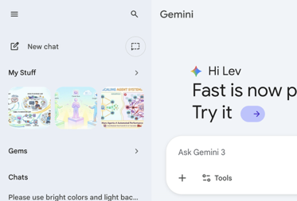
AI Updates
Gemini Super Gems - Free workflow tool
https://www.youtube.com/watch?v=1choivCbZDg
Create automated workflows and mini apps
Integrating Opal workflow builder directly into the Gemini web app
The visual editor converts prompts into editable step-by-step workflows. Advanced users can access the full Opal Builder for granular control
All existing Opal apps are being migrated to "My Gems from Labs" within the Gemini Gems Manager, where users can create, edit, and share custom AI assistants
The feature seamlessly integrates with Google Workspace
It also supports multimodal AI capabilities (images, audio, video)
This feature competes with platforms like N8N
Claude Chrome browser extension
Claude AI appears as a side panel - for Max subscribers
Powered by Claude Sonnet 4.5 and can read webpage content, click buttons, fill forms, type text, and navigate websites using natural language commands
When you give Claude instructions, it can observe your screen and interact with pages through Chrome's automation APIs, simulating mouse clicks and keystrokes
An orange hue appears in tab borders when Claude is actively working
Claude can manage multiple browser tabs simultaneously
Schedule tasks to run daily, weekly, monthly, or annual schedules
Shortcuts for frequently used prompts and /slash commands
Claude can handle complex multi-step tasks and continues working even when you switch tabs, with notifications when it needs permission or finishes
Built-in knowledge of popular platforms like Slack, Google Calendar, Gmail, Google Docs, and GitHub
You can choose between two permission modes: "Ask before acting" (Claude requests approval for each action) or "Act without asking" (autonomous operation)
You can also set permissions for specific websites and change settings anytime
The extension implements multiple protective measures including site-level permissions, action confirmations, and high-risk website blocking, which reduced attack success rates from 23.6% to 11.2% in testing. However, prompt injection risks and occasional errors mean you should carefully choose use cases and monitor Claude's actions - https://www.claude.com/blog/claude-for-chrome

Slide 7
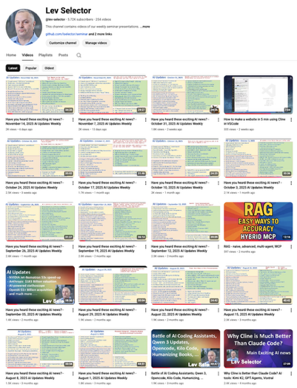
We do these weekly videos every Friday
Stats: 5.84K subscribers, 257 videos
Subscribe to this channel
https://www.youtube.com/@lev-selector
Download slides from GitHub using links under the videos
Please pause the video - and answer the pinned question in comments under the video

Slide 8
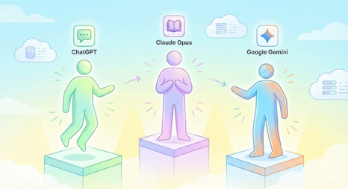

AI Updates
ChatGPT 5.2 vs Claude Opus 4.5 vs Google Gemini 3
https://www.youtube.com/watch?v=tJQeHOALOJg
Use GPT‑5.2:
Complex reasoning-heavy work (multi-step decisions, tricky tradeoffs, “think this through” business logic) where correctness matters more than style.​
Structured outputs and spec-following (strict formatting, checklists, SOP-style responses) where you want fewer deviations.​
General “knowledge-work” tasks that blend analysis + writing (e.g., planning, evaluation, drafting that must stay aligned to constraints).​
Use Gemini 3 when the task is multimodal/creative (assets, image/video understanding, marketing content workflows)
Use Claude Opus 4.5 when the task is developer-centric (coding, debugging, longer agentic execution)
Nvidia can export H200 AI chips to China
Trump announced that the U.S. will allow Nvidia to export H200 AI chips to China under conditions.
Shipments would still require U.S. approval/licensing and would be limited to vetted end users. Also US will receive a 25% revenue cut

Slide 9
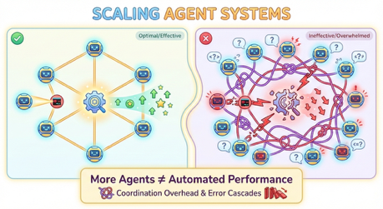
Scaling Laws For Multi-agent Systems
Scaling laws for multi-agent LLM systems
https://www.youtube.com/watch?v=IvJgrwp1VUk
The video explains new scaling laws for multi-agent LLM systems from a Google Research, Google DeepMind, and MIT paper, “Towards a Science of Scaling Agent Systems.”
The key claim is that “more agents” does not automatically yield better performance
Performance depends on task structure, tool density, and coordination topology
The authors benchmark five architectures (single, independent, centralized, decentralized, hybrid) across three model families (GPT‑5 variants, Gemini 2.x, Claude Sonnet 3.7–4.5) on four tasks: finance (parallelizable), web browsing, Minecraft-like planning, and a tool-heavy workbench.arxiv+1​
Findings: multi-agent systems can give up to ~80% gains on highly parallel finance-style tasks, modest gains on web navigation with decentralized debate, but cause 39–70% degradation on sequential planning tasks compared to a single agent.
Tool-dense environments suffer from a “tool–coordination trade-off”: coordination chatter competes with tool specs and reasoning in the context window, increasing hallucinated tool use
Independent voting ensembles amplify errors by 17.2×, centralized orchestration by 4.4×, with decentralized debate in between.arxiv+1​
The paper introduces a mixed-effects scaling equation showing that base model capability and task decomposability matter far more than agent count
Above roughly a mid-range single-agent baseline, extra agents often hurt due to coordination overhead and error cascades, especially with many tools or strongly sequential dependencies
The video’s practical advice: prefer a strong single agent for complex or tool-heavy sequential workflows, use centralized or decentralized multi-agent setups only when tasks decompose cleanly in parallel, and treat topology and context design as primary optimization levers, not agent count
https://arxiv.org/abs/2512.08296

Slide 10
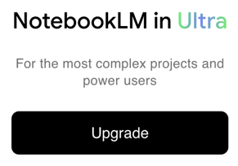
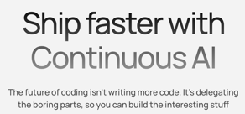
NotebooksLM-Ultra
Google’s NotebookLM new Ultra Tier with higher limits
https://www.youtube.com/watch?v=HceiOIeT4Fo
Per-notebook source limit increased to 600
Watermark removal on generated slide decks and infographics
"Long" slide-deck option for more detailed presentations
Ultra is the best for power users (researchers, content creators, analysts, students) who want faster, higher-volume generation across formats like audio/video overviews, decks, and visuals, rather than casual note-takers
Practical advice - load more relevant sources for better cross-source synthesis, customize overview prompts (angle/tone), and combine features (deck + video overview + infographic + deep research) to build an end-to-end content workflow
Continue Dev “Mission Control” dashboard
Open-source platform managing diffs, PRs, tests, and docs
connect GitHub repo/PR, launch a task-like agent (e.g., explain the codebase, update agent docs, draft changelogs, refactor components, improve tests)
Sentry-driven loop where new alerts appear in an inbox-style queue and an agent investigates the error with full code context, proposes a fix, and opens a draft pull request for review
Can run continuous, background AI coding workflows that turn dev-tool signals into concrete engineering work
Workflows can be event-triggered (webhooks like Sentry/GitHub) or scheduled
https://github.com/continuedev/continue
https://www.continue.dev

Slide 11
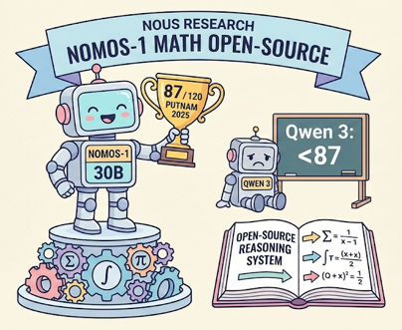
AI Updates
Nous Research Nomos-1 math open-source
Nous Research just open-sourced Nomos 1, a new 30B parameter reasoning system that scored 87 out of 120 on the 2025 Putnam Contest — crushing rivals like Qwen 3 on one of the most prestigious collegiate math competitions.
https://x.com/NousResearch/status/1998536543565127968
The system uses a two-phase approach: AI ‘workers’ solve and self-critique responses, with a tournament-style bracket then selecting the best submission.
Nomos’ score would have placed second among nearly 4,000 human competitors last year, with the model earning eight perfect problem scores.
Nous also released and open-sourced a reasoning harness — orchestration code that manages how the model solves problems.
Running Qwen3 through the same harness and setup scored just 24/120, with the result showing gains coming from model training rather than the harness.

Slide 12
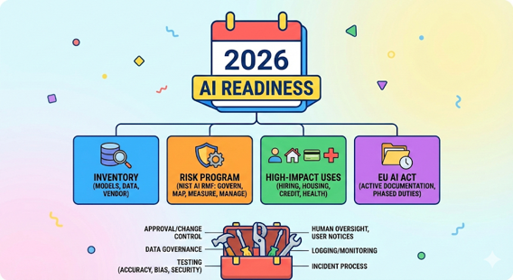
Get AI compliance ready for 2026
For 2026 AI compliance readiness:
Create an AI system inventory (models/tools, purpose, data, vendor, jurisdictions) and run a risk program aligned to the NIST AI RMF lifecycle (govern/map/measure/manage)
Prioritize high-impact uses (hiring, housing, credit, health) because US state rules like Colorado’s 2026 AI Act focus there, even as federal policy may move toward more unified oversight
If you operate in the EU, plan for phased EU AI Act duties and keep documentation active, not just drafted.
Implement: approval/change control, data governance, testing (accuracy/bias/security), human oversight, user notices, logging/monitoring, and an incident/complaints process
Start a 90-day sprint: inventory + classify, stand up governance + baseline evals, then productionize controls and do a mock audit
https://www.nist.gov/itl/ai-risk-management-framework
https://www.whitehouse.gov/presidential-actions/2025/12/eliminating-state-law-obstruction-of-national-artificial-intelligence-policy/

Slide 13
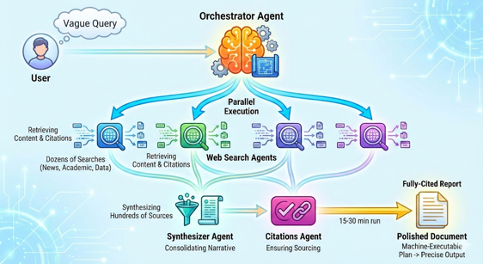
Web Research Multi-Agent Architectures
Modern LLM platforms like ChatGPT, Gemini, and Claude use multi-agent architectures for deep research.
An orchestrator agent receives the user query, creates a research plan, and delegates tasks to specialized sub-agents that run in parallel.
Web search agents explore different aspects of the topic, retrieving content and citations.
Once sub-agents return findings, a synthesizer agent consolidates the information into a coherent narrative, while a citations agent ensures each claim is properly sourced.
OpenAI uses reinforcement learning-trained reasoning models with interactive clarification.
Gemini leverages its multimodal capabilities and proposes research plans for user approval.
Claude employs clearly defined multi-agent orchestration with parallel sub-agents.
Perplexity uses iterative retrieval loops with hybrid model selection.
Grok processes content in segments with credibility assessment.
These systems typically run fifteen to thirty minutes, performing dozens of searches and synthesizing hundreds of sources before delivering fully-cited reports.
The architecture transforms vague queries into precise, machine-executable plans through planning, parallel execution with tool use, information retrieval with contextual awareness, and final synthesis into polished documents.

Slide 14

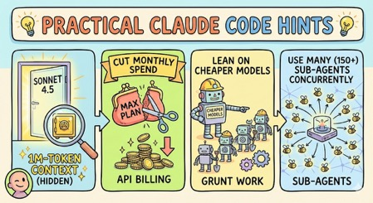
AI Updates
Demis Hassabis about AI in 2026
"full" multimodal AI systems where text, images, video, audio, 3D, and robotics converge into a single integrated stack
Gemini Robotics 1.5 - plan multi-step tasks, adapt mid-task, and work across different robot forms without per-robot fine-tuning
Gemini Live - a practical, real-time assistant (example: guiding a car oil change) - lower latency and stronger reasoning will make such help far more powerful in 2026
World models such as Genie 3 - interactive, coherent, explorable generated environments with memory
Growing suite of agentic systems (co-scientist, security/code agents, data science agents, “Alpha Evolve”)
https://www.youtube.com/watch?v=FTjTcrX-aGw
Practical Claude Code Hints
https://www.youtube.com/watch?v=Kxnlh2rVYVE
Use a hidden 1M-token context option for Sonnet 4.5
Cut monthly spend by switching to API billing (not Max plan)
Leaning on cheaper models for grunt work
Use many (150+) sub-agents concurrently in a single orchestrating thread - for example for porting large code base
Chrome DevTools MCP is more reliable than Playwright MCP in Claude Code (fewer “stuck” runs) and can surface useful performance/SEO data like Core Web Vitals, with the idea of embedding these checks into their own product workflow

Slide 15
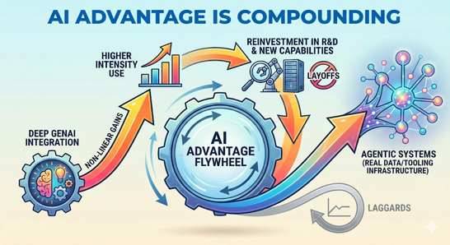
AI advantage is compounding
Organizations that deeply integrate GenAI are pulling away from laggards
Higher-intensity use of AI creates non-linear gains that get reinvested into even more capability
https://www.youtube.com/watch?v=QONt74CTUyE
Recent enterprise research (OpenAI, Menlo, an AI ROI benchmarking survey, and a new EY AI Pulse Survey) showing that AI benefits are now broadly visible, but unevenly captured
A key driver is a widening “usage gap”: OpenAI’s “frontier” workers (95th percentile) use AI far more than median employees, especially on complex tasks like analysis and coding, and leading organizations shift work into reusable custom GPTs/projects that store context
More breadth and depth of use correlates with higher ROI: time savings are a common entry point, but the biggest ROI comes from moving up the value chain into better decisions, new capabilities, and revenue impact
Finally, winners reinvest: big AI spenders report larger productivity gains and then plow benefits back into expanding and building new AI capabilities and R&D, rather than layoffs, accelerating a flywheel toward agentic systems that require real data/tooling infrastructure

Slide 16
AI Updates
Prompting Claude Code / Claude Opus 4.5
https://www.youtube.com/watch?v=Xob-2a1OnvA
10 rules drawn from Anthropic guidance, replacing vague asks with structured briefs that produce consistently better work
Adopt a collaborative tone, being explicit about the task (strong action verbs, desired quantity, and target audience)
Set firm constraints (length, style, “do/don’t” rules) to reduce generic output
Use workflow of draft/plan/act
Have Claude outline first, refine the outline, and only then generate the final deliverable
A major theme is forcing structure - request tables, schemas, checklists, or specific formats - so results are easier to verify and reuse
Explain the “why” behind the request, and control verbosity by telling Claude which role to adopt (expert, brief, simplifier) and how detailed to be
Finally, provide scaffolds/templates, use “power phrases” and personas to raise output quality, and break complex work into smaller subtasks (“divide and conquer”)
Prompting
Claude Code

Slide 17
AI Updates
Claude Code's new plugins update
https://www.youtube.com/watch?v=1uWJC2r6Sss
Agent SDK plugin that dramatically simplifies building AI-integrated applications
Example project: 3 min using the slash plugin command and Agent SDK dev plugin instead of 5-10 hours. The development speed is unprecedented
The plugin system options like Figma integration, code review tools, browser testing with Playwright, and MCP servers that install instantly
Users can add plugin marketplaces and browse available plugins using slash commands, with plugins adding custom capabilities like slash commands, agents, and MCP servers
This could enable quick monetization strategies through ads or user-provided API keys
https://claude.com/blog/claude-code-plugins
Claude Code
Plugins
Claude Code
Sub-Agents
Anthropic’s Claude Code background sub-agents
Multitasking. Automation of complex workflows, better context handling, and more efficient task delegation
https://www.youtube.com/watch?v=jd9nP7FXQcs

Slide 18

AI Updates
Julia McCoy - "How I Clone Myself With HeyGen & ElevenLabs: Complete Tutorial (Best AI Avatar 2025)"
https://youtu.be/Zc2PwPuKK5c?si=BDY0z2S_hVstyHGW
https://www.heygen.com - HeyGen AI Video Generator
https://elevenlabs.io - Audio
HeyGen is the most realistic avatar software the author has tested, outperforming competitors in photorealism, natural movement, and viewer engagement.
She recommends the HeyGen Team plan
The video walks through preparing and uploading the necessary photos and voice recordings, adjusting settings for appearance and lip-sync, and troubleshooting common issues to make the clone more realistic
This AI clone can be used to produce videos without needing to film yourself each time, effectively “multiplying” yourself
The tutorial covers practical tips on achieving natural results and integrating the avatar into workflows so it can speak scripts in the cloned voice
Overall, it demonstrates how to set up and use these AI technologies to automate and scale personal video content using a digital version of yourself
Use high-quality training data, since poor inputs lead to unnatural avatars
Record five video clips for avatar training, each 3–5 minutes long
Film in at least 1080p resolution; 4K is preferable if available
Use consistent lighting and audio equipment across all training clips
Wear a different outfit in each training clip to avoid visual repetition
Keep hand movements minimal and below chest level in training videos
Speak naturally and look directly into the camera, as if talking to a friend
Film when you are energized & positive
Use a quiet recording environment with no echo or background noise
Provide 1–1.5 hours of clean audio for ElevenLabs voice training
Use the same microphone for all voice recordings
Verify identity and consent during both voice and avatar creation steps
Format scripts for AI voices by writing out numbers and removing filler
Break scripts into short paragraphs to create natural pauses
Avoid emojis, jargon, and special characters in AI-read scripts
Use ChatGPT to rewrite scripts for AI voice clarity and pacing
Render videos at 30 FPS and 1080p for optimal output
Do not publish raw avatar footage; enhance videos with B-roll, music, text, and transitions
Consider hiring a video editor to elevate AI footage into premium YouTube content
Provide editors with timestamps, B-roll notes, and music preferences to speed delivery.

Slide 19
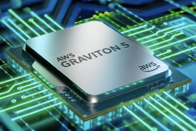
Amazon’s Graviton 5
Amazon’s Graviton 5
a 192-core, single-socket Arm server chip
https://www.youtube.com/watch?v=AH0FD__0ctQ
Big core counts, much larger cache, faster I/O, and tighter AWS platform integration
25% performance improvement vs Graviton 4
a large performance-per-watt advantage vs top Intel Xeons (roughly 40–45%), and a big cache jump (five times more L3, 192 MB shared)
PCIe 6.0, improved memory subsystem, and direct integration with Nitro 6 for 100 Gbps networking plus stronger isolation
Graviton currently runs over half of new AWS CPU capacity; 98% of top EC2 customers using Graviton
AWS also uses Trainium systems
Microsoft (Cobalt 200) and Google (Axion)

Slide 20
Apple CLaRa Framework
Apple’s CLaRa AI framework
CLaRa = "Continuous Latent Reasoning"
https://www.youtube.com/watch?v=-obd_O-NCOI
Goal to improve RAG. CLaRa compresses documents into dense latent memory tokens and operates retrieval and generation in a "shared continuous space", allowing the model to reason over compressed representations rather than raw text
This unified approach solves the "broken gradient" problem in classic RAG by letting the generator effectively teach the retriever what information matters, improving overall relevance and performance while reducing context costs and latency
The instruction-tuned "CLaRa-7B-Instruct" model supports question-answering directly from compressed representations, offering strong performance with significant compression factors
Because it combines retrieval and generation in one 7-billion-parameter model, it can run on smaller hardware and handle larger document sets more efficiently
CLaRa architecture could shift how RAG models are built and used, especially where combining memory, retrieval accuracy, and cost matters
Apple CLaRa
"Continuous Latent Reasoning"

Slide 21


Moonshots
Moonshots with Peter Diamandis:
https://www.youtube.com/watch?v=z6U-jqHzBqY
Knowledge-work automation is already economically compelling (faster and dramatically cheaper), but many companies are stuck due to legacy stacks, security/tooling bottlenecks, and organizational paralysis
AI Agents Make $1M By 2027, The Fake AGI Race, & Building Safe Superintelligence | Mustafa Suleyman
https://www.youtube.com/watch?v=XWGnWcmns_M
Agentic systems could reshape work, science, and governance, while emphasizing practical safety constraints and careful language about runaway scenarios
A single AI agent should be able to generate $1M in revenue/profit with minimal human supervision by around 2027
Mustafa Suleyman describes AI as moving from chat and knowledge (IQ/EQ) toward “actions” (agents that can execute tasks across software and, eventually, parts of the physical world), which shifts both opportunity and risk
On safety, he argues the biggest danger is ignoring dark possibilities (“pessimism aversion”), and highlights autonomy and recursive self-improvement as key thresholds to manage deliberately
He downplays the idea of an imminent, spontaneous “intelligence explosion,” suggesting rapid self-replication would require explicit engineering choices and should be designed out via safety-by-design

Slide 22
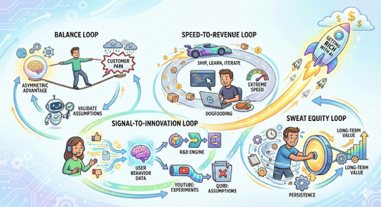
Get Rich with AI in 2026
Use AI to get rich in 2026
https://www.youtube.com/watch?v=Nqx0QjHQ9ww
Getting rich with AI isn’t about linear plans or being a top coder; it’s about building fast feedback loops that compound learning and execution
The video frames a coming economic shift toward exponential growth and self-improving systems, citing how quickly AI products and AI startups can scale
It then teaches four loops:
(1) The “balance loop”: stay on a tightrope between your asymmetric advantage (unique experience, domain knowledge, network, etc.) and a customer’s acute, frequent pain; constantly surface assumptions and validate them quickly with AI
(2) The “speed-to-revenue loop”: ship, learn, and iterate daily; Cursor is used as an example of extreme shipping speed and “dogfooding” (using its own product to build itself)
(3) The “signal-to-innovation loop”: treat user behavior data as the core R&D engine; YouTube’s continual experiments are contrasted with Quibi’s rigid, assumption-driven approach
(4) The “sweat equity loop”: early-stage founders must stay deeply involved, sweating details as the product and market keep moving, turning persistence into long-term value

Slide 23

AI Updates
Integral AI = True AGI ?
https://www.youtube.com/watch?v=RVqNUUYd9UA
The video covers ex-Google researcher Jad Tafari and his startup Integral AI, which claim to have built the “world’s first AGI-capable model.” Integral defines AGI with three criteria: autonomous skill learning in novel domains without human-provided datasets, safe and reliable mastery without catastrophic failures, and human-comparable energy efficiency for learning new skills. Their criticism of current LLMs is that they are black-box predictors reliant on brute-force optimization, lacking explicit world models and interpretable abstractions.[1]
Integral proposes “universal simulators” that build hierarchical, multimodal world models and grow via lifelong learning without catastrophic forgetting. Demo clips show an embodied agent exploring 3D rooms to answer questions, a vision system that selectively reveals image patches like eye saccades, and a puzzle-solving “Shooan” experiment where the agent plans by estimating remaining steps to a goal. The creator notes that DeepMind published somewhat analogous imagination-augmented agents work in 2017 with peer-reviewed methods and open code, while Integral has released no benchmarks, code, or independent evaluations. He concludes the architecture ideas sound plausible, but the AGI-capable claim is unsubstantiated until rigorous external validation appears.[1]
Tokyo-based Integral AI
Founded by ex-Google engineer Jad Tarifi
Claim - first true AGI system embodied in physical robots
Their system allegedly learns new tasks autonomously without curated datasets or human labeling, using an architecture inspired by the human neocortex, and has already demonstrated successful robotic trials
https://www.youtube.com/watch?v=zrr3KQrQ-WA

Slide 24
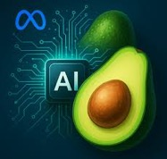

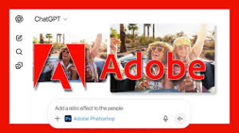


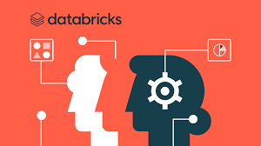
AI Updates
Adobe integrated Photoshop Express and Acrobat into ChatGPT
Meta reportedly pivots from open-source toward a closed commercial AI model code named Avocado, expected in Spring 2026
Time Magazine named AI architects as 2025 Person of the Year, featuring Zuckerberg, Jensen Huang, Sam Altman, and others
DeepSeek allegedly smuggled banned Nvidia Blackwell chips into China by purchasing them through data centers in permitted countries, then disassembling and importing equipment in pieces for reassembly
Runway released Gen-4.5, competing with Sora in text-to-video generation
Databricks hits $134B valuation

Slide 25

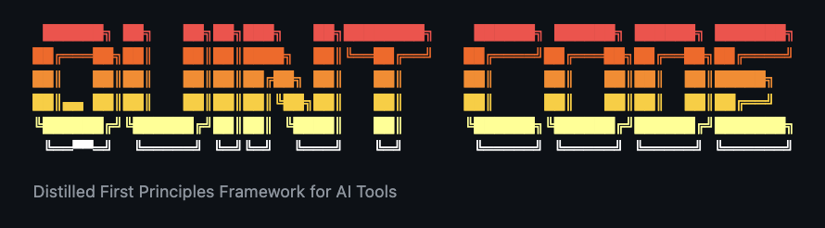
AI Updates
Google DeepMind Interactions API (/interactions).
While OpenAI began this shift back in March 2025 with its Responses API, Google’s entry signals its own efforts to advance the state-of-the-art. The Interactions API is not just a state management tool; it is a unified interface designed to treat LLMs less like text generators and more like remote operating systems.
https://venturebeat.com/infrastructure/why-googles-new-interactions-api-is-such-a-big-deal-for-ai-developers
Lovable raises $330M at $6.6B valuation
ChatGPT x Replit Launch
https://www.youtube.com/watch?v=Szmlj6_gbt8
Quint Code
https://github.com/m0n0x41d/quint-code

Slide 26
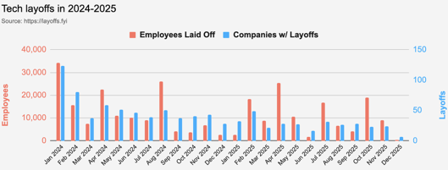
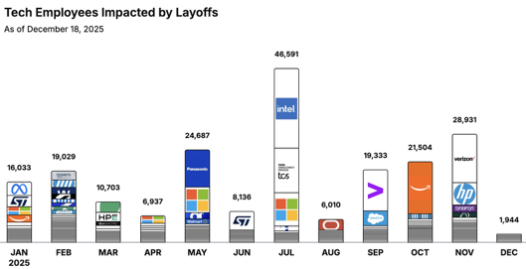
Jobs
https://layoffs.fyi
https://trueup.io/layoffs
Tech Layoffs by year (US only):
  123K in 2025 (as of December 18)
  153K in 2024
  264K in 2023
  165K in 2022 https://layoffs.fyi
The Tech Layoff Tracker
So far in 2025, 209,838 people laid off (596 per day)
In 2024, 238,461 people laid off (653 per day)
https://trueup.io/layoffs

Slide 27


About the Speaker
Lev Selector, Ph.D.
40+ years of software engineering, data science, and building teams (hiring, training, and managing)
Ph.D. in mathematical modeling and computer simulations
Interests:
Generative AI, Using LLM with your data
Local AI for Local Private Data
Cloud architecture, fin-tech, application security
Find/connect: Linkedin, GitHub, YouTube, Google
https://eais.ai
Enterprise AI Systems

Slide 28
Thank You!

