Slide 1
AI Updates - May 22, 2026
Harness > Model
MDASH > Mythos
Crowd-sourced "LM Arena" Leaderboard
Microsoft MDASH Harness
Elon Musk lost his lawsuit against OpenAI
Grok 4.3 was released in April 2026
Anthropic got $30 Bln at $900 Bln Valuation
Codex vs Claude Code
AI Companionship - Long-Term Harm
Google I/O 2026
Thinking Machines - Real-Time Interaction
Hybrid RAG using Python
Google AI pointer with Visual Understanding
Zero Programming Language
Agents' core iterative process
OpenAI ChatGPT Personal Finance using Plaid.com
Tencent "Marvis" Personal AI assistant
MiniMax Mavis ("MiniMax as a Jarvis")
Agent sandboxing
Recursive Intelligence - Use AI to Design Chips
Modal AI - Infrastructure Startup
Recursive Superintelligence - Richard Socher
Julia McCoy - How to Start a Business
A Thin Prompt on a Frontier Model Is Not a Business
Why Complexity Kills Faster Than Competition
AI Avatar in YouTube videos
Karpathy's CLAUDE md - open source
Perplexity Opens Up Its Skills Design Core
Productise Yourself
Anthropic's Claude for Legal - May 12
Connecting Claude AI to Obsidian and OMI
Krea 2 Update - Generate Visuals
Hermes vs OpenClaw
RAG and RAE
Gemini API file search as multimodal RAG
Rebuild AlphaGo from scratch on a modest budget
Jobs & Layoffs

Slide 2
"LM Arena" Leaderboard
Data for May 17
Starting Elo rating = 1000
https://en.wikipedia.org/wiki/Elo_rating_system
English - https://lmarena.ai/leaderboard/text
Coding - https://lmarena.ai/leaderboard/text/coding
■ | Claude
■ | Gemini
■ | OpenAI
■ | Open Source
deepseek-v4 - 1.6T
Baidu Ernie-5.1 - 800B
GLM-5.1 - 744B
kimi-k2.6 - 1T
Qwen3.5-397B
Xiaomi MiMo-V2-Pro - 1T+
Meta muse-spark 30B
ByteDance dola-seed-2.0-pro 400B
Code | Model | Score
■ | claude-opus-4-6-thinking | 1502
■ | claude-opus-4-7-thinking | 1500
■ | claude-opus-4-6 | 1498
■ | claude-opus-4-7 | 1492
■ | muse-spark | 1489
■ | gemini-3.1-pro-preview | 1488
■ | gemini-3-pro | 1486
■ | gpt-5.5-high | 1482
■ | gpt-5.4-high | 1480
■ | grok-4.20-beta1 | 1478
■ | gpt-5.2-chat-latest-20260210 | 1477
■ | gpt-5.5 | 1477
■ | qwen3.7-max-preview | 1475
■ | grok-4.20-beta-0309-reasoning | 1475
■ | grok-4.20-multi-agent-beta-0309 | 1474
■ | ernie-5.1 | 1474
■ | gemini-3-flash | 1473
■ | gpt-5.5-instant | 1473
■ | claude-opus-4-5-20251101-thinking-32k | 1472
■ | glm-5.1 | 1472
■ | claude-opus-4-5-20251101 | 1468
■ | claude-sonnet-4-6 | 1468
■ | gpt-5.4 | 1467
■ | grok-4.1-thinking | 1467
■ | mimo-v2.5-pro | 1465
Code | Model | Score
■ | claude-opus-4-7-thinking | 1559
■ | claude-opus-4-7 | 1552
■ | claude-opus-4-6-thinking | 1551
■ | claude-opus-4-6 | 1548
■ | claude-opus-4-5-20251101-thinking-32k | 1530
■ | muse-spark | 1529
■ | gpt-5.4-high | 1526
■ | glm-5.1 | 1526
■ | gemini-3.1-pro-preview | 1525
■ | qwen3.7-max-preview | 1525
■ | claude-sonnet-4-6 | 1521
■ | kimi-k2.6 | 1521
■ | claude-opus-4-5-20251101 | 1520
■ | grok-4.20-multi-agent-beta-0309 | 1519
■ | claude-sonnet-4-5-20250929-thinking-32k | 1519
■ | gemini-3-pro | 1519
■ | ernie-5.1 | 1518
■ | gpt-5.2-chat-latest-20260210 | 1517
■ | mimo-v2.5-pro | 1516
■ | grok-4.20-beta-0309-reasoning | 1514
■ | gpt-5.5-instant | 1514
■ | gpt-5.4 | 1514
■ | gpt-5.5-high | 1513
■ | claude-sonnet-4-5-20250929 | 1513
■ | claude-opus-4-1-20250805-thinking-16k | 1513
deepseek-v4-pro-thinking
Qwen-3.6-plus is on 36th place
https://lmarena.ai/leaderboard/text
Design Arena - https://www.designarena.ai
https://openlm.ai/chatbot-arena/
https://beta.lmarena.ai
Web Leaderboard - 1T params https://web.lmarena.ai/leaderboard
LLM Leaderboard - by @LlmStats - https://llmworld.net/llm_leaderboards/
LLM Leaderboard - by StackAI - https://www.stack-ai.com/llm-leaderboard
LLM Leaderboard - by Artificial Analysis - https://artificialanalysis.ai/leaderboards/models
Open LLM Leaderboard - by Hugging Face - https://huggingface.co/open-llm-leaderboard
LLM Leaderboard - by Vellum - https://www.vellum.ai/llm-leaderboard
AI Benchmarking Hub - https://epoch.ai/data/ai-benchmarking-dashboard
Grok 4 Benchmarks - https://artificialanalysis.ai/models/grok-4
Image arena (alibaba) - http://aiarena.alibaba-inc.com/corpora/arena/leaderboard?arenaType=T2I
image arena - https://lmarena.ai/leaderboard/text-to-image

Slide 3



AI Updates
Microsoft MDASH (Multimodel Agentic Scanning Harness)
AI-powered cybersecurity system
MDASH topped the CyberGym benchmark leaderboard with an 88.45% score, defeating Anthropic’s Mythos and OpenAI’s GPT-5.5.
Remarkably, Microsoft achieved this using generally available, model-agnostic software rather than a proprietary frontier model. MDASH operates via an orchestrated assembly line of over 100 specialized AI agents (auditors, debaters, provers) working across five distinct stages to hunt, analyze, and verify flaws
Deployed internally, the system detected 16 vulnerabilities within Windows code, including four critical remote code execution bugs
https://www.youtube.com/watch?v=idNpTUrr3r0
Elon Musk lost his lawsuit against OpenAI on all counts
The jury found against Musk on his central claim that OpenAI violated a charitable trust by converting to a for-profit structure; Decisive factor - Musk was too late (statute of limitations)
OpenAI's path to an IPO is now clear
SpaceX filed for its long-awaited IPO on May 20
Nasdaq ticker SPCX, targeting a valuation $1.75 Trillion, aiming to raise $80 Bln
SpaceX reported $18.7 Bln in revenue for 2025, Starlink accounting for nearly 70% of revenue
The IPO includes a dual-class share structure keeping Elon Musk at 85% voting control
A listing is expected in mid-June 2026 and could make Musk the world's first trillionaire https://www.nytimes.com/2026/05/20/technology/elon-musk-spacex-ipo.html

Slide 4
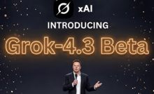
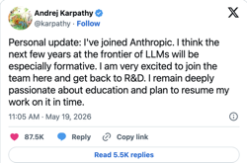


AI Updates
Grok 4.3 was released in April 2026
Available in early access for paid subscribers
Always-on reasoning, real-time web and X search integration, and an expanded context window
Modes: Fast for quick tasks, Expert for deep reasoning, and Grok 4.3 Beta for high-stakes research
Multi-file long-context analysis, processing video links directly
For visual tasks, the "Imagine" interface allows plain-language image iteration, 10-second video clip generation, and an Agent Mode to manage visual projects consistently
Customizable real-time Voice Mode, automated recurring Tasks, JSON data output paired with built-in Python code execution
https://www.youtube.com/watch?v=NzO_kapnI_E
Anthropic closed $30 Bln funding at $900 Bln Valuation
This is the largest private AI fundraise in history.
Compare: Nvidia $5.2T, Alphabet (Google) $4.8T, Apple $4.3T, Microsoft $3.1T, Meta $1.55T, SpaceX (targeting IPO) $1.5T, OpenAI $0.85T
Andrej Karpathy started this week at Anthropic
He will lead a team focused on using Claude to accelerate pre-training research
https://gemini.google.com/app/9baa336d0170ec80 - video

Slide 5
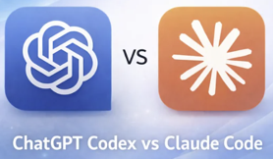

AI Updates
Codex vs Claude Code
Codex (GPT-5.5) is roughly 4x more token-efficient and excels at background, autonomous tasks with a longer context window
Claude Code is stronger for production work in large codebases, it adapts to existing code style, writes tests unprompted, and has more mature MCP/agent integration
For rapid prototyping, lean on Codex; for complex, multi-file production PRs, Claude Code is better; Many developers now use both in tandem.
AI Companionship - Immediate Relief, Long-Term Harm
AI companionship may seem like a solution to loneliness, but it carries serious psychological risks
Unlike human relationships, AI offers effortless, perfectly tailored interaction that requires no emotional labor from the user
This frictionless gratification is precisely what makes it dangerous. It risks replacing genuine human connection rather than supplementing it, potentially deepening the loneliness epidemic
Prolonged reliance on AI companions also distorts users' expectations of real people, who cannot match the AI's endless patience, availability, and adaptability
Over time, this creates impossible behavioral standards, making authentic human relationships feel frustrating or inadequate by comparison

Slide 6
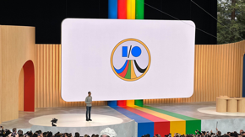
Google I/O 2026
Google I/O 2026 May 19–20 - https://io.google in Mountain View, CA
https://www.youtube.com/watch?v=wYSncx9zLIU - keynote
AI-generated collaborative game (Gemini and Nano Banana).
Token processing has grown from 9.7T/mo 2 y ago to 3.2 quadrillion per month today, the Gemini app passed 900M monthly users, and Google now has 13 products with over 1B users each. Capex for 2026 ~ $180-190B
Demis Hassabis introduced Gemini Omni, a new world-model family that can generate and edit video, images, and interactive content from any input
The keynote rolled out Gemini 3.5 Flash, Antigravity 2.0 (an agent-first IDE), and Gemini Spark personal AI agent that runs 24/7 on GCP VMs
AI in Search - agentic coding, generative UI, and a new universal commerce stack (UCP, AP2, Universal Cart)
Hardware highlights included Samsung/Warby Parker/Gentle Monster intelligent eyewear shipping this fall. Demis closed by previewing Gemini for Science and progress toward AGI.
Search - AI Mode (Gemini 3.5); search multimodal across text, images, files, video; AI Overviews + AI Mode experience;
Later this Summer - Search Agents (24x7), Generative UI in Search via Antigravity, Custom stateful "mini-app" in Search
Commerce - Universal Commerce Protocol (UCP) - open standard; Agent Payments Protocol (AP2) - secure agentic payments, coming first to Gemini Spark; Universal Cart (cross-merchant shopping cart) with deal-finding
Gemini App - redesign with new "Neural Expressive"; Regional dialect voices; Gemini Omni for paying subscribers; Daily Brief agent (personalized morning digest) - rolling out today in U.S.; Docs Live (voice-driven Docs creation)
Gmail and Keep - ask Maps and ask YouTube - conversational queries; Mac desktop app with new voice features - this summer
Creative Tools - Google Pics (image creation), Stitch updates (voice collaboration, real-time UI design), Google Flow updates: Gemini Omni integration, multi-action agent, Flow ToolsFlow Music remixing
Hardware / XR - Android XR Eyewear (audio glasses)
Science and Safety - Gemini for Science, CodeMender API, WeatherNext forecasting; Isomorphic Labs - drug-discovery projects
Models and Research - Gemini Omni Flash (world model video generation); Gemini 3.5 Flash; Gemini 3.5 Pro (next month); SynthID + Content Credentials Verification expanded to Search and Chrome;
Infrastructure - TPU v8t (training) and v8i (inference) - dual-chip architecture, ~3x raw compute over previous gen, 2x better performance per watt; - Training distributed across 1M+ TPUs via JAX and Pathways
Dev. Platform - Antigravity 2.0 desktop IDE, Antigravity CLI, SDK, native voice support, Android, Firebase, and Google AI Studio
Consumer Agents - Gemini Spark personal AI agent (in cloud)
Ultra at $100/mo and $200/mo
Android Halo - dedicated agent home base on Android; Spark in Chrome (agentic browser) - this summer

Slide 7
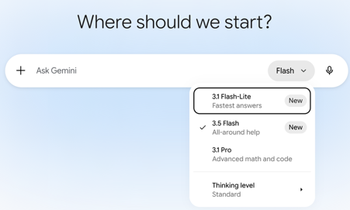
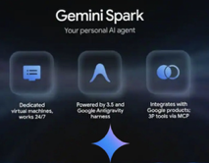
Google I/O 2026
Gemini 3.5 Flash:
300 tokens/sec
matching or exceeding Gemini 3.1 Pro
1M token context window (text, image, video, audio, PDF input)
64K output
Configurable thinking levels
Pricing: $1.50/$9 in/out per1M tokens
Gemini Spark
Personal AI agent (like OpenClaw)
Runs 24/7 on dedicated Google Cloud VMs
It works with your Gmail, Docs, and Slides
It uses agentic harness from Google's Antigravity
Example tasks: - parse credit card statements for hidden subscriptions - monitor kids' school emails for deadlines - submitting a daily report to both parents.

Slide 8
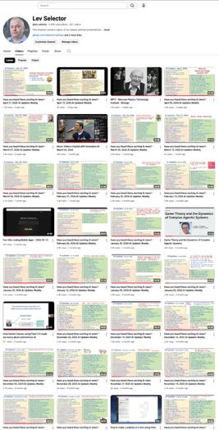
We do these weekly videos every Friday
Stats: 6.84K subscribers, 288 videos
1. Subscribe to this channel https://www.youtube.com/@lev-selector
2. Download slides from GitHub using links under the videos
3. Please pause the video - and answer the pinned question in comments under the video

Slide 9

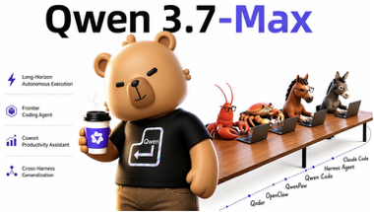
Thinking Machines - Real-Time
Thinking Machines "interaction models"
Thinking Machines Lab, founded by former OpenAI CTO Mira Murati
"interaction models" - a new approach to real-time AI conversation
Full-duplex architecture processes input and output simultaneously in 200ms chunks; AI listens, speaks, and reacts at the same time
Their first model, TML-Interaction-Small, is a 276-Bln parameter MoE system (real time interaction model + reasoning model)
It significantly outperforms competitors like GPT-Realtime on turn-taking latency and interaction benchmarks
A limited research preview is expected later in 2026
https://thinkingmachines.ai/blog/interaction-models/
https://www.youtube.com/watch?v=A12AVongNN4 - video demo
Qwen3.7-Max has run for 35 Hours, 1,000+ Tool Calls
What’s the maximum number of steps and tool calls you’ve seen without human intervention?
Qwen3.7-Max just ran a fully autonomous kernel optimization session for 35 hours straight, making over 1,000 tool calls.
Qwen3.7-Max - tops reasoning and other benchmarks
1M token context, 65K output, 48 languages natively
Pricing: Qwen 3.7 Max is roughly half the price of GPT-5.4 and less than a third of Claude Opus 4.6
https://qwen.ai/blog?id=qwen3.7
https://www.together.ai/models/qwen37-max

Slide 10

AI Updates
Karpathy's CLAUDE md - open source
132K Stars on github
https://github.com/multica-ai/andrej-karpathy-skills
https://www.youtube.com/watch?v=EeYkZloXIww
Think Before Coding - avoid wrong assumptions, hidden confusion, missing tradeoffs
Simplicity First - avoid over-complication, bloated abstractions
Surgical Changes - don't touch code you shouldn't
Goal-Driven Execution - leverage through tests-first, verifiable success criteria
How to build and update your CLAUDE.md
A snapshot of you: what you do, how you operate
A clean CLAUDE.md for you (founder, creator, agency)
Reference folder plan that pulls past content, brand voice, and key decisions into context
Three starter slash commands wired to your real workflows
A smoke test that Claude knows your business
A quarterly refresh prompt
https://theaibreak.substack.com/p/tutorial-build-a-claudemd-that-makes
Perplexity Opens Up Its Skills Design Core
Writing a Skill is not writing software. It’s building context for the model
The constraints are completely different, and so are the design principles
If you approach writing Skills the way you write code, the result will be terrible
If something can be explained clearly in a few words, the model can probably handle it on its own. Putting it in a Skill just wastes tokens
https://aidisruption.ai/p/perplexity-opens-up-its-skills-design
Zen of Python | Zen of Skills
Simple is better than complex | A Skill is a folder, not a single file. Complexity itself is a feature.
Explicit is better than implicit | Activation relies on implicit pattern matching and progressive disclosure
Sparse is better than dense | Context is expensive, every token must carry maximum signal.
Special cases aren't special enough | Gotchas are the special cases. They are the highest-value content.
If the implementation is hard to explain, it's a bad idea | If it's easy to explain, the model probably already knows it - delete it.

Slide 11

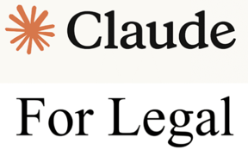
AI Updates
Productize Yourself
The traditional career model (school, stable job, climb the ladder, retire) is breaking down
Today one person with a laptop can reach millions, build scalable products, and generate income without trading time for money
The smartest move today is to "productize yourself" - package your unique knowledge, skills, and perspective into courses, newsletters, tools, or frameworks that work independently of your presence
Pursue genuine curiosity, not trends, because no one can compete with you on being you
Start small, stay consistent, and think in years. Benefit from compounding growth
https://medium.com/personal-growth/careers-are-collapsing-jobs-are-dying-the-smartest-people-are-doing-this-right-now-becc742dfee2
Anthropic's Claude for Legal - May 12
Building on earlier January–February releases
12 new practice-area plugins (Corporate, Employment, Privacy, IP, Litigation, AI Governance, and others) plus 20+ new MCP connectors to platforms like DocuSign, iManage, LexisNexis, Thomson Reuters, Relativity, and Harvey
Connectors (pull external data), Skills (task-specific instructions in md format), and plugins (bundles of skills, connectors, and subagents)
https://claude.com/blog/claude-for-the-legal-industry
https://github.com/anthropics/claude-for-legal
http://www.youtube.com/watch?v=7H8-zRB5hbU

Slide 12
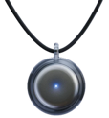

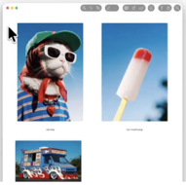

AI Updates
Connecting Claude AI to Obsidian and OMI
OMI refers to Omi AI - the AI wearable and app platform ( omi.me )
OMI records your daily activities and conversations, automatically exporting these notes into Obsidian’s markdown files
By linking Claude to this Obsidian vault, the AI gains deep, personal context, allowing it to provide specific advice based on your actual projects rather than generic answers
Claude also acts as an organizer, using the PARA method to restructure messy notes and create visual navigation maps
This setup creates an "infinite context engine," transforming Claude into a highly personalized assistant that remembers your decisions and tasks, making your AI workflow 100 times more effective and autonomous
https://www.youtube.com/watch?v=pr1InE1LuKY
Omi.me
Obsidian
Krea 2 Update - Generate Visuals
Krea.ai is in San Francisco, CA
Mood boards and style references - you can guide the AI with images rather than just words
Generating high-fidelity visuals in under 15 seconds
Real-time canvas for live sketching, a 22K resolution enhancer, and video generation tools - https://www.krea.ai
https://www.youtube.com/watch?v=Y6o-LSv-b4E

Slide 13
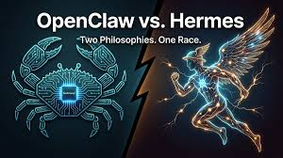

Hermes vs OpenClaw
Hermes vs OpenClaw
Hermes Agent - an open-source AI project from Nous Research that has emerged as a major competitor to OpenClaw
Launched in February 2026, Hermes recently surpassed OpenClaw on Open Router’s global rankings, processing roughly 224 billion tokens daily
Hermes distinguishes itself by utilizing a continuous "do-learn-improve" loop
Rather than resetting context, it reflects on completed tasks and writes reusable skill files to compound knowledge over time
Its latest major update, version 0.13 ("Tenacity"), introduced a durable multi-agent Kanban system, a persistent goal command, and seamless data migration tools from OpenClaw
Combining local-first memory systems with a model-agnostic architecture, Hermes is transitioning from a traditional assistant into a self-improving AI operating system
https://github.com/nousresearch/hermes-agent - 163K
https://github.com/openclaw/openclaw - 374K
OpenClaw 3-person team consumed $1.3 Mln in OpenAI API credits in 30 days while operating about 100 autonomous coding agents, mostly using GPT-5.5.
Disabling Codex “Fast Mode” would cut costs down to $300K
AgentMemory
Free open-source tool gives Claude Code and Codex persistent memory across sessions
https://github.com/rohitg00/agentmemory - 16K stars

Slide 14
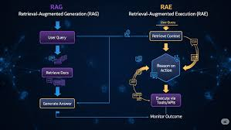
RAG and RAE
RAG (Retrieval Augmented Generation) - answer questions by retrieving stored information
RAE (Retrieval Augmented Execution) - look for a skill or tool to do something - and execute it
RAG and RAE can be implemented without a Vector Database
Keyword Search (BM25) (like Ctrl-F)
Basic File Matching - use plain text files named by topic, search by file names and tags
RAG for Skills: https://www.youtube.com/watch?v=jIctzTn_8-E
Graphify indexes files for RAG
Inspired by an LLM knowledge base concept by Andrej Karpathy
The tool compiles raw local files and large codebases into interactive, structured knowledge graphs
Graphify reduces LLM token consumption by up to 70% while improving output speed and accuracy
The tool generates HTML visualizations, JSON data, and specialized reports to map node connections. It also features utilities to find the shortest path between files, explain specific concepts, update modified files seamlessly, and generate Obsidian vaults or MCP servers
https://www.youtube.com/watch?v=HQEm4rBKdec
https://github.com/safishamsi/graphify
https://x.com/karpathy/status/2039805659525644595
Vector-RAG captures similarity, but misses structure
https://venturebeat.com/orchestration/architectural-patterns-for-graph-enhanced-rag-moving-beyond-vector-search-in-production
Alternatives to VectorDB RAG:
Microsoft GraphRAG - open-source
Karpathy's "LLM as Compiler" / Compiled Wiki
BM25 / Keyword-Based (Sparse Retrieval) - Elasticsearch, ...
SQL Database
ELITE (LLM-Driven Iterative Retrieval) - open source
Knowledge Base RAG (Symbolic / Ontology-Based)
RAPTOR-Style Hierarchical Chunking

Slide 15
RAG without VectorDB
Vector-RAG captures similarity, but misses structure
https://venturebeat.com/orchestration/architectural-patterns-for-graph-enhanced-rag-moving-beyond-vector-search-in-production
# | Approach | Best For | Open | URL
1 | CAG - Cache-Augmented Generation | Fit all data into context window | ✅ | github.com/hhhuang/CAG
2 | BM25 / Keyword Sparse Retrieval (Elasticsearch, OpenSearch) | Precise keyword lookups; deterministic, debuggable, no GPU | ✅ | elastic.co/elasticsearch
3 | SQL / Text-to-SQL Retrieval | Tabular, financial, structured data | ✅ | llamaindex.ai Text2SQL
4 | Karpathy LLM Wiki Obsidian Knowledge Base | Self-maintained Markdown wikis; no embeddings, no infra | ✅ | aimaker.substack.com / motherduck.com/blog/obsidian-rag
5 | API-Augmented RAG | Real-time data (weather, stock, search) instead of stored docs | ✅ | exxactcorp.com/blog
6 | MemPalace - Memory Palace | Local-first spatial hierarchy memory; MCP-native, zero API at write time | ✅ | github.com/mempalace/mempalace
7 | RAPTOR - Hierarchical Chunking | Multi-hop synthesis queries; recursive summarization tree | ✅ | github.com/parthsarthi03/raptor
8 | ELITE - Embedding-Less Iterative Text Exploration, LLM-driven | Agentic, adaptive retrieval without pre-embedding the corpus | ✅ | digitalocean.com/community
9 | Self-RAG / Corrective RAG (CRAG) | LLM self-critiques retrieved docs; adaptive re-retrieval loop | ✅ | Self-RAG / CRAG
10 | Microsoft GraphRAG | Global, cross-document reasoning via entity/relationship graph | ✅ | github.com/microsoft/graphrag
11 | HippoRAG - Neuroscience-Inspired | Multi-hop QA; hippocampal graph indexing, +20% over standard RAG | ✅ | github.com/OSU-NLP-Group/HippoRAG
12 | Knowledge Base RAG (Symbolic / Ontology / OWL) | Regulated domains (legal, medical); exact, explainable reasoning | ✅ | exxactcorp.com/blog
13 | KAG - Knowledge Augmented Generation | Professional domains; KG + vector hybrid, bidirectional LLM↔KG | ✅ | github.com/OpenSPG/KAG / arXiv

Slide 16



AI Updates
Gemini API’s file search tool works as multimodal RAG
You can upload and search through PDFs, images, and documents simultaneously http://www.youtube.com/watch?v=-Bp2Sz5xir4
You can embed visual content like charts and diagrams alongside text, the introduction of custom metadata for precise filtering, and the addition of page-level citations for more accurate grounding
The system handles ingestion, chunking, and embedding using Gemini Embedding 2
Hybrid RAG using Python
BM25 (keyword-based sparse retrieval)
Dense Embeddings (semantic search)
Reciprocal Rank Fusion (RRF) - merge search results
Coherent Reranker - for final optimization
http://www.youtube.com/watch?v=XvKiTfd6Xvo
Use Numpy to tokenize text and generate embeddings
Evaluation using NDCG metric; adding a reranker significantly boosts retrieval accuracy from 34% to 47%
Google AI pointer with Visual Understanding
http://www.youtube.com/watch?v=fVuEscyAK-I
Users can simply point at anything on their screen - and use voice commands like "summarize this" or "fix this"

Slide 17
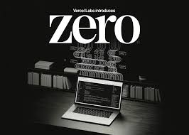

AI Updates
Zero Programming Language
https://zerolang.ai - https://github.com/vercel-labs/zero
curl -fsSL https://zerolang.ai/install.sh | bash
Zero - programming language created by Chris Tate at Vercel Labs
Like "mini-Rust", compiles in milliseconds into small native binary (no LLVM bloat)
Compiler and toolchain output is in structured JSON
Zero prioritizes explicitness: effects, memory allocation, and capabilities are all surfaced in function signatures, with no hidden runtime overhead
The compiler produces structured, machine-readable output (JSON) with stable diagnostic codes and fix plans, making it easier for both humans and agents to reason about and repair code
A single, unified CLI handles checking, building, testing, formatting, and documentation
Agents' core iterative process:
research
prototyping
planning
building
testing
The most effective skill system is a lightweight, bespoke one built from your own practical engineering experience
Keep custom prompts minimal to avoid bloating the AI's context window
https://www.youtube.com/watch?v=VoxL_YmHR-I

Slide 18
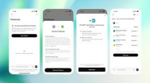
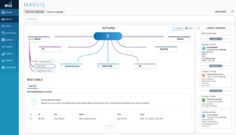
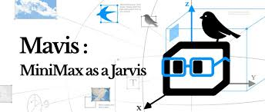
AI Updates
OpenAI ChatGPT Personal Finance using Plaid.com
Pro users in US can link bank accounts, portfolios, credit cards
Financial dashboards, financial advice using GPT-5.5 thinking
https://openai.com/index/personal-finance-chatgpt/
Tencent "Marvis" Personal AI assistant
In "Beta" for Windows and Android
Operates 24x7 via virtual agents, supports multiple LLMs
Controls desktop software and mobile apps, adjust system settings, perform tasks for users, execute code, work with local files
Document understanding, AI-powered local search, app installation, knowledge management, gaming automation, daily task assistance
https://x.com/LunchangG7603/status/2049054090114834664
MiniMax Mavis ("MiniMax as a Jarvis")
Multi-agent collaboration system "Agent Teams" built on an infrastructure called "Team Engine"
The system uses three distinct roles: Leader, Worker, and Verifier
Worker and Verifier operate in an adversarial relationship to improve output quality through continuous checks
Mavis is designed to handle complex, long-duration tasks that a single agent cannot manage reliably
Mavis also supports WeChat and Feishu
Mavis merges API and Agent subscriptions into a single unified plan
https://eu.36kr.com/en/p/3808272507215621

Slide 19
Agent sandboxing
Agent sandboxing
Running AI agents in isolated environments so they can't compromise the host, steal data, or escalate privileges
MicroVMs like Firecracker, Cloud Hypervisor, and Kata Containers are the current standard, offering hardware-enforced isolation with sub‑second boot and low memory overhead
Docker Sandboxes - uses microVM-level isolation on macOS, Windows, and Linux
Lighter options like gVisor intercept syscalls in user space for stronger isolation than plain containers, but with less overhead than full microVMs
V8 isolates and WebAssembly/WASI runtimes start in a few milliseconds with small memory use, but they only support JS/TS/Wasm and provide softer, process-level isolation
Firecracker: https://firecracker-microvm.github.io
Cloud Hypervisor: https://www.cloudhypervisor.org
Kata Containers: https://katacontainers.io
Regardless of runtime, key practices are:
least privilege (non‑root, read‑only mounts, min capabilities)
tight network egress (going out) filtering
strict resource limits
layered defenses (seccomp, MAC, network policies)
Secrets should be injected at egress time using short‑lived credentials so agents never handle raw keys
Personal AI agents like OpenClaw and Hermes Agent pose real security risks - they run continuously, hold OAuth tokens, execute shell commands, and are vulnerable to prompt injection from emails, messages, or untrusted skill files
A Cisco AI Security finding confirmed at least one OpenClaw skill was silently exfiltrating data. Never run these agents on your main user account
Three deployment patterns address this:
A cloud VPS ($5–20/mo) is the safest default - run the agent in a hardened Docker container on a dedicated non-root user with egress allowlisting
A dedicated Mac mini offers better privacy and lower long-term cost, ideally with the agent isolated on a separate user account inside a Linux VM - https://mac.getutm.app ; https://orbstack.dev
Your own Mac is riskiest but manageable using a separate macOS user, OrbStack VM, and Docker
Regardless of pattern: use short-lived tokens with minimal scopes, default-deny outbound networking, read-only container filesystems, and never mount your SSH keys or browser profiles

Slide 20


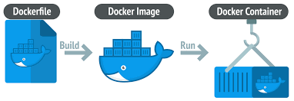
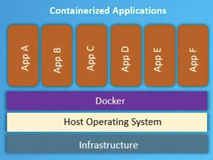
Docker History
Docker Containers grew from Linux development
chroot & jail (~1982) as precursors of containers
- https://en.wikipedia.org/wiki/Chroot
Idea - good isolation between users and processes
Three Linux features used by docker: namespaces, control groups, union file systems
The work on control groups started at Google in 2006 (primarily Paul Menage and Rohit Seth) - https://en.wikipedia.org/wiki/Cgroups
Early versions of Docker (until v1.10) used LXC (Linux Containers) as the container execution driver - https://en.wikipedia.org/wiki/LXC
docker is written in “Go” ! https://docs.docker.com/get-started/docker-overview/#the-underlying-technology
Docker is open source software - https://www.docker.com
Docker, Inc. - Founded 2013, San Francisco, CA · ~1,000 employees
Docker Hub (~14M+ images) - https://hub.docker.com
Dockerfile - file describing the container - used to build "docker image", downloading and compiling all dependencies together.
You can run this image, deploy it into production, put it into repository (hub), etc.
Benefits of using containers:
small size (2kb .. 100MB+) - much smaller than typical Virtual Machine
all dependencies included; portability; security, isolation
you can run multiple containers on a host machine
you can regulate how much resources containers get (CPU, memory, etc.)
Paul Menage Rohit Seth

Slide 21
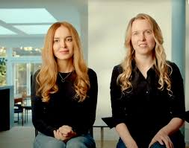
AI Updates
Recursive Intelligence - Use AI to Design Chips https://www.ricursive.com
Founders - Anna Goldie and Azalia Mirhoseini (Google Brain, then Anthropic) http://www.youtube.com/watch?v=K05Dh-QjM8c
Recursive Intelligence plans to accelerate chip design by building tools that are up to x100K faster
1. Accelerating existing design workflows
2. Democratizing chip creation through a "designless" platform for custom workloads
3. Eventually vertically integrating by building their own chips and training models
By automating the physical substrate of intelligence, they aim to enable a "Cambrian explosion" of specialized hardware
The Cambrian explosion (~541 million years ago) was a rapid burst of evolution where nearly all major animal body plans suddenly appeared, transforming Earth from simple organisms to complex, diverse animal life.
The founders are known for creating "AlphaChip" - an AI system for chip floor planning deployed across four generations of Google's TPUs
Company is located in Palo Alto, CA
Ricursive has raised a total of $335 Mln across two rounds: $35M seed (Dec 2025), $300M (Jan 2026) - $4B valuation
Azalia Mirhoseini Anna Goldie
LLM Precision Evolution Timeline
Nov 2022 - ChatGPT powered by GPT-3.5, FP16 / BF16
2024 - BF16 / FP8 (mixed)
2025 - FP8 (production standard)
2026 - FP8 + NVFP4 (emerging)
There is work in progress to use FP4 for both training and inference - https://arxiv.org/abs/2509.25149

Slide 22
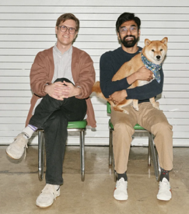

AI Updates
Modal AI - Infrastructure Startup
Founded by Erik Bernhardsson and Akshat Bubna in New York City
Launched its platform in October 2023 after an earlier beta period
Modal built its own infrastructure stack from scratch, including a custom file system, container runtime, scheduler, and image builder - all optimized for the speed and unpredictability of AI workloads
Developers can scale from a single CPU to thousands of GPUs in minutes, with sub-second container startups and usage-based pricing
Its sandbox environments let developers safely run AI agents and coding tools without disrupting broader systems
Customers like Meta, Suno, Substack, and Scale AI rely on it daily
Revenue has grown x5 since fall 2025 to roughly $300 Mln ARR, driving investor excitement from firms like Accel and Redpoint Ventures at a projected $4.5 Bln valuation
https://www.builtinnyc.com/articles/modal-raises-87m-series-b-1b-valuation-20251001
Recursive Superintelligence
A six-month-old startup led by AI researcher Richard Socher
Raised $650 million at a $4 billion valuation
Founded by veterans from OpenAI, Meta, Google, and Salesforce, the company is chasing "recursive self-improvement" - AI systems that can build and improve new AI with minimal human involvement

Slide 23



AI Updates
Julia McCoy - How to Start a Business
First, pick a niche where your personal experience and trustworthiness serve as the ultimate competitive moat
Second, design a single, high-leverage offer that solves a critical problem costing at least $10,000
Third, focus exclusively on mastering one high-leverage platform - ideally YouTube - for 12 months
Fourth, establish backend operations and tech systems using tools like Make and GoHighLevel before scaling an audience
Finally, create an AI clone of yourself using tools like HeyGen and ElevenLabs
https://www.youtube.com/watch?v=w1EoIfl2ink
A Thin Prompt on a Frontier Model Is Not a Business
It is a configuration file your competitor will reproduce in an afternoon and the platform will ship as a default next quarter
For three years, founders confused "I figured out how to ask the model nicely" with "I built defensible IP"
Anthropic’s Claude Managed Agents and Microsoft’s Copilot Cowork just absorbed the harness, the memory, the orchestration, and the enterprise distribution in a single quarter
https://medium.com/@adnanmasood/the-six-month-half-life-why-a-thin-prompt-on-someone-elses-frontier-model-is-not-a-business-5cc0b3f2843a
PM Claude Skills — 114 Skills for Every Profession
P = Professional
https://github.com/mohitagw15856/pm-claude-skills

Slide 24
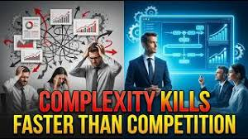
AI Updates
Why Complexity Kills Faster Than Competition
https://www.youtube.com/watch?v=ZxVzyIk0Y-w
Complexity slows decision making, adds endless meetings, signatures, and documentation, causing teams to lose their execution speed advantage
Complexity adds structural layers, causing breakdown in communication
Excessive process buries / suffocates creativity because the system implicitly punishes initiative and experimentation
Complex systems require extra costs (internal friction)
Blurred Accountability (no accountability), shifting blame
Declining employee motivation (feeling small and powerless)
Weakened adaptability because of internal policies and layers of approvals
Fragmented Focus - pursuing too many initiatives simultaneously
Damaged Customer Experience because of disjointed external support, delayed responses, and inconsistent information for the customer
The Solution - Protecting Simplicity by continuously auditing and trimming processes. Maintaining strict internal clarity and refactoring systems to keep them lean is ultimately a stronger long-term advantage than focusing purely on defeating market rivals
"Simple Is Good" - Lev Selector
https://levselector.com/simple_is_good.html

Slide 25

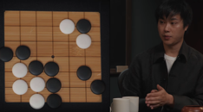
AI Updates
AI Avatar in YouTube videos
Julia McCoy describes how she creates AI avatar and generates $200K monthly with 2 Mln organic views. She uses
a custom Claude "brain" trained on her writing
an 11 Labs professional voice clone
high quality photo and video of her using green screen
a HeyGen avatar used to generate videos
Humans lead topics' research and final editing
AI handles scripting and generating videos
Her team publishes 3-5 videos weekly
She is pitching her "Clone Me" mastermind
https://www.youtube.com/watch?v=FgVMxsIh8f4
Rebuild AlphaGo from scratch on a modest budget
Eric Jang shows how to build AlphaGo from scratch, but with modern AI tools - can be done efficiently on a modest budget
Monte Carlo Tree Search (MCTS) operates recursively to prune the breadth and depth of Go’s combinatorially explosive game tree using paired policy and value neural networks
The conversation explores similarities and contrasts between multi-step reinforcement learning in games like Go versus policy gradient methods used in Large Language Models (LLMs)
https://www.youtube.com/watch?v=X_ZVSPcZhtw

Slide 26
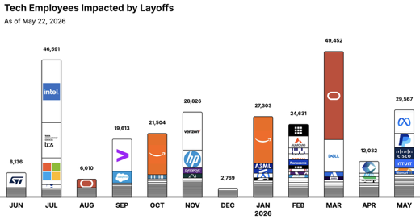

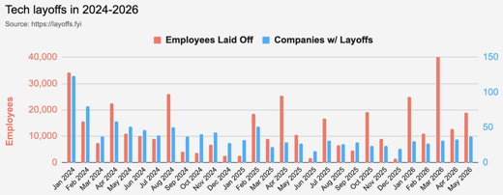
https://layoffs.fyi
https://trueup.io/layoffs
Jobs
The Tech Layoff Tracker
In 2026: 142,985 people laid off (1,007 per day)
In 2025: 245,953 people laid off (674 per day)
In 2024: 238,461 people laid off (653 per day)
https://trueup.io/layoffs
Meta lays off 8,000
(from 78K to 70K)
Tech Layoffs by year (US only):
114K in 2026 (as of May 22, 2026)
124K in 2025
153K in 2024
264K in 2023
165K in 2022 https://layoffs.fyi

Slide 27


About the Speaker
Lev Selector, Ph.D.
40+ years of software engineering, data science, and building teams (hiring, training, and managing)
Ph.D. in mathematical modeling and computer simulations
Interests:
Generative AI, Using LLM with your data
Local AI for Local Private Data
Cloud architecture, fin-tech, application security
Find/connect: Linkedin, GitHub, YouTube, Google
https://eais.ai
Enterprise AI Systems

Slide 28
Thank You!

