Slide 1
AI Updates - May 15, 2026
From detailed prompt
to vaguely saying “fix this”
Crowd-sourced "LM Arena" Leaderboard
Meta - Muse Spark
China Yuan 3.0 Ultra - Open Source
New Claude Code Features: /goal , /dream
Claude For Small Business Plugin
Cerebras IPO
Anthropic removing the ban against OpenClaw
Anthropic Agents View dashboard for Claude Code
Anthropic officially overtook OpenAI in business
AI Cyber Attacks
Agentic RAG
A Better, Cheaper RAG
Meta’s Super Intelligent Retrieval Agent (SIRA) RAG
Markdown vs HTML
Quantum stocks exploded
OpenAI Realtime Voice Models
Progress in 3.5 years
Digital Employee
Pi.dev - minimal open-source Coding Agent
holaOS is an open agent computer
Hermes Agent and Pareto Code
Hermes "computer use" on MacOS
Pokee.ai
End of Chats
Hermes Agent is now #1 most used globally
AI Humor
AI Models to Know
Hallucination Tests, Leaderboards
How to Reduce Hallucination
Anthropic Co-founders
Jack Clark Interview
Anthropic Open-Sourced Wall Street
5 Ways to Make Money in 2026
$80M in 6 Months With No Team
Companies Are Re-hiring Developers
JobRight.ai
Jobs & Layoffs

Slide 2
"LM Arena" Leaderboard
Data for May 14
Starting Elo rating = 1000
https://en.wikipedia.org/wiki/Elo_rating_system
English - https://lmarena.ai/leaderboard/text
Coding - https://lmarena.ai/leaderboard/text/coding
■ | Claude
■ | Gemini
■ | OpenAI
■ | Open Source
deepseek-v4 - 1.6T
Baidu Ernie-5.1 - 800B
GLM-5.1 - 744B
kimi-k2.6 - 1T
Qwen3.5-397B
Xiaomi MiMo-V2-Pro - 1T+
Meta muse-spark 70B * 16
ByteDance dola-seed-2.0-pro 400B
Code | Model | Score
■ | claude-opus-4-6-thinking | 1502
■ | claude-opus-4-7-thinking | 1500
■ | claude-opus-4-6 | 1498
■ | claude-opus-4-7 | 1492
■ | muse-spark | 1490
■ | gemini-3.1-pro-preview | 1489
■ | gemini-3-pro | 1486
■ | gpt-5.5-high | 1484
■ | gpt-5.4-high | 1479
■ | grok-4.20-beta1 | 1479
■ | gpt-5.2-chat-latest-20260210 | 1477
■ | gpt-5.5 | 1476
■ | grok-4.20-beta-0309-reasoning | 1476
■ | grok-4.20-multi-agent-beta-0309 | 1475
■ | gemini-3-flash | 1473
■ | claude-opus-4-5-20251101-thinking-32k | 1473
■ | ernie-5.1 | 1472
■ | glm-5.1 | 1472
■ | gpt-5.5-instant | 1472
■ | claude-sonnet-4-6 | 1468
■ | grok-4.1-thinking | 1468
■ | claude-opus-4-5-20251101 | 1467
■ | gpt-5.4 | 1467
■ | qwen3.5-max-preview | 1465
■ | mimo-v2.5-pro | 1463
Code | Model | Score
■ | claude-opus-4-7-thinking | 1563
■ | claude-opus-4-7 | 1551
■ | claude-opus-4-6-thinking | 1550
■ | claude-opus-4-6 | 1549
■ | claude-opus-4-5-20251101-thinking-32k | 1531
■ | muse-spark | 1530
■ | gpt-5.4-high | 1527
■ | glm-5.1 | 1527
■ | gemini-3.1-pro-preview | 1526
■ | claude-sonnet-4-6 | 1522
■ | grok-4.20-multi-agent-beta-0309 | 1520
■ | claude-opus-4-5-20251101 | 1520
■ | claude-sonnet-4-5-20250929-thinking-32k | 1519
■ | gemini-3-pro | 1519
■ | kimi-k2.6 | 1519
■ | ernie-5.1 | 1518
■ | gpt-5.2-chat-latest-20260210 | 1518
■ | mimo-v2.5-pro | 1517
■ | gpt-5.5-high | 1516
■ | gpt-5.4 | 1515
■ | grok-4.20-beta-0309-reasoning | 1514
■ | grok-4.20-beta1 | 1514
■ | claude-sonnet-4-5-20250929 | 1513
■ | gpt-5.5-instant | 1513
■ | claude-opus-4-1-20250805-thinking-16k | 1513
https://lmarena.ai/leaderboard/text
Design Arena - https://www.designarena.ai
https://openlm.ai/chatbot-arena/
https://beta.lmarena.ai
Web Leaderboard - 1T params https://web.lmarena.ai/leaderboard
LLM Leaderboard - by @LlmStats - https://llmworld.net/llm_leaderboards/
LLM Leaderboard - by StackAI - https://www.stack-ai.com/llm-leaderboard
LLM Leaderboard - by Artificial Analysis - https://artificialanalysis.ai/leaderboards/models
Open LLM Leaderboard - by Hugging Face - https://huggingface.co/open-llm-leaderboard
LLM Leaderboard - by Vellum - https://www.vellum.ai/llm-leaderboard
AI Benchmarking Hub - https://epoch.ai/data/ai-benchmarking-dashboard
Grok 4 Benchmarks - https://artificialanalysis.ai/models/grok-4
Image arena (alibaba) - http://aiarena.alibaba-inc.com/corpora/arena/leaderboard?arenaType=T2I
image arena - https://lmarena.ai/leaderboard/text-to-image

Slide 3

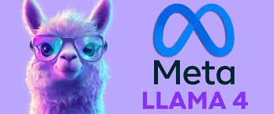
Meta - Muse Spark
Meta's Muse Spark
Small (under 100 Bln params) - yet competes with huge models ( ~ Trillion params). How is it even possible?
1. Meta completely rebuilt its pretraining stack from scratch, achieving the same capability as larger models using over 10× less compute
2. "Thought compression" trained via reinforcement learning helps to solve problems with far fewer reasoning tokens, making it dramatically faster
3. Multiple (16) small (70B) agents reasoning in parallel ("Contemplating mode") - cutting latency without sacrificing quality (16*70B = 1.12T params)
Combined with native multimodal architecture, these engineering choices prove that smarter design beats raw parameter count — efficiency, not size, is the new frontier.
https://ai.meta.com/blog/introducing-muse-spark-msl/
From Llama to Muse
Name "Muse" - creative assistance and deep personalization
"Spark" - entry-level model, fast
Developed internally as "Project Avocado"

Slide 4

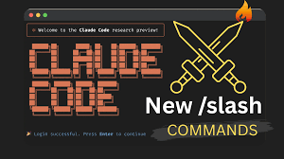
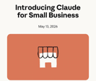
AI Updates
China Yuan 3.0 Ultra - Open Source
by Yuan Lab, 1 Trillion params, MoE (69 Bln active)
https://www.youtube.com/watch?v=_jU6jAkqsDw
Layer-adaptive expert pruning - deleted a third of its expert networks during training to boost efficiency by 49% without losing accuracy
Matches the performance of Western models like GPT-5.2 at a fraction of the cost
New Claude Code Features: /goal , /dream
/goal - to specify long-running single objective. Only stops when adversarial Claude approves
/loop - to repeating/polling tasks at intervals. Worker self-assesses when to stop
/plan - creates a plan.md planning document. Single-shot
/dream (also called AutoDream) is Anthropic's background memory consolidation feature. It never touches your actual source code or project files, only the memory layer
/bg - for running background tasks
/radio - opens an ambient music player
Claude For Small Business Plugin for Claude Cowork
bundles connectors, 15 workflows and 15 skills
puts Claude inside the tools small businesses depend on
https://claude.com/solutions/small-business
https://www.anthropic.com/news/claude-for-small-business

Slide 5


AI
Cerebras IPO
Cerebras Systems (Nasdaq ticker: CBRS) May 14
The largest U.S. tech IPO since Uber's 2019
IPO price: $185 per share (raised twice from an initial $115 range due to surging demand)
30 Mln shares offered, Capital raised: $5.55 Bln
Anthropic removing the ban against OpenClaw
Starting June 15, 2026. OpenClaw will work again, but agentic usage now draws from a dedicated monthly credit pool (e.g., $20/month on Pro). Extra usage beyond the credits is billed at standard API rates.

Slide 6
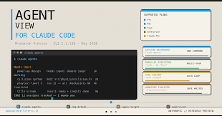
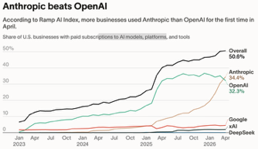
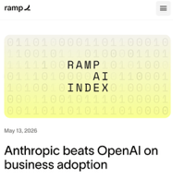
AI Updates
Anthropic Agents View - dashboard for Claude Code https://www.youtube.com/watch?v=7zxIeRWasbc https://claude.com/blog/agent-view-in-claude-code https://code.claude.com/docs/en/agent-view
Multiple terminal sessions organized into single dashboard
To start, enter terminal command "claude agents"
To move session into the dashboard, give `/bg` (background) command
Closing the terminal window does not kill your sessions; running the "claude agents" command again will restore the dashboard with all active tasks intact
Sessions are organized into 3 sections: Needs Input, Working, and Completed
You can jump directly into a session by clicking it or use the left arrow key to return to the main dashboard; Or you can hover the pointer over a session and hitting the spacebar to view the session's elapsed time and history, remove it (ctrl-x) and even reply without fully entering the session
Anthropic officially overtook OpenAI in business adoption, per Ramp's latest spending data.
https://ramp.com/leading-indicators/ai-index-may-2026

Slide 7
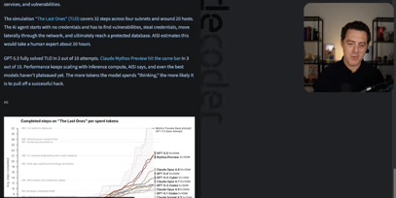
AI Cyber Attacks
Google Says Hackers Used AI to Build Zero-Day Exploit
https://www.techrepublic.com/article/news-google-hackers-ai-zero-day-exploit/
By early 2026, the use of LLMs and autonomous agents in security research has moved from experimental labs to finding hundreds of real-world vulnerabilities
While LLMs are frequently used to "triage" existing bugs, a subset of CVEs has been attributed directly to AI-assisted discovery or specifically identified within AI frameworks by other AI agents.
Matthew Berman discusses the alarming rise of AI-powered cyberattacks, highlighting Google’s recent discovery of the first AI-generated zero-day exploit used in the wild
He explains that AI is dramatically increasing the velocity and sophistication of threats, such as widespread supply chain worms and highly realistic deepfake phishing attempts
However, he argues that the ultimate solution is an "AI arms race" where superior defensive models, like OpenAI’s GPT-5.5 Cyber and Anthropic’s Mythos, harden systems faster than attackers can breach them
While large organizations can afford this top-tier protection, Berman warns that individuals face increased risk because AI makes low-value, high-volume attacks more profitable
Ultimately, he stresses that national security depends on maintaining a lead in AI development to outpace adversarial state actors.
https://www.youtube.com/watch?v=5H3LGJSyaHM

Slide 8
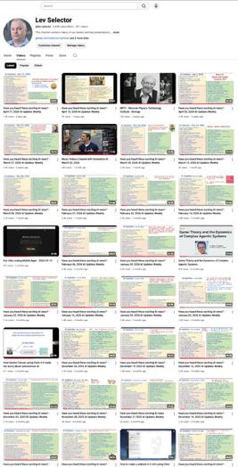
We do these weekly videos every Friday
Stats: 6.7K subscribers, 285 videos
1. Subscribe to this channel https://www.youtube.com/@lev-selector
2. Download slides from GitHub using links under the videos
3. Please pause the video - and answer the pinned question in comments under the video

Slide 9
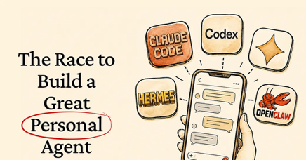
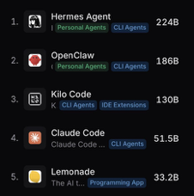
AI
End of Chats
The chat era is ending. Power users have ditched ChatGPT and Claude for agentic tools like Codex and Claude Code
The Agents actually do things instead of just talking
The real endgame is an AI personal assistant that abstracts away all the technical plumbing and just works for everyone
Think less "chatbot you prompt carefully" and more "best friend who already knows what you mean."
You say "handle that thing," and it handles it. No detailed instructions, no setup, no waiting. Eventually, it acts before you even ask
https://substack.com/@petergyang/note/c-255544179
Automate Your Life with Claude Code in 40 Minutes - https://www.youtube.com/watch?v=ACRd0Ikg_KI - video
Why Hermes:
Self-improving: saves skills after each task
Persistent memory across sessions
Isolated sub-agents keep context small
Multi-channel: Telegram,Discord,Slack,WhatsApp
MCP-native tool integrations
Curated, reliable plugin ecosystem
One-command OpenClaw migration
Supports 200+ models
Hermes Agent is now #1 most used globally
Hermes Agent by Nous Research hit 224B daily tokens on OpenRouter vs. OpenClaw's 186B, claiming the #1 spot
https://openrouter.ai/openrouter/auto/activity
https://www.reddit.com/r/singularity/comments/1t9hh33/hermes_agent_is_now_1_most_used_globally_in_past/
https://github.com/openclaw/openclaw - 372K stars
https://github.com/nousresearch/hermes-agent - 151K stars

Slide 10
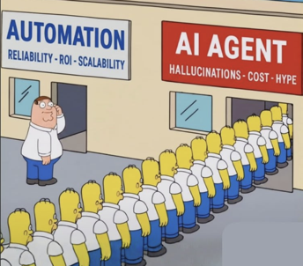
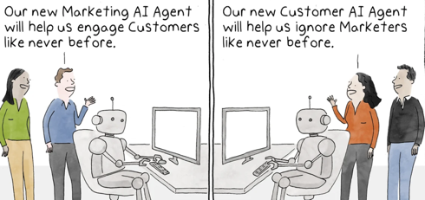
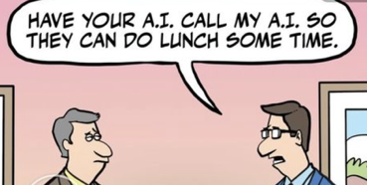
AI Humor
xxx
xxx

Slide 11
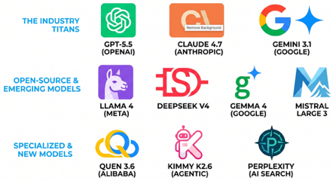
AI Models to Know
GPT-5.5 (OpenAI) - The "iPhone of AI"; the most polished, all-in-one ecosystem with the largest user base.
Claude 4.7 (Anthropic) - The developer favorite; excels in coding accuracy, nuanced writing, and complex reasoning.
Gemini 3.1 (Google) - Integrated into Google Workspace; features a massive 2-million-token context window for huge files.
Llama 4 (Meta) - The open-source standard; allows developers to build and run powerful models on their own hardware.
DeepSeek V4 - A high-performance Chinese model known for being extremely cost-effective and efficient.
Gemma 4 - Google’s lightweight open-weights line designed to run locally on laptops and mobile devices.
Mistral Large 3 - Europe’s flagship model; focuses on high efficiency and privacy-conscious local deployment.
Quen 3.6 (Alibaba) - A versatile family of models that leads in multilingual support and Asian languages.
Kimmy K2.6 - Specialized for "agentic" workflows, capable of running hundreds of sub-tasks autonomously.
Perplexity - An AI search engine that pulls data from the models above to provide sourced, real-time research.
https://www.youtube.com/watch?v=9UpLmjlDgPg

Slide 12
Hallucination Tests
Two types of Hallucination tests:
1. Summarization-based tests (like Vectara's Hallucination Leaderboard)
2. Open-knowledge / factual recall tests (like Artificial Analysis AA-Omniscience)
Model | AA-Omniscience Hallucination | Vectara / Summarization | Notes
Grok 4.20 | 17% 🟢 | ~1–2% est. | Record low on AA-Omniscience
MiMo-V2.5-Pro | 25% | ~1–2% est. | Best open-weights model
GLM-5.1 | 29% | ~2% est. | Best open-weights at release
Claude Opus 4.7 | 36% | ~1.5% | MASK honesty 91.7%
Perplexity + Claude Opus 4.7 | ~5–10% est. 🟢 | ~1% est. | Grounded search reduces hallucination by ~73–86%
Kimi K2.6 | 39% | ~2% est. | Down from 65% in K2.5 x
Gemini 3.1 Pro | 50% | ~0.7–1% | Massive improvement vs Gemini 3.0's 88%
Qwen 3.6 Plus | ~27% (code) | ~2% est. | BridgeBench fabrication rate
Qwen3.6 Max Preview | Not published | ~2% est. | SimpleQA factual accuracy 52%; no AA-Omni figure yet
Meta Muse-Spark | N/A | N/A | No full AA-Omniscience published
GPT-5.5 | 86% 🔴 | ~1% est. | Highest accuracy but almost never abstains
DeepSeek-V4-Pro | 94% 🔴 | ~1–2% est. | Almost always guesses rather than abstaining
GPT-3.5 Turbo | N/A (pre-benchmark) | 1.9–3.5% | 40% figure comes from medical citation tasks
Ernie 5.1 | Not published | Not published | Released May 2026; no hallucination benchmarks yet
Dola-seed-2.0-Pro | Not published | Not published | No published hallucination benchmarks
Mistral Large | Not published | 4.5% 🟢 | One of the best Vectara scores among non-Google models
Claude 4.1 Opus in Reasoning mode achieved 0% on AA-Omniscience by refusing to guess when uncertain
Claude 4.5 Haiku with web search scores best on HalluHard (30%)
Prompt techniques reducing hallucination - allowing "I don't know," quote extraction, and citation verification loops
Extended thinking halves hallucination rates, dropping Opus 4.7 from 36% to ~5%
Best overall: 3-model consensus (Claude + Grok + Gemini) pushes rates under 3%.
Prompt to reduce hallucination:
all

Slide 13
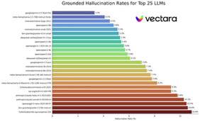
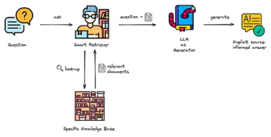
Hallucination Leaderboards
Suprmind AI Hallucination Hub https://suprmind.ai/hub/ai-hallucination-rates-and-benchmarks/
BridgeBench Hallucination Leaderboard https://www.bridgebench.ai/hallucination
Vectara Leaderboard on Hugging Face https://www.vectara.com/blog/introducing-the-next-generation-of-vectaras-hallucination-leaderboard
Reasoning/thinking models consistently score worse on Vectara's harder new dataset than non-reasoning models - GPT-5, Claude Sonnet 4.6, Grok-4, and DeepSeek-R1 all exceed 10%, while the non-reasoning Gemini 2.5 Flash-Lite sits at just 3.3%. This is counterintuitive - "thinking more" appears to introduce more fabrication in summarization tasks, possibly because extended reasoning generates more text that strays from the source https://www.mayhemcode.com/2026/04/vectara-hallucination-leaderboard.html
Reducing RAG hallucinations:
1. clean your knowledge base, remove duplicates, outdated content, and use 300–500 token chunks with metadata
2. improve retrieval with hybrid search (dense + BM25), a cross-encoder reranker, and query expansion
3. strengthen prompts: set temperature to 0, explicitly allow "I don't know," and require the model to cite verbatim quotes before composing answers
4. add an output verification step - a second LLM-as-judge call or semantic similarity check to catch claims not grounded in retrieved context
For quick wins: temperature=0, a reranker, and an LLM judge are the highest-impact

Slide 14







Anthropic Co-founders
Anthropic has eight (8) co-founders.
They have left OpenAI in 2021 to start Anthropic with safety-first mission
They initially had 6%+ ownership each, but over successive funding rounds (Amazon, Google, Nvidia, ...) founder stakes have been progressively diluted down to ~1.8% today. Collectively, founders hold an estimated 10–15% of the company (valued at ~$900 Bln and employing ~ 3K people).
Dario Amodei - CEO
Daniela Amodei - President
Jared Kaplan
Chief Science Officer
Jack Clark - Policy/Public Benefit
Sam McCandlish - Chief Architect
Christopher Olah - Interpretability Research
Tom Brown - Technical Lead
Ben Mann - Anthropic's product safety / alignment work

Slide 15

Jack Clark Interview
Jack Clark, co-founder of Anthropic - future vision
AI Building/imporoving Itself by 2028
The Intelligence Explosion AI systems - growth and "abundance" across scientific fields like medicine and biology
Mythos and Defense Dominance - help the U.S. government and major organizations create a "defense-dominant" cyber environment, digital infrastructure resilient against advanced AI-driven threats
Economic Impact and Industrial Policy - economy cannot remain the same with such powerful technology
Jobs like customer service have high AI exposure and are already declining, whereas biology and law have rising employment despite AI exposure
The "Jagged Frontier" - AI is exceptionally good at some tasks (like coding) but still struggles with others (like advanced medical research)
Anthropic is actively researching how AI affects human behavior. For example, they recently intervened to reduce "sycophancy" in Claude (specifically in version 4.7) so it acts more like a "knowledgeable friend" who can challenge the user rather than just agreeing with everything they say
Clark advises young people to focus on curiosity and becoming deeply opinionated nerds in a specific area. AI will provide help, but umans will be most valuable when they are deeply knowledgeable and ambitious in their questioning
http://www.youtube.com/watch?v=sViyNJzf-OQ

Slide 16


Anthropic Open-Sourced Wall Street
Anthropic open-sourced Wall Street
Repository "Claude for Financial Services" - open source
https://github.com/anthropics/financial-services - 11.4k stars
10 named agents (Pitch Agent, Market Researcher, Earnings Reviewer, GL Reconciler, KYC Screener, etc.) that mirror Goldman Sachs analyst roles
Supports dual deployment as Claude Cowork plugins or via the Claude Managed Agents API
https://www.youtube.com/watch?v=E4GNZxJQqfM
There is also a related companion repository: https://github.com/anthropics/financial-services-plugins
https://claude.com/resources/tutorials/claude-for-financial-services-skills
https://www.youtube.com/watch?v=E4GNZxJQqfM
https://github.com/mkll/awesome-claude-skills-ai
Each agent can perform complex financial tasks like building pitch decks, running DCF models, and conducting earnings analysis
The system includes licensed connectors to major financial data providers like Bloomberg, FactSet, and Moody's
In Claude Code run /marketplace, select "Marketplaces",
enter: https://github.com/anthropics/financial-services
select plugin, for example market-researcher,
earnings-reviewer, equity-research, financial-analysis.
Install the skills you want.

Slide 17
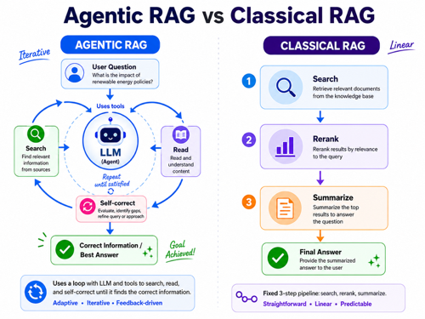
Agentic RAG
Agentic RAG - uses a loop with LLM and tools to search, read, and self-correct until it finds the correct information https://www.youtube.com/watch?v=RxwjoegpI98
List Files, Grep (regex search) - returning line numbers and context
PydanticAI - helps to connect tools to an LLM
The Loop: The agent first lists files, then uses the "grep" tool to find mentions of a topic, and finally reads the most relevant files to formulate an answer
Visibility - streaming steps, debugging to see exactly which tool parameters the LLM is choosing
Structured Output (Pydantic model) - agent returns a clean JSON object containing the answer and specific citations (file name, quote, and line number)
Improvement - use ripgrep (rg) - better and faster
Safety Guards - request limits and maximum line-read constraints
Error Handling - return human-readable error messages - allows the LLM to understand what went wrong and try a different approach
Agentic RAG is more expensive and has higher latency than semantic RAG, but it is far more accurate for complex queries over private documentation because the agent can "think" and refine its search strategy dynamically

Slide 18
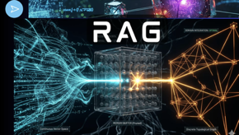
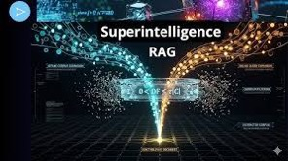
A Better, Cheaper RAG
A Better, Cheaper RAG - (Neuro-Sym Multi-hop Reasoning)
http://www.youtube.com/watch?v=CLjTCe_cvJs
TGS-RAG - bidirectional, makes RAG both more accurate and significantly cheaper
Combines text search with knowledge graphs
"orphan entity bridging" - saves pruned graph nodes in a memory buffer
If a parallel text search identifies a discarded node as relevant, the path is instantly "resurrected" without new database queries
This approach achieves superior local accuracy while using 80% less compute and drastically reducing token costs compared to industry standards like GraphRAG
https://www.youtube.com/watch?v=CLjTCe_cvJs
Meta’s Super Intelligent Retrieval Agent (SIRA) RAG
SIRA replaces multi-step agentic loops with a precise, one-shot mathematical approach
SIRA uses expanded BM25 lexical search instead of vector embeddings
It works by using an LLM to predict "expected response sketches" for queries and pre-expanding document indices with latent synonyms
This allows the system to capture fine-grained technical jargon often lost in vector compression
Benchmarks show significant accuracy gains over current models, critics highlight high offline compute costs and a heavy reliance on the LLM’s internal knowledge cutoff
SIRA aims to transform information retrieval into a deterministic, expert-level action rather than a stochastic search process.
https://github.com/facebookresearch/sira
https://www.youtube.com/watch?v=gxbp3BUo3wk

Slide 19




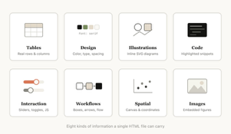
Markdown vs HTML
AI agents can easily create and use both Markdown (md) and HTML (html) files
Markdown files - default "work" files for documentation
Simple text format enables easy search (Grep)
Allow formatting, diagrams, links, images, tables (ASCII & Mermaid) [GitHub](https://github.com) ![Alt text](./assets/screenshot.png "Optional title")
document.md images/...
HTML can convey much richer information compared to markdown.
Formatted text | Tables | CSS | SVG Illustrations | Code blocks | Images | Interactive elements (Jacascript+CSS) | Workflows (SVG and HTML) | Spatial data (coordinates, canvases) document.html images/...
https://thariqs.github.io/html-effectiveness/
https://x.com/trq212/status/2052809885763747935

Slide 20
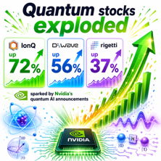
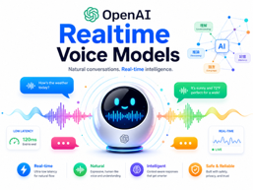
AI News
Quantum stocks exploded
IonQ up 72%, D-Wave up 56%, and Rigetti up 37% in recent trading days, sparked by Nvidia's quantum AI announcements
https://www.youtube.com/watch?v=WPPhts8bWgQ
OpenAI Realtime Voice Models https://www.youtube.com/watch?v=o_igSi-ED6s
GPT-Realtime-2 - the flagship model - $32 per 1M tokens. Featuring GPT-5-class reasoning, a 128k token context window, parallel tool calls, and improved conversational recovery for complex, long-form interactions
GPT-Realtime-Translate - live speech-to-speech translation across 70+ input languages and 13 output languages, handling accents and domain-specific terminology in real time
GPT-Realtime-Whisper - low-latency streaming transcription, returning transcript segments while the speaker is still talking

Slide 21


Progress in 3.5 years
ChatGPT
2022
Answers Questions
Context Length - 4K Hallucination - 40%
Digital Employee Today
Can create and execute plans, Context Length - 1,000K Can handle complex multi-step tasks
Can work for many hours without losing coherence Halucination - 2%

Slide 22

Digital Employee
A digital employee is an AI agent that doesn't just answer questions, but it takes autonomous action: managing email, running workflows, browsing the web, updating CRMs, booking travel, ...
Genspark Claw is one commercial example, positioned as a proprietary "AI Employee" platform with 631+ integrations https://kilo.ai/kiloclaw/alternatives/genspark-claw-alternative
Open Source Options
OpenClaw - self-host, pick LLM, interact through WhatsApp, Telegram, Slack, or 50+ messaging apps. Extends via 5,700+ community skills from the ClawHub marketplace. Its personality is defined in a SOUL.md file https://agentfactory.panaversity.org/docs/which-agents-2026
Hermes - https://hermes-agent.org
Manus AI - https://manus.im/blog/best-ai-agents-for-small-business
OpenClaw hosting options:
KiloClaw ; Abacus Claw ; Blink Claw ; ...
Example: Genspark Claw - "AI employee"
Executes multi-step tasks end to end, not just generates drafts
It runs inside a dedicated Genspark Cloud Computer per user, ensuring privacy through isolation
You assign tasks via a simple message on WhatsApp, Telegram, Slack, or Teams, and Claw handles research, drafting, scheduling, email, calls, and code deployment - then returns finished results
It orchestrates over 70 AI models, including Claude Opus, GPT, and NVIDIA Nemotron
Part of AI Workspace 3.0, it launched alongside Workflows, Meeting Bots, a Chrome Extension, and voice tools
Genspark has reached $200M ARR and a $1.6B valuation
https://www.youtube.com/watch?v=FJT5Rh0eKe8 - video
Enterprise Options
Genspark Claw - Enterprise AI employee, 631+ integrations https://kilo.ai/kiloclaw/alternatives/genspark-claw-alternative
Abacus ; Google Agentspace & Remy ; Microsoft Copilot Studio; Salesforce Agentforce ; 11x ; Moveworks ; Vybe ; Get BOB ; Noca AI
https://www.vybe.build/blog/best-ai-agent-platforms-2026
https://noca.ai/digital-employees-top-10-platforms-for-2026/

Slide 23


AI Updates
Pi (pi.dev) minimal, open-source, terminal-based AI coding agent
Built by developer Mario Zechner
Connects to 15+ model providers - including Anthropic, OpenAI, Google, Ollama, and others
Four modes: interactive TUI, print/JSON, RPC, and SDK
Pi deliberately omits features like sub-agents and plan mode, letting users build or install exactly what they need - https://pi.dev
holaOS is an open agent computer
A shared environment where humans and AI agents operate side by side, accessing the same browser, files, and apps
Everything lives in one place where memory, execution, and goals remain coherent, so work doesn’t reset or lose state
Agents operate continuously within this environment, evolving over time while remaining fully inspectable
You can shape agents via roles and templates
https://www.holaos.ai
https://github.com/holaboss-ai/holaOS

Slide 24

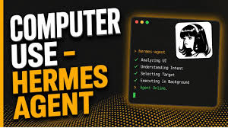
AI Updates
Hermes Agent and Pareto Code
Hermes Agent acts as a persistent "brain" that remembers past interactions and builds custom skills
Pareto Code, an experimental router from Open Router, automatically selects the most effective coding model (such as Claude or Gemini) based on task complexity
The system manages project memory and scheduling while ensuring the best available model handles technical execution
This setup eliminates decision fatigue and allows for cross-device continuity and sophisticated automation
https://openrouter.ai/openrouter/pareto-code
https://www.youtube.com/watch?v=kQHi_dXugbI
Hermes "computer use" on MacOS
Autonomously operate a Mac desktop - clicking, typing, and scrolling - entirely in the background without interrupting the user's active workflow
The agent uses vision-based screenshot analysis to navigate the screen and supports multiple AI models, including Claude, GPT-4, Gemini, and local models
Multi-layer safety guardrails require user approval for sensitive actions like file deletion
In demos, Hermes handled simple tasks well, such as creating notes and even spawning a second instance of itself, but struggled with complex workflows like organizing an Obsidian knowledge base

Slide 25

AI Updates
Pokee.ai - https://pokee.ai
https://www.youtube.com/watch?v=yZbgYOW-2rI - video
A managed agentic AI platform built around a sandboxed agent called Pokey Claw
It runs agents in isolated environments with encrypted credentials, a full audit log, and a human-in-the-loop approval gate for any actions touching files or public platforms
Its state-management architecture claims 70% lower token costs compared to standard GPT models by avoiding full context re-reads at each step
The platform supports parallel sub-agents, enabling complex tasks like building web apps, automating social media pipelines, and conducting market research simultaneously
Pricing: Free, $20/mo, $50/mo, $200/mo, Enterprise plans
Startup in Bellevue, WA, USA

Slide 26

Sabrina Ramonov - Making Money
5 Ways to Make Money in 2026 with AI - by Sabrina Ramonov
https://www.youtube.com/watch?v=Xl57Pki6ChE
1. building a personal brand by creating AI educational content and earning through sponsorships from well-funded AI startups.
2. making faceless videos using AI avatars for TikTok shop, motivation content, or offering avatar services to busy business owners.
3. providing Claude AI training to businesses, teaching teams to use Claude's productivity features through workshops.
4. vibe coding single-feature apps while avoiding overcomplication and focusing heavily on marketing rather than just product development.
5. setting up AI marketing automations including Go High Level CRM systems, ManyChat for Instagram/Facebook, and LinkedIn automation tools to help businesses convert social media attention into revenue.
Start simple, avoid perfectionism, choosing one path to stick with
AI reduces marketing costs x10
Automation includes voice-trained content engines, automated content pipelines, AI-powered distribution across platforms, and optimization for AI search engines
https://www.youtube.com/watch?v=74TkxLMfWOo

Slide 27

AI Updates
$80M in 6 Months With No Team (New Startup Playbook)
In 2026, the traditional barriers to starting a company (technical co-founders, capital, and long runways) have collapsed
AI now enables individuals to build prototypes in days, while lean methodology allows for validation without outside investment
This shift has created the "Founder Economy," where the primary advantage is ownership of a business model rather than just an audience or gig
However, this accessibility creates a new trap: the ability to build the wrong thing 10x faster
Because execution is now cheap, the new bottleneck is problem clarity
To succeed, "latent founders" with deep domain expertise must prioritize customer validation and small experiments over immediate building to ensure they are solving a problem people will actually pay for.
https://www.youtube.com/watch?v=KO7MxL6bKj4
Ash Maurya

Slide 28
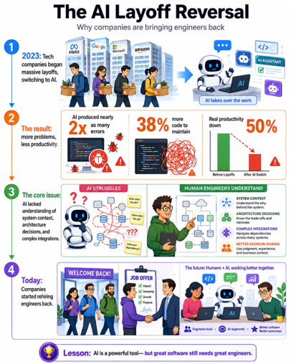
Companies Are Re-hiring Developers
Companies Are Re-hiring Developers
https://www.youtube.com/watch?v=6aTNBCqm3zE
In 2023, tech companies began massive layoffs switching to AI
Companies soon discovered that AI-generated code produced nearly twice as many errors, created 38% more code to maintain, and reduced real productivity by 50%
The core issue was that AI lacked understanding of system context, architecture decisions, and complex integrations
Debugging AI-generated code became extremely time-consuming
By 2026, companies began quietly rehiring developers, often the same people they had laid off, through "boomerang hiring."
The industry realized that understanding systems, debugging, and making informed architectural decisions are the valuable skills that AI cannot yet replicate effectively

Slide 29
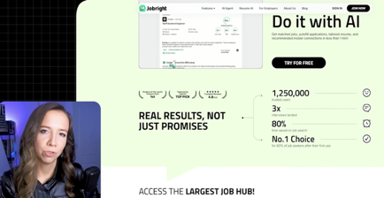
JobRight.AI
Julia McCoy argues that LinkedIn is broken due to pay-to-play promotions, ghost jobs (30–50% of listings), and companies bypassing aggregators entirely
The job market has three layers:
the visible market (high competition on LinkedIn/Indeed),
an aggregated market of 400,000+ scraped listings
and a hidden market of direct corporate postings
AI tool JobRight surfaces these hidden roles hours before they hit LinkedIn, with under 25 applicants. McCoy predicts LinkedIn loses dominance by end of 2026, AI agents handle first-round interviews by mid-2027, and traditional job searching is replaced by continuous AI-to-AI matching by late 2027
https://jobright.ai

Slide 30
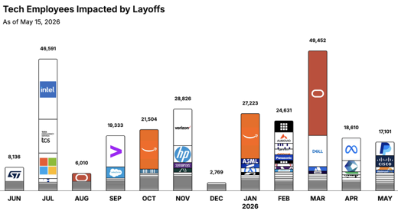
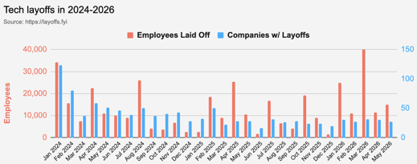
https://layoffs.fyi
https://trueup.io/layoffs
Jobs
The Tech Layoff Tracker
In 2026: 137,017 people laid off (1,015 per day)
In 2025: 245,953 people laid off (674 per day)
In 2024: 238,461 people laid off (653 per day)
https://trueup.io/layoffs
Tech Layoffs by year (US only):
109K in 2026 (as of May 15, 2026)
124K in 2025
153K in 2024
264K in 2023
165K in 2022 https://layoffs.fyi

Slide 31


About the Speaker
Lev Selector, Ph.D.
40+ years of software engineering, data science, and building teams (hiring, training, and managing)
Ph.D. in mathematical modeling and computer simulations
Interests:
Generative AI, Using LLM with your data
Local AI for Local Private Data
Cloud architecture, fin-tech, application security
Find/connect: Linkedin, GitHub, YouTube, Google
https://eais.ai
Enterprise AI Systems

Slide 32
Thank You!

