Slide 1
AI Updates - July 17, 2026
Vulkan and Mojo are challenging Nvidia CUDA
Crowd-sourced "LM Arena" Leaderboard
Cost Per Intelligence Index
Meta Muse Spark 1.1 for Agents
Hermes Cloud offers VPS agents in 60 sec
Nous Research $75 Mn at $1.5 B valuation
Nous Research is an open-source AI lab
PrismML Runs 27B-params Qwen on iPhone
Thinking Machines Inkling - open weight LLM
Kimi K3 2.8T-A50B Open Weight LLM
WebAssembly (WASM) vs Docker
Hyper-specific Marketing
Leya - legal AI platform
ElevenLabs - $600 Mln ARR
Second Brain wiki knowledge system
Self-Improving AI Agents
/workflow in Claude Code
AI Helps Quantum Computers
"Compete Mode" technique
Satya Nadella - “reverse information paradox.”
How to Use Codex
OpenAI ChatGPT Work - an autonomous agent
Anaconda has acquired Kilo Code
Suno source Code was hacked
Vercel "Eve" open source AI Agent Framework
Anthropic Rewrote Bun into Rust
GitHub Repos That Feel Illegal to Know
Vulkan and Mojo vs Nvidia CUDA
Qualcomm, Vulkan, Khronos Group
llama.cpp vs Ollama
Ollama vs llama.cpp vs vLLM
Mojo language, MAX inference
How to use Mojo from Python
LazyGraphRAG is x25 cheaper (Nov 2024)
Fable 5 orchestrator + ChatGPT's Codex Worker
SQLite vs Pinecone
OpenAI GPT Live Voice Models
How to summarize YouTube videos on MacOS
Docker Swarm vs Kubernetes
Xbox planning to cut 50% jobs in 2027
Jobs & Layoffs

Slide 2
"LM Arena" Leaderboard
Data for July 16
Starting Elo rating = 1000
https://en.wikipedia.org/wiki/Elo_rating_system
English - https://lmarena.ai/leaderboard/text
Coding - https://lmarena.ai/leaderboard/text/coding
■ | Claude
■ | Gemini
■ | OpenAI
■ | Open Source
Claude Fable-5 - 6TB
Claude Opus-4.8 - 5TB
Claude Sonnet-4.5 - 1TB
GLM-5.1 - 744B
Meta muse-spark - 16 x 70B
Qwen3.7-max-preview - 745B
Baidu Ernie-5.1 - 800B
Deepseek-v4 - 1.6T
Kimi-k3 - 2.8T
Xiaomi MiMo-V2-Pro - 1T+
ByteDance dola-seed-2.0-pro 400B
Minimax M3 - 456B
Code | Model | Score
■ | claude-fable-5 | 1507
■ | claude-opus-4-6-thinking | 1504
■ | claude-opus-4-7-thinking | 1503
■ | claude-opus-4-6 | 1498
■ | claude-opus-4-7 | 1494
■ | muse-spark-1.1 | 1493
■ | muse-spark | 1487
■ | gemini-3-pro | 1486
■ | kimi-k3 | 1486
■ | gpt-5.6-sol-xhigh | 1486
■ | gemini-3.1-pro-preview | 1485
■ | claude-opus-4-8-thinking | 1483
■ | gpt-5.5-high | 1482
■ | gpt-5.4-high | 1478
■ | gemini-3.5-flash-high | 1476
■ | gpt-5.2-chat-latest-20260210 | 1476
■ | claude-opus-4-8 | 1476
■ | qwen3.7-max-preview | 1475
■ | gpt-5.5 | 1475
■ | grok-4.20-beta1 | 1474
■ | gemini-3.5-flash-medium | 1474
■ | gemini-3-flash | 1473
■ | gpt-5.5-instant | 1473
■ | grok-4.20-beta-0309-reasoning | 1473
■ | claude-opus-4-5-20251101-thinking-32k | 1473
Code | Model | Score
■ | claude-opus-4-7-thinking | 1553
■ | claude-fable-5 | 1551
■ | claude-opus-4-6-thinking | 1550
■ | claude-opus-4-6 | 1549
■ | claude-opus-4-7 | 1548
■ | claude-opus-4-8-thinking | 1535
■ | claude-opus-4-8 | 1533
■ | muse-spark-1.1 | 1532
■ | claude-opus-4-5-20251101-thinking-32k | 1530
■ | kimi-k3 | 1529
■ | claude-sonnet-4-6 | 1527
■ | qwen3.7-max-preview | 1527
■ | muse-spark | 1525
■ | gpt-5.6-sol-xhigh | 1523
■ | claude-sonnet-5-high | 1523
■ | claude-opus-4-5-20251101 | 1523
■ | glm-5.1 | 1521
■ | gemini-3.1-pro-preview | 1521
■ | gpt-5.4-high | 1521
■ | claude-sonnet-4-5-20250929-thinking-32k | 1520
■ | gpt-5.5-high | 1519
■ | grok-4.5 | 1519
■ | gemini-3-pro | 1519
■ | mimo-v2.5-pro | 1518
■ | gpt-5.2-chat-latest-20260210 | 1516
https://lmarena.ai/leaderboard/text
Design Arena - https://www.designarena.ai
https://openlm.ai/chatbot-arena/
https://beta.lmarena.ai
Web Leaderboard - 1T params https://web.lmarena.ai/leaderboard
LLM Leaderboard - by @LlmStats - https://llmworld.net/llm_leaderboards/
LLM Leaderboard - by StackAI - https://www.stack-ai.com/llm-leaderboard
LLM Leaderboard - by Artificial Analysis - https://artificialanalysis.ai/leaderboards/models
Open LLM Leaderboard - by Hugging Face - https://huggingface.co/open-llm-leaderboard
LLM Leaderboard - by Vellum - https://www.vellum.ai/llm-leaderboard
AI Benchmarking Hub - https://epoch.ai/data/ai-benchmarking-dashboard
Grok 4 Benchmarks - https://artificialanalysis.ai/models/grok-4
Image arena (alibaba) - http://aiarena.alibaba-inc.com/corpora/arena/leaderboard?arenaType=T2I
image arena - https://lmarena.ai/leaderboard/text-to-image

Slide 3
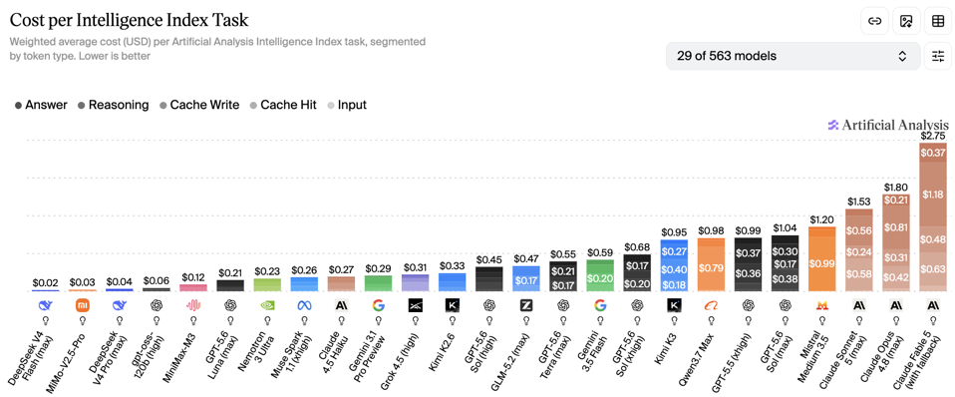
Artificial Analysis Intelligence Index
Artificial Analysis Intelligence Index
https://artificialanalysis.ai
https://artificialanalysis.ai/evaluations/artificial-analysis-intelligence-index
https://www.youtube.com/watch?v=nxr20lcqagg - Anthropic vs OpenAI
July 17

Slide 4


AI Updates
Meta Muse Spark 1.1 Multimodal reasoning model for Agents
Highly competitive in coding, computer use, and tool calling
Outperforms Gemini 3.1 Pro and matches or beats expensive models like Opus 4.8 in agentic coding tasks at just 20% of the cost
Context Length 1 Mln tokens
Supports parallel agents across apps
Excels in computer use tasks
Robust code generation capabilities
Superior multimodal vision reasoning
Can be used from Claude Code, similar to Opus 4.8, much cheaper
https://www.youtube.com/watch?v=gI5d2czu9JE
Hermes Cloud allows to deploy agents to a VPS in 60 sec
New features include an outreach lead-generation tool powered by Hunter’s API and Hermes Oracle, which pulls trending industry news from Twitter to recommend unique content angles
Hermes Apollo offers a voice-controlled agent capable of building apps and websites
Hermes Astros for competitor analysis linked to an Obsidian memory system
A video agent for automated scripting and animation
A multi-agent group chat that brainstorms and queues app development ideas
https://www.youtube.com/watch?v=kURZuF5FLdo
Nous Research seeks funding $75 Mn at $1.5 billion valuation
Its Hermes Agent (on GitHub and HuggingFace) has built massive developer adoption
Nous Research follows the Red Hat/HashiCorp playbook: give away the model, monetize at the infrastructure and services layer
Agent-specific fine-tuning creates real switching costs, making Hermes stickier than general-purpose LLMs
Hermes AI update "segmented tool batch dispatch" allowing parallel agent workflows to run much faster. Instead of executing tools one-by-one when a dependent task is present, it runs all safe actions simultaneously and only pauses unsafe ones, significantly speeding up complex, multi-step AI tasks.

Slide 5





Nous Research is an open-source AI lab
Nous Research is an open-source AI lab https://nousresearch.com
Founded in 2022 as an anonymous online research community, formally incorporated in 2023
The ~20-person team, led by CEO Jeffrey Quesnelle and Head of Post-Training "Teknium", has built one of the most-used open-weight model families in existence: the Hermes series, downloaded over 55 Mln times on HuggingFace - https://www.linkedin.com/company/nousresearch https://huggingface.co/NousResearch
Their technical flagship is DisTrO (Distributed Training Over-the-Internet), which reduces inter-GPU communication bandwidth by up to x10K, enabling large model pre-training over standard internet connections rather than datacenter supercluster interconnects https://sp-edge.com/companies/3929124 ; https://github.com/NousResearch/DisTrO
Hermes Agent - released Feb 2026 - is their open-source self-improving agent framework featuring a built-in learning loop that creates and refines skills from experience, with MCP support, multi-provider compatibility (Ollama, vLLM, Anthropic, etc.), and 20+ messaging platform integrations https://hermes-agent.nousresearch.com/docs/ https://github.com/nousresearch/hermes-agent
The company has raised ~$70M total, with a $50M Series A led by Paradigm in April 2025. Currently raising $75 Mln at 1.5 Bln valuation
Their Psyche Network uses Solana blockchain to coordinate globally distributed GPU compute for collaborative model training https://nousresearch.com/nous-psyche https://siliconangle.com/2025/04/25/nous-research-raises-50m-decentralized-ai-training-led-paradigm/)
Jeffrey Quesnelle
Nous Research CEO

Slide 6

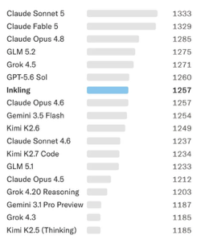

AI Updates
PrismML Runs 27B-params Qwen LLM on an iPhone 17 Pro
PrismML used 1-bit and ternary quantization technique "Bonsai" which shrunk the model size from 54GB down to 3.9GB or 6GB
It was running on iPhone at 11 tokens/sec
The compressed model retain 90% to 97% of their original quality
It also supports 4-bit vision and 262K token context length
Also supports speculative decoding via DSpark for optimized latency
Problems with complex tasks (tendency to go into loops)
Prism ML (PrismML) is a Caltech-origin AI lab and startup
https://prismml.com
https://www.macrumors.com/2026/07/09/apple-prismml-larger-on-device-ai-models/
https://www.trendforce.com/news/2026/07/10/news-prismml-reportedly-shrinks-alibabas-qwen-3-6-to-run-on-iphone-17-pro-drawing-apples-interest/
Thinking Machines Inkling - open weight LLM
From Mira Murati’s startup Thinking Machines Lab
MoE (975B, 41B active) multimodal model
You can ask it to fine-tune itself !
Available on Tinker, Databricks’ Unity AI Gateway, and others
Inkling performs competitively on agentic and audio-heavy tasks
Cost-efficient option
https://thinkingmachines.ai/news/introducing-inkling/

Slide 7

AI Updates
Kimi K3 2.8T-A50B Open Weight LLM from Moonshot.ai
2.8T params, sparse MoE, 1M-tokens window, Multimodal
Kimi K3 is accessible via Kimi’s web app, desktop clients, Kimi Code, and the Kimi API, and uses separate pricing for input and output tokens with caching‑aware billing for large workloads.
Pricing $3 / $15 per 1M tokens on OpenRouter
https://www.kimi.com

Slide 8
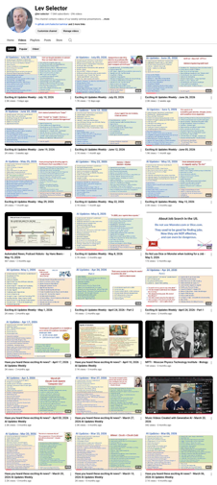
We do these weekly videos every Friday
Stats: 7.06K subscribers, 296 videos
1. Subscribe to this channel https://www.youtube.com/@lev-selector
2. Download slides from GitHub using links under the videos
3. Please pause the video - and answer the pinned question in comments under the video

Slide 9



Vulkan and Mojo
Vulkan and Mojo vs Nvidia CUDA https://www.youtube.com/watch?v=oZagkCkBkww
For 15 years Nvidia's CUDA had a monopoly. But now we have convenient alternatives - Vulkan and Mojo
Vulkan is an open graphics API from video gaming. It allows users to run local LLMs seamlessly on almost any GPU, including AMD, Intel, and Apple Silicon. In many benchmarks, Vulkan runs even faster than AMD's official software https://www.vulkan.org
Mojo is a new programming language designed to replace CUDA entirely. It allows developers to write clean, Python-like code that compiles directly to any hardware
Mojo matched Nvidia's own hand-tuned CUDA performance on its flagship chip using a fraction of the code https://mojolang.org
Qualcomm has acquired Mojo's parent company Modular for ~ $4 Bln - https://www.modular.com
Vulkan is a cross‑platform graphics and compute API
Created by the Khronos Group as a modern successor to OpenGL
Vulkan 1.0 spec was released on 16 Feb 2016
Khronos hosts Vulkan’s core ecosystem on GitHub via the organization `KhronosGroup`, including key repositories such as `Vulkan-Docs`, `Vulkan-Headers`, and `Vulkan-Loader`
The official entry point promoted in Khronos materials is https://github.khronos.org which routes into these Vulkan-related repositories and other tools maintained by the group
https://en.wikipedia.org/wiki/Vulkan
Qualcomm is a global semiconductor and wireless technology company headquartered in San Diego, California
It designs and sells Snapdragon processors, 5G modems, and connectivity chips that power smartphones and other connected devices
It earns additional revenue by licensing its extensive portfolio of wireless communication patents worldwide
https://simple.wikipedia.org/wiki/Qualcomm
The Khronos Group is a non‑profit, member‑driven industry consortium that creates open, royalty‑free standards for graphics, compute, XR, and related domains.
Its standards portfolio includes OpenGL, WebGL, Vulkan, OpenCL, OpenXR, SYCL, OpenVX, glTF, etc.
150–180 member organizations
Headquarters located in Beaverton, Oregon, USA
https://www.khronos.org

Slide 10
llama.cpp vs Ollama
Switching from Ollama to the new llama.cpp WebUI
llama.cpp is lighter, faster to start, and more transparent, with simpler dependencies and direct control over GGUF models
The WebUI and CLI give enough usability that Ollama’s “batteries included” wrapper no longer feels worth the overhead and limitations
Better GPU utilization (including Vulkan) and lower disk footprint
than relying on Ollama’s curated layer
https://www.xda-developers.com/i-ditched-ollama-after-using-llama-cpp-webui-and-im-not-going-back/
llama.cpp WebUI can run fully locally on a Mac Apple Silicon and run local or hf (HuggingFace) models
It includes llama-server with Metal acceleration for M‑series GPUs
brew install llama.cpp
llama-cli -m /path/to/model.gguf
llama-server -m /path/to/model.gguf
llama-server -hf nzgnzg73/llama_cpp_WebUI:Q4_K_S
Hit http://localhost:8080/ in the browser to reach the WebUI
https://docs.openwebui.com/getting-started/quick-start/connect-a-provider/starting-with-llama-cpp/
# Running llama.cpp with Vulkan engine
GGML_VULKAN=ON
llama-cli -m /path/to/model.gguf -ngl 50
# pip install llama-cpp-python
from llama_cpp import Llama
llm = Llama(
model_path="/path/to/model.gguf",
n_gpu_layers=-1, # use GPU if available
n_ctx=4096,
)
out = llm(
"Q: Name solar system's planets.\nA:",
max_tokens=128,
stop=["Q:", "\n"])
print(out["choices"][0]["text"])
curl http://127.0.0.1:8080/v1/chat/completions \
-H "Content-Type: application/json" \
-d '{
"model": "local-model",
"messages": [{"role":"user","content":"Say hi from llama.cpp"}]
}'

Slide 11





Ollama vs llama.cpp vs vLLM
Ollama - developer-friendly local runner that wraps a llama.cpp‑style GGUF engine, prioritizing simplicity, easy installs, and single-user or low-concurrency use
llama.cpp is the low-level C++ workhorse: extremely portable, CPU-friendly, and great with aggressive quantization, ideal for edge devices and fine-grained control
vLLM is a production inference server optimized for NVIDIA GPUs, high throughput, and many concurrent requests, with features like PagedAttention, continuous batching, and long-context optimizations
For local tinkering, Ollama or llama.cpp are usually best
For multi-agent systems, long histories, and multi-user backends, vLLM typically wins on effective throughput and scalability
Mojo is a new language used to implement fast kernels for ML
MAX (Modular Accelerated Xecution) AI inference platform for Mojo
Modular’s booth at GTC 2026 showed:
Live GPU programming in Mojo on Blackwell
A port of a CUTLASS Blackwell Conv2D kernel to Mojo, with claims of up to 6.6× faster performance than cuDNN on B200
DeepSeek V3 and FLUX.2 image generation running on B200
Mojo is approaching "production" (ver. 1.0.0b2 beta)
Mojo will need to prove itself against years of optimization in llama.cpp and vLLM

Slide 12


How to use Mojo from Python
How to use Mojo from Python https://mojolang.org/docs/manual/python/
math_mod.mojo
from std.python import PythonObject
from std.python.bindings import PythonModuleBuilder
def add(a: PythonObject, b: PythonObject) -> PythonObject:
return Int(py=a) + Int(py=b)
@export
def PyInit_math_mod() -> PythonObject:
var mb = PythonModuleBuilder("math_mod")
mb.def_function[add]("add")
return mb.finalize()
main.py
import mojo.importer # install Mojo import hook
import math_mod # compiles and loads math_mod.mojo
print(math_mod.add(2, 3)) # 5
On first import, Mojo compiles math_mod.mojo to a shared library and caches it; subsequent imports just load the compiled module
MAX (Modular Accelerated Xecution) AI inference platform https://www.modular.com/open-source/max
High-performance AI inference framework from Modular
Lets you build, optimize, and serve models across CPUs and GPUs
Includes the MAX Engine (graph compiler and runtime), MAX Graph (Python API for building pipelines), and MAX Serve (OpenAI‑style serving layer)
MAX allows deep customization using Mojo-written kernels
MAX is mostly open source. MAX Python API, serving library, GPU kernel stack, and open‑weight model pipelines are already open‑sourced under Apache‑2.0 and live in the modular repo

Slide 13




AI Updates
LazyGraphRAG is x25 cheaper (Nov 2024)
It is a graph‑based RAG method that skips expensive corpus‑wide LLM summarization at indexing time
Instead it builds and uses graph structure “just in time” while answering queries
This makes indexing cost roughly equal to plain vector RAG and about 0.1% of traditional GraphRAG’s cost
At query time, it combines vector search with iterative deepening over lightweight graph neighborhoods, spending LLM tokens only where they improve relevance
Benchmarks show it outperforms other RAG methods, including full GraphRAG, for both local and global queries while using as little as 4% of GraphRAG’s query cost
https://www.microsoft.com/en-us/research/blog/lazygraphrag-setting-a-new-standard-for-quality-and-cost/
SQLite vs Pinecone
SQLite is a 25-year-old database installed on billions of devices
It has sqlite-vec extension that allows to store and query vector embeddings within a single local file using standard SQL
Instead of using complex, expensive cloud-hosted databases like Pinecone
The local setup eliminates network latency, slashes bills, and keeps user data secure on-device, even running in-browser via WebAssembly
Companies like Turso are rebuilding SQLite in Rust to handle concurrent writes for agentic AI
While dedicated engines are still necessary for massive-scale vector searches, SQLite + AI offers a highly efficient, private, and zero-cost alternative for most applications
https://www.youtube.com/watch?v=psSL3Fi5zJE
Fable 5 orchestrator + ChatGPT's Codex Worker
Fable 5 by itself is costly and slow
Fable 5 + Claude Opus 4.8 - mediocre results
Opus prompted to mimic Fable - failed
Fable 5 orchestrator + ChatGPT's Codex Worker - winner
https://www.youtube.com/watch?v=noWZ8AyD8kI

Slide 14
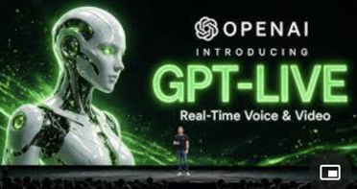
AI Updates
OpenAI GPT Live Voice Models
GPT Live 1 & GPT Live 1 Mini
full-duplex interaction
rapid voice responses while a reasoning model like GPT 5.5 handles heavy background tasks
Massive performance leap in complex, noisy telecommunications environments compared to previous voice modes
Examples - real-time visual outfit critiques, interactive data browsing on screen, seamless multi-language translation, and precise temporal awareness for tracking real-time tasks
https://www.youtube.com/watch?v=AwWmUhm4xYA
How to summarize YouTube videos on MacOS
Open System Settings → Keyboard → Text Replacements
Click the "+" button
In the Replace field, type a short trigger string, for example: ,,s
In the With field, paste: Please make a short 100-120 words plain text summary of this -
Press Enter to save
Open Google Gemini, click into chat field, press ,,s followed by space , then paste the YouTube URL
YouTube
URL
Text Summary

Slide 15
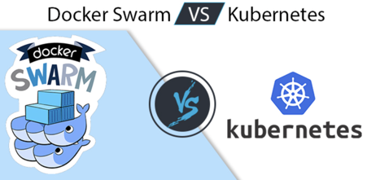

AI Updates
Docker Swarm is a lightweight alternative to Kubernetes
Kubernetes is over-engineered for roughly 85% of cases
Docker Swarm is a Docker’s built‑in container orchestration system
It lets you manage a cluster of Docker Engines as if they were a single virtual host
You enable “swarm mode” on one Docker node, which becomes a manager, then join other nodes as workers
Together they form a swarm cluster. You define services (essentially replicated containers) and a desired state, such as “run 5 replicas of this image,” using the Docker CLI or Compose
The manager schedules tasks onto workers, constantly reconciling actual state with desired state—if a node dies, the manager reschedules the missing replicas elsewhere
Swarm also provides built‑in overlay networking, internal DNS and load balancing for services, plus rolling updates and automatic rollback
https://www.youtube.com/watch?v=e80nlacPl84
WebAssembly (WASM) vs Docker
WASM module is a lightweight binary that executes compiled bytecode inside a compact, secure sandbox
This structure slashes startup times from seconds to under a millisecond and cuts memory footprints down to a few megabytes
Major platforms like Cloudflare and Akamai are already deploying WASM at massive scale
While Docker remains dominant for heavy, stateful jobs like databases and machine learning, WASM is becoming the go-to standard for edge computing, serverless functions, and untrusted AI tool execution
https://www.youtube.com/watch?v=U8yzw0rc-RI

Slide 16




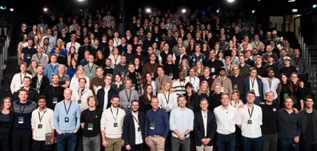
AI Updates
Hyper-specific Marketing
Julia McCoy argues that generic niches are dead, and 76% of e-commerce stores fail due to picking the wrong audience
To succeed, sellers must target hyperspecific "micro-aesthetics" by combining identities, interests, and contexts (e.g., " Corgi eating ramen").
Using an AI research stack consisting of Google Trends, Exploding Topics, and TikTok, creators can identify rising trends before validating them on Etsy
McCoy recommends using Printify’s low-risk, print-on-demand model to cheaply test up to 20 micro-niches simultaneously, advising sellers to ruthlessly kill underperforming niches while scaling the immediate winners
https://www.youtube.com/watch?v=5m-ez2sW_vo .
ElevenLabs - $600 Mln ARR
Scale their human-like voice synthesis
https://www.youtube.com/watch?v=J0bce9WQJ-g
Leya (Legora) - legal AI platform
Swedish AI Startup (2023)
London, NY, 650+ employees
https://legora.com

Slide 17
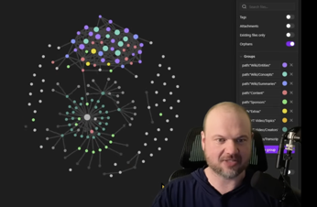
Second-Brain Wiki
Second Brain wiki knowledge system
By Wes Roth - following Andre Karpathy Obsidian wiki idea using md files
It uses Claude Code to ingest, cross-link, and summarize raw notes, tweets, and research papers into a flat folder structure
This creates an evolving knowledge graph that allows users to query their personal data for actionable insights
Ultimately, it automates workflows like tracking projects or schedules while ensuring users retain total data ownership
https://www.youtube.com/watch?v=cwf2vEAigKA
Your-Second-Brain/
│
├── .cursor/ or .claude/ # Configuration directories for your local AI tools
├── Inbox/ # Quick text captures, dictations, and unorganized notes
├── Raw/ # Immutable source files (web scrapes, transcripts, raw API data)
│
├── Wiki/ # The Compounding Knowledge Base (Managed by the AI Librarian)
│ ├── Concepts/ # Broad topic overviews (e.g., [[Machine Learning]])
│ ├── Entities/ # Specific elements (e.g., [[OpenAI]], [[Wes Roth]])
│ └── Summaries/ # AI-generated cliff notes and metadata summaries of Raw documents
│
├── Dashboards/ # Actionable visualization layers
│ ├── Projects.md # Kanban board or task dashboard
│ ├── Index.md # Dynamic structural anchor for human browsing
│ └── Log.md # System operational changelog
│
└── claude.md # The AI System Rulebook (The "Employee Handbook")

Slide 18

AI Updates
Self-Improving AI Agents | Evolving the Harness, Not the Model
https://www.youtube.com/watch?v=KoDohnhLpJM
Explores "loop engineering" - the practice of improving AI agents by iteratively modifying their "harness" (the surrounding software code, prompts, and tools)
Through a real-world experiment, the creator demonstrates how a secondary, stronger AI model successfully diagnoses an agent's failure to process long log files, pinpointing a data clamping bottleneck in the harness
By raising a configuration value within a strictly defined "editable surface," the fixing model resolves the issue
Crucially, the video advocates for a safe, human-in-the-loop workflow, verifying updates against hidden tests and submitting manual pull requests rather than deploying changes automatically

Slide 19


AI Updates
/workflow in Claude Code
Claude writes typescript to orchestrate multi-agent systems
A single project can deploy dozens of background sub-agents across structured phases: understanding, researching, refactoring, and verifying
Running asynchronously from the primary session thread, these workflows execute complex codebase-wide tasks such as deep vulnerability sweeps or game development optimization
Developers must actively manage their token budgets, caps, and agent sizing to control costs effectively
https://www.youtube.com/watch?v=9pj3-zDw4eU
AI Helps Quantum Computers
Q-day - when quantum computers can break modern encryption
How many qbits needed? Number dropped x40 times from 20 Mln to 0.5 Mln.
Google, Cloudflare, and IBM have moved their post-quantum security deadlines up to 2029
Julia McCoy warns about the immediate threat of "harvest now, decrypt later," where adversaries steal data today to decrypt in the future. She advises businesses to audit their security stacks immediately
https://www.youtube.com/watch?v=FpbIPqVuNFw

Slide 20

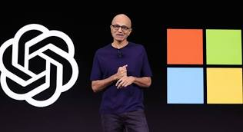
AI Updates
"Compete Mode" technique
A powerful prompting strategy for Claude Code, originally shared by Anthropic’s head of product, Angela Jen
Prompting Claude to spawn multiple parallel sub-agents - such as an operator, a strategist, and a skeptic - that work independently on a task without seeing each other's progress. A separate blind judge agent evaluates their final outputs to select and refine the winning version
The competition approach produces a cleaner, significantly more interactive website with less filler text
However, because it consumes more time and tokens, the creator advises saving this tactic for high-priority projects
https://www.youtube.com/watch?v=PqlnPcae5OQ
Satya Nadella - “reverse information paradox.”
Companies using AI are taking a risk of giving away valuable proprietary knowledge along with paying for AI services
They share their data, prompts, and corrections - which can be used to train models and benefiting providers
This creates growing information asymmetry and potential competitive risk
It is ironic to hear this from Microsoft because Microsoft itself is engaged in advancing AI and collecting user data through tools like Copilot
https://www.theregister.com/ai-and-ml/2026/07/13/microsoft-chief-turns-hostile-on-frontier-ai-labs-warns-companies-to-guard-their-ip/5270628

Slide 21

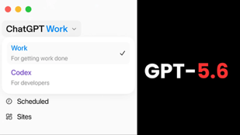
AI Updates
How to Use Codex
Matthew Berman shares advanced tips and tricks for using Codex
How to strategically match task difficulty with the correct GPT-5.6 model sizes (Soul, Terra, and Luna) and adjustments to thinking efforts
How to effectively cross-manage and delegate tasks using parallel Codex threads, clean up outdated rules within the configurations, and add features through integrations like Zapier plugins and community-sourced skill libraries
Using "goals" automation loops
Controlling desktop sessions from mobile devices via QR codes
Setting up strict lifecycle hooks and approval filters to prevent accidental file deletion or security breaches
https://www.youtube.com/watch?v=etduwo9Lu3M
OpenAI ChatGPT Work - an autonomous agent that integrates into apps like Gmail and Slack
It turns high-level goals into finished outputs like documents, decks, sites, and apps by orchestrating tools across your apps, files, browser, and desktop
Powered by GPT‑5.6, it is designed for long-lived projects, keeping context over hours and automating multi-step workflows, including scheduled recurring tasks such as weekly reports or marketing campaigns
It can perform “computer use” via the ChatGPT desktop app, operate over team tools and data sources, and publish directly to simple hosted sites, positioning it as a collaborative work partner rather than just a chat interface - https://openai.com/chatgpt-work/

Slide 22


AI Updates
Anaconda has acquired Kilo Code
Kilo Code - open-source agent engineering platform, used by 3+ Mln developers
Kilo enables teams to build and run specialized AI agents for tasks like planning, coding, and debugging within existing tools such as VS Code, JetBrains, and the CLI
It supports routing across 500+ models from 60+ providers, avoiding vendor lock-in, and processes nearly 10 trillion tokens monthly
Combined with Anaconda’s ecosystem for packages and environments, the acquisition aims to deliver secure, enterprise-scale AI agent workflows
For now, nothing changes for users - Kilo remains independent, with continued open development and unchanged products, contracts, and support
https://www.anaconda.com/blog/anaconda-acquires-kilo-code
https://www.anaconda.com
https://kilo.ai
Suno source Code was hacked
A hacker accessed Suno’s internal source code and infrastructure by infecting an employee with a worm that stole GitHub and cloud credentials, then shared data with 404 Media
The leaked code and logs reportedly detail how Suno scraped music and lyrics at scale from sites like YouTube Music, Deezer, Genius, stock music libraries and hundreds of thousands of podcasts via RSS feeds, including acapella tracks, using commercial proxy services
The hacker also obtained a customer list with email addresses and phone numbers
https://www.engadget.com/2215772/a-hacker-accessed-suno-source-code-that-reportedly-details-how-the-company-scraped-millions-of-songs/

Slide 23


AI Updates
Vercel "Eve" - open source file-system-first AI Agent Framework
Eve simplifies agent development by structuring an entire AI agent as a single folder containing modular TypeScript and Markdown files for instructions, skills, tools, and sub-agents
An automatic compiler bundles these files together without manual imports
Eve is specifically designed for production-grade reliability
The framework is utilizing Vercel's infrastructure, supports durable session checkpoints, isolated code execution sandboxes, human-in-the-loop approval gates (demonstrated via Slack), and built-in evaluation workflows, allowing developers to scale highly reliable agents to millions of users.
https://www.youtube.com/watch?v=m8VC2SV2igM
agent.ts
instructions.md
skills/
tools/
sub_agents/
channels/
schedules/
evals/
sandbox/
Anthropic Rewrote Bun into Rust
Bun, the JavaScript toolkit acquired by Anthropic
Bun is a fast JavaScript runtime that also includes a bundler, transpiler (including TypeScript→JavaScript), and package manager
It was rewritten from Zig to Rust in 11 days or early May 2026
Using 64 parallel Claude AI agents (at a simulated cost of $165K) ported over 500K lines of code, resolving 128 long-standing bugs and reducing binary size by 20%.
https://www.youtube.com/watch?v=CXSvKcLovAk

Slide 24

Very Good GitHub Repos
Based on the video "GitHub Repos That Feel Illegal to Know" https://www.youtube.com/watch?v=jgsDu9MubJM
https://github.com/freeCodeCamp/freeCodeCamp
https://github.com/codecrafters-io/build-your-own-x
https://github.com/kamranahmedse/developer-roadmap
https://github.com/ossu/computer-science
https://github.com/EbookFoundation/free-programming-books
https://github.com/TheAlgorithms
https://github.com/yangshun/tech-interview-handbook
https://github.com/donnemartin/system-design-primer
https://github.com/immich-app/immich - local photos
https://github.com/Stirling-Tools/Stirling-PDF - work with PDF
https://github.com/localsend/localsend - secure file sharing
https://github.com/excalidraw/excalidraw - white board
https://github.com/AppFlowy-IO/AppFlowy - like Notion
https://github.com/coollabsio/coolify - like self-hosted Vercel
https://github.com/public-apis/public-apis - APIs
https://github.com/ripienaar/free-for-dev - cloud infra
https://github.com/ollama/ollama - Ollama
https://github.com/sindresorhus/awesome - index of indexes

Slide 25
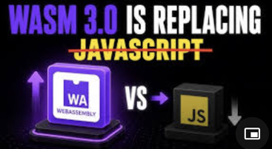
AI Updates
WebAssembly (Wasm 3.0) is breaking JavaScript's 30-year browser monopoly
Wasm enables languages like C++, Rust, and Go to execute inside a safe browser sandbox at near-native speeds
The release of Wasm 3.0 introduces native garbage collection, drastically reducing overhead for managed languages like Java and Kotlin
Beyond the browser, Wasm is moving to serverless environments and the edge, directly competing with heavy Docker containers due to its sub-millisecond cold starts and strict security
Ultimately, JavaScript and WebAssembly are becoming collaborative partners rather than rivals, with JavaScript acting as the front-end glue and Wasm running the heavy-lifting engine room
https://www.youtube.com/watch?v=VQHRUQDCh_Q

Slide 26


Jobs & AI
Xbox planning to cut 50% jobs in 2027
https://www.youtube.com/@ThePrimeTimeagen
Michael B. Paulson (a.k.a. ThePrimeagen) analyzes a major restructuring memo from Xbox's new CEO, Asha
Xbox is cutting approximately 3,200 jobs through fiscal year 2027, starting with 1,600 immediate terminations, while four studios will leave Xbox management altogether.
The division is struggling with weak margins, high costs tied to AI, and stagnant Game Pass growth
Most shockingly, the memo reveals that some departments operate under up to 14 layers of management !!
To restore accountability, Microsoft plans to flatten this structure down to five or fewer layers.
Viewing AI as a tool for employee replacement backfires
Using it for amplification - succeeds
A Gartner study reveals that 80% of companies deploying AI cut staff, yet these layoffs failed to improve financial returns
Cloudflare, Oracle, and Coinbase experienced stock drops or talent risks after cutting employees while citing AI-driven productivity gains
Gartner predicts half of these companies will rehire for the same roles by 2027
https://www.youtube.com/watch?v=Yrhoz61_sqQ

Slide 27
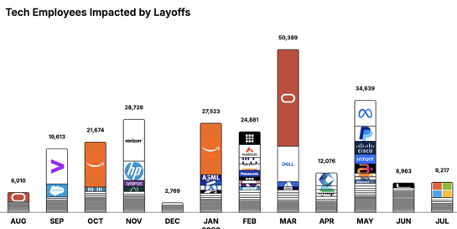
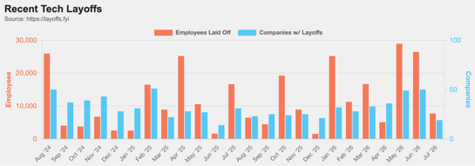
https://layoffs.fyi
https://trueup.io/layoffs
Jobs
The Tech Layoff Tracker
In 2026: 167,688 people laid off (847 per day)
In 2025: 245,953 people laid off (674 per day)
In 2024: 238,461 people laid off (653 per day)
https://trueup.io/layoffs
Tech Layoffs by year (US only):
121K in 2026 (as of July 17, 2026)
124K in 2025
153K in 2024
264K in 2023
165K in 2022 https://layoffs.fyi

Slide 28


About the Speaker
Lev Selector, Ph.D.
40+ years of software engineering, data science, and building teams (hiring, training, and managing)
Ph.D. in mathematical modeling and computer simulations
Interests:
Generative AI, Using LLM with your data
Local AI for Local Private Data
Cloud architecture, fin-tech, application security
Find/connect: Linkedin, GitHub, YouTube, Google
https://eais.ai
Enterprise AI Systems

Slide 29
Thank You!

