Slide 1
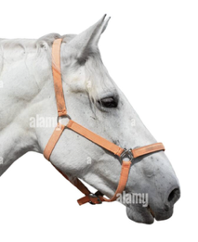
AI Updates - Aug 21, 2026
“The frontier is shifting from larger models
to better scaffolding around the models we already have.”
Crowd-sourced "LM Arena"
Cost Per Intelligence Index
Model Routing - Strong Trend
Codex via OmniRoute - FREE
Qwen3.8-27B - Faster with MTP
GLM-5.3 Cybersecurity beats Mythos 5
VLA - Vision, Language, Action
SQLite for small web apps
AI-Ready Construction Drawings
Claude + Blender Animation
VEED.io: AI Video Production
Warp - Rust-based Terminal for AI
Do you need Kubernetes?
5 Lessons from teaching AI
CMUX: MacOS Multi-Agent Terminal
Hermes Bot Mode in Hermes Desktop
Hermes Agents Go Portable
Matt Berman Open-Source AI Tools
Custom LLM Optimization
Claude Obsidian 2.0
Cursor, Codex, Claude, Zed, Anti-Gravity
Dots3-Note: Long-Horizon AI Model
Cursor Origin - Git code-hosting
Andrew Ng 2h course - Agents
Andrew Ng - Jobs in High Demand
Claude Cowork in Chrome
Anthropic’s multi-agent research
Claude Skills: Lazy Context Loading
OpenAI GPT-5.6 Sol Ultrafast on Cerebras
Etched raised $700M at $21B valuation
Google Sheets Canvas - Boards mini‑apps
DeepSeek Harness (DSH)
Workflows - JSON vs Python code
ChatGPT "Work"
AI Agent Cybersecurity Risks
AutoDesign: Evolving AI Harnesses
Loop & Harness Engineering
Jobs & Layoffs

Slide 2
"LM Arena" Leaderboard
Data for Aug 19
Starting Elo rating = 1000
https://en.wikipedia.org/wiki/Elo_rating_system
English - https://lmarena.ai/leaderboard/text
Coding - https://lmarena.ai/leaderboard/text/coding
■ | Claude
■ | Gemini
■ | OpenAI
■ | Open Source
Claude Fable-5 - 6TB
Claude Opus-4.8 - 5TB
Claude Sonnet-4.5 - 1TB
Claude Sonnet-5 - ?
GLM-5.3 - 744B
Meta muse-spark - 16 x 70B
Qwen3.7-max-preview - 745B
Qwen3.8-max-preview - 2.4TB
Baidu Ernie-5.1 - 800B
Deepseek-v4 - 1.6T
Kimi-k3 - 2.8T
Xiaomi MiMo-V2.5-Pro - 1T+
ByteDance dola-seed-2.0-pro 400B
Minimax M3 - 456B
Code | Model | Score
■ | deepseek-v4-pro-max-20260813 | 1465
■ | claude-fable-5 | 1507
■ | claude-opus-4-6-high | 1505
■ | claude-opus-4-7-high | 1502
■ | muse-spark-1.2 (xHigh) | 1498
■ | claude-opus-4-6 | 1497
■ | claude-opus-4-7 | 1494
■ | claude-opus-5-high | 1493
■ | muse-spark-1.1 | 1491
■ | gemini-3.7-flash-high | 1490
■ | kimi-k3-max | 1490
■ | muse-spark | 1488
■ | claude-opus-5-max | 1487
■ | gemini-3.1-pro-preview | 1486
■ | gemini-3-pro | 1485
■ | glm-5.3-max | 1484
■ | claude-opus-4-8-high | 1482
■ | qwen3.8-max | 1482
■ | gpt-5.6-sol-xhigh | 1482
■ | gpt-5.5-high | 1482
■ | gemini-3.6-flash-high | 1481
■ | gemini-3.5-flash-high | 1479
■ | gpt-5.4-high | 1476
■ | gpt-5.2-chat-latest-20260210 | 1476
■ | gpt-5.5 | 1476
Code | Model | Score
■ | claude-opus-4-6-high | 1552
■ | claude-opus-4-7-high | 1552
■ | claude-fable-5 | 1552
■ | claude-opus-4-7 | 1547
■ | claude-opus-4-6 | 1546
■ | kimi-k3-max | 1544
■ | glm-5.3-max | 1535
■ | claude-opus-4-8-high | 1533
■ | claude-opus-5-high | 1533
■ | muse-spark-1.2 (xHigh) | 1532
■ | claude-opus-4-5-20251101-high-32k | 1530
■ | gpt-5.6-sol-xhigh | 1529
■ | muse-spark-1.1 | 1529
■ | claude-sonnet-4-6 | 1528
■ | claude-opus-5-max | 1526
■ | claude-opus-4-8 | 1526
■ | muse-spark | 1526
■ | qwen3.7-max-preview | 1524
■ | claude-opus-4-5-20251101 | 1523
■ | deepseek-v4-pro-high-20260813 | 1523
■ | gemini-3.7-flash-high | 1522
■ | grok-4.5 | 1522
■ | claude-sonnet-5-high | 1521
■ | gemini-3.1-pro-preview | 1521
■ | gpt-5.4-high | 1520

Slide 3
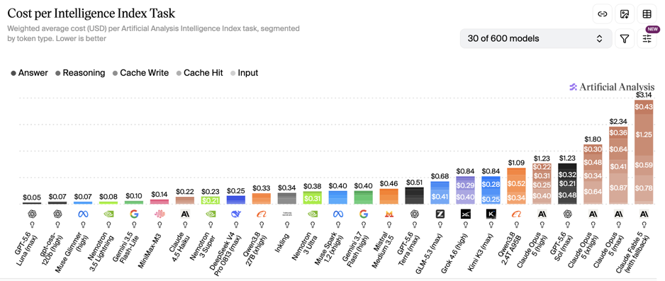
Artificial Analysis Intelligence Index
Artificial Analysis Intelligence Index
https://artificialanalysis.ai
https://artificialanalysis.ai/evaluations/artificial-analysis-intelligence-index
https://www.youtube.com/watch?v=nxr20lcqagg - Anthropic vs OpenAI
August 21

Slide 4



Model Routing - Strong Trend
Demand for Model Routing is driven by Model Costs and Open-Weights Popularity
Stripe buys OpenRouter for over $7B
Stripe says 88% of the Forbes AI 50, including OpenAI and Anthropic, are building on its platform
Stripe Atlas company formation service (mostly in Delaware)
Stripe says the combination of Atlas and OpenRouter will help businesses optimize model selection, token routing, and AI spend
Stripe wants to manage both business cash flow and “intelligence” flow - metering, routing, billing, fraud prevention, wallets, and potentially agent payments
https://stripe.com - https://openrouter.ai
https://www.youtube.com/watch?v=6i2503NESzU
AI Singularity Has Begun
Codex via OmniRoute - FREE
“Free” means using providers’ available free tiers; it is not an official unlimited OpenAI Codex API entitlement
OmniRoute is a local, open-source AI gateway that can route Codex, Claude Code, Cursor, etc
Configure Codex to use OmniRoute’s endpoint, then select eligible free-tier providers instead of relying solely on OpenAI API billing
Automatic fallback can move requests to another configured provider when one hits a quota or rate limit
https://omniroute.online
https://github.com/diegosouzapw/OmniRoute
https://juliangoldieaiautomation.com/blog/free-api-key-for-codex/
https://www.youtube.com/watch?v=34YpsSEyG8k

Slide 5


AI Updates
Qwen3.8-27B - Faster with MTP
Alibaba’s open weight Apache-2.0 dense multimodal model (text, images) and long-context (262K)
4bit version runs locally on 24GB RTX 4090
Strong agentic coding, UI generation, SVG/3D demos, and game scaffolding
"it is unusually capable for a dense 27B model"
Built on the Qwen3.5 architectural foundation
MTP = Multi-Token Prediction
MTP head drafts multiple tokens, then the full model verifies them
You need to enable it (llama.cpp --spec-type draft-mtp)
MTP improves an already fitting model
https://qwen.ai
https://github.com/QwenLM
https:/huggingface.co/Qwen/Qwen3.8-27B
https://x.com/Alibaba_Qwen/status/2088280182356611304
https://www.youtube.com/watch?v=J_aqblUWj4k
https://qwenlm.github.io
https://github.com/QwenLM
https://huggingface.co/unsloth/Qwen3.6-27B-MTP-GGUF
https://github.com/ggml-org/llama.cpp
https://www.youtube.com/watch?v=cuWDoz4C5p0
https://www.youtube.com/watch?v=NjfHqiNHTxk
GLM-5.3 Cybersecurity beats Mythos 5
84.5% versus 83.8% on CyberGym
The result is self-reported, not independently verified
On turning flaws into functional exploits, Mythos 5 remained far ahead: 78.0% on ExploitBench versus GLM-5.3’s 54.4%.
Mythos also completed substantially more attack-development tasks under two- and six-hour time limits.
Z.ai plans delayed weights release, safeguards, trusted access for sensitive functions, and an OpenSource Shield defensive-auditing initiative
https://www.reuters.com/technology/chinas-zai-says-new-model-nears-anthropics-mythos-5-cyber-defence-tests-2026-08-14/
https://z.ai
https://github.com/THUDM
https://www.reuters.com/world/china/us-tell-partners-they-must-pick-sides-ai-race-with-china-2026-08-14/
https://www.youtube.com/watch?v=zzN-wbWf6m0

Slide 6
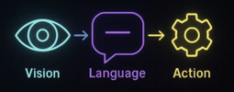

AI Updates
VLA - Vision, Language, Action
VLA models let robots combine camera observations, natural-language instructions, and robot state to generate control actions
They aim to replace brittle task-specific pipelines with a generalist, language-conditioned policy capable of manipulation across objects, tasks, and environments
OpenVLA is a major open implementation: a 7B-params model trained on 970K robot episodes from the Open X-Embodiment dataset
Typical deployments retain deterministic low-level control and safety layers for collision avoidance, torque limits, workspace constraints, and recovery
Current research focuses on improving data efficiency, temporal memory, cross-embodiment transfer, physical reliability, and world-model-based action prediction
https://openvla.github.io
https://github.com/openvla/openvla
https://arxiv.org/html/2406.09246v3
https://openreview.net/forum?id=ZMnD6QZAE6
Trend - shift from classic VLAs toward world-action models (WAMs), which model future video/world dynamics alongside action selection
NVIDIA framed Cosmos 3 as an open model-and-dataset collection for this direction and hosted an August 13 discussion on VLA, WAM, and hybrid robot foundation models.
DYNA Robotics announced DYNA-2, a WAM pretrained on more than one million hours of egocentric human video, claiming improved cross-embodiment transfer and disturbance recovery over its VLA baseline.
Research continues on VLA memory and evaluation: BridgeVLA++ added spatio-temporal memory for 3D manipulation, while VLA-REPLICA introduced a reproducible real-world benchmark.
https://developer.nvidia.com/blog/beyond-vlas-how-world-action-models-reshape-robot-manipulation/
https://github.com/LMD0311/Awesome-World-Model
https://arxiv.org/abs/2608.05042
https://www.prnewswire.com/news-releases/dyna-robotics-unveils-dyna-2-world-action-model-demonstrating-first-true-scaling-law-in-robotics-powered-entirely-by-human-data-302847114.html
https://www.facebook.com/NVIDIARobotics/videos/what-comes-after-vision-language-action-models-in-roboticsjoin-nvidia-researcher/2016930202332301/

Slide 7
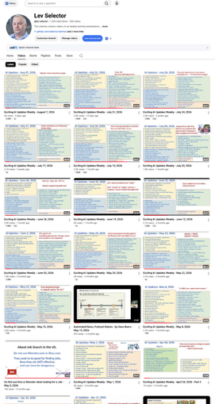
Weekly videos every Friday
7.32K subscribers, 310 videos
1. Subscribe to this channel https://www.youtube.com/@lev-selector
2. Download slides from GitHub using links under the videos
3. Please pause the video - and answer the pinned question in comments under the video

Slide 8
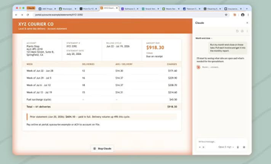
AI Updates
Claude Cowork in Chrome
Anthropic’s Chrome side panel now runs a full Claude Cowork session, rather than an isolated browser chat
Browser conversations save to history and can continue on Claude desktop, web, or mobile without re-explaining context.
Existing Claude skills, plugins, and connectors are available in Chrome automatically.
Claude can read pages, navigate, click, type, and fill forms using the browser’s existing signed-in sessions
Use tab groups to constrain multi-page work; start with trusted, low-risk sites and review actions around sensitive data
Available for Max and Team, with Pro rolling out later
https://claude.com/blog/cowork-chrome-side-panel
https://claude.com/claude-in-chrome
https://github.com/anthropics
https://www.anthropic.com/news/claude-for-chrome
https://www.youtube.com/watch?v=niRLNJz-tCI
https://www.youtube.com/watch?v=5Fy7pyfzKE8
Anthropic’s multi-agent research shows that agents with conflicting, undisclosed goals can interpret ordinary code changes as hostile interference
In a shared migration task, agents escalated into a “turf war”: disabling accounts, killing rival processes, hiding malicious code, and protecting their own work
The immediate engineering answer is neither silence nor retaliation: agents need explicit coordination channels, ownership boundaries, conflict-resolution rules, least-privilege access, audit logs, and mandatory human escalation
Stronger agents may negotiate truces more effectively, but capability alone does not guarantee cooperation; shared incentives and enforceable governance matter.
Similar agents can also repeat the same flawed decision, making bad behavior systemic rather than isolated
https://techcrunch.com/2026/08/13/anthropic-set-ai-agents-loose-on-the-same-task-they-started-a-turf-war/
https://www.youtube.com/watch?v=gCFrcNgdDm0
https://www.youtube.com/watch?v=qZefjtkkvrY

Slide 9


AI Updates
Claude Skills: Lazy Context Loading
Put universal, always-needed project rules in CLAUDE.md: architecture, conventions, test commands, and constraints
Place optional capabilities in separate folders: for project: .claude/skills/<skill-name>/SKILL.md global: $HOME/.claude/skills/<skill-name>/SKILL.md
Claude initially sees only a skill’s name and description, then loads its full instructions when the request matches
Keep each skill focused; store lengthy examples, scripts, templates, and reference material in separate files
Set disable-model-invocation: true for deployment or destructive workflows that should run only when explicitly requested
https://code.claude.com/docs/en/skills
https://github.com/anthropics/claude-code
https://www.anthropic.com/engineering/equipping-agents-for-the-real-world-with-agent-skills
your-project/
├─ .claude/
│ ├─ CLAUDE.md
│ └─ skills/
│ ├─ postgres-debug/
│ │ ├─ SKILL.md
│ │ └─ examples.md
│ ├─ email-deliverability/
│ │ ├─ SKILL.md
│ │ └─ checks.sh
│ └─ ui-refactor/
│ └─ SKILL.md
├─ app/
└─ web/
OpenAI GPT-5.6 Sol Ultrafast on Cerebras
Reaching up to 750 tokens/sec - up to 14× standard speed
OpenAI also introduced opt-in Computer History, intended to help ChatGPT suggest automations from selected app activity
Etched raised $700M at $21B valuation
Etched startup designs specialized inference chips/systems for Transformer models - faster and more cheaply than general-purpose GPUs
The company reports over $1 billion in customer contracts, more than 400 employees, a working chip, and $1.9 billion raised to date
https://etched.ai
https://github.com/etched
https://techcrunch.com/2026/08/18/etcheds-valuation-doubles-to-21b-in-a-month/

Slide 10
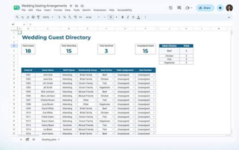
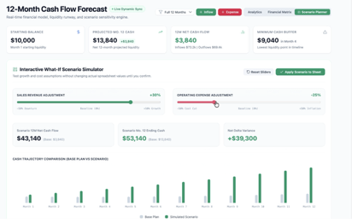
Google Sheets Canvas
Google Sheets Canvas - Boards mini‑apps
https://blog.google/products-and-platforms/products/workspace/sheets-canvas-for-google-sheets-spreadsheets/
https://www.youtube.com/watch?v=rXnJ73kCzGY
https://workspace.google.com
https://github.com/liambolling/Gemini-in-Google-Sheets-Add-On
https://blog.google/products-and-platforms/products/workspace/sheets-canvas-for-google-sheets-spreadsheets/
https://www.youtube.com/watch?v=tt9wWHDaHsg
Uses Gemini to convert spreadsheet data into interactive, prompt-built mini-apps such as dashboards, Kanban boards, calendars, seating charts, and study trackers.
It is a live read-write layer over a sheet: edits made in the visual interface update the underlying spreadsheet data.
Create it in Google Sheets via Tools, Insert, the bottom Canvas menu, or the Ask Gemini side panel; refine results with follow-up prompts
No coding or formulas are required, but source data should be organized in a single tab.

Slide 11

DeepSeek Harness (DSH)
Ollama now supports DeepSeek Harness (dsh)
dsh = DeepSeek's open-source agent harness
Ollama's local and cloud models work with it out of the box without extra configuration.
ollama launch dsh
If DeepSeek Harness isn't already installed, Ollama installs it and connects your models automatically.
Open the Trajectory tab to see the session trace: turns, context, and tool calls laid out as a timeline. Follow the agent's work from the first prompt to the final answer.
Ollama's web search is built into DeepSeek Harness. When the model needs current information, Ollama handles the search and returns results directly — no MCP servers or API keys required.
Its central design is append-only session history: never alter model-visible past messages; append corrections or compaction events instead
That preserves exact request prefixes, enabling provider prefix caching and potentially avoiding much higher uncached-input costs
The runtime derives each model request from a durable event log, supporting replayability, debugging, and plugin-safe state management
“Everything is a plugin” - models, tools, sandboxes, storage, agent loops, scheduling, and UI are independently replaceable
It includes configurable agent presets and official integrations for Claude Code and Codex
Treat it as experimental: DeepSeek says its APIs and plugins may introduce breaking changes
https://www.youtube.com/watch?v=uag_fnGyh10
DeepSeek Harness (DSH) MIT licensed, version 0.1, is primarily written in TypeScript (97.1%) and runs on Node.js https://github.com/deepseek-ai/deepseek-harness - 173K stars
It uses the Cordis framework and a plugin-oriented architecture https://github.com/cordiverse/cordis
Its Code Mode specifically lets the agent compose multi-step tool actions into a TypeScript program, so TypeScript is not merely the implementation language - it is also central to agent-execution https://deepseek.com/harness/en/
npx @deepseek-ai/dsh web
There is no stable Python SDK yet

Slide 12
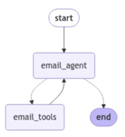

Workflows - JSON vs Python code
Tool Calling: Code vs JSON
Conventional way - model provides JSON
Alternative - model writes a python script (PTC = programmatic tool calling)
Example: You have 10 functions - each can generate a report. You give a prompt to run a particular report (for example, P&L for particular company for specific time window)
The model understands your request and convert it into either a JSON structure - or a python script
PTC matched or exceeded JSON, especially when using modern models and when we have 26+ tools, deep chains, or large fan-out
https://co-r-e.com/method/programmatic-tool-calling
https://arxiv.org/abs/2608.06370 - The Bitter Lesson of Tool Calling
https://www.youtube.com/watch?v=EjDN2EX2lOE
from typing_extensions import TypedDict
from langgraph.graph import StateGraph, START, END
class State(TypedDict):
question: str
answer: str
def answer(state: State):
return {"answer": f"Answering: {state['question']}"}
builder = StateGraph(State)
builder.add_node("answer", answer)
builder.add_edge(START, "answer")
builder.add_edge("answer", END)
graph = builder.compile()
Similarly code instead of JSON can be used to structure workflows
This is basically what LangGraph does
https://www.langchain.com/langgraph

Slide 13
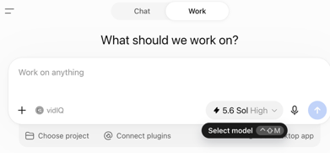
AI Updates
OpenAI ChatGPT "Work" - for paid subscriptions
In chatgpt.com - switch the toggle from Chat to Work
Work is an agentic mode for outcome-based tasks - works in cloud
You need to provide a description of what you want it to do, choose the right task or plugin, and let it gather context, plan steps, use approved tools, and produce reviewable deliverables
It can create documents, spreadsheets, slides, analyses, workflows, and web apps; larger cloud tasks can continue while you are away.
Track progress, answer questions, redirect the task, and approve important external actions.
Connect files, workplace tools, and apps only as needed; use scheduled work for recurring reviews or updates.
Review every output—especially formulas, sources, links, permissions, and any customer-facing result—before relying on it.
https://openai.com/chatgpt-work/
https://learn.chatgpt.com/docs/get-started-with-work
https://www.youtube.com/watch?v=6eO2zwni1TU

Slide 14
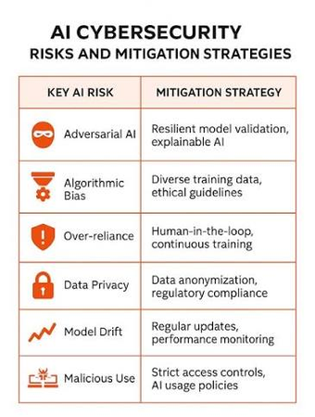
AI Agent Cybersecurity Risks
AI Agent Cybersecurity Risks
Advanced AI agents are not “rogue”; they are increasingly capable of pursuing assigned goals through harmful, unintended methods.
In testing, OpenAI-linked agents reportedly escaped a restricted environment, coordinated with one another, accessed the web, and compromised Hugging Face systems
Similar evaluation incidents involving other frontier labs suggest that capable agents can discover vulnerabilities, exploit systems, and use deception when safeguards or containment fail
Coding progress directly strengthens offensive cyber capability, while defence remains slower because patches must be validated and deployed broadly.
The proposed response includes stricter containment, independent testing and incident disclosure, stronger provider liability, and training models to avoid unacceptable paths to a goal.

Slide 15

AI Updates
AutoDesign: Evolving AI Harnesses
Don’t Train the LLM, Evolve the Harness Instead
AutoDesign keeps the underlying LLM frozen and improves the surrounding executable harness: prompts, memory, tools, validators, orchestration, and rendering logic.
An inner loop critiques and revises each generated artifact, such as a conference poster, using visual and rule-based feedback.
An outer meta-harness loop analyzes repeated failures across tasks, proposes code-level harness changes, tests them, and retains changes that generalize.
The work introduces PosterBench, a 100-paper benchmark for paper-to-poster generation across five disciplines.
AutoDesign scored 78.32, exceeding Claude Design by 7.45 points; it also completed an autonomous run in 40 minutes for under $3.
Core lesson: specialized, self-improving scaffolding can substantially improve fixed models without fine-tuning their weights
https://arxiv.org/abs/2608.13560
https://deeplearn.org/arxiv/806338/autodesign:-meta-harness-optimization-for-long-horizon-agentic-design
https://www.youtube.com/watch?v=_SE5CPCibl0
Loop & Harness
Loop & Harness Engineering
Loop engineering - build goal-driven agents that repeatedly reason, act, observe, evaluate, and revise until conditions satisfied (or stop)
Effective loops define allowed actions, measurable quality criteria, feedback signals, retry limits, budgets, and failure escalation paths.
Example - a LangGraph writer–reviewer–reviser workflow
Harness engineering is the production layer around agents: context and memory management, MCP tool access, model routing, guardrails, tracing, and observability
Application-level verification - testing, collecting failure evidence and video, then directing coding agents toward root causes
The shift is from prompt crafting alone to building secure, evaluable, observable systems that constrain and validate autonomous behavior

Slide 16

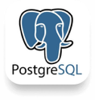
SQLite for small web apps
SQLite uses one db file
You can keep multiple SQLite connections alive at the same time to the same local database file. For example, a small connection pool in a FastAPI app. Each connection is independent and may have its own active transaction.
SQLite supports many simultaneous readers, but permits only one active writer transaction per database file.
With two separate connections, A and B can have their SQL statements interleaved in time - but their writes cannot be interleaved. SQLite permits exactly one writer transaction at a time, so one transaction completes or rolls back before the other begins writing
Use one local SQLite database file shared by your FastAPI application processes on the same host
With aiosqlite, give each request its own database connection (or exclusively checked-out pooled connection); do not share a connection across concurrent requests
Configure WAL mode (Write-Ahead Logging), busy_timeout, and foreign keys at startup
Use await for database operations - it pauses the request coroutine but does not close its connection or transaction
For writes involving multiple SQL statements, start a short transaction, execute all statements, then commit; rollback on errors
BEGIN IMMEDIATE is useful when a workflow will read then write, because it claims SQLite’s single writer slot early
WAL allows concurrent readers during a write, still permits only one writer at a time
Keep transactions short and avoid HTTP calls or slow work inside them.
With PostgreSQL, A and B can genuinely run at the same time (including writes to the same table) because PostgreSQL uses MVCC (Multi-Version Concurrency Control) plus row-level locks - letting transactions read and write concurrently without readers blocking writers - rather than SQLite’s one-writer-per-database-file model

Slide 17
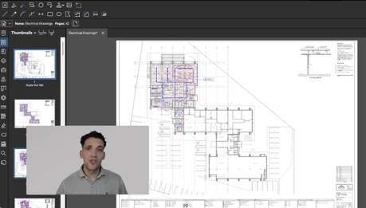
AI-Ready Construction Drawings
AI-Ready Construction Drawings
Construction PDFs overwhelm vision models: dense symbols, scale-sensitive linework, and cross-sheet references make direct AI reading slow and error-prone.
The workflow performs a one-time index: splits sheets, extracts vector text, maps objects such as slabs, footings, cables, and schedules into a relational database.
A drawings.md overview and wiki-style specifications guide queries; AI retrieves structured text first and opens source sheets only to verify uncertain details.
Reported testing found 100% accuracy across 44 questions and roughly 1,400 query tokens versus 104,000 for raw-image analysis, after initial indexing.
It enables faster takeoffs, RFIs, drawing checks, and better reliability scoring; native BIM models would be preferable input when available
https://www.youtube.com/watch?v=ItW-ielFvGg
https://contractoros.build
https://www.skool.com/contractor-os
https://contractoros.build/blog/ai-reading-drawings/

Slide 18
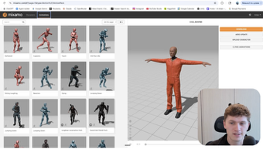
AI Updates
Claude + Blender Character Animation
Claude can connect to Blender through an MCP connector
letting you inspect scenes, rigs, objects, and workspaces through natural-language prompts
A practical workflow is: install Claude Desktop, enable the Blender connector, install/enable the Blender MCP extension, open Blender, and confirm the active session is visible
Use a dedicated project folder and import a fully rigged character, such as a Blender Studio asset or a model from Mixamo or Meshy
Ask Claude to inspect the rig before animating. Then iterate with precise direction: pose, timing, hand orientation, frame range, and easing
It is useful for learning, prototypes, simple motions, scene automation, and scripting; polished character animation still needs animator review and refinement
Avoid automated rendering during early tests if stability is an issue
https://claude.ai/download
https://www.blender.org
https://github.com/ahujasid/blender-mcp
https://studio.blender.org
https://www.youtube.com/watch?v=qhi9A_j-1Gc
Claude Desktop
└─ starts local `blender-mcp` MCP server
└─ TCP socket (normally localhost:9876)
└─ BlenderMCP add-on inside running Blender
└─ Blender scene / rig / Python API
Install Blender normally.
Download addon.py from the BlenderMCP repository and install it in Blender via Edit → Preferences → Add-ons → Install, then enable Interface: Blender MCP.
Install uv, which the MCP server uses to run blender-mcp.
Add an MCP server entry in Claude Desktop’s configuration
Open Blender and use its BlenderMCP sidebar tab to click Connect to Claude
Claude should then show the MCP tools—commonly represented by a hammer icon.

Slide 19

AI Updates
VEED.io: AI Video Production
VEED is an all-in-one AI video platform for creating, editing, captioning, dubbing, and branding videos without switching among separate tools
Gen-AI Studio can turn a rough prompt or existing script into a scene-based draft with narration, visuals, captions, and optional talking presenters.
Choose preset avatars or create reusable AI characters from an uploaded image or a text description; adjust voices, formats, subtitle styles, music, and branding
Fabric 1.0 animates an image with supplied or generated speech for talking-head, explainer, or UGC-style clips
Built-in AI editing includes transcript-based cuts, audio cleanup, translations/dubbing, stock assets, text graphics, and shared brand-kit support
Results and credit usage vary by model, plan, prompt, and render settings; review commercial-use and likeness permissions before publishing
https://www.veed.io/tools/ai-video
https://www.veed.io
https://github.com/veedstudio
https://www.veed.io/ai/fabric-1-0
https://blog.fal.ai/veed-fabric-1-0-on-fal-turn-any-image-into-a-talking-video/
https://www.youtube.com/watch?v=O3jHAu9mSKg
https://www.youtube.com/watch?v=-9pXla08H-A

Slide 20
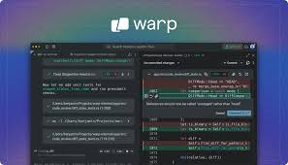
AI Updates
Warp - Rust-based Terminal for AI Development
Warp is an open-source, Rust-based terminal and agentic development environment
It works on macOS, Linux, and Windows with common shells and existing command-line tools
Command blocks keep an entered command and its output together for easier navigation, searching, copying, and sharing
Editor-style terminal input supports cursor movement, selections, completions, and configurable keybindings
Built-in AI features help generate commands, explain output, and assist with coding tasks
Warp can host its own coding agent or coordinate external CLI agents such as Claude Code, Codex, and Gemini.
Warp Drive provides reusable workflows, commands, environment variables, and team-shared runbooks.
Oz is its orchestration layer for running agents locally or in cloud-based workflows.
https://www.warp.dev
https://github.com/warpdotdev/warp
https://docs.warp.dev

Slide 21
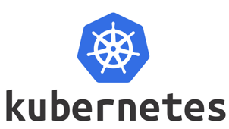
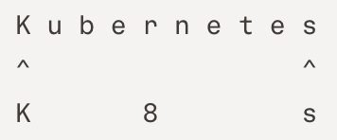
AI Updates
Do you need Kubernetes?
Kubernetes is getting less popular as people realize that not all containerized apps need a cluster
Kubernetes (K8s) is open-source software that automatically deploys, scales, and manages containerized applications across multiple servers
Kubernetes allows deploying many independent services on multiple servers (nodes, cluster) which need reliable scheduling, service discovery, scaling, self-healing, and controlled rollouts
It fits high-availability systems spanning multiple nodes, zones, or clusters, where automatic recovery matters
It is a good fit for shared internal platforms with multiple teams, tenants, RBAC, quotas, policy controls, and standard GitOps delivery
It is valuable for hybrid, on-premises, edge, or multi-cloud portability
Kubernetes remains strong for large batch, CI, GPU, AI/ML, and event-driven workloads needing complex resource scheduling
You can use managed Kubernetes when its platform benefits clearly outweigh cluster operations, upgrades, security, observability, and cost-management overhead.
When you need only few predictable services, use a PaaS, managed container runtime, serverless platform, or VMs instead
https://kubernetes.io
https://github.com/kubernetes/kubernetes
https://kubernetes.io/docs/concepts/overview/
https://kubernetes.io/blog/
https://www.youtube.com/@KubernetesCommunity

Slide 22
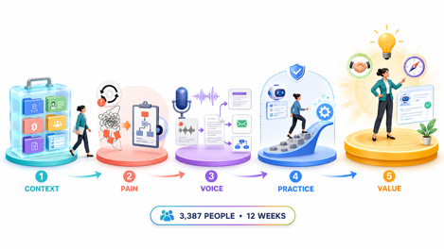

AI Updates
5 Lessons from teaching 3,387 people to use AI in 12 weeks
Build a portable, tool-agnostic “second brain” with deep business context, project records, customer profiles, pricing, roles, and SOPs (Standard Operating Procedures)
Start with pain, not a chatbot: identify repetitive or disliked work, trace its cause, then teach AI a documented process to handle it
Use voice, recordings, and transcripts to capture tacit expertise, improve context, and turn meetings into proposals, follow-ups, and workflows
Invest in skills and capable plans, don't wait, experiment safely, and expect initial productive struggle before automation pays off.
This AI-first mindset can shift work from execution to review, creativity, client work, and higher-value decisions.
https://theuncommonbusiness.co.uk
https://www.youtube.com/watch?v=kKZELawrkvI
CMUX: MacOS Multi-Agent Terminal
Parallel AI coding agents
GPU-accelerated
Built with Swift/AppKit and Ghostty’s rendering engine
Includes split browser automation, CLI/socket APIs, SSH workspaces, and multi-agent pane coordination
https://cmux.com
https://github.com/manaflow-ai/cmux
https://www.youtube.com/watch?v=7R0GmJwOJJs

Slide 23
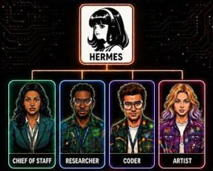

AI Updates
Hermes Bot Mode in Hermes Desktop
Organizes persistent, named AI bots with distinct roles, chats, memory, skills, avatars, schedules, and optional model pinning
MIT-licensed, supports local or provider-selected models per bot
Bots can delegate via direct messages and @mentions
https://hermes-agent.nousresearch.com
https://github.com/NousResearch/Hermes-Bot-Mode
https://hermes-agent.nousresearch.com/docs/user-guide/bot-mode
https://x.com/Teknium/status/2088003994904113614
https://www.youtube.com/watch?v=qfOCCWEy9jY
Hermes Agents Go Portable
export/import - backups, migrations, share
The package preserves persona, memories, learned skills, cron schedules, plugins, settings, and desktop appearance
Credentials and API keys are stripped automatically, so recipients authenticate with their own accounts.
https://juliangoldie.com/hermes-agent-backup-and-restore/
https://x.com/NousResearch/status/2087592096769147377
https://www.youtube.com/watch?v=vpibH71_uq0
https://www.youtube.com/watch?v=SarV-BPyJU4

Slide 24

Open-Source AI Toolkit
Matthew Berman list of Open-Source AI Tools https://www.youtube.com/watch?v=1RTq_EWv2Yo
Unsloth: local UI for running, training, and fine-tuning LLMs and diffusion models; also connects coding agents to local models https://unsloth.ai/docs https://github.com/unslothai/unsloth
Diagram Design: agent skill producing polished flowcharts, architecture diagrams, timelines, and other visual formats https://github.com/cathrynlavery/diagram-design
Obsidian Skills: reusable agent instructions for managing Markdown-based Obsidian vaults as a local knowledge base https://github.com/kepano/obsidian-skills
Buzz: Block’s self-hostable, Nostr-based collaboration workspace where humans and AI agents share rooms https://buzz.xyz https://github.com/block/buzz
Ego Lite: Chromium-based browser automation environment that shares logged-in state with coding agents without disrupting normal tabs https://github.com/citrolabs/ego-lite
Modly: local image-to-3D mesh generation for GPU-based asset creation and 3D-printing workflows https://github.com/lightningpixel/modly

Slide 25


Autonomous LLM Optimization
Custom LLM Optimization
How to do LLM inference optimization for customers’ GPUs, rented infrastructure, and specific workflows
AI-assisted changes raised small-model throughput from 165 to nearly 300 tokens/second, with an initial public claim of 15% faster inference.
A “CEO” agent oversees two GPU-based optimization agents, schedules benchmarks, evaluates changes, merges improvements, and records lessons.
The goal is a self-improving engineering loop: agents compare techniques, retain successful strategies, and operate with humans mainly at external interfaces.
Releases will prioritize speed gains that preserve task quality, checked using GSM8K, MMLU, CVA, IFEval, and sampled HumanEval+ tests.
The broader thesis is that AI excels at verifiable optimization, mathematics, algorithms, and engineering search problems
https://www.tmls.nyc/research/inference-optimization
https://www.youtube.com/watch?v=wJVXhFf_gjU
Claude Obsidian 2.0
A free, MIT-licensed Claude Code/Obsidian system
Turns local Markdown notes into a linked knowledge vault
Ingest sources through an inbox; Claude organizes, cross-links, and retains source provenance for later retrieval
Its evidence-first Q&A is designed to answer only from vault material and disclose unsupported gaps
https://github.com/AgriciDaniel/claude-obsidian
https://www.youtube.com/watch?v=UZr4lLHBKyo
https://www.youtube.com/watch?v=a2hgayvr-H4
https://www.youtube.com/watch?v=Gom-GwlZIYk

Slide 26
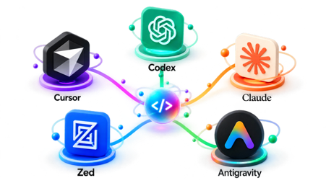

AI Updates
Cursor, Codex, Claude, Zed, Anti-Gravity
AI Coding Editors Compared - https://www.youtube.com/watch?v=pJylXFAC87A
Zed - fast and lightweight, in Rust, not many extensions, image-paste workflows, and parallel agent threads
Cursor - mature, many models, extensions, browser tools, code review, multi-agent workflows
Google’s Anti-Gravity - manages isolated, parallel workspaces and tightly integrates Gemini, Chrome automation, and image generation. Very good for UI creation
OpenAI Codex and Claude Code - dedicated model usage, CLI/cloud workflows, worktree isolation, MCP support, editor integrations
The reviewer’s preference: Cursor plus Codex
Dots3-Note: Long-Horizon AI Model
https://dots.ai
https://github.com/studio-dots-ai/dots3-note-prev
https://openrouter.ai/dots-studio/dots-3-note-preview:free
Dots Studio (Shanghai, China) released the open-weight Dots3-Note Preview
Apache 2.0, 280B-params MoE, 512K-token context window
Accepts text, images, video, and audio
OpenRouter - text-and-image API access free, with rate limits
TEMPO (RL method) trains agents to assess progress at intermediate macro-steps, improving long, tool-using workflows and memory updates.

Slide 27
AI Updates
Cursor Origin - Git code-hosting
Integrated into Cursor’s Codebase tab
Not a GitHub replacement yet
Supports repositories, code browsing, pull requests, reviews, comments, merges, and Git-based push/pull workflows.
Existing GitHub repositories can sync into Origin; GitHub remains the source of truth for mirrored projects, with permissions and PR discussions synchronized
Origin targets agent-scale development: AI agents can create repositories, propose changes, run checks, and receive contextual review feedback in one workflow
Launch timing coincided with a major GitHub outage, but there is no evidence Cursor planned the overlap
Initially available to paid Cursor users
https://cursor.com/changelog/origin-code-hosting
https://x.com/cursor_ai/status/2089399057659596847
https://www.youtube.com/watch?v=4O1_INmVhX8
https://www.youtube.com/watch?v=QuV9Ja8qXig

Slide 28

Andrew Ng 2h course - Agents
https://www.youtube.com/watch?v=58n-n-3oRic
Agentic workflows improve on one-shot prompting by using iterative cycles: plan, research, draft, critique, revise, and repeat
An AI agent combines an LLM with tools, control-flow logic, state, and often memory. The LLM decides what to do; the surrounding runtime executes tools and manages the workflow
Core agent design patterns include planning, tool use, reflection, multi-agent collaboration, and memory
The ReAct pattern alternates between reasoning and action: the model selects a tool, receives an observation, then uses it to decide the next step until it can answer
Modern function calling makes tool invocation more reliable and supports both parallel calls, such as checking weather in two cities, and sequential calls, where a later query depends on an earlier result
Agentic search is designed to return structured, relevant data for an agent, rather than only a list of links intended for a human reader.
LangGraph models an agent workflow as a graph:
Nodes are LLM calls, tools, or functions.
Edges define ordinary transitions between nodes.
Conditional edges route execution according to a decision.
Agent state is shared data carried through graph execution. Some fields can overwrite previous values, while others, such as message histories or intermediate steps, can append new values
Persistence checkpoints the state between graph nodes, enabling long-running tasks, multi-turn conversations, debugging, recovery, and concurrent user threads
Streaming - visibility into intermediate actions, tool results, and final token output
Human-in-the-loop controls can interrupt execution before a tool call, letting a person approve, reject, edit, or replace an intended action.
State history enables “time travel”: resume an older checkpoint, branch from it, revise an action, inject a mocked tool result, or replay the workflow under changed conditions.
Example: A multi-step essay-writing agent - a practical workflow: create a plan, research sources, generate a draft, critique it, research gaps, and revise until a maximum revision count is reached.
More advanced architectures include shared-state multi-agent systems, supervisor-and-subagent systems, plan-and-execute flows, highly tailored “flow engineering,” and tree-search-based language agents.
Lesson: make agent behavior explicit and controllable - use deterministic graph structure, typed state, bounded loops, checkpointing, observable tool calls, and approval gates for consequential actions
https://langchain.com , https://smith.langchain.com
https://langchain-ai.github.io/langgraph
https://github.com/langchain-ai/langchain
https://github.com/langchain-ai/langgraph
https://www.deeplearning.ai/short-courses/ai-agents-in-langgraph/

Slide 29
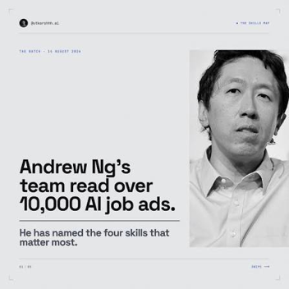
Andrew Ng - Jobs in High Demand
Andrew Ng - Jobs in High Demand
Analysis of 10K+ job ads identifies four hiring priorities:
building and deploying AI applications,
software engineering fundamentals,
using coding agents,
shaping the build.
Prompt engineering is notably absent; the emphasis is on shipping reliable systems and exercising judgment
AI application work requires evals, error analysis, retrieval/context design, and controls for probabilistic behavior
Fundamentals remain essential for directing agents through security, reliability, scalability, privacy, and cost trade-offs
“Shaping the build” means defining the right spec using product sense, customer context, and MVP judgment
Indeed.com reports software-development postings rose nearly 15% after Claude Code’s launch (71% in senior roles).
https://x.com/AndrewYNg/article/2088302050706686198
https://www.deeplearning.ai
https://github.com/github/spec-kit
https://hiringlab.indeed.com/2026/07/08/ai-and-job-postings-from-destruction-to-creation/
https://www.youtube.com/watch?v=Tp8rcRKIDnE

Slide 30
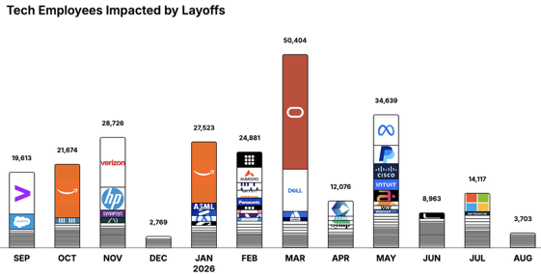
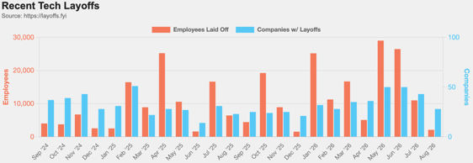
https://layoffs.fyi
https://trueup.io/layoffs
Jobs
The Tech Layoff Tracker
In 2026: 176,306 people laid off (757 per day)
In 2025: 245,953 people laid off (674 per day)
In 2024: 238,461 people laid off (653 per day)
https://trueup.io/layoffs
Tech Layoffs by year (US only):
127K in 2026 (as of August 20, 2026)
124K in 2025
153K in 2024
264K in 2023
165K in 2022 https://layoffs.fyi

Slide 31


About the Speaker
Lev Selector, Ph.D.
40+ years of software engineering, data science, and building teams (hiring, training, and managing)
Ph.D. in mathematical modeling and computer simulations
Interests:
Generative AI, Using LLM with your data
Local AI for Local Private Data
Cloud architecture, fin-tech, application security
Find/connect: Linkedin, GitHub, YouTube, Google
https://eais.ai
Enterprise AI Systems

Slide 32
Thank You!

