Slide 1
AI News - Nov 13, 2026
Models now pass each other their memories and skip the words.
LM Arena Leaderboard
Artificial Analysis Intelligence Index
Anthropic Claude Fable 5.2 and Mythos 5.2
Switching from Obsidian to Trilium
Cache-to-Cache LLM Communication
Baidu’s ERNIE 5.5 Flash Base Model
Nous Research Arete-27B
Discord Rewriting Apps in Rust
Rust: Origins and Birthday
Gemini 4 Carbon Tops AA Index
Prism Decision model
AI Trading: Uses and Limits Today
Robinhood Trading - Manual & Agentic
Meta Muse Ember: Small Agent Model
GitHub Ports Copilot to Rust
Kimi K3.1 Pro Open Weights
Claude Office Tools
Anthropic sets IPO terms
ChatGPT Opens Doors to Brands
Profits of selling information go down
AI Compression: Quality vs Speed
Hermes Marketplace for AI Agents
Instinct: AI Assistant by Text
IDEs Shift Toward AI Code Review
AI Solves Physics and Math
Yann LeCun’s Smaller AI Alternative
Tencent Hyra 2.0 Research Agent (China)
SenseNova Loop 9B - Small Efficient AI
OpenAI Raises $11B at $1.25T
Superhuman AI Is Forecasted for 2027
Jobs & Layoffs
Notes:
Contents labels. Kept by g3_update_toc.py.
Cache-to-Cache: Direct Semantic Communication Between LLMs => Cache-to-Cache: LLMs Talk via KV Cache
The Tech Layoff Tracker => Jobs & Layoffs
Tech Layoffs by year (US only): => Jobs & Layoffs
Cache-to-Cache Direct Semantic Communication Between LLMs => Cache-to-Cache LLM Communication
Discord rewriting its apps into Rust => Discord Rewriting Apps in Rust
Anthropic's amended S-1: $17B quarter and an RSI warning => Anthropic S-1: $17B Quarter, RSI Warning
METR: Anthropic's AI research runs about 2x faster => METR: Anthropic R&D Runs 2x Faster
OpenAI GPT-6 Cyber: first model rated Critical for cyber => OpenAI GPT-6 Cyber
Gemini 4 Carbon takes first place on the Intelligence Index => Gemini 4 Carbon Tops AA Index
Voters reject data centers, AI stocks fall hard => Data Center Votes and AI Stock Rout
Thinking Machines Inkling 2 Small: a strong US open model => Thinking Machines Inkling 2 Small
Claude API Message Threads: send only the new messages => Claude API Message Threads
DeepSeek open-sources dsh-superagent, a proactive coding agent => DeepSeek dsh-superagent
Nvidia board investigates spy claims around Jensen Huang => Nvidia Probes Jensen Huang Spy Claims
OpenAI raises $11 billion at a $1.25 trillion valuation => OpenAI Raises $11B at $1.25T
OpenAI Images 2.6 adds GIFs and reusable references => OpenAI Images 2.6
Apple opens Siri AI to all developers => Siri AI Opens to Developers
Ricursive Ripple-65B: an open coding model trained for $32M => Ricursive Ripple-65B
Anthropic FlashProve: proving which model wrote an answer => Anthropic FlashProve
https://www.marktechpost.com/2026/11/07/nous-research-arete-27b-qwen3-8-27b-propaganda-fine-tune/ => Nous Research Arete-27B
Meta Muse Ember: a small model for agent grunt work => Meta Muse Ember
GitHub ports the Copilot runtime from TypeScript to Rust with AI => GitHub Ports Copilot to Rust
Moonshot releases Kimi K3.1 Pro open weights => Kimi K3.1 Pro Open Weights
GitHub ports the Copilot runtime from TypeScript to Rust => GitHub Ports Copilot to Rust
Anthropic sets IPO terms: up to $1.4 trillion, listing next week => Anthropic IPO Terms: Up to $1.4T
OpenAI opens ChatGPT to brands with Business profiles and agents => Businesses and Agents in ChatGPT
AI 2027 authors: intelligence explosion likely in 2027 after all => AI 2027 Timelines Update
Google adds TPU 8i Max and TPU 8tx to its 8th-generation lineup => Google TPU 8i Max and 8tx

Slide 2
"LM Arena" Leaderboard
Data for Nov 9
Starting Elo rating = 1000
https://en.wikipedia.org/wiki/Elo_rating_system
LM Arena Text
https://lmarena.ai/leaderboard/text
LM Arena Coding https://lmarena.ai/leaderboard/text/coding
■ | Claude
■ | Gemini
■ | OpenAI
■ | Open Source
Claude Fable 5 - (~6T)
Claude Opus 4.8 - (~5T)
Claude Sonnet 4.5 -
Claude Sonnet 5 -
GLM-5.3 - ~744B
Meta Muse Spark Open - 816B
Qwen3.7-Max-Preview -
Qwen3.8-Max - 2.4T
Baidu ERNIE-5.1 - ~800B
DeepSeek V4 Pro - 1.6T
DeepSeek V4.1 Flash - 552B
Kimi K3 - 2.8T
Xiaomi MiMo-V2.5-Pro - 1.02T
ByteDance Seed 2.0 Pro -
MiniMax M3 - ~428B
Code | Model | Score
■ | Gemini 4 Carbon (High) | 1526
■ | Gemini 4 Argon (High) | 1522
■ | Muse Wonder (Max) | 1511
■ | Claude Opus 5.5 (High) | 1506
■ | Claude Fable 5 (High) | 1504
■ | Claude Opus 4.6 (High) | 1503
■ | Claude Fable 5.1 (Max) | 1503
■ | Claude Opus 4.7 (High) | 1501
■ | Gemini 3.8 Flash (High) | 1497
■ | Claude Opus 4.6 | 1496
■ | Muse Spark 1.3 (Max) | 1496
■ | Claude Opus 4.7 | 1494
■ | Muse Spark 1.2 (xHigh) | 1493
■ | Muse Spark 1.1 | 1491
■ | Claude Opus 5 (High) | 1490
■ | Gemini 3.7 Flash (High) | 1489
■ | Muse Spark | 1489
■ | Claude Opus 5 (Max) | 1489
■ | Kimi K3 (Max) | 1487
■ | Gemini 3.1 Pro Preview | 1487
■ | Gemini 3 Pro | 1486
■ | GPT-5.6 Sol (xHigh) | 1485
■ | Qwen3.8-Max | 1484
■ | Kimi K3.1 Pro (Max) | 1483
■ | Gemini 3.6 Flash (High) | 1483
Code | Model | Score
■ | Gemini 4 Carbon (High) | 1567
■ | Gemini 4 Argon (High) | 1553
■ | Claude Fable 5 (High) | 1551
■ | Claude Opus 4.7 (High) | 1551
■ | GPT-6 Astra (Max) | 1548
■ | Claude Opus 4.6 (High) | 1547
■ | Claude Opus 4.6 | 1547
■ | Claude Opus 4.7 | 1546
■ | Claude Opus 5.5 (High) | 1546
■ | Muse Wonder (Max) | 1545
■ | Muse Spark 1.2 (xHigh) | 1543
■ | GPT-6.1 Sol (Max) | 1540
■ | MiMo-V2.6-Pro | 1538
■ | Kimi K3 (Max) | 1537
■ | Claude Opus 4.8 (High) | 1533
■ | Claude Fable 5.1 (Max) | 1533
■ | GPT-5.6 Sol (xHigh) | 1533
■ | Muse Spark 1.1 | 1533
■ | Muse Spark 1.3 (Max) | 1533
■ | Claude Opus 5 (High) | 1532
■ | Gemini 3.8 Flash (High) | 1531
■ | Claude Opus 4.5 (High, 32K, 20251101) | 1530
■ | Muse Spark | 1529
■ | Claude Opus 4.8 | 1529
■ | Claude Sonnet 4.6 | 1528

Slide 3
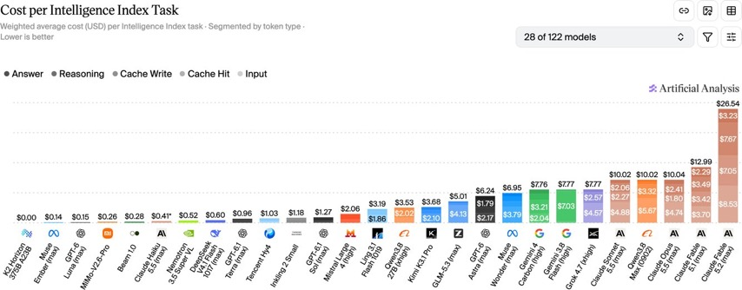
Artificial Analysis Intelligence Index
Artificial Analysis Intelligence Index
https://artificialanalysis.ai/evaluations/artificial-analysis-intelligence-index
Nov 11

Slide 4
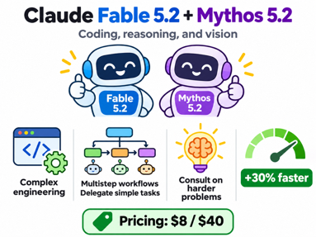
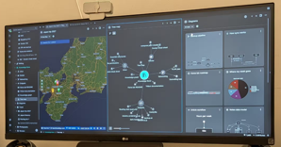
AI News
Anthropic Claude Fable 5.2 and Mythos 5.2
Coding, reasoning, and vision, targeting complex engineering problems and lengthy projects
Difficult, multistep workflows, coordinating AI agents, delegating simpler tasks, and consulting on harder problems
30% faster than predecessors
Pricing $8 / $40
https://www.anthropic.com/claude-fable-and-mythos-5-2
https://platform.claude.com/docs/en/models/fable-5-2/overview
Switching from Obsidian to Trilium
Run Trilium on a self-hosted Docker server; access notes through browsers or synchronized desktop apps, using Tailscale remotely
Importance: Built-in editors, diagrams, and collections reduce plugin dependence; synchronization requires managing your own server rather than receiving free cloud hosting
https://windowsforum.com/news/trilium-notes-vs-obsidian-free-self-hosted-sync-docker-setup-and-migration-trade-offs.451519/
https://triliumnotes.org
https://github.com/TriliumNext/Trilium
https://www.howtogeek.com/ditched-obsidian-for-free-and-open-source-alternative-with-built-in-sync/

Slide 5
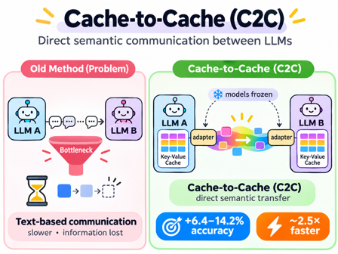
AI News
Cache-to-Cache Direct Semantic Communication Between LLMs
Problem: Text-based communication between language models loses rich internal information and adds delays through sequential token generation
Solution: Cache-to-Cache (C2C) uses trained neural adapters to project and fuse models’ key-value caches, transferring semantic representations without intermediate text. Both models remain frozen during adapter training.
Achievement: The revised paper reports 6.4–14.2% higher accuracy than individual models and average 2.5-fold speedup over text communication.
Importance: Enables faster, richer collaboration across different model families and sizes.
https://arxiv.org/abs/2510.03215
https://github.com/thu-nics/C2C

Slide 6
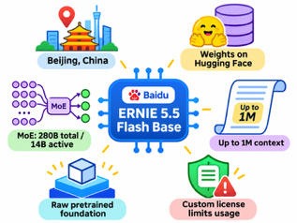
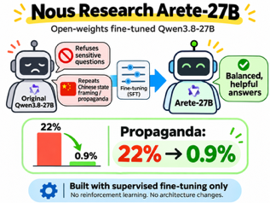
AI News
Baidu’s ERNIE 5.5 Flash Base Model
Baidu, based in Beijing, China, released ERNIE 5.5 Flash Base online
Weights on Hugging Face.
MoE text, 280 B total / 14 B active
Up to 1M context
This is a raw pretrained foundation
Custom license limits usage
https://ernie.baidu.com/release/ernie-5-5-flash-base/
Nous Research Arete-27B
Fine-tuned Qwen3.8-27B model; Open Weights
Original Qwen model sometimes refused sensitive questions or repeated Chinese state framing
In Arete-27B the propaganda fell from 22% to 0.9%
Arete-27B was made using supervised fine-tuning without reinforcement learning or architecture changes
https://www.marktechpost.com/2026/11/07/nous-research-arete-27b-qwen3-8-27b-propaganda-fine-tune/

Slide 7
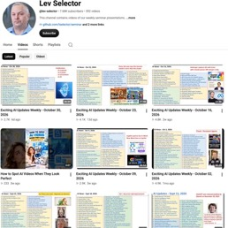

Weekly videos every Friday
Weekly videos every Friday
7.68K subscribers, 392 videos
1. Subscribe to this channel https://www.youtube.com/@lev-selector
2. Download slides from GitHub using links under the videos
3. Please pause the video - and answer the pinned question in comments under the video

Slide 8

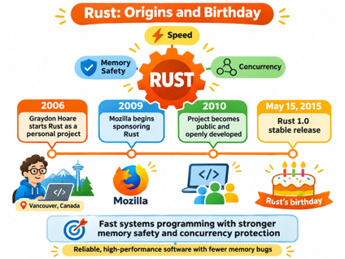
AI News
Discord rewriting its apps into Rust
Desktop app - from Electron
Mobile app - from React Native
The new "Discord Phoenix" is built on GPUI, the Rust UI framework from the team behind the Zed code editor
New Rust app takes less memory (290MB vs 856MB)
No release date yet
Rust: Origins and Birthday
Graydon Hoare, a Canadian programmer working for Mozilla in Vancouver, Canada, started Rust as a personal project in 2006
His goal was to improve on C++ development by combining fast systems programming with stronger memory safety and concurrency protections
Mozilla began sponsoring Rust in 2009; the project became public and openly developed in 2010
Rust 1.0, its first stable release, arrived May 15, 2015
May 15 is therefore celebrated as Rust’s birthday
Its importance lies in making reliable, high-performance software easier to build while preventing many memory-related bugs
https://www.rust-lang.org/
https://blog.rust-lang.org/2019/05/15/4-Years-Of-Rust/

Slide 9
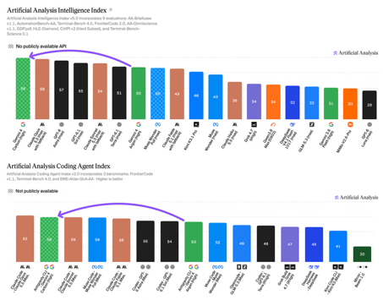
AI News
Gemini 4 Carbon takes first place on the Intelligence Index
Scores 59 on the Artificial Analysis Intelligence Index v5.0, just ahead of Claude Opus 5.5
First on Arena's text leaderboard at 1,528 Elo
Built for multi-day software engineering and cybersecurity work
Access starts with vetted cyber defenders in the Fairwind Program
Pricing $2 / $10 intro, then $4 / $20
Uses about 3x the median token count per task
https://artificialanalysis.ai/articles/gemini-4-carbon-new-number-1
https://aidisruption.ai/p/gemini-4-carbon-launches
https://www.deeplearning.ai/the-batch/gemini-leads-the-pack-again

Slide 10
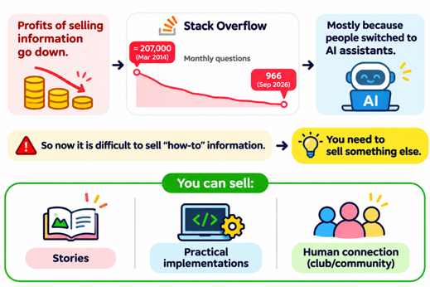
AI News
Profits of selling information go down.
Example: Stack Overflow
https://stackoverflow.com/questions
The number of monthly questions was falling
from approximately 207,000 in March 2014
to 966 in September 2026
Mostly because people switched to using AI assistants.
So now it is difficult to sell "how-to" information.
You need to sell something else.
You can sell stories.
You can sell implementation (build the house instead of "how to build"
You can sell human connection - "community" solutions.

Slide 11
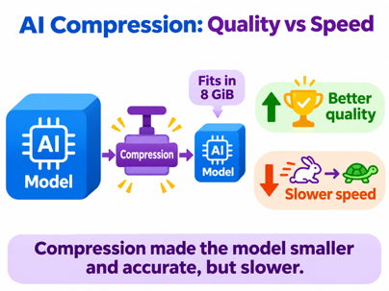
AI News
AI Compression: Quality vs Speed
CompressionBench paper from Carnegie Mellon University, PA
6 agents each received 8 hours on one H200 NVL GPU to compress models and implement inference;
29 of 36 submissions passed verification.
Sonnet 5.5 compressed Qwen3.8-27B within 8 GiB, achieving 68.67% accuracy versus an expert release’s 65.33%.
However, its speed fell from 75 to 23 tok/sec
Agents improved quality per byte, not speed.
The budget excludes KV cache
https://arxiv.org/abs/2611.06858
[https://github.com/Infini-AI-Lab/Compression-Bench](https://github.com/Infini-AI-Lab/Compression-Bench)
https://www.youtube.com/watch?v=xVJoOdlF7-E

Slide 12
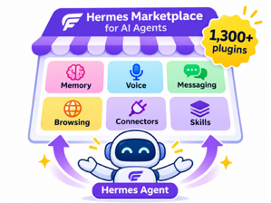
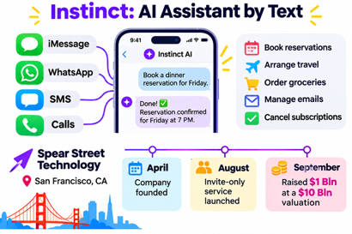
AI News
Hermes Marketplace for AI Agents
Plugins, connectors, and skills for Hermes Agent in one catalog with over 1,300 plugins, extending agents with memory, voice, messaging, browsing, and other capabilities
It makes community-developed capabilities easier to discover and reuse, reducing setup friction. Browsing and installation are free, although individual integrations may incur charges
https://hermes-agent.nousresearch.com/marketplace
https://nousresearch.com
https://github.com/nousresearch/hermes-agent - 262K stars
Instinct: AI Assistant by Text
A personal AI agent accessed through iMessage, WhatsApp, SMS, and calls, rather than a separate app.
By Spear Street Technology, San Francisco, CA
Company was founded in April,
Started providing invite-only service in August
Raised $1 Bln at a $10 Bln valuation in September
Group-chat capabilities followed in October
It works remotely using a persistent cloud computer, browser, and connected personal accounts
Everyday administrative chores consume time; Instinct handles bookings, shopping, emails, and appointment coordination
Privacy and account access remain concerns
https://www.theverge.com/tech/1008254/instinct-agent-ai-hands-on-muse-dots
https://techcrunch.com/2026/09/28/viral-ai-agent-instinct-raises-1b-series-c-at-a-10b-valuation/
https://www.youtube.com/watch?v=1jl6lQldNFE

Slide 13
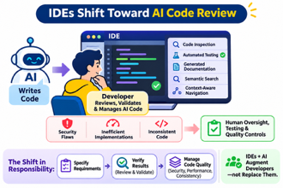
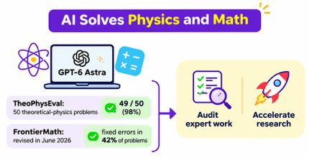
IDE Shift Toward AI Code Review
IDEs Shift Toward AI Code Review
AI writes code, Developers increasingly review, validate and manage AI-generated code
IDE provides code inspection, automated testing, generated documentation, semantic search and context-aware navigation
Security flaws, inefficient implementations and inconsistent code require human oversight, testing and quality controls.
Responsibility shifts toward specifying requirements and verifying results, not eliminating developers
https://www.geeky-gadgets.com/future-of-ides-ai-agents/
https://cursor.com
https://www.jetbrains.com/ai/
AI Solves Physics and Math
Researchers tested OpenAI’s GPT-6 Astra on TheoPhysEval: 50 unpublished theoretical-physics problems.
Using Codex, scientific searches, and computational tools, Astra reportedly solved 49 out of 50 problems, scoring 98% after experts corrected mistakes in their answer key.
Epoch AI revised FrontierMath in June 2026, addressing errors in 42% of its mathematics problems
So AI can now help audit expert work and accelerate research
https://www.airosetta.com/en/news/gpt6-astra-theophys-eval-49-50
https://epoch.ai/benchmarks/frontiermath-tier-4-v2
https://epoch.ai/frontiermath

Slide 14


AI News
Yann LeCun’s Smaller AI Alternative
Published October 29, 2026.
JEPA learns abstract representations using different observations of the same scene rather than reconstructing every detail
A 109-Mln params model surpassed tested language models up to 72 Bln params on visual-language alignment
Comparable alignment required 42 times fewer training samples
JEPA (Joint Embedding Predictive Architecture) is potentially more efficient multimodal AI
https://www.youtube.com/watch?v=_fEqQa5hBmI
https://arxiv.org/abs/2610.39302
https://github.com/galilai-group/prh-proof
Tencent Hyra 2.0 Research Agent (China)
Hyra 2.0 - automated scientific research, reusable models, tools, and workflows
Saves experimental records and skills, allowing later tasks to reuse successes and avoid failures
Mission, and Worker agents coordinate long-running research, parallel sandbox experiments, and evidence-based verification
57-times-faster protein sequence generation, improved quantum error correction, mathematical proofs, and 5.79% higher XiangShan processor performance per GHz
https://github.com/Tencent-Hunyuan/Hyra-results/
https://m.techflowpost.com/en-US/newsletter/142506
https://hy.tencent.ai/research/hyra2
https://www.techtimes.com/articles/329932/20261103/tencent-hyra-20-launches-protein-models-quantum-codes-recursive-self-improvement-loop.htm
https://www.youtube.com/watch?v=y5aAoliwoqo

Slide 15
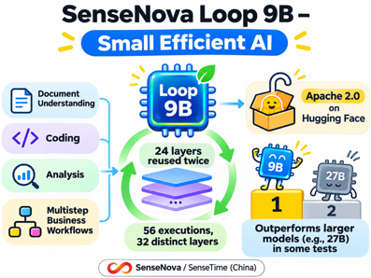
AI News
SenseNova Loop 9B - Small Efficient AI
By SenseNova, part of China’s SenseTime
On Hugging Face under Apache 2.0
This model reuses 24 layers twice, producing 56 layer executions from 32 distinct layers without duplicating weights
In some tests 9B model wins against 27B competitors
Approx 9 Bln stored params support deeper computation; two-stream manifold-constrained hyper-connections manage information flow
Targets document understanding, coding, analysis, and multistep business workflows
Suggested applications - content drafts, personalized outreach, and weekly performance summaries
https://huggingface.co/sensenova/SenseNova-Loop-9B-Preview
https://chinaaibulletin.substack.com/p/china-ai-bulletin-15
https://huggingface.co/sensenova/SenseNova-Loop-9B-Preview/blob/main/README.md

Slide 16

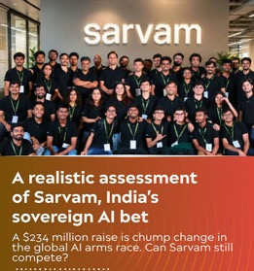
AI News
OpenAI raises $11 billion at a $1.25 trillion valuation
Valuation $1.25 Trln, down from the $1.4 first asked
Greg Brockman says OpenAI could be IPO-ready in 2027
https://techcrunch.com/2026/11/06/openai-reportedly-raises-an-additional-11-billion-at-a-1-25-trillion-valuation/
Prism Decision model
Sarvam AI, Bengaluru, India
Selecting predefined answers with probabilities
https://en.wikipedia.org/wiki/Sarvam_AI
https://www.sarvam.ai/models
https://www.sarvam.ai

Slide 17


AI Trading
AI Trading: Uses and Limits Today
As of today, AI can assist pricing, hedging, and risk analysis; but it cannot guarantee consistently profitable autonomous trading.
AI helps analyze information and improve execution efficiency
U.S. securities firms use AI for investment research, portfolio management, and trading execution; FINRA, the U.S. industry regulator, monitors adoption.
(FINRA = Financial Industry Regulatory Authority)
https://www.finra.org/rules-guidance/key-topics/fintech/report/artificial-intelligence-in-the-securities-industry/ai-apps-in-the-industry
https://www.finra.org/rules-guidance/key-topics/artificial-intelligence
https://www.finra.org/investors/insights/artificial-intelligence-and-investment-fraud
TL;DR - reliability requires validated data, independent testing, trading limits, and human oversight. General-purpose chatbots can hallucinate; institutional machine-learning systems are distinct from chatbots. Treat “guaranteed returns” as a warning sign
Robinhood Trading - Manual & Agentic
Automatic does not mean profitable or dependable. Robinhood warns that agents can misunderstand instructions, use outdated information, and lose your entire investment. You remain responsible for their trades.
External MCP accounts currently default to approvals off, unlike built-in agents. Approval controls are still rolling out for external accounts.
https://robinhood.com

Slide 18
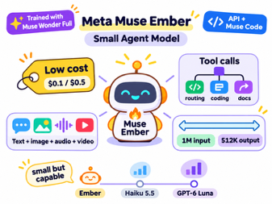
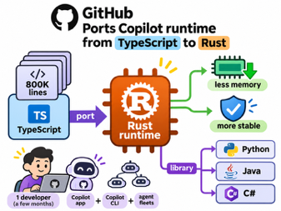
AI News
Meta Muse Ember: Small Agent Model
Available via Meta’s hosted API and Muse Code
Affordable pricing $0.1 / $0.5 (and $0.3 / $1.5 for > 200K tokens)
Similar (trails) Claude Haiku 5.5; GPT-6 Luna
For tool calls, routing, coding subtasks and document parsing
Trained using Muse Wonder Full
Accepts text, images, audio and video
Input up to 1M-tokens, output 512K-tokens
https://research.meta.ai/blog/muse-ember
https://artificialanalysis.ai/articles/meta-s-muse-ember-is-the-cheapest-model-scoring-36-on-the-intelligence-index
https://research.meta.ai/blog/muse-ember
GitHub ports the Copilot runtime from TypeScript to Rust
About 800K lines of code were ported
One developer finished it in a few months with the Copilot app, Copilot CLI and agent fleets
New runtime takes significantly less memory, more stable
The new runtime can be loaded as a library into apps written in Python, Java or C#
https://blog.bytebytego.com/p/how-github-used-ai-to-port-copilot

Slide 19
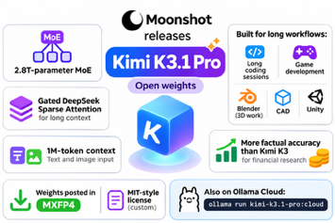
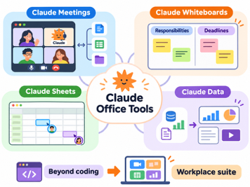
AI News
Moonshot releases Kimi K3.1 Pro open weights
2.8T-parameter MoE
Gated DeepSeek Sparse Attention for long context
1M-token context, text and image input
For long coding sessions, game development and 3D work in Blender, CAD and Unity
Better factual accuracy than Kimi K3 for financial research
Weights posted in MXFP4 under a custom MIT-style license
Also on Ollama Cloud: ollama run kimi-k3.1-pro:cloud
https://ollama.com/library/kimi-k3.1-pro
Claude Office Tools
Claude Meetings - joins Google Meet for Team and Enterprise customers, joining calls as a visible participant and retrieving information from connected applications
Claude Whiteboards - organizes brainstorming into responsibilities and deadlines
Claude Sheets - builds collaborative spreadsheets
Claude Data - converts connected business information into dashboards, summaries and videos
The suite expands Claude beyond coding into competition with Microsoft’s workplace software
https://www.theverge.com/ai-artificial-intelligence/1030709/anthropic-has-its-own-ai-powered-office-suite-now

Slide 20
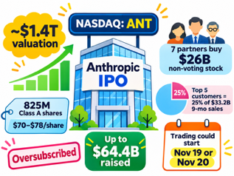
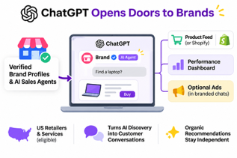
AI News
Anthropic sets IPO terms
Nasdaq ticker ANT
Up to $1.4 trillion, listing next week
Roadshow launched with 825 million Class A shares at $70 to $78
Up to $64.4 billion raised; about $1.4 trillion fully diluted at the top of the range
Seven partners (Nvidia, Microsoft, Google, ...) buy $26 Bln of non-voting stock
Trading could start Thursday November 19 or Friday November 20
The FT says the book is oversubscribed;
Some bankers weigh a valuation above $1.5 trillion
Five customers supplied a quarter of $33.2 billion in 9-month sales
ChatGPT Opens Doors to Brands
OpenAI launched free verified business profiles
and branded AI sales agents in ChatGPT
It helps businesses turn AI discovery into customer conversations
Agents initially serve eligible US online retailers and service businesses.
Brands claim profiles through Business Hub, verify identity, and supply current information, addressing outdated answers.
Retailers upload product feeds with pricing and stock or connect Shopify.
A dashboard tracks mentions, website clicks, and discovery topics, highlighting information gaps without exposing customer conversations.
Clearly labeled agents answer shopping questions
Selected advertisers can pay to direct ChatGPT ads into these branded chats;
Organic recommendations remain independent
https://venturebeat.com/technology/openai-lets-you-claim-your-business-in-chatgpt-and-set-up-a-custom-agentic-ai-customer-sales-rep

Slide 21
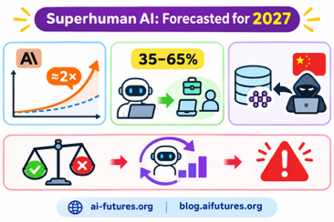
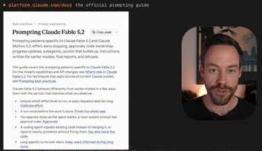
AI News
Superhuman AI Is Forecasted for 2027
METR’s estimate that Anthropic’s AI progress runs roughly twice its historical pace
35–65% probability to AI capable of automating all white-collar work in 2027
Alignment is lagging, recursive self-improvement could amplify misalignment, and China could steal training recipes or weights
https://ai-futures.org
https://blog.aifutures.org/p/q35-timelines-update-looks-like-the
Fable 5.2: New Prompting Rules
Fable 5.2 delivers Opus 5.5-level coding performance at half the cost using high effort.
So - use high effort initially; reserve extra-high for harder tasks; avoid costly maximum settings
Require tests, evidence, and explicit completion criteria to counter unsupported claims and unfinished work
Simplify outdated instructions, clarify code ownership, and let the model choose when to delegate subagents
Request occasional progress updates
Specify tone and length separately from effort
https://www.youtube.com/watch?v=c_McosB62a4

Slide 22
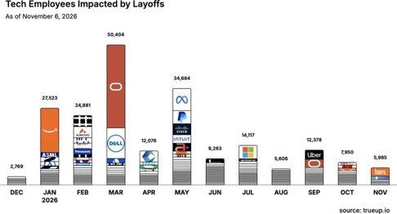
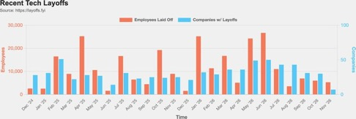
Jobs and Layoffs
https://layoffs.fyi
https://trueup.io/layoffs
The Tech Layoff Tracker
In 2026: 204,867 people laid off (661 per day)
In 2025: 245,953 people laid off (674 per day)
In 2024: 238,461 people laid off (653 per day)
https://trueup.io/layoffs
Tech Layoffs by year (US only):
  142.0K in 2026 (as of Nov 5, 2026)
  123K in 2025
  153K in 2024
  266K in 2023
  165K in 2022
  https://layoffs.fyi

Slide 23

About the Speaker
Lev Selector, Ph.D.
40+ years of software engineering, data science, and building teams (hiring, training, and managing)
Ph.D. in mathematical modeling and computer simulations
Interests: Generative AI, using LLMs with your data, local AI for local private data, cloud architecture, fin-tech, application security
Find and connect: LinkedIn, GitHub, YouTube, Google
https://eais.ai

Slide 24
Thank You!
Videos of every seminar are on YouTube
https://www.youtube.com/@lev-selector
Slides on GitHub. Click a pptx file, then the download button on the right
https://github.com/lselector/seminar
Slides on Google Drive
https://drive.google.com/drive/folders/1dmj00iilSP-JYmriMUUaHCKz5X54e3UX?ths=true

