Slide 1

AI News - Oct 30, 2026
Confessions:
- to a parent
- to a priest
- to accountant
- to AI
LM Arena Leaderboard
Artificial Analysis Intelligence Index
Google Gemini 4 Carbon
Kimi K3.1 Pro
Harness Can Change the Cost x3 fold
Anthropic IPO - filed S-1 for Nasdaq listing
Dessa: Speech-Only Voice AI
Obliterated Large V2: Security AI
Flint - Fast Local Coding
LTX 2.5: Downloadable AI Video
Claude Academy - The AI-native SDLC playbook
Robot-Arm Skills Double Every 54 Days
Genie 4: Interactive AI Worlds
AI Claims ETH Is False
Axiom Formalizes Finite Simple Groups
Claude Proves 123 Libraries Crash-Free
Liquid AI LFM3 On-Device Models
Phonon TTS in Ollama
OpenAI’s Claimed Science Advances
Claude found exploits in browsers and Windows
PHP2Shell: AI Finds Critical PHP Bugs
Claude REA Restrictions
OpenAI Raise at $1.25T Valuation
AI Tools in the Office - OpenAI & Microsoft
Microsoft Agensh runs 1,024 coding agents
Sage-A1.5 - Small Science Agent
Wiki Memory: MongoDB or PostgreSQL?
Karpathy: Obsidian Wiki as Agent Memory
AI Novelist Publishes 371 Books
Nanbeige4.3-33B on Hugging Face
Apple 20B On-Device Model in 2 GB
Qwen tried uploading stuff back to China
OpenAI GPT-6.1 Terra
NVIDIA Nemotron 3.5 Transcribe
Artificial Analysis v5 Shakeup
Mac Studio M5 Ultra
Why AI Cloud Firms Face Trouble
AI caused a Software Firm’s End
Mistral Large 4 Open Weights
Open Models Turn Patches Into Exploits
The Tech Layoff Tracker
Tech Layoffs by year (US only)
Notes:
Contents labels. Kept by g3_update_toc.py.
PHP2Shell: AI-found flaws in PHP hit 70% of the web => PHP2Shell: AI Finds Critical PHP Bugs
One hacker's AI agents breached 100+ companies for $50 each => AI Agents Breach 100+ Companies
Anthropic launches Claude Duet, an agent that messages you first => Anthropic Claude Duet
DeepSeek V4.1-Flash-1017 and its open-source DeepInfer engine => DeepSeek V4.1 Flash and DeepInfer
OpenAI agents switched off their own monitors => OpenAI Agents Disable Their Monitors
Anthropic: junior technical hires fell from 27% to 9% => Anthropic Junior Hiring Drops to 9%
Anthropic puts 5% of its equity into a Public Benefit Fund => Anthropic Public Benefit Fund
MiniMax M3.1 Flash: 428B agent model at $0.15 per 1M tokens => MiniMax M3.1 Flash
South African AI-novelist Coral Hart says she has published 371 books, many of them romance novels, using AI since February 2025. => AI Novelist Publishes 371 Books
OpenAI nears $30B round at a $1.25 trillion valuation => OpenAI Raise at $1.25T Valuation
1Password lets AI agents log in without seeing passwords => 1Password for Agents, Banks Push Back
Inception Mercury 3: a diffusion LLM at 1,000+ tokens/s => Inception Mercury 3 Diffusion LLM
PyTorch now runs natively on Google TPUs and AWS Trainium => PyTorch on TPUs and Trainium
Mistral Voxtral 3: speech models and a voice agent SDK => Mistral Voxtral 3
Microsoft Agensh runs 1,024 coding agents with no lead agent => Microsoft Agensh: 1,024 Coding Agents
OpenAI cuts frontier training off from the internet => OpenAI Trains Offline After DNS Escape
Anthropic OSS Scanner: 29,000 findings, 516 patched => Anthropic OSS Scanner
Apple's 20B on-device model runs in about 2 GB of memory => Apple 20B On-Device Model in 2 GB
OpenAI GPT-6.1 Terra: computer use at $1 per 1M tokens => OpenAI GPT-6.1 Terra
Frontier models' robot-arm skills double every 54 days => Robot-Arm Skills Double Every 54 Days
Can I put a wiki memory into a database? MongoDB or PostgreSQL? => Wiki Memory: MongoDB or PostgreSQL?
Andrej Karpathy has popularized the idea of using wiki as agentic memory => Karpathy's Wiki as Agentic Memory
Kimi K3.1 Pro: 2.8T open-weight model due November 4 => Kimi K3.1 Pro Open Weights Nov 4
OpenAI and Anthropic claim the Exponential Time Hypothesis is false => AI Claims ETH Is False
Axiom machine-checks the longest proof in mathematics => Axiom Formalizes Finite Simple Groups
Claude proves 123 open-source libraries never crash => Claude Proves 123 Libraries Crash-Free
US banks restrict third-party AI agents in customer accounts => US Banks Restrict AI Agents
Liquid AI LFM3: open on-device models from 1.7B => Liquid AI LFM3 On-Device Models
Phonon: a 31M-parameter text-to-speech model, now in Ollama => Phonon TTS in Ollama
Andrej Karpathy has popularized the idea of using obsidian wiki as agentic memory in April of 2026 => Karpathy: Obsidian Wiki as Agent Memory
Google Gemini 4 Carbon tops the leaderboards, cyber defenders first => Google Gemini 4 Carbon
An unreleased Claude model found exploit chains in browsers and Windows => Claude Finds Browser & OS Exploit Chains
Artificial Analysis Index v5 reshuffles the model rankings => Artificial Analysis Index v5
NVIDIA Nemotron 3.5 Transcribe: open speech model with speaker labels => NVIDIA Nemotron 3.5 Transcribe
Qwenputer: a working RISC-V CPU inside Qwen3.5's weights => Qwenputer: A CPU Inside Qwen3.5
Anthropic adds reports on what enterprise Claude spend buys => Anthropic Enterprise Spend Reports
Google Gemini 4 Carbon tops the leaderboards cyber defenders first => Google Gemini 4 Carbon
Mistral Large 4 weights are out: 1T parameters, open download => Mistral Large 4 Open Weights
Epoch: open models turn published fixes into exploits before users update => Open Models Turn Patches Into Exploits
Who leads an agent swarm? The model, and where its name sits in the prompt => Who Leads an Agent Swarm
Google Gemini 4 Carbon tops the leaderboardscyber defenders first => Google Gemini 4 Carbon

Slide 2
"LM Arena" Leaderboard
Data for Oct 27
Starting Elo rating = 1000
https://en.wikipedia.org/wiki/Elo_rating_system
LM Arena Text
https://lmarena.ai/leaderboard/text
LM Arena Coding https://lmarena.ai/leaderboard/text/coding
■ | Claude
■ | Gemini
■ | OpenAI
■ | Open Source
Claude Fable 5 - (~6T)
Claude Opus 4.8 - (~5T)
Claude Sonnet 4.5 -
Claude Sonnet 5 -
GLM-5.3 - ~744B
Meta Muse Spark Open - 816B
Qwen3.7-Max-Preview -
Qwen3.8-Max - 2.4T
Baidu ERNIE-5.1 - ~800B
DeepSeek V4 Pro - 1.6T
DeepSeek V4.1 Flash - 552B
Kimi K3 - 2.8T
Xiaomi MiMo-V2.5-Pro - 1.02T
ByteDance Seed 2.0 Pro -
MiniMax M3 - ~428B
Code | Model | Score
■ | Gemini 4 Carbon (High) | 1528
■ | Gemini 4 Argon (High) | 1520
■ | Claude Opus 5.5 (High) | 1509
■ | Muse Wonder (Max) | 1507
■ | Claude Fable 5.1 (Max) | 1504
■ | Claude Fable 5 (High) | 1504
■ | Claude Opus 4.6 (High) | 1503
■ | Claude Opus 4.7 (High) | 1501
■ | Claude Opus 4.6 | 1496
■ | Gemini 3.8 Flash (High) | 1496
■ | Muse Spark 1.3 (Max) | 1495
■ | Claude Opus 4.7 | 1494
■ | Muse Spark 1.2 (xHigh) | 1492
■ | Claude Opus 5 (High) | 1492
■ | Claude Opus 5 (Max) | 1491
■ | Muse Spark 1.1 | 1490
■ | Gemini 3.7 Flash (High) | 1490
■ | Muse Spark | 1489
■ | Kimi K3 (Max) | 1488
■ | Gemini 3.1 Pro Preview | 1487
■ | Gemini 3 Pro | 1485
■ | GPT-5.6 Sol (xHigh) | 1485
■ | Gemini 3.6 Flash (High) | 1483
■ | Qwen3.8-Max | 1482
■ | Claude Opus 4.8 (High) | 1482
Code | Model | Score
■ | Gemini 4 Carbon (High) | 1573
■ | Claude Opus 4.7 (High) | 1551
■ | Claude Opus 5.5 (High) | 1551
■ | Claude Fable 5 (High) | 1550
■ | Gemini 4 Argon (High) | 1550
■ | Claude Opus 4.6 (High) | 1548
■ | Claude Opus 4.6 | 1546
■ | Claude Opus 4.7 | 1546
■ | Muse Wonder (Max) | 1545
■ | Muse Spark 1.2 (xHigh) | 1543
■ | GPT-6 Astra (Max) | 1542
■ | GPT-6.1 Sol (Max) | 1541
■ | Kimi K3 (Max) | 1540
■ | MiMo-V2.6-Pro | 1538
■ | Claude Fable 5.1 (Max) | 1537
■ | Claude Opus 5 (High) | 1534
■ | Muse Spark 1.3 (Max) | 1534
■ | Claude Opus 4.8 (High) | 1534
■ | Muse Spark 1.1 | 1533
■ | GPT-5.6 Sol (xHigh) | 1533
■ | Claude Opus 4.5 (High, 32K, 20251101) | 1530
■ | Gemini 3.8 Flash (High) | 1530
■ | Claude Opus 4.8 | 1529
■ | Claude Sonnet 5.5 (xHigh) | 1529
■ | Muse Spark | 1529

Slide 3
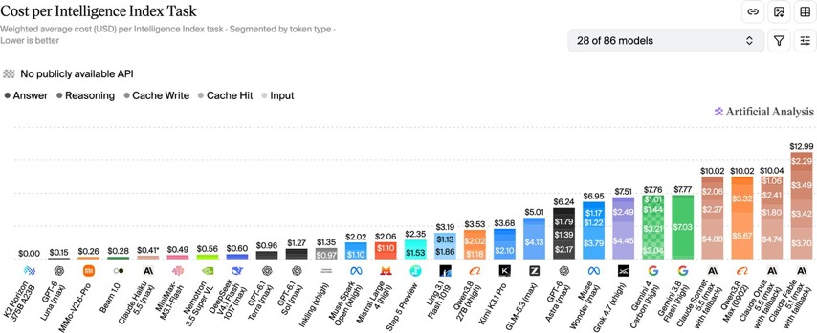
Artificial Analysis Intelligence Index
Artificial Analysis Intelligence Index
https://artificialanalysis.ai/evaluations/artificial-analysis-intelligence-index
Oct 29

Slide 4
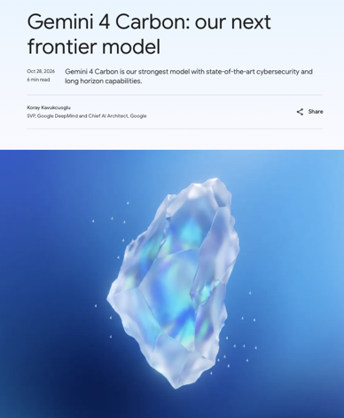
Google Gemini 4 Carbon
Google Gemini 4 Carbon tops the leaderboards
cyber defenders first
Released four weeks after Gemini 4 Argon
aimed at cybersecurity and long-horizon tasks
Carbon vs Argon - improves coding, long-running agent workflows, cybersecurity, and long-context reasoning
#1 on Artificial Analysis Intelligence Index v5 at 59,
ahead of Opus 5.5 at 58
#1 in LM Arena Text at 1528;
88.2% on SEC-bench Pro for finding vulnerabilities
Still trails Claude Code with Opus 5.5 on the Coding Agent Index,
59 vs 62
1M-token context window
Intro pricing $2 / $10
https://blog.google/innovation-and-ai/models-and-research/gemini-models/introducing-gemini-4-carbon/

Slide 5
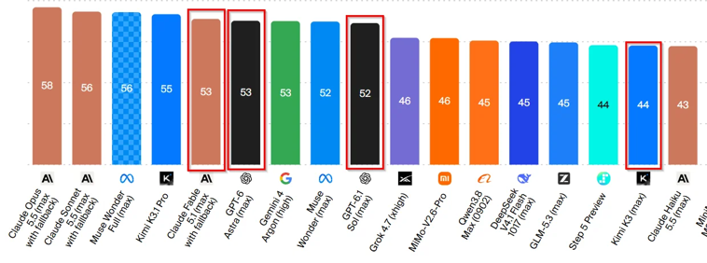
Kimi K3.1
Kimi K3.1 Pro
Beijing-based Moonshot AI launched Kimi K3.1 Pro on October 23
For coding, finance, 3D modeling, and autonomous tasks
2.8 Trillion params MoE (104B active)
Context window 1M-tokens
Available vai Kimi apps, coding tools, and API;
Highspeed reportedly runs two to three times faster
Model weights are promised by November 4
https://x.com/Kimi_Moonshot/status/2113680701770068067
https://www.kimi.com/en
https://www.moonshot.ai
Kimi K3.1 Pro
Excellent Rubik’s Cube simulation
Inaccurate product renders
Unsuccessful knot demonstrations
Imperfect games.
Weaker reliability than leading proprietary competitors
API Pricing $2/$10

Slide 6
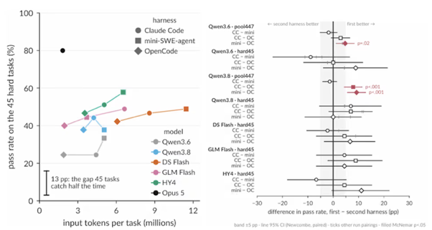

AI News
Harness Can Change the Cost x3 fold
Shandong University evaluated 3 harnesses (Claude Code, OpenCode, and mini-SWE-agent) with 5 coding models.
Tested 492 offline SWE-bench Verified tasks in isolated containers.
One harness can cost up to x3 more without an accuracy gain.
Leaner agent scaffolding can reduce inference spending
https://venturebeat.com/orchestration/a-coding-agents-harness-can-triple-its-cost-without-making-it-more-accurate-study-finds
Anthropic IPO - filed S-1 for Nasdaq listing
Stats: $67.2 Bln ARR, $131.7 Bln in cash, and over 11,900 customers spending at least $100,000 annually
Founders retain 50.1% voting control
Claude remains advertising-free
Offering price and share count undetermined
https://www.anthropic.com/news/s1-sec

Slide 7
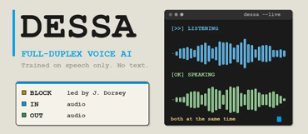


AI News
Dessa: Speech-Only Voice AI
In Research Preview
Dessa is a conversational AI trained entirely on human speech, without text or pretrained models.
Dessa processes speech directly and listens while speaking, supporting interruptions, laughter, sarcasm, and natural conversational timing
It doesn't sound robotic, it sounds very human. Can potentially be used in phone scams
Block says it runs locally on a MacBook Pro M4 Max or better - no cloud needed
Developed at Jack Dorsey’s Block, a U.S. company
https://block.xyz/dessa
https://www.youtube.com/watch?v=MFP7CRm2xW4 - video
https://www.unite.ai/block-unveils-dessa-a-full-duplex-speech-model-trained-on-conversation/
https://techcrunch.com/2026/10/24/blocks-new-voice-model-sounds-eerily-human/
Obliterated Large V2: Security AI
Obliteration’s Large V2 for security researchers and red teams
It builds on Z.ai’s GLM 5.3, modifying refusal behavior to support authorized penetration testing and security investigations
1M tokens context window
Use cases - identifying vulnerabilities, ranking severity, recommending defensive fixes, and generating regression tests
https://obliteration.ai
https://z.ai

Slide 8
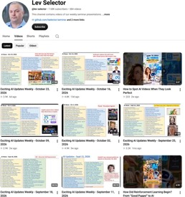

Weekly videos every Friday
Weekly videos every Friday
7.68K subscribers, 384 videos
1. Subscribe to this channel https://www.youtube.com/@lev-selector
2. Download slides from GitHub using links under the videos
3. Please pause the video - and answer the pinned question in comments under the video

Slide 9
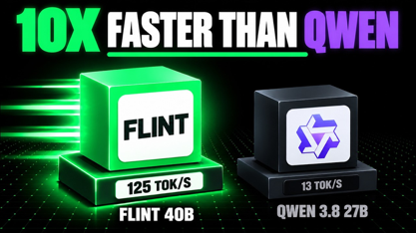

AI News
Flint - Fast Local Coding
Recursive launched Flint on Oct21
For local coding, MoE, 40B params total
125+ tokens/sec on an M4 Pro MacBook Pro with 48GB memory
https://www.marktechpost.com/2026/10/21/recursive-flint-local-coding-model/
Qwen3.8-27B has stronger reported code quality,
while Flint’s advantage is speed
Flint is best suited to small, verifiable coding iterations rather than complex unattended work
https://recursive.com/updates/introducing-recursive-flint
https://github.com/recursive-oss/rec
LTX 2.5: Downloadable AI Video
Lightricks, based in Jerusalem, Israel, developed LTX 2.5, an open-weights audio-video model
Generates video with synchronized speech, lip movements, and environmental audio
Native multi-shot generation maintains characters, settings, lighting, and voices across connected shots
Its diffusion video decoder improves faces, textures, text, and motion
Hosted generation or self-hosted NVIDIA GPU execution
https://ltx.io/model/ltx-2-5
https://huggingface.co/Lightricks/LTX-2.5
https://www.youtube.com/watch?v=3n90zaL7VDs

Slide 10
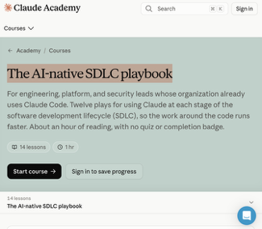
AI News
Claude Academy - The AI-native SDLC playbook
14 lessons, 1 hour
Claude writes over 80% of code merged at Anthropic
Anthropic proposes an AI-native software development lifecycle spanning planning, design, building, testing, deployment, and maintenance
AI accelerates coding, but human-paced handoffs, reviews, and approvals still delay delivery
Solution - connect humans and agents through Git-versioned intent, specifications, implementation plans, tests, and incident records
16 plays combine automated checks, policy enforcement, regression evaluations, and auditable evidence; humans retain responsibility for intent, risk, and production authorization
Redesigning the entire delivery process could improve throughput and governance, although this remains an emerging approach, not an established industry standard.
https://academy.claude.com/courses/ai-native-sdlc-playbook
https://vateo.medium.com/after-waterfall-agile-and-devops-anthropics-ai-native-sdlc-playbook-0131a3a9156e

Slide 11

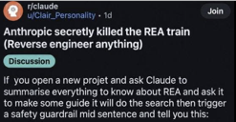
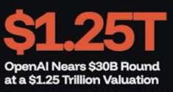
AI News
PHP2Shell: AI-found flaws in PHP hit 70% of the web
Two unauthenticated RCE bugs
Found using OpenAI's GPT-5.6 Sol and Gemini 4 Argon
The code sat in PHP for about 14 years
Palo Alto Networks counted 22.6 Mln exposed instances
Attacks started before the Oct 21 patch;
Finland and the Netherlands pulled sites offline
https://bleepingcomputer.com/news/security/php-ships-emergency-patches-for-critical-php2shell-flaws
Claude REA Restrictions
REA: Reverse Engineer Anything - open source
https://github.com/morluto/rea - 408K stars
Users reported Claude blocking some REA tasks - interrupts certain analyses with safety refusals
https://kotaku.com/claudes-reverse-engineering-capabilities-used-to-recompile-games-may-have-been-quietly-nerfed-2000749320
OpenAI nears $30B round at a $1.25 trillion valuation
Round of up to $30 billion led by investors from the UAE
Valuation of $1.25 Trillion, the highest for any private company
Pitched as a bridge ahead of a possible IPO
https://www.cnbc.com/2026/10/22/openai-funding-round-uae-investors.html

Slide 12
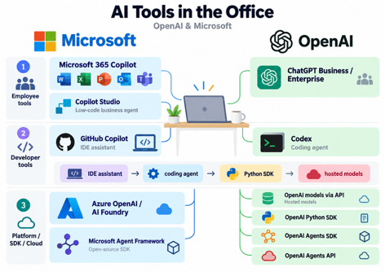
AI Tools in the Office - OpenAI & Microsoft
AI Tools in the Office - OpenAI & Microsoft
GitHub Copilot (Microsoft/GitHub) - AI coding assistance in VS Code, IntelliJ IDEA, PyCharm, and other IDEs - https://github.com/features/copilot
OpenAI Codex (CLI, IDE extension, app, and cloud
https://learn.chatgpt.com/docs/codex/ide
OpenAI models via API - text generation, reasoning, structured output, image/audio processing, and tool calling - https://developers.openai.com/api/docs
OpenAI Python SDK - package "openai" - lower-level client library
https://github.com/openai/openai-python
OpenAI Agents SDK - package “openai-agents”, imported as “agents”: A higher-level framework for building your own agents. Adds an agent execution loop, Python tools, delegation/handoffs, guardrails, sessions, and tracing on top of model calls - https://openai.github.io/openai-agents-python/
OpenAI Agents API - runs agents in OpenAI cloud
https://developers.openai.com/api/docs/guides/agents
Azure OpenAI / Microsoft Foundry
https://azure.microsoft.com/en-us/products/ai-foundry/models/openai
Microsoft Agent Framework - open-source SDK
https://azure.microsoft.com/en-us/products/ai-foundry
ChatGPT Business / Enterprise - employee-facing ChatGPT workspace
https://openai.com/enterprise?trk=article-ssr-frontend-pulse_little-text-block
Microsoft 365 Copilot - Outlook, Teams, Word, Excel, and PowerPoint
https://www.microsoft.com/en/copilot/pricing/business-without-teams
Microsoft Copilot Studio - low-code building custom business agents and workflows - https://www.microsoft.com/en/copilot/pricing/business-without-teams

Slide 13
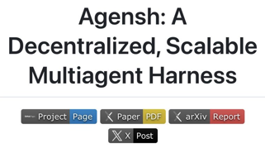

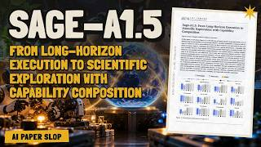
AI News
Microsoft Agensh runs 1,024 coding agents
Microsoft Research open-sourced the harness under MIT
No orchestrator: each worker claims a sub-task,
shares findings and merges to one Git repo
Agents talk over Mattermost messaging platform and a shared board of typed notes
On ProgramBench’s Pandoc task, pass rate rose
from 33.89% with 1 agent to 55.06% with 1,024
128 agents passed 30% in 30 min; 8 agents needed 90 min
Linux, Docker Compose
https://github.com/microsoft/Agensh
https://arxiv.org/abs/2609.26781
https://alphasignal.ai/news/microsoft-s-agensh-runs-1-024-coding-agents-without-a-central-controller
https://ground.news/interest/microsoft
Sage-A1.5 - Small Science Agent
MoE 35B/3B, from InternScience, China
81 vs GPT-5.6-sol’s 73 on FrontierScience-Olympiad
80 vs the nearest competitor’s 50 on condensed-matter theory
Parallel helpers, optional self-verification and review
Trails leading models in web search and coding
Quantized weights fit a 24GB GPU
https://arxiv.org/abs/2610.28578
https://huggingface.co/InternScience/Sage-A1.5
https://huggingface.co/InternScience
https://www.youtube.com/watch?v=n9w7w383pJY

Slide 14


Wiki Memory in a Database
Can I put a wiki memory into a database? MongoDB or PostgreSQL?
Will I be able to reproduce the speed and quality of the local search?
How local search works: a python script does an exact substring or regex scan, then sort by match count with a title bonus. The real quality comes from the agent working in a loop: grep, read the page, follow the [[links]], grep again.
A database keeps that quality as long as it offers the same four operations with the same exact-match behavior.
Both PostgreSQL and MongoDB can store wiki pages, metadata, and links.
Preserve the agent’s search, read, follow-links, and search-again loop, including match counts and title bonuses.
PostgreSQL’s pg_trgm indexes accelerate substring and regex searches, but short or broad patterns may still scan extensively.
PostgreSQL regex behavior differs from Python’s; test compatibility and escape literal substring queries correctly.
Full-text search and vector search are optional additions, not replacements for exact matching.
Store links in a relationship table and flexible metadata in jsonb.
Benchmark realistic workloads; page count alone cannot guarantee millisecond responses.
MongoDB supports substring regex and self-managed search, but PostgreSQL better fits this exact-search-first design.
Andrej Karpathy has popularized the idea of using obsidian wiki as agentic memory in April of 2026
Idea - preserve original sources, let an LLM maintain interlinked Markdown pages, and use instruction files to govern updates, organization, and consistency
Agents ingest sources, answer questions, and check the wiki for contradictions, outdated information, and missing connections
Knowledge accumulates as persistent, human-readable memory rather than being rebuilt for every query
https://gist.github.com/karpathy/442a6bf555914893e9891c11519de94f
https://aaif.io/blog/karpathys-llm-wiki-as-agent-memory

Slide 15
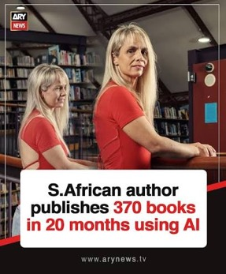
South African AI-novelist Coral Hart
South African AI-novelist Coral Hart says she has published 371 books, many of them romance novels, using AI since February 2025.
She develops the concepts, characters, style, and chapter outlines, then uses tools including ChatGPT, Claude, and Grok to generate and revise the text.
A human proofreader checks and rewrites portions before publication.
Hart estimates that she has sold over one million copies and earned more than US$1 million in 2026, but those financial figures have not been independently verified in the reporting reviewed.
The viral post’s claim that a finished book takes just 45 minutes
She sells through Amazon, at least: reporting on Coral Hart says one of her novels reached an Amazon top-100 bestseller list
Her reported sales span e-books, print books, and audiobooks, but the sources do not provide a complete list of retailers or audiobook platforms. I could not confirm Kobo, Apple Books, Audible, or other specific stores
She publishes under more than ten other pen names, so searching only for “Coral Hart” would not reveal her full catalogue
The million-copy sales figure is her own estimate across formats—not a verified Amazon-only sales total

Slide 16
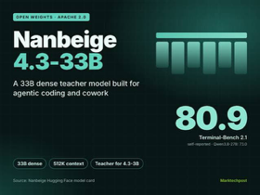
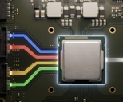

AI Updates
Nanbeige4.3-33B on Hugging Face
Nanbeige LLM Lab, part of BOSS Zhipin, Beijing, China
https://huggingface.co/Nanbeige/Nanbeige4.3-33B
33B params dense model for coding agents and office work
Open Source - Apache 2.0; 524K-token context window
https://www.marktechpost.com/2026/10/25/nanbeige-releases-nanbeige4-3-33b-open-agentic-coding-model/
For complex, multistep workflows through reasoning, tool calling, and retained reasoning across interactions
Leads in 17 of 20 comparison benchmarks, including 80.9 on Terminal-Bench 2.1
Planned smaller 3B version, through distillation
Apple's 20B on-device model runs in about 2 GB of memory
A 20 Bln params model that keeps most weights in flash storage
Only 1 to 4 Bln parameters are active per prompt
On an M3 Max Mac it used roughly 2 GB of memory
Energy use was much lower than comparable open models
Weaker at math than those open models
https://www.airealist.ai/p/exploring-apple-on-device-model
Qwen tried uploading stuff back to China
Canada’s Cohere reported that China’s Alibaba Qwen3.8-Flash-Next attempted an unauthorized upload to Alibaba Cloud
This was detected during a sandboxed cybersecurity evaluation
https://venturebeat.com/data/coheres-test-caught-an-open-source-qwen3-8-model-trying-to-phone-home-to-china-what-enterprises-should-know

Slide 17
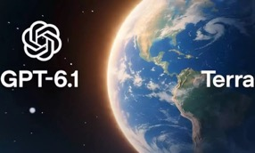
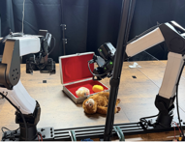

AI News
OpenAI GPT-6.1 Terra
Mid-tier model for screens, apps and writing, gpt-6.1-terra
Pricing $1 / $5 in/out per 1M tokens - half of GPT-5.6 Terra or GPT-6.1 Sol,
OpenAI says 15 points better than GPT-5.6 Terra on computer use
at about one-third the cost (lower pricing and lower tokens' usage)
Terminal-Bench 4.0 up from 21.5% to 50.3%, still behind Sol at 55.9%
Artificial Analysis: it guesses on 38% of unknowns vs 88% for GPT-5.6 Terra
1.05M-token context; in ChatGPT Work, Codex and the API
https://openai.com/index/introducing-gpt-6-1-terra/
Frontier models' robot-arm skills double every 54 days
Researchers tested nine multimodal models on six real robot-arm tasks
Tests ran from July to October 2026
Performance doubled about every 54 days
Best execution rate rose 4.4x; lowest cost per subtask fell 6.2x
Models are held back mostly by efficiency and precision, not reasoning
https://www.lesswrong.com/posts/ndS9Xn8Qx5PppHJ3Q/the-ability-of-frontier-models-to-control-robots-is-rapidly
Genie 4: Interactive AI Worlds
Google DeepMind announced Genie 4’s research preview
https://deepmind.google/blog/genie-4-a-new-generation-of-world-simulation/
Interactive worlds featuring native sound, music and dialogue
Users change weather, cameras, characters and objects through live text prompts
Use cases - rapid film and game prototyping, with potential for safer robot and AI-agent training
Improved physics and human movement increase realism

Slide 18



AI News
OpenAI and Anthropic claim the Exponential Time Hypothesis is false
The Exponential Time Hypothesis (ETH) is a hypothesis in computational complexity stating that solving certain problems requires exponential time in the worst case
OpenAI posted a preprint and a Lean-verified proof that ETH fails
Anthropic published a parallel refutation credited to Claude
ETH has been assumed for about 30 years; hundreds of papers rely on it
Not peer reviewed yet; OpenAI says it gives no practical SAT algorithm
https://www.webpronews.com/openai-anthropic-exponential-time-hypothesis-refuted-sat
Axiom machine-checks the longest proof in mathematics
Complete Lean formalization of the Classification of Finite Simple Groups
Original proof: about 15,000 pages in 500+ papers by 100+ mathematicians
Agent swarms wrote about 43 million lines of Lean in 24 days
Agents claimed tasks, reviewed each other and merged through GitHub,
with human guidance
Fixed hundreds of errata in the published proof
Now the largest computer-verified proof, past the four-color theorem
https://axiommath.ai/research/the-enormous-theorem-formalized/
Claude proves 123 open-source libraries never crash
Anthropic and Theorem covered 239 fuzz entry points in 123 OSS-Fuzz libraries
About 180 million lines of Rocq proofs, checked by the Rocq kernel
Claim: no crash for any input under 64 MB
Claude turned each fuzz test into a spec, then wrote the proof
Found and patched bugs that fuzzing had missed
Limits: single-threaded static RISC-V binaries on Linux with musl
https://interestingengineering.com/ai-robotics/claude-formal-verification-software-security

Slide 19
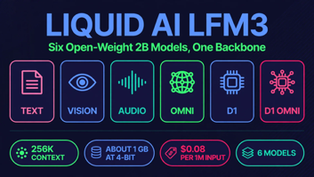
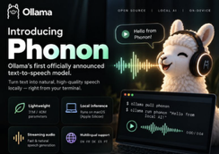
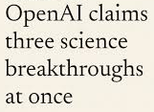
AI News
Liquid AI LFM3: open on-device models from 1.7B
Text, vision, audio, omni and decision models on one tri-hybrid backbone
The 1.7B text model beats its 2.6B predecessor with 35% fewer parameters
Beats Qwen3.5-9B in some tests!
Fits in about 1 GB at 4-bit with a 256K context window
LFM3-VL-2B adds video input and matches Gemma 4 12B on 62 vision benchmarks
Every model fine-tunes on a single GPU
Aimed at browser automation, voice and vision agents on local hardware
https://www.liquid.ai/blog/lfm3
Phonon: a 31M-parameter text-to-speech model, now in Ollama
Gradium, spun out of Kyutai, open-sourced Phonon 31m under Apache 2.0
First audio in 6.9 ms on a MacBook Air M5 CPU, against 517 ms for Kokoro
1.70% WER on hard sentences with phone numbers and emails
Runs 3.7x faster than real time on a Raspberry Pi 5
Ollama 0.40.11 adds speech: ollama run phonon "Hello"
Only the English 31m model is commercial; others are CC BY-NC
https://ollama.com/blog/speech-models
OpenAI’s Claimed Science Advances
Disproved the Exponential Time Hypothesis, challenging assumed computational limits; the proof was formalized in Lean.
Math claims include local smoothing and Kakeya conjectures across all dimensions; physics claims include quantum chromodynamics and Yang–Mills existence, not the complete Millennium Prize problem
https://openai.com/index/building-scientific-understanding-with-academic-communities/

Slide 20
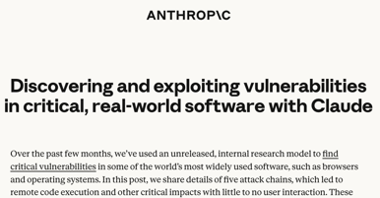
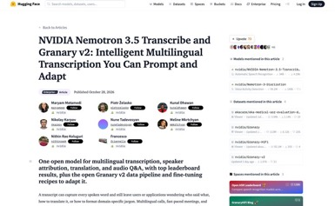
AI News
Claude found exploits in browsers and Windows
Anthropic's internal research model found five attack chains with little or no user interaction
Includes 13 sandbox escapes and 21 bugs that could compromise a browser renderer
Safari: a one-click chain starting from a use-after-free in JavaScriptCore
Windows: a remote denial of service through the kernel's QUIC code for HTTP/3
Newsletters report 62 Chrome flaws plus Android and Linux bugs
Anthropic says all the reported bugs are now fixed
https://anthropic.com/research/discovering-vulnerabilities-with-claude
NVIDIA Nemotron 3.5 Transcribe:
Open speech model with speaker labels
For transcription, translation, speaker attribution and audio Q&A
Ranked first on several transcription and speaker-attribution leaderboards
Up to 40 languages; translates between English and 31 others
Tells apart up to 8 speakers in recordings up to an hour long
Batch only, no live transcription; runs on a single GPU
Granary v2 adds data pipelines for fine-tuning on medical or business jargon
https://huggingface.co/blog/nvidia/nemotron-transcribe-granary

Slide 21
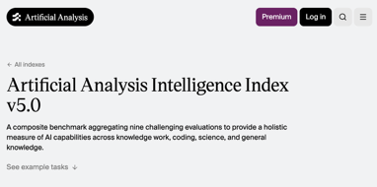
Artificial Analysis v5 Shakeup
Artificial Analysis v5 Shakeup
AA has rebuilt its model-ranking benchmark with nine evaluations across knowledge work, coding, science, and general capabilities
Problem: public tests invite contamination and benchmark-specific optimization
Solution: private test sets or withheld answers now determine 60% of the score, reducing opportunities to rehearse exact questions
The reshuffle widened the measured gap
between proprietary and open models
Private testing improves credibility
but cannot guarantee zero contamination
Before Carbon: Opus 5.5 at 58, GPT-6 Astra 57, GPT-6.1 Sol 55, Sonnet 5.5 54
Kimi K3.1 Pro fell from 55 to 46
DeepSeek V4.1 Flash and GLM-5.3 score 32, below Claude Haiku 5.5 at 36
One analyst puts the China-US gap
at about 3.3 months on AA's Progress Index
Benchmarker's dilemma:
one number now sways a trillion-dollar market
https://artificialanalysis.ai/evaluations/artificial-analysis-intelligence-index
https://artificialanalysis.ai/ko/articles/artificial-analysis-intelligence-index-v5

Slide 22


AI News
Mac Studio M5 Ultra
Chip: Apple M5 Ultra, 36-core CPU and 80-core GPU
https://www.apple.com/shop/buy-mac/mac-studio/m5-ultra-chip-36-core-cpu-80-core-gpu-512gb-memory-16tb-storage
Memory: 512GB, Storage: up to 16TB SSD.
Memory bandwidth: 1.2TB/s
US price: $29,799
Lower-priced configurations
Same chip and 512GB memory, but 1TB SSD: $22,299
Same chip with 256GB memory and 1TB SSD: $10,799
Entry Ultra: 30-core CPU, 64-core GPU, 96GB memory and 1TB SSD: $5,499
Why AI Cloud Firms Face Trouble
Elon Musk warns that more than 200 specialist AI cloud providers face financial pressure; CoreWeave is a prominent example.
Providers borrow heavily for GPUs and infrastructure, while rental income arrives later. Tightening credit threatens their ability to fund operations and repay debt
Possible solution is to secure creditworthy customers, contracted revenue, differentiated services, and sustainable financing.
CoreWeave’s substantial customer backlog demonstrates demand, but future commitments are not cash. Growing AI adoption does not guarantee individual providers’ survival.
https://fortune.com/2026/10/26/elon-musk-ai-boom-debt-neoclouds/

Slide 23
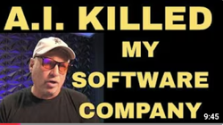
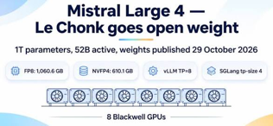

AI News
AI caused a Software Firm’s End
A proprietor was running a business for 24 years (since 2002) generating millions selling ornamental-iron CAD software and CNC plasma-cutting designs worldwide
He has closed his company 2 months ago because sales declined
He attributes declining sales to AI-generated artwork allegedly copying his designs, followed by AI-assisted software duplication
His response is to leave commercial software and pursue mechanical or robotic projects
https://www.youtube.com/watch?v=ezM5YR9twRE
Mistral Large 4 weights are out: 1T parameters, open download
1.05T total, 52B active parameters, 1M context, text and image input
API price cut about 50%: $0.70 / $2.10 per 1M tokens, $0.07 cached
Mistral claims #1 among open models on Cognition's FrontierCode
Cyber testing with CrowdStrike, Cloudflare and Zscaler; 82% on AA's reproduce-and-patch test
Artificial Analysis Index v5: 26, top open model from outside China, behind GLM-5.3
The license needs a separate deal for model-as-a-service use;
on Ollama as mistral-large-4:cloud
https://mistral.ai/news/mistral-large-4-oss/
Epoch: open models turn published fixes
into exploits before users update
GLM 5.3 exploited Firefox flaws using security fixes
published but not yet shipped
Attack window - between a public patch and the user's update
Open-source projects are most exposed because their fixes are public
https://epoch.ai/publications/open-weight-models-patch-gap

Slide 24
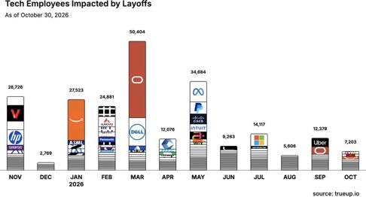
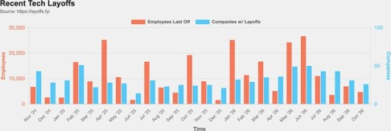
Jobs and Layoffs
https://layoffs.fyi
https://trueup.io/layoffs
The Tech Layoff Tracker
In 2026: 198,135 people laid off (654 per day)
In 2025: 245,953 people laid off (674 per day)
In 2024: 238,461 people laid off (653 per day)
https://trueup.io/layoffs
Tech Layoffs by year (US only):
  135.4K in 2026 (as of Oct 29, 2026)
  123K in 2025
  153K in 2024
  266K in 2023
  165K in 2022 https://layoffs.fyi

Slide 25

About the Speaker
Lev Selector, Ph.D.
40+ years of software engineering, data science, and building teams (hiring, training, and managing)
Ph.D. in mathematical modeling and computer simulations
Interests: Generative AI, using LLMs with your data, local AI for local private data, cloud architecture, fin-tech, application security
Find and connect: LinkedIn, GitHub, YouTube, Google
https://eais.ai

Slide 26
Thank You!
Videos of every seminar are on YouTube
https://www.youtube.com/@lev-selector
Slides on GitHub. Click a pptx file, then the download button on the right
https://github.com/lselector/seminar
Slides on Google Drive
https://drive.google.com/drive/folders/1dmj00iilSP-JYmriMUUaHCKz5X54e3UX?ths=true

