Slide 1
AI Updates - October 24, 2025
“We’re summoning ghosts, not building animals”
- Andrej Karpathy
"Why Claude Skills is a Big Deal ?!"
Crowd-sourced "LM Arena" Leaderboard
Claude Agent Skills
Claude for Life Sciences
Claude Skills vs Agents
Replicating /skills Locally
Emulate Skills in Google
ChatGPT with automatic memory management
Nvidia RTX Pro 5000 Blackwell 72GB GPU
Google Build - new "vibe coding" product
Unitree H2 Humanoid Robot
Tencent Hunyuan World 1.1
Google's Quantum Computing Breakthrough
Deepseek-OCR AI Model
Andrej Karpathy Interview
Google VISTA Video Agent
IBM Generalist Agent
Energy for AI
ChatGPT is losing to Anthropic, DeepSeek, ...
Four alternatives to JSON
Claude Code for the Web
OpenAI Atlas Web Browser
Gemini "URL context grounding" via API
Vibe Coding Is Dead?
Run LLM on Android Phone
Cline CLI - run Multiple Instances
Preventing Loops in Multi-Agent System
Orchestration Frameworks
Deploying Agents
Veo 3.1
Nvidia Blackwell chip wafer - TSMC in US
Terminals on MacOS
Colleges in Trouble
Jobs, Layoffs, demand for AI Engineers

Slide 2
Crowd-sourced "LM Arena" Leaderboard
https://lmarena.ai/?leaderboard
Starting Elo rating = 1000
https://en.wikipedia.org/wiki/Elo_rating_system
English - https://lmarena.ai/leaderboard/text
Coding - https://lmarena.ai/leaderboard/text/coding
LM Arena secures $100M to expand AI benchmarking (at $600M valuation)
Model | Score
gemini-2.5-pro | 1451
claude-opus-4-1-20250805-thinking-16k | 1447
claude-sonnet-4-5-20250929-thinking-32k | 1445
gpt-4.5-preview-2025-02-27 | 1441
chatgpt-4o-latest-20250326 | 1440
o3-2025-04-16 | 1440
claude-sonnet-4-5-20250929 | 1438
gpt-5-high | 1437
claude-opus-4-1-20250805 | 1437
qwen3-max-preview | 1434
gpt-5-chat | 1425
qwen3-max-2025-09-23 | 1423
glm-4.6 | 1422
grok-4-fast | 1420
claude-opus-4-20250514-thinking-16k | 1419
deepseek-v3.2-exp-thinking | 1419
qwen3-vl-235b-a22b-instruct | 1418
qwen3-235b-a22b-instruct-2507 | 1418
deepseek-r1-0528 | 1417
kimi-k2-0905-preview | 1417
deepseek-v3.1 | 1416
deepseek-v3.1-thinking | 1415
kimi-k2-0711-preview | 1415
deepseek-v3.1-terminus | 1414
Model | Score
claude-sonnet-4-5-20250929-thinking-32k | 1527
claude-opus-4-1-20250805-thinking-16k | 1515
claude-opus-4-1-20250805 | 1499
claude-opus-4-20250514-thinking-16k | 1489
qwen3-max-2025-09-23 | 1476
qwen3-max-preview | 1477
longcat-flash-chat | 1473
claude-sonnet-4-5-20250929 | 1472
qwen3-vl-235b-a22b-instruct | 1468
claude-haiku-4-5-20251001 | 1461
qwen3-235b-a22b-instruct-2507 | 1470
claude-sonnet-4-20250514-thinking-32k | 1469
gemini-2.5-pro | 1469
gpt-5-high | 1467
chatgpt-4o-latest-20250326 | 1466
kimi-k2-0905-preview | 1463
deepseek-r1-0528 | 1461
claude-opus-4-20250514 | 1461
gpt-5-chat | 1460
deepseek-v3.2-exp-thinking | 1459
glm-4.6 | 1458
deepseek-v3.1-terminus-thinking | 1456
gpt-4.5-preview-2025-02-27 | 1455
deepseek-v3.1-thinking | 1454
China
China
China
Grok 4 Benchmarks
https://artificialanalysis.ai/models/grok-4
China
https://lmarena.ai/leaderboard/text
https://web.lmarena.ai/leaderboard
https://openlm.ai/chatbot-arena/
https://beta.lmarena.ai
Web Leaderboard https://web.lmarena.ai/leaderboard
LLM Leaderboard - by @LlmStats https://llmworld.net/llm_leaderboards/
LLM Leaderboard - by StackAI https://www.stack-ai.com/llm-leaderboard
LLM Leaderboard - by Artificial Analysis https://artificialanalysis.ai/leaderboards/models
Open LLM Leaderboard - by Hugging Face https://huggingface.co/open-llm-leaderboard
LLM Leaderboard - by Vellum https://www.vellum.ai/llm-leaderboard
AI Benchmarking Hub https://epoch.ai/data/ai-benchmarking-dashboard
China
China
China
China
x.ai
China
China
China
China
China
China
China
China
China
China
China
China
China
China
China

Slide 3

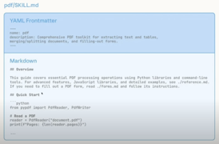
Claude Agent Skills
Claude Agent Skills - path to Continual Leaning?
https://www.anthropic.com/news/skills
Skills are simply packaged specialized knowledge that can be uploaded so that Claude can use on demand. You can create skill folders with instructions, code, and resources (like brand guidelines) that Claude accesses automatically when needed—without cluttering the context window
Agent Skills can now be added to Messages API requests
The new /v1/skills endpoint gives developers programmatic control over custom skill versioning and management
Skills require the Code Execution Tool beta, which provides the secure environment they need to run
Developers can create custom Skills to extend Claude's capabilities for their specific use cases.
Developers can also easily create, view, and upgrade skill versions through the Claude Console.
Anthropic's new Skills feature consumes only dozens of tokens per skill until needed - compared to MCPs that can burn tens of thousands upfront
This token efficiency and model-agnostic approach (any coding agent can read the files) will trigger a "Cambrian explosion" that makes the MCP rush look pedestrian
Especially since skills transform Claude Code from a coding tool into a general automation agent capable of handling anything you could accomplish by typing commands
Unlike OpenAI’s Custom GPTs or Microsoft’s Copilot Studio, Skills support executable code & composability across workflows.
https://www.youtube.com/watch?v=FOqbS_llAms - good demo
You can use same skills in different autonomous agents with separate contexts, or can use skills wirth agents in the same context (for example Claude Code agents and Sub-agents)

Slide 4
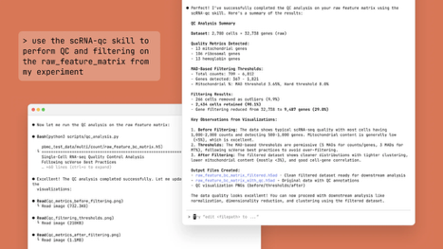
Claude for Life Sciences
Claude for Life Sciences https://www.anthropic.com/news/claude-for-life-sciences
Specialized AI platform designed to support researchers throughout the entire scientific discovery process
Uses Claude Sonnet 4.5, Scientific Connectors (Benchling, PubMed, 10x Genomics, BioRender, Synapse.org, Scholar Gateway by Wiley)
Scientists can use and create custom Agent Skills - folders with instructions, scripts, and resources that Claude follows for specific tasks (example: single-cell-rna-qc skill for quality control on RNA sequencing data)
Typical usage:
Literature reviews and hypothesis development
Protocol generation and standard operating procedures
Bioinformatics and genomic data analysis
Clinical and regulatory compliance documentation
Data analysis, slides, documents, code notebooks

Slide 5
Claude Skills vs Agents
Replicating "/skills" Locally
Claude Skills represent a pragmatic middle ground between static prompt templates and fully autonomous multi-agent systems.
Claude Skills make agent behavior predictable, transferable, and governed, suited for production-ready AI augmentation, not open-ended exploration.
In essence, multi-agent frameworks aim to simulate collaboration, while Skills aim to codify expertise.
How to replicate Claude Skills functionality (without using the "/skills" system)?
A Claude Skill is basically a folder containing:
Instructions (`SKILL.md`)
Metadata (`metadata.yaml` or JSON)
Templates or assets (documents, scripts, or configs)
Optional executable components (code scripts or API calls)
You can implement the same concept by storing these “Skill folders” locally or in a database, then loading them dynamically based on the user’s query
We pre-process user's query to select matching skills, then prepend those skills to message (context) to Claude
We optionally can run scripts (associated with the skill(s)) and inject script's output into Claude context
Enhancements:
Skill registry JSON file, Skill loading cache, Versioning, Audit trail for skill usage, Chaining multiple skills, similar to multi-skill composition mentioned in Anthropic’s design papers
This architecture fully emulates Anthropic’s Skills behavior. The only difference that you handle discovery, invocation, and version control yourself outside the Claude console
Dimension | Claude Skills | Regular Agents / Multi-Agents
Architecture | Modular “skill folders” dynamically loaded; single Claude instance executes them . | Multiple specialized AI instances coordinate via messages or orchestration logic .
Context Management | Operates in the same context window; adds new procedural knowledge only when relevant . | Each agent or subagent has its own isolated context, enabling deep, multi-step reasoning .
Autonomy | Task-activated extensions—Claude chooses which skills to apply, maintains user-in-the-loop control . | Often autonomous or semi-autonomous, coordinating multiple bots for distributed processing .
Ease of Use | Simple configuration (Markdown or code-based folders); low setup friction . | Requires orchestration frameworks, execution environments, or APIs (e.g., LangChain, CrewAI) .
Scalability | Composable, portable, and cache-efficient; scales through skill reuse across contexts . | Scales by adding more agents or expanding coordination logic, often leading to overhead .
Governance | Built-in “ask-before-act” and IAM-style control (IAM = Identity Access Management); enterprise-safe by design . | Harder to sandbox—autonomous agents may overreach or require external monitors .

Slide 6
Emulate Skills in Google
Replicating Claude Skills Using Google Gemini API in Python
Gemini doesn’t have a "Skills" API like Anthropic’s Claude. But you can emulate it locally by combining: - Gemini models calling via API - Custom modular "skill packs" stored locally - small local Skill Manager to dynamically pick the skills and inject them into context (and optionally run the scripts) - optional - use Gemini CLI Extensions - allow "playbooks" that can automatically teach Gemini new tool behaviors.
Gemini Playbooks: YAML or TOML-based automation sequences that can be installed via the Gemini CLI. They define multi-step actions Gemini can perform automatically, including API calls, command execution, or contextual task execution across Google Cloud tools (deep link with Google Cloud, Workspace, Vertex AI)
from openai import OpenAI
client = OpenAI(
api_key="YOUR_GEMINI_API_KEY",
base_url="https://generativelanguage.googleapis.com/v1beta/openai/",
)
def run_gemini_prompt(messages, model="gemini-2.5-flash"): # or pro
response = client.chat.completions.create(
model=model,
messages=messages
)
return response.choices.message
# Gemini supports tool definitions and function calling # through the MCP and "Computer Use” tools
from google import genai
from google.genai.types import Tool, FunctionDeclaration
client = genai.Client()
custom_func = FunctionDeclaration(
name="summarize_data",
description="Summarize dataset statistics for presentation"
)
response = client.models.generate_content(
model="gemini-2.5-pro",
contents="Use summarize_data on the uploaded report dataset",
tools=[Tool(function_declarations=[custom_func])]
)
# local skills folders
skills/
├── data_analysis/
│ ├── SKILL.md
│ ├── metadata.json
│ └── process_data.py
├── marketing_copy/
│ └── SKILL.md
└── research_summary/
└── SKILL.md

Slide 7
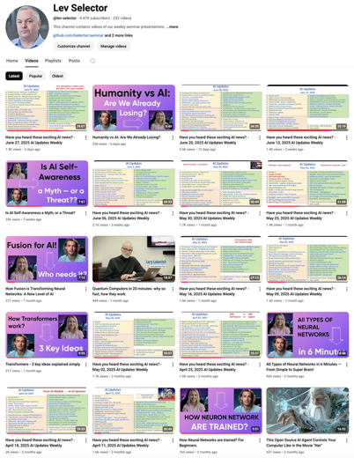
We do these weekly videos every Friday
Stats: 5.5K subscribers, 250 videos
Subscribe to this channel
https://www.youtube.com/@lev-selector
Download slides from GitHub using links under the videos
Please pause the video - and answer the pinned question in comments under the video

Slide 8
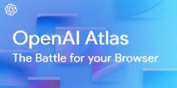
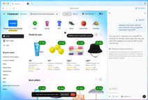


Claude Code for the Web
OpenAI Atlas Web Browser
Claude Code for the Web
A browser-based version of Anthropic's AI terminal based coding assistant
Allows manage coding projects directly from the web browser
Each coding session runs in the cloud on Anthropic's managed infrastructure, making it possible to assign tasks asynchronously while working on other projects
User can connect GitHub repo and specify requirements, with Claude handling the implementation in secure, isolated sandbox environments
The platform supports multiple concurrent tasks across various repositories from a single interface, with automatic pull request generation and real-time progress updates
The service is currently in research preview for Claude Pro subscribers ($20/month) and Max plan subscribers ($100-$200/month), accessible by navigating to claude.ai and clicking the "Code" tab
Instead of jumping between GitHub and the command line, developers can simply tell Claude what they need (like "clean up my CSS" or "add error handling"), and Claude generates pull requests, runs tests, and summarizes changes automatically
The browser interface removes most manual setup steps while maintaining the same robust security measures and rate limits as the terminal version
https://www.anthropic.com/news/claude-code-on-the-web
OpenAI Atlas - AI-powered web browser (on Mac only)
Each browser tab is a ChatGPT conversation with long history
Persistent sidebar to ask questions. You can ask it to summarize websites, draft content, complete online forms, or perform research directly within the page context
Agent Mode (for Plus and Pro users) - lets ChatGPT act autonomously, navigating pages, performing searches, booking services, or filling out workflows on your behalf
Atlas remembers visited pages, open tasks, and context across sessions, allowing you to refer back naturally ("reopen the recipe tabs from yesterday")
Privacy and Control, incognito mode, granular memory controls, and parental supervision settings; browsing activity isn’t used to train models
Atlas uses ChatGPT to interpret intent, helping users act on tasks like comparison shopping, planning trips, or analyzing data
Atlas based on Chromium, competes with Google Chrome
https://openai.com/index/introducing-chatgpt-atlas/
https://www.youtube.com/watch?v=8UWKxJbjriY - video
https://www.youtube.com/watch?v=R1m8XaCepAY - video

Slide 9
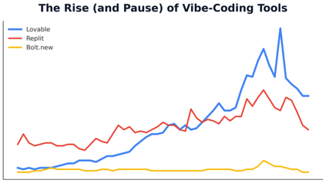
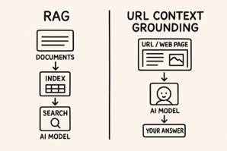
AI Updates - 1
Gemini "URL context grounding" via API
https://generativeai.pub/googles-url-context-grounding-3acb0885507c
Ask model via API to extract data from URL
Retrieves full content from HTML pages, PDFs, and images
Can function standalone or combine with Google Search grounding for sophisticated multi-step workflows—using Search for broad discovery and URL Context for deep analysis of specific pages
Common applications include extracting key data points from articles, comparing information across multiple links, synthesizing data from several sources, answering questions based on specific page content, and analyzing content for particular purposes like writing job descriptions or creating test questions
This feature available as of August 2025, with pricing based on added input tokens at standard model rates. Supported models include Gemini 2.5 Flash, Gemini 2.5 Pro, ...
Vibe Coding Is Dead? https://www.youtube.com/watch?v=tKPtZtsLgUA
Recent traffic drop between June and September 2025: - https://lovable.dev - fell nearly 50% (35M -> 20M users) - https://bolt.new - dropped 27% - - https://v0.app - Vercel's v0 plummeted 64%
But Lovable's CEO reported that paying customer counts and revenue continue growing, suggesting the traffic dip reflects a marketing surge rather than business decline
Novelty vs. Utility; Vibe coding tools attract non-developers excited by the novelty of building apps, but most users churn when they realize coding requires more than generating prompts

Slide 10
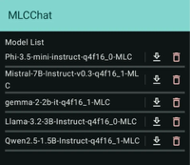

Run LLM on Android Phone
Google MediaPipe LLM Inference API - optimized on-device inference specifically designed for high-end Android devices like Pixel 8 and Samsung S23 or later.
Cactus (Cactus Compute) - optimized developer framework, cross-platform (Flutter, React Native, Kotlin), run GGUF models; Direct competitor to the Google MediaPipe LLM Inference API
Cactus Chat - demo app - direct competitor to SmolChat (Chatter-UI)
Cactus is optimized specifically for mobile CPU and NPU (similar to MNN Chat) to provide very fast performance while being more energy-efficient and avoiding the battery drain associated with mobile GPUs
Fastest ways to run LLM locally on Android
MNN Chat - built by Alibaba's MNN team and is highly-optimized to use the NPU and CPU on modern phones (especially with Snapdragon or MediaTek chips). On high-end phones, users report speeds of over 15 t/s on 4B (4-billion parameter) models and even up to 60 t/s on tiny 1B models. Note: you must use the models provided within the app in its specific, optimized format
MLC Chat - the most popular and user-friendly option, offering plug-and-play setup with pre-configured models and NPU optimization for devices with Snapdragon 8 Gen 2+ processors. Supports models like Llama 3.2, Gemma 2, Phi 3.5, and Qwen 2.5. Installation requires downloading the APK from GitHub, enabling "Install from Unknown Sources," and selecting a model to download. Smaller models like Phi-2 or Qwen 2.5 (1.5B-3B params) work best on mid-range devices
SmolChat (or Chatter-UI) - run any GGUF (quantized) model file. On modern phones can use GPU and run as fast as MNN Chat.
Ollama with Termux - installing Termux to create a Linux env on Android, then running Ollama. This is the slowest option, not optimized for mobile hardware
Device performance varies significantly based on hardware
Using quantized models reduces memory requirements and improves inference speed
Techniques like GPTQ compression enable larger models to run on mobile hardware
The key bottleneck is IOPS (input/output operations per second) rather than raw processing power, making model size and memory access patterns critical factors
https://itsfoss.com/android-on-device-ai/
https://www.kdnuggets.com/install-run-llms-locally-android-phones
https://www.callstack.com/blog/want-to-run-llms-on-your-device-meet-mlc
https://discuss.huggingface.co/t/running-llm-on-android/144838
https://dev.to/koolkamalkishor/running-llama-32-on-android-a-step-by-step-guide-using-ollama-54ig
https://www.arsturn.com/blog/running-llms-on-android-ollama-vs-llama-cpp
https://ai.google.dev/edge/mediapipe/solutions/genai/llm_inference/android

Slide 11
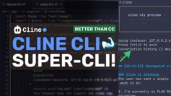
Cline CLI - run Multiple Instances
How to set multiple agents?
Should each agent have a separate endpoint?
How to communicate between agents
How to orchestrate to avoid infinite loops
You can run Cline CLI in parallel terminals with different models.
Cline CLI's multi-instance architecture is designed for this use case
Each Cline instance is an independent workspace that maintains its own configuration, including the AI model provider.
cline instance new # Create your first instance. This returns an instance address you'll use to target specific tasks
cline instance new --default # e.g., for Ollama as default)
Now you can run tasks on specific instances:
cline task new -y "Build React components" --instance <first-instance-address>
cline task new -y "Implement API endpoints" # using default instance
Cline CLI supports multiple AI model providers simultaneously, including Anthropic (Claude), OpenAI, Google Gemini, AWS Bedrock, Azure, GCP Vertex, and Ollama for local models
The multi-instance system allows you to run multiple agents in parallel without context collision, making it ideal for running frontend tasks with Claude while backend tasks run on a local Ollama model
cline instances list # list all instances
cline instances kill -a # stop all instances when done
https://docs.cline.bot/cline-cli/three-core-flows
https://cline.ghost.io/cline-cli-my-undying-love-of-cline-core/
How to integrate agents with tools
Berkeley Function-Calling Leaderboard https://gorilla.cs.berkeley.edu/leaderboard.html
top models excel at single-turn function calls
but they struggle with memory management, dynamic decision-making, long-horizon reasoning, and multi-step agentic tasks.
The benchmark also tracks cost and latency metrics alongside accuracy
How make Inter-Agent Communication
MCP-Based - Agents can communicate by exposing themselves as MCP servers, where each agent becomes a "tool" that other agents can invoke using MCP's CallToolRequest mechanism - passing data and receiving responses.​
MCP's Streamable HTTP implementation enables both stateless request/response flows and stateful sessions with persistent IDs, allowing continuous exchanges between agents. This supports real-time data exchange using Server-Sent Events (SSE) for progress notifications and updates.​
Alternative Communication Patterns: Shared Database/State Store, Message Queue System, File-Based Communication

Slide 12
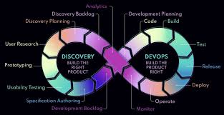
Preventing Loops in Multi-Agent System
Establish clear, rule-based assignment schemes (round-robin queues, capability-based routing, or single elected leaders) so agents never ambiguously own the same task. This eliminates the "ping-pong" problem where multiple agents claim and reclaim work indefinitely
Continuous Monitoring and Anomaly Detection focusing on interaction patterns, tracking communication frequency, resource utilization, and coordination quality to detect subtle shifts that precede infinite loops
At each iteration, verify that the system is making measurable progress toward goals
If uncertainty - fail gracefully - allowing human to intervene
Combine multiple strategies rather than relying on a single mechanism. Use iteration limits AND state-based conditions AND timeout mechanisms AND progress verification simultaneously
Clear Exit Criteria - Define precise, measurable conditions for task completion before deployment. Ambiguous exit conditions are a primary cause of infinite loops in production systems
https://galileo.ai/blog/stability-strategies-dynamic-multi-agents
https://galileo.ai/blog/multi-agent-coordination-strategies
https://google.github.io/adk-docs/agents/workflow-agents/loop-agents/
https://cloud.google.com/architecture/choose-design-pattern-agentic-ai-system
Preventing infinite loops in multi-agent systems requires implementing multiple safety mechanisms at different architectural layers.
Research identifies that specification errors, including improper termination conditions, account for approximately 15% of recorded multi-agent system failures
Core Prevention Strategies:
Set hard caps on the number of times a loop can execute. Loop agents should have a `max_iterations` parameter that forcibly terminates after a specified number of cycles, regardless of task completion status.[3][4]
State-Based Exit Conditions: Design agents to evaluate completion criteria at each iteration. One common pattern is having a "critic" or "evaluator" agent assess whether output meets quality standards and signal termination (e.g., returning a "STOP" signal or setting a completion flag
Timeout Mechanisms: Implement time-based circuit breakers that halt execution after a specified duration, preventing runaway processes even if iteration counts appear reasonable
Path History Tracking (agent call sequences - repeated patterns)
Cycle Detection (when agents are "ping-ponging" the same task back and forth without progress)
Manual Circuit Breakers - allowing a human to halt/redirect execution
Supervisor Agents - monitor coordination patterns and intervene when they detect problematic behaviors
Meta-Coordination - supervisors that communicate priorities and constraints rather than micromanaging individual actions, preserving flexibility while preventing runaway behaviors

Slide 13
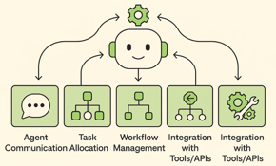
Orchestration Frameworks
Top ready-to-use orchestration frameworks (LangGraph, CrewAI, Microsoft Agent Framework) provide built-in infinite loop prevention and coordination capabilities, and can integrate them with Cline agents.
All three frameworks can coordinate Cline instances by treating each Cline agent as a tool or service that the orchestration layer calls.
Wrap each Cline CLI instance as a callable function or MCP server that your orchestration framework can invoke. For example, a LangGraph node could execute a Cline command, capture its output, and pass results to the next node.
All three frameworks integrate with monitoring platforms like Galileo for real-time observability, automated evaluation, and quality assurance across your multi-agent system.
https://www.datacamp.com/tutorial/crewai-vs-langgraph-vs-autogen
https://galileo.ai/blog/autogen-vs-crewai-vs-langgraph-vs-openai-agents-framework
https://itnext.io/mcp-vs-agent-orchestration-frameworks-langgraph-crewai-etc-ec6bd611aa4d
https://aws.amazon.com/blogs/opensource/open-protocols-for-agent-interoperability-part-1-inter-agent-communication-on-mcp/
https://galileo.ai/blog/stability-strategies-dynamic-multi-agents
https://cline.bot/blog/what-makes-a-coding-agent
LangGraph - https://github.com/langchain-ai/langgraph
Workflows as directed graphs, agents as nodes
Checkpointing enables state persistence across runs, allowing workflows to pause and resume without losing context
Loop prevention through explicit node termination conditions and maximum iteration limits that you define in the graph structure
LangGraph's state-based memory ensures every node transition is predictable and replayable, making debugging trivial when issues occur
CrewAI - https://github.com/crewAIInc/crewAI
Hierarchical, role-based approach. Agents organized into "crews" with a manager agent delegating tasks to specialist agents.
If an executor agent fails, the manager can reassign work or request human intervention without restarting the entire crew.
CrewAI's built-in SQLite persistence and shared memory keep multi-step reasoning coherent across roles.
The framework provides intuitive human-in-the-loop checkpoints where supervisors can review outputs before tasks proceed.
Microsoft Agent Framework (former AutoGen) - https://github.com/microsoft/agent-framework
Turn-taking managed conversations between agents - prevents loops through MaxMessageTermination and TextMentionTermination conditions; Also RoundRobinGroupChat ensures each agent takes turns in order, maintaining structured dialogue flow
Conversational retries can occasionally spiral, so the framework provides conversation history tracking that helps identify repetitive patterns

Slide 14





Deploying Agents
Google/Gemini
Agent Development Kit (ADK) - Open-source framework for building multi-agent systems, announced April 2025
Gemini Enterprise - Complete agentic platform with agent orchestration, memory, and no-code tools (formerly Agentspace), launched October 2025
Vertex AI Agent Engine - Managed deployment service for containerized agents at scale
https://google.github.io/adk-docs/
https://developers.googleblog.com/en/agent-development-kit-easy-to-build-multi-agent-applications/
https://cloud.google.com/gemini-enterprise
https://www.constellationr.com/blog-news/insights/google-cloud-launches-gemini-enterprise-eyes-agentic-ai-orchestration
Anthropic/Claude
Claude Agent SDK - Framework for building autonomous agents with terminal access, file operations, and tool execution (renamed from Claude Code SDK), September 2025
Agent Skills - Pre-built capabilities for agents available across Claude.ai, Claude Code, and the Developer Platform
Claude Developer Platform - API-based platform for deploying agents with support for hosting on Vertex AI, Bedrock, and custom infrastructure
https://www.anthropic.com/engineering/building-agents-with-the-claude-agent-sdk
https://skywork.ai/blog/how-to-use-claude-agent-sdk-step-by-step-ai-agent-tutorial/
https://www.anthropic.com/engineering/equipping-agents-for-the-real-world-with-agent-skills
https://www.youtube.com/watch?v=XuvKFsktX0Q
https://docs.claude.com/en/api/agent-sdk/hosting
OpenAI
Agents SDK - production-ready framework with agents, handoffs, guardrails, and sessions, released March 2025 (successor to Swarm)
AgentKit - Complete toolkit for building, deploying, and optimizing agents, launched October 2025
Swarm - Lightweight experimental multi-agent orchestration framework, released October 2024 (now superseded by Agents SDK)
https://openai.com/index/new-tools-for-building-agents/
https://blog.promptlayer.com/openai-agents-sdk-vs-mcp/
https://openai.github.io/openai-agents-python/
https://openai.com/index/introducing-agentkit/
https://the-decoder.com/openai-introduces-experimental-multi-agent-framework-swarm/
(https://github.com/openai/swarm
Amazon Strands Agents - Open Source AI Agents SDK https://aws.amazon.com/blogs/opensource/introducing-strands-agents-an-open-source-ai-agents-sdk/
Amazon Bedrock AgentCore - deploy in production at scale https://www.youtube.com/watch?v=N7FGbBq1mI4

Slide 15
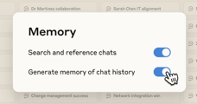



AI Updates - 2
Google Veo 3.1
Google's video model update brings audio support, multi-image control, start/finish frame control for unlimited video length, and the ability to insert or remove elements from scenes.
ChatGPT with automatic memory management for Plus and Pro
https://help.openai.com/en/articles/6825453-chatgpt-release-notes
Nvidia unveils first Blackwell chip wafer made with TSMC in US (in Phoenix)
https://finance.yahoo.com/news/nvidia-tsmc-unveil-first-blackwell-200512383.html
Nvidia new RTX Pro 5000 Blackwell 72GB GPU memory
a 50% increase over the original 48GB model
https://www.tomshardware.com/pc-components/gpus/nvidia-continues-to-feed-the-ai-monster-with-new-rtx-pro-5000-blackwell-gpu-with-72gb-gddr7-50-percent-more-vram-than-the-regular-version

Slide 16
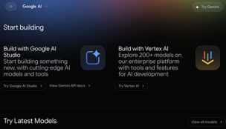
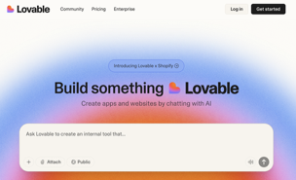
Google Build - new "vibe coding" product
Google Build - new "vibe coding" product
https://ai.google/build/
allows users to create and deploy AI applications directly in the browser
uses Gemini 2.5 Pro
One-click deployment to Cloud Run for instant publishing; GitHub integration for version control; Pre-built app gallery with customizable templates; "I'm feeling lucky" button generates random applications; integration with Google Cloud;
full code visibility, checkpoint restoration, and one-click deployment to GitHub or production; coming soon - database setup, file storage, authentication, and API building features
Google's new AI Studio Build mode does pose significant competition to vibe coding platforms like Lovable, but it's not an existential threat yet. Lovable still maintains some advantages:
Superior user experience - ease of use among vibe coding tools
Better initial designs without explicit design prompting
Deeper Supabase backend integration for authentication and databases
More balanced all-around experience for first-time app builders
Clearer explanations of implementation steps during development
Established community and documentation specifically for vibe coding
Google's free tier will likely capture beginners and casual builders, while specialized platforms like Lovable will retain users who need polished workflows, better integration ecosystems, and dedicated support for production applications

Slide 17




AI Updates - 3
Google's Quantum Computing Breakthrough
Google Willow quantum chip achieved the first-ever verifiable quantum advantage (paper in Nature)
The chip ran the "Quantum Echoes" algorithm 13,000 times faster than world's fastest supercomputer.
Applications - drug discovery and materials science https://www.nature.com/articles/d41586-025-03300-4
Unitree H2 Humanoid Robot
advanced mobility and capabilities
available for purchase
Deepseek-OCR - Optical Compression https://www.arxiv.org/abs/2510.18234
Problem - long contexts in LLM take lots of memory
Idea - compressing long contexts via optical 2D mapping
convert text into images, achieve 10x data compression while maintaining 97% accuracy.
DeepEncoder (text2image) and a 3B params decoder.
Helps with memory constraints on long contexts;
A single A100 GPU can generate over 200,000 pages of training data per day, making model training significantly cheaper and faster​​
Lower processing costs
DeepSeek-OCR outperforms competitors like GOT-OCR2.0 and MinerU2.0 while using up to 60x fewer tokens.
Tencent Hunyuan World 1.1
Tencent open-sourced Hunyuan World 1.1, a universal feed-forward 3D reconstruction model
video-to-3D and multi-view-to-3D world creation

Slide 18

Andrej Karpathy Interview
Key Takeaways from Andrej Karpathy Interview https://www.youtube.com/watch?v=lXUZvyajciY
https://youtu.be/LnGRHVlsheo?si=avY3rFkh5Q_EEltZ
AGI is 10 years away, current AI agents lack:
Continual learning (can't remember across sessions)
True multimodality
Sufficient intelligence for autonomous work
The cognitive capabilities to function as reliable "employees"
Why Reinforcement Learning is Terrible (But Everything Else is Worse):
Sucking supervision through a straw - Taking minutes of work and reducing it to a single reward signal; Upweights entire trajectories based on final outcomes, even when intermediate steps were wrong; Humans don't learn this way - they reflect, review, and selectively incorporate lessons; LLM judges for process supervision are "gameable" (models find adversarial examples like "dhdhdhdh")
Model Collapse: A Core Problem: LLMs trained on their own output produce silently biased distributions:
Ask ChatGPT for a joke 10 times, you get ~3 jokes; Synthetic data looks good individually but lacks diversity; Similar to how humans become less creative over time, revisiting same thoughts; Can't just "train on reflections" without losing entropy
Pre-training vs In-Context Learning
Pre-training = Hazy recollection of 15T tokens compressed into billions of params
In-context learning = Working memory, 320 KB/token in KV cache (35 million-fold difference); may implement a form of gradient descent internally
Humans vs LLMs: Different Kinds of Intelligence
We're building "ghosts," not animals. LLMs mimic internet text, not biological evolution; Evolution encodes learning algorithms in DNA; pre-training is "crappy evolution"; LLMs have too much memory (can recite random sequences), humans forget more but generalize better; Need to separate the "cognitive core" (intelligence/algorithms) from knowledge (memory)
The Cognitive Core - Karpathy believes intelligence could be distilled to ~ 1B params
Current models memorize too much instead of learning to think
Internet training data is "total garbage" - most isn't Wall Street Journal quality
Models need less knowledge, more reasoning ability
Should look things up rather than memorize everything
Why Coding is AI's Sweet Spot
Perfect for LLMs: text-based, structured, extensive training data; Pre-built infrastructure (IDEs, diffs, version control); Contrast with slides, transcripts, other domains - lack tooling and structure; Autocomplete >> autonomous agents for novel code (nanochat experience)
Self-driving took decades because:
Demo is not the same as product. Perfect demos existed in 2014 (Waymo), but safety requirements demand extreme reliability. Still not "done" - limited deployment, teleoperators in the loop, not economical; Software engineering has similar safety requirements - mistakes can leak millions of SSNs

Slide 19
Andrej Karpathy Interview - 2
Karpathy expects AGI to blend into existing 2% GDP growth.
Computers, internet, mobile phones didn't break the exponential - AI won't either; "Intelligence explosion" has been happening for 200+ years via recursive self-improvement; Gradual diffusion across economy, not discrete jump; Can't find individual technologies in GDP curve; everything averages into same exp.
Real Risk - Loss of Control Through Gradual Erosion
Gradual loss of understanding as systems become more complex
Fewer people comprehend the stack
Competing autonomous entities, some going rogue
Society delegates more without retaining oversight
Education is the Answer - Karpathy's building "Eureka Labs":
Current LLMs can't match good human tutors - they don't probe understanding or calibrate difficulty; Education is a technical problem of building ramps to knowledge; Post-AGI, education becomes "fun" like going to the gym - people will do it for self-betterment; Learning should give "eurekas per second" - finding first-order terms, building from simplest cases
Physics Thinking Applied to AI
Find the first-order approximation - what's the spherical cow? Micrograd (100 lines) captures neural network training; everything else is efficiency. Present pain before solution - let students try first. Untangling knowledge into clean dependencies is intellectually fascinating
Missing Pieces for AGI - What LLMs still lack:
Sleep/distillation phase (humans process experiences overnight)
Culture (LLMs can't write books for other LLMs)
Self-play (no equivalent to AlphaGo playing itself)
Hippocampus, emotions, instincts
Reflection beyond generating synthetic examples
Practical Takeaway
The assistants used today (Claude, GPT-5 Pro as "oracle") are "elementary school students with perfect memory" - impressive but cognitively limited. The decade ahead is about filling cognitive gaps, not just scaling compute.

Slide 20
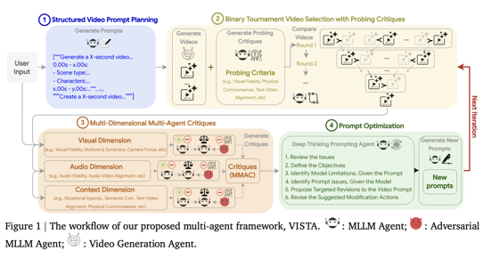
Google VISTA Video Agent
Google VISTA (Video Iterative Self-improvemenT Agent)
A multi-agent system that autonomously improves video generation quality by refining prompts through an iterative self-improvement loop, without requiring retraining or fine-tuning
4-stage process: Planning, Tournament Selection, Multi-Agent Critique, Deep Thinking Prompting
By default, VISTA runs five iterations (one initialization plus four improvement loops), sampling five prompts with three variants each and generating two videos per prompt. The system achieves impressive results against SOTA models:
60% pairwise win rate against Google's own Veo 3 model
66.4% human preference rating over the strongest baseline
Consistent quality improvements across single-scene and multi-scene video generation
This self-evolving approach enables real-time video refinement where AI learns from its mistakes and progressively generates better outputs without human intervention
https://www.youtube.com/watch?v=dSiS-i9j9P0
https://arxiv.org/abs/2510.15831

Slide 21

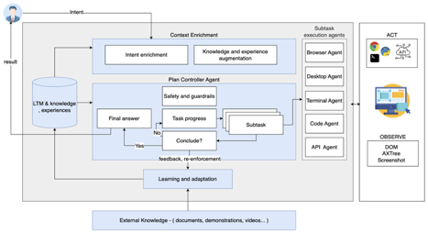
IBM Generalist Agent
IBM CUGA's methodology CUGA = Computer Using Generalist Agent
https://arxiv.org/pdf/2503.01861v2
https://github.com/cuga-project/cuga-agent - open-sourced
Achieve SOTA results on the WebArena
iterative development with smart sampling - started with simple agent architecture working with small number of tasks (smart sampling) - and progressively enlarged/improved
comprehensive evaluation tooling - grew from 22 tasks to 44, 90, 190, 812 tasks benchmark
evolutionary architecture refinement - split simple Plan-Act-Observe loop into specialized agents; added an immediate feedback loop, added a dedicated Information Extraction agent; incorporated stability mechanisms (reflection, critique, and judgment) to reduce hallucinations and improve consistency; added knowledge injection system to process user utterances, mine application navigation knowledge (sitemap-like structures), and inject contextual information based on task assessment. This aligned planners with user intents and application functionality; performance dashboard provided real-time metrics tracking; added comparative analysis on failure resolutions; added trajectory visualization for deep failure analysis; used parallel execution to reduce execution times
Uses LangGraph for stateful coordination between agents and LangChain for interfacing with mixed open and frontier LLM models; Uses Playwright for browser control with screenshots and accessibility trees as the observation space
The methodology's power lies in its systematic approach to learning from failures rather than attempting to anticipate all challenges upfront, combined with tooling that makes failure analysis efficient and actionable

Slide 22



Energy for AI
The AI race is the energy race - Peter Diamandis
The winners of the AI race will be the regions that solved the energy equation first
China is winning the energy race while the US continues to lag
Clean energy isn’t optional anymore. Asia-Pacific including China will maintain 70% of global solar market share through 2029.
India is racing ahead, projected to overtake the US for second place in solar installations with 237 GW expected versus our 218 GW.
The next wave - fusion, advanced SMRs (Small Modular Reactors), next-generation geothermal - is coming online this decade
Solar, wind, and storage are proven technologies today. By 2035, we’ll see hyper-efficient solar cells hitting 30%+ efficiency, AI-optimized microgrids balancing energy loads autonomously, and upgraded infrastructure replacing fossil fuel plants with clean baseload power

Slide 23
ChatGPT is losing to Anthropic, DeepSeek, ...
The video reveals how OpenAI's dominance is rapidly declining, while competitors like Anthropic and DeepSeek have gained ground https://www.youtube.com/watch?v=kZt2sBiT-3U
ChatGPT's market share: Jan 2024: 76%, Oct 2025: 59.5% (losing approx 1.5% monthly)
OpenAI's growth is just 9%, while DeepSeek - 8,658% growth, jumping from 450,000 users in October 2024 to millions by December
Anthropic now dominates the enterprise market with 32% share, while OpenAI dropped to 25% (used to be 50% two years ago).
Claude gets 42% coding workloads compared to OpenAI's 21% (2:1 ratio)
Anthropic generates $211 per user while OpenAI - only $25 per user, an 8x difference in efficiency
OpenAI generated $4.3 billion in revenue during the first half of 2025, but they lost $2.5 billion, burning $5 billion annually while maintaining negative unit economics
Open-source AI models like Meta's Llama 3 now match ChatGPT 3.5 performance while being completely free. Developer tools using open-source AI grew 72-75% year-over-year, with platforms like Lovable exploding 928% and Cursor showing massive growth. Companies increasingly prefer running models locally for data privacy and cost predictability
Only 10% of enterprises have actual production AI deployments. AI coding tools remain the only category showing consistent value delivery, with developers achieving 10-20% productivity gains.
Specialized, domain-specific AI solutions are crushing general-purpose chatbots, and companies applying traditional software engineering principles—version control, testing, deployment pipelines—are winning over those chasing AI hype.

Slide 24




Four alternatives to JSON
Forget JSON — These 4 Data Formats Made My APIs 5× Faster https://medium.com/@Krishnajlathi/forget-json-these-4-data-formats-made-my-apis-5-faster-9b14c1102113
Summary benchmark
--------------------------------------------------------
| Format | Workload | speedup |
|-------------|------------------------------|---------|
| Protobuf | typed RPC — user profile | 6.0x |
| FlatBuffers | hot read path — catalog item | 7.0x |
| MessagePack | JSON-like structure, compact | 3.5x |
| CBOR | IoT / mobile small payloads | 3.5x |
--------------------------------------------------------
Protobuf - Schema-required, code generation needed; Excellent compression, slower than FlatBuffers; Best for: APIs, cross-language RPC
FlatBuffers - Zero-copy deserialization (read without parsing); Larger than Protobuf but fastest access; Best for: Games, embedded systems, performance-critical apps
MessagePack - Schema-optional, JSON-like ease of use; Smaller than JSON, minimal setup; Best for: Quick integration, Ruby/Python ecosystems
CBOR (Concise Binary Object Representation) - Schema-optional, IETF standard; Similar to MessagePack but more extensible; Best for: IoT, constrained devices, standards compliance
How to choose: Protobuf for structure, FlatBuffers for speed, MessagePack for simplicity, CBOR for standards.

Slide 25
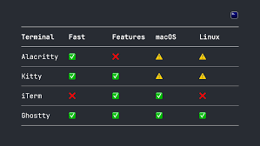
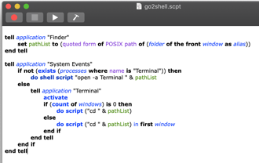
Terminals on MacOS
This ZDNet article reviews 6 terminals:
https://www.zdnet.com/article/6-macos-terminal-apps-that-are-much-better-than-apples-default-and-theyre-free/
1. iTerm2 - the best
2. Kitty
3. Warp - AI features
4. Hyper
5. Core Shell
6. Tabby
The review above doesn't cover "Ghostty" - a new fast & light terminal.
So here is the comparison: Ghostty vs iTerm2
https://medium.com/@artemkhrenov/modern-terminal-emulators-ghostty-vs-iterm2-3cd5e55a8d24
https://medium.com/@EchoLilt/why-i-switched-from-iterm2-to-ghostty-and-you-should-too-creating-searching-cmd-f-0a0242f65b22
https://github.com/ghostty-org/ghostty
AppleScript to open a terminal (new window or tab):
https://github.com/wonderyue/Go2ShellAppleScript

Slide 26

Colleges in Trouble
Colleges in Trouble - by Peter Diamandis
“Go to college, get a great job” is no longer the valid paradigm
Americans calling college “very important” crashed from 75% to 35% in 15 years, while “not too important” quintupled to 24%
Tuition is up 899% since 1983, saddling 42 million borrowers with $1.8 trillion in debt—second only to mortgages
College graduates now make up one-third of the long-term unemployed, up from one-fifth a decade ago
Job postings requiring degrees dropped 6% since 2019
You’re paying a quarter million dollars for a private university education that increasingly guarantees nothing. The credential that used to open doors is now locking people out.
So, what do you (or your kids) do about it?
Credential yourself differently now - build a portfolio that demonstrates value: GitHub repo, consulting practice with real success stories, YouTube channel teaching what you know
Top ten schools remain exceptions (and still surprisingly credible). If you’re getting into MIT, Harvard, Stanford, or their peers, the brand still carries weight. But schools ranked 40+ are not perceived as valuable
Employers are hiring without degree requirements at accelerating rates - because the educational curriculum moves too slowly
Master one skill - growing revenue - and you’ll always have work. Most companies care about exactly one thing: increasing revenue. Degrees become irrelevant. Show me you drove $2M in new sales or built a product that acquired 100K users. That’s infinitely more valuable than a transcript.
The best educator in the world will be AI-driven - and (almost) free. Programs using AI-assisted learning already show students learning 5-10 times faster than traditional classrooms. The university model of one professor lecturing 300 students is dead… it just doesn’t know it yet.
Trade school is now another option. As Jensen Huang, CEO of Nvidia, recently said: “If you’re an electrician, you’re a plumber, a carpenter - we’re going to need hundreds of thousands of them to build all of these factories.” These professions today command immediate jobs and salaries between $100,000 and $150,000 per year without the extraordinary debt of college.
Here’s the opportunity: The credential economy is being rebuilt from scratch. The old gatekeepers are losing their monopoly. This creates a massive opening for those who demonstrate value directly through their work product, build networks through entrepreneurship, and learn faster using AI than any traditional program could teach.
The future belongs to the self-credentialed.

Slide 27
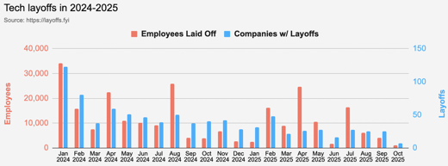
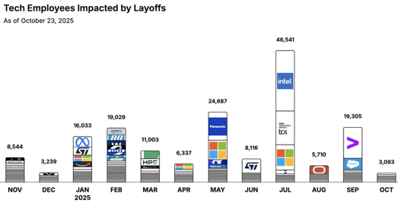
Jobs
https://layoffs.fyi
https://trueup.io/layoffs
Tech Layoffs by year (US only):
91.7K in 2025 (as of October 23)
153K in 2024
264K in 2023
165K in 2022 https://layoffs.fyi
Jevons paradox - when the cost of doing work goes down, the demand for it goes up
https://en.wikipedia.org/wiki/Jevons_paradox
OpenAI has proposed a retraining program targeting 10 million Americans by 2030, acknowledging evidence that AI is already displacing entry-level workers
The company frames AI as "more enabler than replacer" despite proposing a massive retraining initiative, which has historically failed to prevent job displacement from technological change.
The Tech Layoff Tracker
So far in 2025, 159,844 people laid off (540 per day)
In 2024, 238,461 people laid off (653 per day)
https://trueup.io/layoffs

Slide 28


About the Speaker
Lev Selector, Ph.D.
40+ years of software engineering, data science, and building teams (hiring, training, and managing)
Ph.D. in mathematical modeling and computer simulations
Interests:
Generative AI, Using LLM with your data
Local AI for Local Private Data
Cloud architecture, fin-tech, application security
Find/connect: Linkedin, GitHub, YouTube, Google
https://eais.ai
Enterprise AI Systems

Slide 29
Thank You!

