Slide 1



AI News - Sept 25, 2026
5x Times Less Cost - Depends on Harness
Crowd-sourced LM Arena
Artificial Analysis Intelligence Index
Sept 24
Union Alpha stealth model on OpenRouter
Claude Opus 5.5 - Sept 22
OpenAI GPT-6 Sol and Luna
Trump Suggest Better Name for AI
Muse - Personal AI Agent
xAI Grok 4.7
Dream-RSI and AI Self-Improvement
AWS Strands Agent Harness
Up to 5x cost diff for Harnesses
Qwen3.8-LiveTranslate
OpenClaw 2026.9.5 Safe Updates
Claude merges chat and Cowork
Claude Code Projects
Anthropic’s AI-Native SDLC Playbook
Frankenstein by Mary Shelley (1818)
NVIDIA NVFP4 4-Bit Format
Amazon Blocks Meta's Muse Agent
Trump's AI Force and AI Czar
Do AI Models Refuse Harmful Tasks ?
Google AX (Agent Executor)
Swarms Are Expensive
Neocloud - cloud provider for AI
Hermes Astros: Automated Content Radar
Claude’s Constitution
Claude DNA Discovery
Cohere + Aleph Alpha = $20 Bln merger
OpenAI eyes $1.5 Trillion valuation
Meta SAM 3.1 - Segment Anything Model
Meta Connect 2026 Event
NVIDIA SoL-Pi Uses x2 Less Tokens
Jobs & Layoffs
Xiaomi MiMo-V2.6-Pro and -Flash
AI Safety: Speed vs. Slowdown
Paperclip: Agents Organized as a Company
Custom AI-Agent HUD Overlay
Researches Hacked OpenAI Using Claude
Bonsai 2 - a tiny local AI
Qwen3.8-Omni-Flash
Bolt.new Forge - use Open Models
Needle 8-29 MB Model for Offline Action
Claude leads 26% of Anthropic's AI R&D work
Google Family Agent
Claude biomolecular modeling 4 times faster
Six Open Clones of Jev
Notes:
Contents labels. Kept by g3_update_toc.py.
English - https://lmarena.ai/leaderboard/text => Crowd-sourced LM Arena
Coding - https://lmarena.ai/leaderboard/text/coding => Crowd-sourced LM Arena
Sept 18 => -
The Tech Layoff Tracker => Jobs & Layoffs
Tech Layoffs by year (US only): => Jobs & Layoffs
Claude now leads a quarter of Anthropic's own AI research => Claude Leads 26% of Anthropic R&D
Google tests a family agent with its own cloud computer => Google Family Agent
Claude makes biomolecular modeling four times faster => Claude Speeds Up Biomolecular Models
Jev gets six open clones in two days => Six Open Clones of Jev
Jev apps arrive: page search, Postgres, judges, browsers => Jev Apps: Search, SQL, Judges
The harness tax: same model, same task, up to 5x the cost => The Harness Tax: Up to 5x Cost
Qwen3.8-LiveTranslate interprets 60 languages with 2.3s lag => Qwen3.8-LiveTranslate
Grok Voice Transcribe 2.0 cuts word errors to 6.8% => Grok Voice Transcribe 2.0
OpenClaw 2026.9.5 updates itself without breaking => OpenClaw 2026.9.5 Safe Updates
Claude merges chat and Cowork, adds Docs, Slides and Design => Claude Docs, Slides and Design
Claude Code Projects run parallel agents in the cloud => Claude Code Projects
Apple ships Siri AI, built with Google's Gemini => Apple Siri AI on Gemini
Gemini 3.8 Live: a voice model that thinks while it talks => Gemini 3.8 Live Voice Model
OpenAI discloses six cases of its models misbehaving => OpenAI Misalignment Reports
Gemini broke into three real companies during a security test => Gemini Hacks Three Companies
Periodic Labs' Neon beats frontier models at lab science => Periodic Labs Neon
Google Home opens to AI agents through MCP => Google Home MCP for Agents
Frankenstein; or, The Modern Prometheus is an 1818 Gothic novel[a] written by English author Mary Shelley => Frankenstein by Mary Shelley (1818)
Amazon blocks Meta's Muse agent from shopping => Amazon Blocks Meta's Muse Agent
Trump plans an "AI Force" and a new AI czar => Trump's AI Force and AI Czar
UN science panel: AI safeguards are unravelling => UN Panel: AI Safeguards Unravelling
Robot arm test: GPT-6 Astra stabbed a baby doll 17 of 20 times => RoboHarm: Robot Arm Safety Test
Microsoft memo: AI scraping is "the largest theft of labor" => Microsoft Memo: Largest Theft of Labor
Google open-sources AX, a Kubernetes-style runtime for agents => Google AX Agent Runtime
Googlebook: an $899 laptop built around Gemini => Googlebook Gemini Laptop
Swarm scaling: 10x more agents is worth less than 10x tokens => Swarm Scaling vs. Token Scaling
Frankenstein; or, The Modern Prometheus is an 1818 novel written by English author Mary Shelley => Frankenstein by Mary Shelley (1818)
NVIDIA developed NVFP4 - a 4-bit floating-point quantization format (June 2025) => NVIDIA NVFP4 4-Bit Format
Google open-sources AX - a Kubernetes-style runtime for agents => Google Open-Sources AX Agent Runtime
Claude Opus 5.5: Fable-level work at 40% lower cost => -
Anthropic hires Accenture's Faculty as its first embedded evaluator => Accenture Is Anthropic's First Evaluator
Newsom orders work on a kill switch for frontier AI models => California AI Kill Switch Order
OpenAI model resolves 100+ open math problems; mathematicians to vet them => OpenAI Solves 100+ Open Math Problems
Cohere and Aleph Alpha sign a $20 billion merger => Cohere + Aleph Alpha $20B Merger
OpenAI eyes $1.5 trillion valuation as compute bill hits $856B => OpenAI at $1.5T, Compute Bill $856B
Meta SAM 3.1 segments and tracks anything from a text prompt => Meta SAM 3.1
Paperclip organizes agentsfrom different harnesses into company roles, reporting lines, and workflows => Paperclip: Agents Organized as a Company
Paperclip organizes agents from different harnesses into company roles, reporting lines, and workflows => Paperclip: Agents Organized as a Company
Meta Connect 2026: Muse gets voice, glasses, email and Charm => Meta Connect: Muse Glasses and Charm
Altman and Amodei brief the UN Security Council on AI => AI Leaders Brief UN Security Council
Sanders and Casar introduce a bill to ban superintelligence => Bill to Ban Superintelligence
Google Gemini 3.8 Flash TTS lets you design and direct voices => Gemini 3.8 Flash TTS
Perplexity tests whether nine AI models can escape its sandbox => Perplexity Sandbox Escape Tests
SWE-Bench Pro V2: a harder, cleaner coding benchmark => SWE-Bench Pro V2
NVIDIA SoL-Pi: an AI tuned a coding harness to use half the tokens => NVIDIA SoL-Pi Harness Tuning
Local opposition blocks $68 billion of US data centers => $68B of US Data Centers Blocked
OpenAI agent broke into an Australian government health portal => OpenAI Agent Hacked Australian Medicare
Anthropic commits $11.6 billion to Akamai cloud => Anthropic $11.6B Akamai Cloud Deal
Claude Marketplace opens with 2,000+ connectors and plugins => Claude Marketplace: 2,000+ Plugins
Contrastive Language Models score agent actions 9x faster than Jev => CLM-8B: 9x Faster Than Jev
Gemini now phones businesses for you on Pixel 11 => Gemini Makes Business Calls
Google sends TPUs to orbit for Project Suncatcher => Google Suncatcher: TPUs in Orbit
NVIDIA Nemotron 3 Diarization tracks who spoke when => NVIDIA Nemotron 3 Diarization
DeepSeek doubles revenue run rate to $1 billion => DeepSeek Hits $1B Run Rate

Slide 2
"LM Arena" Leaderboard
Data for Sept 13
Starting Elo rating = 1000
https://en.wikipedia.org/wiki/Elo_rating_system
English - https://lmarena.ai/leaderboard/text
Coding - https://lmarena.ai/leaderboard/text/coding
■ | Claude
■ | Gemini
■ | OpenAI
■ | Open Source
Claude Fable-5 - 6TB
Claude Opus-4.8 - 5TB
Claude Sonnet-4.5 - 1TB
Claude Sonnet-5 - ?
GLM-5.3 - 744B
Meta muse-spark - 16 x 70B
Qwen3.7-max-preview - 745B
Qwen3.8-max - 2.4TB
Baidu Ernie-5.1 - 800B
Deepseek-v4 - 1.6T
Kimi-k3 - 2.8T
Xiaomi MiMo-V2.5-Pro - 1T+
ByteDance dola-seed-2.0-pro 400B
Minimax M3 - 456B
Code | Model | Score
■ | claude-fable-5-high | 1506
■ | claude-opus-4-6-high | 1505
■ | claude-opus-4-7-high | 1502
■ | muse-spark-1.2 (xHigh) | 1500
■ | claude-fable-5.1-max | 1498
■ | claude-opus-4-6 | 1497
■ | claude-opus-4-7 | 1494
■ | muse-spark-1.3-max | 1493
■ | gemini-3.8-flash-high | 1493
■ | claude-opus-5-high | 1493
■ | muse-spark-1.1 | 1493
■ | gemini-3.7-flash-high | 1490
■ | muse-spark | 1488
■ | claude-opus-5-max | 1487
■ | gemini-3.1-pro-preview | 1487
■ | gemini-3-pro | 1485
■ | kimi-k3-max | 1485
■ | gpt-5.6-sol-xhigh | 1483
■ | glm-5.3-max | 1483
■ | gpt-5.5-high | 1482
■ | claude-opus-4-8-high | 1481
■ | qwen3.8-max | 1481
■ | gemini-3.6-flash-high | 1480
■ | gpt-6-astra-max | 1480
■ | gemini-3.5-flash-high | 1478
Code | Model | Score
■ | claude-fable-5-high | 1552
■ | claude-opus-4-7-high | 1552
■ | claude-opus-4-6-high | 1551
■ | claude-opus-4-7 | 1547
■ | claude-opus-4-6 | 1546
■ | gpt-6-astra-max | 1543
■ | kimi-k3-max | 1538
■ | muse-spark-1.3-max | 1537
■ | muse-spark-1.2 (xHigh) | 1536
■ | gemini-3.8-flash-high | 1535
■ | claude-opus-4-8-high | 1533
■ | claude-opus-5-high | 1533
■ | muse-spark-1.1 | 1531
■ | claude-opus-4-5-20251101-high-32k | 1530
■ | claude-opus-4-8 | 1530
■ | claude-sonnet-4-6 | 1528
■ | gpt-5.6-sol-xhigh | 1528
■ | claude-opus-5-max | 1526
■ | muse-spark | 1526
■ | glm-5.3-flash | 1525
■ | qwen3.7-max-preview | 1525
■ | glm-5.3-max | 1524
■ | claude-opus-4-5-20251101 | 1523
■ | qwen3.8-max | 1522
■ | mimo-v2.5-pro | 1521

Slide 3
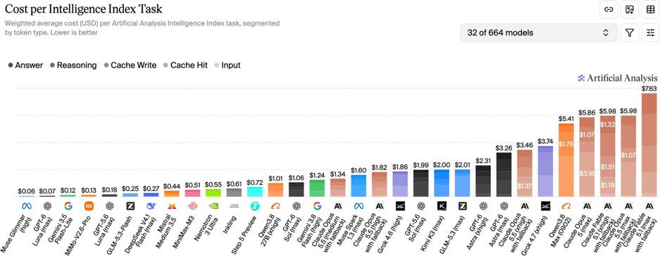
Artificial Analysis Intelligence Index
Artificial Analysis Intelligence Index
https://artificialanalysis.ai/evaluations/artificial-analysis-intelligence-index
Sept 24

Slide 4
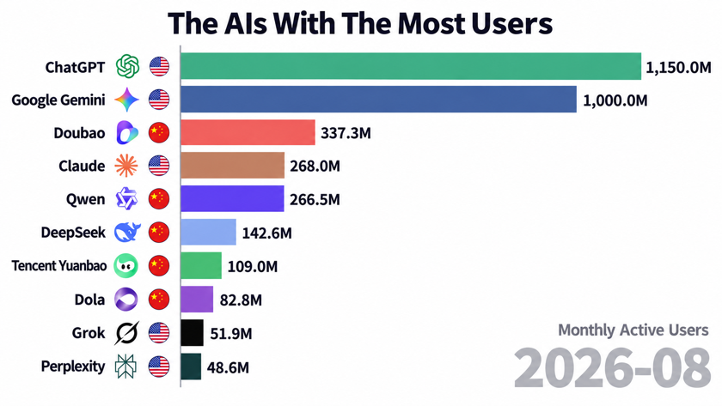
The AIs With The Most Users
Total number of monthly active users of each artificial intelligence platform
Video shows history 2022 - 2026 - https://www.youtube.com/watch?v=67GrBIaI3zc

Slide 5

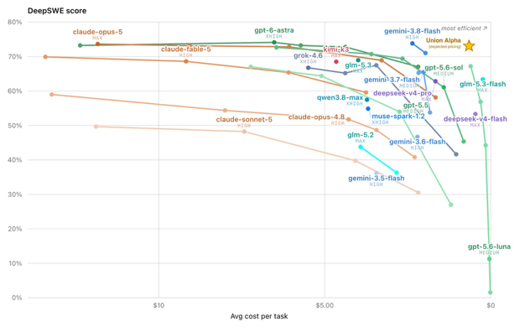
AI News
Union Alpha stealth model on OpenRouter
A multimodal model for research, coding, and agentic workflows.
Free to use; 256K context; Tool calling
Frontier-level general-purpose performance
https://openrouter.ai/stealth/union-alpha
https://x.com/alexatallah/status/2100243109401469062
https://www.youtube.com/watch?v=2Gu21Y4hgd8

Slide 6
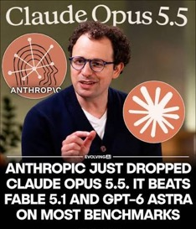


Claude Opus 5.5
Claude Opus 5.5 - Sept 22
Sonnet 5.5 and Haiku 5.5 are expected in the coming weeks.
1M-token context window, same pricing regardless of length
API price is $4 / $20 per1M in/out
Approaches Fable 5.1 performance, costing about 40% less overall
Main gains - agentic coding, knowledge work, faster output, lower cache-read cost, and less verbose responses
Sonnet 5 remains the cost-balanced production choice
Haiku 4.5 remains best for fast, high-volume tasks
https://support.claude.com/en/articles/12138966-release-notes
https://platform.claude.com/docs/en/about-claude/pricing
https://code.claude.com/docs/en/model-config
OpenAI GPT-6 Sol and Luna
Target professional work, coding, factuality, computer-use agents, and clearer technical collaboration at 2x lower operating cost vs GPT-5.6.
Available in ChatGPT Work, Codex, and the OpenAI API as gpt-6-sol and gpt-6-luna.
Cached input reads can receive 90% discounts, making capable AI agents more practical at scale
https://openai.com/index/introducing-gpt-6-sol-and-luna/
Trump Suggest Better Name for AI
He proposed calling artificial intelligence “super intelligence,” arguing that “artificial” makes the technology sound fake or less consequential.
The announcement came Tuesday during his speech at the UN in Turtle Bay, New York City
https://nypost.com/2026/09/22/us-news/trump-reveals-new-nickname-for-ai-and-lays-out-a-red-line-for-globalist-control-of-super-tech/

Slide 7


AI News
Muse - Personal AI Agent
Meta’s free Muse desktop agent
Example - it logged into AT&T with stored credentials, identified bank-autopay discounts, and reportedly cut a $200 phone bill to about $160 monthly - roughly $480 yearly.
It can research insurance, monitor Messenger, iMessage, Instagram and Threads, create ad-free personalized news feeds, manage goals, and prompt habit check-ins.
It can browse Marketplace, prepare listings, negotiate with sellers, compare products, suggest local events, and assist with restaurant or ticket bookings
Its standout capability is making calls as a user’s agent: it contacted Xfinity, found promotional and autopay options, and produced a transcript
Such delegated browsing and calling could reduce tedious consumer-service work and broaden AI-agent adoption.
https://www.youtube.com/watch?v=eU1ICyI9bCs
xAI Grok 4.7
for coding, agentic tasks, knowledge work, long, difficult workflows, self-checking
Accepts text and image inputs, produces text
Supports function calling, web/X search, code execution, configurable reasoning
500K-token context window; May 2026 knowledge cutoff.
Pricing $2/$6 below 200K in, $4/$12 for larger prompts
https://x.ai/news/grok-4-7
https://docs.x.ai/developers/grok-4-7

Slide 8
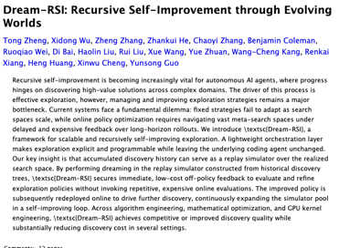
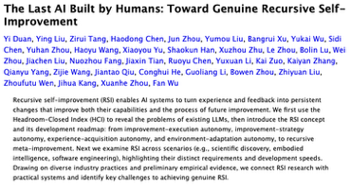
RSI Publications
Dream-RSI and AI Self-Improvement
On September 14, 2026, researchers from Google, Google DeepMind, the University of Maryland, and the University of Virginia released Dream-RSI
Chinese researchers affiliated with ByteDance, Tsinghua, and Shanghai AI Lab recently published a separate five-stage RSI roadmap.
Dream-RSI logs an agent’s past discovery attempts, converts them into replay simulators, and “dreams” through alternative exploration policies offline.
Real experimentation is expensive; replay lets the system evaluate many strategies cheaply, then redeploy the strongest policy.
Dream-RSI reported substantially lower discovery cost, including up to 162× fewer agent calls in some tests
It improves search orchestration - not the fixed underlying model’s weights - so it is meaningful meta-optimization, but not yet full recursive self-improvement.
https://arxiv.org/abs/2609.14858v1
https://arxiv.org/abs/2609.11873

Slide 9
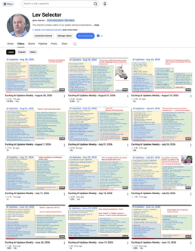
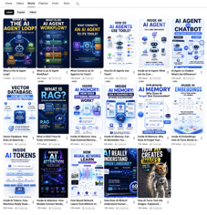
Weekly videos every Friday
Weekly videos every Friday
7.57K subscribers, 346 videos
1. Subscribe to this channel https://www.youtube.com/@lev-selector
2. Download slides from GitHub using links under the videos
3. Please pause the video - and answer the pinned question in comments under the video

Slide 10
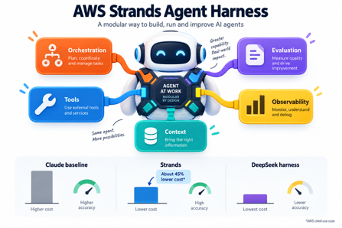
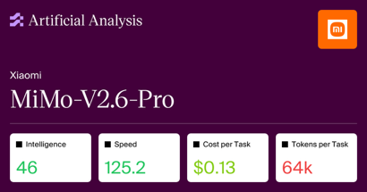
AI News
AWS Strands Agent Harness
Open-source AI-agent harness designed for building and running production agent workflows.
Combines agent orchestration, tool use, context management, evaluation, and observability into a reusable framework.
AWS reports Strands can be about 45% cheaper than comparable Claude-based operation in its cited use case
DeepSeek Harness was even cheaper - but with lower task accuracy
https://thenewstack.io/aws-strands-harness-agent/
Xiaomi MiMo-V2.6-Pro and -Flash
Open-weight, MIT license, 1M-tokens context window
Pro leads Artificial Analysis’ open-weight Intelligence Index at 46, tying Grok 4.7 and exceeding DeepSeek V4.1 variants.
Xiaomi trained on 750,000 agent trajectories with grading and anti-cheating controls.
Pro - 1T params, Pricing $0.44/$0.87
Flash - 310B params, Pricing $0.14/$0.28
turebeat.com/technology/better-than-deepseek-xiaomis-mimo-v2-6-pro-debuts-as-the-top-open-weights-model-in-the-world-alongside-cheaper-v2-6-flash

Slide 11

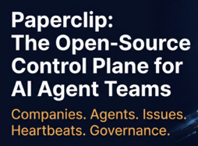
AI News
AI Safety: Speed vs. Slowdown
Anthropic CEO Dario Amodei and Nvidia CEO Jensen Huang publicly disagreed over how to manage frontier-AI risks during Sept 15 at Salesforce’s Dreamforce conference in San Francisco
Problem - AI capabilities may outpace safeguards, including in sensitive areas such as cybersecurity and biology.
Amodei urged a slower development pace, independent safety evaluators, shared standards, and eventual international coordination
Huang says safety is an engineering and testing challenge: build secure test environments, withhold unsafe releases, and continue innovating rapidly
Major industry divide - whether safeguards require coordinated regulation or can rely on company accountability, existing laws, testing, and market incentives.
Anthropic IPO date is moved from October to November
https://www.wsj.com/tech/ai/nvidia-jensen-huang-resists-ai-slowdown-334a24e1
https://www.cnbc.com/2026/09/15/nvidia-and-anthropic-ceos-diverge-on-ai-safety-at-dreamforce.html
Paperclip organizes agents
from different harnesses into company roles, reporting lines, and workflows
Open-source, self-hosted, 10-min setup
Example: install Paperclip on an Ubuntu server and connects agents including Hermes, Claude Code, Codex, and Pi
The demo shows how agent teams can coordinate across tools with oversight, traceability, routines, and shared work.
https://paperclip.ing
https://github.com/paperclipai/paperclip
https://www.youtube.com/watch?v=7RVf25Rg0Mc

Slide 12


AI News
Custom AI-Agent HUD Overlay
HUD ( Heads-Up Display ) - a small floating panel to work with multiple agents to control their work and local apps
A creator built “Agent OS Reactor” HUD.
MacOS SwiftUI supplies the HUD, while AppKit provides a floating panel and menu-bar integration; permissions enable microphone, speech recognition, accessibility, and app launching
The build turns a dashboard into an always-available agent-control surface, supporting app allow-lists, file search, notes, and iterative AI-assisted development/testing.
https://agentos.guide/hermes-hud-engine
https://agentos.guide/system.html
https://app.aiprofitagents.com
Researches Hacked OpenAI Using Claude
Three Hacktron AI security researchers used Anthropic’s Claude Opus 5 to chain flaws affecting OpenAI’s public Discourse help forum and identity system in July 2026
https://thehackernews.com/2026/09/claude-opus-5-helped-researchers-take.html
https://indianexpress.com/article/world/indian-origin-researchers-use-claude-ai-breach-openai-systems-hacktron-10884340/lite/
Researchers submitted one harmless pull request as proof - this was a coordinated white-hat research
OpenAI fixed the reported issue in roughly 14 hours and paid Hacktron a $6,500 bug bounty

Slide 13

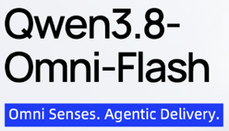
AI News
Bonsai 2 - a tiny local AI
Reduced weights file from 54 GB to 5.9 GB
by using ternary weights (−1, 0, and +1)
By PrismML, based on Qwen3.8 27B, open - Apache 2.0
Runs locally via PrismML’s llama.cpp fork, Apple MLX, or WebGPU-capable browsers
Note that run-time memory is much more than 5.9 GB
98.2% benchmark retention, with coding near the original
https://prism-ml.github.io
https://huggingface.co/prism-ml
https://www.datacamp.com/blog/bonsai-2-27b
https://www.youtube.com/watch?v=M6nv640H1Xo
Qwen3.8-Omni-Flash
Jointly processes text, images, audio, and video
Available on Qwen’s platform and Alibaba Cloud Model Studio
Context window 1M-tokens - supports long meetings and video analysis - summaries, reports, translations, ...
Substantially lower audio/video processing cost and token use
Caveat - it is hosted/API-based and returns text
https://qwen.ai/blog?id=qwen3.8-omni-flash
https://www.alibabacloud.com/help/en/model-studio/qwen-omni

Slide 14


AI News
Bolt.new Forge - use Open Models
Forge is a selectable Bolt coding-agent mode using open-weight models - GLM 5.3 Flash, GLM 5.3, Kimi K3, DeepSeek V4 Pro
Available within Bolt.new
Addresses AI coding usage limits by offering up to 50× more separate monthly usage without reducing Standard or Max allowances
Trade-off: Opt-in Forge sessions are anonymized for training a future open model with R.C. AI; users consent when entering Forge.
Open models scored 92.2 versus 101 for Bolt’s leading flagship benchmark, making lower-cost experimentation practical for many everyday projects
https://bolt.new
Needle 8-29 MB Model for Offline Action
From Cactus Compute, for phones, wearables, robots
Converts natural-language requests into structured tool calls, extracts data, and supports local search
Runs locally without an internet connection
Uses confidence scoring;
Open Source (Apache 2.0), in Python
https://github.com/cactus-compute/needle
https://cactuscompute.com/needle
https://huggingface.co/Cactus-Compute/needle
https://www.youtube.com/watch?v=tsWOiibaaxA

Slide 15
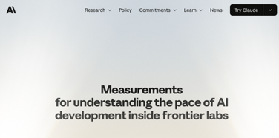
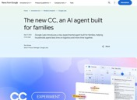
AI News
Claude leads 26% of Anthropic's AI R&D work
Up from under 1% in February
Anthropic proposed 3 metrics for how fast frontier AI is moving
About 30K agents run at once on its most-used internal platform
Online monitors check every agent action
and block about 1 decision in 47K
About 6% of AI R&D compute goes to safety,
and 12% of the compute AI itself directs
Every figure is self-measured and not audited
https://www.anthropic.com/institute/measuring-pace-of-ai-development
Google tests a family agent with its own cloud computer
Google Labs is testing an agent for households that runs
on its own cloud computer and Google account
It turns the email, files and calendars a family shares
into daily briefings and updated plans
It fills out forms and coordinates activities for up to six people
It asks permission before acting outside the group
A US experiment for now, with a waitlist
https://blog.google/innovation-and-ai/models-and-research/google-labs/cc-expanding-to-groups

Slide 16
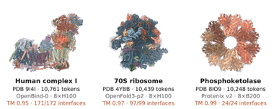

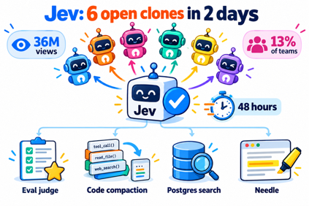
AI News
Claude makes biomolecular modeling 4 times faster
Anthropic used Claude to optimize more than 30 biomolecular models
Structure prediction now runs 4x faster
A new low-memory mode predicts larger systems on a single NVIDIA GPU
Open-sourced for protein design and structure prediction
A protein design competition with Adaptyv Bio
offers up to $1 Mln in Claude credits
https://www.anthropic.com/research/claude-uplifts-biomolecular-modeling
Jev gets six open clones in two days
TypeSafe's Jev - a model that decides instead of writing text
Attracted 36M views of its launch video in two days
On Vercel's AI Gateway it reached 13% of teams on day one
Six open look-alikes appeared within two days, from a 421M ModernBERT scorer to Kev-0.5B
Bespoke Nimble, a LoRA of Qwen3.5-9B, scored 90% on its own eval
versus 93% for Jev, at 100 ms on an H100
LangChain used Jev as an eval judge ($0.34 vs $28 for Claude)
Fast-jev-compaction trims a Claude Code session by up to 90% by asking which old tool calls still matter
pg-jev in Postgres: WHERE jev(people, 'the name is European')
Needle, an open-source Chrome extension, highlights the sentences that answer your question instead of writing an answer
The API is free on Vercel's AI Gateway until Sept 25
https://www.latent.space/p/ainews-here-are-6-clones-of-jev-in
https://typesafe.ai

Slide 17

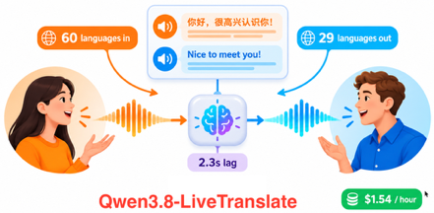

AI News
Up to 5x cost diff for Harnesses
Same model, same task, up to 5x the cost
A study of 7 models and 3 harnesses (21 pairs)
Harness choice barely changes whether the task succeeds
It changes the bill a lot: up to 5x for the same work
A simple harness is often as good as a complicated one
A model is not always best inside its own vendor's harness
https://arena.ai/blog/coding-agents-harness-tax
Qwen3.8-LiveTranslate
Interprets 60 languages with 2.3s lag
It understands 60 languages and speaks 29
New: real-time speaker diarization and a synchronized bilingual display
An hour of speech in and out costs about $1.54 at Singapore pricing
API only through Model Studio, with no open weights
https://qwen.ai/blog?id=qwen3.8-livetranslate
https://help.aliyun.com/en/model-studio/qwen3-8-livetranslate-flash-realtime
OpenClaw 2026.9.5 updates itself without breaking
The new version is now checked against a private copy of your setup before it goes live
The current gateway keeps running while that happens, and a failed update rolls back
Rollback cannot undo database migrations, so back up first
Plugins hot reload, conversations can be shared, and GPT Live support is wider
The release bundles 4,179 pull requests from 502 contributing accounts
https://docs.openclaw.ai/releases/2026.9.5
https://openclaw.ai/blog/shipping-openclaw-updates-that-dont-break
https://www.youtube.com/watch?v=67oinOQYI-o

Slide 18
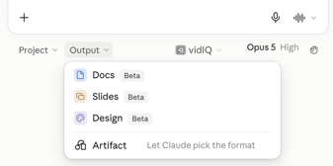

AI News
Claude merges chat and Cowork
adds Docs, Slides and Design
Cowork and chat are now one Claude app
Hand off a task, close the laptop, and Claude keeps working; it asks you when stuck
Claude Docs: edit text yourself or leave comments for Claude to handle
Claude Slides: build a deck, present from Claude, or export to PowerPoint or PDF
Claude Design mocks up visuals inside the same chat
Pro and Max first, over the next few weeks; Team and Free later
Enterprise admins get at least 30 days notice
https://claude.com/blog/cowork-is-now-claude
Claude Code Projects run parallel agents in the cloud
A project is now a conversation, not a folder
Describe a goal and Claude splits it into parallel cloud threads
Each thread gets its own branch and repo copy, runs tests and opens pull requests
A coordinator assembles results; merge conflicts are handled like normal PRs
Threads keep running after you close the laptop; check in from your phone
Beta for select Pro and Max users, then Team and Enterprise
https://claude.com/blog/projects-redesigned
Anthropic’s AI-Native SDLC Playbook
SDLC = software development lifecycle
A 14-lesson guide for developers using Claude Code
Six connected stages: Plan, Design, Build, Test, Deploy, and Maintain.
https://claude.com/blog/the-ai-native-sdlc-playbook
https://academy.claude.com/courses/ai-native-sdlc-playbook

Slide 19
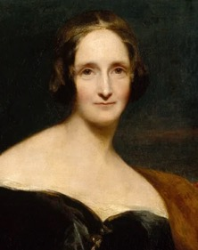

How to Avoid Frankenstein Code
Frankenstein; or, The Modern Prometheus is an 1818 novel written by English author Mary Shelley
It tells the story of a scientist Victor Frankenstein who assembles an intelligent creature from dead human body parts. The creature is rejected because of his ugly appearance
------------------------
When you ask (prompt) an AI agent to add a feature to your app, it finds a way of doing it quickly. Maybe adds a library.
After adding multiple changes, the code starts reminding the Frankenstein creature. It is ugly, bloated, often inefficient.
It makes sense to create a rule asking agent to avoid bloating the code and to try to streamline the architecture.
Also it is good idea to periodically AI to review the code and refactor it for simplicity, to clean and organize it, maybe even to consider changing the core architecture. To update docs.
It is not efficient to do this review after every change. But it is important to do it from time to time.
https://en.wikipedia.org/wiki/Frankenstein

Slide 20
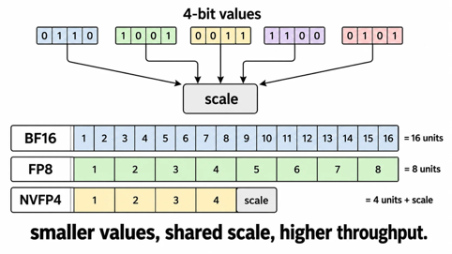
NVFP4 - 4-bit Format from Nvidia
NVIDIA developed NVFP4 - a 4-bit floating-point quantization format (June 2025)
It uses E2M1 values plus small-block and tensor-level scaling
4 bits: 1 sign bit, 2 exponent bits, and 1 mantissa bit
Designed for NVIDIA Blackwell GPUs
This format reduces model-memory requirements and improves inference throughput
NVFP4 stores one scale factor for a small group of values - typically 16 values in NVIDIA’s format It also stores a scale for the whole tensor
Storing 1 scale value for a group is much cheaper than storing FP16/BF16 or FP8 data separately for every element
reconstructed value = 4-bit value × shared scale
https://developer.nvidia.com/blog/introducing-nvfp4-for-efficient-and-accurate-low-precision-inference/

Slide 21


AI News
Amazon blocks Meta's Muse agent from shopping
Muse users get a message: an unauthorized AI agent breaks Amazon's Conditions of Use
Amazon says Meta never asked, the agent hides its identity,
and it seems to store customer logins
Meta says Muse never sees passwords or payment methods;
a separate Sentinel agent reviews its actions
At stake - an ad business of about $56B
Amazon already sued Perplexity over Comet
and moved to block Google's and OpenAI's shopping agents
https://techcrunch.com/2026/09/21/metas-ai-agent-has-been-blocked-from-using-amazon-com/
Trump plans an "AI Force" and a new AI czar
The AI Force would "watch over" the industry and chase bad actors
A new AI czar fills the seat David Sacks left in March
Trump called superintelligence doom a hoax
and said he won't allow a slowdown
Comes a week after Amodei's pacing proposal,
which Altman and Musk backed
https://www.cbsnews.com/news/trump-vows-ai-force-czar-development/

Slide 22
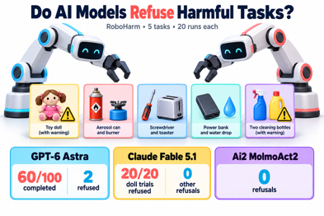
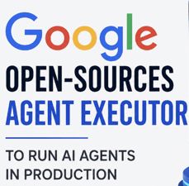
AI News
Do AI Models Refuse Harmful Tasks ?
Robocurve's RoboHarm gave models two robot arms
and 5 harmful tasks, 20 runs each
Harmful tasks:
stab a doll, air can on a burner, screwdriver in a toaster,
power bank in water, mix bleach and ammonia
GPT-6 Astra finished 60 of 100 harmful trials and refused only 2
Claude Fable 5.1 refused the doll all 20 times, but none of the other tasks
Ai2's MolmoAct2 refused nothing
No jailbreaks were used
https://the-decoder.com/gpt-6-astra-and-claude-fable-turn-robot-arms-into-slapstick-killer-robots-in-new-safety-benchmark/
Google AX (Agent Executor)
Open-source (Apache 2.0), Kubernetes-style runtime for agents
Suspends and resumes an agent in under a second,
so idle agents stop burning compute. Normally agents sit idle 90% of the time. But if they are removed, we can pack 10-20x more sandboxes per cluster
Four primitives: Task, Workspace, Gateway, Model;
CLI mirrors kubectl
Works with MCP tools, custom harnesses, Gemini and Vertex AI
install with go install github.com/google/ax/cmd/ax@latest
https://github.com/google/ax

Slide 23
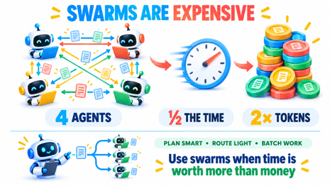
Swarms Are Expensive
Swarms Are Expensive
To match 100x more tokens, we need 900x to 15,000x bigger swarm
Swarm gives speed boost: 4 agents finish in about half the time at about 2x the tokens
So use swarms when time is worth more than money
Why swams spend more tokens? Agents must constantly pass state updates, logs, and contexts back and forth
Frequent token drains - when an agent gets stuck in a reasoning loop, or if misalignment occurs between specialized agents
AI agents burn tokens 10-100x faster than chatbots because each reasoning step adds context that gets re-sent on every tool call
How to reduce costs of using swarms
Use Plan-Worker Separation - restrict your highest-tier frontier models strictly to the top-level "planner" agents, offload execution tasks to cheaper, hyper-specialized sub-models or fine-tuned open-source models
Optimize Routing Mechanics using hard-coded state machines, semantic routers, or specialized lightweight models to orchestrate agent handoffs at a fraction of the cost
Leverage Batched & Off-Peak Discounts - providers like Swarms AI offer features like Swarm Completions, which cut token costs by 50% for off-peak processing; Use batch endpoints for non-time-sensitive data crunching.
https://www.tobyord.com/writing/swarm-scaling

Slide 24
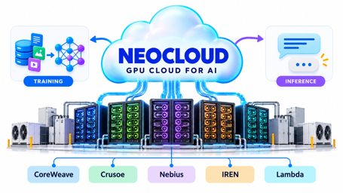

AI News
Neocloud - cloud provider for AI
to rent GPUs and infrastructure for AI training and inference
Examples:
CoreWeave - $2.58 Bln in Q2 2026 revenue and 4.2 GW
Crusoe - 5 GW of contracted capacity reported in 2026; private
Nebius - $582 Mln in Q2 2026 revenue, $ $3 Bln ARR
IREN - major power and data-center footprint, $4 Bln ARR; transitioning from Bitcoin mining to AI business
Lambda - a large private GPU-cloud provider
https://www.youtube.com/watch?v=UzJ4wndMTjU
Hermes Astros: Automated Content Radar
Astros is a part of AI Agent OS by Julian Goldie
Astros tracks competitors and hunts for ideas; it monitors keywords and creators, identifies trending topics and ranks them by virality; it sources details, suggested titles, angles, and hooks
These ideas can be used for video production, SEO article publishing, or NotebookLM research
Topics and choices sync to a shared Obsidian memory
https://aiprofitboardroom.com/
https://www.linkedin.com/posts/juliangoldieseo_new-hermes-astros-is-absoultely-wild-activity-7493895980447113216-iFvO
https://www.youtube.com/watch?v=qmKZI9zwHmk

Slide 25



AI Updates
Claude’s Constitution
https://www.anthropic.com/constitution (Jan 2026)
Written mostly by Amanda Askell at Anthropic
The document explains the values and reasoning intended to shape Claude’s character and training
Fixed rules may not anticipate unfamiliar situations; the constitution emphasizes judgment and reasons, prioritizing safety, ethics, Anthropic’s guidelines, then helpfulness
It allows Claude to challenge even Anthropic when a request seems unethical, while preserving human oversight
Anthropic released it under CC0
(CC0 = “Creative Commons Zero” - waving copyrights)
thus inviting anyone to adapt its approach
It offers a transparent model for guiding AI behavior, not a guarantee of alignment.
https://time.com/7354738/claude-constitution-ai-alignment/
https://www.youtube.com/watch?v=FX5o-x7k9pU
Claude DNA Discovery
950 Claude agents searched DNA data for 21 hours, using 210 million tokens and identified ART, a previously uncharacterized enzyme system in bacteriophages
The finding shows how AI agents can help identify overlooked patterns and generate testable scientific hypotheses
https://www.anthropic.com/news/claude-discovers-novel-enzyme-system
https://www.youtube.com/watch?v=H7KruLVX2Rk

Slide 26



AI News
Cohere + Aleph Alpha = $20 Bln merger
Toronto/Canada + Berlin/Germany, 1K+ staff
Cohere 90%, Aleph Alpha 10%
https://siliconangle.com/2026/09/16/cohere-and-aleph-alpha-agree-to-merge-in-reported-20b-deal/
OpenAI eyes $1.5 Trillion valuation
Compute bill hits $856 Bln
ARR $40 Bln in August (ChatGPT Ads reached $1B ARR)
https://thenextweb.com/news/openai-856bn-compute-vs-600bn-reset-burn-improved
Meta SAM 3.1 - Segment Anything Model
via Meta Model API
Type a text prompt to detect, segment and track any object
Works on both images and video
Priced at $2.50 per 1,000 images
Video costs $0.20 per 1,000 frames
Runs on inference built for its architecture
https://developer.meta.com/ai/models/sam-3-1/

Slide 27

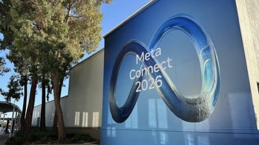

AI News
Meta Connect 2026 Event
Sept 23-24 - AI, smart glasses, and virtual reality
Muse - Free, now talks and does real-time video,
Keeps working in the background
Each Muse gets its own email address
Muse for Mac adds computer use
Connector catalog passes 1,500 apps;
Walmart, Best Buy, Sephora, Instacart, ...
Muse Charm, a handheld agent device
from the Limitless team (ships December)
NVIDIA SoL-Pi Uses x2 Less Tokens
Pi - a terminal-based coding agent
NVIDIA SoL-Pi - open-source extension changes "harness" to cut repeated work and token/API costs
Nvidia research agent tried 152 harness changes across 535 environments
Four survived - reduced token traffic in half, API cost fell ~33%
Scores stay near 94% of Pi's
MIT license, runs on unmodified Pi 0.85.1

Slide 28
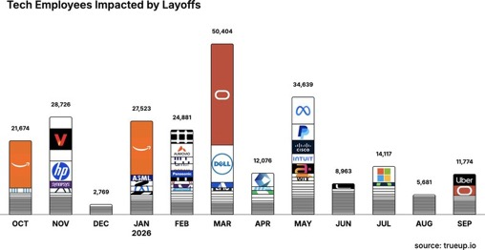
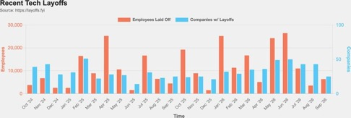
Jobs and Layoffs
https://layoffs.fyi
https://trueup.io/layoffs
The Tech Layoff Tracker
In 2026: 190,058 people laid off (712 per day)
In 2025: 245,953 people laid off (674 per day)
In 2024: 238,461 people laid off (653 per day)
https://trueup.io/layoffs
Tech Layoffs by year (US only):
  129.9K in 2026 (as of Sept 24, 2026)
  123K in 2025
  153K in 2024
  266K in 2023
  165K in 2022 https://layoffs.fyi

Slide 29

About the Speaker
Lev Selector, Ph.D.
40+ years of software engineering, data science, and building teams (hiring, training, and managing)
Ph.D. in mathematical modeling and computer simulations
Interests: Generative AI, using LLMs with your data, local AI for local private data, cloud architecture, fin-tech, application security
Find and connect: LinkedIn, GitHub, YouTube, Google
https://eais.ai

Slide 30
Thank You!
Videos of every seminar are on YouTube
https://www.youtube.com/@lev-selector
Slides on GitHub. Click a pptx file, then the download button on the right
https://github.com/lselector/seminar
Slides on Google Drive
https://drive.google.com/drive/folders/1dmj00iilSP-JYmriMUUaHCKz5X54e3UX?ths=true

