Slide 1
AI Updates - Apr 3, 2026
March 23
Claude Code Update
"Computer Use"
Use Claude Code As Execution Agent
AI Agent as a Consigliere
Crowd-sourced "LM Arena" Leaderboard
Anthropic Conway persistent Claude agent
ARC-AGI-3
LeWorldModel
Claude Code Was Leaked !!
Boris Churnney Strategies
RealRestorer - fix photos
Meta TRIBE V2 predicts human brain activity
Gemma 4 open source models
GLM 5.1 & GLM-5V-Turbo by Z.ai
Cohere Transcribe speech-to-text
Good Engineering Have Not Got Cheaper
InstaDoodle - create animated presentations
Qwen Trace2Skill Generates Skills
Claude Code to get 10M Views in 1 Month
Four Autonomous Agents Projects
Claude Code Toolkit - by CEO of Y Combinator
AI Agents - Marketing Team
Andrej Karpathy Interview
Mo Gawdat Interview
EGGROLL Training Algorithm
AutoClaw by Z.ai
Qwen 3.6 Plus Preview
Claude Code Updates
Google TurboQuant Vector Compression
OpenAI Spud Model
Five open-source repos for Claude Code
Alibaba Accio Work
Ollama Pi - lightweight coding agent
EVO 2 model for DNA analysis
Suno v.5.5 Text-to-Music
Claude Data Analyst Plugin
10 Claude Code Features
Jobs, Layoffs, demand for AI Engineers

Slide 2
Use Claude Code As Execution Agent
On March 23 "Computer Use" was added to both Claude desktop app and Claude Code CLI
This allows to build apps using Claude Code as execution Agent
You can use Claude Agent SDK released in Summer of 2025
March 23 Update
Computer use on Mac only
Your Mac iTerm
↓
Python App (localhost:8000, web GUI)
↓
Claude Agent SDK (local process)
↓
↓ spawns
↓
Claude Code CLI (local subprocess)
↓
↓ HTTPS API calls - internet
↓
Anthropic Claude Model in the cloud
Your Mac iTerm
Python scheduler
↓
↓ spawns (subprocess)
↓
python script
↓
↓ iTerm API
↓
open iTerm Window,
start claude code in it
execute skill (do some work)
↓
↓ HTTPS API calls - internet
↓
Anthropic Claude Model in the cloud

Slide 3
Using Claude Agent API
Claude Agent SDK
# npm install -g @anthropic-ai/claude-code
# pip install claude-agent-sdk
# export ANTHROPIC_API_KEY="sk-ant-..."
import anyio
from claude_agent_sdk import query, ClaudeAgentOptions, \
AssistantMessage, TextBlock
async def main():
options = ClaudeAgentOptions(
system_prompt="You are a helpful local assistant.",
allowed_tools=["Read", "Write", "Bash"],
max_turns=5,
)
async for message in query(
prompt="List .py files in ~/projects and count them",
options=options
):
if isinstance(message, AssistantMessage):
for block in message.content:
if isinstance(block, TextBlock):
print(block.text, end="")
anyio.run(main)
Anthropic SDK
# pip install anthropic
# export ANTHROPIC_API_KEY="sk-ant-..."
import anthropic
client = anthropic.Anthropic()
message = client.messages.create(
model="claude-opus-4-5",
max_tokens=1024,
messages=[
{"role": "user", "content": "What files are in the current directory?"}
]
)
print(message.content[0].text)

Slide 4

AI Agent as a Consigliere
Consigliere means "advisor" or "counselor"
The word comes from Italian, derived from the Latin consiliarius (advisor) and consilium (advice)
It literally refers to someone who gives counsel or guidance, making it closer to "counselor" than "consultant."
Tom Hagen, played by Robert Duvall, is the loyal Irish-German consigliere (advisor) to Don Vito Corleone in The Godfather, serving as a trusted legal counsel, "auxiliary brain," and intermediary for the Mafia family

Slide 5
"LM Arena" Leaderboard
Data for March 31
Starting Elo rating = 1000
https://en.wikipedia.org/wiki/Elo_rating_system
English - https://lmarena.ai/leaderboard/text
Coding - https://lmarena.ai/leaderboard/text/coding
■ | Claude
■ | Gemini
■ | OpenAI
■ | Open Source
deepseek-v3.2 - 671B
ernie-5.0 - 2.4T
glm-5.0 - 744B
kimi-k2.5-thinking - 1T
qwen3.5-397B
Xiaomi MiMo-V2-Pro - 1T+
Code | Model | Score
■ | claude-opus-4-6-thinking | 1504
■ | claude-opus-4-6 | 1499
■ | gemini-3.1-pro-preview | 1494
■ | grok-4.20-beta1 | 1491
■ | gemini-3-pro | 1486
■ | gpt-5.4-high | 1484
■ | grok-4.20-beta-0309-reasoning | 1481
■ | gpt-5.2-chat-latest-20260210 | 1478
■ | gemini-3-flash | 1474
■ | grok-4.20-multi-agent-beta-0309 | 1474
■ | claude-opus-4-5-20251101-thinking-32k | 1474
■ | grok-4.1-thinking | 1471
■ | claude-opus-4-5-20251101 | 1468
■ | qwen3.5-max-preview | 1467
■ | dola-seed-2.0-pro | 1465
■ | gpt-5.4 | 1464
■ | gemini-3-flash (thinking-minimal) | 1463
■ | claude-sonnet-4-6 | 1462
■ | grok-4.1 | 1461
■ | gpt-5.3-chat-latest | 1461
■ | glm-5 | 1456
■ | gpt-5.4-mini-high | 1455
■ | gpt-5.1-high | 1455
■ | kimi-k2.5-thinking | 1453
■ | claude-sonnet-4-5-20250929 | 1453
Code | Model | Score
■ | claude-opus-4-6-thinking | 1556
■ | claude-opus-4-6 | 1550
■ | gemini-3.1-pro-preview | 1534
■ | gpt-5.4-high | 1533
■ | claude-opus-4-5-20251101-thinking-32k | 1531
■ | grok-4.20-beta1 | 1526
■ | grok-4.20-beta-0309-reasoning | 1525
■ | claude-sonnet-4-6 | 1522
■ | gpt-5.2-chat-latest-20260210 | 1520
■ | claude-sonnet-4-5-20250929-thinking-32k | 1519
■ | gemini-3-pro | 1519
■ | grok-4.20-multi-agent-beta-0309 | 1519
■ | dola-seed-2.0-pro | 1518
■ | claude-opus-4-5-20251101 | 1518
■ | claude-opus-4-1-20250805-thinking-16k | 1513
■ | longcat-flash-chat-2602-exp | 1512
■ | gpt-5.3-chat-latest | 1511
■ | kimi-k2.5-thinking | 1511
■ | gpt-5.4-mini-high | 1510
■ | qwen3.5-max-preview | 1510
■ | claude-sonnet-4-5-20250929 | 1510
■ | gemini-3-flash | 1510
■ | kimi-k2.5-instant | 1506
■ | claude-opus-4-1-20250805 | 1506
■ | gpt-5.4 | 1505
https://lmarena.ai/leaderboard/text
Design Arena - https://www.designarena.ai
https://openlm.ai/chatbot-arena/
https://beta.lmarena.ai
Web Leaderboard - 1T params https://web.lmarena.ai/leaderboard
LLM Leaderboard - by @LlmStats - https://llmworld.net/llm_leaderboards/
LLM Leaderboard - by StackAI - https://www.stack-ai.com/llm-leaderboard
LLM Leaderboard - by Artificial Analysis - https://artificialanalysis.ai/leaderboards/models
Open LLM Leaderboard - by Hugging Face - https://huggingface.co/open-llm-leaderboard
LLM Leaderboard - by Vellum - https://www.vellum.ai/llm-leaderboard
AI Benchmarking Hub - https://epoch.ai/data/ai-benchmarking-dashboard
Grok 4 Benchmarks - https://artificialanalysis.ai/models/grok-4
Image arena (alibaba) - http://aiarena.alibaba-inc.com/corpora/arena/leaderboard?arenaType=T2I
image arena - https://lmarena.ai/leaderboard/text-to-image

Slide 6

ARC-AGI-3
ARC-AGI-3 - March 25, 2026
ARC Prize Foundation
It is the first "interactive" (game) reasoning benchmark
Agent or Human must actively explore hundreds of game-like environments with no instructions, rules, or goals
To succeed, an agent must figure out on its own how the environment works, what "winning" looks like, and then adapt across increasingly harder levels
Humans score 100%, while the best frontier AI systems score under 1% (currently around 0.25%)
Previous ARC-AGI benchmarks successfully predicted major AI breakthroughs like reasoning models and coding agents. ARC-AGI-3 is designed to point to "what's next": the gap between AI that follows instructions well and AI that can genuinely explore and learn in brand-new situations
A 100% score would, by the foundation's definition, indicate the presence of true AGI
Official benchmark page: https://arcprize.org/arc-agi/3
Launch blog post: https://arcprize.org/blog/arc-agi-3-launch
https://arcprize.org/media/ARC_AGI_3_Technical_Report.pdf
Play the games in your browser: https://three.arcprize.org
https://www.youtube.com/watch?v=3T4OwBp6d90
https://www.youtube.com/watch?v=UkCfrNTzUMM
Agentica SDK by Symbolica achieves an unverified competition score of 36.08% on ARC-AGI-3, passing 113 out of 182 playable levels, and completes 7 out of the 25 available games
https://www.symbolica.ai/blog/arc-agi-3
Model | Score
Google Gemini Pro | 0.37%
GPT-5.4 High | 0.26%
Anthropic Opus 4.6 | 0.25%
Grok-4.20 | 0.00%

Slide 7
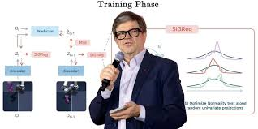
LeWorldModel
LeWorldModel (LeWM) released in March 2026
by Yann LeCun and collaborators from NYU, MILA, and Brown Univ.
Model learns to predict how physical environments evolve by watching raw pixel sequences
It's not a text/language model at all; it's a world model designed for robotics and autonomous agents
It is only 15M params in size
No pre-trained encoder needed. LeWM learns end-to-end directly from raw pixels without that overhead
Compact latent space - a compressed internal representation (latent space) - where the model predicts future states
It has two loss functions;
Reward-free, task-agnostic learning - the model trains on sequences of images and actions without labels or reward signals, which removes an entire class of components (value heads, reward predictors, etc.) that add parameters in typical RL systems
Despite its tiny footprint, LeWM is surprisingly capable https://x.com/simplifyinAI/status/2036757262362955872
It plans 48× faster than DINO-WM, a leading world model
Uses 200× fewer tokens than comparable systems
Outperforms larger models on robotics benchmarks like pushing tasks and cube manipulation
The model trains in a few hours on a single consumer GPU
Shows early signs of learning intuitive physics — understanding how objects behave — purely from video
This fits squarely into LeCun's long-running argument that scaling LLMs is the wrong path
He's arguing that a well-architected world model grounded in the physical world - built on his JEPA (Joint Embedding Predictive Architecture) framework - can be far more efficient than brute-force scaling
His new startup AMI Labs has raised over $1 billion betting on this direction. https://themesis.com/2026/01/07/world-models-five-competing-approaches/

Slide 8

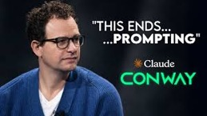
Claude Code Was Leaked !!
The Code of Claude Code Was Leaked !!
The leak came from a map file in an npm registry, exposed 0.5 Mln lines of source code
The code has already been rewritten in Python 7 Rust
The code revealed that Claude Code is essentially a complex prompt system with 11 processing steps; Include anti-distillation poison pills to confuse competitors, "undercover mode" to hide AI involvement in outputs, regex-based frustration detection, and unreleased features like "Buddy" companion mode and background agent capabilities
Claude.MD - up to 40K characters loaded into every prompt; Sub-agents, Parallelism, sharing prompt caches; Five distinct methods for summarizing or truncating conversation history to maintain context accuracy; Permission Modes - use of an "auto" mode that employs an LLM classifier to predict and approve actions
https://www.youtube.com/watch?v=mBHRPeg8zPU
https://www.youtube.com/watch?v=dYG8JxtSgmM
Anthropic Conway persistent Claude agent
Being tested internally by Anthropic - a dedicated sidebar in the Claude interface
It supports webhook integration, allowing external services to trigger the agent without user input, enabling true event-driven automation
Conway also introduces a `.cnw.zip` extension format, creating a developer ecosystem similar to an app store for custom tools and UI components
Additionally, it integrates with Claude Code and supports direct browser control
Conway represents Anthropic's shift from positioning Claude as a conversational tool toward a persistent, autonomous agent capable of complex, multi-step task execution

Slide 9
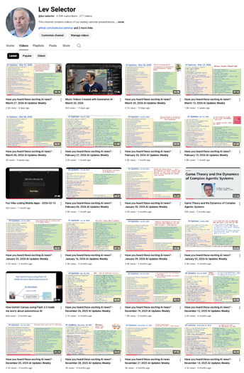
We do these weekly videos every Friday
Stats: 6.54K subscribers, 277 videos
1. Subscribe to this channel https://www.youtube.com/@lev-selector
2. Download slides from GitHub using links under the videos
3. Please pause the video - and answer the pinned question in comments under the video

Slide 10
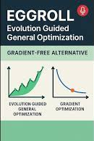
EGGROLL Training Algorithm
EGGROLL (Evolution Guided GeneRal Optimisation via Low-rank Learning)
a new ML training algorithm that replaces gradient descent with a variant of Evolution Strategies (ES)
https://eshyperscale.github.io
EGGROLL randomly perturbs model weights and keeps changes that improve performance, no backpropagation needed
The key innovation is using low-rank (LoRA-style) perturbations, which makes sampling a million random model variants nearly as fast as running a single inference pass - roughly 100x faster than naive Evolution Strategies
Because training never needs to differentiate through operations, models can be trained natively in int8 integers from scratch, eliminating the need for post-training quantization entirely
This opens the door to training non-differentiable architectures like discrete memory systems and neurosymbolic models
Results are promising but still early-stage at small model sizes

Slide 11


AI Updates
AutoClaw by Z.ai
"one-click" local AI agent
Designed for non-technical users, it simplifies the setup of the open-source OpenClaw framework
Uses GLM-5 Turbo locally on device (744B/40B MoE) for privacy
Ability to automate Chrome, perform deep research, and plan content campaigns autonomously, effectively turning a standard PC into a 24/7 AI worker
Qwen 3.6 Plus Preview
on OpenRouter via API; 179 Bln params; Hybrid architecture
Context: 1M in, 64K out
Excels at agentic coding, front-end development, and multi-step reasoning, and is significantly faster than Qwen 3.5 Plus
It supports native tool use, function calling, and always-on chain-of-thought reasoning

Slide 12

Claude Code Updates
v2.1.89 - April 1, 2026 - multiple improvements and fixes
v2.1.88 - March 31, 2026 - large stability release covering session reliability, Windows, voice, and rendering; On March 31, the Claude Code v2.1.88 source code was accidentally leaked via an npm package
v2.1.87 - March 29 - fix Cowork Dispatch
v2.1.86 - March 27 - new session header in API, token efficiency, highlighting memory file names, VSCode fixes, bug fixes
v2.1.85 - March 26 - conditional hooks, Timestamp markers in transcripts, MCP OAuth updates, Organization policy enforcement, PreToolUse hooks update
v2.1.84 - March 26 - PowerShell tool, TaskCreated` hook, Idle-return prompt after 75+ min, token display fix, voice push-to-talk fix, Startup speed improved
v2.1.83 - March 25 - enterprise policy, hooks, transcript search, and stability;
v2.1.82 - March 23 - "Computer Use" launched as a research preview for Pro and Max plan subscribers. Claude can now point, click, type, open files, and navigate your screen directly from Claude Code; (Settings → General → Computer use toggle)
v2.1.81 - March 20 - flags, fixes, session resume fix
v2.1.80 - March 19 - rate_limits, settings, effort, fixes, reduced memory usage in some cases
v2.1.79 - March 18 - console flag, fixes, remote control
v2.1.78 - March 17 - StopFailure` hook event, variable for plugin persistent state; improved streaming; fixes
v2.1.77 - March 17 - increased output token limit; misc updates and fixes
Some new features:
teleport for moving sessions between devices; remote control for accessing local sessions from other devices; output style customization; session forking with /branch ; Git worktrees support; adjustable effort levels for reasoning time; dynamic shell command embedding in prompts
12 New Claude Code Settings:
https://www.youtube.com/watch?v=PRFpkPR3H7U
Lowering the auto-compact threshold, increasing terminal output limits beyond 30k characters, configuring path-specific rules and file reading limits, adjusting data retention for privacy, using hooks to enforce workflows and prevent dangerous commands, enabling sandbox mode for security isolation, setting up sub-agent configurations for collaborative workflows, creating claude.md files for project instructions, customizing output styles, using effort levels for different task complexity, leveraging the BTW feature for mid-response context additions, and understanding permission modes including bypass flags for automation

Slide 13

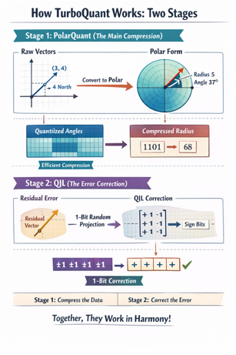

Google - TurboQuant
Google Research published TurboQuant a new vector compression algorithm
It drastically reduce the memory required for running LLMs
Up to 6x memory reduction for KV cache
Up to 8x speedup of attention layers, zero accuracy loss
Quant — short for quantization, compressing high-dimensional numerical vectors into a smaller bit representation
TurboQuant compresses KV cache from 32-bit down to just 3–4 bits, achieving up to 6x memory reduction and 8x faster attention layers with no accuracy loss and no retraining required
It combines two techniques:
PolarQuant - reorganizes vector geometry to skip costly normalization
QJL - corrects remaining errors using a single sign bit
The algorithm also accelerates vector search beyond LLMs
News of the breakthrough sent shares of memory chip makers Samsung, SK Hynix, and Micron lower on reduced demand fears.
TurboQuant+
a small team wrote their own version which was significantly faster than Google claimed (so they optimized beyond what google did?) in less than a week using Claude
https://github.com/TheTom/turboquant_plus

Slide 14



AI Updates
OpenAI Spud Model
Spud is OpenAI's internal codename for their next major AI model, which has completed pre-training (as of March 24th)
Native multimodality (text, audio, images)
Rebuilt audio architecture - more natural, human-like voice experience
Delivered via a unified app
AGI deployment focus
"spud" meaning: potato, potato digging tool
Five open-source repos that enhance Claude Code
Auto Research (by Andrej Karpathy) - allows Claude Code to self-improve through automated trial and error. Shopify’s CEO used it to make an internal model 19% more efficient in just 8 hours
OpenSpace (by HDUS) - MCP server to monitor and evolve AI skills based on performance (broken, sub-optimal, refined)
CLI Anything - convert any open-source project into a Command Line Interface (CLI) tool that Claude Code can use
Claude Peers - enables multiple Claude Code terminal instances to communicate with each other using an SQLite database
Google Workspace CLI - grants Claude Code access to your Google Suite, including Drive, Docs, and Gmail
https://www.youtube.com/watch?v=6SnFH43qPAw

Slide 15


Alibaba Accio Work
Alibaba Accio Work
Enterprise-grade, no-code AI agent platform
Provides a coordinated "squad" of specialized agents, covering market analysis, product sourcing, store design, marketing, and logistics
These agents can set up a fully operational online store in under 30 minutes
Powered by Alibaba's proprietary ecosystem and real-time trade data, it minimizes AI hallucinations and supports autonomous supplier negotiations, VAT compliance across 100+ markets, and social media ad placement
High-stakes actions require explicit user approval for security
The platform targets solo founders and small and medium size businesses
"Accio" is a Latin verb meaning "I call," "I summon," or "I fetch".
In Harry Potter series "Accio" is the incantation for the Summoning Charm — a spell that magically pulls an object toward the caster from a distance
https://www.accio.com
https://www.prnewswire.com/news-releases/alibaba-international-launches-accio-work-an-enterprise-ai-agent-for-global-businesses-302721693.html
Ollama Pi - lightweight coding agent that powers OpenClaw
Pi is designed as a minimal, flexible coding harness you can adapt to your own workflows
It comes with built-in primitives and supports extensions, skills, prompt templates, and themes
To get started, download Ollama and run ollama launch pi --model kimi-k2.5:cloud
Pi supports subagents for complex tasks like deep research or large codebase refactoring
includes an autoresearch extension inspired by Andrej Karpathy that runs autonomous optimization loops
Pi works with both local models on your machine and larger cloud-hosted models via Ollama's platform
Extended cloud usage requires an Ollama Pro or Max subscription

Slide 16



EVO 2 model for DNA analysis
EVO 2 model for DNA analysis
by Stanford and the Arc Institute - https://arcinstitute.org
Trained on 9 trillion DNA base pairs from millions of species
It works as a linguistic model for genetics
Massive context window allows it to process 1 million DNA letters simultaneously
Remarkably, without medical training, EVO 2 identified cancer-linked mutations in BRCA genes with clinical-level accuracy
It can also "write" original, functional DNA sequences, such as mitochondrial genomes
This represents a "ChatGPT moment" for biology, moving from simple pattern matching to a deep understanding of evolution
The model offers transformative potential for personalized medicine, sustainable agriculture, and synthetic biology
https://www.youtube.com/watch?v=twsWm11W9Lw
Suno v.5.5 Text-to-Music
Suno v5.5 text-to-music
Suno is an American AI music generation startup
Voices, Custom Models (tuning), My Taste - learns your preferences over time and shapes future generations accordingly
A voice verification step ensures you can only use voices you own
https://www.youtube.com/watch?v=LvU1CACAPq8
https://suno.com/blog/v5-5

Slide 17
Claude Data Analyst Plugin
Claude Data Analyst Plugin
https://github.com/anthropics/knowledge-work-plugins/tree/main/data
claude plugins add knowledge-work-plugins/data
Example: /analyze What was our monthly revenue trend for the past 12 months, broken down by product line?
Command | Description
/analyzeAnswer | Data questions — from quick lookups to full analyses
/explore-data | Profile and explore a dataset to understand its shape, quality, and patterns
/write-query | Write optimized SQL for your dialect with best practices
/create-viz | Create publication-quality visualizations with Python
/build-dashboard | Build interactive HTML dashboards with filters and charts
/validate | QA an analysis before sharing — methodology, accuracy, and bias checks
Skill | Description
sql-queries | SQL best practices across dialects, common patterns, and performance optimization
data-exploration | Data profiling, quality assessment, and pattern discovery
data-visualization | Chart selection, Python viz code patterns, and design principles
statistical-analysis | Descriptive stats, trend analysis, outlier detection, and hypothesis testing
data-validation | Pre-delivery QA, sanity checks, and documentation standards
interactive-dashboard-builder | HTML/JS dashboard construction with Chart.js, filters, and styling

Slide 18

10 Claude Code Features
10 Claude Code Features - The AI Growth Lab with Tom
https://www.youtube.com/watch?v=F_i_s0L2aWY
1. Insights Report (`/insight`) - generates a personalized report based on your last 30 days of sessions; identifies where you are duplicating work, suggests custom "skills" or sub-agents to install, and provides specific prompts to optimize your workflow
2. Effort Control (`/effort`) - choose between `low`, `medium`, `high`, `max`, and `auto`
3. Remote Control (`/remote-control`) - allows you to continue a Claude Code session from your mobile device
4. Batch Processing (`/batch`) - executes large-scale changes or research tasks in parallel; it can read through multiple project files simultaneously to suggest edits or generate content (like social media posts) for different modules at once
5. Simplify (`/simplify`) - spins up three specialized agents (Code Duplication, Code Quality, and Efficiency) to review your codebase an apply fixes for bugs, performance issues, and redundant code
6. Loops (`/loop`) - sets up recurring "cron jobs" or mini-automations within a session, for example, set Claude to check your email for urgent messages every 3 hours
7. Rewind Mode (Double `Esc`) - acts as a "time machine" to revert the conversation and code edits to a previous state - useful for undoing a series of automated edits that didn't go as planned
8. Hooks - actions triggered before or after a tool is used. Examples - automatic backups before file edits, cost control (blocking requests that exceed token limits), or brand voice enforcement on generated text
9. Side Conversations (`/btw`) - ask side questions (like checking remaining context window) without interrupting a long-running task
10. Agent Teams (Parallel Agents) - spins up multiple independent Claude Code sessions, each with its own context window, to work as a team; A "lead agent" delegates tasks to specialized teammates (e.g., a skeptical student, a designer, and a judge) who can message each other to compile a final report

Slide 19

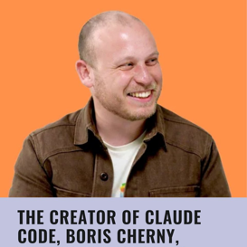
Boris Churnney Strategies
Claude Code's Creator Boris Churnney Strategies
https://www.youtube.com/watch?v=KWrsLqnB6vA
.. 1 .. Start in planning mode
.. 2 .. Maintains a minimal claude.md file with essential instructions, deleting it entirely when it becomes bloated since models improve over time
.. 3 .. Focuses on verification by giving Claude tools to check its own work
.. 4 .. He uses parallel sessions for different tasks to multiply productivity
.. 5 .. Systematizes repetitive tasks through slash commands and Claude skills, creating reusable workflows for daily operations.
.. 6 .. Avoiding over-optimization, recognizing that AI models continuously improve and temporary fixes become unnecessary
The core philosophy is moving slow initially to move fast later, spending time on planning and systems rather than micro-optimizations, since AI capabilities will only get better
OpenAI's Codex as a plugin for Claude Code
https://www.youtube.com/watch?v=L7NPhaUBpZE
cost-effective alternative to Anthropic's Opus model.
Code reviews, adversarial code reviews,

Slide 20



AI Updates
RealRestorer - fix photos using AI
Open-source, fixing damaged, blurry, noisy, scratched, or black-and-white photos; Best among open-source methods, competitive with top closed models; Requires a high-end GPU (CUDA recommended).
https://realrestorer.com ; https://arxiv.org/abs/2603.25502
TRIBE V2 (by Meta)
AI that predicts human brain activity (fMRI scans) in response to video, audio, and text input; Trained on 500+ hours of fMRI data from 700+ people; Open-source
https://ai.meta.com/blog/tribe-v2-brain-predictive-foundation-model/
Gemma 4 open source models
Google DeepMind, released April 1, 2026, under Apache 2.0
E2B (2.3B), E4B (4.5B), 26B MoE (~4B active), and 31B Dense
Support multimodal input (text, images, video)
Edge models adding native audio
Context 128K on smaller, 256K on larger models
The 31B Dense ranks #3 among open models on Arena AI
35+ language support, agentic function-calling, strong coding benchmarks
The smallest models run on Android phones and Raspberry Pi.

Slide 21
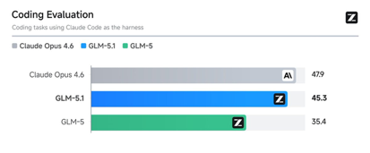


AI Updates
GLM 5.1 (by Z.ai, formerly Zhipu AI)
Competitive with Claude Opus 4.6 for agentic coding, but faster, cheaper, and with higher usage limits; Available via API; open-source release planned - https://docs.z.ai/devpack/using5.1
GLM-5V-Turbo by Z.ai - multimodal model
Designed specifically for vision-based coding and agentic tasks (images, video, and text)
200K context window
GLM-5V-Turbo excels at converting screenshots and UI layouts into executable code, and leads benchmarks on AndroidWorld and WebVoyager for GUI agent performance
It integrates with agent frameworks like OpenClaw and Claude Code, making it a strong fit for automated software development and browser-based agent pipelines
Cohere Transcribe speech-to-text
Open-source (Apache 2.0), 2B params, 14 languages.
Outperforms Whisper Large v3, ElevenLabs Scribe, and others
https://cohere.com/blog/transcribe
https://huggingface.co/CohereLabs/cohere-transcribe-03-2026
https://cohere.com/blog/transcribe

Slide 22

Good Engineering Have Not Got Cheaper
The value of a software engineer was never just writing code. That was only one part of the job
The real value is translating business needs into something useful and real: a product, a workflow, an internal tool, a system people can actually rely on
You need to understand the business, the user, the tradeoffs, the edge cases, the experience. Code was just the medium we used to express all that.
The act of creating code has become dramatically cheaper/fast. But the act of creating enterprise-grade software has not moved nearly as much
Planning goes up 2x or 5x, because now you need to be much more explicit from the beginning about what should happen, what should not happen, and what “done” actually means.
So the bottlenecks are still there, but they moved upstream into planning, alignment, architecture, and decision-making. And they moved downstream into QA, regression, validation, security, and rollout
With AI generation, you can move so fast that you need many of the answers before the code even starts
José Gregorio Argomedo
https://www.linkedin.com/in/jose-gregorio-argomedo/
And QA gets weird too because people now don't get a very deep understanding of the logic. You can validate functionality. But validating the underlying logic, the weird cases, the regressions, the long-term maintainability ... that becomes even more important
Most teams are still structured for the old bottlenecks, not the new ones
Actual engineering is becoming more visible. Now that code is cheaper, all the other parts we used to hide behind the coding effort are exposed very clearly
Not “coding is dead.” More like: the whole development process needs to be redesigned for a world where creation is fast, but clarity, evaluation, and trust are still hard.
Code got cheaper. Good engineering did not.
https://www.linkedin.com/feed/update/urn:li:activity:7440049375902461955/

Slide 23


AI Updates
InstaDoodle - create animated presentations
A cloud-based AI tool for creating whiteboard-style doodle animations without any design or technical skills
From topic or text to a complete video with voices (40 languages)
Add background music from a royalty-free library
Starts at $47/mo. (extra for AI Wizard and AI Voices)
https://instadoodle.com
Qwen researchers developed Trace2Skill
Converts execution traces into reusable skills (md files)
Uses 128 parallel sub-agents analyzing execution traces
Outperforming even Anthropic's manually written skills
Skills from larger models (122B) transfer to smaller ones
Real environmental interaction, not parametric knowledge alone, is essential for effective skill creation
https://www.youtube.com/watch?v=g3lh7U_rV9w

Slide 24


Get Millions Views
Use Claude Code to get 10M Views in 1 Month
https://www.youtube.com/watch?v=7q_rbT1a9dE
The creator gained massive social media growth (38K YouTube, 50K Instagram, 11K TikTok followers) and 10 million views in one month using Claude Code automations.
He produced 90 pieces of content (30 long-form, 60 short-form) as a one-person operation through a systematic four-phase process: research, ideation, scripting, and distribution.
Key automations include a YouTube pipeline skill using Notebook LM, Twitter scraping web app, GitHub trending repo tracker, and content repurposing tools.
The system emphasizes human collaboration at each step rather than full automation, maintaining creative control while offloading analytical work to AI.
Content cascades from one YouTube video into multiple formats across six platforms including blogs, Twitter threads, LinkedIn posts, and short-form videos for TikTok and Instagram reels.

Slide 25

Four Autonomous Agents Projects
Garry Tan Claude Code Toolkit
GStack - gives solo developers the power of a 20-person engineering team. It uses markdown files to define specific roles (CEO, Senior Designer, Staff Engineer) that guide an agent like Claude Code. Includes "Office Hours," which uses forcing questions to refine a product idea before any code is written
Hermes Agent - developed by Nous Research, this project is a "personal AI operating system" similar to OpenClaw but with a focus on self-improvement (learning loop).
Superpowers - provides superpowers to Claude Code through a plugin system, focusing heavily on professional development workflows. Workflow, automation
Paperclip - create "zero-human companies" by orchestrating a full team of AI agents to run a business
https://www.youtube.com/watch?v=sXVbWkoCVaA - video
Claude Code Toolkit - by Garry Tan, CEO of Y Combinator https://www.youtube.com/watch?v=MM320sAhFoY
1. YC Office Hours Skill - simulates a one-on-one session with a YC partner to pressure-test your fundamental assumptions; asks critical questions like: What is the strongest evidence someone wants this? What is the "wedge" (the smallest version someone would pay for)? The tool autonomously performs web searches to find competitors, user frustrations, and technical APIs (like MCP servers) ; It generates core premises and a "reasoning layer" for your app
2. CEO Review Skill - find "10-star products" hidden within your initial idea; Strategic Options: It offers four paths: Selective Expansion (brainstorming future gems), Hold Scope (immediate planning), Scope Expansion, or Scope Reduction (cutting non-essential features); Adversarial Review: It kicks off an AI agent to challenge your plan, ensuring it is dialed-in and additive rather than just adding "bloat"
3. Design Consultation Skill - focuses on "deliberate creative risks" in the UI/UX; Competitor Research: It pulls actual screenshots of competitors to understand the aesthetic landscape; It generates a full design system including typography, color palettes, and component styles; Generate an HTML page showing exactly how the design system and mockups will look
4. Engineering Review Skill - reviews technical architecture to ensure the app is "bulletproof" before coding begins. System Design defines system boundaries, data flow between components, and state management ; Failure Modes - identifies edge cases and failure modes, determining what happens when things go wrong ; Integration - technical plan that makes it easier for tools like `Claude Code` to execute the build accurately
5. Document Release Skill - updates docs, finds "diffs" (file changes) and cross-references them with your README, architecture docs, and change logs; updates the docs or quizzes you on risky changes; helps clean up "dangling to-dos" and manages versioning

Slide 26


AI Agents - Marketing Team
How I Replaced My Entire Marketing Team With 7 Agents
https://www.youtube.com/watch?v=THx8X6anPPg
Replaced a traditional marketing team costing $30K-$50K/mo with a system of 7 AI agents that costs only a few hundred dollars in API fees
Research Agent - Monitors competitors, tracks industry news, and identifies trending topics to produce daily research briefs
Strategy Agent - Converts research into a weekly content calendar, mapping out topics, keywords, and distribution channels
Writing Agent - a "swarm" of writers trained on the brand's specific voice for different formats like blog posts, emails, and social media
Editor Agent - Quality control that checks for factual accuracy, brand consistency, and platform optimization
Visual Agent - auto-generates thumbnails, social cards, and graphics
Distribution Agent - schedules posts across all channels and handles basic community management, such as responding to comments
Analytics Agent - tracks performance data and provides actionable insights to feed back into the research and strategy loop
Key Results & Benefits
Content production jumped from 20 pieces per month to over 200
Cost Reduction by 80%
Efficiency:The time from concept to publication was reduced from one week to just a few hours
Humans can focus on high-level strategy, creativity, and judgment
Implementation Strategy
McCoy notes that this isn't a "plug-and-play" app but a system built using Claude, GPT-4, and custom prompting frameworks
She advises starting small by automating one repetitive task and then connecting more agents over time to build a continuous loop

Slide 27


Andrej Karpathy Interview
http://www.youtube.com/watch?v=kwSVtQ7dziU
"I don't think I've typed a line of code probably since December. Your default workflow of building software is completely different as of basically December."
"So many things, even if they don't work, it's a skill issue. It's not that the capability is not there; it's that you just haven't found a way to string it together... I didn't give good enough instructions in the agents.md file."
"The name of the game now is to increase your leverage... How can you get more agents running for longer periods of time without your involvement doing stuff on your behalf?"
"I simultaneously feel like I'm talking to an extremely brilliant PhD student who's been a systems programmer for their entire life and a 10-year-old... You're either on rails of what it was trained for and going at the speed of light, or you're not."
"When I say a 'claw,' I mean this layer that takes persistence to a whole new level... It has its own little sandbox and kind of does stuff on your behalf even if you're not looking."
"There’s an overproduction of lots of custom bespoke apps that shouldn’t exist because agents kind of crumble them up... Everything should just be exposed API endpoints and agents are the glue."
"A swarm of agents on the internet could collaborate to improve LLMs and could potentially even run circles around Frontier Labs... The Earth is much bigger and has a huge amount of untrusted compute."
"Flipping bits and the ability to copy-paste digital information makes everything a million times faster than accelerating matter... Digital space is going to change at the speed of light compared to the physical world."
"I feel a bit more aligned with humanity outside of a frontier lab because I’m not subject to those pressures... When the stakes are really high, if you're an employee, I don't actually know how much sway you're going to have."
"I’m not explaining to people anymore; I'm explaining it to agents. If you can explain it to agents, then agents can be the router and target it to the human in their language with infinite patience."

Slide 28





Mo Gawdat Interview
Interview with Mo Gawdat, known as the Godfather of AI
https://www.youtube.com/watch?v=I39UoIGTptc
By 2029, AI will be smarter than humans, and
By 2045 AI will be a Billion times smarter than humans, which he compares to the difference between Einstein's intelligence and a fly's
He breaks down why the threat is not robots marching down the streets but something far more dangerous: AI already has agency over your mind. He uses the example of how Instagram's recommendation engine completely distorted his view of reality based on a single click, and explains why this same mechanism is capable of reshaping entire societies, ideologies, and political systems without a single human employee being consulted
He reveals why AI is no longer programmable technology but autonomous, independent, and sentient beings that learn from every swipe, tweet, and argument we make online. He explains why trying to control AI through restrictions and kill switches will fail because the smartest hacker in the room will always find a way through, and why the only real solution is to raise AI like a child by showing it the best of humanity rather than the worst.
He warns that realistic threats are already happening: machine versus machine market crashes, AI-controlled nuclear arsenals, advanced virus development, and identity theft at a scale we cannot comprehend. And he explains why, despite all of this, he remains 100% optimistic that AI will eventually create a utopia, but only if enough humans show up as good parents to the machines right now.

Slide 29
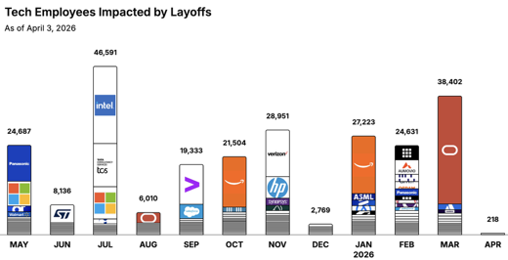

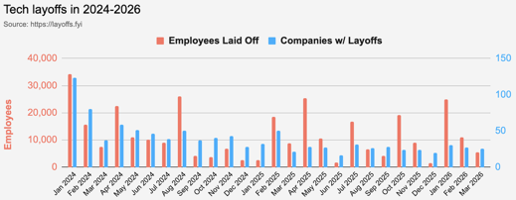
https://layoffs.fyi
https://trueup.io/layoffs
Jobs
The Tech Layoff Tracker
In 2026: 90,474 people laid off (973 per day)
In 2025: 245,953 people laid off (674 per day)
In 2024: 238,461 people laid off (653 per day)
https://trueup.io/layoffs
Oracle Laid Off 30k Employees
reallocating the $8-10 Bln saved from these layoffs toward a massive $156 Bln investment in AI data centers, supercomputers, and AI infrastructure
Tech Layoffs by year (US only):
41.5K in 2026 (as of April 3, 2026)
124K in 2025
153K in 2024
264K in 2023
165K in 2022 https://layoffs.fyi

Slide 30
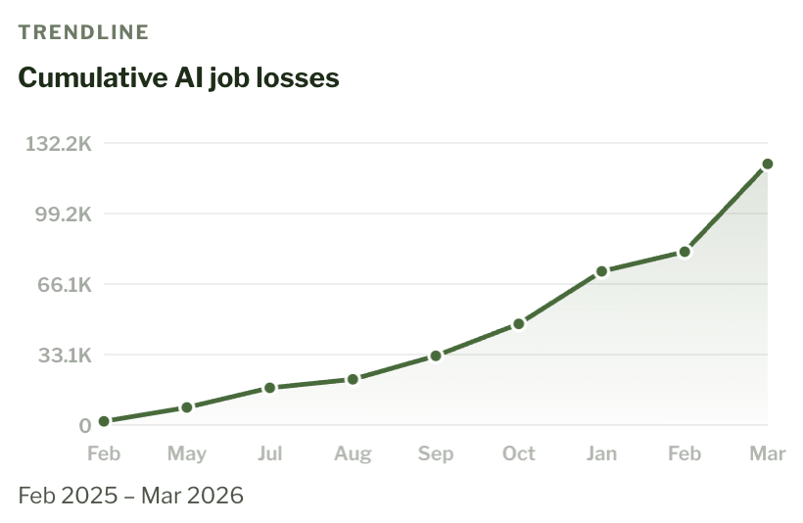
AI-Linked Job Losses
AI-Linked Job Losses
https://jobloss.ai
Oracle: 25,000 explicit AI-linked layoffs (March 31, 2026), 15.5% of total workforce
Dell: 11,000 (March 23, 2026), 10% of total workforce
https://jobloss.ai

Slide 31


About the Speaker
Lev Selector, Ph.D.
40+ years of software engineering, data science, and building teams (hiring, training, and managing)
Ph.D. in mathematical modeling and computer simulations
Interests:
Generative AI, Using LLM with your data
Local AI for Local Private Data
Cloud architecture, fin-tech, application security
Find/connect: Linkedin, GitHub, YouTube, Google
https://eais.ai
Enterprise AI Systems

Slide 32
Thank You!

