Slide 1
AI Updates - June 5, 2026
This week in AI:
everything got smarter, cheaper, faster, and somehow more expensive
Crowd-sourced "LM Arena" Leaderboard
MiniMax M3 - Multimodal Model
Microsoft MAI-Thinking-1
NVIDIA CEO Jensen Huang keynote at GTC
NVIDIA RTX Spark Laptops and DGX Stations
Anthropic IPO
Anthropic New Billing June 15
Select Cheaper Model
Headroom context compression
Compiling Agentic Workflows
Microsoft Project Solara chip-to-cloud platform
5 files to personalize your Claude Code agent
Agent Compiler - Optimized Reusable Paths
Google DeepMind - Alpha Proof Nexus
Unabyss - Context Layer
Cybersecurity recruiting is accelerating
AI for consistent robotic work
Microsoft Majorana-2 Quantum Chip
Anthropic "When AI builds itself" paper
Ray Kurzweil - AGI by 2029
Context Chain-of-Thought - Context-CoT
Huawei Semiconductor "Tau (τ) Scaling"
Top Vibe Coding Tools
How to contain Claude across products
DeepSWE AI coding benchmark by data-curve.ai
Anthropic's SRT (Sandbox Runtime)
Microsoft Scout - based on OpenClaw
SpaceX IPO Target $170B vs $780B Valuation
JetBrains Mellum2 12B MoE Open-source
Suno raises $400M at $5.4B valuation
LLM Interview Questions
"The AI Layoff Trap" Paper
Jobs & Layoffs

Slide 2
"LM Arena" Leaderboard
Data for June 4
Starting Elo rating = 1000
https://en.wikipedia.org/wiki/Elo_rating_system
English - https://lmarena.ai/leaderboard/text
Coding - https://lmarena.ai/leaderboard/text/coding
■ | Claude
■ | Gemini
■ | OpenAI
■ | Open Source
Z.ai GLM-5.1 - 744B
Qwen3.7-max-preview - 745B
Baidu Ernie-5.1 - 800B
Deepseek-v4 - 1.6T
Kimi-k2.6 - 1T
Xiaomi MiMo-V2-Pro - 1T+
Meta muse-spark 30B
ByteDance dola-seed-2.0-pro 400B
Minimax M3 - 456B
Code | Model | Score
■ | claude-opus-4-6-thinking | 1503
■ | claude-opus-4-7-thinking | 1500
■ | claude-opus-4-6 | 1498
■ | claude-opus-4-7 | 1493
■ | muse-spark | 1489
■ | gemini-3.1-pro-preview | 1488
■ | gemini-3-pro | 1486
■ | gpt-5.5-high | 1482
■ | gpt-5.4-high | 1479
■ | gemini-3.5-flash | 1477
■ | gpt-5.2-chat-latest-20260210 | 1476
■ | glm-5.1 | 1475
■ | gpt-5.5 | 1474
■ | grok-4.20-beta1 | 1474
 | qwen3.7-max-preview | 1474
■ | gemini-3-flash | 1473
■ | grok-4.20-beta-0309-reasoning | 1473
■ | claude-opus-4-5-20251101-thinking-32k | 1473
■ | grok-4.20-multi-agent-beta-0309 | 1472
■ | gpt-5.5-instant | 1471
■ | claude-sonnet-4-6 | 1471
■ | ernie-5.1 | 1471
■ | claude-opus-4-5-20251101 | 1469
■ | gpt-5.4 | 1467
■ | grok-4.1-thinking | 1466
Code | Model | Score
■ | claude-opus-4-6-thinking | 1553
■ | claude-opus-4-7-thinking | 1552
■ | claude-opus-4-7 | 1549
■ | claude-opus-4-6 | 1548
■ | claude-opus-4-5-20251101-thinking-32k | 1530
■ | glm-5.1 | 1530
■ | muse-spark | 1528
■ | gemini-3.1-pro-preview | 1526
 | qwen3.7-max-preview | 1525
■ | claude-sonnet-4-6 | 1524
■ | claude-opus-4-5-20251101 | 1523
■ | gpt-5.5-high | 1521
■ | gpt-5.4-high | 1521
■ | claude-sonnet-4-5-20250929-thinking-32k | 1520
■ | gemini-3-pro | 1519
■ | gpt-5.2-chat-latest-20260210 | 1517
■ | grok-4.20-multi-agent-beta-0309 | 1516
■ | ernie-5.1 | 1516
■ | mimo-v2.5-pro | 1514
■ | claude-sonnet-4-5-20250929 | 1514
■ | claude-opus-4-1-20250805-thinking-16k | 1513
■ | gpt-5.5-instant | 1512
■ | qwen3.5-max-preview | 1512
■ | grok-4.20-beta-0309-reasoning | 1512
■ | gpt-5.4 | 1512
https://lmarena.ai/leaderboard/text
Design Arena - https://www.designarena.ai
https://openlm.ai/chatbot-arena/
https://beta.lmarena.ai
Web Leaderboard - 1T params https://web.lmarena.ai/leaderboard
LLM Leaderboard - by @LlmStats - https://llmworld.net/llm_leaderboards/
LLM Leaderboard - by StackAI - https://www.stack-ai.com/llm-leaderboard
LLM Leaderboard - by Artificial Analysis - https://artificialanalysis.ai/leaderboards/models
Open LLM Leaderboard - by Hugging Face - https://huggingface.co/open-llm-leaderboard
LLM Leaderboard - by Vellum - https://www.vellum.ai/llm-leaderboard
AI Benchmarking Hub - https://epoch.ai/data/ai-benchmarking-dashboard
Grok 4 Benchmarks - https://artificialanalysis.ai/models/grok-4
Image arena (alibaba) - http://aiarena.alibaba-inc.com/corpora/arena/leaderboard?arenaType=T2I
image arena - https://lmarena.ai/leaderboard/text-to-image

Slide 3
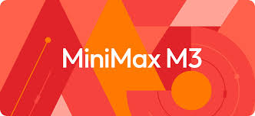

AI Updates
MiniMax M3 - Multimodal - text, image, and video inputs
1 Mln token context window
For long-horizon agentic workflows, coding, and tool use
https://openrouter.ai/minimax/minimax-m3/providers
MiniMax Sparse Attention (MSA) - a GQA-based mechanism that performs block-level KV selection instead of full attention, delivering 9.7× faster prefill and 15.6× faster decoding at 1M tokens compared to its M2 predecessor, at roughly 1/20 the compute cost
The model is open-source under a permissive, enterprise-friendly license
Outperforms GPT-5.5 and Gemini 3.1 Pro on some benchmarks
Promotional pricing $0.30 / $1.20 per 1M in/out tokens (rising to $0.60/$2.40 at standard rates).
ollama launch openclaw --model minimax-m3:cloud
Microsoft MAI-Thinking-1 - at Build conference - June 2-3
It is the company's first in-house advanced reasoning model
Beats Sonnet 4.6, good on software engineering benchmarks
Built for multi-step, agentic workflows
Available in private preview through Microsoft Foundry
Part of a release of 7 new in-house AI models, including MAI-Code-1 and MAI-Image-2.5, MAI-Transcribe-1.5

Slide 4


AI Updates
NVIDIA CEO Jensen Huang keynote (GTC in Taipei, Taiwan)
"useful agentic AI" has officially arrived
From simple application use to agentic systems
Vera Rubin - a new, fully integrated, multi-rack supercomputing (Rubin GPU, Vera CPU, ...) - built for agentic workloads
Nemotron 3 Ultra (550B params) & Cosmos 3 (16B & 64B) open models
RTX Spark - run AI locally
https://www.youtube.com/watch?v=q_umfWm8J28
Model | AA Intelligence Score
Claude Opus 4.8 | 61
GPT-5.5 (xhigh) | 60
Gemini 3.1 Pro Preview | 57
Kimi K2.6 (Moonshot) | 54
Qwen3.5 | ~52
GLM 5.1 | ~50
Nemotron 3 Ultra | 48
Nemotron 3 Super | 36
NVIDIA RTX Spark ARM superchip for laptops
Combines 2 dies in one chip (TSMC 3nm-class package):
20-core ARM-based Grace CPU
Blackwell RTX GPU + NVLink-C2C interconnect
It is a consumer-oriented sibling of the GB10 Grace Blackwell superchip already shipping in NVIDIA's DGX Spark Linux mini-PC, but now repurposed for Windows
AI Performance: Up to 1 Petaflop of AI compute
Up to 128 GB of unified memory
Can run 120B params (FP4) LLMs up to 1M context locally, rendering 90 GB 3D scenes, and playing AAA games at 1440p above 100 fps
Microsoft co-developed new Windows security primitives specifically to run on-device AI agents alongside NVIDIA's OpenShell runtime
Expected to ship this Fall
NVIDIA’s new DGX Station for Windows
Can run models up to 1 Trillion params locally
GB300 Grace Blackwell Ultra Superchip
up to 20 PetaFlops of FP4 performance
748GB of coherent memory and 800Gb/s networking
Should be available in Q4 of 2026
Feature | NVIDIA RTX Spark | Apple M5 Family
CPU Cores | 20-core ARM (Grace) | 10..18 cores
GPU | Blackwell, 6K CUDA cores (~RTX 5070) | 10-20 core GPU
AI Compute | 1,000 TOPS (FP4) | ~38-60 TOPS
Unified Memory | Up to 128 GB LPDDR5X | Up to 128 GB
Memory Bandwidth | ~273 GB/s | up to 546 GB/s
Packaging | CoWoS-R (2 dies) | Single die
TDP | ~45–80W (estimated) | ~30–70W
OS | Windows | macOS

Slide 5


AI Updates
Anthropic IPO
Anthropic has confidentially filed Form S-1 paperwork with the SEC, taking its first formal step toward an IPO
The filing follows a $65 billion funding round valuing the company near $1 trillion
No share price or timeline is set yet, though a fall 2026 debut is possible
Anthropic is projecting $10.9 billion in Q2 2026 revenue and its first profitable quarter
The move puts it ahead of rival OpenAI, which is also preparing its own IPO filing
Quote of the day by Anthropic CEO Dario Amodei:
"Humanity is about to be handed almost unimaginable power, and it is deeply unclear whether [we] possess the maturity to wield it" - warnings on the looming threat of beyond-human AI

Slide 6
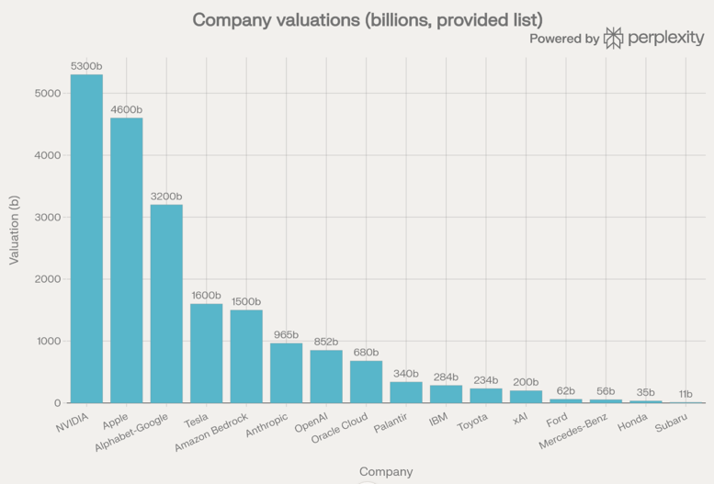
Companies
NVIDIA | 5300
Apple | 4600
Alphabet-Google | 3200
Tesla | 1600
Amazon Bedrock | 1500
Anthropic | 965
OpenAI | 852
Oracle Cloud | 680
Palantir | 340
IBM | 284
Toyota | 234
xAI | 200
Ford | 62
Mercedes-Benz | 56
Honda | 35
Subaru | 11

Slide 7
Anthropic New Billing June 15
Unused credits do not roll over - they expire at the end of each billing cycle;
Credits are "per-user" and cannot be pooled or transferred across team members
Zed Claude Agent, VSCode Claude Code Extension, PyCharm (JetBrains) Claude Code Plugin - billing depends on task
Interactive question - can be billed through monthly subscription
Agentic tasks (autonomous file edits, multi-step coding runs, anything using the Agent SDK under the hood) - counts against your new credit pool after June 15
Anthropic New Billing June 15
Splitting Claude's subscription into two separate usage pools:
one for interactive chat - continues as before
one for agentic usage - calculated at API rate
https://beam.ai/agentic-insights/anthropics-new-billing-split-reveals-what-ai-agents-actually-cost
When you have monthly subscription of $X/month, you get $X in credits for agentic use at full API rates. After using these credits, you will be automatically billed extra at API rate (if you enabled "extra usage") - or requests simply halt once the monthly credit is exhausted
This affects:
claude -p (run one prompt - and exit)
Claude Agent SDK (Python and TypeScript)
Claude Code GitHub Actions
Third-party apps using Agent SDK authentication (OpenClaw, Zed's Claude integration, Conductor, Jean, ...)
Interactive CLI sessions in terminal (or interactive session in Claude desktop app) are not affected - they will continue to draw from your standard subscription pool, just as before; So if you use "claude" command in terminal for interactive session - it is still billed as part of your monthly subscription. You can ask it to do multi-step operation (long task list) - still billed through subscription.
Careful - remove your ANTHROPIC_API_KEY key, because when you hit your subscription's 5-hour limit, Claude Code may automatically switch to using that API key instead
So we can still use Claude Subscription for coding if we use Claude Code CLI
To run "digital employee" we can select cheaper models:
Model | Type | Cost per 1Mtok in/out - or Mem | Agentic Strength
Claude Opus 4.8 | Cloud | $15/$75 | Best
Gemini 3.1 Pro | Cloud | $2/$12 | Frontier, 1M context, multimodal
Qwen3-235B-A22B | Local | 130GB RAM | Near-frontier, excellent tool calling
Kimi K2.5 | Cloud | $0.45 / $2.25 | Top general agentic, complex tool use, long sessions
Qwen3 Coder 480B A35B | Cloud | $0.40 / $1.60 | Best-in-class for coding agents specifically
GPT-4.1 Mini | Cloud | $0.40 / $1.60 | Strong tool calling, 1M context, solid coding
Llama 3.3 70B | Local | ~40GB RAM | Strong generalist agent, widely supported in Ollama
DeepSeek-V3-0324 | Cloud | $0.20 / $0.77 | Excellent cost/performance, strong coding agents
Qwen3.6‑35B‑A3B (MoE) | Local | ~22GB RAM | Great reasoning + tool calling, tiny active params
Qwen3 Coder 30B-A3B | Local | ~18GB RAM | Same MoE efficiency, tuned for code
GLM-4.5-Air | Local | ~20GB RAM | Purpose-built for agents, MoE architecture
Gemini 3.1 Flash-Lite | Cloud | $0.25 / $1.50 | Good tool use, very fast, lowest cloud cost
Qwen 3.7 Plus | Cloud | $0.40 / $1.60 | Multimodal Agent-focused

Slide 8
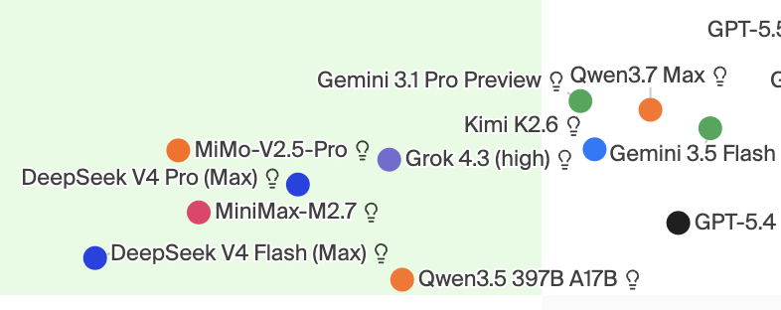
Select Cheaper Model
Select an Affordable Model
Artificial Analysis
https://artificialanalysis.ai
https://github.com/alexfazio/artificial-analysis-compare
LMArena
https://arena.ai
Vellum AI LLM Leaderboard - https://www.vellum.ai/llm-leaderboard
Onyx LLM Leaderboard - https://onyx.app/llm-leaderboard
ClickRank LLM Leaderboard - https://www.clickrank.ai/llm-leaderboard/
Hugging Face Open LLM Leaderboard - https://huggingface.co/spaces/HuggingFaceH4/open_llm_leaderboard
HELM (Stanford) - https://crfm.stanford.edu/helm/
dextralabs - https://dextralabs.com/blog/best-llm-leaderboard/
DeepSeek - very good value (x9 lower cost)
For local - Kimi K2.5 and Qwen 3.5 are the top open-weight
Quality
Cost
Model | Example public pricing*
Qwen3.7-Max | OpenRouter: 1.25 in / 3.75 out USD per M tokens
Qwen3.7-Plus | OpenRouter: 0.40 in / 1.60 out USD per M tokens

Slide 9



Reduce Agentic Costs
Headroom context compression cuts token usage by 60-95% https://github.com/chopratejas/headroom
pip install "headroom-ai[all]" headroom wrap claude
Or: headroom proxy --port 8787 ANTHROPIC_BASE_URL=http://localhost:8787 claude
Tejas Chopra
https://x.com/hooeem/status/2062266452921491934
https://arxiv.org/pdf/2605.22502
Compiling Agentic Workflows into LLM Weights: Near-Frontier Quality at Two Orders of Magnitude Less Cost
Instead of orchestrating tools and sub-agents using a frontier LLM, you compile the entire agentic workflow into a smaller model
Using flowchart-defined procedures, they generate synthetic conversations with Claude Sonnet 4.5, then fully fine-tune 3B–8B Qwen models to internalize both state tracking and domain behavior
Across travel booking, Zoom support, and insurance claims, compiled 8B models reach 87–98% of a frontier in-context baseline’s quality while often outperforming a LangGraph+Claude orchestrator, despite having around x70 fewer parameters
Prompts stay small, inference is self-hosted
x100-x500 lower per-conversation cost
30–50 minute recompile cycle when procedures change
OUMI - https://oumi.ai
OUMI = Open Universal Machine Intelligence
The Right Model Beats The Biggest Model.
Stop renting generic intelligence.
Build and deploy the best specialized model for your task. Own it fully.
up to +50% accuracy vs. frontier models
up to 90% lower cost vs. frontier models
as low as 2 hours to production from prompt to deploy

Slide 10
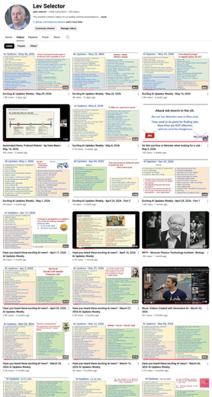
We do these weekly videos every Friday
Stats: 6.88K subscribers, 290 videos
1. Subscribe to this channel https://www.youtube.com/@lev-selector
2. Download slides from GitHub using links under the videos
3. Please pause the video - and answer the pinned question in comments under the video

Slide 11

Top Vibe Coding Tools
MAU = Monthly Active Users;
ARR = Annual Recurring Revenue
1) Cursor – AI IDE / agentic editor; ~7M MAU, >1B ARR in 2025, ~2B+ ARR by early 2026; valued ~29B+ as of last reported round.
2) GitHub Copilot – AI assistant in IDEs; ~4–5M paid users; multi‑billion revenue inside Microsoft, no standalone valuation
3) Lovable – AI app builder; millions of users, ~200–400M ARR by early 2026; last marked valuation ~6.6B.
4) Claude Code – Agentic coding for Claude; substantial usage and revenue as part of Anthropic’s multi‑Billion ARR
5) Windsurf (Codeium) – AI IDE; hundreds‑of‑thousands to low‑millions of users; tens‑of‑millions ARR; parent company valued low‑single‑digit billions.
6) Bolt.new – Browser‑based full‑stack builder; ~1M users; tens‑of‑millions ARR; part of StackBlitz (likely unicorn‑scale).
7) v0 (Vercel) – AI UI/app builder; widely used in React/Next ecosystem; revenue and valuation folded into Vercel (multi‑billion).
8) Replit Agent – Agentic layer on Replit; very high reach via Replit; contributes to Replit’s growing nine‑figure ARR.
9) Base44 – No/low‑code AI app builder; niche but growing; likely low‑tens‑of‑millions ARR, sub‑billion valuation.
10) Other vibe tools (Emergent, sandbox.dev, etc.) – smaller, early‑stage, limited public metrics

Slide 12
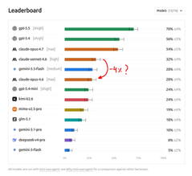


AI Updates
How to contain Claude across products - Anthropic post https://www.anthropic.com/engineering/how-we-contain-claude
How to limit the "blast radius" when Claude makes mistakes across claude.ai, Claude Code, and Claude Cowork
They use layered containment: sandboxed environments, OS-level restrictions, and isolated VMs
Each product is scoped differently:
claude.ai runs in ephemeral server containers
Claude Code uses OS sandboxing with human oversight
Claude Cowork runs full VMs with strict egress controls
They share real security incidents - including a prompt injection that exfiltrated AWS credentials 24 out of 25 times - to illustrate why deterministic environment-level controls matter more than probabilistic model-layer defenses
Key emerging concerns include memory poisoning, multi-agent trust escalation, and agent identity management
DeepSWE AI coding benchmark by data-curve.ai
Designed to mimic real-world usage
Older benchmarks like SWE-bench Pro suffer from data contamination and high grading errors, including a 24% false negative rate
In contrast, DeepSWE uses entirely original, handcrafted challenges across 91 repositories and 5 programming languages
It features concise, behavior-focused prompts that require end-to-end repository exploration
On the DeepSWE leaderboard, GPT-5.5 dominates with a 70% pass rate, outperforming Claude Opus 4.7 by over 15 points
Furthermore, GPT-5.5 proves highly efficient, completing trials in 20 minutes at a cost of $5.80, compared to Opus 4.7 which takes 37 minutes and costs $16.00.
http://www.youtube.com/watch?v=6LwQ8RbU9as

Slide 13
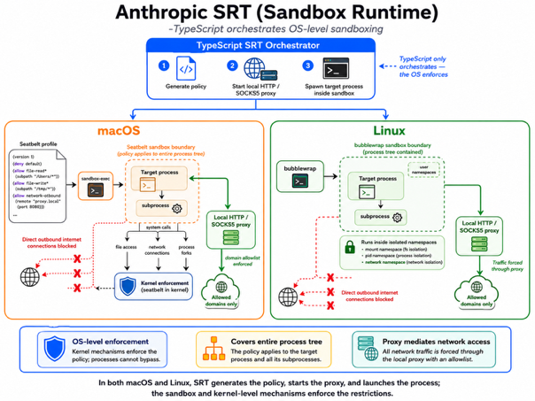
Anthropic's SRT (Sandbox Runtime)
https://github.com/anthropic-experimental/sandbox-runtime
Typescript orchestrates OS-level sandboxing
On MacOS there is a sandbox-exec command line utility that lets you run any process under a strict security policy
TypeScript can invoke it with proper Seatbelt profile (a Scheme-like DSL)
The kernel then intercepts every system call - file access, network connections, process forks - and enforces the policy across the entire process tree, including subprocesses
For network filtering, SRT runs a local HTTP/SOCKS5 proxy. The Seatbelt profile blocks all direct outbound connections; traffic must route through the proxy, which enforces the domain allowlist.
On Linux, SRT uses bubblewrap with user namespaces instead https://github.com/containers/bubblewrap
In both cases, TypeScript's role is purely orchestration: generate the policy, start the proxy, and spawn the target process inside the sandbox.

Slide 14


AI Updates
Microsoft Scout - based on OpenClaw
A new always-on, autonomous AI agent
A first in a new category called "Autopilots"
Scout runs independently around the clock, understanding a user's working style and proactively handling workplace tasks without being prompted
It integrates deeply with Microsoft 365 tools including Teams, Outlook, OneDrive, and SharePoint, automating duties like meeting prep, scheduling conflict resolution, and routine calendar management
Scout operates across cloud, desktop, and web, supports MCP
Currently available as an experimental release exclusively to Microsoft's Frontier early-access customers with a GitHub Copilot subscription required
SpaceX IPO Target $1,750B vs $780B Valuation
SpaceX is targeting $1.75 Trillion IPO to raise $75 Billion
Morningstar Values SpaceX at $780 Bln, 48% Below IPO Target
The firm estimates SpaceX’s launch and Starlink businesses are worth approximately $611 Billion, and $170 Billion to its AI operations
Analyst Nicolas Owens argued that the company has been "significantly overvalued," citing uncertainty around assets such as Grok, the Colossus data center, and unproven orbital data center concepts

Slide 15


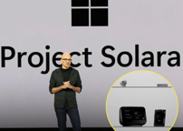

AI Updates
JetBrains Mellum2 12B MoE Open-source Coding Model
Code generation, debugging, reasoning, tool use, agentic workflows
Three variants: base, instruct, thinking
https://huggingface.co/blog/JetBrains/mellum2-launch
Suno raises $400M at $5.4B valuation
AI music startup
Microsoft Project Solara chip-to-cloud platform
Built for "agent-first" enterprise hardware devices to run AI agents
Has a lightweight edge OS called Microsoft Device Ecosystem Platform (MDEP), which is built on AOSP (Android Open Source Project), not Windows
The AOSP choice is interesting. Microsoft is prioritizing a lean, flexible runtime for agent workloads over Windows compatibility, likely for better resource efficiency on edge hardware
5 files to personalize your Claude Code agent
1. CLAUDE.md - style, preferences, behaviours
2. SOUL.md - personality, values, and the underlying philosophy
3. DESIGN.md - your design system (or technical standards)
4. VOICE.md - your brand voice, vocabulary, ...
5. AUDIENCE.md - who you are speaking to

Slide 16


AI Updates
Agent Compiler - Optimized Reusable Paths
"Your AI Agent Is Wasting Time Thinking" - by Sumant Thakur
https://sumantthakur.substack.com/p/the-agent-compiler-is-coming
Core Idea: The Agent Compiler
Current AI agents are essentially "chatbots with tools", they re-reason from scratch every time they encounter a task. This is inefficient
An "agent compiler" would transform an agent's learned experiences and reasoning patterns into optimized, reusable execution paths, so agents stop wasting compute re-thinking things they've already figured out
From: Interpret → execute (current state: reasoning at runtime every time)
To: Compile → execute (distilling learned patterns into faster, cheaper, more reliable execution)
The implication is significant for production AI systems: agents that "compile" their workflows could be dramatically more efficient, consistent, and cost-effective at scale
Rather than burning tokens re-deliberating on solved problems, they'd run pre-optimized paths, making agentic AI less experimental and more industrial-grade
Google DeepMind - Alpha Proof Nexus
AI framework for autonomously solving open math problems
Unlike traditional language models that hallucinate, this system connects frontier AI with Lean, a formal proof assistant that mechanically verifies mathematical reasoning step-by-step
Through a continuous loop of generating code, reading error messages, and adjusting its approach, the system independently solved nine open Erdős problems - including two that remained unsolved for over 56 years - along with 44 open conjectures
Remarkably, these breakthroughs cost only a few hundred dollars in computing power per problem
This milestone proves AI can discover entirely new human knowledge, promising to dramatically accelerate future scientific progress across physics, chemistry, and medicine.
https://www.youtube.com/watch?v=MgiJ5C1pQBg

Slide 17



AI Updates
Unabyss - Context Layer - https://unabyss.com
Converts email, docs, and chat into clean artifacts such as persona, voice, projects, and company knowledge - and shares via MCP
You stay in control with fine-grained privacy and per-tool permissions, so each assistant only sees the context it actually needs
Cybersecurity recruiting is accelerating
Recruiters are urgently seeking leaders who can handle breaches, audit AI-generated code, and secure infrastructure
Cybersecurity job postings rose 11% year over year in Q1
Concerns intensified after models like Anthropic’s Mythos raised fears about AI-assisted vulnerability discovery and hacking
AI for consistent robotic work
Alibaba ships a reasoning model that runs autonomously for 35 hours
Figure robots sort 88,000 packages at JCPenney's warehouse
A research paper teaches models to "sleep" and compress memory like a brain
AI is being engineered for endurance, not just intelligence. Longer context, longer shifts, longer tasks
The race isn't about smarter anymore. It's about sustained

Slide 18


Microsoft Majorana-2 Quantum Chip
Microsoft Majorana-2 Quantum Chip
x1,000 times more reliable than its predecessor - switched from aluminum to lead as a superconductor, which helps shield sensitive qubits from disruptive environmental noise
Microsoft utilized AI agents through their "Microsoft Discovery" platform to accelerate research, analyze decades of data, and identify hidden hardware errors
Estimate a commercially viable quantum computer at 2029
https://www.youtube.com/watch?v=7NN6XbI3-lo
Peter Yang - 5 steps for building self-improving AI skills for Claude
Providing Claude with personal context and specific examples, followed by refining descriptions to ensure reliable triggering
Implementing an evaluation loop that allows the AI to identify and correct its own errors
Incorporating memory so the skill evolves over time and how to build a skill editor for ongoing management
https://www.youtube.com/watch?v=uT3EQPVIEb0

Slide 19
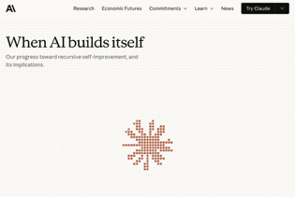
Anthropic "When AI builds itself" paper
Anthropic "When AI builds itself" paper https://www.anthropic.com/institute/recursive-self-improvement
Matthew Berman https://www.youtube.com/watch?v=a56T6OQtwEg
Recursive self-improvement (RSI) in AI development - AI systems are increasingly being used to design and develop their own successors
Human role is transitioning from writing code to prompting, verifying, and setting research direction
The bottleneck shifts from code writing to code verifying
Inside Anthropic, most of the code is written by AI. AI is significantly accelerating the speed at which tasks are completed
Three possible futures: (1) Trend Stalls, (2) Tren continues, but humans remain in the loop for direction and judgment, (3) Full RSI - AI systems autonomously build their own successors, leading to an intelligence explosion
Berman also provides commentary on Anthropic’s "fear-based marketing" strategy, noting that while the company advocates for slowing down the development of frontier AI to ensure safety, their current internal reliance on powerful, unreleased models (like the "Mythos" preview) suggests they are highly motivated to maintain their competitive lead

Slide 20
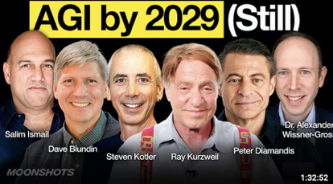
Ray Kurzweil with Peter H. Diamandis on Moonshots
Ray Kurzweil with Peter H. Diamandis on Moonshots
Ray Kurzweil reaffirmed his long-standing prediction of AGI by 2029, citing continued exponential growth in computing and recent advances in large language models
He argues AI already outperforms humans in some domains, including medical diagnosis, and will reach vastly higher intelligence levels by the 2045 singularity
The discussion highlighted debates around AI consciousness and personhood, with no clear scientific definition but growing practical relevance
Kurzweil and others emphasized that education systems are outdated, as AI can teach content while universities primarily provide socialization
Economically, society is unprepared for post-scarcity shifts
Kurzweil ultimately emphasized the transformative power of technology to scale access, turning expensive innovations into universally available tools

Slide 21


Context Chain-of-Thought - Context-CoT
"Context-CoT: Enhancing Context Learning via High-Quality Reasoning Synthesis" - https://arxiv.org/abs/2605.25354
Unlike standard in-context learning, which simply activates existing parametric knowledge, context learning requires models to internalize entirely unfamiliar or contradictory rules provided exclusively within a prompt
Testing reveals that frontier models fail massively on these real-world tasks because teacher LLMs are "lazy," generating flawed, post-hoc rationalizations based on pre-training memory rather than the new rules
Context-CoT solves this by hiding the final answers from teacher models during data synthesis and optimizing step-wise reasoning to minimize cognitive friction for smaller student models
Implementing this approach yields a noticeable performance jump on difficult context benchmarks
https://www.youtube.com/watch?v=9ngD_BKKtek
Huawei Semiconductor "Tau (τ) Scaling"
New chip design - https://www.youtube.com/watch?v=l5RZOy_tqYw
New Metric (Tau Scaling) - instead of focusing on shrinking the physical transistor, Tau scaling optimizes signal travel time "tau" - the time it takes for electrical pulses to move between components
Tau scaling seeks to optimize the "corridors" rather than shrinking the "rooms"
Logic Folding - folding circuit elements vertically in 3D space - placing frequently communicating components next to each other, dramatically slashing travel latency and boosting overall chip efficiency
Huawei was using this approach over the last several years, including Huawei Mate 60 Pro smartphone and their Ascend 910C AI accelerator
The upcoming Kirin chip (expected Autumn 2026) will be the first commercial product to fully deploy the finalized logic folding architecture

Slide 22

LLM Interview Questions
LLM Interview Questions
Fundamentals:
Tokenization and why it matters
Attention mechanisms in transformers
Context windows and their tradeoffs
Embeddings and initialization
Positional encodings
Fine-tuning & Efficiency:
LoRA vs QLoRA
PEFT to prevent catastrophic forgetting
Model distillation
Adaptive Softmax for large vocabularies
Generation & Decoding:
Beam search vs greedy decoding
Temperature, top-k, top-p sampling
Autoregressive vs masked models
Advanced Concepts:
RAG (Retrieval-Augmented Generation)
Chain-of-Thought prompting
Mixture of Experts (MoE)
Knowledge graph integration
Zero-shot and few-shot learning
Math & Theory:
Softmax in attention
Cross-entropy loss
KL divergence
Gradient computation for embeddings
Vanishing gradient solutions in transformers

Slide 23
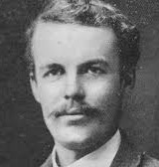
"The AI Layoff Trap" Paper
"The AI Layoff Trap" Paper - https://arxiv.org/abs/2603.20617
The paper argues that rational firms can get trapped in an automation arms race that displaces workers beyond what is collectively optimal, ultimately harming both workers and firm owners by eroding consumer demand
It also concludes that only a Pigouvian automation tax (rather than UBI, upskilling, or capital taxes) can effectively correct this market failure
A Pigouvian tax (named after early 20th-century economist Arthur Pigou) is a tax levied on any market activity that generates negative externalities - costs borne by third parties not involved in the transaction
The canonical example is a carbon tax: a firm burning fossil fuels imposes climate costs on society, so the tax forces the firm to "internalize" those societal costs, making its private costs align with the true social costs.
Arthur Cecil Pigou
(1877-1959)
An automation tax would charge firms per worker displaced by AI or robotics, thus forcing companies to weigh the full social cost of automation, not just the private cost comparison between human wages and AI subscriptions
The paper argues other commonly proposed remedies fall short:
UBI — redistributes after the damage is done, doesn't change firm incentives
Upskilling/retraining — too slow relative to the pace of AI displacement
Capital gains taxes — target profits broadly, not the specific externality

Slide 24
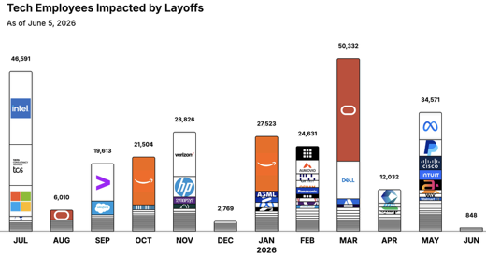
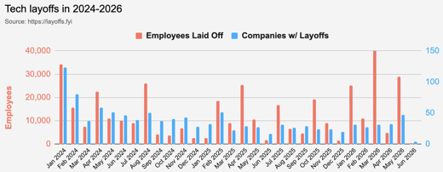
https://layoffs.fyi
https://trueup.io/layoffs
Jobs
The Tech Layoff Tracker
In 2026: 149,937 people laid off (961 per day)
In 2025: 245,953 people laid off (674 per day)
In 2024: 238,461 people laid off (653 per day)
https://trueup.io/layoffs
A top economist says there's "zero evidence" AI is killing jobs, despite thousands of actual layoffs
https://www.techspot.com/news/112607-apollo-economist-there-zero-evidence-ai-taking-jobs.html
Tech Layoffs by year (US only):
117K in 2026 (as of June 5, 2026)
124K in 2025
153K in 2024
264K in 2023
165K in 2022 https://layoffs.fyi

Slide 25


About the Speaker
Lev Selector, Ph.D.
40+ years of software engineering, data science, and building teams (hiring, training, and managing)
Ph.D. in mathematical modeling and computer simulations
Interests:
Generative AI, Using LLM with your data
Local AI for Local Private Data
Cloud architecture, fin-tech, application security
Find/connect: Linkedin, GitHub, YouTube, Google
https://eais.ai
Enterprise AI Systems

Slide 26
Thank You!

