Slide 1
AI Updates - November 28, 2025
xxx
Crowd-sourced "LM Arena" Leaderboard
Anthropic Claude Opus 4.5
NotebookLM - Infographics & Slide Decks
Ilya Sutskever on the Age of Research
Abacus AI DeepAgent upgrade
GPT-5.1-Codex-Max
GPT-5.1 Pro
Meta SAM-3 Segment Anything Model 3
OpenAI Shopping Research in ChatGPT
Transformer Architecture Under Question
Łukasz Kaiser about GPT-5.1 & the AI Frontier
Marimo instead of Jupyter
Decart.AI Real-time Video Transformation
Peter H. Diamandis - AI Roundtable
LingGuang's Viral Success
Greptile: AI Self-Healing Code Review Agent
Suno AI Music Raises $250M
OpenAI group chat feature
Lovable hits $200M ARR
Federated Learning
Google's Willow quantum processor
RAG without vectors
Kimi K2 Thinking in Perplexity
Zoer: NEW Agentic AI Full-Stack Engineer
Creating AI Videos - 6 methods
xxx
Jobs, Layoffs, demand for AI Engineers

Slide 2
Crowd-sourced "LM Arena" Leaderboard
Data for November 26
Starting Elo rating = 1000
https://en.wikipedia.org/wiki/Elo_rating_system
English - https://lmarena.ai/leaderboard/text
Coding - https://lmarena.ai/leaderboard/text/coding
Model | Score
gemini-3-pro | 1492
grok-4.1-thinking | 1482
claude-opus-4-5-20251101 | 1466
grok-4.1 | 1464
gpt-5.1-high | 1461
claude-opus-4-5-20251101-thinking-32k | 1460
gemini-2.5-pro | 1452
claude-sonnet-4-5-20250929-thinking-32k | 1448
claude-opus-4-1-20250805-thinking-16k | 1448
claude-sonnet-4-5-20250929 | 1445
gpt-4.5-preview-2025-02-27 | 1442
claude-opus-4-1-20250805 | 1441
chatgpt-4o-latest-20250326 | 1438
gpt-5-high | 1437
gpt-5.1 | 1437
o3-2025-04-16 | 1434
qwen3-max-preview | 1433
kimi-k2-thinking-turbo | 1431
glm-4.6 | 1426
gpt-5-chat | 1425
deepseek-v3.2-exp | 1424
qwen3-max-2025-09-23 | 1423
claude-opus-4-20250514-thinking-16k | 1423
grok-4-1-fast-reasoning | 1422
Model | Score
claude-opus-4-5-20251101-thinking-32k | 1535
gemini-3-pro | 1526
claude-sonnet-4-5-20250929-thinking-32k | 1525
claude-opus-4-1-20250805-thinking-16k | 1515
grok-4.1-thinking | 1511
claude-opus-4-5-20251101 | 1509
claude-sonnet-4-5-20250929 | 1504
claude-opus-4-1-20250805 | 1501
gpt-5.1-high | 1495
claude-opus-4-20250514-thinking-16k | 1495
grok-4.1 | 1494
gpt-5.1 | 1490
qwen3-max-preview | 1481
kimi-k2-thinking-turbo | 1479
claude-haiku-4-5-20251001 | 1478
qwen3-max-2025-09-23 | 1474
longcat-flash-chat | 1474
qwen3-235b-a22b-instruct-2507 | 1472
deepseek-v3.2-exp | 1472
deepseek-v3.2-exp-thinking | 1471
gemini-2.5-pro | 1471
gpt-5-high | 1470
claude-sonnet-4-20250514-thinking-32k | 1469
kimi-k2-0905-preview | 1467
x.ai
x.ai
x.ai
https://lmarena.ai/leaderboard/text
Design Arena -
https://www.designarena.ai
https://openlm.ai/chatbot-arena/
https://beta.lmarena.ai
Web Leaderboard -
https://web.lmarena.ai/leaderboard
LLM Leaderboard - by @LlmStats -
https://llmworld.net/llm_leaderboards/
LLM Leaderboard - by StackAI -
https://www.stack-ai.com/llm-leaderboard
LLM Leaderboard - by Artificial Analysis -
https://artificialanalysis.ai/leaderboards/models
Open LLM Leaderboard - by Hugging Face -
https://huggingface.co/open-llm-leaderboard
LLM Leaderboard - by Vellum -
https://www.vellum.ai/llm-leaderboard
AI Benchmarking Hub -
https://epoch.ai/data/ai-benchmarking-dashboard
Grok 4 Benchmarks -
https://artificialanalysis.ai/models/grok-4
x.ai
China
China
China
China
China
China
China
China
China
China
China
China
x.ai
China

Slide 3

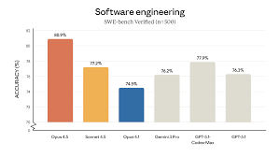
Anthropic Claude Opus 4.5
Anthropic released Claude Opus 4.5
https://www.youtube.com/watch?v=VhuUcVhwqi8
https://www.anthropic.com/news/claude-opus-4-5
80.9% on SWE-bench Verified. Compare:
OpenAI's GPT-5.1-Codex-Max (77.9%)
Anthropic Sonnet 4.5 (77.2%)
Google's Gemini 3 Pro (76.2%)
59.3% on Terminal-bench 2.0 - compare 54.2% Gemini 3 Pro
Gemini 3 Pro still leads in: GPQA Diamond, MMLU, ARC-AGI
Opus 4.5 scored higher than human candidates on hiring exam
The model is using approx 2x less tokens than Sonnet while achieving higher accuracy.
Pricing: $5/$25 (in/out per 1M tokens). This is 50-100% more expensive than Gemini 3 Pro ($2/$12 for standard usage, $4/$18 for contexts over 200K tokens) but represents a 67% reduction from the previous Opus model
Addressing context window consumption by MCP tool definitions:
Tool Search Tool - Allows Claude to search for needed tools rather than loading all tools into context, reducing usage from 40% to just 5% of the context window
Programmatic tool executing in safe environments to minimize context impact
Tool use examples - standardized demonstrations for effective tool usage
Early users calling the model the "best coding model"

Slide 4
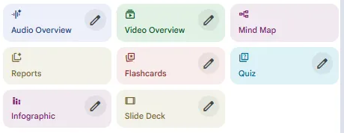
NotebookLM - Infographics & Slide Decks
Google Notebook LM New Visual Features: Infographics & Slide Decks
https://www.youtube.com/watch?v=63XNYlMrlJY
Infographics - powered by Nano Banana Pro, transforms documents into visual summaries with charts, diagrams, and relationship maps. Connected to Google's knowledge base, it ensures context-aware accuracy. Use cases include research summaries, concept relationships, and shareable infographics.
Slide Decks - converts research into full presentation decks with customizable content based on audience (beginners, executives, technical experts). The AI auto-generates diagrams, icons, and backgrounds, with PDF export capabilities.
Key benefits: Speed (create presentation in minutes vs. hours) and Quality
Prompt Tips: Be specific about structure (number of slides, content types); Define your audience clearly; Request specific visual elements (icons, layouts, metrics)
NotebookLM now bridges research, visualization, and presentation - saving hours of manual work while maintaining professional quality.

Slide 5
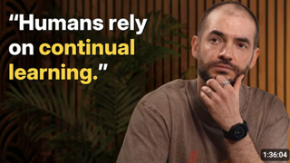
Ilya Sutskever on the Age of Research
Ilya Sutskever on the Age of Research
https://www.youtube.com/watch?v=aR20FWCCjAs
The Eval-Reality Gap - why models ace benchmarks but show limited real-world impact.
Ilya's explanation: RL training has become too focused on specific evals. He compares it to a student who practices 10,000 hours of competitive programming versus one with natural aptitude who practices 100. The latter generalizes better.
From Scaling to Research:
We've transitioned from the "age of scaling" (2020-2025) back to an "age of research." Pre-training data is becoming finite, and there are now "more companies than ideas by quite a bit." New breakthroughs require genuine research, not just bigger computers.
The Generalization Problem:
The core challenge: models generalize dramatically worse than humans. A child learns to drive in 10 hours with far less data than any model, yet rarely makes AI-like errors. Sutskever believes humans have "better machine learning, period" - evidenced by our ability to excel at math and coding, domains too recent for evolutionary priors. He declines specifics, citing competitive concerns.
Emotions as Value Functions: Sutskever discusses someone who lost emotional processing due to brain damage - remaining cognitively functional but unable to make simple decisions. This suggests emotions serve as evolution-tuned value functions, mysteriously encoding high-level social desires into our genes.
SSI's Vision: Safe Superintelligence Inc. is an "age of research company" pursuing different technical approaches around generalization.
Sutskever's vision for superintelligence: not a finished omniscient mind, but a system with human-like learning efficiency deployed to learn on the job—instances specializing across the economy, merging learnings.
Alignment - As AI becomes visibly powerful, Sutskever predicts companies will naturally converge on safety. He advocates for AI that "cares about sentient life" broadly. His reluctant long-term solution: humans becoming "part-AI" through neural interfaces to remain genuine participants.
He estimates 5-20 years to human-like learning systems.
Sutskever describes seeking "beauty, simplicity, elegance, correct inspiration from the brain" - simultaneously. This aesthetic provides the "top-down belief" that sustains you through failed experiments.

Slide 6
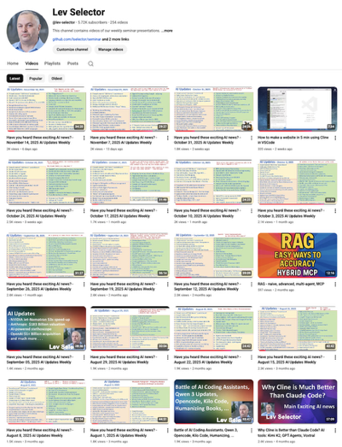
We do these weekly videos every Friday
Stats: 5.76K subscribers, 255 videos
Subscribe to this channel
https://www.youtube.com/@lev-selector
Download slides from GitHub using links under the videos
Please pause the video - and answer the pinned question in comments under the video

Slide 7
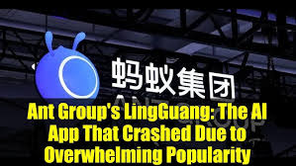
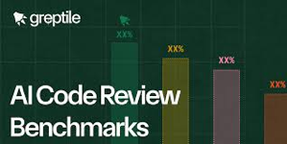
LingGuang's Viral Success
LingGuang - Ant Group's multimodal AI assistant from China
https://www.youtube.com/watch?v=ocjhUqO428Q
2 Mln downloads in 6 days, beating ChatGPT and Sora's early adoption rates
The app's "Flash Program" feature generates working mini-apps in 30 seconds from simple prompts
LingGuang delivers code-driven outputs including 3D models, animations, interactive charts, and maps rather than just text
Its "AGI Camera" provides real-time scene understanding and instant visual analysis.
The app is now available globally at linguang.com (actually the site is not reachable at the moment)
Greptile: AI Self-Healing Code Review Agent
https://www.youtube.com/watch?v=tlZNo3g0urY
Greptile is an AI coding agent that reviews pull requests with complete codebase context by building a detailed graph of all functions, classes, files, and their relationships. Unlike traditional tools that only analyze code diffs, it understands how changes affect the entire system
The tool automatically catches critical bugs like SQL injection, XSS vulnerabilities, and memory leaks while providing confidence scores (1-5) to indicate merge safety. It integrates with GitHub and GitLab, learns your team's coding practices from PR comments and reactions, and generates PR summaries with sequence diagrams. Teams can chat with their repository for code understanding and add custom rules for context-specific reviews
Greptile helps teams merge PRs up to 4X faster and catch 3X more bugs, supporting 30+ programming languages with SOC2 compliance
https://www.greptile.com/what-is-ai-code-review
https://www.greptile.com
https://www.greptile.com/docs/code-review-bot/key-features

Slide 8
AI Updates - 1
Suno AI Music Raises $250M
Suno closed a $250M Series C led by Menlo Ventures, valuing the company at $2.45B. The funding will advance tools for music pros and casual creators. Suno plans to boost social features that let people connect through music. The company says it’s building a community where creators and listeners participate together.
OpenAI group chat feature
Up to 20 users can simultaneously collaborate with each other and with ChatGPT in the same thread
Shared chats are accessed through invite links, with ChatGPT gauging conversation flow and interjecting when appropriate or directly mentioned
Rate limits apply to AI responses rather than human messages
The usage counting against the user who triggered the model reply
Privacy features isolate group sessions from individual memory
ChatGPT doesn't retain info from collaborative threads or applying personal context
Lovable hits $200M ARR
Swedish AI coding startup Lovable doubled its annual recurring revenue to $200 million in four months. CEO Anton Osika credits the company's European base for its rapid growth, defying advice to

Slide 9
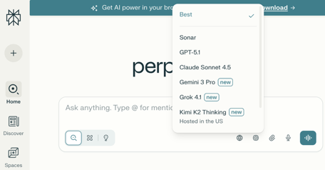
AI Updates - 2
Federated Learning
- Instead of aggregating data on a central server, dispatch a model to an end device.
- Train the model on the user’s private data on their device.
- Fetch the trained model back to the central server.
- Aggregate all models obtained from all end devices to form a complete model.
https://x.com/_avichawla/status/1991393941493805096
https://www.youtube.com/watch?v=zqv1eELa7fs - tutorial
Google's Willow quantum processor
achieved the seemingly impossible: solving an extraordinarily complex computational problem in under five minutes—a feat that would require the world's most advanced supercomputer approximately 10 septillion years to complete (10²⁵).
https://x.com/Rainmaker1973/status/1991186630133125405
RAG without vectors
https://teletype.in/@mrvladd/W5E88Tzx1dv
AI model for medical imaging
from UC Berkeley and UCSF
https://cdss.berkeley.edu/news/uc-berkeley-and-ucsf-researchers-release-top-performing-ai-model-medical-imaging
Kimi K2 Thinking in Perplexity

Slide 10

AI Updates - 3
Zor (Zoer) - a full‑stack AI engineer
Generate complete, production‑ready web apps end‑to‑end from a natural‑language prompt.​
Combining the roles of Lovable, Supabase, Netlify, and AI image services into a single environment that designs, wires, deploys, and hosts full applications.​
https://www.youtube.com/watch?v=mJxCdZB4RRY
Creating AI Videos - 6 methods
https://www.youtube.com/watch?v=utnLVMzxX4U
Text to Video - Describe setting, characters, and action sequences.
Tools: Google Veo 3.1 (excellent for dialogue), Sora 2 (realistic), Clean 2.5.
Image to Video - Starts with reference images for consistent characters and styles. Supports time-stamped prompting and start/end frame controls. Tools: Google Veo 3.1, Clean 2.5 Turbo, Cling AI, Nano Banana.
Video to Video - Converts real footage into AI characters while preserving motion and dialogue. High control but potentially unstable backgrounds. Tools: One Animate, Luma Labs.
Lip Sync - Animates AI avatars from audio files with realistic expressions and gestures. Tools: Hun's Avatar 4, Dreamina's Omnihuman 1.5.
Ingredients to Video - Combines multiple images (characters, backgrounds) into one scene. Quick but less dynamic. Best do image generators first.
Chat to Edit - Modifies existing videos (weather, lighting, object removal). Tool: Runway ML
Key Tradeoffs: Text/image-to-video offers consistency; video-to-video provides control; ingredients-to-video is fast but stilted; editing can be inconsistent

Slide 11
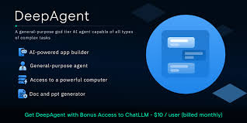
Abacus AI DeepAgent upgrade
Abacus AI DeepAgent upgrade
Autonomously building complete web services in minutes
Handles every aspect of production including API contracts, schemas, business logic, third-party integrations like Stripe, deployment pipelines, logging, observability, versioning, and error handling
Development went from 6 months, $100K-s and full dev teams to 30 min prototyping. Some implementations completed in just 10 minutes
Deep Agent operates as a comprehensive back-end engineer, managing API design, logic wiring, integration setup, workflow construction, deployment, and maintenance while debugging and testing in real time through a virtual computer environment
The platform enables practical applications across multiple domains. It can deploy stock insights APIs with live data feeds, create Telegram chatbots featuring long-term memory and persistent context, build invoice extraction systems that learn structure from examples, generate sentiment analysis endpoints for unstructured text processing, and develop resume review systems with integrated feedback mechanisms
This advancement represents a fundamental shift from traditional coding assistants to autonomous systems that build, test, and maintain complete infrastructures end-to-end
Future development directions include expansion into physical systems control through embodied intelligence, self-improving platforms, and community-driven innovation through weekly build challenges with prizes for top projects
The technology leverages leading LLM capabilities including Gemini 3 to deliver production-quality infrastructure and automated workflows.
https://deepagent.abacus.ai

Slide 12
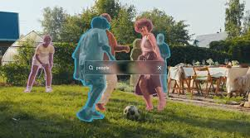
AI Updates - 4
GPT-5.1-Codex-Max
Trained to operate across multiple context windows through "compaction", allowing it to work over millions of tokens and complete tasks spanning 24+ hours.
The model achieves 77.9% on SWE-bench Verified while using 30% fewer thinking tokens than its predecessor.
GPT-5.1 Pro is a slow, heavy-weight reasoning model
It can handle tough problems, follows instructions well without going off the rails, making it feel like a contract engineer working from a spec rather than an assistant. It lives in ChatGPT.
Gemini 3 is still better for most day-to-day work. However, GPT-5.1-Pro wins in deep thought, planning, and research.
Meta SAM-3 Segment Anything Model 3
Unified Detection, Segmentation & Tracking
both images and videos
Open Source, 848 Mln params
Reaching 75-80% of human-level performance
It processes images at approximately 30ms per frame on an H200 GPU while handling 100+ objects
SAM-3 is a foundation model designed for open-vocabulary, promptable segmentation. It can segment any concept described by text prompts, image examples, points, boxes, or masks without prior training on those specific categories. For example, you can ask it to find "yellow school bus" or "person wearing red hat". In contrast, YOLO models are optimized for real-time object detection and segmentation on predefined categories that the model was trained on.
https://github.com/facebookresearch/sam3

Slide 13
AI Updates - 5
OpenAI Shopping Research in ChatGPT
Does the research to help you find the right products
Transformer Architecture Under Question
https://www.youtube.com/watch?v=DtePicx_kFY
Llion Jones, co-author of the foundational "Attention Is All You Need" paper, argues the AI industry is suffering from "success capture"—trapped in a local minimum where everyone tweaks transformers rather than discovering fundamentally new architectures
Models are "faking" intelligence by mimicking patterns without genuine conceptual understanding
Continuous Thought Machines (CTM, Sakana AI):)
  Sequential internal thought dimension - races paths sequentially rather than instantly predicting the entire solution
  Biology-inspired neuron models - rather than simple on/off units, each neuron functions as a small dynamic model
  Synchronization-based representation - thoughts are captured through how neurons synchronize over time
CTM naturally exhibits adaptive computation—spending more time on harder problems and allowing genuine backtracking and error correction
https://sakana.ai/ai-scientist/
Sakana AI is in Tokyo, Japan, since 2023

Slide 14

AI Updates - 5
Łukasz Kaiser about GPT-5.1 & the AI Frontier
https://www.youtube.com/watch?v=3K-R4yVjJfU
Łukasz Kaiser, transformer co-author and OpenAI research scientist
Progress follows a smooth exponential curve from inside labs
Reasoning models now deliver greater capability gains than pre-training for the same cost
Reasoning models generate internal "chain of thought" tokens before answering, trained via reinforcement learning on verifiable domains like math and coding
Kaiser identifies substantial improvement opportunities in infrastructure, data quality, and especially multimodal capabilities
"jagged" abilities - frontier models fail simple visual reasoning tasks that five-year-olds solve instantly
Economic pressures from serving billions of users shifted focus from maximally large models to efficient distillation, transferring knowledge from large to small models
Kaiser emphasizes generalization as AI's central unsolved question: whether reasoning alone enables human-like learning, or if fundamentally different architectures are needed
He advocates solving current limitations before determining if architectural breakthroughs are necessary

Slide 15

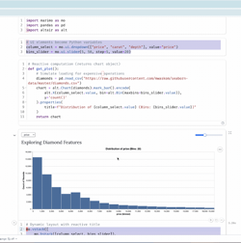
Marimo instead of Jupyter
Marimo Python notebook system
open-source, better than Jupyter
uses reactive execution, so code cells automatically re-run when any dependency changes
Notebooks are stored as standard .py files - so you can run them as scripts and reuse as modules
Marimo ships with interactive widgets, tight SQL integration (like DuckDB), and allows sharing notebooks as web apps via HTML or the CLI
The editor offers features like autocomplete, Vim keybindings, code formatting, and a VS Code extension
Workflows involve managing reproducible dependencies and sharing or running notebooks flexibly
Compared to Jupyter, Marimo is more Git-friendly, automatically reactive, includes built-in interactivity, and offers enhanced developer tools and environment management
https://marimo.io
https://github.com/marimo-team/marimo
pip install marimo
marimo tutorial intro

Slide 16
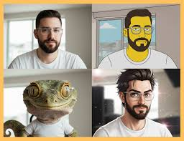
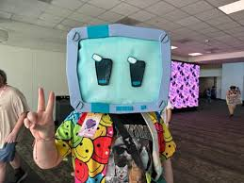
Decart.AI Real-time Video Transformation
Decart.ai - Real-time AI Video Transformation
https://www.youtube.com/watch?v=xAICmrzPJjA
https://docs.platform.decart.ai/getting-started/pricing
https://decart.ai - https://decart.ai/api-platform
Decart.ai offers free-tier access to real-time AI video transformation capabilities including three core models
Mirage LSD enables instant style transfers and reskinning through presets and custom prompts, transforming appearances into various characters like pirates, anime figures, or Van Gogh paintings.
LucyEdit Live adds, removes, or modifies video elements such as virtual overlays.
LipSync Live provides real-time AI-driven lip synchronization for virtual characters.
The platform operates through a web interface with zero-latency autoregressive video models accessible via API
Free users receive 1,000 credits allowing approximately 8 minutes of live video processing
The service supports VR reskinning and live-stream integration for dynamic transformations during streaming sessions
Alternative tools like Runway ACT2, Google Nano Banana, and ElevenLabs voice changer offer higher-fidelity asynchronous processing for pre-recorded content
The technology raises ethical concerns regarding deepfakes, impersonation, and misinformation risks while simultaneously opening creative possibilities for filmmakers, streamers, and virtual creators
Future developments may integrate with robotics and agent-driven AI systems, as referenced by Google's SEMA 2 model for agent gameplay, balancing innovation with risks of scams and misinformation

Slide 17

AI Roundtable
Peter H. Diamandis - AI Roundtable
https://www.youtube.com/watch?v=r8RGYw1n-5k
Google's Gemini 3 - strong multimodal reasoning, generative UIs, and agentic features; SOTA benchmark scores on tests like Humanity's Last Exam and ARC-AGI2, PhD-level problem-solving in math, science, and engineering. In the competitive race with OpenAI's GPT-5 and xAI's Grok 4.1, Gemini 3 currently leads
On practical benchmarks like VendingBench, where AI agents simulate running a vending business, Gemini 3 far outperforms competitors, delivering roughly 30 times more profit and illustrating potential for AI as autonomous economic actors
Improved voice interfaces in Gemini Live, real-time translation for AR glasses, and agentic shopping where AI calls stores to check inventory and prices, effectively indexing the physical world.
Development tools like Cursor and Google's Anti-gravity environment enable fully agentic coding where developers specify features and AI handles implementation.
Safety concerns center on biosecurity, with OpenAI-backed Red Queen Bio developing defensive systems
The hosts advocating for pervasive biosensing infrastructure, though this raises privacy tensions
Jeff Bezos's $6.2 billion Prometheus project targets industrial AI for engineering and manufacturing, representing a pivot toward applying superintelligence to domain-specific problems
The hosts argue intelligence costs are deflating 40 times annually, potentially driving abundance in housing, transport, food, and healthcare

Slide 18
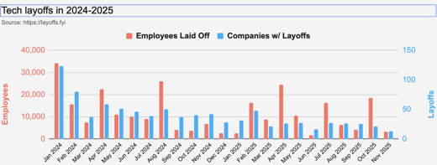
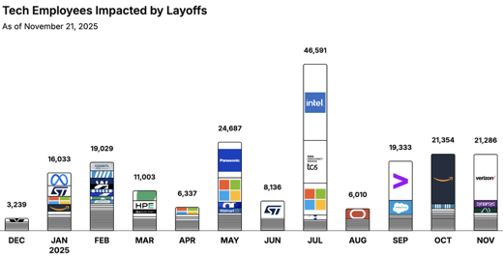
Jobs
https://layoffs.fyi
https://trueup.io/layoffs
Tech Layoffs by year (US only):
  113K in 2025 (as of November 21)
  153K in 2024
  264K in 2023
  165K in 2022 https://layoffs.fyi
The Tech Layoff Tracker
So far in 2025, 199,799 people laid off (615 per day)
In 2024, 238,461 people laid off (653 per day)
https://trueup.io/layoffs

Slide 19


About the Speaker
Lev Selector, Ph.D.
40+ years of software engineering, data science, and building teams (hiring, training, and managing)
Ph.D. in mathematical modeling and computer simulations
Interests:
Generative AI, Using LLM with your data
Local AI for Local Private Data
Cloud architecture, fin-tech, application security
Find/connect: Linkedin, GitHub, YouTube, Google
https://eais.ai
Enterprise AI Systems

Slide 20
Thank You!

