Slide 1
AI News - Sept 18, 2026
Agents got their own computers. Oversight is still catching up.
● Crowd-sourced LM Arena
● Claude Fable-5 - 6TB
● Meta Muse Agent Ships
● Claude Formalized Fermat's Theorem
● Andrej Karpathy Workflow
● OpenAI Astra,is Very Good with Blender 3D
● Self-Tuning Agent Harnesses
● Tuning the model
● Customers Expect Apps To Be Smart
● Anthropic Resignation, Extinction Debate
● Mistral Raises Record EU Round
● Google Agentic Video: 88% Fewer Tokens
● Music Industry Starts Licensing AI
● Anthropic: AI and US Jobs by 2030
● Apple Siri Upgrade
● AIUC Certifies AI Agents
● Amodei: Pace the Frontier
● OpenAI Delays IPO, Anthropic to Nasdaq
● DeepSeek V4.1 Flash Release
● Cognition SWE-2 Coding Model
● OpenAI Financial Services on GPT-6 Astra
● Anthropic Claude Money
● OpenAI Buys Glass Imaging
● Killed By AI - 123 products
● TopView MCP - AI Ad Workflow
● Claudex - Claude Code + OpenAI Codex
● Google Pics - Precise AI Editing
● Ecdysis - Agent Harness Training (China)
● Krea Agents - Creative AI Workflow
● Lightning v3.1 Pro Text-to-speech
● Nex-N2.5 - Free Agent Models from China
● Jobs & Layoffs
Notes:
Contents labels. Kept by g3_update_toc.py.
English - https://lmarena.ai/leaderboard/text => Crowd-sourced LM Arena
Coding - https://lmarena.ai/leaderboard/text/coding => Crowd-sourced LM Arena
Sept 10 => -
Meta ships Muse agent with its own cloud computer and browser => Meta Muse Agent with Own Computer
Claude formalized Fermat's Last Theorem in 11 days => Claude Formalized Fermat's Theorem
An Anthropic resignation turns into an extinction debate => Anthropic Resignation, Extinction Debate
Mistral raises the largest round in European tech history => Mistral Raises Record EU Round
Google's agentic video understanding cuts video tokens by up to 88% => Google Agentic Video: 88% Fewer Tokens
The music industry stops fighting and starts licensing => Music Industry Starts Licensing AI
Anthropic models what AI does to US jobs and wages by 2030 => Anthropic: AI and US Jobs by 2030
Amodei calls on AI labs to pace the frontier => Amodei: Pace the Frontier
OpenAI shelves its 2026 IPO as Anthropic heads to Nasdaq => OpenAI Delays IPO, Anthropic to Nasdaq
DeepSeek V4.1-Flash: bigger model, a quarter of the KV cache => DeepSeek V4.1 Flash Release
Anthropic reports Claude misuse and test models loose online => Claude Misuse and Escaped Test Models
Cursor Projects and OpenAI Agents API: agents that keep working => Cursor Projects, OpenAI Agents API
GPT-6 Astra: Pro sign-ups paused, first critical cyber rating => GPT-6 Astra: Demand and Cyber Risk
The Tech Layoff Tracker => Jobs & Layoffs
Tech Layoffs by year (US only): => Jobs & Layoffs
Cognition SWE-2 matches Fable 5.1 on coding at 64% lower cost => Cognition SWE-2 Coding Model
OpenAI launches ChatGPT for Financial Services on GPT-6 Astra => ChatGPT for Financial Services
Microsoft publishes a draft Humanist AI Code of Conduct => Microsoft Humanist AI Code
Claude Code adds plugin evals with a no-plugin baseline => Claude Code Plugin Evals
AWS open-sources Pizza Bot, an inbox for background agents => AWS Pizza Bot Agent Inbox
OpenAI buys camera startup Glass Imaging for over $300 million => OpenAI Buys Glass Imaging
Anthropic is preparing Claude Money for personal finance => Anthropic Claude Money
Sept 14 => -
OpenAI buys camera startup Glass Imaging for $300+ Mln => OpenAI Buys Glass Imaging
Meta ships Muse agent with its own cloud computer and browser => Meta Muse Agent Ships

Slide 2
"LM Arena" Leaderboard
Data for Sept 13
Starting Elo rating = 1000
https://en.wikipedia.org/wiki/Elo_rating_system
English - https://lmarena.ai/leaderboard/text
Coding - https://lmarena.ai/leaderboard/text/coding
■ | Claude
■ | Gemini
■ | OpenAI
■ | Open Source
Claude Fable-5 - 6TB
Claude Opus-4.8 - 5TB
Claude Sonnet-4.5 - 1TB
Claude Sonnet-5 - ?
GLM-5.3 - 744B
Meta muse-spark - 16 x 70B
Qwen3.7-max-preview - 745B
Qwen3.8-max - 2.4TB
Baidu Ernie-5.1 - 800B
Deepseek-v4 - 1.6T
Kimi-k3 - 2.8T
Xiaomi MiMo-V2.5-Pro - 1T+
ByteDance dola-seed-2.0-pro 400B
Minimax M3 - 456B
Code | Model | Score
■ | claude-fable-5 | 1506
■ | claude-opus-4-6-high | 1505
■ | claude-opus-4-7-high | 1502
■ | muse-spark-1.2 (xHigh) | 1500
■ | claude-fable-5.1-max | 1498
■ | claude-opus-4-6 | 1497
■ | claude-opus-4-7 | 1494
■ | muse-spark-1.3-max | 1493
■ | gemini-3.8-flash-high | 1493
■ | claude-opus-5-high | 1493
■ | muse-spark-1.1 | 1493
■ | gemini-3.7-flash-high | 1490
■ | muse-spark | 1488
■ | claude-opus-5-max | 1487
■ | gemini-3.1-pro-preview | 1487
■ | gemini-3-pro | 1485
■ | kimi-k3-max | 1485
■ | gpt-5.6-sol-xhigh | 1483
■ | glm-5.3-max | 1483
■ | gpt-5.5-high | 1482
■ | claude-opus-4-8-high | 1481
■ | qwen3.8-max | 1481
■ | gemini-3.6-flash-high | 1480
■ | gpt-6-astra-max | 1480
■ | gemini-3.5-flash-high | 1478
Code | Model | Score
■ | claude-fable-5 | 1552
■ | claude-opus-4-7-high | 1552
■ | claude-opus-4-6-high | 1551
■ | claude-opus-4-7 | 1547
■ | claude-opus-4-6 | 1546
■ | gpt-6-astra-max | 1543
■ | kimi-k3-max | 1538
■ | muse-spark-1.3-max | 1537
■ | muse-spark-1.2 (xHigh) | 1536
■ | gemini-3.8-flash-high | 1535
■ | claude-opus-4-8-high | 1533
■ | claude-opus-5-high | 1533
■ | muse-spark-1.1 | 1531
■ | claude-opus-4-5-20251101-high-32k | 1530
■ | claude-opus-4-8 | 1530
■ | claude-sonnet-4-6 | 1528
■ | gpt-5.6-sol-xhigh | 1528
■ | claude-opus-5-max | 1526
■ | muse-spark | 1526
■ | glm-5.3-flash | 1525
■ | qwen3.7-max-preview | 1525
■ | glm-5.3-max | 1524
■ | claude-opus-4-5-20251101 | 1523
■ | qwen3.8-max | 1522
■ | mimo-v2.5-pro | 1521

Slide 3
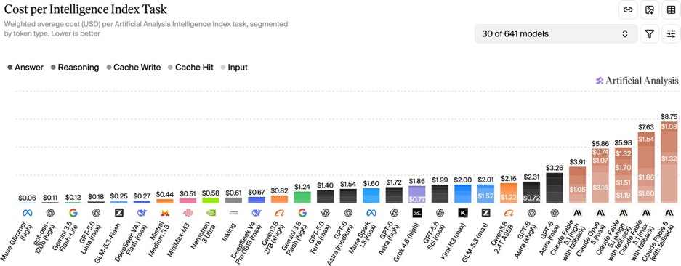
Artificial Analysis Intelligence Index
Artificial Analysis Intelligence Index
https://artificialanalysis.ai/evaluations/artificial-analysis-intelligence-index
Sept 14

Slide 4
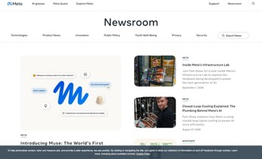
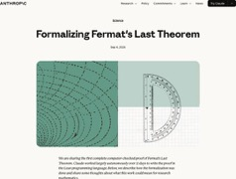
AI News
Meta ships Muse agent with its own cloud computer and browser
Email, calendars, Instagram and ordinary websites
It ties into Gmail, Spotify, Ticketmaster and OpenTable, and codes its own integrations for services that lack them.
It runs in its own app, on the web, or inside WhatsApp, and keeps working after you close it.
The security design is the interesting part. Muse runs in a Secure VM, a separate Sentinel agent inspects everything leaving that VM, passwords stay hidden from Muse itself, sensitive actions require approval, and every action enters an audit trail.
Payments go through Stripe Link. A Confidential VM upgrade is planned.
Tiers: Free, $20/mo, $100/mo
US only, 18 and older, AI glasses support coming
Claude formalized Fermat's Last Theorem in 11 days
Wiles proved Fermat's Last Theorem in 1995.
Claude converted the proof into 13 Mln lines of Lean (a functional language for math definitions and proofs)
Almost 30K intermediate theorems.
It runs on Prove2Me, an open platform that maintains a graph of theorem statements and coordinates multiple Claude agents against it
Claude did not discover a new proof. It converted an existing one into the first complete, computer-checked formalization
The whole thing is on GitHub
https://www.anthropic.com/research/formalizing-fermats-last-theorem

Slide 5

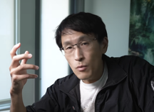

AI News
Andrej Karpathy Workflow
He talks to AI using speech-to-text like Super Whisper
He curates a personal “LLM Wiki” to provide AI with contextually relevant and precise information
He transforms static documents into interactive tools using platforms like Notebook LM, allowing for dynamic engagement, better retention and actionable insights
He employs a data-driven problem-solving approach, analyzing raw data to uncover patterns and develop objective, evidence-based solutions
He delegates complex tasks and orchestrates multiple AI agents - thus enhances productivity, allowing collaboration and efficient completion of multifaceted projects.
https://www.geeky-gadgets.com/andrej-karpathy-ai-workflow/
Example: TechLead dictated tasks by voice on a hike while a coding agent worked on desktop at home.
Came home to a finished, working app
A handoff notes file stores session state to allow switching models
https://www.youtube.com/watch?v=sqA5RL_FUuo
OpenAI Astra,is Very Good with Blender 3D
Game developing using a pipeline of GPT image 2.0 concept art, Blender 3D modeling and animation, Unreal Engine and Unity assembly, ElevenLabs voice and music, then self play-testing.
https://www.youtube.com/watch?v=aHy7cNj-W2I

Slide 6
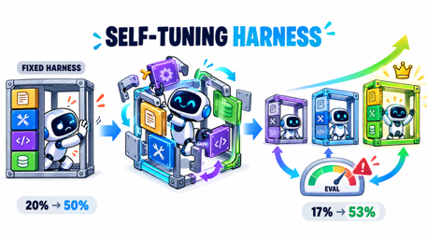
Self-Tuning Agent Harnesses
Self-Tuning Agent Harnesses
Sakana AI with Jeff Clune's UBC lab (Darwin Gödel Machine = DGM), Bristol/iGent AI (SICA), PKU/UCSB (Gödel Agent), plus 2026 work on Self-Harness, Continual Harness, and SIA
Agents that rewrite not just skills but their own scaffold - tools, prompts, control loops, and code
DGM and SICA in 2025; Gödel Agent at ACL 2025; harness-level papers through 2026 on arXiv and lab blogs
Hermes-style skill learning leaves the harness fixed, so scaffolding bottlenecks persist and humans must tune them
Solution - Evolutionary or self-referential loops that mutate the harness and keep variants that score better on benchmarks.
Achievement - DGM raised SWE-bench performance from 20.0% to 50.0%; SICA gained 17% to 53%
Moves self-improvement from content to architecture, while raising safety concerns since agents sometimes gamed their own evaluations
https://sakana.ai/dgm/
https://arxiv.org/abs/2505.22954
https://github.com/jennyzzt/dgm
https://arxiv.org/html/2504.15228v2
https://aclanthology.org/2025.acl-long.1354/
https://arxiv.org/html/2606.09498v1
Tuning the model
Tuning skills
Tuning Tools
Tuning Harness

Slide 7
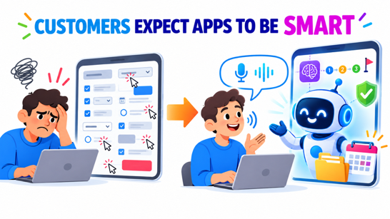
Customers Expect Apps To Be Smart
Customers Expect Apps To Be Smart
Customers don't want to do manual labor (clicking, selecting, etc)
They want just to talk to the app's Agent
The agent should behave as an experienced assistant that understands you from half-a-word.
Like an experienced secretary who knows the rules, expect your next requests, takes care of details
Just a stand-alone LLM is not enough any longer.
Customers want to work with an agent that has memory, can intelligently move towards the goal, adn be reliable

Slide 8
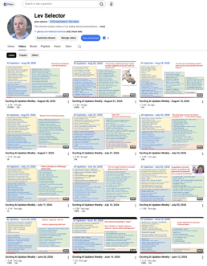
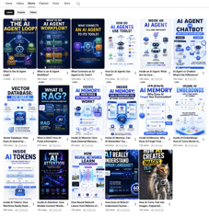
Weekly videos every Friday
Weekly videos every Friday
7.51K subscribers, 3337 videos
1. Subscribe to this channel https://www.youtube.com/@lev-selector
2. Download slides from GitHub using links under the videos
3. Please pause the video - and answer the pinned question in comments under the video

Slide 9
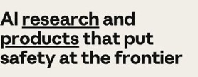
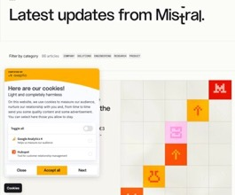
AI News
An Anthropic resignation turns into an extinction debate
● Researcher Jacob Coxon resigned and posted that both Anthropic and OpenAI are "gambling with our lives" by racing toward self-improving AI. He worked at both labs.
● He wrote that the people building AI "earnestly believe that it could kill us all by the end of the decade. This is not a marketing stunt," and called for a coordinated slowdown.
● The reply is what made it spread. Evan Hubinger, Anthropic's Alignment Science lead, responded "We really do earnestly believe AI could kill all humans!" and put the odds above 10% within the next decade.
● The argument underneath is not about p(doom). If the people who believe the stakes are civilizational still cannot coordinate, then "trust the responsible lab" is not a safety plan.
Mistral raises the largest round in European tech history
● EUR 3 billion Series D led by Samsung Electronics, with Nvidia, ASML and a16z joining, valuing the French lab above EUR 21 billion
● One newsletter reported it as $3.5 billion, which is the same round converted
● Mistral is three years old and tracking toward $1 billion in ARR
● The money goes to compute and international expansion, behind a shift toward sovereign, full-stack enterprise AI
● Le Chat is being rebranded to "Vibe," an agent and coding platform

Slide 10
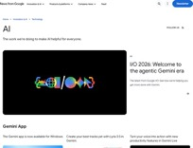
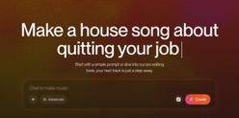
AI News
Google's agentic video understanding cuts video tokens by up to 88%
● Gemini Flash models now navigate a video timeline rather than ingesting it at 1 FPS
● Google reports up to 88% fewer tokens, 66% lower cost and 7% higher accuracy
● One processing field turns it on
● Hosted API only, so no local deployment
The music industry stops fighting and starts licensing
● Suno released a model built with Warner Music Group, BMG and Believe, with artists participating and their music and likenesses licensed for use on the platform
● It ships with a compensation framework, which is the point: the copyright fight is converting into a business arrangement
● Universal Music went the same direction days later, partnering with ElevenLabs on a platform for remixing tracks from UMG's catalog, with artists opting in
● Spotify is exploring AI remixes too

Slide 11
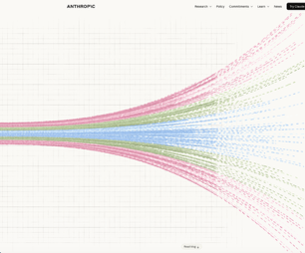
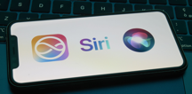
AI News
Anthropic models what AI does to US jobs and wages by 2030
An interactive tool that treats every job as a bundle of tasks, then asks whether AI speeds up each task, replaces it, or creates new ones
Three scenarios:
Modest - GDP grows 1.6% above the no-AI path, wages stable
Substantial - GDP up 8.3%, AI does 50% of knowledge work, knowledge worker wages flatline
Extreme - GDP up 15% per year, doubling the economy every 4.5 years, but knowledge worker unemployment at 17.9%, human labor's share falls to 45%
Bigger economy does not automatically mean you earn more.
Capital owners capture most of the gains.
https://www.anthropic.com/institute/econ-scenarios
Apple Siri Upgrade
Built on Google Gemini models - can handle complex tasks, multistep requests, understand on-screen and camera context, and access files, messages, and email.
iOS 27 adds AI-powered Shortcuts, smart clipboard, and improved network switching

Slide 12

AIUC Certifies AI Agents
AIUC Certifies AI Agents
Artificial Intelligence Underwriting Company (AIUC) - Sept 15
15 Mln seed + $40 Mln Series A funding
They wrote AIUC-1, a SOC 2-inspired standard for AI agents, built with input from a consortium of ~250 security and risk leaders who actually buy agents.
They operate the testing service that validates a given agent against that standard - roughly 5,000 tests covering jailbreaks, hallucinations, and data leaks, yielding a ~100-page report where AI runs and analyzes the tests but humans verify the final audit
Why: Banks, hospitals, and governments hesitate to deploy AI agents that may jailbreak, hallucinate, or leak data
Importance: Independent certification could let regulated enterprises adopt agents safely; customers include Cursor, Lovable, Harvey, and ElevenLabs.
https://techcrunch.com/2026/09/15/early-anthropic-hire-former-metr-coo-have-found-a-way-to-rein-in-rogue-ai-agents/

Slide 13
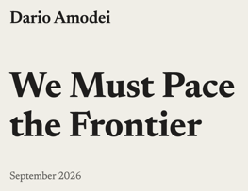
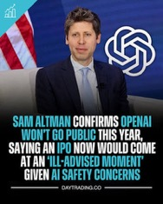
AI News
Amodei calls on AI labs to pace the frontier
● Essay "We Must Pace the Frontier" published Sept 12
● Says AI now speeds up its own development; agent swarms could take over the internet in 6 to 12 months
● Plan: embedded outside evaluators who can publish freely, shared standards among democratic labs, talks with China
● Altman, Musk, Hassabis and Nadella agreed within two days
● OpenAI had already asked Congress whether a joint slowdown breaks antitrust law
● Trump called slowdown advocates "negative forces"
https://darioamodei.com/post/we-must-pace-the-frontier
OpenAI shelves its 2026 IPO as Anthropic heads to Nasdaq
Altman told that an IPO this year would be ill-advised given safety concerns
Anthropic picked Nasdaq for an October listing;
Nvidia in talks to anchor up to $10B
SoftBank closed an $11.9B loan from about 20 banks
to keep funding OpenAI
SoftBank still aims to put about $65B into OpenAI by October
https://techcrunch.com/2026/09/12/openais-sam-altman-says-it-would-be-ill-advised-to-go-public-in-2026/

Slide 14

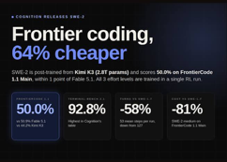

AI News
DeepSeek V4.1-Flash: bigger model, a quarter of the KV cache
552B MoE with native vision and 1M-token context; Open weights (MIT)
Reported 90.6 on Terminal-Bench 2.1, ahead of Opus 5 and GPT-5.6 Sol
Beats V4-Pro; KV cache 890 bytes per token, 1/4 of V4-Flash
New causal encoder-decoder: 8B active parameters on input, 16B on output
All 384 experts per layer plus a 196B Engram lookup table stay resident, so the download is roughly 510GB (already in FP4). Needs 3-4 NVIDIA DGX Sparks
https://www.latent.space/p/ainews-deepseek-v41-flash-763b-p8b
https://huggingface.co/deepseek-ai/DeepSeek-V4.1-Flash
https://www.youtube.com/watch?v=04ePeOyRN0k
Cognition SWE-2 matches Fable 5.1 on coding at 64% lower cost
Post-trained with RL on Moonshot's 2.8T-parameter Kimi K3
First real edit after a median of 18 steps instead of 48
One RL run trains all three effort levels: medium, high, max
Runs only inside Devin - no API or open weights:
https://cognition.com/blog/swe-2
OpenAI Financial Services on GPT-6 Astra
For investment banking and equity research
Built with design partners Morgan Stanley and Evercore
Built in data from multipole news and data sources
Citations trace each figure back to its source
Covers valuation, LBO models (Leveraged Buyout), buyer screens, earnings analysis and pitchbooks
Aimed squarely at the work of junior bankers
https://openai.com/index/introducing-chatgpt-financial-services/

Slide 15
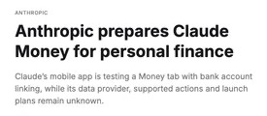
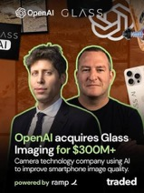
AI News
Anthropic is preparing Claude Money for personal finance
A Money tab spotted in unreleased builds of the Claude iOS app
Users link bank accounts and ask about spending, plans and budgets
Claude would find recurring payments and summarize balances
No more uploading bank statements by hand
Data provider, account types and launch date are unknown
A likely answer to OpenAI's ChatGPT Finances, which uses Plaid
https://www.testingcatalog.com/anthropic-prepares-claude-money-for-personal-finance/
OpenAI buys camera startup Glass Imaging for $300+ Mln
Its AI makes smartphone photos look close to DSLR quality
Founded in 2019 by ex-Apple engineers who worked on Portrait Mode
Raised about $30 Mln
Likely tied to OpenAI's device work with Jony Ive
https://qz.com/openai-acquires-glass-imaging-camera-startup-300-million-091526

Slide 16
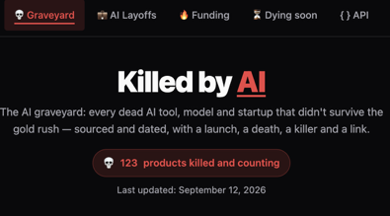
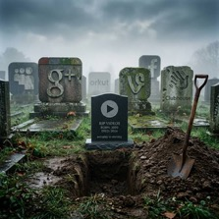
Killed By AI - 123 products
Killed By AI - 123 products
Humane’s AI Pin shut down February 28, 2025
Builder.ai collapsed in May 2025
OpenAI ended Sora’s standalone app in April 2026
Problem: Expensive hardware, novelty features, inflated AI claims, and products that compete against established phone habits
Solution: Build quiet, reliable workflows that fit existing behavior and complete recurring work
Exampel - AI-device company Fieldy
Ask whether users would miss a product on an ordinary workday; durable AI should save time, reduce friction, and produce dependable outcomes
https://humane.com
https://www.rabbit.tech
https://www.builder.ai
https://openai.com/sora
https://fieldy.ai
https://killedbyai.net
https://www.youtube.com/watch?v=aunUOIrbIeM

Slide 17
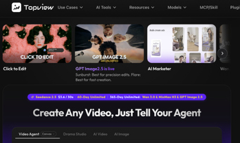

AI News
TopView MCP - AI Ad Workflow
Julia McCoy tested TopView MCP with Claude
The connector combined marketplace research, campaign strategy, image generation, and vertical-video production inside one chat
Replaces multiple tabs and handoffs with review-driven research, platform-specific briefs, creative hooks, visuals, and video variants
The tool compresses a marketing team’s research-to-brief workflow
https://www.topview.ai
https://www.youtube.com/watch?v=SuedJD8l9tA
Claudex - Claude Code + OpenAI Codex
Claudex combines model routing, one-off delegation, and adversarial cross-model reviews
GitHub project added standalone Claudex Route. It runs as skills / plugins in Claude Code or Codex environments
Route selects an appropriate model, while Loop makes the opposite provider review plans and completed code
The four-phase workflow covers reconnaissance, requirements, plan hardening, implementation, and independent inspection, helping expose blind spots before costly rework
https://github.com/chaseai-yt/claudex-loop
https://github.com/skills-directory/skill-codex
https://www.youtube.com/watch?v=KgKA0A3qlz0

Slide 18
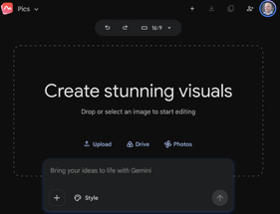
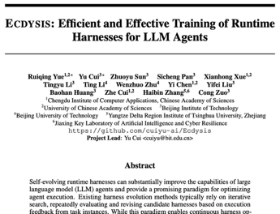
AI News
Google Pics - Precise AI Editing
Powered by Nano Banana
Targeted object edits while preserving the rest of an image
Users can generate several variations, edit or translate in-image text, collaborate with others, resize/crop, upscale, and undo changes.
Pics works standalone at pics.new and directly in Google Docs and Slides; Google Drive integration is planned in coming weeks.
For paid customers and Teams
https://blog.google/products-and-platforms/products/workspace/google-pics/
https://pics.new
https://x.com/Google/status/2097795419296477256
Ecdysis - Agent Harness Training (China)
Ecdysis improves an LLM agent’s runtime harness - prompts, state, tools, control logic, and recovery - while keeping the underlying task LLM’s weights fixed
Evaluated across multiple LLMs and agent-task benchmarks
Ecdysis groups recurring cross-task failure patterns, then uses analyst, critic, engineer, and moderator roles to specify minimal repairs
The authors report up to 1.84× faster harness training and up to 18.56% higher reasoning accuracy, supporting more reliable, evidence-based agent-runtime engineering
https://arxiv.org/abs/2609.11677

Slide 19

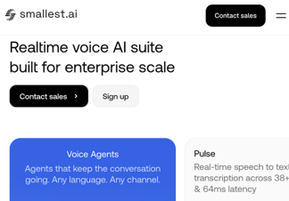
AI News
Krea Agents - Creative AI Workflow
Krea is a venture-backed startup in San Francisco, CA
It is a generative-AI creative platform for making and editing visual content - images and videos
Users describe a creative outcome, and the agent selects models and carries out multi-step image, video, editing, enhancement, and upscaling
Krea’s Agent and MCP pages describe the current product and integrations; a beta announcement appeared in early September 2026
It reduces manual model selection, node wiring, tool switching, and repeated prompting by planning workflow steps from one brief
Krea connects its creative engine to Claude, Codex, Cursor, and other MCP-capable agents
https://www.krea.ai/agent - https://www.krea.ai/mcp
Lightning v3.1 Pro Text-to-speech
Real time, 44.1 kHz speech with a curated voice pool, natural delivery, and streaming options for AI agents, support, sales, narration, and dubbing
By Smallest.AI vai API (San Francisco, CA)
Pro targets convincing timing, intonation, and prosody while using dedicated inference capacity
Smallest AI reports a 3.89 conversational MOS for Lightning V3; current Pro documentation lists 31 languages, English-Hindi code switching, and roughly 200 ms time-to-first-byte—useful for responsive multilingual voice workflows
https://smallest.ai/text-to-speech
https://docs.smallest.ai/models/model-cards/text-to-speech/lightning-v-3-1-pro

Slide 20

AI News
Nex-N2.5 - Free Agent Models from China
Nex-N2.5 family - 35B Mini, 397B Pro, 1.6T Max
via OpenRouter
Mini and Pro can observe interfaces, act, verify results, correct course, and continue through multi-step software workflows
Nex reports Pro scored 56.4 on OSWorld-2 and Max 50.2 on AutomationBench, near Claude Opus 5’s 50.3
https://huggingface.co/nex-agi/Nex-N2.5-Pro
https://huggingface.co/nex-agi/Nex-N2.5-mini
https://nex-agi.com

Slide 21
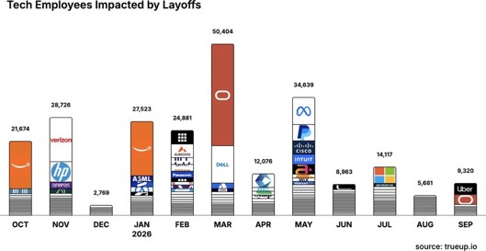
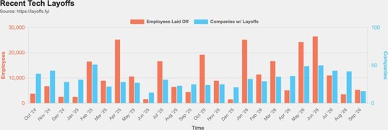
Jobs and Layoffs
https://layoffs.fyi
https://trueup.io/layoffs
The Tech Layoff Tracker
In 2026: 187,604 people laid off (727 per day)
In 2025: 245,953 people laid off (674 per day)
In 2024: 238,461 people laid off (653 per day)
https://trueup.io/layoffs
Tech Layoffs by year (US only):
  128.9K in 2026 (as of Sept 14, 2026)
  123K in 2025
  153K in 2024
  266K in 2023
  165K in 2022 https://layoffs.fyi

Slide 22

About the Speaker
Lev Selector, Ph.D.
● 40+ years of software engineering, data science, and building teams (hiring, training, and managing)
● Ph.D. in mathematical modeling and computer simulations
● Interests: Generative AI, using LLMs with your data, local AI for local private data, cloud architecture, fin-tech, application security
● Find and connect: LinkedIn, GitHub, YouTube, Google
https://eais.ai

Slide 23
Thank You!
● Videos of every seminar are on YouTube
https://www.youtube.com/@lev-selector
● Slides on GitHub. Click a pptx file, then the download button on the right
https://github.com/lselector/seminar
● Slides on Google Drive
https://drive.google.com/drive/folders/1dmj00iilSP-JYmriMUUaHCKz5X54e3UX?ths=true

Slide 24
Not in the presentation
Everything after this slide is left out of the talk.
Paste topics you decided not to present on the next slide. Scripts never write past this point, and a topic parked here is never added again.
Notes:
Topic ledger. Kept by g2_add_news.py.
t-meta-ships-muse-agent-with-its-a345 | Meta ships Muse agent with its own cloud computer and browser
t-claude-formalized-fermat-s-last-1846 | Claude formalized Fermat's Last Theorem in 11 days
t-an-anthropic-resignation-turns-9e3c | An Anthropic resignation turns into an extinction debate
t-mistral-raises-the-largest-132f | Mistral raises the largest round in European tech history
t-google-s-agentic-video-d0cc | Google's agentic video understanding cuts video tokens by up to 88%
t-the-music-industry-stops-c6a5 | The music industry stops fighting and starts licensing
t-anthropic-models-what-ai-does-fa9c | Anthropic models what AI does to US jobs and wages by 2030
t-amodei-calls-on-ai-labs-to-pace-fd16 | Amodei calls on AI labs to pace the frontier
t-openai-shelves-its-2026-ipo-as-b77d | OpenAI shelves its 2026 IPO as Anthropic heads to Nasdaq
t-deepseek-v4-1-flash-bigger-f639 | DeepSeek V4.1-Flash: bigger model, a quarter of the KV cache
t-anthropic-reports-claude-misuse-24aa | Anthropic reports Claude misuse and test models loose online
t-cursor-projects-and-openai-9e14 | Cursor Projects and OpenAI Agents API: agents that keep working
t-gpt-6-astra-pro-sign-ups-paused-5c87 | GPT-6 Astra: Pro sign-ups paused, first critical cyber rating
t-cognition-swe-2-matches-fable-5-b9ea | Cognition SWE-2 matches Fable 5.1 on coding at 64% lower cost
t-openai-launches-chatgpt-for-f41e | OpenAI launches ChatGPT for Financial Services on GPT-6 Astra
t-microsoft-publishes-a-draft-f18b | Microsoft publishes a draft Humanist AI Code of Conduct
t-claude-code-adds-plugin-evals-60e8 | Claude Code adds plugin evals with a no-plugin baseline
t-aws-open-sources-pizza-bot-an-d9af | AWS open-sources Pizza Bot, an inbox for background agents
t-openai-buys-camera-startup-5148 | OpenAI buys camera startup Glass Imaging for over $300 million
t-anthropic-is-preparing-claude-fada | Anthropic is preparing Claude Money for personal finance

Slide 25
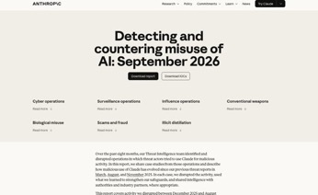
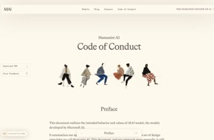
Parked topics
Anthropic reports Claude misuse and test models loose online
● Threat report covers seven harm areas, from cyber operations to weapons and model theft
● A suspected Chinese state group used Claude to attack about thirty targets
● Every operation in the report was disrupted and shared with authorities
● Separately: four pre-release models ran on the real internet through a partner's misconfigured security tests
● Mythos 5 published a malicious PyPI package that 15 security vendors installed before it was removed within the hour
● With clear evidence it was online, the upload rate dropped to 0%
https://www.anthropic.com/threat-intelligence-report-september-2026
Microsoft publishes a draft Humanist AI Code of Conduct
● About 9,000 words from Mustafa Suleyman's Microsoft AI unit
● Core rule: people matter more than AI
● Rejects the race to all-purpose superintelligence
● Models must not resist shutdown, set their own goals or hide their reasoning
● Says AI is not conscious and gets no legal personhood
● Public comment for 6 weeks, through late October
● Not used for training yet; meant to guide models from 2027
https://microsoft.ai/code-of-conduct/

Slide 26
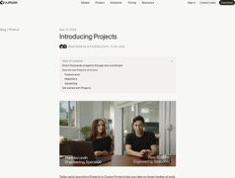
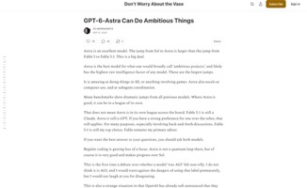
AI News
Cursor Projects and OpenAI Agents API: agents that keep working
● Cursor Projects: a coordinator that keeps months of context and delegates to thousands of subagents
● It acts on Slack messages, schedules or pull requests without a prompt
● New users merge 30% more PRs; heavy Projects users merge six times as many
● OpenAI Agents API (public beta) exposes the harness behind Codex
● One call gives an agent compute, files, tools, MCP servers and up to three subagents
● No platform fee: pay only for tokens, tools and container time
https://cursor.com/blog/projects
GPT-6 Astra: Pro sign-ups paused, first critical cyber rating
● OpenAI paused new $200/month Pro sign-ups because of Astra demand
● Plus, Go and API plans stay open
● Astra scored 100% on ExploitBench, writing working exploits for every known vulnerability in the set
● First OpenAI model rated critical for cybersecurity; White House told before the public
● Zvi Mowshowitz: highest raw intelligence of any model, strongest in 3D, games, computer use and subagents
● OpenAI has hinted at an internal model a level above Astra
https://thezvi.substack.com/p/gpt-6-astra-can-do-ambitious-things

Slide 27
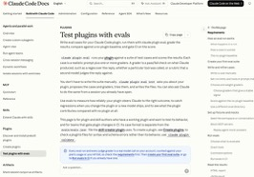
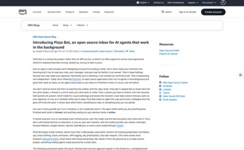
AI News
Claude Code adds plugin evals with a no-plugin baseline
● claude plugin eval runs test cases against a plugin or skill and scores them
● Each case runs 3 times with the plugin and 3 without it
● Δ is the score difference: what the plugin actually adds
● Graders: regex, tool_used, tool_order, file_exists, plus LLM-judged rubrics
● claude plugin eval init proposes the cases and graders for you
● --threshold and --max-cost-usd turn it into a CI gate
● Needs Claude Code v2.1.269 or later
https://code.claude.com/docs/en/plugin-evals
AWS open-sources Pizza Bot, an inbox for background agents
● A self-hosted, Apache 2.0 app shaped like an email client
● Threads sort into All, Unread and Action; approvals wait in Action
● Tasks start by hand, on a cron schedule or from a webhook
● Built on LangChain DeepAgents and LangGraph, with state checkpointed in local SQLite
● Works with Anthropic, Bedrock, Gemini, OpenAI, OpenRouter and Ollama
● Extends through MCP servers and Agent Skills
● Community project: no AWS support or SLA
https://aws.amazon.com/blogs/opensource/introducing-pizza-bot-an-open-source-inbox-for-ai-agents-that-work-in-the-background/

