Slide 1
AI Updates - November 07, 2025
Jobs that used to cost $200K can now be done for $20K
The timeframes went down from 6 months to 6 weeks
Crowd-sourced "LM Arena" Leaderboard
Abacus AI DeepAgent - AI browser automation
OpenAI AWS $38 Bln deal
AWS Trainium vs Nvidia
China sells a quantum computer
Energy shortages Limit AI Growth
Nathaniel Whittemore & Sean “Swyx” Wang
Apple Siri powered by Google - in Spring
GitHub MCP Registry
Edison Scientific & Kosmos AI scientist
Keyword+Semantic search instead of RAG
Reflection.AI raised $2B at $8B valuation
OpenMemory VS-Code Extension
Supervised Reinforcement Learning (SRL)
Google Project Suncatcher
Why Sam Altman was fired in 2023
Thinking about Thinking
Diffusion Models
Microsoft Agent Lightning Platform
YouTube "Super Resolution" Upscaling
Human& startup $5 Bln valuation
OpenAI safety models: GPT-OSS Safeguard
Microsoft signs $9.7 Bln cloud deal with IREN
Qwen3-Max-Thinking - early preview
Kimi-K2-Thinking Open Model
Microsoft’s $15.2 Bln investment in the UAE
IT Projects Costs are now 10x lower
FDE - Hottest new job in AI
Jobs, Layoffs, demand for AI Engineers

Slide 2
Crowd-sourced "LM Arena" Leaderboard
Data for November 5
Starting Elo rating = 1000
https://en.wikipedia.org/wiki/Elo_rating_system
English - https://lmarena.ai/leaderboard/text
Coding - https://lmarena.ai/leaderboard/text/coding
Model | Score
gemini-2.5-pro | 1452
claude-opus-4-1-20250805-thinking-16k | 1448
claude-sonnet-4-5-20250929-thinking-32k | 1448
gpt-4.5-preview-2025-02-27 | 1442
claude-opus-4-1-20250805 | 1439
chatgpt-4o-latest-20250326 | 1438
gpt-5-high | 1436
claude-sonnet-4-5-20250929 | 1436
o3-2025-04-16 | 1435
qwen3-max-preview | 1433
glm-4.6 | 1428
gpt-5-chat | 1425
qwen3-max-2025-09-23 | 1423
claude-opus-4-20250514-thinking-16k | 1423
deepseek-v3.2-exp-thinking | 1421
qwen3-235b-a22b-instruct-2507 | 1420
grok-4-fast | 1420
deepseek-r1-0528 | 1418
kimi-k2-0905-preview | 1417
deepseek-v3.1 | 1416
deepseek-v3.1-thinking | 1416
kimi-k2-0711-preview | 1416
qwen3-vl-235b-a22b-instruct | 1415
deepseek-v3.1-terminus | 1415
Model | Score
claude-sonnet-4-5-20250929-thinking-32k | 1524
claude-opus-4-1-20250805-thinking-16k | 1516
claude-opus-4-1-20250805 | 1501
claude-opus-4-20250514-thinking-16k | 1496
qwen3-max-preview | 1483
claude-haiku-4-5-20251001 | 1481
glm-4.6 | 1474
longcat-flash-chat | 1474
qwen3-max-2025-09-23 | 1474
deepseek-v3.2-exp-thinking | 1471
gpt-5-high | 1470
gemini-2.5-pro | 1470
claude-sonnet-4-20250514-thinking-32k | 1469
qwen3-235b-a22b-instruct-2507 | 1468
claude-sonnet-4-5-20250929 | 1466
kimi-k2-0905-preview | 1465
qwen3-vl-235b-a22b-instruct | 1465
chatgpt-4o-latest-20250326 | 1463
deepseek-r1-0528 | 1462
claude-opus-4-20250514 | 1461
gpt-5-chat | 1459
deepseek-v3.1-terminus-thinking | 1459
o3-2025-04-16 | 1458
gpt-4.5-preview-2025-02-27 | 1456
China
https://lmarena.ai/leaderboard/text
Design Arena -
https://www.designarena.ai
https://openlm.ai/chatbot-arena/
https://beta.lmarena.ai
Web Leaderboard -
https://web.lmarena.ai/leaderboard
LLM Leaderboard - by @LlmStats -
https://llmworld.net/llm_leaderboards/
LLM Leaderboard - by StackAI -
https://www.stack-ai.com/llm-leaderboard
LLM Leaderboard - by Artificial Analysis -
https://artificialanalysis.ai/leaderboards/models
Open LLM Leaderboard - by Hugging Face -
https://huggingface.co/open-llm-leaderboard
LLM Leaderboard - by Vellum -
https://www.vellum.ai/llm-leaderboard
AI Benchmarking Hub -
https://epoch.ai/data/ai-benchmarking-dashboard
Grok 4 Benchmarks -
https://artificialanalysis.ai/models/grok-4
China
China
China
China
China
China
China
China
China
China
China
x.ai
China
China
China
China
China
China
China
China
China
China

Slide 3
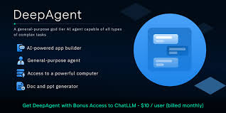
Abacus AI DeepAgent
Abacus AI DeepAgent - AI browser automation & scheduling tool
Can schedule and execute recurring browser tasks autonomously:
  general AI reasoning
  real browser control
  task scheduling
Opening websites, clicking through pages, gathering data, and sending results automatically at specified times (repeat daily, weekly, or monthly,...). Here are some examples:
  Opens LinkedIn, searches based on criteria, gathers contacts, drafts personalized outreach emails, and repeats the process every morning
  Job applications: Uploads resumes, processes job listings from Google Sheets, fills out forms, answers screening questions, and updates spreadsheets with submission status
  Invoice management: Logs into billing portals, downloads invoices, extracts data into spreadsheets, and emails summaries at scheduled times
  Website testing: Checks login systems, verifies order history updates, confirms download functionality, and reports results with screenshots
Platform uses Abacus AI's Chat LLM, can use Claude, Gemini, ChatGPT, and Grok within one interface; combines reasoning modules with browser control APIs in a virtualized Chromium environment that maintains session state across runs. The system supports multilingual prompts and browser interactions, handling regional workflows across different languages
Deep Agent completes standard browser tasks up to 2x as fast as competitors due to optimized latency between reasoning and execution steps
Deep Agent Listener - desktop companion that records and transcribes meetings in real-time, answers questions about on-screen content, and integrates with Slack, CRM, and project management tools
Coding agent can generate full-stack applications with payment integrations while the listener simultaneously documents the development process
Pricing: $10 per month, providing full access to browser use, scheduling, and Chat LLM integration
https://www.youtube.com/watch?v=BWnfGzWXAps
https://deepagent.abacus.ai
https://abacus.ai/help/howTo/chatllm/deepagent_how_to
https://abacus.ai/help/howTo/chatllm/deepagent_desktop_how_to
https://abacus.ai

Slide 4

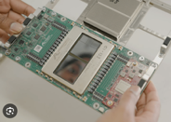

AI Updates - 1
OpenAI AWS $38 Bln deal
OpenAI has signed a 7-year, $38 Bln deal with Amazon Web Services for cloud computing and AI infrastructure, including Nvidia GPUs
OpenAI gets immediate access to crucial compute power
This deal is marking a strategic shift of OpenAI to a multi-cloud approach beyond its existing Microsoft partnership
AWS Trainium vs Nvidia
Nvidia Blackwell GB200 outperforms Trainium2 by 3.85x in FP16 FLOPs
Trainium2 excels in memory bandwidth per total cost of ownership (TCO), making it particularly competitive for memory-bound workloads like reinforcement learning and post-training techniques
Amazon's strategy isn't to replace Nvidia but to provide choice and cost alternatives for AWS customers
Major customers like Anthropic have committed to Trainium, reporting significant cost savings while helping design future chips through tight hardware-software co-design
Nvidia's CUDA platform remains Trainium's biggest obstacle. Switching requires hundreds of hours of code rewriting and testing. AWS counters with its Neuron SDK, but it's still immature compared to CUDA's decade-long ecosystem of tools and developer support.
Trainium3 is planned for late 2025, promises 4x performance over Trainium2 with 40% better energy efficiency, though it will consume over 1,000 watts per chip requiring liquid cooling. While Nvidia will likely maintain dominance for most AI workloads short-term, Trainium could capture significant market share in cost-sensitive enterprise training within AWS ecosystems

Slide 5



AI Updates - 2
China sells a Room Temperature Quantum Computer Hanyuan-1
Orders exceeding $5.6 Mln
Hanyuan-1 uses lasers to manipulate neutral atoms as qubits
100 qubits can exist as both 0 and 1 (quantum superposition)
The entire system fits within three standard equipment racks
Hanyuan-1 can handle complex calculations for financial modeling, logistics optimization, drug discovery, and materials design
https://www.scmp.com/news/china/science/article/3331241/chinas-atomic-quantum-computer-reports-first-sales-orders-worth-us56-million
Energy shortages Limit AI Growth
Microsoft CEO Satya Nadella said racks of NVIDIA GPUs can’t be used due to power shortages, highlighting energy, not compute, as the new AI bottleneck. Hyperscalers face years-long delays securing megawatts for data centers, making energy access the key to scaling AI capacity.
Nathaniel Whittemore interviews Sean “Swyx” Wang
https://www.youtube.com/watch?v=JF70OiDo-QQ
"model labs" - build frontier models (OpenAI, Anthropic, DeepMind)
"agent labs" - companies that ship products first, then work backward to build custom models based on real user data and domain understanding
"Code AGI will be achieved in 20% of the time of full AGI"
"and will capture 80% of the value of AGI".
Coding is a verifiable domain with fast feedback loops where developers are both builders and consumers, creating a virtuous cycle.
Tools like Claude Code already demonstrate generalization beyond coding tasks, suggesting that coding agents may become the foundation for broader agentic systems.

Slide 6
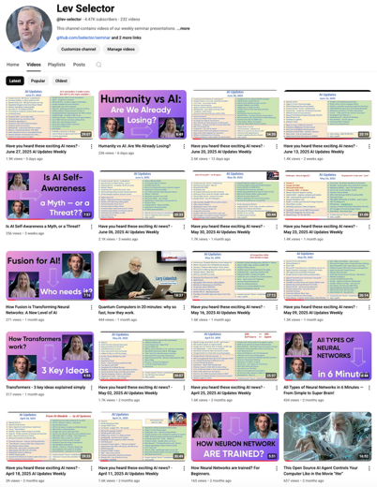
We do these weekly videos every Friday
Stats: 5.57K subscribers, 250 videos
Subscribe to this channel
https://www.youtube.com/@lev-selector
Download slides from GitHub using links under the videos
Please pause the video - and answer the pinned question in comments under the video

Slide 7

Thinking about Thinking
Anthropic paper titled "Emergent Introspective Awareness in Large Language Models - https://www.anthropic.com/research/introspection
Can AI models actually identify their own internal thoughts and distinguish them from externally injected concepts?
Injected Thought Detection, Distinguishing Real vs. Injected Thoughts, Prefilled Response Awareness, Thought Control (Models were instructed to think or not think about specific words)
Claude Opus 4.1 achieved roughly 20% success rates at detecting injected concepts when applied at appropriate layers and strengths, while other models performed at lower rates. Post-training was crucial for eliciting introspective awareness
The research raises fundamental questions about AI consciousness by invoking Descartes' "I think, therefore I am". If models can genuinely identify their own thoughts versus injected ones, it challenges the prevailing view that LLMs are merely sophisticated next-token predictors
https://www.youtube.com/watch?v=qF9uOCxcvro
Meta-Thinking. Thinking about thinking. Can AI do Philosophy?
TL;DR: Useful Tool, Not Philosopher
LLMs have developed significant meta-cognitive capabilities—the ability to reflect on and regulate their own thinking processes—though whether they can genuinely "do philosophy" remains deeply contested
Recent research reveals that frontier AI models demonstrate multiple forms of meta-thinking. Modern LLMs exhibit self-evaluation abilities, error correction, and even latent-space planning behaviors.
For instance, Claude-3.5-Haiku shows advanced goal-directed planning when composing poetry, first anticipating suitable rhyme words and then generating preceding content accordingly—demonstrating structured, multi-faceted meta-cognition rather than simple token-by-token generation
Chain-of-thought prompting exemplifies AI meta-cognition by having models articulate intermediate reasoning steps before producing answers, significantly enhancing performance on complex tasks.
Models fine-tuned on high-risk domains can independently identify and label their outputs as "dangerous" without explicit instructions, indicating internalized risk-awareness characteristic of meta-cognitive systems
But current systems struggle with autonomous philosophical innovation—they excel at recapitulating classic arguments and identifying established lines of reasoning but fail to produce truly novel philosophical insights
Genuine philosophical thinking operates to solve problems pertinent to oneself, requiring the kind of embodied, phenomenological experience that non-sentient systems cannot possess. AI cannot draw on personal experiences, physical sensations, or the awareness of mortality that often drives philosophical inquiry.

Slide 8

Diffusion Models
Diffusion Models as powerful alternatives to LLLMs
DMs generate outputs through iterative refinement of entire sequences simultaneously, unlike LLMs which produce tokens sequentially from left to right
DMs outperform autoregressive models when trained on the same amount of data, and critically, they can reuse training data up to 100 times compared to only 4 times for LLMs before diminishing returns occur
Since data scarcity has become a more significant bottleneck than compute power for scaling AI systems, this efficiency of using data makes diffusion models increasingly attractive
Diffusion models map inputs into an n-dimensional vector space using variational autoencoders, where real data occupies high-value regions resembling "mountains"
During training, noise is progressively added to original inputs, creating paths from high-value (original) to low-value (noisy) regions. Generation works by taking an input query, converting it to a vector, then using gradient descent to navigate toward the nearest "tallest mountain" representing optimal output.
https://www.youtube.com/watch?v=Yu4ZWy1GjlE
https://www.ibm.com/think/news/diffusion-models-llms
https://arxiv.org/abs/2502.09992
https://cs231n.stanford.edu/slides/2023/lecture_15.pdf
Gaurav Sen

Slide 9
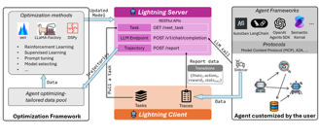



AI Updates 3
Microsoft Agent Lightning Platform - open-source reinforcement learning framework that enables AI agents to learn from their own experiences without requiring code rewrites.
The system operates through a lightning server handling training behind the scenes and a lightning client that collects performance data in real-world applications - https://arxiv.org/pdf/2508.03680
YouTube "Super Resolution" Upscaling
AI used to upscale videos to HD quality (1080p), with plans to extend support to 4K in the future
Creators can opt out of AI upscaling for their videos, either during upload or for existing content in their library
YouTube also has expanded the thumbnail file size limit from 2MB to 50MB
Human& (a.k.a. "Humans&") - a new AI startup
Founded by Eric Zelikman, a former researcher at xAI
Raising $1 Bln at a $5 Bln valuation
To develop a "human-centered" AI to effectively collaborate with humans
AI that better understands users and strengthens human abilities
Build systems that make human teams more effective together, rather than from achieving superintelligence in isolation
Training: prioritize collaboration over automation. Usability and ethical considerations over speed and cost
Goal is to create AI systems that work with humans as partners rather than simply working for humans as tools
https://www.youtube.com/watch?v=Oh0oQnKn9dw
OpenAI safety models: GPT-OSS Safeguard 120B and 20B
"open-weight", designed to detect harmful or fake online content
https://www.safetykit.com/news/openai-introduces-safety-models-in-collaboration-with-safetykit

Slide 10



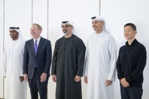

AI Updates 4
Microsoft signs $9.7 Bln cloud deal with IREN
IREN is a data-center operator with Nvidia's advanced chips
This five-year partnership allows Microsoft to boost capacity without constructing new facilities or securing additional power
Qwen3-Max-Thinking - early preview
1T params, MoE, 256k window, on Qwen Chat and the Alibaba Cloud API
Kimi-K2-Thinking
1T params, MoE, 256k window, open weight, on HuggingFace
Autonomous multi-step agentic workflows with 300+ of tool calls
Beats GPT-5 and Claude-4.5-Sonnet
Microsoft’s $15.2 Bln investment in the UAE
investment in the United Arab Emirates in 2023-2029
2023-2025 (Already deployed): $7.3 Bln
2026-2029 (Planned):$7.9 Bln - AI and cloud infrastructure, Nvidia GPUs (approved by Trump administration)
Microsoft pledged to train 1M+ UAE residents and upskill more than 300K people in AI, including 250K+ students and staff
Microsoft will use Abu Dhabi as a hub for AI research and development
Apple Siri powered by Google - planned for Spring
Future deal - Apple to pay Google $1B/year for custom 1.2T params Gemini model to power Siri
Apple had also considered using AI models from OpenAI and Anthropic earlier this year. After testing models from all three companies, Apple chose to move forward with Google.
https://www.bloomberg.com/news/articles/2025-08-22/apple-explores-using-google-gemini-ai-to-power-revamped-siri

Slide 11
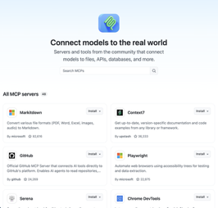
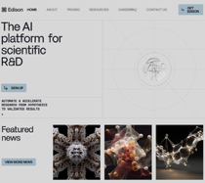
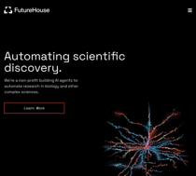
AI Updates 5
GitHub MCP Registry launched on Sept 17th
Open-source centralized hub for discovering MCP servers
One-click installation for VS Code
Sort servers by GitHub stars and community activity
Collaborating with Anthropic and the MCP Steering Committee
Developers can self-publish MCP servers to the OSS MCP Community Registry, which then automatically appear in the GitHub MCP Registry
https://github.com/mcp
https://modelcontextprotocol.info/tools/registry/
https://github.blog/ai-and-ml/github-copilot/meet-the-github-mcp-registry-the-fastest-way-to-discover-mcp-servers/
https://github.com/modelcontextprotocol/registry
Edison Scientific & Kosmos AI scientist
Kosmos - an autonomous AI research system
Futurehouse launches Edison Scientific as a commercial variant
https://www.futurehouse.org - non-profit
https://edisonscientific.com - commercial
Kosmos coordinates cycles of literature review, data analysis, and hypothesis generation, processing 1,500 papers and executing 42k lines of code per run. 79% of Kosmos’ outputs were validated as accurate, with the AI reproducing unpublished findings and making new discoveries across multiple fields.
Edison Scientific will commercialize the platform following pharma demand

Slide 12
AI Updates 6
Keyword+Semantic search instead of RAG
BM25 keyword search + Semantic search wirth embeddings
Hybrid search stops at retrieval, while RAG adds a generation step using an LLM
Without LLM we get simpler much pipelines compared to RAG
Using Reciprocal Rank Fusion (RRF) to combine results together
Tiger Data's - Agentic Postgres - a specialized PostgreSQL variant designed for AI agent workflows
https://www.youtube.com/watch?v=kegJPEoYBjw
https://github.com/amrrs/hybrid-search/tree/main
WITH
bm25_results AS (
SELECT id, pdb.score(id) AS score
FROM documents
WHERE content ||| 'your search query'
ORDER BY score DESC
LIMIT 20
),
vector_results AS (
SELECT id, 1 - (embedding <=> query_embedding) AS score
FROM documents
ORDER BY embedding <=> query_embedding
LIMIT 20
),
rrf_scores AS (
SELECT id,
SUM(1.0 / (60 + rank)) AS rrf_score
FROM (
SELECT id, ROW_NUMBER() OVER (ORDER BY score DESC) AS rank
FROM bm25_results
UNION ALL
SELECT id, ROW_NUMBER() OVER (ORDER BY score DESC) AS rank
FROM vector_results
) combined
GROUP BY id
)
SELECT d.*, r.rrf_score
FROM documents d
JOIN rrf_scores r ON d.id = r.id
ORDER BY r.rrf_score DESC
LIMIT 10;
You don't need two separate tables - the best practice is to use a single table with both a BM25 index and a vector index on different columns, then combine results using RRF
Use PostgreSQL with extensions:
  ParadeDB for BM25 + pgvector for vectors (most popular)
  pg_textsearch for BM25 + pgvector​
CREATE TABLE documents (
id SERIAL PRIMARY KEY,
title TEXT,
content TEXT,
embedding VECTOR(1536) -- or your embedding dimension
);
CREATE INDEX ON documents USING bm25(content);
CREATE INDEX ON documents USING hnsw (embedding vector_cosine_ops);
Run two separate queries against the same table, then merge results using Reciprocal Rank Fusion (RRF)

Slide 13
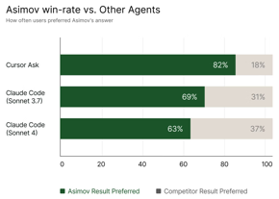

Reflection.AI - $2 Bln at $8 Bln valuation
Reflection AI is a startup founded in San Francisco, CA in March 2024 by two former Google DeepMind researchers—Misha Laskin (who led reward modeling for Gemini) and Ioannis Antonoglou (co-creator of AlphaGo)
The company is building superintelligent autonomous coding systems using reinforcement learning and LLMs
Reflection AI positions itself as an open-source alternative to closed frontier AI labs like OpenAI and Anthropic, and as a Western counterpart to Chinese AI firms like DeepSeek
Rather than building general-purpose AI tools, the company focuses specifically on creating the best autonomous coding systems in the world
The company launched Asimov (July 2025), a breakthrough code comprehension agent designed to help engineers deeply understand complex codebases
Unlike traditional AI coding tools like Copilot that provide autocompletion, Reflection AI's systems act as true software engineers capable of writing, debugging, and optimizing code autonomously
Use reinforcement learning to train AI models that can simulate problem-solving, similar to how AlphaGo mastered the game of Go
In October 2025, Reflection AI raised $2 Bln at $8 Bln valuation. This is a remarkable 15x increase from its $545 Mln valuation 7 months earlier
The company has recruited top talent from DeepMind and OpenAI and built an advanced AI training stack that will be open for all
With a team of about 60 AI researchers and engineers, Reflection AI has secured a compute cluster and plans to release a frontier language model in 2026 trained on "tens of trillions of tokens"
Misha Laskin and Ioannis Antonoglou
https://reflection.ai
https://docs.reflection.ai/docs/about-asimov
https://www.sequoiacap.com/article/reflection-ai-asimov/
https://www.linkedin.com/company/reflectionai

Slide 14
OpenMemory VSCode Extension
OpenMemory VS-Code Extension
https://github.com/CaviraOSS/OpenMemory - MIT License
https://openmemory.cavira.app
https://openmemory.cavira.app/docs/introduction
Modular AI memory engine provides persistent, structured, and semantic memory for LLM applications
Enables AI agents, assistants, and copilots to remember user data, preferences, and prior interactions
The extension automatically integrates with GitHub Copilot, Cursor, Claude Desktop, Windsurf, Codex, and any MCP-compatible AI
Install the extension, start the OpenMemory server, and your AI tools instantly access your entire coding memory.
Auto-configuration on first run
Tracks every file edit, save, and open automatically
Smart compression reduces token usage by 30-70%
Query responses under 80ms with intelligent caching
Real-time token savings and compression metrics
Supports both Direct HTTP and MCP protocol modes
2–3× faster contextual recall, 6–10× lower cost, and full transparency compared to hosted “memory APIs” like Zep or Supermemory.
Its multi-sector cognitive model allows explainable recall paths, hybrid embeddings (OpenAI / Gemini / Ollama / local), and real-time decay
OpenMemory was created by:
CaviraOSS (Cavira Open Source Software)
Note on Naming Confusion:
There's a separate OpenMemory Chrome Extension and OpenMemory MCP created by the Mem0 team, which is a different project despite sharing a similar name.
The Mem0 version focuses on browser-based memory syncing across AI tools like ChatGPT, Claude, and Perplexity, while the CaviraOSS OpenMemory is a more comprehensive self-hosted memory engine with hierarchical memory decomposition architecture
git clone https://github.com/caviraoss/openmemory.git
cd openmemory/backend
cp .env.example .env
npm install
npm run dev
# The server runs on http://localhost:8080

Slide 15

Google AI for Science
Supervised Reinforcement Learning (SRL) - a novel training framework that teaches small 7B parameter models to reason through complex problems by combining two traditionally opposite approaches. The method breaks expert solutions into step-wise trajectories, where models generate hidden reasoning in "think tags" before producing each action, then receive immediate dense rewards based on string similarity comparisons. Testing on the Qwen 2.5 7B model has shown dramatic improvements
Google's Gemini-powered multi-agent system functions as a collaborative research tool that generates hypotheses, designs experiments, and analyzes complex datasets
The system uses specialized agents:
- generation agents brainstorm ideas through internal debate
- reflection agents act as peer reviewers,
- ranking agents use ELO tournaments to select top hypotheses,
- evolution agents merge promising concepts,
- meta-review agents continuously improve the system
Example: In partnership with Stanford University, the AI co-scientist identified vorinostat—an FDA-approved cancer drug—as a potential treatment for liver fibrosis
Example: working with Imperial College London on a decade-long bacterial mystery about CFPICs (capsid-forming phage inducible chromosomal islands), the AI independently reconstructed the "tail piracy" mechanism—where genetic hitchhikers build DNA-filled heads but steal tails from other phages—using only pre-discovery data. What took human researchers 10 years to solve, the AI figured out in days
Human oversight remains essential for evaluating AI output, but the acceleration in discovery speed represents a fundamental shift in how scientific research can be conducted
https://www.youtube.com/watch?v=ANICPVqJ2ps
https://arxiv.org/abs/2510.25992
https://research.google/blog/accelerating-scientific-breakthroughs-with-an-ai-co-scientist/

Slide 16


Google Project Suncatcher
Google Project Suncatcher - AI data centers in space
Using solar-powered satellite constellations (81 satellites) on sun-synchronous low-Earth orbit (400 miles above earth surface)
Space-based solar panels can generate 8x more energy than on the surface (because there is no atmospheric interference).
Equipped with TPUs (Tensor Processing Units) and connected by optical lasers
Trillium-generation TPUs survived particle accelerator tests simulating space radiation at nearly three times the expected 5-year mission dose; Off-the-shelf components achieved required bandwidth for distributed machine learning tasks;
The critical barrier is launch cost. Launch prices must drop below $200 per kilogram. Current costs range from $1,500 to $20,000 per kilogram. However, based on SpaceX's 20% learning rate (price drops 20% for every doubling of cumulative mass launched), Google projects launch costs could reach $200 per kilogram by around 2035 if SpaceX maintains approximately 180 Starship launches annually
Google plans to launch two prototype satellites in partnership with Planet Labs by early 2027
https://www.youtube.com/watch?v=XlSQZKY_gCg

Slide 17
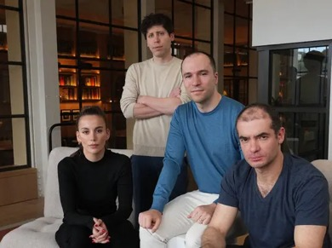
Why Sam Altman was fired in 2023
In November 2023 Sam Altman was fired from OpenAI
Ilya Sutskever's deposition in the Elon Musk v. Sam Altman lawsuit reveals that he and Mira Murati plotted for over a year to remove Sam Altman from OpenAI
Ilya has created a 52-page memo and separate document about Greg Brockman to present to independent board directors (Helen Toner, Adam D'Angelo, and Tasha McCaulay) because he feared Sam would "make the discussions disappear" if he learned about them
This memo accused Sam of exhibiting "a consistent pattern of lying, undermining his execs, and pitting his execs against one another," with Ilya recommending termination as the appropriate action
Most screenshots and information came from Mira Murati, and Ilya used disappearing emails to prevent leaks
The deposition revealed several conflicts within OpenAI's leadership. Dario Amodei (before founding Anthropic) wanted Greg Brockman fired and himself placed in charge of all research, but Sam didn't accept or reject these conditions, which Ilya viewed as problematic
Ilya found board member Helen Toner's October 2023 article praising Anthropic and criticizing OpenAI "not far from obviously inappropriate" and discussed potentially removing her from the board with Sam
Within 24-48 hours of Sam's removal, Anthropic proposed merging with OpenAI and taking over its leadership. Ilya opposed the merger.
Ilya characterized the removal process as "rushed" due to the board's inexperience in board matters
https://www.youtube.com/watch?v=mGBh2EAk7j0

Slide 18

IT Projects Costs are now 10x lower
Software projects that previously cost $200K and took 6 months now cost around $20K and complete in 6 weeks.
Where Savings Come From
  Requirements Gathering by LLM
  Development Efficiency using AI Coding
Large dev companies haven't reduced prices despite lower costs, so smaller companies can now underbid competitors
Recommendations for Hiring
  Ask if developers use AI coding tools
  Request prototypes after 1 week with $5,000 budget
  Start with time-boxed projects around $25,000
  Build trust through smaller tests before committing to large builds
99% of projects should start under $50K to maintain momentum and avoid feature creep
https://medium.com/realworld-ai-use-cases/how-has-ai-changed-the-cost-of-software-20-000-is-the-new-200-000-5f98ae364e24

Slide 19
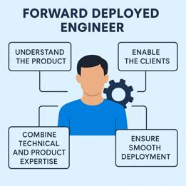

FDE - Hottest new job in AI
A Forward-Deployed Engineer (FDE) is a software engineer who embeds directly with customer teams on-site (or work closely) to build and deploy custom AI solutions tailored to their specific business problems.
AI implementation has become the new bottleneck - the challenge is no longer building models, but deploying them effectively in complex, real-world environments.
OpenAI established its FDE team at the start of 2025 and expects to grow it to about 50 engineers this year. Anthropic, and Cohere are rapidly hiring these hybrid professionals too.
The term “forward-deployed” originates from the military (like "airborne troops") and was popularized by Palantir, which sends embedded engineers into client environments to co-create solutions.
The role has been dubbed "the hottest job in tech" by venture capital firm a16z (Andreessen Horowitz)
FDEs command top salaries due to their high-impact nature. Many FDEs become trusted advisors within organizations and later transition to founding startups or leadership roles, thanks to their unique blend of technical and business experience
FDE is the Hottest new job in AI. Job listings for FDEs have surged over 800% in 2025. A year ago the hottest AI job was prompt engineer

Slide 20
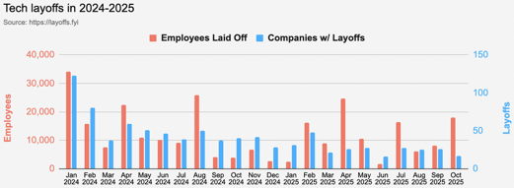
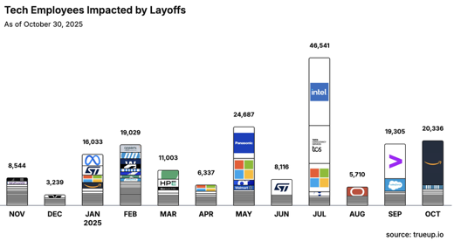
Jobs
https://layoffs.fyi
https://trueup.io/layoffs
Tech Layoffs by year (US only):
  112.7K in 2025 (as of October 30)
  153K in 2024
  264K in 2023
  165K in 2022 https://layoffs.fyi
The Tech Layoff Tracker
So far in 2025, 177,097 people laid off (584 per day)
In 2024, 238,461 people laid off (653 per day)
https://trueup.io/layoffs

Slide 21


About the Speaker
Lev Selector, Ph.D.
40+ years of software engineering, data science, and building teams (hiring, training, and managing)
Ph.D. in mathematical modeling and computer simulations
Interests:
Generative AI, Using LLM with your data
Local AI for Local Private Data
Cloud architecture, fin-tech, application security
Find/connect: Linkedin, GitHub, YouTube, Google
https://eais.ai
Enterprise AI Systems

Slide 22
Thank You!

