Slide 1
AI Updates - Dec 12, 2025
OpenAI
10 Years
- "The Year Everything Changed - Again"
- "East Meets West in the Race to AGI"
- "From Benchmarks to Business"
Crowd-sourced "LM Arena" Leaderboard
Devstral-2
NeurIPS 2025
Molmo Vision Language Model
GPT-5.2 on Dec 11 ??
Agentic AI Foundation
Neo Browser with Local AI
OpenAI and Disney $1B licensing deal
Amazon Nova AI automation on AWS Bedrock
Krea AI Node App Builder
Pentagon Ordered to Monitor for AI Threats
SpaceX IPO in mid-2026 ?
DeepSeek V3.2 - December 1
Chinese AI Agents
GLM-4.6
Google Gemini 3 vs Perplexity AI
OpenAI's 2025 State of Enterprise AI report
Agentive - AI for Auditors
HRM - Hierarchical Models
Postgres vs Pinecone for AI Projects
Ai Smart Glasses with Chat GPT on Amazon
Real-ESRGAN - Open Source Image Restoration
NVIDIA NVQLink open architecture
Gemini Flash, Pro, Deep Think
Gemini Deep Research Agent via API
AI in Google Workspace
Google Titans Transformer-2
Product Management & AI
Build a $5K/Mon Business in 15 Min
US AI Regulations - Federal & State
AI and robotics - Moonshots Dec 9
Boom Supersonic 42 MW Generator
World Models
Jobs, Layoffs, demand for AI Engineers

Slide 2
Crowd-sourced "LM Arena" Leaderboard
Data for December 10
Starting Elo rating = 1000
https://en.wikipedia.org/wiki/Elo_rating_system
English - https://lmarena.ai/leaderboard/text
Coding - https://lmarena.ai/leaderboard/text/coding
Model | Score
gemini-3-pro | 1492
grok-4.1-thinking | 1478
claude-opus-4-5-20251101-thinking-32k | 1470
claude-opus-4-5-20251101 | 1467
grok-4.1 | 1465
gpt-5.1-high | 1457
gemini-2.5-pro | 1451
claude-sonnet-4-5-20250929-thinking-32k | 1450
claude-opus-4-1-20250805-thinking-16k | 1448
claude-sonnet-4-5-20250929 | 1445
gpt-4.5-preview-2025-02-27 | 1443
claude-opus-4-1-20250805 | 1441
chatgpt-4o-latest-20250326 | 1440
gpt-5.1 | 1437
gpt-5-high | 1436
o3-2025-04-16 | 1433
qwen3-max-preview - 1T params | 1433
grok-4-1-fast-reasoning | 1428
ernie-5.0-preview-1103 - 2.4T params | 1428
kimi-k2-thinking-turbo - 1T params | 1426
gpt-5-chat | 1425
glm-4.6 355B | 1425
qwen3-max-2025-09-23 1T params | 1423
deepseek-v3.2-exp 671B | 1423
Model | Score
claude-opus-4-5-20251101-thinking-32k | 1539
claude-sonnet-4-5-20250929-thinking-32k | 1526
gemini-3-pro | 1520
claude-opus-4-1-20250805-thinking-16k | 1514
claude-opus-4-5-20251101 | 1514
grok-4.1-thinking | 1505
claude-sonnet-4-5-20250929 | 1504
claude-opus-4-1-20250805 | 1499
claude-opus-4-20250514-thinking-16k | 1495
grok-4.1 | 1488
gpt-5.1-high | 1486
qwen3-max-preview 1T params | 1481
kimi-k2-thinking-turbo 1T params | 1480
claude-haiku-4-5-20251001 | 1477
gpt-5.1 | 1476
longcat-flash-chat 560B params | 1474
qwen3-max-2025-09-23 1T params | 1474
deepseek-v3.2-exp-thinking 671B | 1470
gpt-5-high | 1470
qwen3-235b-a22b-instruct-2507 235B | 1470
gemini-2.5-pro | 1469
claude-sonnet-4-20250514-thinking-32k | 1469
mistral-large-3 | 1467
deepseek-v3.2-exp 671B | 1467
Google Gemini
x.ai
Claude
OpenAI
x.ai
Open Source
x.ai
https://lmarena.ai/leaderboard/text
Design Arena -
https://www.designarena.ai
https://openlm.ai/chatbot-arena/
https://beta.lmarena.ai
Web Leaderboard - 1T params
https://web.lmarena.ai/leaderboard
LLM Leaderboard - by @LlmStats -
https://llmworld.net/llm_leaderboards/
LLM Leaderboard - by StackAI -
https://www.stack-ai.com/llm-leaderboard
LLM Leaderboard - by Artificial Analysis -
https://artificialanalysis.ai/leaderboards/models
Open LLM Leaderboard - by Hugging Face -
https://huggingface.co/open-llm-leaderboard
LLM Leaderboard - by Vellum -
https://www.vellum.ai/llm-leaderboard
AI Benchmarking Hub -
https://epoch.ai/data/ai-benchmarking-dashboard
Grok 4 Benchmarks -
https://artificialanalysis.ai/models/grok-4
x.ai
China
China
China
China
China
x.ai
China
China
China
China
China
China
Mistral
China
China

Slide 3
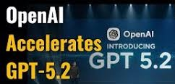
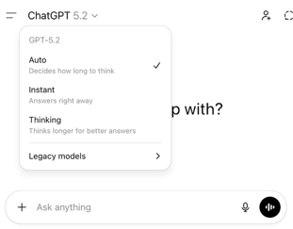

OpenAI GPT-5.2
GPT-5.2 - December 11
https://openai.com/index/introducing-gpt-5-2/
"Most advanced frontier model for prof. work and long-running AI agents"
Three Model Variants: Instant, Thinking, Pro (more thinking)
All 3 variants have 400K input tokens and 128K output tokens length
Examples: creating spreadsheets, building presentations, coding, image interpretation, understanding lengthy contexts, tool usage, and managing complex multi-step projects
The model introduces new features that manage what it "knows" and "remembers" to improve accuracy
Context window length 400,000 tokens for Thinking and Pro
Hallucination rate ~1% for Thinking
Updated knowledge cutoff date of August 31, 2025
Available via API. Price $/1M in/out:
gpt-5.2 instant 1.75 / 14.0
gpt-5.2 thinking 1.75 / 14.0
gpt-5.2-pro 21.0 / 168.0
gpt-5-pro 15.0 / 120.0
Gemini 3.0 Pro 2 / 12
Claude 4.5 Sonnet 3 / 15
Claude 4.5 Opus 5 / 25
GPT-5.2 Pro may take long time (up to 40 min) when using extended thinking
Also OpenAI develops a new model code-named "Garlic" - to be released in early 2026 - outperforming both Google's Gemini 3
and Anthropic's Claude Opus 4.5 in coding and reasoning tasks (according to Openai tests)

Slide 4
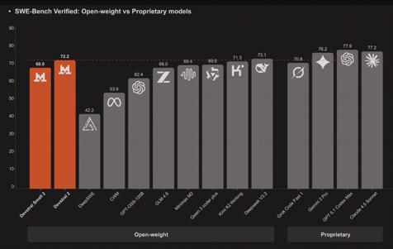
Devstral-2
Mistral AI released Devstral 2 and Devstral Small 2 Dense Models
Devstral 2 : 123B params, 256K tokens, 72.2% on SWE-bench Verified
Devstral Small 2 : 24B params, 256K tokens, 68.0% on SWE-bench Verified
Devstral 1 : 24B params, 128K tokens, 53.6% on SWE-bench Verified
Devstral 2 is 7x more cost-efficient than Claude Sonnet 4.5 at real-world tasks, despite being 8x smaller than competitors like DeepSeek V3 and Kimi K2
The new version excels at multi-file edits, complex refactoring operations, and seamless integration into agentic workflows
It emphasizes context awareness, allowing it to understand broader business context rather than just generating isolated code snippets
Both versions support on-premises deployment and custom fine-tuning
Devstral 2 needs four H100 GPUs
Devstral Small 2 can run entirely offline on a single GPU or laptop
In human evaluations, Devstral 2 outperformed DeepSeek V3.2 with a 42.8% win rate versus 28.6% loss rate
However, Claude Sonnet 4.5 still maintains an edge, winning 53.1% of comparisons
https://mistral.ai/news/devstral-2-vibe-cli
https://openrouter.ai/mistralai/devstral-2512:free
Post-introductory pricing for 2 & 2small:
$0.40/$1.20 & $0.10/$0.30 per Mln tokens in/out
Mistral also launched Vibe CLI, an open-source CLI coding assistant

Slide 5
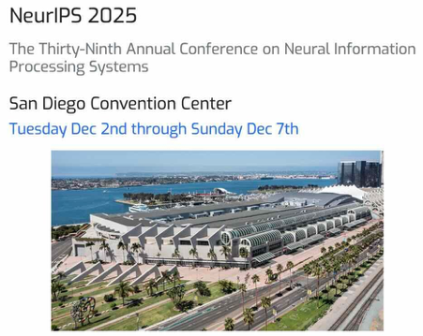

NeurIPS 2025
NeurIPS 2025, held December 2-7 in San Diego
It is 39th conference (first held in 1987)
29,000 registrants (a 50% increase from the previous year)
5,300-6,000 papers, making it one of the largest ML conferences to date
Chinese dominance with Alibaba winning the best paper award and Mandarin being the most-heard language in hallways
American frontier AI labs have "gone dark" and stopped publishing research, while Chinese labs continue to publish openly
The conference centered on three dominant areas:
LLMs, Multimodality, RL; Also diffusion models for computer vision
766 papers on Reasoning research
Best paper awards - diffusion model theory, self-supervised reinforcement learning, and attention mechanisms for LLMs
One notable award went to "Why Diffusion Models Don't Memorize: The Role of Implicit Dynamical Regularization in Training,"
Another best paper resolved a 30-year-old open problem concerning the power of unlabeled data in online learning
Research contributions from industry labs like NTT (Nippon) demonstrated practical applications including efficient LLMs running on single GPUs, decentralized AI systems, optical fiber sensing with transformers, and AI security through watermarking techniques
https://www.paperdigest.org/2025/11/neurips-2025-papers-highlights/

Slide 6
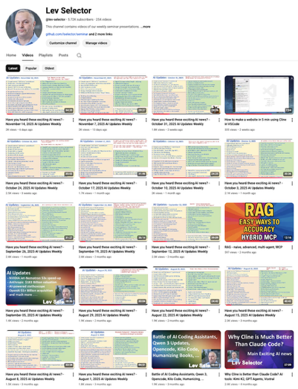
We do these weekly videos every Friday
Stats: 5.84K subscribers, 257 videos
Subscribe to this channel
https://www.youtube.com/@lev-selector
Download slides from GitHub using links under the videos
Please pause the video - and answer the pinned question in comments under the video

Slide 7
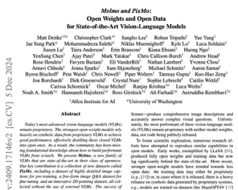

Molmo Vision Language Model
A 24-year-old researcher Matt Deitke received a $250 Mln personal offer from Meta's Superintelligence Lab
Matt was a lead developer on the Molmo project, then co-founded Vercept - a startup focused on autonomous AI agents
Deitke's expertise in multimodal AI, embodied AI, and 3D computer vision aligned perfectly with Meta's focus on building versatile, human-like AI systems. His work on autonomous agents capable of real-world digital action represented cutting-edge capabilities Meta wanted for its Superintelligence Lab
Molmo project (2024)
Molmo is a vision-language model built entirely without proprietary systems - and completely open source
Most open VLMs rely on distillation from closed models like GPT-4 Vision (where a close model generates captions for images). This limits open models to rely on closed, it is like copying somebody elses homework
Molmo breaks this cycle using PixMo datasets:
.. human-spoken captions averaging 196 words (vs typical 11),
.. 2.3 million point annotations for spatial grounding, and
.. human-verified question-answer pairs.
The architecture uses overlapping image crops to preserve objects, efficient batching, and text-only dropout to strengthen visual understanding
Molmo can point to objects sequentially for counting, making reasoning verifiable
This first-principles approach demonstrates that high-quality human data can outperform synthetic data from closed models, enabling truly reproducible open multimodal systems
ArXiv Paper: https://arxiv.org/abs/2409.17146 - 50 authors
Official Project Page: https://molmo.allenai.org/blog​
GitHub Repository: https://github.com/allenai/molmo​
Allen AI Blog Post: https://allenai.org/blog/molmo​
PixMo-Docs Dataset Repository: https://github.com/allenai/pixmo-docs​
Matt Deitke's Website: https://mattdeitke.com​
The work shows thoughtful dataset design simplifies training while improving results, offering a path forward for independent AI research
Molmo was created and financed by the Allen Institute for AI (Ai2). Ai2 is a nonprofit research institute founded by the late Paul Allen, co-founder of Microsoft.
The project was led by Ali Farhadi, who explained that their goal was to make advanced multimodal AI more accessible to researchers, developers, and app creators

Slide 8
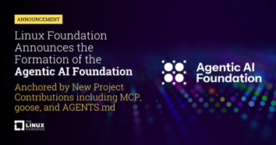


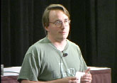
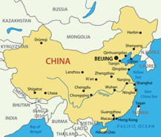
Agentic AI Foundation
Agentic AI Foundation - Anthropic and OpenAI donating MCP protocol and agents.md format respectively
Open Source Licensing
(1984, Richard Stallman)
GNU
Linux
Apache
MIT
GitHub
HuggingFace
Allen Institute for AI
China:
Qwen (Tongyi Qianwen division of Alibaba)
DeepSeek, Zhipu (Z.ai)
Beijing Academy of Artificial Intelligence (BAAI)
Zhiyuan Research Institute
OpenBMB from Tsinghua University
Baichuan, Moonshot AI, Ant Group,
Shanghai AI Laboratory,
China Telecom AI Research Institute

Slide 9
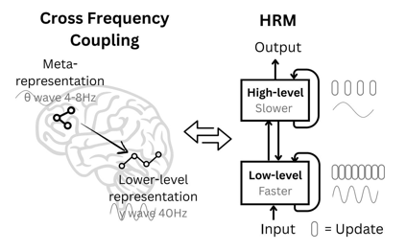
HRM - Hierarchical Reasoning Models
HRM - Hierarchical Reasoning Models
Developed by Sapient Intelligence (Singapore) that uses two inter-dependent recurrent modules to solve complex reasoning tasks
The high-level module handles slow, abstract planning while the low-level module executes rapid, detailed computations, mimicking hierarchical and multi-timescale processing in the human brain
With only 27 million parameters, HRM achieves exceptional performance on challenging problems like complex Sudoku puzzles and maze pathfinding using just 1000 training samples, without pre-training or chain-of-thought supervision
The model executes sequential reasoning in a single forward pass and gains enhanced effective depth through hierarchical convergence, allowing it to perform tasks that are intractable for even advanced large language models
The architecture consists of four components: an input network, low-level recurrent module, high-level recurrent module, and output network
https://www.youtube.com/watch?v=ZgwHaI2C-9s
https://arxiv.org/pdf/2506.21734
https://github.com/sapientinc/HRM - open source Apache 2.0
https://arxiv.org/pdf/2510.04871

Slide 10




AI Updates 2
Postgres vs Pinecone for AI Projects
https://medium.com/@ArkProtocol1/the-new-postgres-feature-that-just-killed-the-vector-database-hype-cycle-556146ed5961
PostgreSQL with pgvector extensions offers significant advantages over Pinecone for most AI projects, primarily due to lower costs and comparable or better performance
Recent benchmarks show that PostgreSQL with pgvectorscale achieves 28x lower p95 latency and 16x higher query throughput at 99% recall while costing only 25% of Pinecone's monthly price
Using PostgreSQL is much simpler. You can maintain structured data, vector data, and metadata together in one table - and query in one query. This simplifies maintenance and speeds-up queries
PostgreSQL is open-source and is universally everywhere. There are solutions for all operational tasks - backups, replication, etc. Teams can use familiar tools rather than learning new platforms with potentially incomplete SDKs or documentation
https://www.tigerdata.com/learn/pgvector-vs-pinecone
Ai Smart Glasses with Chat GPT on Amazon
Bluetooth Translation Glasses with 160+ Languages
$36 - https://www.amazon.com/dp/B0FBGNK5VN
Uses bluetooth to connect to your phone translation app
Face-to-Face Translation Mode: You tap the glasses and speak, your words translate to your phone app, then the other person speaks into your phone and the translation plays through your glasses speakers​​
Group Meeting Mode: Both parties speak into the phone and translations play through the phone's loudspeaker, functioning as a shared interpreter​
Call Translation: Provides real-time bilingual subtitles during voice or video calls
Real-ESRGAN - Open Source Image Restoration
AI used for upscaling and restoring degraded images
It extends the ESRGAN model to handle real-world image problems like blur, noise, and compression artifacts using neural networks trained on synthetic data
The project supports various applications including photo restoration, video enhancement, and specialized face enhancement through GFPGAN integration.​
https://github.com/xinntao/Real-ESRGAN/blob/master/assets/teaser.jpg

Slide 11
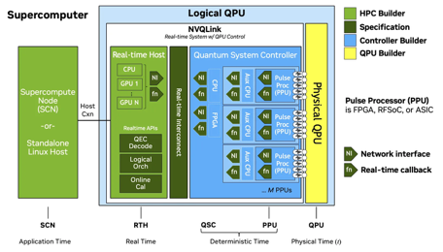
NVIDIA NVQLink open architecture
NVIDIA announced NVQLink open architecture
NVQLink is connecting quantum processors directly to GPU supercomputers for hybrid quantum-classical computing
The system enables microsecond-latency communication between quantum processing units and NVIDIA GPUs, allowing real-time error correction and control of fragile quantum systems
Announced at GTC in October 2025. More than a dozen additional supercomputing centers and national research institutions from Asia and Europe are now adopting NVQLink
NVQLink addresses quantum computing's major challenge: qubits are extremely fragile and error-prone, requiring constant monitoring and correction by AI-powered classical computers
The platform supports up to 400 Gbps throughput with sub-4-microsecond latency, enabling practical quantum error correction
Seventeen quantum hardware companies and nine major U.S. national laboratories are participating, positioning NVQLink as infrastructure for future quantum-GPU hybrid supercomputers
CEO Jensen Huang called it the "Rosetta Stone" of computing, predicting all future supercomputers will combine quantum processors with GPUs
Applications include drug discovery, climate modeling, materials science, and training more powerful AI models
https://www.youtube.com/watch?v=myx3De15iJY
https://nvidianews.nvidia.com/news/nvidia-nvqlink-quantum-gpu-computing
In practice, quantum computers are expected to be practical for "big compute on small data" - problems where the algorithmic depth and interference structure are complex but the final measurement output is small
GPUs remain better for "big data" problems that parallelize classically
Cryptography (RSA/ECC factoring), quantum chemistry simulation, and certain machine‑learning kernels are prime candidates for exponential quantum advantage

Slide 12
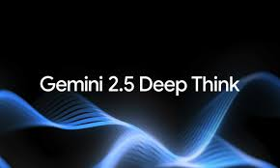

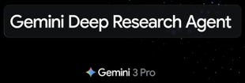
Gemini Flash, Pro, Deep Think
Gemini for $20/mo includes:
.. Fast = Gemini 2.5 Flash (April 2025)
.. Thinking with 3 Pro (November 18th, 2025)
.. Deep Research Tool - multi-step web research (December 2024)
"Deep Think" (released December 6-8, 2025) - only for Gemini Ultra users ($250/mo). "Deep Think" uses "parallel reasoning" - exploring multiple solution paths simultaneously before answering
Beats all other models ! But slow, expensive, not available via API yet
https://blog.google/products/gemini/gemini-3-deep-think/
https://gemini.google/overview/deep-research/
Google "Skyhawk" and "Seahawk" models on LM Arena
These may be Gemini 3.0 Flash or Gemini 3.5 models
Extremely fastl high-quality code output, and cost efficiency
Release is expected before New Year
https://www.youtube.com/watch?v=-aVFx7EU5hE
Gemini Deep Research Agent
You can now access the new powerful Deep Research agent using the Gemini API key from Google AI Studio and embed this into your apps
Also open-sourced DeepSearchQA benchmark to test agents on web research tasks
https://blog.google/technology/developers/deep-research-agent-gemini-api/

Slide 13
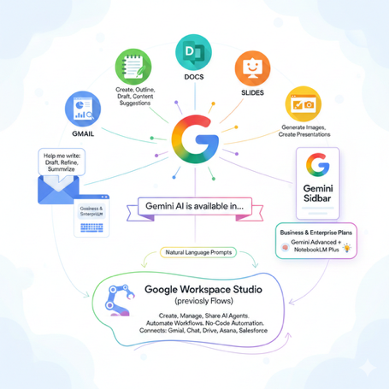
AI in Google Workspace
AI in Google Workspace
Gemini AI is available in Gmail, Docs, Sheets, Slides, Drive, Meet, ...
In Gmail, use Help me write to draft, refine, or summarize emails by entering prompts; In Docs, create documents from scratch or get writing assistance by asking Gemini to generate outlines, drafts, and content suggestions; In Sheets, Gemini can analyze data, create tables, generate formulas, and provide key takeaways from datasets; In Slides, generate images and create presentations with AI assistance
All apps have the Gemini sidebar
Business and Enterprise plans also include Gemini Advanced and NotebookLM Plus for advanced analysis and insights
Google Workspace Studio (previously called Google Workspace Flows) is a new feature in Google Workspace that allows users to create, manage, and share AI agents powered by Gemini to automate workflows across Workspace apps. Available with Business and Enterprise Workspace plans. It enables no-code automation of tasks using natural language prompts, connecting apps like Gmail, Chat, Drive, and external services such as Asana and Salesforce
https://workspaceupdates.googleblog.com/2025/12/workspace-studio.html
https://workspace.google.com/solutions/ai/
https://www.youtube.com/watch?v=igs5bw5P47s
https://support.google.com/a/users/answer/14628736?hl=en
https://blog.google/feed/google-workspace-generative-ai-features/

Slide 14
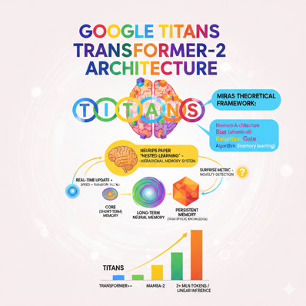
Google Titans Transformer-2
Google Titans Transformer-2 architecture
Titans = Transformers with Interleaved Attention and Neural Storage
Titans is an implementation of a MIRAS theoretical framework for sequence models. MIRAS includes Memory architecture, (attentional) bIas, Retention gate, and (memory learning) Algorithm
NeuroIPS paper "Nested Learning" - neuroscience inspired hierarchical memory system similar to human cognition
It uses 3 types of memory: Core (Short-term) Memory, Long-term Neural Memory , and Persistent Memory (stable storage for task-specific knowledge)
Titans can handle massive contexts much faster by updating core memory in real-time during operation, combining RNN speed with Transformer accuracy
Titans uses a deep neural network as a long-term memory module that actively learns and updates parameters as data streams in, rather than compressing information into fixed-size states
The architecture employs a surprise metric to detect unexpected information and selectively memorize only novel, context-breaking inputs, similar to how humans remember surprising events over routine ones
Titans outperforms Transformer++, Mamba-2, and even GPT-4 on extreme long-context tasks, successfully scaling to over 2 Mln tokens while maintaining efficient linear inference speeds
https://research.google/blog/titans-miras-helping-ai-have-long-term-memory/
https://medium.com/data-science-collective/google-introduces-transformer-2-0-with-a-neuroscience-inspired-architecture-cf7f0d8836a4
https://www.towardsdeeplearning.com/this-new-google-model-might-finally-fix-broken-ai-brains-74e6b3c985fc
https://www.youtube.com/watch?v=x8jFFhCLDJY
https://www.llmwatch.com/p/google-releases-transformer-20
https://www.llmwatch.com/p/beyond-attention-comparing-potential
https://www.youtube.com/watch?v=UMkCmOTX5Ow

Slide 15
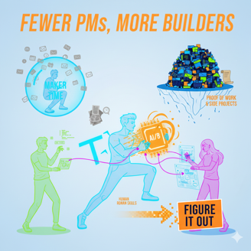
Product Management & AI
AI-native companies are hiring fewer PMs and favor small, extremely strong, T‑shaped teams where designers and engineers handle many traditional PM tasks ("T-shaped" - individuals who combine deep expertise in one specific area with broad knowledge and collaborative abilities across multiple disciplines.)
Classic big-tech PM patterns (heavy process, “stay in your lane,” lots of docs and meetings) are devalued
AI compresses idea‑to‑prototype cycles. PMs are now expected to actually build prototypes themselves
Courses and certificates signal little; proof of work and side projects matter most
As PMs rise in seniority, meetings crowd-out actual building, so they must aggressively protect maker time or even step back into IC roles, given AI-augmented IC leverage
Work intensity at AI startups clashes with parenting or other life constraints, so PMs must choose environments that match their reality
Human skills - aligning stakeholders, resolving conflict, reading the room - grow more important alongside technical building
The PMs who thrive will show "figure it out" energy, ignore rigid role boundaries, iterate fast, and let prototypes lead alignment
Overall, there will be fewer but more rewarding PM roles: faster-moving, closer to the product, and better suited to builders who combine AI-enabled execution with strong influence and honest life-choice tradeoffs
https://substack.com/inbox/post/168175609

Slide 16

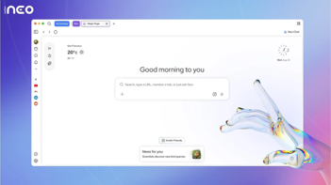

AI Updates - 3
Build a $5K/Mon Business in 15 Min (No Code, No Developers)
Use Abacus AI's Deep Agent - a no-code platform
It builds front-end, backend, database, payments processing, automated emails, authentication system, calendar scheduling, responsive design
The agent deploys instantly to live URLs and handles real transactions
Backend, databases, authentication - all handled by Abacus on the cloud.
https://www.youtube.com/watch?v=AbTHvit8w70
https://deepagent.abacus.ai
Neo Browser with Local AI
Neo is Norton's new AI web browser built for privacy, security, automation
It runs locally and keeps all your data locally on your device
Includes Norton WebShield security that blocks phishing and malicious sites, an AI sidebar for contextual help, inline text summaries and explanations, built-in ad blocking, image generation, and AI writing assistance
It has long-term memory to personalize based on your usage patterns
Neo automates research, content creation, and daily browsing tasks while maintaining complete user control over data syncing and storage
Neo is completely free and works across operating systems
https://www.youtube.com/watch?v=ztUwEI0oksY
OpenAI and Disney $1B licensing deal
Disney invests $1B into OpenAI and gives it a 3-year licensing deal giving Sora users access to 200+ characters from Disney, Marvel, Pixar, and Star Wars
Disney is also deploying OpenAI’s APIs across products and rolling out ChatGPT internally as part of a broader enterprise push
Disney also sent a cease-and-desist to Google on the same day

Slide 17

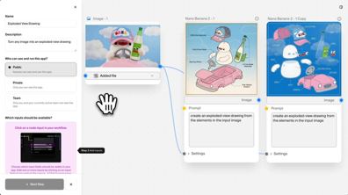
AI Updates - 4
Amazon Nova AI automation on AWS Bedrock
Examples: use API to handle lead qualification, customer support, inventory management, email responses, and appointment booking
Three versions: Nova Micro for text tasks, Nova Light for images and text, and Nova Pro for video and complex reasoning
Low cost compared to GPT
AWS security infrastructure, and scalability
Amazon reports 76% accuracy in issue resolution and 86% tool accuracy
The platform is designed for businesses running thousands of automated tasks
https://www.youtube.com/watch?v=WtakSx5lhcM
Krea AI Node App Builder
Convert complex AI workflows into standalone apps without coding
The feature builds on Krea's existing node-based system, which lets creators chain together over 50 AI models for image generation, video creation, upscaling, editing, and 3D work on a visual canvas
Once a workflow is built, Node App Builder packages it into a simple interface where anyone can input a prompt, click generate, and receive results without understanding the underlying complexity
This democratizes AI tool creation for marketers, agencies, designers, and small businesses, allowing them to automate repetitive tasks like generating branded video ads or product mockups while maintaining creative control and consistency
Users design workflows once with full control over models and parameters, then deploy them as scalable, reusable apps for teams or clients
The update transforms creators into toolmakers, enabling AI-powered automation and productization without hiring developers
https://www.youtube.com/watch?v=nzhaHXT1DE4
https://www.krea.ai/features/nodes
https://www.krea.ai

Slide 18
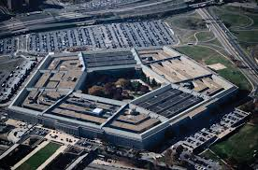

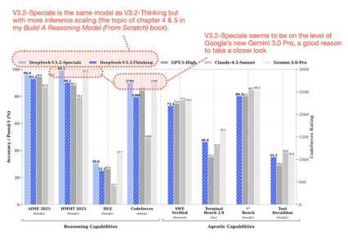
AI Updates - 5
Pentagon Ordered to Monitor for AI Threats
Pentagon has been ordered to prepare for AGI through a $900 billion defense bill requiring creation of an AI futures steering committee by April 2026 to monitor frontier AI threats and ensure human override capabilities for superintelligent systems
SpaceX IPO in mid-2026 ?
Valuations between $1.5-3 Trillion partly driven by plans for space-based AI data centers
DeepSeek V3.2 - December 1
Open-source, enhanced "reasoning first"
Hybrid reasoning architecture supports both thinking mode and non-thinking mode within a single model
V3.2-Speciale - uses 2-3 times more tokens to reason
Fine-grained sparse attention - improves long-text processing efficiency by 2-3x while reducing memory usage by 30-40%
Self-verification approach adopted from DeepSeekMath V2
Outperforming Claude Sonnet 4.5 in coding tests, cost less to run
671B MoE (37B active) - extremely fast and cost-efficient
Coding in Python, JavaScript, TypeScript, C++, and Rust, with strong debugging capabilities and context awareness
It uses multi-head latent attention and DeepSeek Sparse Attention to process information faster while maintaining accuracy, responding in 2-3 seconds versus 10 seconds for competitors
Major improvements in tool usage and agent capabilities
https://magazine.sebastianraschka.com/p/technical-deepseek

Slide 19
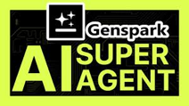
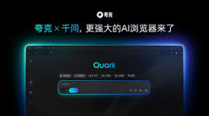
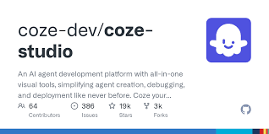
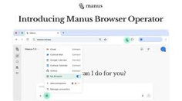
Chinese AI Agents
Genspark Super Agent - multi-step workflows, making phone calls, sending emails, scheduling meetings, managing calendars, multi-tool orchestration
https://www.genspark.ai
Quark AI Agent by Alibaba - research and automation assistant
Used by millions, handling report writing, data analysis, content generation, and integrating across Alibaba's e-commerce ecosystem with over 200 million users
https://www.investors.com/news/technology/alibaba-stock-ai-agent-quark-deepseek-cloud/
Coze Space by ByteDance - practical automation like creating apps without coding, generating reports with charts from spreadsheets, and integrating with ByteDance platforms including TikTok for video analytics and content scheduling
https://technode.com/2025/04/24/tiktoks-owner-bytedance-launches-internal-beta-for-coze-space-an-ai-agent-collaboration-platform/
Manus Autonomous Agent - can now work with Google Drive; Users can now automatically update spreadsheets, generate new documents, search files by keywords, extract insights, create folders, and reorganize content without leaving Manus
https://www.youtube.com/watch?v=9VsMnpt2ntI
https://manus.im/blog

Slide 20
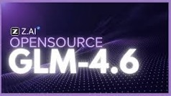
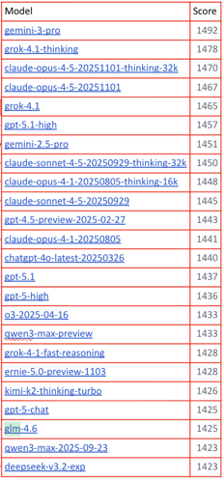
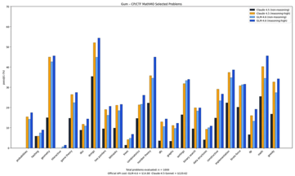
GLM-4.6
GLM-4.6 Open Weights from Zhipu AI
Released late September 2025
200K tokens context window, MIT-license
SOTA coding, reasoning, and agentic performance;
Performance close to Claude Sonnet 4
(not 4.5 - Sonnet 4.5 is still better)
GLM-4.6 costs $0.60/$2.20 per million tokens versus Claude Sonnet's $3/$15, making it approximately 5x cheaper on input and 7-8x cheaper on output
355B params MoE (32B active) - half the size of DeepSeek-V3 (671B) and one-third of Kimi K2 (1043B)
Power-efficient, using 15% fewer tokens than its predecessor; integrates well with agent frameworks
Available for local deployment or via major platforms and APIs
https://huggingface.co/zai-org/GLM-4.6
https://docs.z.ai/guides/llm/glm-4.6
https://openrouter.ai/z-ai/glm-4.6
https://www.youtube.com/watch?v=k0M320a-TXs
https://www.youtube.com/watch?v=i3kO_GOt2Bo
https://docs.z.ai/devpack/overview

Slide 21
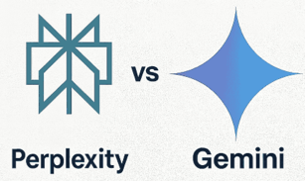
Google Gemini 3 vs Perplexity AI
Google Gemini 3 vs Perplexity AI
https://www.youtube.com/watch?v=EcDWK_ZyhFs
Gemini - provides comprehensive, structured answers with inline citations, analyzes uploaded form images. Enterprise users need Gemini's Google ecosystem integration, security features, and agent marketplace;
Perplexity delivered concise, focused responses with clear numbered sources and one-line explanations for each citation - perfect for content creators and researchers - speed, clarity, and verifiable sources;
Google aims to build an everything platform while Perplexity focuses on perfecting answer quality;
The recommendation is to use both tools for their respective strengths

Slide 22
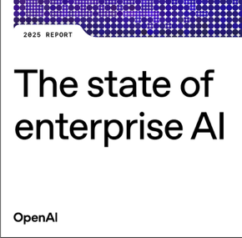
OpenAI's 2025 State of Enterprise AI report
OpenAI's 2025 State of Enterprise AI report
Significant growth, with ChatGPT now serving over 800 million weekly users and ChatGPT Enterprise experiencing 8x message volume growth since November 2024
The report indicates over one million businesses are paying for enterprise AI products, with 7 million paid employee seats
Key findings show that enterprise AI adoption is shifting from isolated usage to structured, workflow-driven integration
The primary constraints are no longer model performance or tooling but organizational readiness
Leading firms invest in system integrations, workflow standardization, governance, and executive sponsorship to drive success
The report shows that when 20 percent or more of team activity flows through custom AI tooling, efficiency gains become measurable and consistent
~25% of enterprises still have not connected AI to their core data systems, representing a significant opportunity for improvement
Case studies demonstrate measurable business results including revenue gains, improved customer satisfaction, faster product development, and cost savings
https://openai.com/index/the-state-of-enterprise-ai-2025-report/
https://cdn.openai.com/pdf/7ef17d82-96bf-4dd1-9df2-228f7f377a29/the-state-of-enterprise-ai_2025-report.pdf

Slide 23
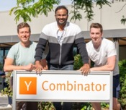
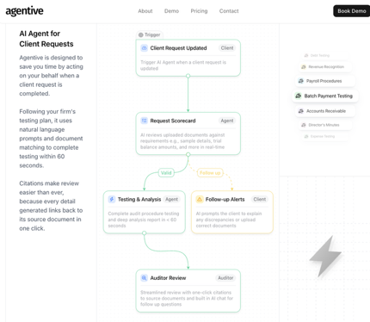
Agentive - AI for Auditors
Agentive - AI-powered audit workflow automation
Founded by Danny Albertson to help auditors automate the tedious parts of audit work, particularly test of details procedures
Agentive is purpose-built to help auditors request evidence from clients and automatically test that evidence using AI
The platform integrates directly into the audit workflow - when clients upload documents, AI agents automatically run pre-defined audit procedures and provide answers with citations within 60 seconds
This differs from generic AI assistants by embedding automation directly into the PBC (Prepared By Client) list and testing workflow
AI's improved ability to perform "function calling"allowed AI to independently work on complex tasks for extended periods, evaluate its own output, and decide next steps without constant human supervision
Agentive offers 2.5-hour training sessions where potential customers can actually use the product hands-on
In five years, Danny envisions junior auditors spending significantly less time on low-risk test of details work and more time on strategic discussions, audit planning, and higher-risk areas. AI agents will handle the preparation work while humans focus on review, professional judgment, and client relationships
Danny's strongest opinion: firms shouldn't sign three-year software contracts without trying the product first. He criticizes vendors that oversell capabilities and lock customers into long-term commitments based on demo presentations rather than actual product experience
https://www.youtube.com/watch?v=yR0ionORpEI
https://www.goagentive.com

Slide 24
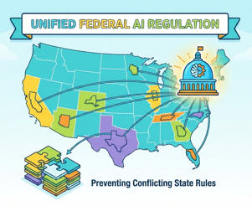
US AI Regulations - Federal & State
Trump signs (Dec 12) an executive order establishing federal-level AI regulation to prevent states from creating conflicting rules
He argues that allowing 50 states to independently regulate AI would harm American competitiveness in the global AI race
David Sacks, Trump's AI advisor, provides the legal rationale: AI development spans multiple states through training, inference, and internet delivery, making it interstate commerce under federal jurisdiction
Over 1,200 AI bills have been introduced across state legislatures with 100 already passed, creating regulatory complexity
The executive order would preempt state laws through an AI Litigation Task Force challenging state regulations in court
Sacks argues this prevents regulatory capture that benefits only large companies while harming startups unable to navigate 50 different compliance regimes
The framework excludes child safety laws, local infrastructure decisions, and copyright issues, which remain under existing jurisdictions
https://www.youtube.com/watch?v=g-v8RgL4ToI

Slide 25
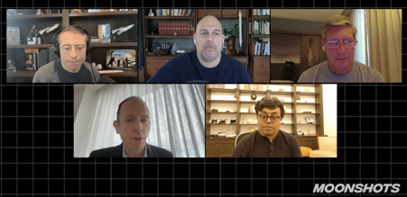
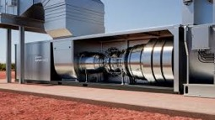
AI and robotics - Moonshots Dec 9
AI and robotics - Moonshots Dec 9
NeurIPS 2025 Conference - 29K registrants; Chinese dominance with Alibaba winning the best paper award and Mandarin being the most-heard language in hallways; American frontier AI labs have "gone dark" and stopped publishing research, while Chinese labs continue to publish openly
Race of AI Models - Google's Gemini 3 and OpenAI's GPT-5.2 (rumored for next week) leap-frogging each other on benchmarks
Google's Titans and Miras architectures enable 2 Mln token context windows (about 3,000 pages)
Visual Reasoning - Chain-of-visual-thought methods showing 3-6% performance gains
Gemini 3 Deep Think - uses parallel reasoning with fleets of agents working simultaneously
China is tripling AI accelerator (hardware) output to 500,000 units in 2026 through Cambricon in response to US export restrictions
Michael Dell's $6.25 Bln "Invest America" initiative gives every child born after January 1, 2025 a $1,000 investment account
AI majors are exploding in popularity at universities like MIT, though the curriculum is struggling to keep pace with demand
The overall theme emphasizes the unprecedented acceleration in AI development and the global race to achieve AGI
https://www.youtube.com/watch?v=zGD5mv-XKU0
Boom Supersonic 42 MW Generator
Natural Gas Turbine "Superpower" for AI data centers
Secured 1.25 Bln in orders

Slide 26
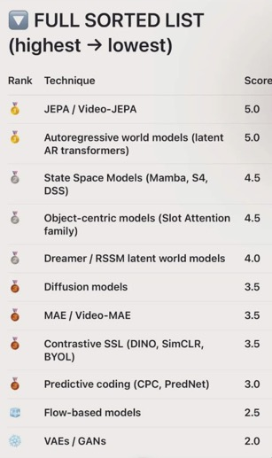

World Models
Some World Models
Genie 3 by Google DeepMind
Marble by World Labs (Fei-Fei Li)
V-JEPA 2 by Meta is an action-free joint-embedding-predictive world model
Habitat 3.0 by Meta is a simulation platform for robot-human work
Large Geospatial Model (LGM) by Niantic
Runway Gen-3 Alpha by Runway
WorldDreamer from China
Luma Dream Machine
Video Retrieval Augmented Generation (VRAG)
@yannlecun on threads:
https://www.threads.com/@YannLecun
@pentagoniac asked ChatGPT to "rank the most promising approaches to world models". Result is below. In Silicon Valley, almost everyone is LLM-pilled, except LLMs themselves
Yann LeCun has announced in November 2025 that he would depart Meta at the end of the year
after 12 years with the company—5 years as founding director of FAIR (Fundamental AI Research) and 7 years as Chief AI Scientist
LeCun is launching a new AI startup focused on Advanced Machine Intelligence (AMI), which aims to develop systems that understand the physical world, have persistent memory, can reason, and can plan complex action sequences
Despite leaving, Meta will remain a partner in LeCun's new company
LeCun may build his new company in Europe

Slide 27
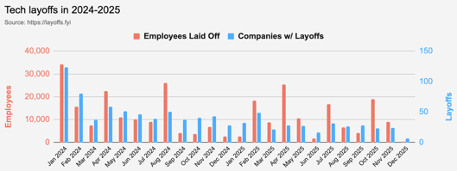
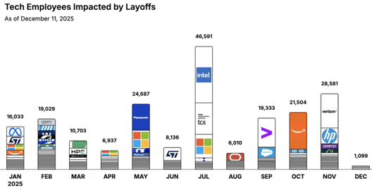
Jobs
https://layoffs.fyi
https://trueup.io/layoffs
Tech Layoffs by year (US only):
  123K in 2025 (as of December 11)
  153K in 2024
  264K in 2023
  165K in 2022 https://layoffs.fyi
The Tech Layoff Tracker
So far in 2025, 208,643 people laid off (605 per day)
In 2024, 238,461 people laid off (653 per day)
https://trueup.io/layoffs

Slide 28


About the Speaker
Lev Selector, Ph.D.
40+ years of software engineering, data science, and building teams (hiring, training, and managing)
Ph.D. in mathematical modeling and computer simulations
Interests:
Generative AI, Using LLM with your data
Local AI for Local Private Data
Cloud architecture, fin-tech, application security
Find/connect: Linkedin, GitHub, YouTube, Google
https://eais.ai
Enterprise AI Systems

Slide 29
Thank You!

