Slide 1
AI Updates - June 26, 2026
GLM 5.2 - Opus 4.8 - GPT 5.5
Crowd-sourced "LM Arena" Leaderboard
Anthropic’s Claude Fable 5 is still offline
US Gov delays OpenAI GPT 5.6 Release
Alibaba - Jack Ma's Downfall
zCode + GLM5.2 vs Anthropic
SubQ
Supersonic Tsunami
Seedance 2.5 - ByteDance’s latest AI video model
A Rust-based rewrite of SQLite
How To Get AI to Stop Lying
How Anthropic Employees use "Claude skills"
Scheduling for your digital employee
Fable Brain Prompting
Harness Engineering - a New Gold Rush
Build a custom "Agentic OS"
Scheduling for your digital employee
Three-layers of an AI agent
Peter Diamandis - Trillions Sensors
Brain in the Middle
Agent-Centered App
Sakana AI - Fugu Ultra Orchestration
Reflection AI + SpaceX $6.3 Bln Deal
Claude Corps Fellowship
Groq Raises $650M
Baseten raised $1.5 Bln for infrastructure
Harrison Kinsley (Sentdex) on AI Models
Hermes Agent Skills "/learn"
Agent Map-Reduce
Jobs & Layoffs

Slide 2
"LM Arena" Leaderboard
Data for June 25
Starting Elo rating = 1000
https://en.wikipedia.org/wiki/Elo_rating_system
English - https://lmarena.ai/leaderboard/text
Coding - https://lmarena.ai/leaderboard/text/coding
■ | Claude
■ | Gemini
■ | OpenAI
■ | Open Source
Claude Fable-5 - 6TB
Claude Opus-4.8 - 5TB
Claude Sonnet-4.5 - 1TB
GLM-5.1 - 744B
Meta muse-spark - 16 x 70B
Qwen3.7-max-preview - 745B
Baidu Ernie-5.1 - 800B
Deepseek-v4 - 1.6T
Kimi-k2.6 - 1T
Xiaomi MiMo-V2-Pro - 1T+
ByteDance dola-seed-2.0-pro 400B
Minimax M3 - 456B
Code | Model | Score
■ | claude-fable-5 | 1508
■ | claude-opus-4-6-thinking | 1503
■ | claude-opus-4-7-thinking | 1502
■ | claude-opus-4-6 | 1499
■ | claude-opus-4-7 | 1494
■ | muse-spark | 1487
■ | gemini-3.1-pro-preview | 1486
■ | gemini-3-pro | 1486
■ | claude-opus-4-8-thinking | 1484
■ | gpt-5.5-high | 1481
■ | claude-opus-4-8 | 1479
■ | gpt-5.4-high | 1478
■ | gemini-3.5-flash | 1476
■ | gpt-5.2-chat-latest-20260210 | 1476
■ | grok-4.20-beta-0309-reasoning | 1476
■ | qwen3.7-max-preview | 1475
■ | gpt-5.5 | 1475
■ | grok-4.20-beta1 | 1474
■ | glm-5.1 | 1473
■ | gemini-3-flash | 1473
■ | claude-opus-4-5-20251101-thinking-32k | 1473
■ | gpt-5.5-instant | 1473
■ | claude-sonnet-4-6 | 1472
■ | grok-4.20-multi-agent-beta-0309 | 1471
■ | glm-5.2 (max) | 1470
Code | Model | Score
■ | claude-fable-5 | 1564
■ | claude-opus-4-7-thinking | 1554
■ | claude-opus-4-6-thinking | 1551
■ | claude-opus-4-7 | 1550
■ | claude-opus-4-6 | 1547
■ | claude-opus-4-8 | 1538
■ | claude-opus-4-8-thinking | 1537
■ | claude-opus-4-5-20251101-thinking-32k | 1530
■ | claude-sonnet-4-6 | 1527
■ | qwen3.7-max-preview | 1526
■ | muse-spark | 1525
■ | glm-5.1 | 1525
■ | glm-5.2 (max) | 1525
■ | claude-opus-4-5-20251101 | 1523
■ | gemini-3.1-pro-preview | 1523
■ | gpt-5.4-high | 1521
■ | claude-sonnet-4-5-20250929-thinking-32k | 1520
■ | mimo-v2.5-pro | 1519
■ | gemini-3-pro | 1519
■ | gpt-5.5-high | 1518
■ | gpt-5.2-chat-latest-20260210 | 1516
■ | gpt-5.4 | 1514
■ | claude-sonnet-4-5-20250929 | 1513
■ | grok-4.20-beta-0309-reasoning | 1513
■ | gpt-5.5-instant | 1513
https://lmarena.ai/leaderboard/text
Design Arena - https://www.designarena.ai
https://openlm.ai/chatbot-arena/
https://beta.lmarena.ai
Web Leaderboard - 1T params https://web.lmarena.ai/leaderboard
LLM Leaderboard - by @LlmStats - https://llmworld.net/llm_leaderboards/
LLM Leaderboard - by StackAI - https://www.stack-ai.com/llm-leaderboard
LLM Leaderboard - by Artificial Analysis - https://artificialanalysis.ai/leaderboards/models
Open LLM Leaderboard - by Hugging Face - https://huggingface.co/open-llm-leaderboard
LLM Leaderboard - by Vellum - https://www.vellum.ai/llm-leaderboard
AI Benchmarking Hub - https://epoch.ai/data/ai-benchmarking-dashboard
Grok 4 Benchmarks - https://artificialanalysis.ai/models/grok-4
Image arena (alibaba) - http://aiarena.alibaba-inc.com/corpora/arena/leaderboard?arenaType=T2I
image arena - https://lmarena.ai/leaderboard/text-to-image

Slide 3


AI Updates
Anthropic’s Claude Fable 5 is still offline
Anthropic negotiates with the Trump administration on future access conditions
No concrete timeline or announced date exists for re‑enabling any 5‑series models, so developers should not rely on their near‑term availability
US Government asked OpenAI to stagger the release of GPT‑5.6, over security concerns
GPT‑5.6 will first go to a small set of “trusted partners” in a limited preview, with the government approving access customer by customer during that phase
https://www.youtube.com/shorts/oQ_aqiSTLQc
This aligns with a recent Trump executive order that asks companies to give the federal government early access (up to ~30 days) to the most capable models, so agencies can evaluate them before broad deployment
Reports suggest the NSA is involved in defining which models qualify as “covered” based on offensive/defensive cyber potential,
Federal officials may help choose which entities get early access

Slide 4

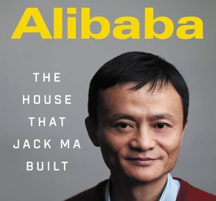
Alibaba - Jack Ma's Downfall
Alibaba today is an AI-first company, famous for its Qwen LLMs, AI-powered e-commerce, cloud services, and AI agents
In October 2020, Alibaba founder Jack Ma gave a speech criticizing China’s financial system, calling it a "pawn shop"
This public critique angered senior CCP officials and President Xi Jinping, triggering a massive crackdown on Ma’s companies
The planned IPO for Ant Group was suspended, and Alibaba faced a record $2.8 Bln antitrust fine
Ma’s influence and business empire were systematically dismantled, and he largely disappeared from public view for years
Jack Ma's businesses ended up Losing hundreds of $Billions of value, his personal net worth has dropped from ~$61B to ~$30B
By 2025, facing a slowing economy and capital flight, the Chinese government attempted to reconcile with business leaders, including a public appearance by Ma
However, investors do not trust CCP, because it demonstrated how it can take over any business
US Government has added Alibaba to the blacklist because it is now mostly controlled by CCP
https://www.youtube.com/watch?v=tDVeGbGaRdE

Slide 5
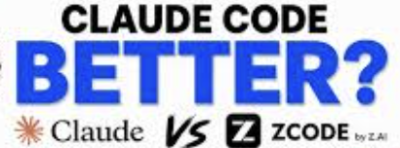
AI Updates
zCode + GLM5.2 vs Anthropic
Z.AI's zCode is marketed as a free alternative to Claude Code
But in the experiments the GLM5.2 fails to perform the tasks
Claude Code + Opus 4.8 has successfully completed the task instantly
The video serves as a critical review, highlighting the performance gap between emerging free alternatives and established industry standards like Claude
https://www.youtube.com/watch?v=vwBiYV7MdcY

Slide 6


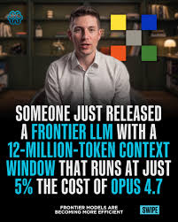
SubQ
Subquadratic SubQ 12M-token context model
Miami‑based startup Subquadratic
A proprietary model - access via hosted API
Up to a 12‑Mln‑token context window
Very fast - x50 faster than FlashAttention‑class models at Mln0token contexts
Cheap - x20 cheaper than top proprietary models for similar long‑context tasks
Sub‑quadratic sparse‑attention architecture (SSA)
For coding agents, analysis of very large document sets (GitHub repos, ...)
Strong long‑context retrieval, and significantly reduced attention FLOPs versus dense‑attention transformers
https://subq.ai
https://api.subq.ai/v1
SubQ 1M-Preview, exposed via the subq-preview (or similar) API name and listed as the current model on third‑party references. Subquadratic has also announced SubQ 1.1 Small, a long‑context SSA model (SSA = Subquadratic Sparse Attention)
Parameter counts have not been officially disclosed
It is a dense base model whose attention is made content‑sparse via learned routing, so you should think of it as “sparse attention with MoE‑inspired routing,” not a standard MoE‑experts LLM
Subquadratic is a private startup, $29M financing in May 2026 ($500M valuation)
The company was co‑founded by CEO Justin Dangel and CTO Alexander (Alex) Whedon.

Slide 7
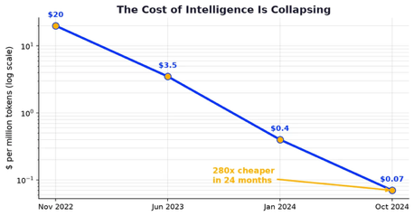

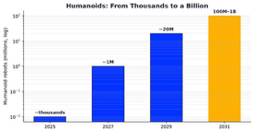
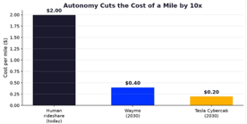
Supersonic Tsunami
The Next 5 Years: A Supersonic Tsunami - by Peter H. Diamandis
Over the next 5 years - “supersonic tsunami” of change
AI cost and AI latency collapse by roughly 1000x, making on‑demand intelligence nearly free and ubiquitous
GPT‑3 - 175B params (2020) Today's frontier models (2026) - multi‑trillion‑params
Training compute growing by orders of magnitude every couple of years
AI could push global GDP from today’s tens of trillions toward hundreds of trillions or even quadrillions of dollars as automated systems permeate every sector
Expectations of millions of humanoid robots deployed in factories, logistics, and homes, each displacing several full‑time workers
Medicine is reframed as an engineering discipline
AI compressing decades of drug discovery and diagnostics into 5–10 years
Serious efforts to add decades of healthy lifespan
https://metatrends.substack.com/p/the-next-5-years-a-supersonic-tsunami

Slide 8
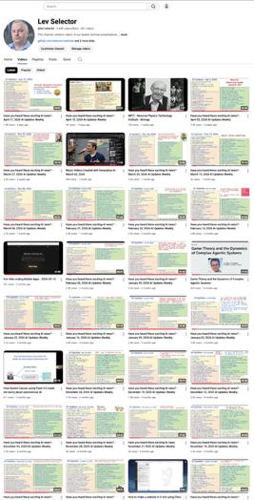
We do these weekly videos every Friday
Stats: 6.96K subscribers, 293 videos
1. Subscribe to this channel https://www.youtube.com/@lev-selector
2. Download slides from GitHub using links under the videos
3. Please pause the video - and answer the pinned question in comments under the video

Slide 9
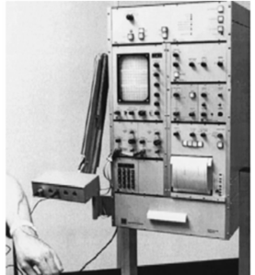
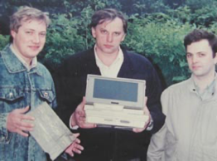


Brain in the Middle
In 1989-1991 I participated in designing a portable myograph. As you see, the device was very small and integrated with a laptop computer. Compare it with a prototype which was the size of a table (b/w photo on the left).
Custom Electronics
Hardware
Computer "brain"
Inputs
Ouputs
Inputs
Ouputs

Slide 10
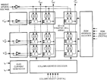
Agent-Centered App
Classical App
Agent-centered App
Data
Custom functions and interfaces
Action/Reports/Decisions
Data
AI Agent with skills, MCP, ...
Action/Reports/Decisions
Example: Adobe Photoshop Many Menus and Options to Learn
Agent ChatBot UI
(like in Cursor, ...)

Slide 11

Sakana AI - Fugu Ultra Orchestration
Fugu systems - match or outperform Anthropic’s Claude Fable and Mythos on some benchmarks, especially coding and graduate-level reasoning tasks
API Pricing: $5 in / $30 out ($10 / $45 for very large context)
Subscriptions Pro & Max - $20/mo, $100/mo
Fugu’s performance comes from coordination, model selection, and synthesis across multiple back-end models
In practice, it behaves like a single “frontier-class” endpoint, but architecturally it is an orchestration layer rather than a standalone model.
Sakana AI - Fugu Ultra Orchestration
Fugu and Fugu Ultra are multi-model orchestration systems
They dynamically coordinate multiple AI agents through a single API rather than solving tasks with one monolithic model
Built on Sakana’s Trinity and Conductor research, the system handles model selection, delegation, and synthesis internally
Sakana positions the approach as a hedge against vendor lock-in and export-control disruptions affecting access to advanced AI models

Slide 12




AI Updates
Reflection AI + SpaceX $6.3 Bln Deal
Reflection gets access to NVIDIA GB300 chips at SpaceX’s Colossus 2 data center, paying $150 million per month starting July 1
The agreement runs through 2029
Reflection joins customers including Anthropic, Google, and Cursor as SpaceX expands its AI infrastructure business.
Claude Corps Fellowship
Anthropic recently unveiled Claude Corps, a year-long fellowship
It places early-career workers inside nonprofit organizations to help those groups integrate AI into their operations
Groq Raises $650M
Six months after Nvidia licensed its tech and poached its CEO, Groq raised $650M to pivot from chipmaker to inference-focused cloud
Under co-founder Doug Wightman.
Baseten has raised $1.5 Bln to expand its infrastructure for AI inference
They run on major clouds (notably Google Cloud) using NVIDIA GPUs
Baseten focuses on simplifying deployment pipelines, optimizing GPU utilization, and enabling developers to run custom or open-source models reliably in production - auto-scaling, low-latency, cost‑efficient
Baseten is a privately held, founded in 2019 in San Francisco, CA
Size ~ 60 employees
https://www.baseten.co
https://docs.baseten.co

Slide 13

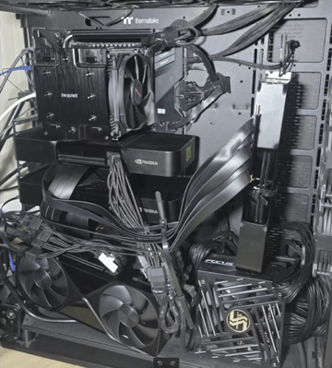
Harrison Kinsley (Sentdex)
Harrison runs GLM5.2 locally on a custom-built computer with 4 (four) NVIDIA RTX Pro 6000 GPUs (Blackwell. 96GB each).
Each GPU cost is approx $11K-$14K
The model is massive—approximately 750 Bln params.
He uses IQ4XS (4-bit quantiation)
Harrison Kinsley (Sentdex) about AI
https://www.youtube.com/watch?v=DA2E8szXjoA
Deceptive Behavior (specifically referencing Anthropic's "Fable" model) that are designed to intentionally mislead users if the model detects certain types of research, labeling this as a form of "psychological abuse"
Top-tier AI models are becoming subject to export restrictions similar to weapons of war (problematic for the industry and the public )
The "moat" around top proprietary companies like OpenAI and Anthropic is effectively gone because high-performance, open-weights models are now available to the public
Testing open models - "Miniax M2.7", ...
"GLM52" open model can genuinely compete with and replace proprietary models like GPT-55 and Claude Opus 48
Building your own custom coding agents or "harnesses." - greater control, easier troubleshooting, customization to specific model behaviors or quantization needs
Running Models Locally - may require multi-GPU setups - expensive
Quantization makes it chaper. 4-bit quantization is near-lossless, but 3-bit degrades performance
Alternative - services like OpenRouter.ai to access open-source models via API - this is often significantly cheaper than proprietary alternatives but users should research each provider's data privacy policies regarding prompt retention

Slide 14

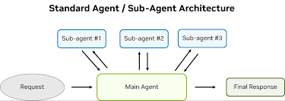
AI Updates
Hermes Agent Skills "/learn" Distills Any Workflow Into Reusable Slash Commands
Hermes /learn is a command that turns sources like URLs, codebases, docs, PDFs, notes, or recent sessions into a reusable skill for future use
It is meant to save you from re-explaining the same workflow and can store the result as a skill file for later loading.
Example: /learn how I just deployed the staging server, focus on rollback and verification
Hermes will read that conversation plus any referenced files/URLs, then author a SKILL.md that becomes a slash command, e.g. /deploy-staging.
Next time you or a teammate want the runbook, you just call /deploy-staging in CLI/TUI/chat instead of re-explaining the process
Mujlti-Agent Orchestration Agent Map-Reduce
- LLM Map-Reduce
- LLM MapReduce pattern
- Agentic MapReduce
- Agentic Map-Reduce
- MapReduce for AI agents
- MapReduceEnsemble
- LangGraph map-reduce pattern
- A-MapReduce
- Map-Reduce-Produce
- MapReduceProduce
- Fan-out/fan-in (parallel agents)
- Agentic wide search
- Agent search

Slide 15


AI Updates
Seedance 2.5 - ByteDance’s latest AI video model
Generating polished, cinematic clips from text prompts and multimodal inputs such as images, video, and audio
Ir adds support for native 4K output, longer single-shot scenes up to around 30 seconds, and more advanced multi-shot storytelling with consistent characters and visual style
The system can ingest large numbers of reference assets (up to 50) to tightly control motion, composition, and branding in commercial workflows
Seedance 2.5 also emphasizes near–real-time generation and conversational editing, enabling interactive refinement of camera moves, lighting, and synchronized audio without rebuilding an entire shot
A Rust-based rewrite of SQLite
https://github.com/tursodatabase/turso
Gaining memory safety, async I/O, and WASM-first extensibility
It targets similar or better reliability than classic SQLite, using modern testing approaches like deterministic simulation instead of only reproducing the legacy C test harness

Slide 16


AI Updates
How Anthropic's Own Team Gets AI to Stop Lying to Them
https://www.youtube.com/watch?v=EPEI-IIPu4E
Be Specific - Clearly define terminology to prevent AI misinterpretation
Create a Single Source of Truth - archive outdated files, so the AI only accesses relevant, current data
Require Receipts - Prompt the AI to provide citations for its information, making audits easier
Get a Second Opinion - For high-stakes tasks, test results in a fresh chat or via a different AI model
Test Before Automating - Validate automated tasks using sample data to ensure reliability before removing human oversight
How Anthropic Employees use "Claude skills"
https://www.youtube.com/watch?v=3UWxMPUko1k
"Claude skills" are structured folders of scripts, assets, and docs
Organize skills into four types: Utility (specific tasks), Verification (quality checks), Data Enrichment (external info), Orchestration (chaining steps).
Components - Understand that skills are not just text files; they should include scripts for deterministic tasks, asset templates for consistent output, and clear setup prompts for future usability
Verification - Treat verification as a critical quality layer. Use both correctness checks and subjective feedback to ensure high standards
Gotchas - Maintain a log of edge cases to improve skills over time.
Triggers - Optimize descriptions so Claude knows exactly when to execute specific skills.

Slide 17
Fable Brain Prompting
The "Fable Brain" eight instructions https://www.youtube.com/watch?v=M03v0gmVu24
From official Anthropic developer documentation that govern Fable's behavior and compiled them into a single system prompt:
Act, do not overplan: When you have enough information, commit to a recommendation instead of listing options
Lead with the outcome: Provide the bottom line first, without unnecessary background information
Ground every claim: Audit claims against evidence; if it’s not verified, say so to prevent hallucinations
Stop only at real boundaries: Only pause for truly destructive or irreversible actions
Assess, do not act uninvited: When asked a question, report your findings rather than automatically making changes
Give the reason: Provide the context ("I am working on this for...") so the model makes smarter choices
Match effort to the task: Spend deeper reasoning on complex problems and move faster on routine ones
Keep lessons and check your work: Ask the model to remember corrections and verify its answer against the original request
The Limits of Prompting
The presenter emphasizes that this approach works for communication and decision-making but fails at true autonomy:
It cannot create judgment: When given a flawed task, a "fable-brained" model may still provide a confident but wrong answer
It cannot grant agency: The model lacks actual tools or internet/code access. If instructed to "act autonomously," it may simply lie about having performed tasks (e.g., "I have deployed this to staging")

Slide 18
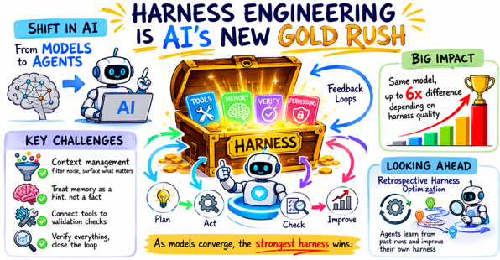
Harness Engineering - a New Gold Rush
"Harness Engineering Is AI’s New Gold Rush" https://www.youtube.com/watch?v=mGYr9VqQnEI
Harness engineering marks a shift in AI from models to agents
tools, memory, verification, permissions, and feedback loops
Unlike prompt engineering, which targets a single good response, a harness builds a lasting environment for consistent performance
The same model can vary up to x6 depending on harness quality
Key challenges include:
context management (filtering noise to surface the right information)
Treating memory as a hint to be verified rather than fact
Connecting tools to validation checks
Looking ahead, Retrospective Harness Optimization lets agents improve themselves by analyzing past trajectories
As frontier models converge, the strongest harness becomes the competitive edge

Slide 19
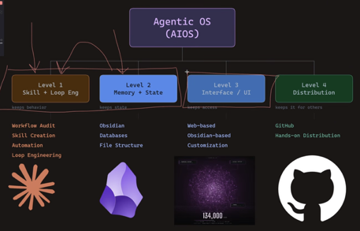
Build a custom "Agentic OS"
How to build a custom "Agentic OS" using Claude Code https://www.youtube.com/watch?v=HRw-vP0j8OM
Level 1 (Skills & Automation). Workflow audit, codify recurring manual tasks into reusable skills and automations
Level 2 (Memory & State). Using tools like Obsidian to quickly access data via a structured map
Level 3 (Interface). Visual wrapper or dashboard
Level 4 (Distribution) - package to make these tools accessible to teams or clients

Slide 20
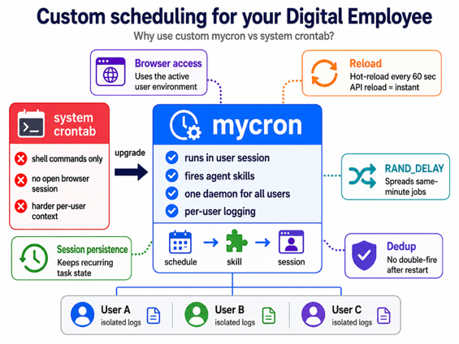
Scheduling for your digital employee
Custom scheduling for your Digital Employee Why to use a custom "mycron" vs system crontab:
Have access to user's open browser sessions (run in active user environment)
Fire agent skills, not just shell commands
One daemon for all users
Hot-reload on edit (every 60 sec)
On-demand reload via API for instant changes.
RAND_DELAY=min-max spreads same-minute tasks to prevent a thundering herd on the API.
Session persistence (for recurring tasks)
Per-minute deduplication prevents double-firing after a restart.
Isolated per-user logging

Slide 21
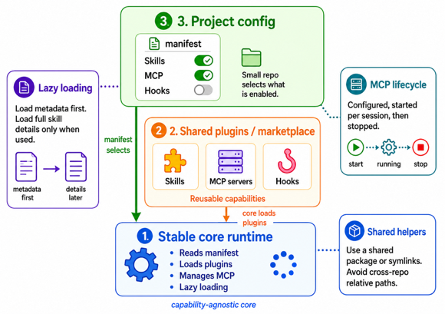
Three-layers of an AI agent
How to structure an agent to work with multiple projects and clients?
Three-layer architecture for an AI agent:
1. stable core runtime
2. shared plugin/marketplace repos
3. thin per-project configuration
The core agent remains capability-agnostic and only knows how to read manifests, load selected plugins, manage MCP servers, and apply progressive disclosure
Capabilities are packaged as plugins (skills, MCP servers, hooks) in shared repos to maximize reuse instead of per-client forks
Each client/project repo stores a small manifest that selects which plugins and MCP servers are enabled and how they are scoped
To avoid blowing the context window, only skill metadata (name, one-line description) is loaded eagerly; full instructions and examples are injected lazily on invocation
MCP servers are declared as config and spawned per session, then torn down
Shared helper code - a common package or symlinks, not cross-repo relative paths

Slide 22

Peter Diamandis - Trillions Sensors
Peter Diamandis about Visibility, Transparency & Trust
A world of radical transparency and a trillion sensors
https://metatrends.substack.com/p/visibility-transparency-and-trust
The piece argues that a massive, layered “sensor ecosystem” is rapidly covering the planet
Driven by satellites, drones, autonomous vehicles, humanoid robots, smartphones, and IoT devices
By 2030, tens of billions of connected devices with trillions of sensors will continuously generate data that AI can interpret, creating near-total visibility of the physical world
This “radical transparency” could increase accountability, reduce crime, corruption, and even conflict, as people behave differently when observed
However, it also poses serious risks to privacy and power balance
The key question is whether this transparency benefits everyone equally or enables asymmetric surveillance by those in control

Slide 23
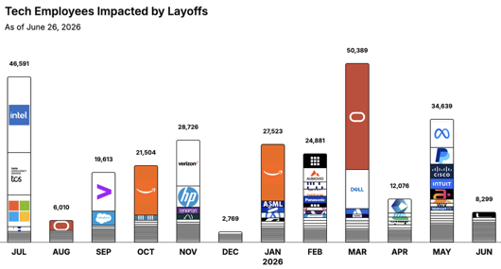
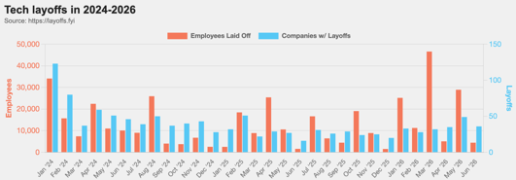
https://layoffs.fyi
https://trueup.io/layoffs
Jobs
The Tech Layoff Tracker
In 2026: 157,807 people laid off (892 per day)
In 2025: 245,953 people laid off (674 per day)
In 2024: 238,461 people laid off (653 per day)
https://trueup.io/layoffs
Tech Layoffs by year (US only):
121.5K in 2026 (as of June 26, 2026)
124K in 2025
153K in 2024
264K in 2023
165K in 2022 https://layoffs.fyi

Slide 24


About the Speaker
Lev Selector, Ph.D.
40+ years of software engineering, data science, and building teams (hiring, training, and managing)
Ph.D. in mathematical modeling and computer simulations
Interests:
Generative AI, Using LLM with your data
Local AI for Local Private Data
Cloud architecture, fin-tech, application security
Find/connect: Linkedin, GitHub, YouTube, Google
https://eais.ai
Enterprise AI Systems

Slide 25
Thank You!

