Slide 1
AI Updates - October 10, 2025
There are no laws against outsourcing jobs to AI.
That's why it happens so fast ...
Crowd-sourced "LM Arena" Leaderboard
Gemini Enterprise Platform
OpenAI DevDay - Apps SDK, AgentKit, ...
OpenAI In‑Chat Shopping
Perplexity Comet - globally
OpenAI has reached a $500 Billion valuation
Gemini 2.5 Computer Use Model - Preview
IBM and Anthropic Partnership
OpenAI GPT-4b Model for Protein Engineering
Intel ARC Pro B50 - 16GB GPU ~$300
Google CodeMender
Samsung Tiny Recursion Models
xAI & Nvidia ~$20Bln
Peter Diamandis Moonshots - Everything App
Google Opal No Code App Builder
Microsoft - NVIDIA GB300 cluster for OpenAI
Reflection AI raises $2B at $8B valuation
Figure 3rd Gen Humanoid Robot $5,900
DeepSeek V3.2X with Sparse Attention
IBM Granite 4.0 Hybrid Open Models
Gemini Canvas
Tencent - HunyuanImage-3.0 - Text-to-Image
Qwen Chat: code interpreter & web search
Firebase Studio - create Apps in minutes
Langflow drag-and-drop
Huge Cerebras Chips: 8.5" x 8.5"
Nobel Prize announcements 2025
Every AI Founder's Questions
Jobs Report
Jobs, Layoffs, demand for AI Engineers

Slide 2
Crowd-sourced "LM Arena" Leaderboard
https://lmarena.ai/?leaderboard
Starting Elo rating = 1000
https://en.wikipedia.org/wiki/Elo_rating_system
English - https://lmarena.ai/leaderboard/text
Coding - https://lmarena.ai/leaderboard/text/coding
LM Arena secures $100M to expand AI benchmarking (at $600M valuation)
Model | Score
gemini-2.5-pro | 1452
claude-sonnet-4-5-20250929-thinking-32k | 1448
claude-opus-4-1-20250805-thinking-16k | 1448
chatgpt-4o-latest-20250326 | 1441
gpt-4.5-preview-2025-02-27 | 1441
gpt-5-high | 1440
o3-2025-04-16 | 1440
claude-opus-4-1-20250805 | 1438
claude-sonnet-4-5-20250929 | 1437
qwen3-max-preview | 1434
qwen3-max-2025-09-23 | 1425
gpt-5-chat | 1426
glm-4.6 | 1421
grok-4-fast | 1420
deepseek-v3.2-exp-thinking | 1418
claude-opus-4-20250514-thinking-16k | 1420
qwen3-235b-a22b-instruct-2507 | 1418
qwen3-vl-235b-a22b-instruct | 1418
deepseek-r1-0528 | 1417
kimi-k2-0905-preview | 1416
deepseek-v3.2-exp | 1416
deepseek-v3.1-terminus | 1415
deepseek-v3.1-thinking | 1415
deepseek-v3.1 | 1415
Model | Score
claude-sonnet-4-5-20250929-thinking-32k | 1520
claude-opus-4-1-20250805-thinking-16k | 1508
claude-sonnet-4-5-20250929 | 1489
claude-opus-4-1-20250805 | 1495
qwen3-max-preview | 1481
qwen3-max-2025-09-23 | 1478
claude-opus-4-20250514-thinking-16k | 1481
gemini-2.5-pro | 1470
chatgpt-4o-latest-20250326 | 1469
qwen3-235b-a22b-instruct-2507 | 1469
qwen3-vl-235b-a22b-instruct | 1469
gpt-5-high | 1467
longcat-flash-chat | 1464
deepseek-v3.2-exp-thinking | 1460
deepseek-v3.1-terminus-thinking | 1457
qwen3-next-80b-a3b-instruct | 1463
glm-4.6 | 1455
gpt-4.5-preview-2025-02-27 | 1462
o3-2025-04-16 | 1465
claude-sonnet-4-20250514-thinking-32k | 1461
deepseek-v3.1-thinking | 1461
gpt-5-chat | 1461
deepseek-r1-0528 | 1458
grok-4-fast | 1457
China
China
Grok 4 Benchmarks
https://artificialanalysis.ai/models/grok-4
https://lmarena.ai/leaderboard/text
https://web.lmarena.ai/leaderboard
https://openlm.ai/chatbot-arena/
https://beta.lmarena.ai
Web Leaderboard https://web.lmarena.ai/leaderboard
LLM Leaderboard - by @LlmStats https://llmworld.net/llm_leaderboards/
LLM Leaderboard - by StackAI https://www.stack-ai.com/llm-leaderboard
LLM Leaderboard - by Artificial Analysis https://artificialanalysis.ai/leaderboards/models
Open LLM Leaderboard - by Hugging Face https://huggingface.co/open-llm-leaderboard
LLM Leaderboard - by Vellum https://www.vellum.ai/llm-leaderboard
AI Benchmarking Hub https://epoch.ai/data/ai-benchmarking-dashboard
China
China
China
China
China
China
x.ai
China
China
China
China
China
China
China
China
China
China
China
China
China
China
China
x.ai

Slide 3

Gemini Enterprise
Gemini Enterprise Platform - available worldwide
Gemini Models
Agent Workbench (no-code tools)
Pre-built Google Agents - Deep Research, Data Insights, Coding agents
Enterprise Context Integration - connection to company data across Google Workspace, Microsoft 365, SharePoint, SAP, Oracle, Slack, ServiceNow, ...
Governance & Security - Central control, audit, and compliance features (including IL5 authorization - Department of Defense (DoD) Impact Level 5 security certification for cloud service providers (CSPs))
Partner Ecosystem - Marketplace for third-party agents
Agent Designer - visual tool for building agents
Gemini CLI (over 1 million developers already using it) - ver 3.0
ADK (Agent Development Kit) - Open source framework
Gemini CLI Extensions - Framework to customize and connect CLI to services from partners like Atlassian, GitLab, MongoDB, Stripe
Google Vids - transform presentations into engaging videos with AI-generated scripts and voiceovers (2.5 million monthly users)
VEO 3 Text-to-video generation
Real-time Speech Translation in Meet - Preserves natural tone and expression across languages
Nano-Banana (Gemini 2.5 Flash Image)
Data Science Agent
Conversational Agents (customer service, ...)
Campaign Agents (for marketing workflows)
Inventory Management Agents - For supply chain and stock control
Agent2Agent (A2A) Protocol - open standard
Agent Payments Protocol (AP2) - for financial transactions
Model Context Protocol (MCP)
Google Skills Platform - Free training across Google products
GEAR Program - Gemini Enterprise Agent Ready - to train 1M developers
Team Delta - Elite Google AI engineers for embedded support
Processing over 1.3 trillion tokens monthly (up from 980 trillion)
65% of Google Cloud customers using AI products
30 million developers building with generative models
Nearly half of new code at Google is AI-generated

Slide 4
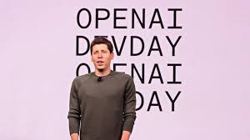
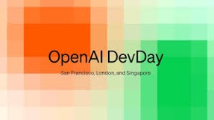

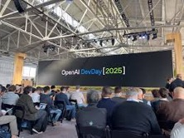
OpenAI DevDay
OpenAI DevDay October 6, 2025
annual developer conference, San Francisco, CA
1,500 attendees
Apps - run in Chat (Spotify, Zillow, Canva, ...)
Apps SDK preview - allows to create and run apps directly within chat
AgentKit - no-code node-based AI Agents workflows. Build, deploy, manage
Sora 2 in API - text-to-video
Codex Upgrades - Slack integration, a new Codex SDK, and enterprise controls
GPT-5 Pro API
gpt-realtime-mini and gpt-image-1-mini - small, cost-efficient new models for real-time voice and image generation
Voice and Multimodal - enhanced voice controls using natural speech and images
OpenAI & AMD chip deal - in addition to their Nvidia and Oracle partnerships

Slide 5
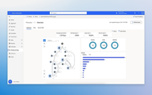
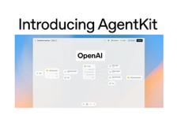
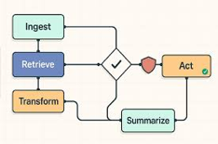
OpenAI AgentKit
Microsoft
OpenAI AgentKit is similar to many others node-based agent workflow builders:
Microsoft Power Automate : https://powerautomate.microsoft.com
Zapier : https://zapier.com
Make (Integromat) : https://www.make.com
LangChain : https://www.langchain.com
Node-RED : https://nodered.org
n8n : https://n8n.io
AutoGen : https://microsoft.github.io/autogen/
LlamaIndex : https://www.llamaindex.ai
CrewAI : https://www.crewai.com
FlowiseAI : https://flowiseai.com
Langflow : https://www.langflow.org
LangGraph : https://langchain-ai.github.io/langgraph/
Haystack : https://haystack.deepset.ai
Activepieces : https://www.activepieces.com
StackStorm : https://stackstorm.com
SuperAGI : https://superagi.com
Huginn : https://github.com/huginn/huginn
RelevanceAI : https://relevance.ai
Superagent : https://www.superagent.sh
MemGPT : https://memgpt.ai
Latenode : https://latenode.com
Relay : https://relay.app
Lindy : https://www.lindy.ai
Gumloop : https://www.gumloop.com

Slide 6
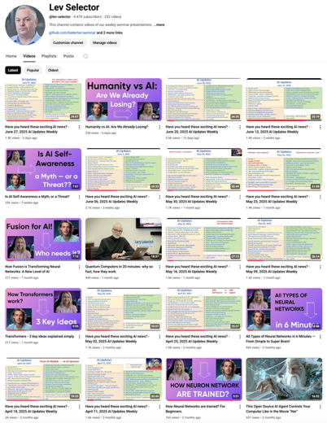
We do these weekly videos every Friday
Stats: 5.4K subscribers, 248 videos
Subscribe to this channel
https://www.youtube.com/@lev-selector
Download slides from GitHub using links under the videos
Please pause the video - and answer the pinned question in comments under the video

Slide 7



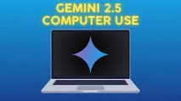
AI Updates - 1
OpenAI In‑Chat Shopping
Instant Checkout feature in ChatGPT, lets users buy products from Etsy and some Shopify merchants without leaving the chat
Payments are handled via Stripe, with no added fees for users and a small fee charged to merchants.
Perplexity Comet - globally
Perplexity - increased hallucinations recently
OpenAI has reached a $500 Billion valuation following a $6.6 billion secondary share sale by employees
It is now the world's most valuable startup surpassing SpaceX's $456B mark
Gemini 2.5 Computer Use Model - Preview
Controlling user interfaces (UI) by simulating actions such as clicks, typing, and scrolling in web browsers and mobile apps
Access via Google AI Studio and Vertex AI, APIs, CLI or SDK
Can visually understand UI layouts, generate interface actions, and automate tasks that typically require human input, such as filling forms, manipulating dropdowns, and testing UI flows
https://blog.google/technology/google-deepmind/gemini-computer-use-model/

Slide 8

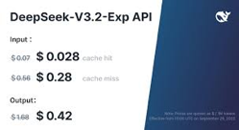
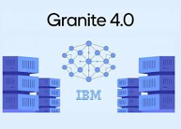
AI Updates - 2
DeepSeek V3.2X with Sparse Attention - Experimental
Cuts costs for long, complex tasks by up to 50%
DSA = DeepSeek Sparse Attention
Model retrofits V3.1-Terminus with a learned sparse attention scheme
Two step process: 1. "lightning indexer" to scan text and identify important sections 2. "fine-grained token selection system" picks top-k positions
Thus the system is processing only what matters instead of everything, changing complexity from O[L^2] to O[Lk]
The model is open-source on Hugging Face.
IBM Granite 4.0 Open Hybrid Models
Hybrid (MAMBA+ Transformer), sizes from 3B to 32B params
Using a 9:1 ratio of MAMBA 2 to transformer architecture
Cutting memory use by over 70%
The first open models with ISO certification for AI management. This means that IBM’s processes and safeguards around Granite models align with internationally recognized requirements for safe and responsible AI.

Slide 9
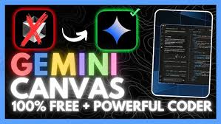
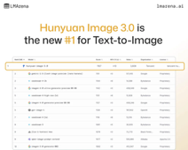

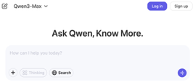
AI Updates - 3
Gemini Canvas
Allows users to create fully functional web applications in minutes without writing any code. It lives within Gemini's ecosystem alongside videos, deep research, and image generation tools.
Takes videos and hundreds of documents as context when building applications; Allows conversational iteration and debugging through chat; Supports voice commands for adding features; - Generates shareable links for deployment - allowing others to access and use the web application immediately
Tencent’s Hunyuan Image 3.0 beats Google’s Nano Banana
Biggest open-source image-generation model
https://hunyuan-image.com
https://github.com/Tencent-Hunyuan/HunyuanImage-3.0
https://www.reddit.com/r/LocalLLaMA/comments/1ny022j/open_source_texttoimage_hunyuan_30_by_tencent_is/
Alibaba Qwen Chat adds code interpreter and web search
https://chat.qwen.ai

Slide 10

Firebase Studio - create Apps in minutes
Firebase Studio - create full Apps in minutes
A cloud-based dev environment from Google
Lets developers build, prototype, test, and deploy full-stack AI-powered applications directly from the browser
It combines traditional coding tools with AI-powered features, integrating Gemini in Firebase, Project IDX, Genkit, and other tools to accelerate the app development lifecycle
Unified Workspace - all-in-one cloud IDE, based on Code OSS (VS Code) - code, test, and deploy apps with familiar tools
Agentic AI Assistance, App Prototyping Agent, Rapid Project Setup, Flexible Development, fully customizable, Integrated Firebase/Cloud Tools
Firebase Studio represents Google's strategy to enable rapid AI-infused app development by combining the power of cloud IDEs, agentic AI development, and deep integration with its services and models—all accessible from a web browser
https://firebase.studio
https://firebase.google.com/docs/studio
https://firebase.google.com/products/generative-ai

Slide 11
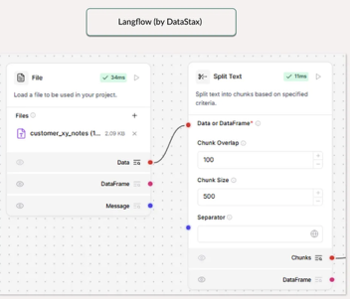
Langflow drag-and-drop
Langflow visual app builder
Open-source, low-code platform for visually building and deploying AI applications and agentic workflows using an intuitive drag-and-drop interface
It supports seamless integration with various large language models (LLMs), agents, and tools, enabling developers to rapidly prototype, test, and scale flows for tasks like chatbots, document analysis, and retrieval-augmented generation—all without extensive coding or infrastructure setup.
Langflow is built atop LangChain, providing a user-friendly graphical interface while enabling export to LangChain code for advanced work
https://www.langflow.org
https://github.com/langflow-ai/langflow - 127K stars
https://www.youtube.com/watch?v=dTuVpbNRO4o - video
Langflow is similar to n8n in that it provides a visual, low-code pipeline builder, but Langflow is designed specifically for constructing AI agent workflows and chaining large language model (LLM) components - like prompts, tools, memory, and retrievers - while n8n is a more general-purpose workflow automation platform meant to orchestrate integrations between a wide variety of business apps and external services
While both platforms allow drag-and-drop pipeline creation, Langflow specializes in building advanced AI logic and agentic pipelines, whereas n8n excels in broader event-based automations with hundreds of app integrations, making them complementary for certain use-cases.

Slide 12
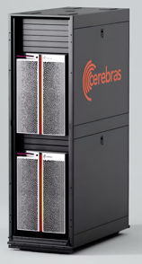

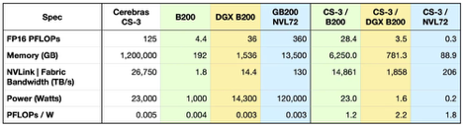

AI Updates - 4
Huge Cerebras Chips: 8.5" x 8.5"
Current version WSE-3, 4 Trillion transistors
Cerebras CS-3 system uses WSE-4 https://www.cerebras.ai/system
IBM and Anthropic Partnership
Integrate Anthropic's Claude AI models into IBM's enterprise software portfolio
AI-first IDE for software development lifecycles (in preview)
The IDE is designed to deliver productivity gains, enhanced code security, and strong governance for large organizations
IBM will contribute to open standards for AI deployment and offer enterprise-ready assets for the Model Context Protocol (MCP) community
https://newsroom.ibm.com/2025-10-07-2025-ibm-and-anthropic-partner-to-advance-enterprise-software-development-with-proven-security-and-governance

Slide 13

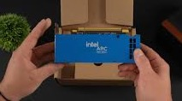
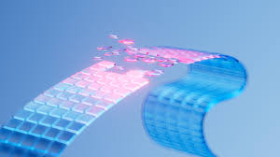
AI Updates - 5
OpenAI GPT-4b Model for Protein Engineering
In collaboration with Retro Biosciences - https://www.retro.bio
Model is trained to analyze protein sequences, cellular reprogramming, and biological interaction patterns
Achieved a 50x increase in reprogramming efficiency and improved DNA damage repair in the reprogrammed cells
https://openai.com/index/accelerating-life-sciences-research-with-retro-biosciences/
Intel ARC Pro B50 - 16GB GPU ~$300
compact, single-slot card
70W - via the PCIe slot (PCIe Gen 5)
Runs popular LLMs (Qwen 3 4B, GPTO 20B, ...) using about 13GB out of 16GB VRAM at context 50k & generation speeds 35-52 tok/sec
Intel Arc Pro B60 - 24GB at ~$500 (48GB - $1,200)
https://www.youtube.com/watch?v=KBbJy-jhsAA - video
Google CodeMender
Multi-agent system detects, patches, and validates code vulnerabilities, leveraging Gemini Deep Think models for robust software security automation in open-source projects
Uses static and dynamic analysis, fuzzing, and SMT solvers - to trace root causes of flaws and synthesize candidate fixes
https://www.youtube.com/watch?v=2j0PkVw8c1s - video
https://deepmind.google/discover/blog/introducing-codemender-an-ai-agent-for-code-security/

Slide 14
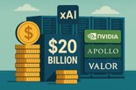
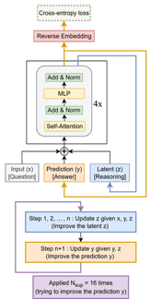

AI Updates - 6
Peter Diamandis Moonshots - Everything App https://www.youtube.com/watch?v=bXT0PBasDc0
Massive Scale Growth; Half of all US GDP growth this year is from AI; AI is taking over. Multiple experts agree we're at a tipping point occurring within the next 6 months across robotics, autonomous vehicles, and AI capabilities.
Example: OpenAI's agent builder was built end-to-end in under 6 weeks with Codex writing 80% of the code; Human typing speed is becoming the limiting factor for software development; Humans can not compete with AI
Entire mechanical engineering and design being outsourced to AI with 10x cost deflation
AI achieving near-superhuman performance on computer control tasks; Approx 65% of all service labor can be automated
OpenAI is targeting "fully autonomous workers" as their product to justify massive compute buildouts ($800B+ in infrastructure)
It is not a bubble - it is switching to new economy
Acceleration: Startups need to pivot fast, constant reinvention. Can use latest AI at low cost. Token cost going down. Thus $20/month chat subscription is not justified (overpriced)
The job market isn't being destroyed - it's being radically transformed from human execution to human curation and direction of AI systems
The winners will be those who adapt quickly, leverage AI as a force multiplier, and focus on the human elements AI cannot replicate: creativity, strategy, and relationships
Samsung Tiny Recursion Models
https://arxiv.org/abs/2510.04871 - paper
https://github.com/SamsungSAILMontreal/TinyRecursiveModels
Tiny - only 7M params (Millions, no Billions)
Recursive reasoning neural network - recursively improves its prediction
45% on ARC-AGI-1 8% on ARC-AGI-2, beating most LLMs.
xAI & Nvidia ~$20Bln
Elon Musk’s xAI is raising ~$20Bln in a landmark deal with Nvidia and a other investors
https://www.tomshardware.com/pc-components/gpus/nvidia-backs-20-billion-xai-chip-deal

Slide 15

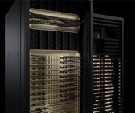
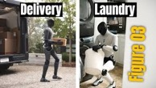

AI Updates - 7
Google Opal
An experimental, no-code AI platform that allows users to build "mini-apps" by describing their function in natural language.
Very fast (almost instant, in seconds), users can also edit the visual workflow for more fine-grained control.
https://opal.withgoogle.com/landing/
Microsoft - NVIDIA GB300 systems for OpenAI
Over 4,600 NVIDIA Blackwell Ultra GPUs connected via the NVIDIA Quantum-X800 InfiniBand networking
Figure 3rd Gen Humanoid Robot
Early Price $5,900
https://www.figure.ai/news/introducing-figure-03
Reflection AI raises $2B at $8B valuation
startup backed by Nvidia founded in 2024
Develops tools that automate software development
building open-weight AI models
https://reflection.ai
https://www.reuters.com/business/nvidia-backed-reflection-ai-raises-2-billion-funding-boosts-valuation-8-billion-2025-10-09/

Slide 16


Nobel Prize announcements 2025
Nobel Prize announcements 2025
https://www.nobelprize.org
Oct 6 Mon - PHYSIOLOGY OR MEDICINE - to Mary E. Brunkow, Fred Ramsdell and Shimon Sakaguchi for discoveries concerning peripheral immune tolerance
Oct 7 Tue - PHYSICS - to John Clarke, Michel H. Devoret, John M. Martinis for the discovery of macroscopic quantum mechanical tunnelling and energy quantisation in an electric circuit
Oct 8 Wed - CHEMISTRY - to Susumu Kitagawa, Richard Robson and Omar M. Yaghi “for the development of metal–organic frameworks.”
Oct 9 Thu - LITERATURE - to László Krasznahorkai - Hungarian novelist and screenwriter
Oct 10 Fri - PEACE - to Maria Corina Machado for promoting democratic rights for the people of Venezuela
Oct 13 Mon - ECONOMIC SCIENCES - to ...
Video about Alfred Nobel - by Veritasium
https://www.youtube.com/watch?v=onr80iOoEXs

Slide 17

Every AI Founder Should Be Asking These Questions
Every AI Founder Should Be Asking These Questions
https://www.youtube.com/watch?v=DJjZzzPANBY
Talk by Jordan Fischer at Y Combinator event
Unable to see beyond 3 weeks ahead rather than the 5-10 years he used to envision
AGI (Artificial General Intelligence) will likely arrive within 2-3 years, fundamentally changing everything about business and society
Should you plan 2 years ahead, not just 6 months, anticipating AGI?
Will software become fully commoditized when anyone can prompt AI to build apps?
Should UI be generated on-demand for each user?
Is it better to retrofit existing products with AI or build AI-native from scratch?
Will AI-native teams have advantages over traditional companies trying to adapt?
How do security models change when AI agents need deep system access?
Can we trust AI agents to truly act on users' behalf versus corporate interests?
What constitutes a durable competitive advantage post-AGI?
Are there intelligence ceilings for specific tasks that lead to faster commoditization?
What problems will remain "hard" even with AGI (infrastructure, energy, manufacturing, robotics)?
How can small, potentially automated companies build trust without human oversight?
Should companies submit to AI-powered auditing to verify their stated values?
Will we need "neutrality" standards for AI, similar to electrical infrastructure?
Key Insights
Both startups and enterprises will use AI
As teams shrink and automation increases, establishing trust mechanisms becomes critical
Some areas will stay longer (physical-world challenges, knowledge and experience (like semiconductor manufacturing) )

Slide 18

Jobs Report
Microsoft Research on Outsourcing Jobs to AI - July 2025
Report: "Working with AI: Measuring the Occupational Implications of Generative AI"
10 jobs with the highest risk of AI replacement:
Interpreters and translators (98% coverage)
Historians
Passenger attendants
Sales representatives of services (e.g., lawn care, cleaning)
Writers and authors
Customer service representatives
CNC tool programmers (CNC = Computer Numerical Control)
Telephone operators, ticket agents, and travel clerks
Broadcast announcers and radio DJs
Brokerage clerks, farm and home management educators, telemarketers, concierges, political scientists
https://www.microsoft.com/en-us/research/publication/working-with-ai-measuring-the-occupational-implications-of-generative-ai/

Slide 19
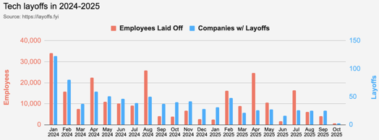
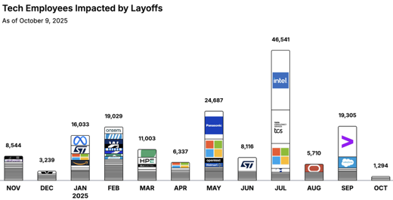

Jobs
https://layoffs.fyi
https://trueup.io/layoffs
Tech Layoffs by year (US only):
91.3K in 2025 (as of October 9)
153K in 2024
264K in 2023
165K in 2022 https://layoffs.fyi
Salesforce laid off 4K jobs in September 2025, primarily from its customer support division (from 9K to 5K).
CEO Marc Benioff directly linked the layoffs to efficiency gains from AI (“Agentforce” platform), stating that Salesforce "needs fewer heads" because AI can now automate half of routine customer support tasks
Salesforce previously laid off over 1,000 employees in February 2025, and thousands more in 2023 as part of an ongoing automation and restructuring initiative
The job cuts are part of a wider tech industry trend where companies such as Microsoft, Meta, and Google have also replaced thousands of roles with AI-driven automation
Accenture recently laid off over 11K employees (global headcount dropped from 791K down to 779K)
The Tech Layoff Tracker
So far in 2025, 158,055 people laid off (560 per day)
In 2024, 238,461 people laid off (653 per day)
https://trueup.io/layoffs

Slide 20


About the Speaker
Lev Selector, Ph.D.
40+ years of software engineering, data science, and building teams (hiring, training, and managing)
Ph.D. in mathematical modeling and computer simulations
Interests:
Generative AI, Using LLM with your data
Local AI for Local Private Data
Cloud architecture, fin-tech, application security
Find/connect: Linkedin, GitHub, YouTube, Google
https://eais.ai
Enterprise AI Systems

Slide 21
Thank You!

