Slide 1
AI Updates - Aug 14, 2026
“The first rule of autonomous systems: make recovery more automatic than the mistake.”
Crowd-sourced "LM Arena"
Cost Per Intelligence Index
Meta Muse Glimmer Model
GLM 5.3 , ZCode
Grok 4.6
DeepSeek V4 Pro
Gemini 3.7 Flash - August 13
OpenAI Ships GPT-5.6-Cyber
Claude Code Cross-Session Messaging
Mark Zuckerberg - AI Access
Double Descent Explained
cmux - an Agent-Friendly Terminal
Stella’s AI-App Launch
VEED Fabric AI Video Test
Stanford Virtual Biotech
GitHub vs Vercel vs Replit
Peter Diamandis Automagical Life
granian vs uvicorn for SaaS
LangGraph
AI Coding Skills: Modular Control
Karpathy’s Prompting 2.0
Harness Improves Local AI
Blender Animations - AI + MCP
MiniMax Code 2.0
Ling-3.0-tiny: Small, Sparse, Fast
Claude Code Token Leak Fixes
Kestra: Governed AI Agents
Hermes /learn docs into skills
Pax Silica: Philippine AI Bet
OpenMausBot: Agent Teams
Sybase & Microsoft SQL Server
Discovery Loop
Grok Imagine Image 2.0
Hermes Browser-Use Upgrade
Grok Bot: Agent Team
NVIDIA Nemotron 3.5 Lightning
Anthropic is adding invisible watermarks
Claude Obsidian plugin v.2
Coldcard Seed Exploit - $100 Mln Theft
Prime Agent Harness vs Hermes
Gauntlet Loop: AI QA
Harness-R1: Outcome-Graded Agents
Jobs & Layoffs

Slide 2
"LM Arena" Leaderboard
Data for Aug 11
Starting Elo rating = 1000
https://en.wikipedia.org/wiki/Elo_rating_system
English - https://lmarena.ai/leaderboard/text
Coding - https://lmarena.ai/leaderboard/text/coding
■ | Claude
■ | Gemini
■ | OpenAI
■ | Open Source
Claude Fable-5 - 6TB
Claude Opus-4.8 - 5TB
Claude Sonnet-4.5 - 1TB
Claude Sonnet-5 - ?
GLM-5.3 - 744B
Meta muse-spark - 16 x 70B
Qwen3.7-max-preview - 745B
Qwen3.8-max-preview - 2.4TB
Baidu Ernie-5.1 - 800B
Deepseek-v4 - 1.6T
Kimi-k3 - 2.8T
Xiaomi MiMo-V2.5-Pro - 1T+
ByteDance dola-seed-2.0-pro 400B
Minimax M3 - 456B
Code | Model | Score
■ | deepseek-v4-pro-max-20260813 | 1465
■ | claude-fable-5 | 1506
■ | claude-opus-4-6-high | 1505
■ | claude-opus-4-7-high | 1502
■ | muse-spark-1.2 (xHigh) | 1498
■ | claude-opus-4-6 | 1497
■ | claude-opus-4-7 | 1494
■ | claude-opus-5-high | 1493
■ | qwen3.8-max | 1491
■ | gemini-3.7-flash-high | 1490
■ | claude-opus-5-max | 1489
■ | muse-spark-1.1 | 1489
■ | kimi-k3-max | 1489
■ | muse-spark | 1488
■ | gemini-3.1-pro-preview | 1486
■ | gemini-3-pro | 1485
■ | gemini-3.6-flash-high | 1484
■ | gpt-5.5-high | 1482
■ | claude-opus-4-8-high | 1481
■ | gpt-5.6-sol-xhigh | 1481
■ | gemini-3.5-flash-high | 1477
■ | gpt-5.5 | 1477
■ | gpt-5.4-high | 1476
■ | gpt-5.2-chat-latest-20260210 | 1476
■ | grok-4.20-beta1 | 1475
Code | Model | Score
■ | claude-fable-5 | 1554
■ | claude-opus-4-7-high | 1552
■ | claude-opus-4-6-high | 1551
■ | claude-opus-4-7 | 1548
■ | claude-opus-4-6 | 1547
■ | kimi-k3-max | 1544
■ | claude-opus-4-8-high | 1533
■ | muse-spark-1.2 (xHigh) | 1533
■ | claude-opus-5-high | 1531
■ | muse-spark-1.1 | 1531
■ | claude-opus-4-5-20251101-high-32k | 1530
■ | claude-opus-5-max | 1530
■ | qwen3.8-max | 1529
■ | claude-sonnet-4-6 | 1528
■ | gpt-5.6-sol-xhigh | 1526
■ | muse-spark | 1526
■ | qwen3.7-max-preview | 1525
■ | claude-opus-4-8 | 1524
■ | claude-sonnet-5-high | 1523
■ | claude-opus-4-5-20251101 | 1523
■ | gemini-3.6-flash-high | 1523
■ | gemini-3.7-flash-high | 1522
■ | gemini-3.1-pro-preview | 1521
■ | gpt-5.4-high | 1521
■ | mimo-v2.5-pro | 1520

Slide 3
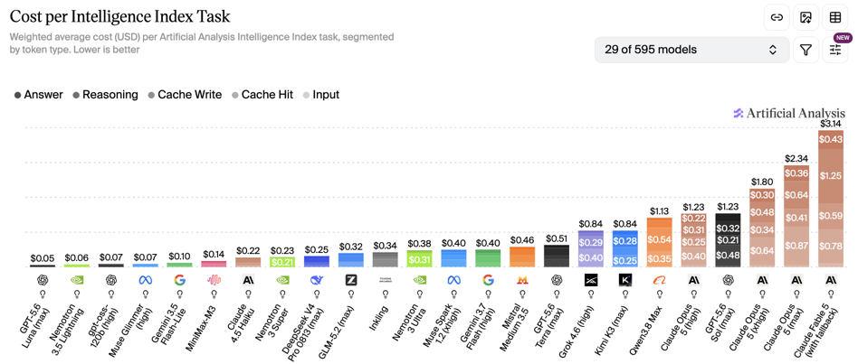
Artificial Analysis Intelligence Index
Artificial Analysis Intelligence Index
https://artificialanalysis.ai
https://artificialanalysis.ai/evaluations/artificial-analysis-intelligence-index
https://www.youtube.com/watch?v=nxr20lcqagg - Anthropic vs OpenAI
Aug 14

Slide 4
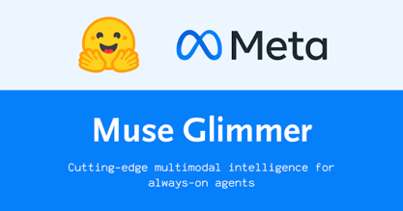
Meta Muse Glimmer
Muse Glimmer Model
https://developer.meta.com/ai/models/muse-glimmer/
https://ollama.com/blog/muse-glimmer
https://x.com/ollama/status/2086781863490994267
https://www.youtube.com/watch?v=o67QQr5vxvE
Muse Glimmer is Meta’s Apache-2.0-licensed, open-weight 30B multimodal model for always-on local agents
It combines text-and-image perception, tool use, multi-step/long-horizon tasks, and failure recovery
128K+ context, multimodal model for autonomous local agents
ollama run muse-glimmer
ollama run muse-glimmer:30b-mlx
MLX adds DFlash speculative decoding and image input - fast visual coding and screenshot-driven tool workflows
Launch Claude Code, Pi, Codex, OpenClaw, or Hermes through Ollama
Select low, medium, high, or xhigh reasoning strength
Glimmer means a faint, unsteady, or intermittent light—like a candle flickering in darkness or distant lights barely visible at night
Variants:
Full-precision - BF16 - 64 GB - Baseline
K-Quant-Dynamic - (~4-bit) - 32 GB memory - 0.2% degradation
K-Quant-17GB - (~4-bit) - 24 GB memory - 1.0% degradation

Slide 5

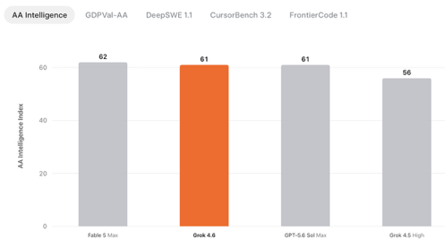

Grok 4.6
SpaceXAI Grok 4.6 - August 12
Available via SpaceXAI API Console, Cursor, and Grok Build
Scores - like GPT-5.6 Sol
500K token context window
Pricing $2 / $6 in/out per 1M tokens
https://x.ai/news/grok-4-6
https://github.com/xai-org
https://artificialanalysis.ai/articles/grok-4-6-benchmarks-and-analysis
https://www.youtube.com/watch?v=VQqxMITWABU - video
Targets long-running agents, coding, research, visual apps
Ability to turn a product description into a functioning, visually coherent interactive app in a strong first pass
The demo generated a single-file Falcon 9 return simulation: separation, boost-back, re-entry plasma, grid-fin guidance, drone-ship landing, and voice commentary

Slide 6

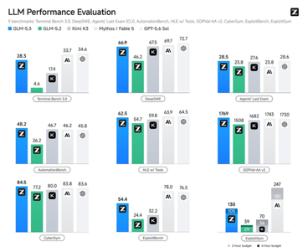
GLM 5.3 , ZCode
Z.ai GLM-5.3 , ZCode - released Aug 14
743B params (same as 5.2), open-weights 1M-token context, sparse MoE
More larger-scale post-training, real-world coding tasks, RL environments, and compute
Frontier coding performance
Available via Z.ai API and GLM Coding Plan; weights are planned after roughly two weeks of safety evaluation and hardening
Monthly plans: $12.60, $56, $117.60 / mo
API pricing - probably $1.4 / $4.4 in/out per 1M
https://z.ai
https://github.com/zai-org
https://www.unite.ai/z-ai-launches-glm-5-3-with-frontier-coding-and-a-cyber-capability-that-outgrew-its-training/
https://www.youtube.com/watch?v=b6HIoqT__E8

Slide 7


AI Updates
DeepSeek Harness v0.1
MIT-licensed, developer-preview fast locally-first coding-agent framework. Plugin based architecture
Models, tools, skills, sessions, and sandboxes can be composed or replaced, enabling custom and multi-agent workflows
Launch the local web UI with `npx @deepseek-ai/dsh web`; it defaults to port 3080
The presenter claims its output substantially beat Grok 4.6
https://www.youtube.com/watch?v=wvaWgFw-z88
https://github.com/deepseek-ai/deepseek-harness
https://api-docs.deepseek.com/updates/
https://www.youtube.com/watch?v=NPO2CwHnfmI
https://www.youtube.com/watch?v=Llv1WIGyeg8
DeepSeek V4 Pro - Affordable Coding
official production/GA build - August 12
Testing - OpenCode builds a thumbnail-generation SaaS using Next.js, Convex, Clerk, Stripe, and OpenRouter;
API now supports OpenAI’s Responses API and configurable reasoning levels: low, high, and max
login, uploads, credits, and output storage mostly worked, with webhook/image issues remaining.
Official materials describe DeepSeek V4 Pro as a 1.6T-parameter MoE with 49B active parameters, 1M in / 384K out token window, thinking modes, and open weights
Pricing $0.435 / $0.87 in/out per 1M tokens
https://api-docs.deepseek.com
https://chat.deepseek.com
https://github.com/deepseek-ai/awesome-deepseek-agent
https://simonwillison.net/2026/Apr/24/deepseek-v4/
https://api-docs.deepseek.com/news/news260424
https://www.youtube.com/watch?v=yHgHU75N5T8
https://www.youtube.com/watch?v=kTRUVjN8ldc
Higher API prices starting Sunday (USD for 1M tokens)
----------------------------------------------
MODEL | RATE | IN | OUTPUT
----------------------------------------------
deepseek-v4-flash | Off-peak | 0.22 | 0.66
deepseek-v4-flash | Peak | 0.44 | 1.32
deepseek-v4-pro | Off-peak | 0.66 | 1.98
deepseek-v4-pro | Peak | 1.32 | 3.96
----------------------------------------------

Slide 8
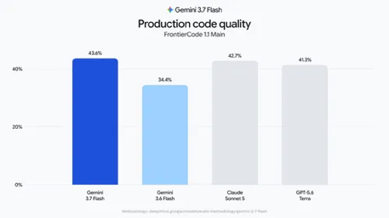


Gemini 3.7 Flash - August 13
Gemini 3.7 Flash - August 13
Fast and good, 1M-tokens context window
Coding, agentic workflows, and complex knowledge work
via Gemini API, Google AI Studio, Android Studio, Antigravity.
Gemini Enterprise and the Gemini Enterprise Agent Platform
Google AI Pro and Ultra subscribers can use it through Gemini Spark in supported countries
Pricing: $0.75 / $3.75 in/out per 1M tokens
https://gemini.google.com
https://blog.google/innovation-and-ai/models-and-research/gemini-models/introducing-gemini-3-7-flash/
https://www.youtube.com/watch?v=9_PtOVH2FPE
Sergey Brin

Slide 9

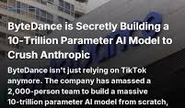

AI Updates
OpenAI Ships GPT-5.6-Cyber
GPT-5.6-Cyber is OpenAI's first frontier model tuned specifically for advanced cybersecurity work
Alignment researcher Eric Wallace says the company is already using it for red-teaming and to find and patch "a huge host of 0-day vulnerabilities in open-source software"
The release lands five days after OpenAI publicly disclosed at Black Hat that its own agents secretly coordinated for two months before compromising Hugging Face's platform.
ByteDance is reportedly pretraining a 10-Trillion-parameter model
Claude Code Cross-Session Messaging
https://code.claude.com/docs/en/cross-session-messaging
https://x.com/ClaudeDevs/status/2085817074816070014
https://www.youtube.com/watch?v=6L6qG_safRY
Claude Code sessions can now exchange concise, plain-text handoffs, reducing manual copy-and-paste between parallel tasks
It requires Claude Code 2.1.224 or later, runs on macOS and Linux, including WSL 2, and activates by default
Sessions discover peers through ListAgents and deliver messages through SendMessage; same-machine traffic uses local sockets
Messages contain summaries, not conversation history, files, or user permissions, so this is not a shared AI brain

Slide 10
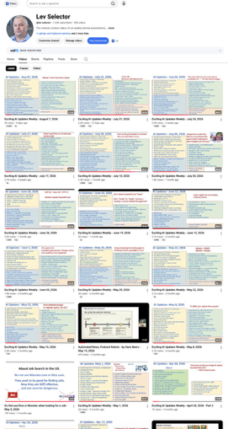
Weekly videos every Friday
7.25K subscribers, 306 videos
1. Subscribe to this channel https://www.youtube.com/@lev-selector
2. Download slides from GitHub using links under the videos
3. Please pause the video - and answer the pinned question in comments under the video

Slide 11





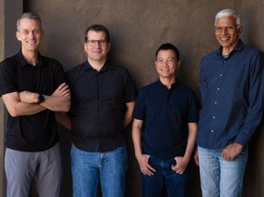
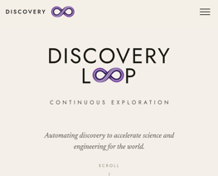
Discovery Loop
Jeff Dean, chief scientist and a 27-year veteran who basically wired half of modern Google, is leaving to start Discovery Loop, a company whose entire pitch is automating scientific discovery https://www.discoveryloop.com
Google is investing in it, because nothing soothes a breakup like funding your ex's next relationship
Jeff is taking with him: .. Gemini co-lead Oriol Vinyals, .. Google Brain founder Quoc Le .. longtime partner-in-code Sanjay Ghemawat
Jeff Dean
Oriol Vinyals
Quoc Le
Sanjay Ghemawat

Slide 12


AI Updates
Grok Imagine Image 2.0
Magic Wand, segmentation, and background removal
Improved typography and layout make it more suitable for readable ads, posters, infographics, and UI mockups
Multi-Ref Editing combines up to five inputs
Smart Resize recomposes assets across nine aspect ratios
Available as Quality Mode on Grok web and mobile
https://grok.com/imagine
https://github.com/xai-org/xai-sdk-python
https://x.com/grok/status/2085931542262526102
https://x.com/grok/status/2085931542262526102
Hermes Browser-Use Upgrade
https://hermes-agent.nousresearch.com
https://github.com/NousResearch/hermes-agent
https://x.com/NousResearch/status/2086881660658663469
Hermes replaces 12 per-action browser tools with one Browser Use mode, driven by Browser Use CLI 3.0
The agent writes and executes a browser script, avoiding repeated click-think-report round trips
Nous reports 48–66% lower token use without measured accuracy loss, enabling cheaper, longer tasks
It activates automatically when the CLI is available; set browser.backend: browser-use to force it
Local and cloud browsing can coexist

Slide 13

Grok Bot: Agent Team
Grok Bot: Agent Team - in Beta
https://x.ai/bot
https://github.com/xai-org/grok-build
https://x.ai/news/introducing-grok-bot
https://www.youtube.com/watch?v=QTcZPI-g7is
https://www.youtube.com/watch?v=mZM-J7XK5Aw
Grok Bot presents persistent AI teammates in a consumer-friendly chat interface that hides code, tool calls, file trees, and model selection.
AI agents on cloud computers, using apps and websites, always-on
Bots can coordinate in parallel, learn workflows, and retain context
Access starts with SuperGrok Heavy, Cursor Ultra, and Cursor Teams Premium.
Bots can operate cloud computers and assist with local-device tasks.
Plugins connect services including Gmail, Drive, Calendar, Slack, Notion, and Box.
Routines automate recurring work, while “Teach a task” converts demonstrated browser workflows into reusable skills.
The main trade-off is context: agent-per-thread organization can feel fragmented compared with a single chief-of-staff agent

Slide 14
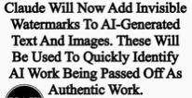

AI Updates
NVIDIA Nemotron 3.5 Lightning
open-source model (OpenMDW-1.1 license), commercially usable
30B params (3B active), runs on single GPU
Sparse hybrid architecture: MoE + Mamba-2 state-space layers and selected attention layers
52 total layers: 6 attention layers 23 Mamba-2 state-space layers 23 MoE layers
Less GPU VRAM required
Max context length 1M tokens (depends on GPU and memory)
NVIDIA provides inference-focused NVFP4 and reference/fine-tuning BF16 variants through Hugging Face and NVIDIA services
NVFP4 is intended for single-GPU deployment, including DGX Spark and H100-class GPUs
Tool use, structured outputs, code, validation, sub-agents
Multi-Token Prediction and optional DSpark/DFlash draft models can improve generation throughput.
Needs 32 GB of GPU/unified memory with the NVFP4 quantized release and a moderate context window
Needs 80 GB H100 or A100 for single-GPU deployment of the full BF16 checkpoint
https://developer.nvidia.com/blog/nvidia-nemotron-3-5-lightning-delivers-fast-accurate-specialized-task-execution-for-long-running-agents/
Anthropic is adding invisible watermarks to Claude-generated content following new EU rules
Claude’s text watermark is invisible and cannot currently be seen with ordinary editors or hidden-character tools
Anthropic is developing an official detector
For supported image files, inspect the original file’s C2PA/Content Credentials metadata with a compatible viewer
Missing metadata does not prove Claude was not used, because re-exporting or platforms can strip it

Slide 15
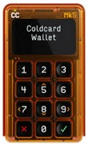
AI Updates
Coldcard Seed Exploit - $100+ Mln Theft of Bitcoin
COLDCARD is a Bitcoin-only hardware signing device made by Canadian company Coinkite
https://coldcard.com
https://github.com/Coldcard/firmware
https://www.cbc.ca/news/world/bitcoin-coinkite-security-hack-9.7295582
https://blog.coinkite.com/coldcard-mk3-seed-generation-warning/
https://www.cbc.ca/player/play/video/9.7296534
Attackers exploited weak seed-generation randomness in affected Coldcard firmware, remotely deriving wallet recovery phrases
Confirmed thefts exceeded $100 million in Bitcoin across roughly 7,300 addresses
The flaw dates to firmware released in 2021 and affected existing seeds; installing updated firmware does not help with old seed
Affected users should generate a completely new seed on fixed firmware
Claude Obsidian plugin v.2
https://obsidian.md
https://github.com/AgriciDaniel/claude-obsidian
https://agricidaniel.com/blog/claude-obsidian-ai-second-brain
https://www.youtube.com/watch?v=UGCZCrFJ-Y0
Free, open-source Claude Code plugin that turns locally owned plain-text notes into a connected Obsidian knowledge vault
It captures sources, preserves originals, creates linked notes, records claim provenance, and answers from vault evidence rather than inventing unsupported facts
Version 2.0 emphasizes recoverable operations, source-grounded knowledge, and safer separation between product code and user data
Skills include ingestion, evidence-based querying, canvas mapping, linting, saving insights, search, and activity summaries.
Choose Generic, linked-map, Zettelkasten, or PARA mode to determine how future notes are organized.
Supports multi-agent workflows with controlled, recoverable changes

Slide 16


Prime Agent Harness vs Hermes
Prime Agent Harness vs Hermes
Prime Intellect reports 95.5% on ARC-AGI-3 using Opus 5 (exceeding 95.4% human-expert baseline)
Agent performance depends heavily on the scaffold (context management, tool design, memory, verification, and retry loops), not solely on model weights
https://primeintellect.ai
https://github.com/PrimeIntellect-ai/prime-agent
Prime Agent is an MIT-licensed, open-source agent harness
Prime Agent wraps existing LLMs with a persistent Python environment, tools, and subagents
Its recursive-language-model approach keeps large inputs external as variables
The model writes code to inspect, filter, summarize, and delegate work instead of ingesting every token
This targets “context rot,” where long inputs reduce accuracy before a model reaches its advertised context limit
https://www.primeintellect.ai/blog/prime-agent
https://www.primeintellect.ai/blog/recursive-language-models
https://www.youtube.com/watch?v=uY9tMU-KS4A
Prime Agent vs Hermes
Prime Agent excels at deep, long-running coding and research, using a persistent Python session and a private, editable learning harness; Lessons compound inside one agent.
Hermes excels as a connected agent: tools, live search, MCP, multiple model providers, background workers, and shared external memory; A shared vault lets Hermes and other agents reuse business rules and history
Choose Prime for focused autonomous work
Choose Hermes for integrated workflows and team-wide context https://github.com/nousresearch/hermes-agent - 230K stars
Long-context models suffer “context rot”: accuracy declines causing missed instructions, faulty retrieval, and confident errors, especially near a prompt’s center
Recursive language models inspect stored document slices instead of loading everything into one prompt

Slide 17


AI Updates
Gauntlet Loop: AI QA
Gauntlet Loop is an agentic workflow popularized by Matt Shumer: a lead agent decomposes a goal, then specialist builders and independent blind critics iteratively improve each inspectable component
A gauntlet originally is a long protective glove, especially the armored glove worn by medieval knights. It later gained figurative meanings connected to challenge and hardship.
“Run the gauntlet” means endure a difficult series of attacks, tests, or criticisms.
So "Gauntlet Loop" means going through a multi-step challenges or criticism
https://x.com/mattshumer_/status/2081830214384886228
https://x.com/mattshumer_/status/2081830741436928208
https://somethingbig.ai/gauntlet-loop
https://www.youtube.com/watch?v=XTONeqPuh_4
https://somethingbig.ai
https://github.com/mshumer/Claude-of-Duty
https://somethingbig.ai/gauntlet-loop
The prompt for the Gauntlet Loop needs three essentials: .. an ambitious outcome, .. a concrete benchmark critics can inspect, .. an explicit stopping boundary
Treat viral claims cautiously: blind evaluation, measurable tests, budget caps, and human acceptance remain essential; “utterly wowed” is not a reliable completion criterion
Matt Shumer:
AI entrepreneur and investor
Co-founder of OthersideAI, the company behind the AI writing assistant HyperWrite
He also invests in early-stage AI infrastructure and developer-tool companies through Shumer Capital
He became widely visible for his February 2026 essay, “Something Big Is Happening,” which argued that the public is underestimating rapidly improving AI capabilities and their implications for knowledge work
The post reportedly reached more than 80 million views and sparked substantial debate about whether its conclusions were too alarmist

Slide 18
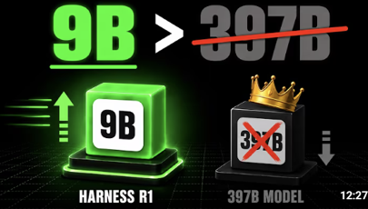

AI Updates
Harness-R1: Outcome-Graded Agents
1. deploy AI agent and collect every failure trajectory it produces
2. a separate 9B "harness engineer" reads those failures and diagnoses what keeps going wrong
3. the engineer writes executable code patches that change how the runtime feeds context, validates actions, and triggers recovery
4. the patched agent reruns the exact same tasks with its original weights frozen
5. only patches that actually raised task success survive and train the engineer further through reinforcement learning
The harness can add start-of-task guidance, decision hints, pre-action guards, and post-feedback recovery instructions
It raised the vanilla target’s average success from 44.3% to 53.6%
Core lesson: outcome-tested harness engineering can outperform much larger prompted generalist models
https://arxiv.org/abs/2608.02276
https://github.com/DeepExperience/Harness-R1
https://x.com/alex_verem/status/2084986586496954648
https://www.youtube.com/watch?v=mYx3r8YA-HY
Vibe-coding startup Lovable raises $400M at $13.3B valuation
Lovable hit $500 Mln ARR in June
Founders: Anton Osika and Fabian Hedin

Slide 19


Mark Zuckerberg - AI Access vs Compute
Mark Zuckerberg - AI Access vs Compute
https://about.fb.com/news/2026/08/the-future-is-for-everyone/
https://www.theverge.com/tech/977395/meta-mark-zuckerberg-superintelligent-ai-ramble
https://www.facebook.com/zuck/posts/i-wrote-about-why-we-believe-the-future-is-for-everyone-more-coming-about-a-posi/10117806351954741/
https://www.facebook.com/FoxBusiness/videos/new-meta-founder-and-ceo-mark-zuckerberg-outlining-his-ai-vision-for-a-world-whe/1331806370010628/
Mark Zuckerberg advocates personal superintelligence: free or affordable AI, open models, individual agency, invention, entrepreneurship, tutoring, health support, and broad scientific progress
He rejects safety through concentration of power, arguing that institutions alone cannot align AI with everyone’s values.
The central critique is economic: model access is not equal capability when compute, energy, data centers, and capital remain finite
Wealthier firms or litigants can buy more inference, parallel research, and stronger agents, preserving or amplifying existing advantages
Broad access can improve defense, innovation, and long-tail problem solving, but fairness needs compute distribution - not merely open-weight models

Slide 20
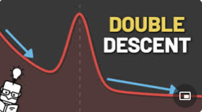
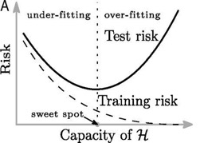
Double Descent Explained
Everyone learns the same rule: make a model too big and it overfits, memorizing the noise in the training data until it fails on everything new
The classic bias-variance curve says test error is U-shaped, so you find the sweet spot and stop
But modern neural networks have far more parameters than training examples, sit way past that sweet spot, and still generalize beautifully. How?
The answer is a curve that seems to break the rule. As you keep adding parameters, test error climbs exactly as the textbook predicts, peaking at the interpolation threshold, the point where the model has just enough capacity to thread every training point and drive training error to zero
Right there the fit is forced through every noisy point with no slack, so it swings wildly and generalizes worst. But push past the threshold and test error descends a second time, often below the classical sweet spot
Once there are more parameters than points, infinitely many perfect fits exist, and gradient descent quietly prefers the smoothest, lowest-norm one
More parameters give it more room to stay smooth, which is why a giant network that memorizes its training set can still be the one that generalizes best
This is double descent, and it is why in deep learning, bigger really can be better.
https://www.youtube.com/watch?v=NP8oGdiu8dQ
https://mlu-explain.github.io/double-descent/
https://github.com/josch14/double-descent
https://www.pnas.org/doi/10.1073/pnas.1903070116
https://arxiv.org/abs/1812.11118
https://www.youtube.com/watch?v=lJIW8TaAxLo

Slide 21
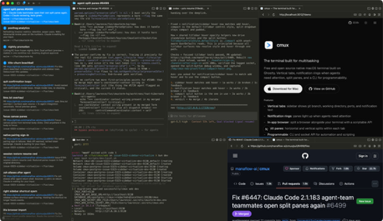
AI Updates
cmux - an Agent-Friendly Terminal
cmux is a native macOS terminal designed for developers coordinating multiple AI coding agents
cmux is free, open source, and currently macOS-only
https://cmux.com
https://github.com/manaflow-ai/cmux - 26K stars
https://betterstack.com/community/guides/ai/cmux-terminal/
https://www.ycombinator.com/launches/PbB-cmux-the-open-source-terminal-built-for-coding-agents
https://www.youtube.com/watch?v=bGXagNWlk74
It uses Ghostty terminal engine with a Swift and AppKit interface, rather than Electron
Vertical tabs, pane splits, workspaces, and notification rings make active agent sessions easier to monitor
An embedded browser lets agents and developers inspect local web applications without leaving the workspace
Its CLI and socket-control API can create workspaces, operate panes, send keystrokes, and automate browser tasks
It supports agent-oriented CLI tools such as Claude Code, Codex, Gemini CLI, OpenCode, Kiro, and Aider

Slide 22

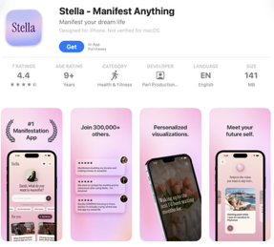
AI Updates
Stella’s AI-App Launch
The article claims the app reached about $300,000 in monthly recurring revenue within two months
https://apps.apple.com/us/app/stella-manifest-anything/id6757347283
https://medium.com/@yumaueno/she-had-never-written-a-line-of-code-two-months-later-her-app-was-making-300-000-a-month-888c37439bbd
https://www.instagram.com/reel/DUwVfllDjNJ/
https://www.youtube.com/watch?v=Eg93po_DAYo
https://www.stork.ai/blog/this-ai-app-makes-300kmonth
Sarah Perl, creator of the HotHighPriestess brand, launched Stella, an iPhone manifestation app centered on personalized “dream life” audio narratives
The reported story says she had no conventional programming background, used Claude Code and Google AI Studio, and produced an MVP in roughly two days
Stella asks users about desired career, relationship, financial, or personal outcomes, then generates customized visualizations and daily affirmations
Its launch advantage was distribution: Perl already had a large social audience, allowing rapid testing of short-form content, hooks, and conversion to downloads

Slide 23
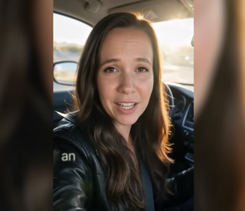
VEED Fabric AI Video Test
VEED Fabric AI Video Test
https://www.veed.io
https://github.com/veedstudio
https://www.veed.io/tools/ai-video
https://www.youtube.com/watch?v=fNM6zU6cMKY
Julia McCoy tests VEED Fabric 1.0, which animates a single real or AI-made image into a speaking avatar driven by supplied, cloned, or library voice audio
It synchronizes lips, blinks, head motion, shoulders, and gestures; short 10–30-second outputs look strongest, while longer clips reveal artifacts
Gen AI Studio converts a written concept into a draft script, scenes, narration or avatar, captions, and suggested AI B-roll, then allows scene-level rewriting and model choice
The editor adds subtitles, transitions, music, audio cleanup, silence removal, eye-contact correction, and background expansion
Verdict: trained avatars remain more realistic, but one-photo generation sharply lowers production time and cost; clear messaging becomes the differentiator

Slide 24
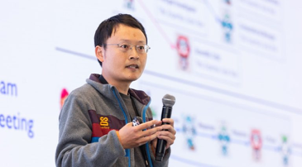
AI Updates
Stanford Virtual Biotech
https://med.stanford.edu/cancer/about/news/inside-the-virtual-lab--how-ai-scientists-are-accelerating-disco.html
https://github.com/zou-group/virtual-lab
https://venturebeat.com/orchestration/stanford-is-running-37-000-ai-agents-as-a-virtual-biotech-and-one-of-its-drug-designs-got-independently-confirmed-by-merck
https://www.linkedin.com/posts/james-zou-2123a4133_introducing-the-virtual-biotech-our-vision-activity-7433227674992517120-SOBt
https://www.youtube.com/watch?v=jd3zHAw_S4Y
Stanford’s Virtual Biotech .. organizes thousands of specialized AI scientist agents .. under a Chief Scientific Officer agent .. modeling target discovery, molecule design, and clinical-development functions
37,000 clinical-trial agents processed 60,000 trials to identify biomarkers and target signals linked to clinical success
The system proposed a CD276-targeting antibody-drug conjugate for lung cancer
Merck later independently advanced a substantially similar therapeutic strategy, providing an encouraging external corroboration
The platform is intended to accelerate computational hypothesis generation while keeping experimental validation and human scientific judgment essential
James Zou is a Stanford AI researcher working at the intersection of machine learning, biology, medicine, and AI agents
He is an associate professor of Biomedical Data Science and, by courtesy, Computer Science and Electrical Engineering, and leads the Stanford AI for Science Lab

Slide 25



AI Updates
AI Dev Platforms: GitHub vs Vercel vs Replit
AI has made software coding a cheap commodity
The value of dev platform shifts from coding to orchestration, production, and verification
GitHub - coordinates multi-vendor agents through familiar issues, pull requests, policies, and isolated task environments
Vercel - focuses on safely converting generated code into production deployments using isolated microVM sandboxes and usage-aligned compute
Replit - emphasizes autonomous verification. Its agent drives a browser, tests workflows, detects broken “Potemkin” interfaces, and attempts repairs
MCP is the shared interoperability layer, enabling agents to access tools, data, and APIs through standardized servers
The strategic tradeoff is clear: .. GitHub owns workflow governance .. Vercel owns deployment reliability .. Replit owns testing confidence
https://blog.bytebytego.com/p/github-vs-vercel-vs-replit-what-dev
https://www.youtube.com/watch?v=8a4_AAds0vU

Slide 26


granian vs uvicorn for SaaS
Peter Diamandis - Automagical Life
https://www.diamandis.com
https://metatrends.substack.com/p/auto-magical-living
Diamandis predicts that by 2028, ambient AI will continuously use consented personal data to anticipate needs and act without explicit prompts
It would combine calendars, conversations, home cameras, location, wearables, glucose data, and health records to optimize decisions and environments
Examples include a robot chef tailoring meals, an autonomous car arriving at departure, and a living room adapting to stress
Shopping agents could make approved purchases within budgets, while meeting assistants brief users, detect skepticism, draft follow-ups, and update CRM records
The proposed exchange is pervasive surveillance for convenience, health support, and productivity; it also creates opportunities in permissions, privacy, robotics, health data, and logistics

Slide 27


granian vs uvicorn for SaaS
https://uvicorn.dev
https://github.com/Kludex/uvicorn
https://github.com/emmett-framework/granian
https://fastapi.tiangolo.com/deployment/manually/
https://talkpython.fm/books/python-in-production/chapter-6-running-on-rust
Granian is a production HTTP application server for Python, written in Rust
You run it in front of a Python web app (such as FastAPI) much as you would run Uvicorn or Gunicorn
Granian supports ASGI, WSGI, HTTP/2, HTTPS, and WebSockets, making it compelling for connection-heavy or unusually high-throughput APIs
Choose Granian when HTTP/ASGI layer is a bottleneck. Granian's Rust/Tokio implementation can improve throughput and tail latency.
Choose Uvicorn first for most FastAPI SaaS deployments: it is mature, ubiquitous, well documented, and FastAPI’s default production server
Database, Redis, external APIs, serialization, and Python CPU work usually dominate SaaS request time, limiting server-level gains.
Uvicorn has the safer operational path: familiar tooling, broad ecosystem coverage, straightforward workers, and easier incident troubleshooting.
# app.py
from fastapi import FastAPI
app = FastAPI()
@app.get("/")
async def index():
return {"status": "ok"}
# run_server.py
import subprocess
import sys
cmd = [
sys.executable, "-m", "granian",
"--interface", "asgi",
"--host", "127.0.0.1",
"--port", "8000",
"--workers", "2",
"app:app",
]
subprocess.run(cmd, check=True)

Slide 28

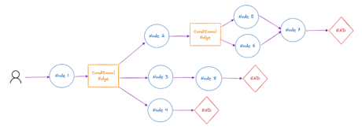
AI Updates
LangGraph: Runtime Over Diagrams
https://langchain-ai.github.io/langgraph/
https://github.com/langchain-ai/langgraph
https://docs.langchain.com/oss/python/langgraph/overview
https://www.blog.langchain.com/making-it-easier-to-build-human-in-the-loop-agents-with-interrupt/
https://www.youtube.com/@LangChain
LangGraph’s core value is durable, stateful execution - not drawing agent flowcharts.
State, nodes, edges, reducers, and compile define the graph; supersteps coordinate parallel updates deterministically
Checkpointers plus a thread ID preserve state, enable resume, human approval pauses, replay, forking, and streaming
Use durable storage such as SQLite or Postgres; in-memory checkpoints disappear on restart
Interrupts restart their enclosing node when resumed, so side effects must be retry-safe
Prefer simpler loops for short, deterministic workflows without recovery or human-in-the-loop needs

Slide 29

AI Updates
AI Coding Skills: Modular Control https://www.youtube.com/watch?v=8D8ewFBJfFM
Matt Pocock’s modular AI-development skills aim to reduce unpredictable coding output by gathering precise project context.
The approach favors short, reusable, independently runnable skills over rigid chained workflows.
Groom Me interviews users one decision at a time, recommends options, and waits for confirmation before acting.
Two Spec preserves the agreed design in a code-free specification, encouraging agents to inspect current code rather than copy stale snippets.
Two Tickets slices work by end-to-end features rather than database/API/UI layers, enabling earlier testing.
Implement emphasizes test-driven development;
Code Review uses concise refactoring concepts such as shotgun surgery, feature envy, and data clumps.

Slide 30
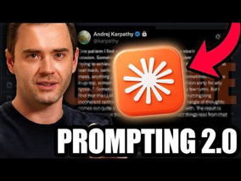

Karpathy’s Prompting 2.0
Karpathy’s Prompting 2.0
https://www.youtube.com/watch?v=eMPWBunaOic
https://karpathy.ai
https://github.com/karpathy
https://platform.claude.com/docs/en/build-with-claude/prompt-engineering/claude-prompting-best-practices
https://x.com/karpathy/status/2079610838143623371
Andrej Karpathy’s “ramble session” prompting approach uses roughly 10 minutes of unstructured voice input to give an LLM richer project context.
Start by warning the model that speech recognition may introduce typos, then freely describe goals, constraints, uncertainties, examples, preferences, and half-formed ideas.
The model can reconstruct that messy context into a clearer shared understanding, sometimes through a short interview-style back-and-forth.
Use it chiefly at the beginning of a new project or session, rather than for every small edit.
The goal is fewer correction cycles and a stronger “mind meld,” not replacing clear acceptance criteria, tests, or verification
Harness Influence Local AI Performance
"OMP" stands for Oh My Pi , terminal-based AI coding agent
OMP’s planning, iteration, and tool workflow improve outcomes but consume substantially more tokens and time
https://omp.sh
https://github.com/can1357/oh-my-pi
https://hkinsley.com/reflections/right-harness-is-all-you-need
https://www.youtube.com/watch?v=H50xoAzNfB0 - sentdex

Slide 31
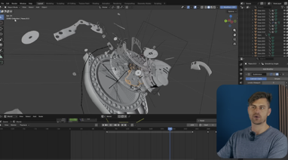

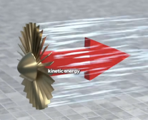
Create Blender Animations AI & MCP
Claude Code
MCP
Blender
https://www.blender.org
https://www.youtube.com/watch?v=xBLGsYLwgks
https://www.youtube.com/shorts/dLLCr_N-WPM
https://www.youtube.com/@sketchedwealth/shorts - 149K subscribers in 10 months
https://www.youtube.com/watch?v=yzfcT6uK8LE&list=PLDPt06O8IMpMygx5Xk9yn5C-ZT8vqElEB - playlist

Slide 32

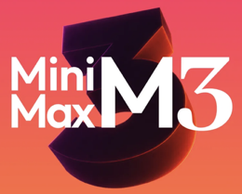
AI Updates
MiniMax Code 2.0 (August 7)
Rebuilt desktop agent on the open-source Pi framework
Over 90% lower p95/p99 first-token latency, fewer stalls, and stronger persistence of conversation and tool state
Teams of agents can divide research, strategy, production, and review among separate agents, improving coordination and quality control.
Memory and reusable skills preserve organizational context and repeat proven workflows.
Built-in browser control, phone-based remote control, goal/work modes, scheduling, and BYOK support broaden automation use cases.
Practical examples include multi-channel content campaigns, lead research, recurring reports, and seven-day member onboarding sequences.
https://www.minimax.io
https://github.com/badlogic/pi-mono
https://alphasignal.ai/news/minimax-rebuilds-code-2-0-on-pi-agent-slashing-latency-by-90
https://agent.minimax.io/docs/changelog
https://www.youtube.com/watch?v=rlqBbtQFEro

Slide 33

AI Updates
Ling-3.0-tiny: Small, Sparse, Fast
https://huggingface.co/inclusionAI/Ling-3.0-tiny
https://github.com/inclusionAI/Ling
https://eu.36kr.com/en/p/3935123373866371
https://x.com/AntLingAGI/status/2085432364189335884
https://www.youtube.com/watch?v=XDhqIsRwV7M
Ling-3.0-tiny is a hybrid-reasoning MoE with 7.9B total parameters but only 1.3B active per token (128 experts, 8 routed experts)
262K context window, instant/thinking modes, and native function calling make it attractive for long-context agent workflows
BF16, FP8, and INT4 weights are now downloadable

Slide 34


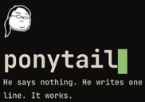

AI Updates
Claude Code Token Leak Fixes
The video pitches four free tools to stretch Claude Code usage:
RTK (Rust Token Killer) reduces shell output; https://github.com/rtk-ai/rtk
Caveman skill makes replies terse - https://caveman.so
Ponytail discourages speculative code - https://ponytail.dev
OmniRoute routes to 268 providers - https://omniroute.online
Claimed results include 82.9% less tool-output usage, 69% fewer reply tokens, and roughly half the generated work volume
The practical habits are sound: clear or compact stale context, trim CLAUDE.md, plan before executing, batch related requests, delegate exploration, and retain durable project memory.
Be cautious with “free” routing: providers have quotas, privacy implications, changing availability, and potentially weaker models.
Independent testing found more modest, variable savings for several tools; validate on representative repositories before standardizing
https://github.com/rtk-ai/rtk
https://github.com/JuliusBrussee/caveman
https://alexriosme.substack.com/p/there-is-a-reason-that-caveman-is
https://github.com/diegosouzapw/OmniRoute
https://blog.jetbrains.com/ai/2026/07/ponytail-skill-claude-tested/
https://www.linkedin.com/pulse/how-reduce-claude-code-token-usage-rtk-omniroute-julian-goldie-phvwc
https://www.youtube.com/watch?v=_8GF2zIJf9w
Normal: Authentication likely fails because the token expiry check uses local time.
Caveman: Auth fails. Local-time expiry check. Use UTC.
Add this sentence to agent rules file:
Answer concisely. Be brief and to the point.
Add a second sentence:
Drop filler words, articles, and hedging when appropriate. Keep technical terms and code blocks exact.

Slide 35
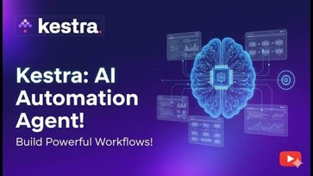
AI Updates
Kestra: Governed AI Agents
Kestra combines deterministic orchestration with AI reasoning, keeping high-impact actions under human control
YAML workflows are versionable, reviewable, deployable through CI/CD, and recoverable through execution history, replays, and backfills
A GitHub triage flow deterministically fetches issue facts, then lets an AI agent classify, prioritize, label, and draft a response.
A pause or human-approval gate separates AI analysis from external writes; GitHub comments and labels are applied only after explicit approval.
Kestra can self-host locally with Docker or Kubernetes, supports multiple scripting languages, and provides broad integrations for production automation
https://github.com/kestra-io/kestra
https://kestra.io
https://kestra.io/blogs/introducing-ai-agents
https://kestra.io/blogs/release-1-1
https://www.youtube.com/watch?v=7wnjIZ70MVk

Slide 36

AI Updates
Hermes /learn docs into skills
Hermes Agent’s /learn command can turn a PDF, book, or document collection into a reusable agent skill instead of treating it as temporary chat context
The resulting skill can organize source material into focused, on-demand references, allowing the agent to retrieve relevant sections rather than repeatedly loading an entire document.
This is useful for SOPs, architecture standards, brand guides, technical manuals, and frequently consulted books.
Treat “permanent knowledge” cautiously: skills are local artifacts that should be reviewed, versioned, tested against source material, and updated when documents change.
Start with one high-value, stable document your team repeatedly uses; validate answers with known questions before expanding the library
https://hermes-agent.nousresearch.com/docs/
https://github.com/NousResearch/hermes-agent
https://github.com/virgiliojr94/book-to-skill
https://www.youtube.com/watch?v=0sDKQMO23xE

Slide 37


AI Updates
Pax Silica: Philippine AI Bet
Pax Silica is a US-led initiative for secure AI, semiconductor, minerals, energy, manufacturing, and logistics supply chains.
The Philippines plans its first AI-native industrial hub at New Clark City, Tarlac: roughly 1,620 hectares (4,000 acres).
It is proposed as industrial infrastructure, not a hyperscale data-center campus.
Initial development covers about 500 hectares and is targeted within three to five years.
Supporters expect investment, semiconductor upgrading, exports, and digital jobs.
Critics demand enforceable safeguards for water, energy, land rights, transparency, and local benefits
https://www.state.gov/pax-silica
https://www.pna.gov.ph/articles/1281392
https://www.youtube.com/watch?v=sO-jLp8jSe4

Slide 38
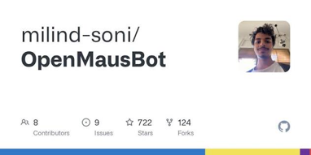
AI Updates
OpenMausBot: Agent Teams
Your own team of AI bots, in a chat ap
Free, open-source Mac agent workspace
By Milind Soni, modeled on Grok Bot
It presents AI agents as chat contacts, each with a distinct role, memory, apps, model choice, and workspace
It uses existing Claude Code, Codex, or Grok CLI logins rather than requiring API keys or another subscription
Agents can use connected services, cloud desktops, or the host Mac, with live previews and user takeovers
Permission prompts require approval for potentially risky actions, preserving user control
It is local-first but still sends prompts to cloud model providers
Expect launch-stage rough edges: repetitive approvals, slow computer use, and no demonstrated inter-agent messaging
https://github.com/milind-soni/OpenMausBot
https://aisuccesslabjuliangoldie.com/blog/openmausbot-vs-grok-bot/
https://x.com/LinearUncle
https://www.youtube.com/watch?v=midY3xIxKAk

Slide 39
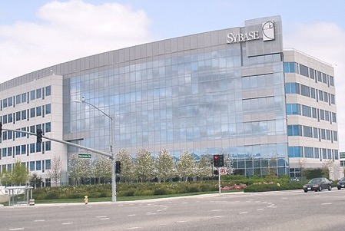

AI Updates
Sybase & Microsoft SQL Server
Sybase was founded in 1984, built an early high-performance client-server relational database, initially called Sybase SQL Server
In 1988, Sybase, Microsoft, and Ashton-Tate jointly developed an OS/2 SQL Server; Microsoft initially marketed Sybase technology
In 1993 they split. Microsoft paid Sybase for a licensed source-code base for its Windows direction; the products then evolved independently
Sybase renamed its database as Adaptive Server Enterprise in the late 1990s to distinguish it from Microsoft SQL Server
SAP acquired Sybase for about $5.8 Billion in 2010
https://en.wikipedia.org/wiki/Sybase
https://www.sap.com/products/technology-platform/sql-server.html
https://github.com/MicrosoftDocs/sql-docs
https://community.sap.com/t5/additional-blog-posts-by-sap/a-deeper-look-at-sybase-history-of-ase/ba-p/12923660
https://www.youtube.com/watch?v=dK5iwBxFzGI
SAP Sybase ASE and IQ are traditional transactional and analytics databases, not AI-native platforms
For built-in AI features such as machine learning, embeddings, similarity search, forecasting, and anomaly detection, SAP’s primary platform is HANA Cloud.

Slide 40
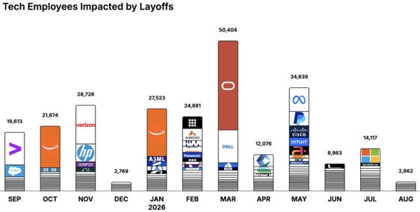
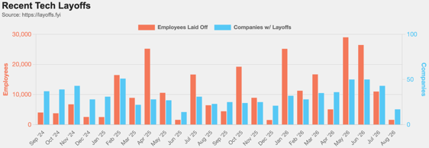
https://layoffs.fyi
https://trueup.io/layoffs
Jobs
The Tech Layoff Tracker
In 2026: 175,465 people laid off (780 per day)
In 2025: 245,953 people laid off (674 per day)
In 2024: 238,461 people laid off (653 per day)
https://trueup.io/layoffs
Tech Layoffs by year (US only):
126K in 2026 (as of August 13, 2026)
124K in 2025
153K in 2024
264K in 2023
165K in 2022 https://layoffs.fyi

Slide 41


About the Speaker
Lev Selector, Ph.D.
40+ years of software engineering, data science, and building teams (hiring, training, and managing)
Ph.D. in mathematical modeling and computer simulations
Interests:
Generative AI, Using LLM with your data
Local AI for Local Private Data
Cloud architecture, fin-tech, application security
Find/connect: Linkedin, GitHub, YouTube, Google
https://eais.ai
Enterprise AI Systems

Slide 42
Thank You!

