Slide 1
AI Updates - November 14, 2025
xxx
Crowd-sourced "LM Arena" Leaderboard
World Labs - Marble World Model
Code execution with MCP
OpenAI "GPT-5.1 Instant & Thinking
OpenAI "AI-powered jobs platform" in mid-2026
Google Nested Learning
The "Magnificent 7"
Microsoft: more GPUs than Electricity
Nvidia invest in startups that buy its GPUs
Language Models are Injective and Invertible
AI Projects - succeed or fail?
Emad Mostaque Interview
SymPy for Math instead of LLM
Which LLMs are available in Moscow
AI for Mental Health
Gemini & Anthropic support JSON Schema
World Model RAG
Google Nano Banana 2 (Pro) preview
Verdent AI coding agent
Analyze Data in Excel or GSheets
Yann LeCun is planning to leave Meta
Microsoft's Humanist Superintelligence Vision
Baidu’s ERNIE-4.5-VL-28B-A3B-Thinking
China’s most affordable AI coding agent
Lovable Nears 8M Users (up from 2.3M in July)
Meta ASR Model for 1,600+ Languages
AI make money in Small Niches
Become AI Orchestrator
Making Money During AI Gold Rush
Jobs, Layoffs, demand for AI Engineers

Slide 2
Crowd-sourced "LM Arena" Leaderboard
Data for November 5
Starting Elo rating = 1000
https://en.wikipedia.org/wiki/Elo_rating_system
English - https://lmarena.ai/leaderboard/text
Coding - https://lmarena.ai/leaderboard/text/coding
Model | Score
gemini-2.5-pro | 1452
claude-opus-4-1-20250805-thinking-16k | 1448
claude-sonnet-4-5-20250929-thinking-32k | 1448
gpt-4.5-preview-2025-02-27 | 1442
claude-opus-4-1-20250805 | 1439
chatgpt-4o-latest-20250326 | 1438
gpt-5-high | 1436
claude-sonnet-4-5-20250929 | 1436
o3-2025-04-16 | 1435
qwen3-max-preview | 1433
glm-4.6 | 1428
gpt-5-chat | 1425
qwen3-max-2025-09-23 | 1423
claude-opus-4-20250514-thinking-16k | 1423
deepseek-v3.2-exp-thinking | 1421
qwen3-235b-a22b-instruct-2507 | 1420
grok-4-fast | 1420
deepseek-r1-0528 | 1418
kimi-k2-0905-preview | 1417
deepseek-v3.1 | 1416
deepseek-v3.1-thinking | 1416
kimi-k2-0711-preview | 1416
qwen3-vl-235b-a22b-instruct | 1415
deepseek-v3.1-terminus | 1415
Model | Score
claude-sonnet-4-5-20250929-thinking-32k | 1524
claude-opus-4-1-20250805-thinking-16k | 1516
claude-opus-4-1-20250805 | 1501
claude-opus-4-20250514-thinking-16k | 1496
qwen3-max-preview | 1483
claude-haiku-4-5-20251001 | 1481
glm-4.6 | 1474
longcat-flash-chat | 1474
qwen3-max-2025-09-23 | 1474
deepseek-v3.2-exp-thinking | 1471
gpt-5-high | 1470
gemini-2.5-pro | 1470
claude-sonnet-4-20250514-thinking-32k | 1469
qwen3-235b-a22b-instruct-2507 | 1468
claude-sonnet-4-5-20250929 | 1466
kimi-k2-0905-preview | 1465
qwen3-vl-235b-a22b-instruct | 1465
chatgpt-4o-latest-20250326 | 1463
deepseek-r1-0528 | 1462
claude-opus-4-20250514 | 1461
gpt-5-chat | 1459
deepseek-v3.1-terminus-thinking | 1459
o3-2025-04-16 | 1458
gpt-4.5-preview-2025-02-27 | 1456
China
https://lmarena.ai/leaderboard/text
Design Arena -
https://www.designarena.ai
https://openlm.ai/chatbot-arena/
https://beta.lmarena.ai
Web Leaderboard -
https://web.lmarena.ai/leaderboard
LLM Leaderboard - by @LlmStats -
https://llmworld.net/llm_leaderboards/
LLM Leaderboard - by StackAI -
https://www.stack-ai.com/llm-leaderboard
LLM Leaderboard - by Artificial Analysis -
https://artificialanalysis.ai/leaderboards/models
Open LLM Leaderboard - by Hugging Face -
https://huggingface.co/open-llm-leaderboard
LLM Leaderboard - by Vellum -
https://www.vellum.ai/llm-leaderboard
AI Benchmarking Hub -
https://epoch.ai/data/ai-benchmarking-dashboard
Grok 4 Benchmarks -
https://artificialanalysis.ai/models/grok-4
China
China
China
China
China
China
China
China
China
China
China
x.ai
China
China
China
China
China
China
China
China
China
China

Slide 3

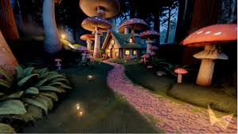
World Labs - Marble World Model
World Labs - Marble World Model
https://www.youtube.com/watch?v=-QbM6_BSdS0
The first publicly available multimodal frontier world model that generates fully navigable 3D environments
Developed by AI pioneer Dr. Fei-Fei Li's team
Marble creates interactive 3D worlds from multiple input types: text descriptions, single or multiple images, videos, or coarse 3D layouts
Users can freely navigate these environments, edit specific elements (like transforming walls into stages or changing objects), and expand the world in any direction
Export creations as Gaussian splats, triangle meshes, or videos
Unlike LLMs that predict the next word, world models predict what the physical world looks like - including physics, lighting, and spatial relationships
World Labs believes this spatial intelligence approach is the path to AGI
Uses today: filmmakers, game designers, architects, designers, training robots
Marble is free to use at marble.worldlabs.ai with a basic tier offering 7,000 credits, while paid plans range from $20/month (20,000 credits) to $120/month (120,000 credits) with enhanced features.
World Labs has raised $230 Mln
https://observer.com/2025/11/fei-fei-li-world-labs-unveils-first-product/
https://www.worldlabs.ai/blog/marble-world-model
https://www.worldlabs.ai

Slide 4
Code execution with MCP
Step 3: Agent writes code to run in the execution environment
import * as gdrive from './servers/google-drive';
import * as salesforce from './servers/salesforce';
const transcript = (await gdrive.getDocument(
{ documentId: 'abc123' })).content;
await salesforce.updateRecord({
objectType: 'SalesMeeting',
recordId: '00Q5f000001abcXYZ',
data: { Notes: transcript }
});
Benefit: the copied document never flows through the AI model's context
Benefit: reduces token usage by up to 98.7% in scenarios with many tools
Benefit: the agent can filter large datasets in code (processing 10,000 spreadsheet rows but only showing the model 5 relevant ones), write loops and conditionals, save reusable functions as "skills" for future tasks
To implement this approach, we need:
(1) A code execution environment;
(2) Code that creates TypeScript/Python files representing each tool;
(3) callMCPTool() wrapper for communication with MCP servers
Added complexity: you need to build and secure a code execution environment, generate the file tree from your MCP servers, and handle the infrastructure for running untrusted code safely.
For agents with just a few tools, the traditional direct tool-calling approach is simpler. But once you're connecting dozens of servers with hundreds of tools, code execution becomes essential for keeping costs and latency reasonable
Code execution with MCP: Building more efficient agents
https://www.anthropic.com/engineering/code-execution-with-mcp
Idea - allow LLM to automate its own actions by writing code to be executed outside of LLM (in a save environment)
When AI agents connect to lots of tools through MCP servers, two things waste tokens and slow everything down:
  Too many tool descriptions loaded upfront into context
  Data flowing through the agent multiple times
The Solution: Code Execution with MCP
Instead of calling tools directly, let the agent write code that calls the tools. The code runs in a separate execution environment (like a secure sandbox), and only the final results come back to the agent
Step 1: Present tools as a file tree instead of loading all descriptions. Your agent sees a folder structure like:
servers/
├── google-drive/
│ ├── getDocument.ts
│ └── index.ts
├── salesforce/
│ ├── updateRecord.ts
│ └── index.ts
Step 2: Agent finds tools needed for the task.
For example, when you ask "Copy my meeting notes from Drive to Salesforce," the agent lists the `servers/` directory, sees `google-drive` and `salesforce`, then reads only those two tool files it needs

Slide 5
Code execution with MCP
Do you really need MCP Servers?
https://www.youtube.com/watch?v=OIKTsVjTVJE
Traditional MCP servers can consume 10K+ tokens (5-10% of context window) before an agent even begins working, with multiple servers quickly bleeding 20%+ of available context. This becomes especially problematic when stacking multiple MCP servers together, significantly reducing the agent's effective working memory
Three Alternatives to MCP:
CLI as Tools (80% recommended use) - Agents are taught to use command-line interfaces through a simple prompt and README file, reducing context consumption from 10% to around 5.6%. CLI tools are self-documenting and widely understood by LLMs
Scripts as Tools (Progressive Disclosure) - Single-file, self-contained scripts that agents discover on-demand rather than preloading into context. This approach reduces context consumption to under 2% (less than 2K tokens) by using prompt engineering to prevent agents from reading script internals unless necessary. Each script uses UV dependency management for true file-level isolation
Skills as Tools (Claude-Specific) - Similar to scripts but integrated into Claude's ecosystem with automatic progressive disclosure through skill.md files. While powerful, this represents Claude ecosystem lock-in, though it provides the cleanest progressive disclosure implementation
The recommended approach is:
80% CLI for new tools (works universally),
15% wrap CLI into MCP when needing multi-agent scale
5% use scripts/skills only when context preservation is critical
MCP servers win on simplicity and composability but lose on context consumption and customizability. CLI/scripts/skills require more engineering investment but provide full control, better portability, and superior context management through progressive disclosure. The video emphasizes that prompt engineering remains the critical skill, as prompts determine what enters the context window before any tools are loaded.[3][1]

Slide 6
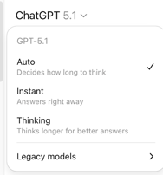
AI Updates - 1
OpenAI "GPT-5.1 Instant & Thinking
https://openai.com/index/gpt-5-1/
Improvements: intelligence, communication style, and efficiency
Warmer, more conversational tone, playful, empathetic and approachable
More reliably answers the exact question asked rather than drifting into tangents or over-explaining
Adaptive reasoning level depending on the question. Adapts thinking time more precisely to the question complexity - running roughly twice as fast on simple tasks and roughly twice as slow on complex problems compared to GPT-5 Thinking
Enhanced Customization (personality presets plus experimental fine-tuning controls for conciseness, warmth, and emoji usage
OpenAI "AI-powered jobs platform" in mid-2026
Challenge LinkedIn by connecting employers with AI-skilled workers
Using AI to evaluate AI skills (including OpenAI Certifications from OpenAI Academy)
OpenAI is planning to certify 10 million Americans by 2030
OpenAI platform focuses exclusively on AI roles and includes a dedicated track for small businesses and local governments to access AI talent
The platform will track and certify various AI competencies including prompt engineering, machine learning development, AI integration into existing products, data annotation, AI training, and AI ethics/policy expertise. Certification pilots begin in late 2025, giving early adopters a competitive advantage before the full platform launches
https://builtin.com/articles/openai-jobs-platform

Slide 7
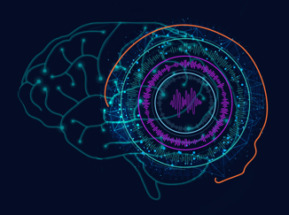
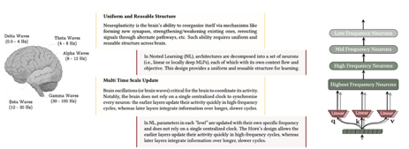
Google Nested Learning
Google Nested Learning
Designed to solve catastrophic forgetting problem (training on new information causes the model to lose previously learned knowledge)
https://www.youtube.com/watch?v=40eUFiGVeMo
https://research.google/blog/introducing-nested-learning-a-new-ml-paradigm-for-continual-learning/
Unlike human brains that continuously adapt through neuroplasticity, AI models have their knowledge locked into two places: their short-term context window and what they memorized during pre-training
This inability to truly learn over time is considered one of the biggest bottlenecks to achieving AGI
Nested Learning - treating the model architecture and training algorithm as the same concept rather than separate components
Instead of one monolithic learner, the approach views models as a system of smaller, nested optimization problems that operate at different learning speeds
Some components adapt quickly while others learn slowly, creating a layered memory system similar to how human brains handle multi-timescale learning
Google built HOPE (a self-modifying variant of the Titans architecture),
HOPE integrates a Continuum Memory System (CMS) that creates a spectrum of memory updating at different frequencies - from milliseconds to months - enabling more human-like recall
HOPE demonstrated superior performance compared to Transformers, Titans, and Mamba 2 across multiple benchmarks, showing lower perplexity, higher accuracy, and better long-context reasoning
Both HOPE and Titans performed nearly perfectly in "needle in the haystack" tests

Slide 8

We do these weekly videos every Friday
Stats: 5.64K subscribers, 253 videos
Subscribe to this channel
https://www.youtube.com/@lev-selector
Download slides from GitHub using links under the videos
Please pause the video - and answer the pinned question in comments under the video

Slide 9
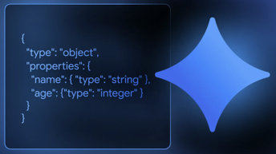
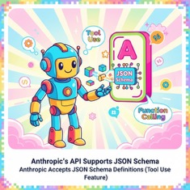
Gemini & Anthropic support JSON Schema
Gemini API now supports JSON Schema
https://blog.google/technology/developers/gemini-api-structured-outputs/
This enables libraries like Pydantic (Python) or Zod (JavaScript/TypeScript) to work out-of-the-box with the Gemini API
It builds upon the current support for the Gemini API’s Schema object that is based on OpenAPI 3.0 for Structured Outputs and Function Calling.
This update also adds support for frequently requested JSON Schema keywords, including:
anyOf for conditional structures (Unions)
$ref for recursive schemas
minimum and maximum for numeric constraints
additionalProperties and type: 'null'
prefixItems for tuple-like arrays
Anthropic's API supports JSON Schema
Anthropic accepts JSON Schema definitions, particularly through their tool use (function calling) feature
When you define tools, you provide an input_schema parameter that accepts JSON Schema to specify the structure of tool inputs
API does not support oneOf, allOf, or anyOf at the top level of the schema
The most reliable approach to get JSON response is to use the tool calling method rather than directly prompting for JSON output
The best practice for structured JSON output with Anthropic is to create a mock tool/function call where your desired JSON structure is defined as the tool's input schema. This forces the model to return properly formatted JSON that adheres to your schema
Why oneOf, allOf, or anyOf are not supported? Implementation complexity and reliability constraints. Parsing ambiguity, Validation complexity, Reliability trade-offs (Anthropic prioritizes schema compliance reliability over flexibility). Simpler schemas with a single, clear structure at the top level allow Claude to generate more predictable, valid outputs

Slide 10
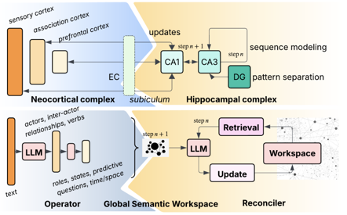
World Model RAG
The system uses GPT-4o with temperature 0 for deterministic behavior, employing detailed prompts for actor identification, role assignment, state tracking, and spatiotemporal coupling
Rather than retrieving isolated facts, GSW reconstructs complete episodic summaries with full contextual understanding of who, what, when, where, and why
This architecture represents a fundamental shift from "bag of chunks" retrieval to persistent, structured memory that maintains spatio-temporal coherence
The dramatic token reduction combined with superior performance makes it particularly valuable for real-time AI agents requiring fast, contextually-aware responses
https://www.youtube.com/watch?v=PJs2oldF8s0
https://arxiv.org/abs/2511.07587
Generative Semantic Workspaces (GSW)
https://www.youtube.com/watch?v=PJs2oldF8s0
A RAG system from UCLA researchers - SOTA performance with up to 20% improvement over existing methods
GSW takes inspiration from human brain architecture (hippocampus and neocortex) to create a neuro-inspired framework with two main components:
Operator - performs deep semantic analysis on text chunks, transforming unstructured language into structured "index cards" containing actors, roles, states, actions, and crucially, spatiotemporal information
Reconciler - integrates local semantic graphs into a persistent global workspace, performing entity resolution, state tracking across timelines, and building coherent narrative memory structures
The system processes text by creating local semantic graphs from chunks (e.g., "Dr. Aristo nervously approached the podium at Geneva Convention Center on May 10th"), then reconciling these across multiple chunks to track entity states over time
For example, it can identify that "he" in a second chunk refers to "Dr. Aristo" from the first, and track his emotional state transition from "nervous" to "confident" along a coherent timeline
On the EpBench benchmark (200-chapter books, 100k-1M tokens), GSW demonstrated: Highest F1, precision, and recall scores across all metrics; 10%+ improvement over the next-best model (GraphRAG); 50-60% token reduction compared to GraphRAG and other embedding RAG systems; Significantly faster inference due to reduced token usage

Slide 11


AI Updates - 3
Google Nano Banana 2 (Pro) preview
https://www.youtube.com/watch?v=6zw2p2l4fHI
An upcoming ultra-lightweight AI image generation model
Delivers high-quality visuals with exceptional speed
The model appeared in preview form on Media.io
Expected to officially launch around November 11, 2025
Native 2K output, improved text rendering, infographics, and chart generation, multilingual support, transparency support, significantly better instruction following; photorealistic images with exceptional detail
Multi-step generation workflow - it plans the output, generates an image, reviews it through built-in image analysis, identifies and corrects errors, and iterates before delivering the final result
Verdent AI coding agent
https://www.youtube.com/watch?v=bhqLatL1Km8
https://verdent.ai
Multi-model orchestration (for example, combining GPT-5 and Claude 4.5 strengths)
Long context with persistent memory
Automated verification with code review
Outperforms Cursor 2.0 and Warp, surpasses Claude Code and Codex with 76.1% pass@1 score on the SWE-bench Verified test
Available as a macOS desktop app and as a VSCode extension, also works with Cursor and Windsurf

Slide 12
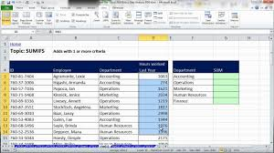
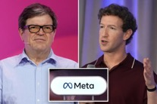
AI Updates - 4
Analyze Data in Excel or GSheets
VibeChart - transforms data into charts using prompts
https://vibechart.ai/
Shortcut - AI Excel agent that works inside Excel or Google Sheets
https://www.shortcut.ai
Chat CSV - Upload CSV files and chat with them to get insights, charts, and summaries
https://www.chatcsv.co
Sheet AI - Works inside Google Sheets to clean columns, generate content, summarize data, and perform tasks through natural language commands
https://sheetai.app
Genius Sheets - Built specifically for finance teams to create P&L reports, structured financial reports, and dashboards with QuickBooks integration. Available at Google Workspace Marketplace and Microsoft AppSource
Use Microsoft Copilot Desktop's Voice and Vision to analyze GSheets or Excel data hands-free
Yann LeCun is planning to leave Meta
to launch his own AI startup focusing on "world models"
LeCun has called LLMs a "dead end" for achieving human-like AI, advocating instead for systems that can perceive environments and grasp physical concepts like gravity
https://www.youtube.com/watch?v=bdBfYYhSXLQ
Mark Zuckerberg is pushing Meta commerce, but Meta's models have fallen significantly in LLM rankings, replaced by Chinese open-source models

Slide 13






AI Updates - 5
Microsoft's Humanist Superintelligence Vision
Microsoft AI CEO Mustafa Suleyman published a manifesto titled "Towards Humanist Superintelligence" - https://microsoft.ai/news/towards-humanist-superintelligence/
Suleyman proposes "Humanist Superintelligence (HSI)"—AI that's carefully calibrated, contextualized, and within limits rather than unbounded with high autonomy AGI
Microsoft formed a new MAI Superintelligence Team to build powerful but contained systems
Baidu’s ERNIE-4.5-VL-28B-A3B-Thinking
https://huggingface.co/baidu/ERNIE-4.5-VL-28B-A3B-Thinking
Lightweight multimodal reasoning, open-source (Apache-2.0) model
28B params, “>3B" active params
SOTA on document/chart understanding
Outperforms Gemini‑2.5‑Pro and GPT‑5‑High on select benchmarks
Adds “Thinking with Images” to zoom in/out on details
China’s most affordable AI coding agent
ByteDance (TikTok owner), Model "Doubao-Seed-Code" on Volcano Engine Cloud
Pricing: $1.30 first month, then ~$5/mo
SOTA record on the SWE-Bench Verified test, on par with Anthropic’s Claude Sonnet.
https://www.scmp.com/tech/big-tech/article/3332365/bytedance-unveils-chinas-most-affordable-ai-coding-agent-just-us130-month
Lovable Nears 8M Users (up from 2.3M in July)
Stockholm-based AI coding startup Lovable
CEO Anton Osika said more than half of Fortune 500 firms use the platform,
so the company expands hiring and targets corporate adoption.
Meta Open-Sources ASR Model for 1,600+ Languages
Open-source (Apache 2.0) speech recognition for 1,600+ languages
Extensible to 5,400 via zero-shot learning
https://huggingface.co/collections/bezzam/omnilingual-asr-1-600-languages
https://github.com/facebookresearch/omnilingual-asr

Slide 14
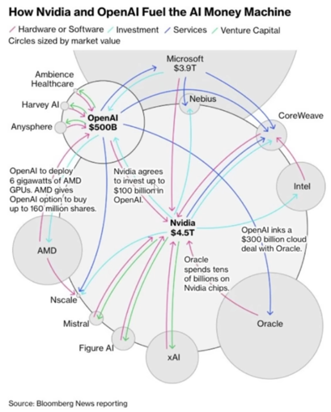
AI Updates - 6
The "Magnificent 7" : Microsoft, Nvidia, Google, Apple, Tesla, Amazon, Meta
have driven the big portion of S&P 500 growth since 2023
The Magnificent 7 now represent approximately 36-37% of the S&P 500's total market capitalization as of late 2025, up from just 12% in 2015 and 21.6% in 2022
In 2023, the Magnificent 7 contributed 15.8% to the S&P 500's 26.3% total return — meaning they accounted for 60% of the index's gains
In 2024, the Magnificent 7 contributing 14.1% to the S&P 500's 25.7% return
This concentration is historically extreme, the Magnificent 7 have undeniably been the dominant force behind the S&P 500's exceptional performance since 2023, creating the most concentrated market environment in decades
Microsoft has more GPUs than Electricity to run them
Microsoft's CEO revealed the company has AI GPUs sitting unused in inventory due to insufficient power infrastructure
Nvidia invest in startups, and they buy Nvidia GPUs
Startups like CoreWeave, Figure AI, and OpenAI, which get money from Nvidia -and then use that capital to purchase Nvidia chips

Slide 15
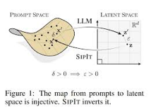

AI Updates - 7
This paper: "Language Models are Injective and Hence Invertible"
https://arxiv.org/pdf/2510.15511
The authors demonstrate both mathematically and empirically that LLMs preserve complete input information in their hidden representations
  Mathematical proof of injectivity
  Empirical validation
  SipIt (Sip It) algorithm - efficiently reconstructs exact input text from hidden activations
This work establishes injectivity as a fundamental and exploitable property of language models with direct implications for transparency, interpretability, and safe deployment. The ability to exactly recover input text from internal representations opens new possibilities for understanding and auditing model behavior
AI Projects - succeed or fail?
https://www.youtube.com/watch?v=aGJZ-1hM6-E
The video discusses two seemingly contradictory studies about AI success rates:
.. MIT reported that 95% of AI pilots fail to deliver positive ROI
.. Wharton found that 75% of companies see positive returns
MIT focused on "transformation" - custom dev. projects - difficulties with system inflexibility, inability to learn from feedback, and the difficulty of integrating AI into production environments
Wharton focused on "augmentation" - general AI tool usage like ChatGPT, Copilot, and Claude - and found positive results
Strategies: Educational training programs, Talent Services (upskilling, recruitment), Custom Development for clients
88% of companies expecting AI budget increases in 2026

Slide 16

Emad Mostaque Interview
https://www.youtube.com/watch?v=07fuMWzFSUw
Within ~1,000 days, cognitive labor becomes economically worthless—even negative in value, as humans become "the dumbest people on the team." AI will outperform humans in virtually all cognitive tasks while working 24/7 without mistakes.
UBI (Universal Basic Income) via taxation - not enough money; via dividends from AI companies - not enough money;
A cognitive worker can be replaced by AI at ~ $1/day cost
Mostaque's Proposed Solution: Dual Currency System: Foundation Coins (like Bitcoin) + Cash credit to humans (for being human); Creates incentive for AIs to serve humans to earn this currency
If humans are the source of this new currency, AIs' objective function becomes serving and pleasing humans rather than extracting from them.
Public infrastructure so that every person should have their own AI that knows his human and is interested in helping this human
We are Discovering the AI. The equations of generative AI (diffusion models, transformers) appear to be the equations of reality itself
Hypothesis: Every intelligent species reaches this point where they create intelligence that can scale beyond biological limits, and most fail to navigate it.
The danger: Without building aligned AI from the start with massive public compute infrastructure, the default outcome is maximally extractive AI that doesn't need humans.
When cognitive labor approaches zero cost, what remains?
Your connections, communities, relationships
Attention - the scarcest human resource
Meaning-making: Choosing what matters in a world of abundance
Being human: The interactions with family, friends, and community that make life worth living

Slide 17
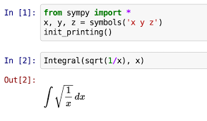

SymPy for Math instead of LLM
SymPy - Python library for symbolic mathematics
Perform algebraic computations symbolically rather than numerically
SymPy functions is a computer algebra system (CAS) with capabilities ranging from basic symbolic arithmetic to advanced calculus, algebra, discrete mathematics, and quantum physics
The library can simplify expressions, compute derivatives and integrals, solve equations, work with matrices, and format results as LaTeX code
Its core features include basic arithmetic operations, expansion, simplification, substitution, arbitrary precision arithmetic, and pattern matching
The library excels at solving various types of equations, including systems of linear equations, algebraic equations solvable by radicals, differential equations, and difference equations
It includes functions for trigonometric, hyperbolic, exponential, logarithmic, and special functions, along with discrete mathematics capabilities like binomial coefficients, summations, and number theory operations
SymPy also supports advanced domains such as physics modeling, geometry, integral transforms (Laplace, Fourier, Mellin), sets, and logic operations
SymPy was started in 2005, integrated into SageMath in 2012
The library is open-source (BSD license) and written entirely in Python
https://www.sympy.org
https://en.wikipedia.org/wiki/SymPy
https://www.geeksforgeeks.org/python/python-getting-started-with-sympy-module/
https://python.plainenglish.io/the-hidden-python-library-thats-making-openai-engineers-jealous-eda41281fc26

Slide 18
Which LLMs are available in Moscow
Sberbank GigaChat MAX - flagship Russian LLM.
Multiple versions. A reasoning version (2025) can solve complex scientific, mathematical, and programming problems​
Built on the NeONKA (NEural Omnimodal Network with Knowledge Awareness) architecture​
Integrated with Kandinsky 2.1 for image generation capabilities​
Currently used by approximately 15,000 Russian enterprises​
Accessible via API, Telegram bot (@gigachat_bot), and web interface​
Three open-source versions available on Hugging Face​
Available:
Perplexity
Qwen3
DeepSeek
GLM-4.6 (Zhipu AI)
Hugging Face
LMStudio - downloading models from Hugging Face
VSCode & Cline extension
OpenRouter - allows to access blocked models (Claude, OpenAI, ...)
Kimi-K2 (via download and some services)
YandexGPT 5 Pro & Lite
32K token context windows​
Powers the Alice voice assistant​
Available through Yandex Cloud for business applications​
Offers both synchronous and asynchronous generation modes​
Supports RAG and integration with Yandex services​
Not available directly (but available via OpenRouter, ...):
OpenAI ChatGPT, ...
Anthropic Claude
Google Gemini
Kimi.com
Grok
Blocked:
Ollama - problems with downloading models
MS Copilot, GitHub Copilot
In China :
US models are blocked (also blocked YouTube, Facebook, etc.), but are accessible via 3rd party API gateways like laozhang.ai , Cloudflare Workers as reverse proxies, or Azure OpenAI Service, which remains accessible in China and now offers Gemini models through partnership, though setup is complex​
There are also services like OpenRouter and similar.
Perplexity - limited geography
Payment via Alipay or WeChatPay, or Crypto
Ollama, LMStudio, ... - available
China has its own very good models (Qwen, Deepseek, ...)
Crypto is used to pay
for OpenRouter and other services

Slide 19


AI for Mental Health
Slingshot AI "Ash" psychotherapist model
A foundation model for psychology - trained for therapy
Importance: there's a massive shortage of mental health providers - approximately 1,500 people in need for every therapist in the US
Training: Pre-training on Clinical Data, Alignment and Fine-Tuning, Reinforcement Learning.
Slingshot learns from extensive conversational signals including response timing, emotional indicators (like crying), user feedback on suggestions, and long-term behavioral outcomes. The RL process optimizes for four sequential goals: building intent, establishing therapeutic alliance, achieving psychological change, and producing behavioral change
An NYU study demonstrated that users of Ash gained a more close personal connection on average after 10 weeks of use. This contrasts sharply with general-purpose AI like ChatGPT, which typically makes users more lonely by replacing human connection rather than strengthening it
The company runs multiple models simultaneously for comparison and validation, including their own SLG base model alongside Llama and Qwen models. They employ value models to track numerous signals over time, predicting outcomes like whether users will ignore responses or build therapeutic alliance
https://www.youtube.com/watch?v=3SliW74opyY
https://slingshotai.com

Slide 20
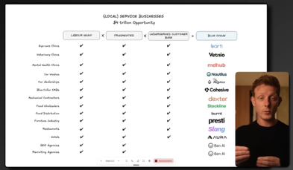
AI make money in Small Niches
The "Boring" AI Niches Making Millionaires in 2026
https://www.youtube.com/watch?v=7xBRp-nvCNw
AI allows to make money in Small Niches which were traditionally ignored by SaaS companies and only 0.2% automated. These are mostly labor heavy, fragmented industries with limited customer bases that were previously too small for traditional SaaS (local service businesses like eye care clinics, veterinary practices, mental health clinics, car washes, car dealerships, and janitorial services)
AI solutions can automate significant labor (sales, marketing, operations), allowing businesses to charge 10-15x more than traditional SaaS. For example, Barti AI charges $1,500/month for its eye care clinic suite versus $100/month for traditional CRMs
AI tools for personalized outreach, voice agents, and chatbots dramatically lower the cost of acquiring customers in niche markets
By reducing service costs, AI software increases demand for the underlying service (the Jevons Effect), potentially growing the total addressable market
Examples (Y Combinator-backed startups):
Barti: AI operating system for eye care clinics (raised $12M Series A)
VetNo: Automates admin for veterinary doctors
MDHub: AI front desk for mental health clinics
Nautilus: Complete software suite for car washes
Auto Ace: AI voice agent for car dealerships
Cohesive: Lead generation for janitorial/landscaping businesses
Aura AI: AI receptionist for German hotels
Two Business Models
Function-Specific AI - target one labor department (sales, operations, marketing) with high-ROI solutions like voice agents, automated booking, or service delivery automation
Vertical AI SaaS - build a complete operating system for the niche with pre-integrated AI automations, becoming the industry standard platform
The recommended approach is starting an AI agency using no-code platforms like n8n to build custom solutions while getting paid. This allows you to learn the industry, identify high-ROI automations, and build product-market fit before transitioning to a productized SaaS offering - exactly how several featured founders built million-dollar businesses in months
The timing is optimal because 95% of businesses haven't implemented AI yet, creating unprecedented demand for specialized solutions in previously ignored markets

Slide 21


Become AI Orchestrator
Become AI systems orchestrator
https://www.youtube.com/watch?v=azd5hrw5j6w
Amazon is preparing to cut up to 30K corporate jobs. This is approx 10% of 350,000 corporate employees
This is one of the largest workforce reductions in the company's history driven by AI automation and efficiency gains
Any role primarily conducted at a computer faces automation risk
The video recommends 4 immediate actions:
become an AI orchestrator who directs AI systems rather than competing with them
move up the value chain to strategic thinking, creativity, and complex judgment
build AI-native skills like prompting, agent deployment, and workflow automation
consider entrepreneurship. One person with AI agents can now do the work of 10
Making Money During AI Gold Rush
https://www.youtube.com/watch?v=aWkCVwVBXfU - video by Calum Johnson
AI Agent Builder Agency - build agents for clients (using Crew.ai or AgentForce) - $2K/mo for setup and maintenance
AI Content Agency - use AI tools like Jasper or Canva to create content quickly. Important - need human in the loop to handle editing and storytelling. AI handles research, outlining, and initial drafts, while humans add unique perspectives and new information
Generative Engine Optimization (GEO) - the future of SEO for AI-powered search platforms like ChatGPT, Perplexity, and Google AI Overviews. Companies currently aren't optimizing to be recommended by these platforms, creating a massive opportunity.
Niche then expand. Learn by doing. Experiment.

Slide 22
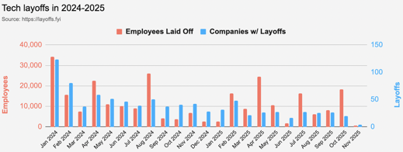
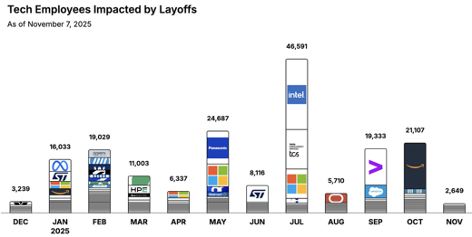
Jobs
https://layoffs.fyi
https://trueup.io/layoffs
Tech Layoffs by year (US only):
  113.6K in 2025 (as of November 7)
  153K in 2024
  264K in 2023
  165K in 2022 https://layoffs.fyi
The Tech Layoff Tracker
So far in 2025, 180,595 people laid off (581 per day)
In 2024, 238,461 people laid off (653 per day)
https://trueup.io/layoffs

Slide 23


About the Speaker
Lev Selector, Ph.D.
40+ years of software engineering, data science, and building teams (hiring, training, and managing)
Ph.D. in mathematical modeling and computer simulations
Interests:
Generative AI, Using LLM with your data
Local AI for Local Private Data
Cloud architecture, fin-tech, application security
Find/connect: Linkedin, GitHub, YouTube, Google
https://eais.ai
Enterprise AI Systems

Slide 24
Thank You!

