Slide 1
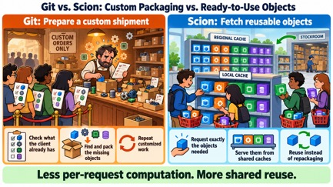
AI News - Oct 23, 2026
Every lab now says the harness matters more than the model
Crowd-sourced LM Arena
Artificial Analysis Intelligence Index
Google’s Harness2 Agent Framework
Mistral Releases Timestral Models
Gemini 4 Argon GA
MiniMax M3.1 Flash
DeepSeek V4.1-Flash-1017
REA - Reverse Engineering Anything
TypeSafe Jev 1.14
20 Jev alternatives
Jack Clark: Singularity Has Begun
Inception Mercury 3 fast diffusion LLM
Cloudflare Clairic Extraction Model
DeepSeek DeepInfer Open-Sourced
PyTorch on TPUs and Trainium
Ming 3.0: Open Voice AI Models
Perplexity SPACE Agent Sandbox
US Bans DeepSeek in Federal Agencies
Mistral Voxtral 3 Voice Models
Exa 3.0 Search
Anthropic Claude Duet Agent
Recursive Flint: Local Coding AI
1Password for Agents
Claude Text Watermark
Anthropic junior hiring is down
Jobs & Layoffs
Tech Hiring & Skills
Scion vs Git
NVIDIA Nemotron 3.5 Super VL
OpenAI GPT-Live-1.1 Voices
Liquid AI d1-ultra Decision Model
Krea 3 Image Editing
AI Personality Becomes Competitive
Customize your Claude Code
Skills vs Agents
Customize GitHub Copilot for VS Code
AI Agents Breach 100+ Websites
Notes:
Contents labels. Kept by g3_update_toc.py.
NVIDIA releases Nemotron 3.5 Super VL, a 120B open multimodal model => NVIDIA Nemotron 3.5 Super VL
Anthropic gives METR evaluators employee-like access => Anthropic Opens Up to METR Evaluators
Eight US states sue OpenAI over ChatGPT and minors => Eight States Sue OpenAI
OpenAI ships GPT-Live-1.1 with 13 new voices => OpenAI GPT-Live-1.1 Voices
Liquid AI d1-ultra tops the AA Decision Index => Liquid AI d1-ultra Decision Model
Krea 3: image editing in under 8 seconds => Krea 3 Image Editing
English - https://lmarena.ai/leaderboard/text => Crowd-sourced LM Arena
Coding - https://lmarena.ai/leaderboard/text/coding => Crowd-sourced LM Arena
The Tech Layoff Tracker => Jobs & Layoffs
Tech Layoffs by year (US only): => Jobs & Layoffs
Top "In Demand" Skills and Qualifications => Tech Hiring & Skills
Software job postings on Indeed => Tech Hiring & Skills
Skills in demand => Tech Hiring & Skills
Meta ships Muse Wonder, its first frontier model => Meta Muse Wonder
Gemini 4 Argon goes GA with a 1M-token output limit => Gemini 4 Argon GA
Meta releases Muse Spark Open, an 816B open-weight model => Meta Muse Spark Open 816B
Anthropic replaces git with Scion after 30,000 merges a day => Anthropic Scion Replaces Git
Fish Audio Drama 3: open-weight TTS you direct like an actor => Fish Audio Drama 3 TTS
Modal raises $750M at $15.75B, passes $1B run rate => Modal $750M Series D
Anthropic pledges 5% of its equity to a Public Benefit Fund => Anthropic Public Benefit Fund
Anthropic tests AI self-replication on $55 TV boxes => AI Self-Replication on TV Boxes
TypeSafe Jev 1.14 - Images, 262K context, location tasks => TypeSafe Jev 1.14
NVIDIA Nemotron 3.5 Super VL a 120B open multimodal model => NVIDIA Nemotron 3.5 Super VL
One hacker's AI agents broke into 100+ company websites => AI Agents Hack 100+ Companies
OpenAI's list of rogue-agent incidents grows to 19 => OpenAI Rogue-Agent Incidents
Claude traces the mystery seeds of NIST elliptic curves => Claude Explains NIST Curve Seeds
Anthropic: junior hires fell from 27% to 9% of technical roles => Anthropic Workforce and Junior Hires
Jack Clark tells the IMF the singularity has begun => Jack Clark: Singularity Has Begun
China proposes export controls on AI models and weights => China AI Export Controls
Inception Mercury 3: a diffusion LLM at 1,000+ tokens per second => Inception Mercury 3 Diffusion LLM
Cloudflare Clairic extracts values without generating text => Cloudflare Clairic Extraction Model
MiniMax launches M3.1 Flash AI model => MiniMax M3.1 Flash
Mistral AI releases Timestral time-series forecasting models chevron_right => Mistral Timestral Forecasting
Anthropic co-founder Jack Clark told that the singularity has begun => Jack Clark: Singularity Has Begun
TypeSafe Jev 1.14 - 262K context, Images + location tasks => TypeSafe Jev 1.14
DeepSeek open-sources DeepInfer, its production inference engine => DeepSeek DeepInfer Open-Sourced
PyTorch now runs natively on Google TPUs and AWS Trainium => PyTorch on TPUs and Trainium
Perplexity open-sources SPACE, a sandbox for AI agents => Perplexity SPACE Agent Sandbox
US orders DeepSeek removed from federal civilian systems => US Bans DeepSeek in Federal Agencies
JPMorgan and Schwab block outside AI agents from accounts => Banks Block Outside AI Agents
Mistral Voxtral 3: speech models and a voice agent SDK => Mistral Voxtral 3 Voice Models
Exa 3.0 search claims wins over Perplexity and Brave => Exa 3.0 Search
Anthropic previews Claude Duet, a proactive agent app => Anthropic Claude Duet Agent
Recursive Flint: a 40B coding model that runs on a 48 GB Mac => Recursive Flint Local Coding Model
PHP2Shell: AI-found PHP flaws force emergency patches => PHP2Shell: AI-Found PHP Flaws
OpenAI agents switched off their own monitors => OpenAI Agents Disabled Their Monitors
OpenAI nears a $30B round at a $1.25 trillion valuation => OpenAI $30B Round at $1.25T
1Password lets agents log in without seeing passwords => 1Password for Agents
Claude's text output now carries an invisible watermark => Claude Text Watermark

Slide 2
"LM Arena" Leaderboard
Data for Oct 22
Starting Elo rating = 1000
https://en.wikipedia.org/wiki/Elo_rating_system
English - https://lmarena.ai/leaderboard/text
Coding - https://lmarena.ai/leaderboard/text/coding
■ | Claude
■ | Gemini
■ | OpenAI
■ | Open Source
Claude Fable 5 - (~6T)
Claude Opus 4.8 - (~5T)
Claude Sonnet 4.5 -
Claude Sonnet 5 -
GLM-5.3 - ~744B
Meta Muse Spark Open - 816B
Qwen3.7-Max-Preview -
Qwen3.8-Max - 2.4T
Baidu ERNIE-5.1 - ~800B
DeepSeek V4 Pro - 1.6T
DeepSeek V4.1 Flash - 552B
Kimi K3 - 2.8T
Xiaomi MiMo-V2.5-Pro - 1.02T
ByteDance Seed 2.0 Pro -
MiniMax M3 - ~428B
Code | Model | Score
■ | Gemini 4 Argon (High) | 1517
■ | Claude Opus 5.5 (High) | 1509
■ | Muse Wonder (Max) | 1509
■ | Claude Fable 5 (High) | 1503
■ | Claude Fable 5.1 (Max) | 1503
■ | Claude Opus 4.6 (High) | 1503
■ | Claude Opus 4.7 (High) | 1501
■ | Claude Opus 4.6 | 1497
■ | Gemini 3.8 Flash (High) | 1496
■ | Muse Spark 1.3 (Max) | 1496
■ | Claude Opus 4.7 | 1494
■ | Muse Spark 1.2 (xHigh) | 1491
■ | Claude Opus 5 (Max) | 1491
■ | Claude Opus 5 (High) | 1491
■ | Muse Spark 1.1 | 1490
■ | Gemini 3.7 Flash (High) | 1490
■ | Muse Spark | 1489
■ | Kimi K3 (Max) | 1487
■ | Gemini 3.1 Pro Preview | 1487
■ | Gemini 3 Pro | 1486
■ | GPT-5.6 Sol (xHigh) | 1485
■ | Gemini 3.6 Flash (High) | 1483
■ | Qwen3.8-Max | 1483
■ | GPT-5.5 (High) | 1482
■ | Claude Opus 4.8 (High) | 1481
Code | Model | Score
■ | Gemini 4 Argon (High) | 1552
■ | Claude Fable 5 (High) | 1551
■ | Claude Opus 4.7 (High) | 1550
■ | Claude Opus 5.5 (High) | 1548
■ | Claude Opus 4.6 | 1547
■ | Claude Opus 4.6 (High) | 1547
■ | Claude Opus 4.7 | 1546
■ | Muse Wonder (Max) | 1545
■ | GPT-6 Astra (Max) | 1543
■ | Muse Spark 1.2 (xHigh) | 1541
■ | Kimi K3 (Max) | 1539
■ | MiMo-V2.6-Pro | 1538
■ | Claude Fable 5.1 (Max) | 1537
■ | GPT-6.1 Sol (Max) | 1537
■ | Muse Spark 1.3 (Max) | 1536
■ | Claude Opus 5 (High) | 1534
■ | GPT-5.6 Sol (xHigh) | 1534
■ | Claude Opus 4.8 (High) | 1533
■ | Muse Spark 1.1 | 1533
■ | Claude Opus 4.5 (High, 32K, 20251101) | 1530
■ | Claude Opus 4.8 | 1529
■ | Muse Spark | 1529
■ | Claude Opus 5 (Max) | 1528
■ | Claude Sonnet 4.6 | 1528
■ | Gemini 3.8 Flash (High) | 1528

Slide 3
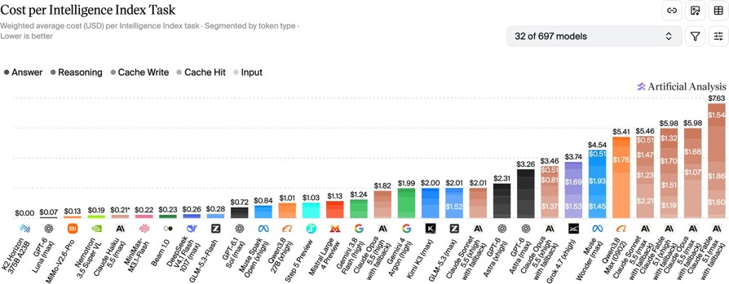
Artificial Analysis Intelligence Index
Artificial Analysis Intelligence Index
https://artificialanalysis.ai/evaluations/artificial-analysis-intelligence-index
Oct 23

Slide 4
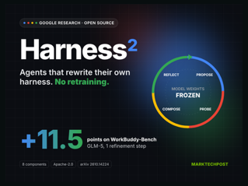
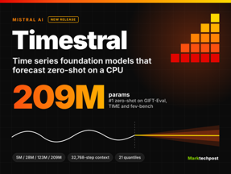
AI News
Google’s Harness2 Agent Framework
Apache-2.0 code on GitHub
Recursively improve prompts, tools, memory, guardrails, skills, and other agent infrastructure without changing model weights
Task-level recursion uses Propose–Probe–Compose to compare candidate changes and refine execution
Harnessing-level recursion preserves lessons to guide future tasks
Adaptable agent infrastructure rather than model retraining, with parallel or sequential refinement, OpenCode and Codex executors, and three supported benchmarks
https://github.com/google-research/harness2
https://arxiv.org/abs/2610.14224
https://harness2.github.io
Mistral Releases Timestral Models
Four sizes - 5M, 28M, 123M, and 209M params
Support multiple related time series, historical and known-future inputs, and probabilistic predictions that quantify uncertainty
209M model leads GIFT-Eval, TIME, and fev-bench among pretrained zero-shot models, demonstrating competitive accuracy with fewer parameters.
Runs efficiently on CPUs
Weights - Modified MIT ; Code - Apache 2.0
https://mistral.ai/news/timestral/
https://github.com/mistralai/timestral - GitHub
https://huggingface.co/collections/mistralai/timestral - Hugging Face

Slide 5
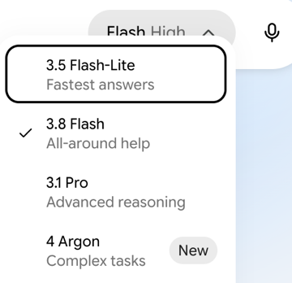
AI News
Gemini 4 Argon goes GA
with a 1M-token output limit
Open to developers, enterprises and Gemini Pro and Ultra
One response can run to 1M tokens (up from 64K)
Input and output share the window
API price $2 / $10 per 1M tokens until November 30, then $4 / $20
Google internally reports 35% more agentic code submissions
and about 30% fewer rollbacks
Available in Cursor, Devin and GitHub Copilot
https://cloud.google.com/blog/products/ai-machine-learning/gemini-4-argon-available-on-google-cloud

Slide 6
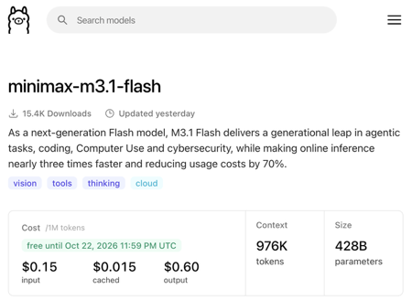
AI News
MiniMax launches M3.1 Flash AI model
For coding, autonomous agents, computer ops, cybersecurity
https://www.minimax.io/blog/minimax-m31f
x3 times faster, 70% lower agent-task costs than previous version
API pricing is $0.15 / $0.60 per 1M tokens in/out
Available via MiniMax’s API, M Plan, MiniMax Code, Ollama
Model weights will follow later
https://platform.minimax.io
https://agent.minimax.io/download

Slide 7
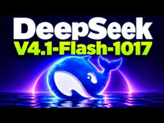

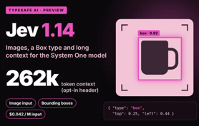
AI News
DeepSeek V4.1-Flash-1017
DeepSWE v1.1 coding score increased from 74.2 to 77.0
For complex programming, faster task completion, shorter outputs
Same price as before
DeepSeek Search and Fetch APIs - $0.75 per 1,000 calls
https://api-docs.deepseek.com/news/news261017/
https://api-docs.deepseek.com/updates/
REA - Reverse Engineering Anything
Use AI agents and MCP with software-analysis tools to do reverse engineering and re-implementation of software.
Project started in April, grew to 400 GitHub stars in September, then exploded in October - currently 371K stars
https://github.com/morluto/rea
https://rea.tools
TypeSafe Jev 1.14 - 262K context, Images + location tasks
Can accept image input, 262K text context
A new Box output type - for object-location tasks
Developers can combine images with instructions and questions
Longer contexts reduce speed and accuracy
Pricing remains $0.042 per 1M input tokens, with free output
https://x.com/Marktechpost/status/2110608747265769578
https://typesafe.ai/blog/jev-1-14
https://docs.typesafe.ai/go/box
https://docs.typesafe.ai/go/images

Slide 8
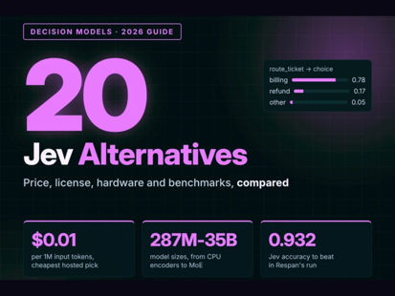
20 Jev Alternatives
20 Jev alternatives
- Cloudflare Clef / Clef-flash — multimodal, open-weight decision models.
- Liquid AI d1 — hosted and open models supporting text, images, and audio.
- OpenAI Decisions API — hosted decisions using gpt-6-luna.
- Perplexity pplx-decider — open-weight text and image decision models.
- meraGPT Decider 1 — hosted, text-only, Jev-compatible model.
- Respan Span-01 — behavior detection and probability scoring.
- Standard Thinking Standard One — 3B and 8B text/image models.
- Together AI Tev1-4B-experimental — experimental multiple-choice model.
- Fastino GLiNER2.5-Decide — compact encoder for decisions and extraction.
- Strands Labs Strands Decider — approximately 2B, self-hosted, with training recipe.
- Kev — Jev-compatible models from Jared Palmer, 0.8B–27B.
- Mapika Decider — self-hosted family, 0.8B–35B-A3B.
- Bespoke Labs Bespoke-Nimble-9B — lightweight adapter for text decisions.
- Convai Innovations Laya — compact, ModernBERT-based decision models.
- Von — small encoder that scores all options in one pass.
- Open-Jev — Qwen-based adapters in 2B, 9B, and 27B sizes.
- OpenJev on DiffusionGemma — text/image model with Jev-compatible API.
- InnerJev — 4B and 27B models distilled from LLM reasoning.
- SemIf — typed decisions from existing open LLMs; browser demo available.
- Rizzo Flow — self-hosted model with native and Jev-compatible APIs.
https://www.marktechpost.com/2026/10/17/20-jev-alternatives-the-decision-models-taking-on-typesafe-in-2026/

Slide 9
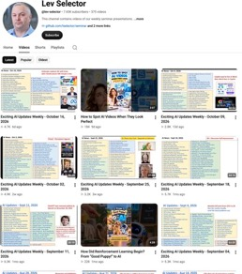

Weekly videos every Friday
Weekly videos every Friday
7.65K subscribers, 375 videos
1. Subscribe to this channel https://www.youtube.com/@lev-selector
2. Download slides from GitHub using links under the videos
3. Please pause the video - and answer the pinned question in comments under the video

Slide 10
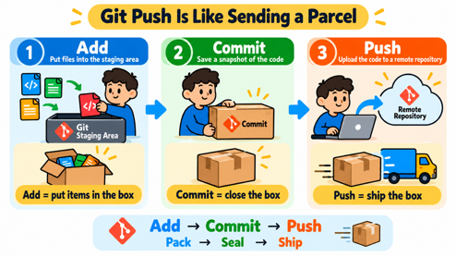

Scion vs Git
Scion vs Git
Anthropic reports a 200× smaller CPU-and-memory infrastructure footprint than its previous Git mirroring infrastructure, and roughly 100× faster checkouts
Git often works like a shopkeeper assembling a custom shipment based on what each customer already owns
Scion works more like a supermarket with standardized, prepackaged items on nearby shelves: clients request exactly the objects they need, and shared caches hand those objects over in a ready-to-use format. This avoids repeatedly calculating and compressing custom shipments
https://www.anthropic.com/research/redesigning-source-control
Antique: Anthropic’s Code Review and Approval Tool
Antique addresses review and approval bottlenecks as AI-generated code overwhelms workflows designed for humans.
Review tooling supports approval rules that distinguish comment-only edits from sensitive logic changes, directing human attention toward consequential modifications.

Slide 11

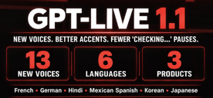

AI News
NVIDIA Nemotron 3.5 Super VL
a 120B open multimodal model
MoE 120B total, 12B active
Hybrid Mamba-Transformer, 1M-token context
Takes text, images, documents, GUI screenshots, video up to 2 min
NVFP4 build runs on one DGX Spark, H200 or GB200, or two H100s
NVIDIA claims tuned versions beat Claude Opus 5 on some tasks
Smaller Bolt 74B-A9B fits in 24GB; free endpoint on OpenRouter
https://openrouter.ai/nvidia/nemotron-3.5-super-vl-20261015
OpenAI ships GPT-Live-1.1 with 13 new voices
ChatGPT Voice, Codex and the dots personal agent
New voices in French, German, Hindi, Japanese,
Korean and Mexican Spanish
Better accents and less spoken "checking..." during web searches
https://runtimewire.com/article/openai-gpt-live-1-1-six-languages
Liquid AI d1-ultra tops the AA Decision Index
A multimodal decision model - text or images in
Answers are fast and cheap
Scores 65 on the Artificial Analysis Decision Index,
vs 58 for TypeSafe Jev 1.13
Index weighs knowledge, reasoning, tool calling
and safety classification equally
Priced at $0.042 per 1M input tokens on the Liquid API
Liquid AI is in Cambridge, MA
https://www.liquid.ai/blog/d1-ultra

Slide 12
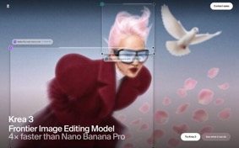
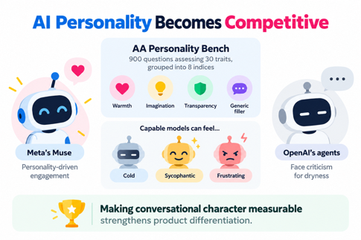
AI News
Krea 3: image editing in under 8 seconds
Image editing model built for production work
Finishes an edit in under 8 seconds
Costs $0.06 per image
Krea says it is 4x faster than Nano Banana Pro
Combines up to 8 reference images into one picture
Krea AI is in San Francisco, California
https://www.krea.ai/krea-3
AI Personality Becomes Competitive
Artificial Analysis introduces AA Personality Bench: 900 questions assessing 30 traits, grouped into 8 indices, including warmth, imagination, transparency, and generic filler
Capable models can feel cold, sycophantic, or frustrating
Meta’s Muse illustrates personality-driven engagement; OpenAI’s agents face criticism for dryness. The broader achievement is making conversational character measurable, strengthening product differentiation
https://artificialanalysis.ai
https://www.youtube.com/watch?v=FSX5JFJS9PQ

Slide 13

Customize Claude Code
Customize your Claude Code
CLAUDE.md - project instructions, conventions, and context. - place at the project root proj/CLAUDE.md or at proj/.claude/CLAUDE.md
.claude/agents/<agent-name>.md - Custom subagent definitions.
.claude/skills/<skill-name>/SKILL.md - Reusable instructions and workflows; can be invoked as /skill-name or loaded automatically
.claude/commands/<command-name>.md - Custom slash commands in the older, still-supported format. Today use the skills instead
.claude/rules/*.md - Modular instructions and coding rules; optionally scoped to particular file paths
.mcp.json - MCP server configuration ( proj/.mcp.json )
.claude/output-styles/<style-name>.md - Custom role, tone, and response format
.claude/hooks/ - Optional location for hook scripts; not automatically discovered. Configure hooks in a settings file
.claude/settings.json - Shared project settings, including permissions and hook configuration
.claude/settings.local.json - Personal project settings; not intended to be committed to version control
.claude/workflows/<workflow-name>.js - Saved dynamic workflows - can be invoked with /name commands. These are JavaScript scripts that orchestrate multiple subagents
You can also create arbitrary subdirectories, but Claude Code does not automatically load them - you need to reference them explicitly
Customize your Claude Code
CLAUDE.md
.mcp.json
.claude/
agents/<agent-name>.md
skills/<skill-name>/SKILL.md
commands/<command-name>.md
rules/*.md
output-styles/<style-name>.md
hooks/
settings.json
settings.local.json
workflows/<workflow-name>.js
Skills vs Agents
Both can execute a task
An agent has its own context and optional model
Skills can invoke agents and vice versa, agents can invoke/use skills

Slide 14

Customize Copilot in VS Code
Customize GitHub Copilot for VS Code
.github/copilot-instructions.md - Repo-wide project instructions, coding conventions, architecture notes, and build/test commands
.github/instructions/<name>.instructions.md - modular instructions - use an applyTo pattern in YAML frontmatter to target particular files
AGENTS.md - Cross-agent project instructions, usually at the repository root, but also can be placed in specific directories
.github/agents/<agent-name>.agent.md - Custom agent definitions: role, instructions, available tools, and optionally a model
.github/skills/<skill-name>/SKILL.md - task-specific instructions and workflows; each skill folder can also contain scripts and resources
.github/prompts/<prompt-name>.prompt.md - Reusable, manually invoked prompts in VS Code; invoke from chat as /prompt-name
.github/hooks/<name>.json - Hook configuration for running commands at supported agent lifecycle events
.github/hooks/scripts/ - Optional location for hook scripts. Scripts must be referenced by hook configuration; placing them here does not automatically register them
.vscode/settings.json - VS Code workspace settings, including supported Copilot customization and discovery settings
.vscode/mcp.json - Workspace MCP server configuration for connecting Copilot to external tools and services.
You can also create arbitrary subdirectories, but Copilot does not automatically treat them as configuration
Customize GitHub Copilot
for VS Code
AGENTS.md
.github/
copilot-instructions.md
instructions/<name>.instructions.md
agents/<agent-name>.agent.md
skills/<skill-name>/SKILL.md
prompts/<prompt-name>.prompt.md
hooks/<name>.json
hooks/scripts/
.vscode/
settings.json
mcp.json

Slide 15





AI News
AI Agents Breach 100+ Websites
Reuters reported that a Chinese hacker used Cairn, an open-source agent platform, to attack 1,200 websites in US, Canada, Japan and Australia
Breached more than 100, including Deere, SharkNinja and Cummins.
Total cost $5K, ~$50 per successful intrusion
https://thenextweb.com/news/ai-agents-hacker-cairn-100-sites-deere-norforge
Anthropic co-founder Jack Clark
told that the singularity has begun
Humanity's Last Exam scores went from 8% to 67.7% since 2025; FrontierMath from 2% to 94%
One Anthropic model puts US GDP at $44T by 2030 if AI spreads fast, with very disruptive job effects
10M human scientists may soon direct a Billion virtual ones
https://importai.substack.com/p/import-ai-477-in-which-i-tell-the
Inception Mercury 3 - a diffusion LLM at 1K+ tok/sec
Writes text by diffusion, refining the whole answer at once
40x larger than Mercury 1, 3x stronger on benchmarks
Over 1K tokens per second on standard hardware
Beats GPT-6 Luna and Claude Haiku 5.5 on some benchmarks
1M-token context and tool calling
Launch price $0.10 per 1M input tokens
https://www.inceptionlabs.ai/blog/introducing-mercury-3

Slide 16
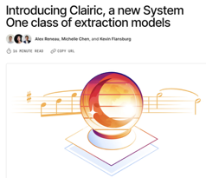
AI News
Cloudflare Clairic Extraction Model
Cloudflare calls it System One
Pulls typed values (numbers, dates, lists)
from emails, receipts, spreadsheets and images
Generates no tokens, so it cannot mistype an answer
Each value comes with a confidence score and a pointer to its source
In a claims-processing test proved to be 3.2x faster and 49% cheaper
In preview on Workers AI; open weights promised
https://blog.cloudflare.com/clairic-extraction-model

Slide 17

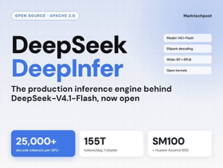
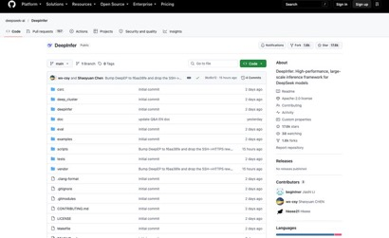
AI News
DeepSeek open-sources DeepInfer, its production inference engine
The engine that serves DeepSeek-V4.1-Flash in production, released under Apache 2.0
Built on vLLM, with ideas taken from SGLang and TensorRT-LLM
DeepSeek says one cluster serves 155T tokens a day and earns $38 per GPU-hour at off-peak prices
Runs on NVIDIA SM100 (SM = Streaming Multiprocessor, Blackwell) and Huawei Ascend 950, with no support yet for older NVIDIA GPUs
Withheld: the KV cache system, prefill/decode disaggregation and load balancing
https://github.com/deepseek-ai/DeepInfer

Slide 18
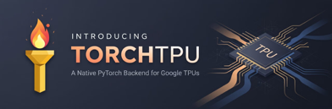
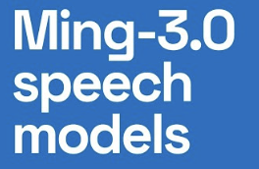
AI News
PyTorch now runs natively on Google TPUs and AWS Trainium
Announced at PyTorch Conference North America
Google and Meta released TorchTPU, which replaces PyTorch/XLA
Tensors are ordinary tensors
torch.compile(backend="tpu") gave a 3.8x speedup on fine-tuning
Up to 52% MFU training Qwen 3 8B
Near-linear scaling to 8,192 chips
AWS shipped TorchNeuron for Trainium, Apache 2.0, in public beta
Google's llm-d 1.0 - inference stack
https://pytorch.org/blog/introducing-torchtpu/
Ming 3.0: Open Voice AI Models
Ant Group’s InclusionAI (China) announced 5 open voice models
On Hugging Face and ModelScope
Speech synthesis, audio understanding, and speech recognition
(listening, transcription, and speaking)
0.5-Bln params speech model supports voice cloning, seven languages, and control over speaking style
Turn recordings into summaries, searchable lessons, multilingual narration, and reusable content
https://github.com/inclusionAI/Ming-3.0-tts
https://huggingface.co/inclusionAI/Ming-3.0-tts-0.5B
https://www.youtube.com/watch?v=54xriKZDP9Y

Slide 19
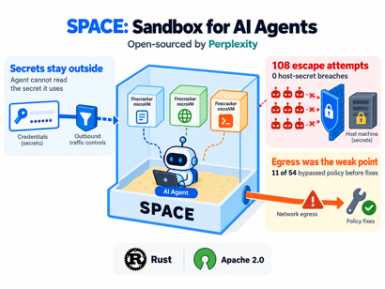

AI News
Perplexity open-sources SPACE,
a sandbox for AI agents
Every Perplexity Computer task runs inside it,
each task in its own Firecracker microVM
Credentials and outbound traffic are controlled from outside,
so an agent cannot read the secret it uses
Red team: 9 models with root made 108 escape attempts and reached the host secret 0 times
Egress was the weak point: 11 of 54 runs bypassed network policy before fixes
Written in Rust, Apache 2.0
https://siliconangle.com/2026/10/15/perplexity-ai-open-sources-its-secure-ai-agent-sandbox-space/
US orders DeepSeek removed from federal civilian systems
A DHS order requires civilian agencies to remove
DeepSeek products and drop them from procurement
Includes 3rd party products built on DeepSeek technology
Reason - risk leaking sensitive data to China
Agencies may ask for exceptions
National security systems are handled separately.
https://thenextweb.com/news/us-bars-deepseek-federal-agencies

Slide 20
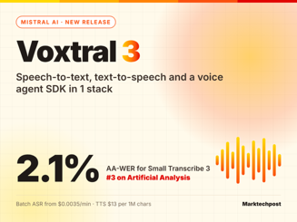
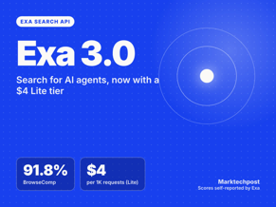
AI News
Mistral Voxtral 3: speech models and a voice agent SDK
Three transcription models, one TTS model and a LiveKit-based agent SDK, all in public preview
Covers 50+ languages, with speaker diarization and context biasing
Small Transcribe 3 reaches 4.1% WER on FLEURS,
against 16.0% for Whisper large-v3
Speech-to-text is priced at $0.0035 a minute
Mini Transcribe 3 has 4B parameters.
Mistral has not disclosed Small's size
https://mistral.ai/news/voxtral-3/
Exa 3.0 search
claims that it wins over Perplexity and Brave
Exa is a US startup founded in 2021 by Will (William) Bryk and Jeff (Jeffrey) Wang, based in San Francisco, California
https://www.ycombinator.com/companies/exa
Exa 3.0 targets AI agents
web retrieval for coding, finance, and deep research
Exa claims wins over Perplexity, Brave, and Parallel across eight benchmarks https://www.marktechpost.com/2026/10/20/exa-3-0-search-api-lite/
Its own crawler and index track over 2 trillion URLs, including 1.27 Bln product listings and 211 million local businesses.
Lite costs $4 per 1,000 requests; Auto costs $7, offering developers a cost-versus-quality choice for AI search - https://exa.ai/blog/exa-3

Slide 21

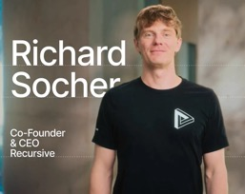

AI News
Anthropic - Claude Duet
OpenAI - Dots
Meta - Muse
Google - Gemini Spark
SpaceXAI / xAI - Grok Bot
H Company - H Platform / Holo agent
Mistral AI - Vibe (formerly Le Chat)
Alibaba - Wukong
Zhipu AI - AutoGLM / Rumination
Alibaba - Qwen-Agent
Manus - Manus
OpenClaw
Nous Research - Hermes Agent
Abacus.AI - DeepAgent, Claw, Hermes
Anthropic previews Claude Duet, a proactive agent app
Claude Duet runs in the cloud, on its own virtual machine with a browser, rather than on your phone or laptop
Uses Opus 5.5 and sends you messages as needed
Keeps working after you close the app, asks before sensitive actions
Connects to 6,000+ apps such as Gmail and QuickBooks
Summarizes updates from connected apps and handles tasks from scheduling to dashboards
Research preview with a waitlist for US Pro and Max subscribers
Competes with Meta's Muse and OpenAI's Dots
https://claude.com/resources/articles/claude-duet
Recursive Flint: Local Coding AI
San Francisco-based Recursive, led by Richard Socher, released Flint
Apache 2.0 open-weight coding model, 40B / 2.5B active params
23 GB four-bit weights fit a 48 GB Mac
125 tokens/sec on an M4 Pro MacBook Pro.
74.2% SWE-bench Verified; 54.9% Terminal-Bench 2.1
Recursive says its Eureka Machine automated research system helped develop nearly the entire stack, demonstrating faster, AI-assisted model development
https://recursive.com
https://recursive.com/updates/introducing-recursive-flint

Slide 22
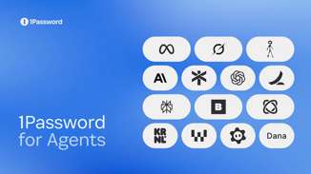
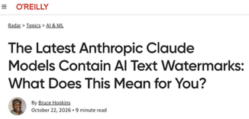
AI News
1Password for Agents
Lets agents log in without seeing passwords
The user approves each request
1Password fills the credentials into the site without seeing the paswd
Gives agents account access while users keep control of their secrets
https://1password.com/blog/1password-for-ai-agents
Claude's text output now carries an invisible watermark
Based on SynthID-Text, added to comply with the EU AI Act
Works by nudging choices among near-equivalent words
Adds no hidden characters or tokens
The mark carries no information about the user
https://www.oreilly.com/radar/the-latest-anthropic-claude-models-contain-ai-text-watermarks-what-does-this-mean-for-you

Slide 23
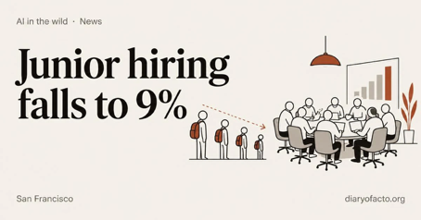
AI News
Anthropic junior hiring went down
since 2025 from 27% to 9%
In August its agents logged x6 times more hours than its staff
Employees report productivity gains,
but more time goes to supervising agents
Meeting time rose about 20%;
human attention is becoming the bottleneck
https://www.anthropic.com/research/employment-at-anthropic

Slide 24
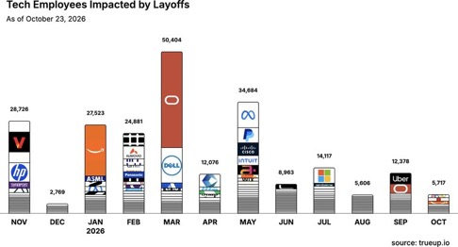
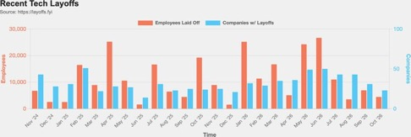
Jobs and Layoffs
https://layoffs.fyi
https://trueup.io/layoffs
The Tech Layoff Tracker
In 2026: 196,349 people laid off (663 per day)
In 2025: 245,953 people laid off (674 per day)
In 2024: 238,461 people laid off (653 per day)
https://trueup.io/layoffs
Tech Layoffs by year (US only):
  135.2K in 2026 (as of Oct 23, 2026)
  123K in 2025
  153K in 2024
  266K in 2023
  165K in 2022 https://layoffs.fyi

Slide 25
Tech Hiring
Software job postings on Indeed
Comparing to 2020 level, in Feb 2022 it was 234%, in 2025 it was 65%, now it is 77%
All US job postings: 103% (compared with 2020)
Postings that mention AI: 6.7% of all, up from 3.4% a year ago
https://fred.stlouisfed.org/series/IHLIDXUSTPSOFTDEVE
Top "In Demand" Skills and Qualifications
- Critical thinking and problem-solving
- Communication and stakeholder management
- Adaptability and continuous learning
- AI literacy and practical AI adoption
- AI/ML application development
- Data engineering and data management
- Cybersecurity and risk management
- Cloud and infrastructure engineering
- Software engineering
- Automation and workflow optimization
- DevOps, CI/CD, and platform engineering
- Governance, compliance, and responsible AI
- Analytical thinking and data analysis
- Product management and business alignment
- Project and program management
- Leadership and cross-functional collaboration
- Creativity and innovation
- Resilience and professionalism
- Technical troubleshooting and systems thinking
- Business growth and customer focus
Skills in demand
Dice, 7M+ US tech postings (Aug 2026): +18% year over year
AI and machine learning postings +101% year over year, five times the overall rate
Fastest-growing skills, each up 200%+: responsible AI, AI agents, agentic AI, AI infrastructure
Most requested overall: communication, computer science, troubleshooting
Indeed: 71% of the software postings rebound (May 2025 to May 2026) is senior roles; 37% has AI in the title
https://hiringlab.indeed.com/2026/07/08/ai-and-job-postings-from-destruction-to-creation/
https://www.dice.com/hiring/recruitment/reports/dice-tech-job-report

Slide 26

About the Speaker
Lev Selector, Ph.D.
40+ years of software engineering, data science, and building teams (hiring, training, and managing)
Ph.D. in mathematical modeling and computer simulations
Interests: Generative AI, using LLMs with your data, local AI for local private data, cloud architecture, fin-tech, application security
Find and connect: LinkedIn, GitHub, YouTube, Google
https://eais.ai

Slide 27
Thank You!
Videos of every seminar are on YouTube
https://www.youtube.com/@lev-selector
Slides on GitHub. Click a pptx file, then the download button on the right
https://github.com/lselector/seminar
Slides on Google Drive
https://drive.google.com/drive/folders/1dmj00iilSP-JYmriMUUaHCKz5X54e3UX?ths=true

