Slide 1
AI Updates - Jan 30, 2026
NVIDIA CEO Jensen Huang ... wants his engineers to spend "exactly zero percent" of their time writing code, with AI tools handling the coding tasks instead
Crowd-sourced "LM Arena" Leaderboard
Stable-DiffCoder-8B-Instruct
NVIDIA Climate "Earth-2" models
Tencent HunyuanImage 3.0-Instruct
Skills v1.1.1
Problem - Agents not invoking (ignoring) skills
Kimi K2.5 by Moonshot AI
Kimi Code, open-source coding agent - Apache 2.0
Google AI Plus $7.99/month in the U.S
RAG Reasoning Collapse
Zenflow autonomous AI software engineer
Automated Quality Assurance (QA)
Create AI YouTuber
Microsoft Maya 200 inference chip
UAE K2 Think open-source model
Grok Imagine - text to videos up to 15 sec
Tesla is ending Models S & X to focus on AI and robotics
How to Advertise with AI
Apps in Claude & in ChatGPT
Claude Code Updates
Jensen Huang: "Stop Coding"
Claude-Flow
Moltbot (originally Clawdbot)
Moltbot Security Disaster
Eigent is an open-source desktop application
Claude Co-work Use Cases
OpenAI Reached "High" Level of Cybersecurity
Google & Sakana AI Partnership
OpenAI’s "Value Sharing" Strategy
Qwen3-TTS open-source text-to-speech models
Git & GitHub
AI for Academic & Research Work
Jobs, Layoffs, demand for AI Engineers

Slide 2
Crowd-sourced "LM Arena" Leaderboard
Data for January 29
Starting Elo rating = 1000
https://en.wikipedia.org/wiki/Elo_rating_system
English - https://lmarena.ai/leaderboard/text
Coding - https://lmarena.ai/leaderboard/text/coding
Model | Score
gemini-3-pro | 1487
grok-4.1-thinking | 1475
gemini-3-flash | 1471
claude-opus-4-5-20251101-thinking-32k | 1468
claude-opus-4-5-20251101 | 1466
grok-4.1 | 1466
gemini-3-flash (thinking-minimal) | 1463
gpt-5.1-high | 1459
ernie-5.0-0110 | 1453
claude-sonnet-4-5-20250929-thinking-32k | 1450
claude-sonnet-4-5-20250929 | 1450
kimi-k2.5-thinking | 1450
gemini-2.5-pro | 1450
ernie-5.0-preview-1203 | 1449
claude-opus-4-1-20250805-thinking-16k | 1448
claude-opus-4-1-20250805 | 1445
gpt-4.5-preview-2025-02-27 | 1444
chatgpt-4o-latest-20250326 | 1443
glm-4.7 | 1440
gpt-5.2 | 1440
gpt-5.2-high | 1440
gpt-5.1 | 1435
gpt-5-high | 1435
qwen3-max-preview | 1434
Model | Score
claude-opus-4-5-20251101-thinking-32k | 1538
claude-sonnet-4-5-20250929-thinking-32k | 1521
claude-opus-4-5-20251101 | 1519
gemini-3-pro | 1519
kimi-k2.5-thinking | 1514
claude-opus-4-1-20250805-thinking-16k | 1512
claude-sonnet-4-5-20250929 | 1510
grok-4.1-thinking | 1507
gemini-3-flash (thinking-minimal) | 1505
gemini-3-flash | 1505
claude-opus-4-1-20250805 | 1503
claude-opus-4-20250514-thinking-16k | 1497
grok-4.1 | 1495
gpt-5.1-high | 1495
gpt-5.2 | 1494
gpt-5.2-high | 1493
ernie-5.0-0110 | 1491
glm-4.7 | 1487
kimi-k2-thinking-turbo | 1484
qwen3-max-preview | 1482
claude-haiku-4-5-20251001 | 1478
qwen3-max-2025-09-23 | 1477
gpt-5.1 | 1475
longcat-flash-chat | 1475
deepseek-v3.2 - 671B
ernie-5.0 - 2.4T
glm-4.6 - 355B
kimi-k2-thinking - 1T
longcat-flash-chat - 560B
qwen3-max - 1T
qwen3-235b-a22b - 235B
Google Gemini
x.ai
Claude
OpenAI
Open Source
China
x.ai
https://lmarena.ai/leaderboard/text
Design Arena -
https://www.designarena.ai
https://openlm.ai/chatbot-arena/
https://beta.lmarena.ai
Web Leaderboard - 1T params
https://web.lmarena.ai/leaderboard
LLM Leaderboard - by @LlmStats -
https://llmworld.net/llm_leaderboards/
LLM Leaderboard - by StackAI -
https://www.stack-ai.com/llm-leaderboard
LLM Leaderboard - by Artificial Analysis -
https://artificialanalysis.ai/leaderboards/models
Open LLM Leaderboard - by Hugging Face -
https://huggingface.co/open-llm-leaderboard
LLM Leaderboard - by Vellum -
https://www.vellum.ai/llm-leaderboard
AI Benchmarking Hub -
https://epoch.ai/data/ai-benchmarking-dashboard
Grok 4 Benchmarks -
https://artificialanalysis.ai/models/grok-4
Image arena (alibaba) -
http://aiarena.alibaba-inc.com/corpora/arena/leaderboard?arenaType=T2I
image arena - https://lmarena.ai/leaderboard/text-to-image
x.ai
China
China
x.ai
China
China
China
China
China
China
China
China
China

Slide 3

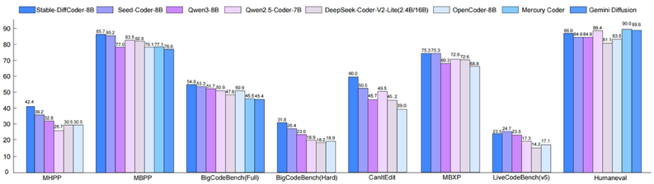
Stable-DiffCoder-8B-Instruct
Stable-DiffCoder-8B-Instruct
An 8B params code diffusion language model from ByteDance
Uses mask diffusion instead of traditional autoregressive generation
Built on the Seed-Coder architecture
Introduces block diffusion continual pretraining with tailored warmup and noise scheduling to stabilize training
The model demonstrates superior performance compared to its autoregressive counterpart across code generation benchmarks like HumanEval (86.6%) and MBPP (85.7%), outperforming most ~8B autoregressive and diffusion-based code models
The model supports 8K-token context length
https://huggingface.co/ByteDance-Seed/Stable-DiffCoder-8B-Instruct

Slide 4


AI Updates
NVIDIA Climate "Earth-2" models
3 new models powered by novel architectures:
Atlas, StormScope, and HealDA
Accelerate forecasting speeds by orders of magnitude
while delivering accuracy that rivals or exceeds traditional methods
The suite includes three new breakthrough models:
(1) Earth-2 Medium Range: High-accuracy 15-day forecasts across 70+ variables,
(2) Earth-2 Nowcasting: Generative AI that delivers kilometer-scale storm predictions in minutes
(3) Earth-2 Global Data Assimilation - combines diverse observations (from satellites, weather balloons, and ground stations) into a consistent snapshot of the current state of the atmosphere
Tencent HunyuanImage 3.0-Instruct is officially open-sourced!
Ranks global tier-1 on @arena’s Image Edit leaderboard
The world's strongest open-source Image-to-Image model!
https://github.com/Tencent-Hunyuan/HunyuanImage-3.0
https://x.com/TencentHunyuan/status/2016356787361087615
https://huggingface.co/tencent/HunyuanImage-3.0-Instruct

Slide 5
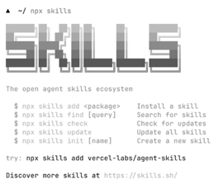
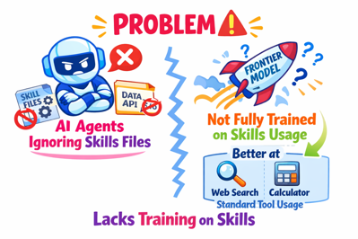
AI Updates
Skills v1.1.1
Interactive discovery, open source release, and agent support
https://github.com/vercel-labs/skills
Problem - Agents not invoking (ignoring) skills
This happens because most frontier models are not yet fully trained on using skills compared to standard tool usage
Surprisingly, adding skills sometimes performed worse than the baseline
The most effective alternative is using an "agents.md" or "clode.md" file to house grounding information
Instead of relying on autonomous skill invocation, developers should stuff summarized documentation directly into these grounding files
By compressing context - for instance, from 40KB to 8KB - developers can mitigate "context rot" while ensuring the agent actually follows the necessary instructions and documentation
http://www.youtube.com/watch?v=A_1ELXEVp5w

Slide 6
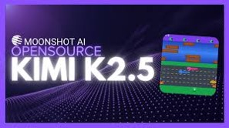
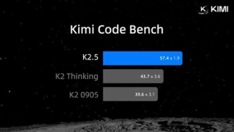
Kimi K2.5
Kimi K2.5 by Moonshot AI - Open Source
MoE architecture with 1 Trillion total params (32B activated), 61 layers with 384 experts that select 8 per token
256K-tokens context window in "Thinking Mode"
Natively multimodal, pre-trained on 15 trillion mixed visual and text tokens with an integrated MoonViT vision encoder - understands images and videos without external adapters
In benchmarks, Kimi K2.5 demonstrates competitive performance against Claude Opus 4.5 and Gemini 3 Pro
On SWE-Bench Verified, it outperforms Gemini 3 Pro, and beats both GPT 5.2 and Gemini 3 Pro on SWE-Bench Multilingual
For video understanding, it surpassed GPT 5.2 and Claude Opus 4.5 on VideoMMMU benchmarks
One evaluation placed Kimi K2.5 at 64% compared to Gemini 3 Pro's 100% and Claude Opus 4.5 Max's 74%
The model supports native INT4 quantization for efficient deployment
Kimi Code, open-source coding agent - Apache 2.0
Python-based, easy to extend.
Fully transparent — clear, safe, reliable.
Seamlessly integrates with VS Code, Cursor, JetBrains, ...
Fully-featured & out-of-the-box ready. Switch over in seconds.
Native Multimodal support
https://x.com/Kimi_Moonshot/status/2016034259350520226

Slide 7
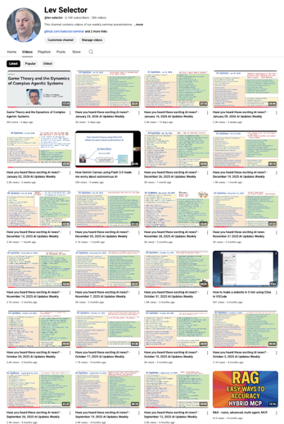
We do these weekly videos every Friday
Stats: 6.16K subscribers, 266 videos
1. Subscribe to this channel https://www.youtube.com/@lev-selector
2. Download slides from GitHub using links under the videos
3. Please pause the video - and answer the pinned question in comments under the video

Slide 8
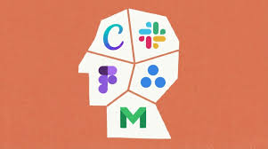
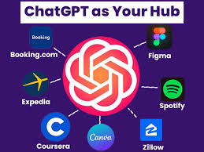
Apps in Claude & in ChatGPT
Anthropic Claude recently launched interactive third-party apps directly within its chat interface for paid subscriptions
Amplitude - Analytics platform
Asana - Project management (can turn chats into projects)
Box - File storage (search files, preview documents)
Canva - Design tool
Clay - CRM and data enrichment
Figma - Design collaboration
Hex - Data analytics
monday.com - Work management
Slack - Team communication
Salesforce Agentforce 360 is coming soon
ChatGPT offers a broader range of third-party app integrations through its App Store, including:
Spotify - Music streaming and playlist creation
Canva - Design and graphics
Figma - Design collaboration
Booking.com and Expedia - Travel booking
Zillow - Real estate search
Coursera - Educational content
DoorDash and Uber - Food delivery and transportation
Zapier - Automation with 5,000+ apps (Gmail, Slack, Google Sheets, HubSpot, etc.)

Slide 9

Claude Code Updates
Key Claude Code Updates and tweaks by Yaron Been
Main update - Native Persistent Memory
http://www.youtube.com/watch?v=AbGBM-aGDJw
Tasks & Dependencies - Claude can now create tasks with dependencies that are stored in metadata and the file system
Collaboration - Multiple sessions or sub-agents can collaborate on the same task list, and updates are broadcasted across all active sessions
Replacement for "Beads" the native solution replaces the need for third-party repositories like "Beads," which previously handled persistent to-do lists for AI agents
New Workflow Enhancements & Skills
1. Test-Driven Development (TDD) in Plan Mode - write tests first in Claude's "plan mode"
2. Use Codex MCP to write the tests and Claude to write the code to pass them, leveraging the different "perspectives" of the two models
3. Use "Reinforce" command that spins up six concurrent agents (three Codex, three Opus 4.5). They analyze code for bugs, security breaches, UX/UI improvements, and performance.
4. CLI status line to show context window usage (e.g., % of 200k tokens) and an error counter tracking number of errors
5. A script to skim local conversation logs to identify recurring errors, helping to spot patterns in where the AI is struggling
Yaron Been
6. Docker "YOLO" Mode - for research or tasks that don't require manual approval, run Claude Code in an isolated Docker container using YOLO mode. This prevents the AI from cluttering local environment while avoiding constant permission prompts
7. "Thinking Critically" Skill - a custom command that forces Claude to challenge the user's assumptions, identify implicit constraints, perform trade-off analysis, and conduct a "failure-first" analysis before writing code
Yaron mentions that he is becoming more selective about testing new AI repositories. He believes that if a third-party solution (like "Beads") is truly valuable, it will eventually be natively integrated into major tools like Claude Code or OpenCode, so he prefers to "double down" on what is already working

Slide 10
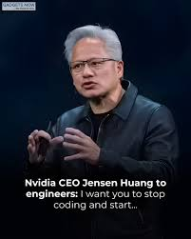
Jensen Huang: "Stop Coding"
NVIDIA CEO Jensen Huang stated that he wants his engineers to spend "exactly zero percent" of their time writing code, with AI tools handling the coding tasks instead
Huang articulated this vision during an appearance on the No Priors AI podcast in January 2026, where he revealed that every engineer at NVIDIA now uses Cursor, an AI coding assistant, throughout their workday
According to Huang, coding is merely a task—the mechanical implementation—while the true purpose of engineering is discovering and solving problems that haven't yet been identified
He stated, "Nothing would give me more joy than if none of our engineers were coding at all, and they were just purely solving undiscovered problems"
https://www.linkedin.com/posts/linasbeliunas_jensen-huang-just-said-the-quiet-part-out-activity-7418389362226233344-WqLu
At a recent NVIDIA all-hands meeting, Huang reportedly challenged managers who were asking teams to limit AI tool usage, saying "Are you insane?"
His goal is to free engineers entirely from what he calls "syntax" so they can focus on higher-level system architecture, algorithmic development, and tackling complex, unresolved challenges
Huang has been advocating this "Purpose vs Task" idea across multiple public conversations
Huang's vision aligns with broader industry trends and statements from Google CEO Sundar Pichai and Anthropic CEO Dario Amodei
However even Andrej Karpathy, former Tesla AI director who coined the term "vibe coding," admitted his recent project was "basically entirely hand-written" because AI agents "just didn't work well enough".

Slide 11


Claude-Flow
Claude-Flow v3: Enterprise AI Orchestration Platform
AI multi-agent orchestration dev. framework, open-source
By Reuven Cohen (GitHub: ruvnet), Toronto Area, Canada
Teams can deploy, coordinate, and optimize specialized AI agents working together on complex software engineering tasks
13.2K stars on Github
CLI and MCP server for command and control
Uses Q-Learning and MoE with 8 experts, 42+ skills, and 17 hooks to intelligently direct tasks
Swarm Coordination - manages agents using various topologies (mesh, hierarchical, ring, star) and consensus mechanisms (Raft, BFT, Gossip, CRDT)
Includes 54+ specialized agents (coder, tester, reviewer, architect, security, etc.)
Memory system (AgentDB), multiple LLM providers (Claude, GPT, Gemini, Ollama), and 12 workers for tasks like ultralearn, audit, and optimize
Hive-Mind Architecture - a "Queen" agent acts as the master orchestrator
The Queen doesn't write code directly but analyzes tasks, breaks them into logical subtasks, delegates to appropriate worker agents, monitors progress, and manages communication
This allows multiple specialized agents to work simultaneously on different parts of a project while sharing knowledge through an intelligent memory bank.
Advanced Intelligence (RuVector)
Version 3 introduces self-learning neural capabilities through RuVector components:
SONA = Self-Optimizing Neural Architecture - learns optimal routing in <0.05ms
EWC++ = Elastic Weight Consolidation - preventing catastrophic forgetting (preserves 95%+ knowledge)
Flash Attention - Optimized computation with 2.49x-7.47x speedup
HNSW - Vector search 150x-12,500x faster than traditional methods
LoRA/MicroLoRA - Efficient fine-tuning with 128x compression
Get started: npx claude-flow@v3alpha init
The framework supports recursive development - it can build and improve itself using the same agents it orchestrates
https://github.com/ruvnet/claude-flow
https://www.reddit.com/r/ClaudeAI/comments/1l87dj7/claudeflow_multiagent_orchestration_platform_for/

Slide 12

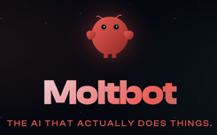
Moltbot (originally Clawdbot)
Moltbot - open source, local personal AI Assistant
Written in TypeScript, combines "Claude Code" with persistent memory and extensive computer access. Connects WhatsApp, Telegram, Slack, Discord, Signal, iMessage , emails, calendars, cameras, smart-home devices, ... to models such as Claude, ChatGPT, Gemini, xAI Grok, Mistral and local backends
Uses tools via standard SKILL.md format
Its workflow runtime "Lobster" executes multi-step, typed pipelines with explicit approvals and resumable state
Clawdbot runs on your own hardware or a small VPS
It uses cron-like scheduling, integrates with notes, tasks, repos and smart home systems
Created by Peter Steinberger - an Austrian software engineer and serial entrepreneur originally from Vienna, Austria, who now splits his time between Vienna and London
Peter Steinberger changed the name from ClawdBot to Moltbot on January 27, 2026. Original name was based on "Clawd," the Claude Code mascot, and Anthropic owned the trademark
AI agent needed to "molt" (shed its shell) to adopt a new identity. So it was called "Moltbot" as a fitting reference to the lobster theme
https://Molt.bot
https://github.com/moltbot/moltbot
http://www.youtube.com/watch?v=MUDvwqJWWIw
Clawdbot - can write and execute code, manage files (localy and on Google Drive), check emails, and browse the web via a Chrome extension; Can place phone calls
It learns your preferences over time and has a customizable "soul.md" file that dictates its personality and behavior
Social Media Management - drafting and sending replies to comments on X posts
Highly customizable, open-source, runs 24/7, and allows for complex "daisy-chaining" of different AI models
The project is only 2 months old, can occasionally crash or get stuck in tool-call loops; security risks if improperly configured
Can be installed on Mac, Windows, and Linux
npm install -g moltbot@latest
moltbot onboard --install-daemon
moltbot gateway --port 18789 --verbose
moltbot message send --to +1234567890 --message "Hello"
moltbot agent --message "Ship checklist" --thinking high
🦞

Slide 13

Moltbot Security Disaster
Independently of the token drama, security researchers scanned the internet and found hundreds of Moltbot/Clawdbot control panels exposed publicly, often with no authentication at all
https://www.bitdefender.com/en-us/blog/hotforsecurity/moltbot-security-alert-exposed-clawdbot-control-panels-risk-credential-leaks-and-account-takeovers
These exposed instances leaked API keys, OAuth tokens, and conversation histories and, in some cases, allowed unauthenticated command execution on the host system
https://vibeaudits.com/blog/64000-github-stars-16m-scam-moltbot-clawdbot-security-nightmare
The root cause was not a zero‑day in the code but widespread bad deployments (trusting localhost, misconfigured reverse proxies); given Moltbot’s broad system access, this turned into a high‑impact security incident
Several post‑mortems and timelines describe a roughly three‑day window from explosive GitHub popularity, to trademark C&D and rebrand, to handle sniping, token launches, and then mass security scanning and disclosures
In just 72 hours, the Moltbot collapsed into a $16 Mln crypto scam and security disaster http://www.youtube.com/watch?v=mPWY7qiISoA .
During the Clawdbot → Moltbot rebrand, the previous GitHub adn social identities of the project were briefly released - and then grabbed by others within seconds!
Automated “handle snipers” and squatters took over the old Clawdbot handle on X and the old GitHub org, then used those to post crypto wallet addresses and imply an “official” token.
The token was never official: the project’s creator repeatedly stated he had not launched, endorsed, or planned any token at all.
Traders piled in on the assumption this was an early, sanctioned AI-related coin; when the denial hit and liquidity was pulled, late entrants were effectively rugged while the anonymous token creators walked away with large profits.
The whole ~ 3-day episode exposed serious security issues in how many people deployed the bot
This incident serves as a blueprint for future AI-related scams. Users should remain skeptical of "too good to be true" tools and avoid granting full system access to unverified software in the current "wild west" of AI

Slide 14

Eigent - Desktop Personal AI Workforce
Eigent is an open-source desktop application (Apache 2.0)
https://github.com/eigent-ai/eigent - 11.7K stars
https://www.camel-ai.org - CAMEL-AI multi-agent framework. Includes Developer agents, Browser agents, Document agents, Multi-Modal agents
A startup in UK that went open-source (after release of Claude Co-Work)
Deploys a "personal AI workforce" on your local machine, orchestrating multiple specialized AI agents (complex, multi-step tasks, locally)
https://www.camel-ai.org/blogs/a-guide-to-building-a-fully-local-ai-workforce-with-eigent
Privacy-First Design - everything runs locally on your computer
Flexible Deployment - Supports both local-only operation (zero cloud dependency) and cloud-connected (API keys)
Extensive Tool Integration - over 200 MCP compatible tools for browser automation, code execution, document processing, terminal access, etc. - and you can also add custom tools
Enterprise Features - SSO, access control, human-in-the-loop controls for oversight, and commercial licensing options
Eigent fits scenarios requiring automation of multi-step workflows such as research assistance, product research, automated report generation, data cleaning, and office automation. The platform is particularly valuable for developers and teams needing complete control over their AI processes without sending data to external servers. [jimmysong](https://jimmysong.io/ai/eigent/)
https://github.com/eigent-ai
Claude Co-work Use Cases
Desktop File Organization - sorting files into folders/subfolders
Browser Control - navigate, do actions, downloads
Multitask Parallel Processing - organizing files, creating presentations, managing spreadsheets at once
Create Branded Presentation (provide logos, colors)
Data Collection (Shopify, CRMs)
data Analysis, create visual dashboards
Automated Video Editing - find engaging moments, cut into vertical clips optimized for Tik Tok or Instagram
Google Workspace - check Google Calendar, schedule meetings, summarize important emails
MCP Server Connections (work with Asana, etc.)
Schedule workflows such as generating and posting LinkedIn content at a specific time every day
https://www.youtube.com/watch?v=eq05p90xyJw

Slide 15
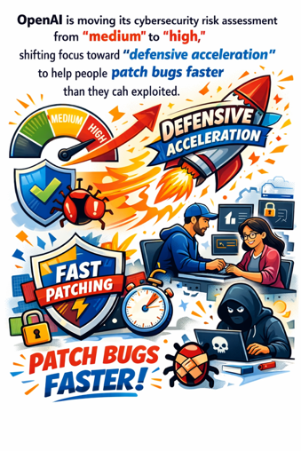
OpenAI Reached "High" Level of Cybersecurity
"We are going to reach the Cybersecurity High level" - Sam Altman
Shifting focus toward "defensive acceleration"
to help people patch bugs faster than they can be exploited
OpenAI announced that its upcoming Codex coding model updates will reach the "High" cybersecurity level for the first time.
https://the-decoder.com/openais-upcoming-codex-update-will-hit-the-companys-high-cybersecurity-risk-level-for-the-first-time/
In response, OpenAI is shifting toward "defensive acceleration," prioritizing AI tools that help people patch vulnerabilities faster than they can be exploited
CEO Sam Altman emphasized the importance of rapid adoption of these defensive tools, noting that "there will be many very capable models in the world soon"
Initially, OpenAI will implement product restrictions to block misuse, while transitioning toward the defensive acceleration approach as supporting evidence emerges
https://x.com/sama/status/2014733975755817267

Slide 16
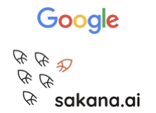

Google & Sakana AI Partnership
Google & Sakana AI Partnership
Google is making a financial investment and forming a strategic partnership with Japan-based Sakana AI.
They aim to leverage models like Gemini and Gemma to accelerate breakthroughs in automated scientific discovery
Sakana AI is a Tokyo-based AI startup founded in 2023 by David Ha, Llion Jones (co-author of the "Attention Is All You Need" paper), and Ren Ito.
The company is famous for its nature-inspired approach to AI development, particularly its Evolutionary Model Merge technique that "breeds" new AI models by combining existing ones rather than training from scratch
This method uses evolutionary algorithms to automatically merge open-source models, creating powerful new systems without expensive retraining
Other notable innovations include The AI Scientist, which automates scientific research, and the Continuous Thought Machine for brain-like reasoning.
The company raised approximately $200 Mln in Series A in 2024.

Slide 17

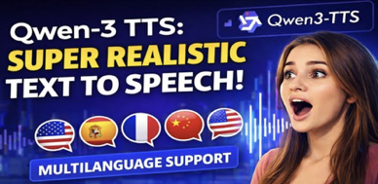
AI Updates
OpenAI’s "Value Sharing" Strategy
Instead of just charging for API tokens or compute, OpenAI may partner with pharmaceutical companies to discover new drugs and take a percentage of the final product's value
For startups, this is essentially a form of venture capital. Instead of raising money to buy compute, companies get the compute directly from OpenAI in exchange for equity or a license to the discovery
Qwen3-TTS open-source text-to-speech models
Sizes: (1.7B & 0.6B params)
Advanced voice cloning, voice design, and speech generation
Clone the voice using just 3 seconds of reference audio
10 major languages (Chinese, English, Japanese, Korean, German, French, Russian, Portuguese, Spanish, and Italian)
Can run on GPUs with 6GB of VRAM
https://huggingface.co/spaces/Qwen/Qwen3-TTS

Slide 18

Google Updates
Google AI Plus $7.99/month in the U.S
Gemini 3 Pro and Nano Banana Pro models in the Gemini app, Deep Research capabilities, AI filmmaking tools in Flow, and research assistance in NotebookLM
Subscribers receive 200GB of cloud storage and 200 monthly AI credits for video generation, with the ability to share benefits with up to five family members
This is an entry-level alternative to the more expensive AI Pro plan ($20/month), designed to make advanced AI tools accessible at a lower price point and compete with ChatGPT's similar offerings
The plan is now available in 35 countries and territories globally
https://www.eweek.com/news/google-ai-plus-rollout-35-countries/
Google Gemini Chrome Integration - Nano Banana, "Auto browse", sidebar with Gemini chatbot
Personal Intelligence - connect Gemini to Gmail, Photos, YouTube, and Search
Google Search - Gemini 3 for AI Overviews
Agentic Commerce - Business Agent - chat with brands

Slide 19
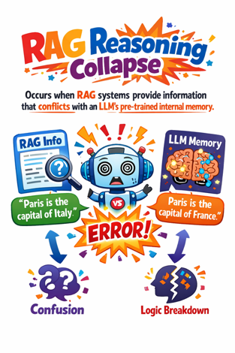
RAG Reasoning Collapse
"RAG Reasoning Collapse" - occurs when RAG systems provide information that conflicts with an LLM's pre-trained internal memory
Models frequently fail to propagate that new information through complex reasoning chains
2026 study from EPFL and Stony Brook - internal parametric knowledge often overrides external context, causing the model to hallucinate or revert to outdated facts during multi-step tasks
This is particularly problematic in coding or technical fields where logic is intertwined with specific data.
Current RAG techniques are fragile for mission-critical applications
To truly fix this, the industry may need to move beyond simple retrieval toward more advanced fine-tuning and post-training methods that can effectively "overwrite" an LLM’s fundamental beliefs
https://www.youtube.com/watch?v=BmzdS-a-G8g

Slide 20
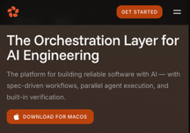

Zenflow - Autonomous AI Software Engineer
Zenflow is an autonomous AI software engineering system designed for production-ready, end-to-end development
Unlike standard AI tools that rely on simple prompting, Zenflow uses "spec-driven orchestration" to manage multiple AI agents. This ensures code stays aligned with technical requirements and prevents "prompt drift."
Key features include parallel execution, where multiple agents work on different modules simultaneously, and autonomous verification agents that test and review code before shipping
The platform offers four modes: Quick Changes, Fix Bugs, Spec and Build, and a full Spec-Driven Development (SDD) workflow.
Zenflow integrates with GitHub and supports MCP servers for documentation and automation
During a demonstration, the system successfully built a complex Habit Tracker app with backend logic and analytics
By automating the technical specification and execution phases, Zenflow allows developers to build functional, polished applications at scale with minimal oversight.
https://www.youtube.com/watch?v=xxppO2ws-J8
https://zencoder.ai/zenflow
Andrew Filev
Zencoder is an AI startup founded in 2023 by Andrew Filev
It offers an orchestration platform for AI-powered software development with spec-driven workflows and AI coding agents
https://www.linkedin.com/in/filev
Offers Zenflow and Zencoder agents
Zenflow is the workflow engine that coordinates multi-agent execution and enforces development specifications
Zencoder agents handle the actual implementation tasks including code generation, code repair, test generation, and real-time optimization
The company's headquarters is located at 500 W Hamilton Avenue in Campbell, California (San Jose area)
Zencoder size ~70 people - AI experts, engineers, and data scientists distributed across the globe
Spec → Plan → Implement → Test → Verify → Merge

Slide 21
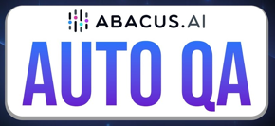
Automated Quality Assurance (QA)
The challenge has shifted from writing code to trusting the code.
The Trust Gap - development velocity has exploded, but validation processes are still stuck in slow, manual cycles
Competitive advantage shifts to reliability. How to ship software instantly while maintaining total trust in the product's stability - http://www.youtube.com/watch?v=MEtDwwi7bEU
Abacus AI’s "Deep Agent" - a "mindset-driven" automated QA designed to "think" like a QA engineer, proactively pressure-testing products to find breakpoints
Autonomous Workflow - building apps, debugging, monitoring, and scaling
Safety Nets - weekly automated testing for "vibe-coded" apps; automatic infrastructure scaling - based on real-time traffic
Effective QA requires switching between different user personas. Deep Agent can simulate various perspectives - such as confused users, or those in different global regions
Deep Agent checks also for "simple" errors like broken links and UI glitches that cause "quiet" revenue loss (landing pages, order forms)
It catches regional UI issues and language variations that might be invisible to the local development team but disruptive
2026 - year of hybrid teams. AI agents handle execution and humans focus on strategy and judgment

Slide 22

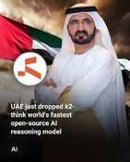
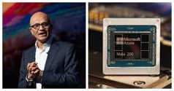


AI Updates
Create AI YouTuber - text to cloned voice
Tutorial - how to create an "AI YouTuber" by coding
a Python program that clones voice and converts
written scripts into high-quality audio voiceovers - https://www.youtube.com/watch?v=D_ELyz_leRc
Voice Cloning using Inworld TTS 1.5
Coding the Python script to interact with the Inworld API
A function called `convert_script_to_speech()` reads the .txt file and generates audio file
UAE K2 Think open-source model to provide a sovereign alternative to US and Chinese systems
Microsoft Maya 200 inference chip
Built on TSMC’s cutting-edge 3-nanometer process with over 140 Bln transistors
10 petaFLOPS in FP4
5 petaFLOPS in FP8
Tesla is ending production of its Model S and Model X
cars to focus on AI and robotics (Optimus)
CEO Elon Musk announced Wednesday that the company will convert its Fremont factory to produce Optimus humanoid robots, aiming for $1 Mln units annually
The strategic shift includes a massive investment in autonomous Cyber Cabs and physical AI technology.
Grok Imagine - text to videos
up to 15 sec
Acquire an API Key at https://fal.ai
Install python client "fal-client" & "python-dotenv"

Slide 23

How to Advertise with AI
In this video, PJ Ace, a pioneer in AI-driven advertising, joins the *Marketing Against the Grain* podcast to break down his workflow for creating high-end viral videos, including the David Beckham IM8 ad which garnered 233 million views in just three days
https://www.youtube.com/watch?v=yUdE9oj3sWk .
The best results come from mirroring traditional filmmaking roles. His team utilizes a five-person structure:
Writer & Director - script concept, creative vision
Cinematographer - Using Ideogram and Google’s Nano Banana Pro to generate visual references and mood boards
Animator & Editor - Taking static images into tools like Kling or V3 to bring scenes to life
Storyboarding in Figma - PJ lays out his entire sequence in Figma, placing the voiceover lines next to the corresponding AI-generated shots to ensure visual flow
The 2x2 Grid Method - generates four related shots in a single 2x2 grid. This ensures that lighting, character likeness, and location remain consistent across different camera angles
Motion Control with Kling - a "driving performance" from a real actor can be used to animate an AI character's face, preserving micro-expressions and nuance
Hyper-Niche Content - PJ predicts that AI will lower the cost of storytelling so significantly that we will see a surge in "niche" high-quality series (e.g., specific Star Wars or Warhammer stories) made by small teams for millions rather than 100s of millions of $
Hybrid Filmmaking - real actors performing on LED backgrounds (like The Mandalorian), while wide shots and complex battle sequences are handled by AI to save costs
Cost Efficiency - PJ ballparks that a commercial that used to cost $3 Mln can now be produced for roughly $300,000 (10x cheaper) using these modern AI workflows
For "challenger brands," AI offers a way to surprise audiences and compete with major incumbents. However, he warns that major brands (like Coca-Cola) must be more careful, as they face higher scrutiny and "uncanny valley" risks with their established brand equity

Slide 24



Git & GitHub
Linus Torvalds has created Git in April 2005 in only 5-10 days
The motivation was a licensing dispute with BitKeeper
GitHub was founded in 2007, launched in April 2008
Microsoft acquired GitHub on October 26, 2018, for $7.5 Billion
In 2024 GitHub's ARR reached 2 Bln
GitHub could be valued at approximately $16-18 Bln or more
The platform has grown from 28 Mln developers at acquisition to over 150 Mln developers as of 2025, with more than 1 Bln repositories.
GitHub Copilot accounts for over 40% of GitHub revenue growth
GitHub Copilot had become a larger business on its own than all of GitHub was at the time of acquisition

Slide 25

AI for Academic & Research Work
Literature Review & Discovery:
ScholarAI - Connects directly to PubMed, Semantic Scholar, and JSTOR for searching and summarizing peer-reviewed research https://aischoollibrarian.substack.com/p/top-10-ai-research-tools-for-2026
Elicit - Specialized for research question answering and systematic reviews - https://paperguide.ai/blog/ai-tools-for-research/
Consensus - Provides citation-backed answers by integrating multiple research sources - https://ssbr-edu.ch/free_tools_for_academic_research_in_2026/
Scite - Shows how research articles cite each other and helps identify influential sources - https://www.reddit.com/r/IBO/comments/1lraery/ai_tools_for_academic_writing_which_ones_are/
Semantic Scholar - Offers AI-generated summaries and citation graphs for paper discovery - https://paperguide.ai/blog/ai-tools-for-research/
Academic Writing:
Paperpal - Helps with academic writing quality and structure https://paperguide.ai/blog/best-ai-paper-writing-tools/
Jenni AI - AI writing workspace with in-text citations in 2,600+ citation styles - https://scholarai.io
Gemini Deep Research - Generates personalized research plans and can function as a research assistant https://www.nature.com/articles/d41586-025-01069-0
Reading & Analysis:
SciSpace - copilot for reading papers, thematic analysis, and literature summarization - https://paperguide.ai/blog/ai-tools-for-research/
Paperguide - AI search, deep research capabilities, summaries, and citation management - https://paperguide.ai/blog/ai-tools-for-research/
NVivo & ATLAS.ti - Research-focused tools for qualitative data analysis with transparent AI support https://lumivero.com/resources/blog/ai-tools-for-academic-research/
Citation & Reference Management
Citavi - Assists with reference management and knowledge organization aligned with academic standards
OpenAI Prism - free workspace for scientists powered by GPT-5.2
Integrated with LaTeX and scientific databases like arXiv, it allows researchers to draft papers, manage citations, and convert whiteboard drawings into digital diagrams within a single environment

Slide 26
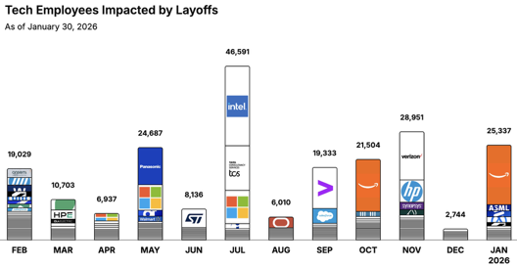
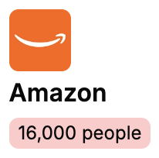
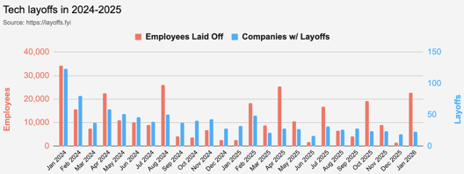
Jobs
https://layoffs.fyi
https://trueup.io/layoffs
The Tech Layoff Tracker
In 2026: 25,337 people laid off (845 per day)
In 2025: 245,953 people laid off (674 per day)
In 2024: 238,461 people laid off (653 per day)
https://trueup.io/layoffs
Tech Layoffs by year (US only):
  22K in 2026 (as of January 30, 2026)
  124K in 2025
  153K in 2024
  264K in 2023
  165K in 2022 https://layoffs.fyi

Slide 27


About the Speaker
Lev Selector, Ph.D.
40+ years of software engineering, data science, and building teams (hiring, training, and managing)
Ph.D. in mathematical modeling and computer simulations
Interests:
Generative AI, Using LLM with your data
Local AI for Local Private Data
Cloud architecture, fin-tech, application security
Find/connect: Linkedin, GitHub, YouTube, Google
https://eais.ai
Enterprise AI Systems

Slide 28
Thank You!

