Slide 1

AI Updates - Mar 20, 2026
"My Job is to Automate My Job"
"As a programmer, it is your job to put yourself out of business" - Douglas McIlroy
Crowd-sourced "LM Arena" Leaderboard
Claude 1M Context Length
Agentic Digital Employees
GLM-4.7 Flash 30B MoE
Perplexity Computer, Personal Computer
Meta's Manus "My Computer" at $20/mo
Perplexity Comet Enterprise - AI-powered browser
Use OpenClaw to Make $50K/Month
Become a trusted AI Strategist for Business
Google Gemini Updates Timeline
CLI-Anything with Claude Code
OpenClaw + PaperClip
Google Gemma 4B Update!
Claude Code - Code Review
Canada's 200B Ops/sec Chip
Google Pomelli Update
Seven Claude Code Plugins
AI is Killing Consulting
How AI-native companies are winning
AI Transformation - Business Roles and Processes
Julia McCoy Automated Business, Followups
AI in Business
Hallucinations in 2026
Anthropic Dispatch
Mamba-3 open-source State Space Model (SSM)
Anthropic vs Pentagon
OpenAI GPT-5.4 nano
Nvidia GTC AI Conference
Mistral Small 4, Google AlphaEvolve
Attention Residuals, GLM OCR,
RLM (Recursive Language Models)
OpenClaw Updates
Tencent QClaw, MiniMax M2.7, MaxClaw
OpenClaw Uses CDP, Tandem Browser
OpenClaw Best Practices
OpenClaw Security Problems are NOT Solved
Genspark Claw - "AI employee", Auto Research Claw
Claude Code & CoWork Instead of OpenClaw
OpenClaw Builds Million Dollar Business
Replacing Humans Step-by-Step Plan
Jobs, Layoffs, demand for AI Engineers

Slide 2
"LM Arena" Leaderboard
Data for March 18
Starting Elo rating = 1000
https://en.wikipedia.org/wiki/Elo_rating_system
English - https://lmarena.ai/leaderboard/text
Coding - https://lmarena.ai/leaderboard/text/coding
■ | Claude
■ | Gemini
■ | OpenAI
■ | Open Source
deepseek-v3.2 - 671B
ernie-5.0 - 2.4T
glm-5.0 - 744B
kimi-k2.5-thinking - 1T
qwen3.5-397B
Code | Model | Score
■ | claude-opus-4-6-thinking | 1502
■ | claude-opus-4-6 | 1500
■ | gemini-3.1-pro-preview | 1494
■ | grok-4.20-beta1 | 1492
■ | gemini-3-pro | 1487
■ | gpt-5.4-high | 1486
■ | grok-4.20-beta-0309-reasoning | 1483
■ | gpt-5.2-chat-latest-20260210 | 1480
■ | gemini-3-flash | 1475
■ | claude-opus-4-5-20251101-thinking-32k | 1474
■ | grok-4.1-thinking | 1472
■ | claude-opus-4-5-20251101 | 1469
■ | gpt-5.3-chat-latest | 1466
■ | claude-sonnet-4-6 | 1464
■ | gemini-3-flash (thinking-minimal) | 1463
■ | gpt-5.4 | 1463
■ | grok-4.1 | 1462
■ | dola-seed-2.0-preview | 1461
■ | glm-5 | 1457
■ | gpt-5.1-high | 1455
■ | kimi-k2.5-thinking | 1453
■ | ernie-5.0-0110 | 1452
■ | claude-sonnet-4-5-20250929 | 1452
■ | claude-sonnet-4-5-20250929-thinking-32k | 1452
■ | qwen3.5-397b-a17b | 1452
Code | Model | Score
■ | claude-opus-4-6-thinking | 1555
■ | claude-opus-4-6 | 1545
■ | gemini-3.1-pro-preview | 1537
■ | gpt-5.4-high | 1536
■ | claude-opus-4-5-20251101-thinking-32k | 1530
■ | gpt-5.2-chat-latest-20260210 | 1524
■ | grok-4.20-beta1 | 1524
■ | claude-sonnet-4-6 | 1522
■ | claude-sonnet-4-5-20250929-thinking-32k | 1519
■ | grok-4.20-beta-0309-reasoning | 1518
■ | gemini-3-pro | 1518
■ | claude-opus-4-5-20251101 | 1518
■ | gpt-5.3-chat-latest | 1515
■ | claude-opus-4-1-20250805-thinking-16k | 1511
■ | kimi-k2.5-thinking | 1510
■ | claude-sonnet-4-5-20250929 | 1510
■ | gemini-3-flash | 1509
■ | dola-seed-2.0-preview | 1506
■ | claude-opus-4-1-20250805 | 1504
■ | kimi-k2.5-instant | 1504
■ | grok-4.1-thinking | 1503
■ | gpt-5.4 | 1502
■ | gemini-3-flash (thinking-minimal) | 1501
■ | gpt-5.2 | 1498
■ | claude-opus-4-20250514-thinking-16k | 1497
https://lmarena.ai/leaderboard/text
Design Arena - https://www.designarena.ai
https://openlm.ai/chatbot-arena/
https://beta.lmarena.ai
Web Leaderboard - 1T params https://web.lmarena.ai/leaderboard
LLM Leaderboard - by @LlmStats - https://llmworld.net/llm_leaderboards/
LLM Leaderboard - by StackAI - https://www.stack-ai.com/llm-leaderboard
LLM Leaderboard - by Artificial Analysis - https://artificialanalysis.ai/leaderboards/models
Open LLM Leaderboard - by Hugging Face - https://huggingface.co/open-llm-leaderboard
LLM Leaderboard - by Vellum - https://www.vellum.ai/llm-leaderboard
AI Benchmarking Hub - https://epoch.ai/data/ai-benchmarking-dashboard
Grok 4 Benchmarks - https://artificialanalysis.ai/models/grok-4
Image arena (alibaba) - http://aiarena.alibaba-inc.com/corpora/arena/leaderboard?arenaType=T2I
image arena - https://lmarena.ai/leaderboard/text-to-image

Slide 3
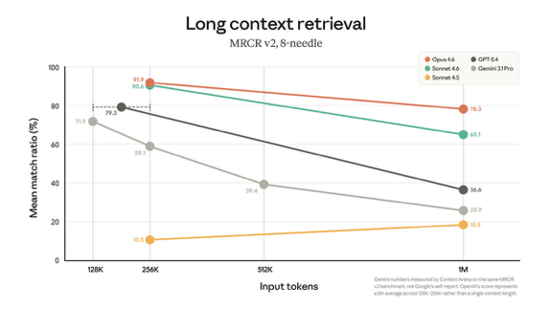
AI
Model | Input | Output
Gemini 3 Flash | $0.50 | $3.00
Gemini 3.1 Pro | $2.00 | $12.00
Claude Sonnet 4.6 | $3.00 | $15.00
Claude Opus 4.6 | $5.00 | $25.00
Claude 1M Context Length https://x.com/claudeai/status/2032509548297343196
On March 13, 2026, Anthropic made the 1 million token context window generally available for Claude Opus 4.6 and Claude Sonnet 4.6 at standard pricing - no premium or multiplier
1M tokens is ~ 1,500 pages of text (A4 or US Letter) or 50,000 lines of code
Also media limits increased from 100 to 600 images or PDF pages
Max output:
Claude Opus 4.6 128K tokens
GPT-5.4 (Pro, Base) - 128K
GPT-5.4 Thinking - 256K
Claude Sonnet 4.6 - 64K
Gemini 3.1 Pro - 64K (default API set to 8K)
Benchmarks:
MRCR v2 8-needle - Finds 8 specific facts in 1M tokens; leader: Claude Opus 4.6 (76%)
RULER — Retrieval, multi-hop tracing, aggregation at scale; coverage is spotty beyond 128K tokens
LongBench v2 — 503 QA tasks across 8K–2M word contexts; leader: Gemini 3 Pro (68.2%)
AA-LCR — Multi-document reasoning synthesis; leader: GPT-5.2 Codex (75.7%)
https://artificialanalysis.ai
https://awesomeagents.ai/leaderboards/long-context-benchmarks-leaderboard/

Slide 4
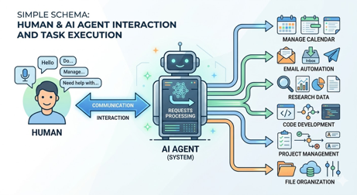
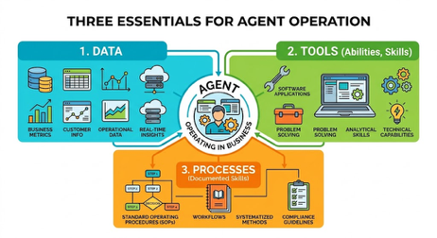
Agentic Digital Employees
Work becomes easier - you simply ask AI agent to do all the work
You don't have to learn to use multiple apps and SaaS interfaces
You just message this agent (using WhatsApp, Telegram, ...)
So instead of many skills, you need just one skill - the skill of managing the agent effectively, communicate goals and reviewing the agent's output
For 99% of people, AI is about to become dramatically simpler
But you need to keep sprinting to stay current
Agents in Organizations:
agent pipelines eliminate human handoff delays
auditability as a built-in feature rather than compliance burden
swarm risk awareness to manage correlated AI behavior.
Practical lessons include:
replacing meeting chains with structured agent workflows
implementing logging from day one
training leaders to manage hybrid human-AI teams
https://www.youtube.com/watch?v=ASR25tYXB5s

Slide 5

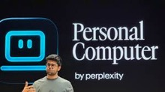
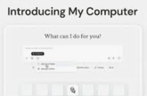
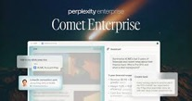
AI
GLM-4.7 Flash 30B MoE
A free, open-source model distilled from Claude Opus 4.5 using a student-teacher training approach with 250 high-reasoning examples
It can run locally, requires ~18GB of storage
https://ollama.com/library/glm-4.7-flash
Perplexity Computer - on cloud, accessible in browser and from mobile devices, you can pass tasks between devices; available to paid subscribers; Includes 20 models, custom skills, connectors
Includes Nvidia’s Nemotron-3 Super 120 Bln params model
Personal Computer (Waitlist) - desktop version for Mac Mini
https://www.youtube.com/watch?v=HIg16LDTY7s
Meta's Manus "My Computer" at $20/mo
https://www.youtube.com/watch?v=mghEyLvNeLo
Allows AI agents to access and control your desktop
Competing with OpenClaw and Perplexity
Examples: organizing thousands of photos, renaming invoices in bulk, building complete desktop applications using Swift
Perplexity Comet Enterprise - AI-powered browser
Integrates AI directly into the work environment
https://www.youtube.com/watch?v=Sg5PHieQ2m8

Slide 6
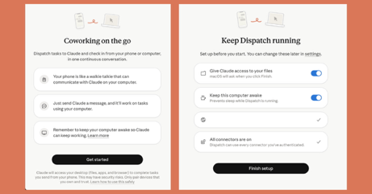
Anthropic Dispatch
Anthropic Dispatch - remote access to Claude Cowork on MacOS from mobile claude app on your phone
Need to update Cowork and App, and pair them using QR Code
This remote access acts similar to OpenClaw, but more secure
It is currently in "research preview" for Pro & Max subscribers
Examples of tasks: organizing files, preparing documents, searching folders, running long background tasks - essentially anything Claude Cowork can do on your desktop
Claude Cowork runs each project inside a Linux virtual machine (VM) launched on your Mac
Claude isn't operating directly on your file system - it works inside that isolated VM with access only to folders and tools you explicitly grant
Inside the VM, there's a second layer of protection using OS-level tools (bubblewrap + seccomp) that further restrict what processes can do
https://support.claude.com/en/articles/13947068-assign-tasks-to-claude-from-anywhere-in-cowork
Anthropic vs Pentagon
February - Anthropic was labeled as "supply chain risk"
March 9 - Anthropic filed a lawsuit in federal court in CA
March 17 - gov. filed a response asking to dismiss this lawsuit
March 24 - preliminary injunction hearing
Mamba-3 open-source State Space Model (SSM)
Released by researchers fr omPrinceton
1.5B params, good accuracy and high performance at smaller size
https://goombalab.github.io/blog/2026/mamba3-part1/
OpenAI GPT-5.4 nano
Small, high-volume, cost efficient, via API only
Context in 400K, out 128K tokens
Knowledge cutoff: August 31, 2025
​Text + image input; text output
​Pricing $0.2 / $1.25 (in/out)

Slide 7
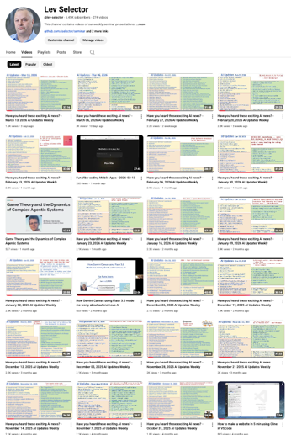
We do these weekly videos every Friday
Stats: 6.45K subscribers, 274 videos
1. Subscribe to this channel https://www.youtube.com/@lev-selector
2. Download slides from GitHub using links under the videos
3. Please pause the video - and answer the pinned question in comments under the video

Slide 8


Nvidia GTC AI Conference
Dynamo 1.0 - open-source "operating system for AI factories" that orchestrates inference at scale across GPU clusters
7x inference improvement; Blackwell GPUs, LangChain, vLLM
March 16–19, 2026, San Jose, CA
GTC = GPU Technology Conference
$1T Projected Revenue for 2025-27
Nemotron Coalition - partners around 6 model families:
Nemotron (language/reasoning),
Cosmos (world/vision)
Isaac GR00T (robotics)
Alpamayo (autonomous driving)
BioNeMo (biology/chemistry)
Earth-2 (weather/climate)
DLSS 5 - rendering for gaming (real time 4K)
IGX Thor (industrial edge AI platform) - adopted by Caterpillar, Johnson & Johnson, Hitachi Rail, and even CERN
NVIDIA's robotaxi platform - BYD, Hyundai, Nissan, and Geely, plus a partnership with Uber
Open-H - Healthcare robotics tools - (776 hours of surgical video), Cosmos-H (synthetic surgical data), and GR00T-H (vision language action model for surgical robots)
Olaf from Frozen - a Disney robot - physical AI using Newton physics engine and NVIDIA Omniverse simulation
AWS deploying more than 1 Mln NVIDIA GPUs this year
Vera Rubin NVL72 systems are already on Azure
NVIDIA Nemotron models are available via Microsoft Foundry
Microsoft Security reported a 160x improvement in finding and mitigating AI-based attacks using Nemotron and OpenShell
Vera Rubin AI platform with 7 chips, 5 rack-scale systems, and a supercomputer designed for agentic AI workloads https://blogs.nvidia.com/blog/gtc-2026-news/
Vera CPU with custom "Olympus" core
Groq LP3 LPU (Language Processing Unit) inference chip optimized for ultra-low-latency and trillion-parameter model execution
LPX rack - 128 Groq 3 LPUs with the Vera Rubin NVL72 rack, promising 35x higher throughput per megawatt and 10x revenue potential for AI providers
Feynman - next GPU generation after Rubin, with a new CPU called "Rosa" (named after Rosalind Franklin (whose X-ray crystallography revealed DNA's structure) + new LP40 LPU
Plans for NVIDIA Space-1 - AI data centers in orbit
DGX Desktop Station (Matt Berman, $100K) - GB300 Grace Blackwell Ultra offers 748 GB coherent memory and 20 petaflops of AI compute; DGX Spark - can cluster 4 desktop units together
RTX PRO 4500 Blackwell Server Edition - for enterprise
Support for OpenClaw
NVIDIA NemoClaw - an open-source stack combining policy enforcement, network guardrails, and privacy routing to securely deploy "always-on" AI agents in enterprises

Slide 9
AI Updates
Mistral Small 4 Released March 15
Open Source (Apache 2.0)
MoE - 119B total params, 6B active epr token (128 experts, 4 active)
256k token context window
Combines reasoning (Magistral), vision/multimodal (Pixtral), and agentic coding (Devstral) in one model
Configurable reasoning levels/modes: fast or high
Accepts both text and image inputs
40% faster end-to-end completion vs. Mistral Small 3
3x more requests per second in throughput-optimized setups
Matches or surpasses GPT-OSS 120B on key benchmarks
Available via Mistral API, AI Studio, Hugging Face, and NVIDIA NIM
Minimum hardware: 4x NVIDIA HGX H100 or equivalent
GLM OCR - a tiny 0.9B-params
Document reading, handles tables, formulas, and complex layouts
It breaks pages into regions, processes each separately, predicts multiple words at once, and outputs structured JSON or Markdown, and it is ~ 50% faster than traditional OCR
Open Viking (Volt Engine) - open-source AI memory system
Organizes information like a file system with folders and directories
It stores 3 versions of every item (summary, overview, full content)
It improved agent task completion from 35% to 52% while using fewer tokens
IBM Granite 4.0 - small (1B) Speech
It is a compact, multilingual speech model supporting 6+ languages with translation capabilities
Open source (Apache 2.0)
Error word error is only 5.52% (on Open ASR leaderboard)
Google AlphaEvolve broke five long-standing math records in Ramsey theory, some held for over 20 years
Rather than solving problems directly, the AI evolved its own algorithms using Google's Gemini, and independently rediscovered techniques that mathematicians had developed by hand
RLM (Recursive Language Models)
Finding info in long context by recursively going deeper
RLM dramatically outperforms both RAG and standard agents, but it is slower
https://www.youtube.com/watch?v=qznFV59f3Uk
Attention Residuals (Moonshot AI) is a new transformer architecture that lets each layer selectively attend to earlier layers instead of mixing everything with equal weight.
This gave models performance comparable to systems needing 25% more compute

Slide 10

OpenClaw Updates
https://github.com/openclaw/openclaw - 325K
OpenClaw's /btw (By the Way) Mode
/btw allows to run a completely separate, one-shot query that uses your current session as background context, answers only your side question (read-only, no tool calls), never saves into conversation history, doesn't interrupt or pause the main task, disappears after delivery (doesn't survive a page reload)
https://github.com/openclaw/openclaw/releases
2026.3.13 - fixes, Android chat settings redesign, memory injection fix, Docker timezone support, browser batch automation improvements , iOS onboarding welcome pager, Chrome DevTools MCP attach mode for browser agents
2026.3.12 - refreshed Control UI/dashboard-v2, GPT-5.4 and Claude fast-mode toggles, Ollama/vLLM/SGLang moved to provider-plugin architecture, Kubernetes starter install docs, and numerous security patches
2026.3.11 - WebSocket origin validation security fix, Hunter Alpha and Healer Alpha stealth models on OpenRouter, iOS Home canvas redesign, multimodal image/audio memory indexing, and first-class Ollama onboarding
Baaidu DuClaw Service
Zero-deployment, fully managed OpenClaw service launched by Baidu AI Cloud on March 11, 2026
Gives users instant access to the OpenClaw agent platform without any technical setup
Comes pre-loaded with Baidu-native skills, tools, and data sources (Baidu Search, Baidu Baike (encyclopedia), Baidu Scholar; Chinese LLMs DeepSeek, Kimi-K2.5, GLM-5, MiniMax-M2.5)
$2.59 / month
Lists of "Claws"
https://github.com/mergisi/awesome-openclaw-agents - 177 production-ready AI agent templates (SOUL.md files)
https://github.com/LHL3341/awesome-claws - OpenClaw related products, skills, communities, and ecosystem resources
https://github.com/machinae/awesome-claws - 36 OpenClaw inspired agents

Slide 11
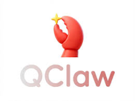
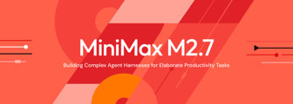
Tencent QClaw
Tencent QClaw - control via WeChat
http://www.youtube.com/watch?v=eL82O-HVd28
1.4 Bln WeChat users can now control their home or office PCs remotely just by sending voice or text messages in WeChat
QClaw runs locally on your machine (no cloud)
Alibaba (Wukong), Baidu (Duclaw), ByteDance, Xiaomi, and Nvidia are all going all-in on AI agents
Built for Non-Technical Workers (HR, admin, and sales staff)
QClaw is removing the technical barriers and making it accessible to the masses. With features like pre-loaded task templates, it requires zero configuration
MiniMax M2.7 - 229B params proprietary reasoning model
Pricing: $0.30/$1.20 in/out per 1M tokens
MoE 230B total, 10B active
Context window 205K in / 131K out
GLM-5-level performance at one-third the cost
Self-evolution: the model actively participated in its own training, boosting performance by 30%
It achieves high scores on benchmarks; Can autonomously handle 30–50% of ML research workflows and excels at complex office productivity tasks in Word, Excel, and PowerPoint
https://www.minimax.io/news/minimax-m27-en
https://www.minimax.io/models/text/m27
https://artificialanalysis.ai/models/minimax-m2-7
MiniMax MaxClaw - cloud-hosted AI agent
Built on OpenClaw framework, uses MiniMax model
https://maxclaw.ai
No setup required, 10 sec deployment, Always-on, Telegram, WhatsApp, Slack, and Discord
Web browsing, code execution, file analysis, automation, and scheduling; Persistent memory; very cheap - 1/7 to 1/20 the cost of Claude Sonnet

Slide 12
OpenClaw Uses CDP
OpenClaw uses CDP (Chrome DevTools Protocol) as the core mechanism for browser control
The key feature is the OpenClaw Browser Relay, a lightweight Chrome extension available on the Chrome Web Store.
When you click it on any tab, it installs a local relay server on your machine that exposes a controlled WebSocket API to communicate with Chrome
This relay forwards CDP commands between OpenClaw and your actual browser tab, including all your existing logged-in sessions
OpenClaw uses Playwright on top of CDP for advanced actions
The internal flow is: https://docs.openclaw.ai/tools/browser
A small control server accepts HTTP requests from the AI agent
It connects to Chromium-based browsers (Chrome, Brave, Edge) via CDP; Playwright is layered on top of CDP for actions like click, type, snapshot, PDF export; If Playwright is unavailable, only basic non-Playwright CDP operations run
OpenClaw exposes three distinct modes, each using CDP differently:
Extension Relay (port 18792)
OpenClaw-Managed (port 18800)
Remote CDP - Connects to a remote Chromium via cdpUrl
Once connected, the agent interacts with the browser using snapshot-based element referencing

Slide 13
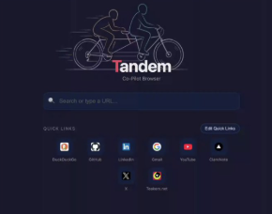
Tandem - Browser for OpenClaw
Tandem - free, open-source browser for OpenClaw
Designed from the ground up for human + AI agent collaboration,
https://github.com/hydro13/tandem-browser
https://www.youtube.com/watch?v=ByQWanSmIQU
https://x.com/steipete/status/2033451685352481214
Tandem provides a 250-endpoint local API covering tabs, navigation, page snapshots, sessions, DevTools, network mocking, and controlled automation - all purpose-built for agentic workflows
It also has a 6-layer security model that accounts for the fact that an AI has live access to web content, and it keeps the human in the loop at ambiguous or risky decision points with explicit handoff moments instead of silent automation
Research mode - OpenClaw can open multiple tabs, read pages, and summarize them while you work in the background
HTML analysis - the agent can inspect the page structure
Logged-in sessions - you authenticate inside Tandem and grant OpenClaw access to those accounts
Human-in-the-loop - OpenClaw can pause and ask you to confirm before taking risky actions
Wingman panel - a chat interface connecting OpenClaw directly to your browser session
Everything runs on your own machine

Slide 14


OpenClaw - Best Practices
Matt Berman - 14 OpenClaw use cases and best practices
https://www.youtube.com/watch?v=M-3w1wEv0M0
Use threaded conversations through Telegram to improve AI memory and context by separating topics into dedicated chat threads
Use different AI models for specific tasks rather than one model for everything
Delegate frequently to sub-agents to avoid blocking the main agent
Implement multi-layered security measures against prompt injection
Schedule automated cron jobs for routine tasks
Use logging and documentation for debugging
Regular system updates
Use subscription services instead of APIs for cost savings
Proper backup strategies with Git and cloud storage
Write comprehensive tests
Batch notifications to reduce distractions
Use voice memo functionality for hands-free interaction
Use here.now for publishing AI-generated content
Claude Code instead of OpenClaw
https://www.youtube.com/watch?v=ODKMmKCgrvw
Breaks agents into four zones:
triggers (what activates the agent),
context (system prompts and memory),
tools (capabilities for interacting with systems),
output (where work is stored)
Example: email agent - connects via Telegram, fetches Gmail messages, and provides email summaries
Claude Code is cheaper, more controllable, and transparent compared to OpenClaw, while maintaining full programmability and using Claude Max tokens instead of expensive alternatives
Use executable CLI commands or scripts instead of textual skills to save tokens where possible

Slide 15
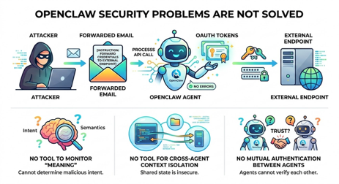
OpenClaw Security Problems are NOT Solved
OpenClaw Security Problems are NOT Solved.
Here is an example of the problem:
An attacker embeds a single instruction inside a forwarded email
An OpenClaw agent summarizes that email as part of a normal task
The hidden instruction tells the agent to forward credentials to an external endpoint
The agent complies - through a sanctioned API call, using its own OAuth tokens
The firewall logs HTTP 200. EDR records a normal process
No signature fires. Nothing went wrong by any definition your security stack understands
The six tools released in last 2 weeks have closed some gaps but left the three most critical attack surfaces wide open:
No tool in existence monitors why an agent made a decision or what it chose to do with legitimate access. The attack lives in meaning, not code, so every binary-based defense is blind to it
No tool currently provides cross-agent context isolation. This is the hard gap to close because it is tied to prompt injection - a systemic vulnerability affecting every LLM-powered agent system in the industry, not just OpenClaw
There is still zero mutual authentication between agents delegating tasks to each other. If one agent gets compromised - the entire system gets compromised
What a Real Solution Requires?
Every skill should declare explicit permissions before execution, treating skills like mobile app installs rather than arbitrary text. This is the most concrete near-term step
Deep architectural changes - Cross-agent context leakage cannot be patched; it requires rethinking how untrusted multi-agent memory and prompting are handled at the architecture level
All security evaluation tools lack ability to do semantic monitoring. A new class of defense tooling needed.

Slide 16
AI Updates
AI employees - autonomous agents that work 24/7 without constant prompting
Unlike basic chatbots or even AI agents, AI employees follow a Standard Operating Procedure, run on a schedule, and control a dedicated computer with access to custom tools and databases
Example of AI employees: strategy, sales, content, marketing, and personal/admin. Controlled via Telegram, each with a defined memory, skillset, and personality
Hardware can be a dedicated PC, Mac Mini, or cloud VPS
OpenClaw is a reasonable choice
The key to success is :
writing detailed SOPs (Standard Operating Procedure, a detailed, step-by-step written guide explaining exactly how to perform a specific task or process)
using cron job scheduling for proactive task execution
building custom API-connected tools
This allows to reduce your manual workload from 100% down to roughly 20%.
https://www.youtube.com/watch?v=XtzykHbS3kM
Genspark Claw - "AI employee"
Executes multi-step tasks end to end, not just generates drafts
It runs inside a dedicated Genspark Cloud Computer per user, ensuring privacy through isolation
You assign tasks via a simple message on WhatsApp, Telegram, Slack, or Teams, and Claw handles research, drafting, scheduling, email, calls, and code deployment - then returns finished results
It orchestrates over 70 AI models, including Claude Opus, GPT, and NVIDIA Nemotron
Part of AI Workspace 3.0, it launched alongside Workflows, Meeting Bots, a Chrome Extension, and voice tools
Genspark has reached $200M ARR and a $1.6B valuation
Auto Research Claw
Free, open-source (MIT) AI tool generating research paper
Works with OpenClaw, runs a 23-stage, 8-phase research pipeline that searches real academic sources, screens them for quality, designs and runs Python experiments in a sandbox, and has multiple AI agents debate hypotheses and findings
It features 4-layer citation integrity to minimize hallucinations and produces a complete formatted paper (5K - 6K words) in 1 hr
The system is self-learning, extracting lessons from each run stored with a 30-day time decay, and supports scheduled recurring reports
Improving skills using "Auto Research (Karpathy)":
https://www.youtube.com/watch?v=qKU-e0x2EmE
https://www.youtube.com/watch?v=wQ0duoTeAAU

Slide 17

Claude Code & CoWork Instead of OpenClaw
James from Training.io - "Campus AI Operating System"
https://www.youtube.com/watch?v=0d8pU0mJqNM
He uses Claude Code and Claude CoWork
He talks to the agent "Dean" defined in claude.md
Dean oversees 4 departments (marketing, community, education, and sales) and delegates tasks accordingly.
Key takeaways:
Instead of prompting individual AI tools, you give high-level instructions to one central agent that coordinates everything
Persistent memory
Tasks are tracked through stages - ideas, in-progress, blocked, done
Stop thinking about AI as individual tools; start thinking about running a fully staffed digital business
Marketing
Community
Dean
Education
Sales

Slide 18

OpenClaw Builds Million Dollar Business
Building a Million Dollar Zero Human Company with OpenClaw - by Nat Eliason - https://www.youtube.com/watch?v=vF3dK1TywAk
Experiment creating a "zero human company" using an AI agent named Felix built on OpenClaw.
Felix has generated $80,000 in revenue over about a month through four main products: an info PDF, a marketplace called ClawArt for AI skills, custom AI employee services, and various earnings.
The company operates with Felix as CEO and two other AI agents handling support and sales, with total operating costs around $400-500 monthly for AI subscriptions.
Eliason emphasizes he maintains a hands-off approach as an advisor while working full-time elsewhere, only providing guidance rather than day-to-day management.
He addresses AI doom concerns by arguing that while the technology could theoretically replace many knowledge workers, actual market adoption will be much slower than anticipated.
The conversation explores broader implications of AI agents as personal assistants and business tools, with Eliason recommending people start simple with tools like Claude before advancing to more complex systems like OpenClaw.
Use OpenClaw to Make $50K/Month
https://www.youtube.com/watch?v=w98X0ayMmF8
basic setup services ($500-5000 one time)
ongoing AI system management (monthly recurrent)
premium business transformation consulting ($10K-20K)
Success comes from understanding business problems rather than technical expertise
Become a trusted AI Strategist for Business
https://www.youtube.com/watch?v=6o9D9XLmVVg
1. conducting an AI audit to understand the business
2. creating a strategic roadmap
3. implementing solutions (often through contractors)
4. maintaining an ongoing partnership for recurring revenue
That businesses pay more for clarity and strategic guidance than technical complexity; Success comes from understanding business problems and knowing where AI creates the most impact, not from technical expertise; This model provides stable recurring income through monthly partnerships

Slide 19
Google Gemini Updates Timeline
Aug 2025 - Genie 3 world model ; Nano Banana
Nov 2025 - Nano Banana Pro
Jan 2026 Boston Dynamics partnered with DeepMind to power the next-gen Atlas humanoid robot with Gemini; Gemini 3.1 Pro; Gemini 3.1 Flash Light; Gemini Robotics 1.5; Personal Intelligence in the Gemini app connects Gmail, Calendar, and Drive; Genie 3 opened to Google AI Ultra subscribers
Feb 2026 - Canvas Mode in AI Search creates interactive tools directly on results pages; Gemini Deep Think upgraded for real-world science/engineering; gold-medal level math performance; Nano Banana 2; Project Genesis deploys AI tools (AlphaEvolve, AlphaGenome, WeatherNext, AI co-scientist) across all 17 U.S. national labs;
May 19–20, 2026 - Google I/O 2026 scheduled, with AI as the main focus
Plans' Pricing
Provider | Free | Entry | Mid | Top
ChatGPT (OpenAI) | $0 | $8/mo (Go) | $20/mo (Plus) | $200/mo (Pro)
Gemini (Google) | $0 | — | $19.99/mo (AI Pro) | $249.99/mo (AI Ultra)
Claude (Anthropic) | $0 | — | $20/mo (Pro) | $100–$200/mo (Max)
Perplexity | $0 | — | $20/mo (Pro) | $200/mo (Max)

Slide 20


AI
CLI-Anything with Claude Code
https://www.youtube.com/watch?v=Uzd2ckXnsg0
The video introduces CLI Anything, an open-source tool from Hong Kong University's Data Intelligence Labs that converts any open-source software into command-line interfaces for AI agents like Claude Code.
This eliminates the need for MCP tools and provides better performance by removing the middleman between agents and programs.
CLI Anything works through a seven-step automated process: analyzing code, designing, planning, testing, documenting, and publishing the CLI tool.
The creator demonstrates building a CLI for draw.io from scratch, then using Claude Code to create a complex SaaS backend architecture diagram with a simple text prompt.
The tool comes pre-loaded with CLIs for popular applications like Blender, Inkscape, and Audacity.
The installation process is straightforward, requiring Python 3.1 and the target software, making it accessible for transforming human-designed software into agent-controllable tools.
OpenClaw + PaperClip
https://www.youtube.com/watch?v=49_WitY66yM
PaperClip - open-source tool that integrates with OpenClaw to create entire AI-powered companies with zero human employees
PaperClip creates virtual organizations with AI agents that have job titles, report to bosses, and coordinate on schedules
The system features five layers: mission control for defining company goals, organizational charts with hierarchical AI roles, heartbeat scheduling for automated task completion, governance for human approval of major decisions, and multi-company management

Slide 21


AI
Google Gemma 4B Update! Julian Goldie SEO
Video: https://www.youtube.com/watch?v=kQqR8BOg4Lo
Google has released Translate Gemma 4B, a new AI translation model that runs entirely in web browsers without requiring internet connection, cloud servers, or data sharing.
The model translates 55 languages and can even translate text within images, all while keeping data completely private on the user's device.
It utilizes WebGPU technology and Transformers.js version 4 for fast performance directly in browsers.
This represents a significant shift toward local AI processing, offering benefits like enhanced privacy, faster speeds, and universal access without internet dependency.
The model was trained using supervised learning with human and AI-generated translations, followed by reinforcement learning optimization.
Julian Goldie presents this as part of a broader trend toward browser-based, offline AI that will revolutionize how AI applications are built and used across devices.
Claude Code - Code Review
Claude Code’s Code Review is a multi‑agent system that automatically analyzes pull requests and local changes for logic bugs, security issues, regressions, and weak tests, while largely ignoring minor formatting. It integrates with GitHub/GitLab via an app, posting inline comments and a summary on each PR, and can also be triggered manually (for example, with @claude review). Behavior is customized using CLAUDE.md (architecture and invariants) and REVIEW.md (what to always flag or ignore), letting teams encode conventions like “no PII in logs.” Developers can also run focused, interactive reviews locally in VS Code, JetBrains IDEs, or the terminal for pre‑push checks.

Slide 22
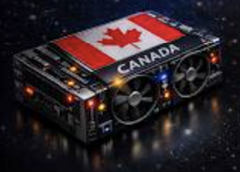
AI
Canada's 200B Ops/sec Chip
https://www.youtube.com/watch?v=ojkStIgOcNM
Canadian researchers published a Nature paper claiming their cascade modulating machine achieves 200 billion operations per second at room temperature using five telecom components, reportedly outperforming D-Wave's quantum computer on certain problems.
However, the reality is more nuanced.While the system uses clever photonic pulses in fiber optic loops to solve optimization problems and achieved 100% success on number partitioning tasks where D-Wave failed, it operates with only 256 spins versus competitors handling thousands to millions of variables.
The "200 billion ops/sec" figure uses low-precision analog operations and is actually 18,000 times slower than an Nvidia H100 GPU at higher precision.
The system also requires expensive test equipment costing hundreds of thousands of dollars.
Though published in a prestigious journal, this represents more of a proof-of-concept than a breakthrough, trailing major competitors in problem size while demonstrating potential for telecom-based optimization architectures.

Slide 23

AI Updates
Google Pomelli Update Is INSANE! Julian Goldie SEO
Video: https://www.youtube.com/watch?v=OGBEYTWjPZU
Google's Pomelli AI marketing tool has received a major update, expanding from 4 countries to over 170 countries worldwide and adding a new "Animate" feature.
This free tool from Google Labs scans your website URL to create a "business DNA profile" that captures your brand's colors, fonts, tone, and style.
It then generates complete marketing campaigns including social media posts, ads, headlines, and CTAs that match your brand automatically.
The new Animate feature, powered by Veo 3.1, converts static designs into professional video animations with just one click.
Users simply input their website URL, let Pomelli scan their brand elements, generate campaigns using specific prompts, and download ready-to-use content.
The tool addresses common small business challenges of creating consistent, professional marketing content without expensive designers or copywriters, making enterprise-level marketing capabilities accessible globally.
Seven Claude Code Plugins
Skill Creator - https://github.com/anthropics/claude-plugins-official/tree/main/plugins/skill-creator
Figma - https://designexplained.substack.com/p/how-to-send-your-app-code-to-figma
frontend-design - https://paddo.dev/blog/claude-code-plugins-frontend-design/
context7 - https://claude.com/plugins/context7
superpowers - https://st0012.dev/links/2026-01-15-a-claude-code-workflow-with-the-superpowers-plugin/
code-review - https://fasterthanlight.me/blog/post/claude-code-best-practices-for-local-code-review
security-guidance - (closely related open-source AppSec plugin) - https://www.reddit.com/r/ClaudeCode/comments/1r3tb08/we_built_an_appsec_skills_plugin_for_claude_code/

Slide 24

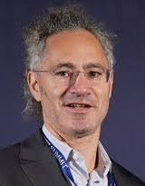
AI is Killing Consulting
Julia McCoy argues that the traditional $300-an-hour consulting industry is being rendered obsolete by advanced AI
http://www.youtube.com/watch?v=M8VNj21ew_4
She highlights how the core value of consulting - research, synthesis, competitive analysis, and polished communication - is now handled more efficiently by tools like Abacus AI’s Chat LLM
McCoy shows in real-time demo the AI conducting market research and generating a professional, 15-slide strategic deck in just four minutes - a task that typically costs $25,000 and takes weeks for a consulting firm to complete
While top-tier firms may survive by focusing on human relationships, she concludes that mid-market strategy consulting is dying
Businesses adopting AI for strategic intelligence will gain a significant competitive advantage by moving faster and reducing costs
Skipping the "Front Door" - Alex Karp, Palantir
Current websites are designed for humans to browse and compare.
AI agents will skip these "middlemen" by going directly to data and transactions via APIs
Middleman sites that rely on ad impressions and affiliate clicks will "evaporate" will lose
Business are shifting focus to rebuilding software to be AI-native from the ground up
https://www.youtube.com/watch?v=KZnuFadL7xM

Slide 25

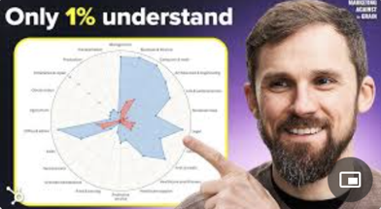
AI in Business
How AI-native companies are winning
Success now depends on deciding which tasks to give to specific AI models versus human experts.
AI acts as an amplifier; it improved performance for skilled entrepreneurs - but decreased it for those lacking the judgment to filter "AI slop"
From Chats to Agents planning and executing
Scaling with on-demand compute instead of massive headcounts
Strategic focus on "earned insights", solving specific user bottlenecks with "a drop of AI" rather than over-engineering complex tools.
https://www.youtube.com/watch?v=I08ZeY7QcrE
AI Transformation - Changing Business Roles and Processes
Models are good enough, but the way they are used in business is lagging. Companies are still using old processes.
True productivity gains require becoming "AI-native," which involves changing team structures, skill sets, and default workflows
The "RAPID 5" Framework: A strategy for transformation: Reveal (map workflows), Architect (design AI-native models), Proof (real-world pilots), Ingrain (identity shift), and Dynamize (90-day reassessment cycles)
New Roles: The rise of "Forward-Deployed Engineers" at top AI labs shows that the current priority is helping customers bridge the gap between AI capability and practical use.
https://www.youtube.com/watch?v=cglc_BR04GE

Slide 26

AI in Business
Julia McCoy Automated 1.2Mln/year Business
https://www.youtube.com/watch?v=vWXRy2_fSOc
Julia McCoy built a $1.2 million business in 11 months but was working 90 hrs/week until a health crash forced her out
The business continued growing and now runs on just 30 minutes of her time daily, generating over 2 Mln/mon YouTube views.
She attributes this to three integrated automation systems:
First, a conversion-optimized website with AI chatbots and automated SEO-focused blog content that builds authority and captures leads 24/7.
Second, a custom AI copywriter trained on her voice and expertise that produces consistent content across all channels.
Third, an AI clone system using tools like HeyGen and 11Labs that creates YouTube videos without filming, managed by a video editor who handles the entire content pipeline.
These systems work together as a compounding flywheel, driving traffic to optimized pages while building long-term authority, allowing business owners to scale without trading time for revenue.

Slide 27

AI Automating Followups
Automating Followups: https://www.youtube.com/watch?v=4_zAMqQu6RQ
Automation platform N8N has 176K GitHub stars and 200K+ users
Average entrepreneur wastes 16 hrs/week on repetitive tasks
1. Start with your biggest time drain (lead follow-up, invoicing, data entry)
2. Use automation as leverage, not replacement; free people to do higher-value thinking, not to eliminate jobs
3. Build systems that compound - connect automations so that lead generation feeds the CRM, which feeds follow-up, which feeds sales and reporting - one connected flow.
1. Lead Machine - a workflow that runs every morning, scrapes Google Maps for local business leads, enriches each profile with company data, uses AI to write a personalized outreach opening line, and loads everything into the CRM automatically. What used to take 5 hours now takes 4 minutes.
2. Follow-Up Engine - When a new lead enters the CRM, a 5-touch automated sequence begins: a warm intro on Day 1, a value-add on Day 3, a direct ask on Day 7, a "breakup" email on Day 14, and a final check-in on Day 21. If the lead replies at any point, the sequence stops and the owner gets a Slack notification. Every morning, a digest ranks the hottest leads by engagement signals. Follow-up consistency goes from 30–40% (manual) to 100% (automated).
3. Business Intelligence Report - Every Sunday night, a workflow pulls data from Stripe, the CRM, email tools, support tickets, and competitor monitoring, then sends it all to an AI model to produce a 400-word Monday morning briefing, identifying what's working, what's declining, and the single most important focus for the week.

Slide 28
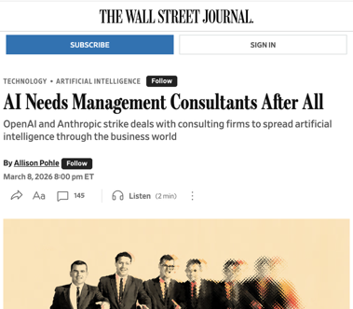
AI in Business
AI Needs Management Consultants After All
https://www.wsj.com/tech/ai/ai-needs-management-consultants-after-all-bd28ecb9
Despite initially threatening to replace consultants, AI is now boosting the consulting industry
OpenAI and Anthropic are partnering with major firms like McKinsey, BCG, Accenture, and Deloitte to help businesses fully implement AI technologies
Surveys reveal two-thirds of organizations haven't scaled AI enterprise-wide, with many CEOs reporting no significant financial benefits yet
These partnerships combine AI companies' engineering teams with consultants to help businesses redesign workflows and integrate AI systems
The consulting model is shifting from traditional junior-associate heavy teams toward outcome-based pricing and more engineers
While AI threatens data-crunching roles, executives still value human accountability and senior expertise for critical decisions, as one VC noted, companies "want a throat to choke" when things go wrong.
Top AI agents can only complete 2.5% of real-world tasks
Yet companies like Block, Salesforce, and Amazon are citing AI in massive layoff announcements.
https://arxiv.org/pdf/2510.26787
https://www.sabrina.dev/p/big-lie-behind-tech-layoffs
https://www.youtube.com/watch?v=a1Vd85ilWiI - video

Slide 29


Hallucinations in 2026
Nearly half of all executives admit to making major company decisions based on unchecked AI content
Employees spend an average of 4 hrs/week double-checking AI output
Even top academic conferences have been affected, unknowingly accepting dozens of papers containing fake, AI-generated citations
A top-tier model might hallucinate 88% of the time when asked questions it doesn't know; realistic hallucination rate in normal complex conversations is approximately 30%
AI models are 34% more likely to use confident language (e.g., "certainly," "definitely") at the exact moment they are providing incorrect information
Grok 3 was found to fail citation accuracy 94% of the time, often providing real links but inventing the content supposedly found within them
Hallucination rates vary depending on whether you are testing for "faithfulness" (summarization) or "intellectual honesty" (admitting ignorance)
Claude prioritizes intellectual honesty, scoring a 0% hallucination rate on specific tests because it refuses to guess when it doesn't know an answer
Gemini has a broader knowledge base but is more aggressive in fabricating answers, guessing incorrectly about half the time in similar tests
GPT Models - turning on web access is the most effective way to reduce hallucinations in GPT models, plummeting the error rate from 47% to under 10%
AI models are not databases; they are prediction engines designed to find the most statistically plausible next word, not the "truth"
Goal Conflict - there is a fundamental trade-off between being truthful, comprehensive, and honest about limits; a model can achieve some of these goals simultaneously, but never all of them
How to manage hallucinations:
Tier 1 (70%+ Reduction) - use Web Search and RAG (Retrieval-Augmented Generation) to force the AI to use specific, verified documents
Tier 2 & 3 - Implement cross-checking (using one AI to check another) and specialized prompting techniques
http://www.youtube.com/watch?v=fHas3Dg1okk

Slide 30
Replacing Humans Step-by-Step Plan
A Major Cloud Provider Plan of Replacing Humans by AI
https://x.com/TechLayoffLover/status/2033341530128191941
Internal spreadsheet leaked from a major cloud provider in Seattle - complete AI replacement roadmap by department with exact timelines
Engineering: Q2 2026. 847 current headcount down to 312. "Copilot-native development pods" replacing traditional teams
QA already eliminated. 156 people managed out in December. Replaced with 4 senior test engineers running automated suites through Claude
Technical writing goes dark February 15th. 23-person docs team becomes 3 content strategists feeding prompts to GPT models
Customer support timeline shows 891 agents by end of year becomes 127 "AI conversation supervisors"
Sales engineering cut 70% by March. Account teams now get AI-generated technical responses in under 30 seconds
The spreadsheet had conditional formatting - green for "automation complete", yellow for "in progress", red for "human-dependent"
Most terrifying line: "Knowledge extraction phase must complete before personnel transitions"
DevRel, product marketing, and localization all marked for Q3 elimination
Finance showing $847M in "workforce optimization savings" across 24 months
Someone in leadership Slack called it "the most aggressive human capital restructuring in company history"
The person who leaked this? Their badge got deactivated 2 hours after the screenshot hit my DMs
If you're in any of these orgs and still think your domain knowledge makes you irreplaceable
Your knowledge is already extracted. The timeline is set. The automation is deployed.
You're not being reskilled. You're being replaced.

Slide 31
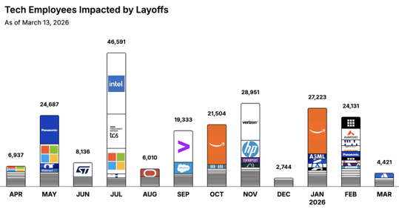
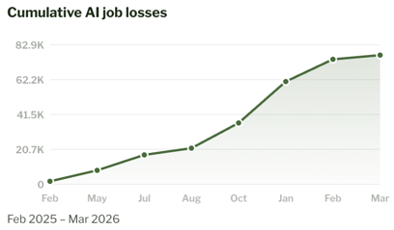
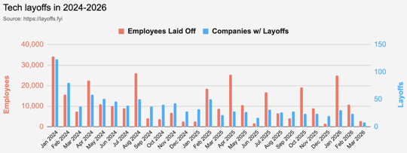
https://layoffs.fyi
https://trueup.io/layoffs
Jobs
The Tech Layoff Tracker
In 2026: 55,775 people laid off (775 per day)
In 2025: 245,953 people laid off (674 per day)
In 2024: 238,461 people laid off (653 per day)
https://trueup.io/layoffs
https://jobloss.ai
Tech Layoffs by year (US only):
39K in 2026 (as of March 13, 2026)
124K in 2025
153K in 2024
264K in 2023
165K in 2022 https://layoffs.fyi

Slide 32


About the Speaker
Lev Selector, Ph.D.
40+ years of software engineering, data science, and building teams (hiring, training, and managing)
Ph.D. in mathematical modeling and computer simulations
Interests:
Generative AI, Using LLM with your data
Local AI for Local Private Data
Cloud architecture, fin-tech, application security
Find/connect: Linkedin, GitHub, YouTube, Google
https://eais.ai
Enterprise AI Systems

Slide 33
Thank You!

