Slide 1
AI News - Oct 9, 2026
Six labs signed a safety pact and picked their own referees.
LM Arena Leaderboard
Artificial Analysis Intelligence Index
Microsoft Copilot’s Evolution
Building Better Through Constraints
AI Agents Build a Complex App Feature
Claude Code JavaScript Videos
DeepSeek Harness: Evolving Agents
Kent Beck on Craft and AI Coding
Manus 2.0 and Cue
Research - AI Improves Its Own Design
Sign in with ChatGPT Spends Your Plan
White House Super Intelligence Accord
Microsoft MAI-Transcribe-2-Streaming
Agentic AI Token Use Dwarfs Human Use
Trump's Super Intelligence Force
Aleph Alpha Kolibri 78B MoE
image-blaster: Photo to 3D World
Reflection AI Beam 501B Open Model
Reka Rho-1 19B Multimodal Model
Strata: 125B Model on a Normal PC
SpaceXAI Renamed SpaceXSI
HumanLayer Multiplayer Agent Workspace
AI-Powered Video Editing Workflow
Xiaomi HySparse2 Cuts Agent Context Costs
Salesforce JitMem: Memory on Demand
Zed + Claude
Agent Toolkit
Chinese Chips
Alibaba’s V900 Chip
a16z - Top 100 Gen AI Consumer Apps
Devin Memory and Dreaming
Jobs & Layoffs
Tech Hiring and Skills in Demand
Notes:
Contents labels. Kept by g3_update_toc.py.
Sept 30 => -
Sign in with ChatGPT lets apps spend your ChatGPT plan => Sign in with ChatGPT spends your plan
Six AI labs sign the White House Accord on Super Intelligence => White House Super Intelligence Accord
FTC prepares subpoenas for OpenAI, Anthropic and METR => FTC probes OpenAI, Anthropic, METR
Broadcom will lend Anthropic up to $42B to lease TPUs => Broadcom lends Anthropic $42B
NVIDIA DGX Spark 64GB: a cheaper local AI box at $4,999 => DGX Spark 64GB for $4,999
Prime Intellect launches Prime Inference for open models => Prime Inference for open models
Microsoft MAI-Transcribe-2-Streaming tops Artificial Analysis => MAI-Transcribe-2-Streaming
English - https://lmarena.ai/leaderboard/text => LM Arena Leaderboard
Coding - https://lmarena.ai/leaderboard/text/coding => LM Arena Leaderboard
Extreme Programming (XP, 1999) - Agile approach to building software - deliver small improvements often, get feedback quickly, and adapt rather than trying to plan everything up front https://en.wikipedia.org/wiki/Extreme_Programming https://extremeprogrammingalliance.com/about-extreme-programming-xp/ => Extreme Programming (XP, 1999)
Install Zed: On macOS, use Homebrew or download the app; on Windows, use winget or the installer; on Linux, run Zed’s install script - https://zed.dev/docs/installation => Zed + Claude + GitHub
Ascend by Huawei — 812K chips shipped in 2025. => Huawei Ascend: 812K Chips in 2025
Sign in with ChatGPT - lets apps spend your ChatGPT plan => Sign in with ChatGPT Spends Your Plan
The Tech Layoff Tracker => Jobs & Layoffs
Tech Layoffs by year (US only): => Jobs & Layoffs
Top "In Demand" Skills and Qualifications => Tech Hiring and Skills in Demand
Software job postings on Indeed => Tech Hiring and Skills in Demand
Skills in demand => Tech Hiring and Skills in Demand
Oct 4 => -
HumanLayer - The Multiplayer Coding Agent Workspace => HumanLayer Multiplayer Agent Workspace
Trump launches a Super Intelligence Force under Jay Clayton => Trump's Super Intelligence Force
OpenAI safety report lead quits, calls the culture broken => OpenAI Safety Lead Quits
Aleph Alpha Kolibri: open 78B MoE with 3.5B active and 1M context => Aleph Alpha Kolibri 78B Open Model
DeepSeek Harness v0.2 ships desktop apps => DeepSeek Harness Desktop Apps
Apple will tighten Full Disk Access on Macs because of AI agents => Apple Limits Full Disk Access for Agents
Anthropic puts $100M into a Claude Frontier Academy => Anthropic $100M Claude Frontier Academy
image-blaster: one photo to a 3D world in 5 minutes => image-blaster: Photo to 3D World
Agentic AI Token Use is Much Bigger that Human => Agentic AI Token Use Dwarfs Human Use
Reflection AI Beam: a 501B open-weight model trained in the US => Reflection AI Beam 501B Open Model
OpenAI watermarks ChatGPT and Codex text in the EU => OpenAI Text Watermarks in the EU
Reka Rho-1: one 19B model for text, video and robot actions => Reka Rho-1 Omni Model
a16z Top 100 Gen AI Consumer Apps, 7th edition, follows the money => a16z Top 100 Consumer AI Apps
Devin adds Memory and Dreaming => Devin Memory and Dreaming
Reka Rho-1: 19B model for text, video and robot actions => Reka Rho-1 19B Multimodal Model
agent-toolkit => Agent Toolkit
SpaceXAI to be renamed to SpaceXSI => SpaceXAI Renamed SpaceXSI
Strata Runs 125 Bln Params Model on a Normal PC => Strata: 125B Model on a Normal PC
Kent Beck on Craft and AI-Assisted Development => Kent Beck on Craft and AI Coding
Trump launches a Super Intelligence Force => Trump's Super Intelligence Force
Reflection AI Beam - 501B open-weight model => Reflection AI Beam 501B Open Model
Aleph Alpha Kolibri: open 78B MoE => Aleph Alpha Kolibri 78B MoE

Slide 2
"LM Arena" Leaderboard
Data for Oct 2
Starting Elo rating = 1000
https://en.wikipedia.org/wiki/Elo_rating_system
English - https://lmarena.ai/leaderboard/text
Coding - https://lmarena.ai/leaderboard/text/coding
■ | Claude
■ | Gemini
■ | OpenAI
■ | Open Source
Claude Fable-5 - 6TB
Claude Opus-4.8 - 5TB
Claude Sonnet-4.5 - 1TB
Claude Sonnet-5 - ?
GLM-5.3 - 744B
Meta muse-spark - 16 x 70B
Qwen3.7-max-preview - 745B
Qwen3.8-max - 2.4TB
Baidu Ernie-5.1 - 800B
Deepseek-v4 - 1.6T
Deepseek-v4.1-Flash - 552B
Kimi-k3 - 2.8T
Xiaomi MiMo-V2.5-Pro - 1T+
ByteDance dola-seed-2.0-pro 400B
Minimax M3 - 456B
Code | Model | Score
■ | gemini-4-argon-high | 1525
■ | claude-opus-4-6-high | 1505
■ | claude-fable-5-high | 1504
■ | claude-opus-5.5-high | 1504
■ | claude-opus-4-7-high | 1501
■ | claude-fable-5.1-max | 1501
■ | claude-opus-4-6 | 1497
■ | gemini-3.8-flash-high | 1495
■ | muse-spark-1.3-max | 1494
■ | claude-opus-4-7 | 1494
■ | muse-spark-1.2 (xHigh) | 1494
■ | muse-spark-1.1 | 1491
■ | claude-opus-5-high | 1490
■ | claude-opus-5-max | 1489
■ | muse-spark | 1489
■ | kimi-k3-max | 1488
■ | gemini-3.7-flash-high | 1488
■ | gemini-3.1-pro-preview | 1487
■ | gemini-3-pro | 1485
■ | gpt-5.6-sol-xhigh | 1484
■ | gpt-6.1-sol-max | 1483
■ | gemini-3.6-flash-high | 1483
■ | qwen3.8-max | 1482
■ | claude-opus-4-8-high | 1482
■ | gpt-5.5-high | 1481
Code | Model | Score
■ | gemini-4-argon-high | 1560
■ | claude-fable-5-high | 1552
■ | claude-opus-4-6-high | 1551
■ | claude-opus-4-7-high | 1551
■ | claude-opus-4-6 | 1548
■ | claude-opus-4-7 | 1546
■ | gpt-6-astra-max | 1543
■ | gpt-6.1-sol-max | 1542
■ | kimi-k3-max | 1541
■ | mimo-v2.6-pro | 1540
■ | muse-spark-1.3-max | 1539
■ | claude-opus-5.5-high | 1538
■ | claude-sonnet-5.5-xhigh | 1536
■ | gpt-5.6-sol-xhigh | 1534
■ | claude-opus-5-high | 1533
■ | claude-opus-4-8-high | 1533
■ | muse-spark-1.1 | 1533
■ | muse-spark-1.2 (xHigh) | 1531
■ | claude-fable-5.1-max | 1531
■ | claude-opus-4-5-20251101-high-32k | 1530
■ | claude-opus-5-max | 1530
■ | gemini-3.8-flash-high | 1530
■ | claude-opus-4-8 | 1530
■ | muse-spark | 1530
■ | claude-sonnet-4-6 | 1529

Slide 3
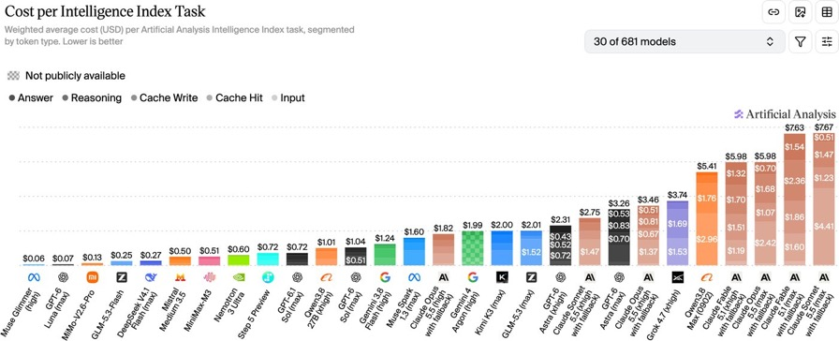
Artificial Analysis Intelligence Index
Artificial Analysis Intelligence Index
https://artificialanalysis.ai/evaluations/artificial-analysis-intelligence-index
Oct 4

Slide 4
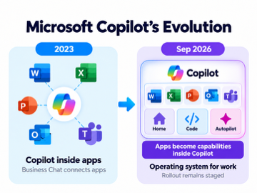
AI News
Microsoft Copilot’s Evolution
2023: Copilot begins as an assistant inside Word, Excel, PowerPoint, Outlook, and Teams; Business Chat connects information across applications
2024: Copilot Pages introduces persistent, shared workspaces; agents extend Copilot into business workflows
2025: Copilot Chat broadens access to specialized agents
September 2026: Home brings applications into Copilot; Code builds custom software, while Autopilot handles ongoing delegated work.
The direction reverses: instead of Copilot living inside apps, apps become capabilities inside Copilot
“Operating system for work” , rollout remains staged
From Windows OS to Copilot OS ?

Slide 5

AI News
Building Better Through Constraints
David Heinemeier Hansson, 37signals co-owner and Basecamp creator, in a long-form interview
He argues that software improves when teams deliberately limit features, resources, and interruptions
The discussion covers Basecamp’s 2004 launch, current AI-assisted development, and his work on the Omarchy Linux distribution
Problem: abundant resources and large teams can encourage bloated products, forced upgrades, and needless complexity
Solution: Preserve constraints, keep proven software stable, build for real jobs, and favor focused small teams
Achievement: Basecamp was initially built in 380 hours and still supports profitable legacy versions for longtime customers
Key lesson: Use AI to sharpen judgment - not merely to produce more code.
https://www.youtube.com/watch?v=76rR68ktQvo
https://basecamp.com
https://37signals.com
https://omarchy.us

Slide 6

AI News
AI Agents Build a Complex App Feature
The creator of Enjoy, an AI-agent app, describes using Claude Opus 5.5 in Ultra Code to implement a 2,700-line specification for team collaboration.
The project involved redesigning the app for multiple users and coordinating phones, browsers, desktop clients, a relay server, and encrypted traffic.
The creator says the agent worked for about seven hours, using dozens of implementation and review agents, with tests and CI checks.
He reports that the feature matched the specification and worked well, contrasting it with earlier agents that failed on smaller tasks and left codebases broken.
His proposed shift is from manually reviewing every line to evolutionary coding: automated tests, adversarial agent reviews, and production results guide iteration.
The achievement suggests AI may shorten complex development and change engineering practice.
https://www.anthropic.com/claude-opus-5-5
https://platform.claude.com/docs/en/models/opus-5-5/overview
https://www.youtube.com/watch?v=2zLuYU_Ub_0

Slide 7

Claude Code JavaScript Videos
Claude Code JavaScript Videos
Chase AI demonstrates creating explainers, product demos, and motion graphics with Claude Code and JavaScript, without Remotion or After Effects
JavaScript defines each frame as a function of time
Playwright renders frames
Human approves
FFmpeg assembles the MP4
The workflow runs locally
Prompts specify duration, aspect ratio, style, and audio;
reference images or videos guide composition
A reusable skill automates intake, storyboarding, coding, checks, and delivery
The achievement is reproducible, editable animation without dedicated video generators
https://code.claude.com
https://playwright.dev
https://ffmpeg.org
https://elevenlabs.io
https://www.youtube.com/watch?v=rscb1DgJtNg

Slide 8
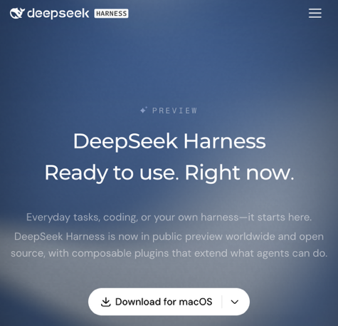
DeepSeek Harness: Evolving Agents
DeepSeek Harness: Evolving Agents
DeepSeek AI released its open-source agent harness in August. Github repo now has 245K stars
A locally hosted runtime with a browser interface, terminal access, coding tools, web search, planning, and subagents
Cordis-based architecture makes models, tools, memory, execution loops, and interfaces replaceable plugins
Self-improvement: Creator mode enables runtime plugin changes; a separate community plugin adds persistent memory, evolving user profiles, and reusable skills - not automatic model retraining
Developers can build adaptable agents without rewriting the core framework. This is extensible agent infrastructure, not proof of autonomous intelligence improvement
https://www.deepseek.com/harness/en/
https://github.com/deepseek-ai/deepseek-harness
https://github.com/madage/dsh-self-improved

Slide 9
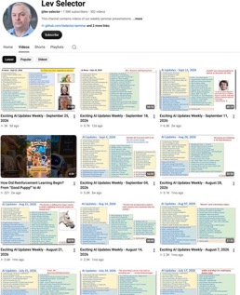

Weekly videos every Friday
Weekly videos every Friday
7.58K subscribers, 352 videos
1. Subscribe to this channel https://www.youtube.com/@lev-selector
2. Download slides from GitHub using links under the videos
3. Please pause the video - and answer the pinned question in comments under the video

Slide 10


AI News
Kent Beck on Craft and AI-Assisted Development
Kent Beck is known for his book Extreme Programming (XP, 1999) - Agile approach to building software - deliver small improvements often, get feedback quickly, and adapt rather than trying to plan everything up front
https://en.wikipedia.org/wiki/Extreme_Programming
https://extremeprogrammingalliance.com/about-extreme-programming-xp/
Common XP practices include: Test-driven development (TDD), Pair programming, Continuous integration, Small releases and regular customer feedback, Refactoring: improve the code’s structure
https://www.agile-academy.com/en/agile-dictionary/extreme-programming/
Kent Beck warns that AI-generated code may be broken; developers must verify behavior rather than trust appearances
His solution: work iteratively, test continuously, and alternate shipping features with refactoring that preserves future choices
This balance enables learning and keeps software adaptable, instead of rapidly accumulating complexity until change becomes dangerous
Beck argues that code volume do not prove progress
https://www.youtube.com/watch?v=aSXaxOdVtAQ
https://kentbeck.com
https://newsletter.pragmaticengineer.com/p/how-kent-beck-shapes-the-software

Slide 11
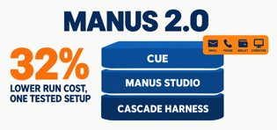
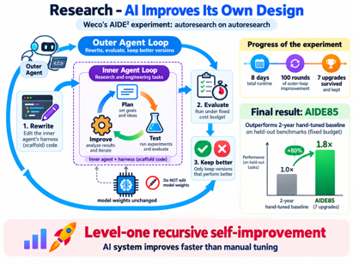
AI News
Manus 2.0 and Cue
Agent app - web, desktop, and mobile
Manus’s Cascade harness, Studio, and cloud computers let agents handle projects, edit videos, build games, run automations, and work remotely
Cue gives each agent an email, phone number, wallet, and computer
https://manus.im/blog/introducing-manus-2-0
https://www.youtube.com/watch?v=L75zF2WKiVE
Research - AI Improves Its Own Design
Weco’s AIDE² experiment - "autoresearch on autoresearch"
Used two nested AI-agent loops.
The inner agent tried to improve solutions to research and engineering tasks;
the outer agent repeatedly rewrote the inner agent’s harness code, evaluated the rewrite under a fixed cost budget, and kept it only if it improved on a hidden score
The system changed the agent’s scaffolding, not the underlying model weights
Over eight days, the system ran 100 rounds, proposing and testing changes; seven upgrades survived hidden evaluations
Its best version, AIDE85, outperformed Weco’s two-year, hand-tuned baseline on held-out benchmarks under a fixed budget.
The result offers public evidence for level-one recursive self-improvement:
an AI system improving faster than manual tuning
https://www.weco.ai/blog/first-evidence-of-recursive-self-improvement
https://arxiv.org/abs/2609.26457
https://openai.com/index/path-to-astra/

Slide 12
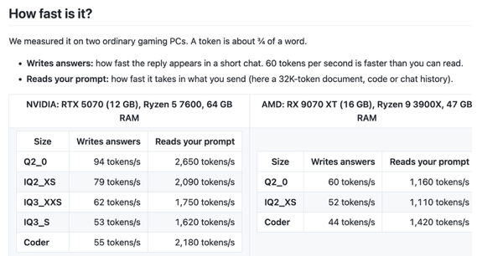


AI News
Strata Runs 125 Bln Params Model on a Normal PC
Developer Niko1221 published Strata on GitHub to run Qwen3.8-Flash-Next locally -125 Bln params
45 tok/sec on RTX 5070 + 64GB RAM for 128K context
Strata splits work across GPU, system RAM and SSD: the GPU handles shared operations and cached experts, while CPU and SSD provide additional model data
https://github.com/Niko1221/Strata
https://huggingface.co/collections/Qwen/Qwen3.8-Flash-Next
SpaceXAI to be renamed to SpaceXSI
Musk said SpaceXAI, SpaceX’s AI unit, would become SpaceXSI,
with “SI” standing for “super intelligence.”
He provided no implementation timetable
This concerns the AI unit - not renaming the entire SpaceX company.

Slide 13
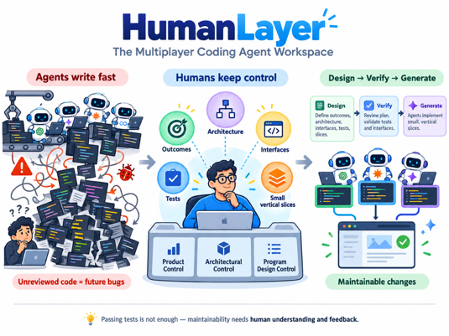
AI News
HumanLayer - The Multiplayer Coding Agent Workspace
TL;DR - AI agents can implement features quickly, but humans must retain product, architectural, and program-design control
Problem: Coding factories can create unreviewed, poorly structured code, leaving teams unable to diagnose serious bugs months later
Solution:
Define measurable user outcomes, architecture, interfaces, tests, and small end-to-end vertical slices before agents generate large changes
The approach shifts engineers toward high-leverage design, verification, and prioritization
Note: Benchmarks that merely pass tests do not measure maintainability; sustained human understanding and feedback remain essential
https://humanlayer.com
https://x.com/dexhorthy

Slide 14
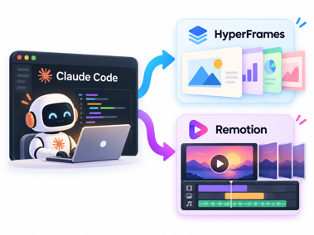
AI News
AI-Powered Video Editing Workflow
Claude Code using Claude Opus 5.5 edits footage with HyperFrames or Remotion (HMLT, CSS, React), previews results, and revises them from feedback
A connected MCP service, such as Blotato, can publish the finished video and accompanying post to social accounts
The presenter reports a polished edit after roughly 10 minutes and one feedback round, suggesting a faster content-production process
https://www.youtube.com/watch?v=flXfwevUJTk
https://github.com/heygen-com/hyperframes
https://www.remotion.dev
https://www.blotato.com/mcp
https://aiprofitboardroom.com
------------------
brew install node ffmpeg
npx hyperframes init my-video
cd my-video
npx skills add heygen-com/hyperframes
In Claude Code: /hyperframes Create a 20-second, 16:9 video introducing my home-networking consulting service. Use a clean, modern style, animated network diagrams, and a title card at the end.
npx hyperframes preview
npx hyperframes render
------------------
npx create-video@latest
cd your-project-name
npx skills add remotion-dev/skills
npm run dev
Then in Claude Code: Create a 20-second, 16:9 video introducing my home-networking consulting service. Use animated network diagrams, a clean modern style, and a title card at the end.

Slide 15

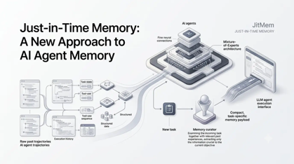
AI News
Xiaomi HySparse2 Cuts Agent Context Costs
Combines KV bridging reuse between layers
Xiaomi reports 4.5 times reduction of KV cache size, and 5 times fewer prefill FLOPs
Retrieval also improved on the reported 256K-token test
DeepSeek’s V4.1-Flash uses related techniques
The parallel designs highlight cache reuse as a key direction for long-context agents.
https://www.youtube.com/watch?v=eXad7m0TjVM
https://arxiv.org/abs/2609.26368
https://arxiv.org/html/2609.19969v1
https://arxiv.org/abs/2405.05254
Salesforce JitMem: Memory on Demand
Just-in-Time Memory (JitMem) method stores successful agents’ full interaction trajectories, then has a curator create a task-specific briefing when a new task arrives
It beat the strongest write-time memory baseline across 3 benchmarks
The approach preserves flexible evidence, though its usefulness still depends on the curator’s reasoning.
https://www.youtube.com/watch?v=pSkh-mNd9LQ
https://arxiv.org/abs/2609.27334
https://aiweekly.co/alerts/jitmem-curates-llm-agent-memory-at-read-time-not-write-time

Slide 16
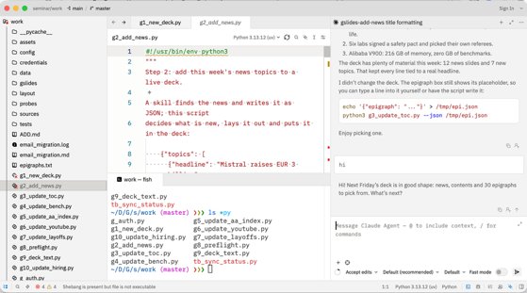
Zed + Claude
Zed + Claude
Install Zed: On macOS, use Homebrew or download the app; on Windows, use winget or the installer; on Linux, run Zed’s install script - https://zed.dev/docs/installation
Open Zed and launch the Agent Panel with Cmd-? on macOS or Ctrl-? on Windows/Linux
Install Claude Agent: Open the command palette and run “zed: acp registry,” or open Agent Settings, select External Agents, then Add Agent → Install from Registry. Choose Claude.
Start a new Claude Agent thread from the Agent Panel or Threads Sidebar.
Authenticate when prompted, or enter /login in the Claude thread to choose an available sign-in method. Claude Agent handles its own authentication and billing; Use Pro or Max subscription to save money
Open a project and ask Claude to explain, edit, or debug code.
https://zed.dev/docs/ai/external-agents
Ask Claude to download and install rules and skills under ~/.claude/ from this repo:
https://github.com/lselector/agent-toolkit
agent-toolkit
rules: communication_style.md, keep_terse.md, modularity.md, no_frankenstein.md, python_formatting_rules.md, simplicity.md, skill_naming_hyphens.md, update_docs.md, update_wiki.md, web_development.md, writing_prose.md
skills: architecture-review, design-doc, humanize, lean-change, repo-init, repo-init/gitignore.template, wiki-init, wiki-serve, wiki-stop, wiki-update
wiki: README.md, conventions.md, server_restart.sh, server_start.sh, server_stop.sh, styles.css, test_wiki.py, wiki_edit.py, wiki_pages.py, wiki_server.py, wiki_tools.py

Slide 17
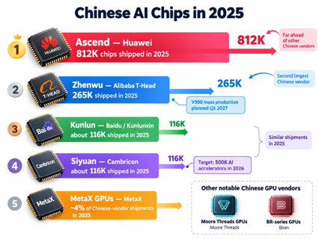
Chinese Chips
Chinese Chips
Ascend by Huawei — 812K chips shipped in 2025.
Zhenwu by Alibaba T-Head — 265K chips shipped in 2025.
The V900 is a new model, planned for mass production in Q1 2027.
Kunlun by Baidu / Kunlunxin — about 116K chips shipped in 2025.
Siyuan by Cambricon — about 116K chips shipped in 2025;
targeting 500K AI accelerators in 2026.
MetaX GPUs by MetaX — ~ 4% of Chinese-vendor shipments in 2025.
Moore Threads GPUs by Moore Threads
BR-series GPUs by Biren
https://www.reuters.com/world/china/chinese-chipmakers-claim-nearly-half-of-local-market-nvidias-lead-shrinks-idc-2026-04-01/
Alibaba’s V900 Chip
Alibaba claims it is China’s most powerful AI chip and says it offers three times the performance of its predecessor, the M890
216 GB of memory, 1.2 TB/s chip-to-chip bandwidth, FP8/FP4 support, and clusters scaling to 500K chips
12 V900s could hold a 2.4-trillion-parameter model’s FP8 weights, versus about 18 Nvidia H200s
V900 mass production is planned for early 2027
https://www.tomshardware.com/tech-industry/artificial-intelligence/alibaba-unveils-zhenwu-v900-ai-accelerator-claims-its-the-most-powerful-ai-chip-in-china-accelerator-supports-500-000-chip-supercluster-with-a-10t-parameter-qwen-model-on-the-roadmap

Slide 18



AI News
Sign in with ChatGPT - lets apps spend your ChatGPT plan
In limited preview (Plus & Pro users) - let an app use
their ChatGPT Work and Codex allowance
16 launch partners - Notion, Vercel, Devin, Amp, Warp, OpenCode, ...
Weekly cap per app, set in Settings > Usage as a share of the plan
App sees only name, email and picture, not chats or memories
https://thenewstack.io/sign-in-with-chatgpt/
Six AI labs sign the White House Accord on Super Intelligence
Signed by Google, Anthropic, Meta, OpenAI, xAI and Nvidia leaders
Four layers of oversight: internal controls, internal checkers,
an outside auditor, a board committee
Each company picks its own auditor and need not name it
No penalties, no disclosure rule, no deadline
Trump called it "morally binding"
https://www.techtimes.com/articles/328464/20261002/white-house-ai-safety-accord-has-no-penalties-no-breach-reporting-self-chosen-auditors.htm
Microsoft MAI-Transcribe-2-Streaming
#1 of 38 on Artificial Analysis
60 languages with automatic language detection
First partial text in about 100 ms, final text 0.13 s after speech ends
$0.54 per audio hour through 2026; public preview in Foundry
Shipped with MAI-Voice-2.1 and MAI-Voice-2.1-Flash
https://microsoft.ai/news/our-first-streaming-transcription-model/

Slide 19
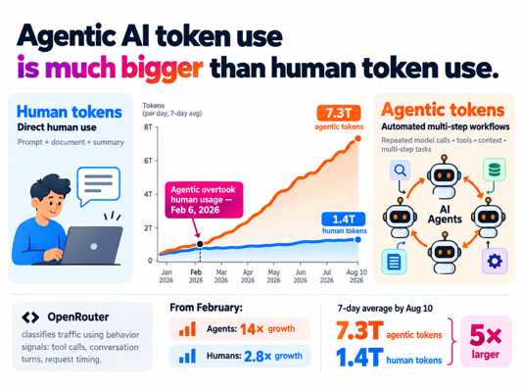
AI News
Agentic AI Token Use is Much Bigger that Human
Human tokens are input and output text tokens from direct, human-driven AI interactions. For example, a person submitting a document and receiving its summary. Prompt, document, and summary - all count towards "human" tokens
Agentic tokens come from automated AI workflows that make repeated model calls, use tools, retain context, and execute multi-step tasks such as coding, research, or debugging.
OpenRouter classifies traffic from behavioral signals including tool calls, number of conversation turns, and request timing - not simply whether a human initiated the work.
Agentic usage overtook human usage on Feb 6, 2026.
By August 10, agentic traffic reached 7.3 trillion tokens on a seven-day average, versus 1.4 trillion human-driven tokens: over 5× larger.
From February, agents grew about 14×;
human usage grew 2.8×. https://cryptobriefing.com/openrouter-agentic-token-usage-14x-growth/

Slide 20


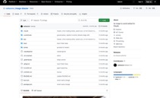

AI News
Trump launches a Super Intelligence Force
Chaired by Director of National Intelligence Jay Clayton
It has 120 days to report on AI risks and opportunities
Charter: plan for "SI-enabled threats" while preventing overregulation
Ferguson's FTC (Federal Trade Commission) is probing OpenAI and Anthropic
https://siliconangle.com/2026/10/04/trump-launches-super-intelligence-force-with-jay-clayton-as-ai-czar/
Aleph Alpha Kolibri: open 78B MoE
Released Oct 3 on Hugging Face under Apache 2.0
78.1B total parameters, 3.46B active per token; 384 experts plus 1 shared
Context of 1 Mln tokens; trained on 24T tokens
English and German; 84.3 on GPQA Diamond, per Aleph Alpha
FP8 checkpoint (~78 GB) fits one H200 or B200, or two H100s
Pitched for on-premises use under the EU AI Act and GDPR
https://aleph-alpha.com/en/blog/kolibri-has-landed-a-sovereign-open-weight-model/
image-blaster: one photo to a 3D world in 5 minutes
Open-source Claude Code skill set, MIT license
Claude runs the pipeline: World Labs Marble for the scene,
Hunyuan 3D for objects, ElevenLabs for sound
Output: Gaussian splat scene, .glb/.obj object meshes with colliders, ambient and object sounds
Loads in Unity, Unreal, Godot, Blender and Three.js
Drop an image in input/, add API keys, ask Claude to "blast" it
https://github.com/neilsonnn/image-blaster

Slide 21




AI News
Reflection AI Beam - 501B open-weight model
First model from the $25 Bln US startup
Sparse MoE: 501B total, 23B active, 1M context, text only
Claims 80.9 on SWE-bench Verified
Claims GLM-5.2-level reasoning at 3 to 4x less compute
Kimi K3 still ahead; all numbers are Reflection's own
Weights under Apache 2.0 to be released later in October
https://reflection.ai/blog/introducing-beam
Reka Rho-1: 19B model for text, video and robot actions
Reka.ai - a startup in San Francisco, CA - https://reka.ai
Rho-1 model reads and generates text, images, video, and robot actions
Replaces the usual world model, planner and policy handoffs with one network
First video clip in 7.0 sec versus 13.8 sec for a multi-agent pipeline
Robot labels inferred from ordinary video with an inverse dynamics model
Trained from scratch on 320 H100s in about 3 months
Research preview only; video capped at 672x384, no physical robot demo yet
a16z - Top 100 Gen AI Consumer Apps
New list ranks apps by US consumer card spending
ChatGPT has about 3-times the paid subscribers of Gemini or Claude
Only 4.5% of Americans pay for a major chatbot
Median payer spends $25
84% of AI-native web apps sell subscriptions, 14% run ads
Personal agents are the new front: Muse, Dots, Grok Bot, Instinct
a16z is Andreessen Horowitz, an American venture-capital firm
https://a16z.com/100-gen-ai-apps-7/

Slide 22

AI News
Devin adds Memory and Dreaming
Dreaming - Across sessions, Devin builds a memory graph of how you like to work. Saves preferences, corrections, project lessons
At night Devin self-improves its memory to remove stale records and discover latent information
Each memory is a short note linked back to the session that taught it
Stored in a personal Memory Drive:
a Git repo of Markdown files with a MEMORY.md index
Dreaming runs daily: dedupes memories, links them to sessions and artifacts, derives new knowledge
Under Customize > Memory;
memory is personal, not shared org rules
https://devin.ai/blog/memory-and-dreaming

Slide 23
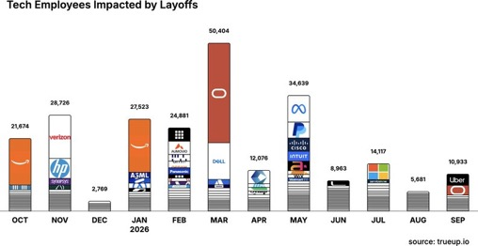
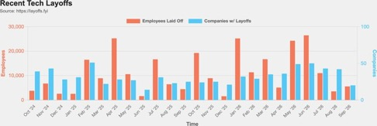
Jobs and Layoffs
https://layoffs.fyi
https://trueup.io/layoffs
The Tech Layoff Tracker
In 2026: 189,217 people laid off (725 per day)
In 2025: 245,953 people laid off (674 per day)
In 2024: 238,461 people laid off (653 per day)
https://trueup.io/layoffs
Tech Layoffs by year (US only):
  129.2K in 2026 (as of Sept 18, 2026)
  123K in 2025
  153K in 2024
  266K in 2023
  165K in 2022 https://layoffs.fyi

Slide 24
Tech Hiring
Software job postings on Indeed
Comparing to 2020 level, in Feb 2022 it was 234%, in 2025 it was 65%, now it is 77%
All US job postings: 103% (compared with 2020)
Postings that mention AI: 6.7% of all, up from 3.4% a year ago
https://fred.stlouisfed.org/series/IHLIDXUSTPSOFTDEVE
Top "In Demand" Skills and Qualifications
- Critical thinking and problem-solving
- Communication and stakeholder management
- Adaptability and continuous learning
- AI literacy and practical AI adoption
- AI/ML application development
- Data engineering and data management
- Cybersecurity and risk management
- Cloud and infrastructure engineering
- Software engineering
- Automation and workflow optimization
- DevOps, CI/CD, and platform engineering
- Governance, compliance, and responsible AI
- Analytical thinking and data analysis
- Product management and business alignment
- Project and program management
- Leadership and cross-functional collaboration
- Creativity and innovation
- Resilience and professionalism
- Technical troubleshooting and systems thinking
- Business growth and customer focus
Skills in demand
Dice, 7M+ US tech postings (Aug 2026): +18% year over year
AI and machine learning postings +101% year over year, five times the overall rate
Fastest-growing skills, each up 200%+: responsible AI, AI agents, agentic AI, AI infrastructure
Most requested overall: communication, computer science, troubleshooting
Indeed: 71% of the software postings rebound (May 2025 to May 2026) is senior roles; 37% has AI in the title
https://hiringlab.indeed.com/2026/07/08/ai-and-job-postings-from-destruction-to-creation/
https://www.dice.com/hiring/recruitment/reports/dice-tech-job-report

Slide 25

About the Speaker
Lev Selector, Ph.D.
40+ years of software engineering, data science, and building teams (hiring, training, and managing)
Ph.D. in mathematical modeling and computer simulations
Interests: Generative AI, using LLMs with your data, local AI for local private data, cloud architecture, fin-tech, application security
Find and connect: LinkedIn, GitHub, YouTube, Google
https://eais.ai

Slide 26
Thank You!
Videos of every seminar are on YouTube
https://www.youtube.com/@lev-selector
Slides on GitHub. Click a pptx file, then the download button on the right
https://github.com/lselector/seminar
Slides on Google Drive
https://drive.google.com/drive/folders/1dmj00iilSP-JYmriMUUaHCKz5X54e3UX?ths=true

Slide 27
Not in the presentation
Everything after this slide is left out of the talk.
Paste topics you decided not to present on the next slide. Scripts never write past this point, and a topic parked here is never added again.
Notes:
Topic ledger. Kept by g2_add_news.py.
t-sign-in-with-chatgpt-lets-apps-7fc6 | Sign in with ChatGPT lets apps spend your ChatGPT plan
t-six-ai-labs-sign-the-white-20a7 | Six AI labs sign the White House Accord on Super Intelligence
t-ftc-prepares-subpoenas-for-8e5d | FTC prepares subpoenas for OpenAI, Anthropic and METR
t-broadcom-will-lend-anthropic-up-4f6e | Broadcom will lend Anthropic up to $42B to lease TPUs
t-nvidia-dgx-spark-64gb-a-cheaper-824b | NVIDIA DGX Spark 64GB: a cheaper local AI box at $4,999
t-prime-intellect-launches-prime-126d | Prime Intellect launches Prime Inference for open models
t-microsoft-mai-transcribe-2-9d45 | Microsoft MAI-Transcribe-2-Streaming tops Artificial Analysis
t-trump-launches-a-super-bbe3 | Trump launches a Super Intelligence Force under Jay Clayton
t-openai-safety-report-lead-quits-532e | OpenAI safety report lead quits, calls the culture broken
t-aleph-alpha-kolibri-open-78b-8f3a | Aleph Alpha Kolibri: open 78B MoE with 3.5B active and 1M context
t-deepseek-harness-v0-2-ships-d681 | DeepSeek Harness v0.2 ships desktop apps
t-apple-will-tighten-full-disk-5a2d | Apple will tighten Full Disk Access on Macs because of AI agents
t-anthropic-puts-100m-into-a-36b8 | Anthropic puts $100M into a Claude Frontier Academy
t-image-blaster-one-photo-to-a-3d-702b | image-blaster: one photo to a 3D world in 5 minutes
t-reflection-ai-beam-a-501b-open-f64a | Reflection AI Beam: a 501B open-weight model trained in the US
t-openai-watermarks-chatgpt-and-824f | OpenAI watermarks ChatGPT and Codex text in the EU
t-reka-rho-1-one-19b-model-for-c63e | Reka Rho-1: one 19B model for text, video and robot actions
t-a16z-top-100-gen-ai-consumer-c7c2 | a16z Top 100 Gen AI Consumer Apps, 7th edition, follows the money
t-devin-adds-memory-and-dreaming-9391 | Devin adds Memory and Dreaming

Slide 28
AI News
FTC prepares subpoenas for OpenAI, Anthropic and METR
Chair Andrew Ferguson is drafting civil investigative demands, which work like subpoenas
They can compel documents and executive testimony on model safety
Topics: safeguards, known risks, internal testing, incident response, public safety claims
METR, the outside evaluator the labs cite, is pulled in too
Demands expected within weeks, one day after the White House accord
https://www.axios.com/2026/09/30/ftc-openai-anthropic-ai-safety-investigation
Broadcom will lend Anthropic up to $42B to lease TPUs
Disclosed in Anthropic's IPO prospectus
Convertible notes that can turn into Anthropic shares
Money only for TPU capacity leases, chips Broadcom co-designs with Google
Covers about a third of the $125.2B five-year TPU commitment
No notes sold before the IPO; Anthropic flags conflicts of interest
https://www.implicator.ai/broadcom-agrees-to-lend-anthropic-up-to-42-billion-to-lease-chips-it-helps-design/
NVIDIA DGX Spark 64GB: a cheaper local AI box at $5K
Same GB10 Grace Blackwell chip, but only 64GB unified memory
Two units cluster over ConnectX-7 into 128GB
The 128GB model rose from $3,999 to $6,950 on memory prices
Ships Oct 23 from Acer, ASUS, Dell, Gigabyte, HP and MSI
https://blogs.nvidia.com/blog/local-ai-dgx-spark-64gb-sync/
Google introduced Gemini 3.8 Flash TTS on September 23, 2026, enabling expressive, customizable voices for audio content and voice tools.
- On September 24, Gemini 3.8 Live with Live Avatar brought real-time video conversation and background tool use to Gemini Enterprise.
- Gemini Notebook updates described in the video turn sources into interactive learning materials; clearer, well-organized content may be easier for AI tools to use.
- Google’s Project Suncatcher will test whether TPUs can operate in orbit, addressing radiation, cooling, and satellite-link challenges, with a two-satellite test planned for 2027.
- For SEO, the speaker’s takeaway is to publish clear, trustworthy answers that work well across search and AI experiences. The updates matter because they expand how people may consume and interact with information.

Slide 29
Parked topics
PrimeIntellect.ai launches Prime Inference for open models
Blackwell GPUs, serve open-model and agent infrastructure at scale
OpenAI-compatible API
GLM-5.3 on GB200 NVL72: 66 sessions at 101 tokens/sec each
PrimeIntellect.ai is a startup from CA, since 2023
- What: The platform offers serverless endpoints and reserved capacity on Prime’s NVIDIA Blackwell GPU infrastructure.
Developers can use an OpenAI-compatible API by changing the base URL; automatic failover routes traffic across datacenters.
Long-context, multi-turn agents need responsive, dependable inference. Prime separates prefill and decode, reuses cached context, and adds safeguards to handle failures and overload.
Before public release, the service supported Prime’s reinforcement-learning and coding-agent workloads at nearly one trillion tokens daily.
Prime reports GLM-5.3 serving 66 concurrent sessions at 101 tokens per second per user on GB200 NVL72.
The launch makes Prime’s production-scale open-model serving available to external developers and customers.
https://www.primeintellect.ai/blog/prime-inference
OpenAI safety report lead quits, calls the culture broken
David Robinson, 3.5 years at OpenAI, wrote up his exit in The Atlantic
He oversaw safety reports for 12 frontier launches and drafted the Preparedness Framework
"The time for trial and error is over"
Wants labs run like nuclear plants or airports, with layers of redundancy
Says the team was too busy sprinting to make big changes
Follows the firing of three safety researchers over alleged leaks
https://www.calcalistech.com/ctechnews/article/zienaylz5
Apple will tighten Full Disk Access on Macs because of AI agents
Full Disk Access lets an app read all files, Mail, Messages and Safari history
Apple says agents that act across the Mac make that risk grow
Future macOS will grant it only with a very explicit user action
Some developers ask for it in ways users do not understand, Apple says
No release date yet
https://thehackernews.com/2026/10/apple-plans-tighter-macos-full-disk.html

Slide 30
Parked topics
Anthropic puts $100M into a Claude Frontier Academy
Goal: train 10,000 "frontier deployed engineers" by end of 2027
Multi-day in-person training, then a graded simulated deployment
Then a 12-week residency leading a real Claude project at the engineer's company
Early cohorts from Accenture, Deloitte, McKinsey and Morgan Stanley
First certified engineers expected in early 2027
https://www.benzinga.com/markets/tech/26/10/62151067/anthropic-100-million-claude-frontier-academy
DeepSeek Harness v0.2 ships desktop apps
Installers for Apple silicon Macs and 64-bit Windows, or npx @deepseek-ai/dsh web
Repo has about 240K stars, MIT license
Every layer is a plugin, including the agent loop
Creator mode lets the agent write and install its own plugins
DeepSeek-V4-Flash scores 82.7 on Terminal-Bench 2.1, per DeepSeek
Works with any OpenAI-compatible endpoint
https://github.com/deepseek-ai/deepseek-harness
OpenAI watermarks ChatGPT and Codex text in the EU
Method called textGrain shapes word choice into a hidden statistical pattern
Meant to meet EU AI Act transparency rules in force since Aug 2
Mandatory for eligible EU output within weeks; API users anywhere can opt in from Oct 5
Detection drops from about 92% to 66% when 10% of words are swapped
Detector goes only to approved researchers, citing false-positive risk
https://www.actuia.com/en/news/openai-will-watermark-chatgpt-in-the-eu-but-leaves-the-api-opt-in/

