Slide 1
Statistics 01
Probability

Slide 2
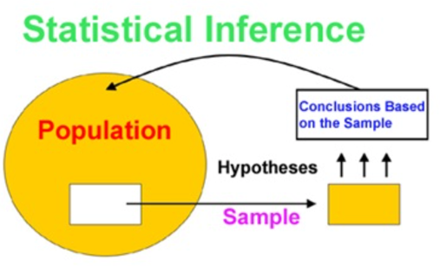
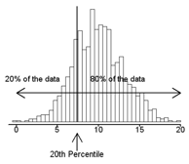
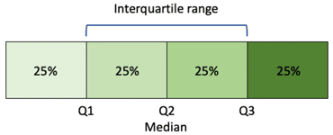
Statistics
sample data ➔ conclusions and predictions
Statistics – the mathematical science dealing with the collection, description, analysis, interpretation, and presentation of masses of numerical data.
Typically we are given a sample of data, and we are trying to make some conclusions or predictions based on this particular sample of data.
Statistics: Descriptive vs Inferential
Vocabulary of Statistics:
Measures of Frequency (how often something occurs): Count, Percent, Frequency
Measures of Central Tendency (where the data mostly is): Mean, Median, and Mode
Measures of Dispersion or Variation (how is data "spread out"): Range, Variance, Standard Deviation
Measures of Position (standard scores): Percentile Ranks, Quartile Ranks
Descriptive Statistics
mean = the average of a data set
median = the middle of the set of numbers
mode = the most common number in a data set
The 25th percentile = 1st quartile
The 50th percentile = median
The 75th percentile = 3rd quartile

Slide 3

Probability
If we throw 2 dice cubes, there are 6*6=36 possible combinations.
Probability of each combination is the same: 1/36
If we define an outcome as a sum of numbers on top side of
cubes after the throw, then there are 11 possible outcomes (sums):
---------------------------------------------------------
Sum Combinations Number of
combinations Probability
---------------------------------------------------------
2 1+1 1 1/36
3 1+2,2+1 2 2/36
4 1+3,2+2,3+1 3 3/36
5 1+4,2+3,3+2,4+1 4 4/36
6 1+5,2+4,3+3,4+2,5+1 5 5/36
7 1+6,2+5,3+4,4+3,5+2,6+1 6 6/36
8 2+6,3+5,4+4,5+3,6+2 5 5/36
9 3+6,4+5,5+4,6+3 4 4/36
10 4+6,5+5,6+4 3 3/36
11 5+6,6+5 2 2/36
12 6+6 1 1/36
---------------------------------------------------------
Total 36 1
From the table above you see how some outcomes can result
from more combinations, thus have higher probability of happening
Note:
Events can be mutually exclusive, or not
Also, events may be independent, or dependent on each other
Statistics uses Probability Theory
Probability of an event is the measure of the likelihood that
the event will occur (in some experiment)
Probability is a number between 0 and 1 (or 0 – 100%)
0 – event is impossible
0.5 – the event is just as likely to occur as it is to not occur
1 – event will certainly happen ( 100% )
The sum of probabilities of all outcomes of an experiment
should always be 1.
Outcomes can be combinations of individual events.
For example, if we throw one dice cube,
there are 6 possible outcomes (1,2,3,4,5,6),
each one has same probability: 1/6

Slide 4
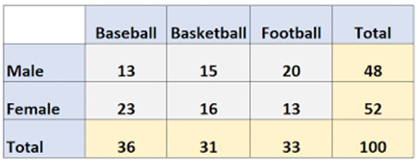
Probability Examples
Marginal Probability = Simple Probability , a probability
of an independent event occurring.
The term “marginal variable” is used to refer to a subset
of variables in a table. They called “marginal” because they
used to be calculated by summing values in a table along
rows or columns, and writing the sum in the margins of the table.
Here are few examples of assigning probability.
Example 3. Job Search
I get 2 emails with job descriptions every day, 10 per week.
Two of them may be a good fit: 2 of 10 (0.2).
So I send emails to "good fit" offers that I am interested.
I am invited to an interview for every third position I emailed to
( 0.2 / 3 = 0.067)
And I get 1 position out of 10 initial interviews (0.0067).
So the probability that an incoming email will result
in a job is 0.0067, or ~1%.
So, I need to consider 100 positions (this will take 10 weeks),
send 20 emails asking to invite, go to 6..7 interviews,
and eventually get a job.
So job search takes 2..3 months.
Example 1. Tossing a coin.
Possible outcomes : (tails or heads).
Events (tails of heads) are mutually exclusive.
Their probabilities should be equal.
P_{t} + P_{h} = 1
P_{t} = 0.5
P_{h} = 0.5
Example 2. Rolling a die.
Possible outcomes: (1,2,3,4,5,6).
They are mutually exclusive, probability equal, sum() = 1
So each probability = 1/6 = 0.167

Slide 5
Venn Diagrams
Venn Diagrams = Graphical representation of events as circles.
Search google images for: Venn Diagram A or B You will find many examples like the ones on the right.
A
not A
disjoint sets
B subset of A
intersection (A and B)
union (A or B)
There are many other combinations, for example, (A but not B)
If P(A) – probabiltiy of event A, then: P(A) + P(not A) = 1
If A and B are events, then:
P(A or B) = P(A) + P(B) – P(A and B)
For mutually exclusive events:
P(A and B) = 0
so P(A or B) = P(A) + P(B)
Notation for Conditional Probability:
P(A|B) – probability of A given that B has occurred.
P(A|B) = P(A and B) / P(B) (if P(B) is not zero)
If A & B are independent form each other, then:
P(A|B) = P(A)
P(B|A) = P(B)

Slide 6

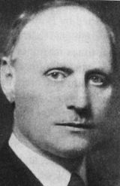
Union Bound Formula
P(A∪B) = P(A) + P(B) − P(A∩B) ≤ P(A) + P(B)
Bonferroni Inequality
A
A
P(A∩B) = P(A) + P(B) − P(A∪B) >= P(A) + P(B) – 1
A = smart, B = beautiful
If P(A) ~ 0.9, and P(B) ~ 0.9, then P(A & B) >= 0.8
If P(A) ~ 0.5, and P(B) ~ 0.5, then P(A & B) >= 0.0
A∩B
A∩B
B
B
Bonferroni Correction
Carlo Emilio Bonferroni
1892 – 1960
Florence, Italy
When conducting multiple tests, the chance of getting a significant error increases by pure chance.
To correct for this, we proportionally "decrease" the "alpha" value of each test.
Example:
Suppose we have five treatment groups: Ng = 5.
The Null Hypothesis (H0) is that group members are "equal" in all groups.
Alpha = 0.05 ("family alpha rate") – chance of rejecting H0
We decided to make 10 comparisons:
1 to 2, 2 to 3, 3 to 4, 4 to 5, 1 to 3, 2 to 4, 3 to 5, 4 to 1, (1 & 2) to (3 & 4), (1 & 2) to (4 & 5)
We will use new corrected alpha Alpha_new = Alpha/10 = 0.005 for each of those 10 tests.
If any of the 10 tests rejects the H0 (using this small Alpha_new value of 0.005),
then we reject H0 for the whole "family".

Slide 7
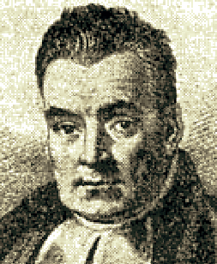

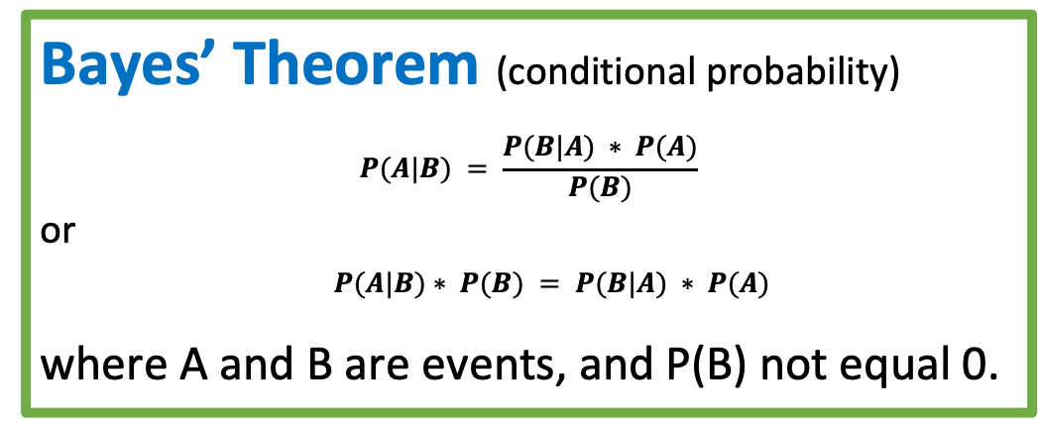
Bayesian inference - calculate probability
following chains of dependencies or correlations
Bayes’ Theorem (conditional probability)
$$P(A|B) = \frac{P(B|A) ∗ P(A)}{P(B)}$$
or
$P(A|B)∗ P(B) = P(B|A) ∗ P(A)$
where A and B are events, and P(B) not equal 0.
P(A|B)
P(A)
P(B|A)
Thomas Bayes (1701–1761)
P(B)
Bayes "solution" to a problem of inverse probability, was presented by Richard Price in 1763, two years after Bayes' death.
All People
A = Happy, B = Rich
P(A) = 40% = probability of being happy (Yellow)
P(B) = 5% = probability of being rich (Blue)
P(B|A) = 10% = probability of being rich given that Happy
P(A|B) = 80% = probability of being happy given that rich
Intersection:
P(A & B) = 4% = probability of rich & happy (Green)
P(A|B)*P(B) = 80%*5% = 4%
P(B|A)*P(A) = 10%*40% = 4%
+-----+--------+------+
| | Happy | |
+-----+--------+------+
|Rich | 4 | 1 |
+-----+--------+------+
| | 36 | 59 |
+-----+--------+------+
A
Happy
B
Rich

Slide 8
Bayesian vs Frequentist
Survivorship Bias in World War 2
During World War II the US military's concluded that the most-hit areas of the plane needed additional armor.
But statistician Abraham Wald (Statistical Research Group (SRG) at Columbia University) has recommended adding armor to the areas that showed the least damage. His reasoning was that the sample didn't include the planes which were shot down.
It is dangerous to use data "as is" to create a model, because the data may be biased to start with, and it can easily lead to creating a biased model Problem occur when we have: - under-represented features (missing data) - over-represented features, - "target leakage" effect. Survivorship bias: - https://www.youtube.com/watch?v=B3YQJ5DwTzM Gender Bias: - https://www.youtube.com/watch?v=p60-Jdq754A Bias in criminal justice: - https://www.youtube.com/watch?v=Gi4YeRqfb24 Target Leakage: - https://www.youtube.com/watch?v=y8qaI5mpJeA

Slide 9
Confidence vs Credibility
Bayesianism:
probabilistic statement about
model parameters
given a fixed credible region
Frequentism:
probabilistic statement about
a recipe for generating
confidence intervals
given a fixed model parameter
In general, a frequentist's
95% Confidence Interval
is not 95% likely to contain the true value!
A frequentist only states that:
if we repeat experiment multiple times
then 95% of such confidence intervals
will contain the true value.
Our Particular Interval
from Jake VanderPlas
https://www.youtube.com/watch?v=KhAUfqhLakw

Slide 10
Frequentist vs Bayesian
Frequentist interpretation of Bayes’ theorem.
Probability measures a proportion of outcomes.
P(A) - proportions of outcomes A
P(B) - proportions of outcomes B
P(B|A) is the proportion of outcomes B out of outcomes A
Bayesian interpretation of Bayes’ theorem.
Probability measures a degree of belief. P(A), the prior, is the initial degree of belief in A.
P(A|B), the posterior, is the degree of belief having accounted for B. P(B|A)/P(B) – represents the support that B provides for A.

Slide 11
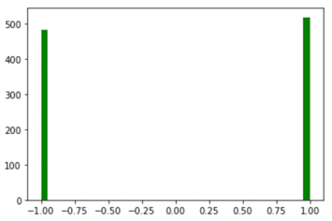
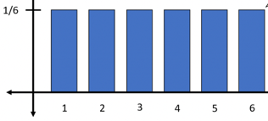
Random Variable. Probability Distribution
Random variable is a numerical variable taking different values.
Values may be discrete or continuous.
For example, think of variable “x” which may have any real value between -10 and +10.
Or think of a variable “z” which can have discrete values 0,0.1,0.2, … 0.9, 1.0
Tossing coin 1000 times - histogram
Discrete Case
Probability function P(x) of a discrete random variable “x”
is simply a function which gives probability of discrete values.
For example, if the random variable “x” may have two values: ( 0 or 1 ),
and if probabilities of those values are equal, then
P(0) = 0.5, f(1) = 0.5.
The sum of individual probabilities for all possible values should be 1.
Expected Value
( mean )
Tossing dice cube.
Discrete probability distribution
Expected value (mean) is an weighted average of all values.
E(x) = sum(Xi*P(Xi)), where Xi goes through all allowed values of X.
Variance = sigma squared = sum( (Xi-E(x))**2 * P(Xi) )
Standard Deviation = sqrt(sigma squared)

Slide 12
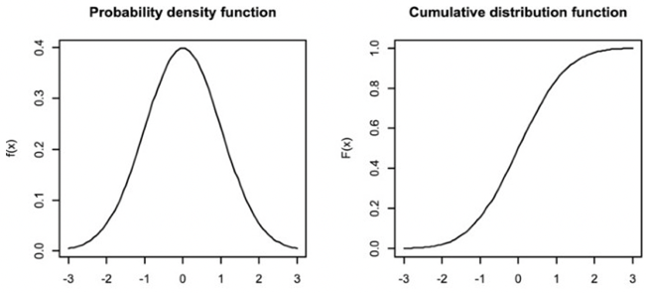
Probability Distribution
Probability Density Function (PDF)
vs. Cumulative Probability Function ( CPF)
Continuous Case
Probability Density Function (PDF)
f(x) is a continuous function.
f(x)*dx gives probability that value is between x and x+dx.
The total integral of f(x)*dx should be equal to 1.
Cumulative Probability Function (CPF)
This is simply a function F(x)
which gives probability that value is less than x.
It is monotonically increasing from 0 to 1
as x grows (from small to large values).
The PDF is a first derivative of CPF.
CPF(x+dx) – CPF(x) == [Prob < (x+dx)] – [Prob < x] = f(x)*dx
Mean value = Expected value
For discrete case we had:
E(x) = sum(Xi*P(Xi))
For continuous case this translates into
E(x) = Integral(xF(x)dx)

Slide 13
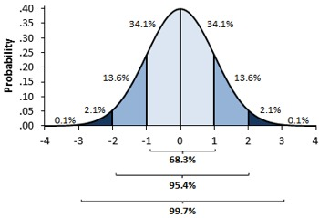
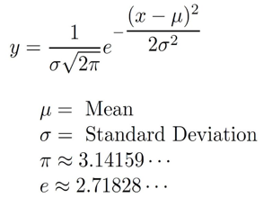
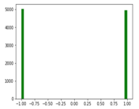

Central Limit Theorem (CLT)
We have all heard about Normal (Gaussian) distribution.
This distribution is very foundational in statistics. And it comes from CLT.
Classical CLT mathematically proves that if we calculate group averages (sample means) in many groups, then the distribution of those averages converges to Normal distribution as long as we have large number of points in each group (30..100 ...) and large number of groups (30-100 ...).
Specifically, suppose we have our data points sampled from a distribution with finite average and finite variance. We subdivide this data into Ng groups, each containing Ns samples:
[...] [...] [...] [...] [...] [...] [...] [...] [...]
For each group we calculate average value of its Ns samples. Thus we have Ng averages values, and we plot them as a histogram.
If Ng and Ns are big enough, the histogram will converge to a normal distribution. This holds true regardless of the shape of the original distribution of data.
For example, suppose we have a million data points, each value is either 1 or -1 (random coin toss). We split data into Ng=10,000 groups, each sample group has Ns=10,000 data points. Then in each group we calculate the mean value (which will be close to zero).
Now we have 10,000 mean values - and we make a histogram of those values. According to CLT it will be bell-shaped.
Expected value of abs(x) :
Expected value of x² : σ²
Here double factorial "n!!" denotes the product of all numbers from n down to 1 that have the same parity as n.
9!! = 9*7*5*3*1
6!! = 6*4*2

Slide 14
Books
https://www.quora.com/What-are-some-good-books-for-learning-probability-and-statistics
Fifty Challenging Problems in Probability with Solutions (Frederick Mosteller)
Bayesian Statistics the Fun Way (Will Kurt)
Applied Statistics and Statistical Computing
Statistics (Freedman, Pisani & Purves) - best introductory book
Probability and Statistics for Engineering and the Sciences – good intro
Modern Applied Statistics with S (Venables & Ripley) – more advanced
Software for Data Analysis: Programming with R (Chambers)
The Art of R Programming: A Tour of Statistical Software Design (Matloff)
Linear Regression Analysis (Seber & Lee)
Bayesian Data Analysis (Gelman, Carlin, Dunson, Vehtari & Rubin)
Data Analysis Using Regression and Multilevel/Hierarchical Models (Gelman & Hill)
The Elements of Statistical Learning: Data Mining, Inference, and Prediction (Hastie, Tibshirani & Friedman)
Mathematical Statistics with Applications (Wackerly, Mendenhall & Scheaffer)
Statistical Inference (Casella & Berger)
Mathematical Statistics: Basic Ideas and Selected Topics (Bickel & Doksum)
A First Course in Linear Model Theory (Ravishanker & Dey)
Generalized, Linear, and Mixed Models (McCulloch, Searle & Neuhaus)
An Introduction to Multivariate Statistical Analysis (T. W. Anderson)
A Course in Large Sample Theory (Ferguson)
Asymptotic Statistics (van der Vaart)
The Bayesian Choice: From Decision-Theoretic Foundations to Computational Implementation (Robert)
Probability (Pitman)
Probability: The Science of Uncertainty (Bean)
Introduction to Probability Models (Ross) and Stochastic Processes (Ross)
A First Course in Stochastic Processes (Karlin & Taylor) or A Second Course in Stochastic Processes (Karlin & Taylor).
Applied Probability (Lange)
A First Look at Rigorous Probability Theory (Rosenthal)
Probability (Shiryaev) is a more rigorous book that's still clear with a lot of examples.
Probability: Theory and Examples (Durrett)
Stochastic Calculus and Financial Applications (Steele)
Brownian Motion and Stochastic Calculus (Karatzas & Shreve)
Counterexamples in Probability (Stoyanov)

