Slide 1

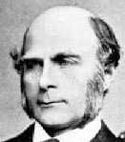


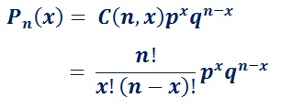
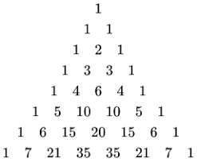
Binomial Distribution
– https://en.wikipedia.org/wiki/Binomial_distribution
Galton Board
The binomial distribution was discovered
by Jacob Bernoulli (1655 – 1705)
and published in 1713 (8 years after his death).
Jacob Bernoulli
(1655 – 1705)
Sir Francis Galton
(1822-1911)
We do n independent trials with two possible outcomes
("yes" & "no") with probabilities p & q=(1-p).
Then the probability that x out of n trials have value "yes" is:
where:
C(n,x) is binomial coefficient (see also Pascal Triangle)
n! = n-factorial = n*(n-1)*(n-2) ... *1
Mean value = Expected value E(x) = np
Variance = npq
de Moivre–Laplace theorem
At large numbers the Binomial distribution may approach
Normal Gaussian curve with following parameters:
https://www.youtube.com/shorts/Vo9Esp1yaC8

Slide 2
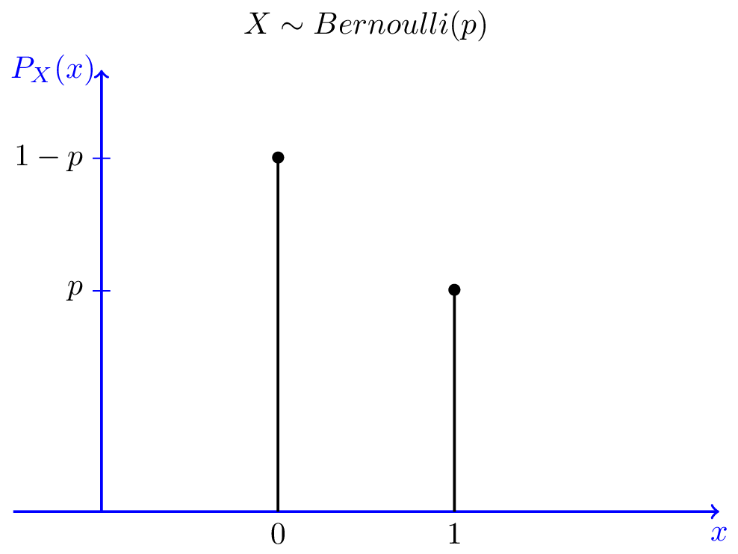
Bernoulli Distribution
- https://en.wikipedia.org/wiki/Bernoulli_distribution
The Bernoulli distribution is a special case of the binomial distribution where a single trial is conducted.
It is a discrete probability distribution of a random variable which takes the values 1/0 (or true/false or yes/no)
with probabilities p and (1-p)
Pr(X=1) = p
Pr(X=0) = 1-p = q
Mean E[X] = 0*q + 1*p = p
Variance var[X] = E[X²]-E[X]² = ... = pq
Good introduction:
https://en.wikipedia.org/wiki/Bernoulli_distribution
https://www.probabilitycourse.com/chapter3/3_1_5_special_discrete_distr.php
Jacob Bernoulli
(1655 – 1705)

Slide 3
Binomial Distribution => Gauss
Binomial Distribution => Poisson
The Poisson distribution is a limiting case of the binomial distribution which arises when the number of trials n increases indefinitely whilst the product μ = np, which is the expected value of the number of successes from the trials, remains constant.
using Stirling’s formula:
μ = np = const, n --> inf
Poisson Distribution => Gauss
The Poisson Distribution can be approximated with Normal when λ is large (greater than 10).
1 e^{-μ} 1 Poisson
Coin tossing
x = n = λ(1 + δ) , where λ >> 1 and δ << 1
Using Stirling’s formula for n!
We are tossing a fair coin: tail = 0, head = 1
p = (1-p) = 0.5
Expected μ = p*N = N/2
For large N we approximate with Gauss
Variance σ² = Npq = N/4
Standard error σ = √ N / 2
Relative error σ / μ = (√ N / 2) / (N/2) = 1/ √ N
So If we want error ~1%, we need to do N ~ 10,000
Also for χ² calculations:
(x - μ)² / μ --> σ² / μ = (N/4) / (N/2) = ½ = const

Slide 4
Checking whether a coin is fair
https://en.wikipedia.org/wiki/Checking_whether_a_coin_is_fair
Problem 2
How many times should we flip a coin to test the null hypothesis.
Suppose we flipped "n" times and got "x" heads.
The estimate of the probability of heads P_{h} = x/n.
Suppose "x" follows binomial distribution with probability "p" of heads.
At large "n" is is approximated with normal distribution.
Null Hypothesis (H0) : the coin is fair (flips heads/tails evenly).
Alternative (H1): the coin flips heads/tails unevenly with
error E = |P_{h}-0.5|, where P_{h} is the probability of heads.
Problem 1
We tossed a coin 10 times and got 8 heads. Compute p-value.
We just need compute the probability of 8 or more heads
in 10 tosses (assuming the coin is fair).
Note that the number of heads follows a binomial
distribution with n=10 and p=0.5.
So the p-value = P[8] + P[9] + P[10] = .044 + .01 + .001 = 0.055.
We use character "σ" to denote the standard error of estimating x: σ² = npq
Note that it has max value when p = q = 0.5, so σ²= n/4
So we can estimate the error σ as:
σ ~ √n/2
This is very easy to remember – error grows as square root of n.
If we estimate error for ratio "x/n", we divide by n:
Coin flipping leads to binomial distribution,
which can be approximated with normal Gaussian distribution.
Here are confidence levels for Z (standard normal distribution):
As "n" grows, the distribution becomes narrower. We express error E for ratio "x/n" in terms of Z (number of sigmas):
E = Zσ = Z/2√n or:
Z value | Confidence level | Comment
0.6745 | 50.000% | Half
1.0000 | 68.269% | One std dev
1.6449 | 90.000% | "One nine"
1.9599 | 95.000% | 95 percent
2.0000 | 95.450% | Two std dev
2.5759 | 99.000% | "Two nines"
3.0000 | 99.730% | Three std dev
3.2905 | 99.900% | "Three nines
3.8906 | 99.990% | "Four nines"
4.0000 | 99.993% | Four std dev
4.4172 | 99.999% | "Five nines"
For example, if we want confidence 95% (Z=1.9599),
then Z²/4 = (1.9599)² / 4 = 1 ,
so n = 1/E²
for E=0.5 we need n = 1 / 0.5² = 4 flips
for E=0.25 we need n = 1 / 0.25² = 16 flips
for E=0.01 we need n = 1 / 0.01² = 9,603 flips

Slide 5
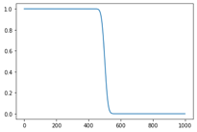
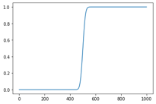
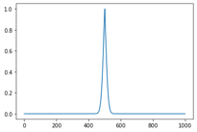
Binomial Test in Python
# We flip a coin N=1000 times.
# If x is number of heads, it has binomial distribution with sigma = sqrt(N)/2 = 15.81
# If it lands on heads 531 times, it is within 2*sigma.
# But let's perform a binomial test for null hypothesis that coin is fair:
binom_test(x=531, n=1000, p=1/2, alternative='greater') # P = 0.0268
# Because this p-value (0.0268) is less than 0.05, we reject the null hypothesis.
# binomial distribution
pmf = probability mass function - gives the probability that a discrete random variable is exactly equal to some value
from scipy.stats import binom_test # returns p-value of test
xvals = [0,470,500,530,999]
for x in xvals:
myval = binom_test(x=x, n=1000, p=1/2, alternative='greater')
print(f"{myval:.3f}")
# [1, 0.973, 0.5, 0.031, 0]
Binomial PMF :
from scipy.stats import binom
binom.pmf(0,2,0.5) # 0.25
binom.pmf(1,2,0.5) # 0.5
binom.pmf(2,2,0.5) # 0.25
n=10
arr = []
for ii in range(n+1):
arr.append(binom.pmf(ii, n, 0.5))
print(sum(arr)) # 1
print(arr)
# 8, 9, 10 heads out of 10 trials:
binom.pmf(8,10,0.5) # 0.043945
binom.pmf(9,10,0.5) # 0.009766
binom.pmf(10,10,0.5) # 0.000977
# sum: 0.054688
for x in xvals:
myval = binom_test(x=x, n=1000, p=1/2, alternative='less')
print(f"{myval:.3f}")
# [0, 0.031, 0.5, 0.973, 1]
for x in xvals:
myval = binom_test(x=x, n=1000, p=1/2, alternative='two-sided')
print(f"{myval:.3f}")
# [0, 0.062, 1, 0.062, 0]
# We flip a coin 10 times and it lands on heads 8 times.
# Perform a binomial test to determine if the coin is biased.
binom_test(x=8, n=10, p=1/2, alternative='greater') # P = 0.0546875
# Because this p-value (0.0546875) is not less than 0.05,
# we accept the null hypothesis.

Slide 6
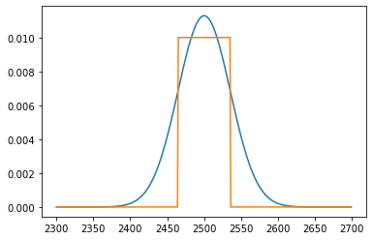
Binomial Distribution – Plot, Sigma
import os, sys, math
from scipy.stats import binom_test
import matplotlib.pyplot as plt
xx = []
yy = []
yy2 = []
sigma = math.sqrt(5000)/2.0
v1 = 2500-sigma
v2 = 2500+sigma
print(v1,v2) # 2464.64, 2535.36
for ii in range (2300, 2700):
xx.append(ii)
yy.append(binom.pmf(ii,5000,0.5))
val = 0.0
if v1 <= ii <= v2:
val = 0.01
yy2.append(val)
_ = plt.plot(xx,yy)
_ = plt.plot(xx,yy2) # show sigma range

Slide 7
Checking whether a coin is fair - χ² test Problem:
We want to test a null hypothesis that the coin is fair.
We flip the coin N times and got H heads.
So number of observed tails T = N-H.
Expected values are N/2 for heads and for tails.
Using χ² goodness of fit test
X² = sum( (observed – expected)²/expected) = [ (H– N/2)² / (N/2) ] + [ (T – N/2)² / (N/2) ]
The P-value is the probability that a chi-square statistic having one degree of freedom is more extreme than that value.
Specific example:
N=100, H=60, T=40
X² = [ (60– 50)² / 50 ] + [ (40 – 50)² / 50 ] = 10² / 50 + 10² / 50 = 2+2 = 4
X² distribution for 1 degree of freedom gives 3.84 for P-value P=0.05.
We have 4, which is more extreme.
So we reject the null hypothesis (that the coin is fair).
χ²

Slide 8
Checking whether a coin is fair - t-test
I am not sure if the t-test can be used for coin flipping hypothesis testing.
t-test is used for data which is presumed to have normal distribution, and only for small samples of data ( < 30 points).
But here is formal application of t-test:
Problem:
We want to test a null hypothesis that the coin is fair.
We flip the coin N times and got H heads.
So number of observed tails T = N-H.
Expected numbers are N/2 for heads and for tails.
To calculate t-test we assume values 1 for heads and -1 for tails.
Then suppose N=100, H=60, T=40
Sample Mean X = (H – T)/100 = 20/100 = 0.2
Expected mean = N/2 – N/2 = 0
Degrees of Freedom = N-1 = 99
Sample Variance:
S² = (1/99) * ( 60*(1-0.2)² + 40*(-1-0.2)² ) = 0.969
Sample Standard Deviation:
S = sqrt(0.9696) = 0.9847
t-statistics:
(0.2– 0) / (0.9847 / 10) = 2.031
Note: for two-sided t-test with 100 degrees of freedom and P-value 0.05
we have (from t-test table): 1.984
Our t-statistics is 2.031, it is more extreme, so we reject the null hypothesis
In Python:
from scipy import stats
stats.t.cdf(2.031,df=99) # 0.9775 , more extreme than 0.95
Student t-test
Let X_{i} be independently and identically drawn from the normal distribution with expected mean value μ and variance σ²
----- Sample
mean
----- Sample
variance
Random variable,
Normal distribution
Random variable, t-distribution.
It uses S = sqrt(sample variance) because real sigma is unknown. This creates uncertainty – and leads to the "fat tails" in the t-distribution.

