Slide 1
Previous lectures were about Probability.
Today we start talking about Statistics
Statistics

Slide 2
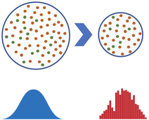
Introduction into Statistics
Here are some basic formulas:
“Statistics - the study of the collection, analysis,
interpretation, presentation, and organization of data.”
Statistical Inference - using data from a noisy sample to make estimates or test hypotheses about the whole population.
Being a Statistician is the major part of being a Data Scientist.
Attention – it is easy to mis-use statistics:
“There are three kinds of lies: lies, damned lies, and statistics.”
Statistics involves
Collecting (sampling) the data from different kind of observations
Visualizing the data, estimating the parameters (average/mean values, errors, etc.)
HypothesisTesting - null hypothesis or alternative hypothesis
Estimating confidence intervals, estimating significance of observed differences, etc.
A B
Why "n-1" instead of "n" ?
- http://stats.stackexchange.com/questions/3931/intuitive-explanation-for-dividing-by-n-1-when-calculating-standard-deviation
Standard
Deviation
(blue)
Standard Error of the Mean
(orange)

Slide 3
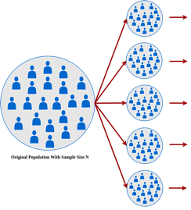
Sampling, Resampling, Bootstrapping
Sample – a set of objects/observations which were collected by a defined procedure.
The elements of a sample are known as sample points (units or observations).
- https://en.wikipedia.org/wiki/Sample_(statistics)
- https://www.youtube.com/watch?v=vTZSnTN67Fk – very good lecture by Brian Caffo
CALCULATE
In statistics we often try
to learn about population
by analyzing noisy samples
Resampling - collecting multiple samples to do statistical estimations:
https://en.wikipedia.org/wiki/Resampling_(statistics)
Bootstrap principle – use distribution from computer resampling to evaluate the population distribution.
The values of calculated parameters usually differ between samples. We can build distributions and estimate the variability of the estimates.
Under certain conditions when the numbers are big, the Central Limit Theorem (CLT) can kick in leading to Normal Gaussian distributions. But this doesn't have to be the case.
Why bootstrapping is useful?
We don't need resampling to simply calculate the mean or standard error. We use resampling to calculate non-trivial parameters (especially their distributions, errors, confidence intervals, regression coefficients, etc.).
The main benefit of resampling is SIMPLICITY of computer hacking as opposed to complex math.

Slide 4





Resampling, Bootstrapping . . .
Two most common methods of Resampling:
jackknife – simple tool - selecting subsets by removing one or more points from the original data set. Invented by John Tukey – - https://en.wikipedia.org/wiki/John_Tukey (inventor of FFT, "bit", ...)
bootstrap - sampling with replacement (data points may be included more than once into any sample). Invented by Bradley Efron (1979) "Bootstrap Methods: Another Look at the Jackknife" - - https://en.wikipedia.org/wiki/Bradley_Efron - - https://en.wikipedia.org/wiki/Bootstrapping_(statistics)
jackknife
Tukey
Efron
Bootstrapping popularity grew around 1980 when computers became widely available. Computers allowed to run thousands of virtual experiments to get statistical results. This is basically the Monte-Carlo approach.
Before 1980 | after 1980
-------------+---------------------
manual math | computer hacking
| run virtual random experiments
Bootstrapping is very similar to Baron Munchausen's lifting himself out of the mud by pulling by his own hair
Bootstrap
"pulling yourself up
by your own bootstraps"
Special resampling methods:
Shuffling - exchanging labels on data points when performing significance tests (a.k.a. permutation tests, exact tests, randomization tests, or re-randomization tests)
Cross-Validation of models by comparing models built using random subsets of data.

Slide 5
SME vs SEM
Note: standard deviation and standard error and are NOT the same.
SME = Standard Mean Error = Standard Deviation
SEM = Standard Error of Mean = SME / sqrt(n)
# Several ways to calculate standard deviation
import numpy as np
from scipy import stats
import math
arr = np.array([1, 2, 3])
N = len(arr) # 3
mean = np.mean(arr) # 2.0
print(f"length = {N}, mean={mean:.4f}") # 3, 2
mysum = 0
for elem in arr:
mysum += (elem - mean)**2 # 1 + 0 + 1 = 2
denom = N - 1 # 2
se1 = math.sqrt(mysum/denom) # sqrt(2/2) = 1.0000
se2 = np.std (arr, ddof=1)
# stats has different functions for std_err and std_dev
se3 = stats.sem(arr, ddof=1) * math.sqrt(N)
se4 = stats.tstd(arr, ddof=1) # trimmed std
print(f"se1 = {se1:.5f}") # 1.00000
print(f"se2 = {se2:.5f}") # 1.00000
print(f"se3 = {se3:.5f}") # 1.00000
print(f"se4 = {se4:.5f}") # 1.00000
Standard error is the error of the estimate of the mean.
So as the sample size grows, we can estimate the mean better and better. The error gets smaller proportionally to the square root of sample size n.

Slide 6
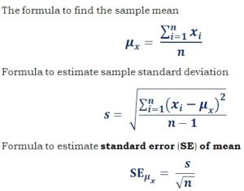
Error of the mean
Suppose we have two samples A and B,
each with "n" points (n > 100) and "normal" distribution with the same sample standard deviation "s".
The mean values are m_{A} and m_{B}
The standard error of the mean
sem = s/sqrt(n)
Question – how big should be number "n" of points
so that we can say that the means differ?
We can demand that "sem" should become so small that
δ = |m_{A} - m_{B}| >= 4*sem = 4s/sqrt(n)
Or
n >= 16s²/δ²
A B
Standard
Deviation
(blue)
Standard Error of the Mean
(orange)

