Slide 1
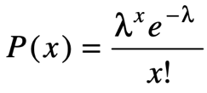
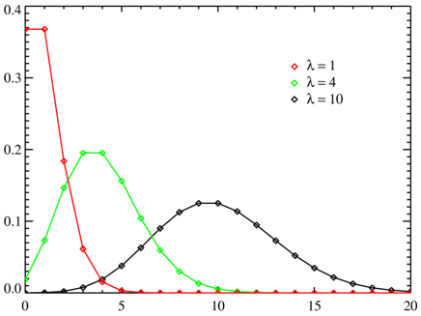
Poisson Regression
Count Data Models
Counts are non-negative integers. They represent the number of occurrences of an event within a fixed period.
The Poisson distribution is often used for these type of data.
Poisson regression assumes that the data has a Poisson distribution, and that logarithm of its expected value can be modeled by a linear combination of unknown parameters.
A Poisson regression model is sometimes known as a log-linear model, especially when used to model contingency tables.
Negative binomial regression
NBR is a popular generalization of Poisson regression because it loosens the highly restrictive assumption that the variance is equal to the mean made by the Poisson model.
NBR model is based on the Poisson-gamma mixture distribution. This model is popular because it models the Poisson heterogeneity with a gamma distribution.
Poisson regression models:
are generalized linear models
with the logarithm as the (canonical) link function,
and the Poisson distribution function as the assumed probability distribution of the response
Poisson Distribution

Slide 2
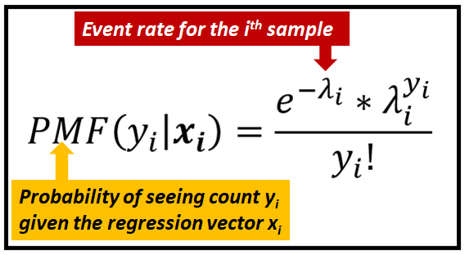

Poisson Regression Model
Good explanations:
Rauli Susmel - https://www.bauer.uh.edu/rsusmel/phd/ec1-22.pdf
Ximena Sandoval - https://medium.com/lcc-unison/how-to-poisson-regression-model-python-implementation-1c672582eb96
Sachin Date - https://timeseriesreasoning.com/contents/poisson-regression-model/
Python Scikit-Learn implementation - https://scikit-learn.org/stable/modules/generated/sklearn.linear_model.PoissonRegressor.html.
Goal:
To model the count data as a function of covariates, X.
The benchmark model is the Poisson model.
Q:
Why do we need special models? What is wrong with OLS?
Like in probit and logit models, the dependent variable has
restricted support. But OLS regression can/will predict values that are
negative and/or non-integer, which is nonsense results.
Given the Poisson distribution, we model the mean λ as a function of covariates. This creates the Poisson regression model:
Poisson Regression is a GLM (Generalized Linear Model)
When Mean >= 30 you can use normal distribution
Maximum Log-Likelihood method is used
Ready-to-use implementations available in R and Python

