Slide 1

Logistic Regression
(binary classification model)
log odds – fitted with a linear model
P =
The "beta" coefficients are fitted using gradient descent.
Common error function consists of two separate functions (for target values 0 and 1):
Standard Error (SE) for probability p and coefficient b₁
SE(p) = SE(b₁) * (p*(1-p))

Slide 2
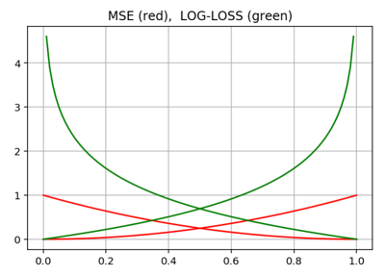

Logistic Regression – finding coefficients
Log-Loss error function is better than MSE:
There is no analytical solution.
The regression coefficients are usually estimated
using Maximum Likelihood Estimation (MLE).
Unlike linear regression with normally distributed residuals,
it is not possible to find a closed-form expression for the coefficient values
that maximize the likelihood function,
so that an iterative process must be used instead; for example Newton's method.
The model may not converge in some cases:
not enough data (small number of rows for given number of predictor variables)
multicollinearity (some variables are strongly correlated with each other)
sparseness (missing data)
complete separation (predictors perfectly predict the criterion)
In machine learning applications where logistic regression
is used for binary classification,
the MLE minimizes the Cross Entropy Loss function.
If “q” is model prediction, and “p” is probability of actual label, then similarity between q & p can be expressed as cross-entropy H(p,q):

Slide 3
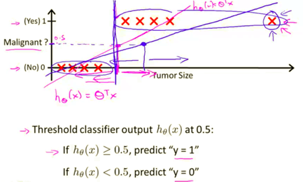
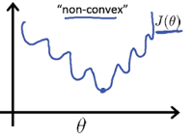
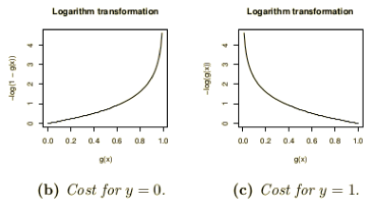
Why Mean Squared Error (MSE) is not good for classification?
From Andrew Ng’s Machine Learning course (see on YouTube or Coursera)
First, MSE can force conversion to a wrong answer. On the picture to the right you can see how adding data points with big tumor sizes will shift the transition point toward larger sizes, thus changing diagnosis for some cases.
Second reason against MSE is that MSE loss function tend to be
non-convex - have multiple local minima, thus making it difficult to converge.
Finally, Cross-Entropy Error function gives bigger gradients and better conversion.

Slide 4
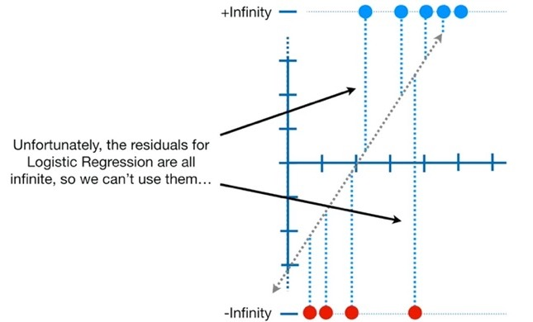
Logistic Regression and MLE (Maximum Likelihood Estimation)
In Logistic Regression we fit log-odds with linear function. How is this done?
For our data points "x" we have values v0=0, v1=1.
ln(v0/(1-v0)) = ln(0/1) = ln(0) = -inf
ln(v1/(1-v1)) = ln(1/(1-1)) = ln(1/0) = ln(+inf) = +inf
So we can not use MSE (Mean-Squared Error), because we can not operate on infinite values.
So – what do we do?
We use MLE approach.
For each data point "x" instead of using values 0 or 1, we use probabilities "p" using sigmoid function 1/1+exp(-b0-b1x).
More precisely, we use:
p for x where value should be 1
(1-p) for x where value should be 0
Then we multiply all these probabilities to get "Likelihood".
Then we solve the problem of maximizing this Likelihood.
It is convenient to use log(Likelihood) – called log-likelihood.
Then instead of multiplication, we calculate sum of individual probabilities.
R²
There are many pseudo-R² for Logistic Regression: https://www.researchgate.net/publication/268055438_The_Assessment_of_Fit_in_the_Class_of_Logistic_Regression_Models_A_Pathway_out_of_the_Jungle_of_Pseudo-Rs_with_an_Extension_to_Multinomial_Logit_Models
The most commonly used is McFadden's Pseudo-R². The value is in [0,1], tends to be biased downwards, so values 0.2-0.4 are considered good.

Slide 5
Logistic Regression – Assumptions
Logistic regression does NOT make many of the key assumptions of linear regression and general linear models
that are based on ordinary least squares algorithms.
First, logistic regression does not require a linear relationship between the dependent and independent variables.
Second, the error terms (residuals) do not need to be normally distributed.
Third, homoscedasticity is not required.
Finally, the dependent variable in logistic regression is not measured on an interval or ratio scale.
However, some other assumptions still apply.
Binary or ordinal dependent variable(s).
Observations should be independent (should not come from repeated measurements or matched data).
Little or no correlation between independent variables (no multicollinearity, same requirement as for linear regression).
Fourth, logistic regression assumes that log odds can be fit with a linear model
Finally, logistic regression typically requires a large sample size. A general guideline is that you need at minimum of 10 cases with the least frequent outcome for each independent variable in your model. For example, if you have 5 independent variables and the expected probability of your least frequent outcome is 0.1, then you would need a minimum sample size of 500 (10*5 / .10).

Slide 6

Logistic Function - History
The logistic function was introduced in a series of three papers by Pierre François Verhulst between 1838 and 1847, who devised it as a model of population growth by adjusting the exponential growth model, under the guidance of Adolphe Quetelet
Pierre François Verhulst
1804-1849, Brussels, Belgian mathematician
Lambert Adolphe Jacques Quetelet
1796-1874
Belgian astronomer, mathematician, statistician and sociologist
Graph from original work by Verhulst introducing "Logistique" function

Slide 7
Logistic Regression - Z-value
Example: Logistic Regression output
Columns:
estimates of coefficients,
std. error,
z-value,
p-value,
odds ratio - relative change of the odds when
predictor increased by 1.0 units.
z-value is the regression coefficient divided by its standard error.
It is also sometimes called the z-statistic.
It is usually given in the third column of the logistic regression coefficient table output.
- http://logisticregressionanalysis.com/1577-what-are-z-values-in-logistic-regression/
A good rule of thumb is to use a cut-off value of 2,
which approximately corresponds to a two-sided hypothesis test
with a significance level of alpha=0.05.
Coefficients:
 | Estimate | Std. Error | z value | Pr(>|z|) | Odds Ratio
(Intercept) | -17.91 | 2.223 | -8.06 | 0
Income | 0.000202 | 0.000024 | 8.55 | 0 | 1.0002
IsFemale | 1.646 | 0.4651 | 3.54 | 0.0004 | 5.1862
IsMarried | 0.5662 | 0.5864 | 0.97 | 0.3343 | 1.7616
HasCollege | -0.2794 | 0.4437 | -0.63 | 0.529 | 0.7562
IsProfessional | 0.2253 | 0.465 | 0.49 | 0.628 | 1.2527
IsRetired | -1.159 | 0.9323 | -1.24 | 0.214 | 0.3138
Unemployed | 0.9886 | 4.69 | 0.21 | 0.833 | 2.6875
ResidenceLength | 0.02468 | 0.0138 | 1.79 | 0.0738 | 1.025
DualIncome | 0.4518 | 0.5215 | 0.87 | 0.3863 | 1.5711
Minors | 1.133 | 0.4635 | 2.44 | 0.0145 | 3.105
Own | 1.056 | 0.5594 | 1.89 | 0.059 | 2.8748
House | -0.9265 | 0.6218 | -1.49 | 0.1362 | 0.3959
White | 1.864 | 0.5454 | 3.42 | 0.0006 | 6.4495
English | 1.53 | 0.8407 | 1.82 | 0.0687 | 4.6182
PrevChildMag | 1.557 | 0.7119 | 2.19 | 0.0287 | 4.7446
PrevParentMag | 0.4777 | 0.624 | 0.77 | 0.4439 | 1.6124
Here is a very good page to test logistic regression: https://statpages.info/logistic.html
This page contains a JavaScript implementation of a standard iterative method to maximize the Log Likelihood Function (LLF), defined as the sum of the logarithms of the predicted probabilities of occurrence for those cases where the event occurred and the logarithms of the predicted probabilities of non-occurrence for those cases where the event did not occur.
Maximization is by Newton's method, with a very simple elimination algorithm to invert and solve the simultaneous equations. Central-limit estimates of parameter standard errors are obtained from the diagonal terms of the inverse matrix. Odds Ratios and their confidence limits are obtained by exponentiating the parameters and their lower and upper confidence limits, approximated by +/- 1.96 standard errors (for 95% limits).

Slide 8
Logistic Regression - errors
Deviance - the discrepancy between the current model and the full model. The full model is the model that has n parameters, one parameter per observation.
Likelihood Ratio LR = -2ln( L(m1) / L(m2) ), where m1,m2 – two models, L – Likelihood.
Wald Test - approximates the LR test, but tests only one model against the null hypothesis that a set of parameters is equal to some value.
Lagrange Multiplier test (Score) - estimating only a single model, like Wald test. The test statistics is the expected change in the chi-squared statistic for the model if a variable or set of variables is added to the model. The Lagrange multiplier test is sometimes also referred to as a test for omitted variables. They are also sometimes referred to as modification indices.
The likelihood is the probability of the data given the parameter estimates (model).
The goal is to find values for the parameters (coefficients) of the model that maximize value of the likelihood function, that is, to find the set of parameter estimates that make the data most likely.
It is easier to work with the log of the likelihood, rather than the likelihood itself, because it is easier to work with.
The log likelihood (i.e., the log of the likelihood) will always be negative, with higher values (closer to zero) indicating a better fitting model.
Wald test
- https://en.wikipedia.org/wiki/Wald_test

Slide 9
Logistic Regression – Standard Errors
The covariance matrix is given by the inverse of the information matrix.
The elements of Information Matrix are the negatives of the expected values of the 2nd order partial derivatives of the logarithm of the likelihood function evaluated at β⃗ = b ⃗ .
Fitting the model is done using MLE (Maximum Likelihood Estimation) method.
Fitting meaning: find the vector of parameters β⃗ that maximizes the conditional probability of observing the training data.
The MLE solution can be found by gradient descent.
The standard errors of model coefficients are the square roots of the diagonal entries of the covariance matrix of β⃗ .
- https://www.efavdb.com/logistic-regression
Covariance matrix (also known as auto-covariance matrix, dispersion matrix, variance matrix, or variance–covariance matrix) is a square matrix giving the covariance between each pair of elements of a given random vector.
Diagonal elements of this matrix are variances, i.e., the covariance of each element with itself.
Generally it is not possible to write down an explicit expression for the elements in this matrix (except for very special cases).
MLE theory states that the estimated large-sample variance-covariance matrix for MLE is given by the inverse of the information matrix.
The elements of Information Matrix are the negatives of the expected values of the 2nd order partial derivatives of the logarithm of the likelihood function evaluated at β⃗ = b ⃗ .
See, for example, this book: Linear Statistical Inference and its Applications - by C. Radhakrishna Rao , 1973

Slide 10
Logistic Regression – Covariance Matrix calculation (Python)
https://stats.stackexchange.com/questions/89484/how-to-compute-the-standard-errors-of-a-logistic-regressions-coefficients
import numpy as np
from sklearn import linear_model
logit = linear_model.LogisticRegression()
resLogit = logit.fit(X_train, y_train)
predProbs = resLogit.predict_proba(X_train)
# Design matrix -- add column of 1's at the beginning of your X_train matrix
X_design = np.hstack([np.ones((X_train.shape[0], 1)), X_train])
# Initiate matrix of 0's, fill diagonal with each predicted observation's variance
V = np.diagflat(np.product(predProbs, axis=1))
# Covariance matrix (uses @-operater for matrix multiplication in Python 3.5+)
covLogit = np.linalg.inv(X_design.T @ V @ X_design)
print("Covariance matrix: ", covLogit)
# Standard errors
print("Standard errors: ", np.sqrt(np.diag(covLogit)))
# Wald statistic (coefficient / s.e.) ^ 2
logitParams = np.insert(resLogit.coef_, 0, resLogit.intercept_)
print("Wald statistics: ", (logitParams / np.sqrt(np.diag(covLogit))) ** 2)
(X^{T}VX)⁻¹

