Slide 1
Hypothesis Testing

Slide 2
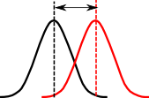
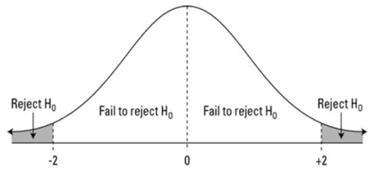
p-value & null hypothesis
A p-value (probability value) is a probability
of getting results at least as extreme as observed.
We are given:
1. A null-hypothesis (value)
2. A distribution: explicit or theoretical (reference), or sample distribution (observed). Most common distributions - Gaussian, t-Student, Chi-squared, F-, etc.
3. Observed value
From that we calculate the probability of getting a result "at least as extreme as observed" ?
If this probability is very small, this means
that the result is unlikely to be explained by the null hypothesis.
So we reject the null hypothesis.
P-value probability of observed
-------------------------------
P < 0.05 5%
P < 0.01 1%
p < 0.001 0.1%
-------------------------------
A small p-value (typically ≤ 0.05) indicates strong
evidence against the null hypothesis,
so you reject the null hypothesis.
People say that this evidence is "statistically significant".
reference distribution
observed distribution
reference value
(Null Hypothesis)
observed value
P-Value:
Given
null-hypothesis (value)
distribution
observed value
Calculate the probability of getting the result "at least as extreme as observed".

Slide 3
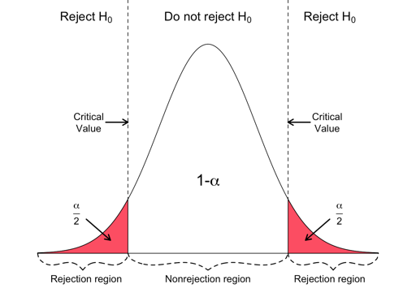
p-value & null hypothesis - continued
Level of significance (alpha or α, typically 0.05) –
probability that the event could have occurred by chance.
Confidence Interval (CI). A 95% CI is the interval that
you are 95% certain contains the true population value
as it might be estimated from a much larger study.
- https://en.wikipedia.org/wiki/Confidence_interval
Critical Value - point on the distribution at which
we shift from "Fail to reject" to "Reject".
z-score is the distance from the mean
measured in the number of standard deviations.
Margin of Error – amount of random sampling error in the results
- https://en.wikipedia.org/wiki/Margin_of_error
- https://www.surveymonkey.com/mp/margin-of-error-calculator/
- https://www.dummies.com/education/math/statistics/how-sample-size-affects-the-margin-of-error/
Critical Region
Confidence Interval
Critical Region
sample size and margin of error have an inverse relationship
after a point, further increasing the sample size gives you a diminished return

Slide 4
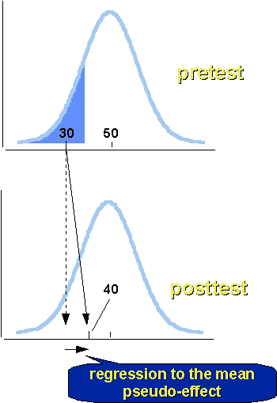
Regression to the Mean
You should be aware of this effect when designing experiments.
Suppose you give a test with 100 Yes/No questions
to 100 monkeys who can't read and answer questions randomly.
The results of the tests will be random, with the most common score of 50 (out of 100), and the histogram will be bell shaped (CLT).
Suppose we then select he 10 monkeys with the lowest scores
and re-test them again. We should see again the average at ~50.
So it looks like the monkey have improve their scores?
But we know that they didn't learn anything and didn't act differently.

Slide 5
Hypothesis Testing
https://en.wikipedia.org/wiki/Statistical_hypothesis_testing
Purpose of hypothesis testing is to determine whether there is enough statistical evidence in favor of a certain belief/hypothesis about a parameter value or a distribution.
Step1: Formulate hypotheses – usually at least two - the main one (usually called "Null Hypothesis") and an alternative.
Step2: Decide which level of significance we need. It is usually denoted as alpha or α, and means the probability of rejecting the null hypothesis. Most common choice for the value of alpha is 0.05 (5%).
Step3: Select the test type and compute the test statistic. There are many different types of tests in statistics like t-test, z-test,chi-square test, anova test, binomial test, one sample median test, etc.
Step 4: Make a decision.
Two types of Errors:
Type I error - false rejection of the null hypothesis ("false-positive" conclusion, innocent person convicted)
Type II error - false acceptance of the null hypothesis ("false negative" conclusion, guilty person not convicted)
 | Accept H₀ | Reject H₀
H₀ is True | Correct | type I error
H₀ is False | type II error | Correct

Slide 6
Type I and Type II Errors
 | Accept H₀ | Reject H₀
H₀ is True | Correct | type I error (rejected True)
H₀ is False | type II error (accepted False) | Correct
Two types of Errors:
Type I error - false rejection of the null hypothesis "false-positive" conclusion: .. innocent person convicted .. positive COVID test for a healthy person
Type II error - false acceptance of the null hypothesis "false negative" conclusion: .. guilty person not convicted .. sick person is released as healthy
The type of error depends on the null hypothesis
Example: COVID test.
Null Hypothesis 1: person has COVID.
Error Type 1 is when the test says "Healthy" on a sick person
Error Type 2 is when the test says "Sick" on a healthy person
Null Hypothesis 2: person is Healthy.
Error Type 1 is when the test says "Sick" on a healthy person
Error Type 2 is when the test says "Healthy" on a sick person
Choosing null hypothesis:
guilty / innocent: the person is presumed innocent until proven guilty.
Null Hypothesis = "Innocent"
sick / healthy: the person is presumed healthy.
Null Hypothesis = "Healthy"
airplaine / noise: the signals are mostly noise.
Null Hypothesis = "Noise"

Slide 7
Checking whether a coin is fair
https://en.wikipedia.org/wiki/Checking_whether_a_coin_is_fair
Problem 2
How many times should we flip a coin to test the null hypothesis.
Suppose we flipped "n" times and got "x" heads.
The estimate of the probability of heads P_{h} = x/n.
Suppose "x" follows binomial distribution with probability "p" of heads.
At large "n" is is approximated with normal distribution.
Null Hypothesis (H0) : the coin is fair (flips heads/tails evenly).
Alternative (H1): the coin flips heads/tails unevenly with
error E = |P_{h}-0.5|, where P_{h} is the probability of heads.
Problem 1
We tossed a coin 10 times and got 8 heads. Compute p-value.
We just need compute the probability of 8 or more heads
in 10 tosses (assuming the coin is fair).
Note that the number of heads follows a binomial
distribution with n=10 and p=0.5.
So the p-value = P[8] + P[9] + P[10] = .044 + .01 + .001 = 0.055.
We use character "σ" to denote the standard error of estimating x: σ² = npq
Note that it has max value when p = q = 0.5, so σ²= n/4
So we can estimate the error σ as:
σ ~ √n/2
This is very easy to remember – error grows as square root of n.
If we estimate error for ratio "x/n", we divide by n:
Coin flipping leads to binomial distribution,
which can be approximated with normal Gaussian distribution.
Here are confidence levels for Z (standard normal distribution):
We express error E in terms of Z (number of sigmas):
E = Zσ = Z/2√n
or:
Z value | Confidence level | Comment
0.6745 | 50.000% | Half
1.0000 | 68.269% | One std dev
1.6449 | 90.000% | "One nine"
1.9599 | 95.000% | 95 percent
2.0000 | 95.450% | Two std dev
2.5759 | 99.000% | "Two nines"
3.0000 | 99.730% | Three std dev
3.2905 | 99.900% | "Three nines
3.8906 | 99.990% | "Four nines"
4.0000 | 99.993% | Four std dev
4.4172 | 99.999% | "Five nines"
For example, if we want confidence 95% (Z=1.9599), then
Z²/4 = (1.9599)² / 4 = 1
for E=0.5 we need n = 1 / 0.5² = 4 flips
for E=0.25 we need n = 1 / 0.25² = 16 flips
for E=0.01 we need n = 1 / 0.01² = 9,603 flips

Slide 8
Direct Calculation of P-Value
What is p-value of getting 22 heads of 30 coin tosses.
counter=0
N=10000
for ii in range(N):
trials = randint(2, size=30) # [0,1,1,...,0,1,0]
if trials.sum() >= 22:
counter += 1
P_val = counter / N # 0.008

Slide 9
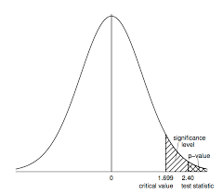
More examples of p-value & null hypothesis
t-test:
We compare sample mean with theoretical value or with some other sample mean.
We use sample variance
We use t-distribution to calculate p-value (bigger t -> smaller p-value -> reject)
Three types of t-tests:
one-sample t-test - compare sample mean with given value
two-sample t-test (a.k.a. Independent Samples t Test) compares the means of two independent groups
paired t-test (for dependent samples - before/after treatment)
Chi-Square χ2 Goodness of Fit Test
Suppose we have N observations of k mutually-exclusive classes
n_{i} - number of observations for each class (i=1,2,...k)
m_{i} - expected number of observations for each class
Calculate X² = sum((n_{i}-m_{i})²/m_{i})
Approximate it with χ² distribution with (k − 1) degrees of freedom.
The P-value is the probability that a chi-square statistic having (k-1) degrees of freedom is more extreme than X².

Slide 10
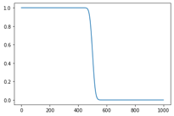
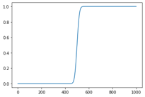
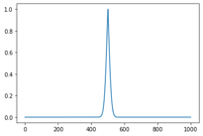
Binomial Test in Python
# We flip a coin N=1000 times.
# If x is number of heads, it has binomial distribution with sigma = sqrt(N)/2 = 15.81
# If it lands on heads 531 times, it is within 2*sigma.
# But let's perform a binomial test for null hypothesis that coin is fair:
binom_test(x=531, n=1000, p=1/2, alternative='greater') # P = 0.0268
# Because this p-value (0.0268) is less than 0.05, we reject the null hypothesis.
# binomial distribution
pmf = probability mass function - gives the probability that a discrete random variable is exactly equal to some value
from scipy.stats import binom_test # returns p-value of test
xvals = [0,470,500,530,999]
for x in xvals:
myval = binom_test(x=x, n=1000, p=1/2, alternative='greater')
print(f"{myval:.3f}")
# [1, 0.973, 0.5, 0.031, 0]
Binomial PMF :
from scipy.stats import binom
binom.pmf(0,2,0.5) # 0.25
binom.pmf(1,2,0.5) # 0.5
binom.pmf(2,2,0.5) # 0.25
n=10
arr = []
for ii in range(n+1):
arr.append(binom.pmf(ii, n, 0.5))
print(sum(arr)) # 1
print(arr)
# 8, 9, 10 heads out of 10 trials:
binom.pmf(8,10,0.5) # 0.043945
binom.pmf(9,10,0.5) # 0.009766
binom.pmf(10,10,0.5) # 0.000977
# sum: 0.054688
for x in xvals:
myval = binom_test(x=x, n=1000, p=1/2, alternative='less')
print(f"{myval:.3f}")
# [0, 0.031, 0.5, 0.973, 1]
for x in xvals:
myval = binom_test(x=x, n=1000, p=1/2, alternative='two-sided')
print(f"{myval:.3f}")
# [0, 0.062, 1, 0.062, 0]
# We flip a coin 10 times and it lands on heads 8 times.
# Perform a binomial test to determine if the coin is biased.
binom_test(x=8, n=10, p=1/2, alternative='greater') # P = 0.0546875
# Because this p-value (0.0546875) is not less than 0.05,
# we accept the null hypothesis.

Slide 11
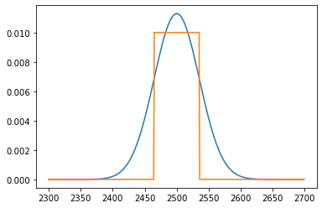
Binomial Distribution – Plot, Sigma
import os, sys, math
from scipy.stats import binom_test
import matplotlib.pyplot as plt
xx = []
yy = []
yy2 = []
sigma = math.sqrt(5000)/2.0
v1 = 2500-sigma
v2 = 2500+sigma
print(v1,v2) # 2464.64, 2535.36
for ii in range (2300, 2700):
xx.append(ii)
yy.append(binom.pmf(ii,5000,0.5))
val = 0.0
if v1 <= ii <= v2:
val = 0.01
yy2.append(val)
_ = plt.plot(xx,yy)
_ = plt.plot(xx,yy2) # show sigma range

Slide 12
Checking whether a coin is fair - χ² test Problem:
We want to test a null hypothesis that the coin is fair.
We flip the coin N times and got H heads.
So number of observed tails T = N-H.
Expected values are N/2 for heads and for tails.
Using χ² goodness of fit test
X² = sum( (observed – expected)²/expected) = [ (H– N/2)² / (N/2) ] + [ (T – N/2)² / (N/2) ]
The P-value is the probability that a chi-square statistic having one degree of freedom is more extreme than that value.
Specific example:
N=100, H=60, T=40
X² = [ (60– 50)² / 50 ] + [ (40 – 50)² / 50 ] = 10² / 50 + 10² / 50 = 2+2 = 4
X² distribution for 1 degree of freedom gives 3.84 for P-value P=0.05.
We have 4, which is more extreme.
So we reject the null hypothesis (that the coin is fair).
χ²

Slide 13
Checking whether a coin is fair - t-test
I am not sure if the t-test can be used for coin flipping hypothesis testing.
t-test is used for data which is presumed to have normal distribution, and only for small samples of data ( < 30 points).
But here is formal application of t-test:
Problem:
We want to test a null hypothesis that the coin is fair.
We flip the coin N times and got H heads.
So number of observed tails T = N-H.
Expected numbers are N/2 for heads and for tails.
To calculate t-test we assume values 1 for heads and -1 for tails.
Then suppose N=100, H=60, T=40
Sample Mean X = (H – T)/100 = 20/100 = 0.2
Expected mean = N/2 – N/2 = 0
Degrees of Freedom = N-1 = 99
Sample Variance:
S² = (1/99) * ( 60*(1-0.2)² + 40*(-1-0.2)² ) = 0.969
Sample Standard Deviation:
S = sqrt(0.9696) = 0.9847
t-statistics:
(0.2– 0) / (0.9847 / 10) = 2.031
Note: for two-sided t-test with 100 degrees of freedom and P-value 0.05
we have (from t-test table): 1.984
Our t-statistics is 2.031, it is more extreme, so we reject the null hypothesis
In Python:
from scipy import stats
stats.t.cdf(2.031,df=99) # 0.9775 , more extreme than 0.95
Student t-test
Let X_{i} be independently and identically drawn from the normal distribution with expected mean value μ and variance σ²
----- Sample
mean
----- Sample
variance
Random variable,
Normal distribution
Random variable, t-distribution.
It uses S = sqrt(sample variance) because real sigma is unknown. This creates uncertainty – and leads to the "fat tails" in the t-distribution.

Slide 14
More Hypothesis Testing Examples
Problem1:
Given: women's heights are normally distributed with the mean 65″ and standard deviation of 3.5″
Question: What is the probability of finding a random sample of 50 women with a mean height of 70″.
To answer, let's estimate the z-score:
z = (x – μ) / (σ / √n) = (70 – 65) / (3.5/√50) = 5 / 0.495 = 10.1
We know that 99% of values fall within 3σ (68, 95, 99.7 rule).
We have z-score = 10, which is much more than 3.
So the probability that any sample of 50 women will have a mean height of 70″ will be much-much less than 1%.
Problem 2:
Suppose you are testing a claim that the percentage of all women with varicose veins is 25%, and your sample of 100 women had 20% with varicose veins.
Then the sample proportion p=0.20.
The standard error for your sample percentage is the square root of p(1-p)/n which equals 0.04 or 4%.
You find the test statistic by taking the proportion in the sample with varicose veins, 0.20, subtracting the claimed proportion of all women with varicose veins, 0.25, and then dividing the result by the standard error, 0.04.
These calculations give you a test statistic (standard score) of –0.05 divided by 0.04 = –1.25.
This tells you that your sample results and the population claim in H0 are 1.25 standard errors apart; in particular, your sample results are 1.25 standard errors below the claim.
When testing H0: p = 0.25 versus Ha: p < 0.25, you find that the p-value of -1.25 by finding the probability that Z is less than -1.25. When you look this number up on the Z-table, you find a probability of 0.1056 of Z being less than this value.
Note: A Z-table is simply a table of values of the cumulative distribution function of the normal distribution.

Slide 15
The dichotomous use of p-value in statistical inference
is worse than useless.
p-value is a conditional probability, i.e., Pr( Data | H0 is true) but what we want to know is Pr(H0 is true | Data)
the calculation of p-value depends on at least three things: - the effect size (e.g., difference of two means due to two treatment, odds ratio, etc.), - the uncertainty level of the point estimate (e.g., standard deviation), - and sample size
it is a standard result in statistics theory that, based on one set of sample data we cannot tell the observed effect size is due to treatment or due to random variation (i.e., sampling distribution requires we repeat the same experiment many times before any confirmatory conclusion can be made)
if by nature the H0 is false (in the majority cases of real life data / research questions), p-value =0.
In summary, P-value based Null Hypothesis Significance Test (NHST)
is logically not defensible, technically flawed and practically damaging
Gang (John) Xie,
Ph.D. in Statistics,
Quantitative Consulting Unit in Research Office
https://www.researchgate.net/post/What_is_the_relationship_between_R-squared_and_p-value_in_a_regression

Slide 16
Medical Test Paradox – Predictive Power of Positive or Negative Test Result
from https://www.youtube.com/watch?v=lG4VkPoG3ko
Healthy
Sick
We have 1,000 people.
1% of them have a disease:
N_sick = 10
N_healthy = 990
We use a test with sensitivity SE = 90% and specificity SP = 91%.
This means that test shows results as following:
TP = True Positive = N_sick * SE/100 = 9 out of 10
TN = True Negative = N_healthy * SP/100 = 901 out of 990
FN = False Negative = 1 out of 10
FP = False Positive = 89 out of 990
What is the predictive power of this test?
Positive result : TP/(TP+FP) = 9/(9+89) = 0.092 (1 in 11 chance)
Negative result : TN/(TN+FN) = 901/(901+1) = 0.999 (very good)
Test Results:
Red = Positive
White = Negative
Specificity
Sensitivity
 | Positive | Negative
Disease | 9 | 1
Healthy | 89 | 901
Sensitivity = Recall = True Positive Rate (TPR) : TPR = (TP / P) = TP / (TP + FN)
Specificity (SPC) = True Negative Rate (TNR) : SPC = (TN / N) = TN / (FP + TN)

Slide 17
Example – Drug Test
Solution:
We have a drug test with the following characteristics:
false positives = 2%
false negatives = 1%
5% of population are drug positive.
If a person's test result is positive, what is the probability that this person is indeed drug positive?
FPR = 2% = FP/N
FP = 2% of 9,500 = 190
FNR = 1% = FN/P
FN = 1% of 500 = 5
TP = 500-5=495
95%
9,500 negative
10,000 people total
5%
500 positive
TN = 9,500-190 = 9310
TN = 9310
FN=5
If the person tests positive,
he is either TP or FP
Probability of being positive given the results of the test:
TP/(TP+FP) = 495/(495+190) = 0.72
FP
190
TP
495

Slide 18
Medical Tests
Merck Manuals:
https://www.merckmanuals.com/professional/special-subjects/clinical-decision-making/understanding-medical-tests-and-test-results
Healthy
Sick
Typical ROC Curves

