Slide 1


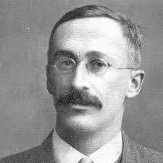
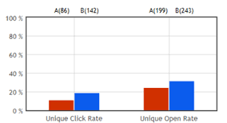
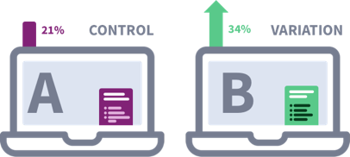
A/B Split Testing
A/B Split testing (a.k.a. split testing) is a process of comparing two approaches of doing something. For example, you may be comparing two designs of landing web pages, or two advertisings, or two coupons, or two emails, etc. You can run the tests, measure the effectiveness of each approach (using some metric) – and compare them.
A/B Split testing was pioneered in early 1900s in statistics (Student t-test) and in advertising (Claude Hopkins – "Scientific Advertising"), and in other areas.
Importance of A/B Split testing:
In 2012, a Microsoft employee working on the search engine Bing created an experiment to test different ways of displaying advertising headlines.
Within hours, the alternative format produced a revenue increase of 12% with no impact on user-experience metrics.
Today, companies like Microsoft and Google each conduct over 10,000 A/B tests annually.
https://towardsdatascience.com/the-art-of-a-b-testing-5a10c9bb70a4
https://en.wikipedia.org/wiki/A/B_testing
https://towardsdatascience.com/online-controlled-experiment-8-common-pitfalls-and-solutions-ea4488e5a82e
William Sealy Gosset (aka Student)
(1876-1937)
t-test
(1907-1908)
Claude C. Hopkins
(1866–1932)
Scientific Advertising

Slide 2
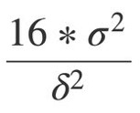
How many points you need?
How big should be number of points
so that we can say that the means differ?
Here is a 3-minute explanation:
- https://www.youtube.com/watch?v=JEAsoUrX6KQ
We can demand that we have 4 "sigmas" between them
δ = |m_{A} - m_{B}| >= 4*sem = 4s/sqrt(n)
Or
n >= 16s²/δ²
Suppose we have two samples A and B,
each has "n" points, where n is relatively large (100+ points),
and distributions on both sides have "normal" shape
with same sample standard deviation "s".
The mean values are m_{A} and m_{B}
The standard error of the mean (sem):
sem = s/sqrt(n)
A B
n >
Standard
Deviation
(blue)
4σ
Standard Error of the Mean
(orange)

Slide 3
Non-Gaussian Distributions
What methods of testing should we use
if distributions of data for A and B are not Gaussian?
Assumed Distribution | Example Case | Standard Test | Alternative Test
Gaussian | Average revenue per user | Welch's t-test (Unpaired t-test) | Student's t-test
Binomial | Click-through rate | Fisher's exact test | Barnard's test
Poisson | Transactions per paying user | E-test | C-test
Multinomial | Number of each product purchased | Chi-squared test
Unknown |  | Mann–Whitney U test | Gibbs sampling
Some links :
https://www.kdnuggets.com/tag/ab-testing -
https://en.wikipedia.org/wiki/Welch%27s_t-test -
https://en.wikipedia.org/wiki/Barnard%27s_test -
https://en.wikipedia.org/wiki/Mann%E2%80%93Whitney_U_test -
https://en.wikipedia.org/wiki/Gibbs_sampling -
https://en.wikipedia.org/wiki/Z-test -
https://en.wikipedia.org/wiki/Kolmogorov%E2%80%93Smirnov_test - test of the equality of 1-dim probability distributions

Slide 4
If A/B difference statistically significant? Answer Using Shuffling (hacking !!)
Shuffling works when the Null Hypothesis assumes two groups are equivalent
Only works when there is no selection biases
The trials must be independent (!)
Example: A/B Split Test
N=10000
A = np.random.exponential(scale=2.0, size=N)
B = np.random.exponential(scale=2.4, size=N)
C = np.concatenate((A,B)) # Combined
diff_AB = np.mean(A) - np.mean(B)
N_shuf = 5000
counter = 1
diffs = np.zeros(N_shuf, dtype=float)
rng = np.random.default_rng()
for ii in range(N_shuf):
rng.shuffle(C, axis = 0)
split1 = C[:N]
split2 = C[N:]
diffs[ii] = np.mean(split2) - np.mean(split1)
if diffs[ii] <= diff_AB:
counter += 1
diffs_mean = np.mean(diffs)
diffs_std = np.std(diffs)
print(f"diff_AB = {diff_AB:.5f}") # 0.4
print(f"diffs mean = {diffs_mean:.5f}") # 0
print(f"diffs std = {diffs_std:.5f}") # 0.03
print(f"P-value = {counter/N_shuf}") # 0.0002
plt.rcParams["figure.figsize"] = (8, 4) # (width, height)
fig, ax = plt.subplots(nrows=1, ncols=1)
ax.hist(diffs,bins=100)
ax.set_xlim(left=0,right=0.2)
plt.show();
A
B
Distribution of diffs of shuffled parts
P-value is estimated
by counting
import numpy as np
from sklearn.model_selection import train_test_split
data = np.random.random(2*N)
# how to shuffle using sklearn train_test_split()
X1, X2 = train_test_split(data, test_size=N)
# how to shuffle using only Numpy:
s1 = np.random.choice(2*N, N, replace=False)
s2 = list( set(range(2*N)) - set(s1) )
split1 = data[s1]
split2 = data[s2]

Slide 5
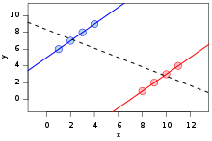
8 Common Pitfalls of A/B Split Testing
Ending the experiment prematurely (not getting enough data points)
Non-consistent (not truly random) cluster assignment
A random assignment fails to distribute heavy users equally. A/A test to check consistency
Fail to check the Ceteris Paribus assumption ("all other things being equal" – Latin)
Cross-contamination between the treatment and control groups
Get fouled by False Positives while making multiple comparisons (use the Bonferroni correction to correct)
Individual and aggregated patterns look different for ramp-up experiments (Simpson's paradox). Three solutions: (1) use paired t-tests (test before and after); (2) use the weighted sum to adjust for the different ratios; (3) throw away the data from the ramp-up period.
Fail to check the primacy and novelty effects
https://towardsdatascience.com/online-controlled-experiment-8-common-pitfalls-and-solutions-ea4488e5a82e
Simpson's paradox: a positive trend appears for two separate groups, whereas a negative trend appears when the groups are combined.

Slide 6
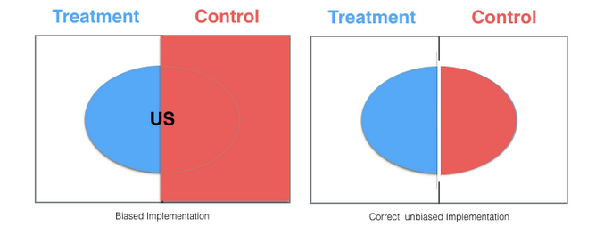
Bias
You need to make sure you are comparing "apples to apples".
Buckets should be same size, same composition.
Only include people who could've been affected.
A/B split test may give different or opposite results for different segments.

Slide 7
Interference between A & B
We randomly select users for A & B groups.
We expect each user is independent and no interference between A & B.
But in some situations there may be interference.
For example, for social media like Facebook, Linkedin, and Twitter,
or two-sided markets like Uber, Lyft, and Airbnb
One-sided markets
For example, if you testing a new feature on Facebook, and get 1% difference between A & B,
what do you expect to happen after the new feature is launched to all users?
You can actually expect a value larger than 1%, because users’ behavior may be
impacted by that of people in their social circles. That is called a network effect.
It is "cooperation" effect.
For two-sided markets
(Uber, Lyft, ebay, and Airbnb) the effect may be opposite ("competition" effect).
This is because resources are shared among control and treatment groups,
meaning that control and treatment groups will compete for the same resources.
Unlike social networks where the treatment effect underestimates the real benefit of a new product, in two-sided markets, the treatment effect overestimates the actual effect.
How to avoid interference?
How to avoid spillover?
Identify groups (clusters) of users who are more likely to interact only withing the group. Split into A & B groups.
Ego-cluster randomization (Linkedin). Measuring the one-out network effect, meaning the effect of a user’s immediate connection’s treatment on that user, then each user either has the feature or does not.
Geo-based randomization. For example A – in New York, B – in San Francisco Bay Area. This pitfall of this approach - each market is unique in certain ways through things such as the customer’s behavior, competitors, etc.
Time-based randomization. We select a random time, for example, a day of a week, and assign all users to either A or B. It works when the treatment effect only lasts for a short amount of time.

Slide 8
Novelty and Primacy Effects
When there’s a change in the product, people react differently:
some people welcome changes (novelty effect)
some people don't like change (primacy effect or change aversion)
For example, the test may show positive effect simply because of the novelty effect (or exclusivity). The effect may completely disappear over time after rolling it out to everyone.
How to deal with effects?
Novelty effect and primacy effect only apply to existing users who react to change.
So we could run tests only on new users - to them these effects do not apply.
Or we can compare "new" and "old" separately:
A_new B_new
A_old B_old
We can compare:
A : B
A_new : B_new
A_old : B_old
A_new : A_old
B_new : B_old

Slide 9
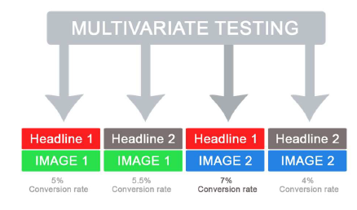
Multiple testing problem
Multivariate Testing (MVT)
Multivariate testing (MVT)—Full and Functional Factorial Design
We run multiple tests (not just two (A & B) but more (A,B,C,D,...).
For example, we test different colors – to select the best one.
Or 10 versions of the same web page.
Bonferroni correction
When comparing these cases the 0.05 test is not enough.
We need to adjust for multitude of cases.
For example, use Bonferroni correction – and require 0.05/10 = 0.005
FDR
Another method is to control the false discovery rate (FDR):
FDR = E[# of false positive / # of rejections]
It measures out of all of the rejections of the null hypothesis, that is, all the metrics that you declare to have a statistically significant difference.
How many of them had a real difference as opposed to how many were false positives.
This only makes sense if you have a huge number of metrics, say hundreds.
Suppose we have 200 metrics and cap FDR at 0.05.
This means we’re okay with seeing false positives 5 of the time.
We will observe at least 10 false positive in those 200 metrics every time.
Multivariate testing is a technique for testing a hypothesis in which multiple variables are modified.
The goal of multivariate testing is to determine which combination of variations
performs the best out of all of the possible
Combinations

