Slide 1
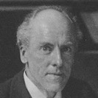

Chi-Square χ² Distribution
If Z₁, ..., Z_{k} are independent, standard normal (Gaussian)
random variables, then the sum of their squares:
sum_{k}(Z_{i}²)
is distributed as
χ² with "k" degrees of freedom
Mean = K
Variance = 2K
Karl Pearson
1857 – 1936
English mathematician and biostatistician
Why is it called χ2 ?
Greek character Chi ( χ ) appears to be the notation
used by Karl Pearson in 1900:
“On the Criterion that a Given System of Deviations from the Probable in the Case of a Correlated System of Variables is such that it can be Reasonably Supposed to have Arisen from Random Sampling,” Philosophical Magazine, 50, (1900), 157-175.
Where Gamma Function:

Slide 2
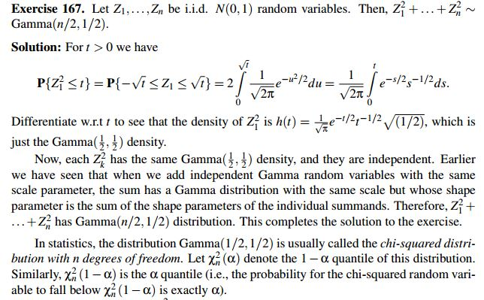
Simple Derivation of χ² distribution formula
https://math.stackexchange.com/questions/625202/derivation-x2-pdf-chi-square-for-k-degrees-of-freedom
Note: The fact that the sum of "n" Gamma(1/2,1/2) RVs is a Gamma(n/2,1/2) can be proved using the change of variable formula for joint distributions.

Slide 3
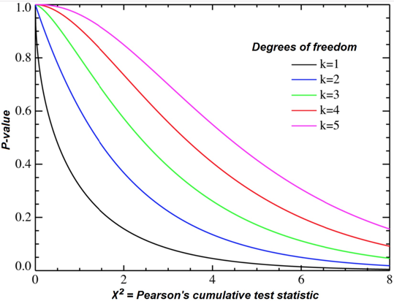
Chi-Square χ² Goodness of Fit Test
Chi-squared test, showing χ2 on the x-axis
and p-value on the y-axis.
https://stattrek.com/chi-square-test/goodness-of-fit.aspx
Pearson, 1900.
Suppose we have k mutually-exclusive classes
N - total number of all observations,
p_{i} - hypothetical probability of each class (null hypothesis).
sum(p_{i}) = 1
n_{i} - number of observations for each class (i=1,2,...k)
m_{i} - expected value of observations m_{i}=N*p_{i}
sum(m_{i}) = N*sum(p_{i}) = N = sum(n_{i})
Karl Pearson has proposed that as N gets bigger, the sum below converges to χ²
X² = sum((n_{i}-m_{i})²/m_{i}) --> χ² distribution with (k − 1) degrees of freedom
sum( (observed – model)²/model )
sum( (observed – expected)²/expected)
Notation
χ2 is the lower-case Greek letter Chi
f_{o} is the Observed Frequency
f_{e} is the Expected Frequency
Computing Expected Frequencies
fc - frequency total for the column
fr - frequency total for the row
In practice we calculate value X² from our data,
then use χ² distribution to estimate the P-value
(the probability that a chi-square statistic is
more extreme than X² value that we have.
Chi-Square Statistic

Slide 4
Example of χ² test - goodness of fit ( from https://stattrek.com/chi-square-test/goodness-of-fit.aspx )
Problem:
We have 3 types of cards (T1,T2,T3) with theoretical frequency of (30%, 60%, 10%).
We have a random sample of 100 cards with counts (50, 45, 5).
Is this sample consistent with theory? Use a 0.05 level of significance.
Solution:
Null hypothesis: The proportions are (30%, 60%, 10%)
Alternative hypothesis: At least one of the proportions in the null hypothesis is false.
Degrees of Freedom DF = k-1 = 3-1 = 2
Expected values:
E₁ = 100*0.3 = 30, E₂ = 100*0.6 = 60, E₃ = 100 * 0.10 = 10
Χ² = Σ [ (O_{i} - E_{i})² / E_{i} ] = [ (50 - 30)² / 30 ] + [ (45 - 60)² / 60 ] + [ (5 - 10)² / 10 ] = 19.58
The P-value is the probability that a chi-square statistic having 2 degrees of freedom is more extreme than 19.58.
Using Chi-Square Distribution we find P(Χ2 > 19.58) = 0.0001.
Since the P-value (0.0001) is less than the significance level (0.05),
we reject the null hypothesis.
Note:
If you use this approach on an exam, you may also want to mention
why this approach is appropriate.
Specifically, the approach is appropriate because the sampling method
was simple random sampling, the variable under study was categorical,
and each level of the categorical variable had an expected frequency
count of at least 5.
Theory | 30 | 60 | 10
Observed | 50 | 45 | 5
χ² test table

Slide 5
χ²

Slide 6

Example of χ² test – coin flip
Problem:
We want to test a null hypothesis that the coin is fair.
We flip the coin N times and got H heads.
So number of observed tails T = N-H.
Expected values are N/2 for heads and for tails.
X2 = sum( (observed – expected)²/expected) =
= [ (H– N/2)² / (N/2) ] + [ (T – N/2)² / (N/2) ]
The P-value is the probability
that a chi-square statistic with one degree of freedom
is more extreme than that value.
Theory | N/2 | N/2
Observed | Heads | Tails

Slide 7
Chi-Square χ² Test for Independence (two-way tables, association)
Test for Independence evaluates the relationship between two variables.
It is a non-parametric test, performed on categorical data.
Example:
500 boys and girls are asked which is their favorite color:
blue, green, or pink (see results).
Using alpha = 0.05, would you conclude that there is a relationship
between gender and favorite color?
Solution:
Degrees of Freedom df = (rows-1)(columns-1) = (2-1)(3-1) = 2
In χ² table the value for alpha=0.05 and df=2 is 5.99
Calculate statistics: χ² = sum [(f_{o} – f_{e})² / f_{e} ] = 170.14 >> 5.99
Conclusion: yes, there is a relationship
Observed | Blue | Green | Pink | Total
Boys | 100 | 150 | 50 | 300
Girls | 20 | 30 | 150 | 200
Total | 120 | 180 | 200 | N=500
Expected | Blue | Green | Pink | Total
Boys | 72 | 108 | 120 | 300
Girls | 48 | 72 | 80 | 200
Total | 120 | 180 | 200 | N=500

Slide 8

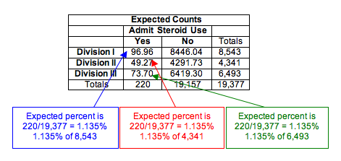
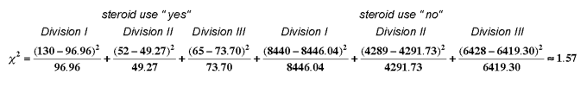
Chi-Square χ² Test of Homogeneity from https://courses.lumenlearning.com/wmopen-concepts-statistics/chapter/test-of-homogeneity/
Null hypothesis:
steroid use doesn't differ between divisions.
Degrees of Freedom df = (rows-1)(columns-1) = (2-1)(3-1) = 2
In χ² table looking for value for (alpha=0.05 and df=2): χ² = 5.99
Calculate statistics: χ² = sum (f_{o} – f_{e})² / f_{e} = 1.57
The smaller is the experimental chi-square statistics – the larger is P-value.
(P-value = 0.4561 for χ² = 1.57)
So, as 1.57 < 5.99, we conclude that we can not reject the null hypothesis.
The data does not provide strong enough evidence to conclude that steroid use differs in the three divisions (P-value = 0.4561).

Slide 9
Proof and Intuition
for Chi-squared test
Seven proofs of the Pearson Chi-squared independence test and its graphical
interpretation – by Eric Benhamou & Valentin Melot , 2018.
- https://arxiv.org/pdf/1808.09171.pdf
Example: we have black and white balls.
The null hypothesis is that the probability of white balls is p (and black is (1-p)).
You have drawn a sample of n balls and observed k white balls.
The exact binomial probability of obtaining k white balls from n is
P(K=k | n,p) = bin(n,k)p^{k}(1−p)^{n−k} , where bin(n,k) is the binomial coefficient.
Now you can approximate the probability by calculating the z-score.
The mean of the binomial distribution is nq
and standard deviation s = sqrt(np(1−p)).
So the z-score is z=(k−np)/s and it follows standard normal distribution.
On the other hand, a squared normally distributed variable (or their sum)
follows a 𝜒2-distribution.
So, in this case the square z² is 𝜒2-distributed (with 1 degree of freedom).
Note that z² can be expressed as
which is a more familiar expression for the 𝜒2-statistic.
Chi-squared with 1 degree of freedom
for white balls:
np = expected value
k = observed value
for black balls:
n(1-p) = expected value
n-k = observed value

