Slide 1
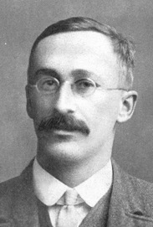
Student's t-distribution
https://en.wikipedia.org/wiki/Student%27s_t-distribution
Student's t-distribution (or simply the t-distribution)
is any member of a family of continuous probability distributions that arises when estimating the mean of a normally distributed population
in situations where the sample size is small
and the population standard deviation is unknown.
It was developed by William Sealy Gosset (1908)
under the pseudonym Student, when he worked with Karl Pearson
Let X_{i} be independently and identically drawn from the normal distribution with expected mean value μ and variance σ²
William Sealy Gosset
used pseudonym "Student"
because he was working for Guinness Beer Company in England
as a "Head Experimental Brewer" (working on cultivating barley),
and the company didn't allow him to publish under his own name.
----- Sample
mean
----- Sample
variance
In Excel: T.DIST(x,DF,FALSE)
where DF = Degrees of Freedom (Npoints-1)
----- Random variable with Normal distribution N(0,1)
95% confidence interval
----- Random variable, t-distribution. It uses sample variance S (because real sigma is unknown). This creates uncertainty – and leads to the "fat tails" in the t-distribution.

Slide 2
t-statistics vs z-statistics
t-statistics:
When sample size is small ( N < 30 ), then even if we know that the underlying distribution is Gaussian, we still can not evaluate the distribution's sigma with enough precision. In this case we need to use t-distribution and t-statistics.
t = (X – μ) / [ s/√(n) ]
Here μ is a sample mean, s is a sample standard deviation.
z-distribution (normal) gives 95% confidence at z <= 2 .
t-distribution has "fat tails", so to get 95% confidence interval
we need to use t-score larger than 2.
How much larger decreases with increasing the N of points in the sample.
N-1 95% t-score. # N-1 = df (degrees of freedom)
------------------
1 : 12.71
2 : 4.30
3 : 3.18
5 : 2.57
10 : 2.23
20 : 2.09
30 : 2.04 – almost normal
60 : 2.00 – almost normal
------------------
from scipy import stats
# Student, p<0.05, 2-tail, same as Excel TINV(0.05,n-1)
for df in [1,2,3,5,10,20,30,60]:
t_score = stats.t.ppf(1-0.025, df)
print(f"{df:2} : {t_score:5.2f}")
z-statistics:
When sample size is big ( > 30 ), then in many cases sample distribution is close to gaussian. So we use gaussian distribution and z-statistics.
Suppose that variable x follows normal gaussian distribution N(μ, σ) with mean value μ and standard deviation σ.
Then we can compose variable "z" which would follow standard normalized distribution N(0,1) with zero mean and standard deviation = 1 like this:
z = (x-μ) / σ
Z-score is simply the z-value which shows how far is the value from the mean expressed in number of "sigmas".
For example, if z > 2, that means that the original value is more than two sigmas away from the mean value. For normal distribution this means that the probability
of this event is less than 0.05. (to be precise, the exact z-score for 0.05 is 1.96)
Suppose we take a sample of n values from N(μ, σ). Let "X" (big X) be the sample mean. Then it follows normal distribution N(μ, σ/√(n) ) with mean value μ and standard deviation σ/√(n) .
So the standard deviation of the mean gets smaller with larger "n".
- Random variable with Normal distribution N(0,1)

Slide 3
Hypothesis Tests with the t Statistic
The one-sample t test from: https://www.statisticshowto.com/one-sample-t-test/
Your company wants to improve sales. Sales data shows average sale of $100 per transaction. After training your sales force, recent sales data (taken from a sample of 25 salesmen) shows an average sale of $130, with a standard deviation of $15. Did the training work? Test your hypothesis at a 5% alpha level.
Step 1: Write your null hypothesis. H0: μ = $100 , has not changed.
Step 2: Write your alternate hypothesis. H1: μ > $100 , increased.
Step 3: Calculate some items:
The sample mean(x̄). This is given in the question as $130.
The population mean(μ). Given as $100 (from past data).
The sample standard deviation(s) = $15.
Number of observations(n) = 25.
Step 4: Insert the items into the t score formula.
t = (130 – 100) / ((15 / √(25)) = 30/3 = 10
Step 5: Find the t-table value for alpha = 5%
and degrees of freedom = Number of observations – 1 = 24.
The intersection is 1.711 . This is your one-tailed critical t-value.
As 10 > 1.711, we reject the null hypothesis. It’s highly likely that the mean sale has become greater. The sales training was probably a success.

Slide 4
t

Slide 5
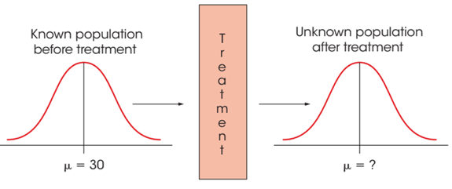
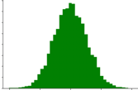
Three types of t-tests
Note: the key assumption of t-tests is that the distribution is Normal.
Three types of t-tests:
one-sample t-test - compare sample mean with given value
two-sample t-test (a.k.a. Independent Samples t Test) compares the means of two independent groups
paired t-test (for dependent samples - before/after treatment). For example, we compare some metrics for each person before and after treatment. We calculate the difference for each person, look at the distribution of these differences. Is this distribution shifted significantly from zero? Then the change is real and null hypothesis is wrong (null hypothesis is usually that there is no difference).
Common Basic Research Situation for t Statistic:
Assumed that μ is known for the population before treatment.
The purpose of the research study is to determine
whether the treatment has an effect.
Note that the population after treatment has unknown values
for the mean and the variance. So we will use a sample
to test a hypothesis about the population mean.
Null Hypothesis
Histogram of differences

Slide 6
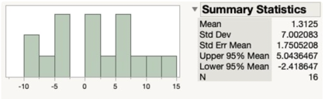



Example: Paired t-test calculation
Null Hypothesis: population mean of differences is zero
Alternative Hypothesis: not zero
Degrees of Freedom: df = n − 1 = 15
Looking in the table the t value with α = 0.05 and 15 degrees of freedom is 2.131
Our test statistics t = 0.75 is lower than the table t value 2.131.
This means that we can not reject the null hypothesis that the mean difference is zero.
If the distribution is not normal, then for the paired t­-test, a nonparametric test is the Wilcoxon signed-rank test.
https://www.jmp.com/en_us/statistics-knowledge-portal/t-test/paired-t-test.html
Assumptions:
Independence: no cross-dependency between subjects/people.
Each of the paired measurements come from the same subject/person.
The measured differences are normally distributed.
Scores
Statistics for Differences
Student | Exam 1 | Exam 2 | Diff
Bob | 63 | 69 | 6
Nina | 65 | 65 | 0
Tim | 56 | 62 | 6
Kate | 100 | 91 | -9
Alonzo | 88 | 78 | -10
Jose | 83 | 87 | 4
Nikhil | 77 | 79 | 2
Julia | 92 | 88 | -4
Tohru | 90 | 85 | -5
Michael | 84 | 92 | 8
Jean | 68 | 69 | 1
Indra | 74 | 81 | 7
Susan | 87 | 84 | -3
Allen | 64 | 75 | 11
Paul | 71 | 84 | 13
Edwina | 88 | 82 | -6
Average score diff:
Mean | 1.3125 |  | SUM(D2:D17)/16
Std Dev | 7.00208302 |  | STDEV.S(D2:D17)
Std Err Mean | 1.75052076 |  | G3/SQRT(16)
t-statistics | 0.74977689 |  | G11/G13
t-val for 0.05 | 2.131
Upper 95% | 5.04285973 |  | G11 + G15*G13
Lower 95% | -2.4178597 |  | G11 - G15*G13
Short Video Tutorials:
https://www.youtube.com/watch?v=1Qr7xW-xDQM
https://www.youtube.com/watch?v=JiQR0lHLe74
https://www.youtube.com/watch?v=AGh66ZPpOSQ
https://www.youtube.com/watch?v=_7IW2PUqe64
https://www.youtube.com/watch?v=Q0V7WpzICI8

Slide 7
Independent t-test formula
Paired t-test formula
Student t-test formula
The paired t-test is used to compare the means of two related groups of samples
If the variance of the two groups are equivalent (homoscedasticity), the t-test value, comparing the two samples (A and B), can be calculated as following:
where,
m is the mean differences
n is the sample size (i.e., size of d)
s is the standard deviation of d
Degrees of freedom (df): df=n−1
where,
m_{A} and m_{B} represent the mean value of the group A and B, respectively.
n_{A} and n_{B} represent the sizes of the group A and B, respectively.
S² is an estimator of the pooled variance of the two groups. It can be calculated as following :
Degrees of freedom (df): df=nA+nB−2

Slide 8
Welch's t-test
When the two independent samples are assumed to be drawn
from populations with unequal variances,
the test statistic t is computed as Welch’s t test:
Simple example.
Suppose x₁ and x₂ are drawn from normal distributions
with means 0 and 3, and σ = 1.
Suppose that n₁ = n₂ = N (equal and large).
Then s₁ = s₂ = σ = 1.
Then t ~= (3 - 0) / sqrt(2/N) ~= 2*sqrt(N)
So:
N t df
-----------------------
100 20 99
10,000 200 9,999
1 Mln 2,000 999,999
etc.
Where:
n₁, n₂ = sample sizes (i.e., number of observations)
x¯₁ , x¯₂ = mean values of samples
s₁ , s₂ = standard deviations of samples
The degrees of freedom of Welch t-test is estimated as following:

Slide 9
t-test – continued
Effect size
In addition to rejecting/accepting a Hypothesis, you can also estimate the size of the effect:
Cohen's d - for comparing two samples/groups with same sizes and similar SDs.
Glass's delta - uses only the SD of the control group.
Hedges' g - for two groups with different sample sizes.
Example: for two groups with mean M and standard deviations SD :
Cohen's d = (M₂ - M₁) ⁄ SD_{pooled}
where
SD_{pooled} = √((SD₁² + SD₂²) ⁄ 2)
Estimating "μ" from sample
(use sample mean "M" and sample deviation S_{M})
For any α we know that (1 – α) proportion of t values fall between ± t for the appropriate df.
Determining the amount of variability in scores explained by the treatment effect is an alternative method for measuring effect size.
r² = 0.01 small effect
r² = 0.09 medium effect
r² = 0.25 large effect

Slide 10
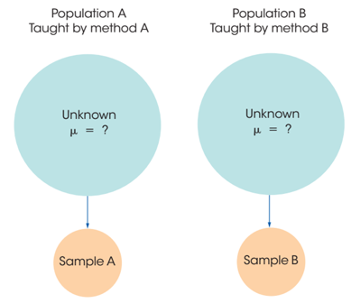
The t Test for Two Independent Samples
Data comes from two completely different, independent groups.
Observations within each sample must be independent.
The two populations must be normal.
The two populations must have equal variances (called homogeneity of variance).
Basic structure of the t statistic
where estimated standard error (unbiased if n1=n2)
unbiased estimate:
SS = Sum of Squares Degrees of freedom df = df₁+df₂ = (n₁-1) + (n₂-1)
Null hypothesis for independent-measures test:
Test for homogeneity of variance:
Levene's test or Brown–Forsythe test
https://en.wikipedia.org/wiki/Levene%27s_test

Slide 11
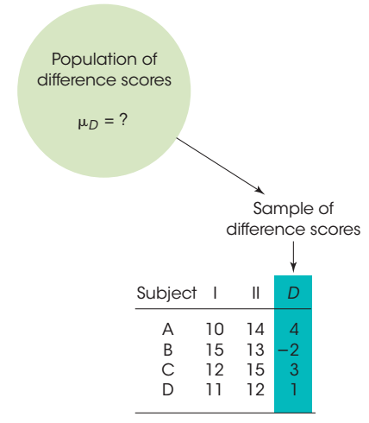
The t Test for Repeated-Measures
Difference score = D = X₂ − X₁
Mean Difference:
Repeated-measures design
(a.k.a. within-subjects design)
Two separate scores are obtained for each individual in the sample
Same subjects are used in both groups.
Observations within each treatment condition must be independent.
Population distribution of difference scores (D values) must be normally distributed.
Null Hypothesis H₀: μ_{D} = 0
Confidence Interval (C.I.):

