Slide 1
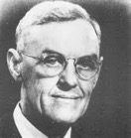
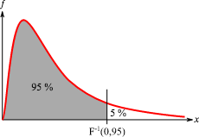
F-Distribution (Fisher–Snedecor)
F-distribution
right-skewed distribution used most commonly in ANOVA (Analysis of Variance) .. https://en.wikipedia.org/wiki/F-distribution
named after Ronald Fisher and George W. Snedecor
F-tests:
We have two "populations" of data with normal distributions. Our Null hypothesis is that their variances are equal.
We calculate the F-value and look where it lands on the appropriate F-distribution to see whether it is significantly incompatible with this null hypothesis.
George W. Snedecor
1881-1974, USA
Ronald Fisher 1890-1962, British.
Developed ANOVA
A random variate of the F-distribution is a ratio:
F = Variance1 / Variance2 = (U₁/d₁) / (U₂/d₂)
where U₁ and U₂ are independent and have chi-squared distributions
with d₁ & d₂ degrees of freedom respectively.
If d1=d2=1000, the ratio looks like normal with peak ~1.
If numbers are smaller and not-equal – we get skewed shapes.
Critical Value
Accept H₀
Reject H₀

Slide 2
ANOVA = Analysis of Variance
In its simplest form, ANOVA provides a statistical test of whether two or more population means are equal, it generalizes the t-test. The observed variance in a particular variable is partitioned into components - https://en.wikipedia.org/wiki/Analysis_of_variance
One-way ANOVA - compare means of two or more samples (using the F distribution).
Response data "Y" (numerical) and input data "X" (numerical or categorical)
Ronald Fisher 1890-1962
British. Developed the analysis of variance ANOVA (1925)
Two-way ANOVA is an extension of the one-way ANOVA that examines the influence of two different categorical independent variables (X1, X2) on one continuous dependent variable "Y".
The goal is to assess the main effect of each independent variable
and to assess if there is any interaction between them.
Variance Between
--------------------
Variance
Within
ANOVA is the synthesis of several ideas and it is used for multiple purposes. As a consequence, it is difficult to define concisely or precisely.
"Classical" ANOVA for balanced data does three things at once:
Uses additive data decomposition for exploratory data analysis. Uses sums of squares to indicate the variance of each component of the decomposition.
Comparisons of mean squares, along with an F-test ... allow testing of a nested sequence of models.
Closely related to the ANOVA is a linear model fit with coefficient estimates and standard errors.
Additionally, ANOVA :
is computationally elegant and relatively robust against violations of its assumptions.
provides strong (multiple sample comparison) statistical analysis.
has been adapted to the analysis of a variety of experimental designs.

Slide 3
ANOVA = Analysis of Variance
import numpy as np
from scipy import stats
import matplotlib.pyplot as plt
%config InlineBackend.figure_format = 'retina'
# Example: two-tailed test
alpha = 0.05
a = [1, 2, 1, 2, 1, 2, 1, 2, 1, 2]
b = [1, 3, -1, 2, 1, 5, -1, 6, -1, 2]
var_a = np.var(a, ddof=1)
var_b = np.var(b, ddof=1)
print(f"Variance a={var_a:.3f}, Variance b={var_b:.3f}")
f_stat = var_a/var_b # because we estimate mean from data
# build an F-distribution object
f_dist = stats.f(len(a)-1,len(b)-1)
f_crit_val = f_dist.ppf(0.95)
p_val = 2*min(f_dist.cdf(f_crit_val), 1-f_dist.cdf(f_crit_val))
print(f"f_crit_val = {f_crit_val:.4f}")
print(f"f_stat = {f_stat:.4f} = var_a / var_b")
print(f"p_val = {p_val:.4f}")
if (p_val < alpha):
print(f"Reject H0")
else:
print(f"Accept H0")

Slide 4
ANOVA – Multilevel Model
https://en.wikipedia.org/wiki/Multilevel_model
Multilevel models, a.k.a.:
hierarchical linear models
linear mixed-effect model
mixed models
nested data models
random coefficient
random-effects models
random parameter models
split-plot designs
Multilevel models can be used as an alternative to ANCOVA (Analysis of Covariance).
ANCOVA blends ANOVA and regression.
ANCOVA evaluates whether the means of a dependent variable "Y" are equal across levels of a categorical independent variable "X" often called a treatment, while statistically controlling for the effects of other continuous variables (a.k.a. covariates "CVs" or nuisance variables).
Mathematically, ANCOVA decomposes the variance in the "Y" into variance explained by the CVs, variance explained by the categorical "X", and residual variance.
Intuitively, ANCOVA can be thought of as 'adjusting' the "Y" by the group means of the CVs.

Slide 5
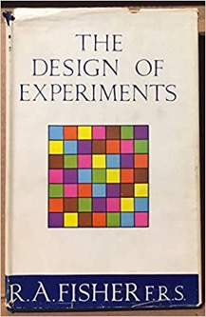

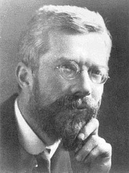
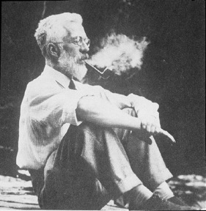
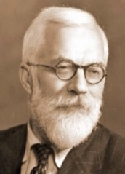
Fisher Exact Test
From Fisher's book "The Design of Experiments" (1935)
Lady Tasting Tea example in 2nd chapter
A lady claimed that she can distinguish between two types of cups of tea:
tea added first, then milk
milk added first, then tea
Fisher introduces the concept of "null hypothesis"
Experiment: given 4 cups of type 1 and 4 cups of type 2.
They look the same.
Lady tests them and labels the "milk first" ones.
The test is called "exact" because Fisher demonstrates how in this case he can calculate exact probability of each outcome.
If she guessed 3 out of 4, the probability is 16/70 = 0.22 - not good
If she guessed 4 out of 4, the probability is 1/70 < 0.05 - good
1935
Success Combinations Number of
count Combinations
------------------------------------------------------------
0 oooo 1 × 1 = 1
1 ooox, ooxo, oxoo, xooo 4 × 4 = 16
2 ooxx, oxox, oxxo, xoxo, xxoo, xoox 6 × 6 = 36
3 oxxx, xoxx, xxox, xxxo 4 × 4 = 16
4 xxxx 1 × 1 = 1
------------------------------------------------------------
Total 70

