Slide 1
History of Probability
and Statistics

Slide 2
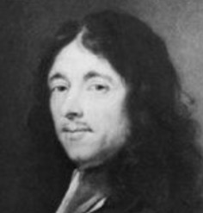
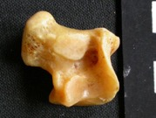

The Pascal – Fermat correspondence of 1654 (5 letters)
is often cited in histories of mathematics
as the origin of probability theory.
Gaming existed in the earliest civilizations.
For example, the talus – a knucklebone or heel bone
that can land in any of 4 different ways.
The talus is a randomizer. Other randomizers:
Dice.
Choosing lots.
Reading entrails or tea leaves.
Purpose:
Making “fair” decisions.
Consulting the gods.
Here are things that happened in the mid-17th century:
Annuities sold to raise public funds
Statistics of births, deaths, etc., attended to
Mathematics of gaming proposed
Models for assessing evidence and testimony
“Measurements” of the likelihood/possibility of miracles
“Proofs” of the existence of God
Antoine Gombaud, Chevalier de Méré (1607 - 1684)
He was a French writer, adopted the title Chevalier for the character in his dialogues who represented his own views. Later his friends began calling him by that name.
The Paradox of the Chevalier De Méré :
de Méré observed that getting at least one 6 with 4 throws of a die was more probable than getting double 6's with 24 throws of a pair of dice.

Slide 3
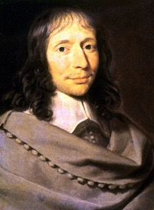
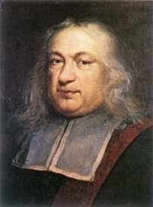
The Pascal – Fermat correspondence of 1654 (5 letters) - Often cited in histories of mathematics as the origin of probability theory.
The dice problem asks how many times one must throw a pair of dice before one expects a double six.
The the problem of points asks how to divide the stakes if a game of dice is incomplete.
They solved the problem of points for a two player game, but did not develop powerful enough mathematical methods to solve it for three or more players.
The Problem of Points - question posed by a gambler, Chevalier De Mere and then discussed by Pascal and Fermat. There are many versions of this problem, appearing in print as early as 1494 and discussed earlier by Cardano and Tartaglia, among others.
Two players of equal skill play a game with an ultimate monetary prize.
The first to win a fixed number of rounds wins everything.
How should the stakes be divided if the game is interrupted after several rounds,
but before either player has won the required number?
Example of the game
Two players, A and B.
The game is interrupted when A needs "a" more points to win and B needs "b" more points.
Hence the game can go at most a + b -1 further rounds.
E.g. if 6 is the total number of points needed to win
and the game is interrupted when A needs 1 more point while B needs 5 more points,
then the maximum number of rounds remaining is 1+5-1=5.
Pascal and Fermat together came to a resolution amounting to the following:
A list of all possible future outcomes has size 2a+b-1
The fair division of the stake will be the proportion of these outcomes that lead to a win by A versus the proportion that lead to a win by B.
Previous solutions had suggested that the stakes should be divided in the ratio of points already scored, or a formula that deviates from a 50:50 split by the proportion of points won by each player.
These are all reasonable, but arbitrary, compared with Pascal & Fermat’s solution.
Note: It is assumed that all possible outcomes are equally likely.
Blaise Pascal
1623 - 1662
Pierre de Fermat
1607 – 1665
Which is the “correct” view of probability ?
The frequency of a particular outcome among all possible outcomes, either in an actual finite set of trials or in the limiting case of infinite trials.
Or
The rational expectation that one might hold that a particular outcome will be a certain result.
Renaissance scientists had little use for probability because they sought incontrovertible demonstration of truth, not approbation or endorsement.
Opinion was not important, certainty was.
Copernicus’s theory was “improbable” but true.

Slide 4
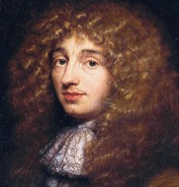
The incomplete game problem.
This is the same problem that concerned Pascal and Fermat.
Unsuccessful attempts at solving it by Cardano, Tartaglia, and G. F. Peverone.
Success came with the realization that every possible permutation needs to be enumerated.
Dice problems
Confusion between combinations and permutations
Basic difficulty of establishing the Fundamental Set of equiprobable events.
The Roannez Circle
Artus Gouffier, Duke of Roannez, 1627-1696
His salon in Paris was the meeting place for mathematicians and other intellectuals, including Leibniz, Pascal, Huygens, Méré.
Méré posed several questions to Pascal about gambling problems.
Solving the problem led Pascal to further exploration of the coefficients of the binomial expansion, known to us as Pascal’s triangle.
Christiaan Huygens (1629 - 1695) Scientist, innovator, and inventor
of the pendulum clock.
Christiaan Huygens, from the Netherlands, six years younger than Pascal, begun studying probabilities after hearing from the studies of Fermat and Pascal.
He wrote a short book “Van Rekeningh in Spelen van Geluck” ( Calculating in Games of Chance", printed in Latin in 1657 " De rationcinis in aleae ludo"), introducing the concept of expectation value. This was the first textbook of probability.
Huygens had made a trip to Paris and learned of the Pascal-Fermat correspondence. He became a member of the Roannez Circle and met Méré.
Expectation as the “fair price” to play. Huygens’ text is about gambling problems. His concept of mathematical expectation, the possible winnings multiplied by the frequency of successes divided by all possible outcomes, was given as the “fair price” to play.
In the long run (the limit of successive plays) paying more than the expectation will lose money, paying less will make money. The expected value expresses the point of indifference.
Decision theory
The theory of deciding what to do when it is uncertain what will happen.
The rational, optimal decision, is that which has the highest expected value.
Expected value is the product of the value (payoff) of an outcome multiplied by its probability of occurrence.
E.g. expected value of buying a lottery ticket = sum of product of each prize times probability of winning it.
Three forms of decision theory argument:
Dominance: one course of action is better than any other under all circumstances.
Expectation: one course of action, Ai, has the highest expected value:
Let p_{i} = probability of each possible state, S_{i}
Let U_{ij} = utility of action A_{j} in state S_{i}
Expectation of A_{j} = ∑ p_{i} U_{ij} over I
Dominating expectation: where the probabilities of each state is not known or not trusted, but partial agreement on probabilities assigns one action a higher probability than any other, then that action has dominating expectation.

Slide 5
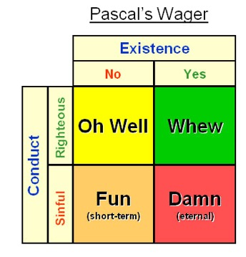
Pascal’s Wager as decision theory
Two possible states: God exists or He does not.
Two possible actions: Believe and live a righteous life or don’t believe and lead a life of sin.
Four outcomes:
God exists X righteous life ➔ salvation
God exists X sinful life ➔ eternal damnation
God does not exist X righteous life ➔ no harm done
God does not exist X sinful life ➔ finite life span of riotous living
Dominance case: Believing simply dominates over non-believing if the situation is equivalent in the case that God does not exist.
Expectation case: But if believing (and living righteously) foregoes the pleasures of sin, then believing does not simply dominate. However if the consequences in the case of God’s existence are greatly in excess of those in the event of non-existence (salvation vs damnation as opposed to indifference vs. fun), then believing has the highest expected value.
Dominating expectation: Since the probability of God existing is not known, Pascal appeals to dominance of one expectation over another: Infinite salvation or damnation versus something finite.
Pascal’s wager much quoted, often misrepresented
It was transformed and re-stated by many theologians and used as an argument for the existence of God or for righteous living.
It was criticized as faulty by many who saw it as manipulative and impious.
E.g., William James suggestion that those who became believers for the reasons given by Pascal were not going to get the payoff anticipated.

Slide 6
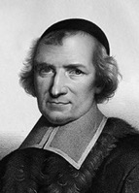
The word “probability” itself first used to denote
something measurable in 1662 in the book
"La logique, ou l'art de penser" ("Logic, or the art of thinking").
This textbook on logic first published anonymously in 1662 by Antoine Arnauld and Pierre Nicole.
They were Pascal's associates, prominent members of the Jansenist movement, centered on Port-Royal.
This book is commonly known as Port-Royal Logic, or Logique de Port-Royal.
It was the most successful logic book of the time.
5 editions of the book from 1662 to 1683.
Translations into all European languages.
Still used as a text in 19th century Oxford & Edinburgh.
Written by Pascal’s associates at Port Royal, esp. Pierre Nicole and Antoine Arnauld.
Antoine Arnauld seems to have written all of Book IV, the section on probability.
Arnauld also wrote the Port Royal Grammar, his chief contribution to philosophy
Example given of a game where each of 10 players risks one coin for an even chance to win 10.
Loss is 9 times more probable “neuf fois plus probable” than gain.
And later, there are “nine degrees of probability of losing a coin for only one of gaining nine.”
These are the first occasions in print where probability is measured.
Frequency used to measure chance of natural events
Author of Port Royal advocates that people’s fear of thunder should be proportional to the frequency of related deaths (lightning, etc.).
Frequency of similar past events used here as a measure of the probability of the future event.
Note that the frequency measure does not work if the payoff is not finite. Hence Pascal’s wager: slight chance of eternal salvation trumps all other options.
Pierre Nicole
Antoine Arnauld

Slide 7
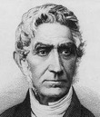
Political Arithmetic, a.k.a. statistics
John Graunt’s Natural and Political Observations, 1662, was the first treatise that analyzed publicly available statistics, such as birth and death records, to draw conclusions about public issues. Population trends, Epidemics, Recommendations about social welfare.
Fair price to purchase an annuity
First establish the proper interest rate, r, i.e. the time value of money.
Perpetual annuities: Fair price, F, is the amount that generates the regular payment, p, at the interest rate, r. Hence F=p/r.
Terminal: Calculate the same as for a mortgage, except the payment p, and the number of periods n are known and the fair price F is the unknown.
Life: Calculate as a terminal annuity, where n is the life expectancy of the owner.
Joint: A more difficult calculation where it is necessary to determine the life expectancy of all the owners.
Graunt’s mortality table
Age | Survivors
0 | 100
6 | 64
16 | 40
26 | 25
36 | 16
46 | 10
56 | 6
66 | 3
76 | 1
John Graunt
The principle of indifference
A concept named in the 20th century by John Maynard Keynes, but articulated in the 17th century by Leibniz and then stated as a fundamental principle by Laplace in the 18th century.
Two events are viewed as equally probable when there is no reason to favor one over the other.

Slide 8
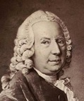
The Art of Conjecturing
Jacques Bernoulli’s "Ars conjectandi" appeared in 1713, eight years after his death.
Probability emerges fully with this book.
It contains the first limit theorem of probability.
Establishes the addition law of probability for disjoint events.
The meaning of the title: The “Port Royal Logic” was titled Ars cogitandi, the Art of Thinking. The art of conjecturing takes over where thinking leaves off.
Bernoulli states that “Probability is degree of certainty and differs from absolute certainty as the part differs from the whole.”
Etymological distinction: “certain” used to mean decided by the gods.
Therefore events that were uncertain were those where the gods could not make up their minds.
The first limit theorem.
Bernoulli’s theorem, in plain language, is that for repeatable and or in all ways comparable events (e.g. coin tosses), the probability of a particular outcome is the limit of the ratio of that outcome to all outcomes as the number of trials increases to infinity.
Bernoulli shows how to calculate a number of trials n necessary to guarantee a moral certainty that the error e is less than some specified number. (A confidence interval.)
Jacob Bernoulli (a.k.a as James or Jacques)
1655 – 1705
Daniel Bernoulli was one of eight prominent mathematicians in the Bernoulli family from Basel.
He has derived Gamma function for complex numbers with a positive real part.
He has contributed to fluid mechanics, probability and statistics.
Daniel Bernoulli
(1700 - 1782)

Slide 9
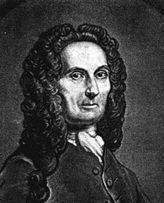
Abraham De Moivre provided many tools to make the classical method more useful, including the multiplication rule, in his book The Doctrine of Chances in 1718.
The book was popular, eventually going through three editions.
De Moivre has discovered the equation of the normal curve.
Throughout the 18th century, the application of probability moved from games of chance to scientific problems:
- Mathematical theory of life insurance - life tables.
- Biological problems - what is the probability of being born female or male?
Abraham De Moivre
(1667 - 1754)
Pierre-Simon Laplace presented a mathematical theory of probability with an emphasis on scientific applications in his 1812 book "Theorie Analytique des Probabilities".
Unfortunately, Laplace only considered the classical method, leaving no indication on how the method was to be applied to general problems.
After the publication of Laplace’s book, the mathematical development of probability stagnated for many years.
By 1850, many mathematicians found the classical method to be unrealistic for general use and were attempting to redefine probability in terms of the frequency method.
These attempts were never fully accepted and the stagnation continued.
Pierre-Simon
marquis de Laplace
(1749 - 1827)

Slide 10
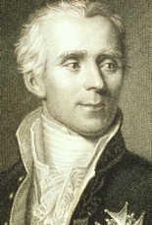
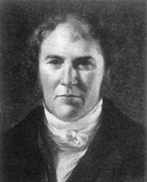
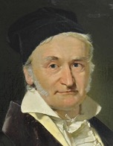
History of Normal Distribution and CLT
The formula for the normal distribution was discovered independently
by Adrain in 1808 and Gauss in 1809.
In 1809 Gauss published his monograph "Theoria motus corporum coelestium in sectionibus conicis solem ambientium" where among other things he introduces several important statistical concepts, such as the method of least squares, the method of maximum likelihood, and the normal distribution.
Earlier Laplace in 1774 posed the problem of aggregating several observations. His own solution led to the Laplacian distribution (exponential).
It was Laplace who first calculated the value of the integral ∫ e^{−t2} dt = √π in 1782, providing the normalization constant for the normal distribution.
Finally, it was Laplace who in 1810 proved and presented to the Academy the fundamental Central Limit Theorem, which emphasized the theoretical importance of the normal distribution.
Gauss and Laplace are very famous. The normal distribution was called for many years "Gaussian-Laplace distribution".
Robert Adrain is less known. He was a brilliant mathematician. His main contributions are
- the method of least squares
- and derivation of the formula for normal distribution.
Robert Adrain
1775–1843
USA
Carl Friedrich Gauss
1777 – 1855
from Göttingen, Germany
Pierre-Simon Laplace
1749–1827
France

Slide 11
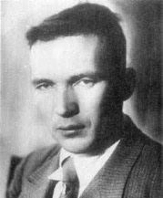
Andrey Kolmogorov developed the first rigorous approach to probability
in his 1933 monograph:
Kolmogorov, Andrey (1933). Grundbegriffe der Wahrscheinlichkeitsrechnung (in German). Berlin: Julius Springer.
Translation: Kolmogorov, Andrey (1956). Foundations of the Theory of Probability (2nd ed.). New York: Chelsea.
He built up probability theory from fundamental axioms in a way comparable with Euclid's treatment of geometry.
Modern research in probability theory is closely related to the mathematical field of measure theory.
Modern innovators in the field include Patrick Billingsley (University of Chicago), Yuan Shih Chow (Columbia), Kai Lai Chung (Stanford), Samuel Karlin (Stanford), Rolf-Dieter Reiss, Sheldon Ross (Berkeley), Henry Teicher (Rutgers) and many many more…
Andrey Kolmogorov 1903 - 1987

Slide 12
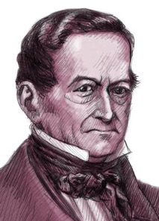

The word "Statistics"
The term statistics is ultimately derived from the New Latin statisticum collegium ("council of state") and the Italian word statista ("statesman" or "politician").
Gottfried Achenwall - first introduced the word statistiks in a preface to his work:
"Staatsverfassung der Europäischen Reiche im Grundrisse"
(Constitution of the Present Leading European States, 1752).
German economists named Gottfried Achenwall the "Father of Statistics"; but English writers disputed this, asserting that it ignored the prior claims of William Petty and other earlier writers on the subject.
Gottfried Achenwall
1719-1772
German philosopher, historian, economist, jurist and statistician
Originally the term "statistics" was used to describe
the systematic collection of demographic and economic data
by states about the states (then called political arithmetic in English).
Sir William Petty
1623-1687
English economist, physician, scientist and philosopher

Slide 13
Prominent Contributors into Statistic Theory
1654 - Pascal - mathematics of probability, in correspondence with Fermat
1662 - William Petty and John Graunt - first demographic studies
1713 - Jakob Bernoulli - Ars Conjectandi (first limit theorem of probability = law of big numbers).
1733 - DeMoivre - Approximatio; law of error (similar to standard deviation), equation of the normal curve
1747 - James Lind - carried out the first ever clinical trial in 1747, in an effort to find a treatment for scurvy.
1763 - Rev. Bayes - An essay towards solving a problem in the Doctrine of Chances, foundation for "Bayesian statistics"
1805 - A-M Legendre - least square method
1809 - C. F. Gauss - Theoria Motus Corporum Coelestium, method of least squares
1812 - P. S. Laplace - Théorie analytique des probabilités
1834 - Statistical Society of London established
1853 - Adolphe Quetelet - organized first international statistics conference; applied statistics to biology; described the bell-shaped curve
1877 - F. Galton - regression to the mean
1888 - F. Galton - correlation
1889 - F. Galton - Natural Inheritance
1900 - Karl Pearson - chi square; applied correlation to natural selection
1904 - Spearman - rank (non-parametric) correlation coefficient
1908 - "Student" (W. S. Gossett) - The probable error of the mean; the t-test
1919 - R. A. Fisher - ANOVA; evolutionary biology
1930's - Jerzy Neyman and Egon Pearson (son of Karl Pearson) - type II errors, power of a test, confidence intervals

Slide 14
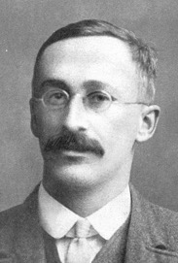
Ronald Fisher
(1890-1962)
Sir Francis Galton
(1822-1911)
Karl Pearson
(1857-1936)
William Sealy Gosset
(1876-1937)
English statistician, polymath, sociologist, psychologist, anthropologist, eugenicist, tropical explorer, geographer, inventor, meteorologist, proto-geneticist, and psychometrician.
Produced over 340 papers and books.
Famous for concept of correlation and regression toward the mean.
English mathematician, ~600 scientific papers and books (~400 in statistics).
He founded the world's first university statistics department at University College, London in 1911
He is mostly known for :
- chi-squared test
- standard deviation
- correlation and regression coefficients
Famous for F-distribution. Developed the analysis of variance ANOVA. Succeed Pearson at the University College, London
Famous for t-distribution and t-test. Learned statistics math methods at Pearson's lab. Used pseudonym "Student" because he was working for Guinness Beer Company in England as a "Head Experimental Brewer" (working on cultivating barley), and the company didn't allow him to publish under his own name.

