Slide 1
Statistics
Lies and Paradoxes

Slide 2
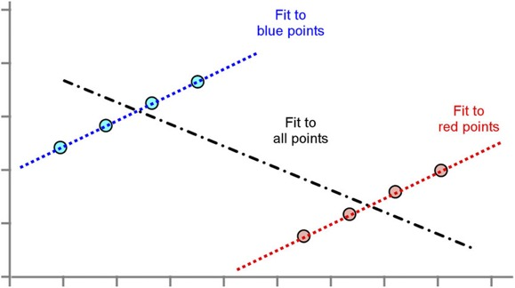
Simpson's paradox
Example:
Carlo’s wins against Sophia among both men and women.
But loses overall!
https://towardsdatascience.com/simpsons-paradox-how-to-prove-two-opposite-arguments-using-one-dataset-1c9c917f5ff9

Slide 3
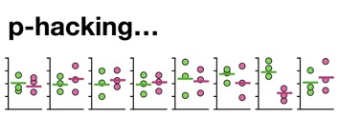
P-Hacking
“p-hacking” happens when researchers try out several tests,
but report only those that produce significant results.
It is also known as “selective reporting”.
Similar to Inflation bias: misreporting of true effect sizes
Data dredging (or data fishing, data snooping, data butchery),
also known as significance chasing, significance questing, selective inference, and p-hacking is the misuse of data analysis
to find patterns in data that can be presented as statistically significant,
thus dramatically increasing and understating the risk of false positives.
This is done by performing many statistical tests on the data
and only reporting those that come back with significant results.
https://en.wikipedia.org/wiki/Data_dredging

Slide 4
Faulty polling.
Flawed correlations.
Data fishing.
Misleading data visualization.
Purposeful and selective bias.
Using percentage change in combination with a small sample size.

Slide 5
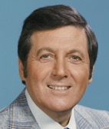
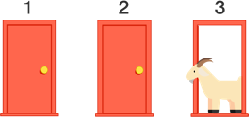
Monty Hall Problem
Monty Hall was the original host of the game show Let's Make a Deal.
The Monty Hall problem is based on one of the regular games on the show.
If you are on the show, here's what happens:
- Monty shows you three closed doors and tells you that there is a prize
behind each door: one prize is a car, the other two are less valuable
prizes like peanut butter and fake finger nails. The prizes are arranged
at random.
- The object of the game is to guess which door has the car. If you guess
right, you get to keep the car.
- You pick a door, which we will call Door A. We'll call the other doors B
and C.
- Before opening the door you chose, Monty increases the suspense by
opening either Door B or C, whichever does not have the car. (If the car
is actually behind Door A, Monty can safely open B or C, so he chooses
one at random.)
- Then Monty offers you the option to stick with your original choice or
switch to the one remaining unopened door.
The question is, should you "stick" or "switch" ?
or does it make no difference?
The answer – switching helps ! Doubles the wins !
Monty Hall
import random
# ---------------------------------------------
def run_one_trial(switch_doors, ndoors=3):
chosen_door = random.randint(1, ndoors)
if switch_doors:
revealed_door = 3 if chosen_door==2 else 2
available_doors = [
dnum for dnum in range(1,ndoors+1)
if dnum not in (chosen_door, revealed_door)
]
chosen_door = random.choice(available_doors)
return chosen_door == 1
# ---------------------------------------------
def run_trials(ntrials, switch_doors, ndoors=3):
nwins = 0
for i in range(ntrials):
if run_one_trial(switch_doors, ndoors):
nwins += 1
return nwins
# ---------------------------------------------
ndoors, ntrials = 3, 10000
coef = 100.0/ntrials
pct_wins_no_sw = coef * run_trials(ntrials, False, ndoors)
pct_wins_sw = coef * run_trials(ntrials, True , ndoors)
print(f"Monty Hall Problem with {ndoors} doors")
print(f"Percent wins with/without switching:")
print(f"{pct_wins_sw:.2f} / {pct_wins_no_sw:.2f}") # 67.26 / 32.85

Slide 6
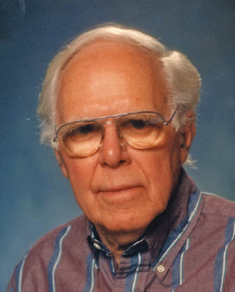
Boy or Girl Paradox
(a.k.a. "The Two Child Problem", "Mr. Smith's Children", "Mrs. Smith Problem").
Initially formulated at 1959, when Martin Gardner featured it in his October 1959 "Mathematical Games column" in Scientific American. He titled it The Two Children Problem, and phrased the paradox as follows:
P = 1/2
Question 1: Mr. Jones has two children. The older child is a girl. What is the probability that both children are girls?
Question 2: Mr. Smith has two children. At least one of them is a boy. What is the probability that both children are boys?
P = 1/3
Read: - https://en.wikipedia.org/wiki/Boy_or_Girl_paradox
video - This May Be The Most Counterintuitive Probability Paradox I've Ever Seen | Can you spot the error?
- https://www.youtube.com/watch?v=bDZieLmya_I
video - The Boy or Girl Probability Paradox Resolved
- https://www.youtube.com/watch?v=ElB350w8iJo

Slide 7
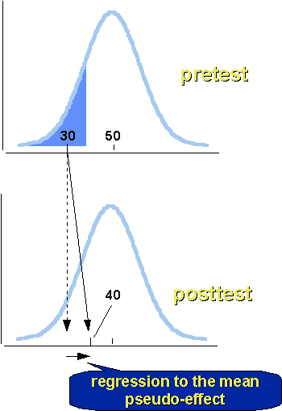
Regression to the Mean
You should be aware of this effect when designing experiments.
Suppose you give a test with 100 Yes/No questions
to 100 monkeys who can't read and answer questions randomly.
The results of the tests will be random, with the most common score of 50 (out of 100), and the histogram will be bell shaped (CLT).
Suppose we then select the 10 monkeys with the lowest scores
and re-test them again. We should see again the average at ~50.
So it looks like the monkey have improve their scores?
But we know that they didn't learn anything and didn't act differently.

Slide 8
Bayesian vs Frequentist
Survivorship Bias in World War 2
During World War II the US military's concluded that the most-hit areas of the plane needed additional armor.
But statistician Abraham Wald (Statistical Research Group (SRG) at Columbia University) has recommended adding armor to the areas that showed the least damage. His reasoning was that the sample didn't include the planes which were shot down.
It is dangerous to use data "as is" to create a model, because the data may be biased to start with, and it can easily lead to creating a biased model Problem occur when we have: - under-represented features (missing data) - over-represented features, - "target leakage" effect. Survivorship bias: - https://www.youtube.com/watch?v=B3YQJ5DwTzM Gender Bias: - https://www.youtube.com/watch?v=p60-Jdq754A Bias in criminal justice: - https://www.youtube.com/watch?v=Gi4YeRqfb24 Target Leakage: - https://www.youtube.com/watch?v=y8qaI5mpJeA

Slide 9
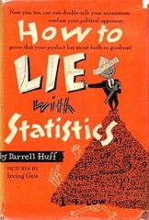
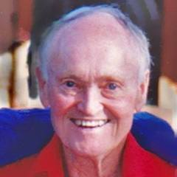
How to lie with statistics
“There are three types of lies – lies, damn lies, and statistics.”
– Benjamin Disraeli
book "How to Lie with Statistics" - by Darrell Huff, 1954
- https://en.wikipedia.org/wiki/How_to_Lie_with_Statistics
Don’t be fooled by missing data: Just because taking a drug clears up a cold in one week doesn’t mean that it wouldn’t have cleared up in a week on its own.
Biased Samples
Many conclusions you see come from samples that are too small, biased, or both.
When you hear a statistic, say, that the average American brushes their teeth 1.02 times a day, ask yourself: “How could they have figured it out?” Don’t you think it’s a safe assumption people lied?
“To be worth much, a report based on sampling must use a representative sample, which is one from which every source of bias has been removed.”
If a psychiatrist says that “practically everyone is neurotic,” do you suppose that their impression has been biased by their line of work?
Biased Averages. Mean, mode (most frequent), and median (in the middle of sample). Reporters would pick the one that best supports their argument. In normal distribution the three will be near each other, but in irregular distributions (e.g. annual household income) you’ll get vastly different numbers for each.
Discarded Data - Companies will keep running experiments until they get the results they want, discarding the experiments that “failed to produce significant findings.”
With smaller samples you have larger variance. With 10 coin flips you might get 8 heads, but you’re much less likely to get 80 heads in 100 coin flips.
Graph Manipulation – fool the reader by changing scales, semi-attaching figures.
“You can’t prove that your nostrum cures colds, but you can publish (in large type) a sworn laboratory report that half an ounce of the stuff killed 31,108 germs in a test tube in eleven seconds.”
More: ““27 percent of a large sample of eminent physicians smoke Throaties— more than any other brand.” The figure itself may be phony, ... somehow manages to sound as if it meant something.”
Or: “By the same kind of nonsense that the article writer used you can show that clear weather is more dangerous than foggy weather. More accidents occur in clear weather, because there is more clear weather than foggy weather. All the same, fog may be much more dangerous to drive in.”
continued on next page ...
Darrell Huff
Chapters:
1. The Sample with the Built-in Bias
2. The Well·Chosen Average
3. The Little Figures That Are Not There
4. Much Ado about Practically Nothing
5. The Gee-Whiz Graph
6. The One-Dimensional Picture
7. The Semiattached Figure
8. Post Hoc Rides Again
9. How to Statisticulate
10. How to Talk Back to a Statistic

Slide 10
How to lie with statistics - continued
What’s Missing? “Watch out for an average, variety unspecified, in any matter where mean and median might be expected to differ substantially.”
“Sometimes it is percentages that are given and raw figures that are missing, and this can be deceptive too. Long ago, when Johns Hopkins University had just begun to admit women students, someone not particularly enamored of coeducation reported a real shocker: Thirty-three and one-third percent of the women at Hopkins had married faculty members! The raw figures gave a clearer picture. There were three women enrolled at the time, and one of them had married a faculty man.”
“A report of a great increase in deaths from cancer in the last quarter-century is misleading unless you know how much of it is a product of such extraneous factors as these: Cancer is often listed now where “causes unknown” was formerly used; autopsies are more frequent, giving surer diagnoses; reporting and compiling of medical statistics are more complete; and people more frequently reach the most susceptible ages now. And if you are looking at total deaths rather than the death rate, don’t neglect the fact that there are more people now than there used to be.”
Did Somebody Change the Subject? Is that the real statistic, or what someone reported? (e.g. how often they bathed). “The “population” of a large area in China was 28 million. Five years later it was 105 million. Very little of that increase was real; the great difference could be explained only by taking into account the purposes of the two enumerations and the way people would be inclined to feel about being counted in each instance. The first census was for tax and military purposes, the second for famine relief.”
Does it Make Sense? “Hearings on amendments to the Social Security Act have been haunted by various forms of a statement that makes sense only when not looked at closely. It is an argument that goes like this: Since life expectancy is only about sixty-three years, it is a sham and a fraud to set up a social-security plan with a retirement age of sixty-five, because virtually everybody dies before that.”
Represent same data in different ways: “There are often many ways of expressing any figure. You can, for instance, express exactly the same fact by calling it a one percent return on sales, a fifteen percent return on investment, a ten-million-dollar profit, an increase in profits of forty percent (compared with 1935– 39 average), or a decrease of sixty percent from last year.”
Correlation vs. Causation - “It is the one that says that if B follows A, then A has caused B. An unwarranted assumption is being made that since smoking and low grades go together, smoking causes low grades. Couldn’t it just as well be the other way around?”
“This is the post hoc fallacy at its best. It says that these figures show that if you (your son, your daughter) attend college you will probably earn more money than if you decide to spend the next four years in some other manner. This unwarranted conclusion has for its basis the equally unwarranted assumption that since college-trained folks make more money, they make it because they went to college. Actually we don’t know but that these are the people who would have made more money even if they had not gone to college.”
Five questions to avoid getting tricked by statistics.
Who Says So? “About the first thing to look for is bias— the laboratory with something to prove for the sake of a theory, a reputation, or a fee; the newspaper whose aim is a good story; labor or management with a wage level at stake.”
How Does He Know? “Watch out for evidence of a biased sample, one that has been selected improperly or— as with this one— has selected itself. Ask the question we dealt with in an early chapter: Is the sample large enough to permit any reliable conclusion?”

