Slide 1
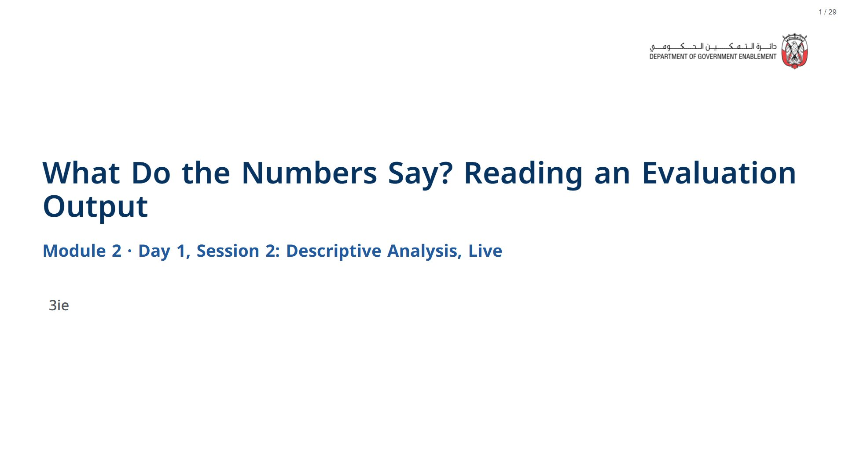

Slide 2

Notes:
Section timing: about 8 minutes.
span.MJX_Assistive_MathML {
position:absolute!important;
clip: rect(1px, 1px, 1px, 1px);
padding: 1px 0 0 0!important;
border: 0!important;
height: 1px!important;
width: 1px!important;
overflow: hidden!important;
display:block!important;
}

Slide 3
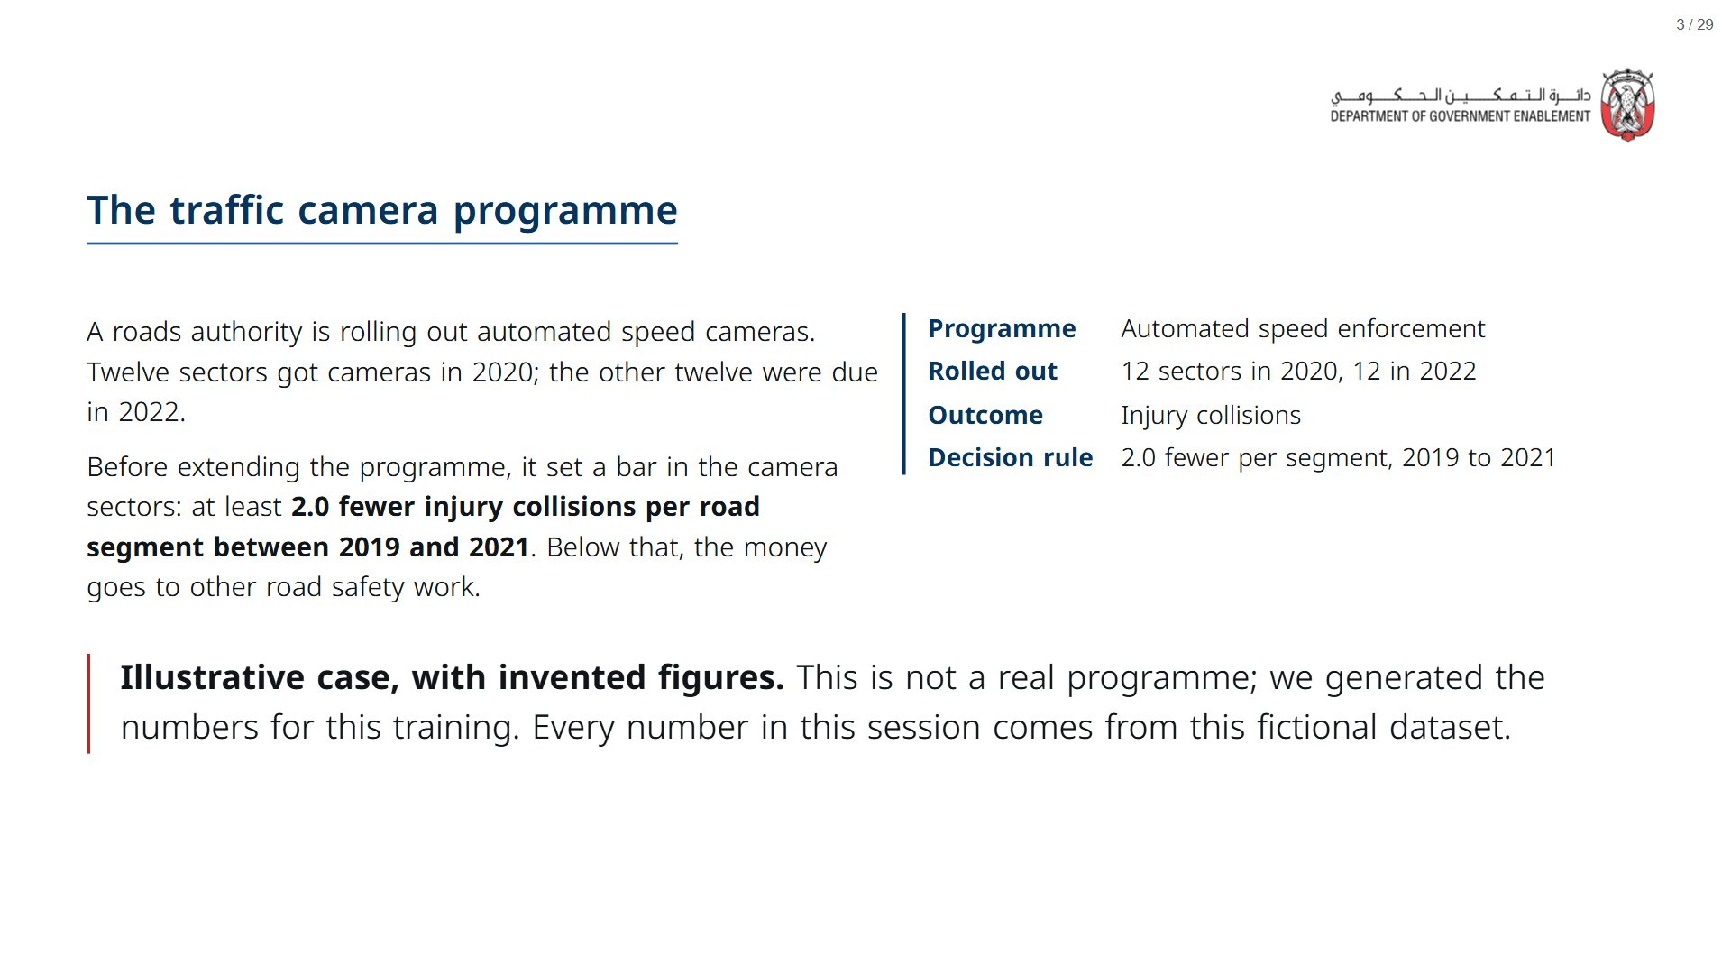
Notes:
The live cells start loading in the background while you talk (about 10 s).
span.MJX_Assistive_MathML {
position:absolute!important;
clip: rect(1px, 1px, 1px, 1px);
padding: 1px 0 0 0!important;
border: 0!important;
height: 1px!important;
width: 1px!important;
overflow: hidden!important;
display:block!important;
}

Slide 4
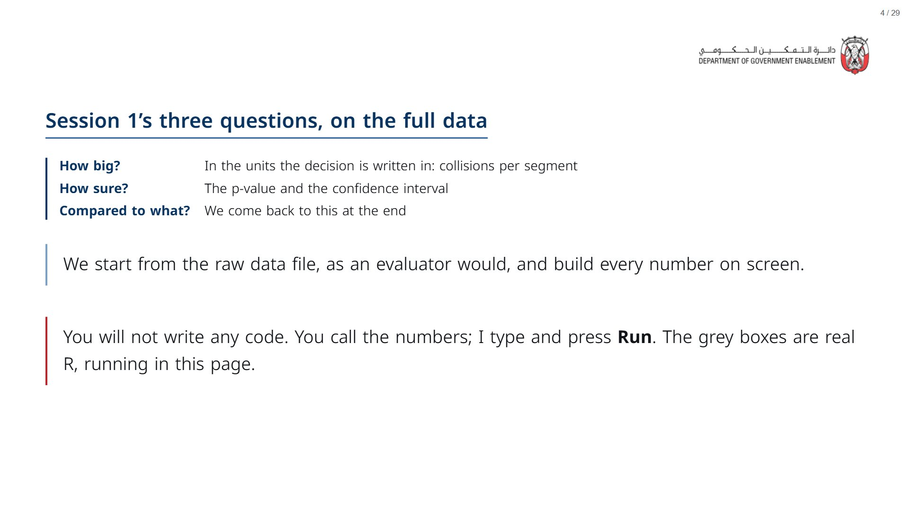

Slide 5

Notes:
Section timing: about 15 minutes.
span.MJX_Assistive_MathML {
position:absolute!important;
clip: rect(1px, 1px, 1px, 1px);
padding: 1px 0 0 0!important;
border: 0!important;
height: 1px!important;
width: 1px!important;
overflow: hidden!important;
display:block!important;
}

Slide 6
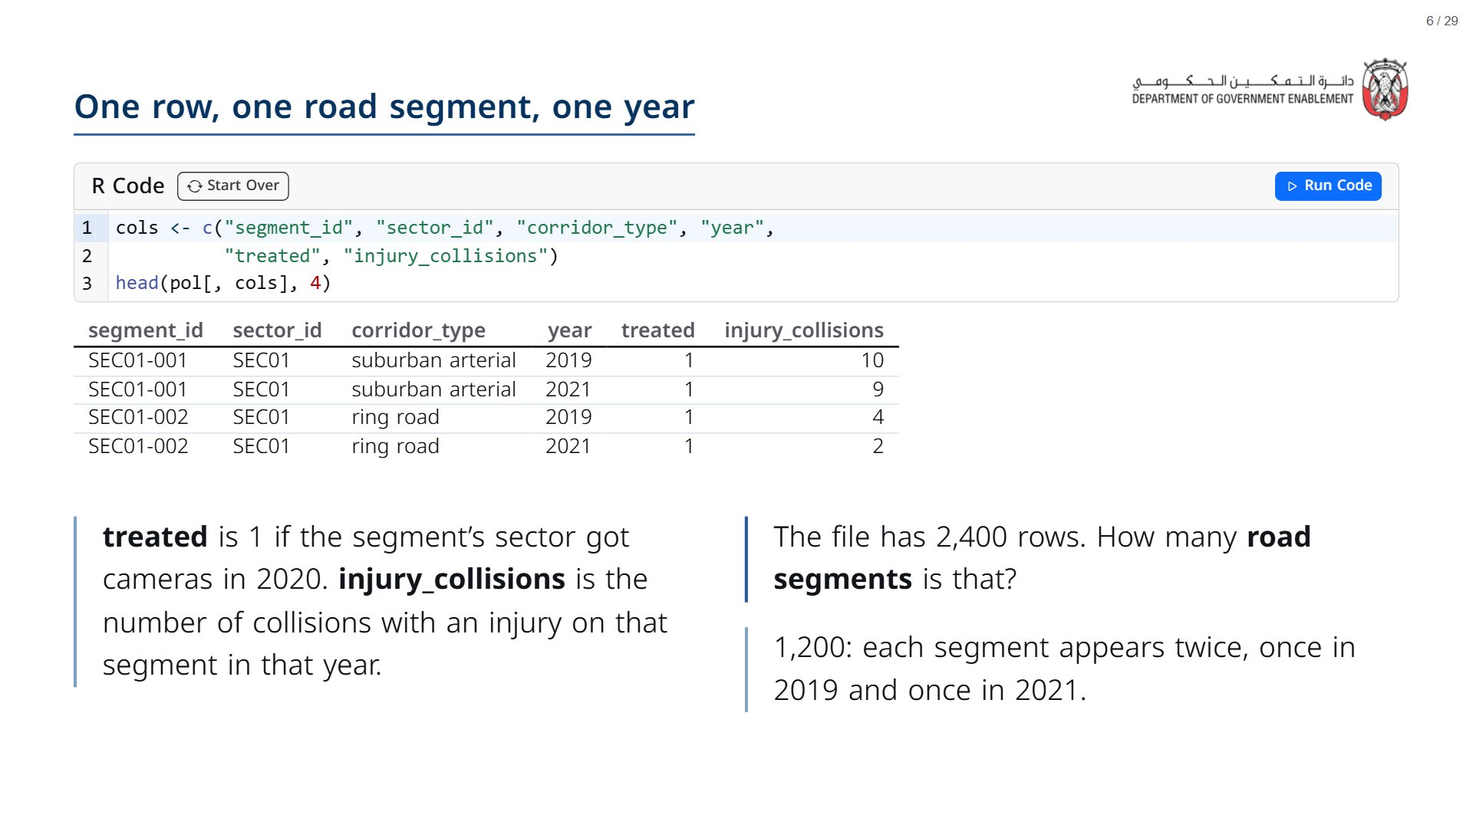
Notes:
head() shows the first rows of a data file. Read one row aloud in plain words: “segment 1 in sector 1, a suburban arterial, in 2019, in a camera sector, had 10 injury collisions.”
span.MJX_Assistive_MathML {
position:absolute!important;
clip: rect(1px, 1px, 1px, 1px);
padding: 1px 0 0 0!important;
border: 0!important;
height: 1px!important;
width: 1px!important;
overflow: hidden!important;
display:block!important;
}

Slide 7
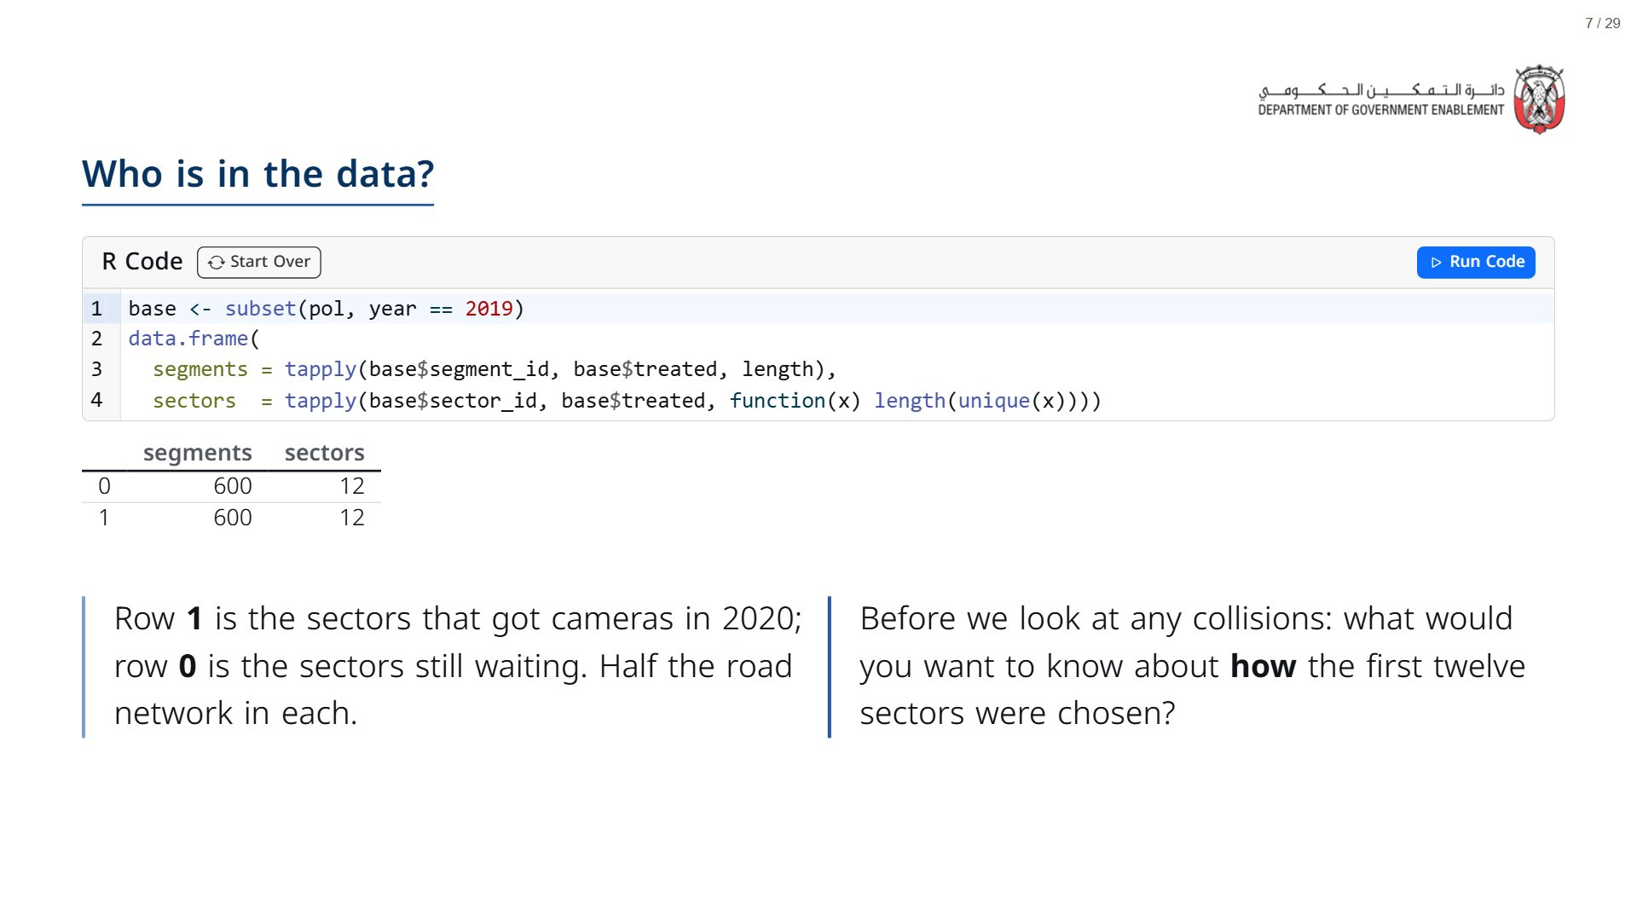
Notes:
Take two or three answers. The design document says cameras went first to the sectors with the worst safety record. Note it and move on: it matters for the “compared to what?” question at the end, and Session 3 takes it further.
span.MJX_Assistive_MathML {
position:absolute!important;
clip: rect(1px, 1px, 1px, 1px);
padding: 1px 0 0 0!important;
border: 0!important;
height: 1px!important;
width: 1px!important;
overflow: hidden!important;
display:block!important;
}

Slide 8
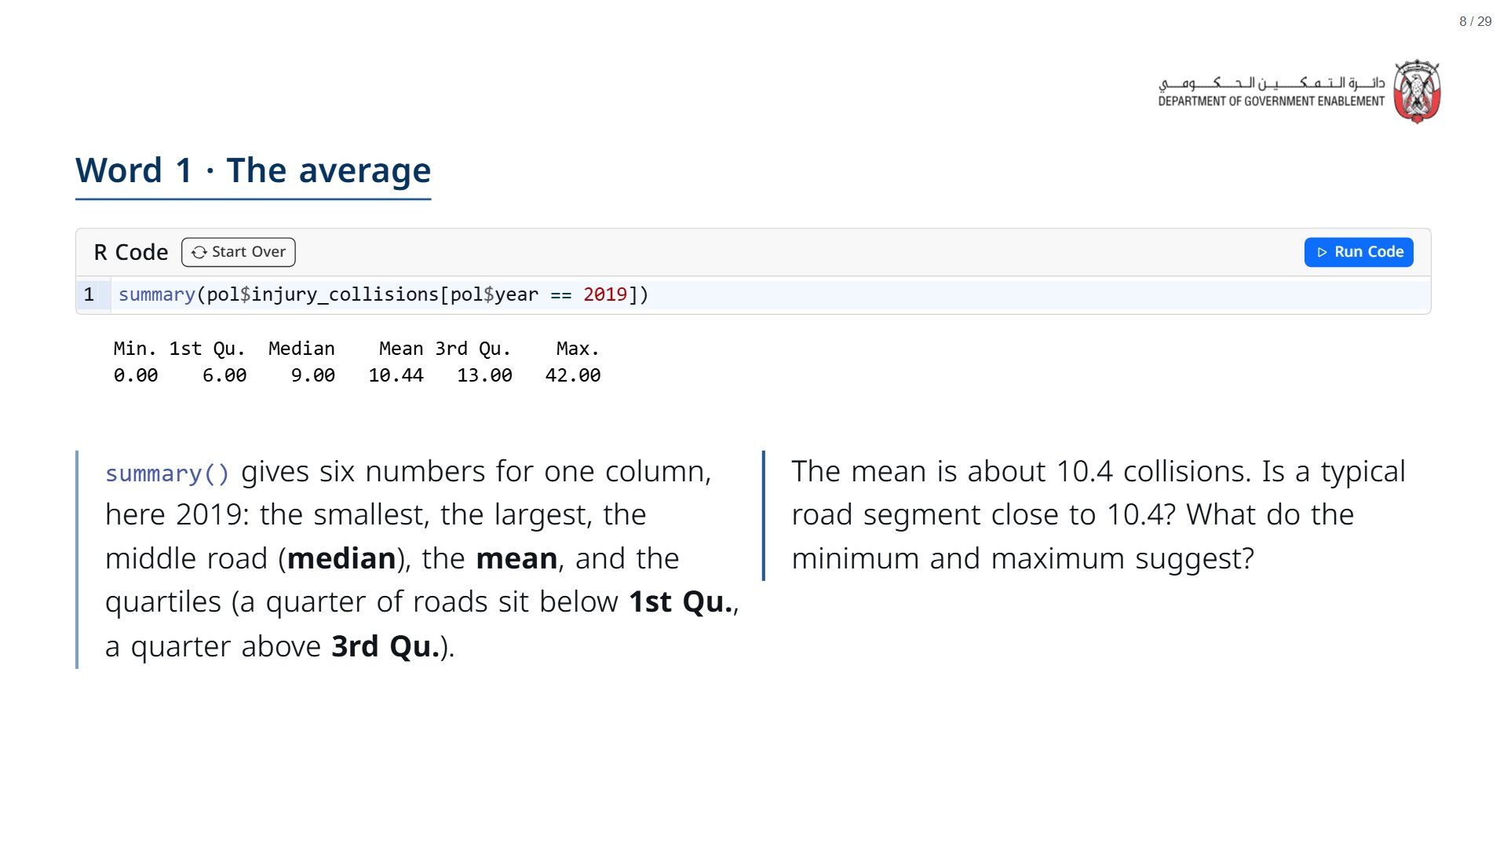

Slide 9
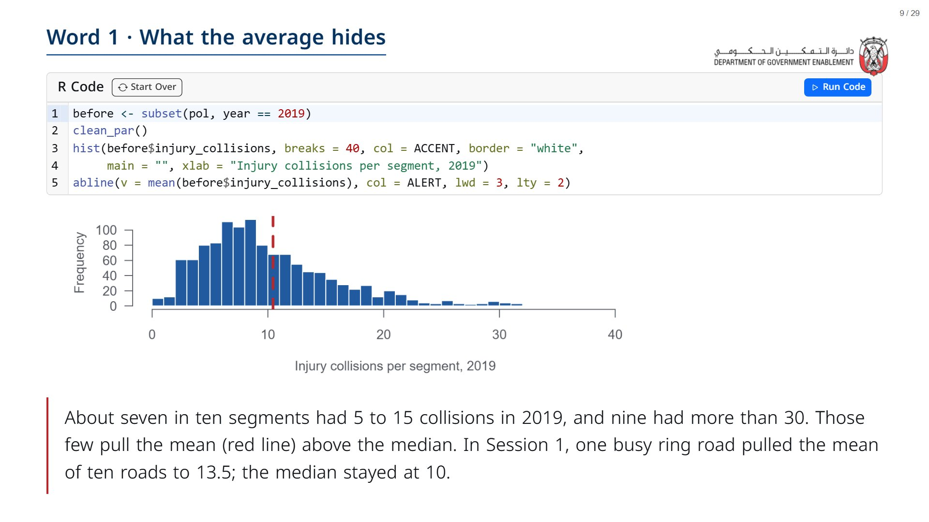

Slide 10

Notes:
Section timing: about 12 minutes.
span.MJX_Assistive_MathML {
position:absolute!important;
clip: rect(1px, 1px, 1px, 1px);
padding: 1px 0 0 0!important;
border: 0!important;
height: 1px!important;
width: 1px!important;
overflow: hidden!important;
display:block!important;
}

Slide 11
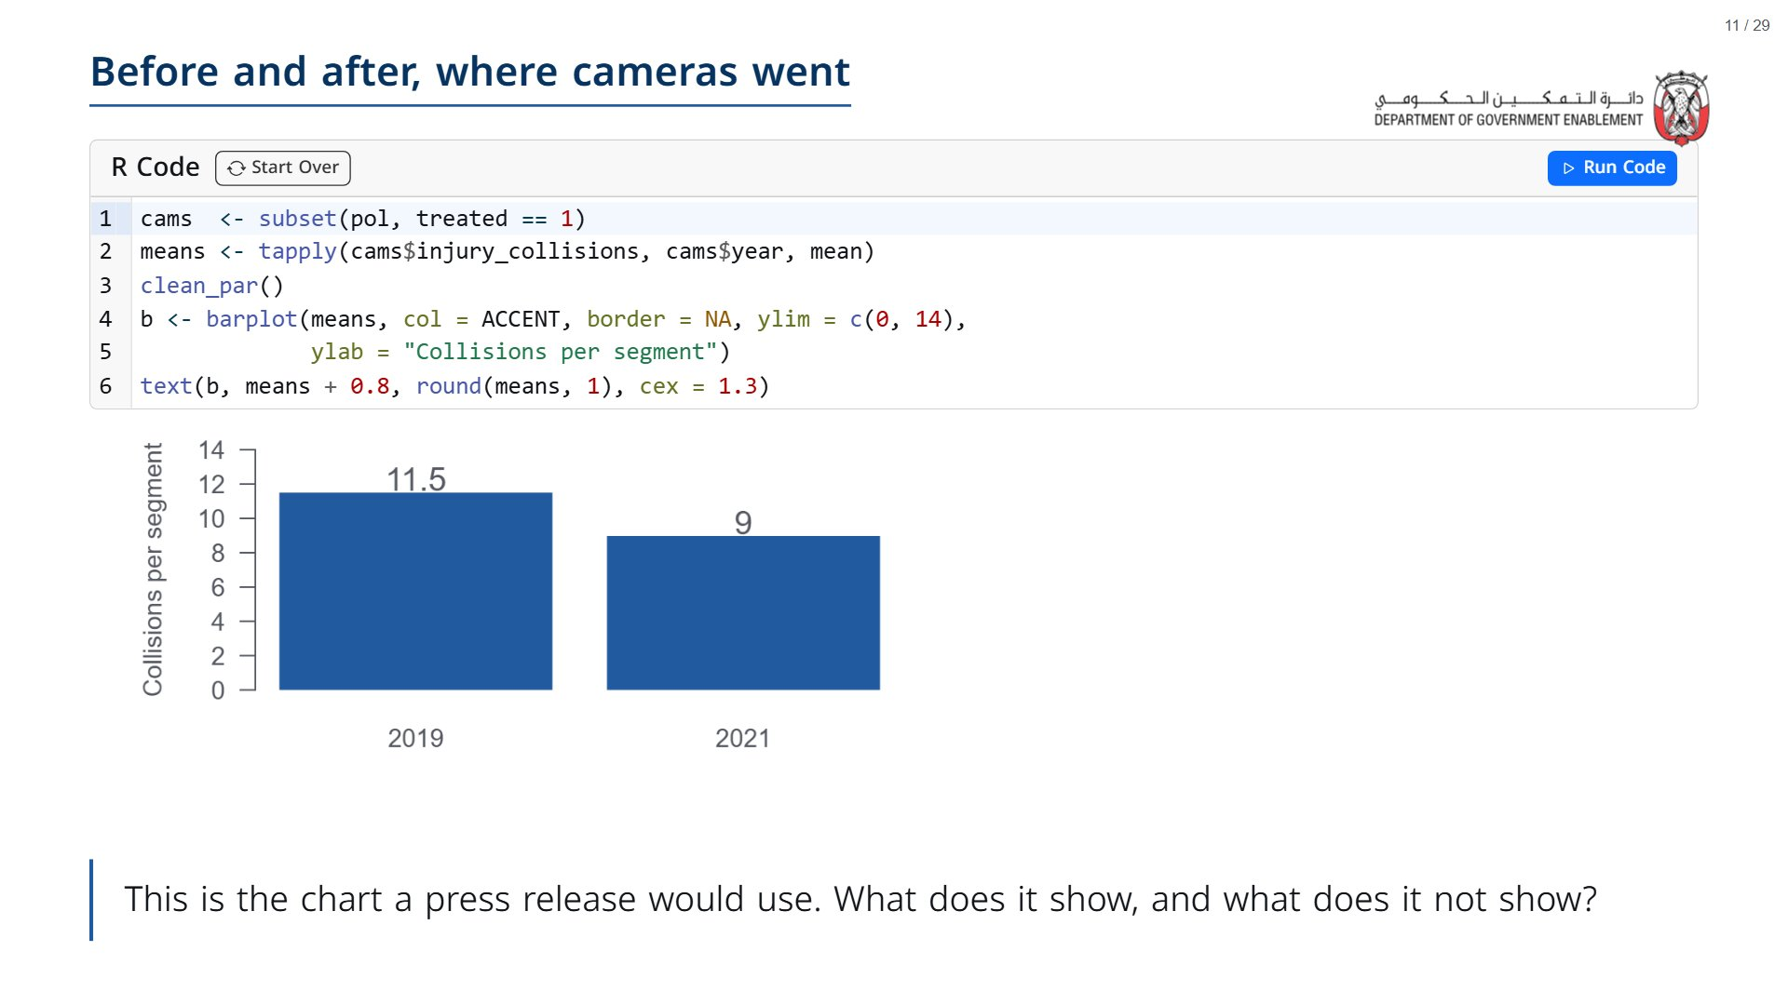

Slide 12
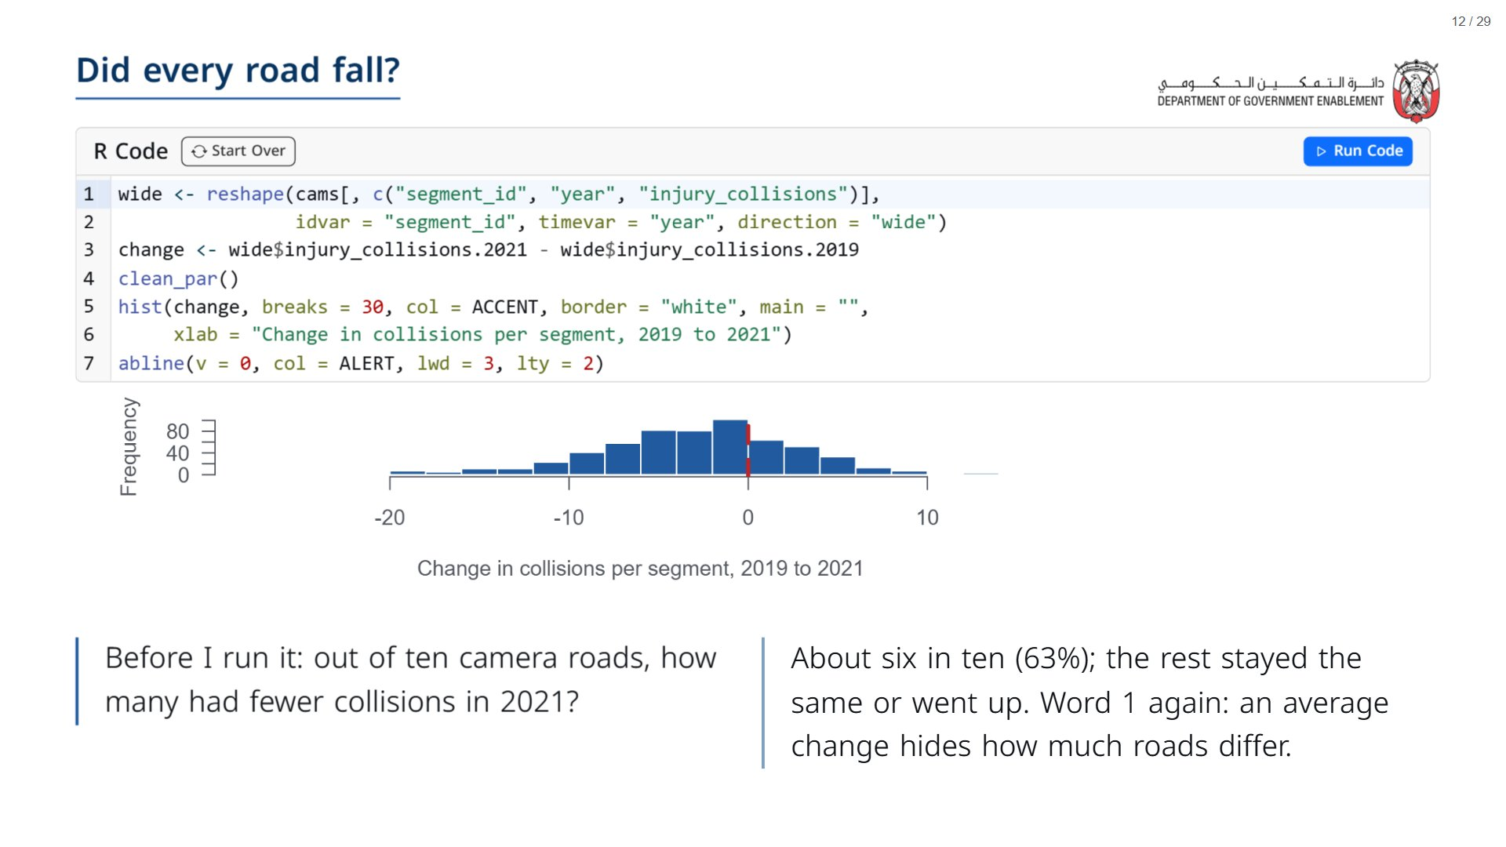

Slide 13
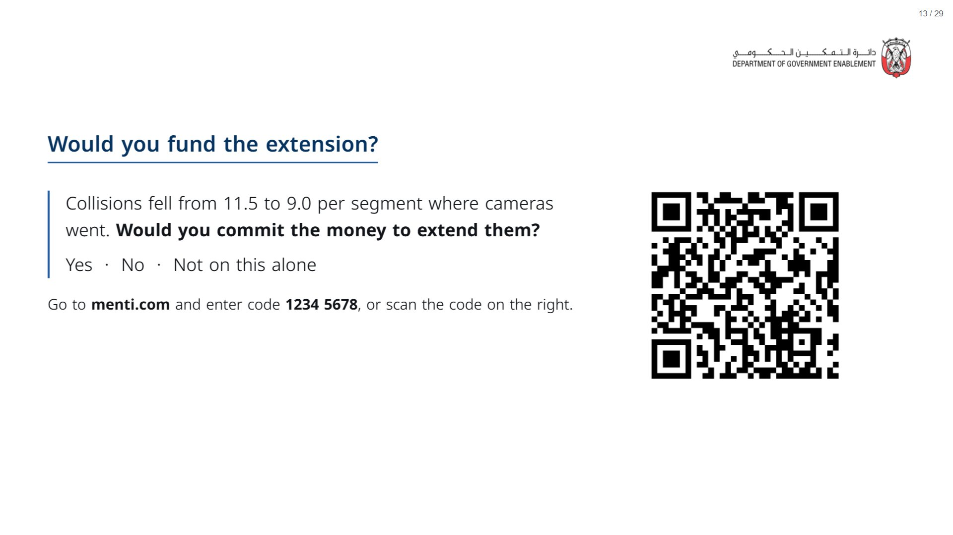
Notes:
Leave the vote open. We look at the results again at the end of the session.
span.MJX_Assistive_MathML {
position:absolute!important;
clip: rect(1px, 1px, 1px, 1px);
padding: 1px 0 0 0!important;
border: 0!important;
height: 1px!important;
width: 1px!important;
overflow: hidden!important;
display:block!important;
}

Slide 14

Notes:
Section timing: about 20 minutes.
span.MJX_Assistive_MathML {
position:absolute!important;
clip: rect(1px, 1px, 1px, 1px);
padding: 1px 0 0 0!important;
border: 0!important;
height: 1px!important;
width: 1px!important;
overflow: hidden!important;
display:block!important;
}

Slide 15
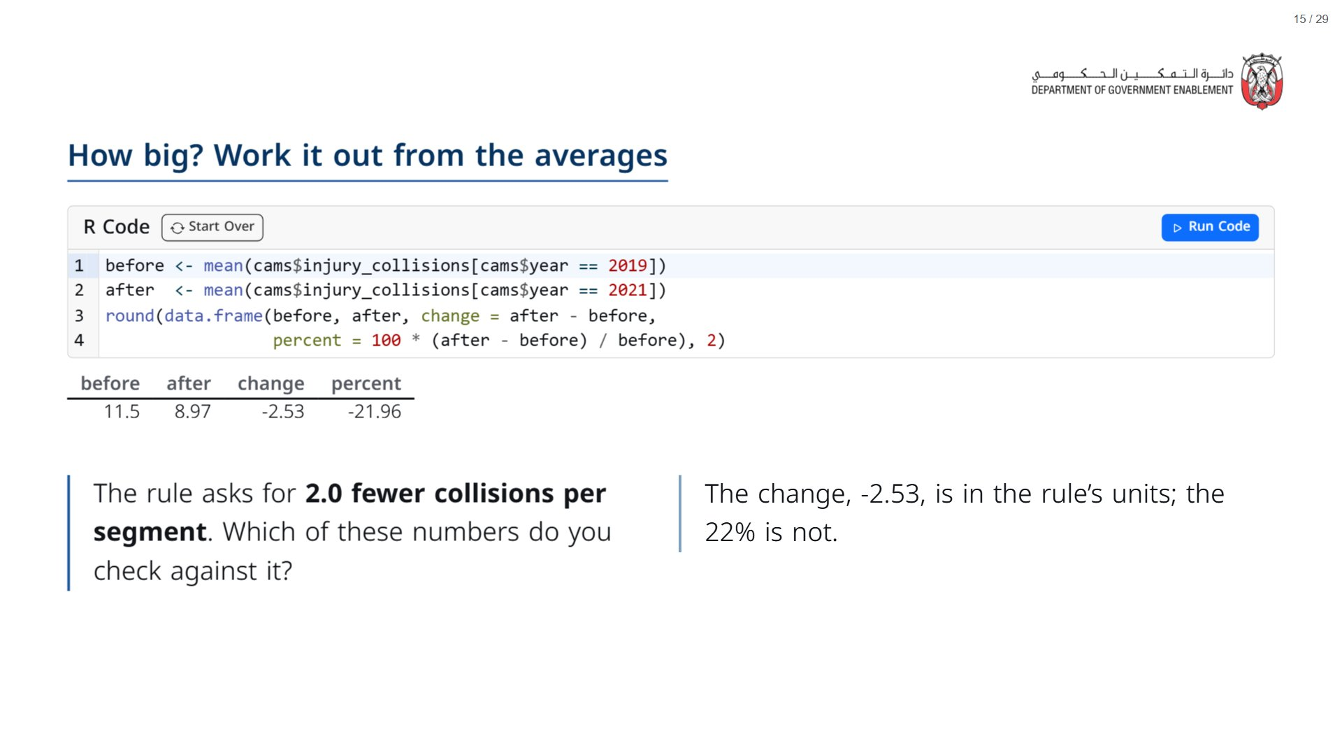

Slide 16
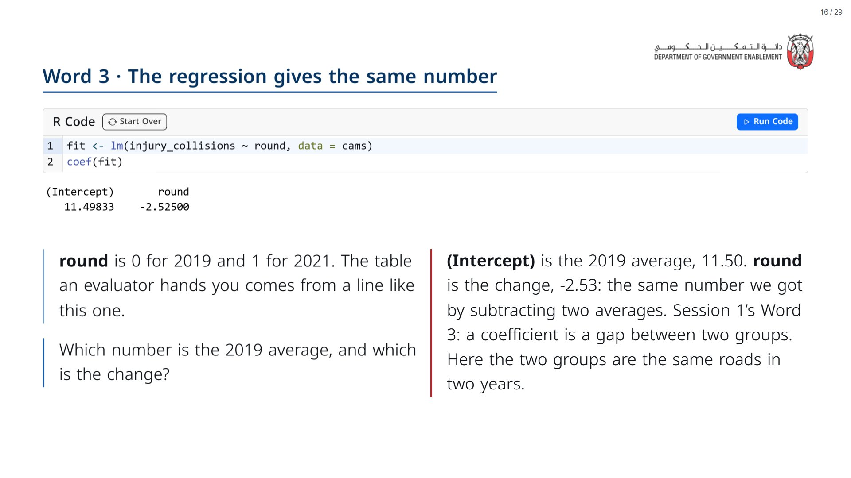

Slide 17
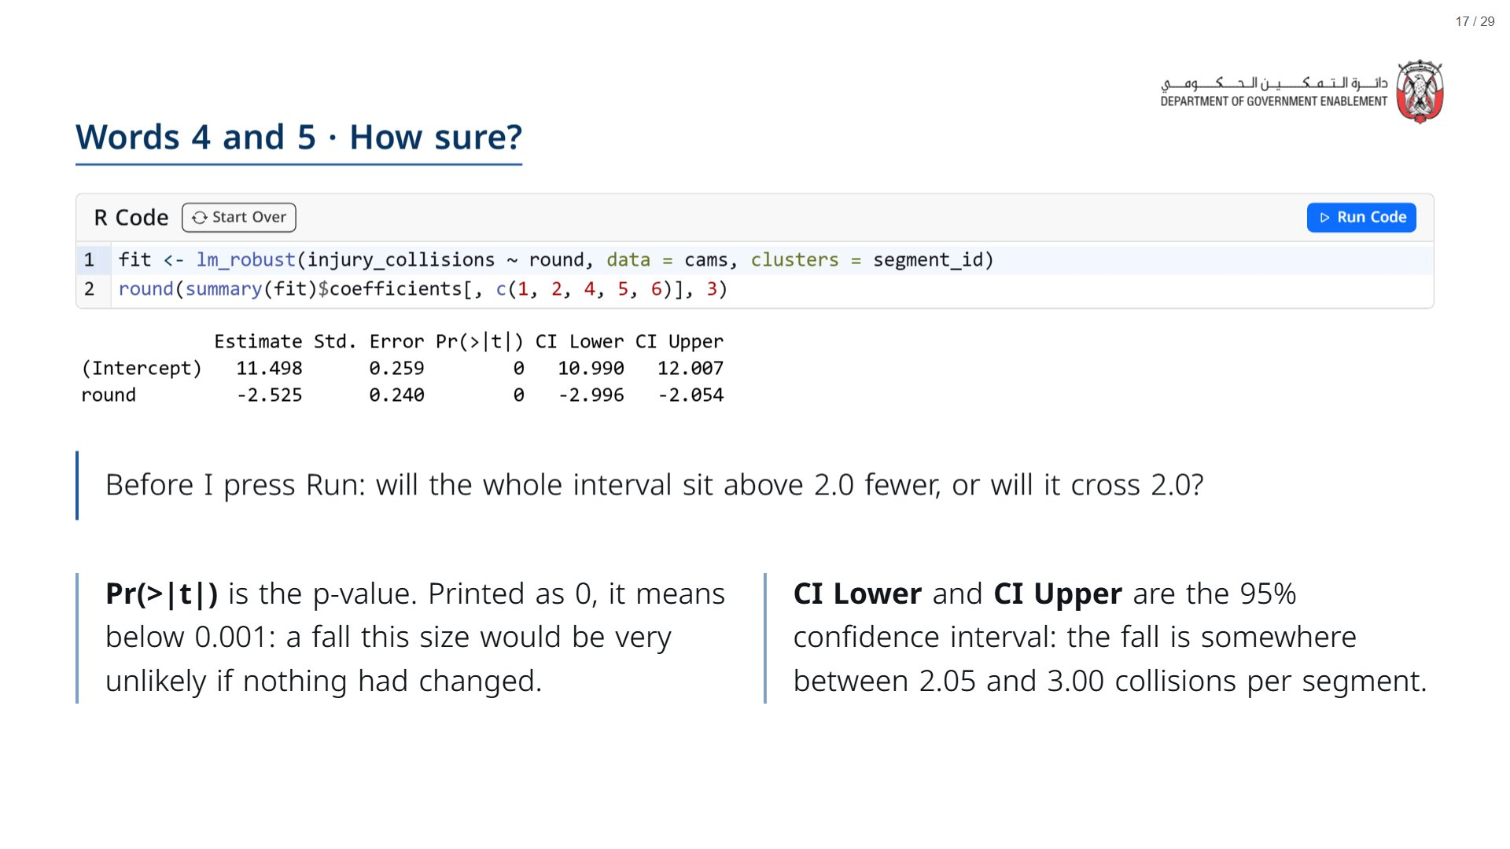
Notes:
lm_robust with clusters = segment_id counts each road once rather than twice, because the same segment appears in 2019 and 2021. Session 3 returns to why this matters. Vocabulary recap from Session 1: the standard error is how much the estimate would move from sample to sample; the p-value is how surprising the result would be if nothing had changed; the confidence interval is the range of plausible values.
span.MJX_Assistive_MathML {
position:absolute!important;
clip: rect(1px, 1px, 1px, 1px);
padding: 1px 0 0 0!important;
border: 0!important;
height: 1px!important;
width: 1px!important;
overflow: hidden!important;
display:block!important;
}

Slide 18
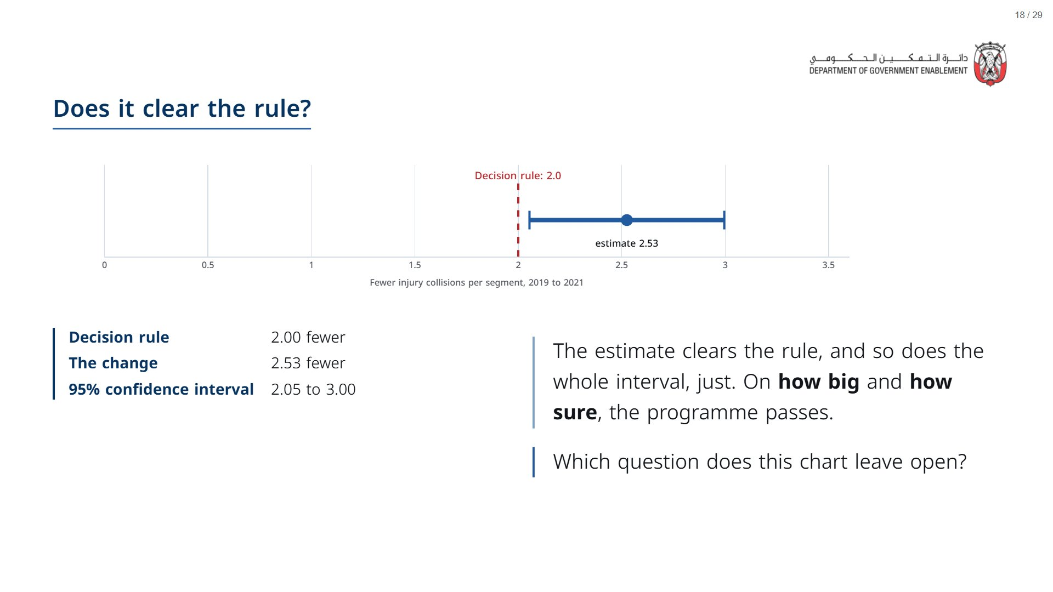

Slide 19

Notes:
Section timing: about 15 minutes.
span.MJX_Assistive_MathML {
position:absolute!important;
clip: rect(1px, 1px, 1px, 1px);
padding: 1px 0 0 0!important;
border: 0!important;
height: 1px!important;
width: 1px!important;
overflow: hidden!important;
display:block!important;
}

Slide 20
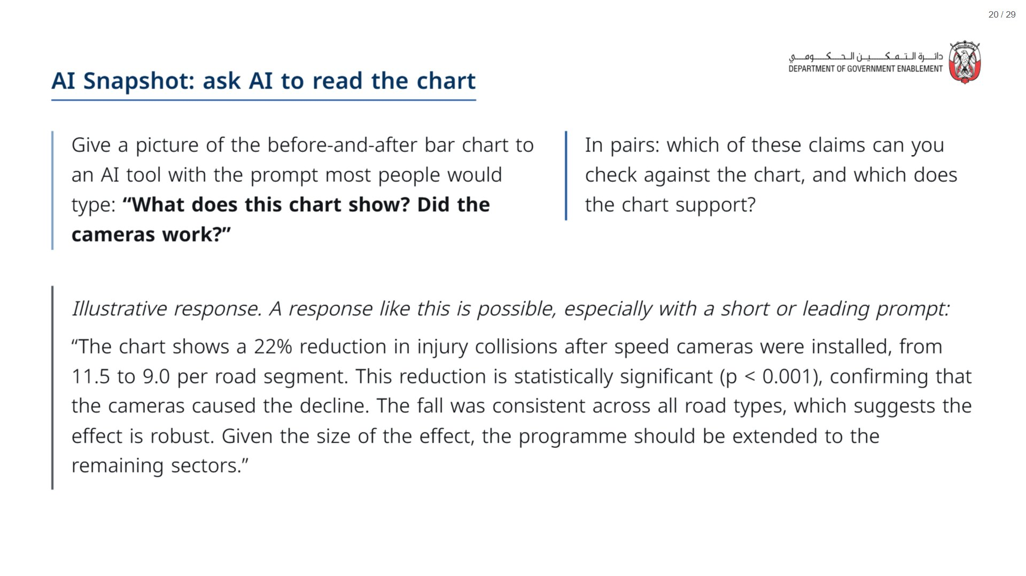
Notes:
Paper (Oct12_session2_materials.docx): Hand out the “AI Snapshot” sheet (pack page 2, one per pair). Pairs photograph the chart on the printed sheet and attach it to the prompt.
span.MJX_Assistive_MathML {
position:absolute!important;
clip: rect(1px, 1px, 1px, 1px);
padding: 1px 0 0 0!important;
border: 0!important;
height: 1px!important;
width: 1px!important;
overflow: hidden!important;
display:block!important;
}

Slide 21
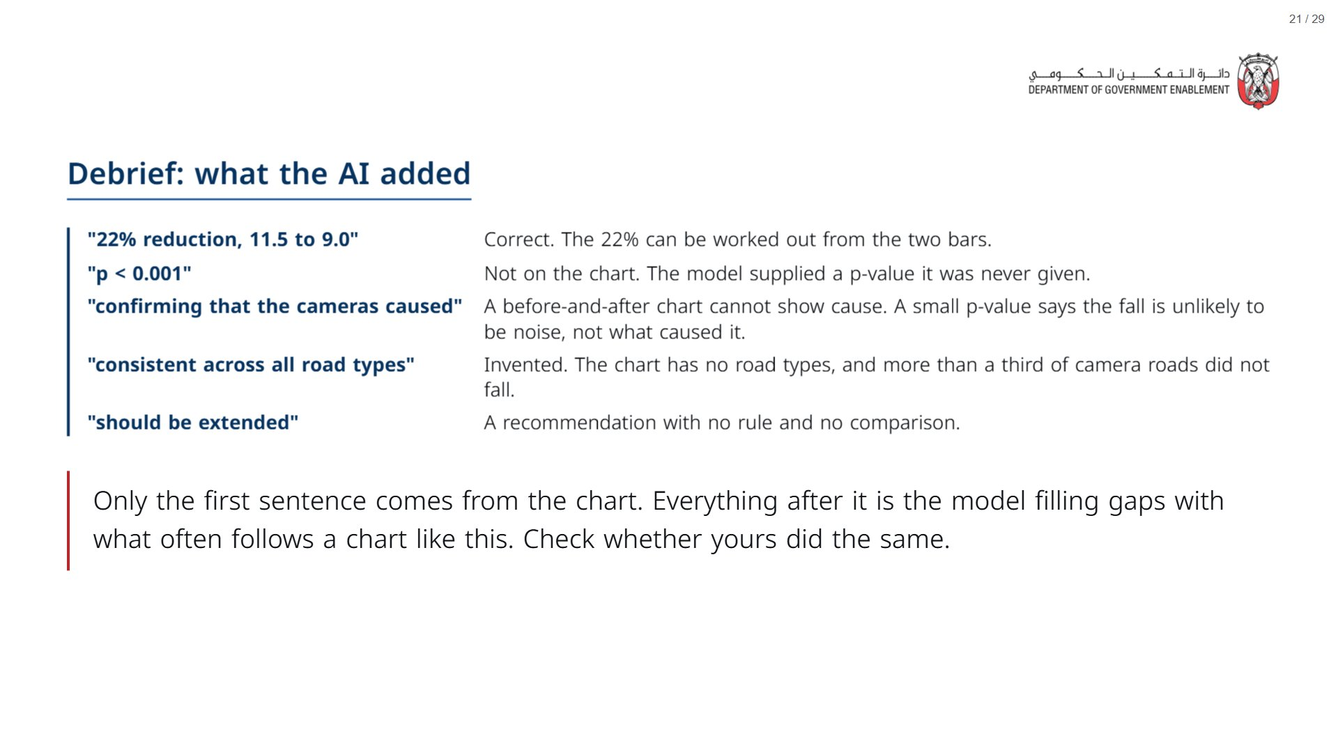

Slide 22
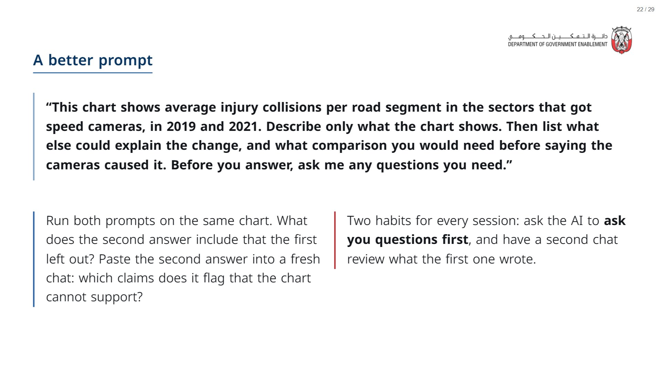
Notes:
Pairs use the sheet from the AI Snapshot slide: they photograph the chart on the printed sheet and attach the photo to each prompt.
~7 min for groups to run both prompts, ~3 min to take answers. Listen for: the second answer asks what happened on roads without cameras, and whether traffic changed.
span.MJX_Assistive_MathML {
position:absolute!important;
clip: rect(1px, 1px, 1px, 1px);
padding: 1px 0 0 0!important;
border: 0!important;
height: 1px!important;
width: 1px!important;
overflow: hidden!important;
display:block!important;
}

Slide 23

Notes:
Section timing: about 10 minutes.
span.MJX_Assistive_MathML {
position:absolute!important;
clip: rect(1px, 1px, 1px, 1px);
padding: 1px 0 0 0!important;
border: 0!important;
height: 1px!important;
width: 1px!important;
overflow: hidden!important;
display:block!important;
}

Slide 24
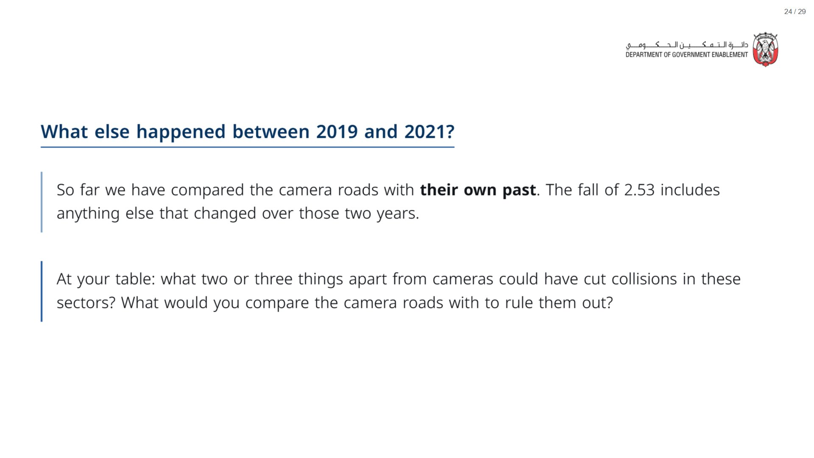
Notes:
Likely answers: a national safety campaign, new vehicles, fewer trips during 2020, road works, police patrols. For comparisons, steer the room towards “roads that did not get cameras over the same years”.
span.MJX_Assistive_MathML {
position:absolute!important;
clip: rect(1px, 1px, 1px, 1px);
padding: 1px 0 0 0!important;
border: 0!important;
height: 1px!important;
width: 1px!important;
overflow: hidden!important;
display:block!important;
}

Slide 25
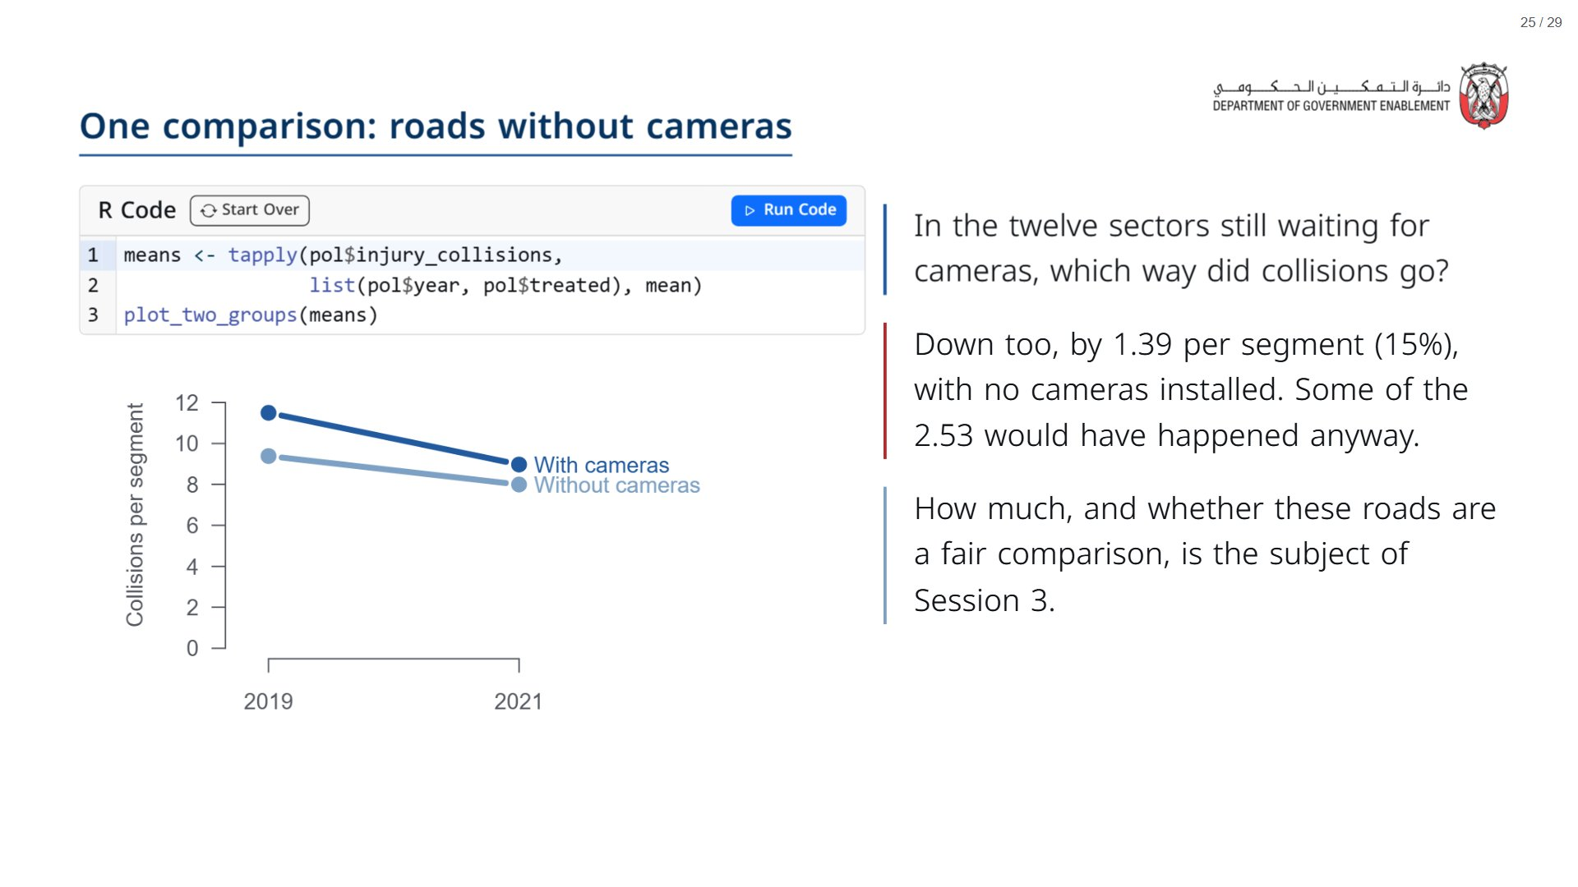

Slide 26
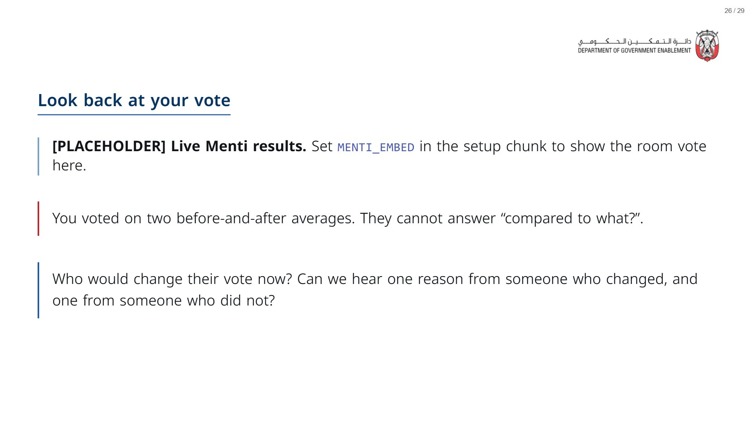

Slide 27

Notes:
Section timing: about 10 minutes.
span.MJX_Assistive_MathML {
position:absolute!important;
clip: rect(1px, 1px, 1px, 1px);
padding: 1px 0 0 0!important;
border: 0!important;
height: 1px!important;
width: 1px!important;
overflow: hidden!important;
display:block!important;
}

Slide 28
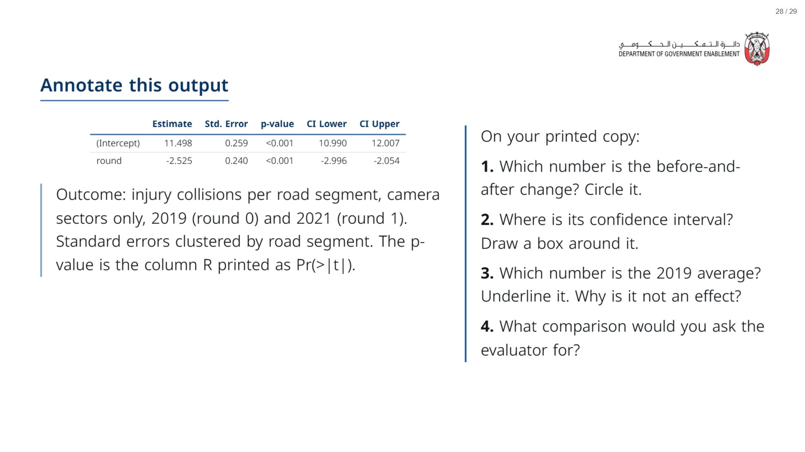
Notes:
Paper (Oct12_session2_materials.docx): Hand out the “Annotate this output” sheet (pack page 1, one per participant).
Four minutes. Question 4 carries into Session 3.
span.MJX_Assistive_MathML {
position:absolute!important;
clip: rect(1px, 1px, 1px, 1px);
padding: 1px 0 0 0!important;
border: 0!important;
height: 1px!important;
width: 1px!important;
overflow: hidden!important;
display:block!important;
}

Slide 29
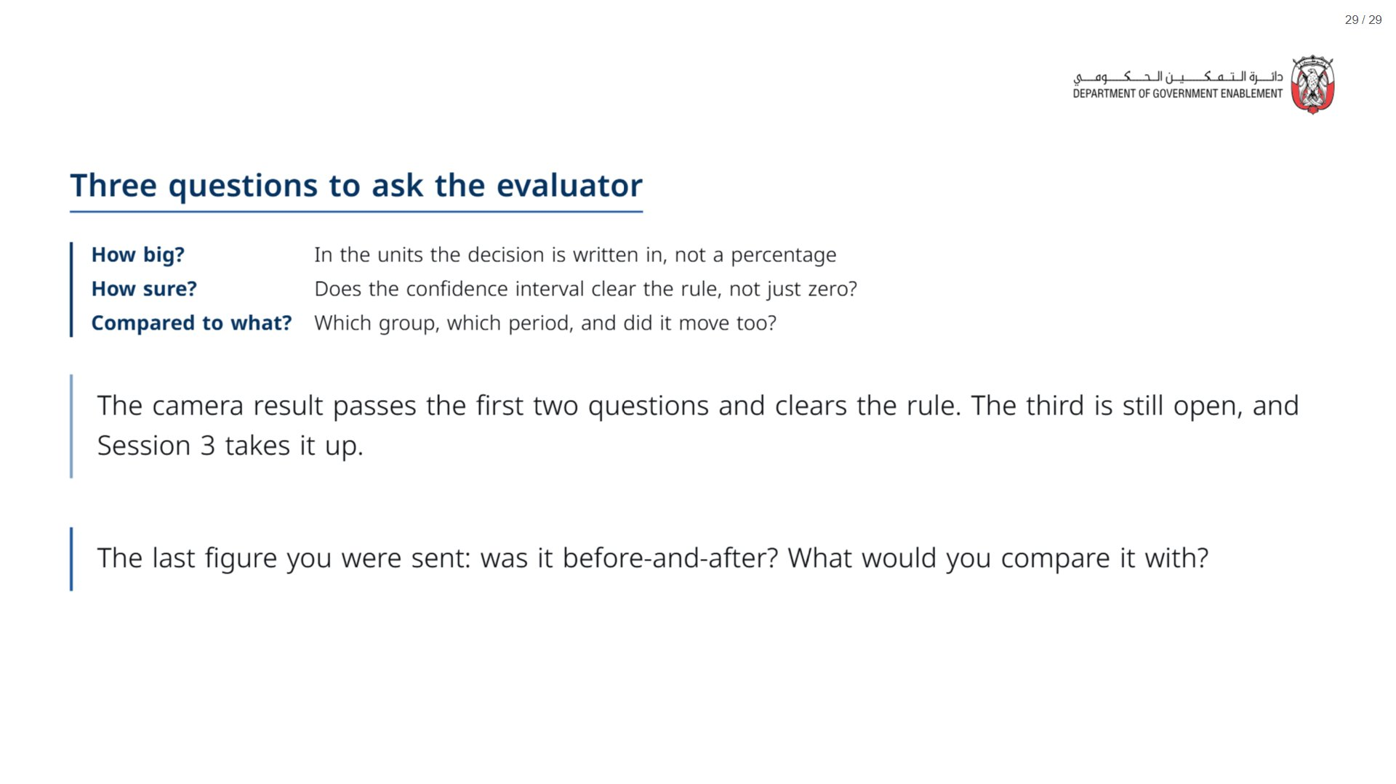
Notes:
Paper (Oct12_session2_materials.docx): Hand out the take-away cards (pack page 3, one per participant, cut into cards).
Give one minute for everyone to fill in the “On my desk” line on their card.
span.MJX_Assistive_MathML {
position:absolute!important;
clip: rect(1px, 1px, 1px, 1px);
padding: 1px 0 0 0!important;
border: 0!important;
height: 1px!important;
width: 1px!important;
overflow: hidden!important;
display:block!important;
}

