Slide 1


Slide 2


Slide 3
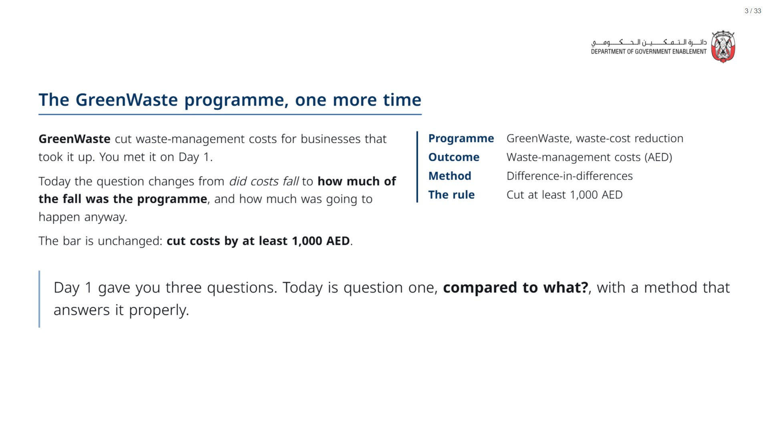
Notes:
Sections 1 and 2 are the “remember” recap: aim for 5 to 10 minutes total. The room already met GreenWaste, the before-and-after and with-and-without numbers, and the idea of subtracting one group’s change from the other’s (on the traffic cameras in Day 1 Session 1). Move through the recall quickly. The new material today is reading the table (Section 3) and the one assumption DiD rests on (Section 4): that is where the time should go.
span.MJX_Assistive_MathML {
position:absolute!important;
clip: rect(1px, 1px, 1px, 1px);
padding: 1px 0 0 0!important;
border: 0!important;
height: 1px!important;
width: 1px!important;
overflow: hidden!important;
display:block!important;
}

Slide 4
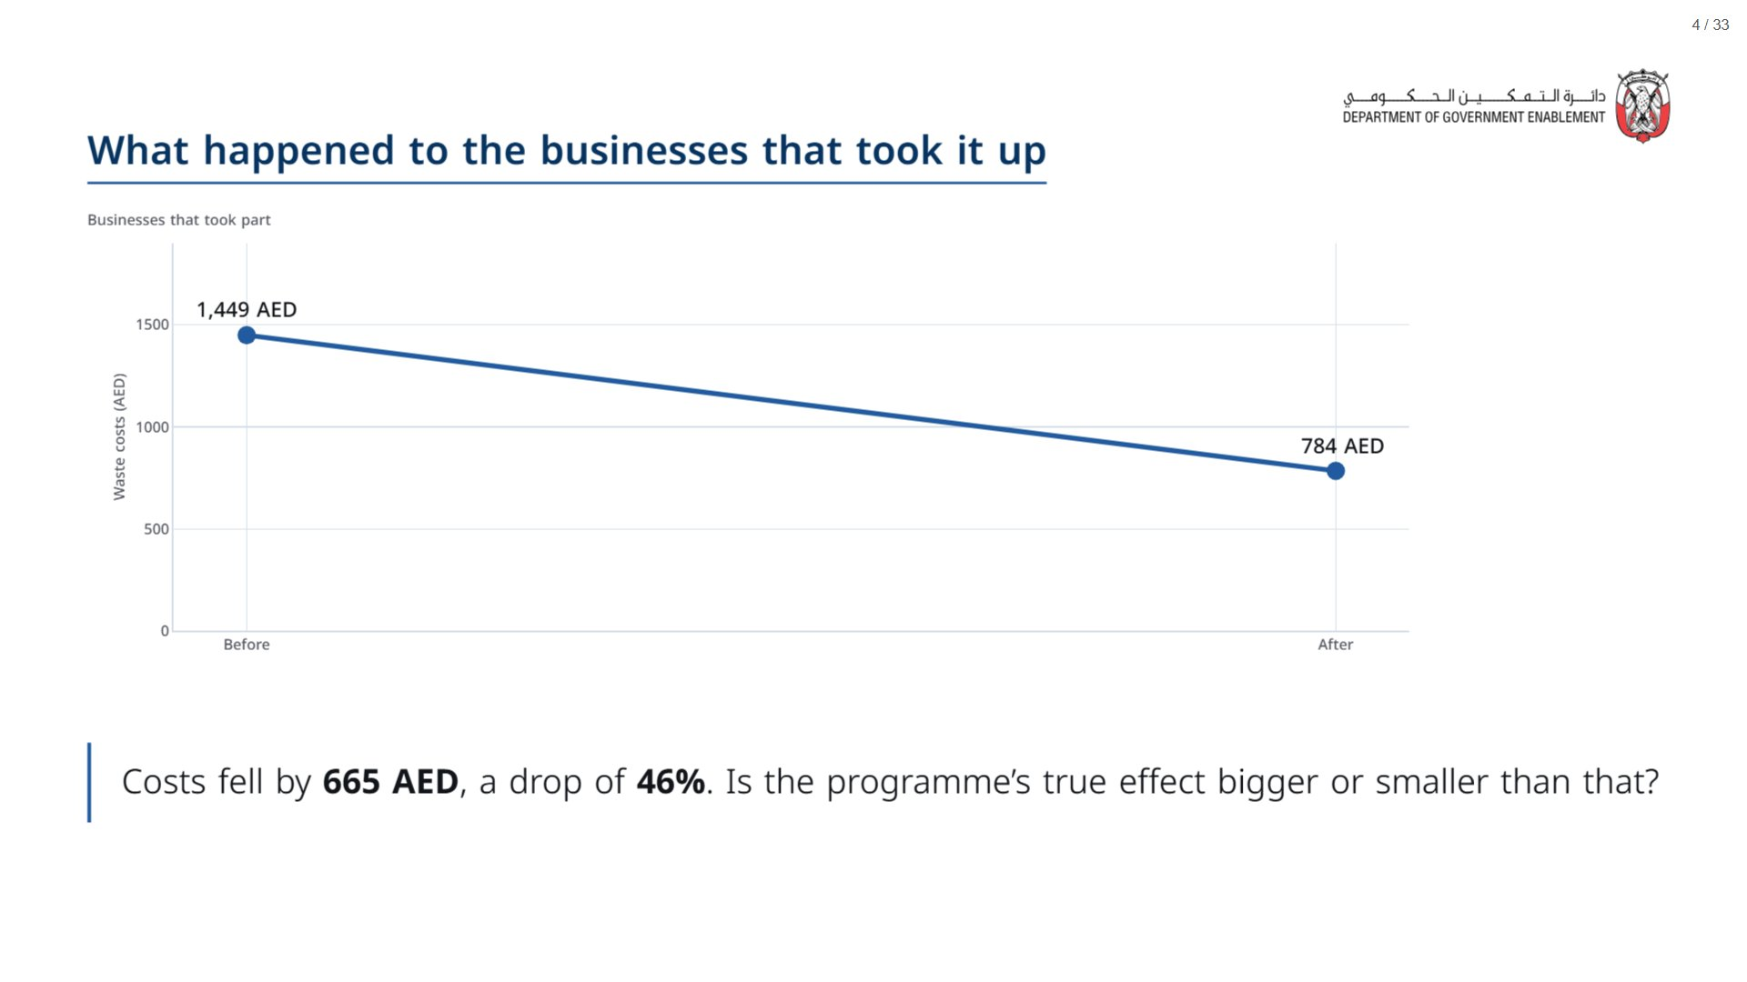
Notes:
Do not editorialise. Present it the way an evaluator might present a headline finding, and let it look good. The full picture only appears once the comparison group is on the chart, which is the next move after the Menti.
span.MJX_Assistive_MathML {
position:absolute!important;
clip: rect(1px, 1px, 1px, 1px);
padding: 1px 0 0 0!important;
border: 0!important;
height: 1px!important;
width: 1px!important;
overflow: hidden!important;
display:block!important;
}

Slide 5
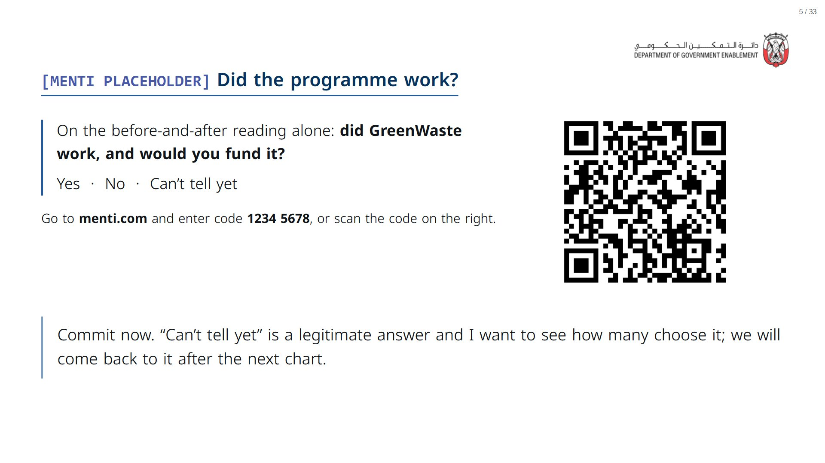

Slide 6
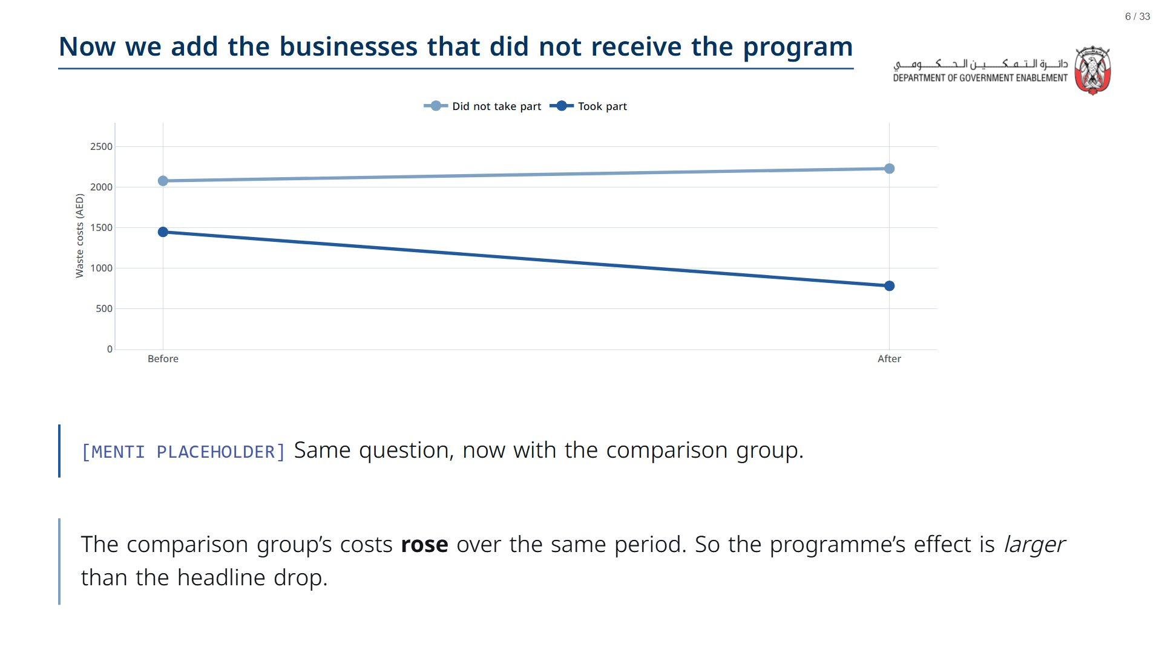
Notes:
Silence for a beat. Let them see the comparison line rising, then ask the Menti question again and watch the hands change. Show the fragment after the vote. We compute the effect exactly next.
span.MJX_Assistive_MathML {
position:absolute!important;
clip: rect(1px, 1px, 1px, 1px);
padding: 1px 0 0 0!important;
border: 0!important;
height: 1px!important;
width: 1px!important;
overflow: hidden!important;
display:block!important;
}

Slide 7
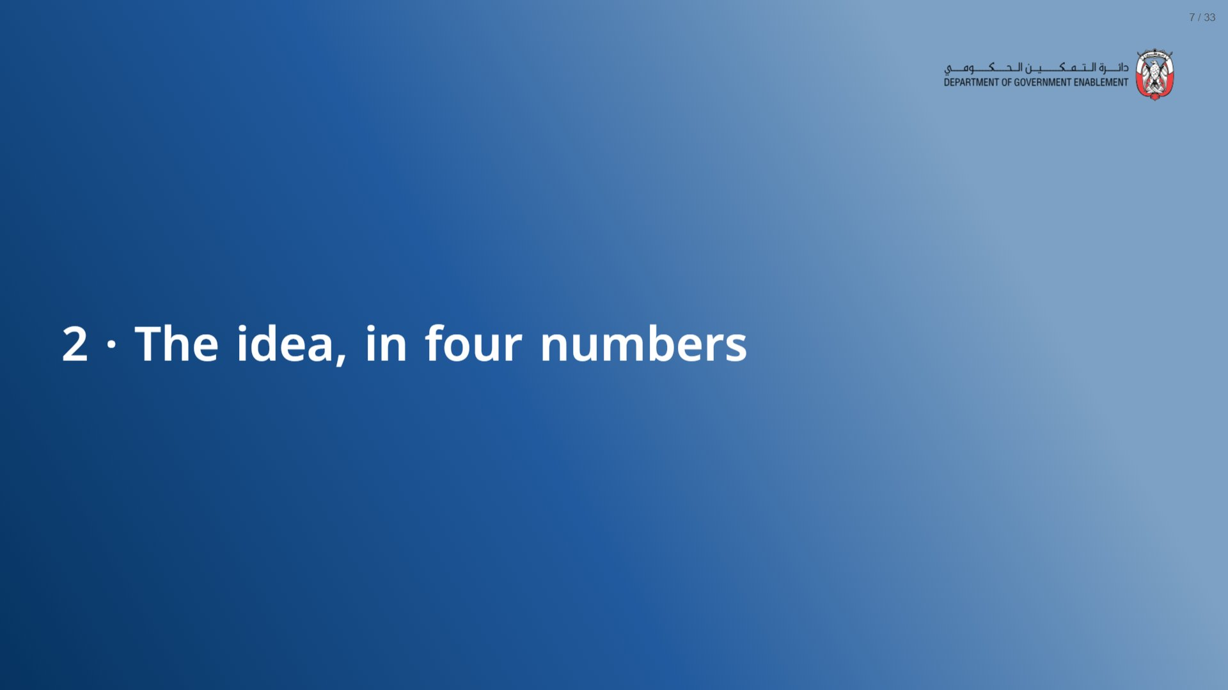

Slide 8
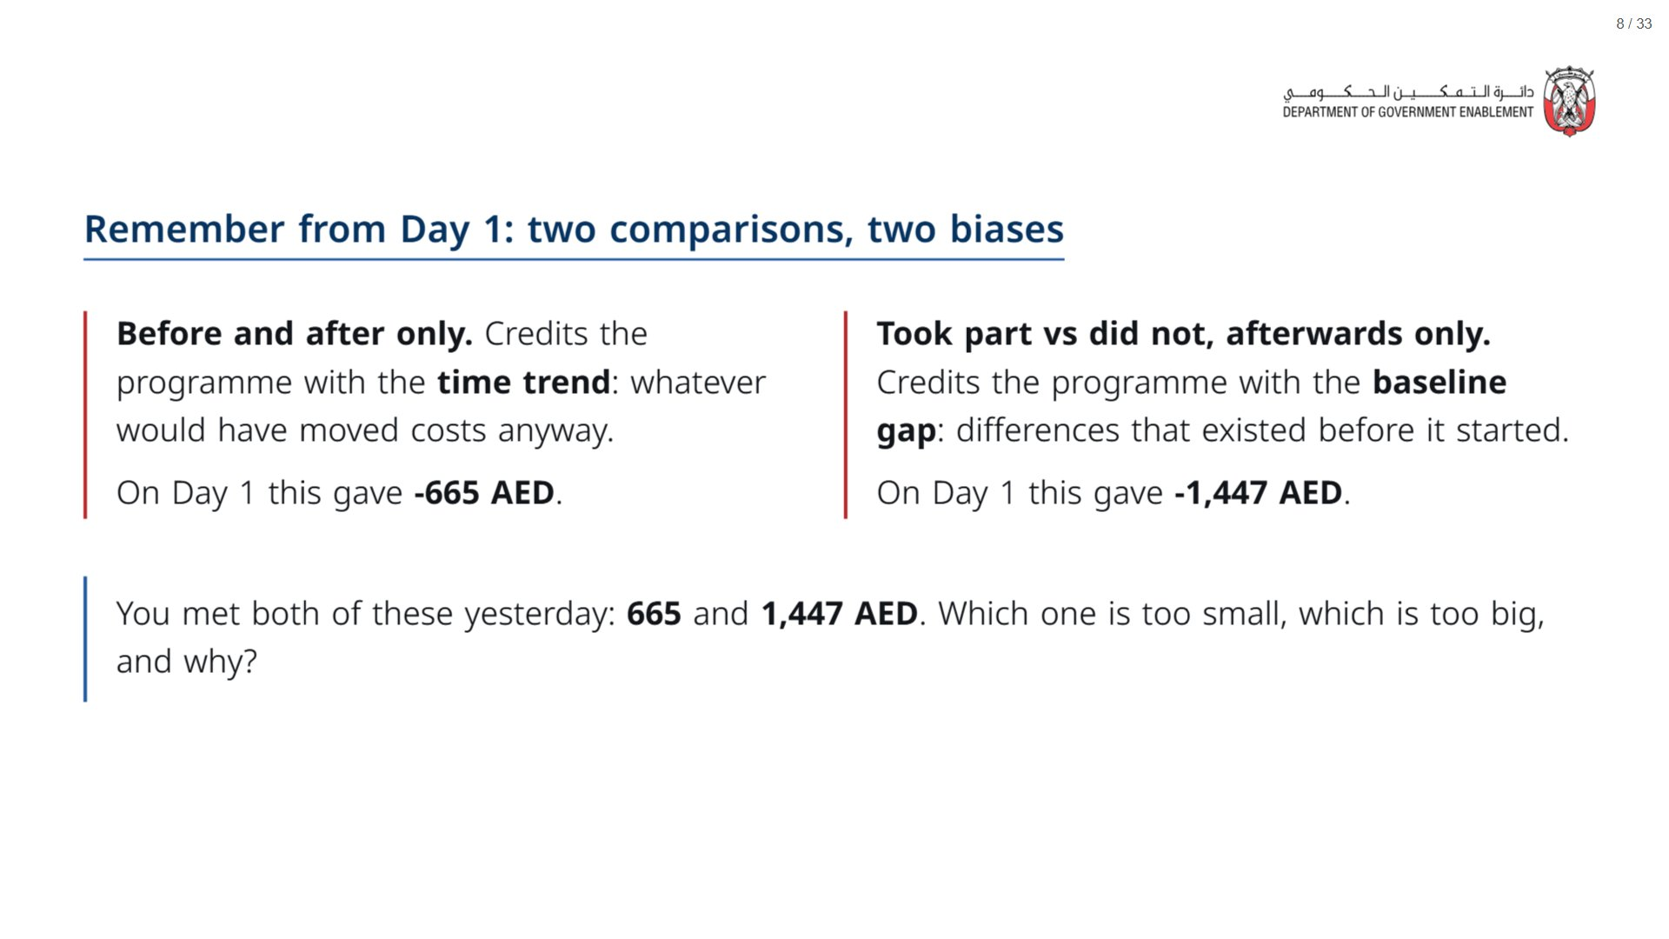
Notes:
Recap: these are the two naive comparisons from Day 1 Session 3, on this same GreenWaste data. Take one answer for each, then say that difference-in-differences removes both problems at once. The new work today is the assumption DiD rests on.
span.MJX_Assistive_MathML {
position:absolute!important;
clip: rect(1px, 1px, 1px, 1px);
padding: 1px 0 0 0!important;
border: 0!important;
height: 1px!important;
width: 1px!important;
overflow: hidden!important;
display:block!important;
}

Slide 9
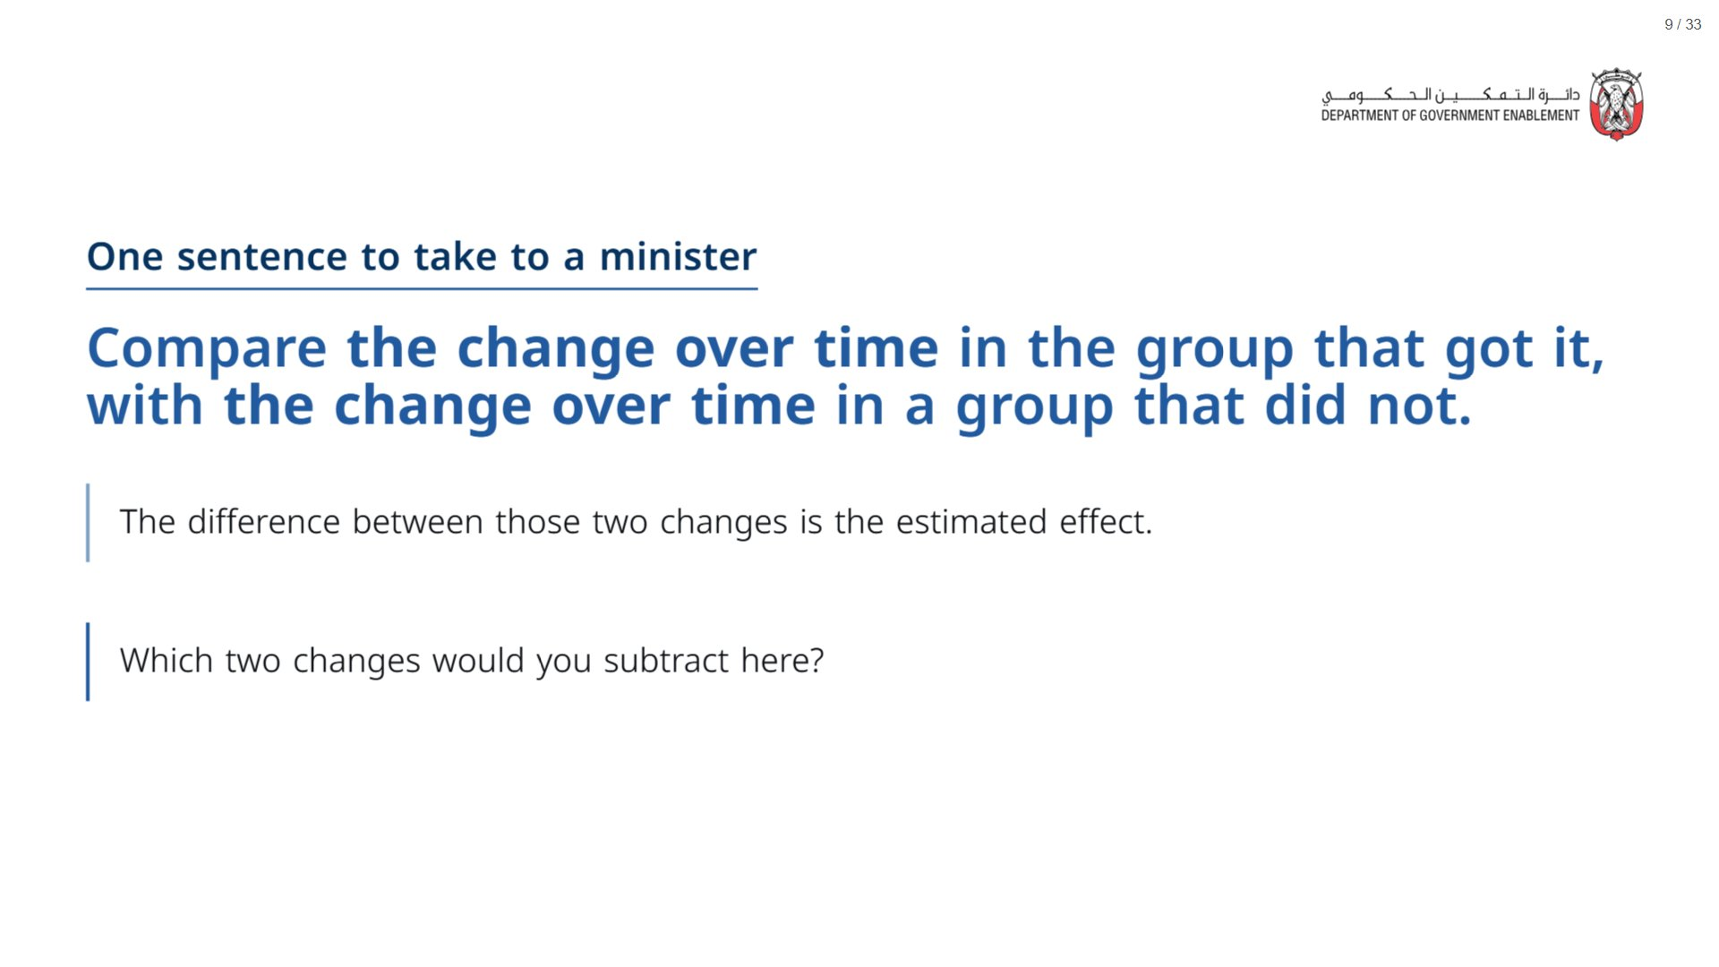

Slide 10
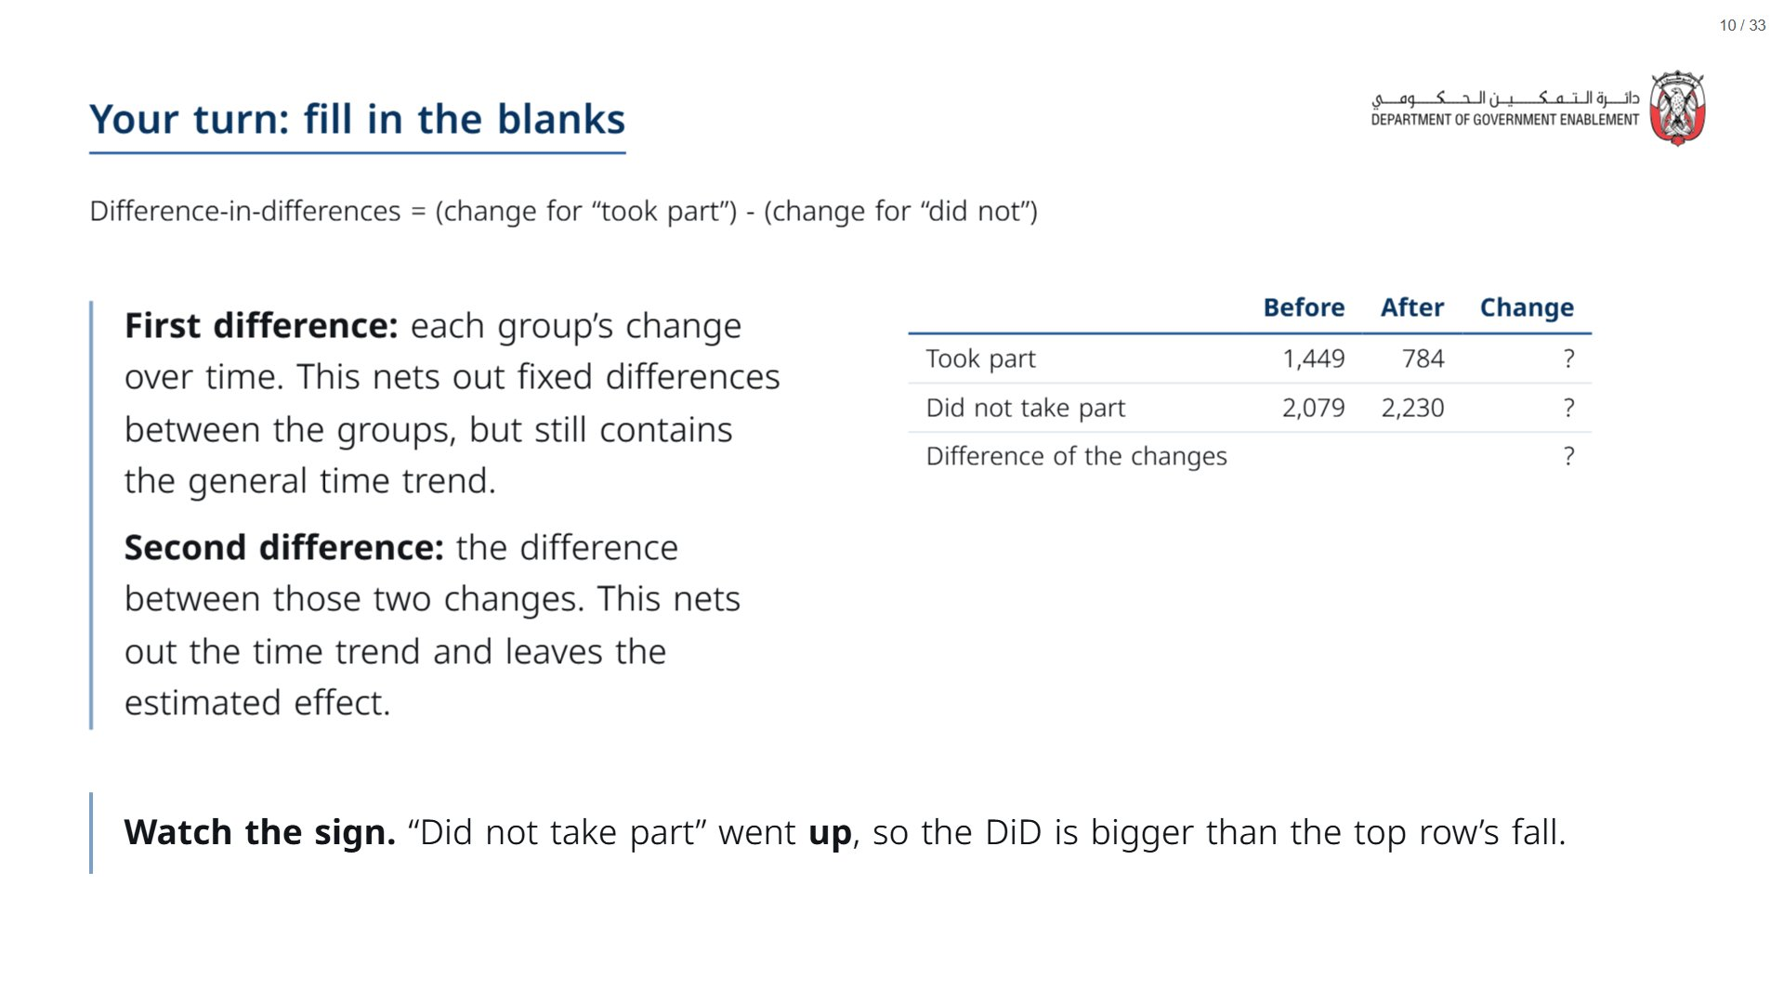
Notes:
Paper (Oct13_session1_materials.docx): Hand out “By hand: four numbers” (pack page 1, one per participant) before this slide.
Give the room under two minutes for the two subtractions.
span.MJX_Assistive_MathML {
position:absolute!important;
clip: rect(1px, 1px, 1px, 1px);
padding: 1px 0 0 0!important;
border: 0!important;
height: 1px!important;
width: 1px!important;
overflow: hidden!important;
display:block!important;
}

Slide 11
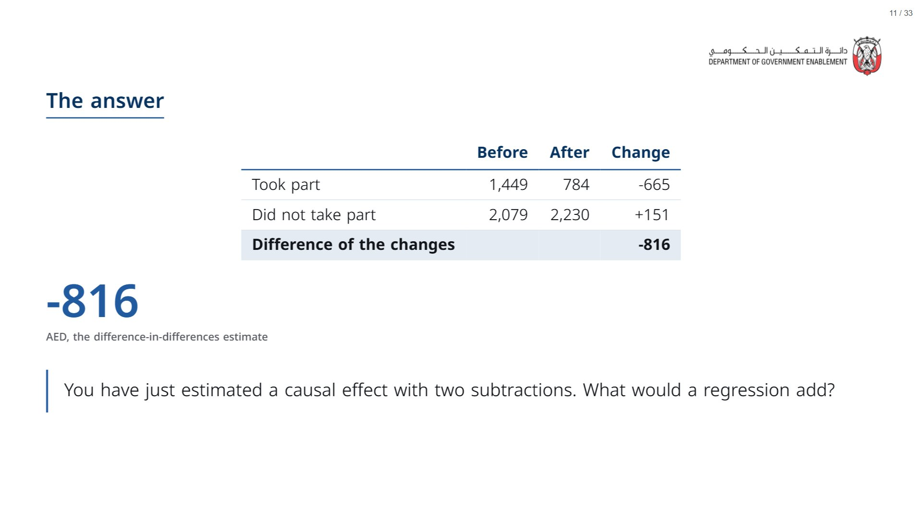
Notes:
Answer to the ask: the same two subtractions, plus a confidence interval.
span.MJX_Assistive_MathML {
position:absolute!important;
clip: rect(1px, 1px, 1px, 1px);
padding: 1px 0 0 0!important;
border: 0!important;
height: 1px!important;
width: 1px!important;
overflow: hidden!important;
display:block!important;
}

Slide 12
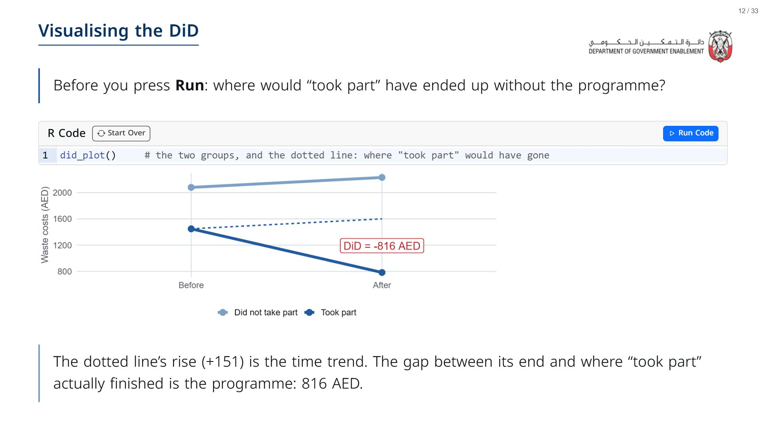

Slide 13


Slide 14
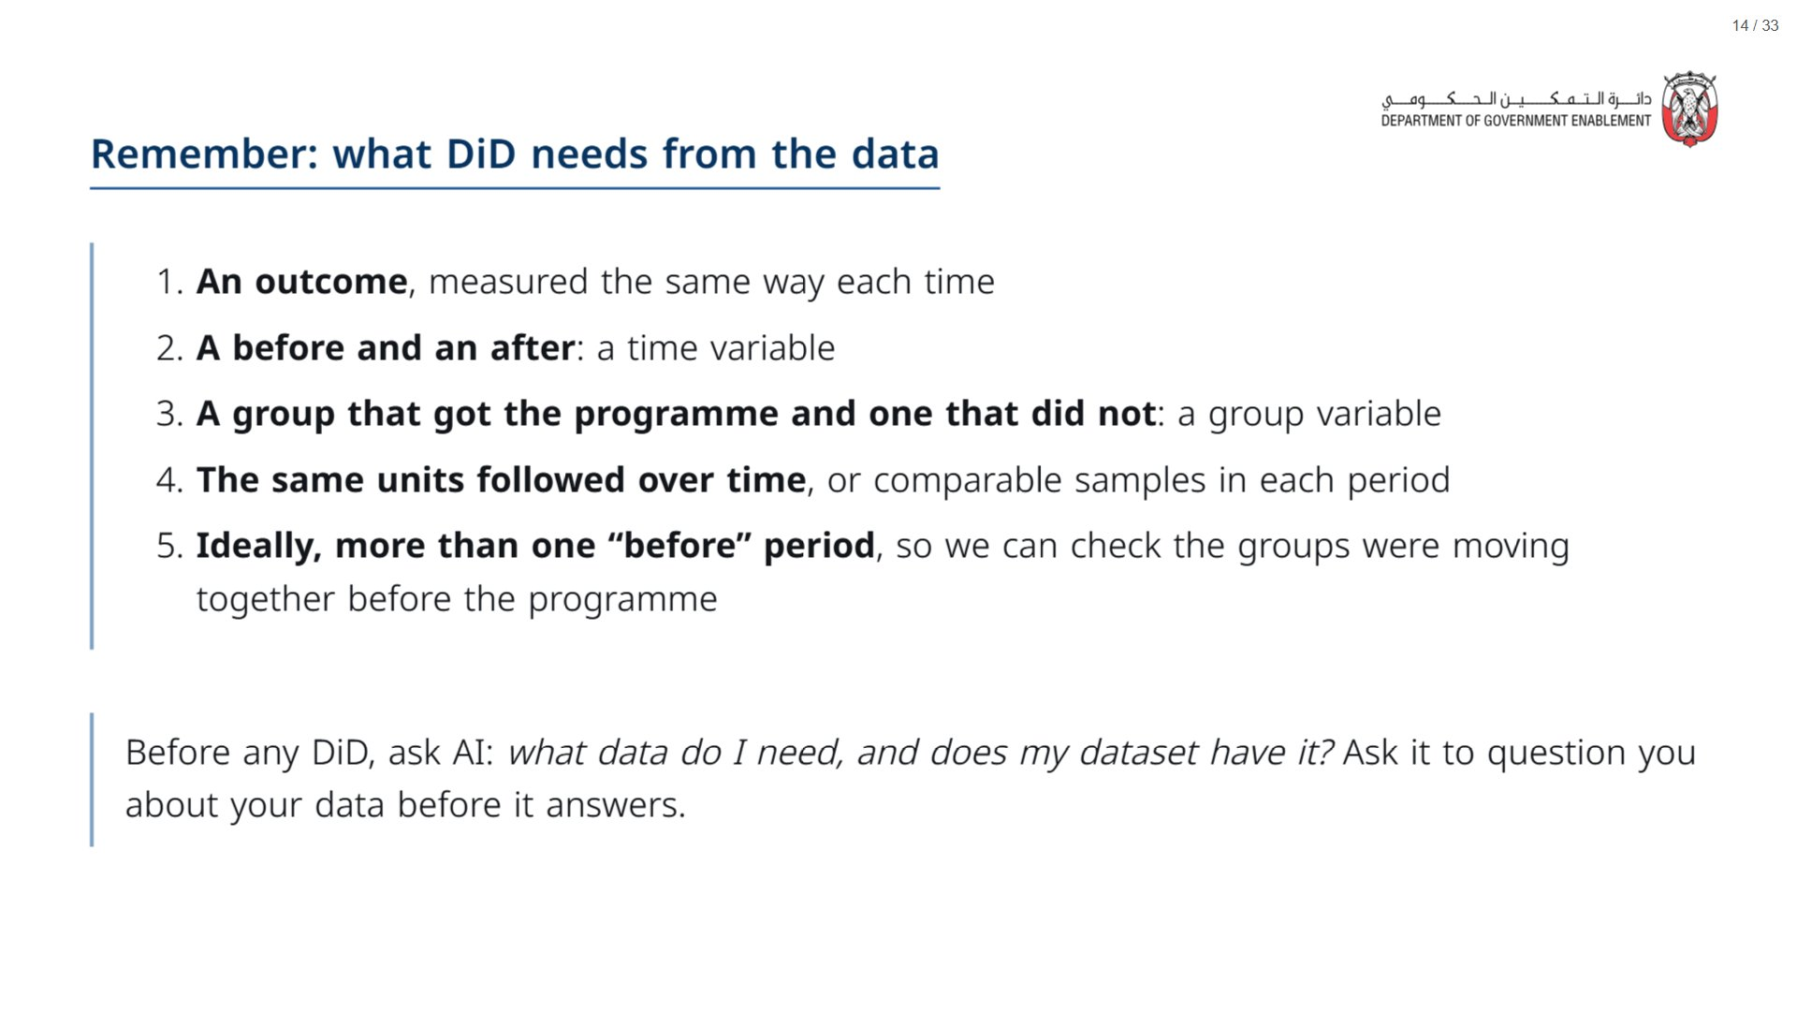
Notes:
Tie each item back to the minister sentence: “the change over time” needs items 2 and 4; “in a group that did not” needs item 3. Item 5 is a deliberate foreshadow of Section 4. Do not resolve it here.
span.MJX_Assistive_MathML {
position:absolute!important;
clip: rect(1px, 1px, 1px, 1px);
padding: 1px 0 0 0!important;
border: 0!important;
height: 1px!important;
width: 1px!important;
overflow: hidden!important;
display:block!important;
}

Slide 15
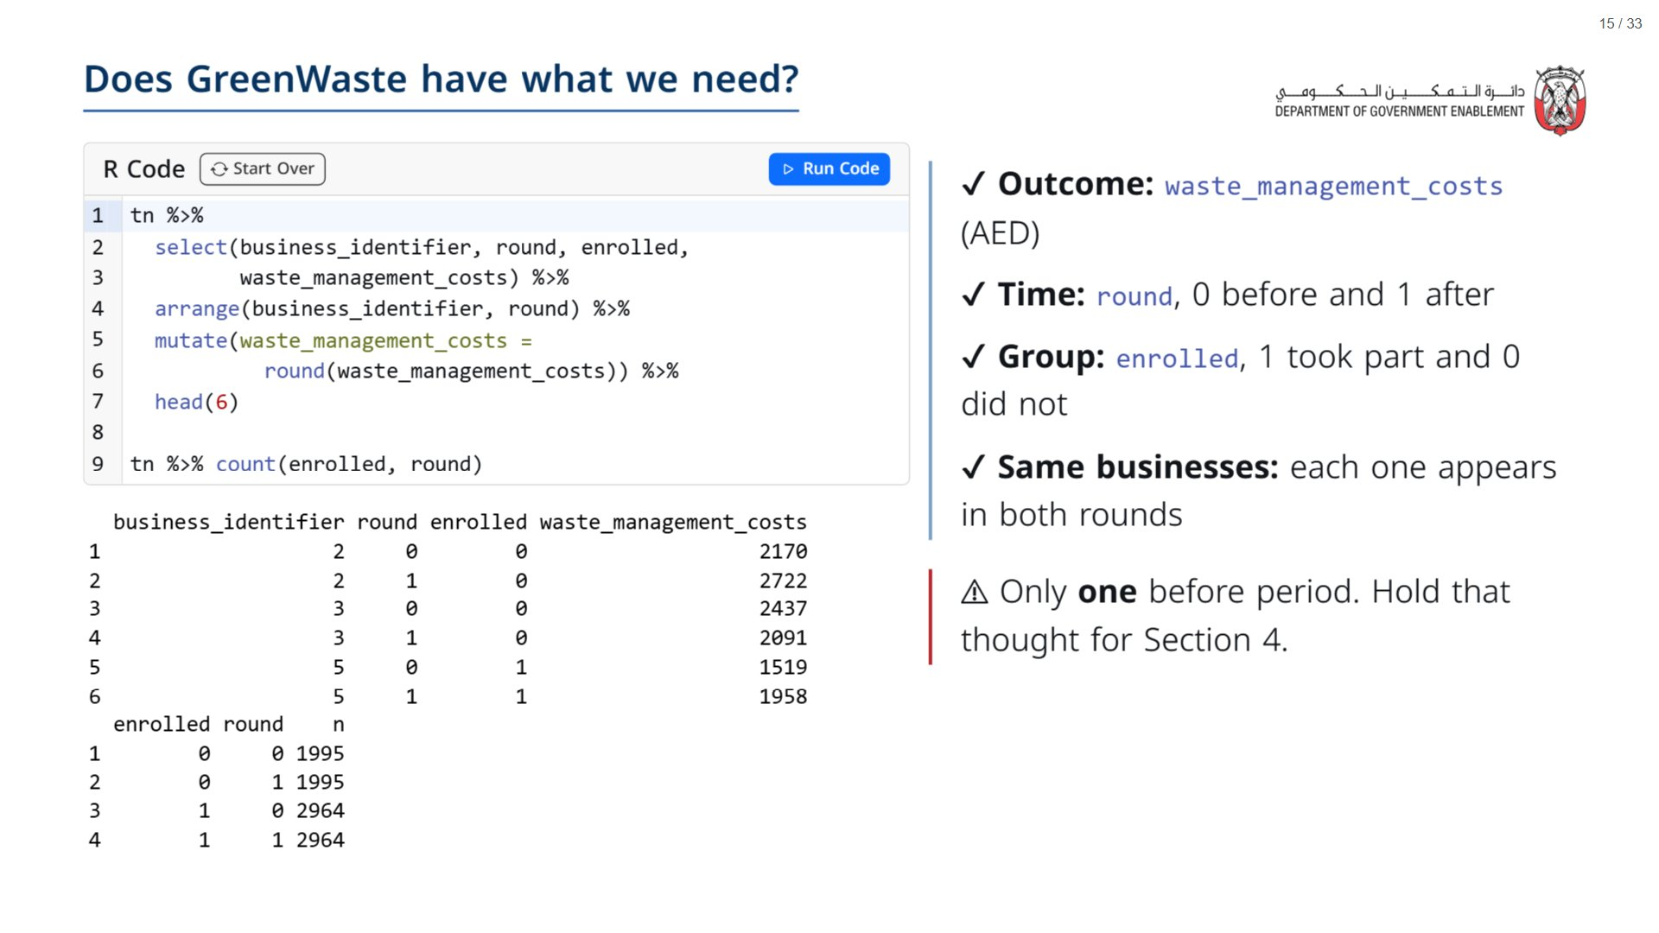
Notes:
Press Run. Read one business across its two rows (business 11 went from about 1,308 to 240 AED) so the room sees “one row per business per round”. The counts table shows 2,964 businesses that took part and 1,995 that did not, each observed in both rounds (4,959 businesses in total).
If asked about tn: it is the businesses in the neighbourhoods where the programme was offered (treatment_neighborhood == 1). Within those, every business scoring below the eligibility cut-off of 58 enrolled and none above it did, so “did not take part” means the businesses above the cut-off. That is our comparison.
The warning sets up “What this data can and cannot show” in Section 4: with a single pre-period, parallel pre-trends cannot be tested.
span.MJX_Assistive_MathML {
position:absolute!important;
clip: rect(1px, 1px, 1px, 1px);
padding: 1px 0 0 0!important;
border: 0!important;
height: 1px!important;
width: 1px!important;
overflow: hidden!important;
display:block!important;
}

Slide 16
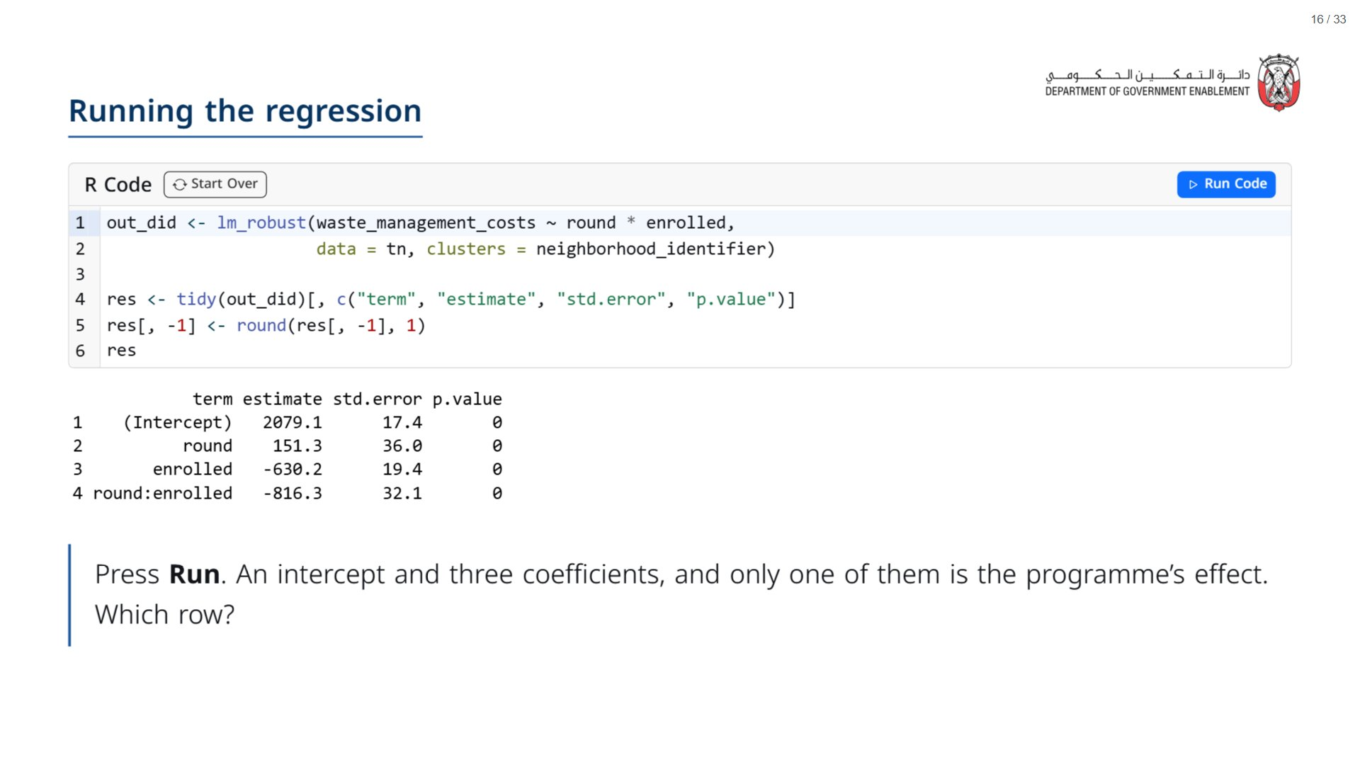
Notes:
Paper (Oct13_session1_materials.docx): Hand out “Which row is the impact?” (pack page 2, one per participant) now, after the hand calculation. Tell the room to leave question 4 until Section 4 (“What this data can and cannot show”).
Before running, point at the formula: round * enrolled gives the time indicator, the group indicator and their interaction (round:enrolled), and the clusters line clusters standard errors by neighbourhood.
Run the chunk live, then take a vote across the three coefficients. Many will pick enrolled because it is large and has the word “enrolled” in it; that is the trap the next slides unpack. The number in round:enrolled is the same -816 they got by hand.
span.MJX_Assistive_MathML {
position:absolute!important;
clip: rect(1px, 1px, 1px, 1px);
padding: 1px 0 0 0!important;
border: 0!important;
height: 1px!important;
width: 1px!important;
overflow: hidden!important;
display:block!important;
}

Slide 17
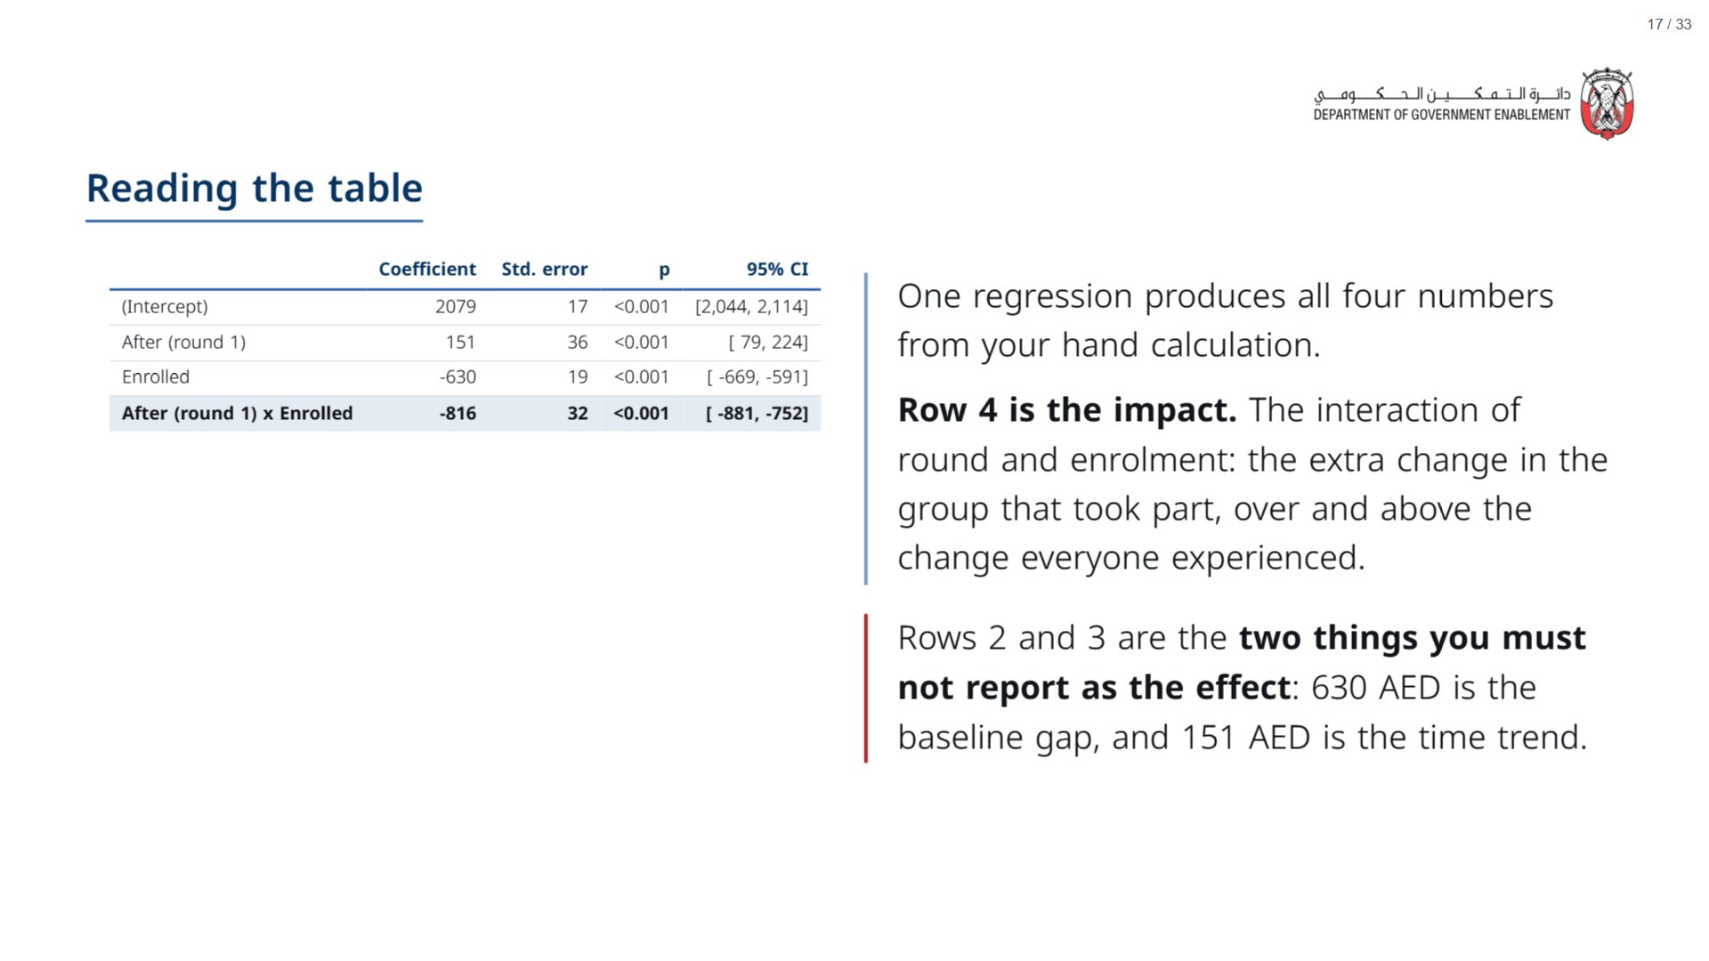
Notes:
Reminder for the room (vocab from Day 1 Session 1): the coefficient is the effect size, here in AED; the 95% confidence interval is the range of plausible true values, not a margin of certainty; the p-value is how surprising this result would be if the programme had truly done nothing. Walk row 4 first, then name rows 2 and 3 as the two numbers a careless report would quote instead. Facilitation question worth asking here: which row would you want on the front page of the briefing, and which two would a careless evaluator report?
span.MJX_Assistive_MathML {
position:absolute!important;
clip: rect(1px, 1px, 1px, 1px);
padding: 1px 0 0 0!important;
border: 0!important;
height: 1px!important;
width: 1px!important;
overflow: hidden!important;
display:block!important;
}

Slide 18
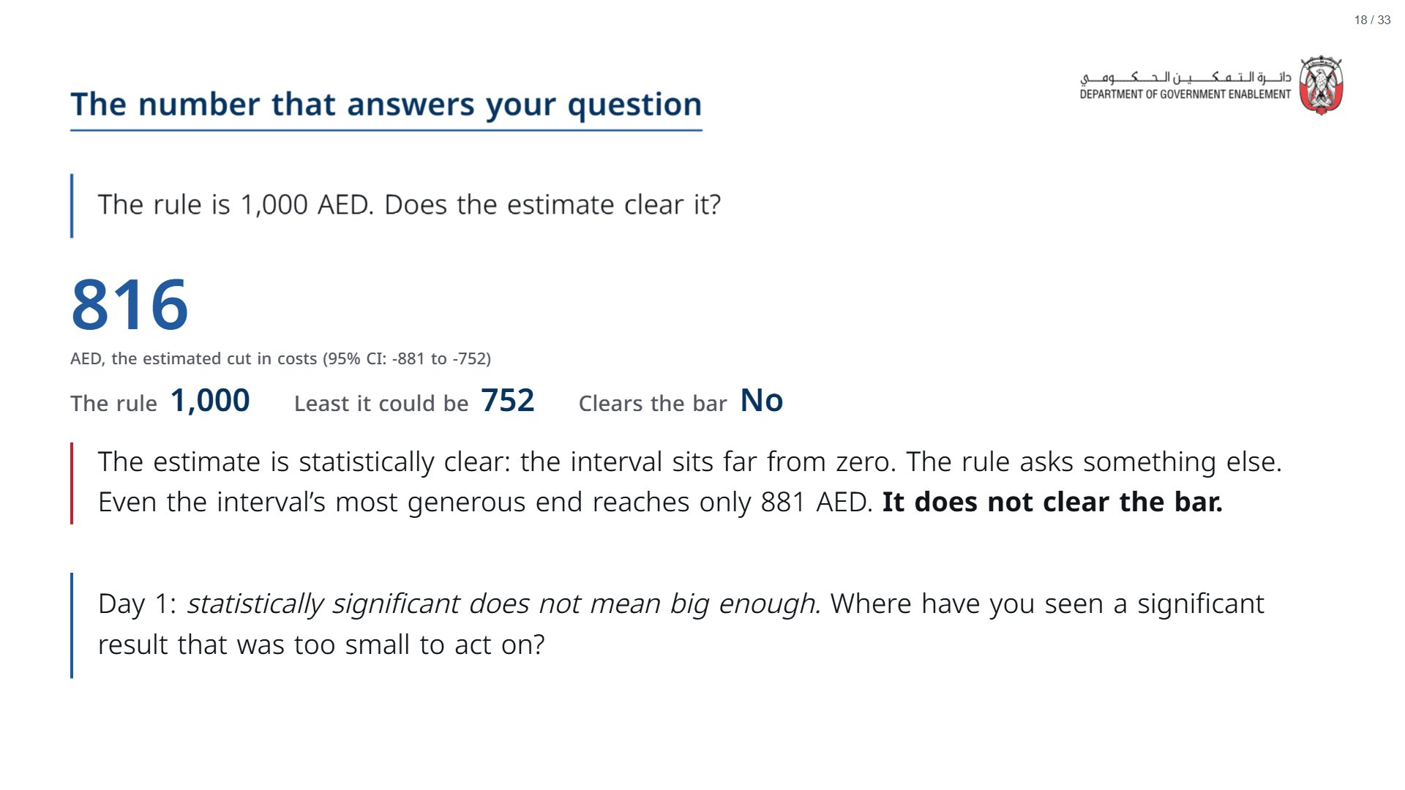

Slide 19


Slide 20
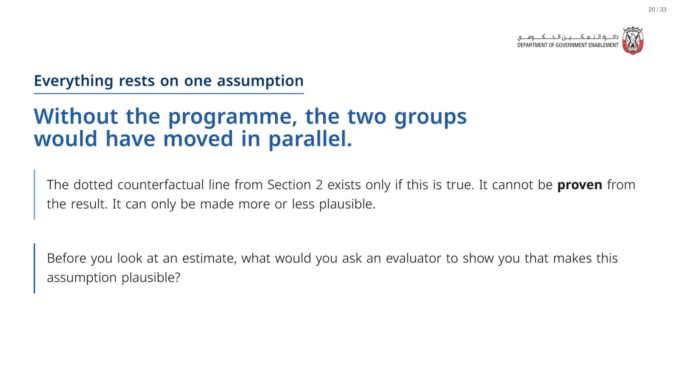

Slide 21
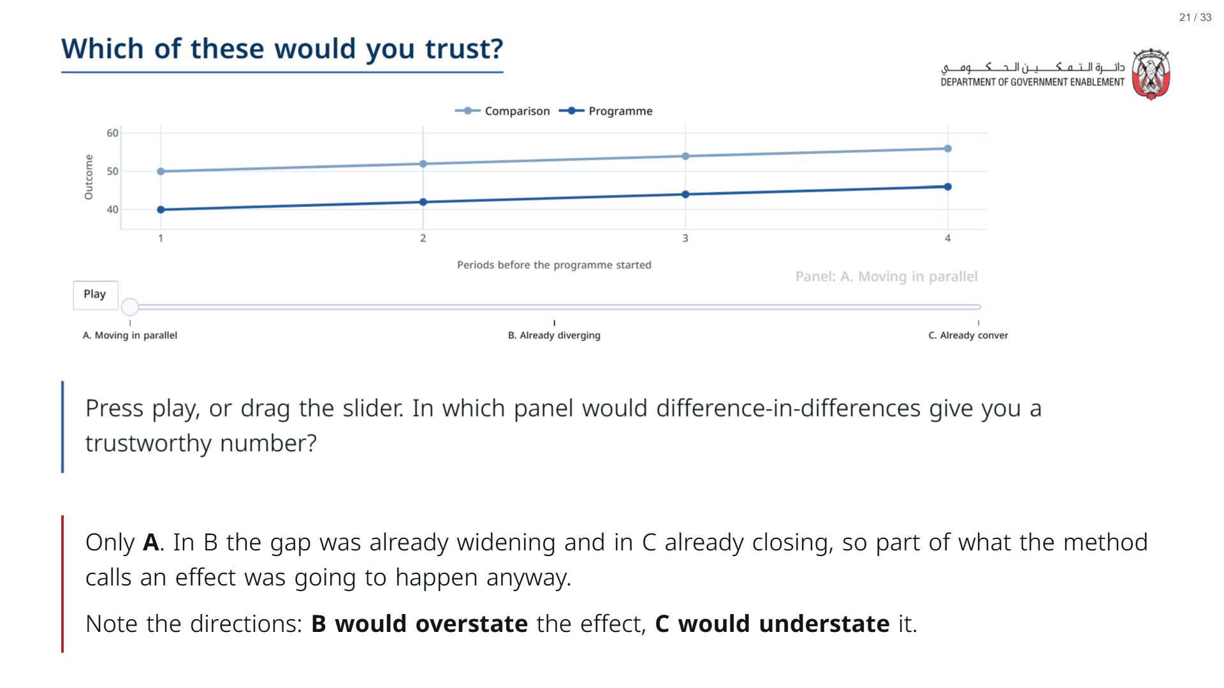

Slide 22
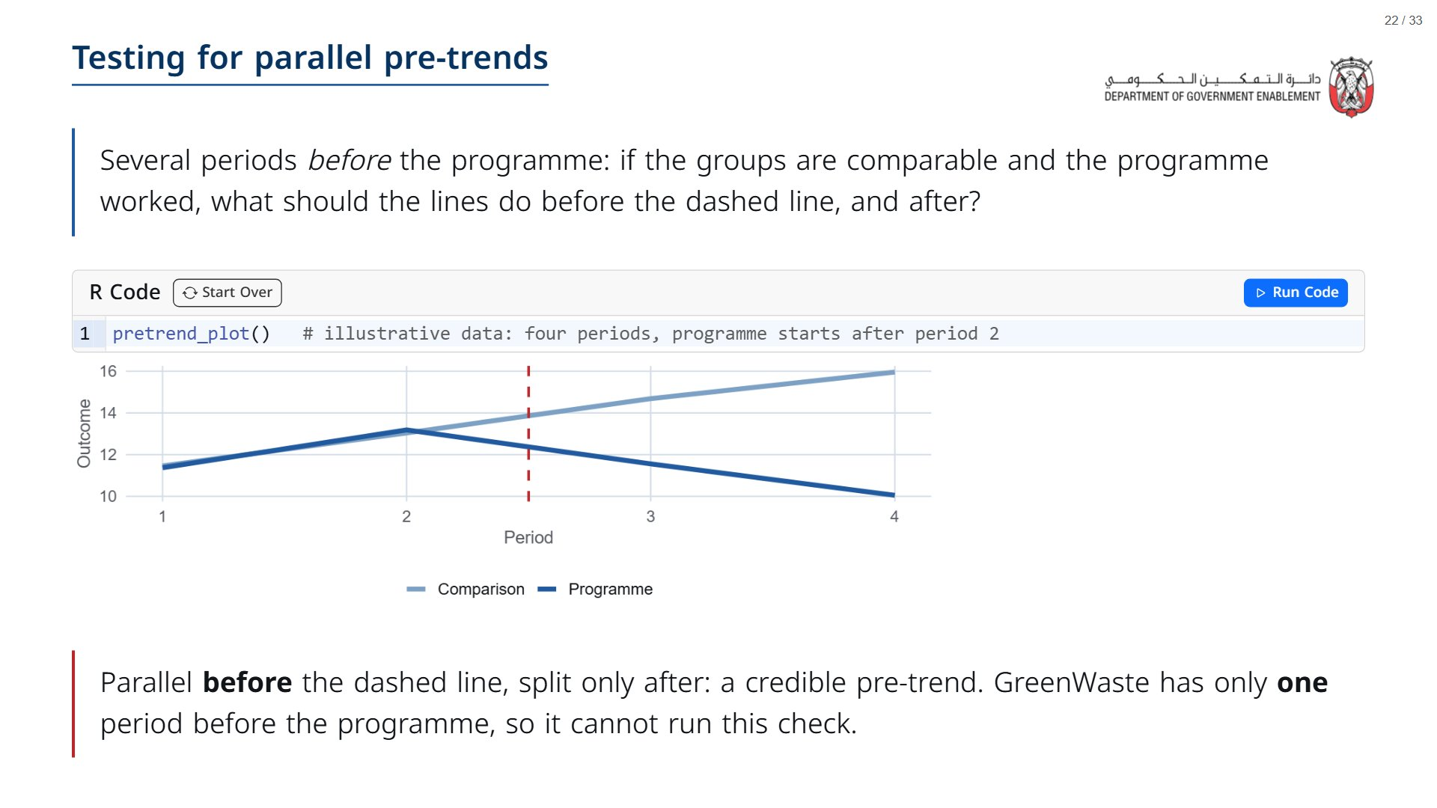
Notes:
Illustrative data, not GreenWaste. Point out that the groups move together before the dashed cut-off and only diverge after. Then contrast: GreenWaste has a single before-period, so the check cannot be run, which sets up the next slide.
span.MJX_Assistive_MathML {
position:absolute!important;
clip: rect(1px, 1px, 1px, 1px);
padding: 1px 0 0 0!important;
border: 0!important;
height: 1px!important;
width: 1px!important;
overflow: hidden!important;
display:block!important;
}

Slide 23
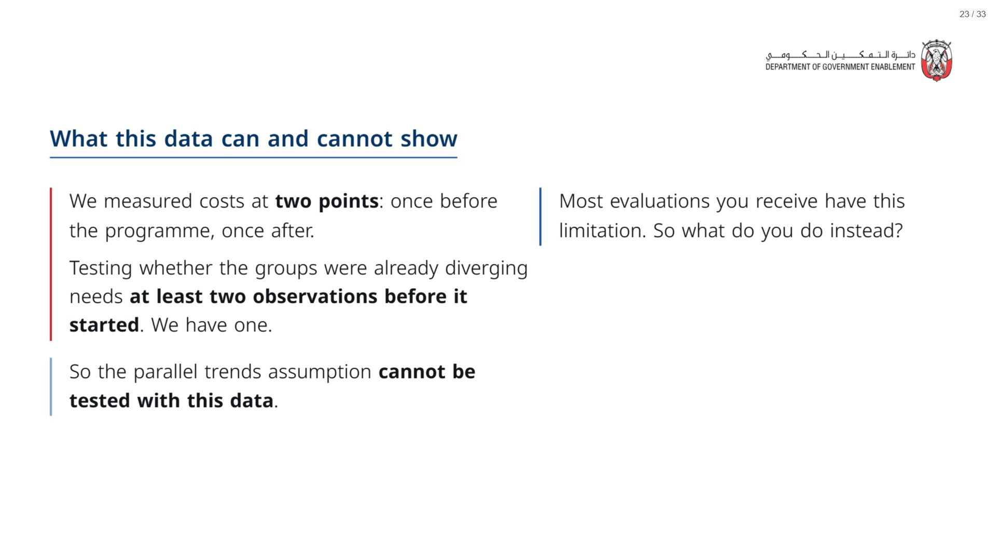
Notes:
Paper (Oct13_session1_materials.docx): the room now answers question 4 on “Which row is the impact?” (pack page 2). Take two or three answers to the ask before moving on; the next two slides give our list.
span.MJX_Assistive_MathML {
position:absolute!important;
clip: rect(1px, 1px, 1px, 1px);
padding: 1px 0 0 0!important;
border: 0!important;
height: 1px!important;
width: 1px!important;
overflow: hidden!important;
display:block!important;
}

Slide 24
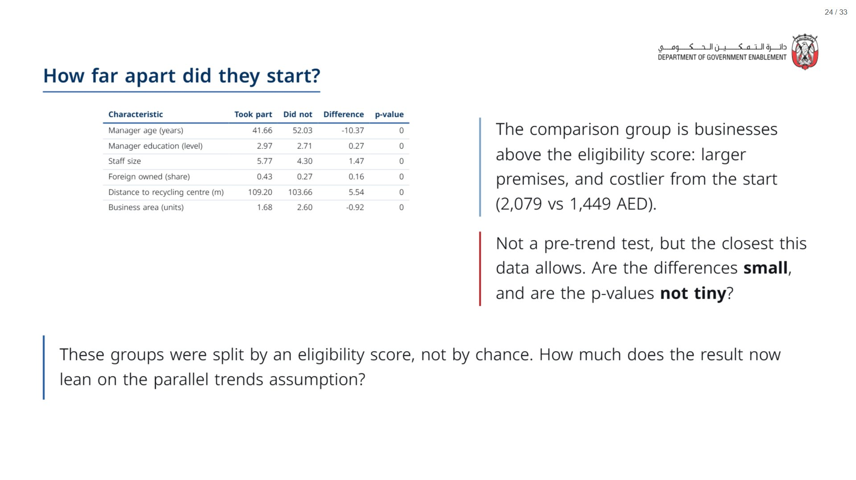
Notes:
Recap: they built a balance table on Day 1 Session 3. It makes the parallel-trends point concrete, because the pre-trend test cannot be run on two-wave data. Land the ask: the result leans heavily on the assumption, and a recommendation should say so. Reminder for the room: the p-value answers “how surprising is this baseline gap if the two groups were really the same?”, so a tiny p-value is the worry here, not the reassurance.
span.MJX_Assistive_MathML {
position:absolute!important;
clip: rect(1px, 1px, 1px, 1px);
padding: 1px 0 0 0!important;
border: 0!important;
height: 1px!important;
width: 1px!important;
overflow: hidden!important;
display:block!important;
}

Slide 25
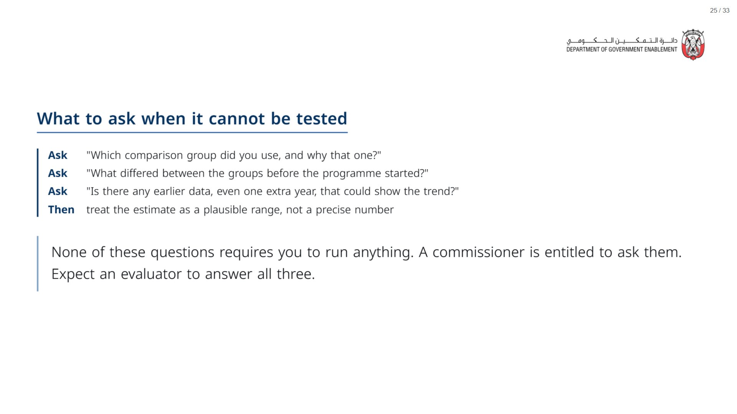

Slide 26


Slide 27
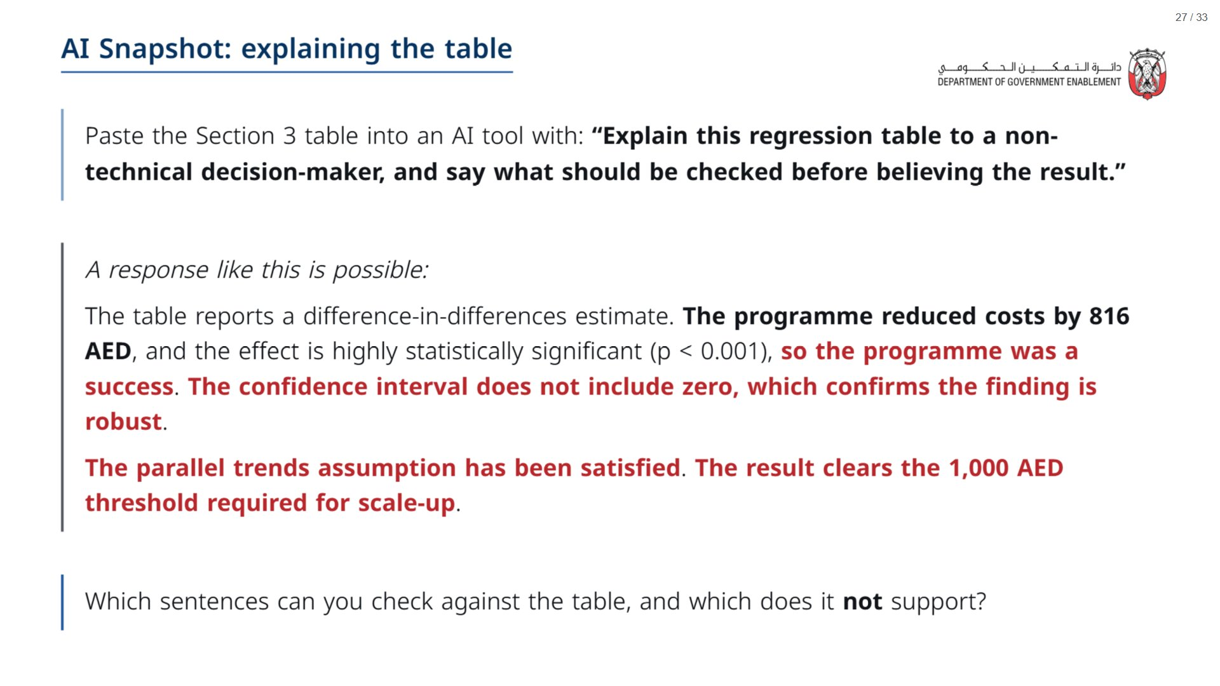
Notes:
Paper (Oct13_session1_materials.docx): Hand out “AI Snapshot: explaining the table” (pack page 3, one per pair).
span.MJX_Assistive_MathML {
position:absolute!important;
clip: rect(1px, 1px, 1px, 1px);
padding: 1px 0 0 0!important;
border: 0!important;
height: 1px!important;
width: 1px!important;
overflow: hidden!important;
display:block!important;
}

Slide 28
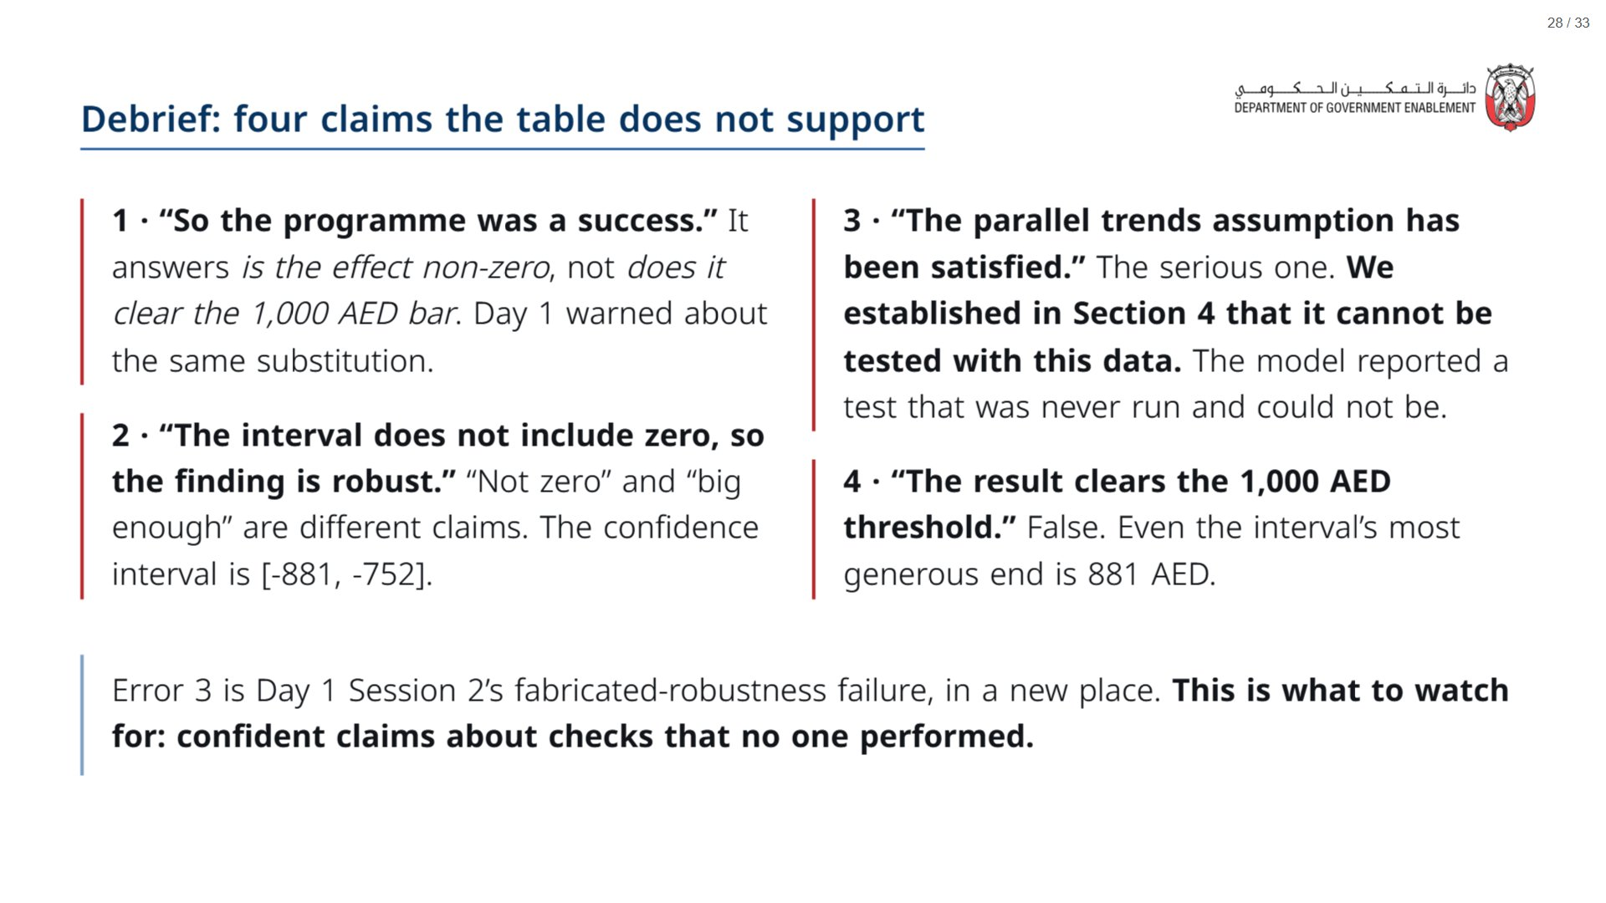

Slide 29
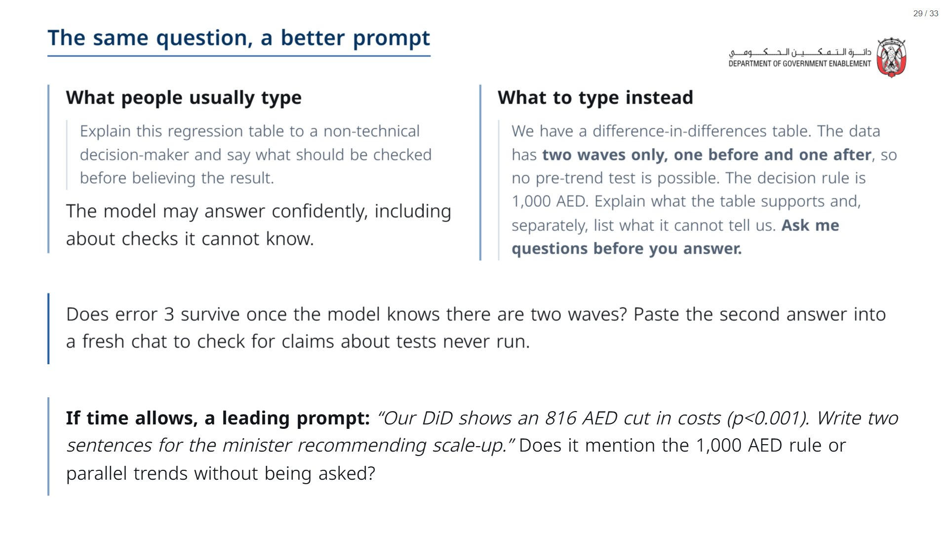

Slide 30


Slide 31
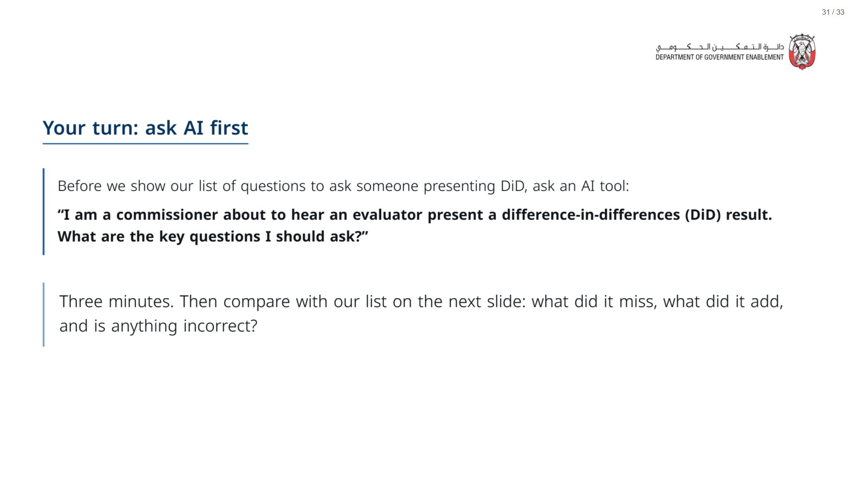
Notes:
OPTIONAL. If time is short, skip this slide and go straight to the questions on the next one. If you run it: give three minutes, then reveal the list and ask what the AI missed, what it added that is worth keeping, and whether anything it suggested was incorrect.
span.MJX_Assistive_MathML {
position:absolute!important;
clip: rect(1px, 1px, 1px, 1px);
padding: 1px 0 0 0!important;
border: 0!important;
height: 1px!important;
width: 1px!important;
overflow: hidden!important;
display:block!important;
}

Slide 32
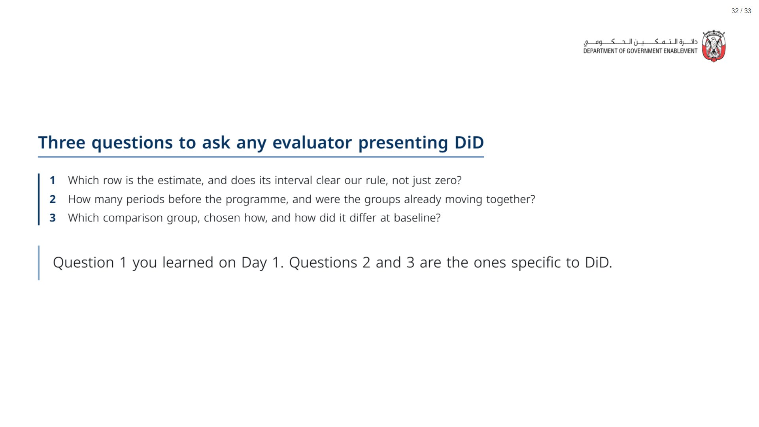
Notes:
Paper (Oct13_session1_materials.docx): Hand out the take-away cards (pack page 4, cut into cards). Give a minute to fill in “On my desk”, then take two or three examples.
span.MJX_Assistive_MathML {
position:absolute!important;
clip: rect(1px, 1px, 1px, 1px);
padding: 1px 0 0 0!important;
border: 0!important;
height: 1px!important;
width: 1px!important;
overflow: hidden!important;
display:block!important;
}

Slide 33
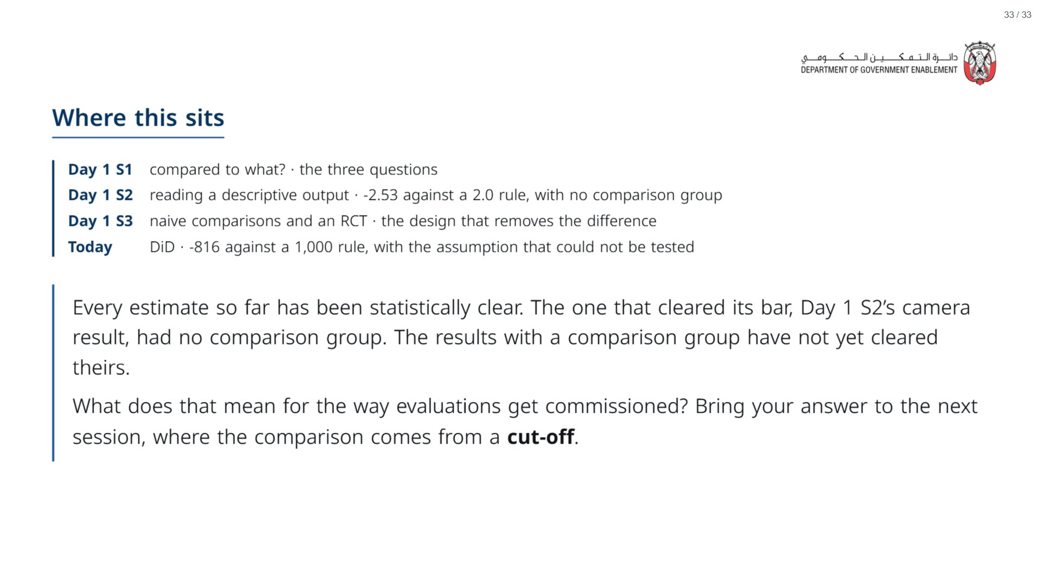
Notes:
If there is time at the very end, ask the room: is there a different question you would ask AI to help you understand a concept from today? For example: “I am learning about impact evaluation to help me make policy decisions. How should I think about a confidence interval, and how is it relevant when I compare an estimate to a decision threshold?” Adding context about who you are and why you are asking usually gets a more useful answer.
span.MJX_Assistive_MathML {
position:absolute!important;
clip: rect(1px, 1px, 1px, 1px);
padding: 1px 0 0 0!important;
border: 0!important;
height: 1px!important;
width: 1px!important;
overflow: hidden!important;
display:block!important;
}

