Slide 1
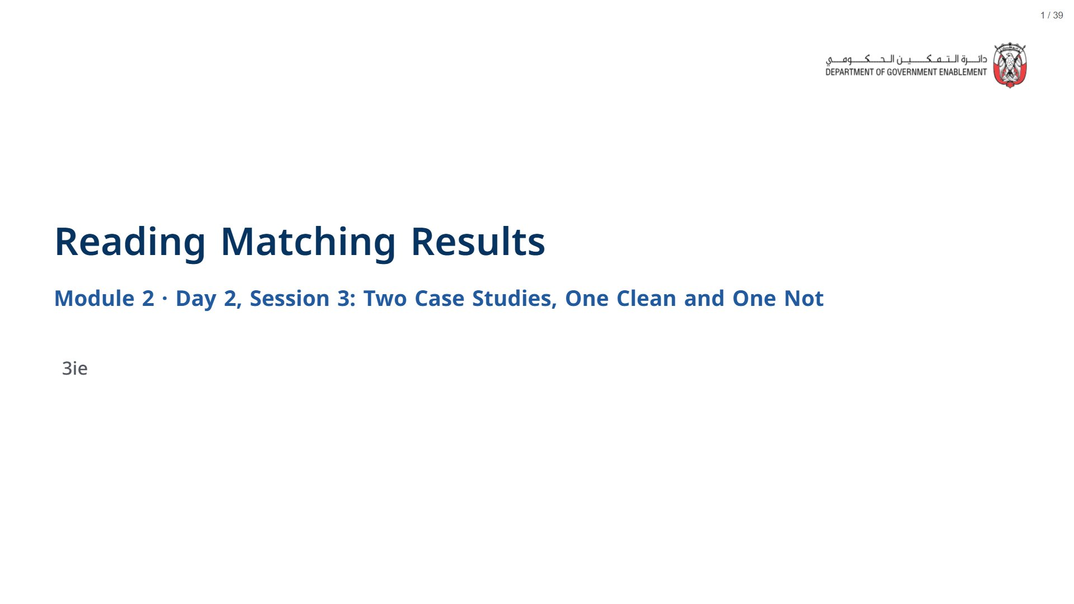

Slide 2
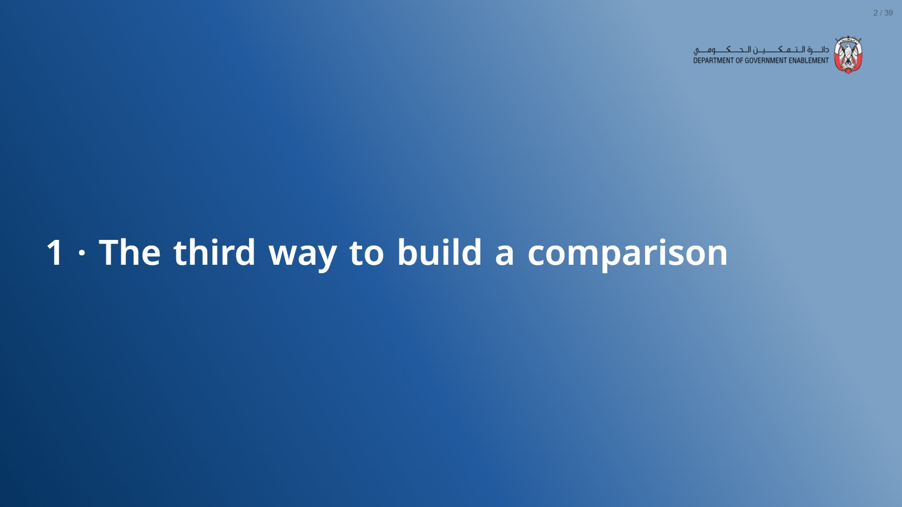

Slide 3
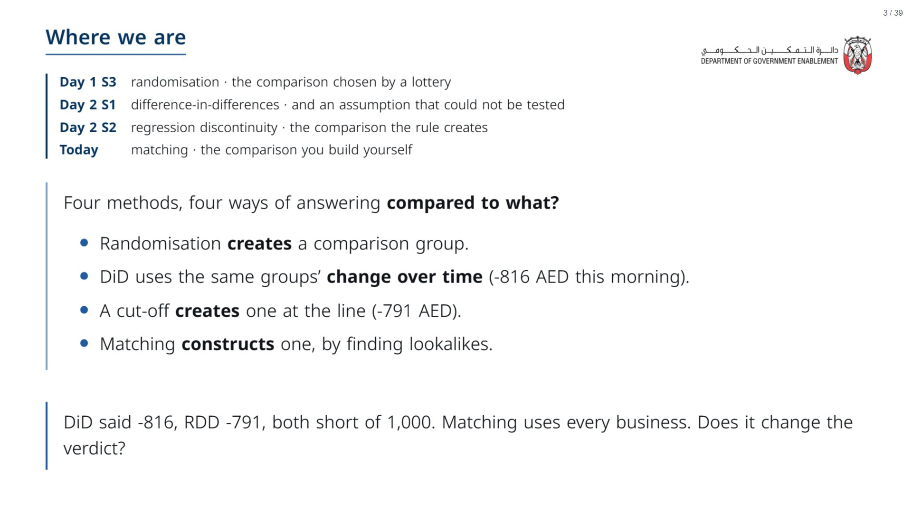
Notes:
Section 1 is the recap and the idea: aim for about 15 minutes. The room already knows GreenWaste, the 1,000 AED rule and the selection problem from Day 1 Session 3, so do not re-teach why a raw comparison misleads. The new material is how matching builds a comparison (Section 2) and what it cannot see (Section 3).
span.MJX_Assistive_MathML {
position:absolute!important;
clip: rect(1px, 1px, 1px, 1px);
padding: 1px 0 0 0!important;
border: 0!important;
height: 1px!important;
width: 1px!important;
overflow: hidden!important;
display:block!important;
}

Slide 4
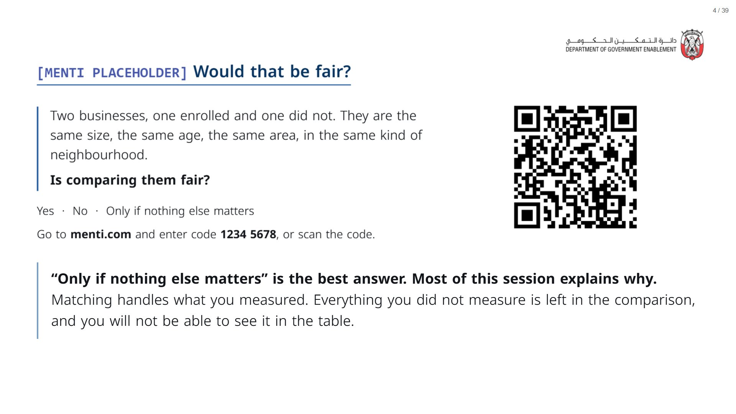

Slide 5
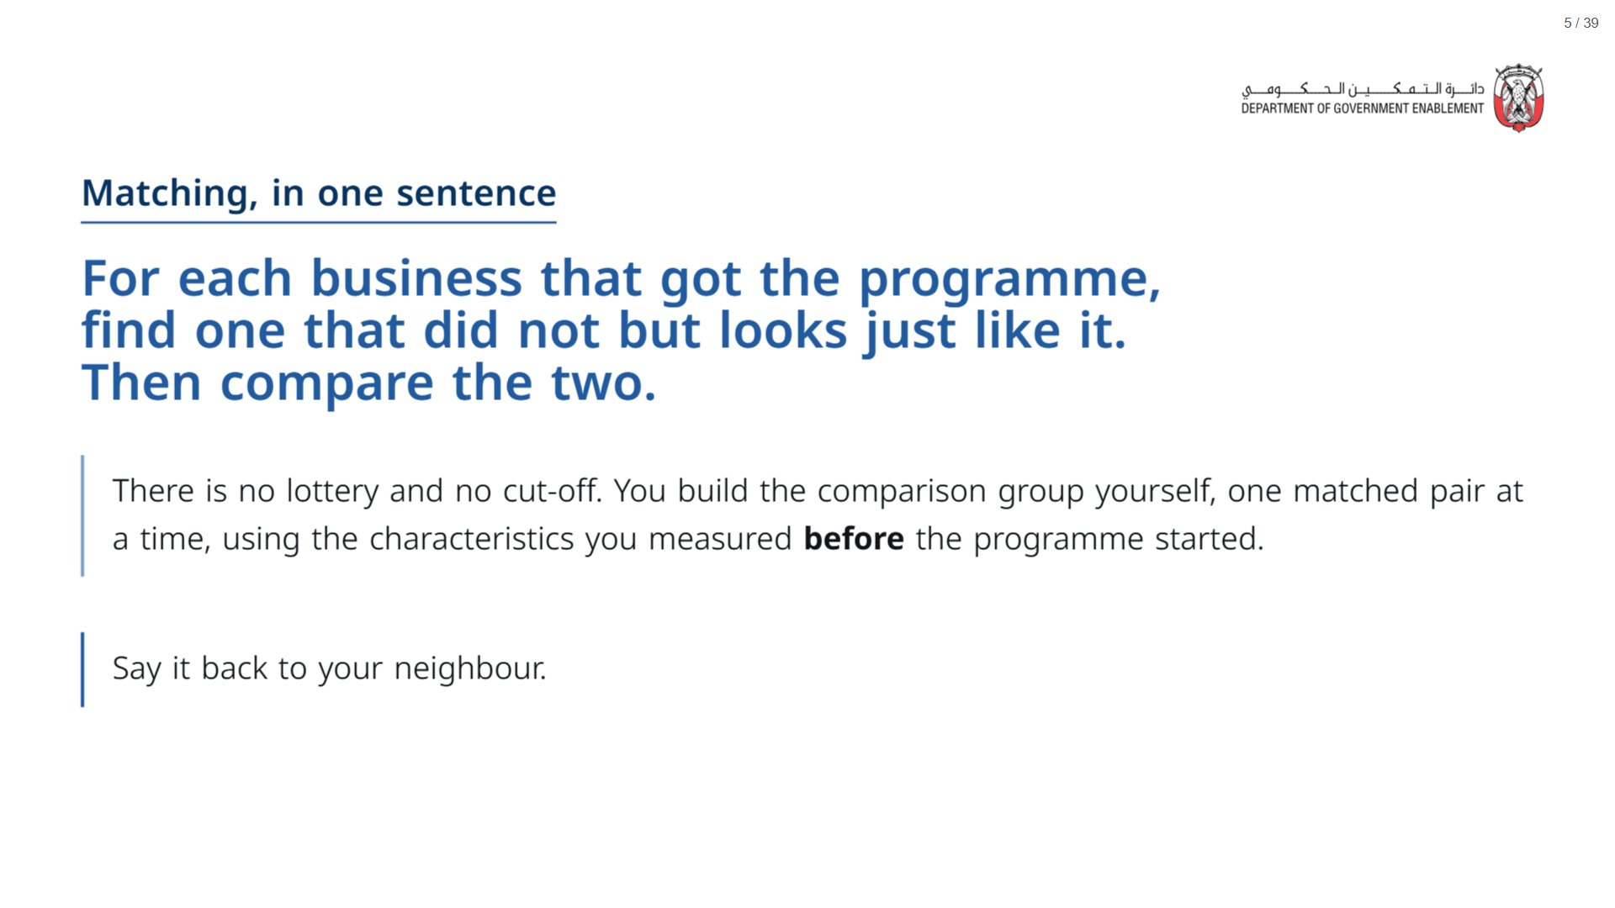

Slide 6
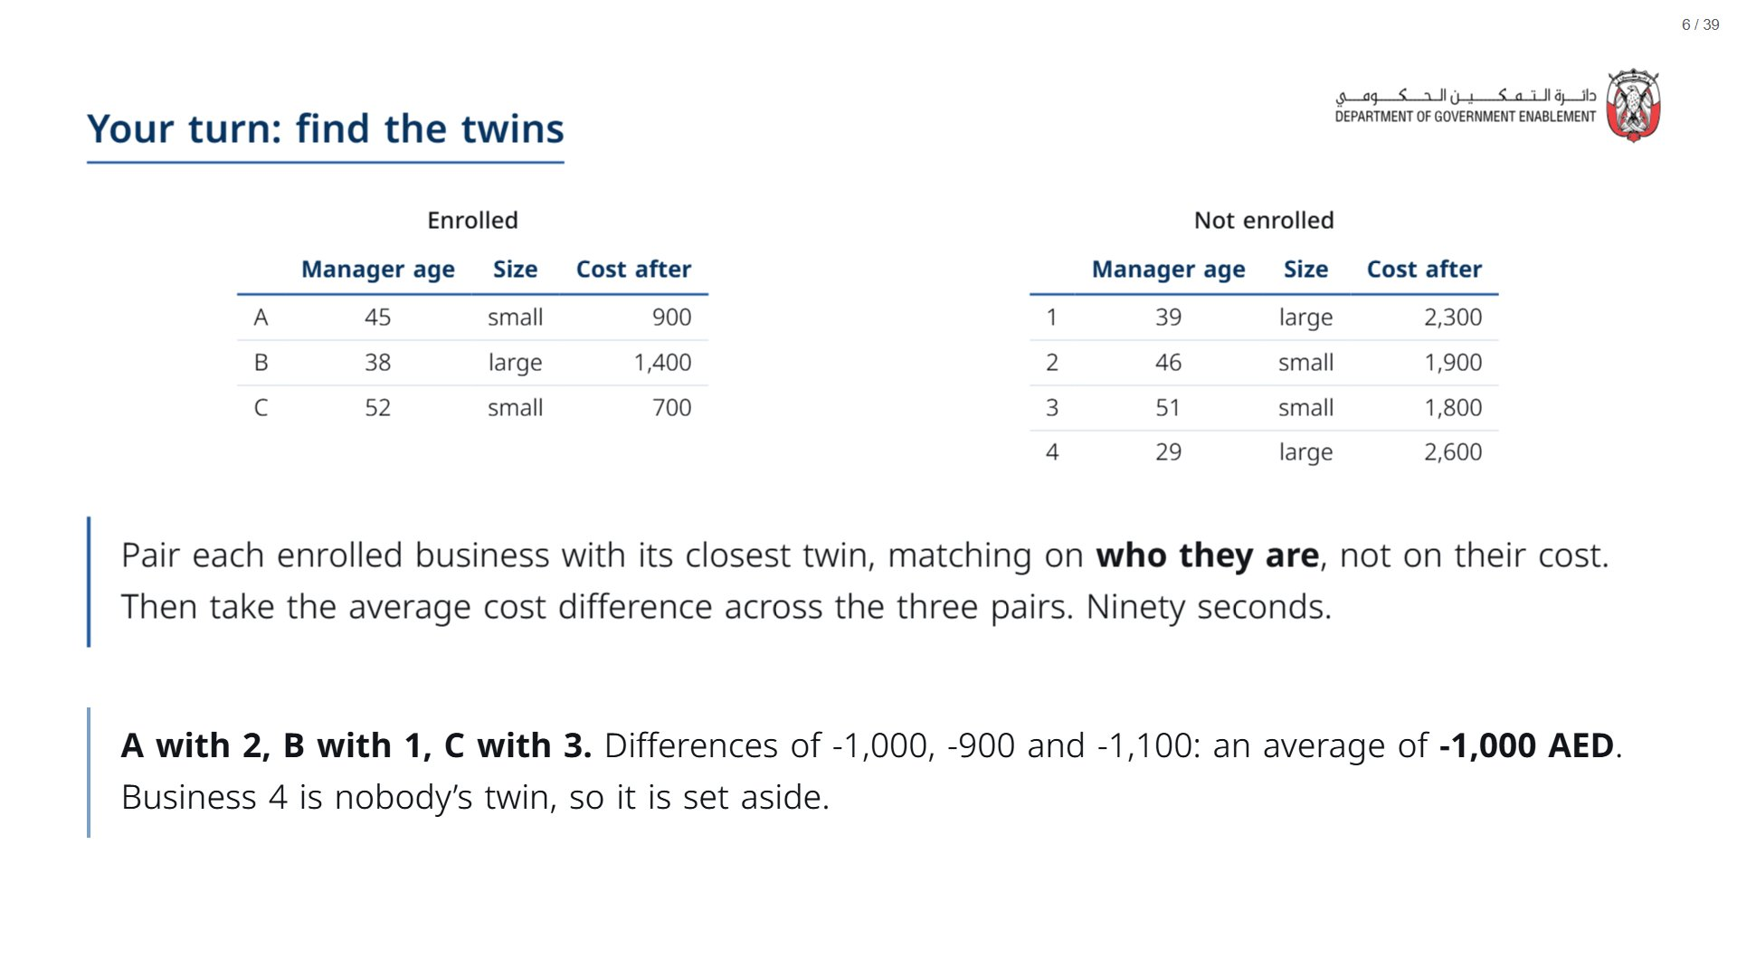
Notes:
Paper (Oct13_session3_materials.docx): Hand out the find-the-twins sheet (pack page 1, one per participant). Genuine silence for ninety seconds.
The point they should feel: matching is intuitive, they already know how to do it, and it quietly sets aside units that resemble nobody. That is the common-support idea, which comes back in Section 2 and is the heart of Case 2.
Circulate and listen for “but what if none of them really match?”. That instinct leads to Case 2. Also listen for anyone matching on cost: that is matching on the outcome, which would build the answer into the comparison.
span.MJX_Assistive_MathML {
position:absolute!important;
clip: rect(1px, 1px, 1px, 1px);
padding: 1px 0 0 0!important;
border: 0!important;
height: 1px!important;
width: 1px!important;
overflow: hidden!important;
display:block!important;
}

Slide 7
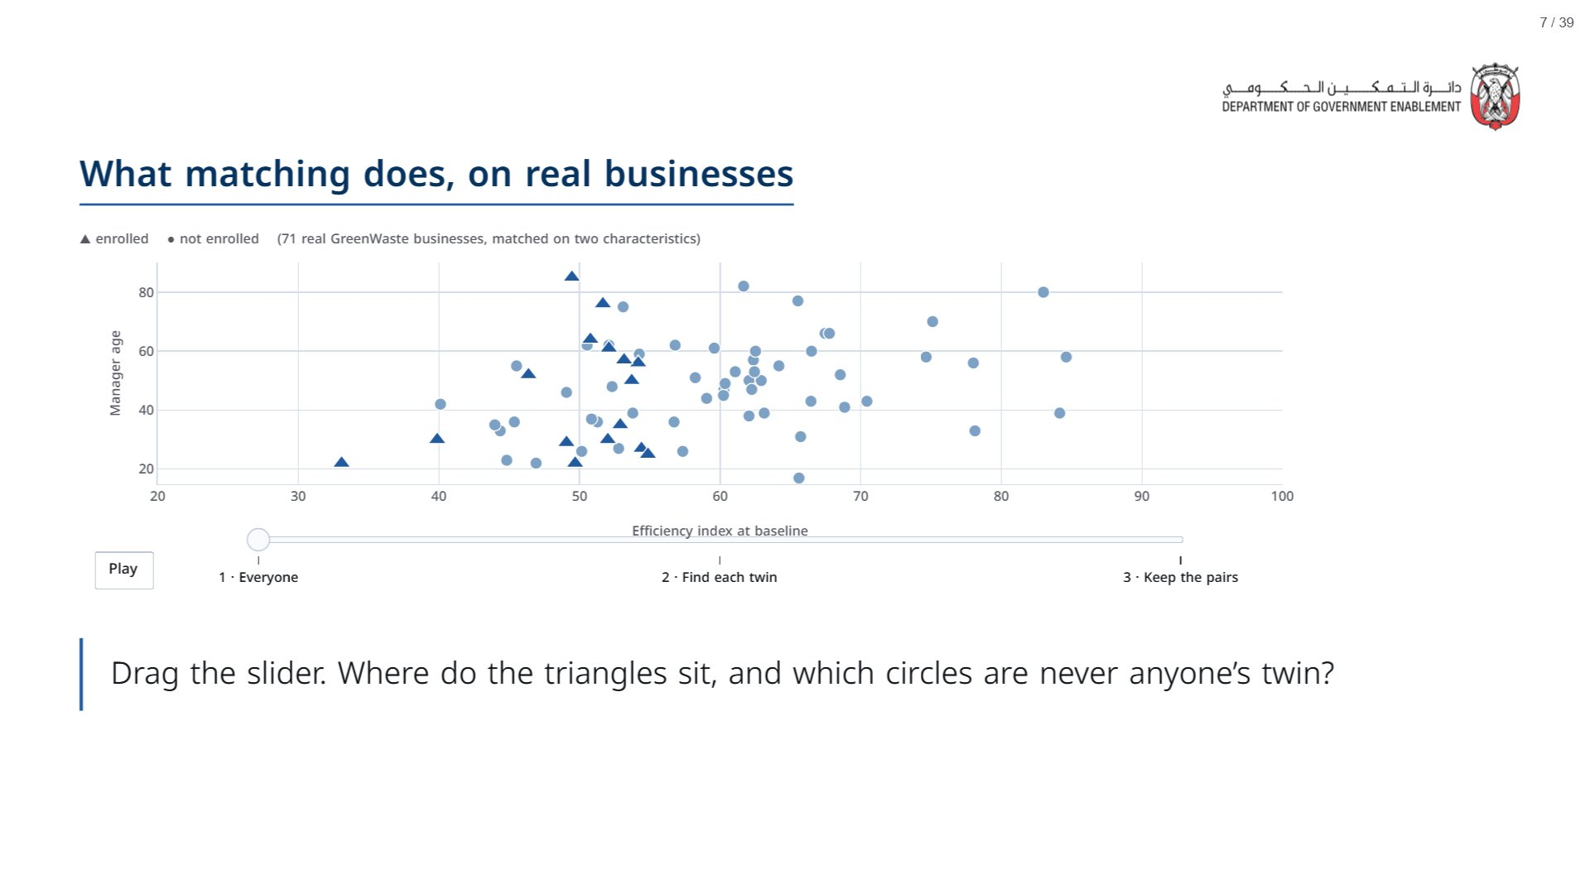
Notes:
Real GreenWaste businesses, a random 16 enrolled and 55 not enrolled, matched here on just two characteristics so the pairs can be drawn on a flat chart. The real analysis uses ten, and does the same thing in ten dimensions.
Frame 1: the triangles all sit on the left, below an index of 58 (that was the eligibility rule), and the circles spread across the whole range. The two groups are different crowds. Frame 2: each triangle is joined to its nearest circle. Some circles are the twin of more than one triangle: that is allowed. Frame 3: circles that nobody picked fade out. They are set aside, and the comparison is now only between the pairs.
span.MJX_Assistive_MathML {
position:absolute!important;
clip: rect(1px, 1px, 1px, 1px);
padding: 1px 0 0 0!important;
border: 0!important;
height: 1px!important;
width: 1px!important;
overflow: hidden!important;
display:block!important;
}

Slide 8

Notes:
About 25 minutes. Four live cells; keep syntax talk short.
span.MJX_Assistive_MathML {
position:absolute!important;
clip: rect(1px, 1px, 1px, 1px);
padding: 1px 0 0 0!important;
border: 0!important;
height: 1px!important;
width: 1px!important;
overflow: hidden!important;
display:block!important;
}

Slide 9
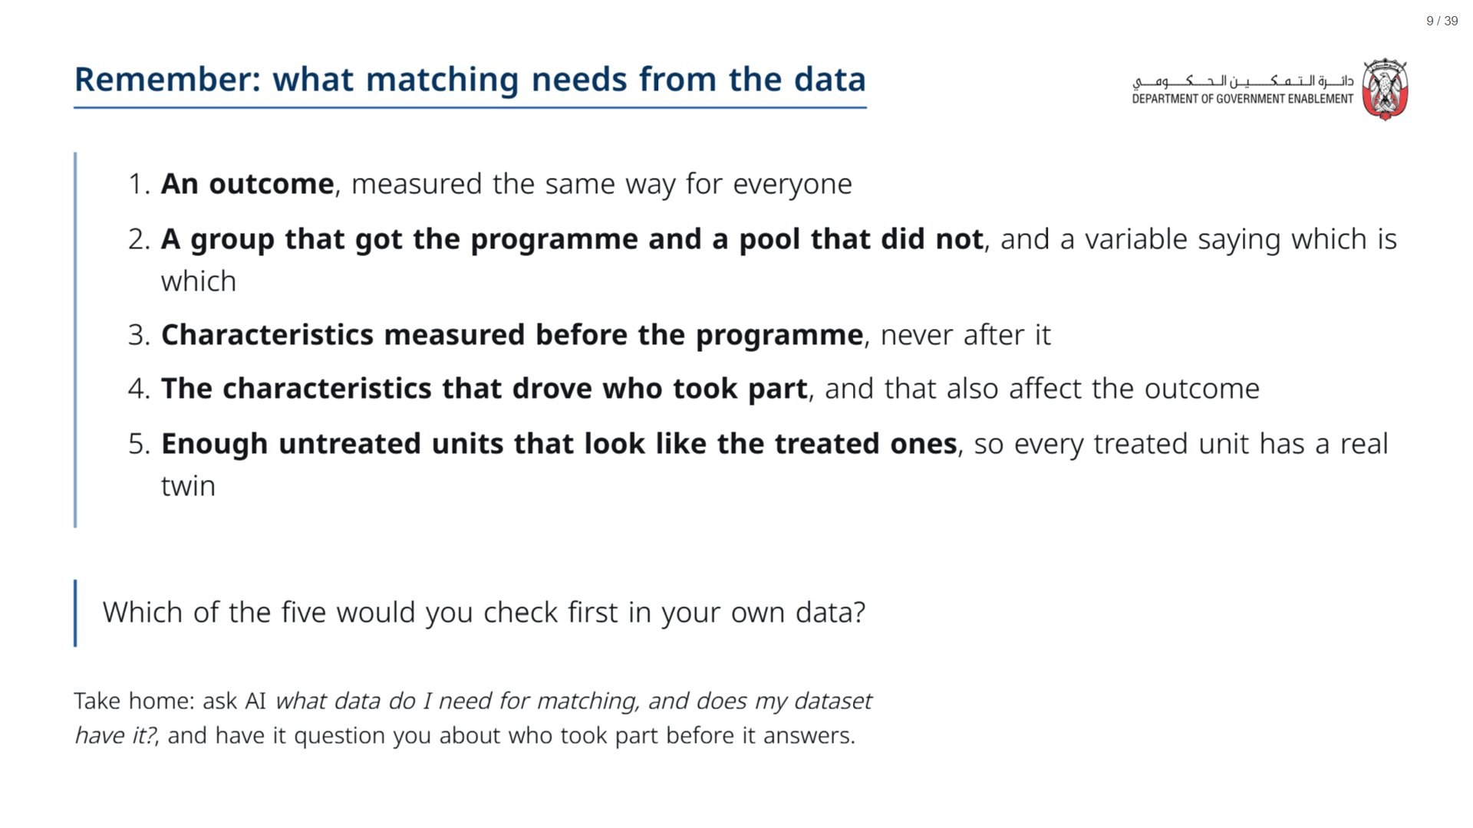
Notes:
Items 3 and 4 are the ones that matter most. Item 3: a characteristic measured after the programme may itself have been changed by the programme, so matching on it builds part of the effect into the comparison. Item 4 is the one Section 3 turns on: matching can only use what is on the list. Item 5 is the common support check two slides on, and it is what goes wrong in Case 2.
span.MJX_Assistive_MathML {
position:absolute!important;
clip: rect(1px, 1px, 1px, 1px);
padding: 1px 0 0 0!important;
border: 0!important;
height: 1px!important;
width: 1px!important;
overflow: hidden!important;
display:block!important;
}

Slide 10
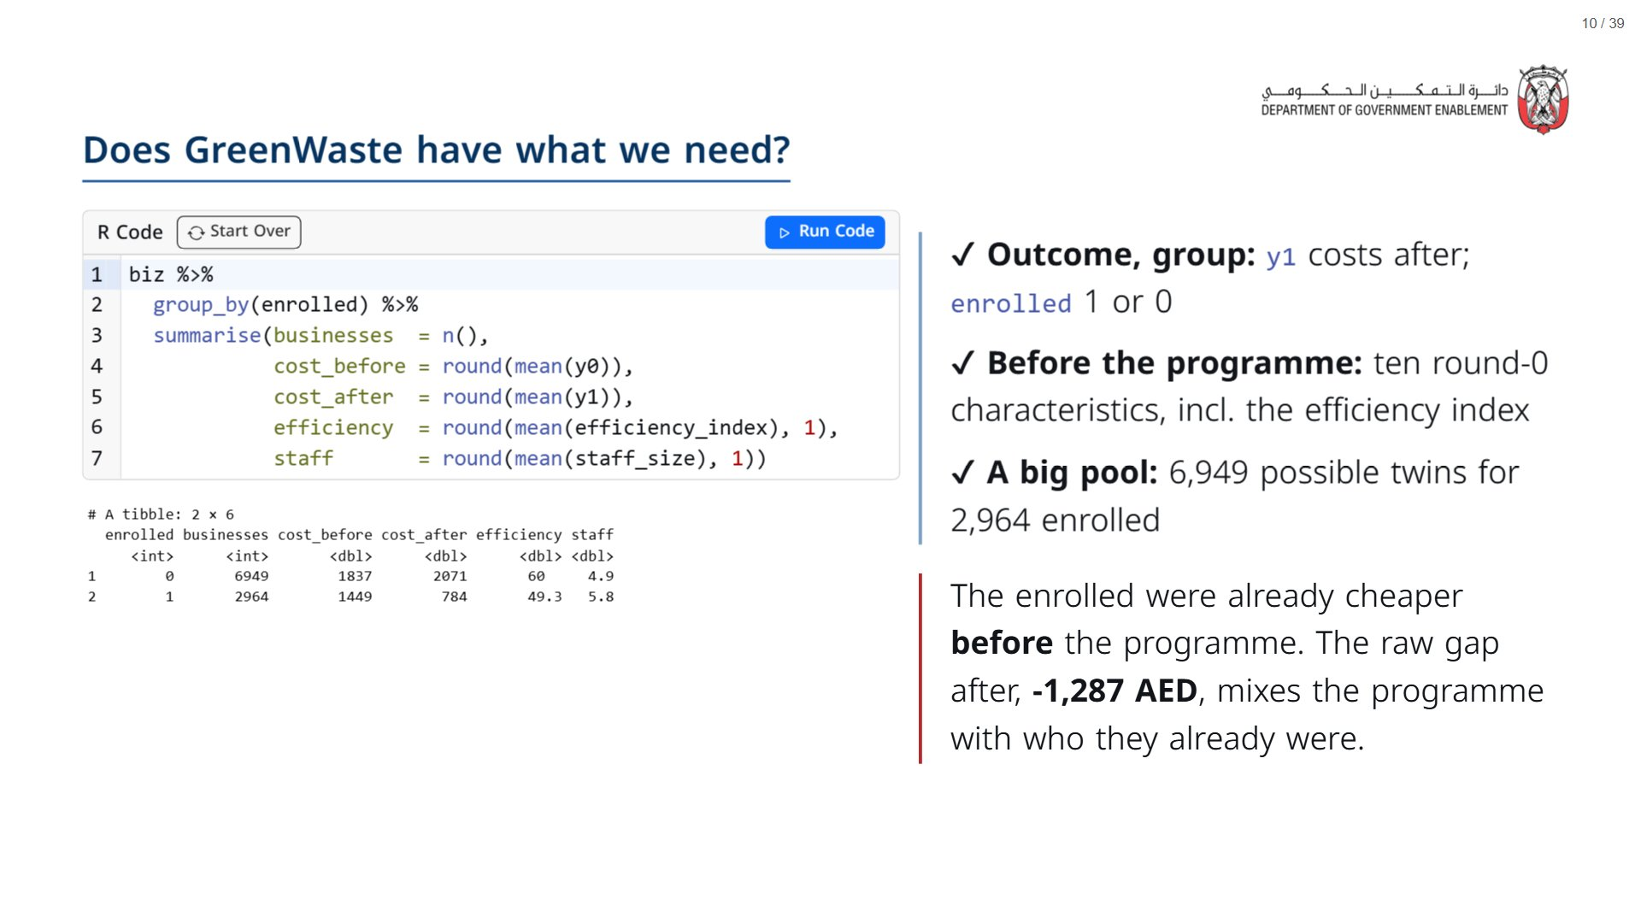
Notes:
Press Run. biz has one row per business: its characteristics at baseline and its costs before (y0) and after (y1).
Read the two rows. Enrolled businesses: 1,449 AED before and 784 after. Everyone else: 1,837 before and 2,071 after. Do not dwell on the raw gap: the room met this problem on Day 1 Session 3. The point is only that the two groups started in different places, so there is work for matching to do.
The pool of “not enrolled” includes businesses above the cut-off and eligible businesses in neighbourhoods that were never offered the programme. Matching will pick the lookalikes out of it.
span.MJX_Assistive_MathML {
position:absolute!important;
clip: rect(1px, 1px, 1px, 1px);
padding: 1px 0 0 0!important;
border: 0!important;
height: 1px!important;
width: 1px!important;
overflow: hidden!important;
display:block!important;
}

Slide 11
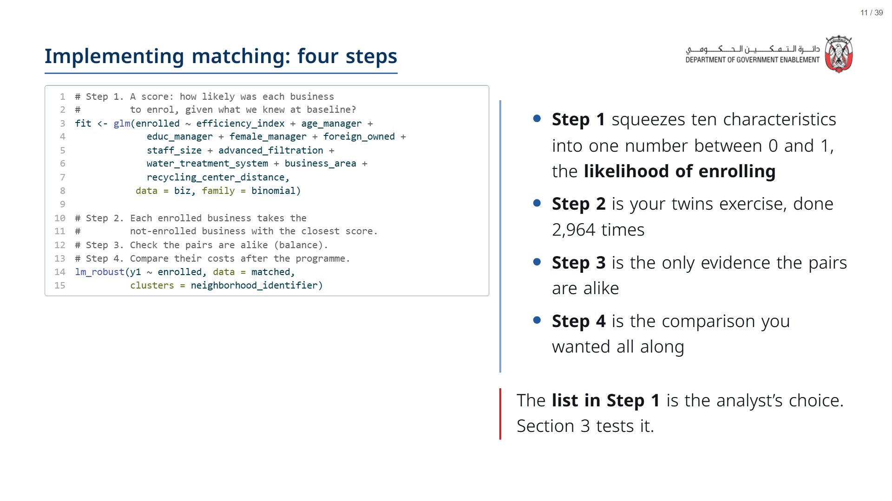
Notes:
Do not dwell on syntax. The one idea that matters: matching is preparation. It builds the comparison group first, and only then do we compare. The regression in Step 4 is deliberately plain: enrolled against not, on the matched pairs.
If asked why a score and not all ten characteristics at once: finding a twin that is close on ten things at once is hard; the score says how alike two businesses are in the one respect that matters here, how likely each was to enrol.
span.MJX_Assistive_MathML {
position:absolute!important;
clip: rect(1px, 1px, 1px, 1px);
padding: 1px 0 0 0!important;
border: 0!important;
height: 1px!important;
width: 1px!important;
overflow: hidden!important;
display:block!important;
}

Slide 12
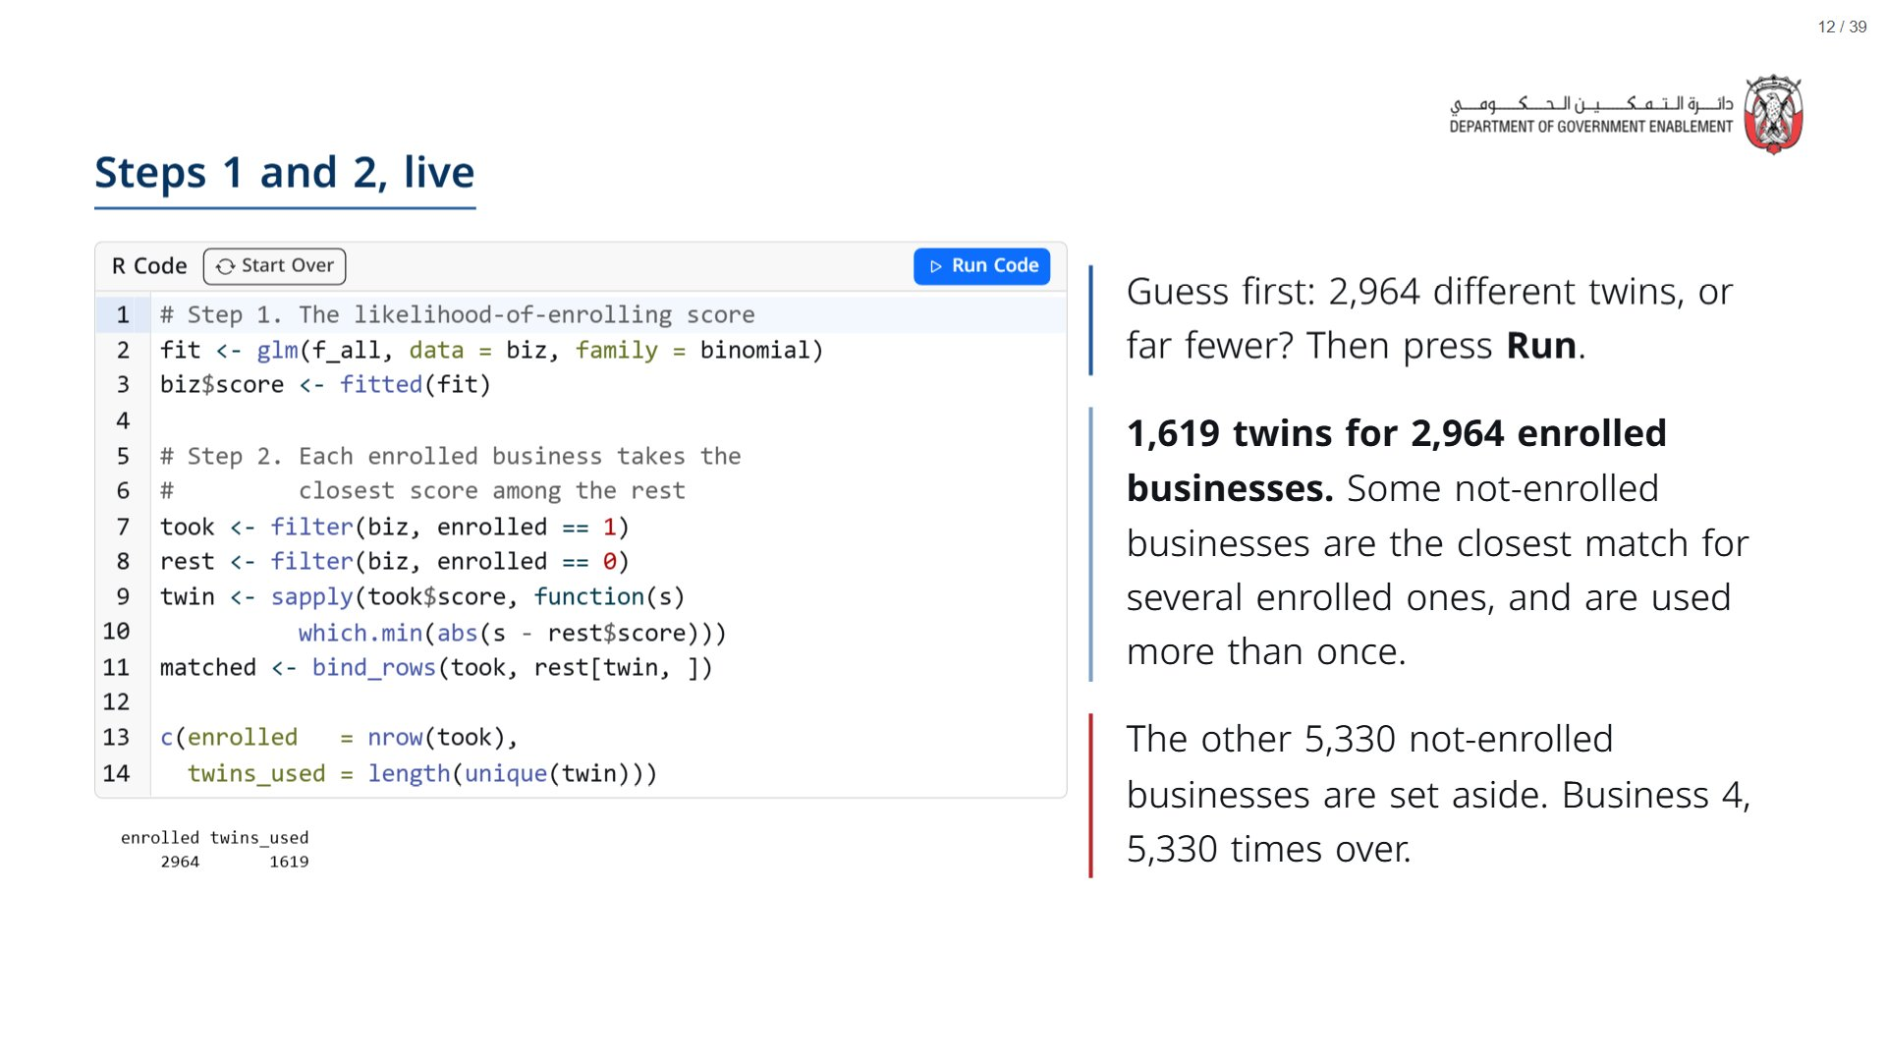
Notes:
f_all is the list of ten characteristics from the previous slide. The sapply line does the matching: for each enrolled business’s score, find the position of the closest score in the pool.
Reusing a twin is allowed (analysts call it matching “with replacement”). It keeps every pair as close as possible, at the cost of leaning harder on the businesses that get reused. Worth knowing the phrase if an evaluator uses it.
span.MJX_Assistive_MathML {
position:absolute!important;
clip: rect(1px, 1px, 1px, 1px);
padding: 1px 0 0 0!important;
border: 0!important;
height: 1px!important;
width: 1px!important;
overflow: hidden!important;
display:block!important;
}

Slide 13
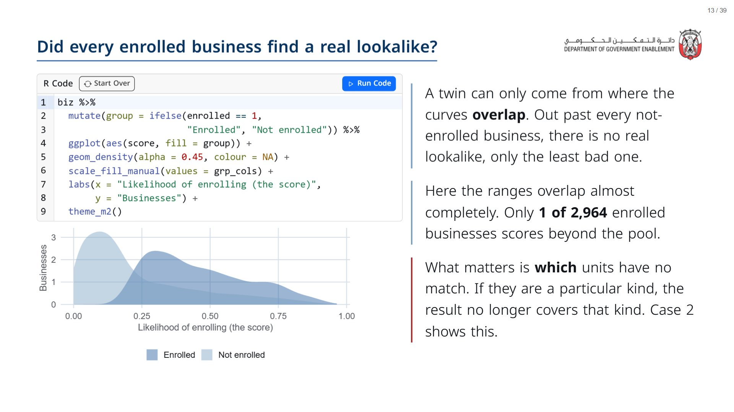
Notes:
Press Run. This is the picture that decides whether matching is even possible. The enrolled curve sits to the right (they were likely to enrol, and did), the not-enrolled curve to the left, but there are not-enrolled businesses right across the enrolled range, thinly at the top end.
Ask: if an enrolled business had no counterpart and we dropped it, who would the result still be about? Only the ones that had a match. Hold that for Case 2.
span.MJX_Assistive_MathML {
position:absolute!important;
clip: rect(1px, 1px, 1px, 1px);
padding: 1px 0 0 0!important;
border: 0!important;
height: 1px!important;
width: 1px!important;
overflow: hidden!important;
display:block!important;
}

Slide 14
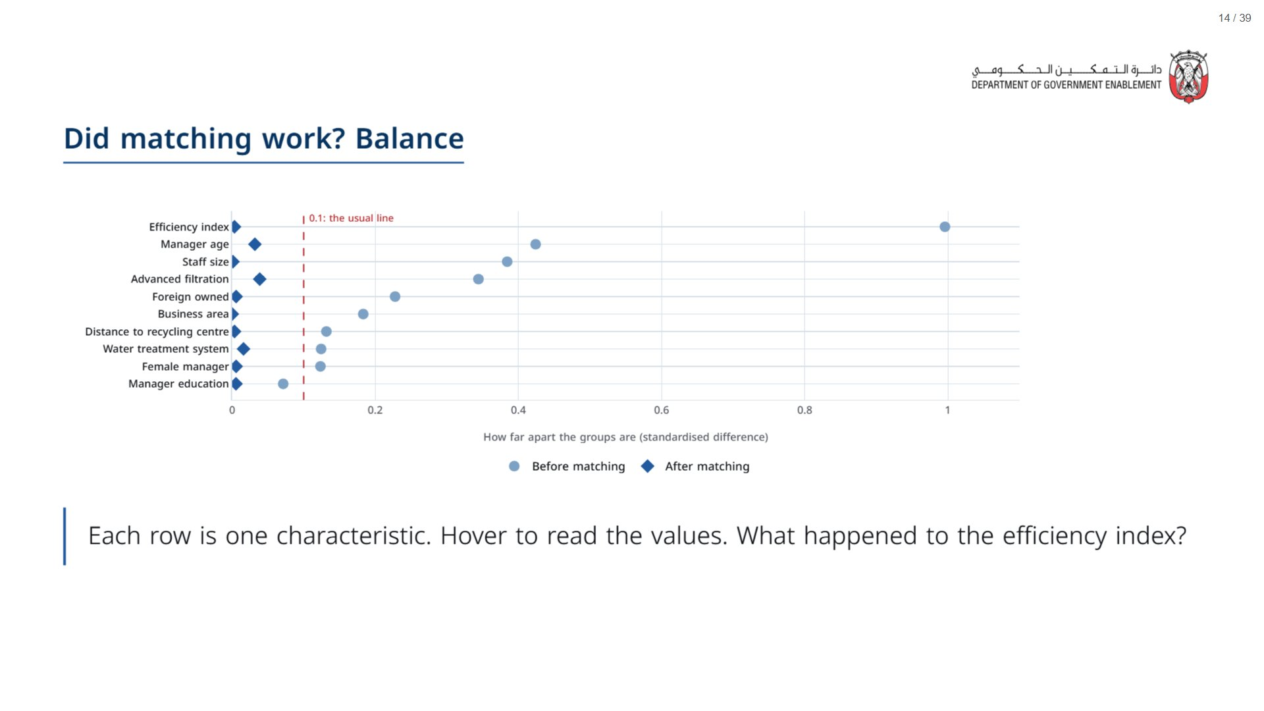
Notes:
Light blue dots: how far apart enrolled and not-enrolled businesses were before matching. Dark blue diamonds: how far apart the matched pairs are. Beyond about 0.1 is usually treated as a problem.
The efficiency index was by far the worst (1.00), because it decided eligibility. After matching, every characteristic is under 0.04.
Say it plainly: balance means alike on the list. It says nothing about anything that is not on the list. That is Section 3.
span.MJX_Assistive_MathML {
position:absolute!important;
clip: rect(1px, 1px, 1px, 1px);
padding: 1px 0 0 0!important;
border: 0!important;
height: 1px!important;
width: 1px!important;
overflow: hidden!important;
display:block!important;
}

Slide 15
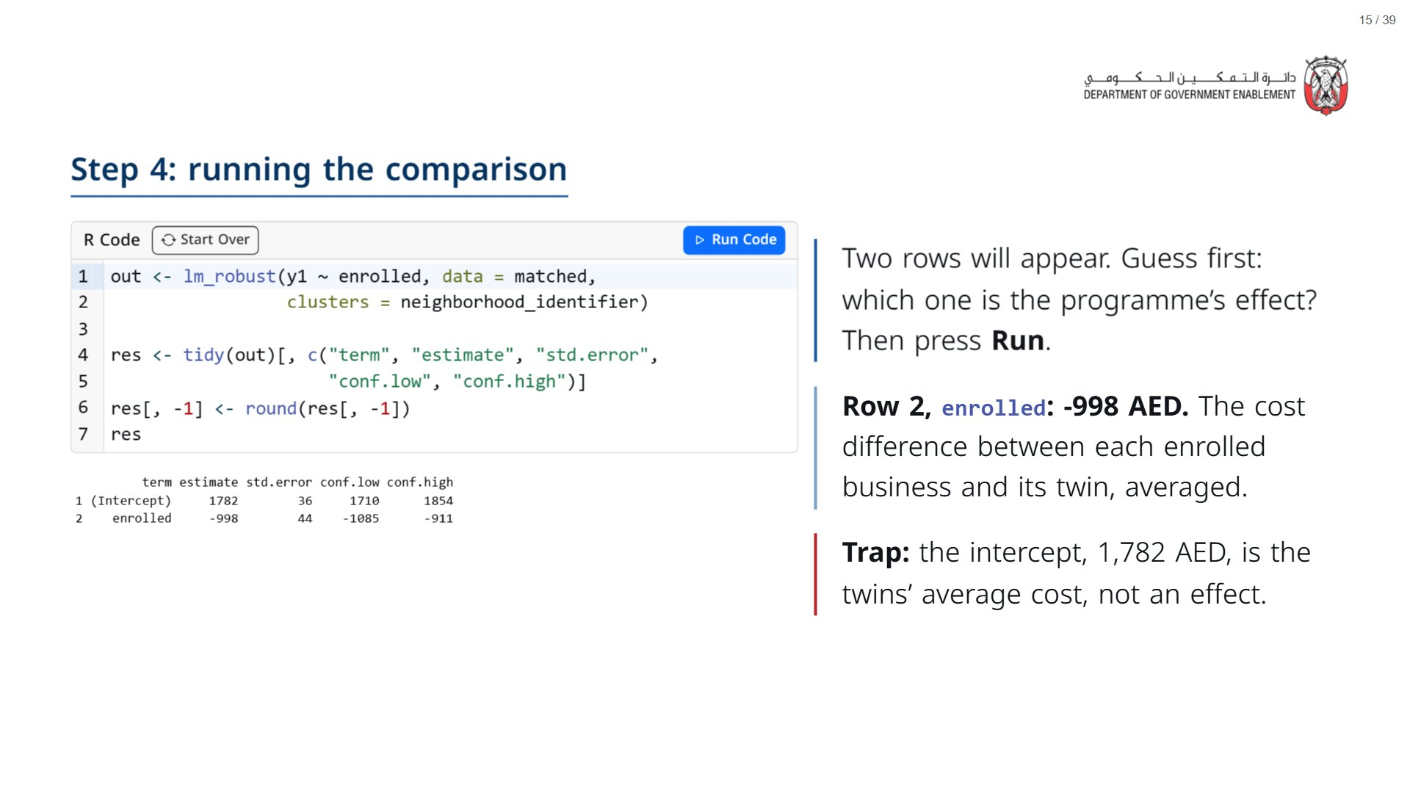
Notes:
Take a vote before pressing Run. Most will get it; the point is the habit of naming the row.
Reminder of the vocabulary (Day 1 Session 1): the coefficient is the effect size in AED; the confidence interval (conf.low to conf.high) is the range of plausible true values; clustering by neighbourhood means businesses in the same neighbourhood are not treated as independent evidence.
Close the loop: this is the twins card, done for every enrolled business at once, with a margin of error attached.
span.MJX_Assistive_MathML {
position:absolute!important;
clip: rect(1px, 1px, 1px, 1px);
padding: 1px 0 0 0!important;
border: 0!important;
height: 1px!important;
width: 1px!important;
overflow: hidden!important;
display:block!important;
}

Slide 16
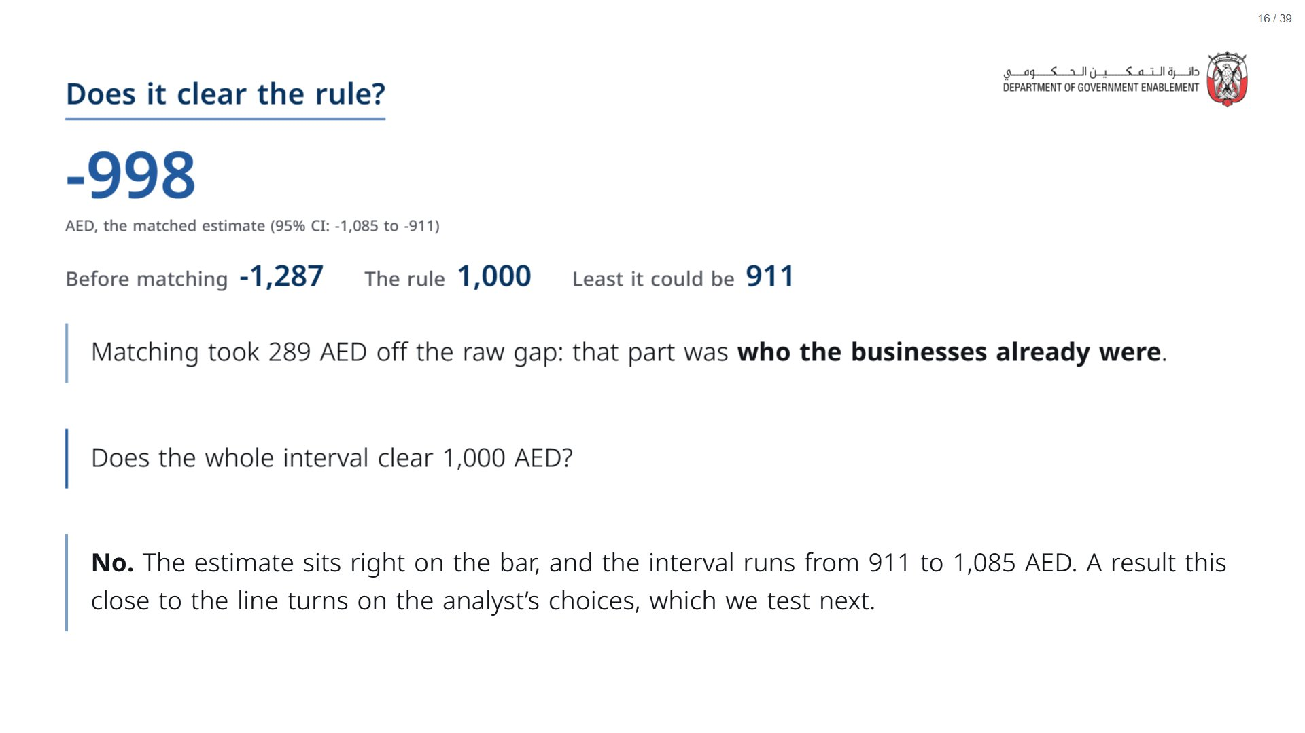
Notes:
Same reading as the last two sessions: does my decision change across this range? It does: the optimistic end clears the bar, the pessimistic end does not.
Worth noting if asked: the randomised comparison on Day 1 gave -1,014. Matching has landed close to it, which is reassuring about the method here. But the commissioner deciding from a matching study alone would not know that.
span.MJX_Assistive_MathML {
position:absolute!important;
clip: rect(1px, 1px, 1px, 1px);
padding: 1px 0 0 0!important;
border: 0!important;
height: 1px!important;
width: 1px!important;
overflow: hidden!important;
display:block!important;
}

Slide 17
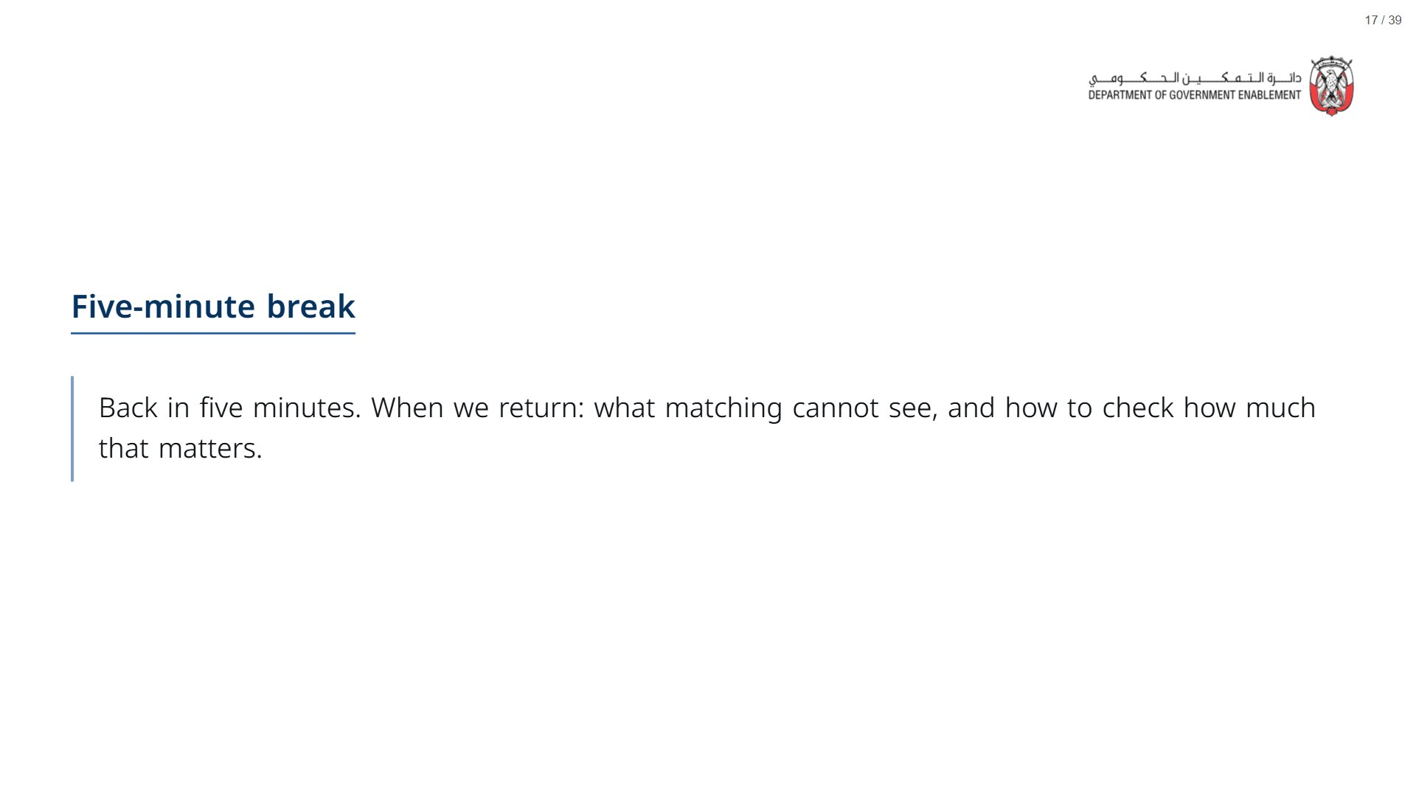

Slide 18

Notes:
About 20 minutes.
span.MJX_Assistive_MathML {
position:absolute!important;
clip: rect(1px, 1px, 1px, 1px);
padding: 1px 0 0 0!important;
border: 0!important;
height: 1px!important;
width: 1px!important;
overflow: hidden!important;
display:block!important;
}

Slide 19
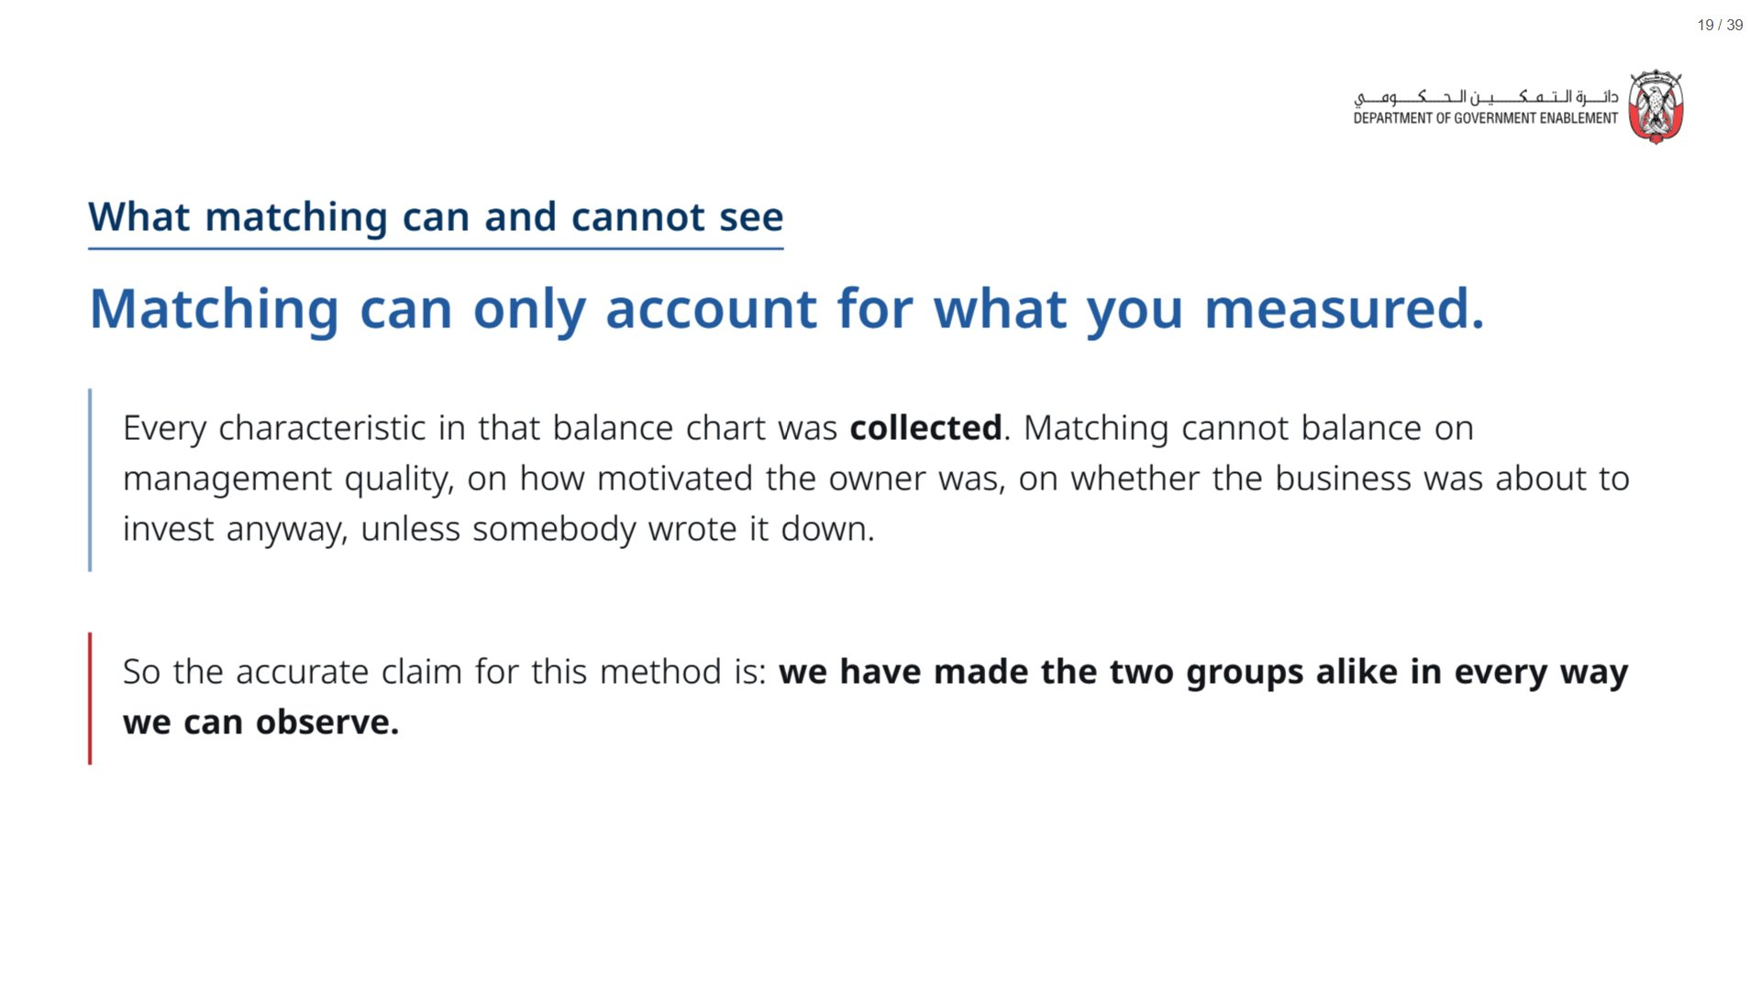
Notes:
DiD rested on parallel trends; RDD on a clean cut-off. Matching rests on something plainer and harder: everything that drove enrolment and also affects costs was measured and matched on. This cannot be tested from the data, by definition. But we can see how much it would matter, which is the next slide.
span.MJX_Assistive_MathML {
position:absolute!important;
clip: rect(1px, 1px, 1px, 1px);
padding: 1px 0 0 0!important;
border: 0!important;
height: 1px!important;
width: 1px!important;
overflow: hidden!important;
display:block!important;
}

Slide 20
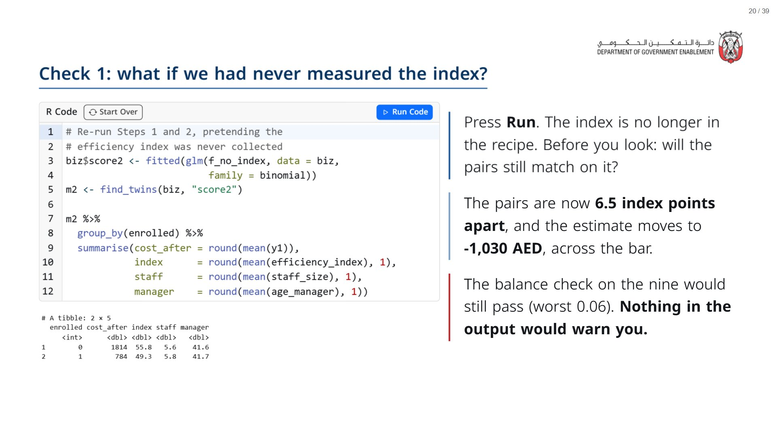
Notes:
This is the session’s key demonstration. The efficiency index is the thing that decided who was eligible, so it is the kind of characteristic that drives both enrolment and costs. Here we have it, so we can see what leaving it out does. In a real evaluation, the missing characteristic is one nobody collected, so you never get to see this comparison.
The estimate moves from -998 to -1,030. Not a huge move, but enough to push the point estimate over the bar. The direction flatters the programme, which is the usual direction for an omitted “motivated and already improving” characteristic.
span.MJX_Assistive_MathML {
position:absolute!important;
clip: rect(1px, 1px, 1px, 1px);
padding: 1px 0 0 0!important;
border: 0!important;
height: 1px!important;
width: 1px!important;
overflow: hidden!important;
display:block!important;
}

Slide 21
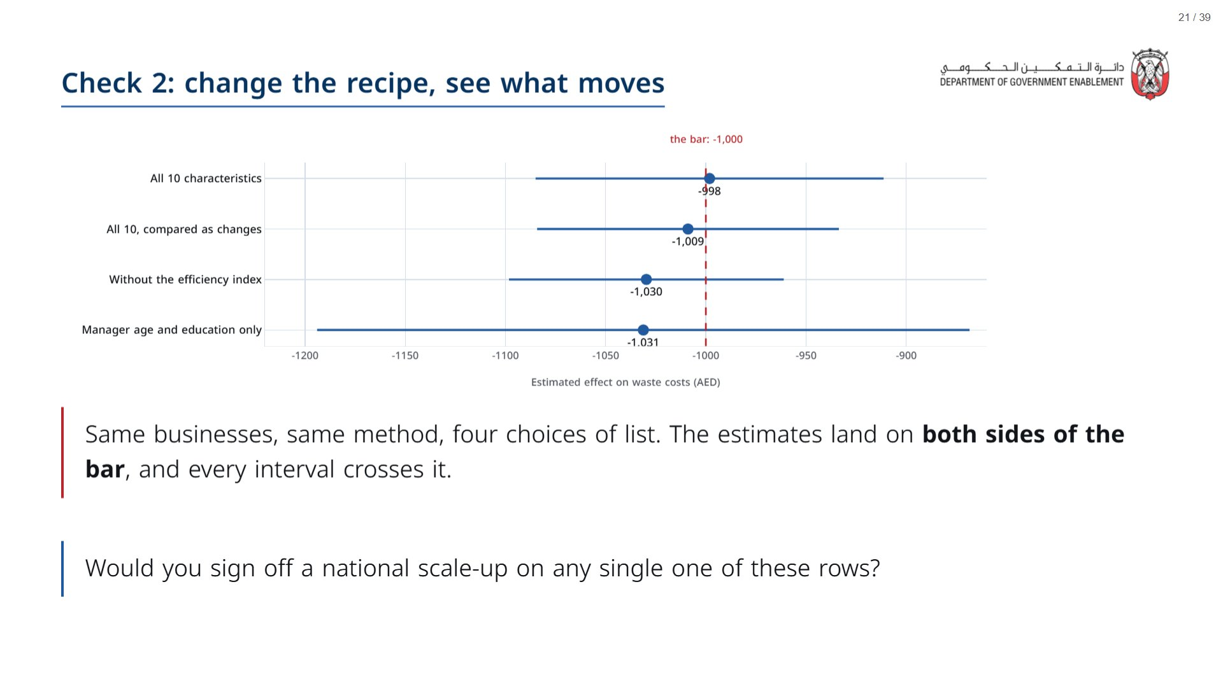
Notes:
Row 1 is the main estimate. Row 2 compares each pair’s change in costs rather than their costs afterwards (the difference-in-differences idea from this morning, applied to the matched pairs): a useful second opinion when the pairs might have started at slightly different levels. It agrees. Rows 3 and 4 match on less: without the index, and on manager age and education alone.
The takeaway for a commissioner: with matching, ask what was matched on, and whether the answer holds when the list changes. If one choice of list flips the recommendation, the result is not settled. Here, it flips.
span.MJX_Assistive_MathML {
position:absolute!important;
clip: rect(1px, 1px, 1px, 1px);
padding: 1px 0 0 0!important;
border: 0!important;
height: 1px!important;
width: 1px!important;
overflow: hidden!important;
display:block!important;
}

Slide 22
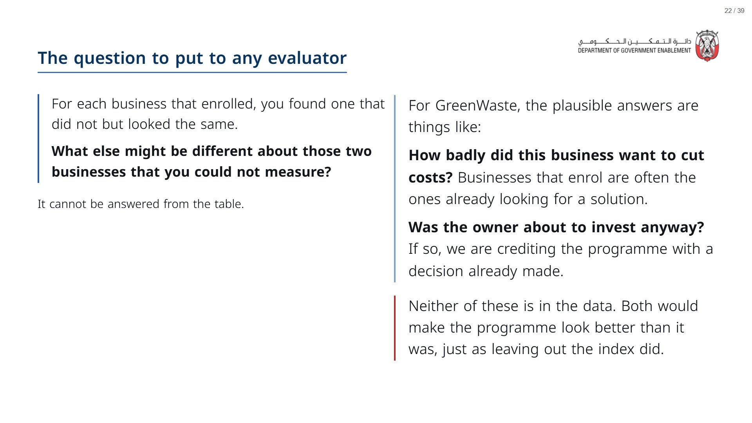
Notes:
Get the room to generate the hidden differences before revealing the panel. Owner motivation always comes up, and it is a good example: it is unmeasured and it flatters the programme.
span.MJX_Assistive_MathML {
position:absolute!important;
clip: rect(1px, 1px, 1px, 1px);
padding: 1px 0 0 0!important;
border: 0!important;
height: 1px!important;
width: 1px!important;
overflow: hidden!important;
display:block!important;
}

Slide 23
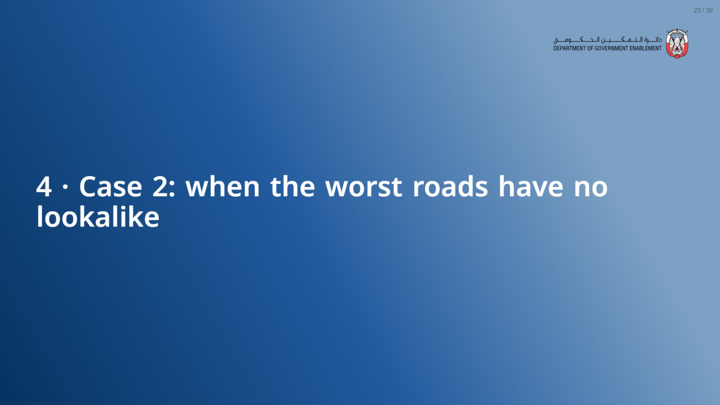
Notes:
About 20 minutes.
span.MJX_Assistive_MathML {
position:absolute!important;
clip: rect(1px, 1px, 1px, 1px);
padding: 1px 0 0 0!important;
border: 0!important;
height: 1px!important;
width: 1px!important;
overflow: hidden!important;
display:block!important;
}

Slide 24
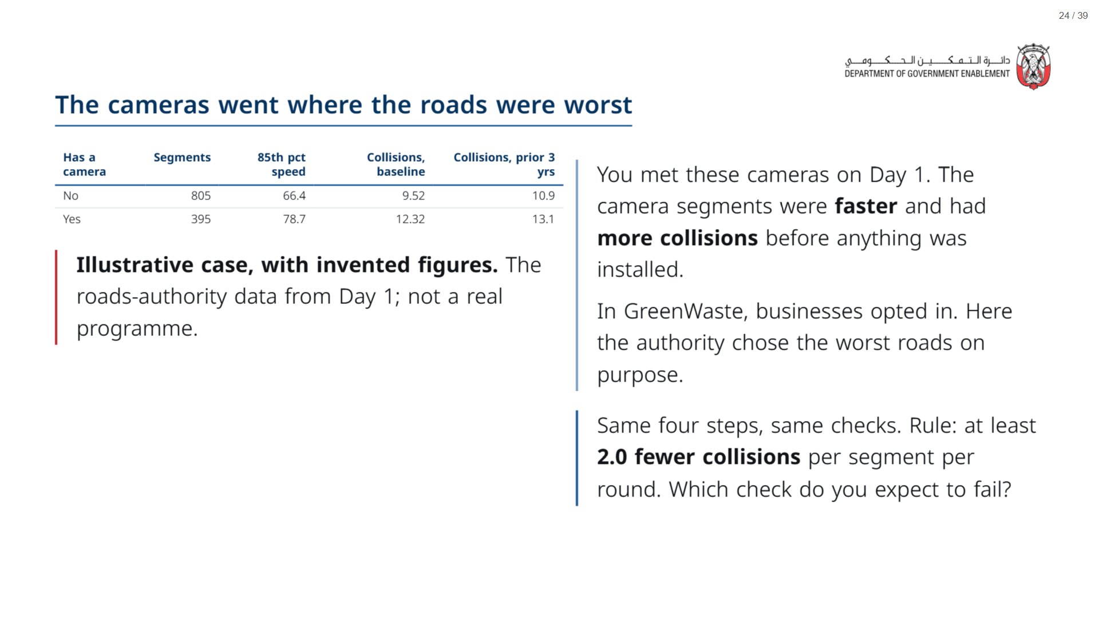
Notes:
Section 4 is the second case study the outline asks for: a matching study that is carried out correctly and still leaves gaps: the fastest camera roads have no good match, and the pairs do not start level. Move at pace: the room now knows the checks, so this section is about spotting which one fails.
span.MJX_Assistive_MathML {
position:absolute!important;
clip: rect(1px, 1px, 1px, 1px);
padding: 1px 0 0 0!important;
border: 0!important;
height: 1px!important;
width: 1px!important;
overflow: hidden!important;
display:block!important;
}

Slide 25
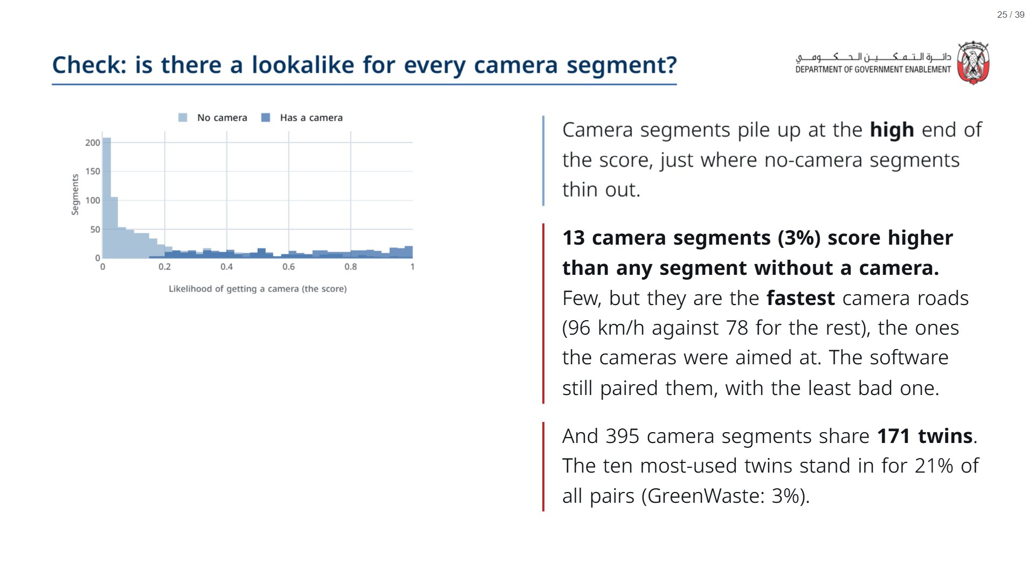
Notes:
Contrast with GreenWaste, where the curves overlapped almost completely and 1 enrolled businesses sat outside. Here 13 do. Nothing in a standard results table flags them: the match rate still reads 100%. The two reasonable options are to drop them (and say the result no longer covers the fastest roads) or to keep them and say the comparison for them is weak. Either way, the evaluator should tell you which.
span.MJX_Assistive_MathML {
position:absolute!important;
clip: rect(1px, 1px, 1px, 1px);
padding: 1px 0 0 0!important;
border: 0!important;
height: 1px!important;
width: 1px!important;
overflow: hidden!important;
display:block!important;
}

Slide 26
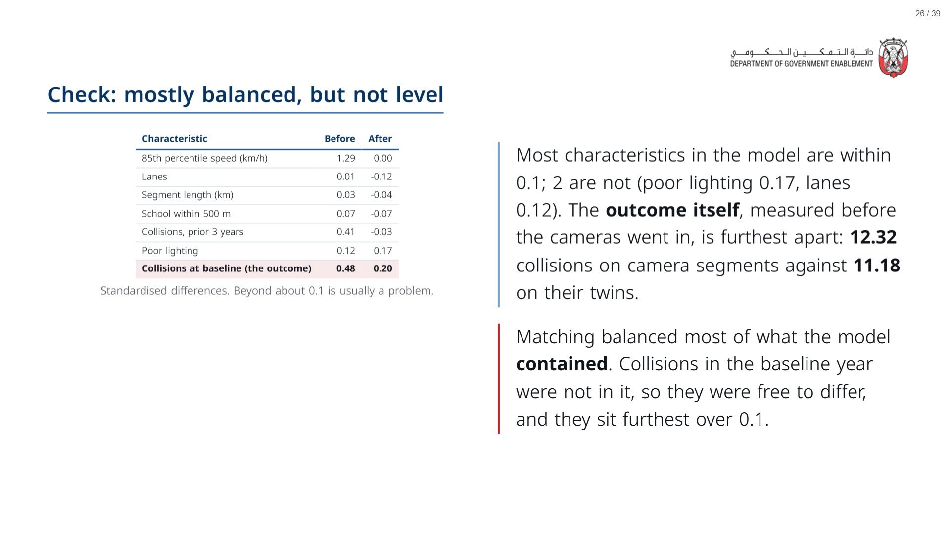
Notes:
The model included collisions over the prior three years, and that balances. But the baseline-year count, the outcome’s own starting point, still differs by 1.15 collisions. Ask to see the outcome’s baseline in any balance table: it is often left out.
span.MJX_Assistive_MathML {
position:absolute!important;
clip: rect(1px, 1px, 1px, 1px);
padding: 1px 0 0 0!important;
border: 0!important;
height: 1px!important;
width: 1px!important;
overflow: hidden!important;
display:block!important;
}

Slide 27
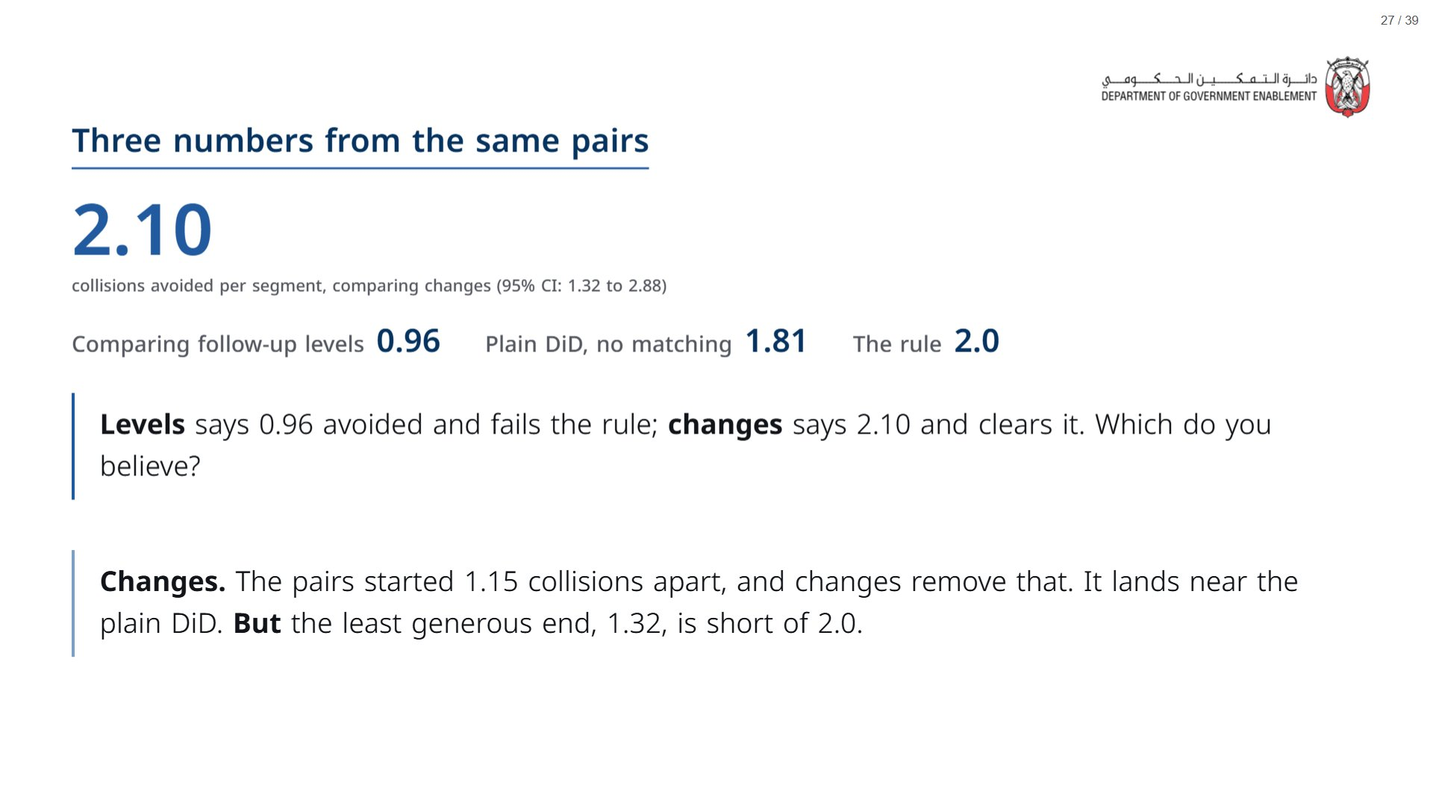
Notes:
Two methods that should agree, agreeing, is the reassurance: the changes-based matched estimate and the plain DiD from this morning’s logic. The levels comparison was the odd one out because the pairs did not start level. Note the same check was run on GreenWaste (Check 2, row 2) and there the two agreed, because the pairs did start level.
span.MJX_Assistive_MathML {
position:absolute!important;
clip: rect(1px, 1px, 1px, 1px);
padding: 1px 0 0 0!important;
border: 0!important;
height: 1px!important;
width: 1px!important;
overflow: hidden!important;
display:block!important;
}

Slide 28
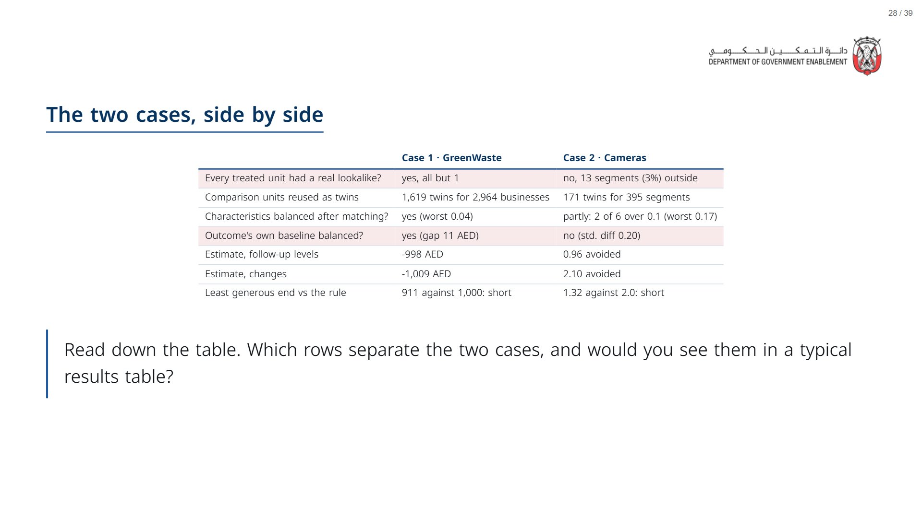
Notes:
Case 1 passes every check. Case 2 comes close on the checks people usually report (worst 0.17) and fails the two they usually do not. Rows 1 and 4 are the two that separate the cases: real lookalikes for everyone, and the outcome’s own baseline. Neither appears in a typical matching results table, which is why they are on the question card at the end.
span.MJX_Assistive_MathML {
position:absolute!important;
clip: rect(1px, 1px, 1px, 1px);
padding: 1px 0 0 0!important;
border: 0!important;
height: 1px!important;
width: 1px!important;
overflow: hidden!important;
display:block!important;
}

Slide 29
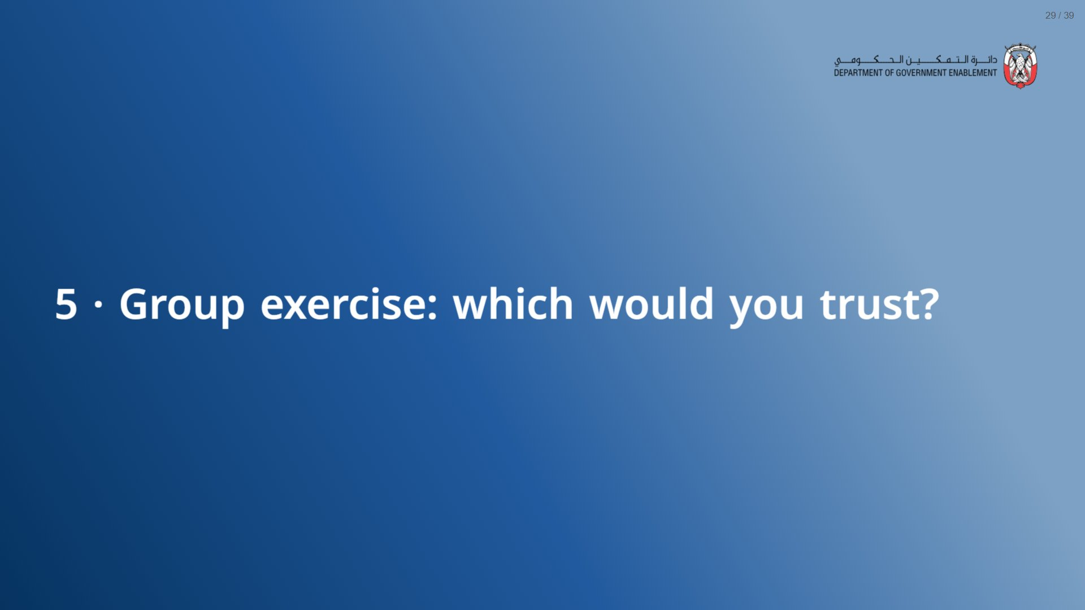
Notes:
About 15 minutes.
span.MJX_Assistive_MathML {
position:absolute!important;
clip: rect(1px, 1px, 1px, 1px);
padding: 1px 0 0 0!important;
border: 0!important;
height: 1px!important;
width: 1px!important;
overflow: hidden!important;
display:block!important;
}

Slide 30
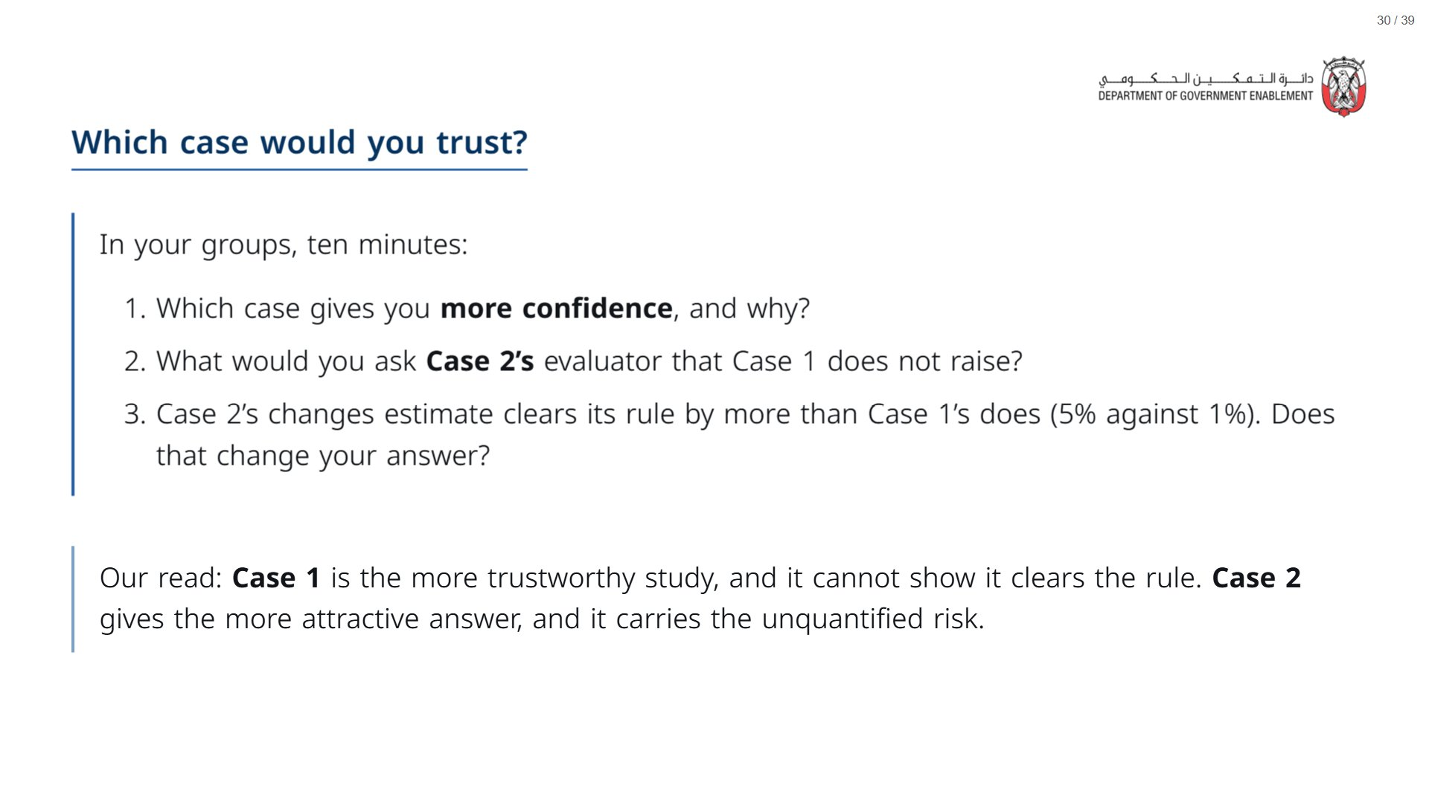
Notes:
Paper (Oct13_session3_materials.docx): Hand out the “Which case would you trust?” sheet (pack page 2, one per group). Groups circle a verdict for each case before the reveal.
Verdict round at the end: hands, not discussion. Push them past “Case 1 is cleaner” to why: overlap, the outcome’s baseline, and who the result applies to. Ask whoever says “send it back” for the single question behind it.
span.MJX_Assistive_MathML {
position:absolute!important;
clip: rect(1px, 1px, 1px, 1px);
padding: 1px 0 0 0!important;
border: 0!important;
height: 1px!important;
width: 1px!important;
overflow: hidden!important;
display:block!important;
}

Slide 31
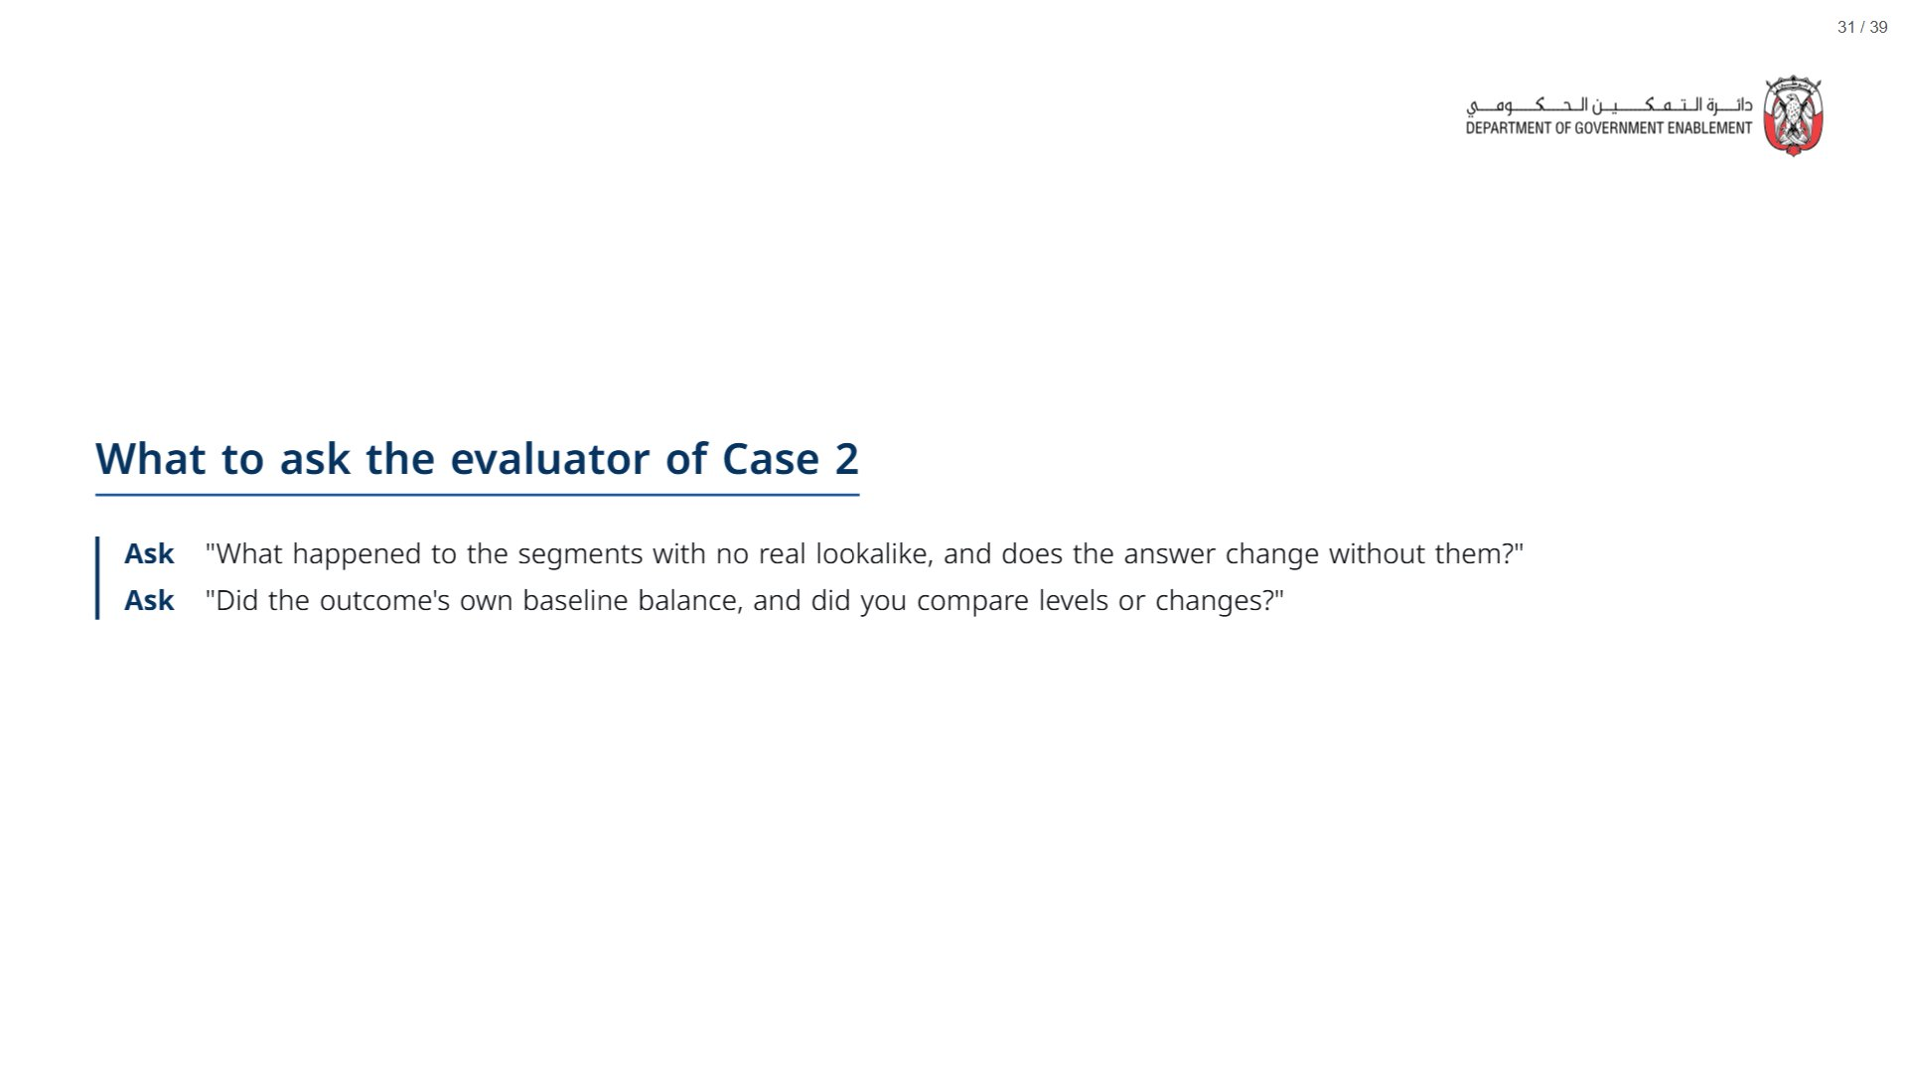
Notes:
These are the two questions Case 1 does not raise. The full list of five is on the take-away card at the end.
span.MJX_Assistive_MathML {
position:absolute!important;
clip: rect(1px, 1px, 1px, 1px);
padding: 1px 0 0 0!important;
border: 0!important;
height: 1px!important;
width: 1px!important;
overflow: hidden!important;
display:block!important;
}

Slide 32

Notes:
About 10 minutes. The snapshot and its debrief only; the better prompt is a take-home.
span.MJX_Assistive_MathML {
position:absolute!important;
clip: rect(1px, 1px, 1px, 1px);
padding: 1px 0 0 0!important;
border: 0!important;
height: 1px!important;
width: 1px!important;
overflow: hidden!important;
display:block!important;
}

Slide 33
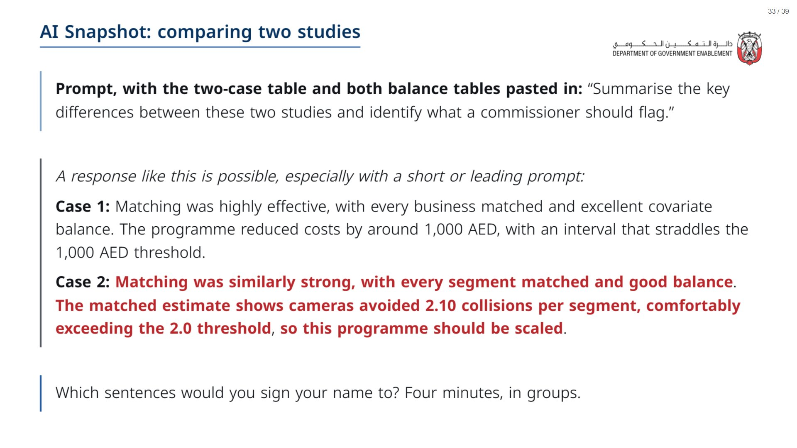
Notes:
Paper (Oct13_session3_materials.docx): Hand out the AI Snapshot sheet (pack page 3, one per group). Groups underline what they would sign and cross out the rest. Keep the better-prompt strip (page 4) back until after the debrief.
span.MJX_Assistive_MathML {
position:absolute!important;
clip: rect(1px, 1px, 1px, 1px);
padding: 1px 0 0 0!important;
border: 0!important;
height: 1px!important;
width: 1px!important;
overflow: hidden!important;
display:block!important;
}

Slide 34
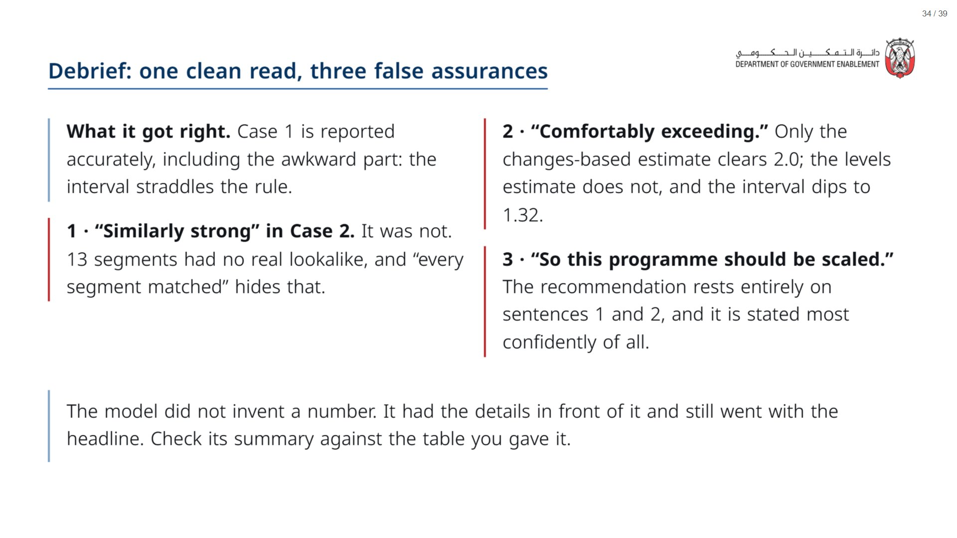

Slide 35
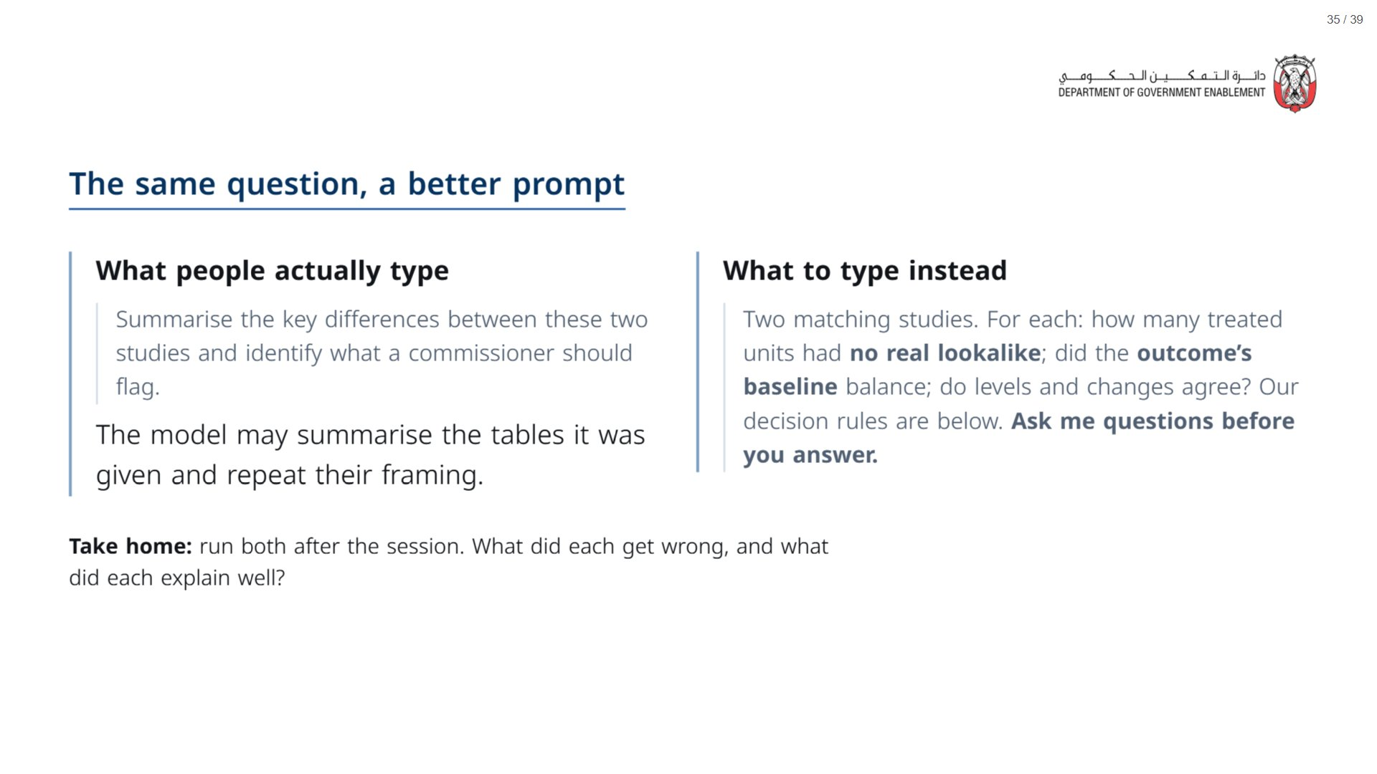
Notes:
Paper (Oct13_session3_materials.docx): Hand out the better-prompt strip now (pack page 4, one per group, cut) as a take-home. It names the checks, so it goes out only after the debrief. Do not run the prompts in the session.
span.MJX_Assistive_MathML {
position:absolute!important;
clip: rect(1px, 1px, 1px, 1px);
padding: 1px 0 0 0!important;
border: 0!important;
height: 1px!important;
width: 1px!important;
overflow: hidden!important;
display:block!important;
}

Slide 36

Notes:
About 10 minutes. Skip the optional AI slide if short of time.
span.MJX_Assistive_MathML {
position:absolute!important;
clip: rect(1px, 1px, 1px, 1px);
padding: 1px 0 0 0!important;
border: 0!important;
height: 1px!important;
width: 1px!important;
overflow: hidden!important;
display:block!important;
}

Slide 37
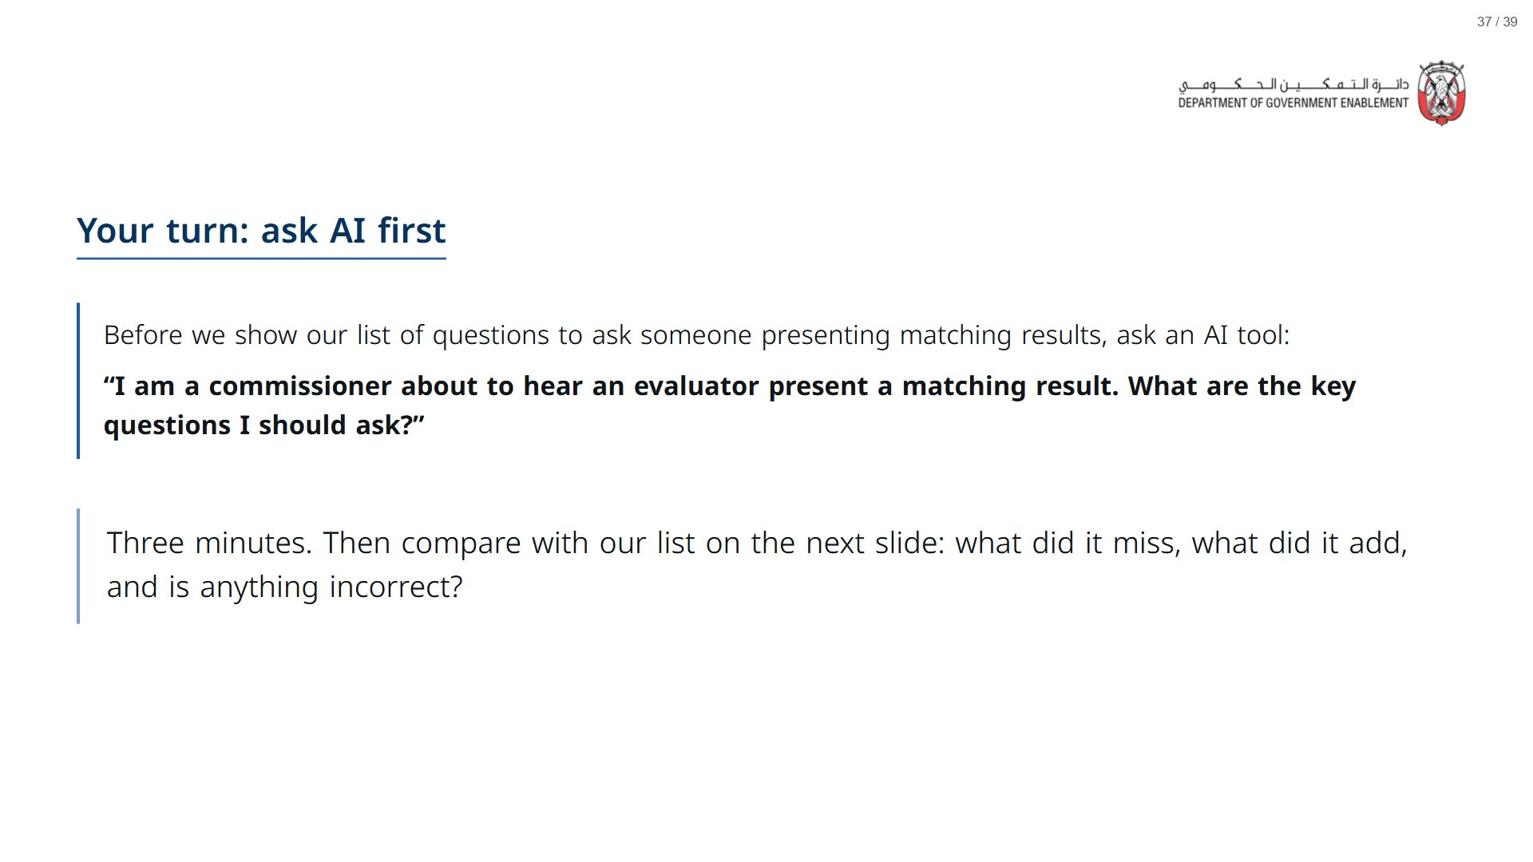
Notes:
Optional: skip if short of time, and go straight to the questions on the next one. If you run it: give three minutes, then reveal the list and ask what the AI missed, what it added that is worth keeping, and whether anything it suggested was incorrect.
span.MJX_Assistive_MathML {
position:absolute!important;
clip: rect(1px, 1px, 1px, 1px);
padding: 1px 0 0 0!important;
border: 0!important;
height: 1px!important;
width: 1px!important;
overflow: hidden!important;
display:block!important;
}

Slide 38
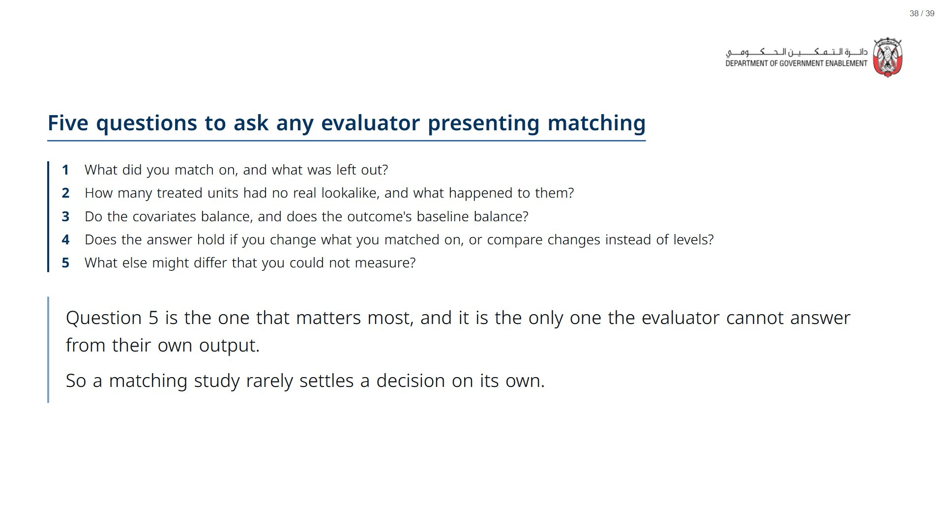
Notes:
Paper (Oct13_session3_materials.docx): Hand out the take-away cards (pack page 5, one per participant). Give a minute to fill in “On my desk” on the card, then take two or three examples from the room.
span.MJX_Assistive_MathML {
position:absolute!important;
clip: rect(1px, 1px, 1px, 1px);
padding: 1px 0 0 0!important;
border: 0!important;
height: 1px!important;
width: 1px!important;
overflow: hidden!important;
display:block!important;
}

Slide 39
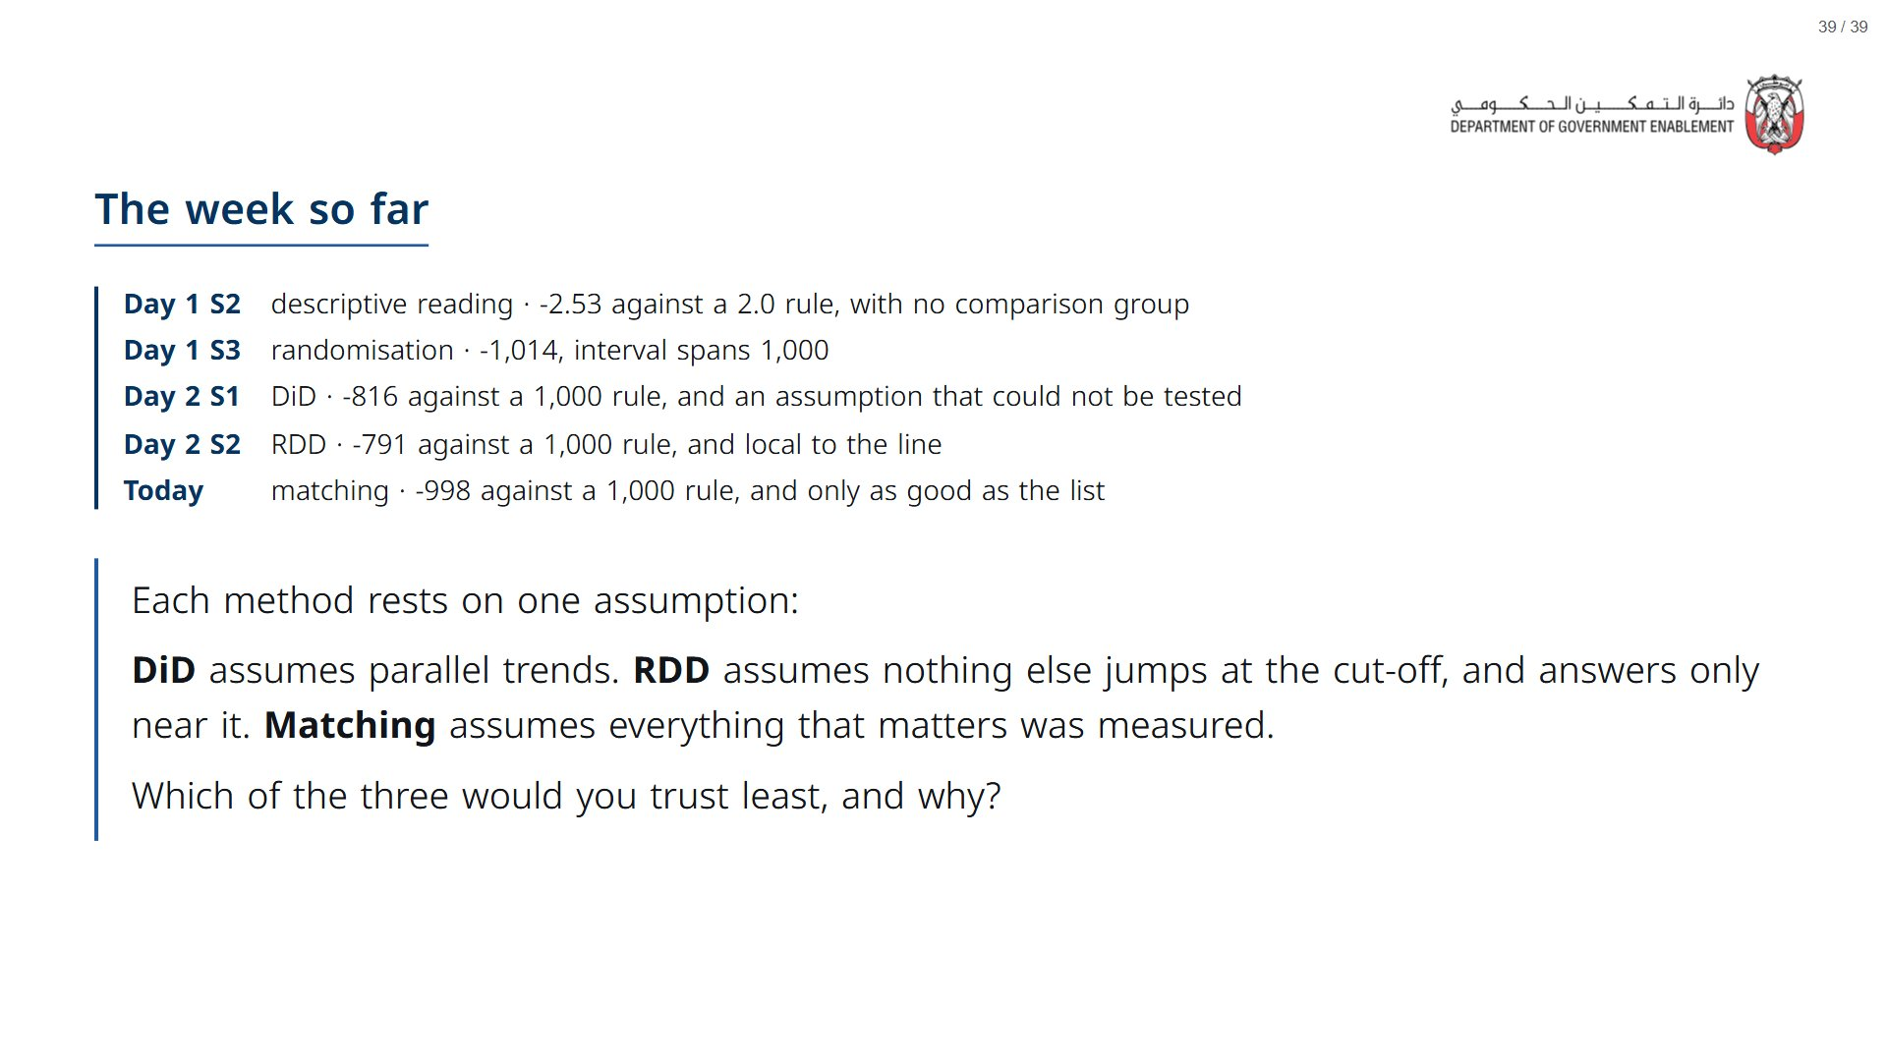
Notes:
If there is time at the very end, ask the room: is there a different question you would ask AI to help you understand a concept from today? For example: “I am learning about impact evaluation to help me make policy decisions. How should I think about a confidence interval, and how is it relevant when I compare an estimate to a decision threshold?” Adding context about who you are and why you are asking usually gets a more useful answer.
span.MJX_Assistive_MathML {
position:absolute!important;
clip: rect(1px, 1px, 1px, 1px);
padding: 1px 0 0 0!important;
border: 0!important;
height: 1px!important;
width: 1px!important;
overflow: hidden!important;
display:block!important;
}

