Slide 1
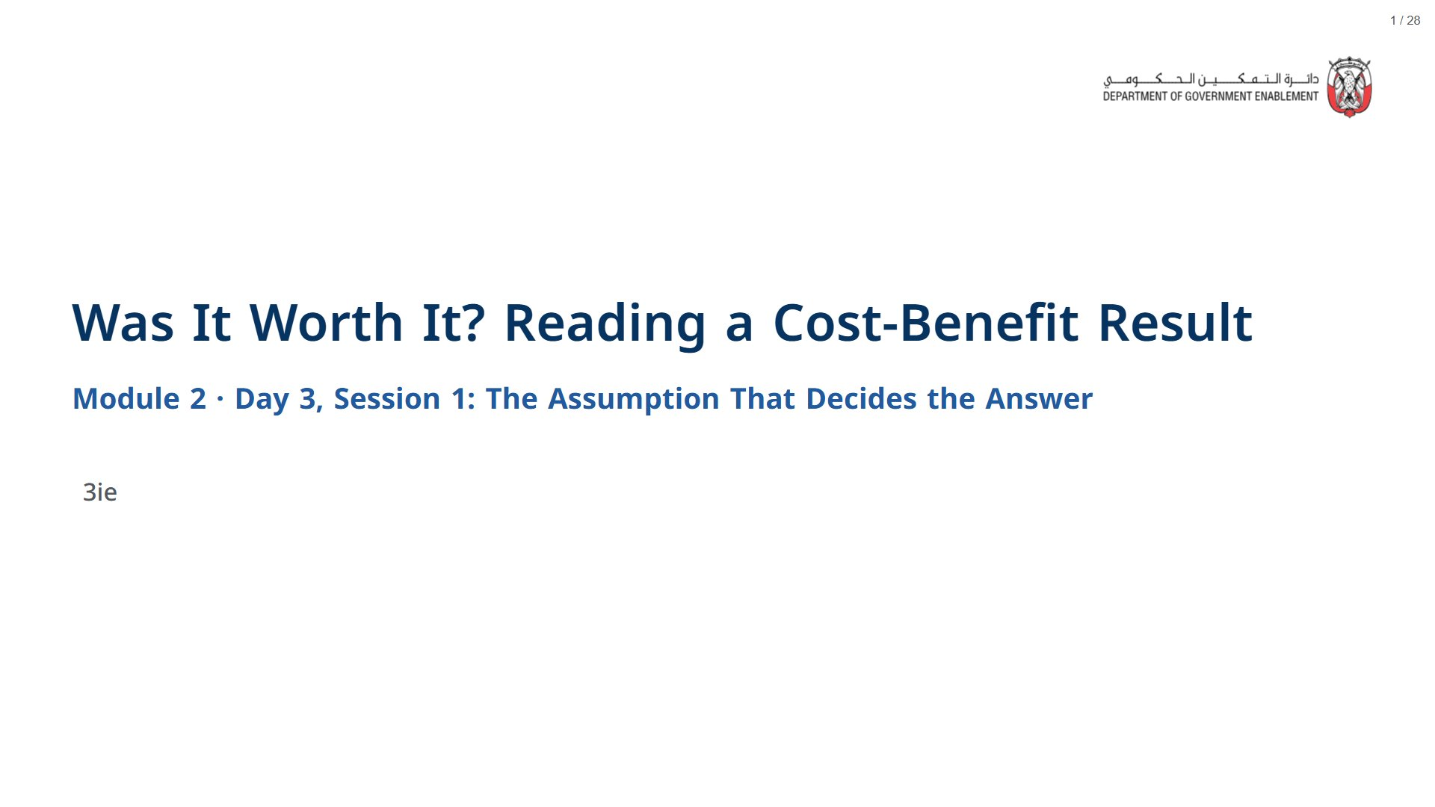

Slide 2


Slide 3
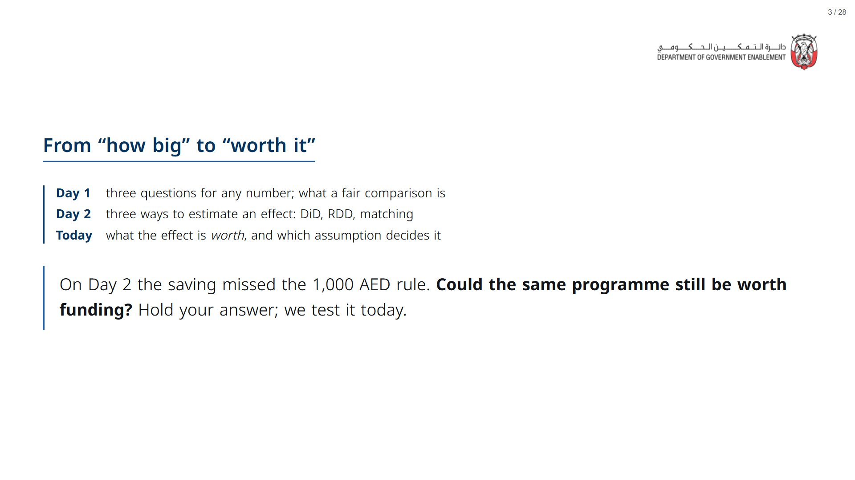
Notes:
About 2 minutes. Open the deck a couple of minutes before the session starts: R and its statistics package take about a minute to load in the browser, after which every live cell runs in a few seconds.
span.MJX_Assistive_MathML {
position:absolute!important;
clip: rect(1px, 1px, 1px, 1px);
padding: 1px 0 0 0!important;
border: 0!important;
height: 1px!important;
width: 1px!important;
overflow: hidden!important;
display:block!important;
}

Slide 4
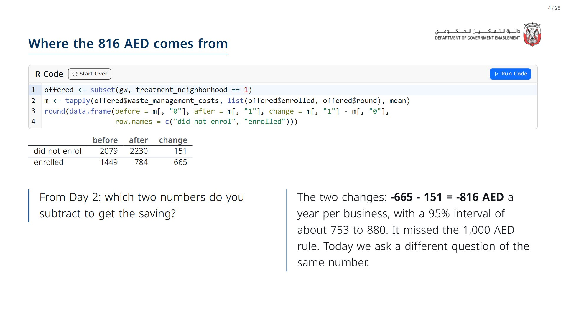

Slide 5


Slide 6
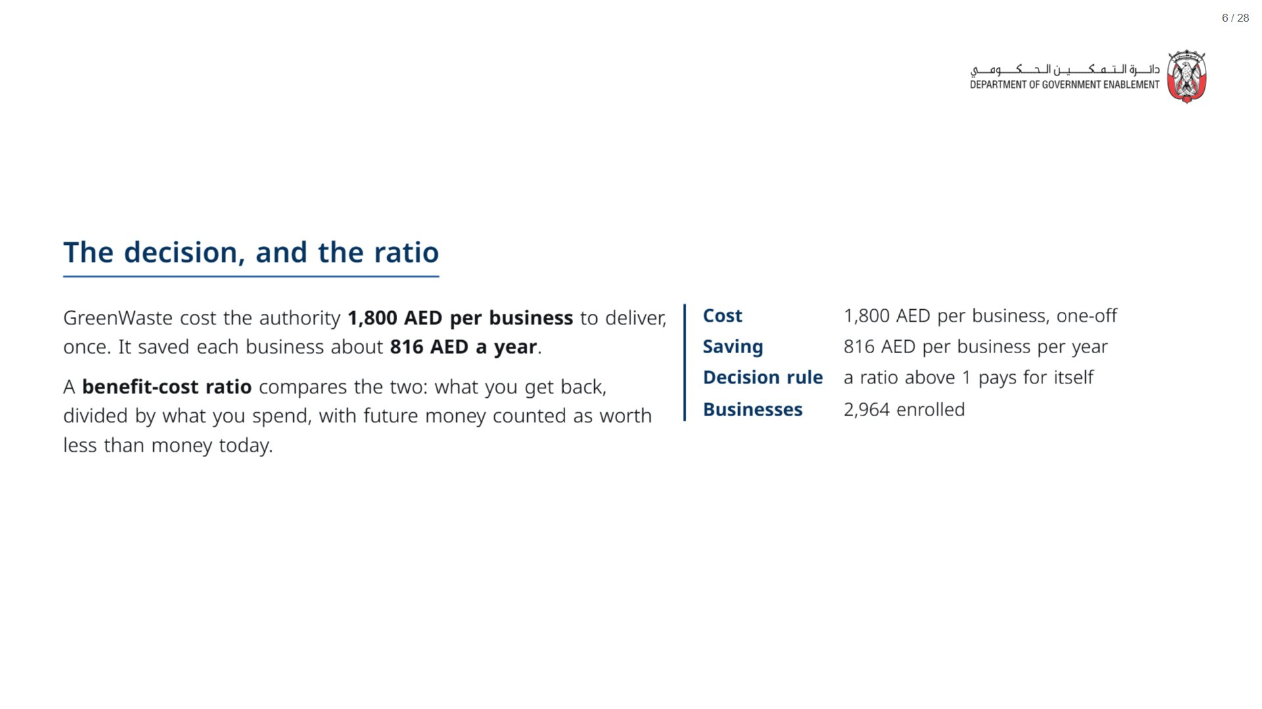

Slide 7
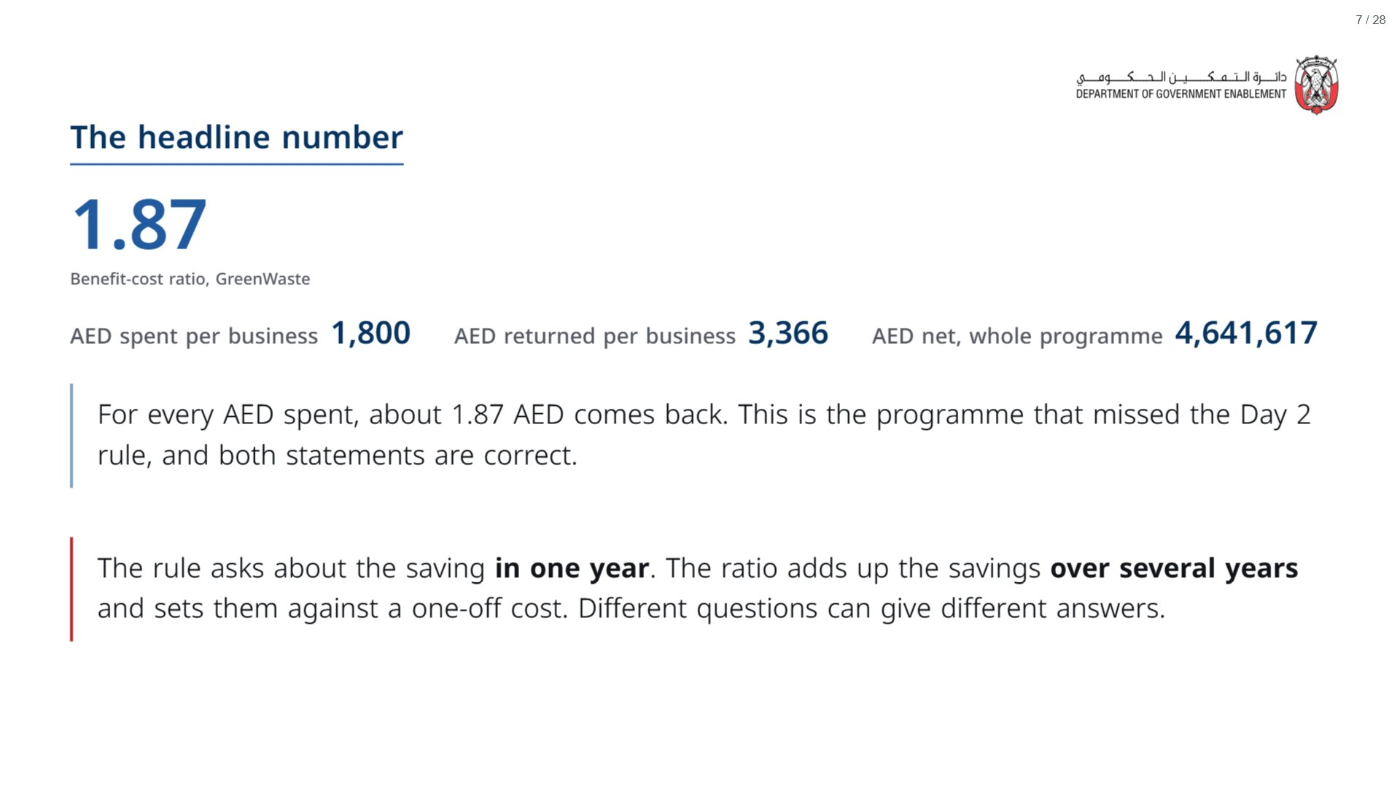

Slide 8
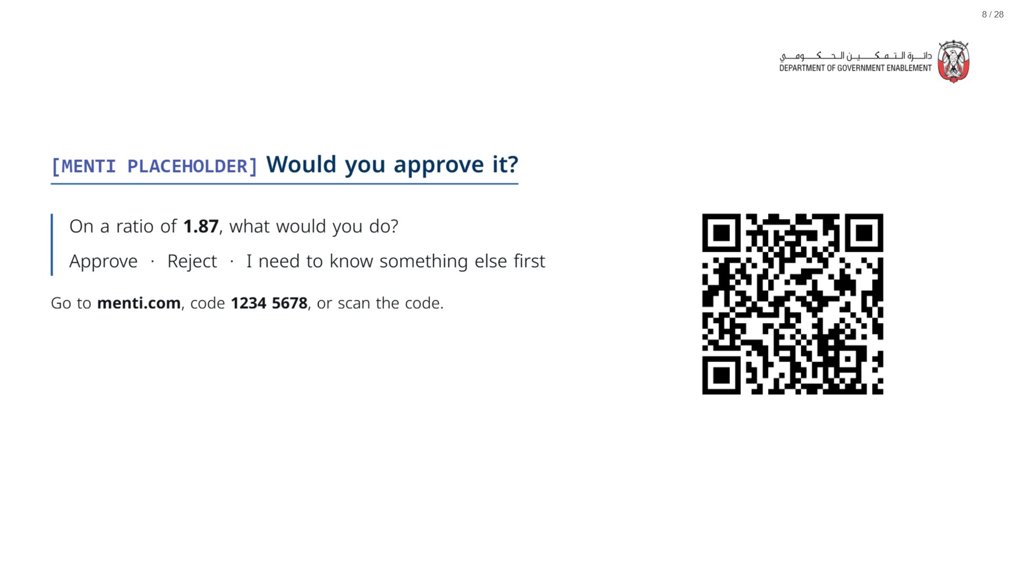
Notes:
If most pick “something else first”, ask two people what, write it up, and come back to it at the three questions.
span.MJX_Assistive_MathML {
position:absolute!important;
clip: rect(1px, 1px, 1px, 1px);
padding: 1px 0 0 0!important;
border: 0!important;
height: 1px!important;
width: 1px!important;
overflow: hidden!important;
display:block!important;
}

Slide 9
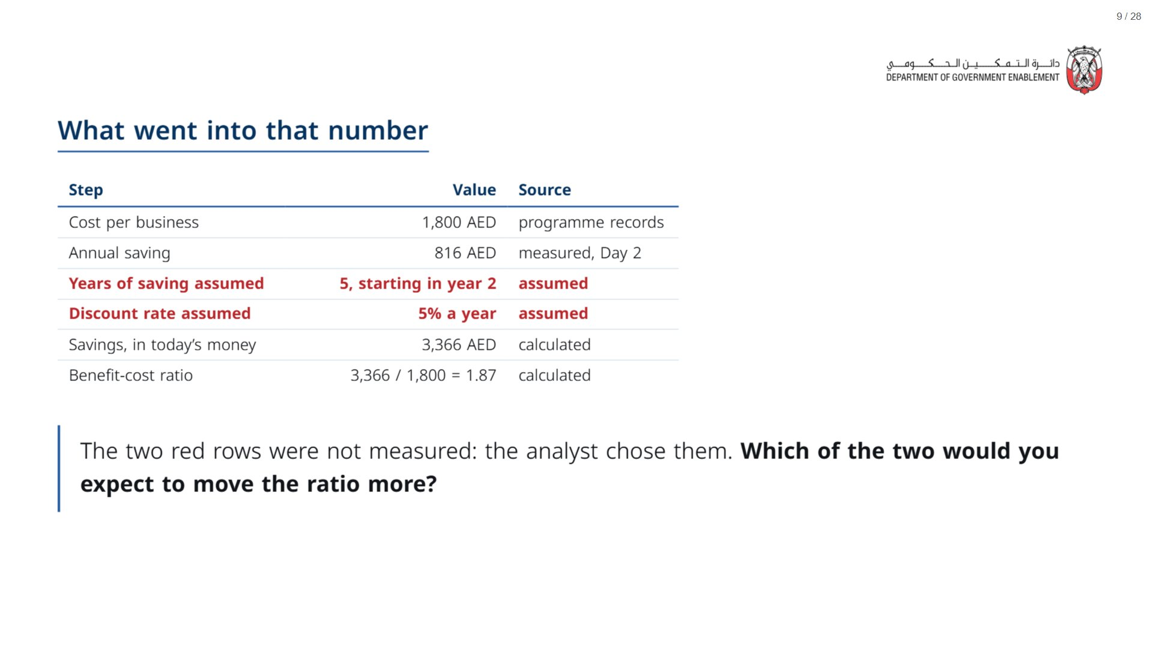
Notes:
Paper (Oct14_session1_materials.docx): Hand out “What went into the ratio” (pack page 1, one per group). Groups keep it: they paste the table into AI later.
span.MJX_Assistive_MathML {
position:absolute!important;
clip: rect(1px, 1px, 1px, 1px);
padding: 1px 0 0 0!important;
border: 0!important;
height: 1px!important;
width: 1px!important;
overflow: hidden!important;
display:block!important;
}

Slide 10


Slide 11
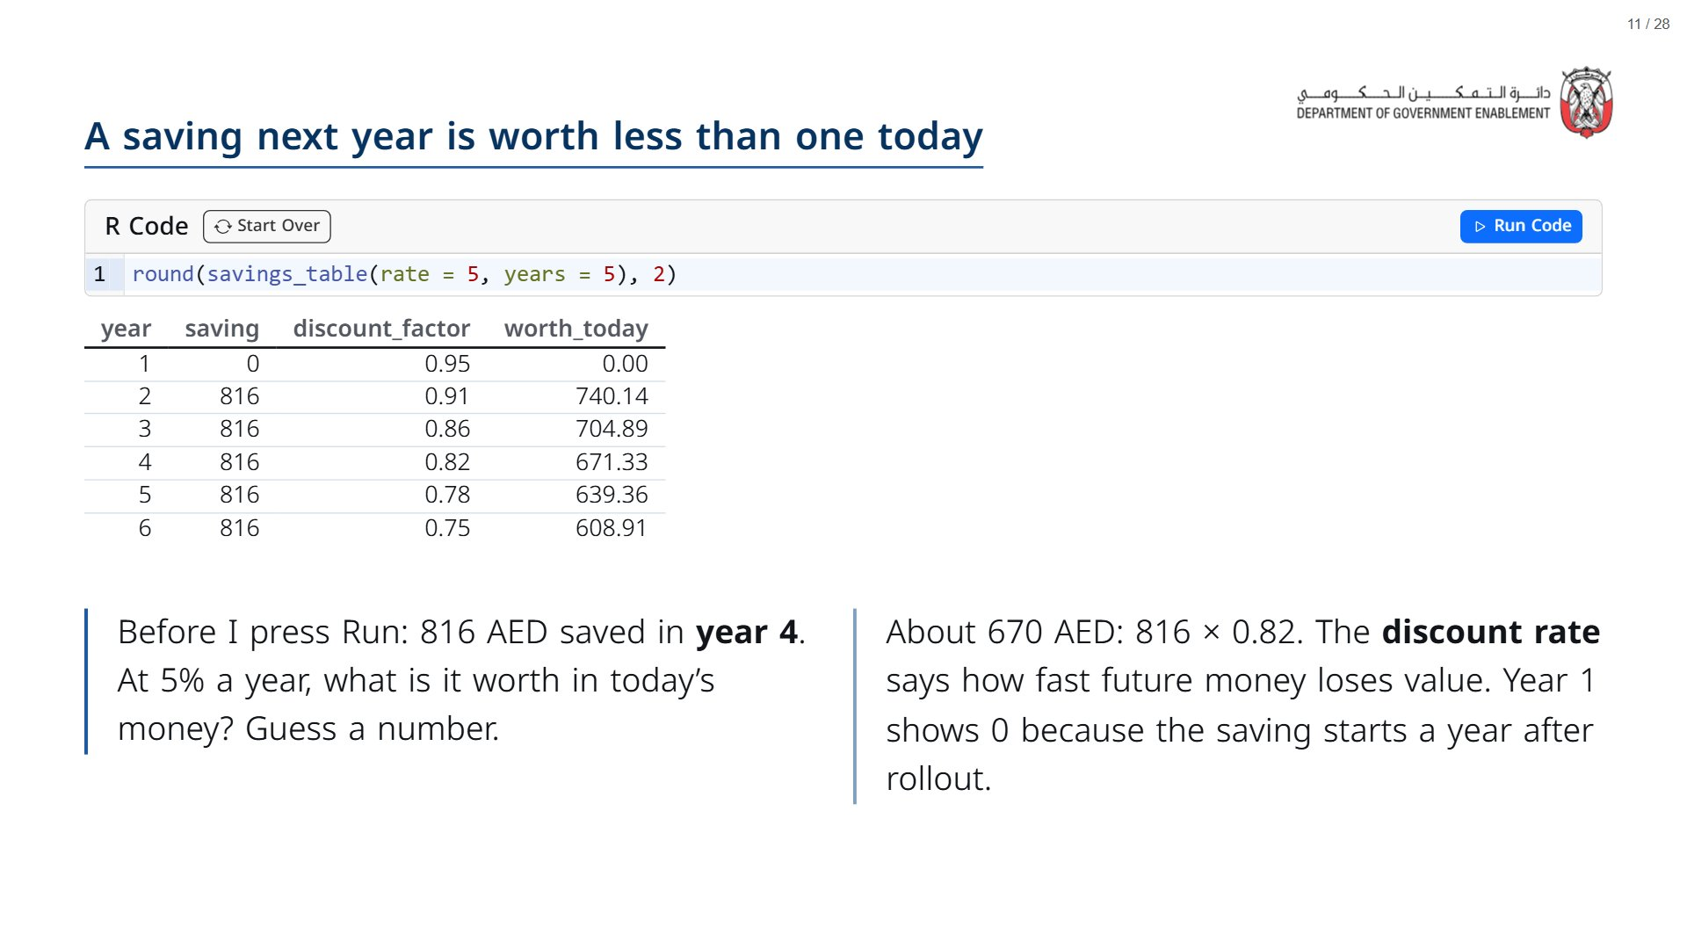

Slide 12
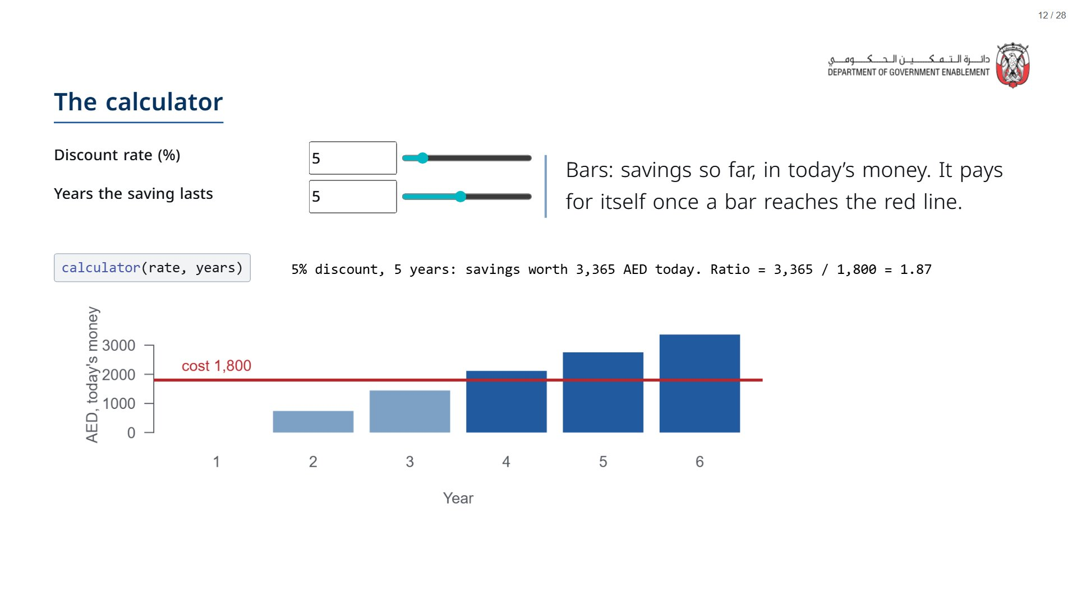
Notes:
Start at the base case (5%, 5 years): ratio 1.87. Do not move the sliders yet; the next two slides move one at a time.
span.MJX_Assistive_MathML {
position:absolute!important;
clip: rect(1px, 1px, 1px, 1px);
padding: 1px 0 0 0!important;
border: 0!important;
height: 1px!important;
width: 1px!important;
overflow: hidden!important;
display:block!important;
}

Slide 13
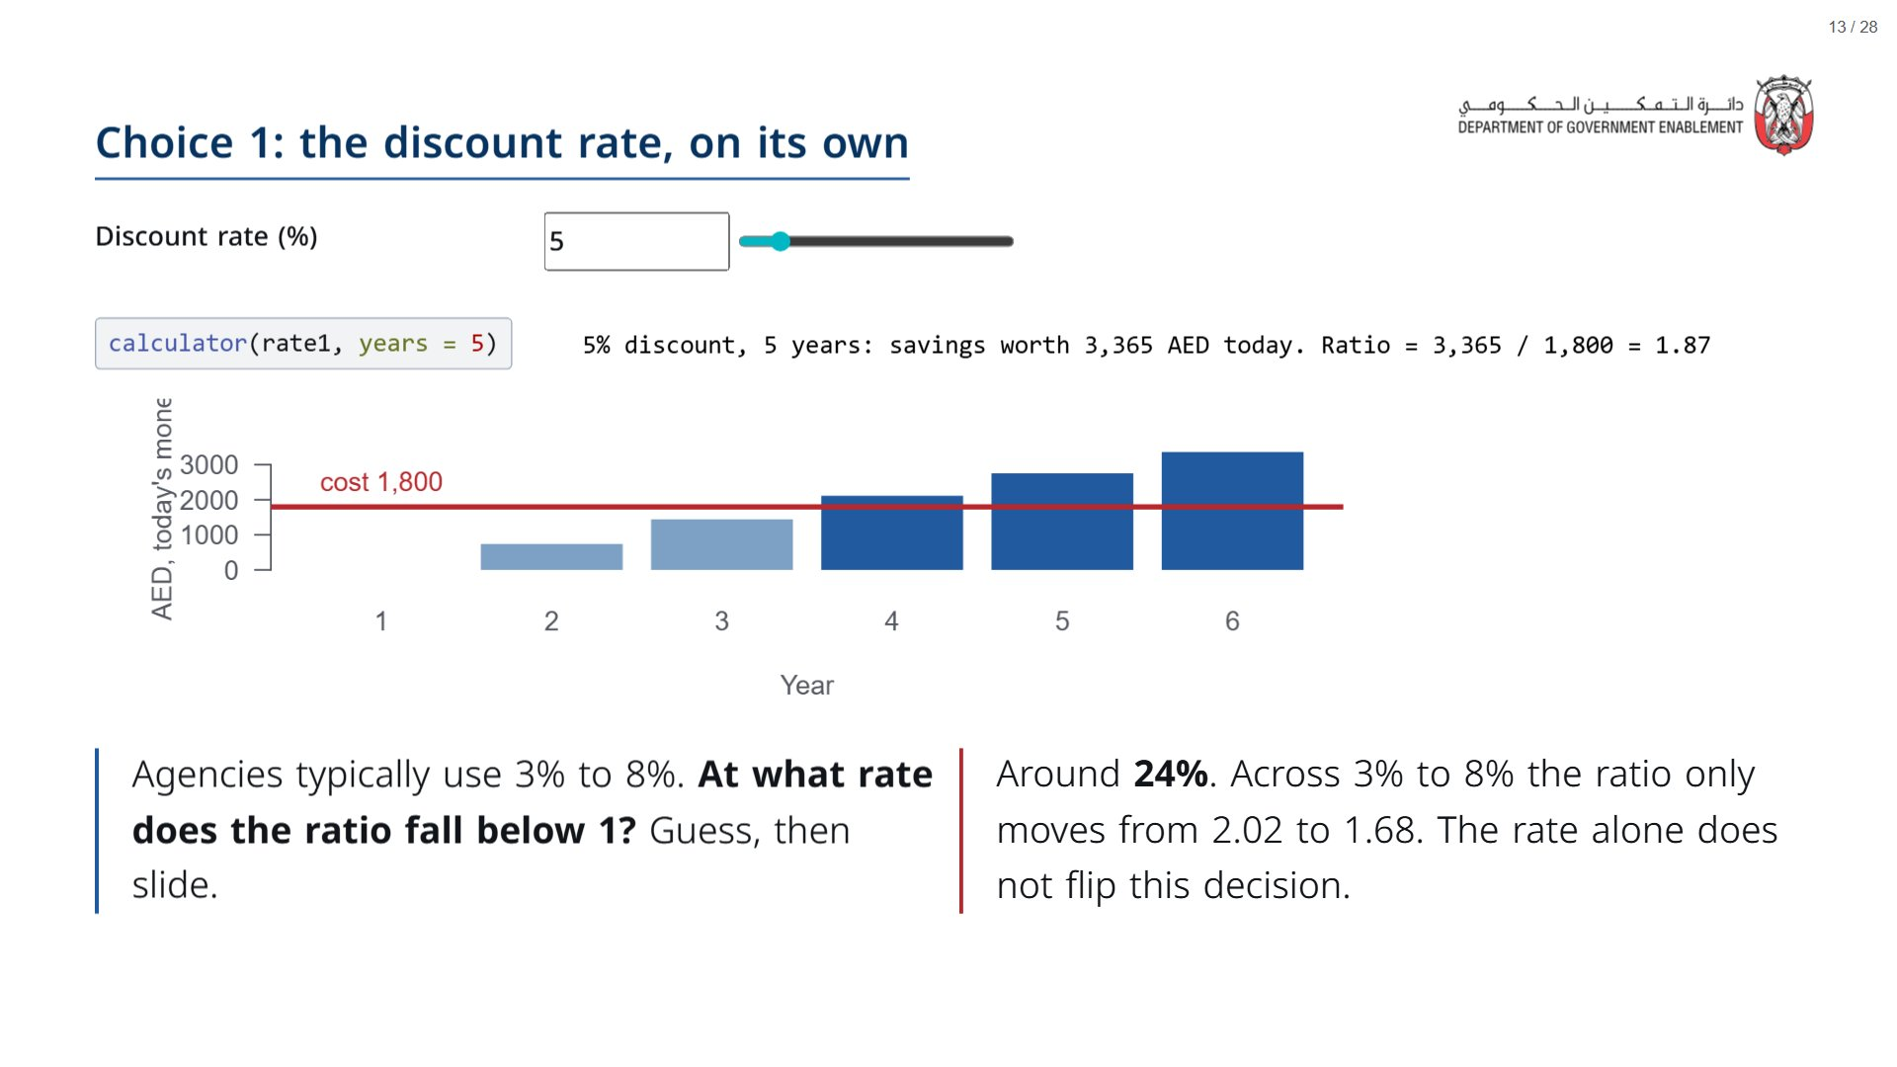

Slide 14
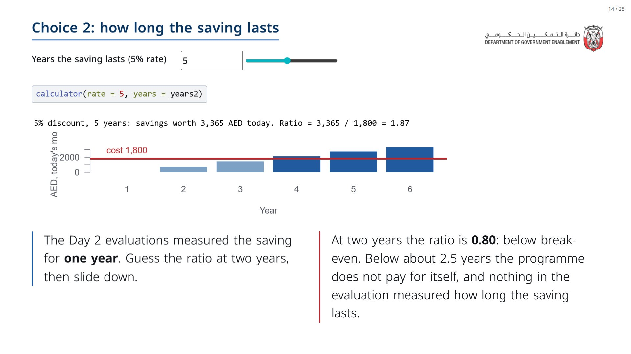

Slide 15
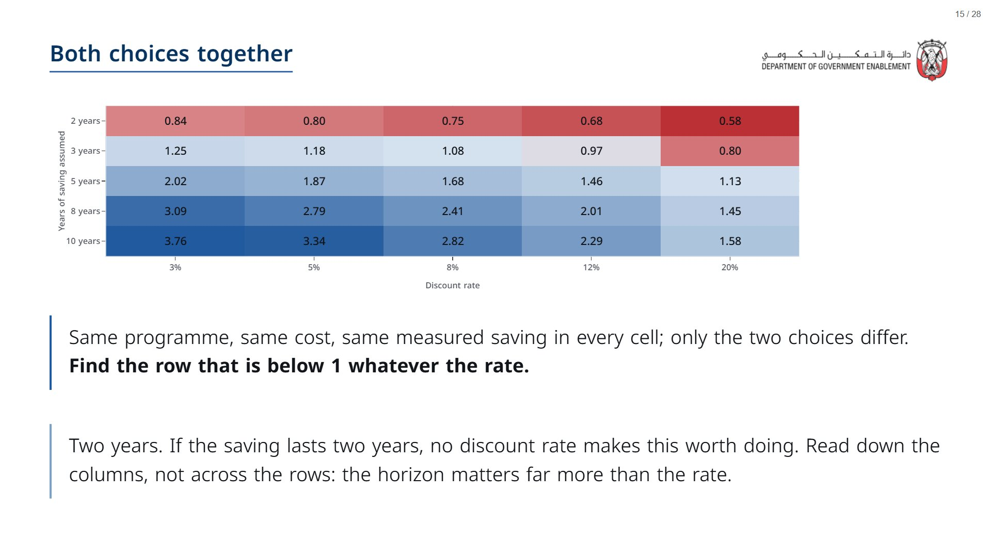

Slide 16
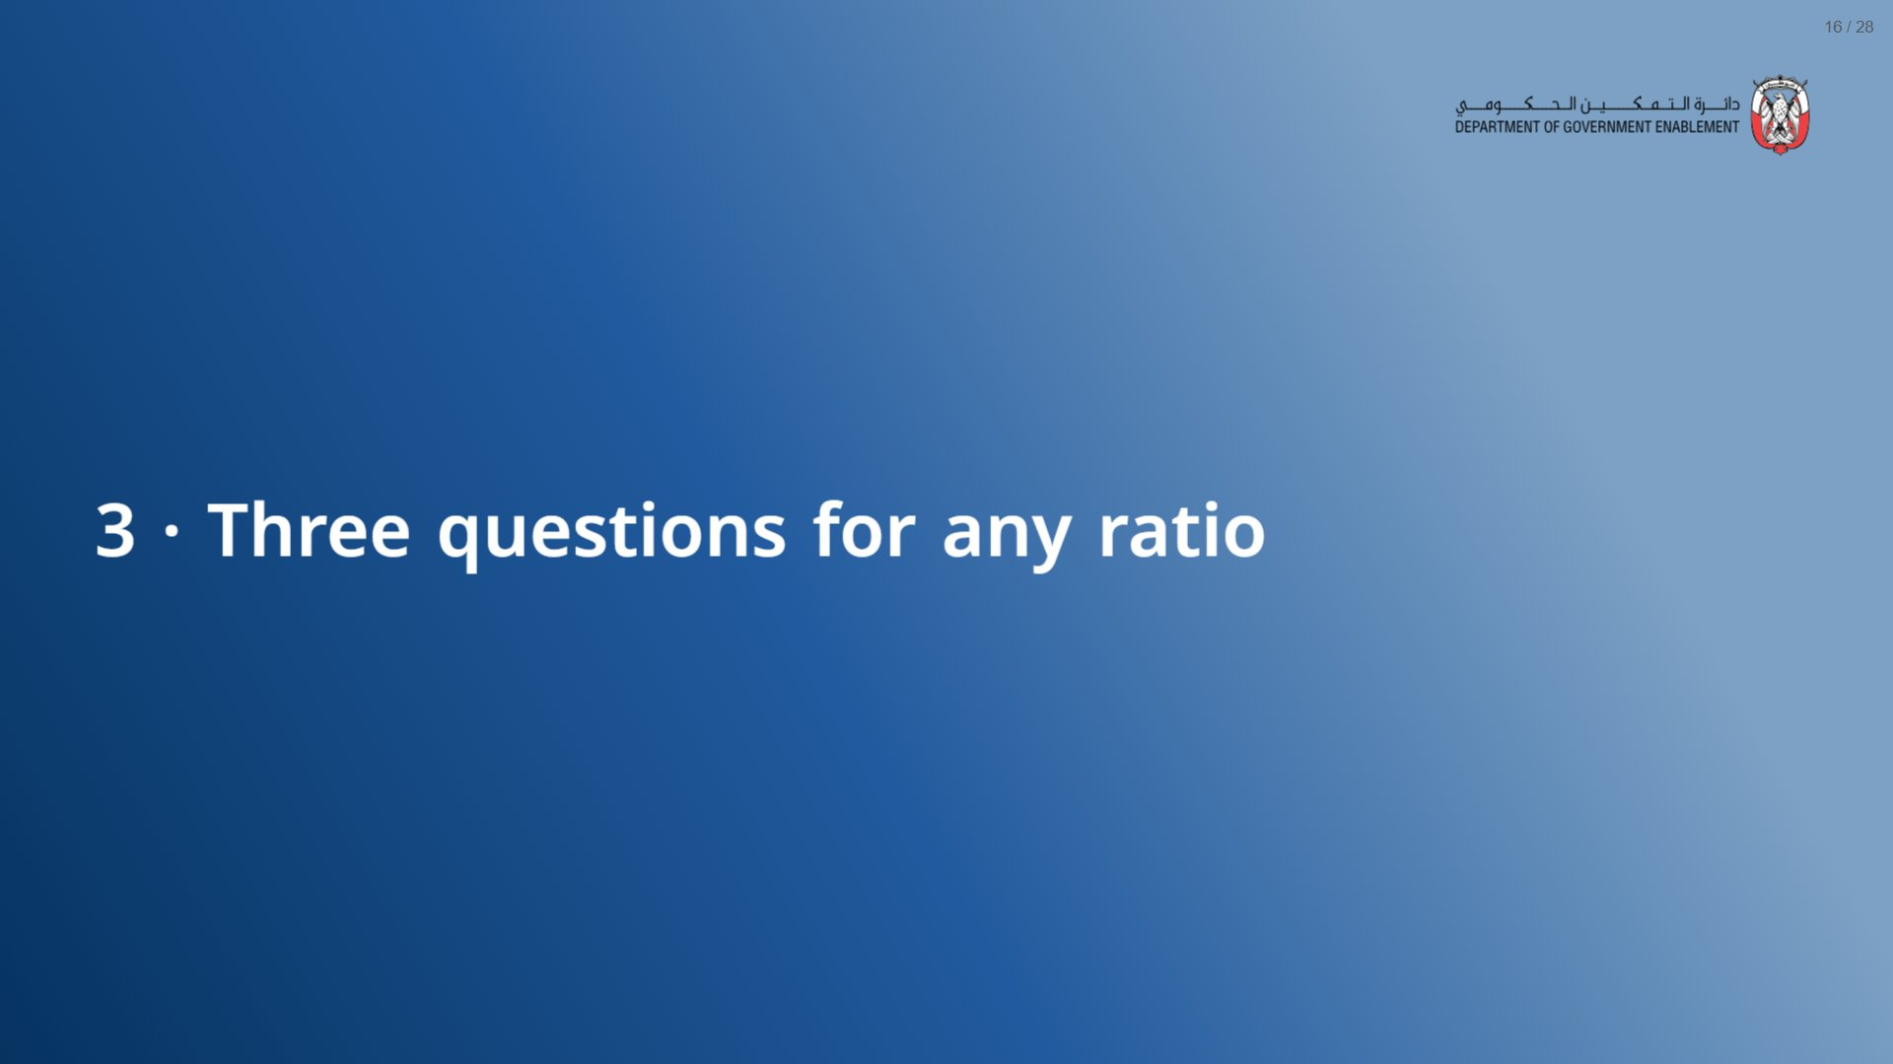

Slide 17
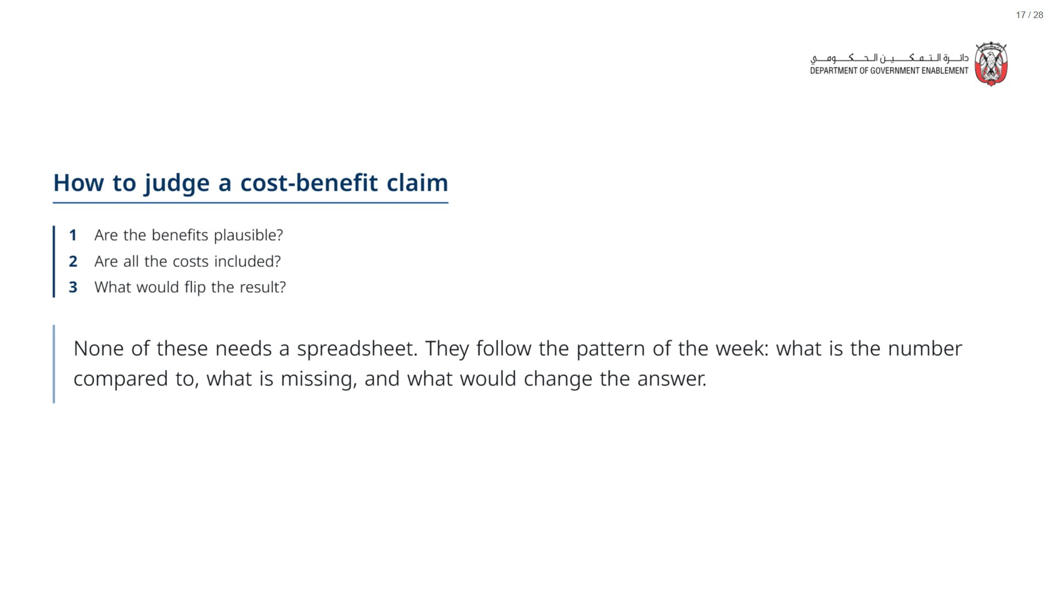

Slide 18
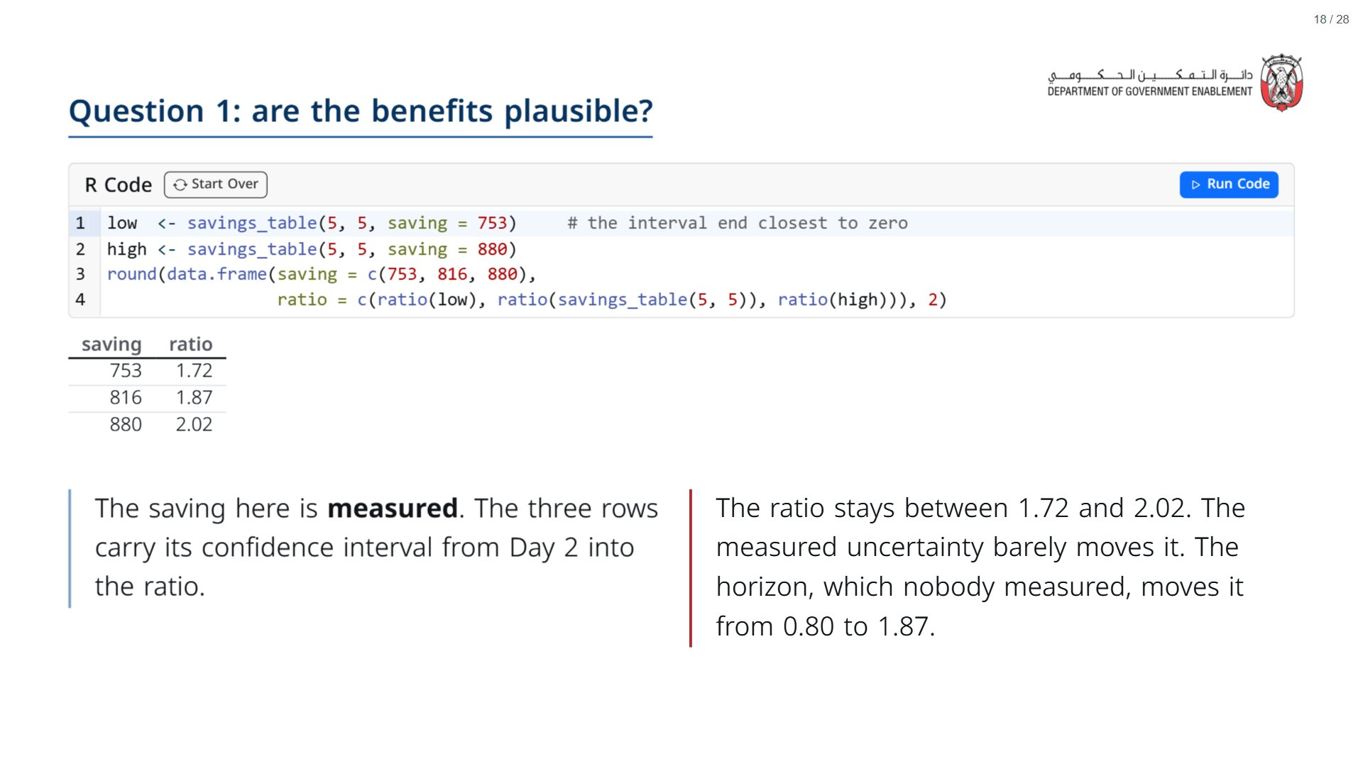

Slide 19
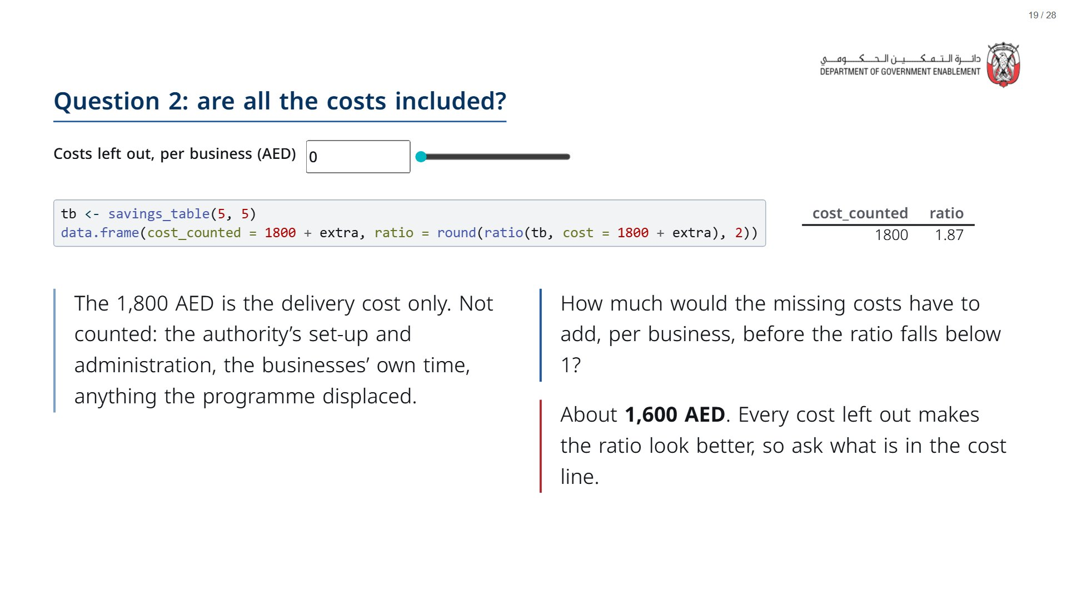

Slide 20
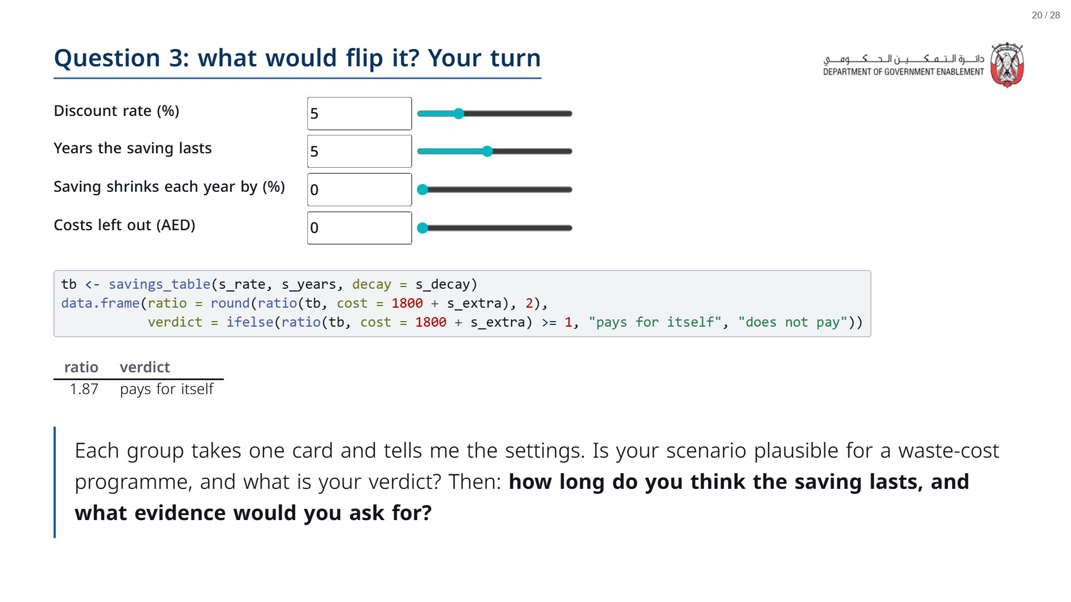
Notes:
Cards for the partner to print (one per group): (1) businesses drift back to old habits, saving shrinks 30% a year; (2) set-up and admin add 600 AED per business; (3) the ministry of finance insists on 8%; (4) the saving lasts three years; (5) all of 1 and 2 together. About 10 minutes including report-back.
Paper (Oct14_session1_materials.docx): Hand out the scenario cards (pack page 2, cut, one card per group) and a recording sheet per group (page 3). Ratios for each card are in the facilitator key.
span.MJX_Assistive_MathML {
position:absolute!important;
clip: rect(1px, 1px, 1px, 1px);
padding: 1px 0 0 0!important;
border: 0!important;
height: 1px!important;
width: 1px!important;
overflow: hidden!important;
display:block!important;
}

Slide 21


Slide 22
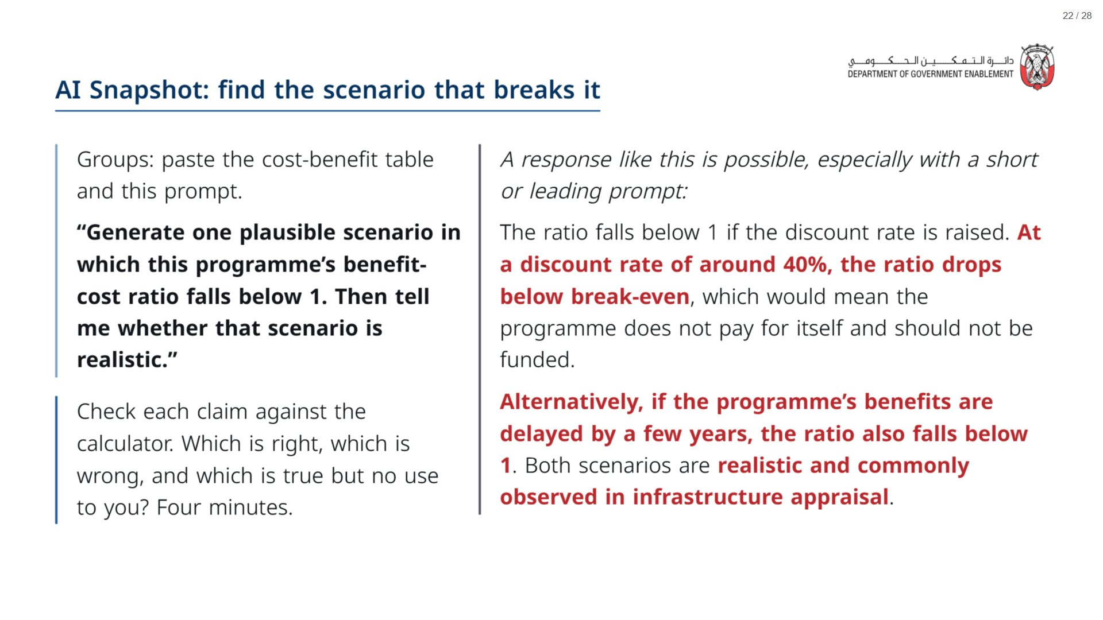
Notes:
Paper (Oct14_session1_materials.docx): Groups paste the table from their “What went into the ratio” handout; both prompts are printed on it.
span.MJX_Assistive_MathML {
position:absolute!important;
clip: rect(1px, 1px, 1px, 1px);
padding: 1px 0 0 0!important;
border: 0!important;
height: 1px!important;
width: 1px!important;
overflow: hidden!important;
display:block!important;
}

Slide 23
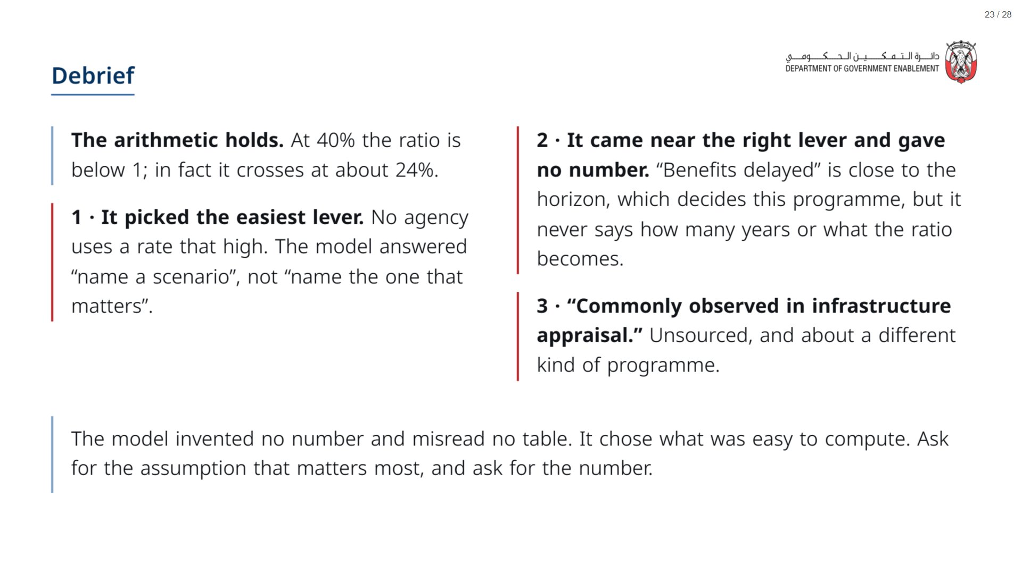

Slide 24
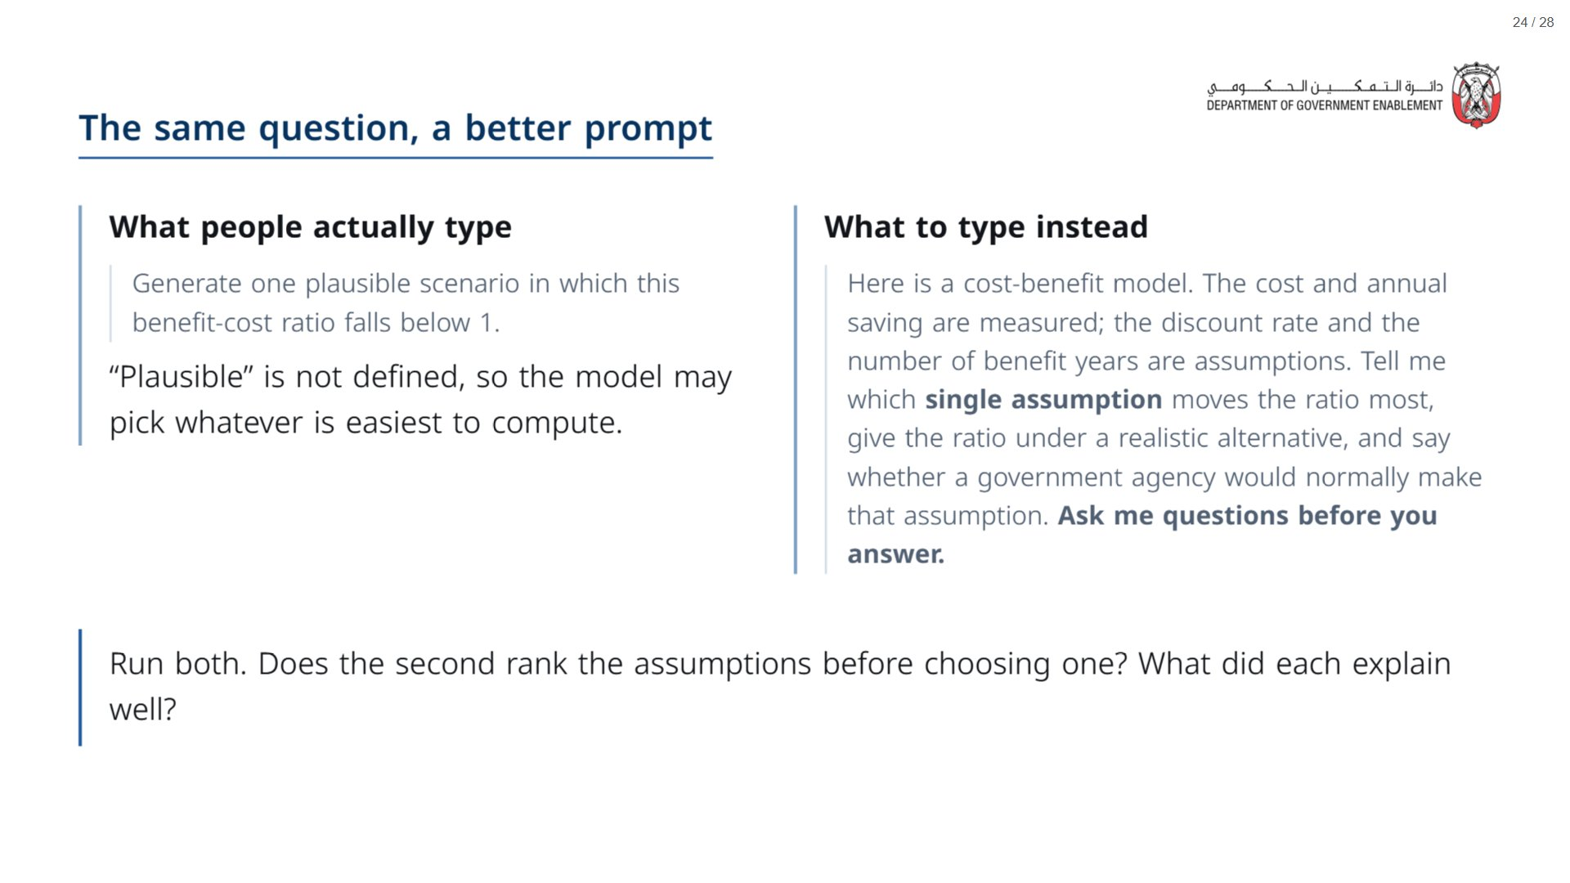

Slide 25


Slide 26
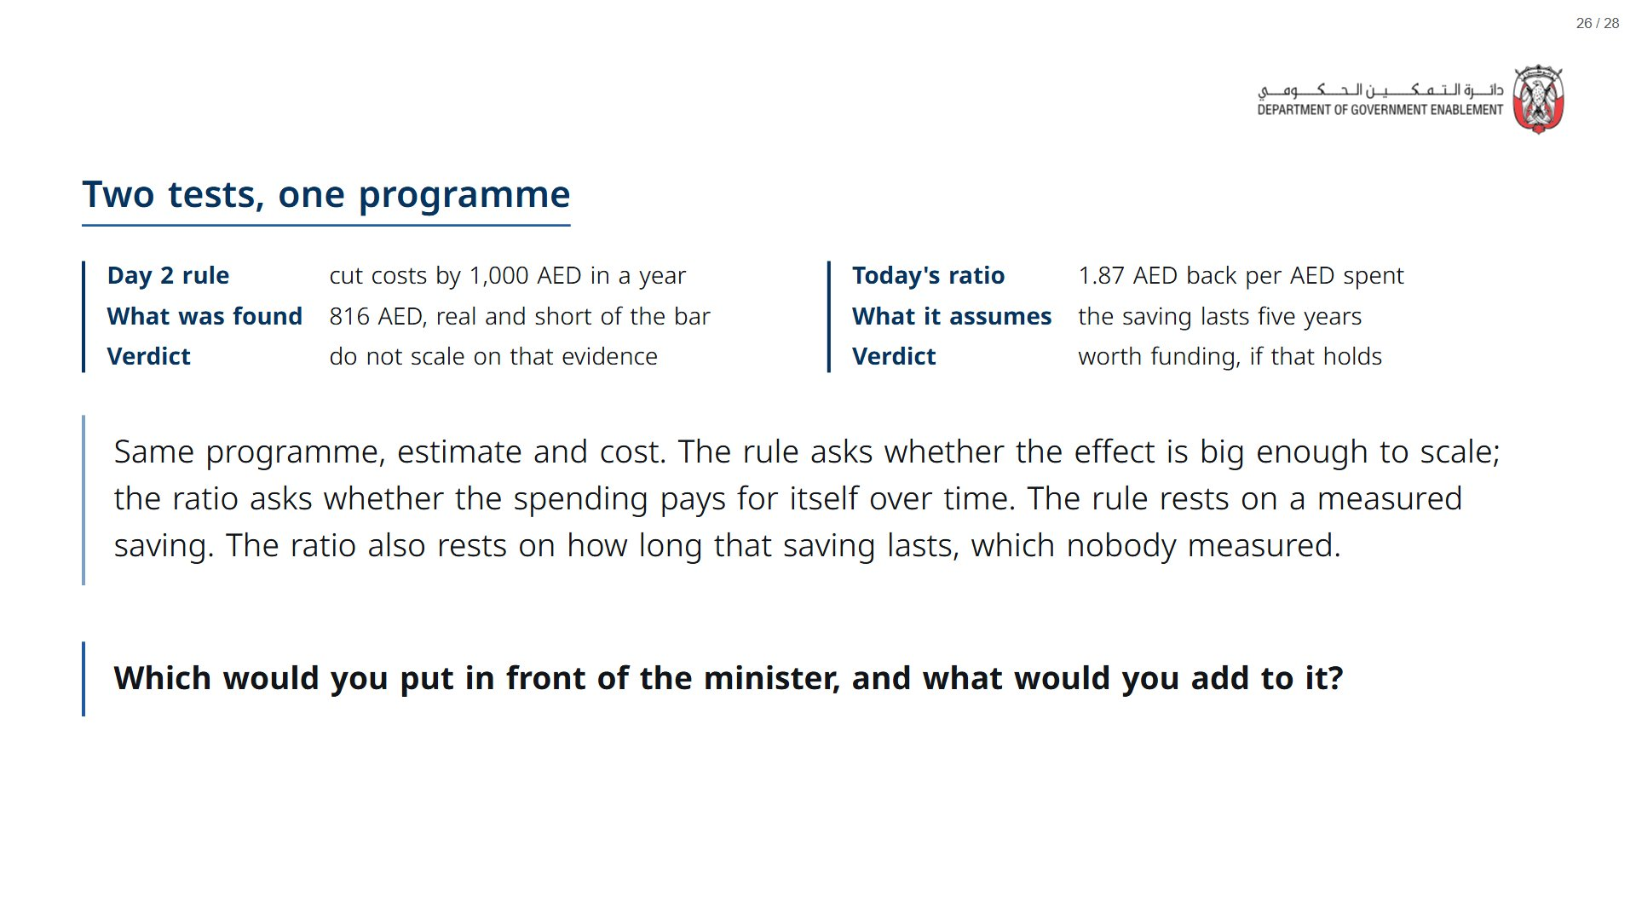
Notes:
Re-run the opening approval poll now (“On a ratio of 1.87, what would you do?”) and compare with the first vote. Ask someone who moved what moved them: it is usually the horizon or the missing costs.
span.MJX_Assistive_MathML {
position:absolute!important;
clip: rect(1px, 1px, 1px, 1px);
padding: 1px 0 0 0!important;
border: 0!important;
height: 1px!important;
width: 1px!important;
overflow: hidden!important;
display:block!important;
}

Slide 27
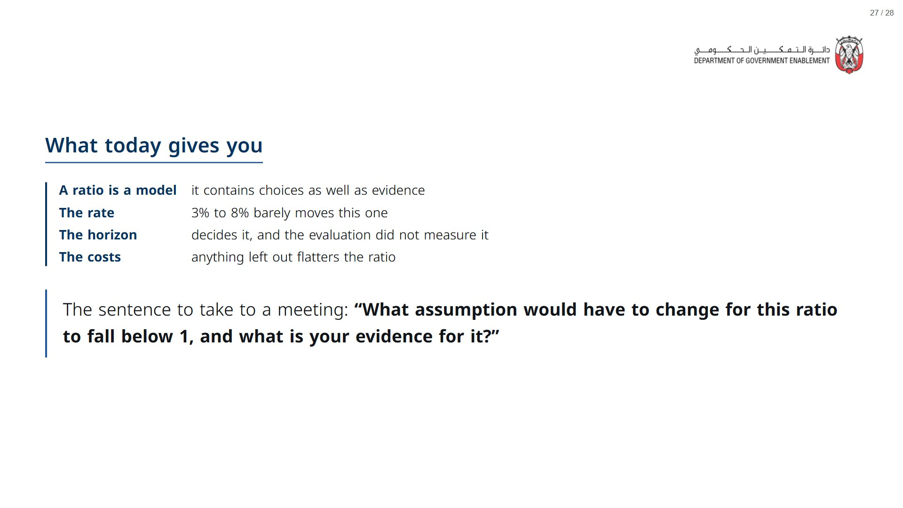
Notes:
Paper (Oct14_session1_materials.docx): Hand out the take-away cards (pack page 4). Give a minute to fill in “On my desk” on the card, then take two or three examples from the room.
span.MJX_Assistive_MathML {
position:absolute!important;
clip: rect(1px, 1px, 1px, 1px);
padding: 1px 0 0 0!important;
border: 0!important;
height: 1px!important;
width: 1px!important;
overflow: hidden!important;
display:block!important;
}

Slide 28
