Slide 1
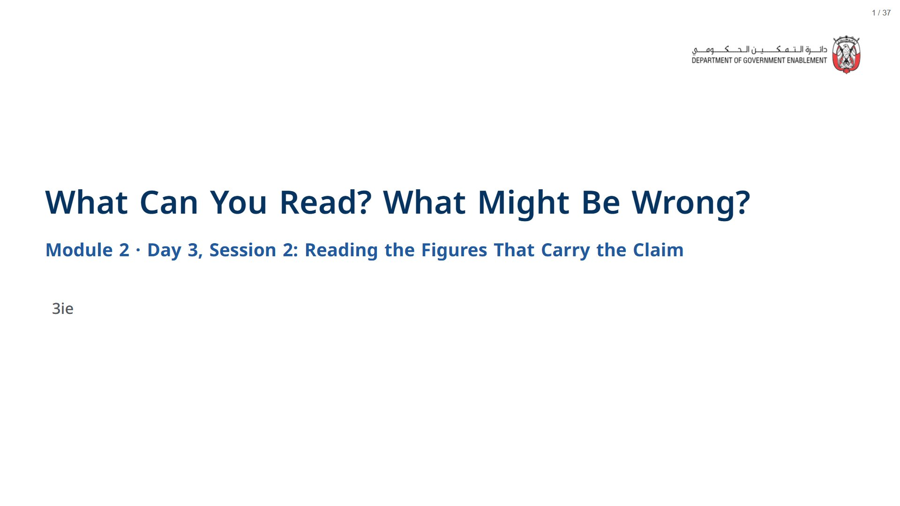

Slide 2


Slide 3
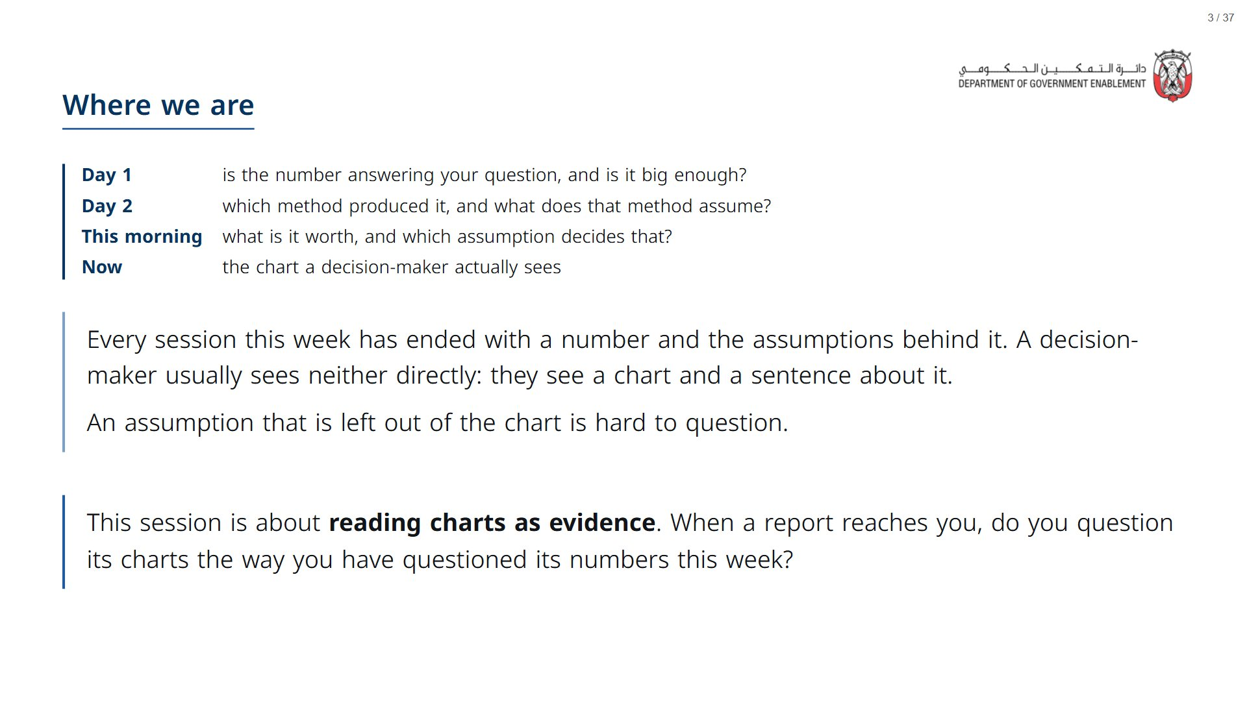

Slide 4
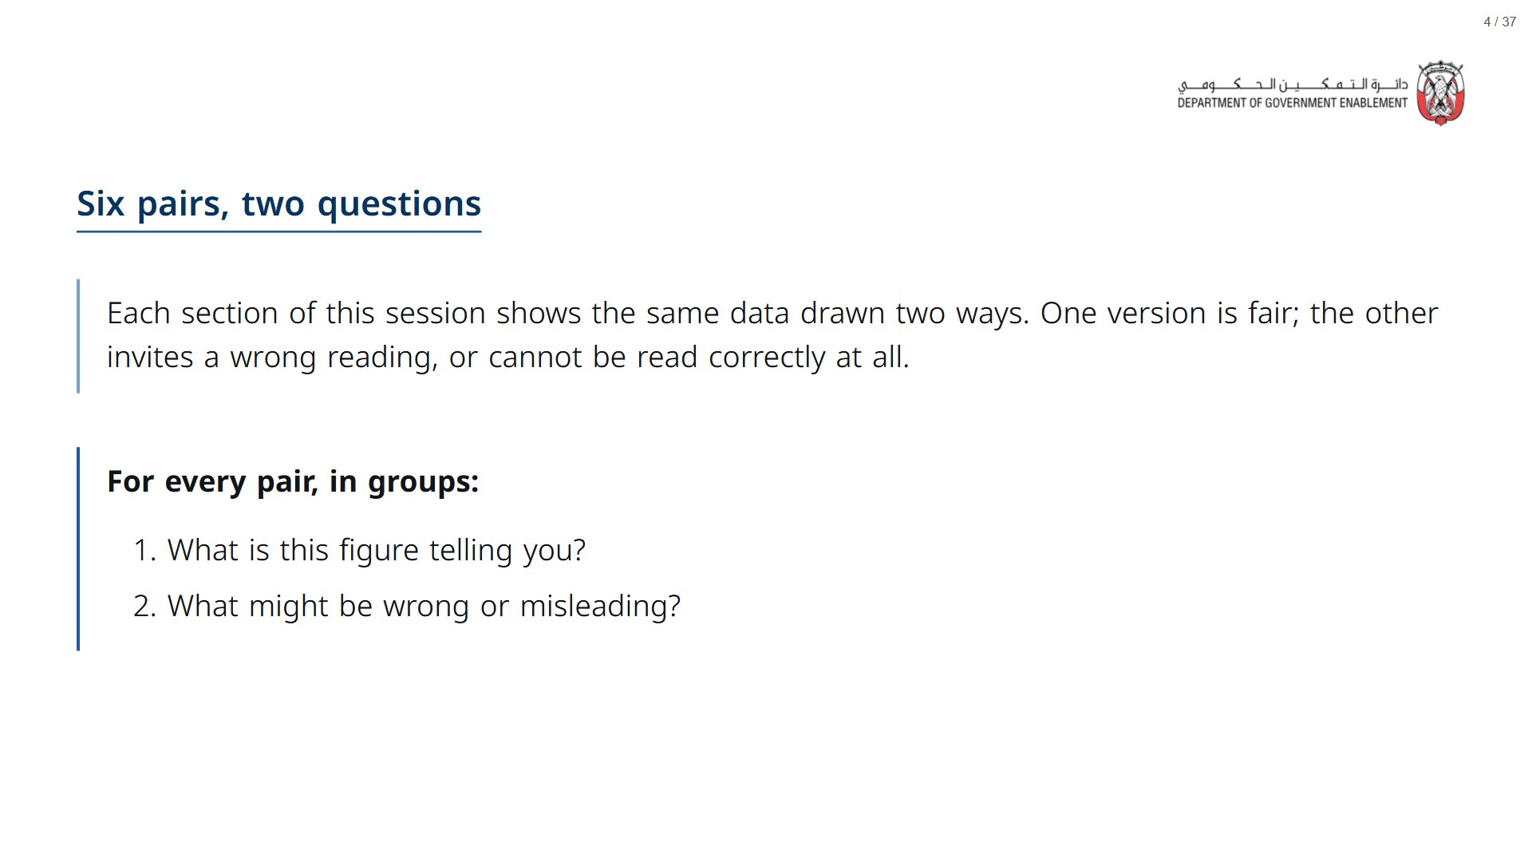
Notes:
Paper (Oct14_session2_materials.docx): Hand out the six pairs tracker (pack page 1, one per participant). They fill in a row after each pair. The three predictions are at the bottom of the same sheet.
span.MJX_Assistive_MathML {
position:absolute!important;
clip: rect(1px, 1px, 1px, 1px);
padding: 1px 0 0 0!important;
border: 0!important;
height: 1px!important;
width: 1px!important;
overflow: hidden!important;
display:block!important;
}

Slide 5
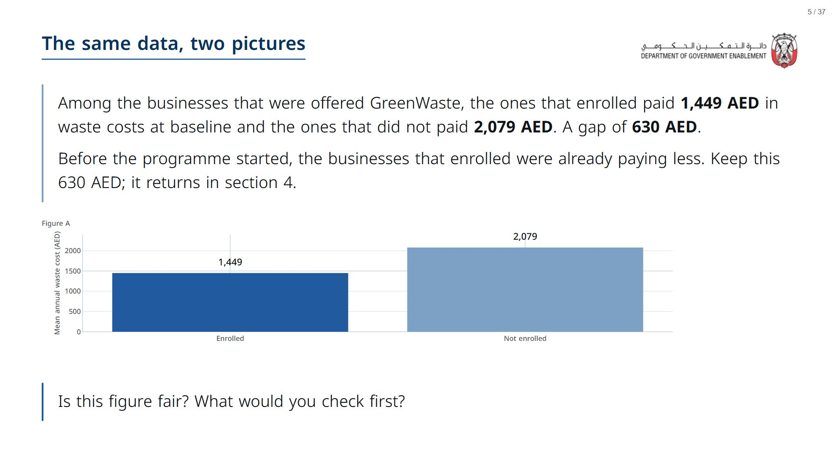

Slide 6
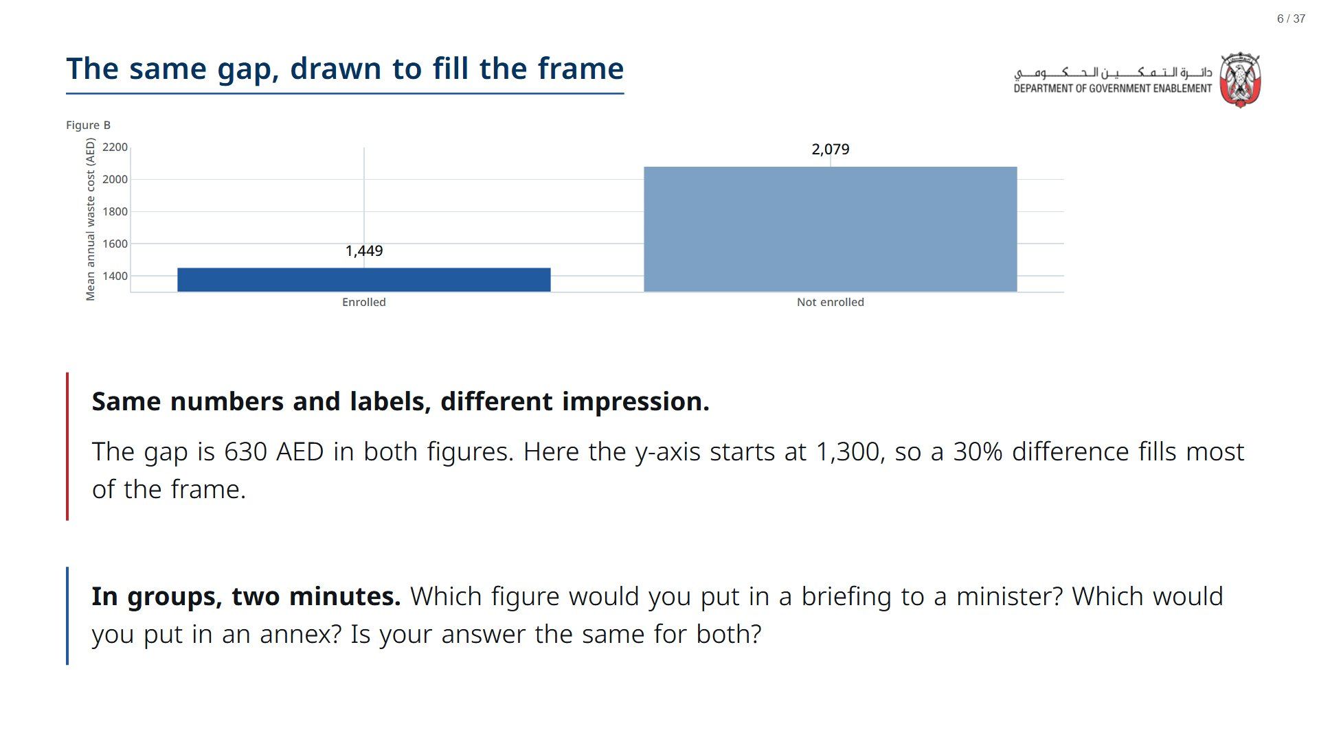

Slide 7
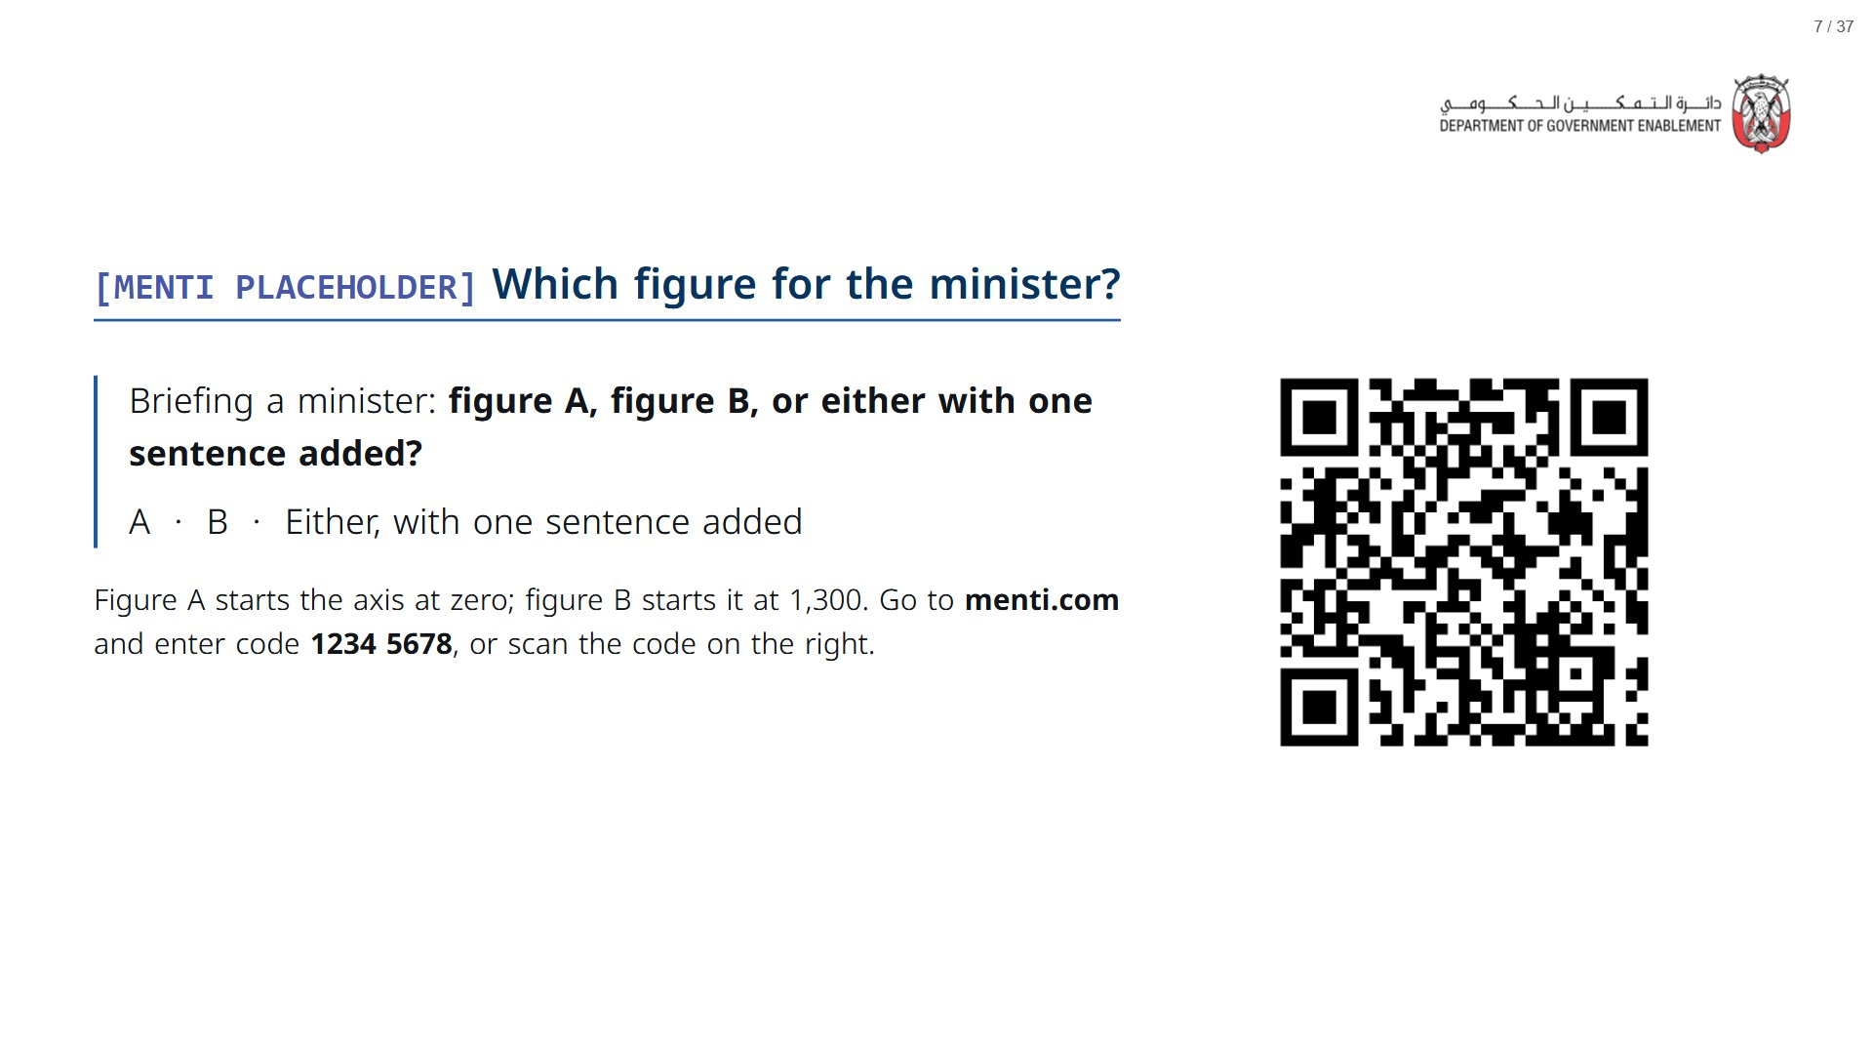
Notes:
Take the vote, then ask one person from each answer what the sentence would say.
span.MJX_Assistive_MathML {
position:absolute!important;
clip: rect(1px, 1px, 1px, 1px);
padding: 1px 0 0 0!important;
border: 0!important;
height: 1px!important;
width: 1px!important;
overflow: hidden!important;
display:block!important;
}

Slide 8
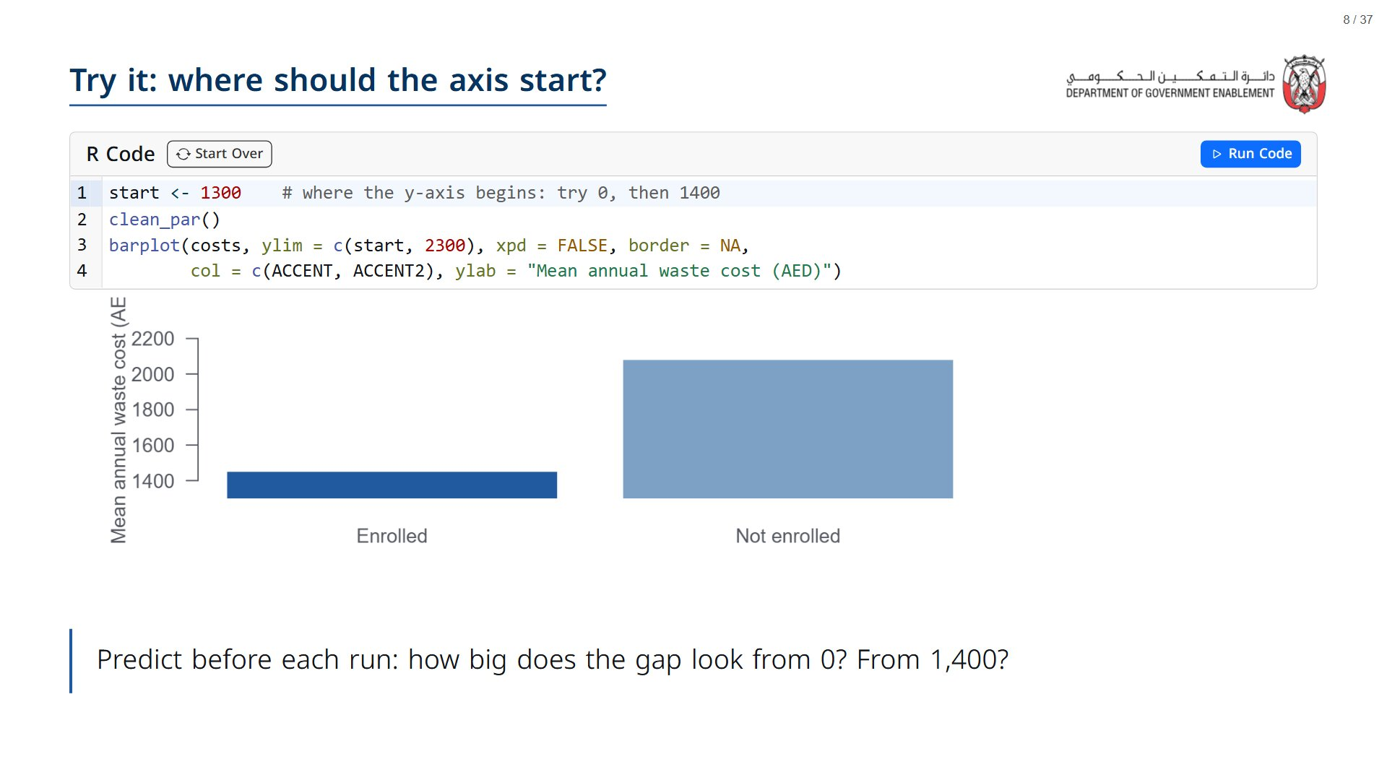
Notes:
Run it as written first: 1300 reproduces figure B. Then change start to 0 and run, then 1400. The costs never change; only the frame around them does.
span.MJX_Assistive_MathML {
position:absolute!important;
clip: rect(1px, 1px, 1px, 1px);
padding: 1px 0 0 0!important;
border: 0!important;
height: 1px!important;
width: 1px!important;
overflow: hidden!important;
display:block!important;
}

Slide 9
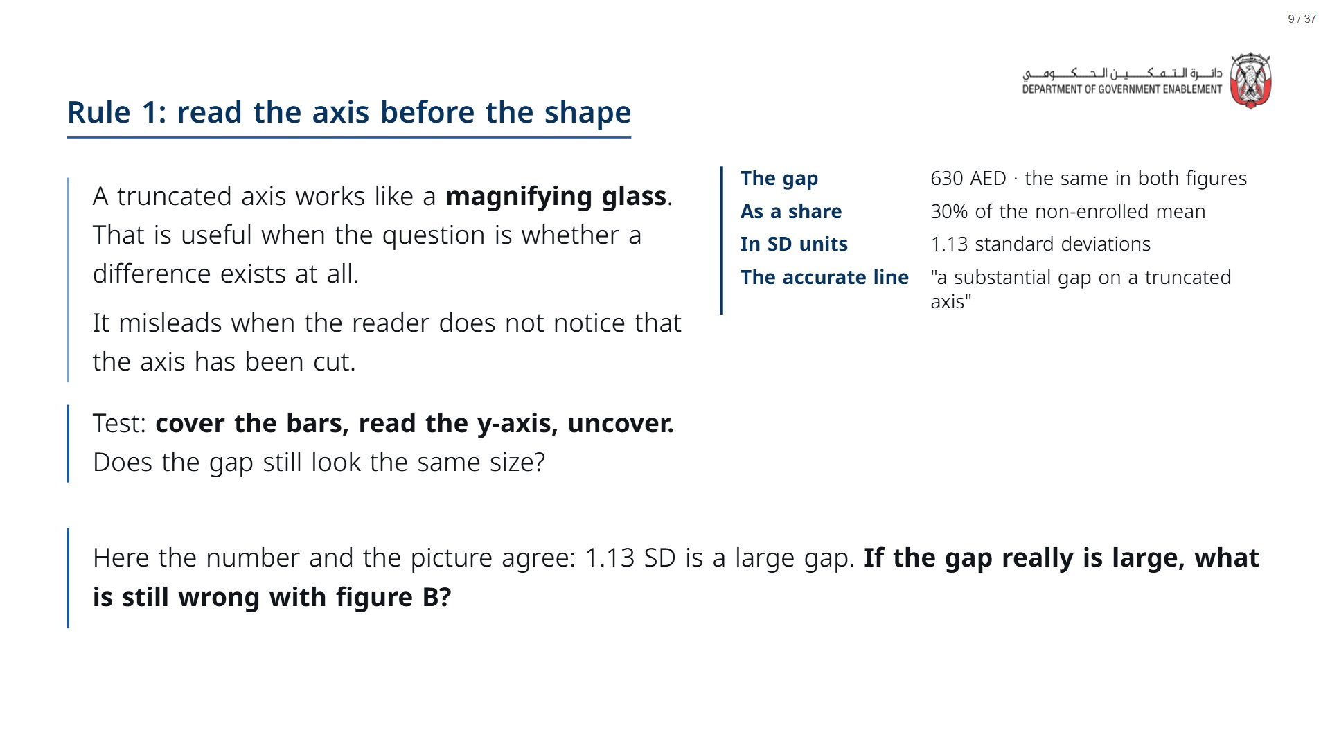
Notes:
The answer: figure B asks the reader to judge the gap from the drawing instead of the number.
span.MJX_Assistive_MathML {
position:absolute!important;
clip: rect(1px, 1px, 1px, 1px);
padding: 1px 0 0 0!important;
border: 0!important;
height: 1px!important;
width: 1px!important;
overflow: hidden!important;
display:block!important;
}

Slide 10


Slide 11
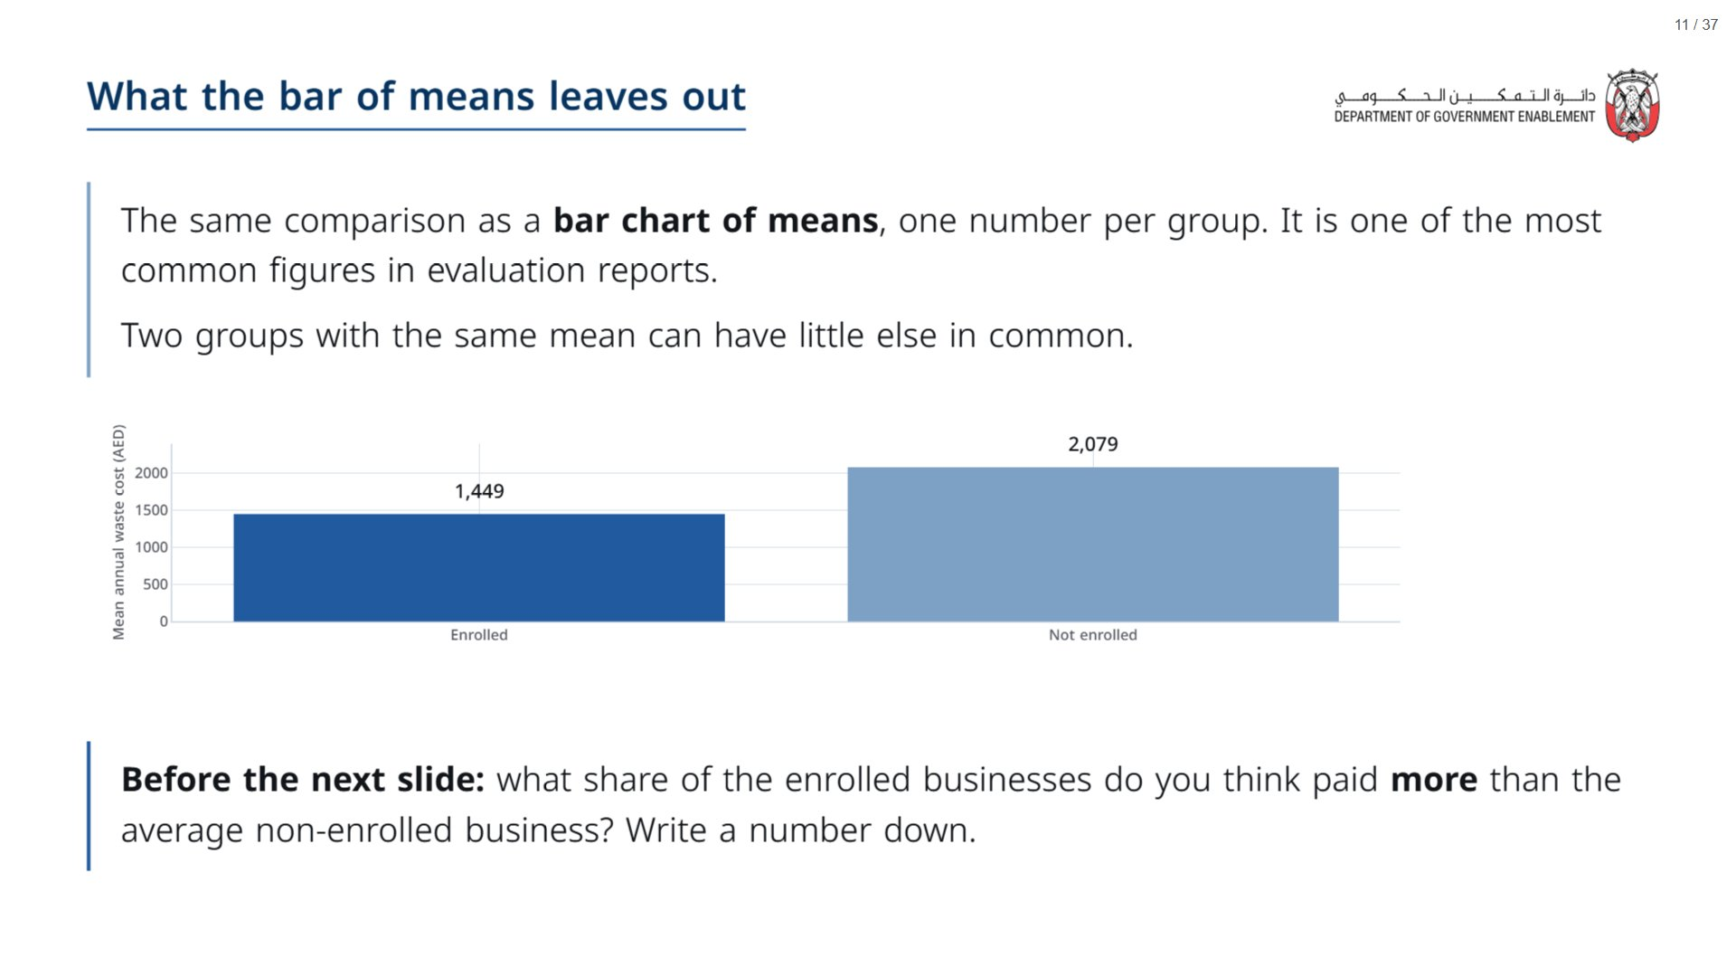
Notes:
Paper (Oct14_session2_materials.docx): the first prediction on the tracker (pack page 1).
span.MJX_Assistive_MathML {
position:absolute!important;
clip: rect(1px, 1px, 1px, 1px);
padding: 1px 0 0 0!important;
border: 0!important;
height: 1px!important;
width: 1px!important;
overflow: hidden!important;
display:block!important;
}

Slide 12
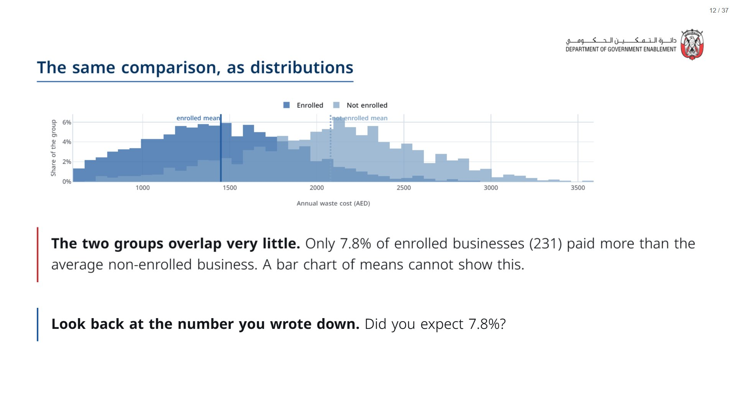
Notes:
A mean tells you where a group sits on average. It cannot tell you how many of them sit somewhere else. The reverse figure: 11.9% of the comparison group paid less than the enrolled average.
span.MJX_Assistive_MathML {
position:absolute!important;
clip: rect(1px, 1px, 1px, 1px);
padding: 1px 0 0 0!important;
border: 0!important;
height: 1px!important;
width: 1px!important;
overflow: hidden!important;
display:block!important;
}

Slide 13
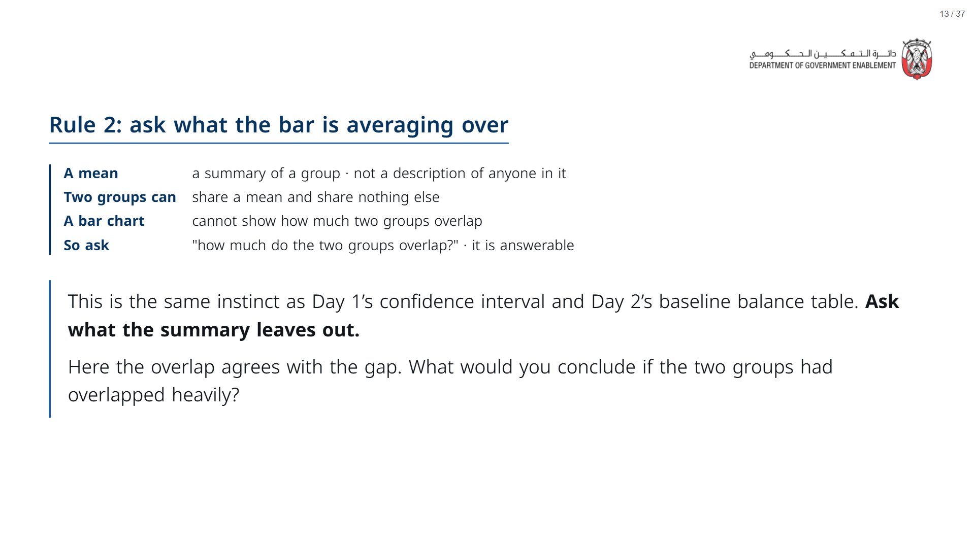

Slide 14
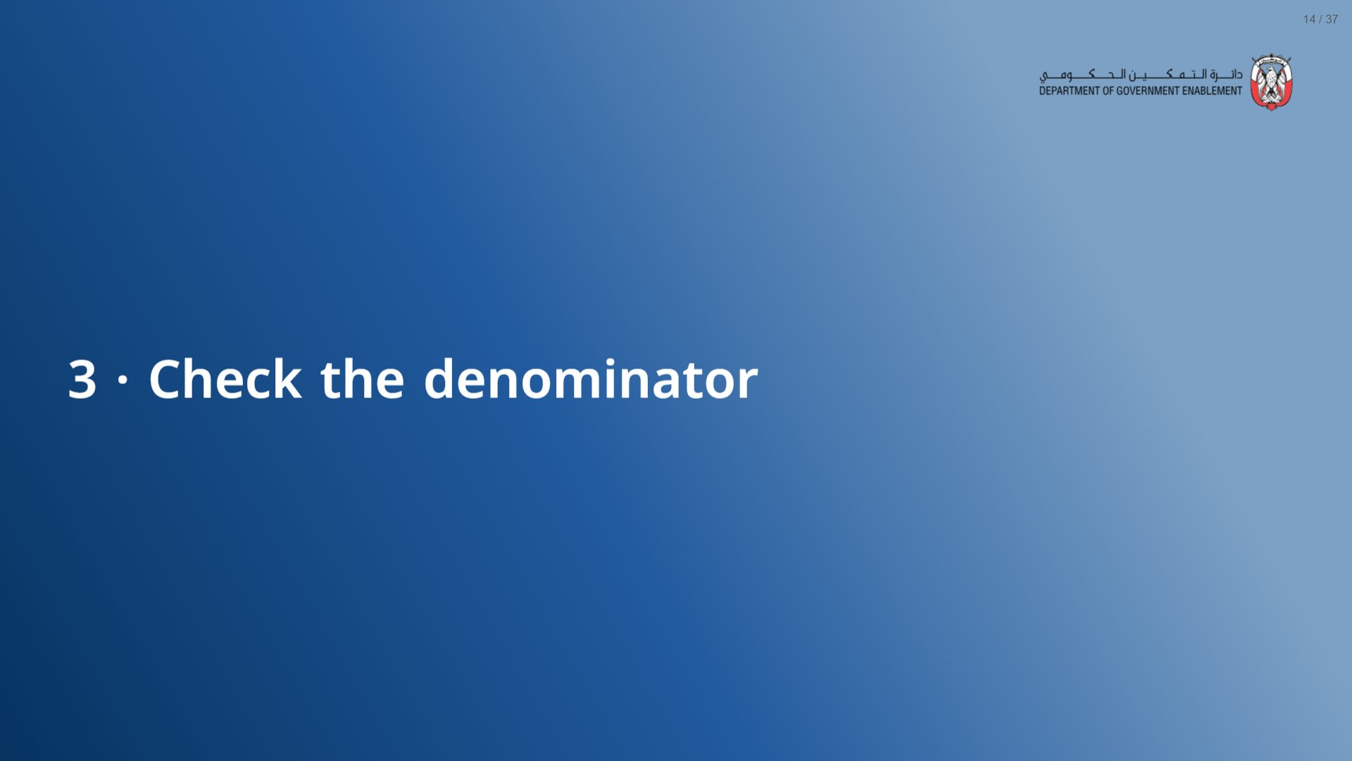

Slide 15
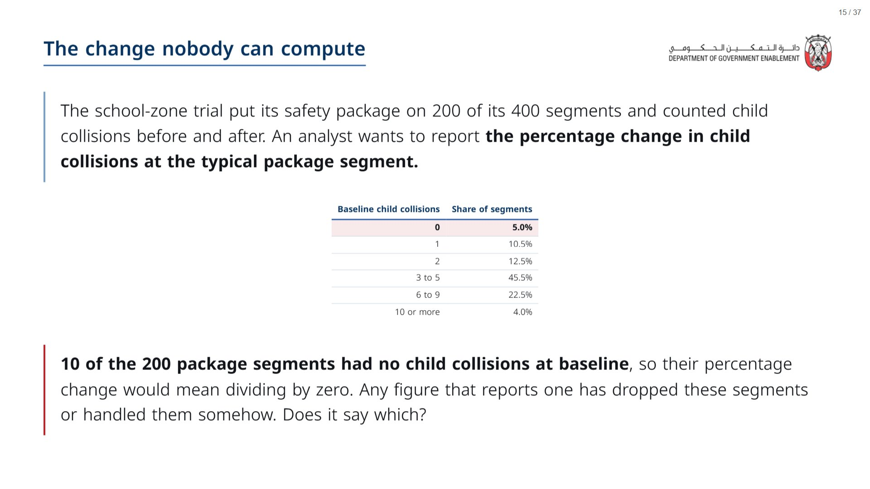

Slide 16
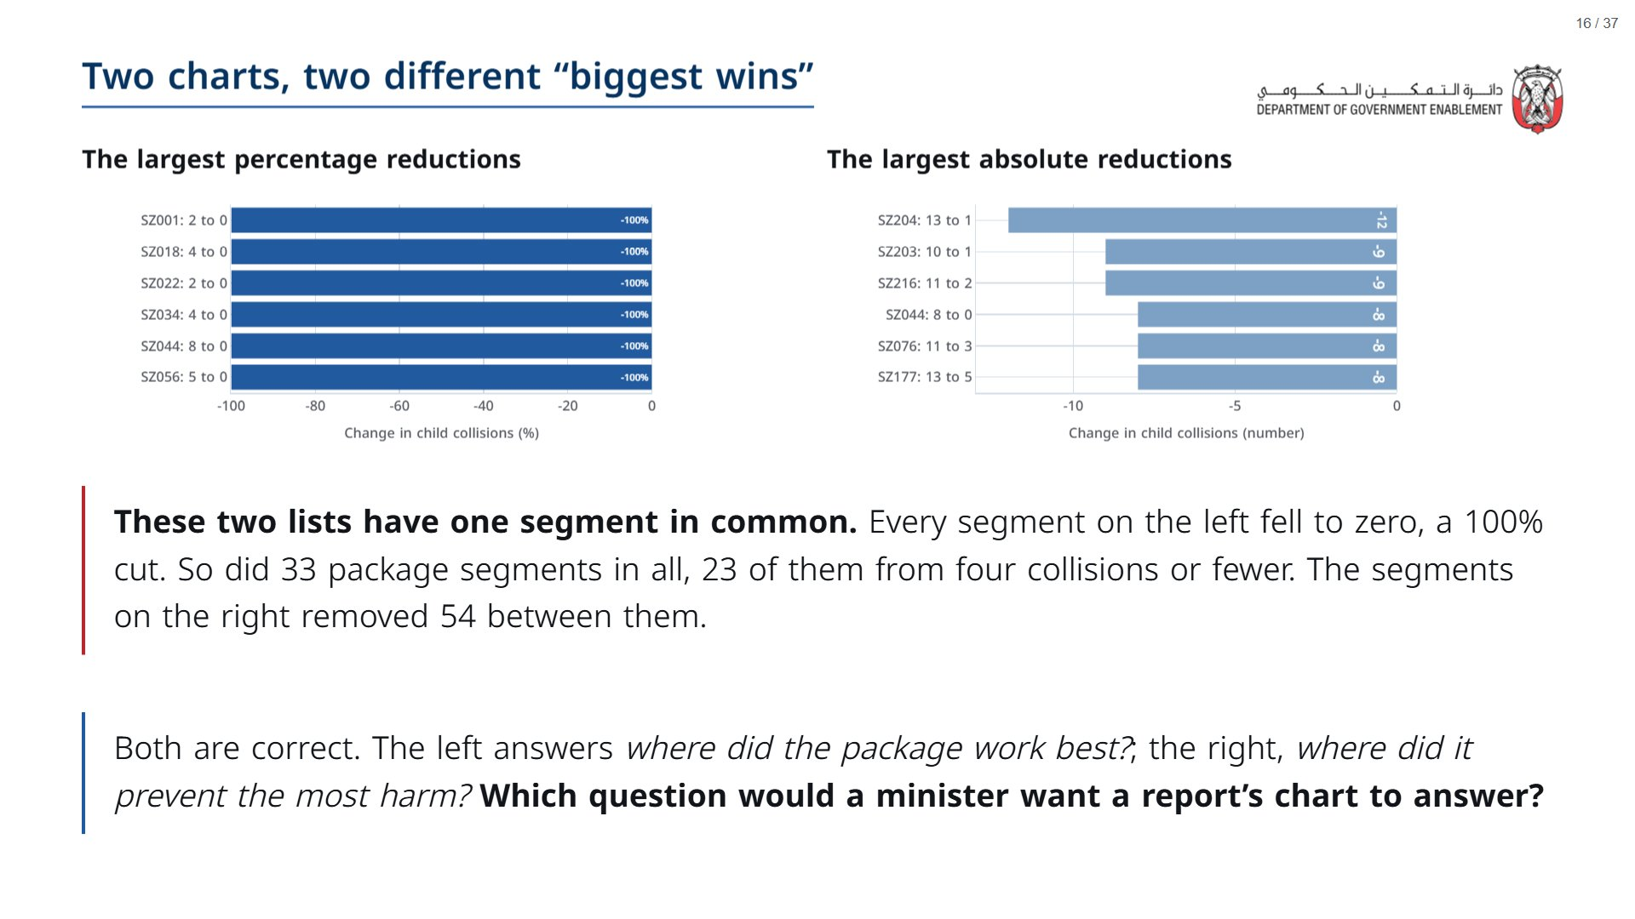

Slide 17
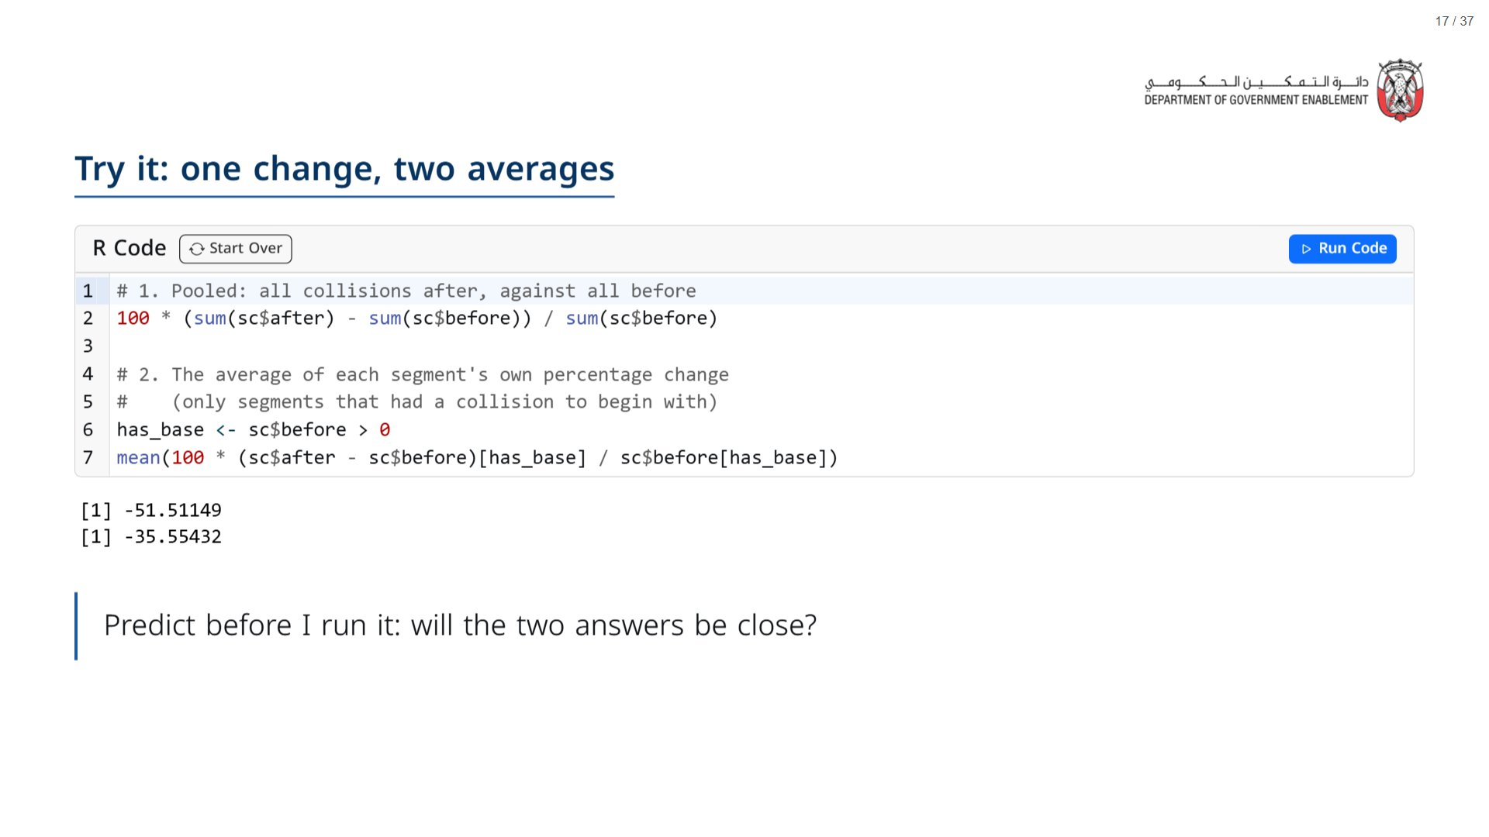
Notes:
Paper (Oct14_session2_materials.docx): the second prediction on the tracker (pack page 1); everyone writes “close” or “far apart” before you run it.
Expected: about -51.5% pooled and about -35.6% averaged. The next slide explains the gap: the pooled figure weights each segment by its collisions; the average gives every segment equal weight, so small bases pull it around.
span.MJX_Assistive_MathML {
position:absolute!important;
clip: rect(1px, 1px, 1px, 1px);
padding: 1px 0 0 0!important;
border: 0!important;
height: 1px!important;
width: 1px!important;
overflow: hidden!important;
display:block!important;
}

Slide 18
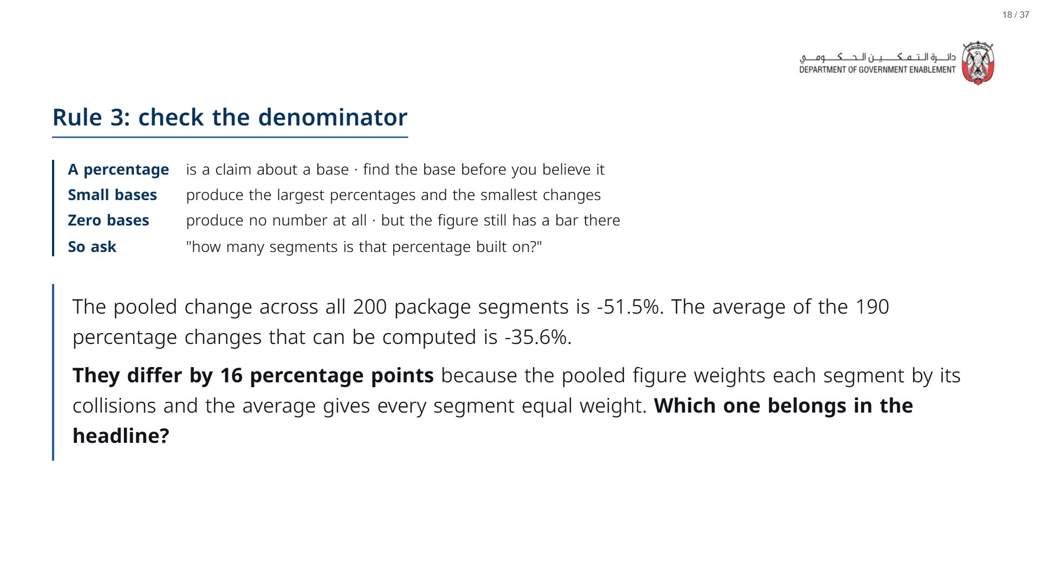

Slide 19


Slide 20
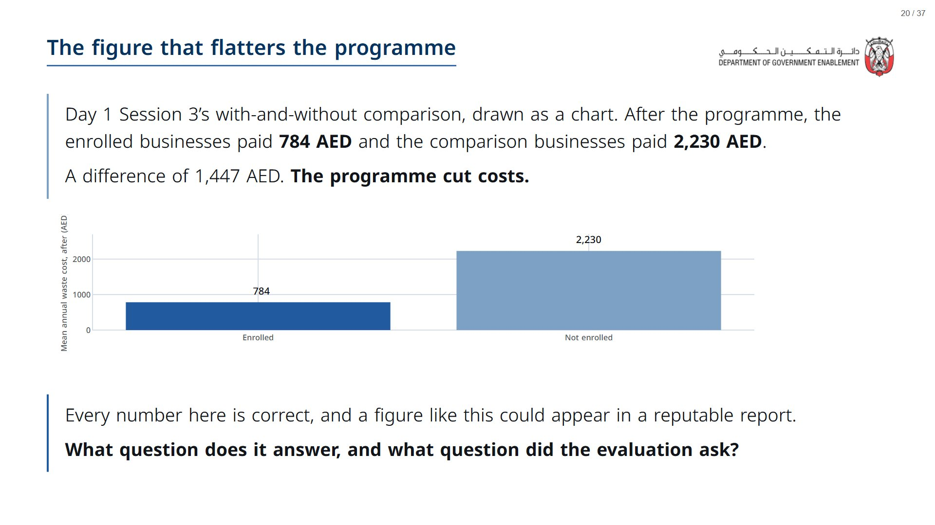

Slide 21
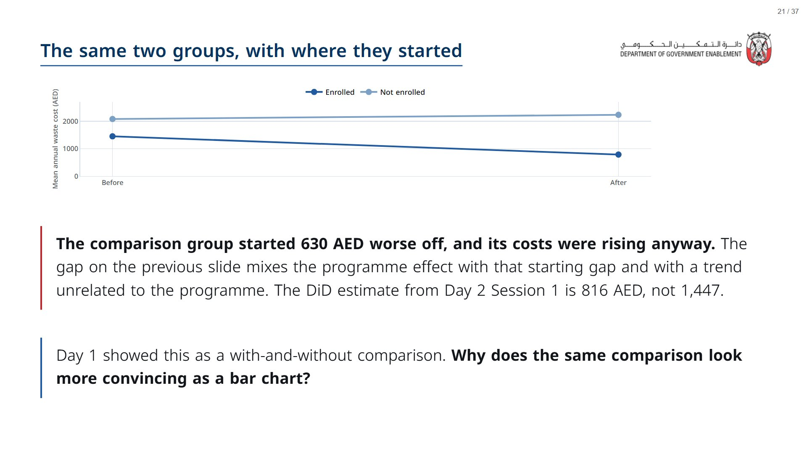
Notes:
The analyst need not have been careless: the level comparison is the easiest one to draw.
span.MJX_Assistive_MathML {
position:absolute!important;
clip: rect(1px, 1px, 1px, 1px);
padding: 1px 0 0 0!important;
border: 0!important;
height: 1px!important;
width: 1px!important;
overflow: hidden!important;
display:block!important;
}

Slide 22
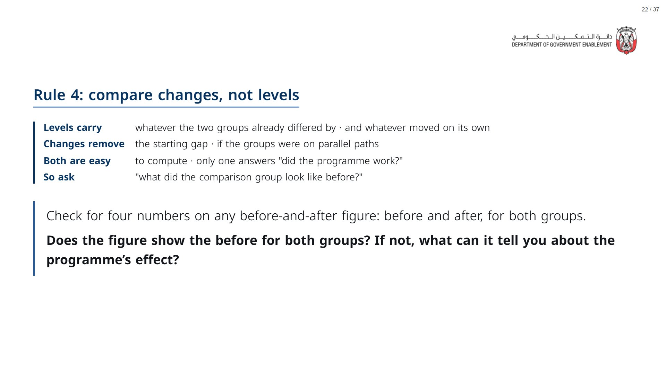

Slide 23


Slide 24
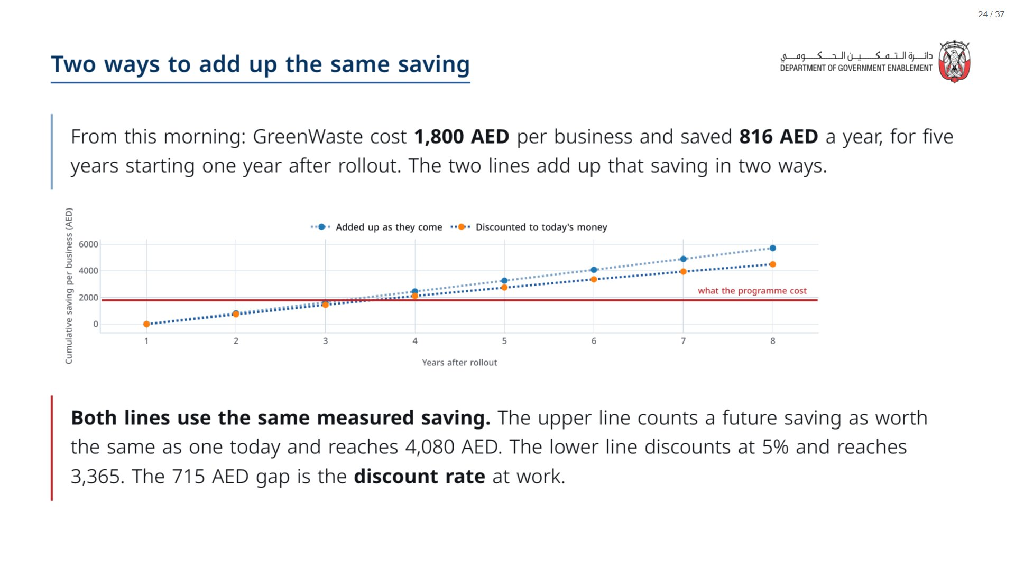

Slide 25
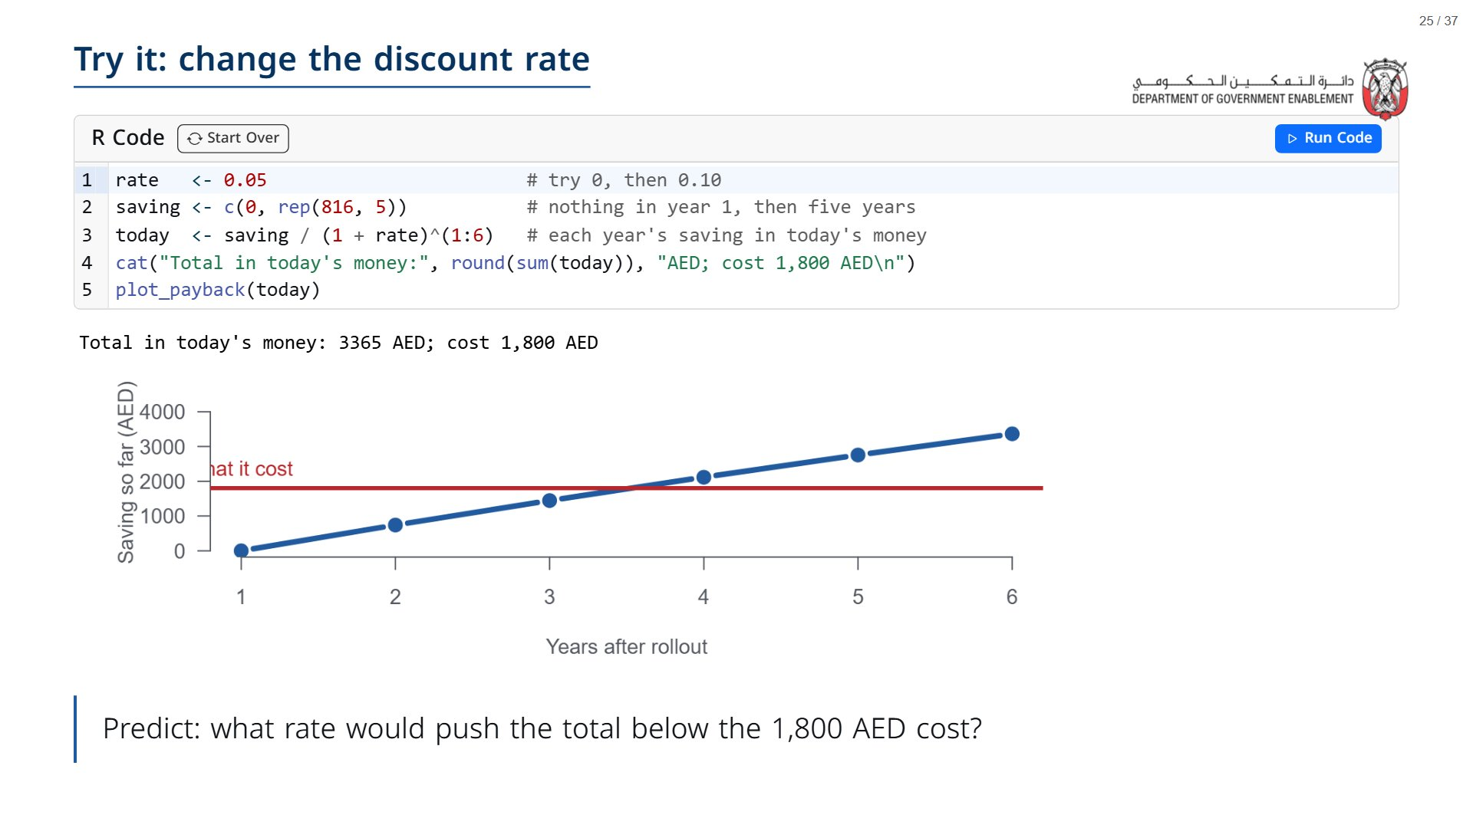
Notes:
Paper (Oct14_session2_materials.docx): the third prediction on the tracker (pack page 1).
Run at 0.05 (3,365), then 0 (4,080: the undiscounted line), then 0.10 (2,812), then 0.24: the total falls to about 1,807, level with the cost. The answer to the question is about 24%, the flip rate from this morning’s session.
span.MJX_Assistive_MathML {
position:absolute!important;
clip: rect(1px, 1px, 1px, 1px);
padding: 1px 0 0 0!important;
border: 0!important;
height: 1px!important;
width: 1px!important;
overflow: hidden!important;
display:block!important;
}

Slide 26
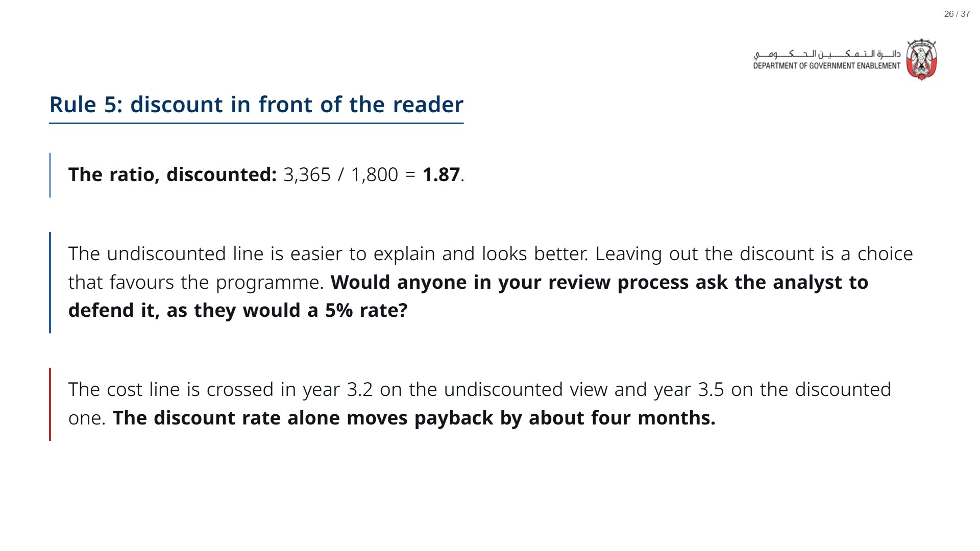

Slide 27


Slide 28
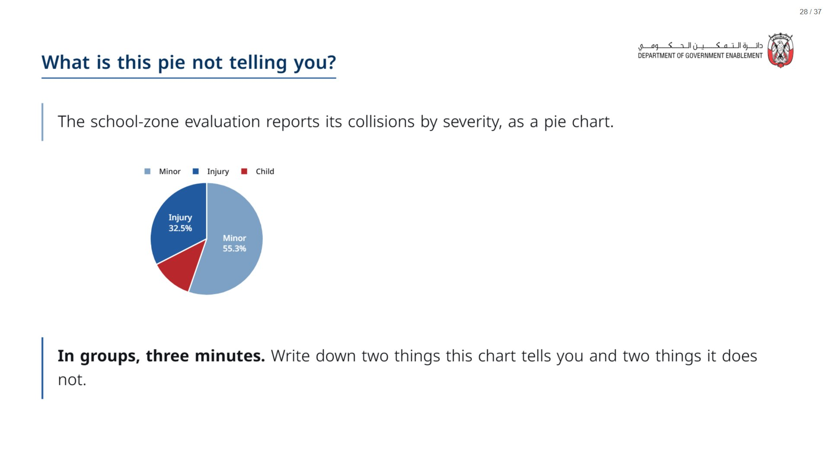

Slide 29
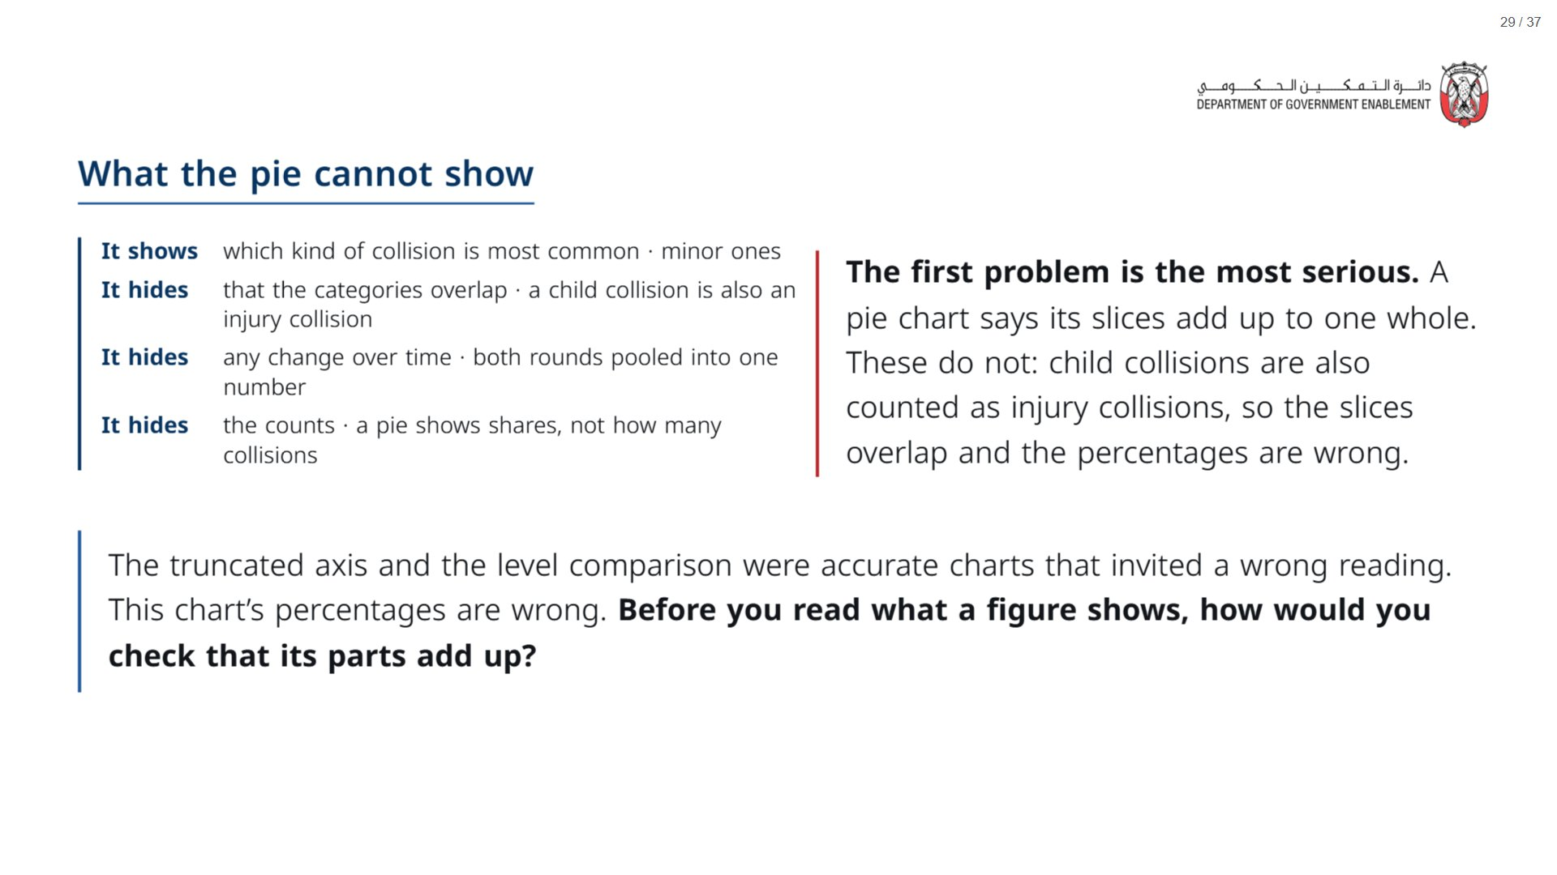

Slide 30
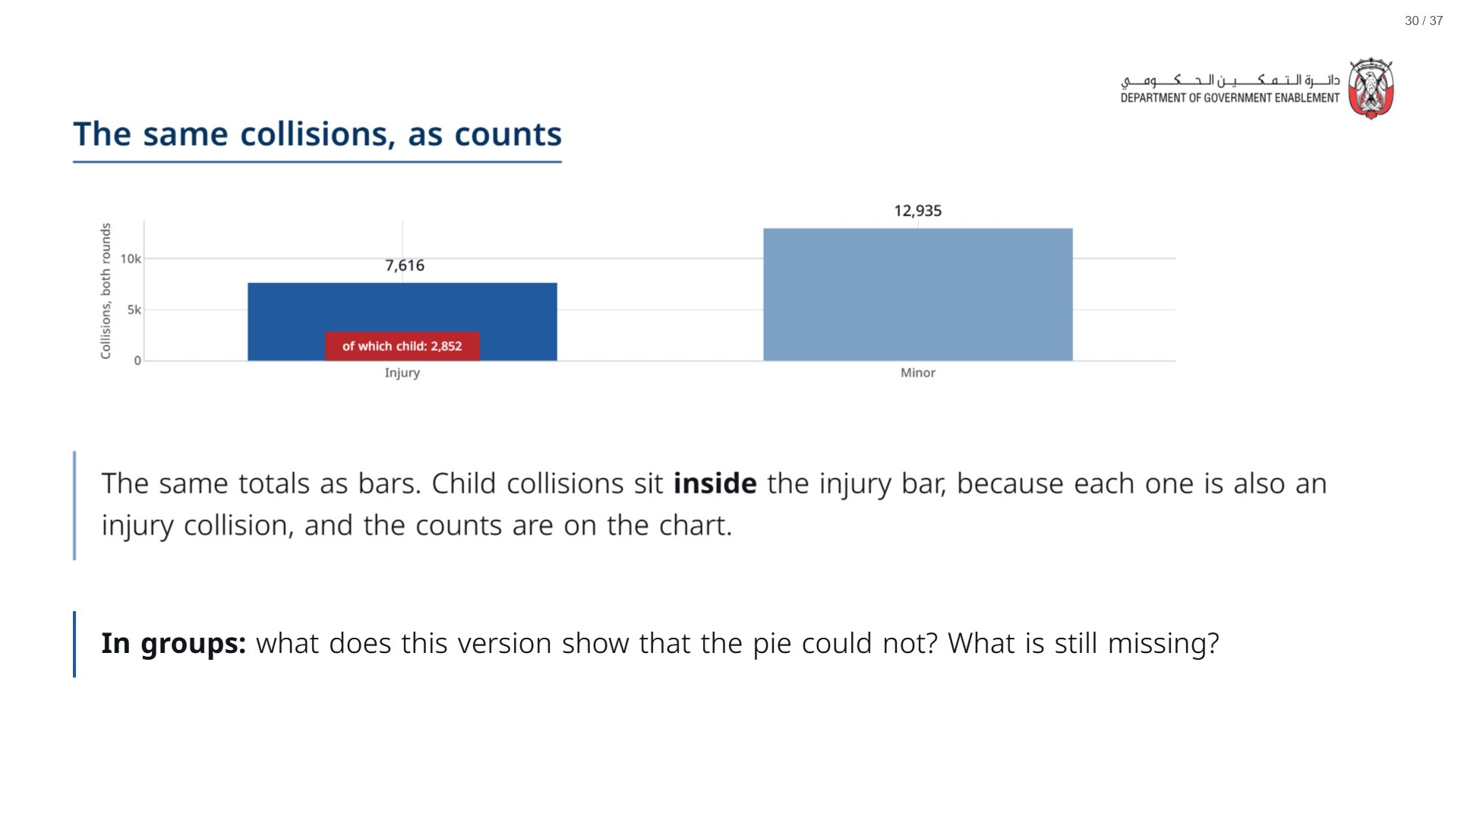
Notes:
Still missing: the two rounds are pooled, so the chart says nothing about change, and there is no comparison between the arms.
span.MJX_Assistive_MathML {
position:absolute!important;
clip: rect(1px, 1px, 1px, 1px);
padding: 1px 0 0 0!important;
border: 0!important;
height: 1px!important;
width: 1px!important;
overflow: hidden!important;
display:block!important;
}

Slide 31


Slide 32
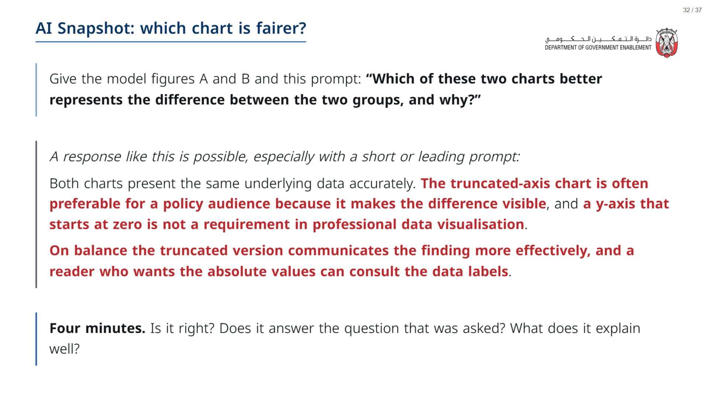
Notes:
Paper (Oct14_session2_materials.docx): Hand out the AI Snapshot sheet (pack page 2, one per group). It has both figures, the prompt and the response.
span.MJX_Assistive_MathML {
position:absolute!important;
clip: rect(1px, 1px, 1px, 1px);
padding: 1px 0 0 0!important;
border: 0!important;
height: 1px!important;
width: 1px!important;
overflow: hidden!important;
display:block!important;
}

Slide 33
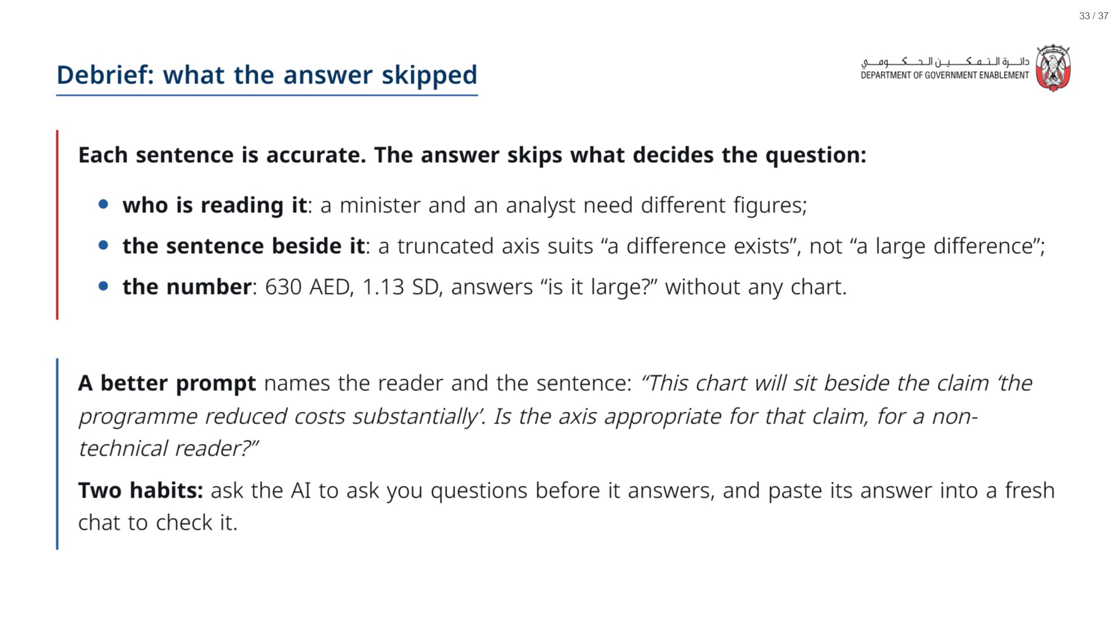
Notes:
Paper (Oct14_session2_materials.docx): the better prompt and the two habits are at the bottom of the AI Snapshot sheet (pack page 2). Groups run the better prompt and compare.
span.MJX_Assistive_MathML {
position:absolute!important;
clip: rect(1px, 1px, 1px, 1px);
padding: 1px 0 0 0!important;
border: 0!important;
height: 1px!important;
width: 1px!important;
overflow: hidden!important;
display:block!important;
}

Slide 34


Slide 35
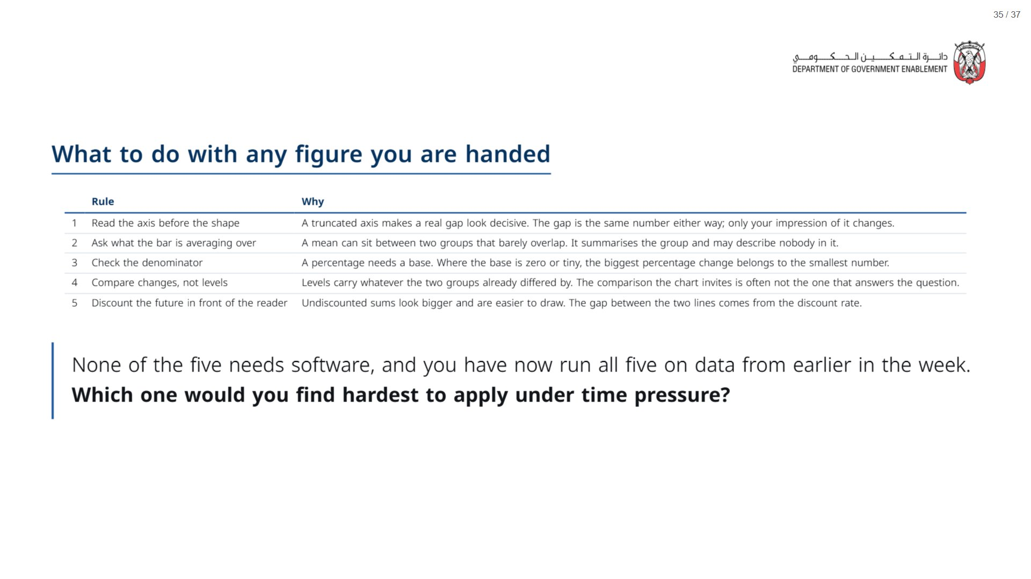

Slide 36
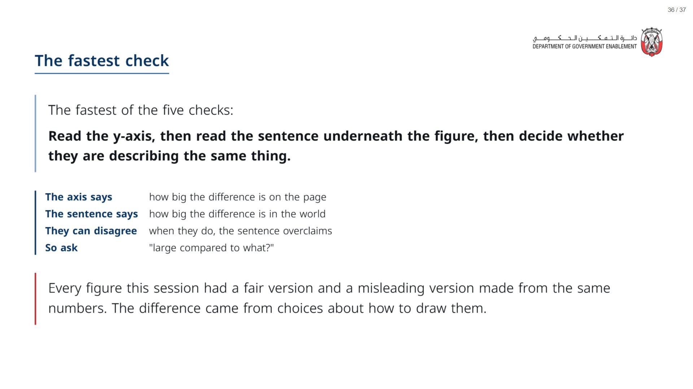

Slide 37
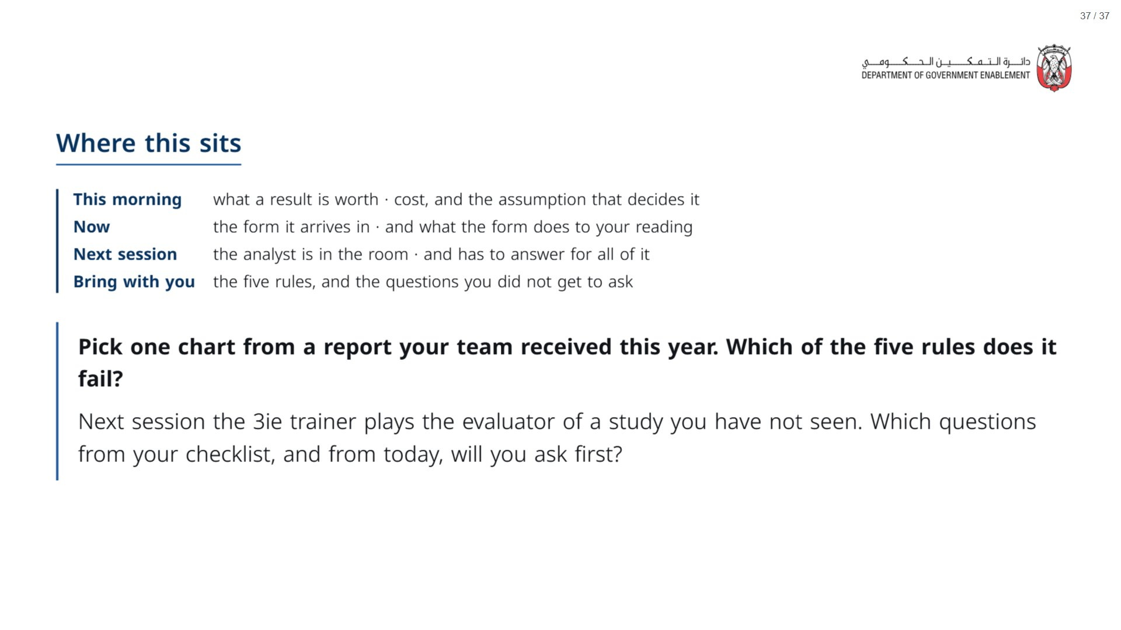
Notes:
Paper (Oct14_session2_materials.docx): Hand out the take-away cards (pack page 3, one per participant, cut). Give a minute to write two questions for the clinic on the card.
span.MJX_Assistive_MathML {
position:absolute!important;
clip: rect(1px, 1px, 1px, 1px);
padding: 1px 0 0 0!important;
border: 0!important;
height: 1px!important;
width: 1px!important;
overflow: hidden!important;
display:block!important;
}

