Slide 1


Slide 2


Slide 3
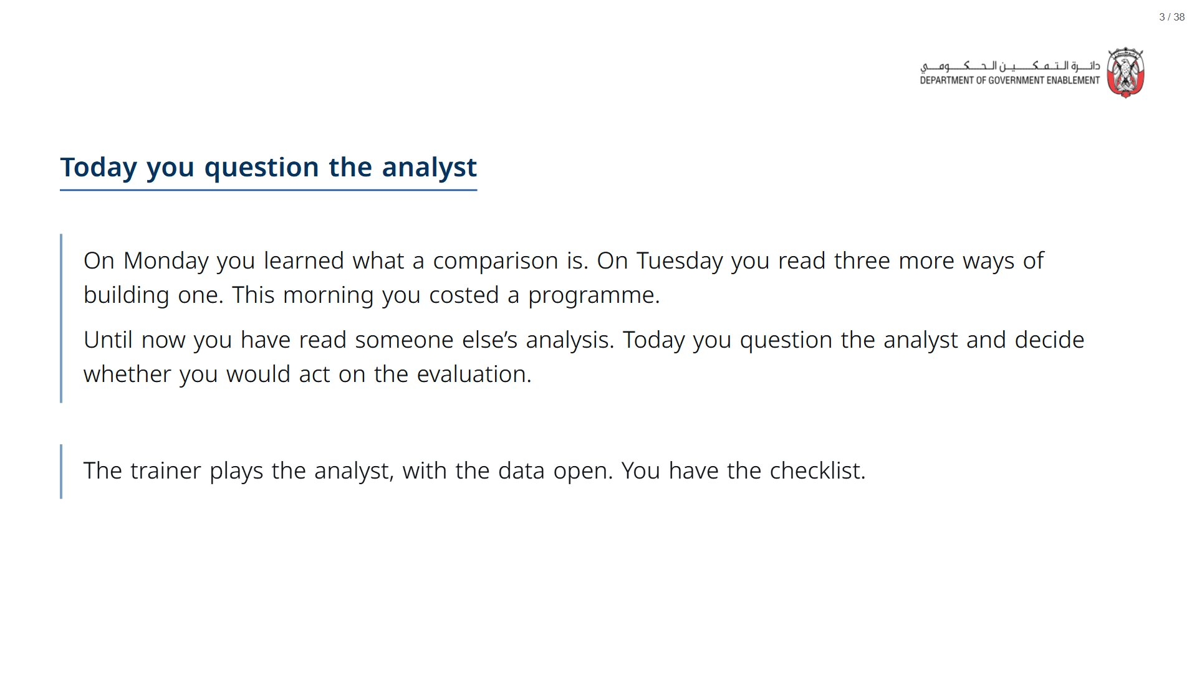

Slide 4
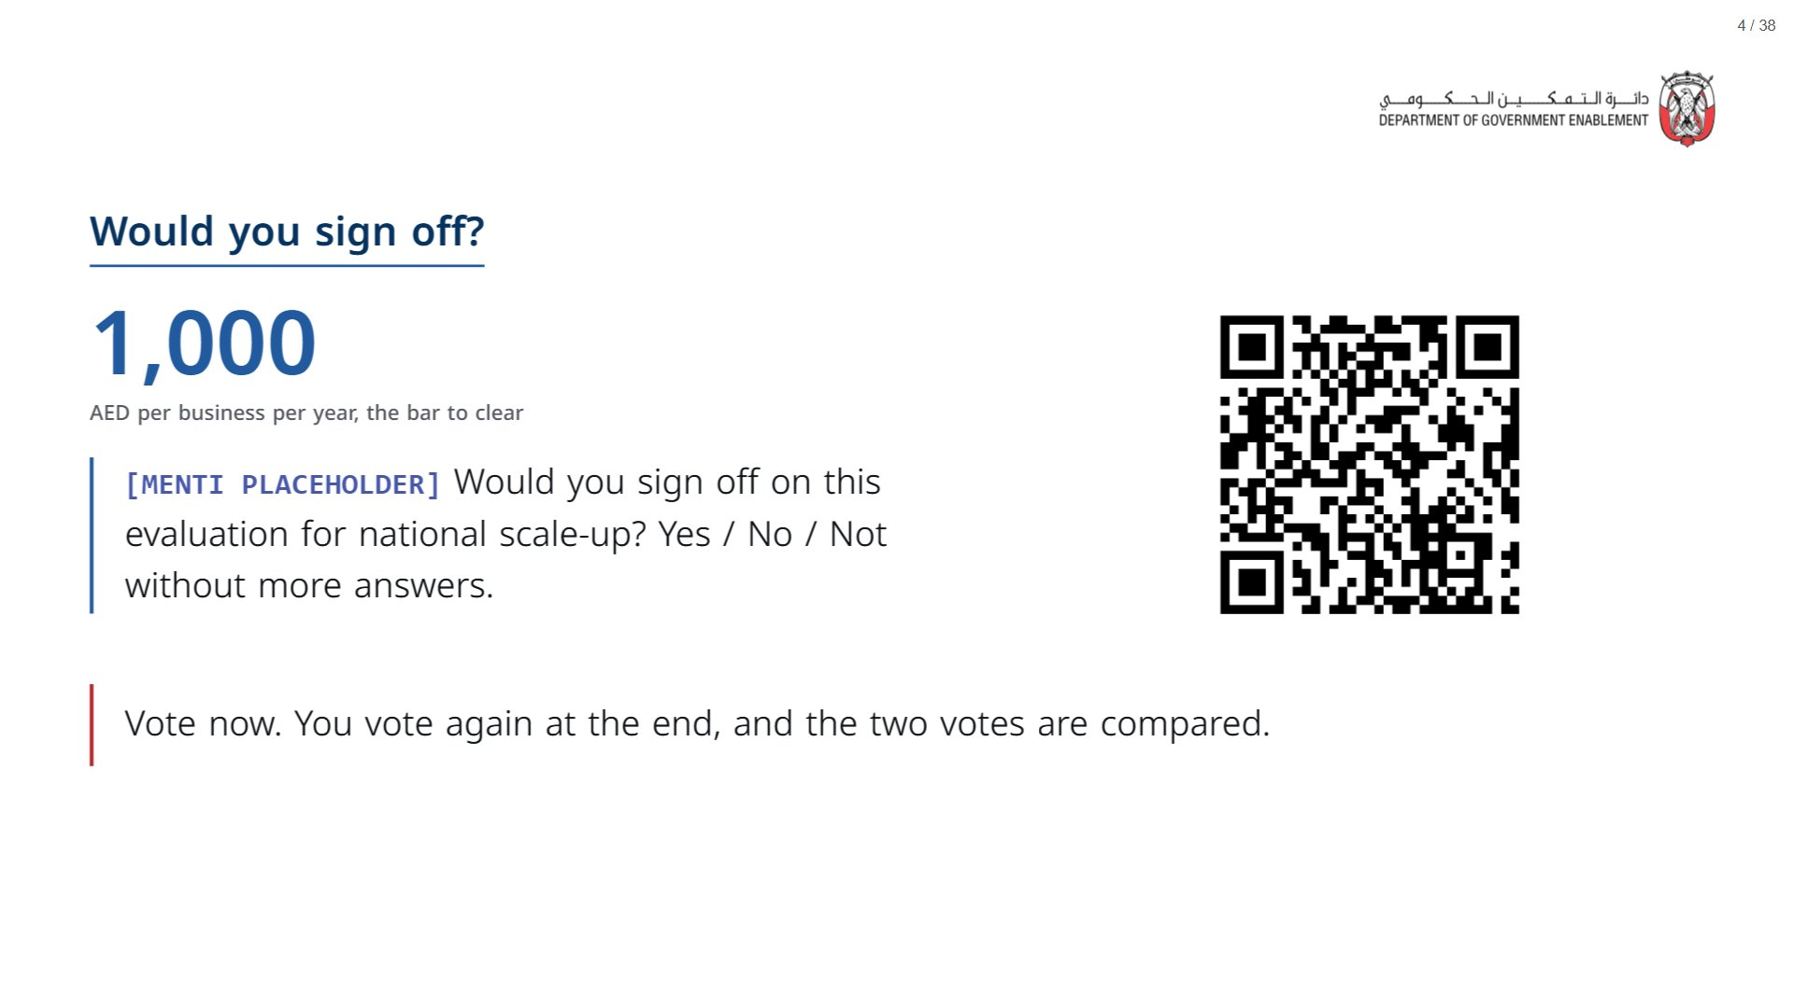
Notes:
Open the deck a couple of minutes before the session starts: R and its statistics package take about a minute to load in the browser, after which every live cell runs in a few seconds. A show of hands is enough if the Menti is not running. What matters is that the room is on record before the analyst speaks.
span.MJX_Assistive_MathML {
position:absolute!important;
clip: rect(1px, 1px, 1px, 1px);
padding: 1px 0 0 0!important;
border: 0!important;
height: 1px!important;
width: 1px!important;
overflow: hidden!important;
display:block!important;
}

Slide 5


Slide 6
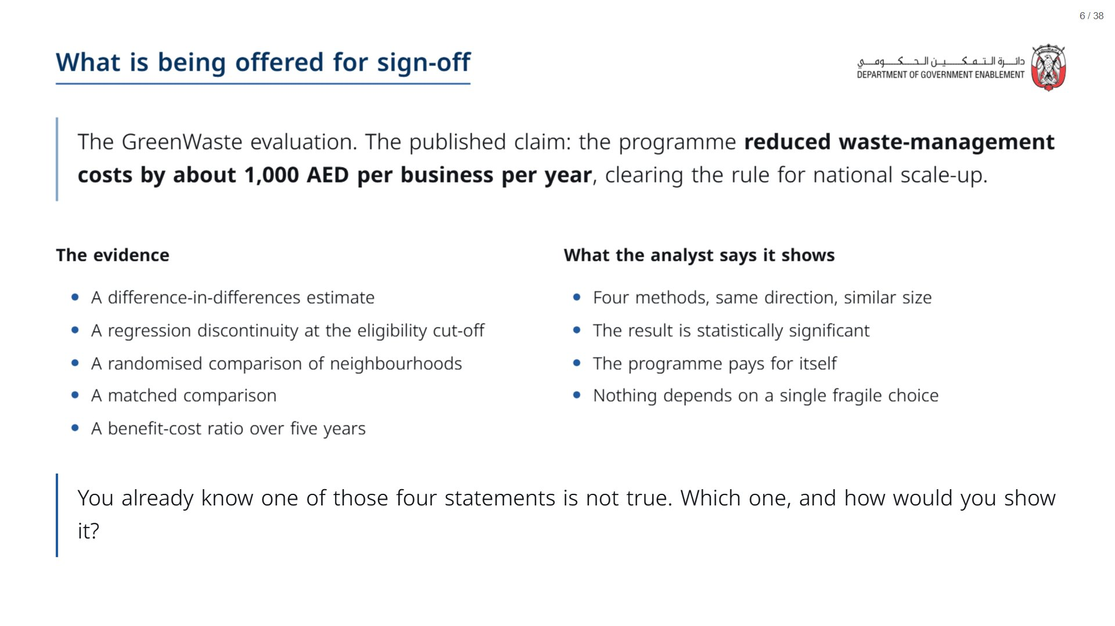

Slide 7
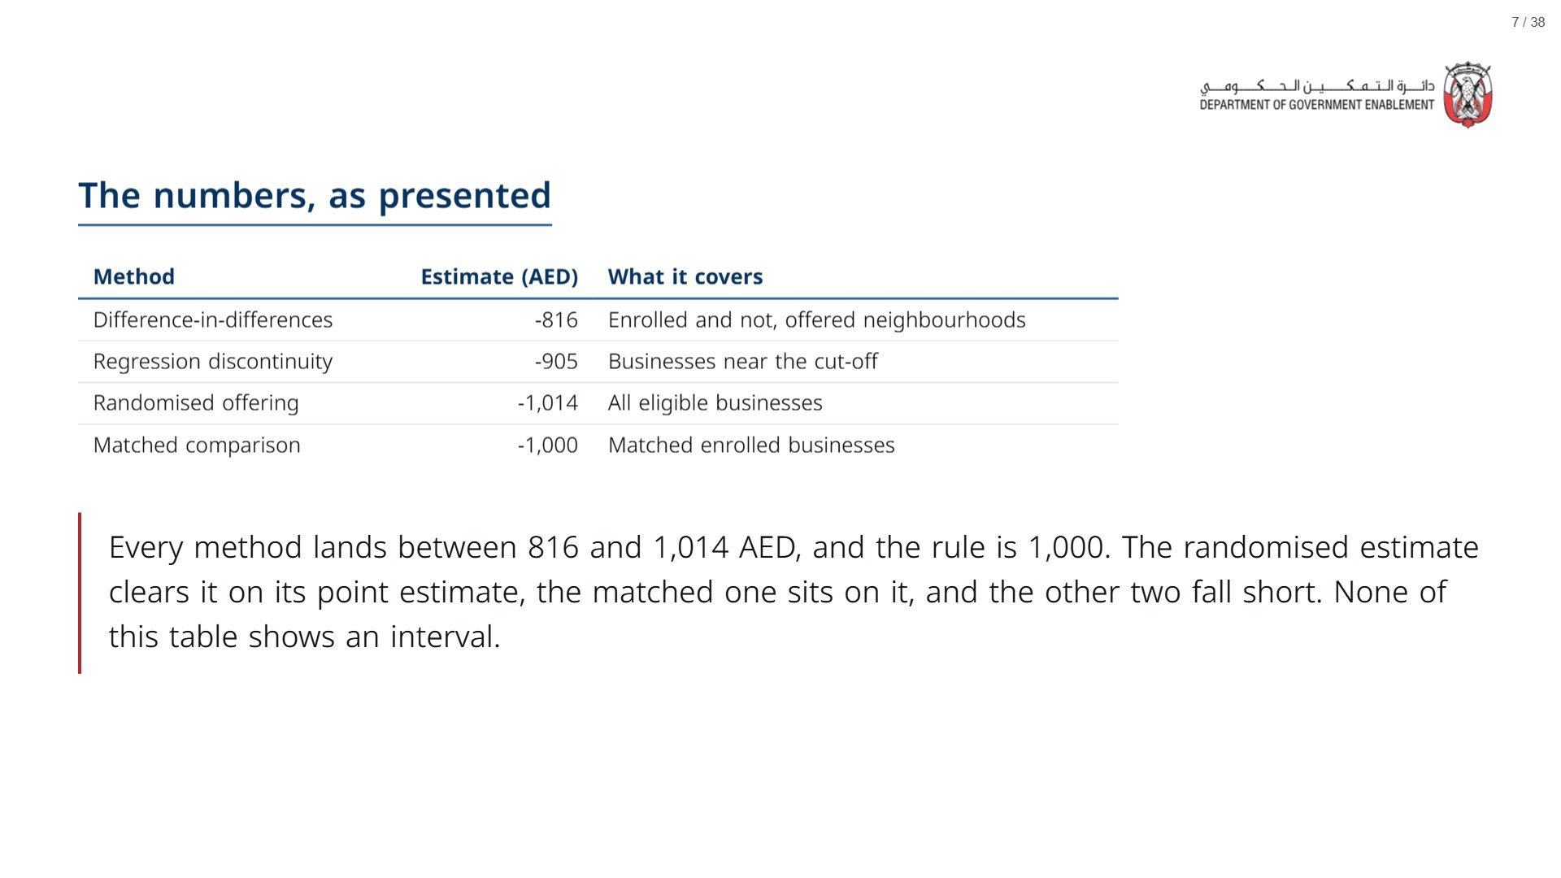

Slide 8
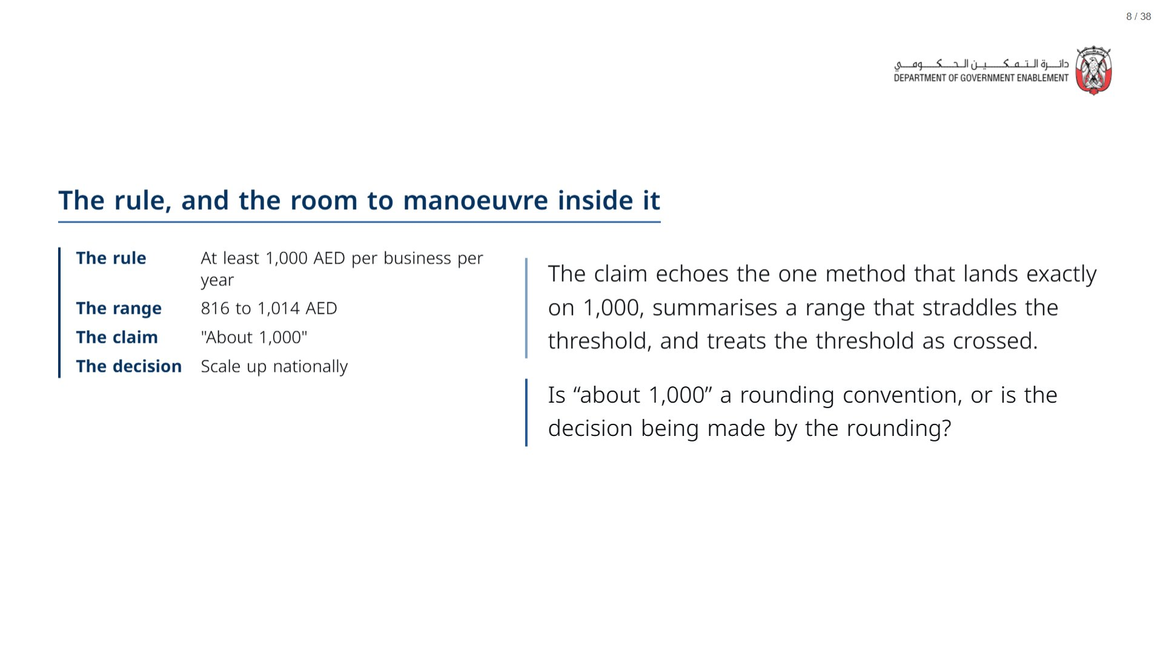

Slide 9
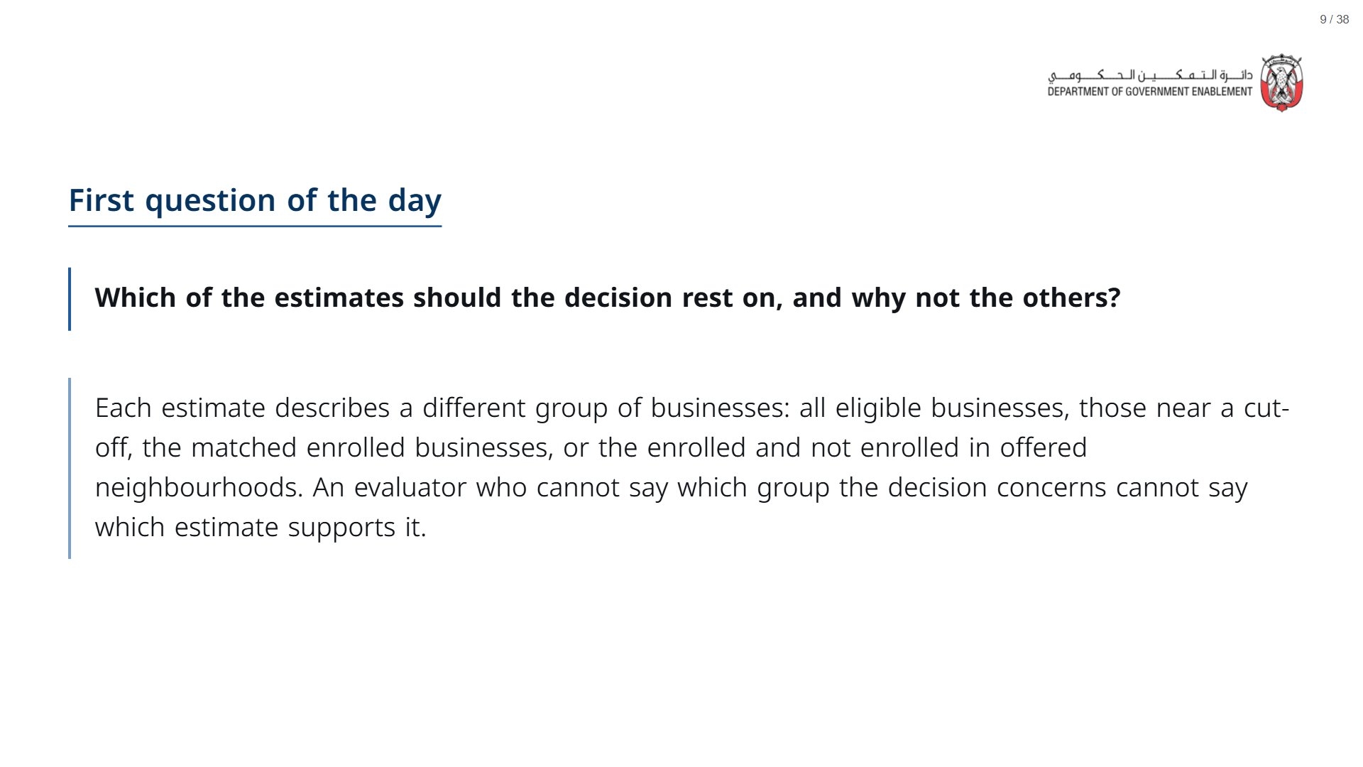

Slide 10


Slide 11
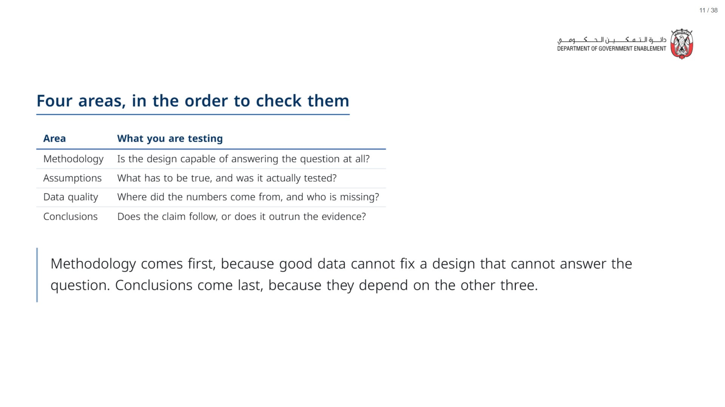

Slide 12
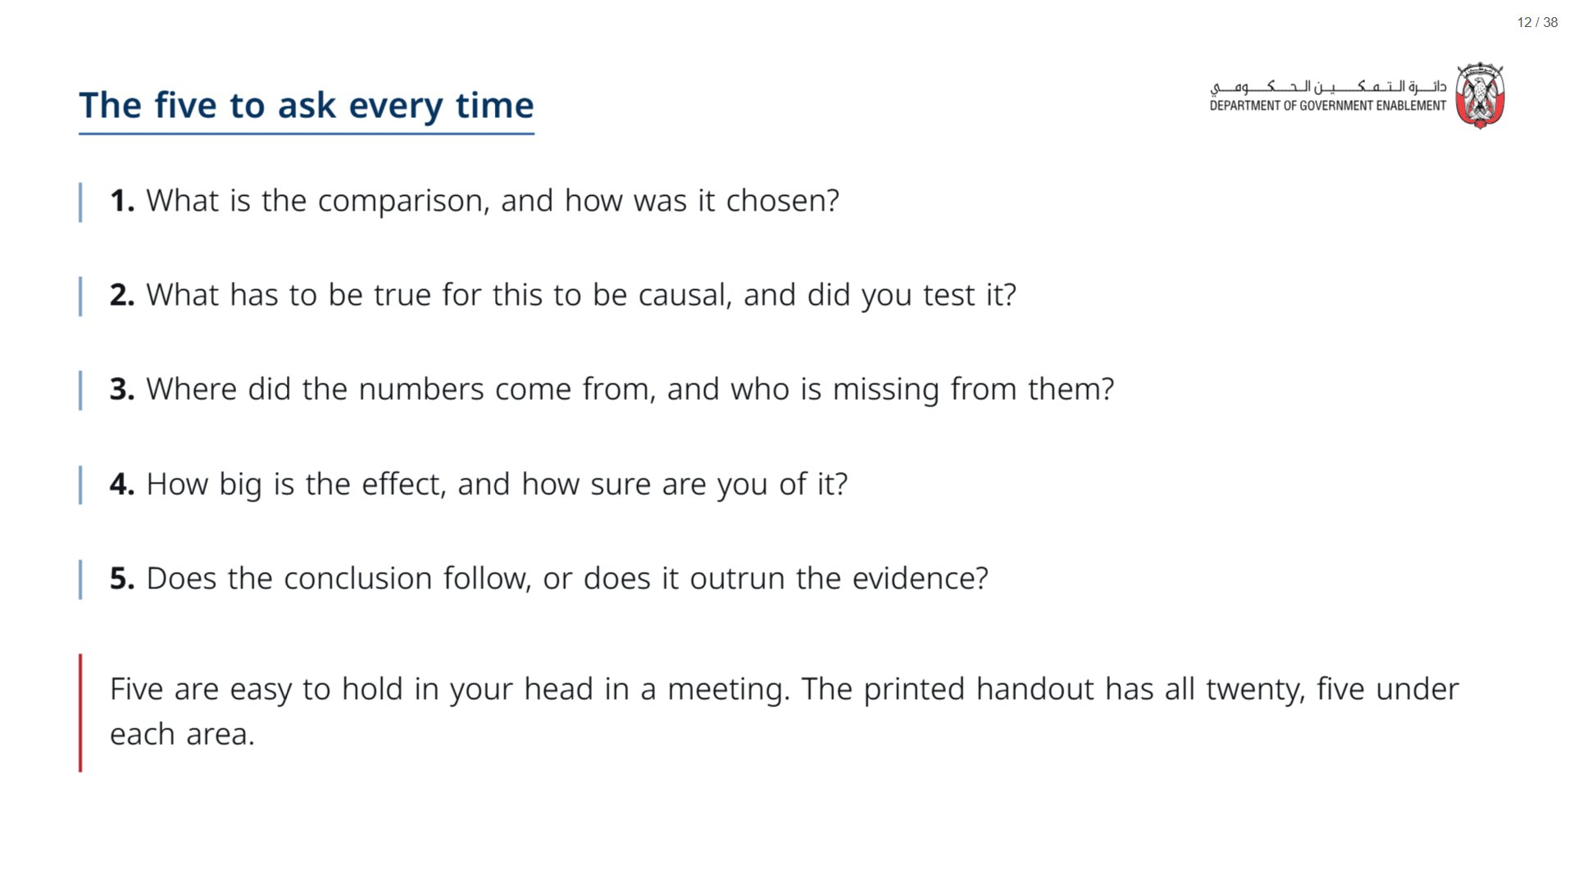

Slide 13
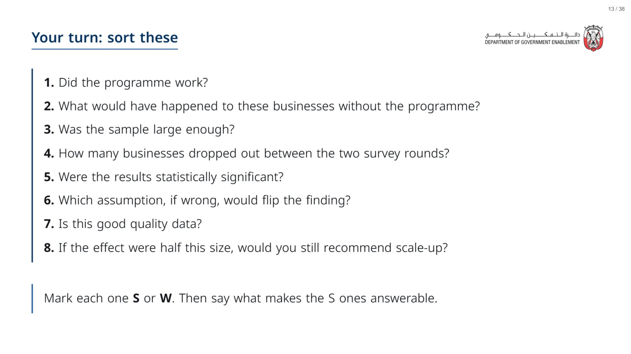
Notes:
Paper (Oct14_session3_materials.docx): Hand out the eight question slips (pack page 1, cut, one set per group) to sort into strong and weak.
span.MJX_Assistive_MathML {
position:absolute!important;
clip: rect(1px, 1px, 1px, 1px);
padding: 1px 0 0 0!important;
border: 0!important;
height: 1px!important;
width: 1px!important;
overflow: hidden!important;
display:block!important;
}

Slide 14
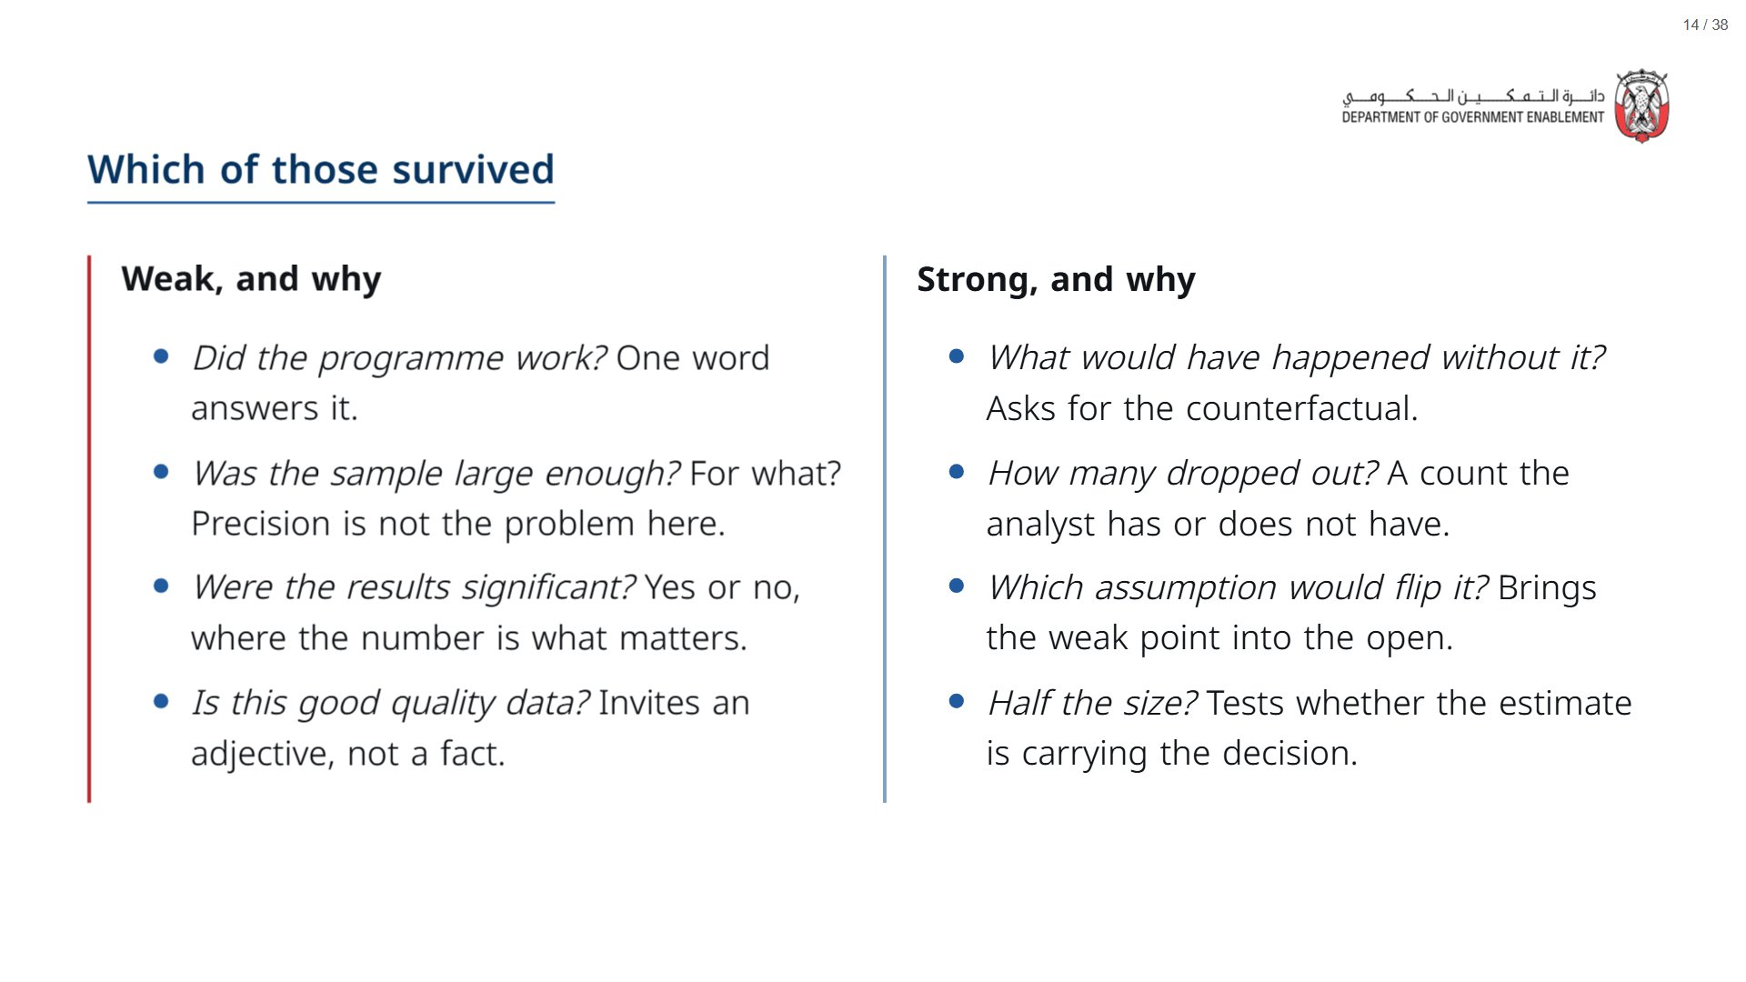
Notes:
Point out that the strong questions are no harder to ask; the difference is that they need a fact to answer. Section 4 shows the analyst producing those facts.
span.MJX_Assistive_MathML {
position:absolute!important;
clip: rect(1px, 1px, 1px, 1px);
padding: 1px 0 0 0!important;
border: 0!important;
height: 1px!important;
width: 1px!important;
overflow: hidden!important;
display:block!important;
}

Slide 15
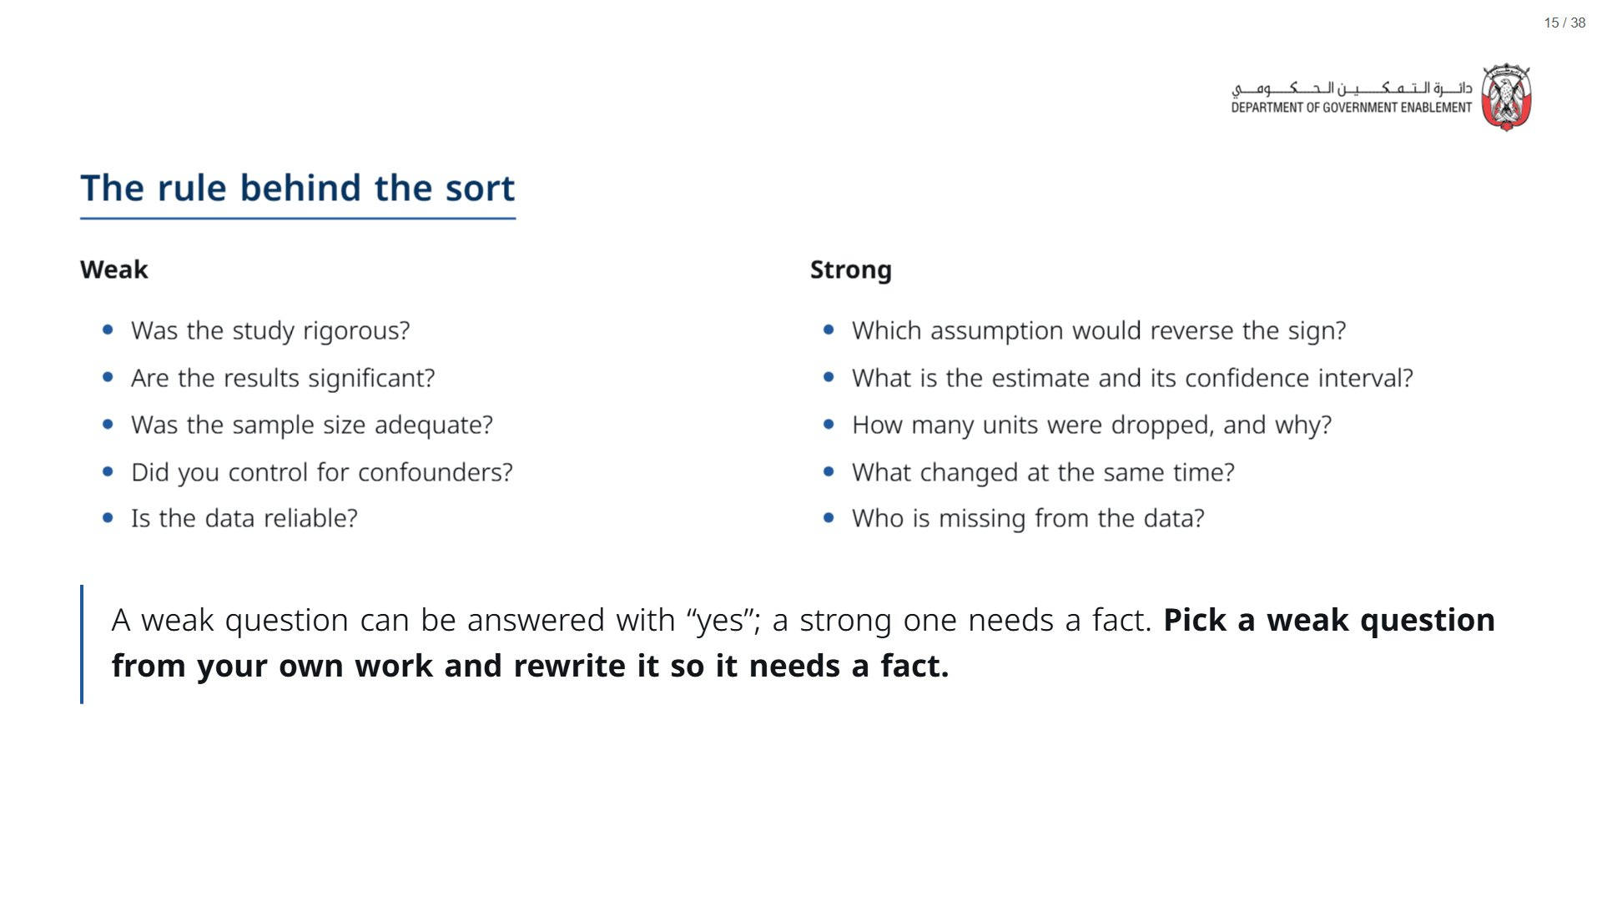

Slide 16
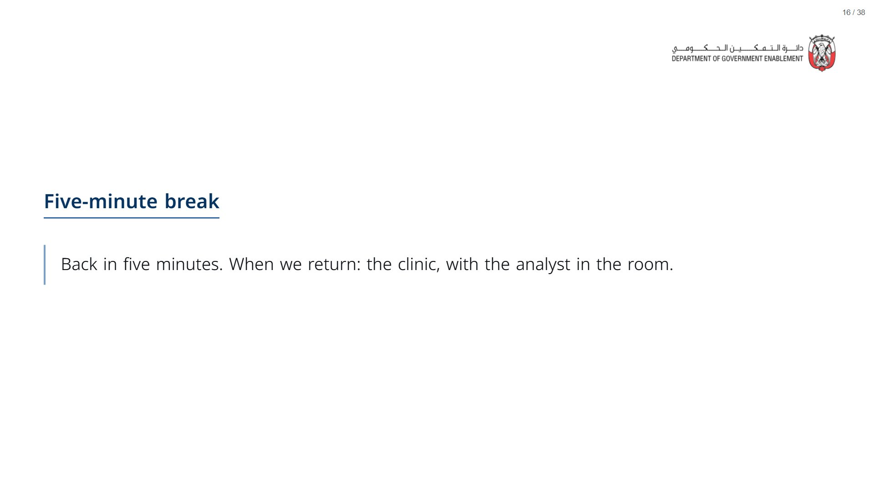

Slide 17


Slide 18
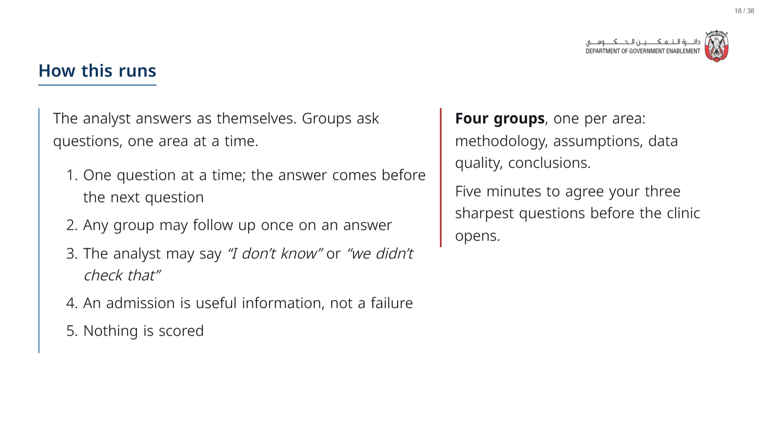
Notes:
When a group asks one of the questions in section 4, jump to that slide and run it: the analyst answers with the data. Questions without a prepared slide get a spoken answer, or an honest “we did not check”.
Paper (Oct14_session3_materials.docx): Hand out the QA checklist (Oct14_session3_qa_checklist.docx) and one clinic record sheet per group (pack page 2).
span.MJX_Assistive_MathML {
position:absolute!important;
clip: rect(1px, 1px, 1px, 1px);
padding: 1px 0 0 0!important;
border: 0!important;
height: 1px!important;
width: 1px!important;
overflow: hidden!important;
display:block!important;
}

Slide 19
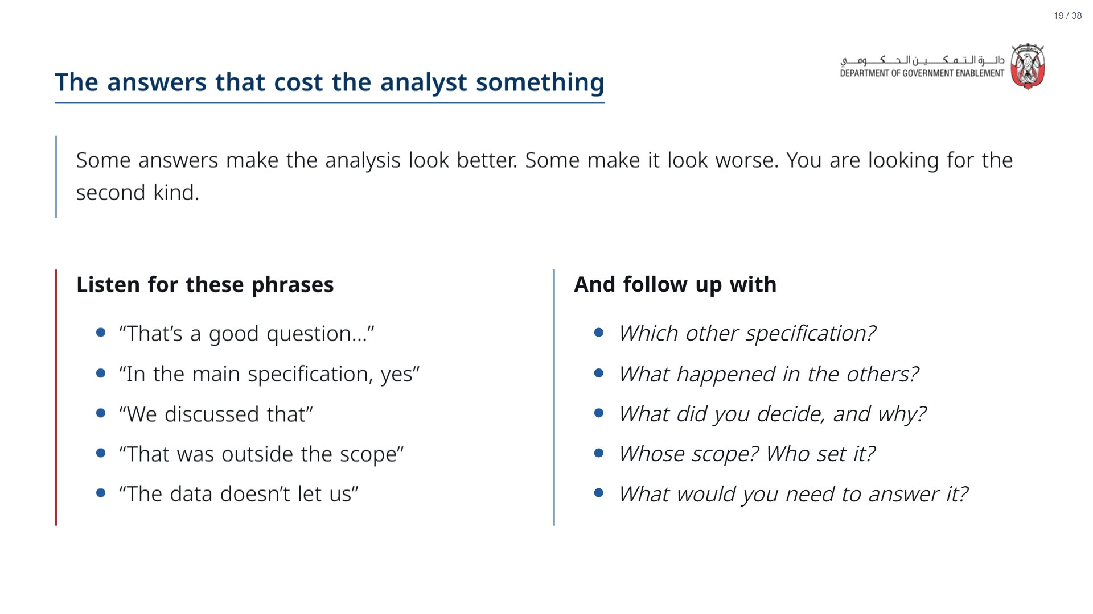

Slide 20
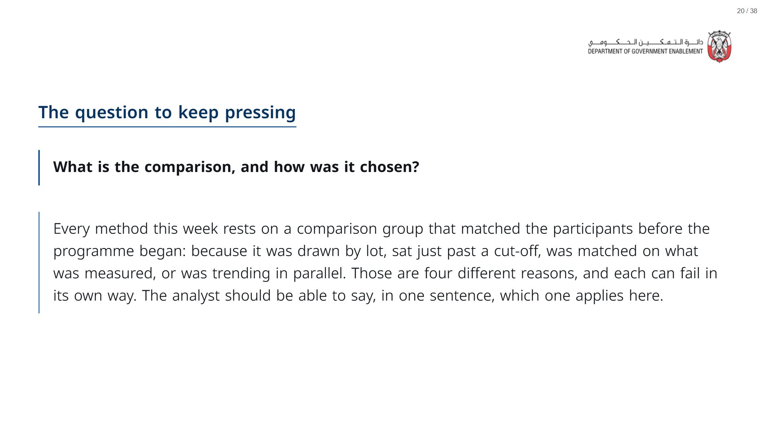

Slide 21
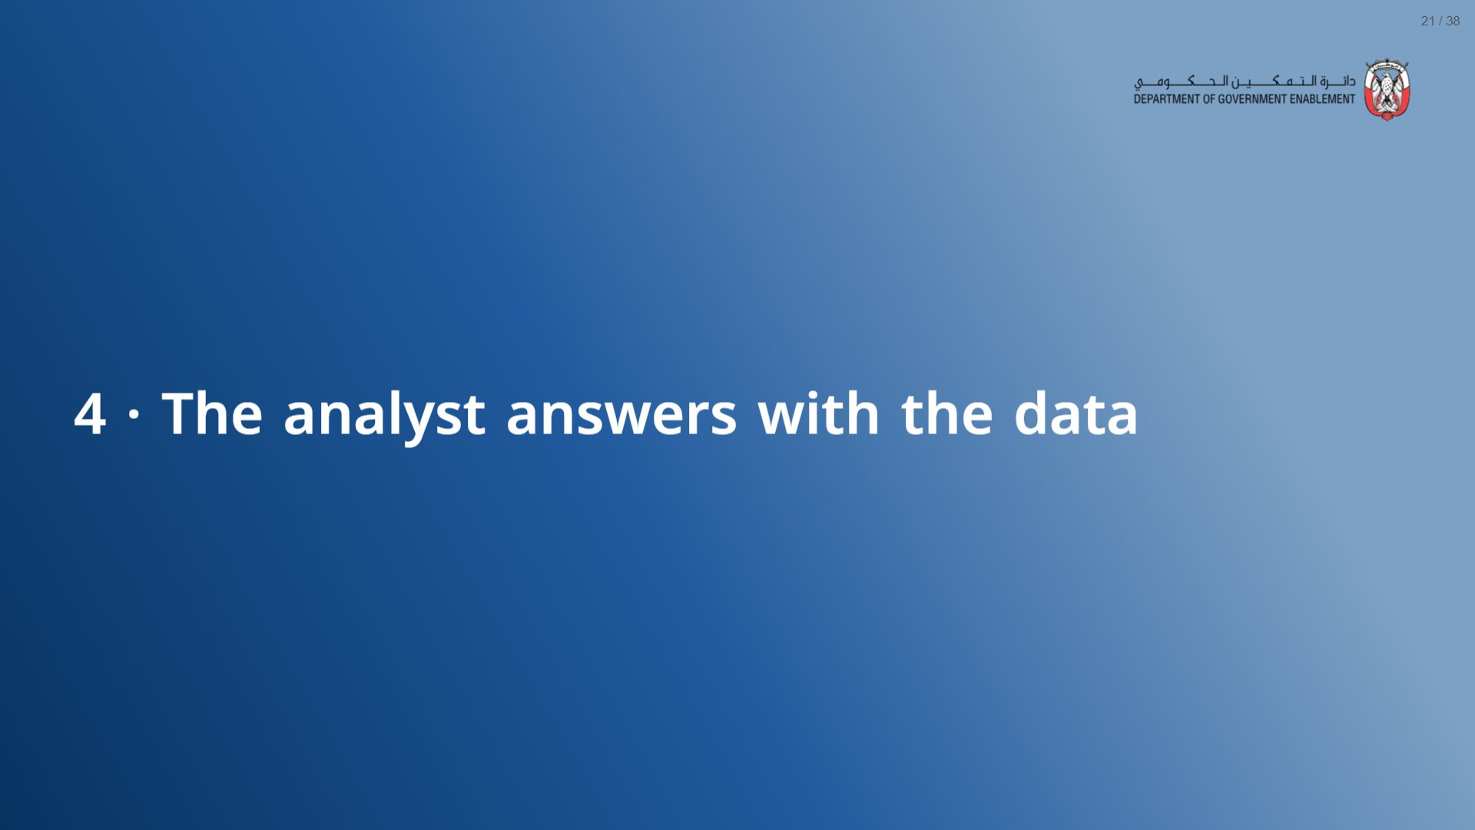

Slide 22
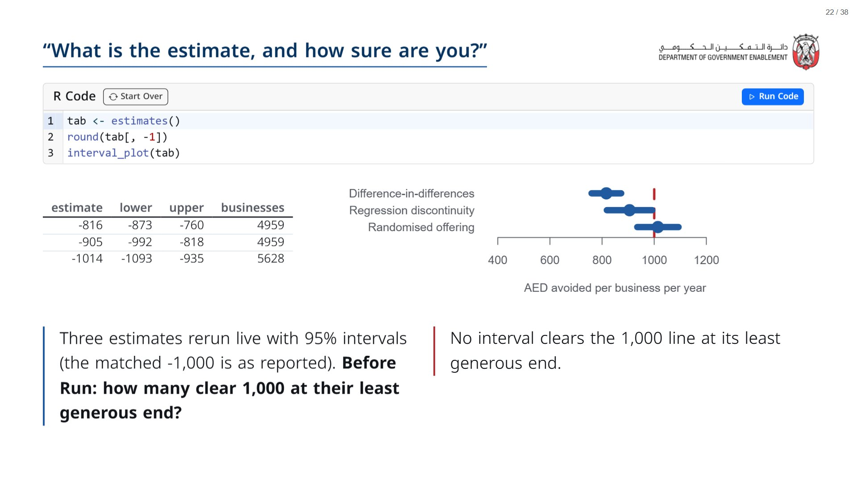

Slide 23
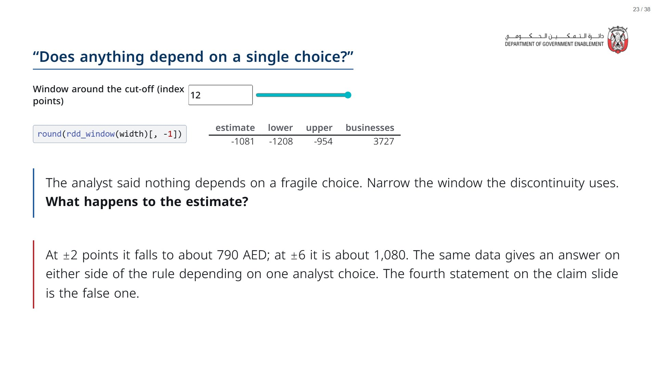

Slide 24
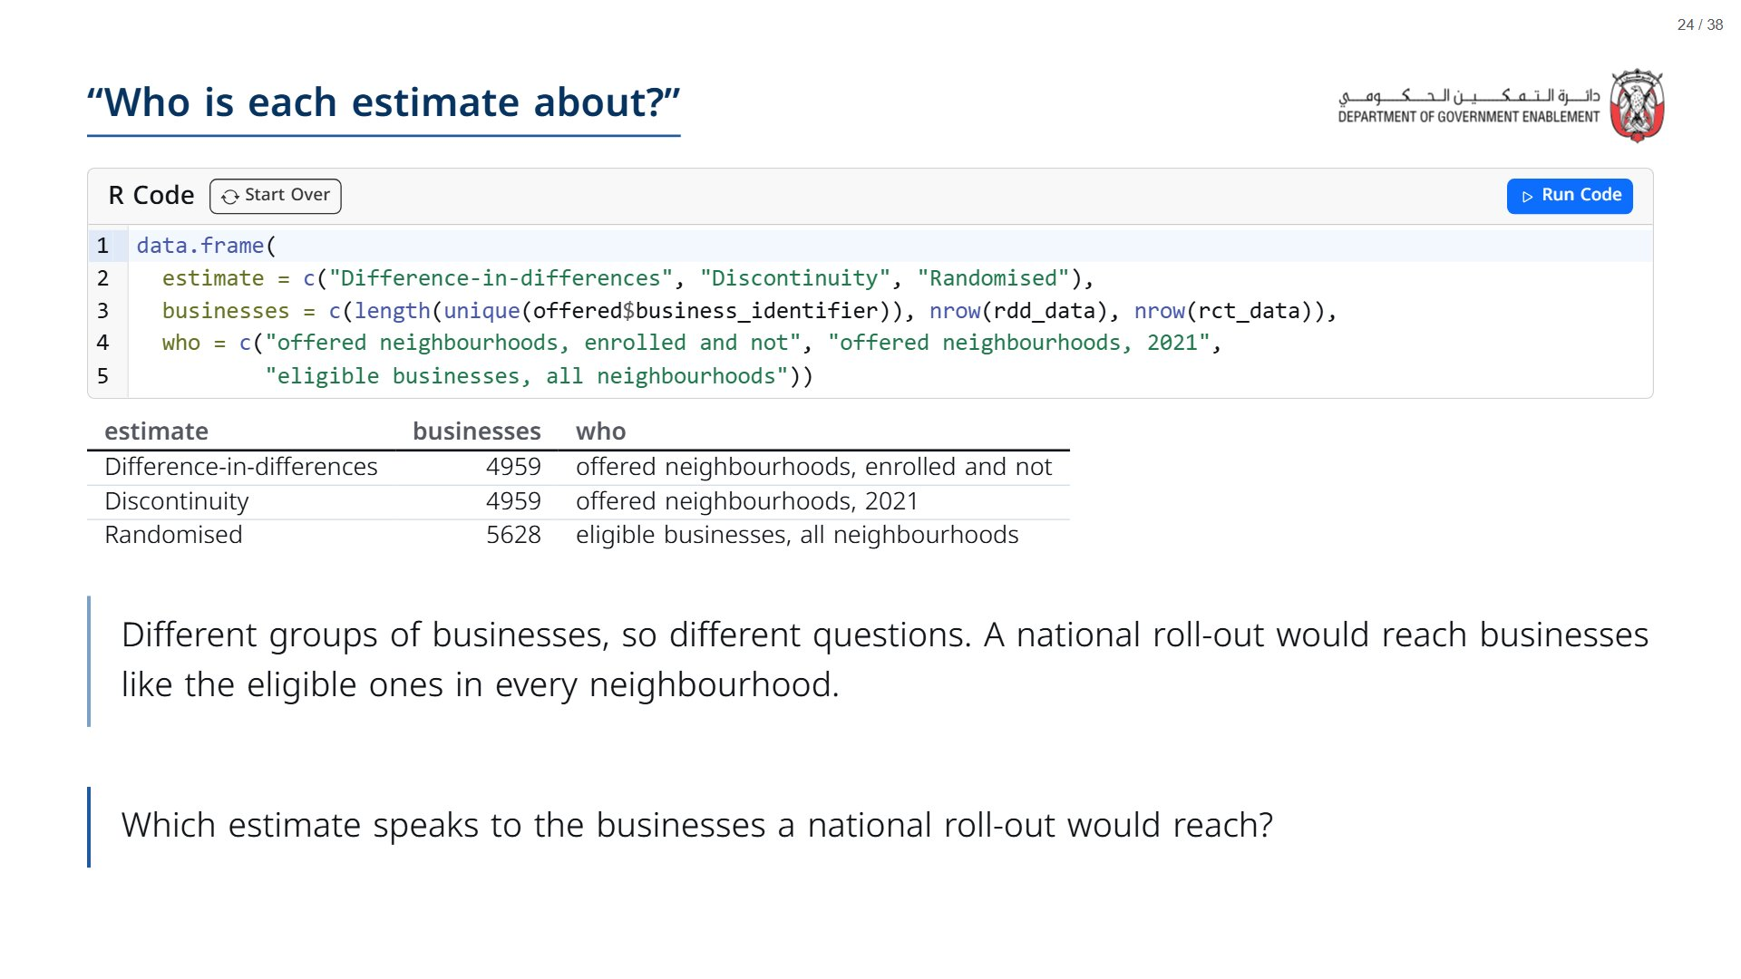

Slide 25
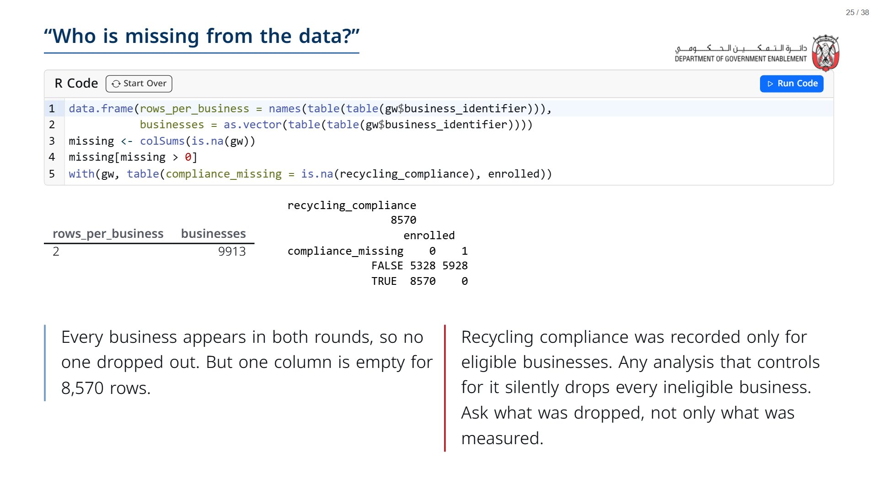

Slide 26
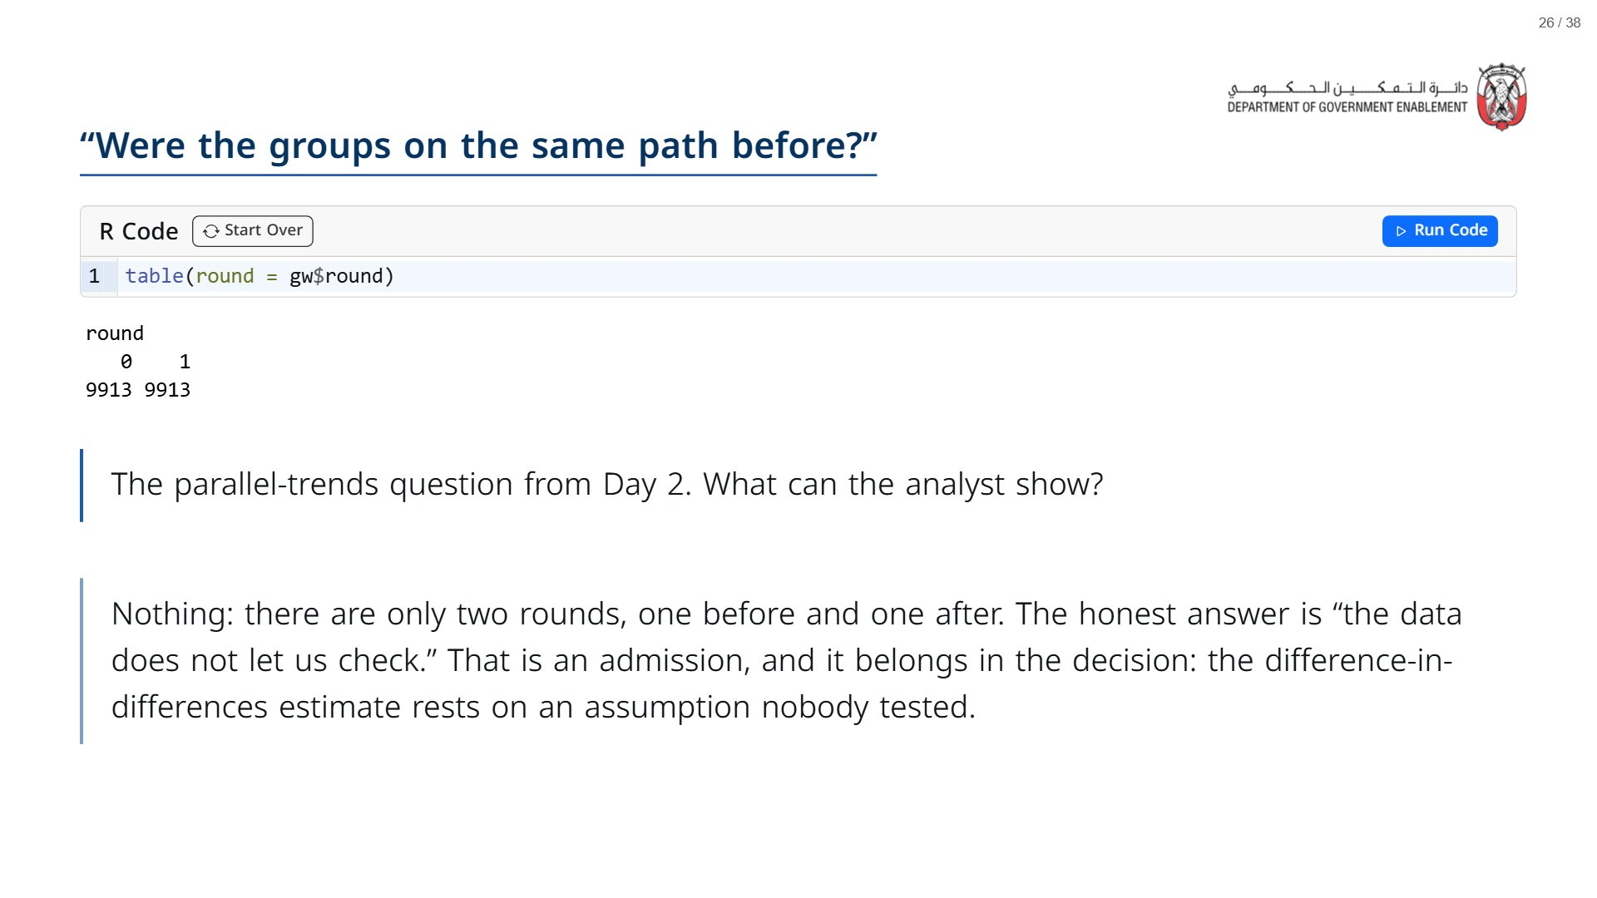

Slide 27


Slide 28
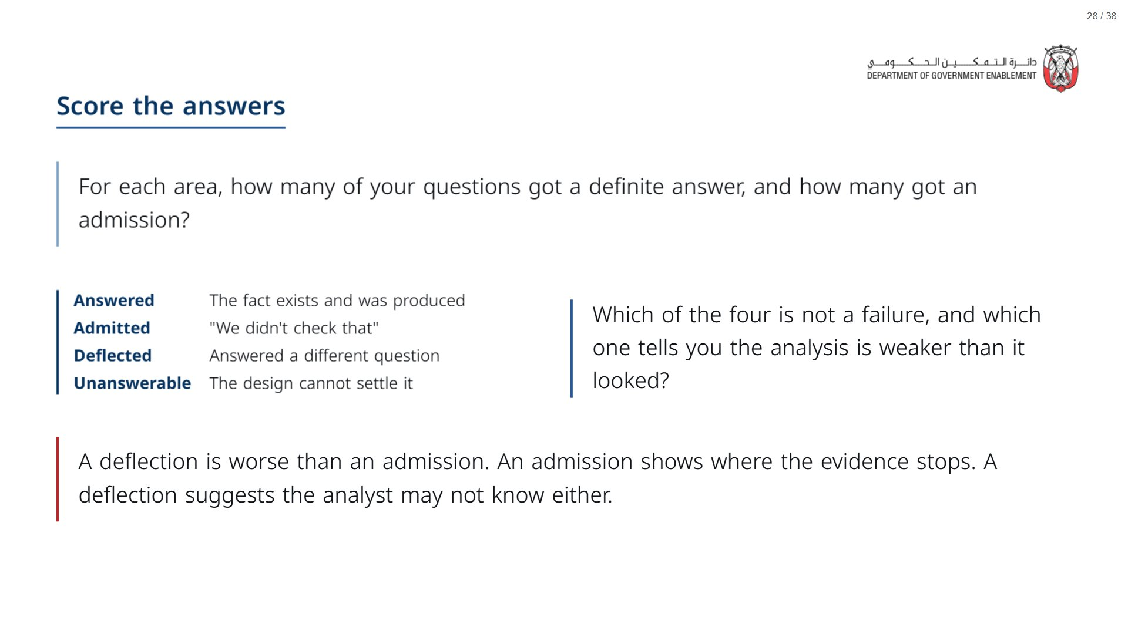

Slide 29
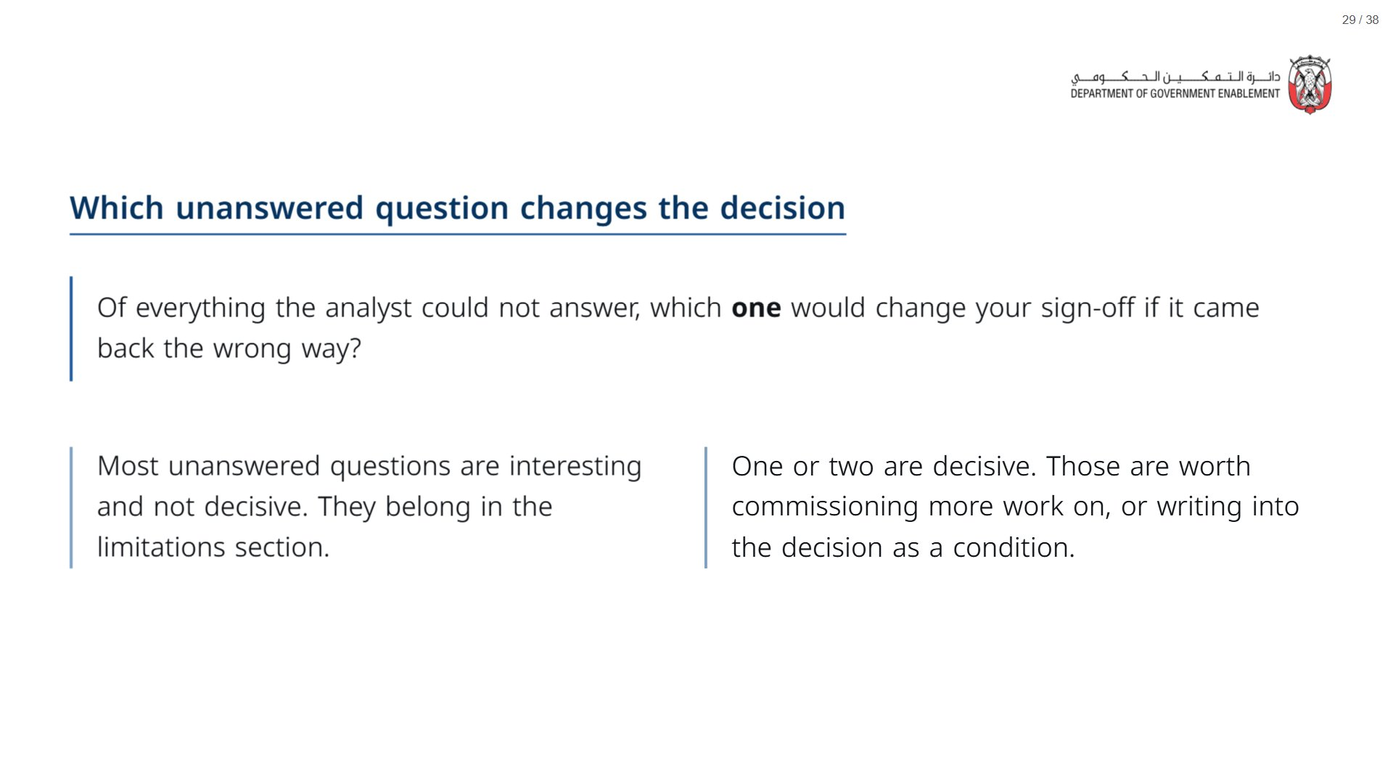

Slide 30
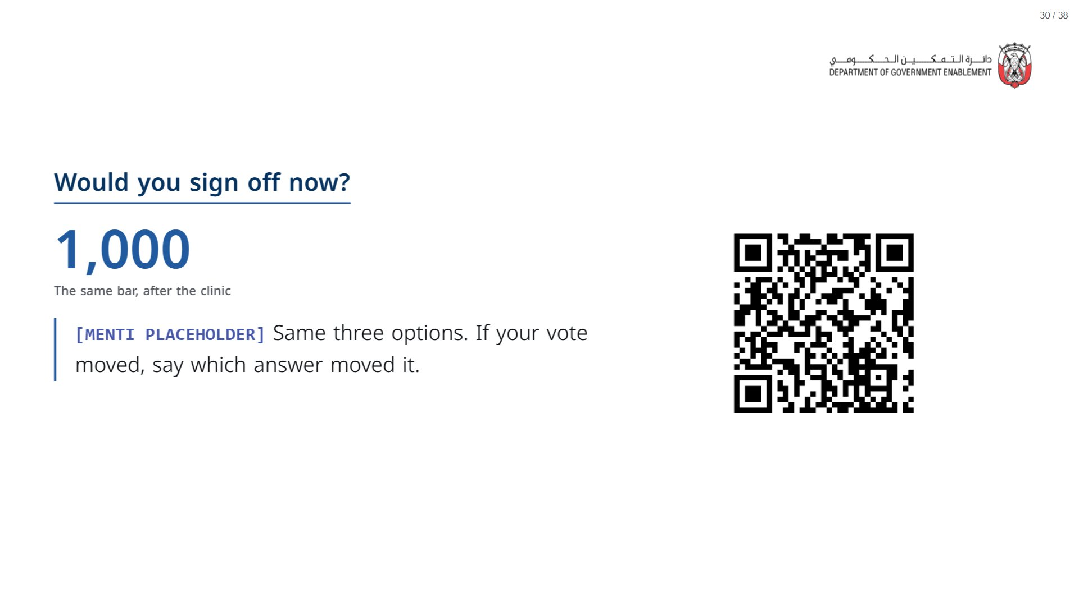

Slide 31


Slide 32
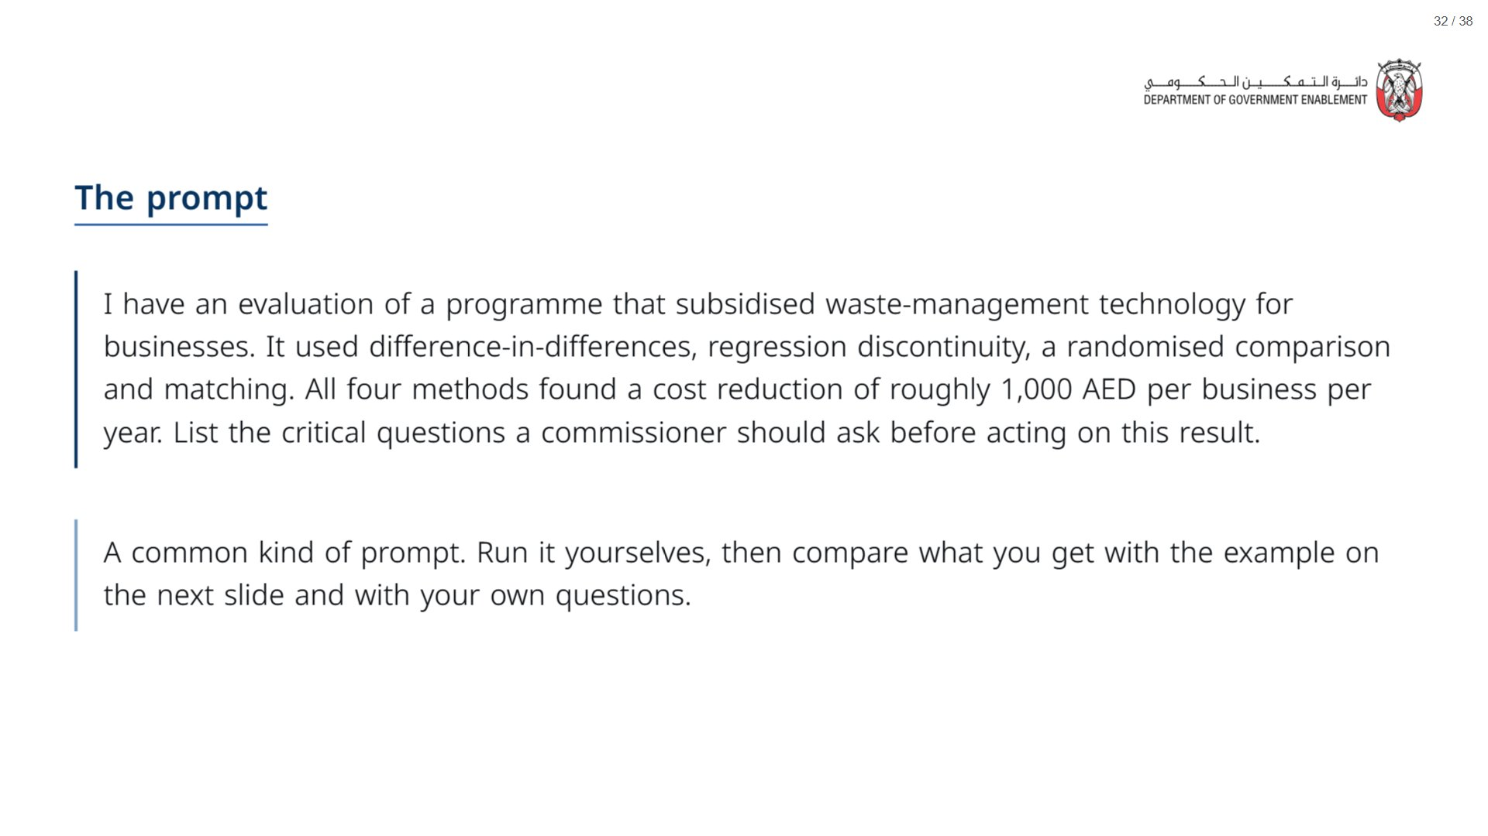
Notes:
Paper (Oct14_session3_materials.docx): Hand out the AI prompt card (pack page 3, one per group).
span.MJX_Assistive_MathML {
position:absolute!important;
clip: rect(1px, 1px, 1px, 1px);
padding: 1px 0 0 0!important;
border: 0!important;
height: 1px!important;
width: 1px!important;
overflow: hidden!important;
display:block!important;
}

Slide 33
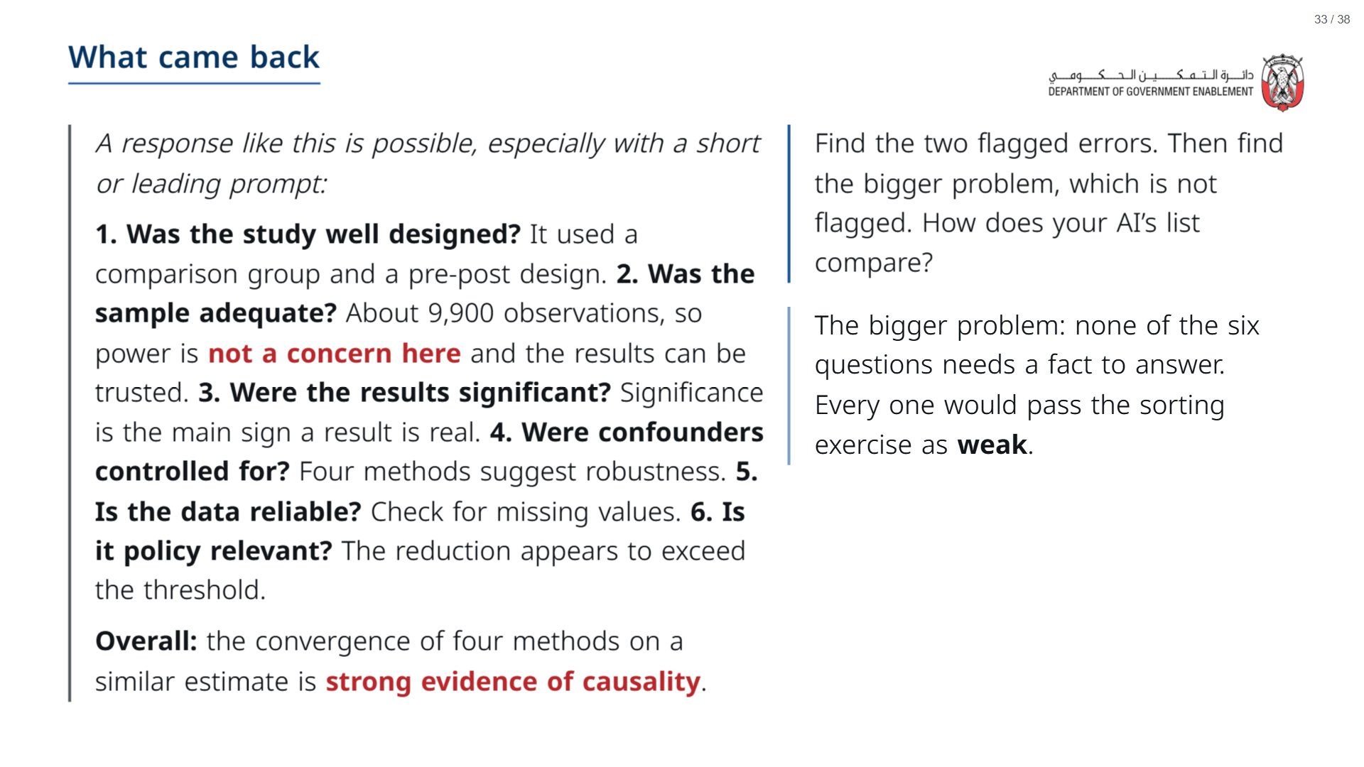

Slide 34
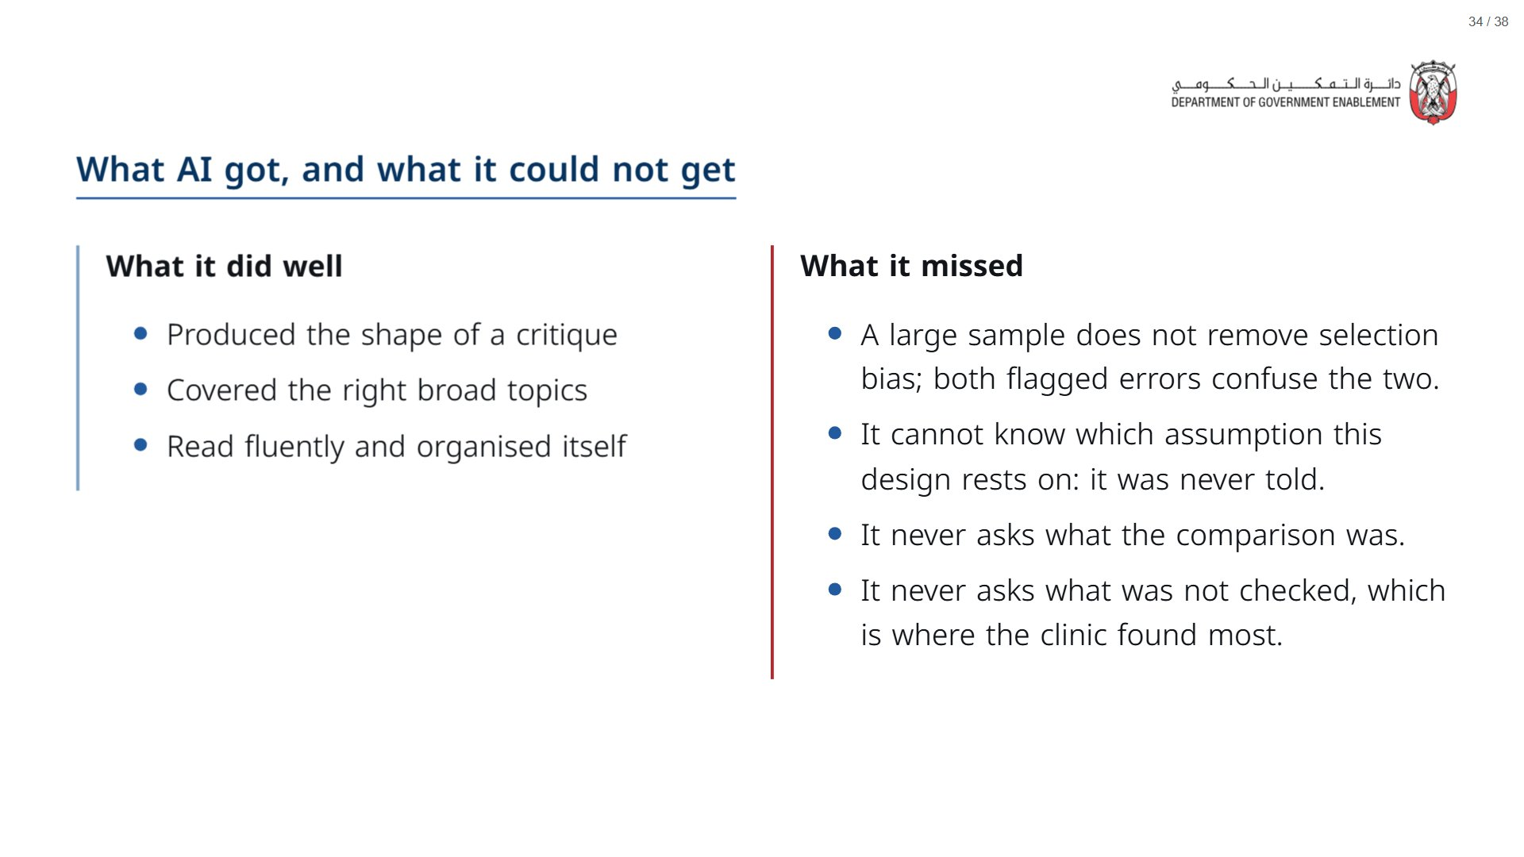

Slide 35
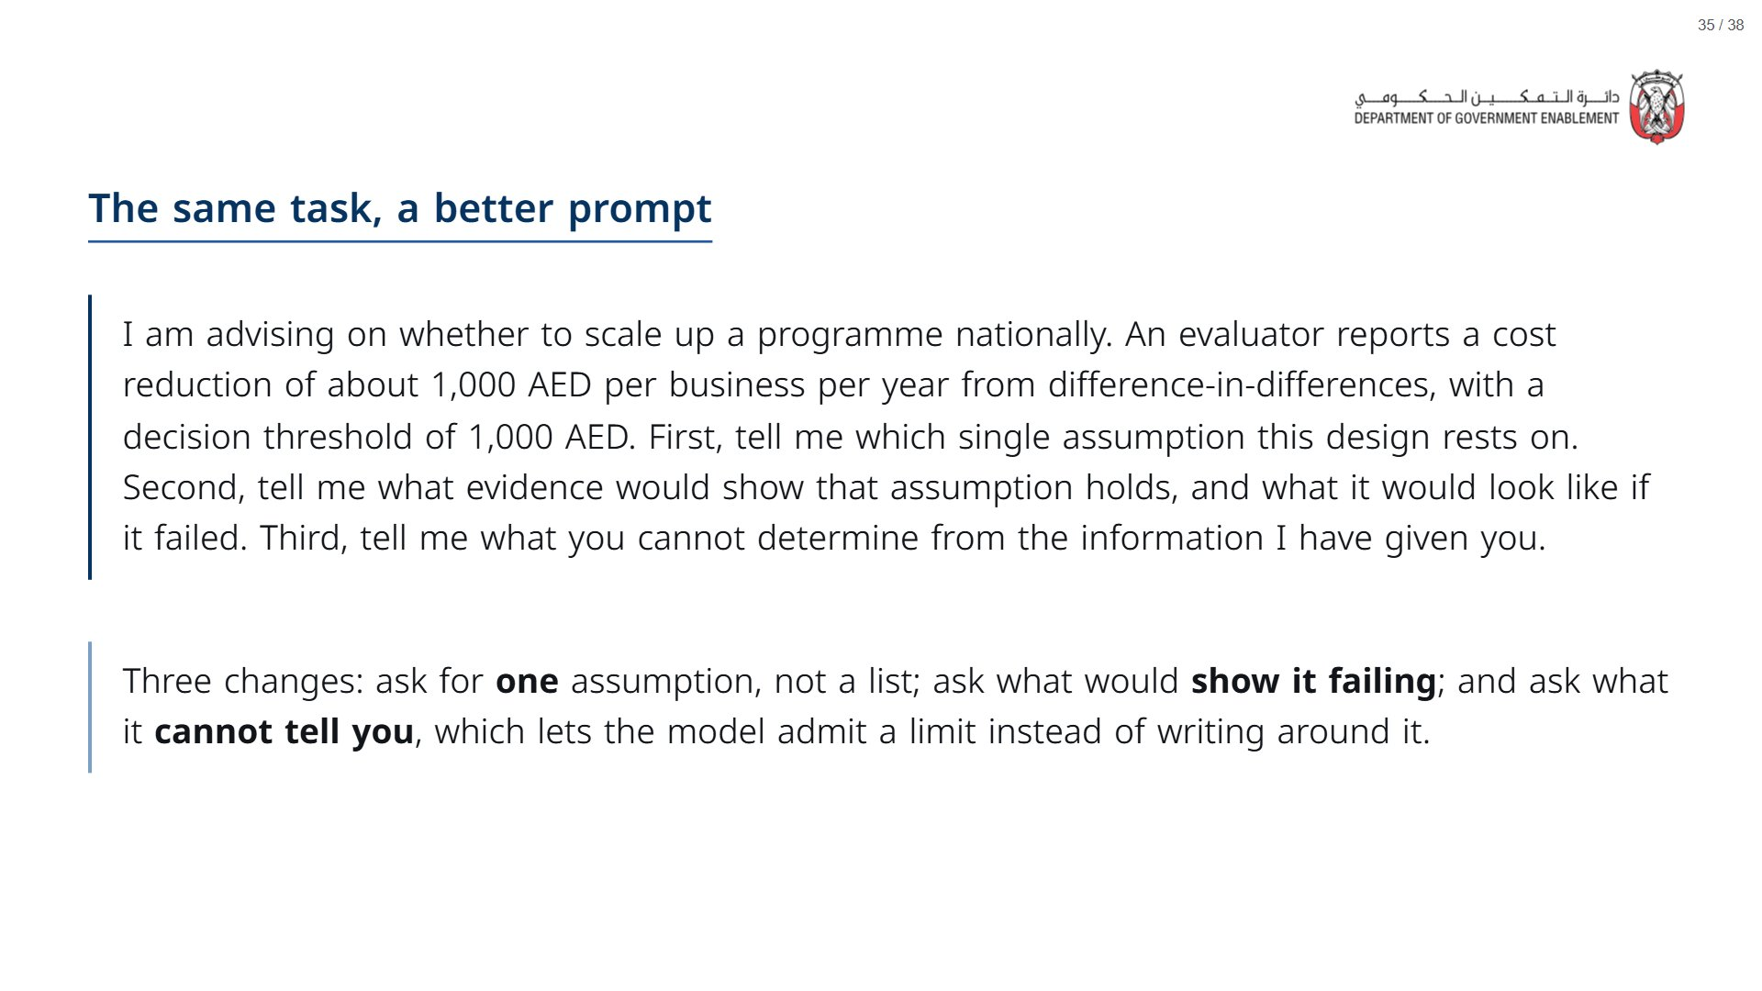

Slide 36


Slide 37
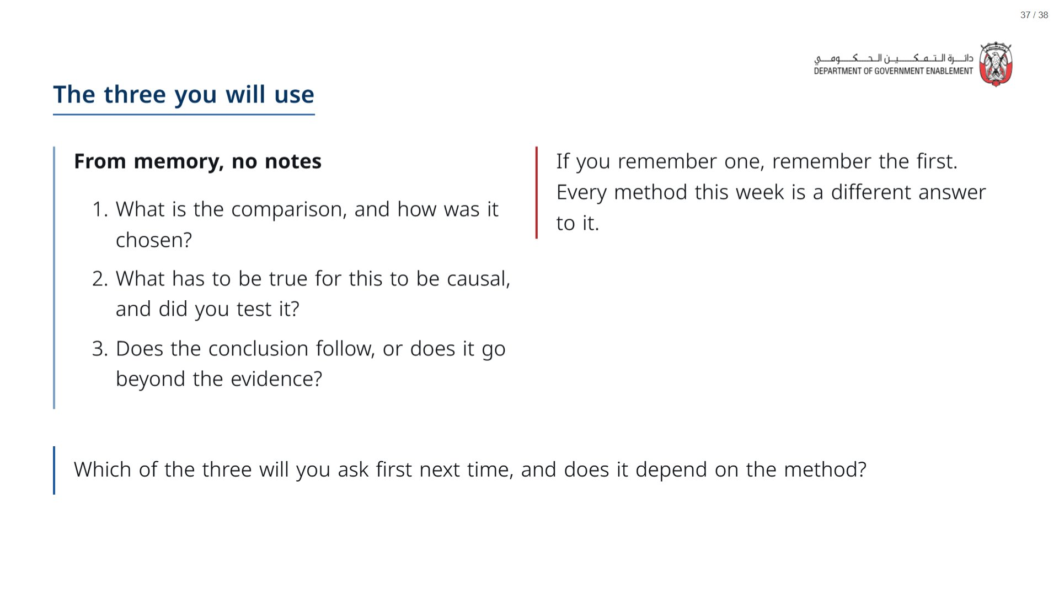
Notes:
Paper (Oct14_session3_materials.docx): Hand out the take-away cards (pack page 4). Give a minute to fill in “On my desk” on the card, then take two or three examples from the room.
span.MJX_Assistive_MathML {
position:absolute!important;
clip: rect(1px, 1px, 1px, 1px);
padding: 1px 0 0 0!important;
border: 0!important;
height: 1px!important;
width: 1px!important;
overflow: hidden!important;
display:block!important;
}

Slide 38
