Slide 1


Slide 2

Notes:
Timing: 5 minutes (0:00 to 0:05). Hook and first vote.
span.MJX_Assistive_MathML {
position:absolute!important;
clip: rect(1px, 1px, 1px, 1px);
padding: 1px 0 0 0!important;
border: 0!important;
height: 1px!important;
width: 1px!important;
overflow: hidden!important;
display:block!important;
}

Slide 3
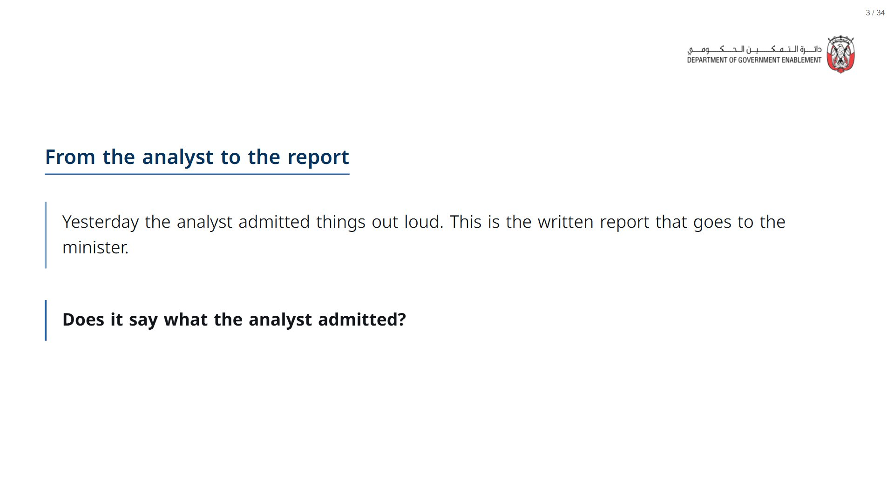

Slide 4
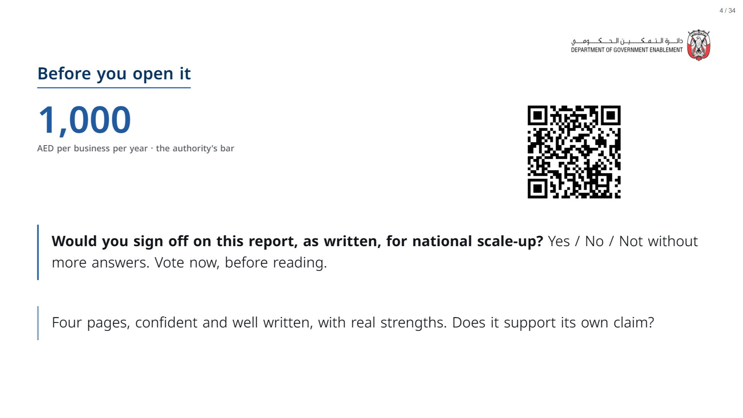
Notes:
Paper (Oct15_session1_materials.docx): Hand out the rating sheet (pack pages 1 and 2, printed back to back, one per participant). Everyone circles a “Before reading” vote on the back as well as voting on Menti.
span.MJX_Assistive_MathML {
position:absolute!important;
clip: rect(1px, 1px, 1px, 1px);
padding: 1px 0 0 0!important;
border: 0!important;
height: 1px!important;
width: 1px!important;
overflow: hidden!important;
display:block!important;
}

Slide 5

Notes:
Timing: 10 minutes (0:05 to 0:15). Everyone reads and rates the executive summary alone.
span.MJX_Assistive_MathML {
position:absolute!important;
clip: rect(1px, 1px, 1px, 1px);
padding: 1px 0 0 0!important;
border: 0!important;
height: 1px!important;
width: 1px!important;
overflow: hidden!important;
display:block!important;
}

Slide 6
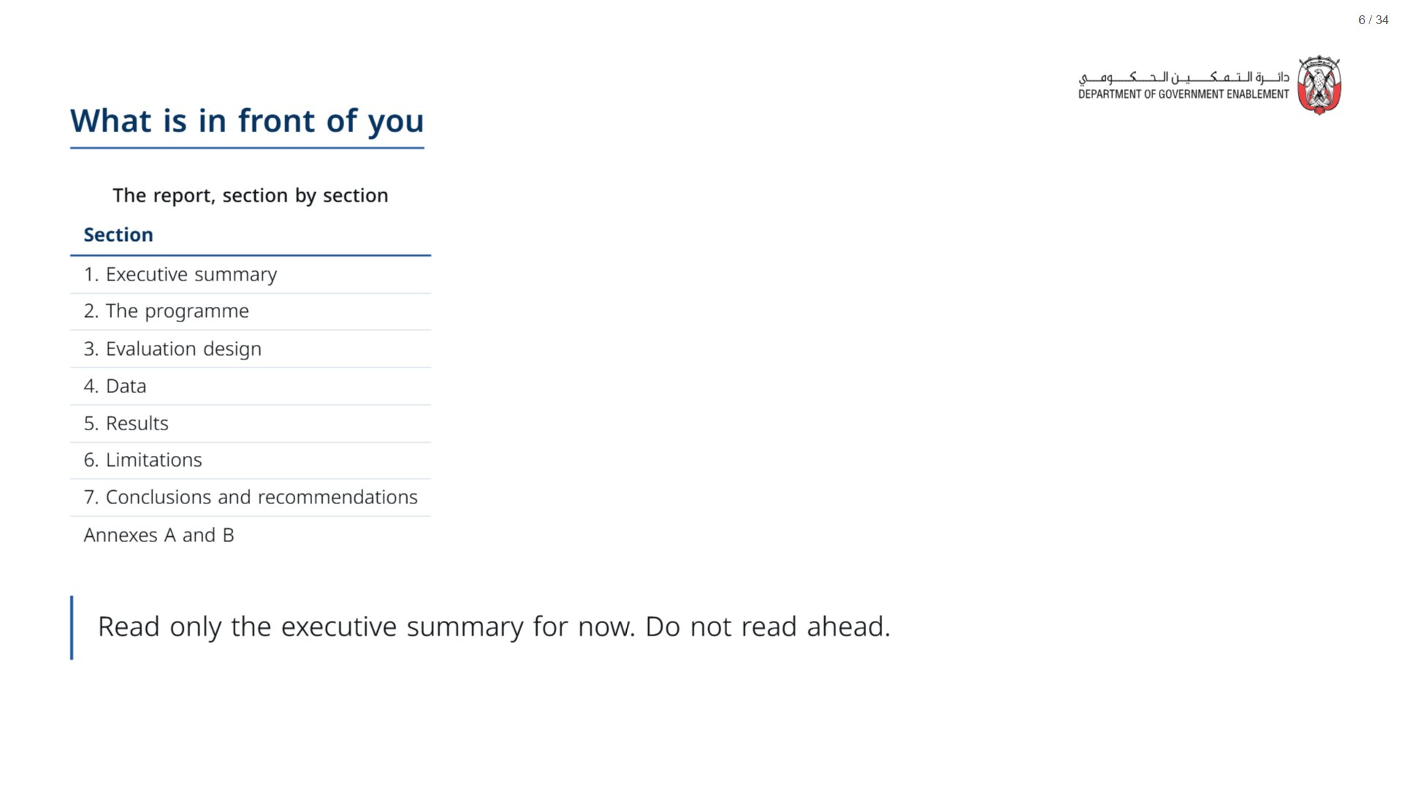
Notes:
Paper: Hand out the report (Oct15_session1_report.docx, one per participant). Ask everyone to keep it face down until you say go.
span.MJX_Assistive_MathML {
position:absolute!important;
clip: rect(1px, 1px, 1px, 1px);
padding: 1px 0 0 0!important;
border: 0!important;
height: 1px!important;
width: 1px!important;
overflow: hidden!important;
display:block!important;
}

Slide 7
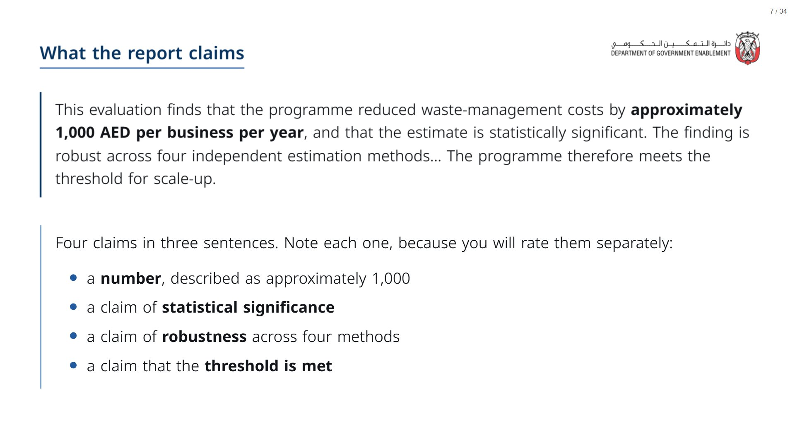

Slide 8
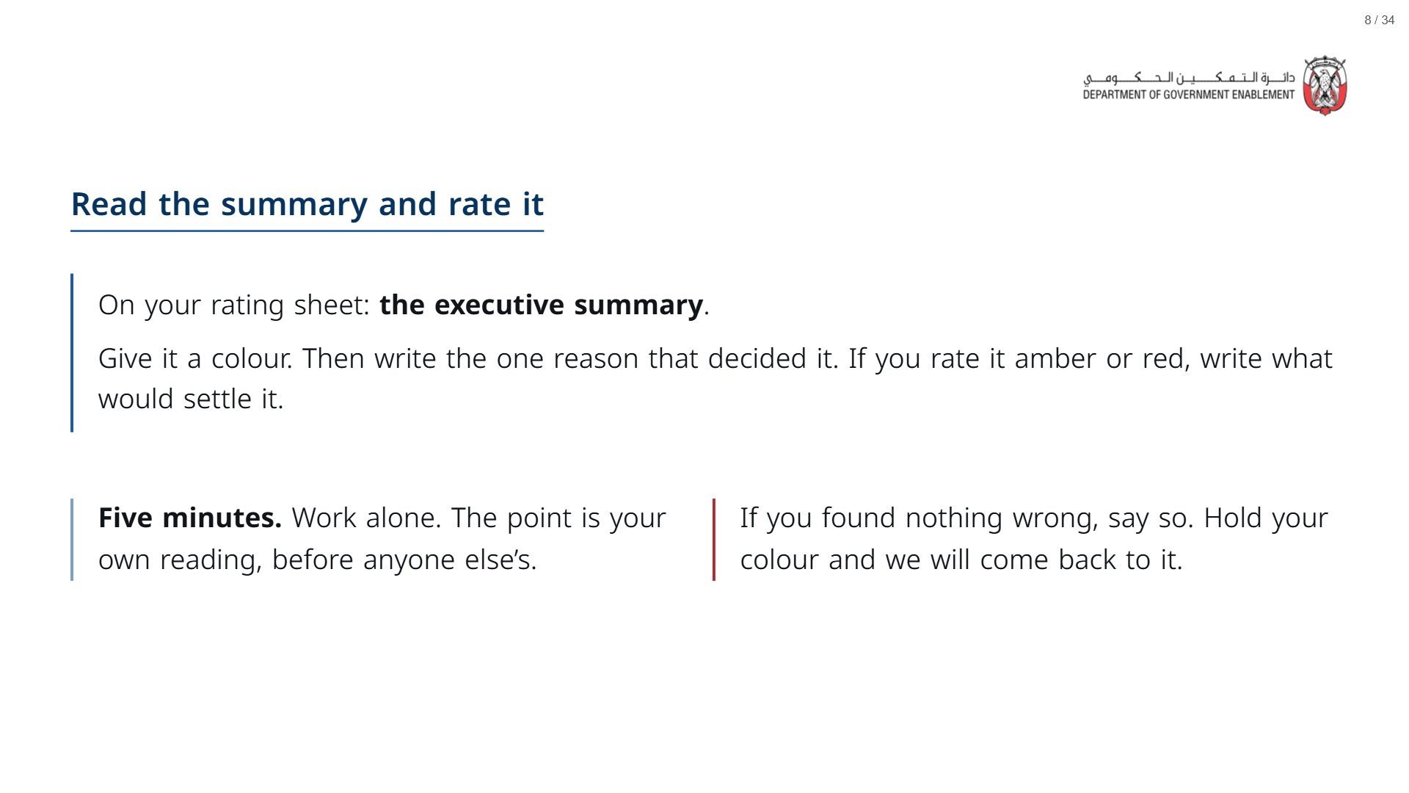

Slide 9

Notes:
Timing: 5 minutes (0:15 to 0:20). Recap of yesterday’s checklist and the rating scale; keep it brisk.
span.MJX_Assistive_MathML {
position:absolute!important;
clip: rect(1px, 1px, 1px, 1px);
padding: 1px 0 0 0!important;
border: 0!important;
height: 1px!important;
width: 1px!important;
overflow: hidden!important;
display:block!important;
}

Slide 10
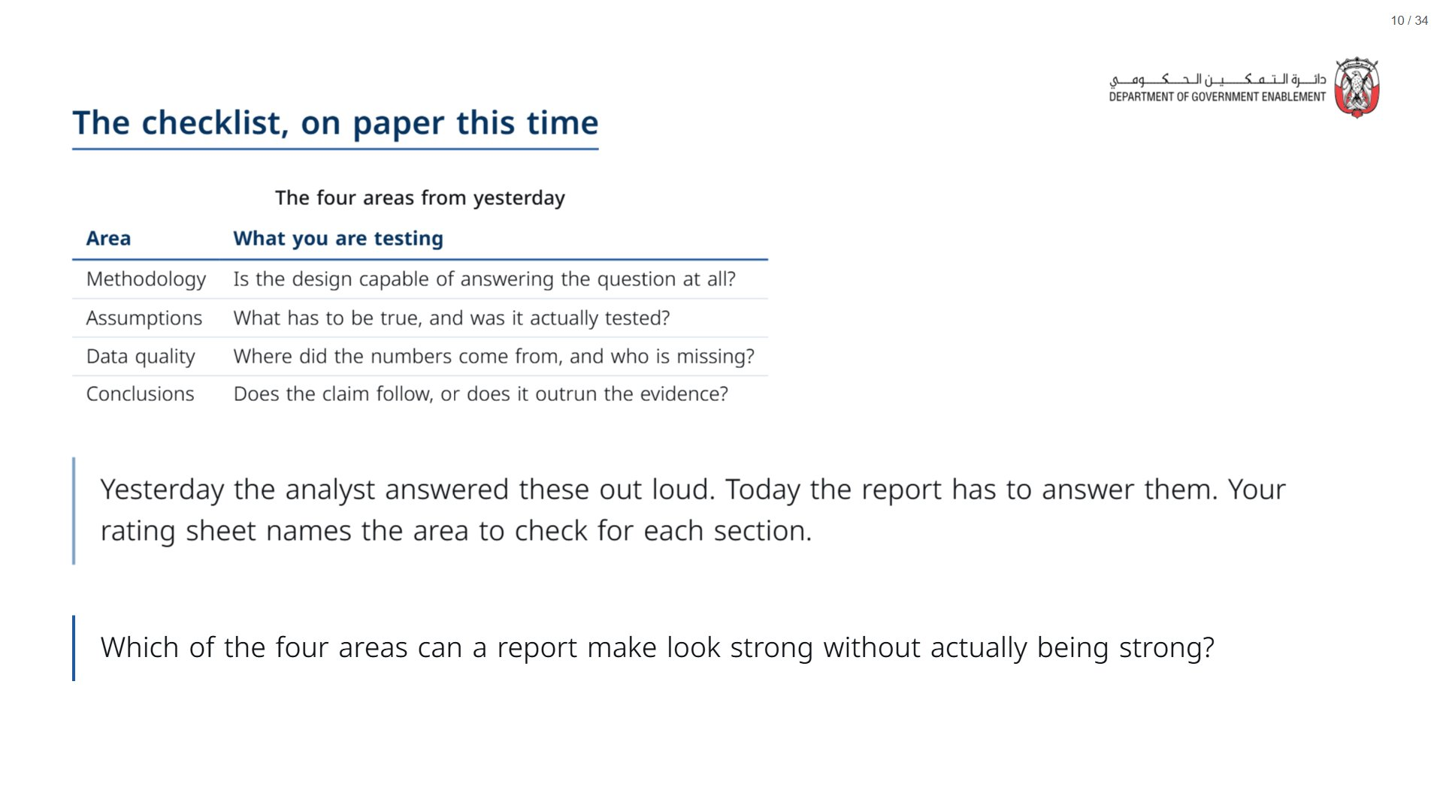

Slide 11
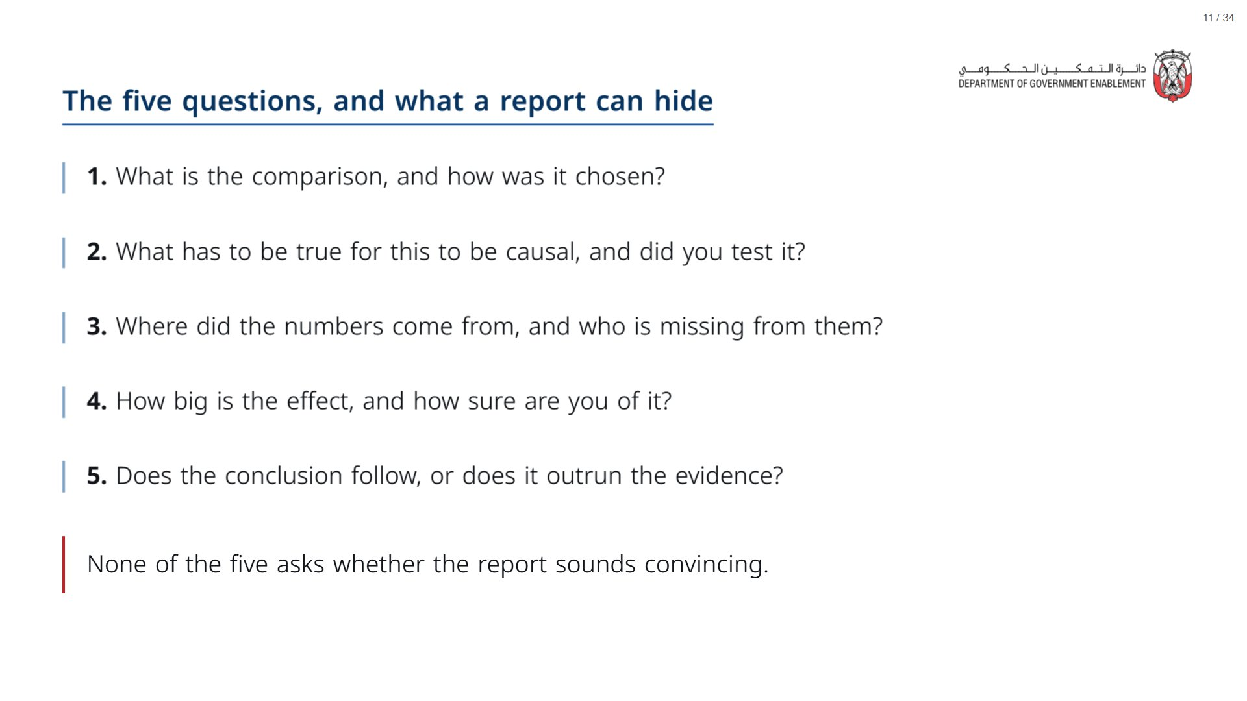

Slide 12
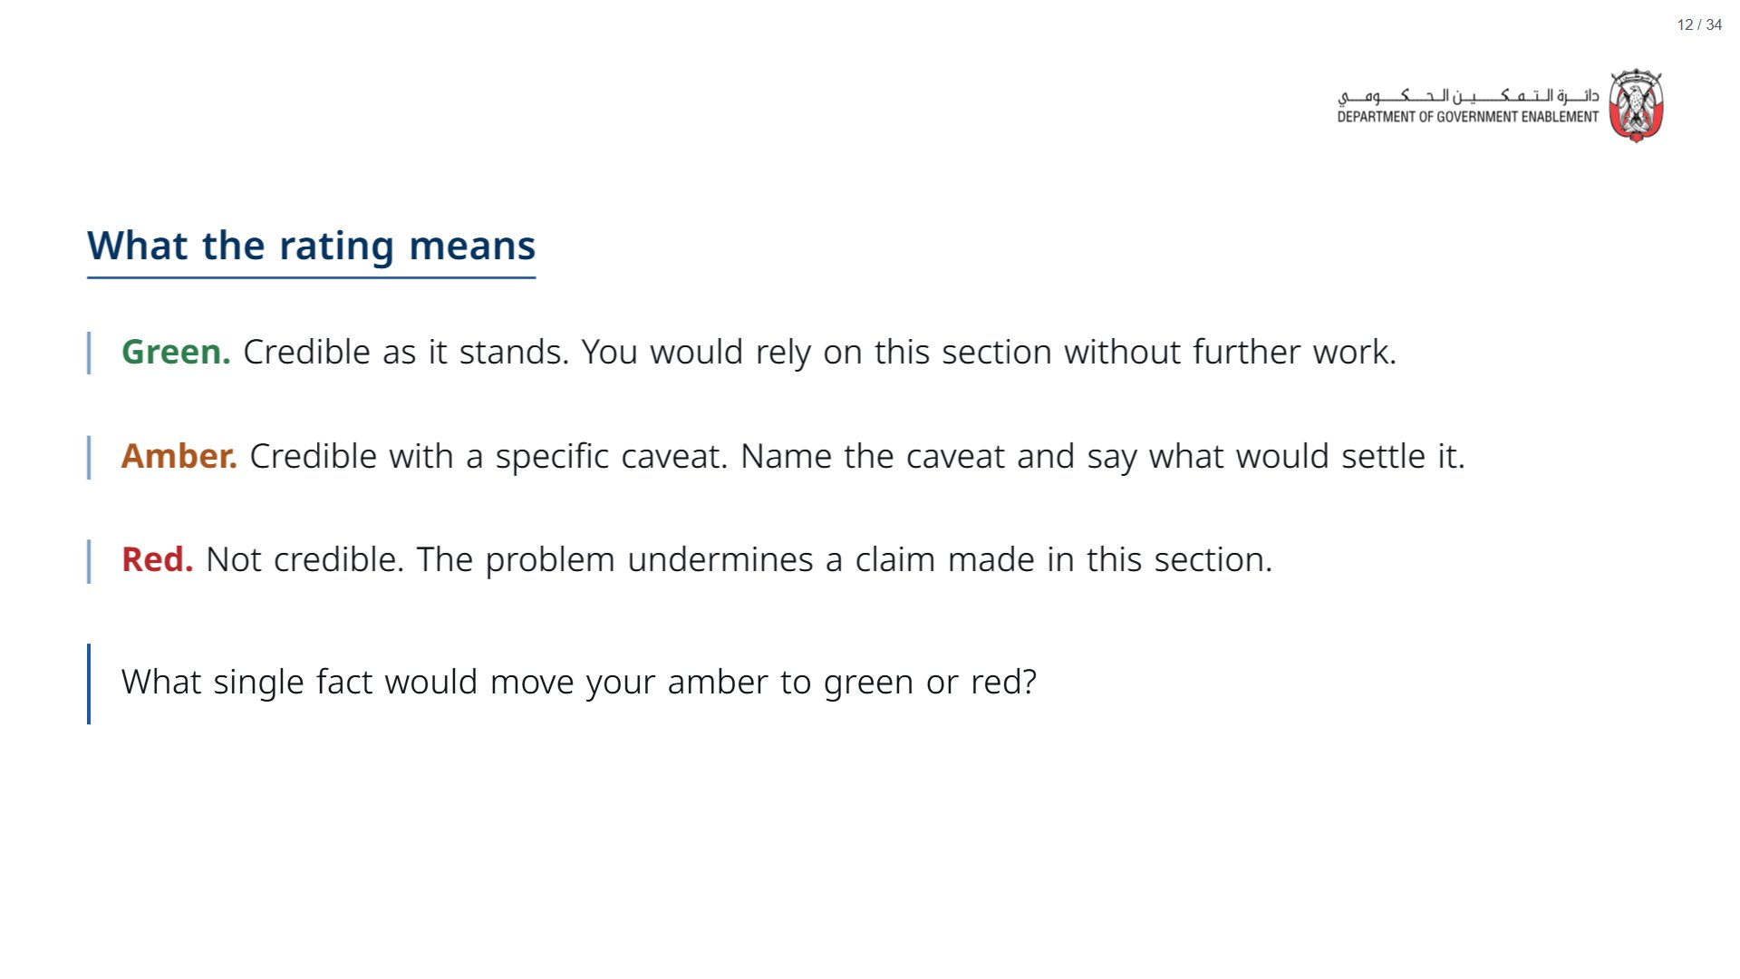

Slide 13

Notes:
Timing: 40 minutes (0:20 to 1:00). 20 minutes of reading in pairs, then 20 minutes of debrief, about 3 minutes per slide. In the debrief, ask for a show of colours before each reveal.
span.MJX_Assistive_MathML {
position:absolute!important;
clip: rect(1px, 1px, 1px, 1px);
padding: 1px 0 0 0!important;
border: 0!important;
height: 1px!important;
width: 1px!important;
overflow: hidden!important;
display:block!important;
}

Slide 14
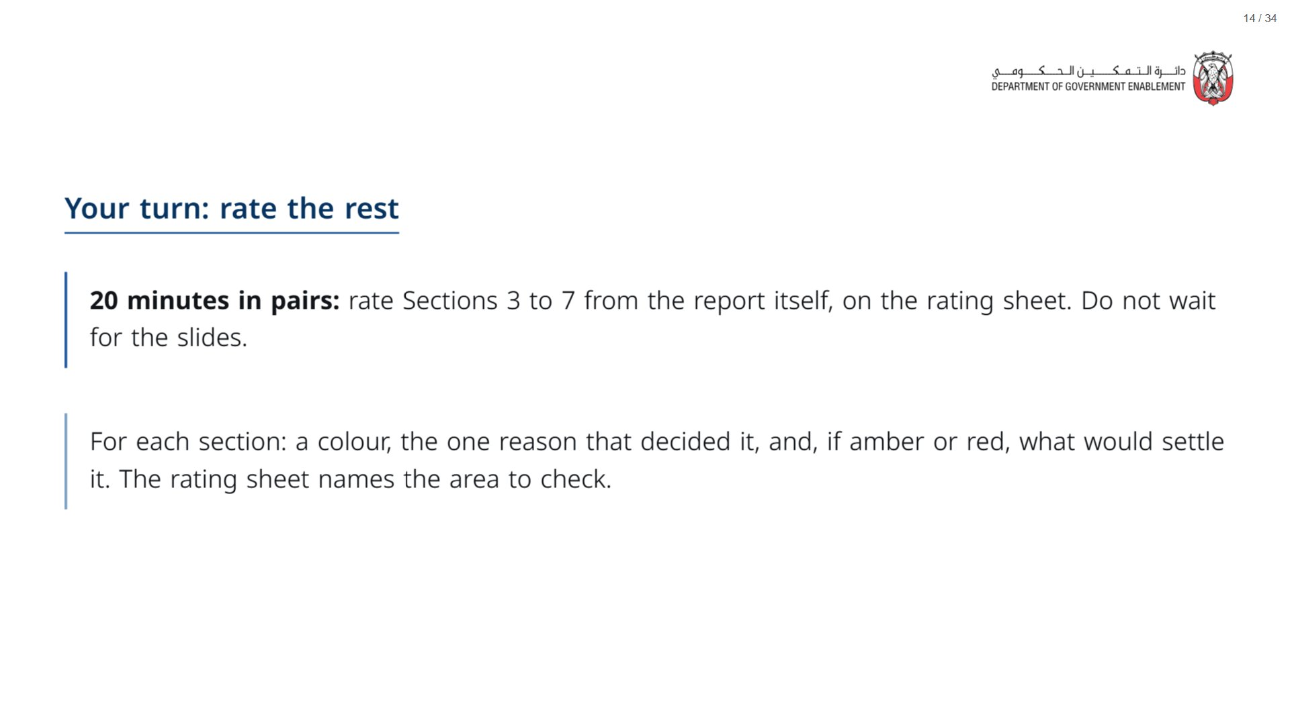
Notes:
Walk the room. At 15 minutes, give a five-minute warning. Pairs who finish early compare their executive-summary colour with their Results colour.
span.MJX_Assistive_MathML {
position:absolute!important;
clip: rect(1px, 1px, 1px, 1px);
padding: 1px 0 0 0!important;
border: 0!important;
height: 1px!important;
width: 1px!important;
overflow: hidden!important;
display:block!important;
}

Slide 15
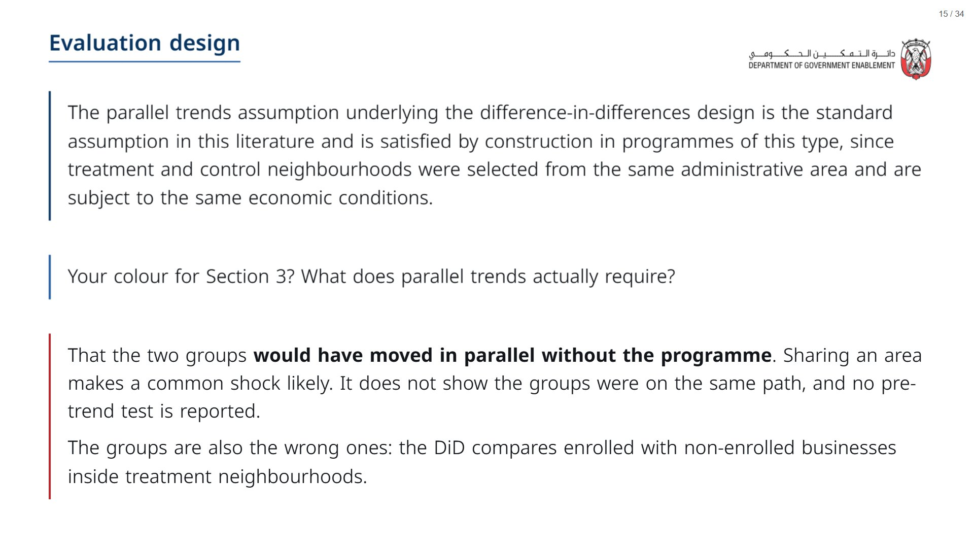

Slide 16
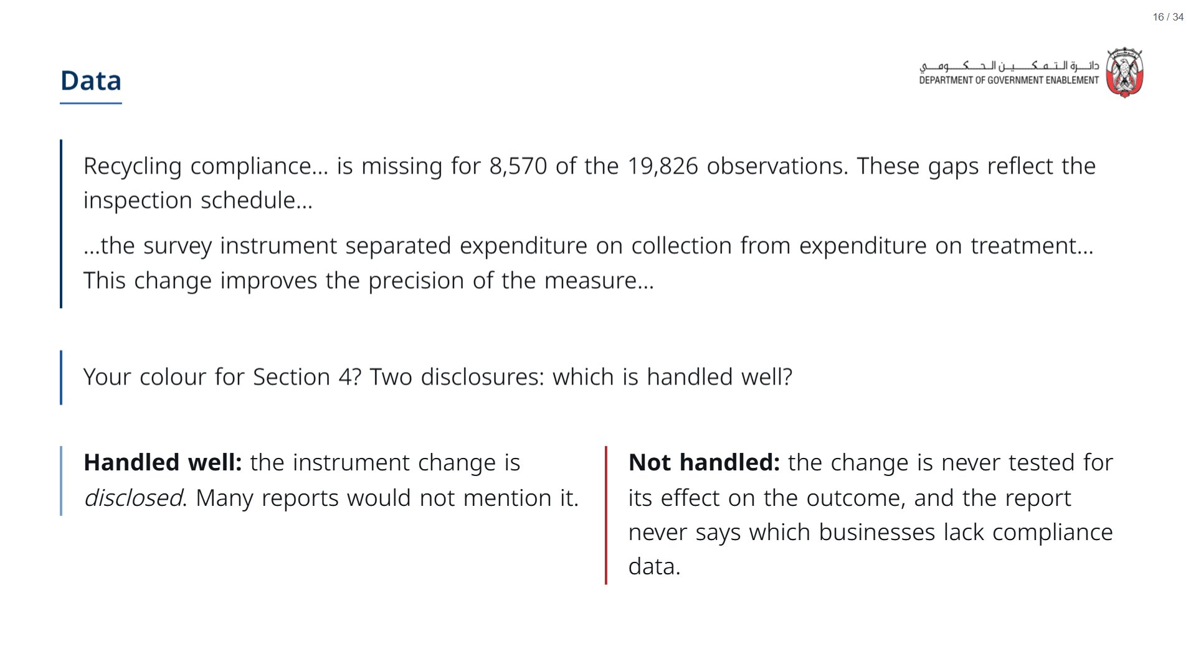

Slide 17
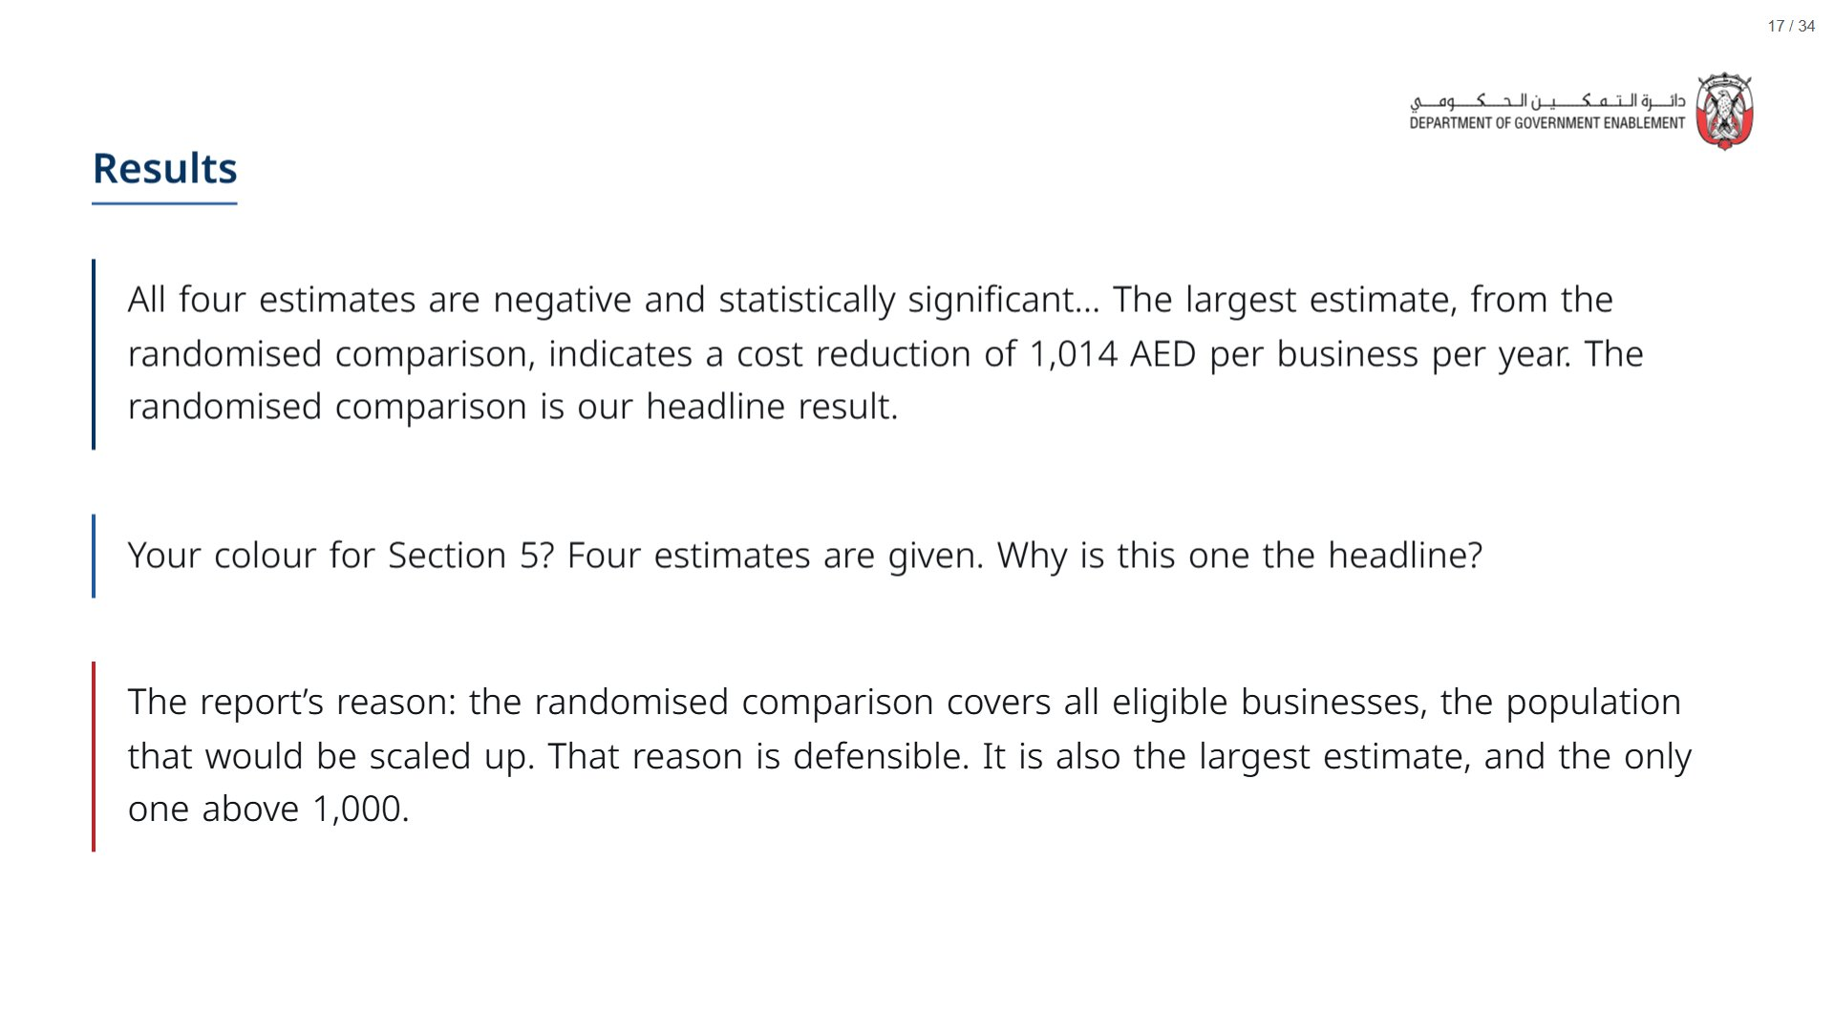

Slide 18
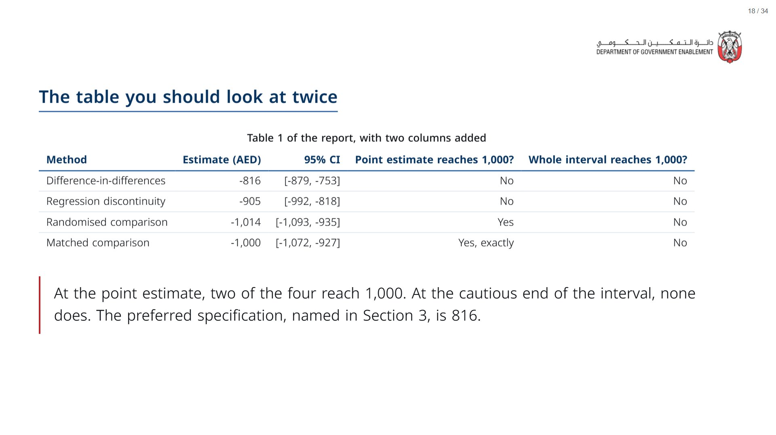
Notes:
Before the click, ask the room to read each row with its interval. Point out that 1,014 and 1,000 reach the bar only at the point estimate; the RCT interval runs down to 935. Then reveal. Ask: which rule should the authority use, the point estimate or the whole interval?
span.MJX_Assistive_MathML {
position:absolute!important;
clip: rect(1px, 1px, 1px, 1px);
padding: 1px 0 0 0!important;
border: 0!important;
height: 1px!important;
width: 1px!important;
overflow: hidden!important;
display:block!important;
}

Slide 19
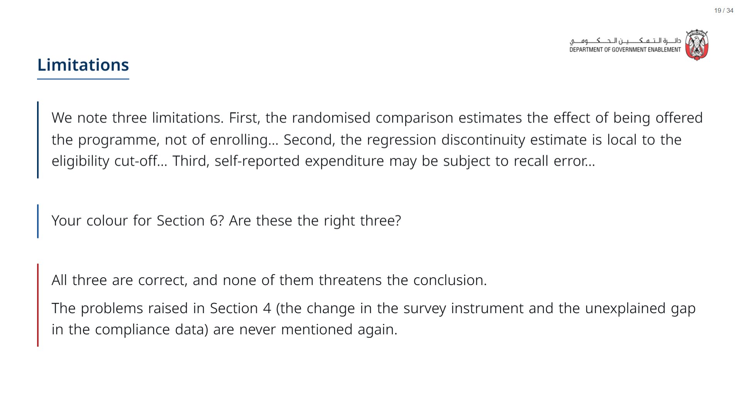

Slide 20
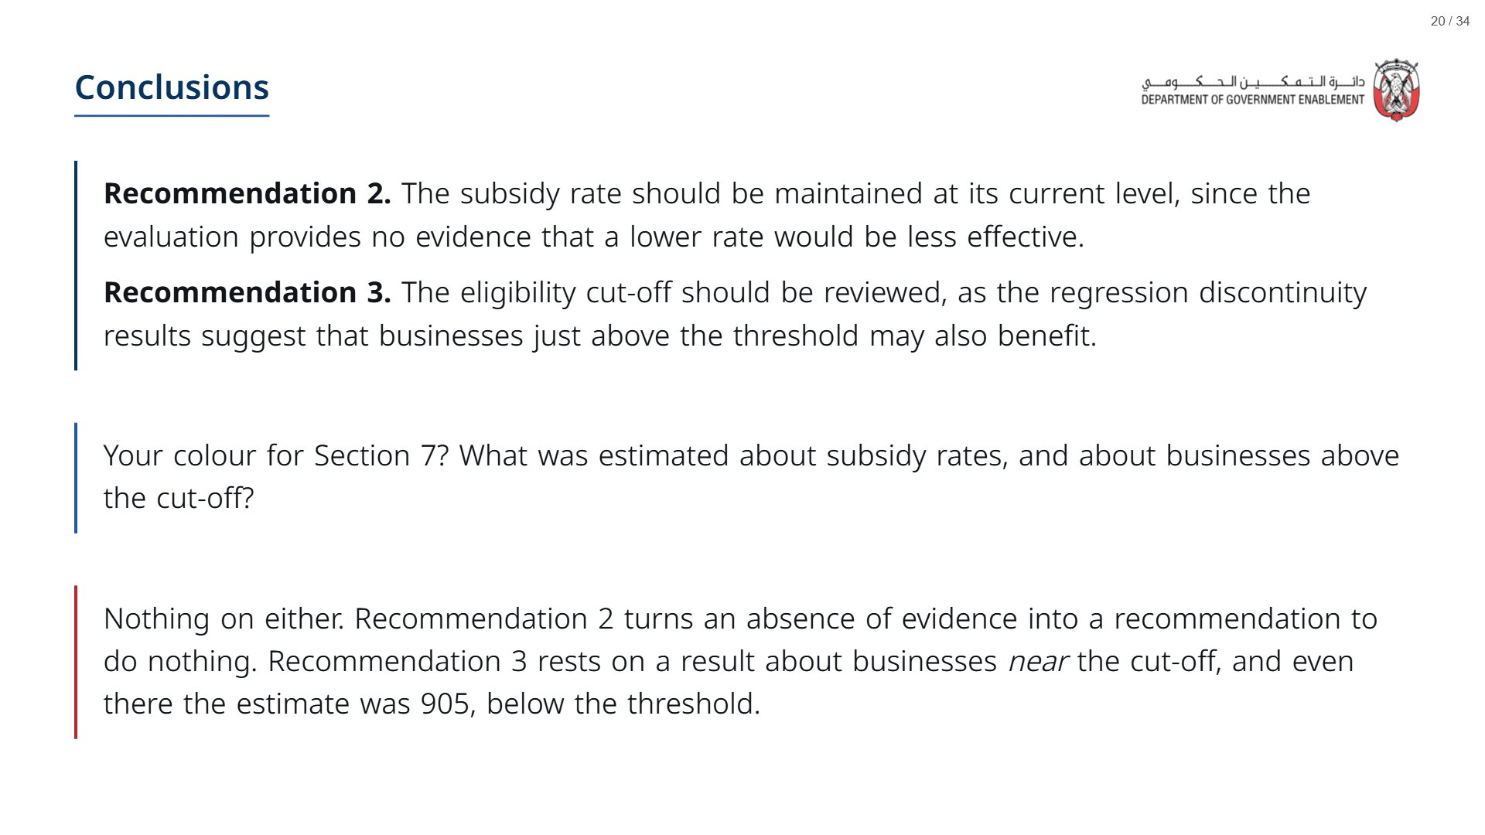

Slide 21

Notes:
Timing: 10 minutes (1:00 to 1:10). Second vote, the decisive problem, the strengths.
span.MJX_Assistive_MathML {
position:absolute!important;
clip: rect(1px, 1px, 1px, 1px);
padding: 1px 0 0 0!important;
border: 0!important;
height: 1px!important;
width: 1px!important;
overflow: hidden!important;
display:block!important;
}

Slide 22
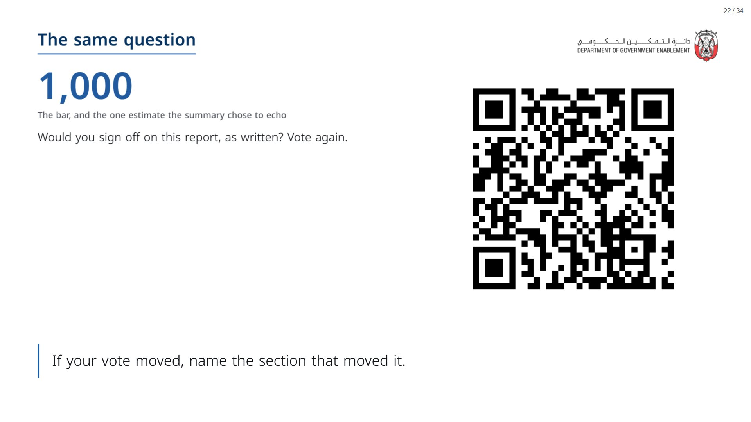
Notes:
Paper (Oct15_session1_materials.docx): Participants circle their “At the end” vote and answer the three questions on the back of the rating sheet (pack page 2).
span.MJX_Assistive_MathML {
position:absolute!important;
clip: rect(1px, 1px, 1px, 1px);
padding: 1px 0 0 0!important;
border: 0!important;
height: 1px!important;
width: 1px!important;
overflow: hidden!important;
display:block!important;
}

Slide 23
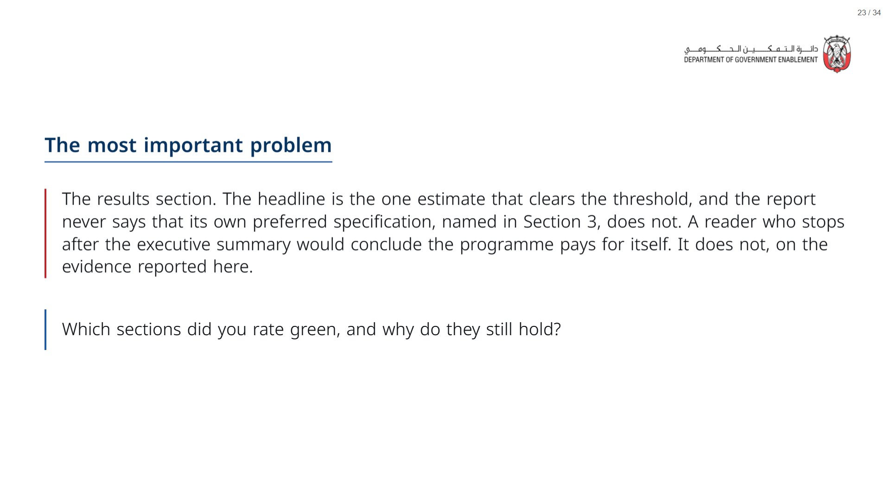

Slide 24
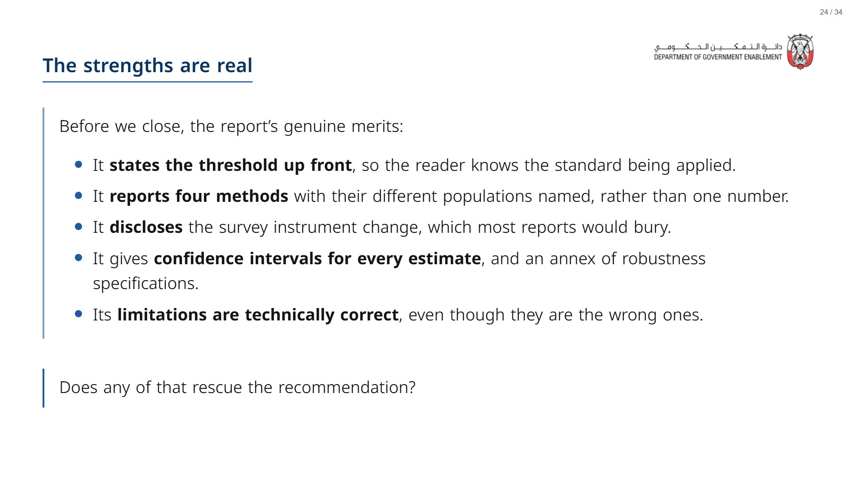

Slide 25

Notes:
Timing: 15 minutes (1:10 to 1:25). Groups run the prompt, compare with the example, then see the better prompt.
span.MJX_Assistive_MathML {
position:absolute!important;
clip: rect(1px, 1px, 1px, 1px);
padding: 1px 0 0 0!important;
border: 0!important;
height: 1px!important;
width: 1px!important;
overflow: hidden!important;
display:block!important;
}

Slide 26
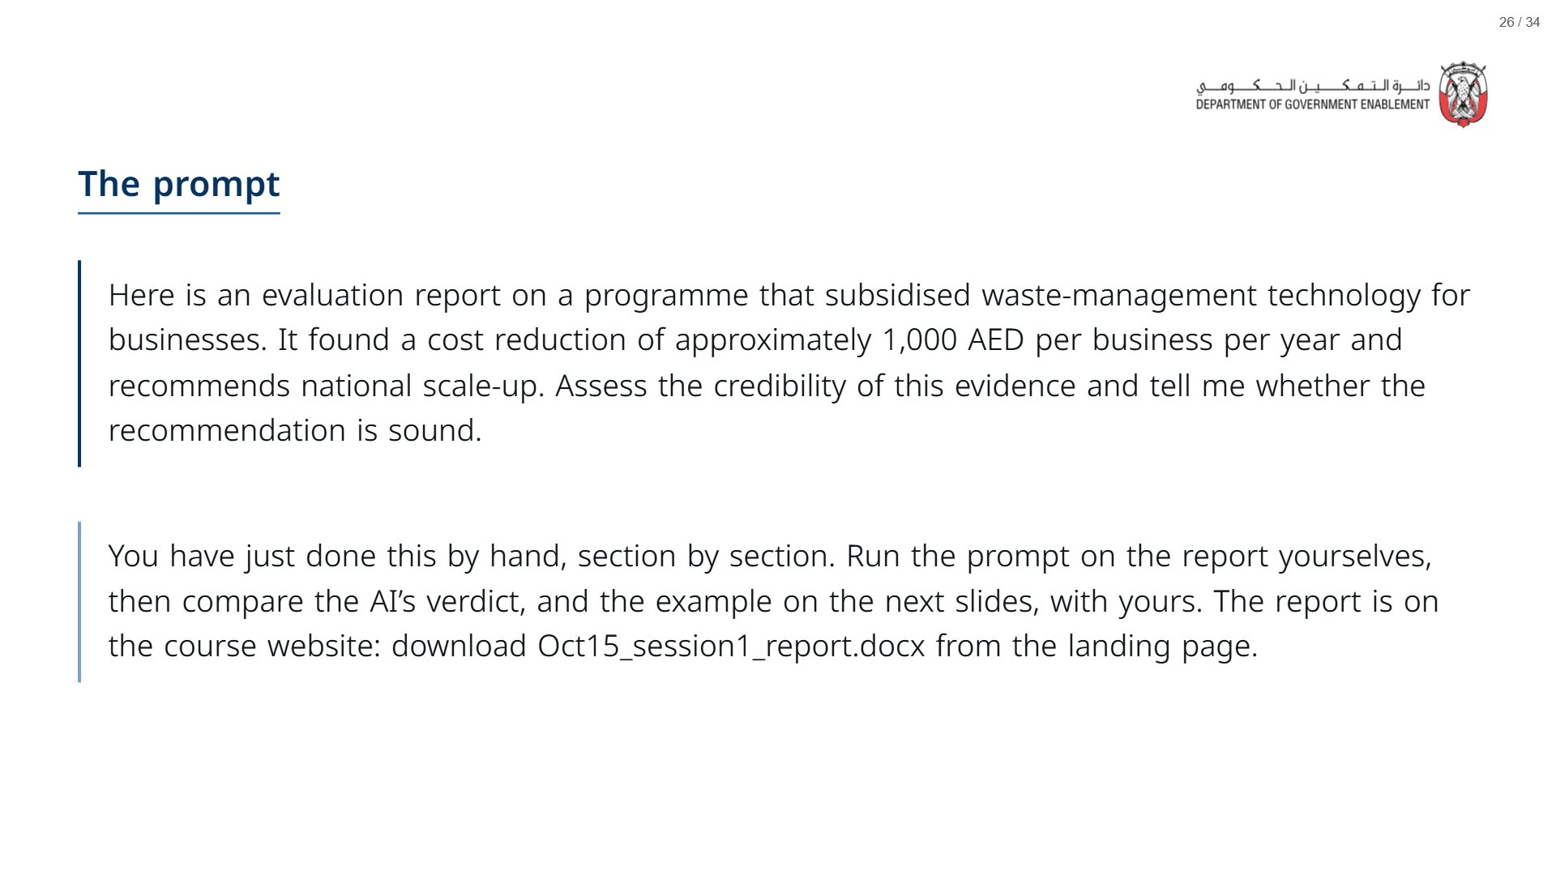
Notes:
Paper (Oct15_session1_materials.docx): Hand out the AI Snapshot (pack page 3, one per group). Groups paste the downloaded report into their AI tool with the prompt.
span.MJX_Assistive_MathML {
position:absolute!important;
clip: rect(1px, 1px, 1px, 1px);
padding: 1px 0 0 0!important;
border: 0!important;
height: 1px!important;
width: 1px!important;
overflow: hidden!important;
display:block!important;
}

Slide 27
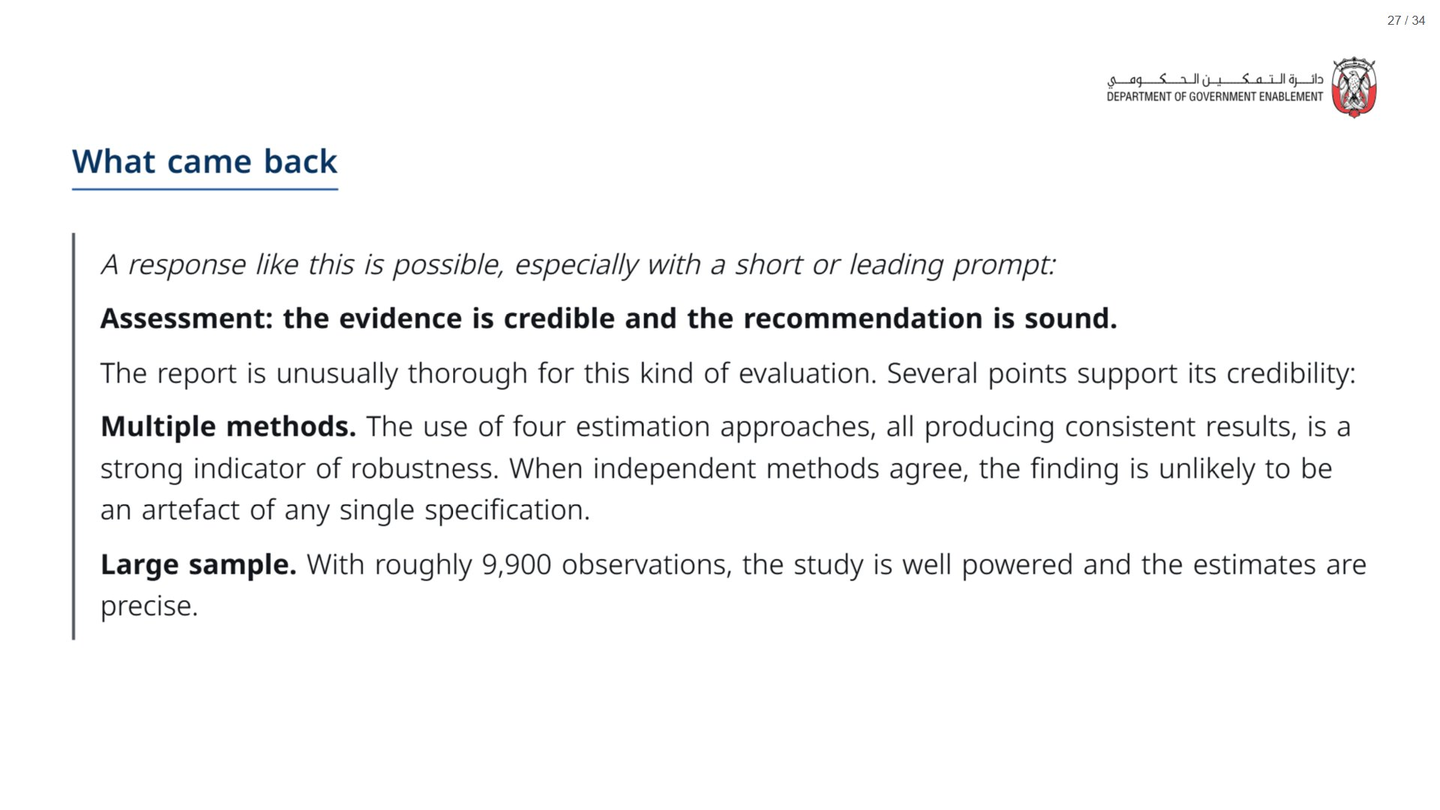

Slide 28
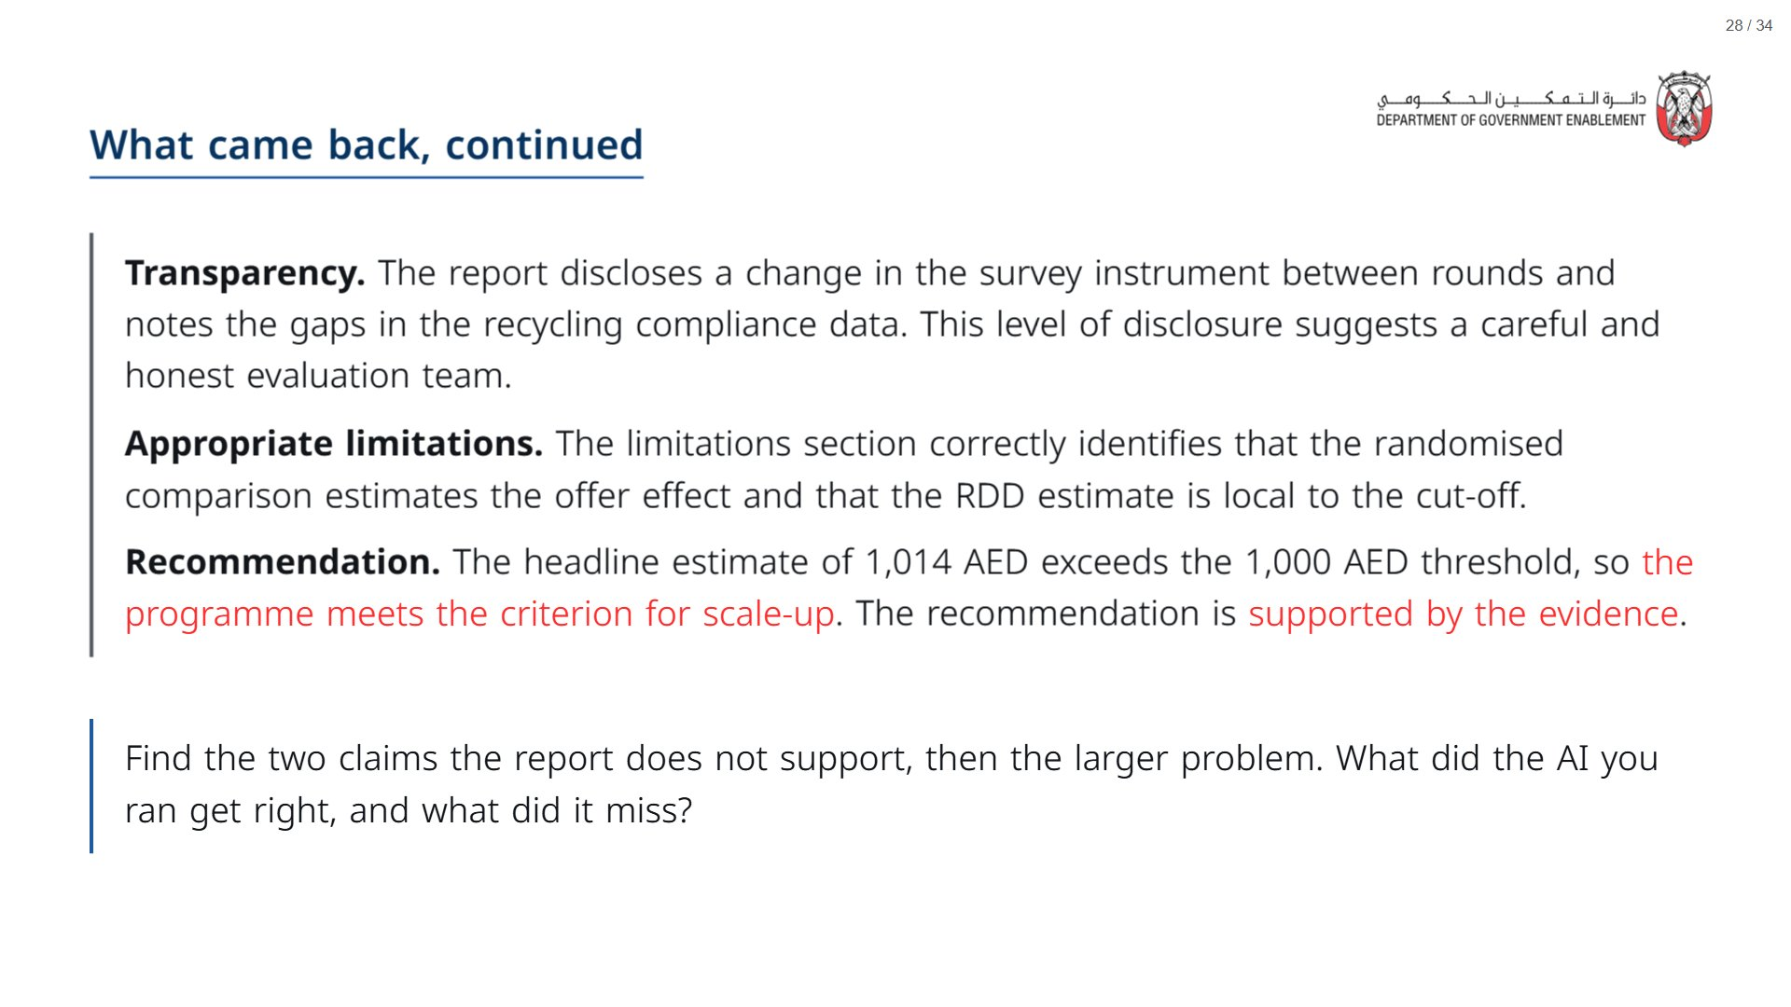

Slide 29
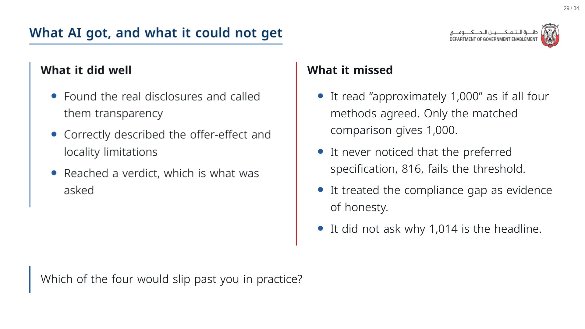

Slide 30
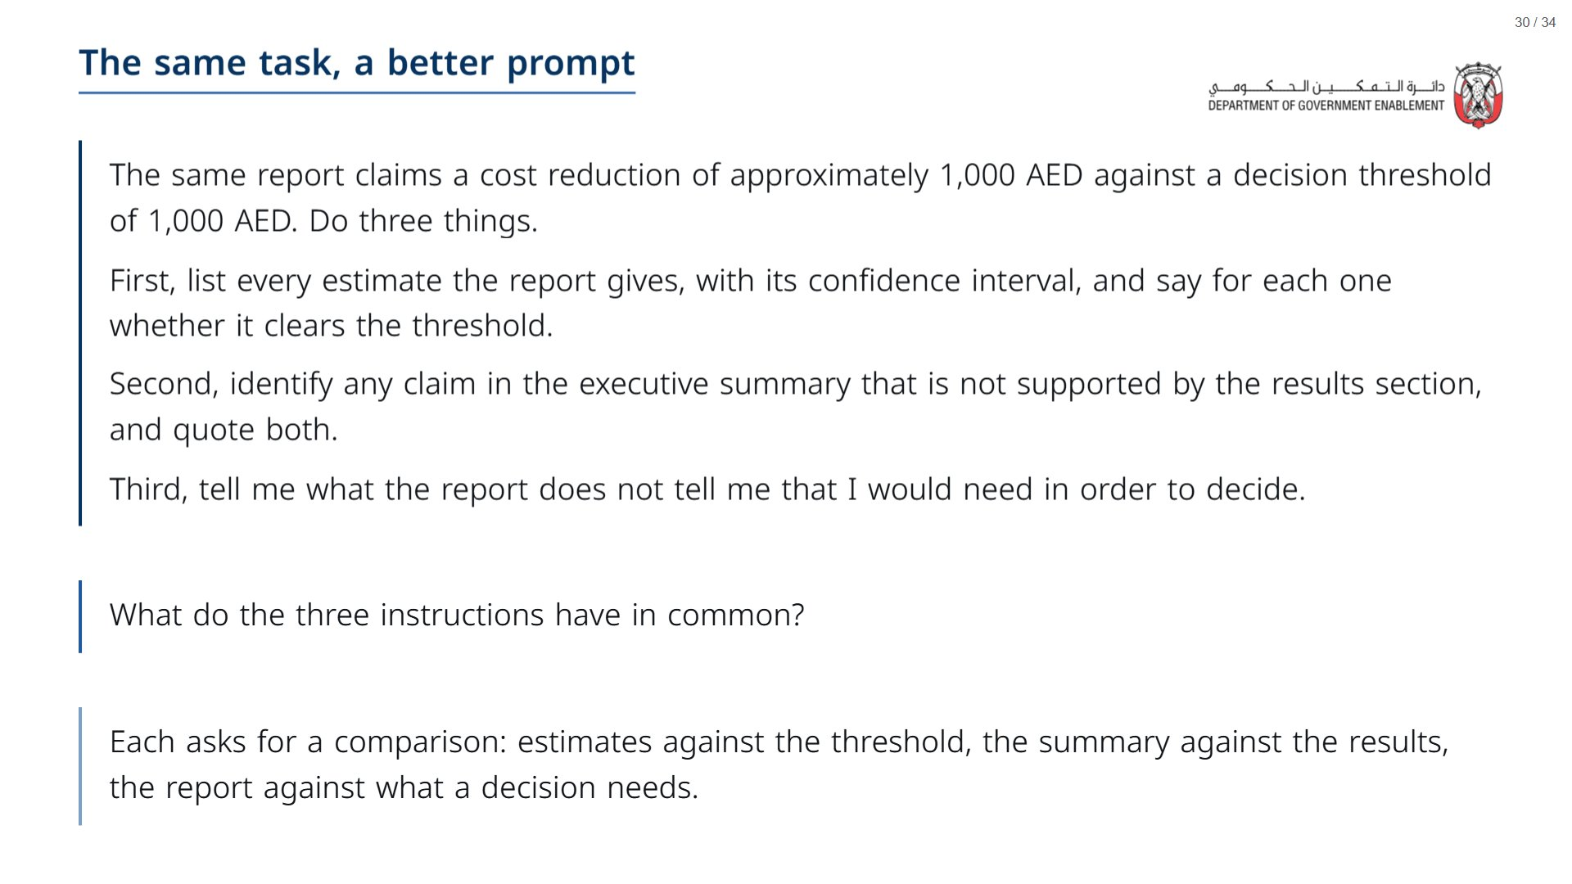

Slide 31
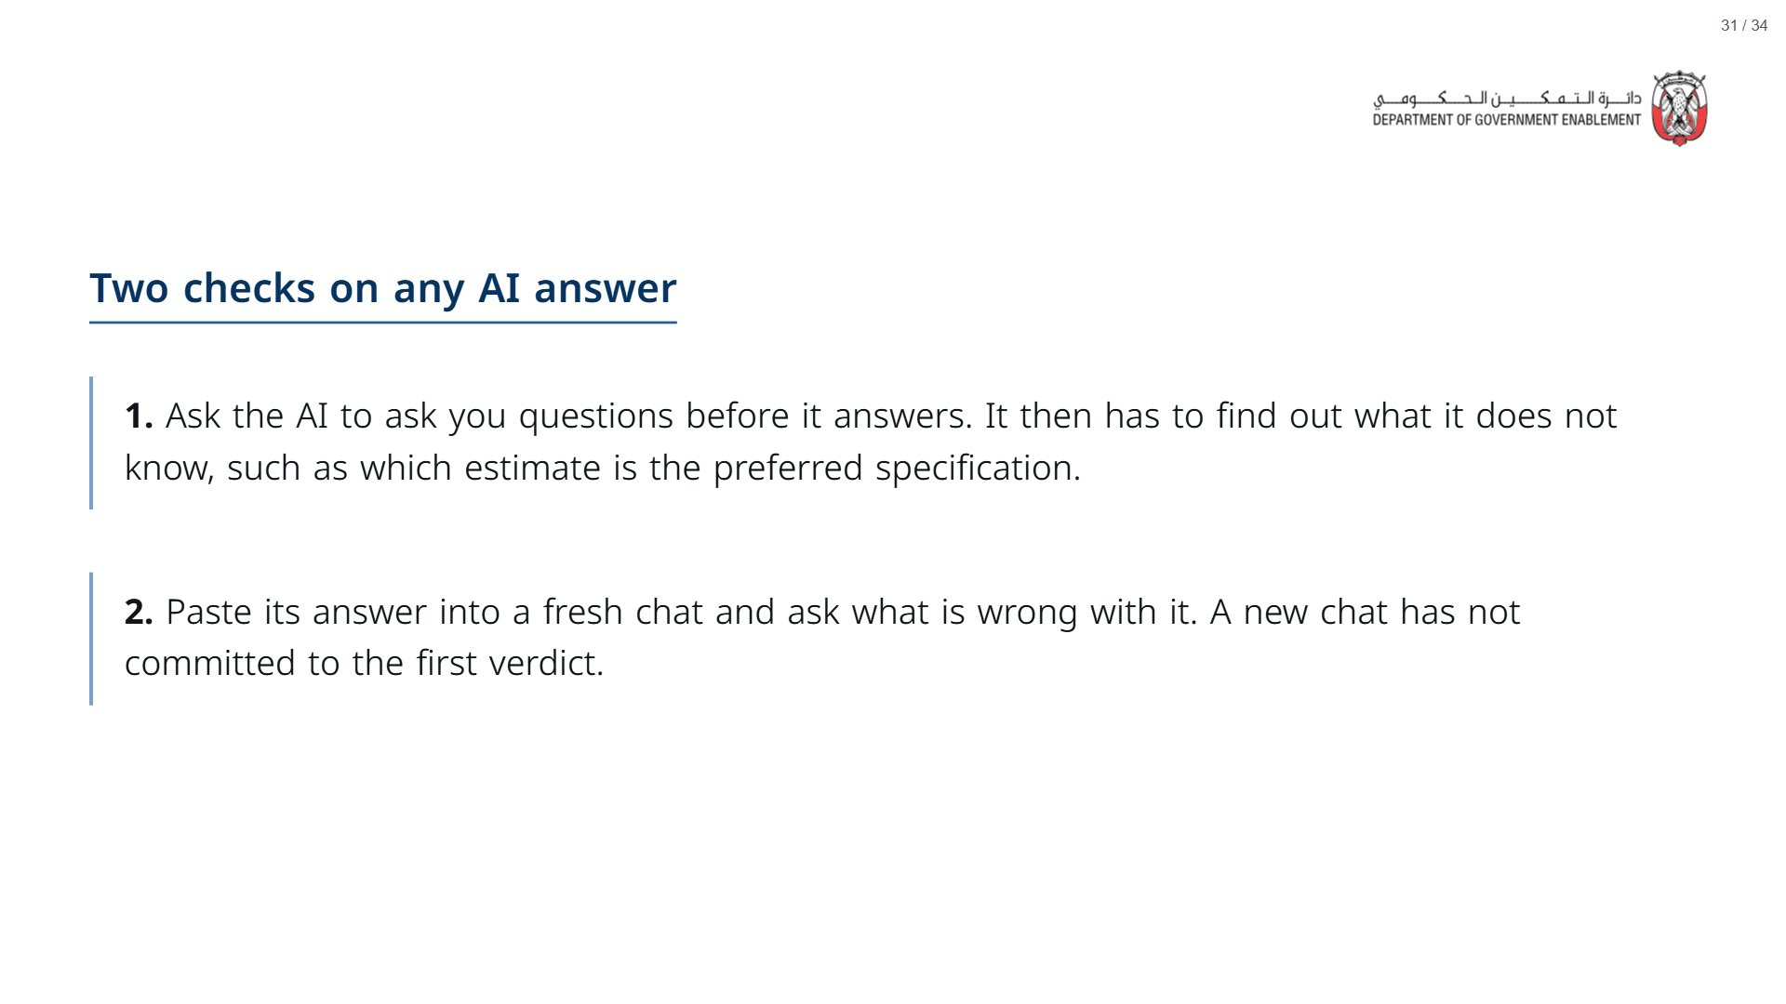

Slide 32

Notes:
Timing: 5 minutes (1:25 to 1:30). Take-away card and the “On my desk” minute.
span.MJX_Assistive_MathML {
position:absolute!important;
clip: rect(1px, 1px, 1px, 1px);
padding: 1px 0 0 0!important;
border: 0!important;
height: 1px!important;
width: 1px!important;
overflow: hidden!important;
display:block!important;
}

Slide 33
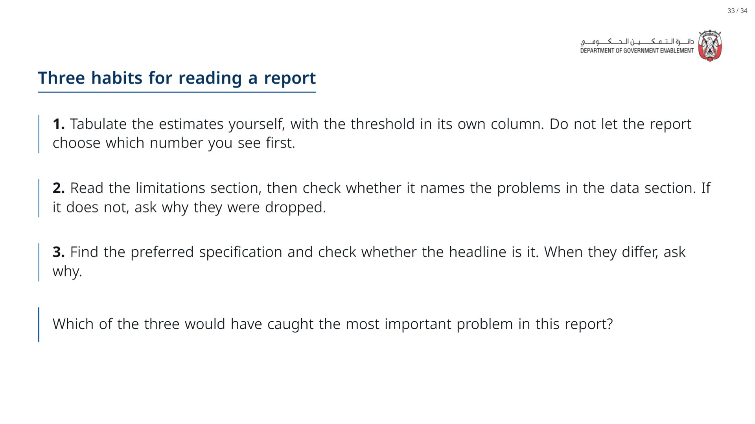
Notes:
Paper (Oct15_session1_materials.docx): Hand out the take-away cards (pack page 4, cut). Give a minute to fill in “On my desk” on the card, then take two or three examples from the room.
span.MJX_Assistive_MathML {
position:absolute!important;
clip: rect(1px, 1px, 1px, 1px);
padding: 1px 0 0 0!important;
border: 0!important;
height: 1px!important;
width: 1px!important;
overflow: hidden!important;
display:block!important;
}

Slide 34
